Slide 1
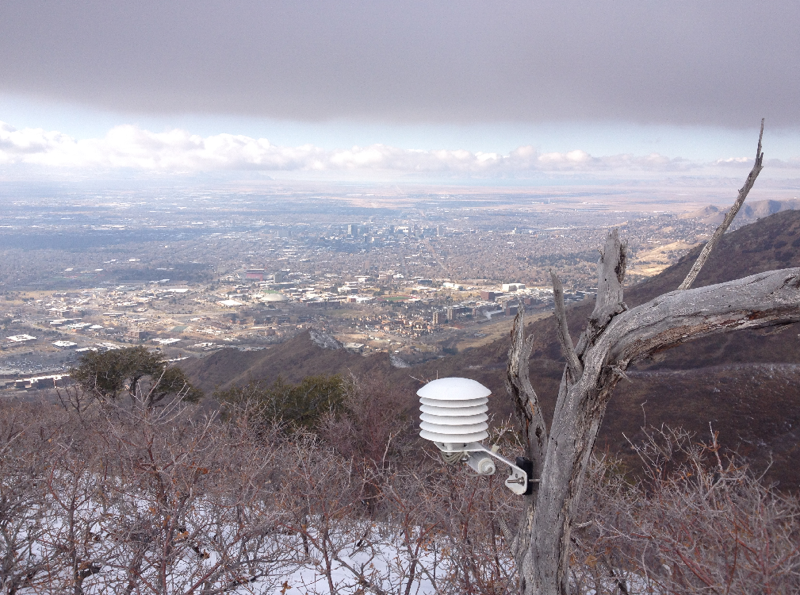
14 Dec. 2015 Update – Meteorological observations for the 2015 Study of wintertime PM2.5 pollution in the Salt Lake Valley
Sebastian W. Hoch

Slide 2
Instrumentation
Basic meteorology (wind speed, wind direction, Temp/RH) at WBB (roof level; [MesoWest]) and at HTE [DAQ]
Turbulence (TKE) at HTE and WBB
Vertical wind profile (above HTE) – Lidar
Aerosol backscatter (above HTE, WBB) – Ceilometer
AWS outside WBB
Potential additions
Downtown SLC rooftop basic meteorology
Pseudo-vertical temperature profile (HTE – WBB – WBB – Mt Wire)
Done
To Do!
Data Quicklooks (ceilometer and lidar, more to come)
http://www.inscc.utah.edu/~hoch/DAQSTUD/quicklooks/

Slide 3
