Slide 1
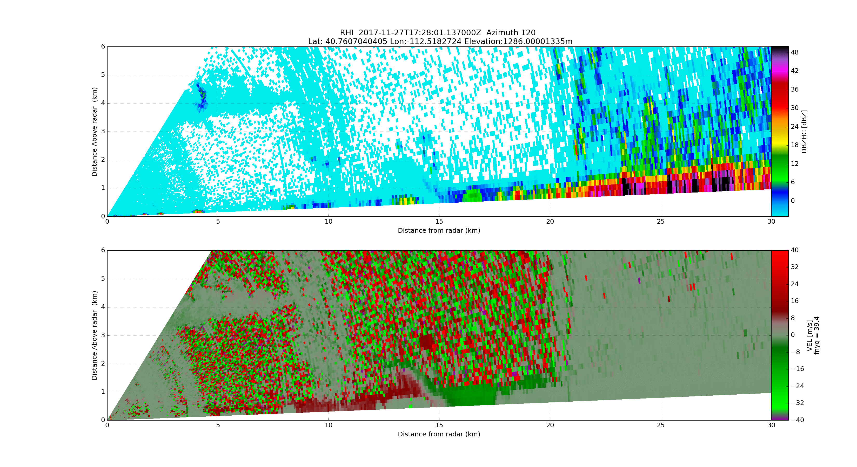
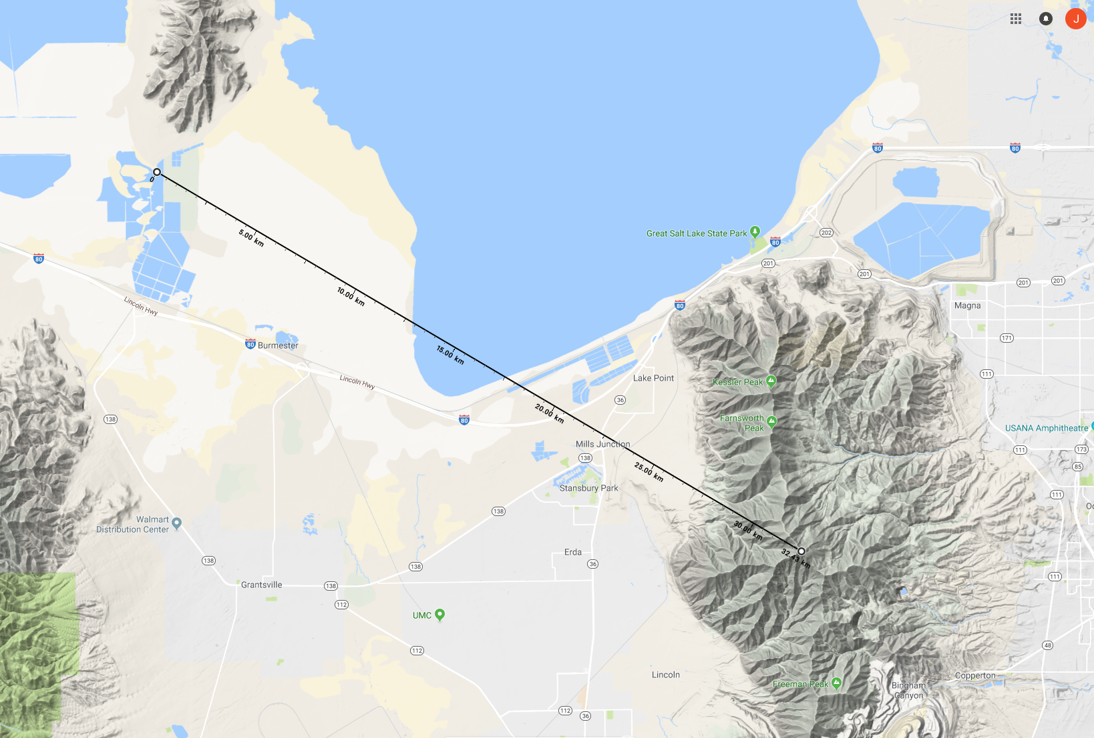
Blocked
Blocked
Scale differs from above
Bench
Oquirrh Mts
S Shore

Slide 2
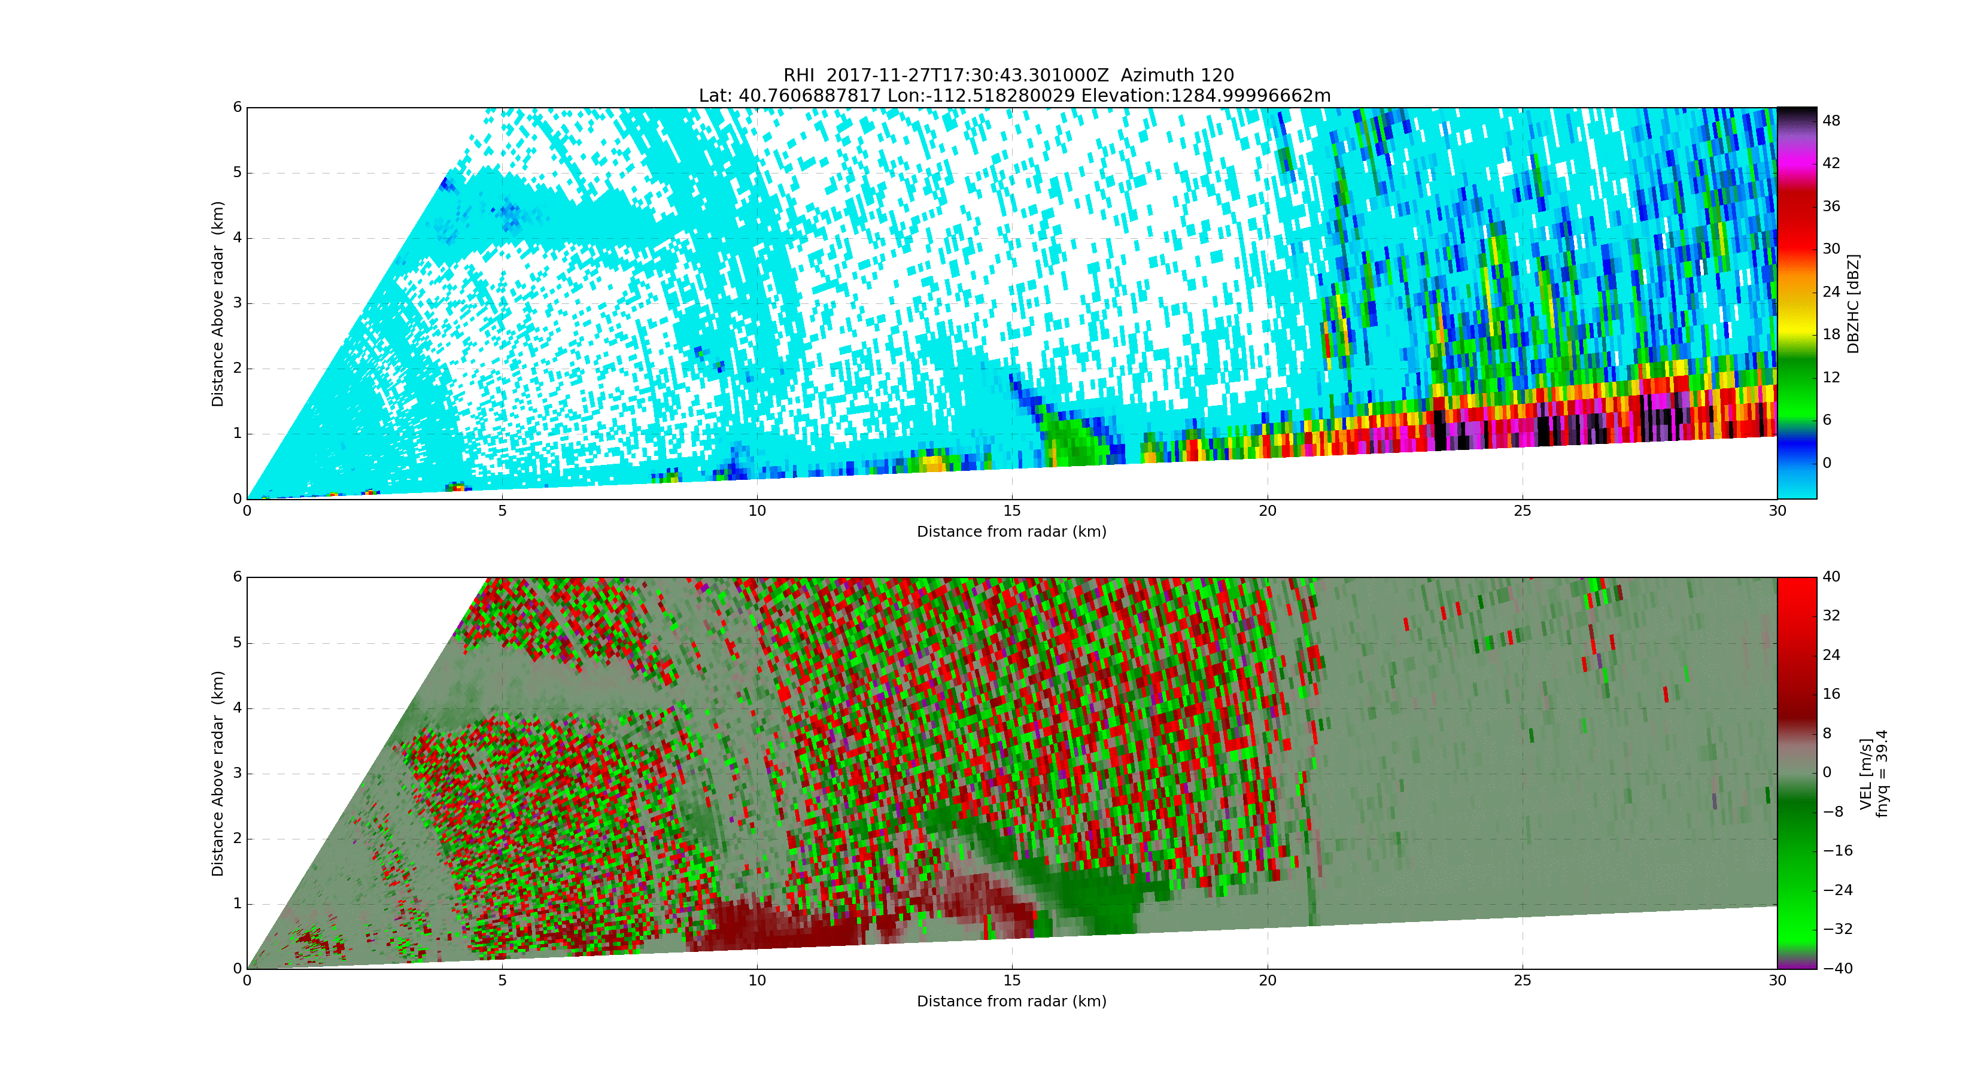
Blocked
Blocked
Scale differs from above
Bench
Oquirrh Mts
S Shore

Slide 3
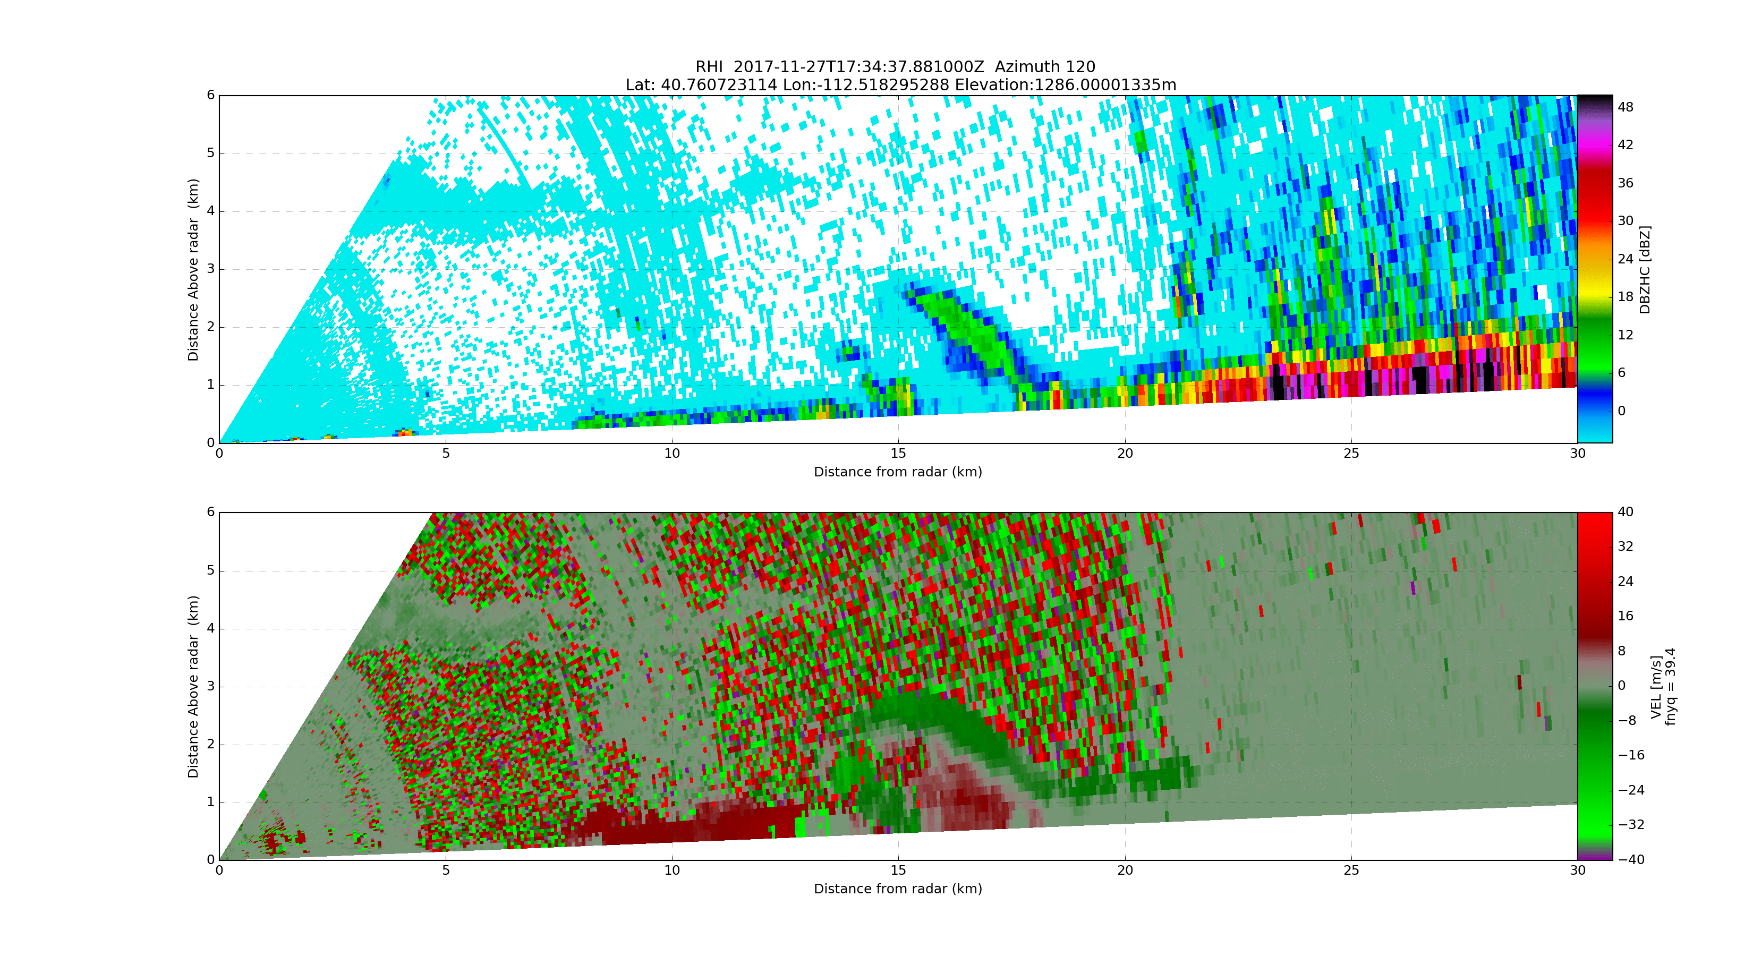
Blocked
Blocked
Scale differs from above
Bench
Oquirrh Mts
S Shore

Slide 4
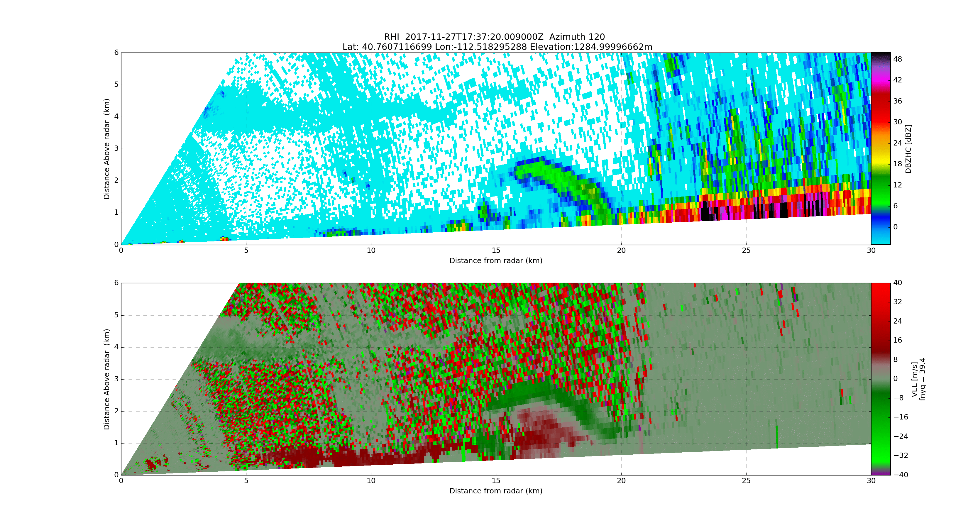
Blocked
Blocked
Scale differs from above
Bench
Oquirrh Mts
S Shore

Slide 5
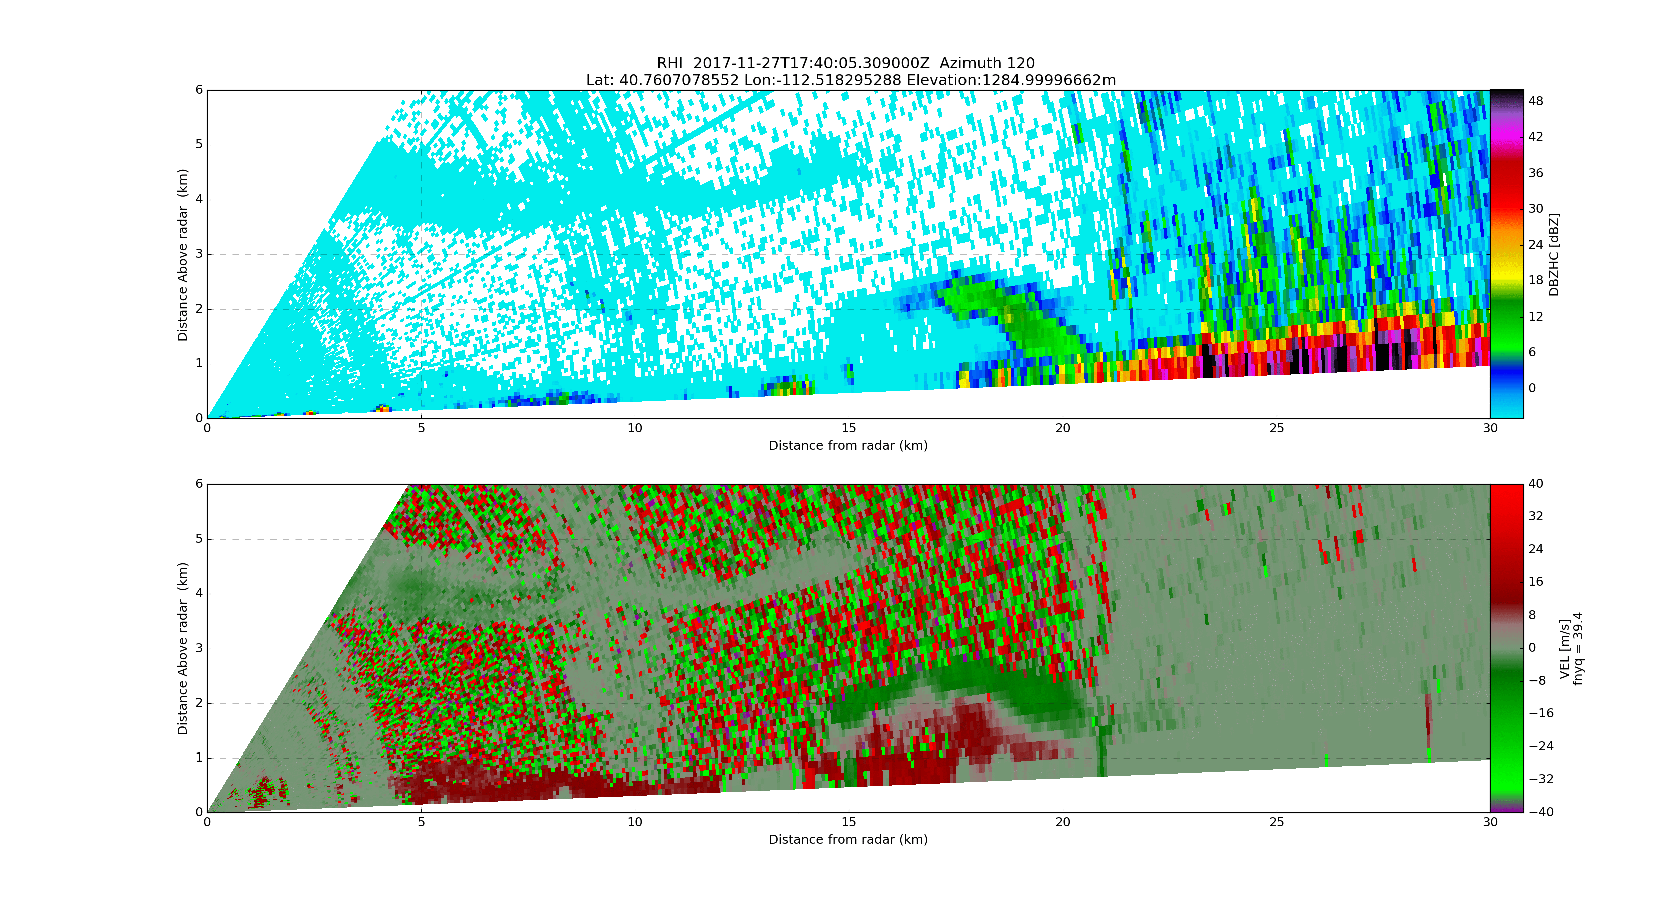
Blocked
Blocked
Scale differs from above
Bench
Oquirrh Mts
S Shore

Slide 6
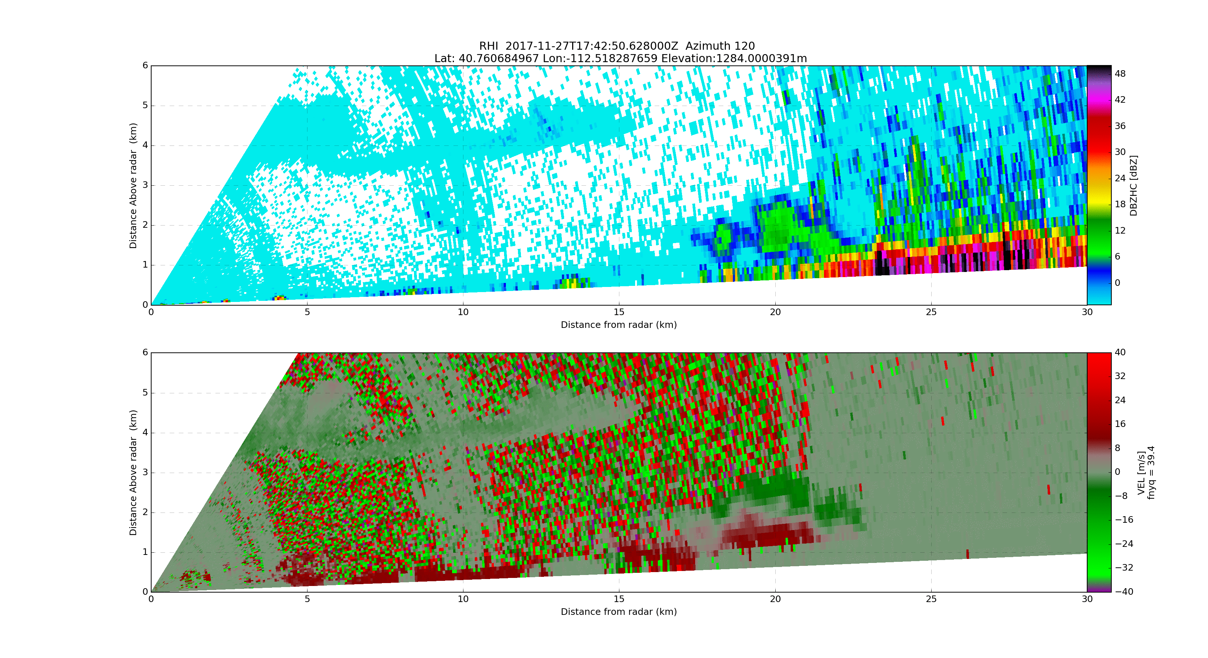
Blocked
Blocked
Scale differs from above
Bench
Oquirrh Mts
S Shore

Slide 7
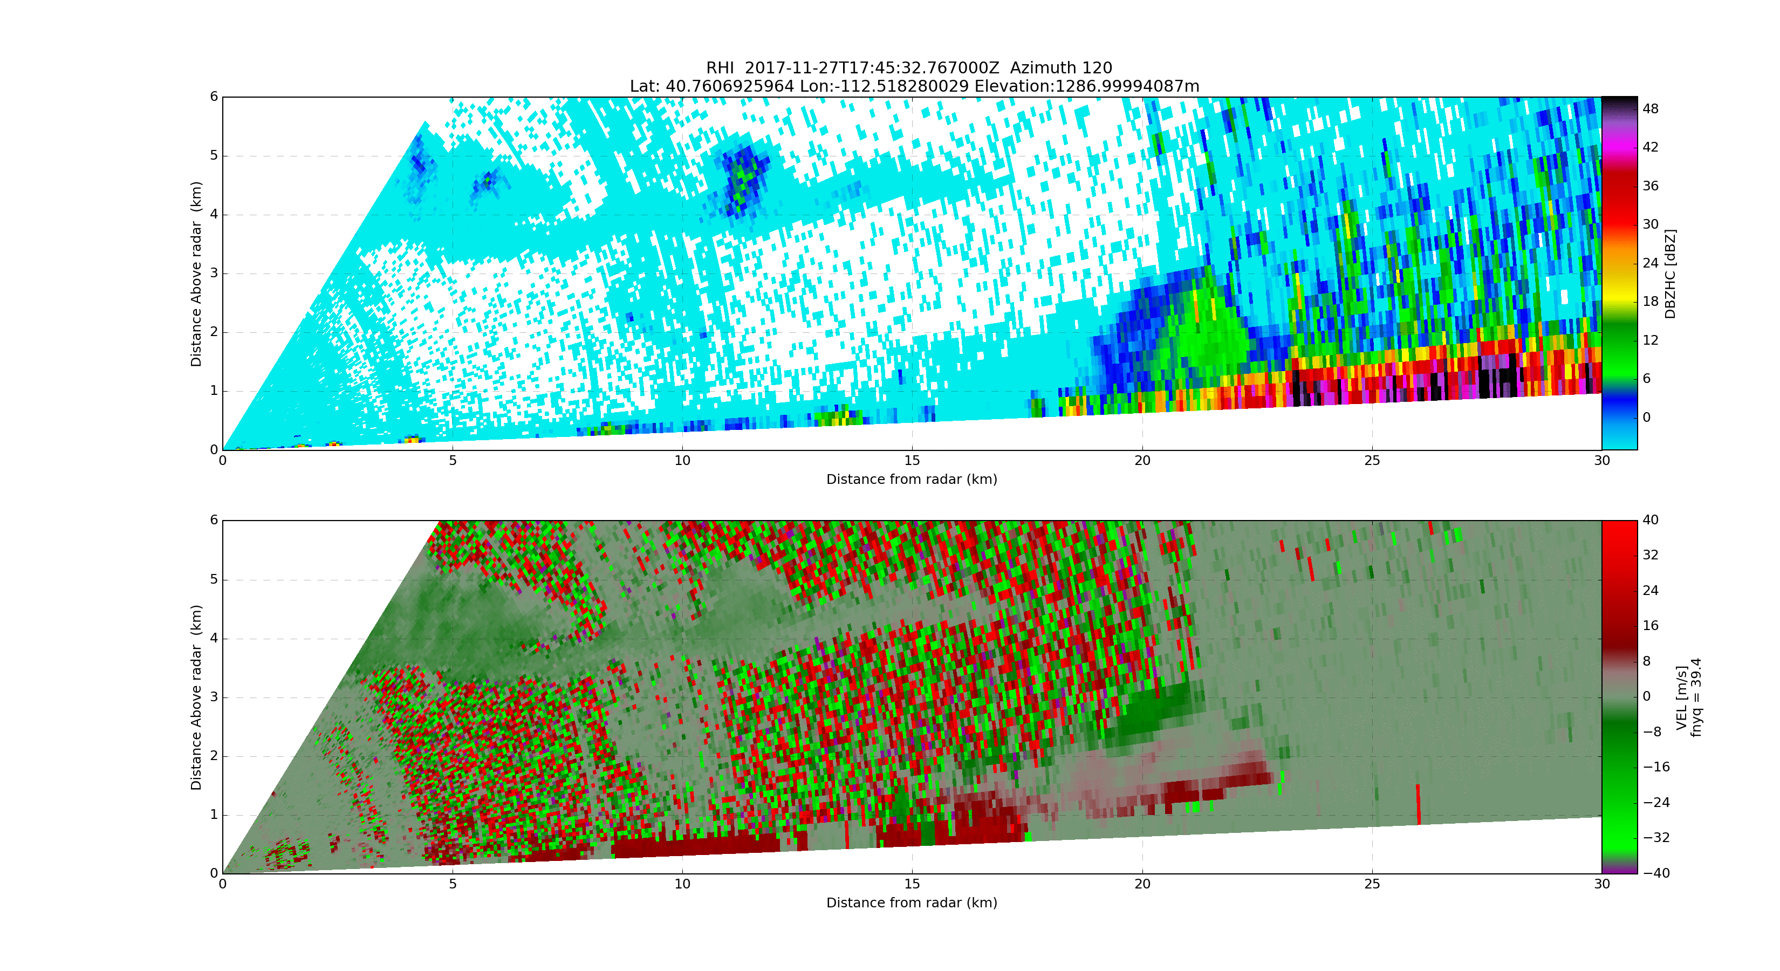
Blocked
Blocked
Scale differs from above
Bench
Oquirrh Mts
S Shore

