Slide 1
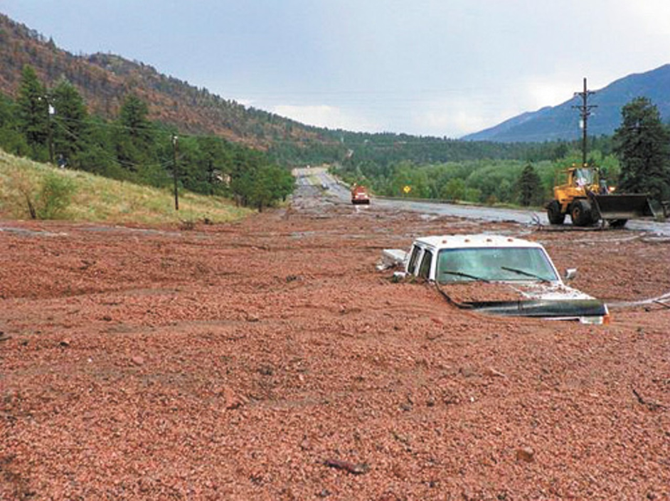
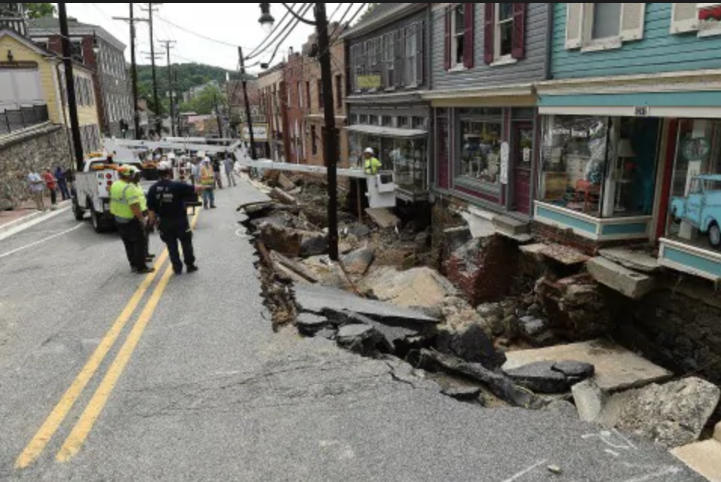
Analysis of Extreme Rainfall Forecasts from the HRRR Model
Waldo Canyon, CO – Colo. Springs Independent
Ellicott City, MD -- Washington Post
Trevor Alcott¹, Eric James², Kelly Mahoney³
¹NOAA/ESRL Global Systems Division
²CIRES, affiliated with NOAA/ESRL/GSD
³NOAA/ESRL Physical Sciences Division
ASDSO Annual Conference – Westminster, CO – 21 Mar 2019

Slide 2
Research at NOAA/ESRL Global Systems Division
Focused on improving numerical weather prediction across a wide range of spatial and temporal scales
Current goals include:
Creating a “fully coupled earth system modeling prediction capability”
Providing “the most accurate forecasts, including uncertainty and probabilities, to the right people at the right time, and in the right form for optimal understanding and decision-making”

Slide 3
The RAP/HRRR Modeling Suite
represents a regional subset of overall NWP research and development
regional models allow forecasting at smaller spatial and temporal scales than a global system, given finite computing resources
13-km RAPid Refresh model forecasts cover all of North America, and provide initial and boundary conditions to support:
3-km hourly High-Resolution Rapid Refresh (HRRR) forecasts for the contiguous US, Alaska, Hawaii and the Caribbean
3-km twice-daily HRRR Ensemble (HRRR-E) system that estimates the amount of uncertainty and a range of possible solutions over the contiguous US

Slide 4
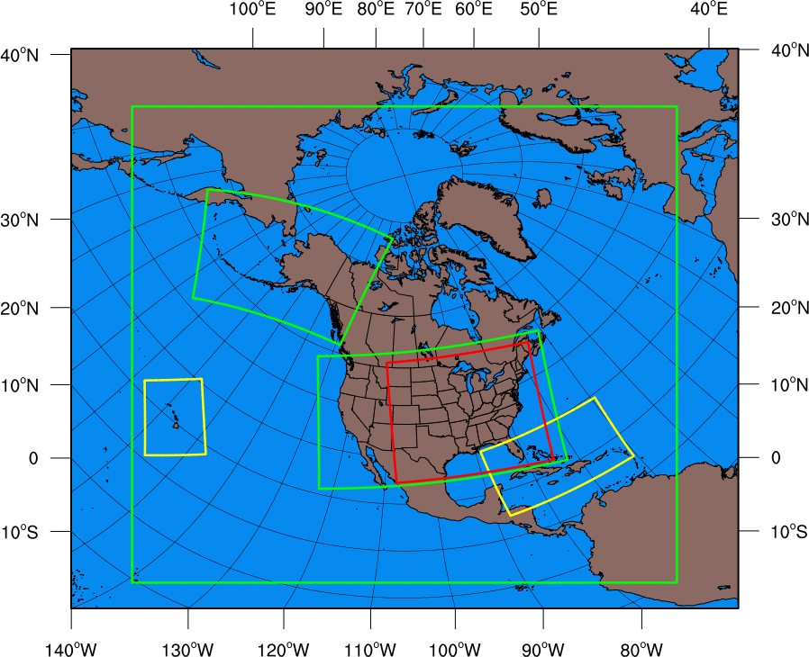
13-km Rapid Refresh (RAP) North America domain
HRRR-E ensemble
3-km regional HRRR domains

Slide 5
Acronyms and Definitions
NWP: Numerical Weather Prediction
weather forecast models that integrate forward from the current atmospheric state, using differential equations for fluid dynamics and approximations for smaller-scale processes
RAP: Forecasts for all of North America at 13-km spatial scales
HRRR: Forecasts for smaller regional domains at 3-km scale
QPF: Quantitative precipitation forecast
total liquid equivalent produced by the model
QPE: Quantitative precipitation estimate
estimate of total liquid equivalent that fell on the surface, constructed using a combination of gauge/radar data where available, and regression equations over high terrain

Slide 6
Project Introduction and Research Questions
Much recent interest in assessing:
climatological characteristics of extreme precipitation
ability of NWP models to predict extreme precipitation
CO-NM Regional Extreme Precipitation Study, focused on improving dam safety, motivated a deep dive into HRRR precipitation climatology
For the latest version of HRRR: how hard can it rain in the model world?
Where and when does the heaviest precipitation occur?
How do maximum forecast precipitation magnitudes compare to observed/analyzed values?
How do maximum precipitation magnitudes vary with respect to elevation?

Slide 7
Data and Methods
Forecast (QPF): Experimental HRRR forecasts run locally at NOAA/ESRL
3-km grid spacing
WRF-ARW version 3.8.1 with updates, effectively v3.9
Thompson (2008) microphysics
RUC land-surface model
MYNN PBL scheme
Analysis (QPE): NCEP Stage-IV precipitation analysis
6-h accumulations ending 00, 06, 12, 18 UTC
4.7-km grid spacing, budget interpolated to HRRR grid
May 2017– May 2018 frozen experimental HRRR, code is consistent with current operational model (HRRRv3; implemented 18 July 2018)
6164, 1-h HRRR forecasts (70% complete)
951, 6-h QPF-QPE pairs (65% complete)

Slide 8
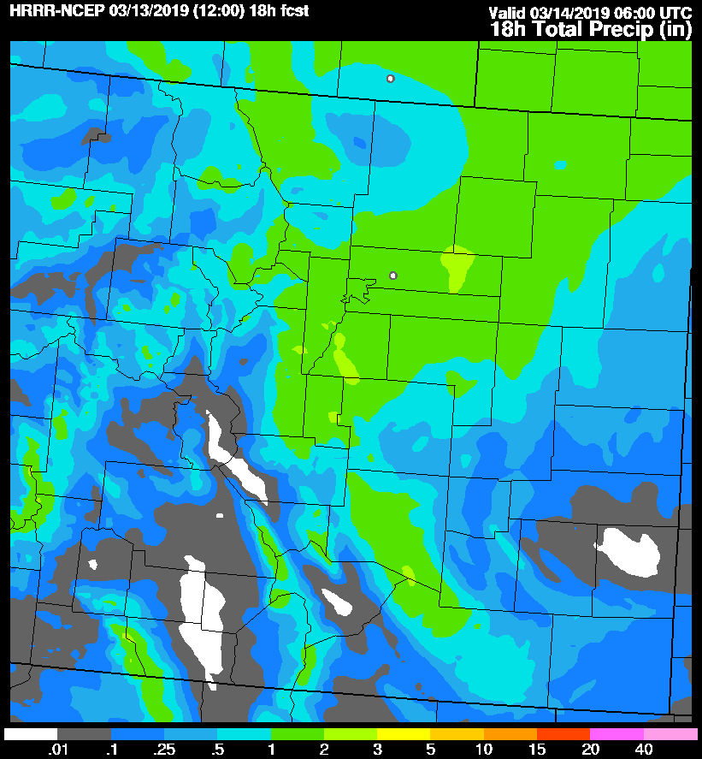
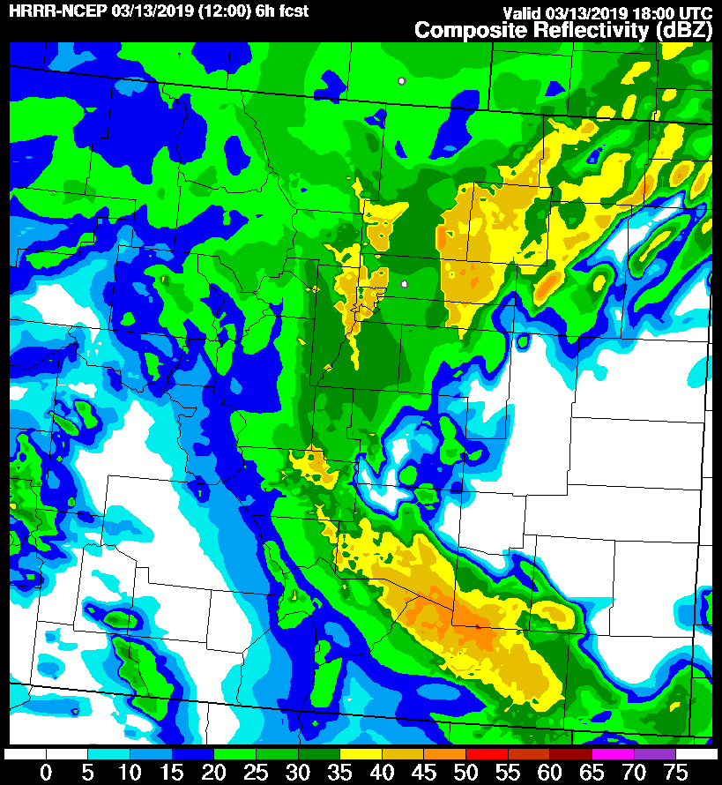
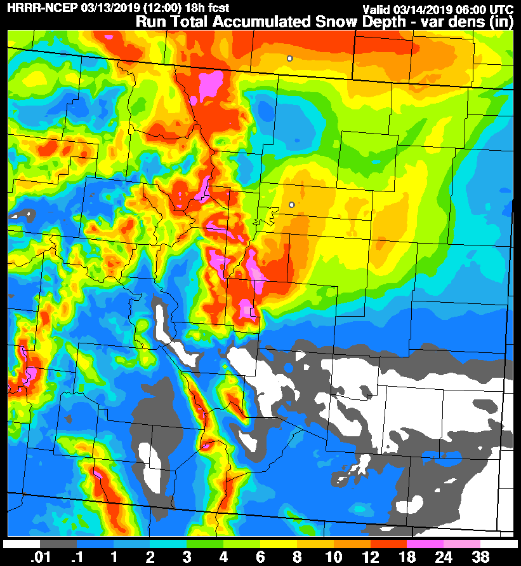
Sample HRRR Forecasts

Slide 9
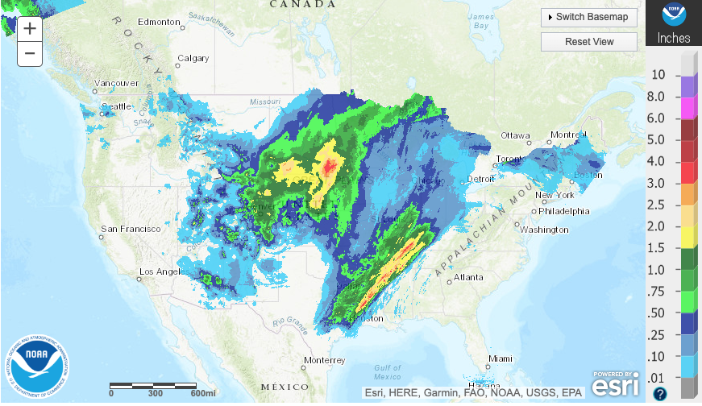
The “Truth”: Stage-IV Precipitation Analysis

Slide 10
Overview of HRRR QPF performance
HRRR simulates stratiform/widespread and convective/localized precipitation features with realistic spatial and temporal characteristics
Due to the inherently low predictability of localized convection, extreme events are unlikely to be forecast in the precise location where they occur
but the overall dimensions and frequency of occurrence are still skillful when considering a large set of forecast/analysis pairs
Some overprediction of heavy precipitation occurs at earlier lead times, but improvement is noted later in the forecast

Slide 11
Overview of Stage-IV performance
Stage-IV remains the best estimate of observed precipitation, based on comparisons between gridded QPE and independent gauge data
Some caveats:
several areas of the US have poor radar coverage, especially in the West
multiple agencies produce datasets that are stitched together to produce Stage-IV, and not everyone agrees on the weighting of gauge vs. radar data, or quality control procedures
mountain areas devoid of both gauge and radar data are estimated using extrapolated regression relationships

Slide 12
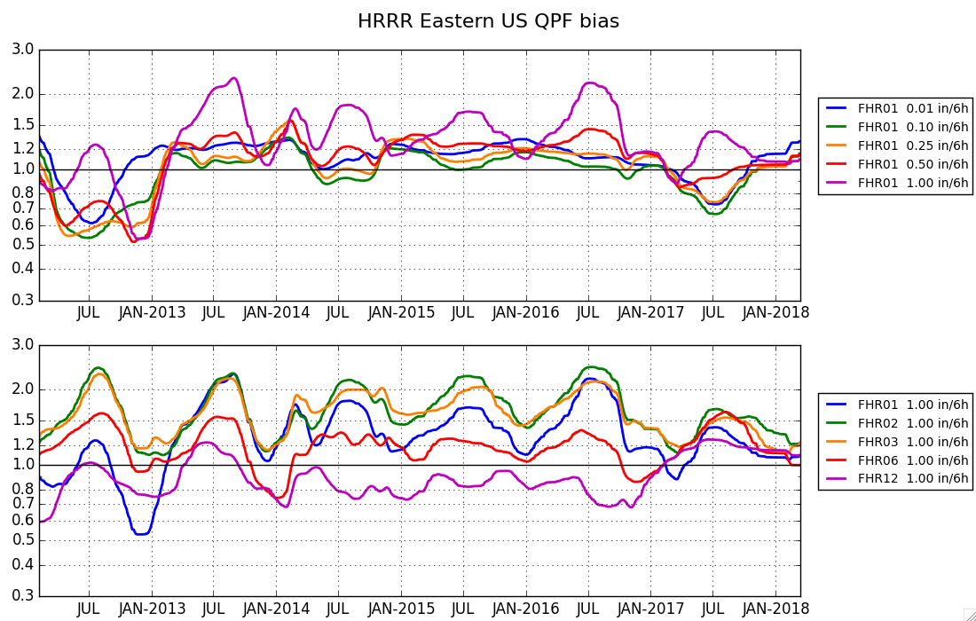
Heavier rainfall
HRRR QPF bias over time, for various thresholds
Longer forecast lengths
HRRR QPF bias over time, for various forecast hours

Slide 13
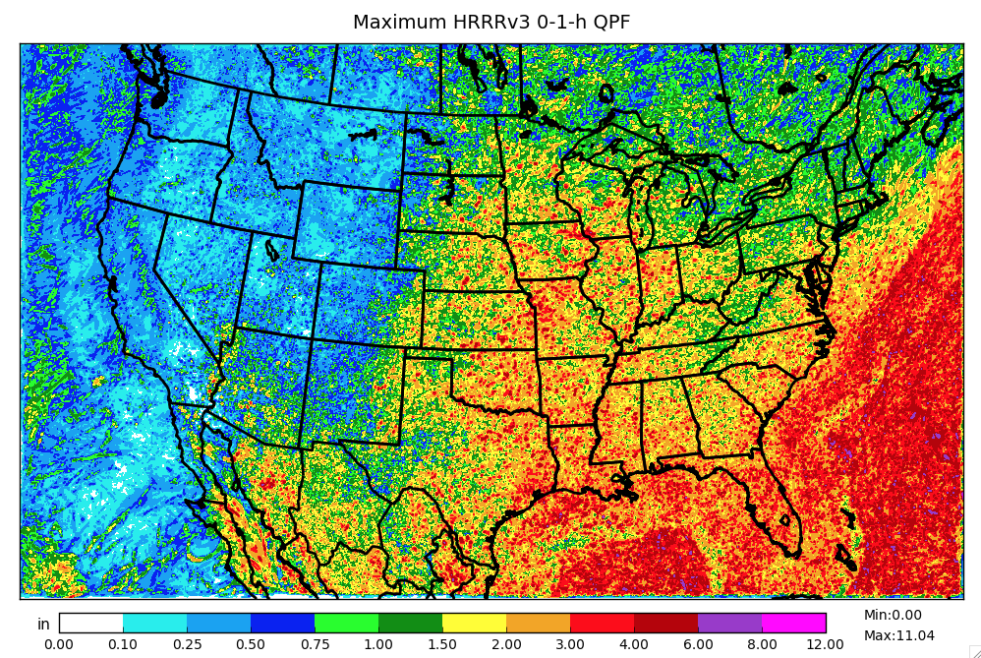

Slide 14
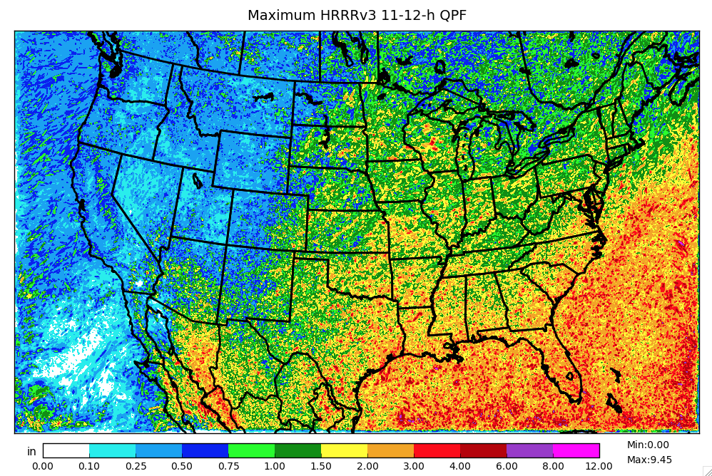

Slide 15
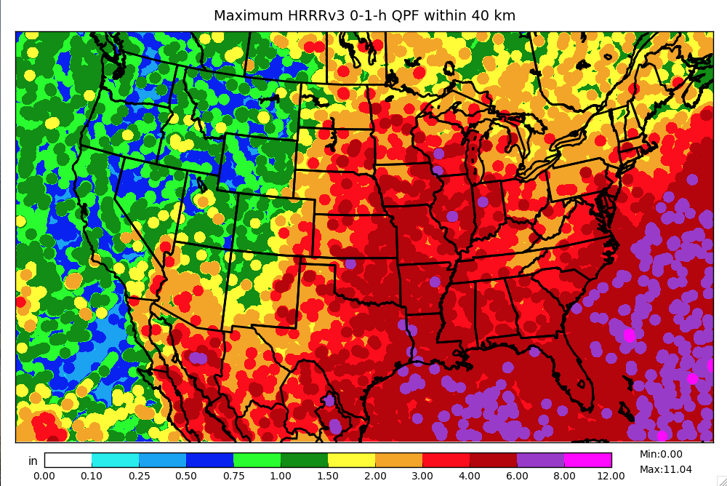

Slide 16
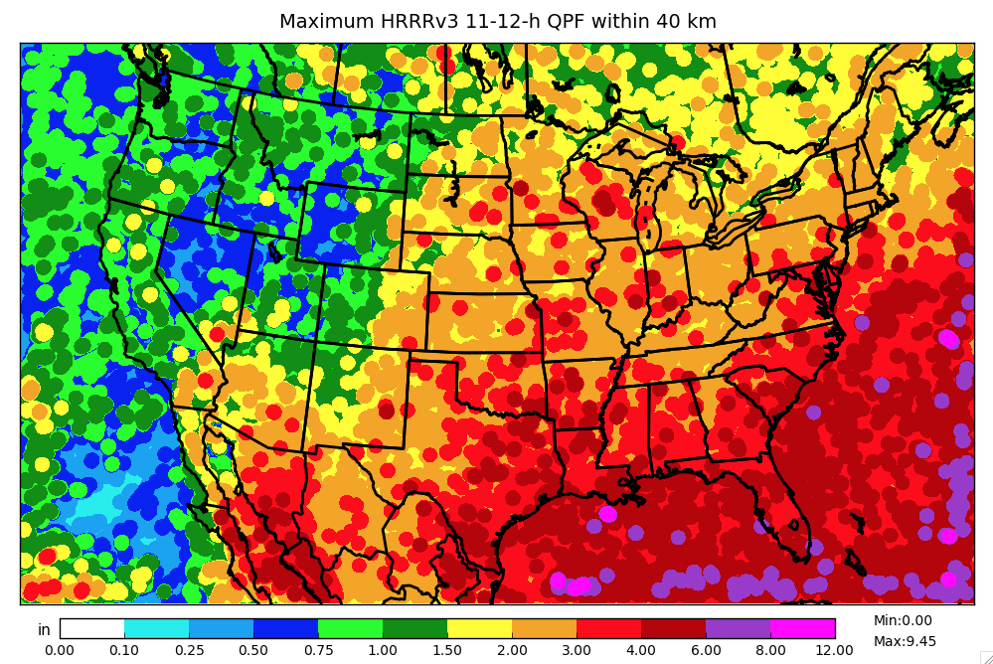

Slide 17
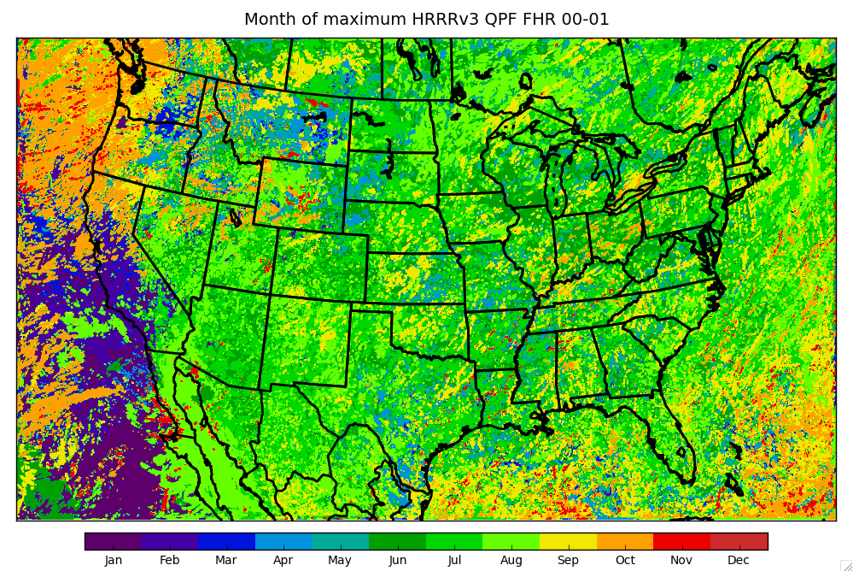

Slide 18
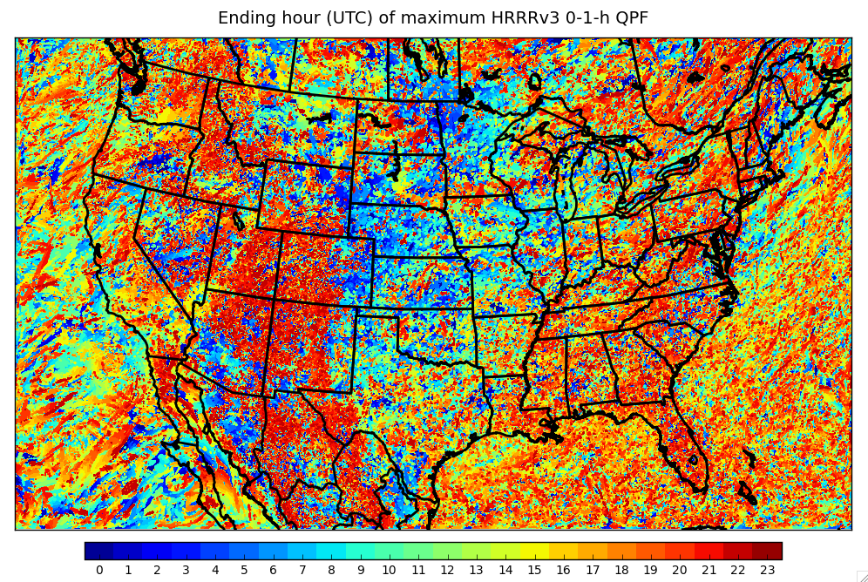

Slide 19
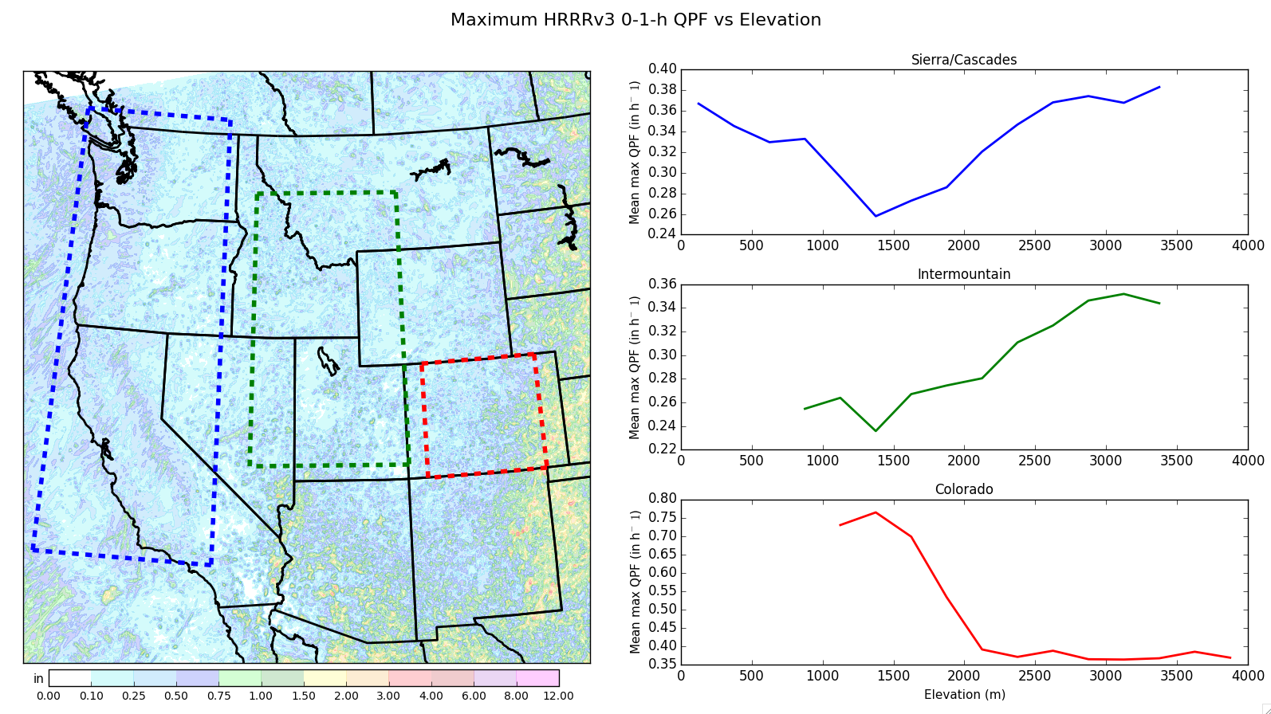

Slide 20
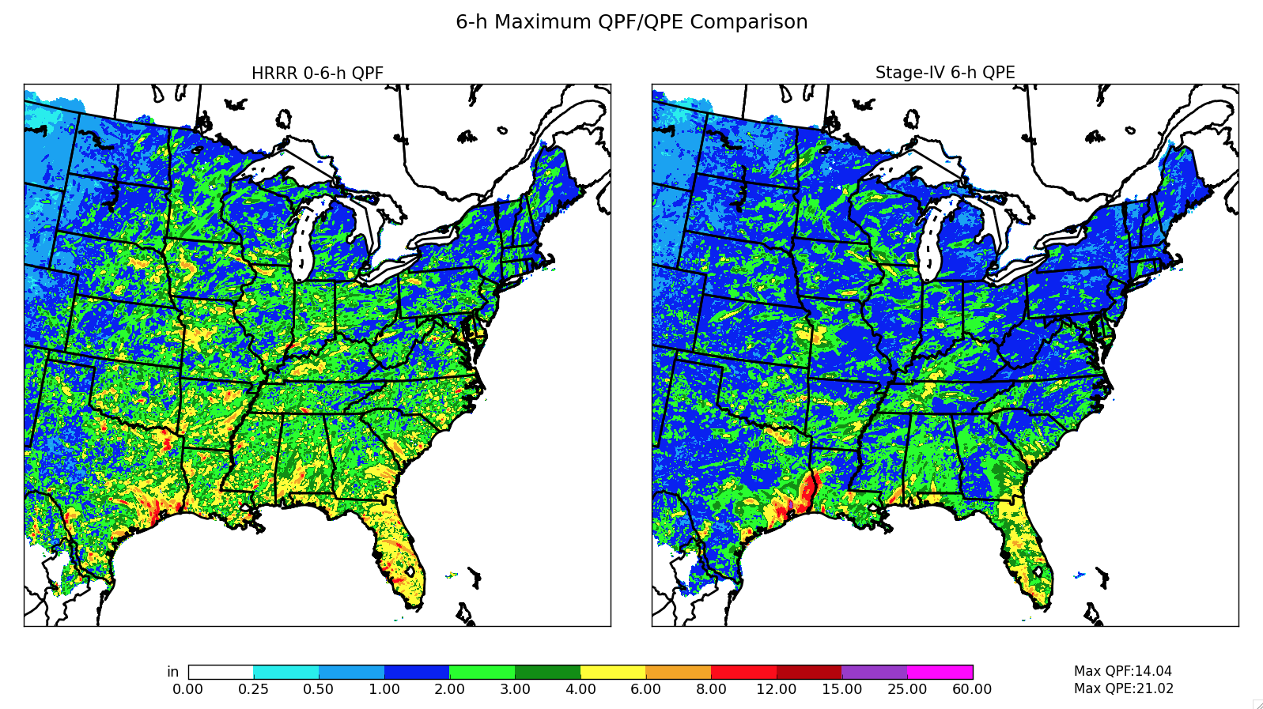

Slide 21
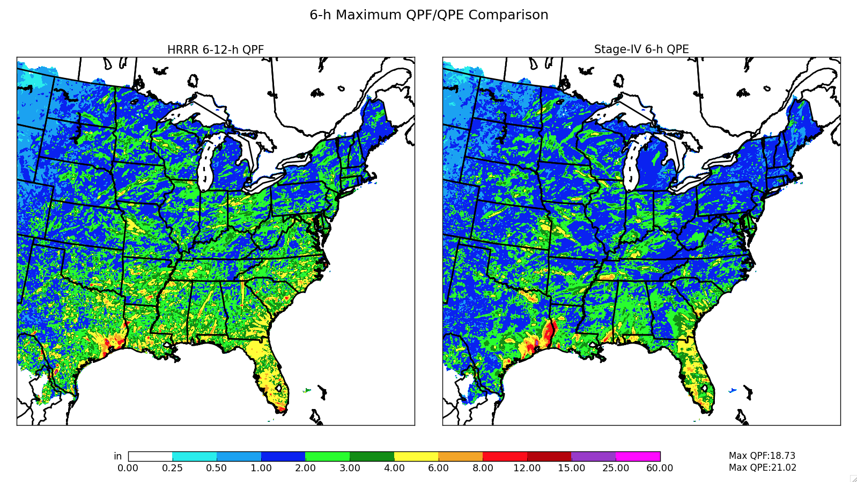

Slide 22
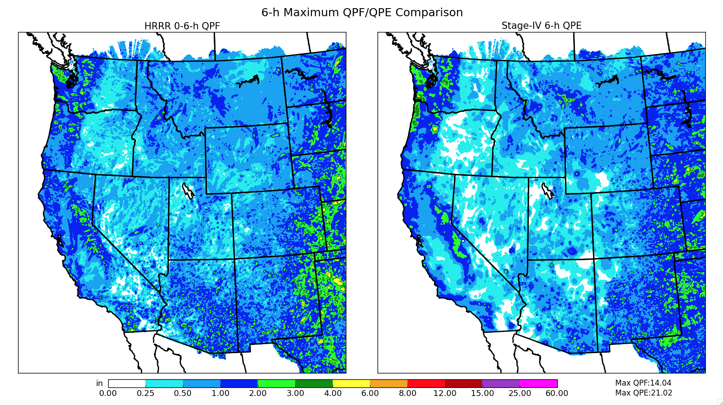

Slide 23
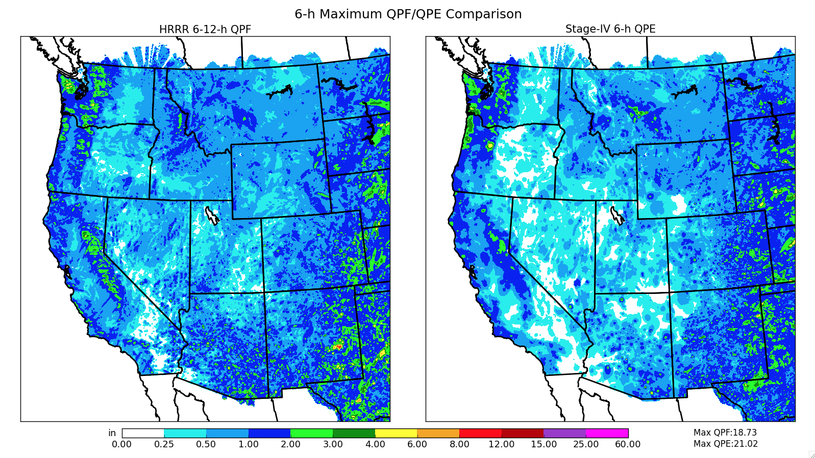

Slide 24
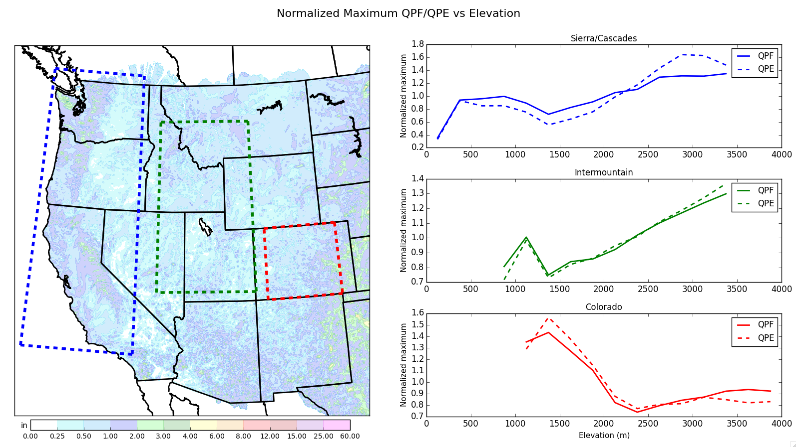

Slide 25
Summary
Maximum HRRR 1-h QPF ranges from near zero to over 12 in across the CONUS domain, some physically consistent and some inexplicable regional features
In the West, HRRR rarely produces 1-h QPF magnitudes associated with flash flooding
Early HRRR forecasts have much higher coverage of 2-6 in / 6 h values than Stage-IV analyses in Eastern US
“bias” is reduced for longer lead forecasts, i.e., > 6 h
Maximum-rainfall-rate-vs-elevation relationship varies substantially from West Coast to interior ranges
with a few exceptions, forecasts and analyses show similar normalized elevation relationships for maximum 6-h rates

