Slide 1
Does Aerosol Loading in a Convective Environment Influence Cirrus Anvil Properties?
Betsy Berry and Jay Mace
University of Utah
American Geophysical Union 2011 Fall Meeting

Slide 2
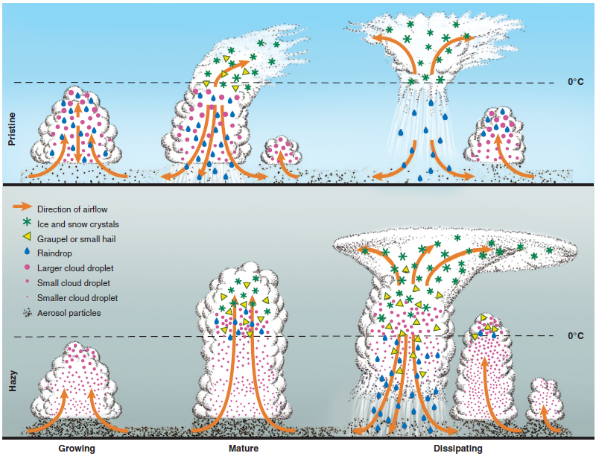
Aerosol Impacts on Deep Convection
Rosenfeld et al. 2008
“invigoration”
More CCN→
more small droplets→
less collision→ delayed raindrop formation
Smaller sizes are lofted higher where they freeze→ latent heat release leads to increased buoyancy and a stronger updraft
Higher cloud top height → condensate at higher levels spreads out over a larger area

Slide 3
Motivation
Recent studies give conflicting results that aerosols can either invigorate or weaken convective cloud growth
Anvils in polluted environments have smaller ice particle sizes and smaller fall velocities compared to pristine environments (Morrison and Grabowski, 2011)
Can we see this effect in observations?

Slide 4
Data: multi-platform approach
CloudSat and CALIPSO to define cirrus and obtain microphysical properties from 2C-ICE data product (Deng et al., 2010)
Geostationary satellite data to track cirrus in time (Soden, 1998) and link to convection (Tb<210K)
MODIS Atmosphere L2 Joint Product: Aerosol Optical Thickness (AOT) within 50km of CloudSat
Large-scale dynamics from NCEP/NCAR reanalysis

Slide 5
Limitations and Assumptions
Difficult to measure aerosol-cloud interactions
We assume that aerosol in nearby clear air is representative of aerosol in cirrus anvil
Potential contamination of AOT from optically thin cirrus
We don’t know what the aerosol loading was at the time of convective initiation

Slide 6
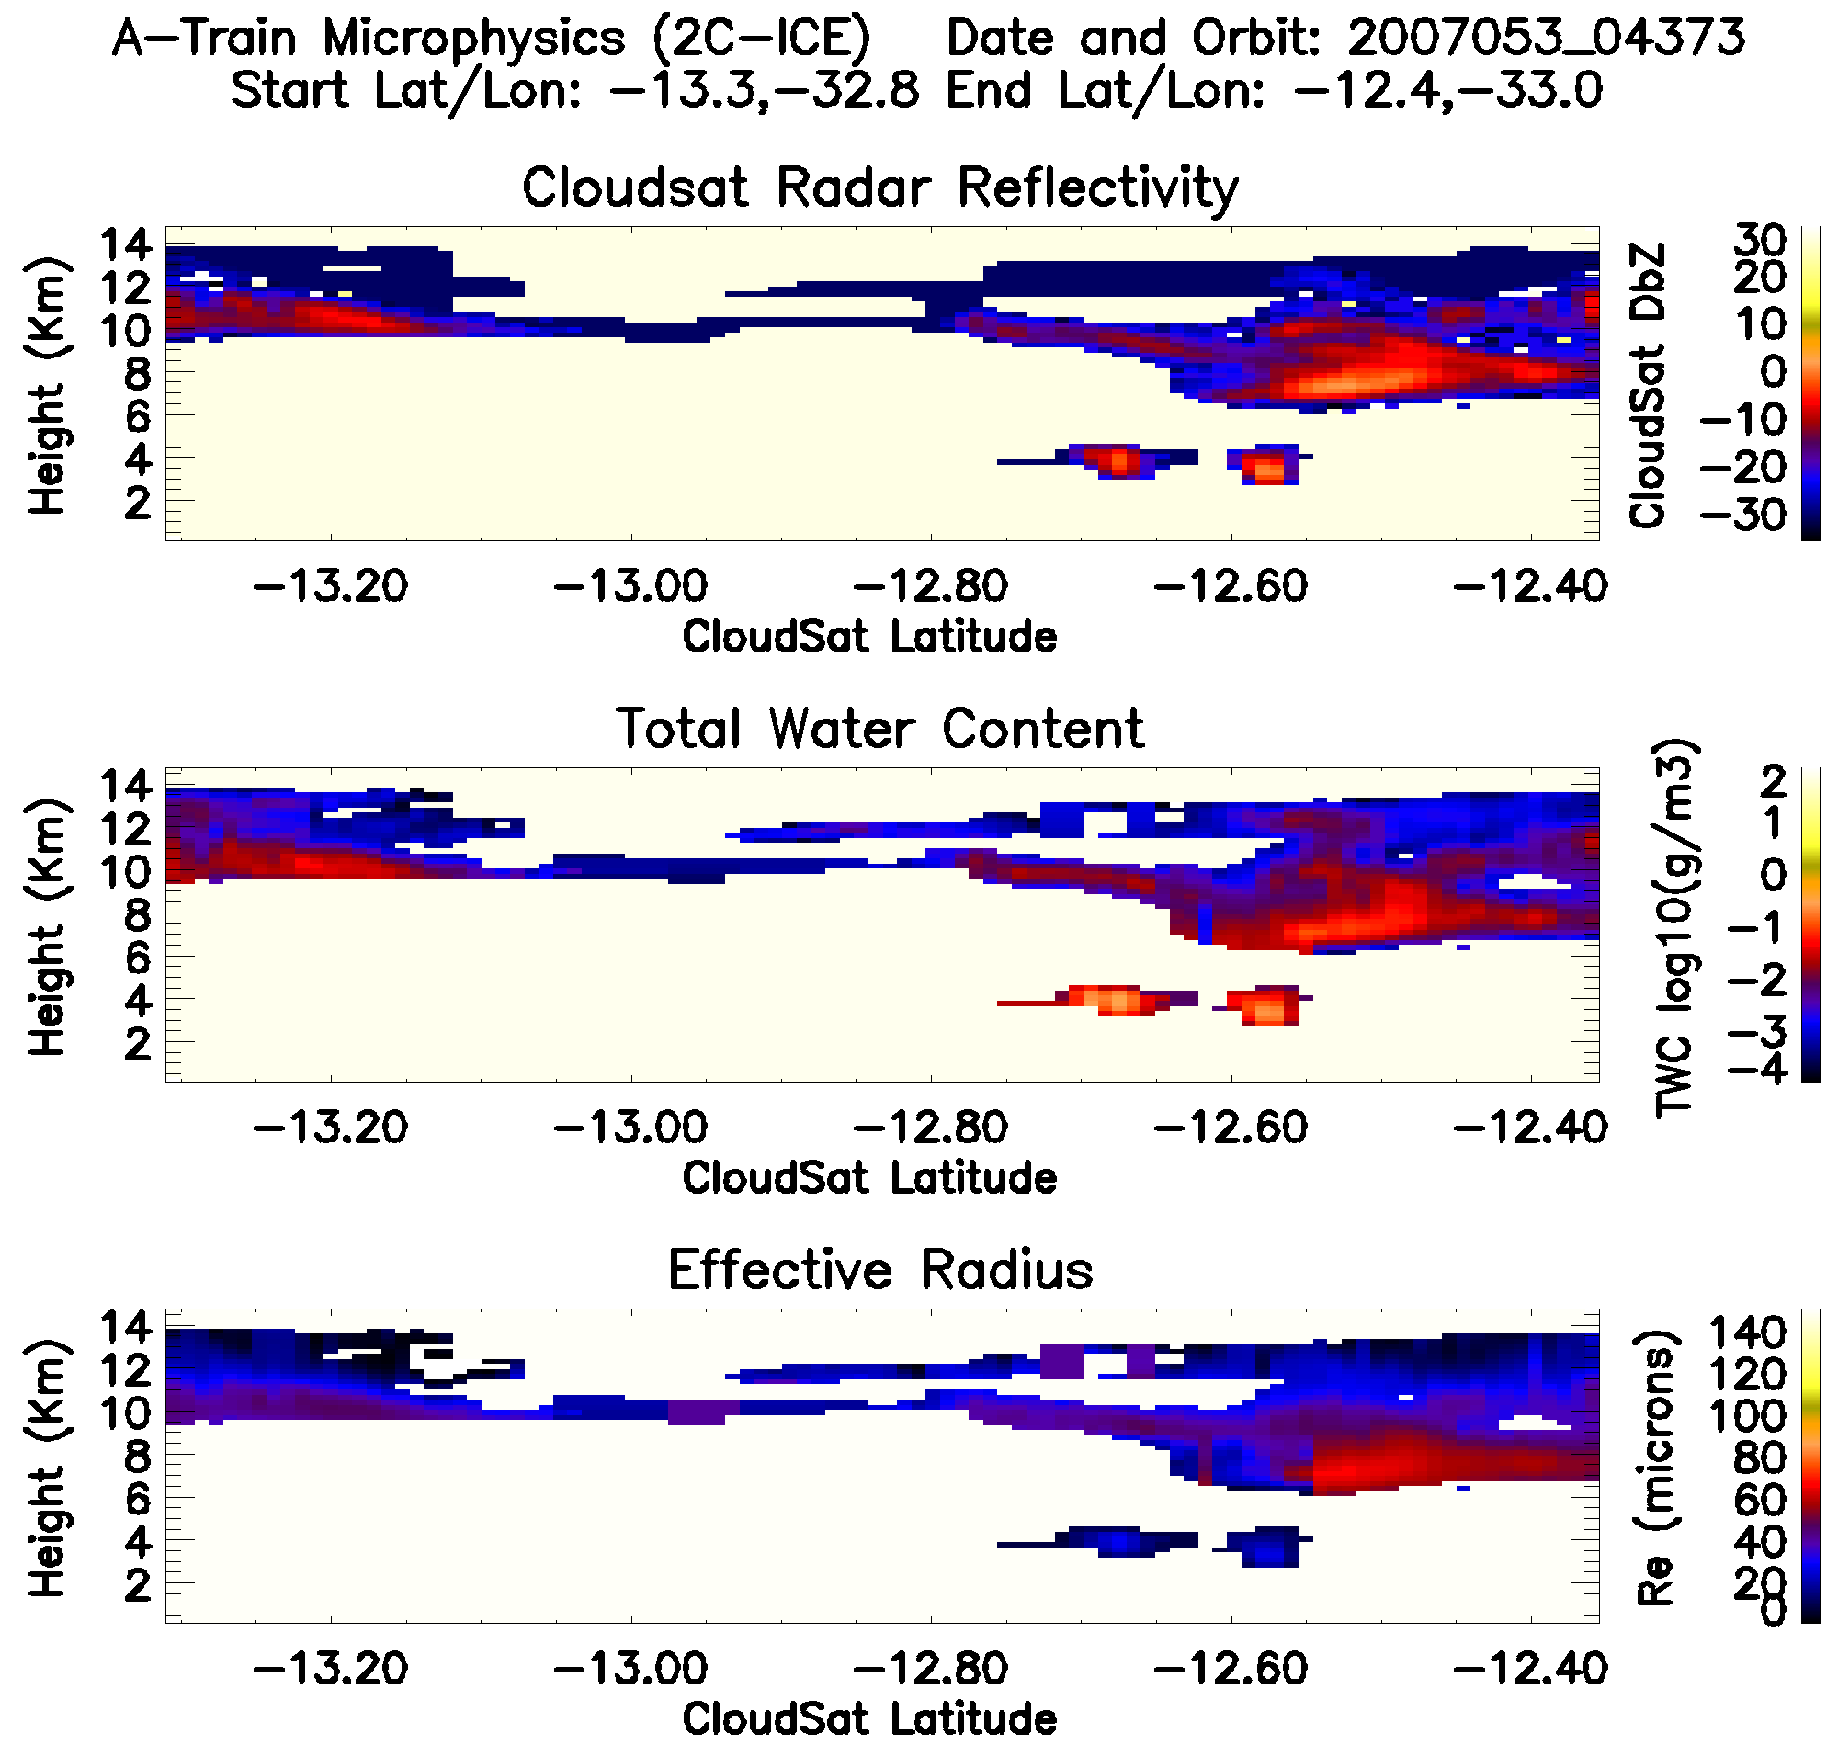
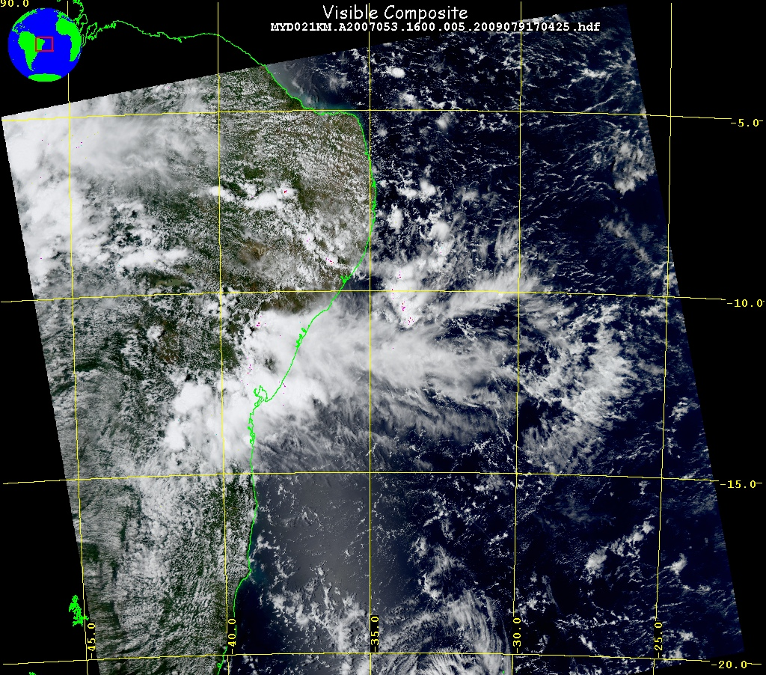
Example: Cirrus event observed by the A-Train on February 15, 2007 at 1604UTC

Slide 7
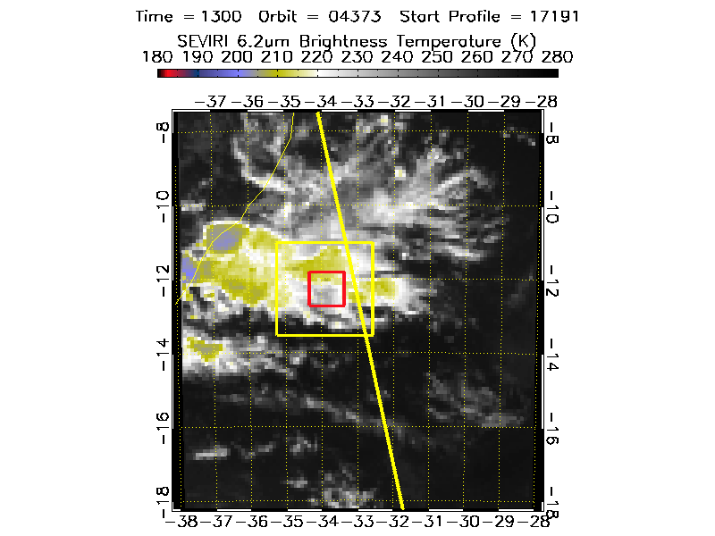
Link to Convection

Slide 8

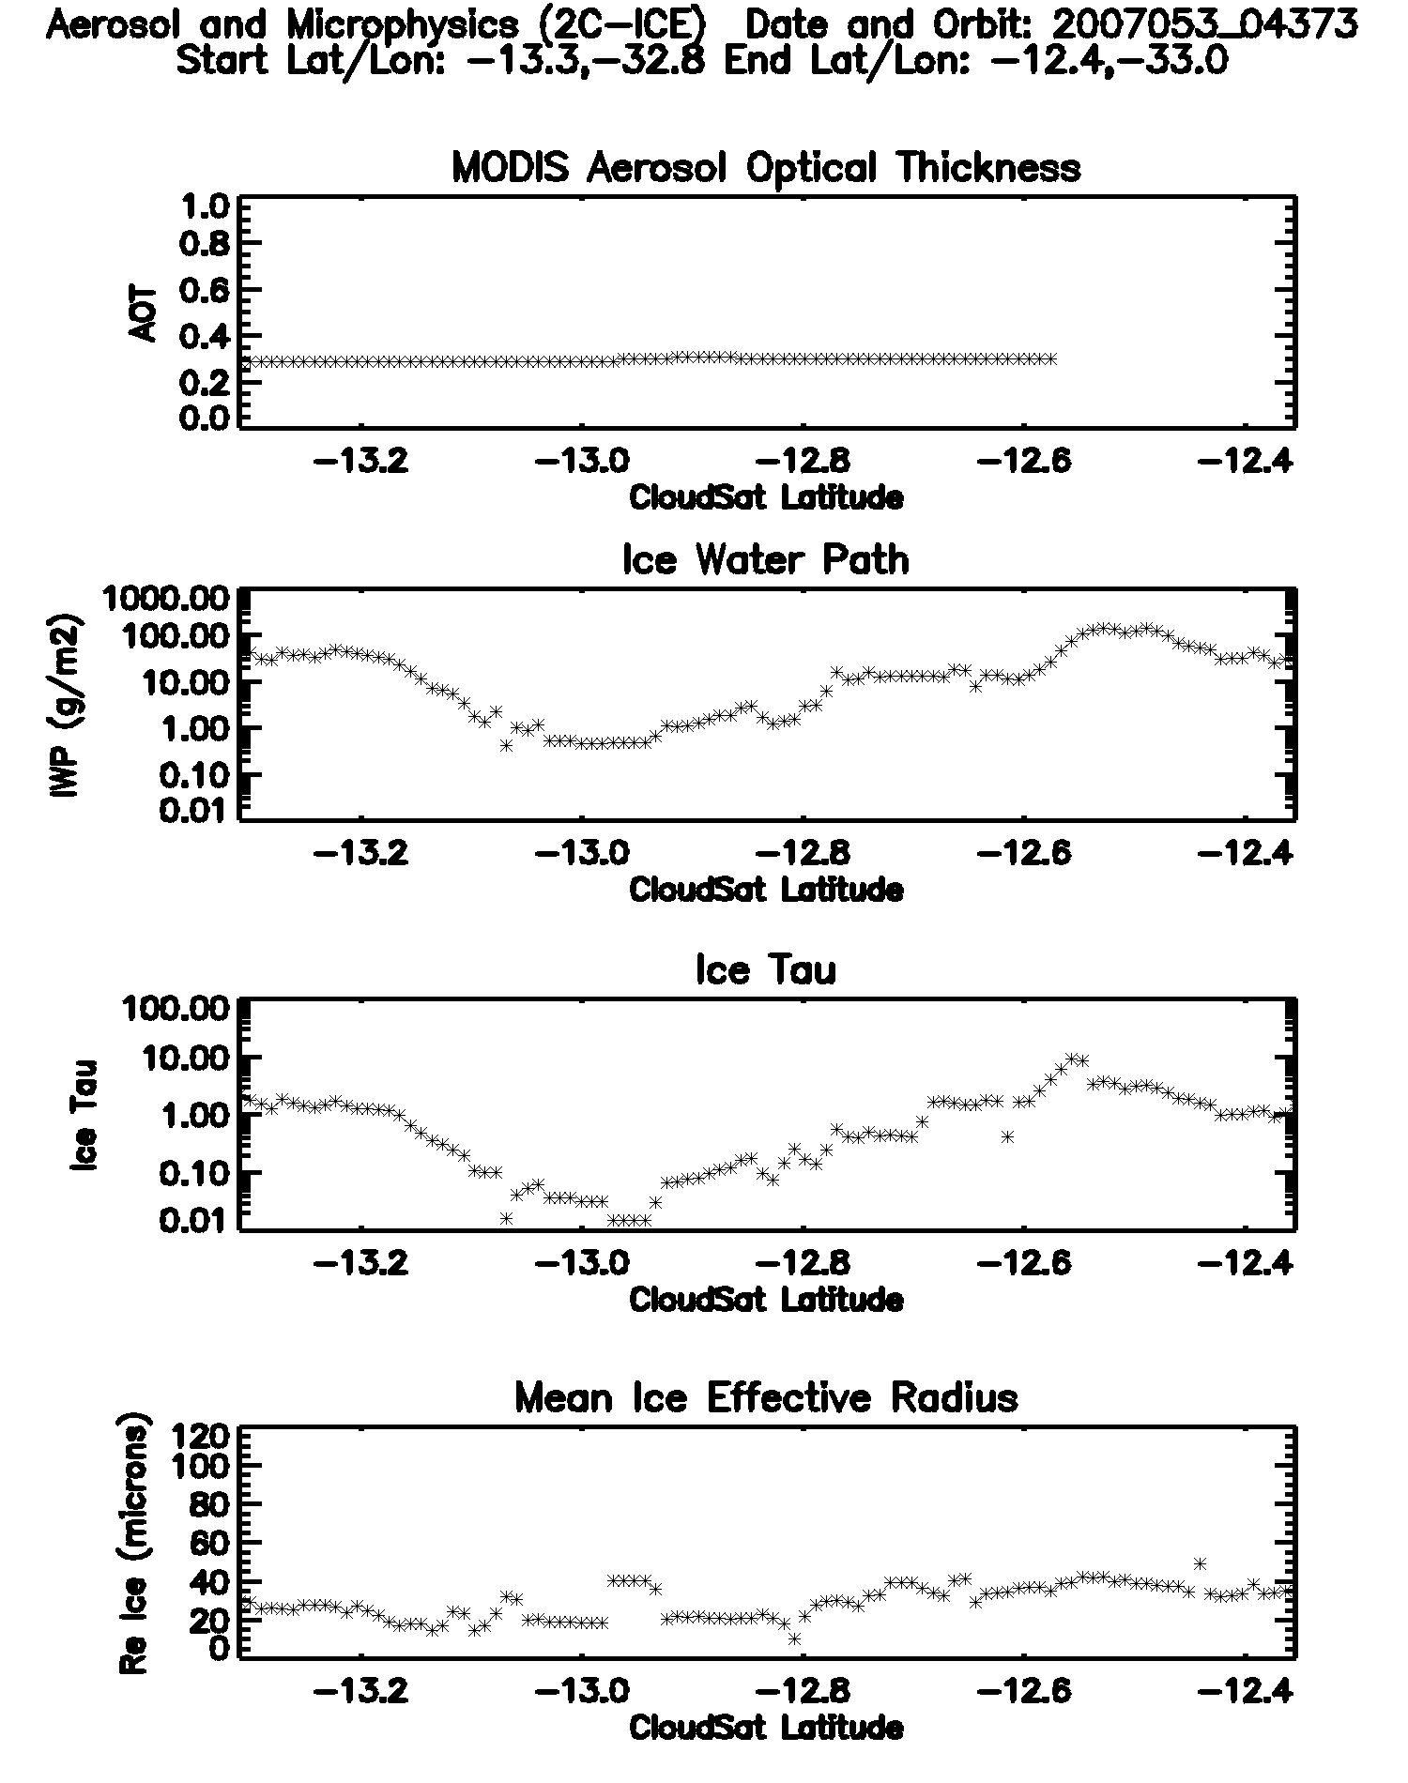
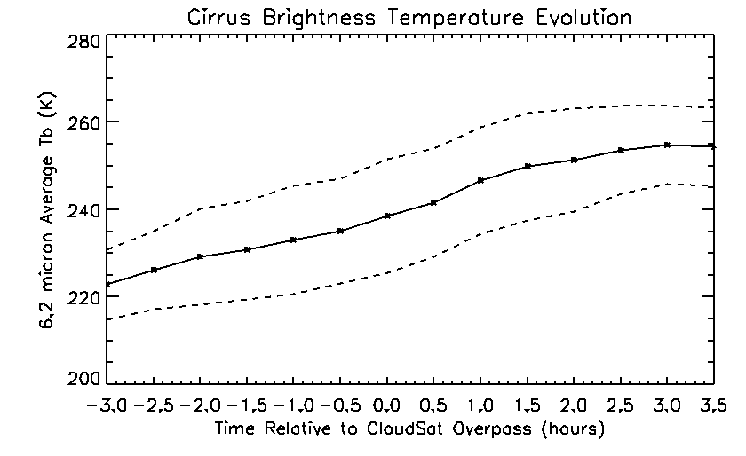
AOT and cirrus microphysics
dTb/dt=2.7K/0.5hr
Back in time
Forward in time

Slide 9
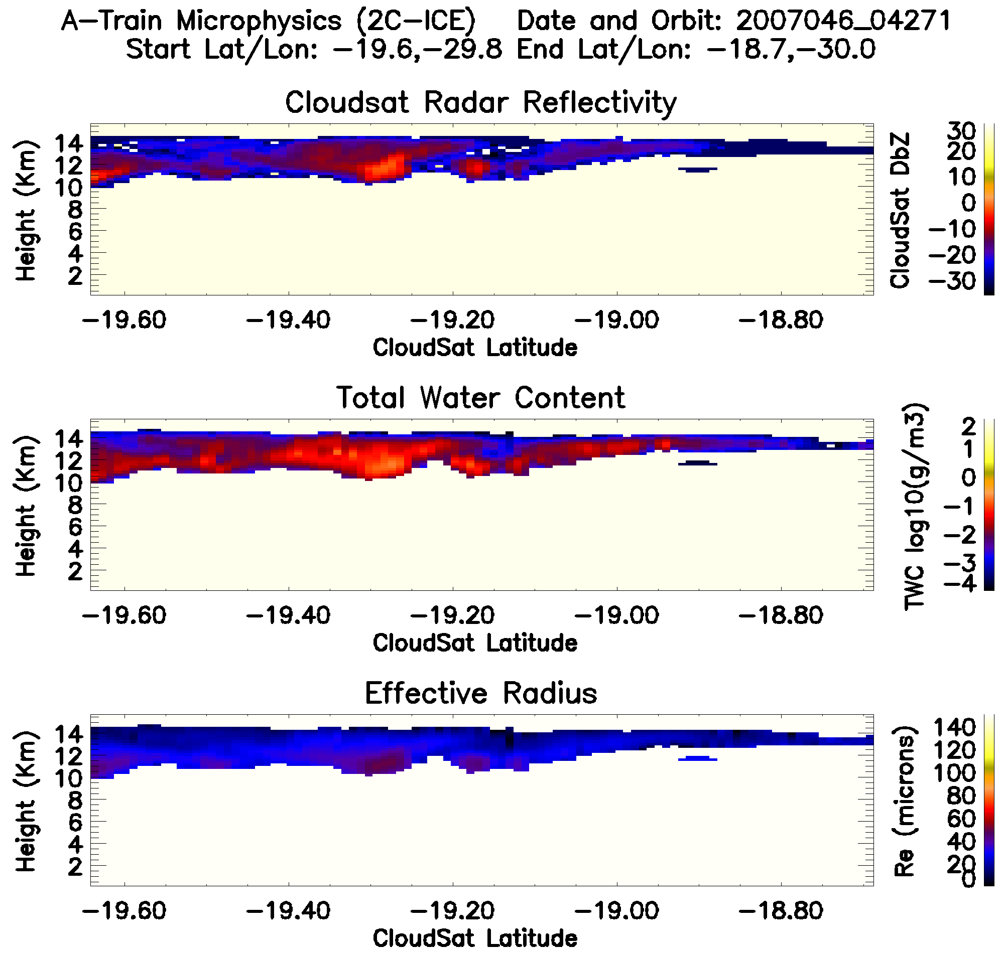
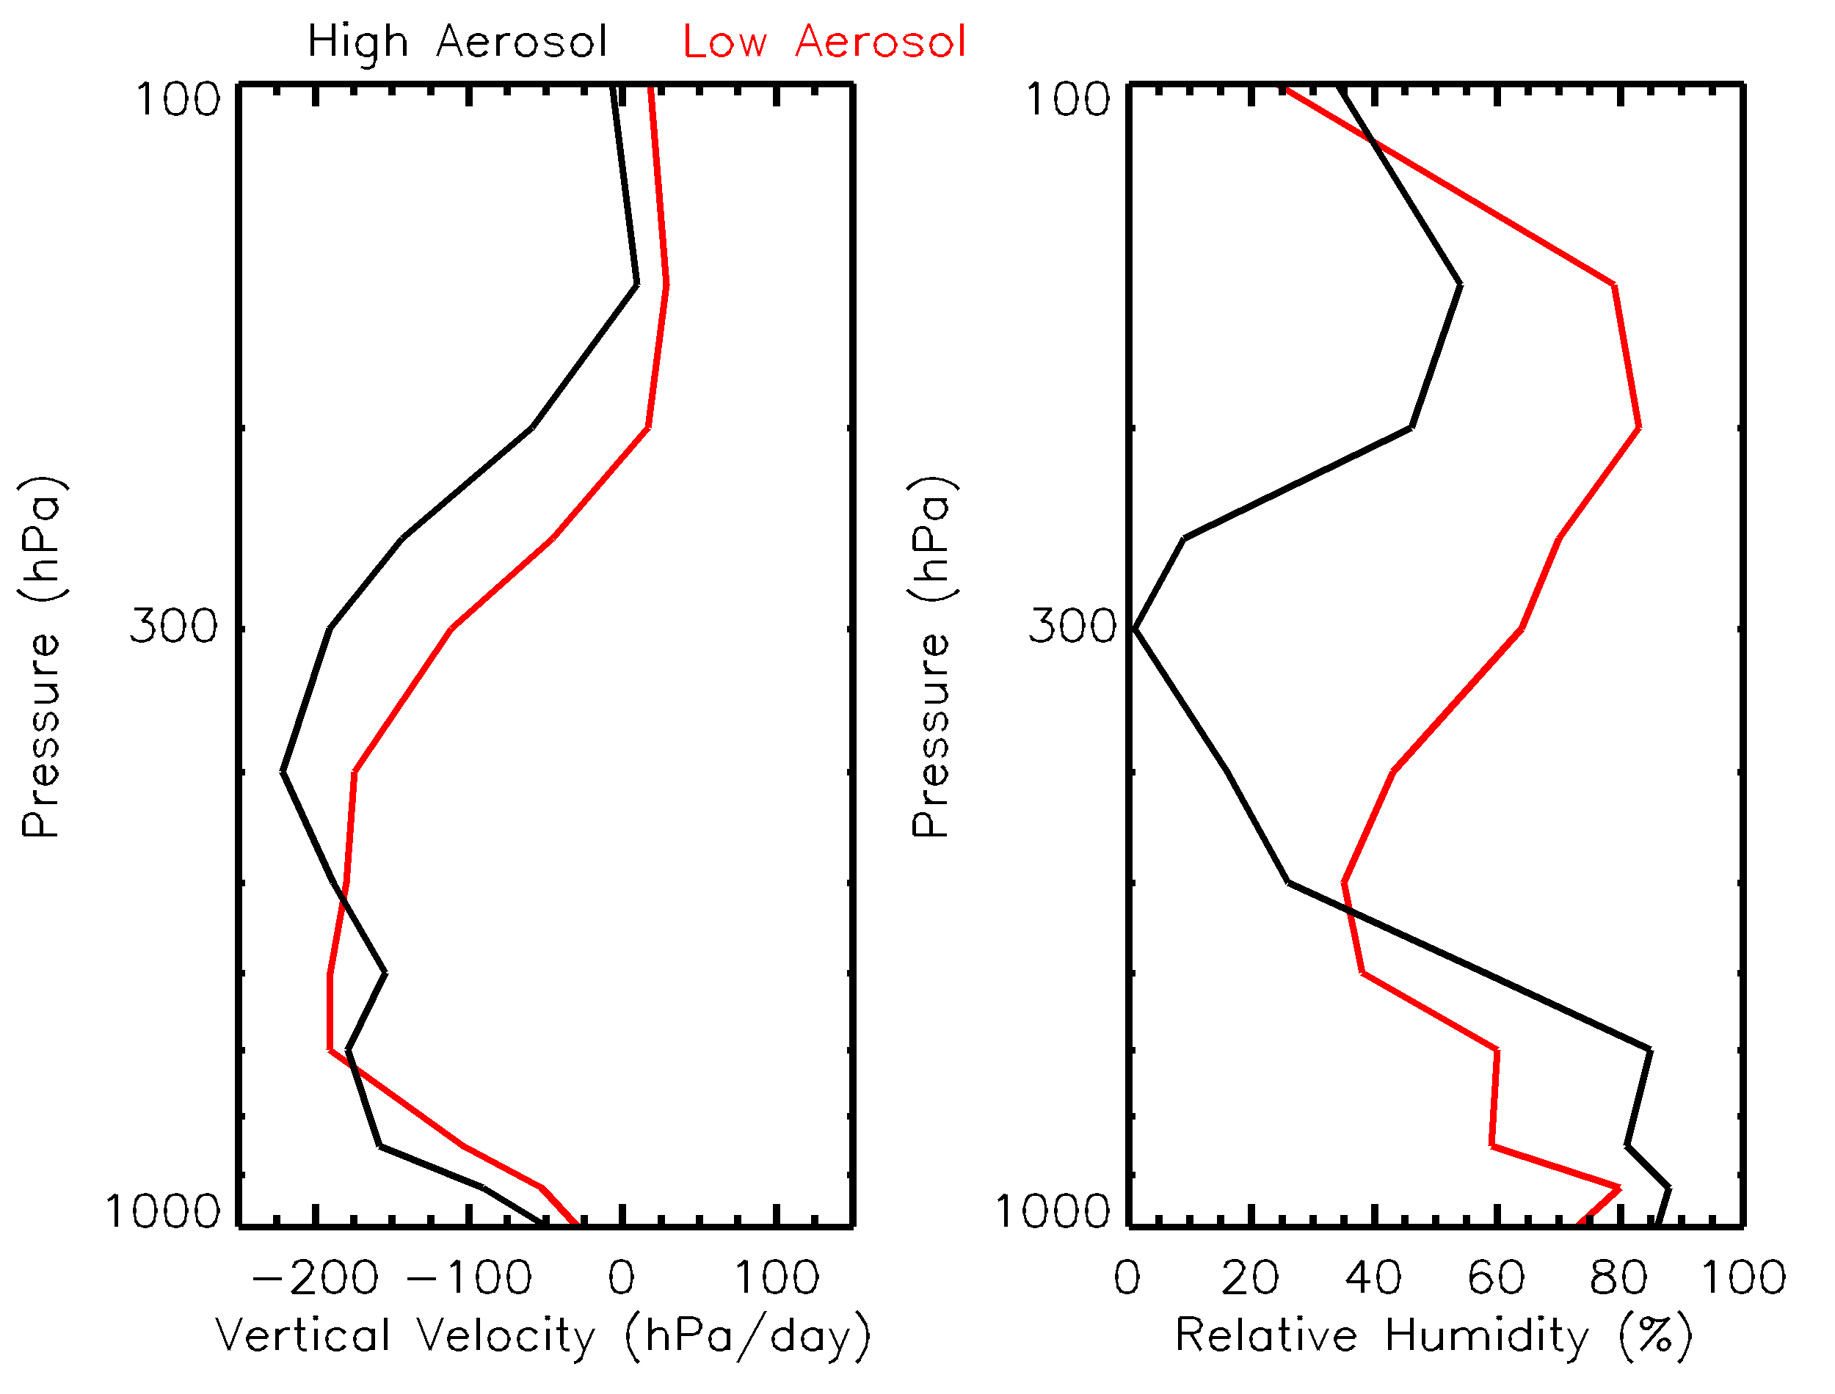
Large-scale dynamic environment
Low Aerosol Case High Aerosol Case

Slide 10
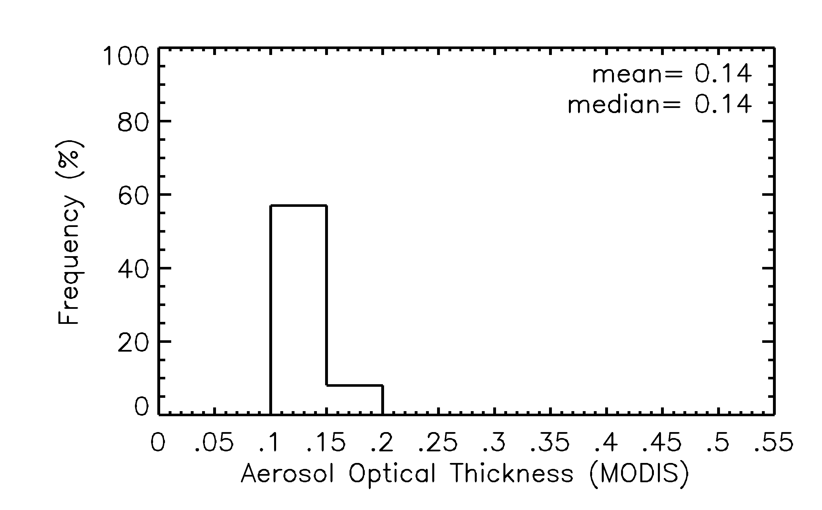
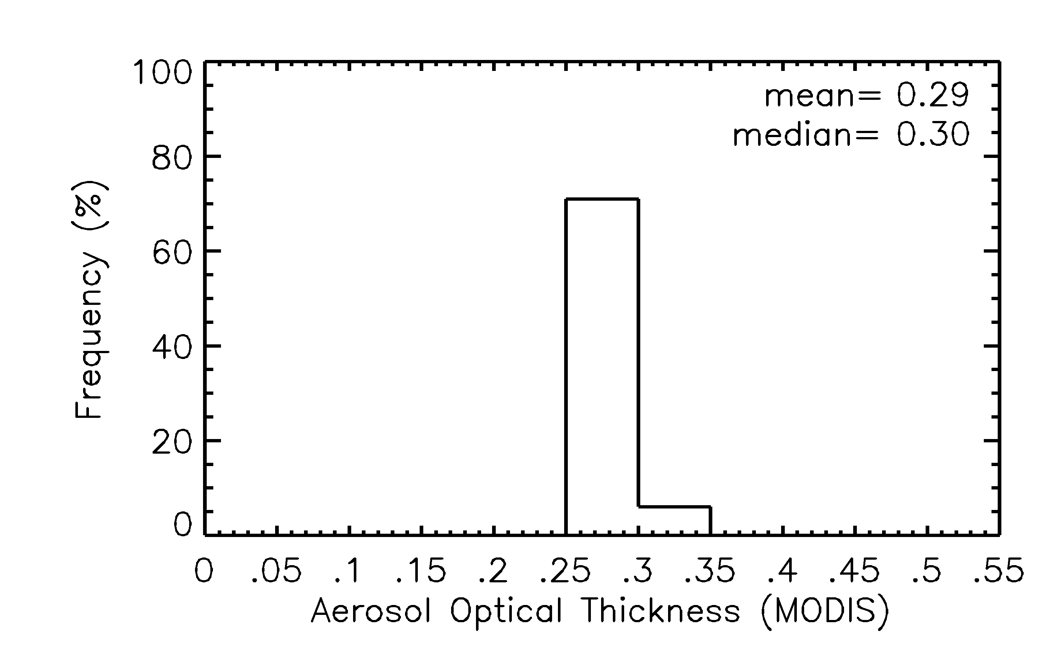
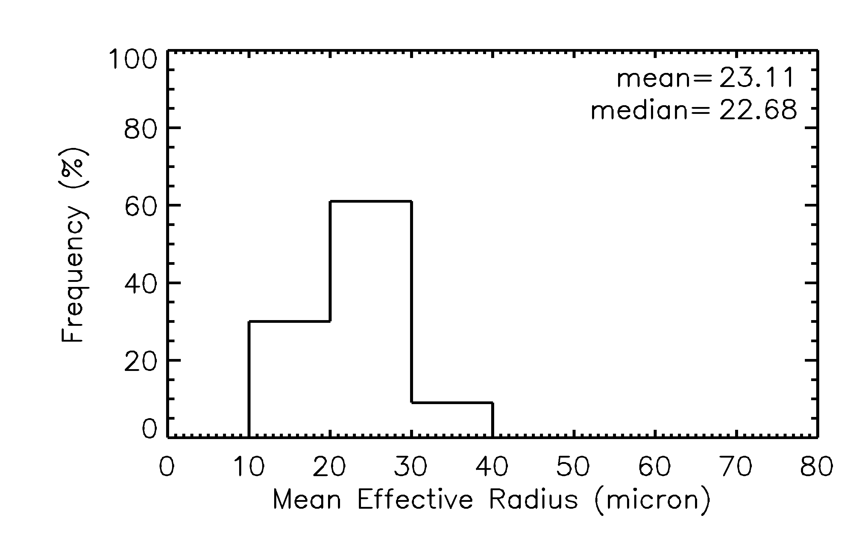
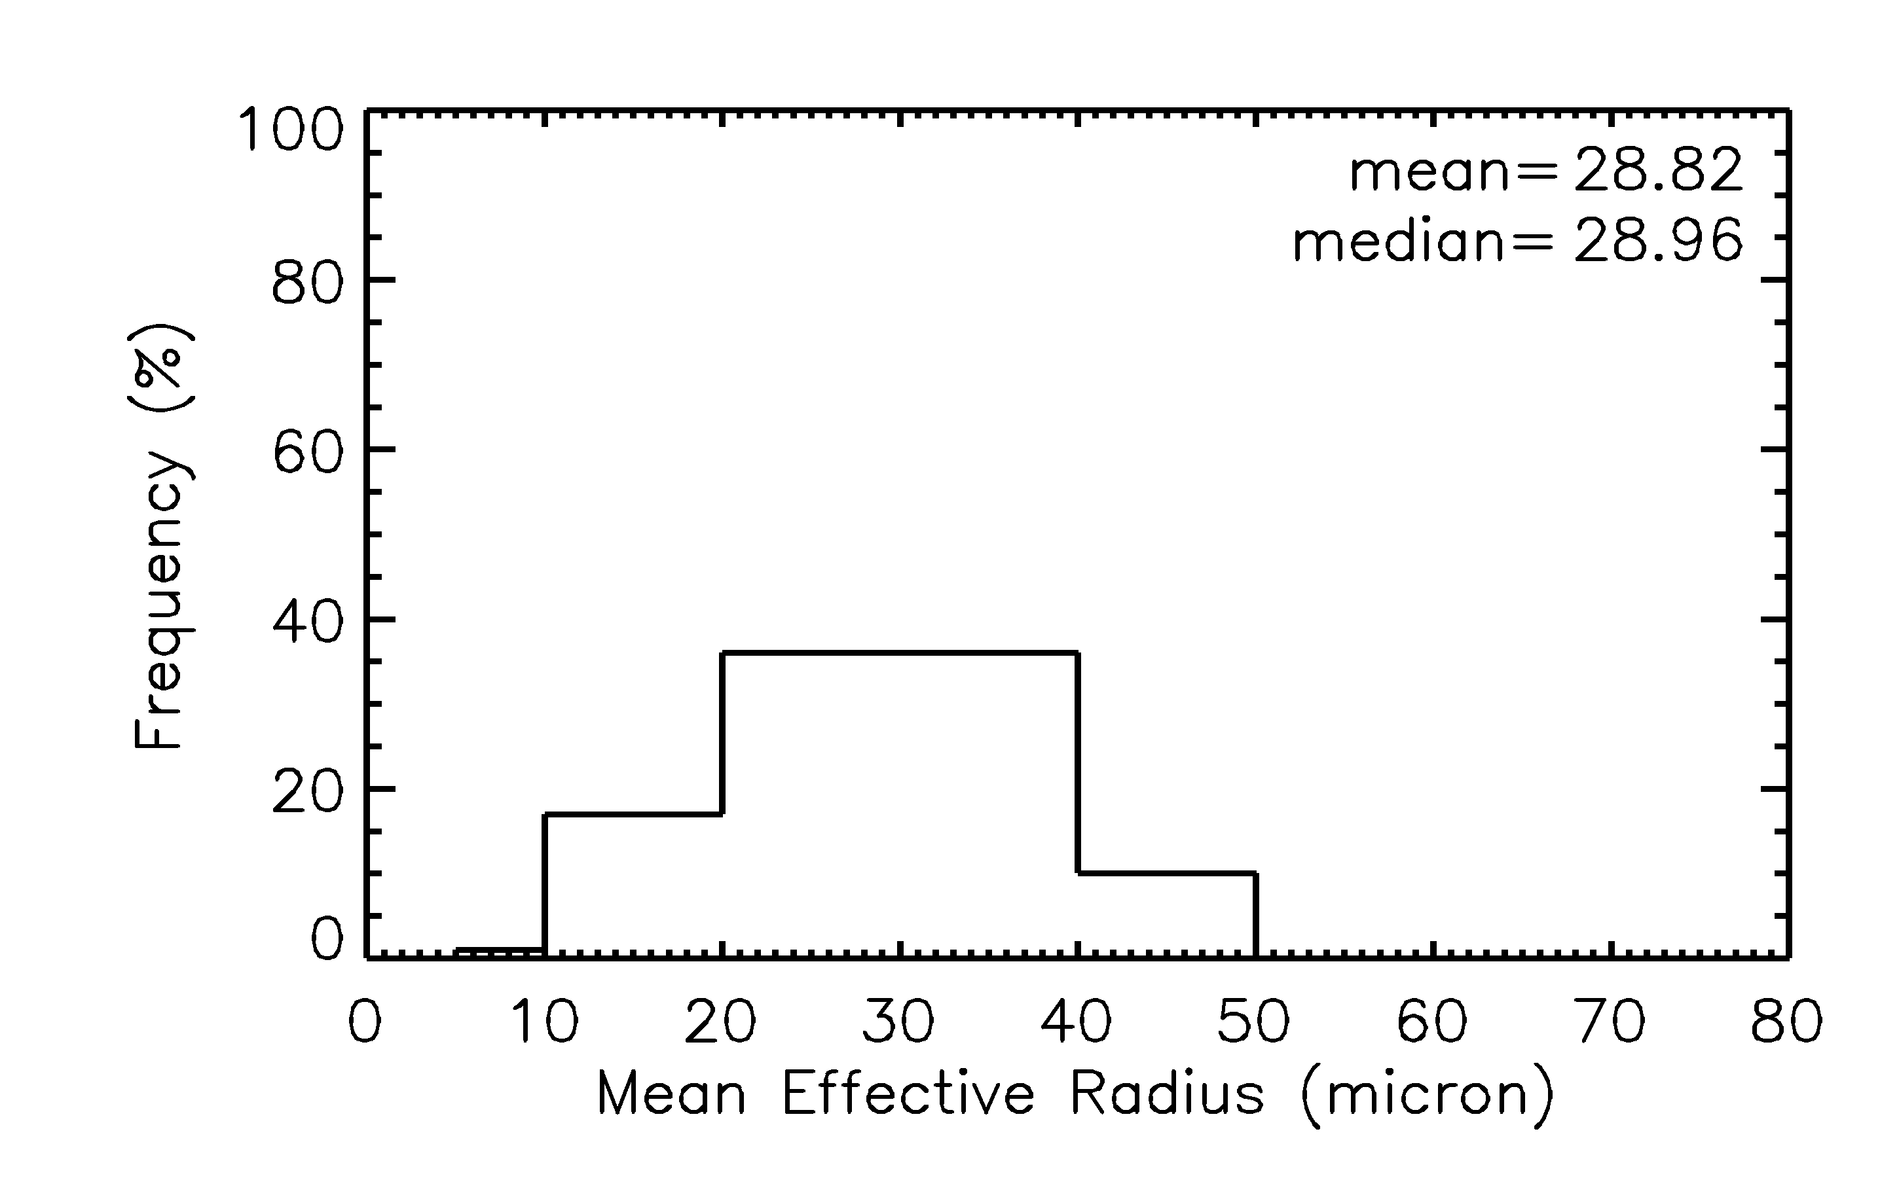
Low aerosol case
High aerosol case
<
AOT
<
Re Ice

Slide 11
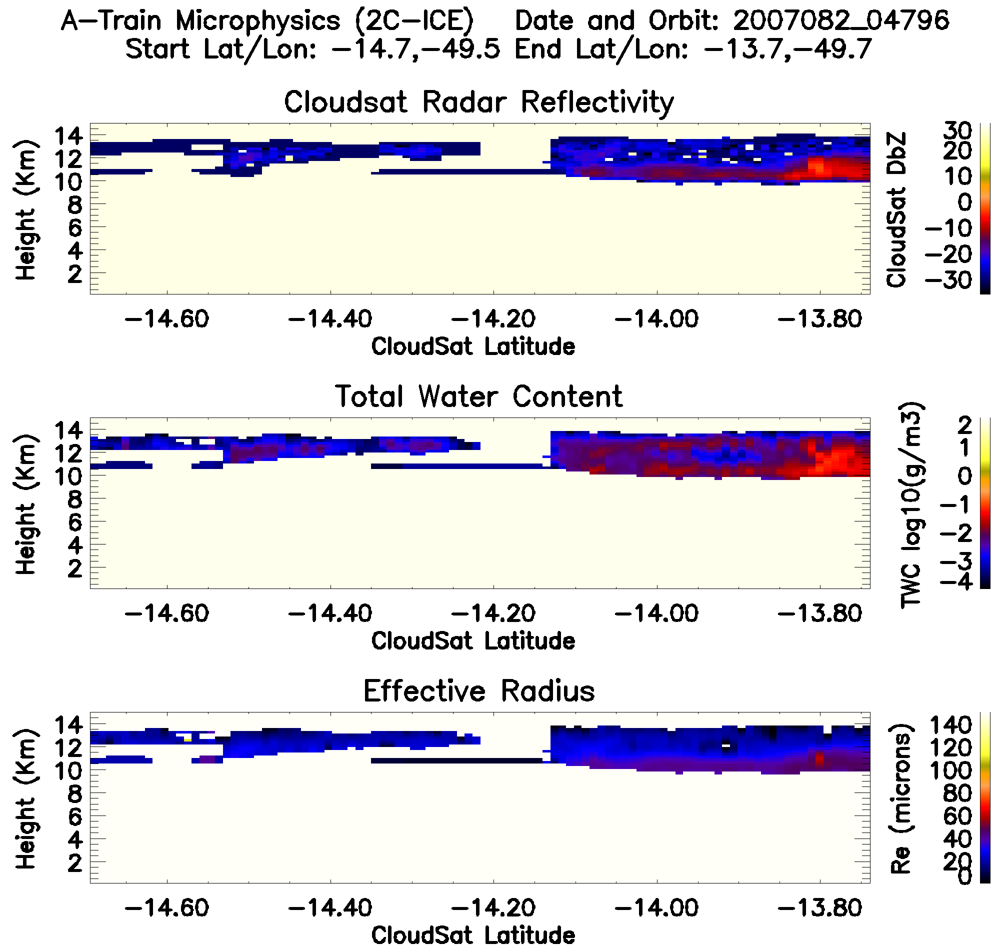
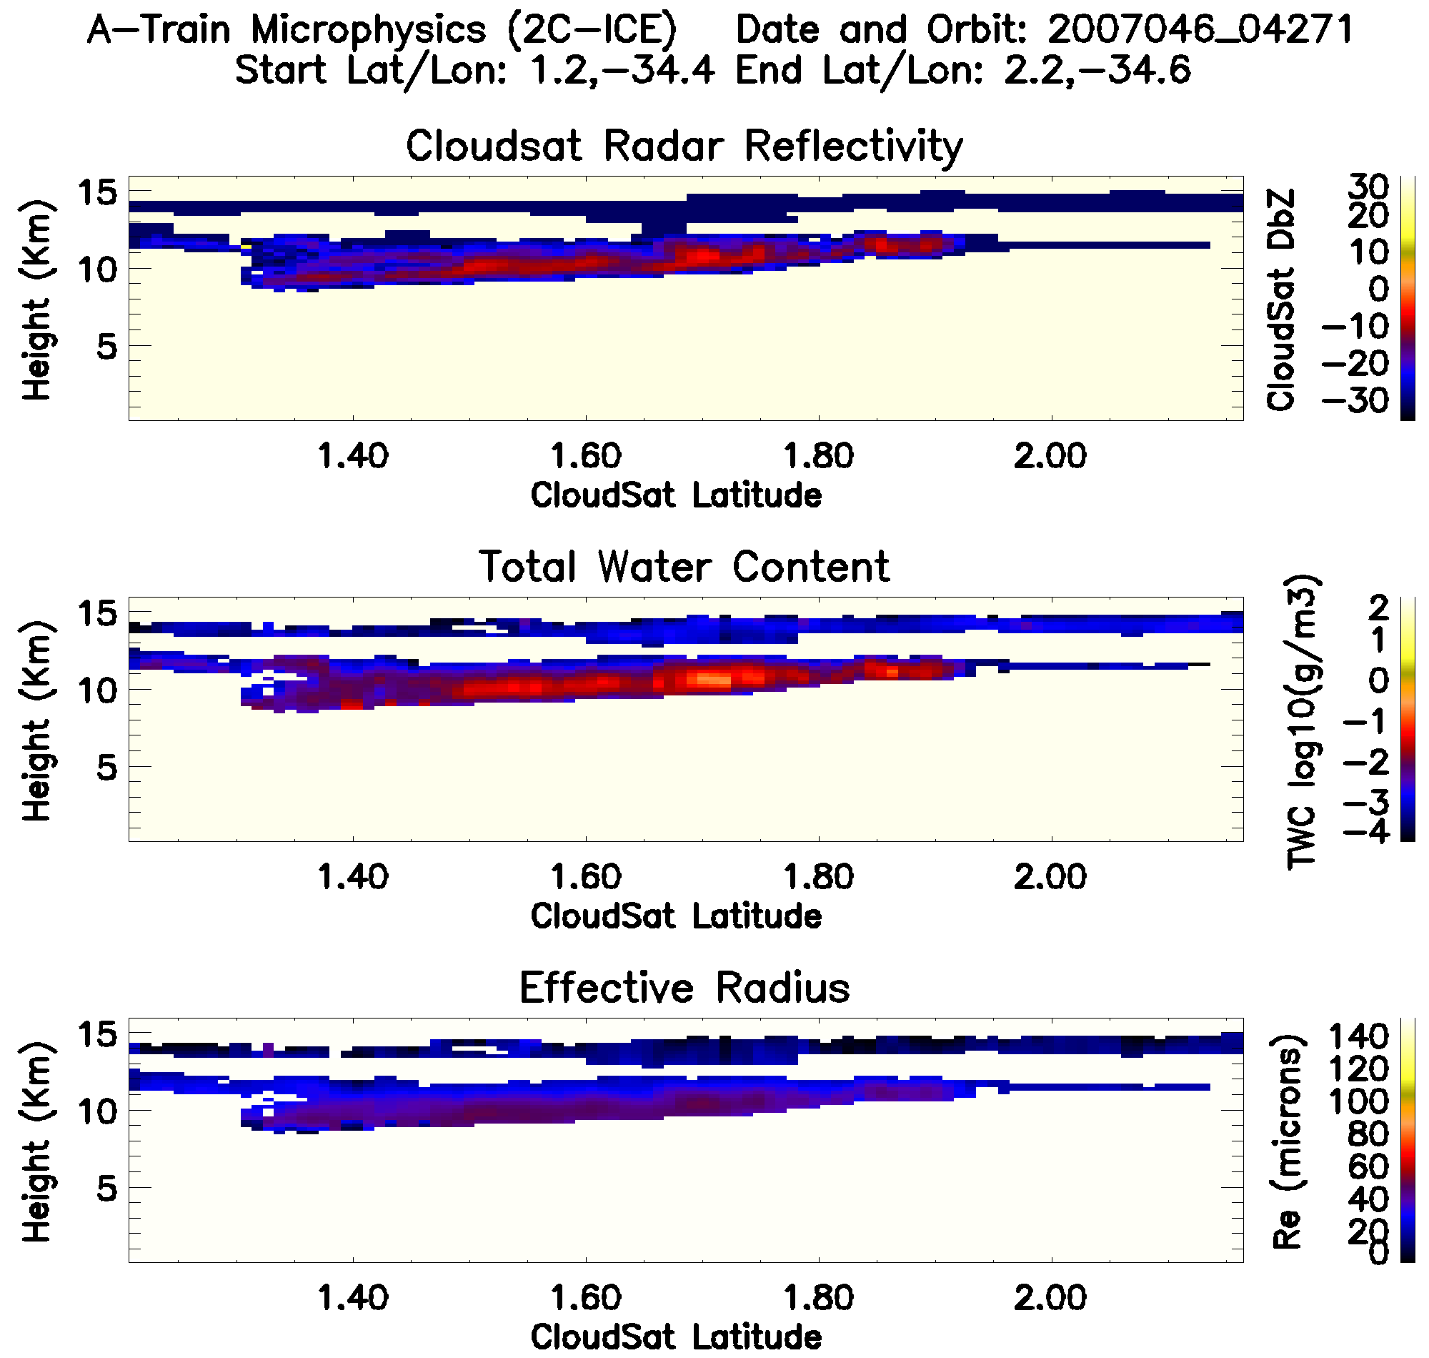
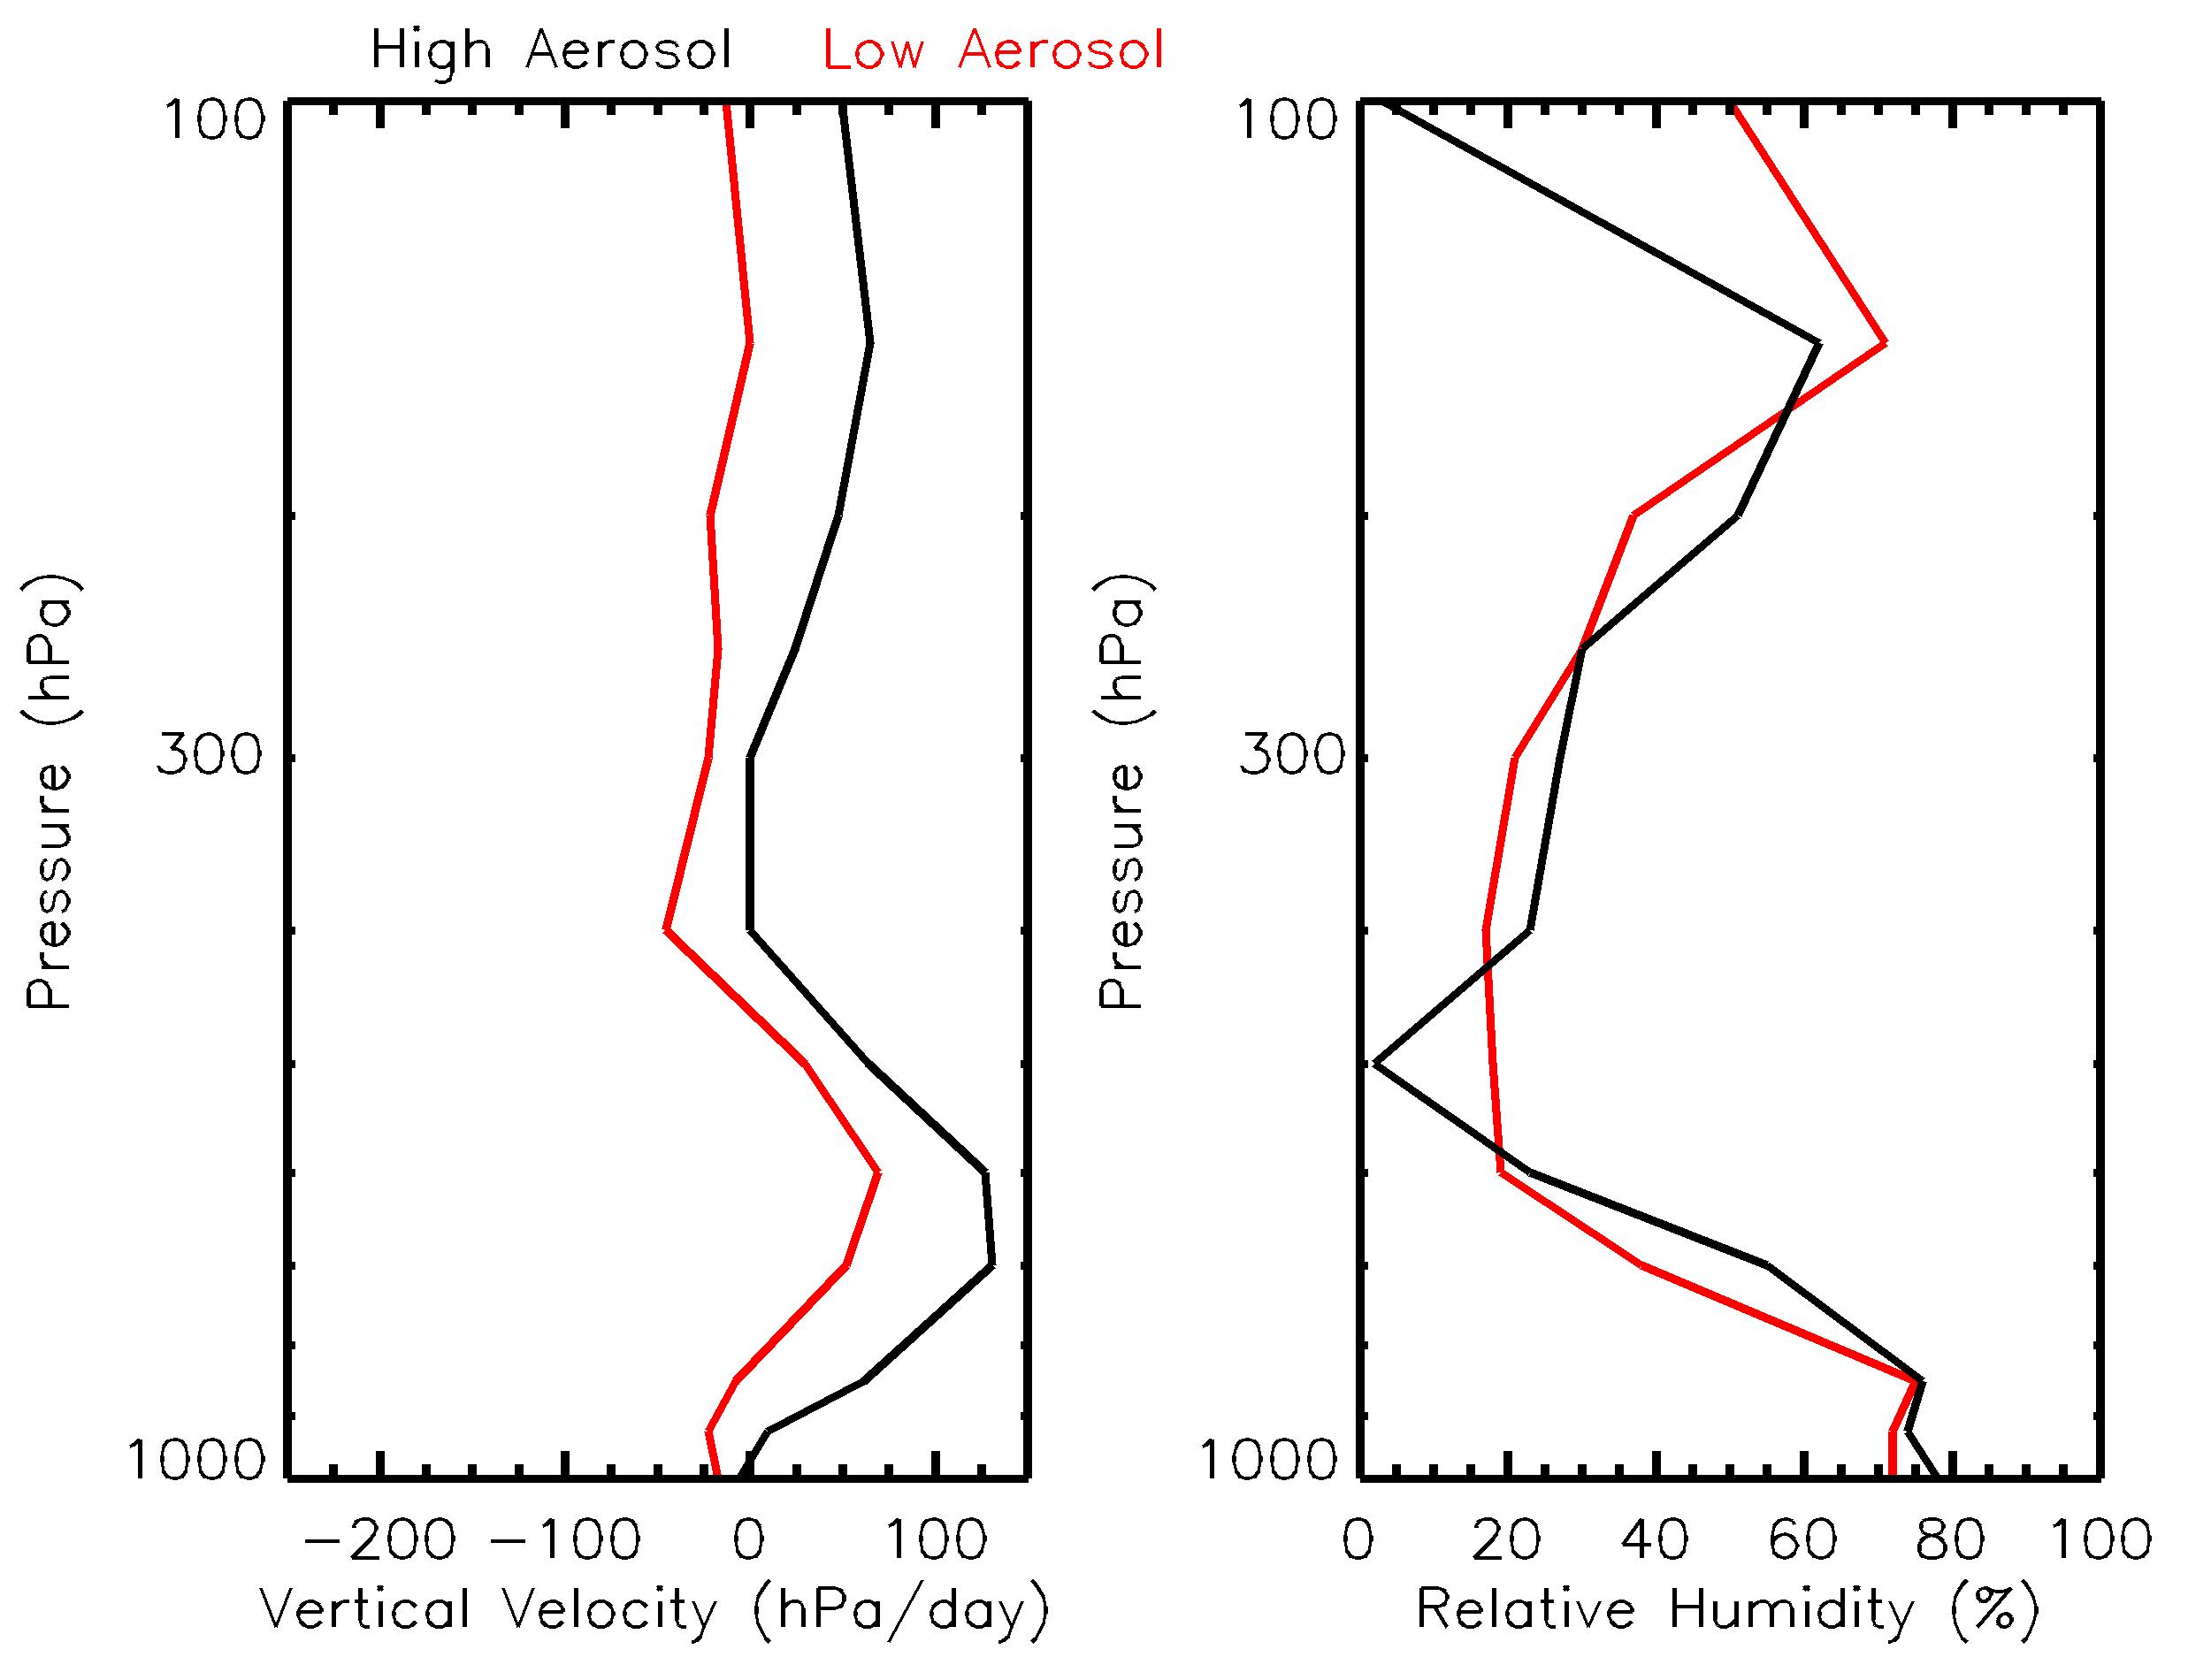
Large-scale dynamic environment
Low Aerosol Case High Aerosol Case

Slide 12
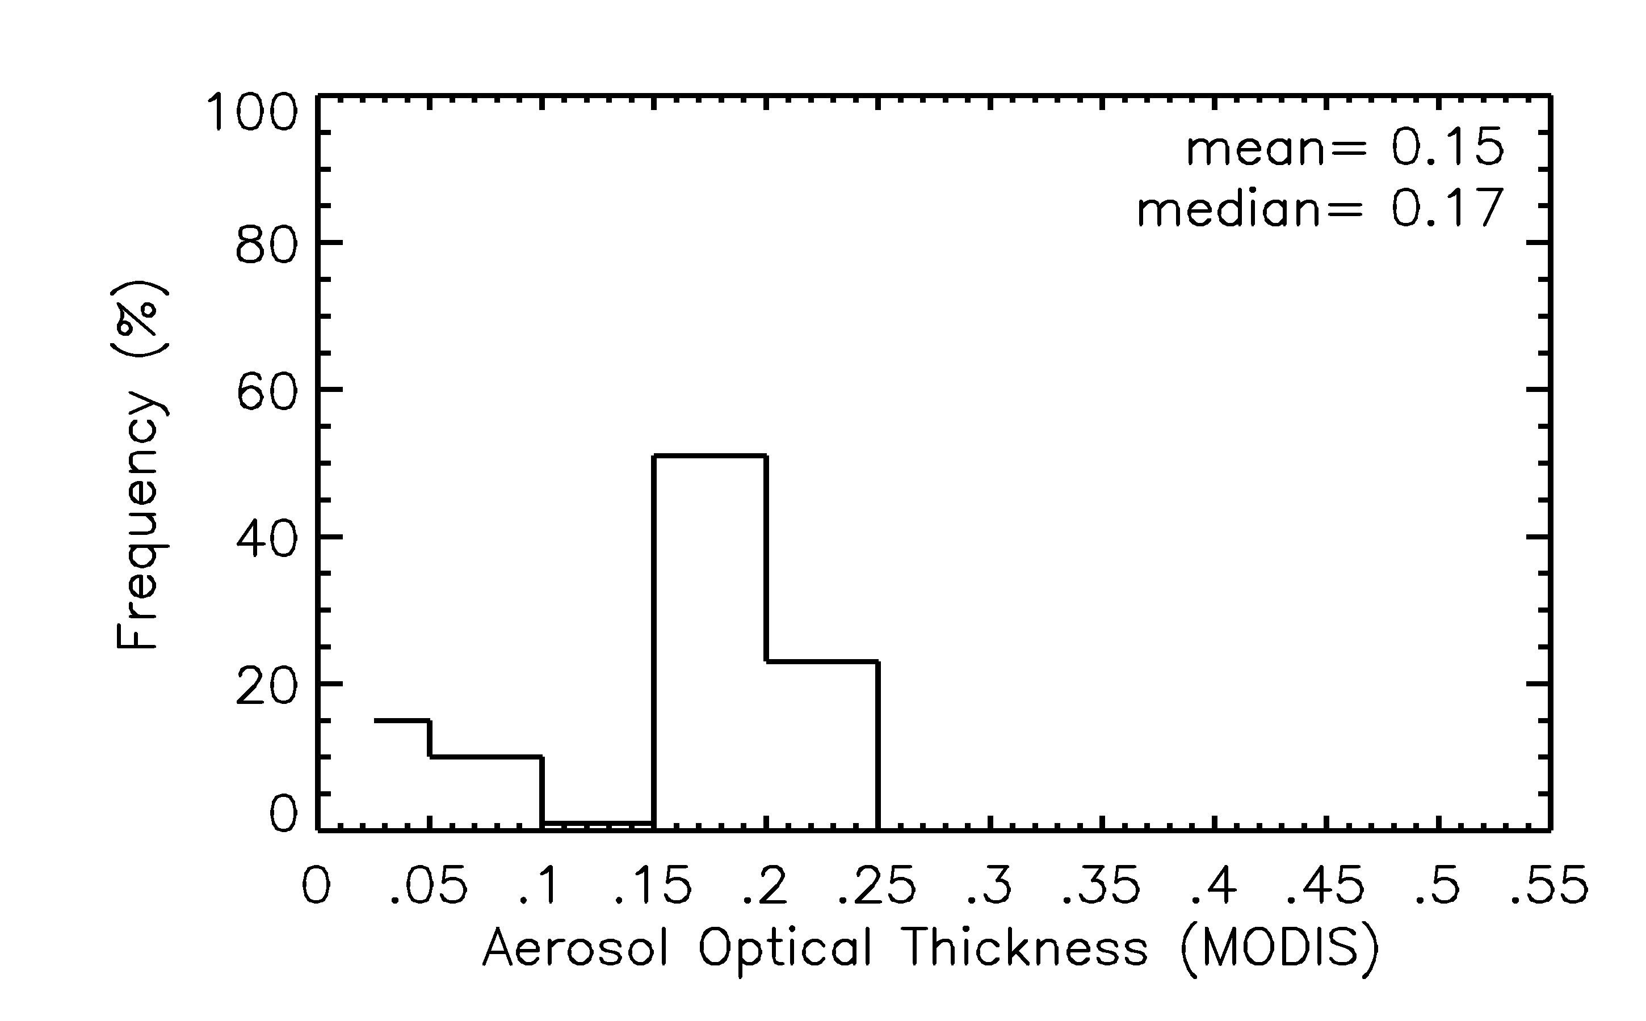
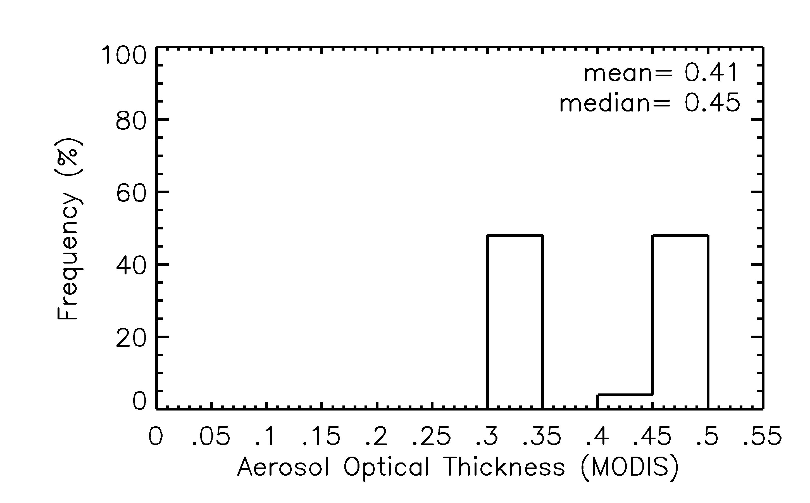
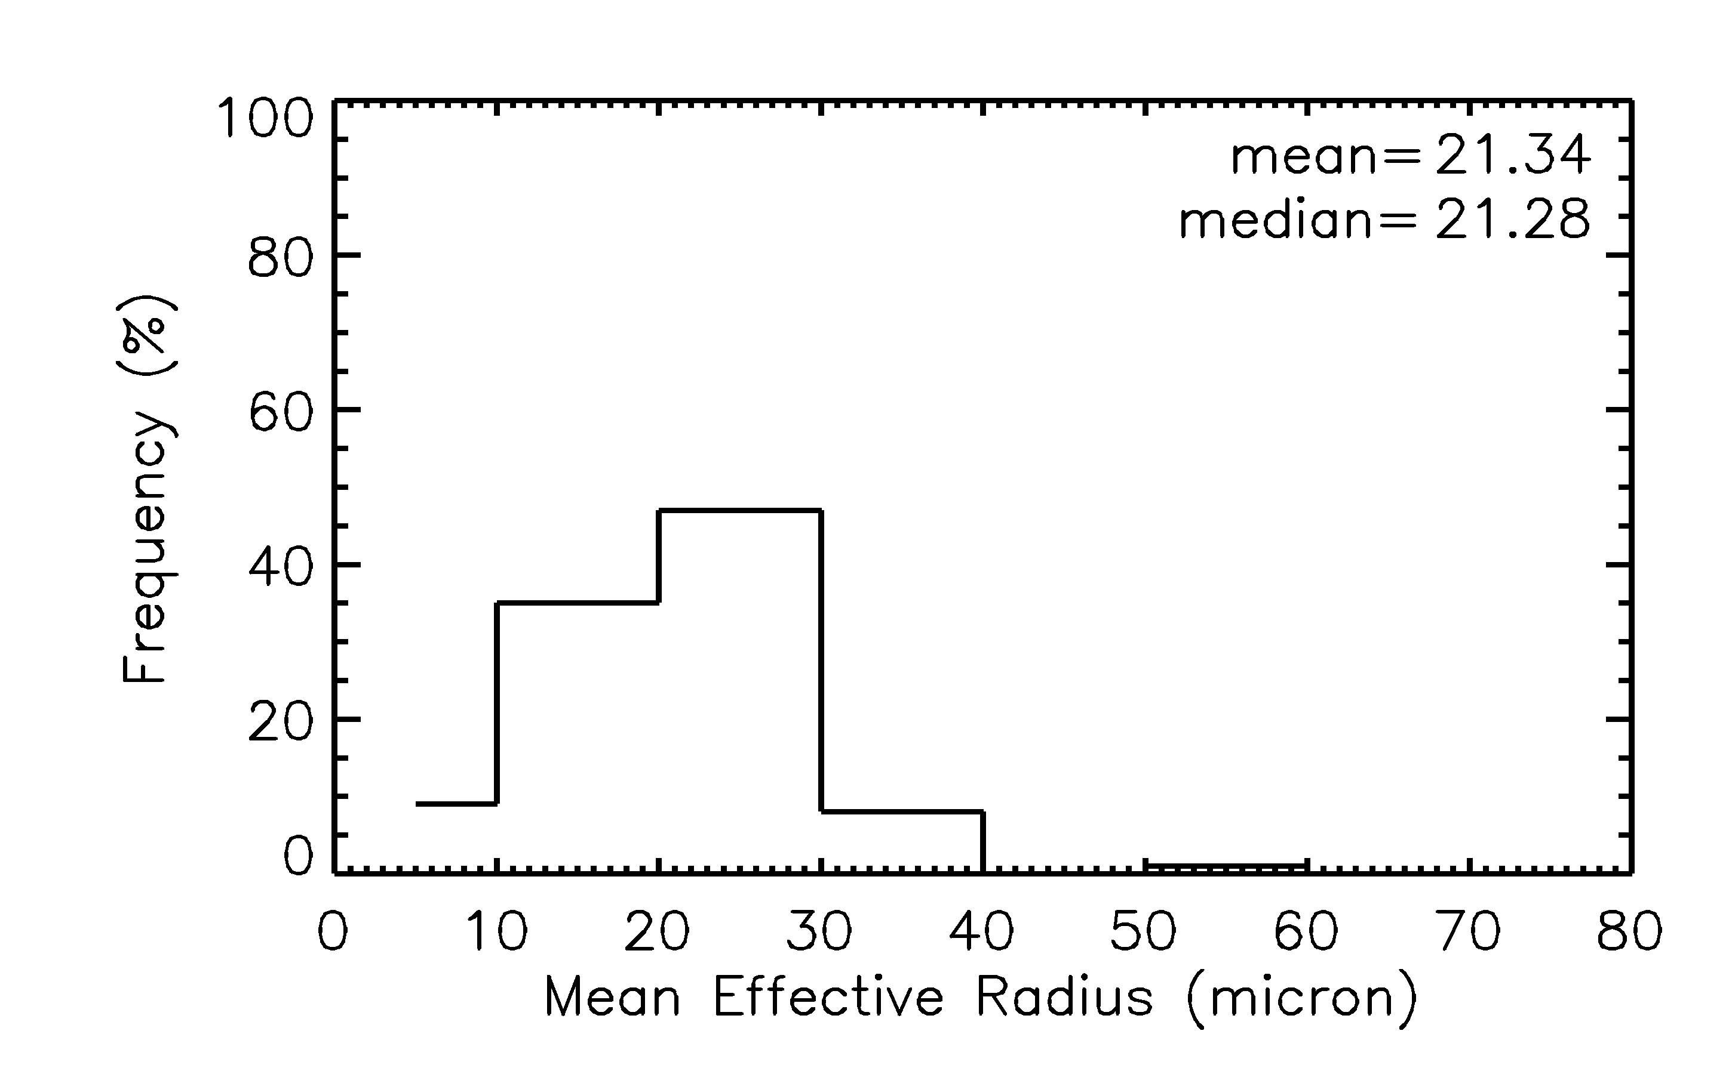
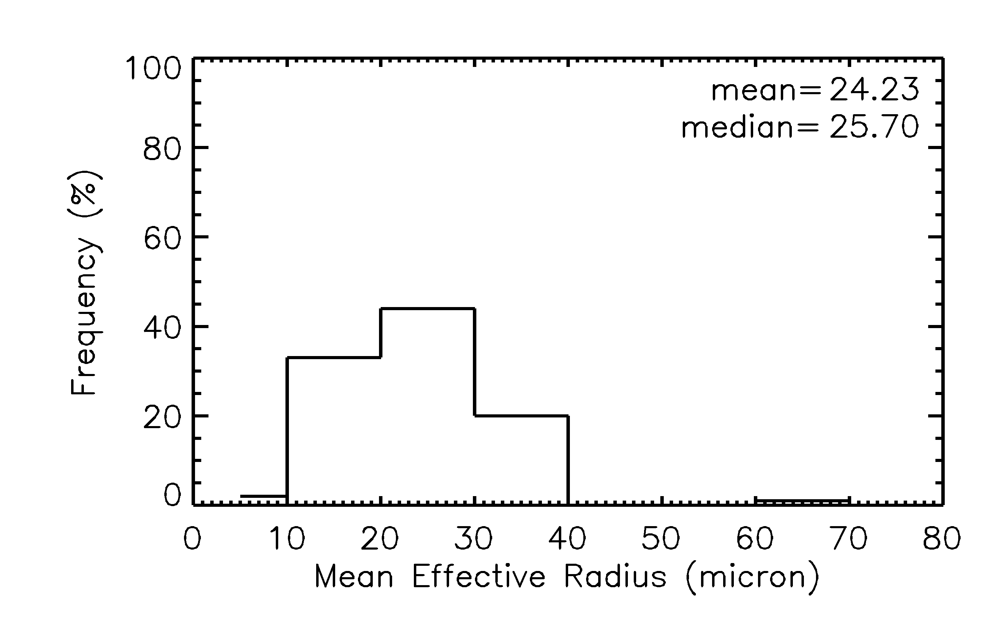
Low aerosol case
High aerosol case
<
AOT
Re Ice
<

Slide 13
Conclusions
In both sets of cases we found that anvils with higher aerosol loading are characterized by larger ice effective radius (3-6 microns)
Need to incorporate many cases to develop statistics
Use CALIPSO and OMI data for information about vertical distribution of aerosol and aerosol properties

