Slide 1
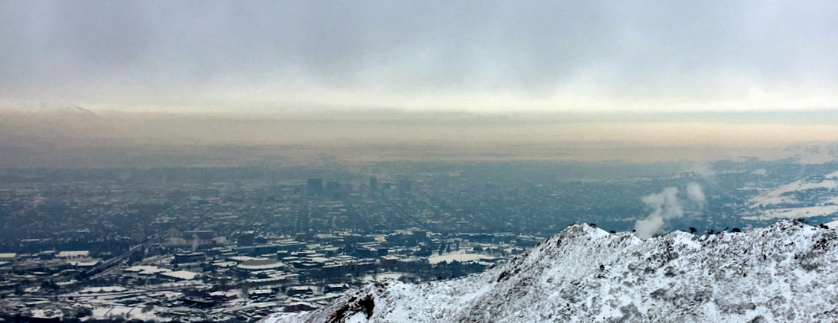
Cold Air Pool Exchange Processes during the Utah Wintertime Fine Particulate Study
Sebastian W. Hoch and E. T. Crosman
Atmospheric Sciences Department, University of Utah
Meteorology
Cold-Air Pools
Transport
Mixing
Layering
Air Chemistry
Media Event
20 January 2017
110 INSCC
Sponsors:

Slide 2
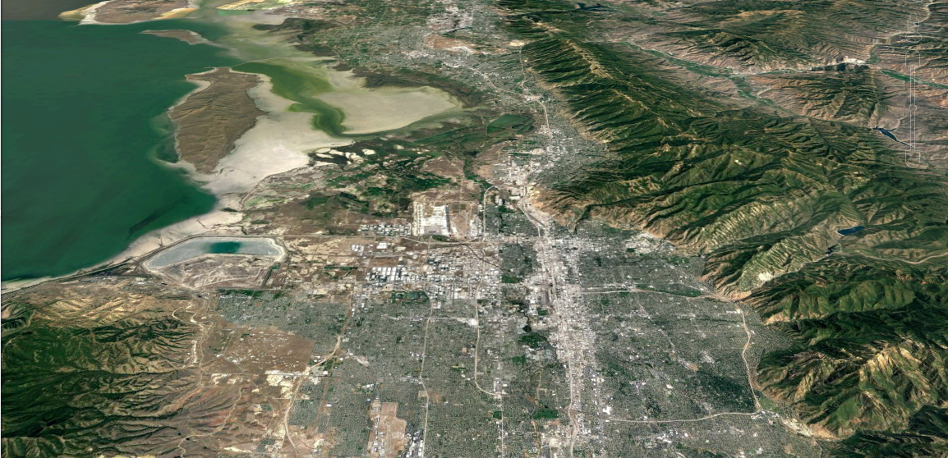
Nighttime and daytime cold-air pool exchange processes
NIGHT
DAY
Lake Exchange
Lake Exchange
Up-Canyon Flows
Down-Canyon Flows
Surface-based mixing
Up-Canyon
Flows
Valley Cold Pool
Valley Cold Pool

Slide 3
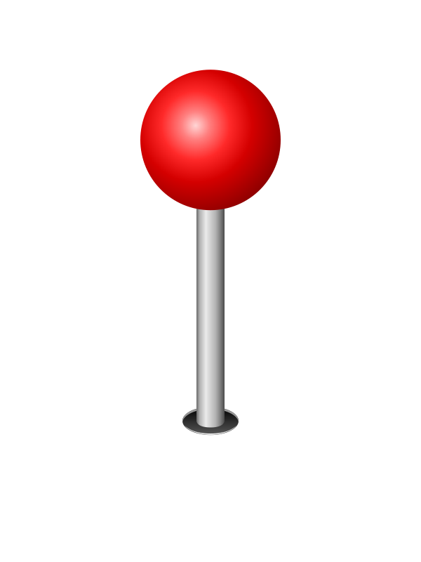
Observation Sites …
Vertical wind profile
Aerosol (pollution) loading
Surface values of PM_{2.5} and Ozone
DAY
Lake Exchange
Up-Canyon Flows
UU
Hawthorne
Elementary
SLC
Landfill
Parleys
Canyon
Exit
Up-Canyon
Flows
Valley Cold Pool

Slide 4
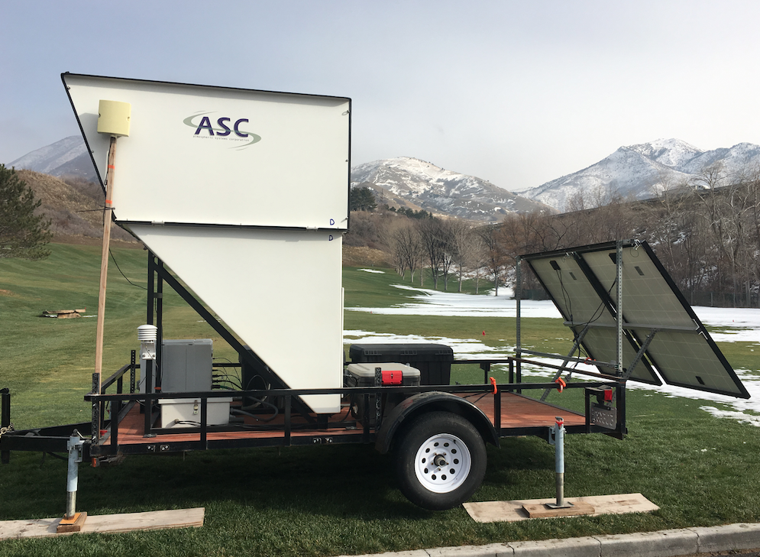
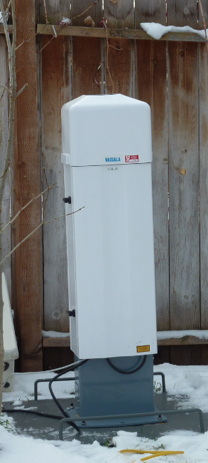
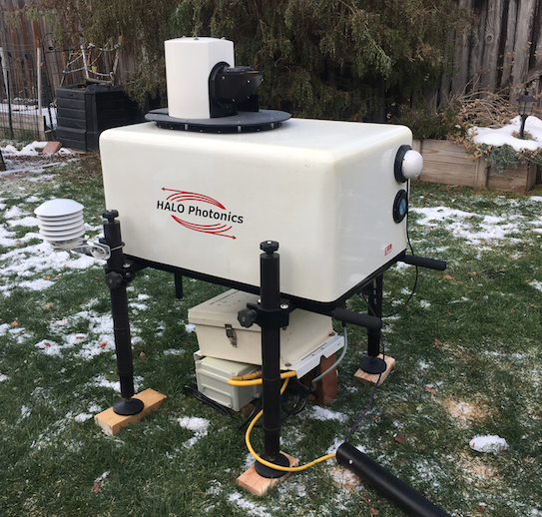
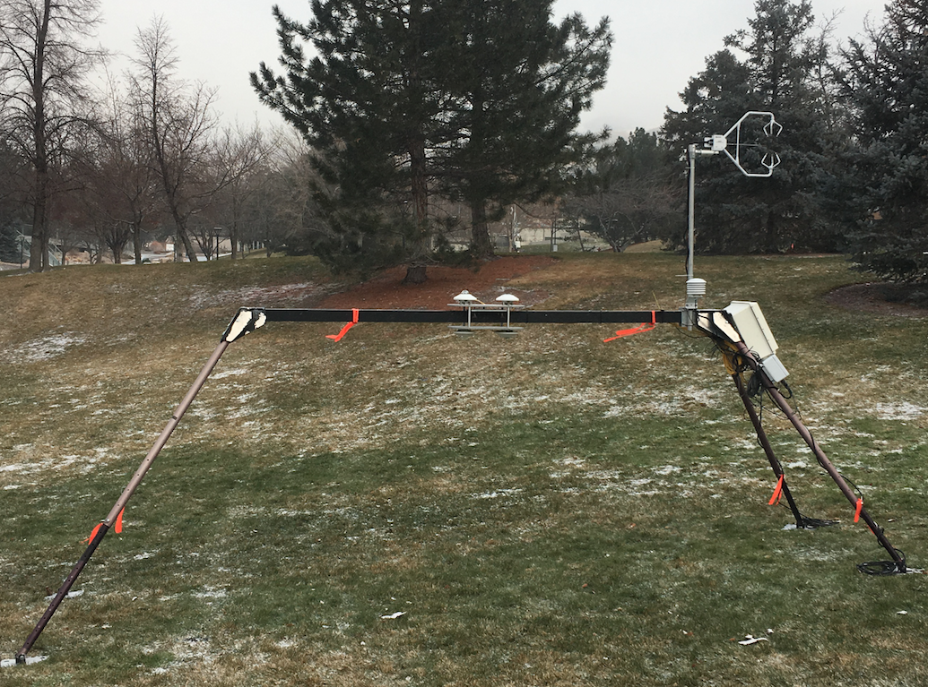
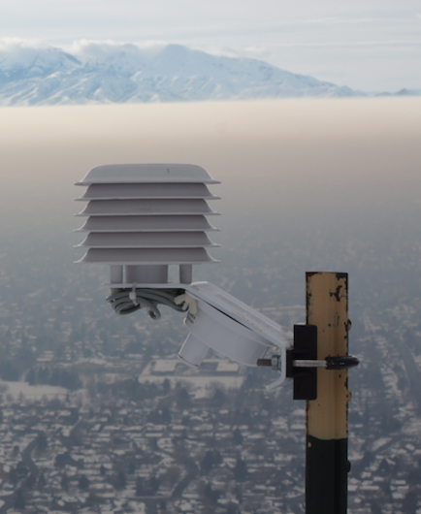
SoDAR
LiDAR
Ceilometer: Aerosol Backscatter
Radiation Balance & Turbulence
Temperature
Data quicklooks (LiDAR and Ceilometer)
http://www.inscc.utah.edu/~hoch/AIRQUAL_2016-2017/
Spatial maps with surface PM_{2.5} and O₃ concentrations, by Alex Jacques (including TRAX and KSL Chopper data)
http://meso2.chpc.utah.edu/aq
LINKS

