Slide 1
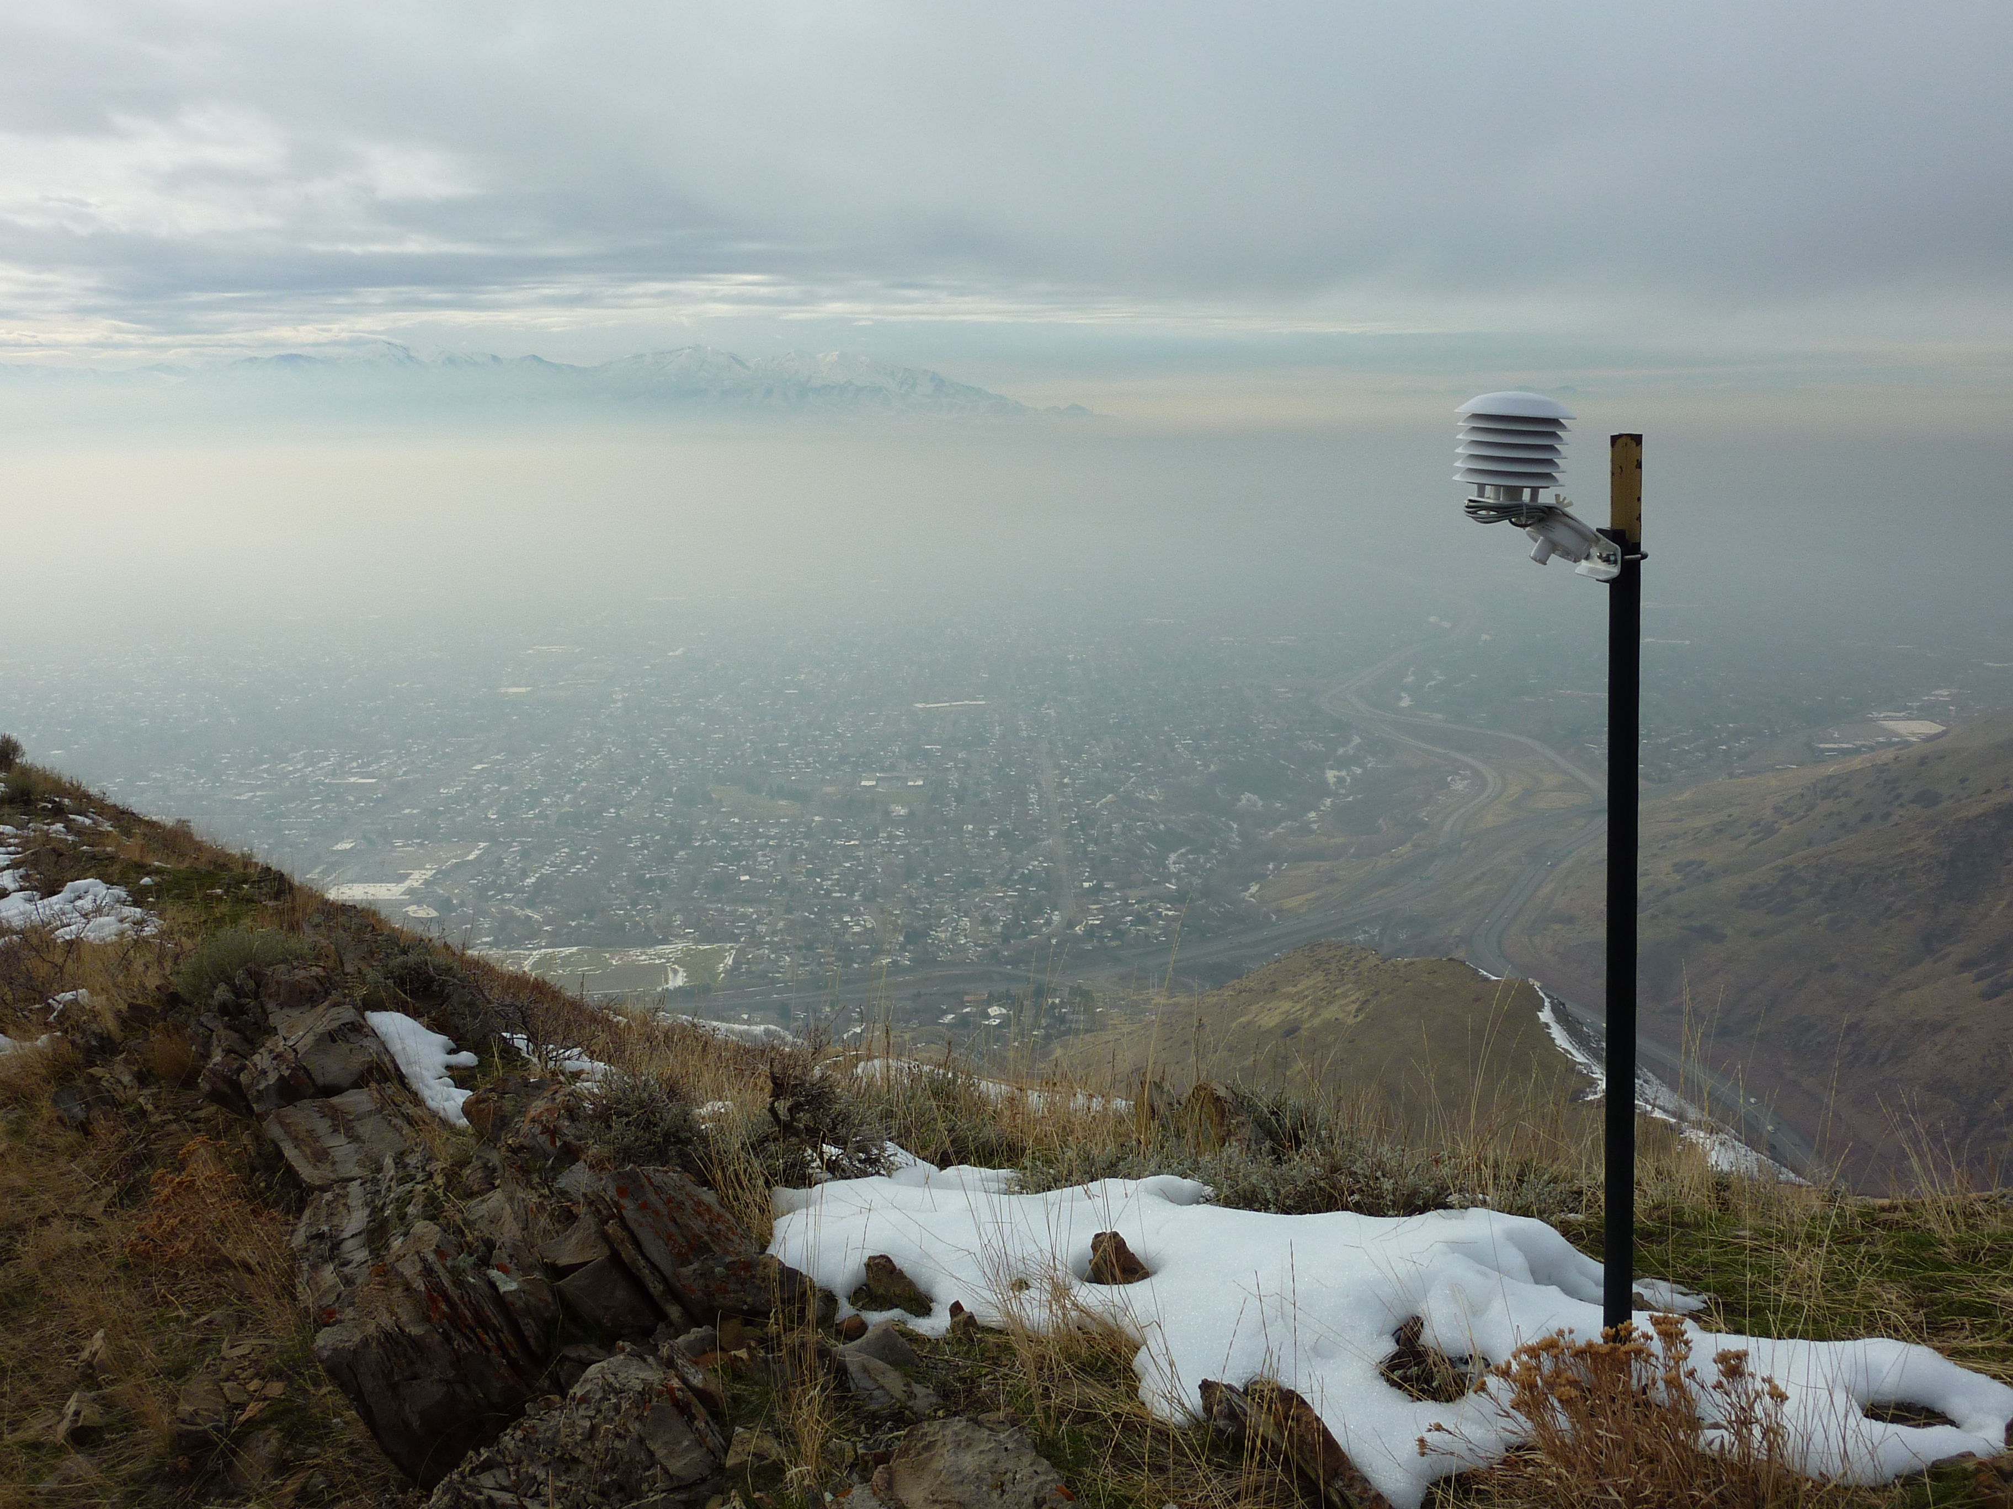



Case Study of the 6-16 February 2016
Salt Lake Valley Persistent Cold-Air Pool
Sebastian W. Hoch, Erik T. Crosman, Munkh Baasandorj, Alex Jacques, John C. Lin, Ryan Bares, Randy Martin, John Sohl, John Horel, C. David Whiteman
2016 AMS Mtn. Met.
Burlington, VT
sebastian.hoch@utah.edu

Slide 2
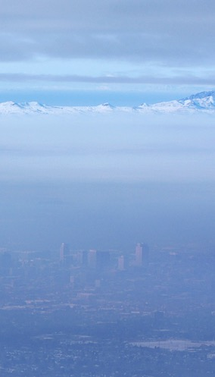
Background (1)
The Salt Lake City basin is one of the three populated Utah valleys marked as non-attainment areas for PM_{2.5} pollution (UDEQ, 2015)
Adverse health effects of the PM_{2.5} are well documented, both for short term and long term exposure (adverse birth outcome, asthma, heart disease, heart attacks, chronic obstructive pulmonary disease).
Chemical composition of PM_{2.5} pollution in Utah valleys shows high mass contribution of Ammonium Nitrate (NH₄NO₃; 70-80%), and Ammonium Chloride (NH₄Cl; 10-15%) (Kelly et al. 2013; Kuprov et al. 2014)
Ammonium Nitrate (NH₄NO₃) is a ”secondary pollutant” forming from gaseous ammonia (NH₃) and nitric acid (HNO₃).
SLC, UT. 14 Jan 2011

Slide 3
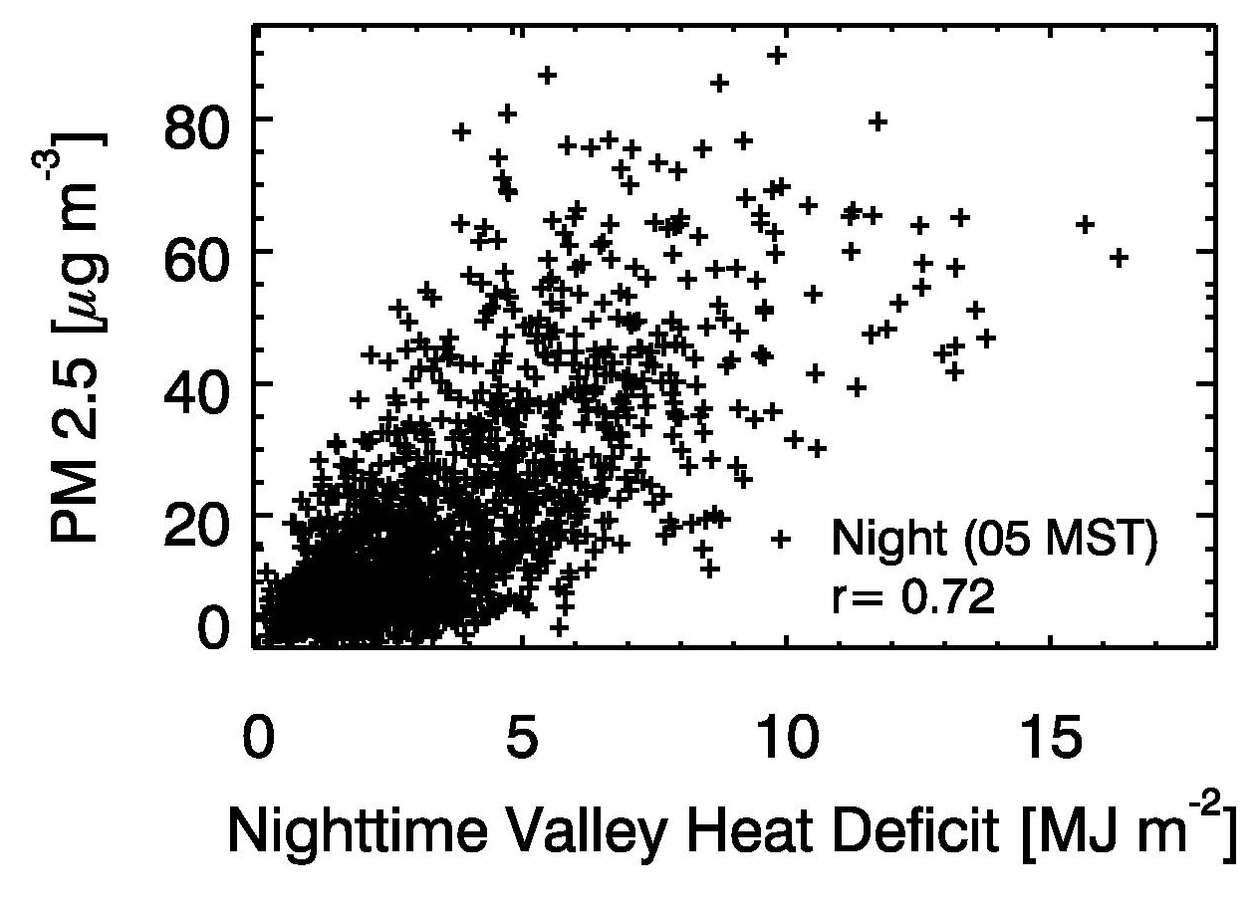
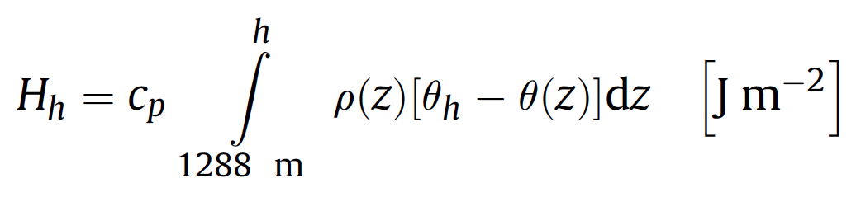

Background (2)
The (somewhat) known:
Wintertime pollution episodes are closely linked to persistent cold-air pools (PCAPs).
Heat deficit concept is very useful.
The life cycle of PCAPs and their dependence on meteorological processes has previously been investigated (PCAPS, COLPEX,…)
The less known:
The reactive pathways for NH₄NO₃ formation are unknown.
Very little is known about the spatial variation of PM_{2.5} concentrations and precursor gases within a PCAP.
Temporal variations (on timescales < 24 hours) are unknown.
Whiteman et al. 2014, Atmos. Env.
Lareau et al. 2013, BAMS; Lareau and Horel 2015, BLM; Lareau and Horel 2015, JAS; Holmes et al. 2015, EST; Crosman and Horel 2016, BLM; Price et al. 2011, BAMS; …

Slide 4

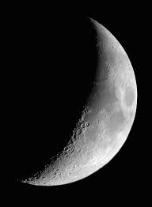

The Wintertime PM2.5 Air Pollution Study (2015/16)
The Utah Department of Environmental Quality (UDEQ) funded a study to investigate the links between chemical and meteorological processes under PCAP conditions.
Chemistry:
Identify the dominant reactive pathways of NH₄NO₃ formation.
Meteorology:
Characterize persistent wintertime cold air pools (PCAPs) associated with pollution episodes.
Chemistry – Meteorology Connections:
Investigate the meteorological processes that modulate the temporal and spatial pollutant concentrations under PCAP conditions?
Ammonium nitrate
Ammonia
Nitric acid
NH₃
HNO3
HNO3
HONO
H₂O
Het. uptake
OH, M
M
N₂O₅
hν,NO
NO₂
NO₃
NO₂
NO
hν
O₃

Slide 5
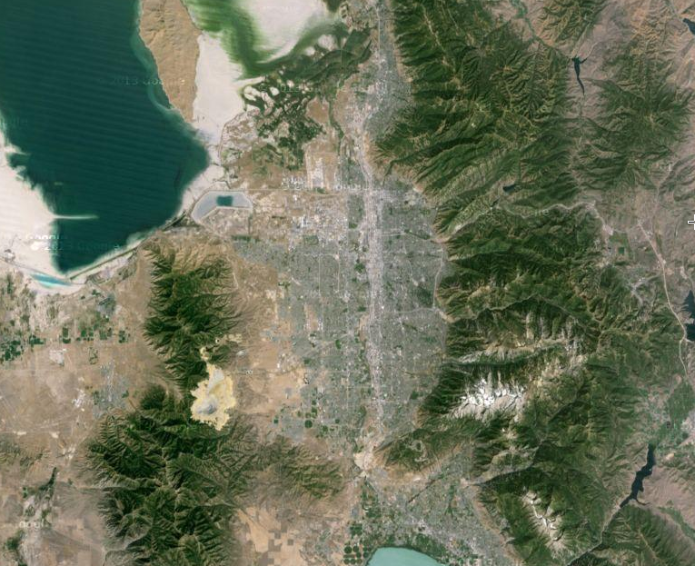
The Salt Lake City Basin
Great
Salt
Lake
Wasatch Range
Oquirrh Mtns.
Traverse Range
Google Earth Image
~30 km

Slide 6
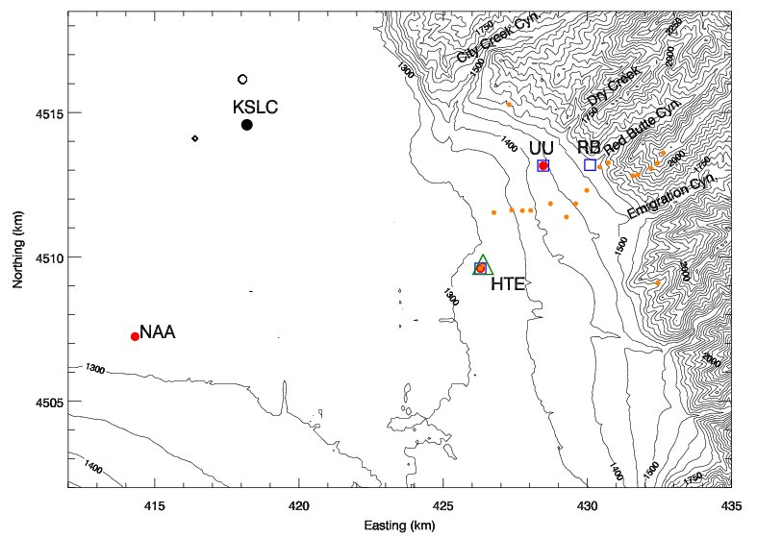
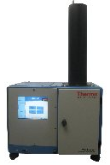
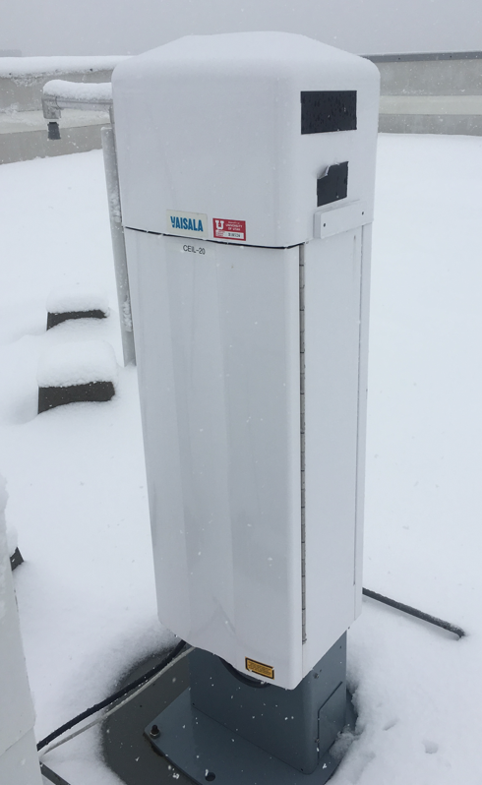
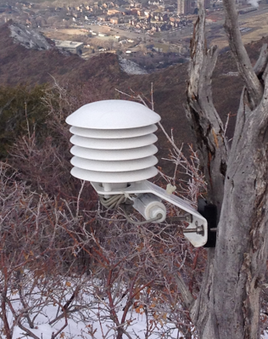
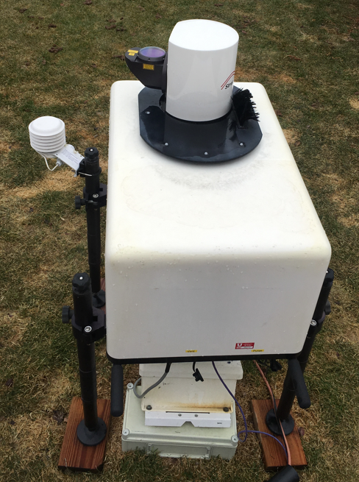

Experimental Design
PM 2.5 and Chemistry
Temperature and Wind profile
NWS
Radiosonde
Pseudovertical
Transect
Aerosol Backscatter
UU
Wind Lidar
TEOM

Slide 7


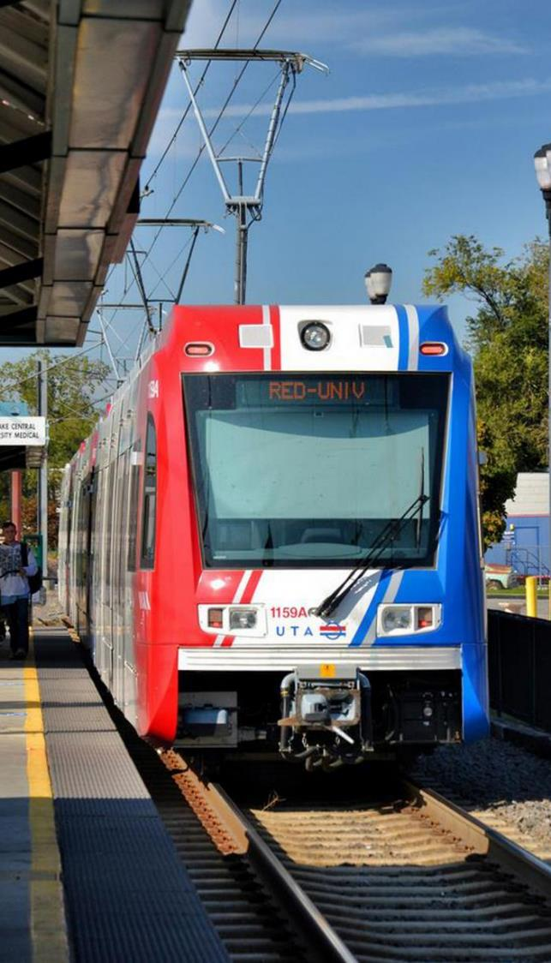
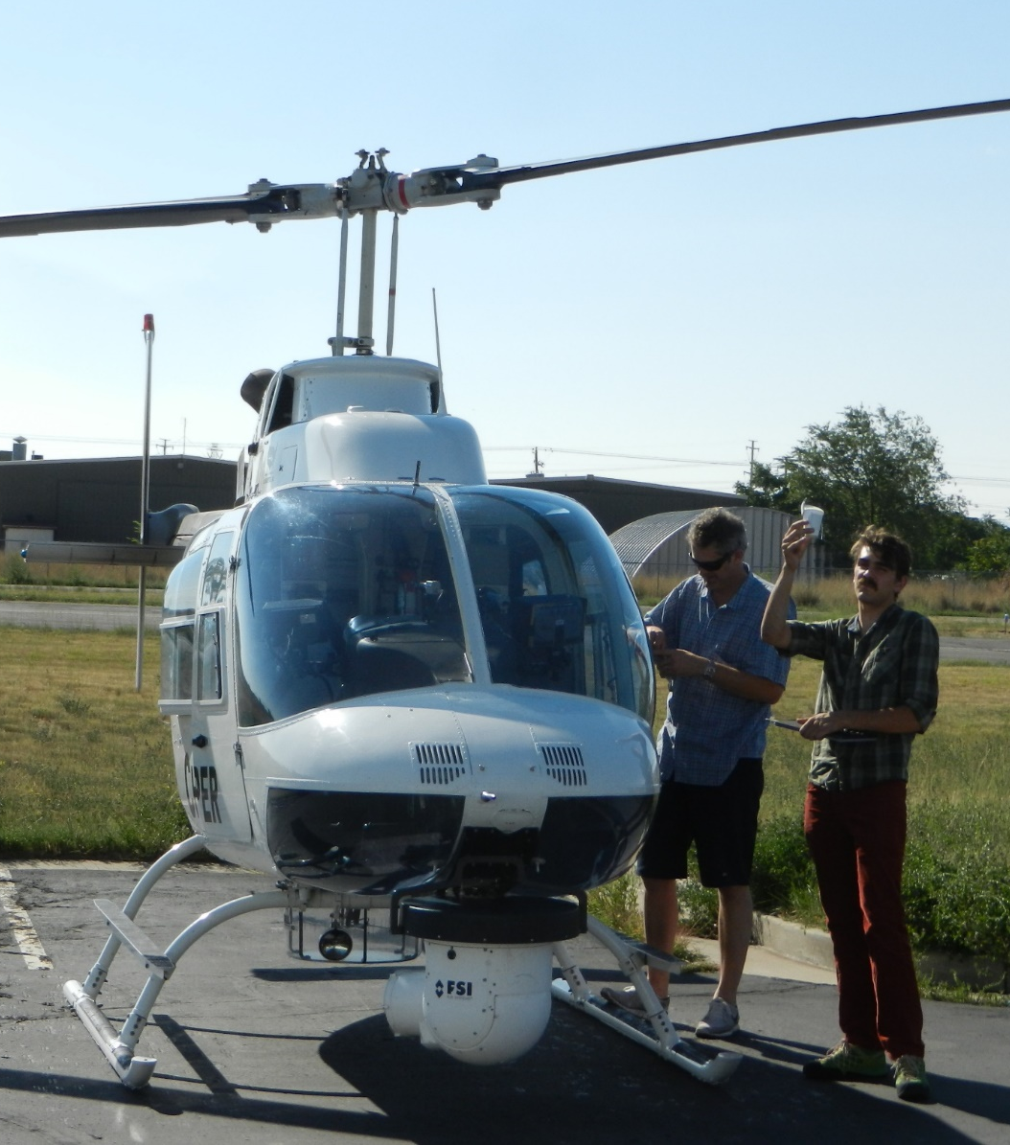
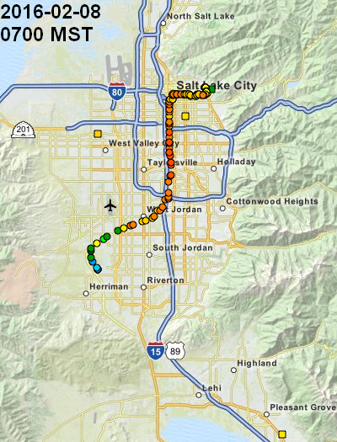
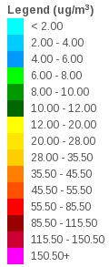
Mobile Platforms
Chopper
Logan Mitchell, Ben Fasoli, Alex Jacques, Luke Leclair-Marzolf

Slide 8
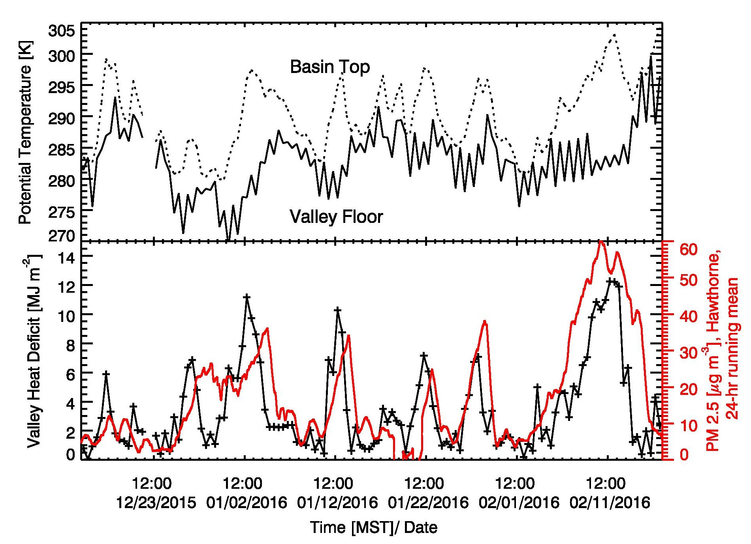
The 2015-2016 Cold Season
Valley Heat Deficit and PM_{2.5}
(2200 m MSL)
(1300 m MSL)
4 Jan.
NAAQS
(below 2200 m MSL)
7 – 14 Feb.
9 Exceedances (typically 18) of the NAAQS of 35 μg/m³

Slide 9
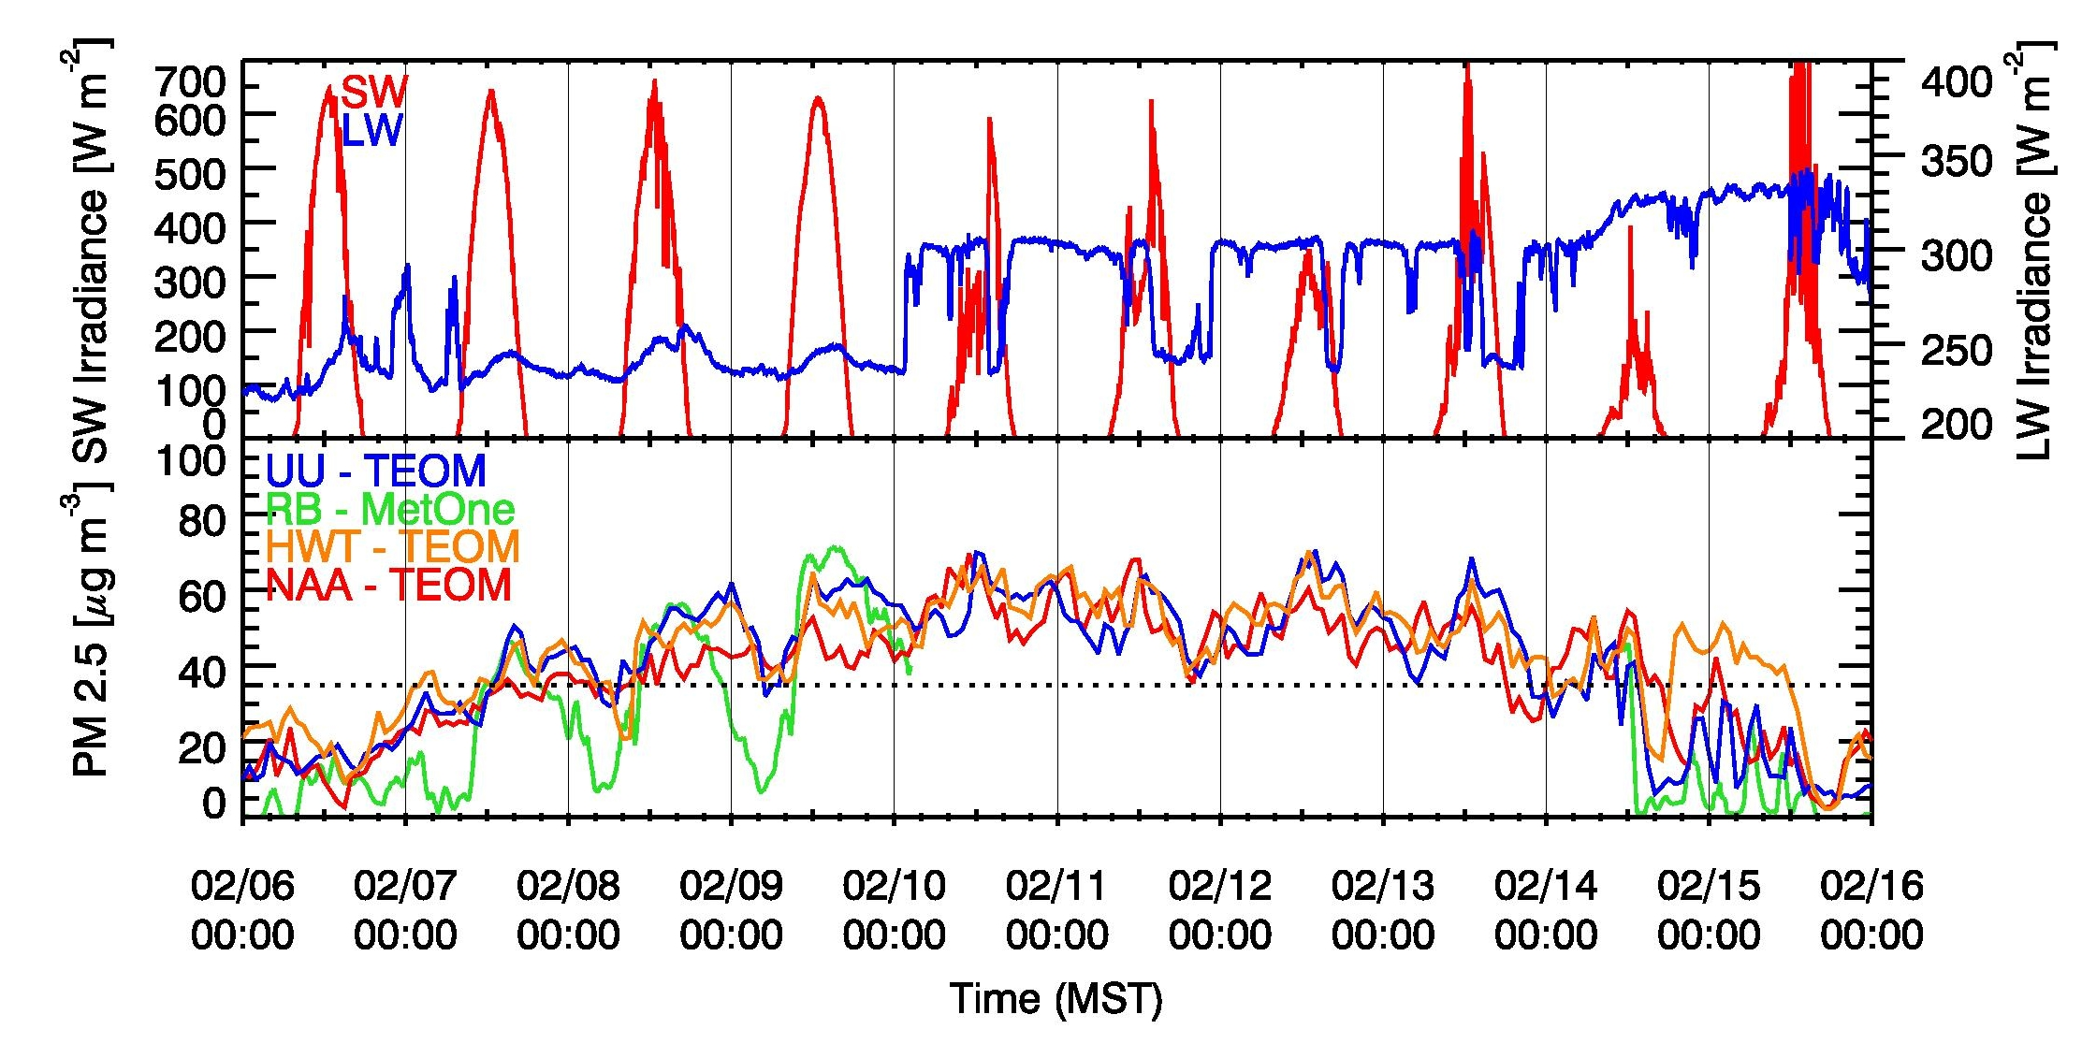
Results
Temporal variations
“Clear”
“Haze/Fog”
Daily increase by ~10-15 μg/m³
(Whiteman et al. 2014: 10 μg/m³ )
Constant level of ~60 μg/m³
(Whiteman et al. 2014: 60 μg/m³ )

Slide 10
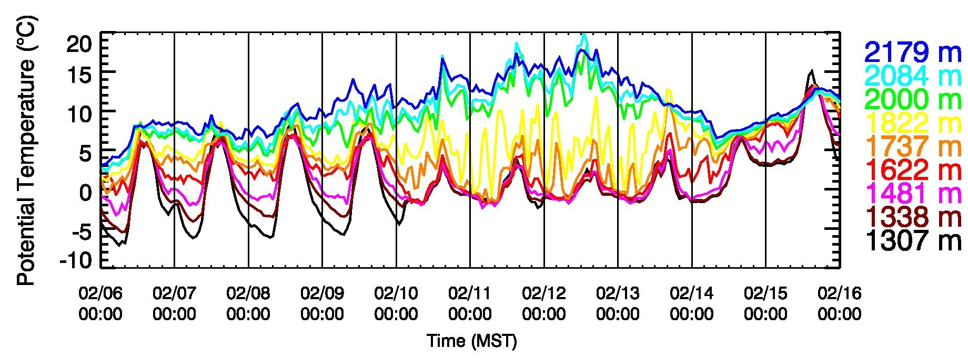
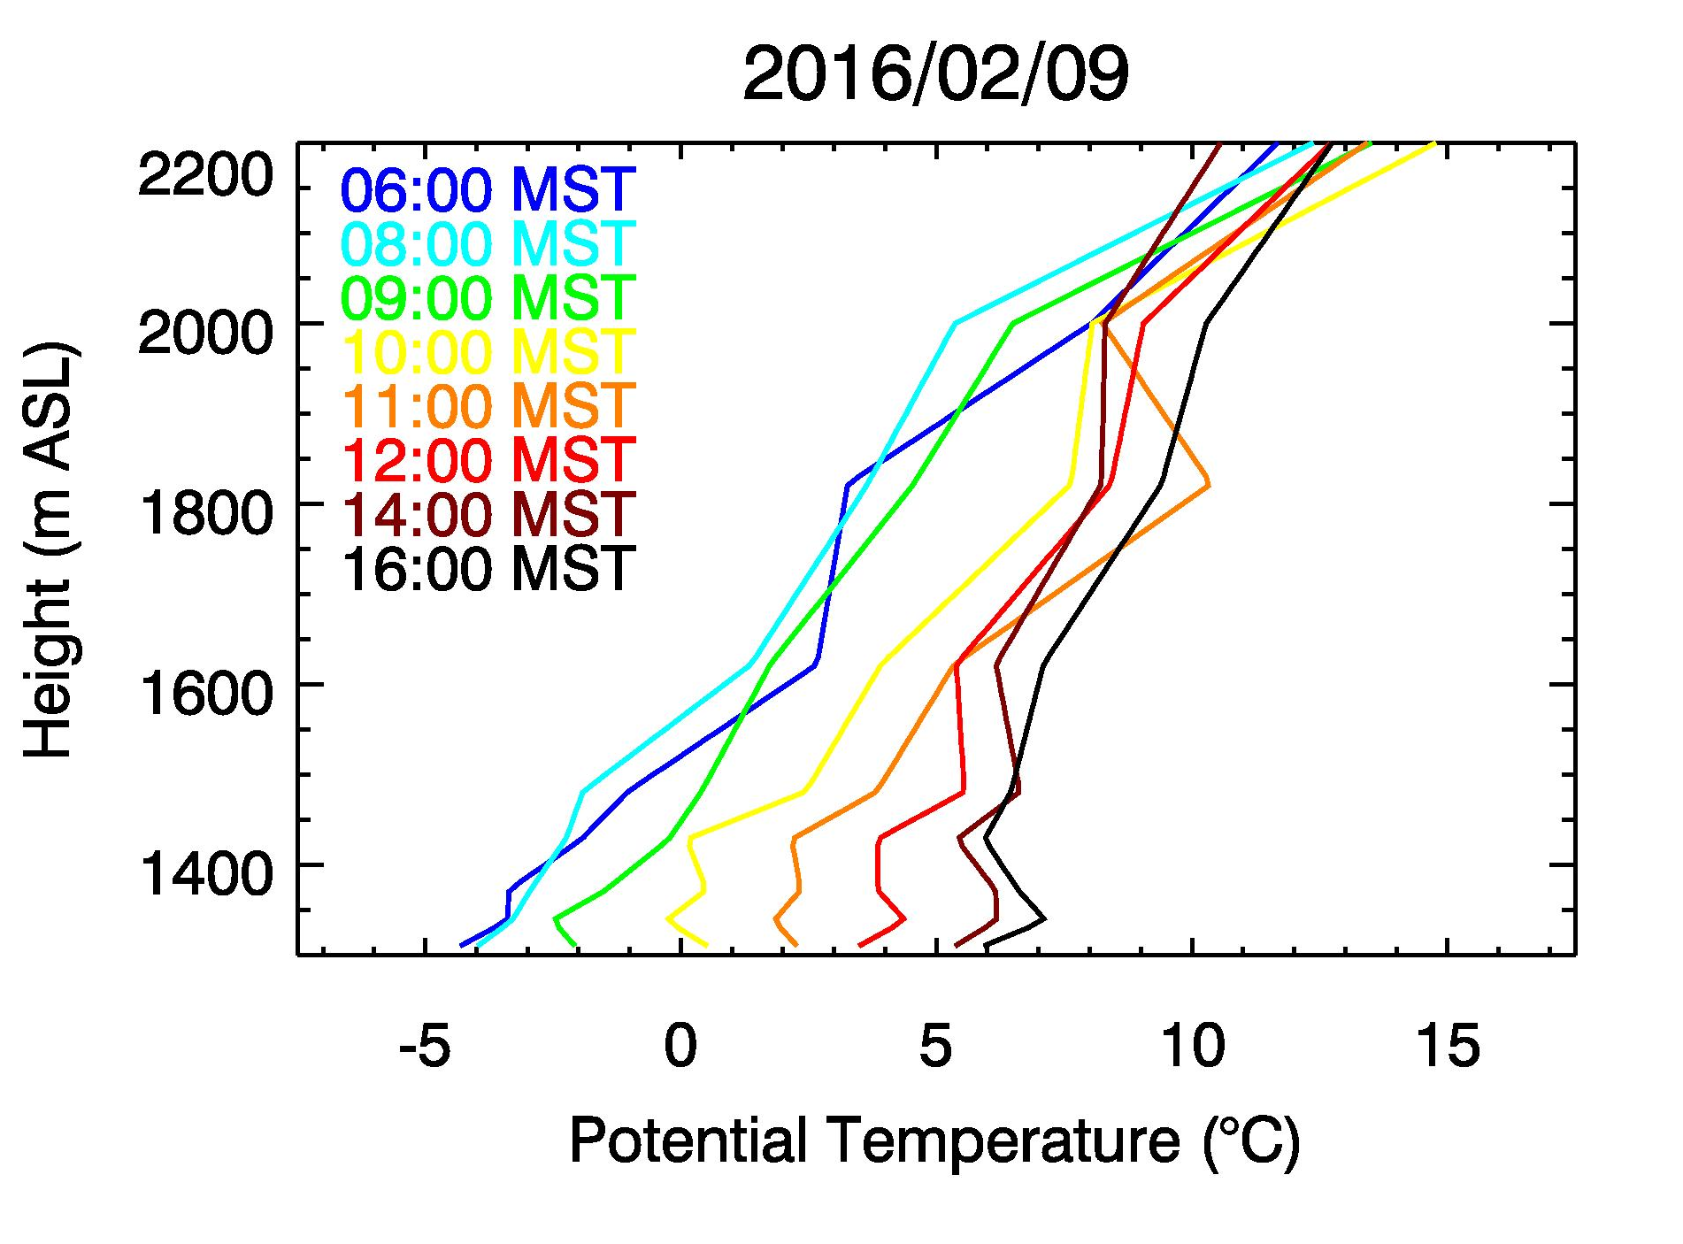
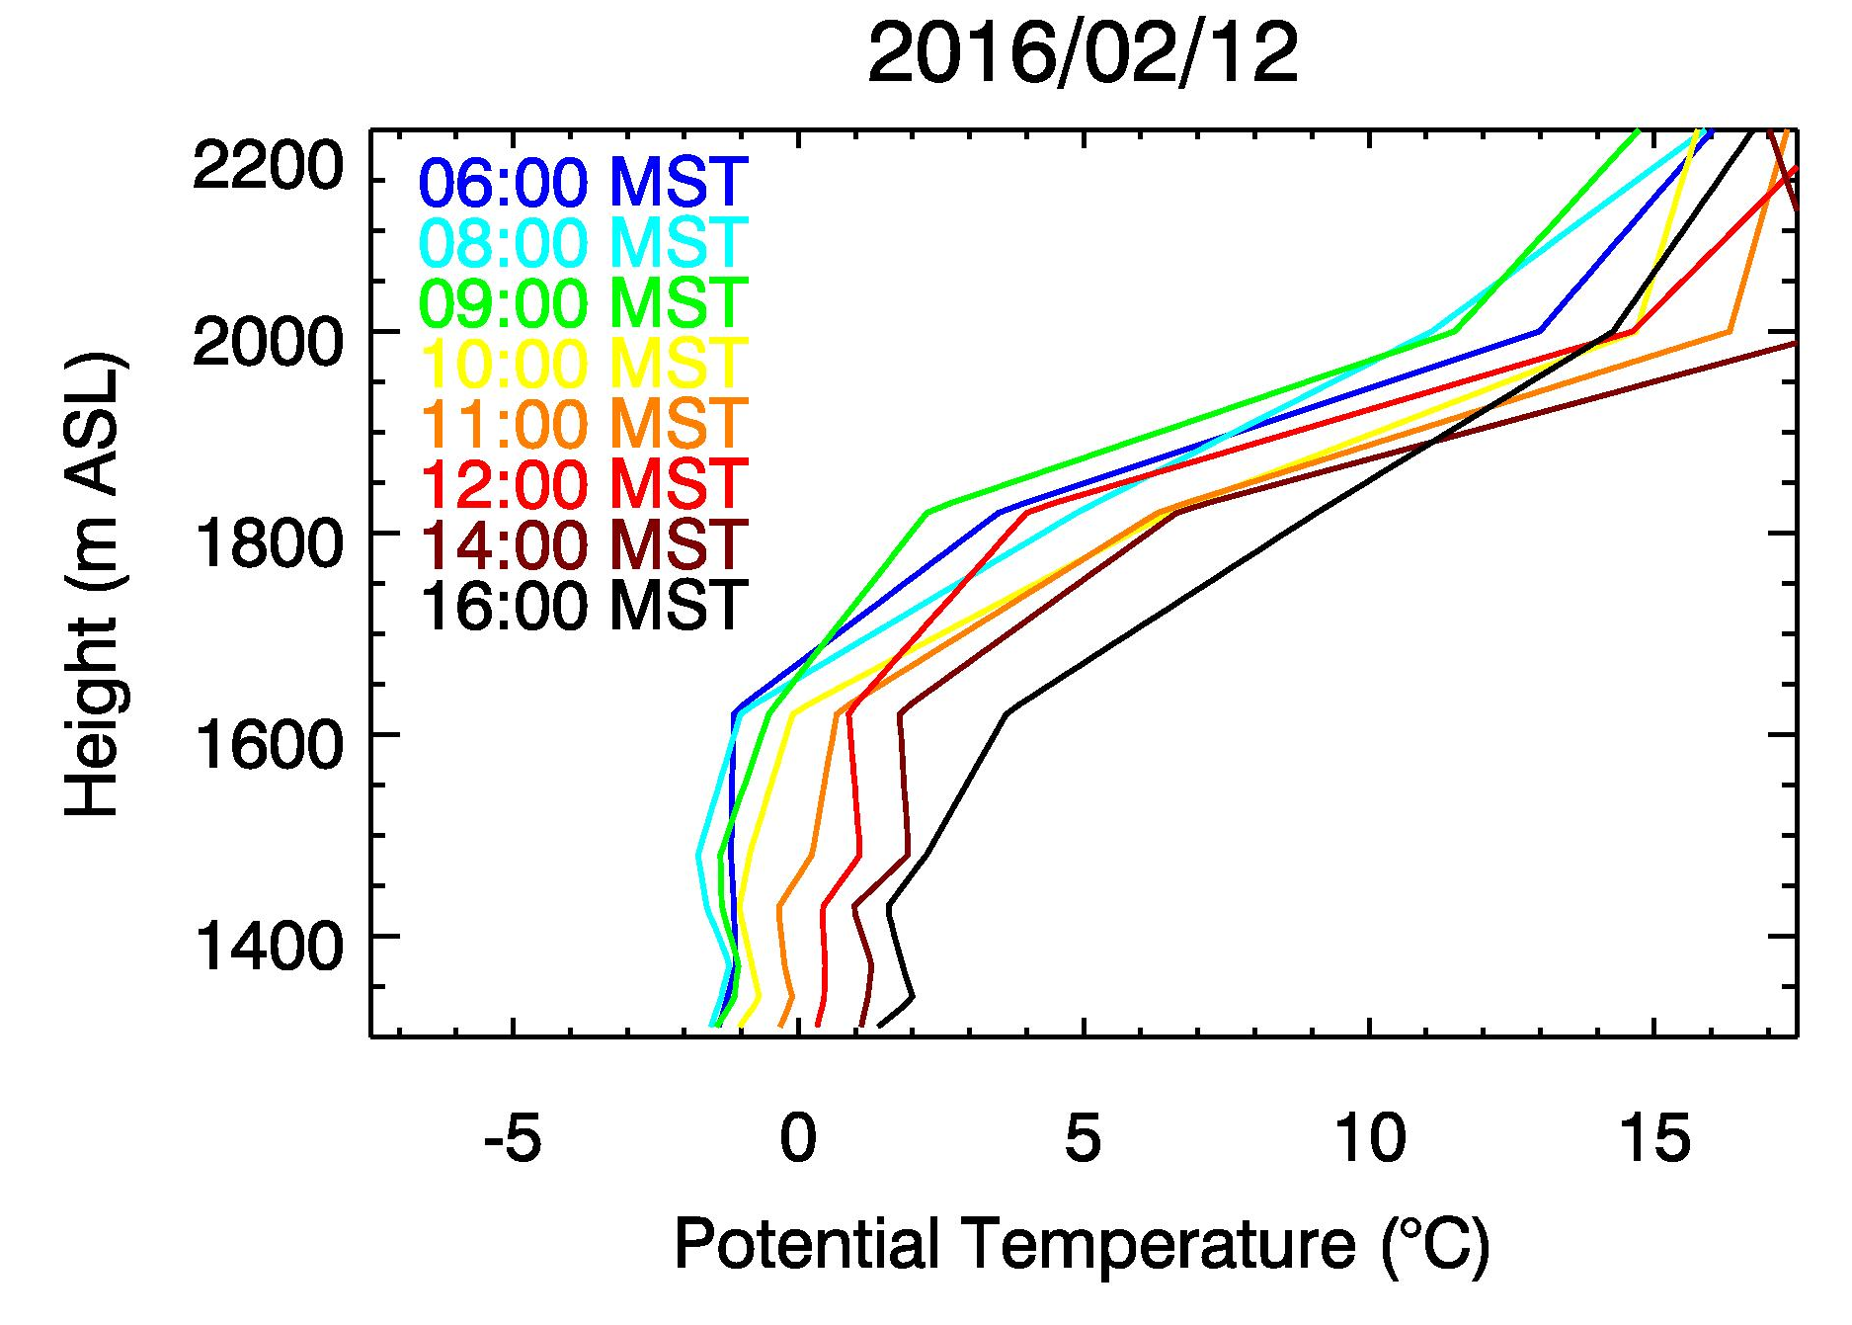
Temperature Structure 6-16 February 2016
“Clear”
“Haze/Fog”
Nocturnal strengthening of CAP
Daytime heating & mixing
Dampening of diurnal cycle
Lowest 400 m remain “well mixed”

Slide 11
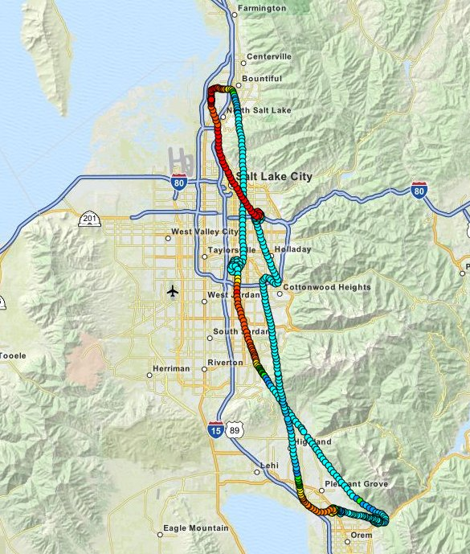
Results – Spatial Variations (vertical)
9 Feb. 2016
1) Takeoff
~1 Hour flight
4) Landing
Chopper
2) Dip-down
South SLC
3) Dip-down
Utah Basin

Slide 12
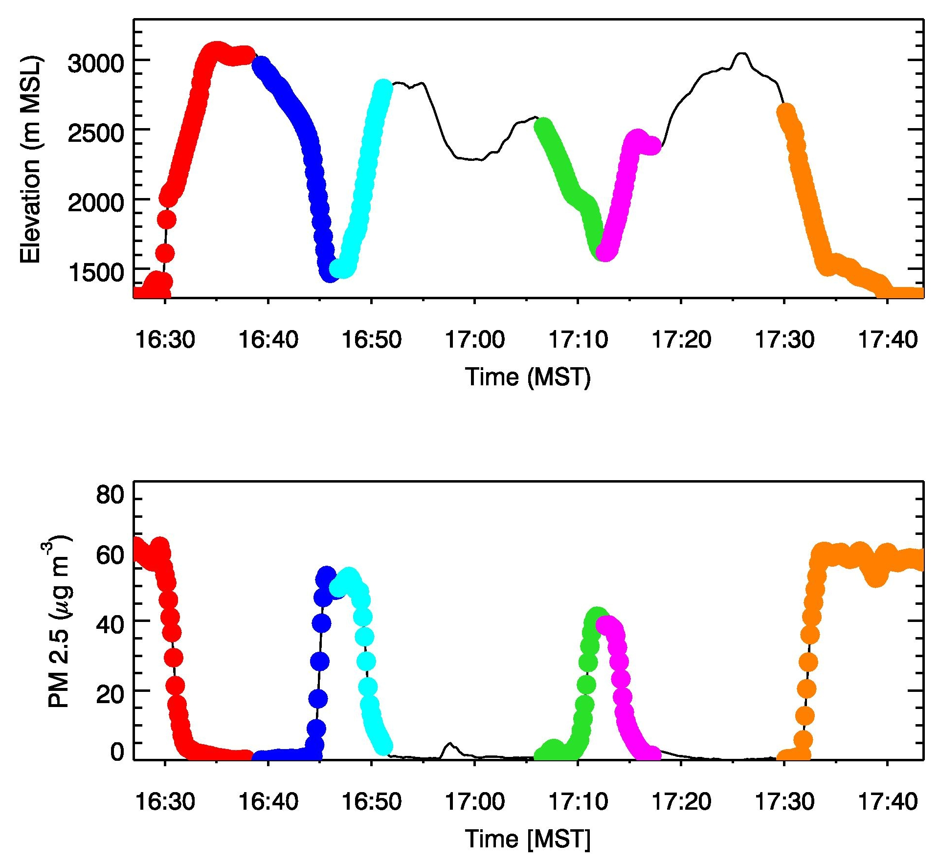
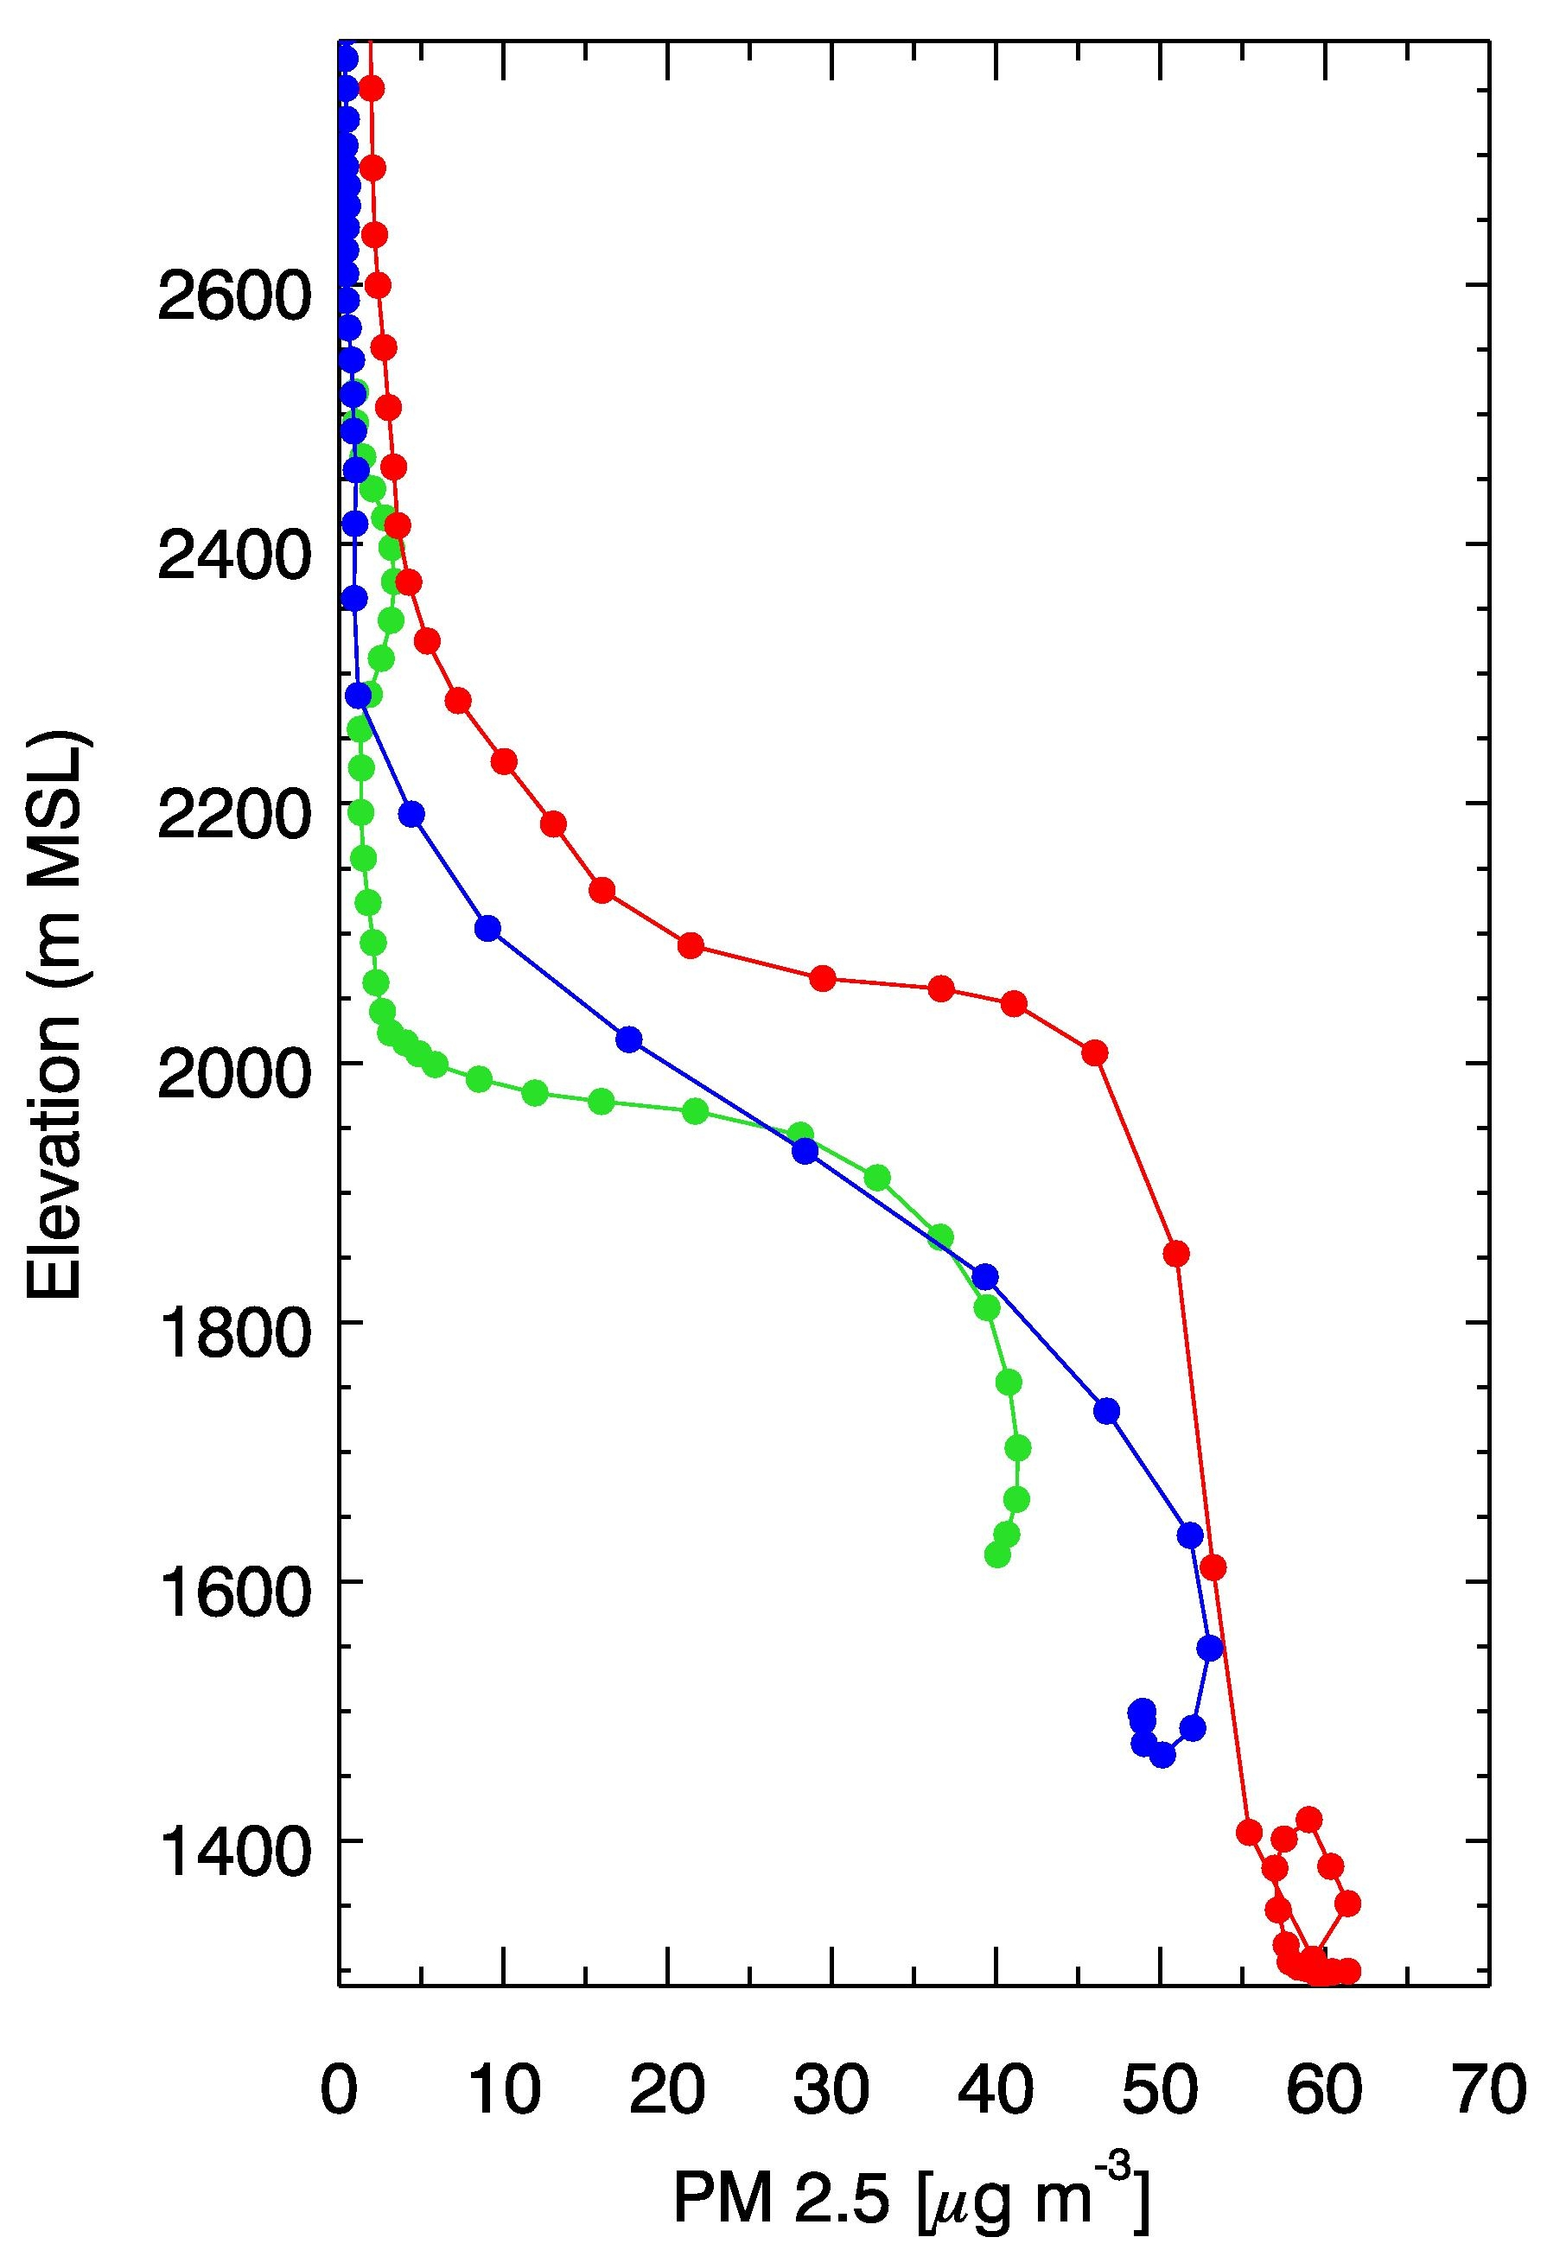
Spatial Variations : News Helicopter Flight 9 Feb. 2016
North Salt
Lake Basin
South Salt
Lake Basin
Utah
Basin
North Salt
Lake Basin
Salt Lake City Basin
Utah Basin

Slide 13
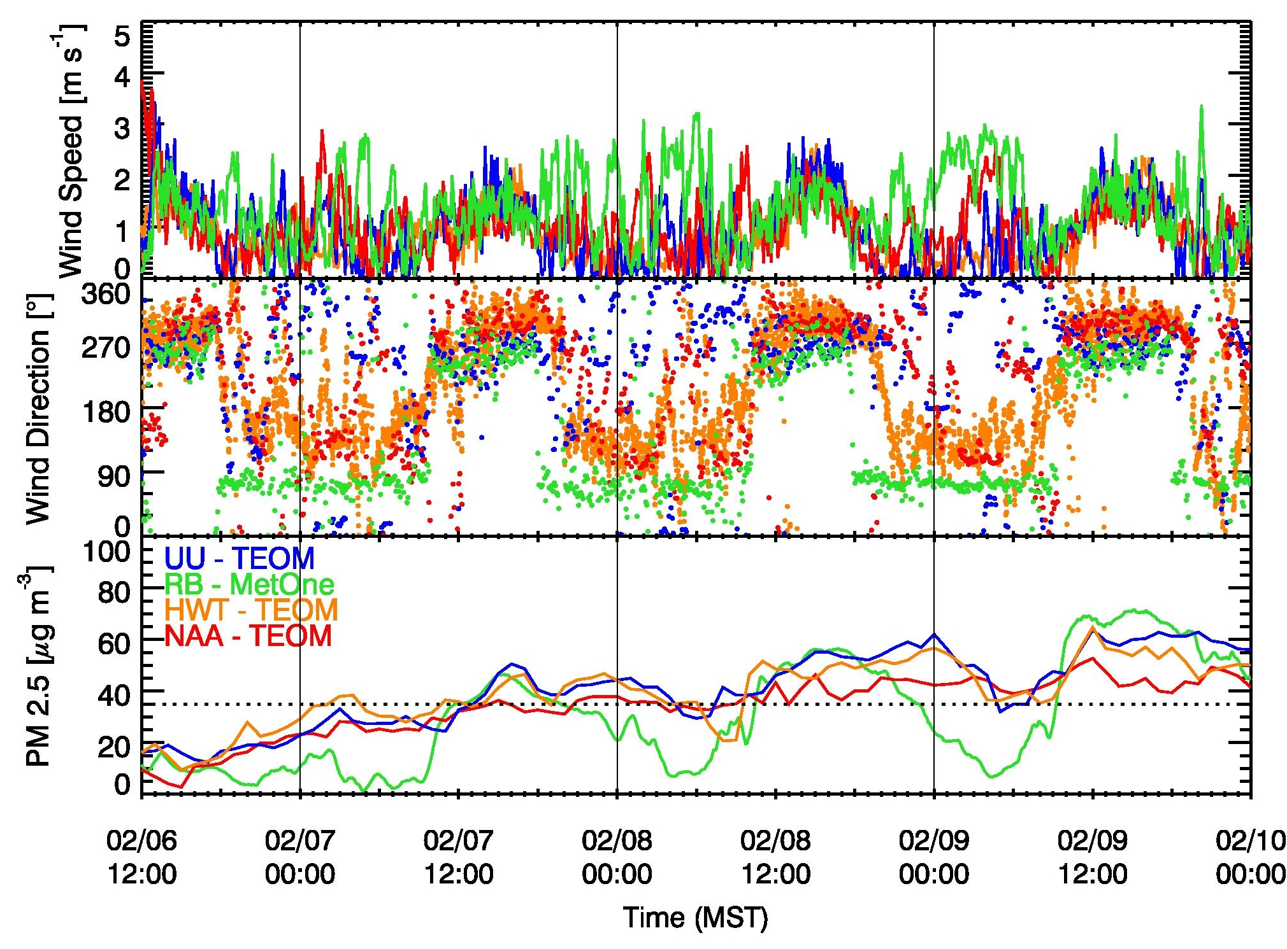
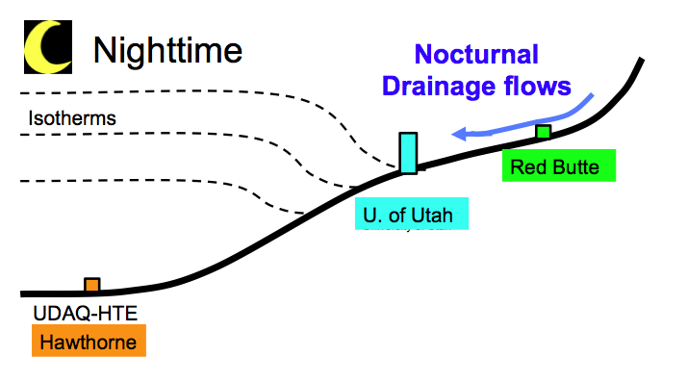
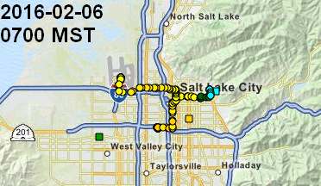
Tributary canyons, down-canyon flows, and air quality
Hawthorne
U. of Utah
Red Butte
ENE down-canyon flow
NAA
Cleaner air at mouth of Red Butte Canyon

Slide 14
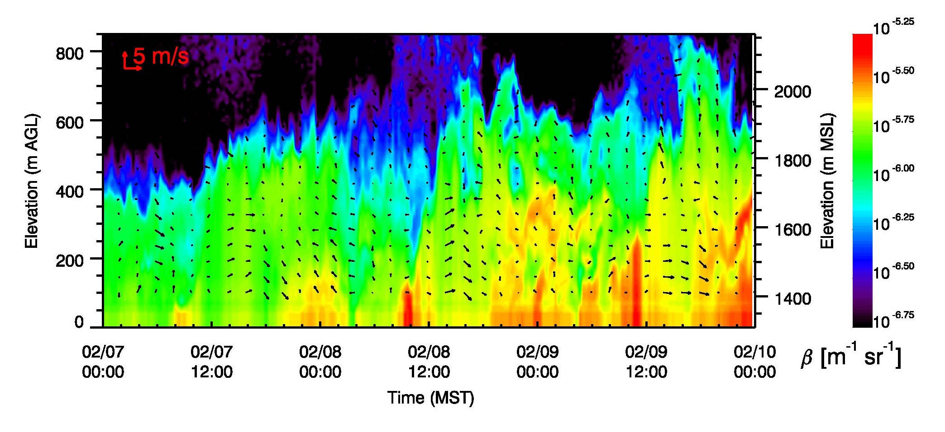
5 km

Slide 15
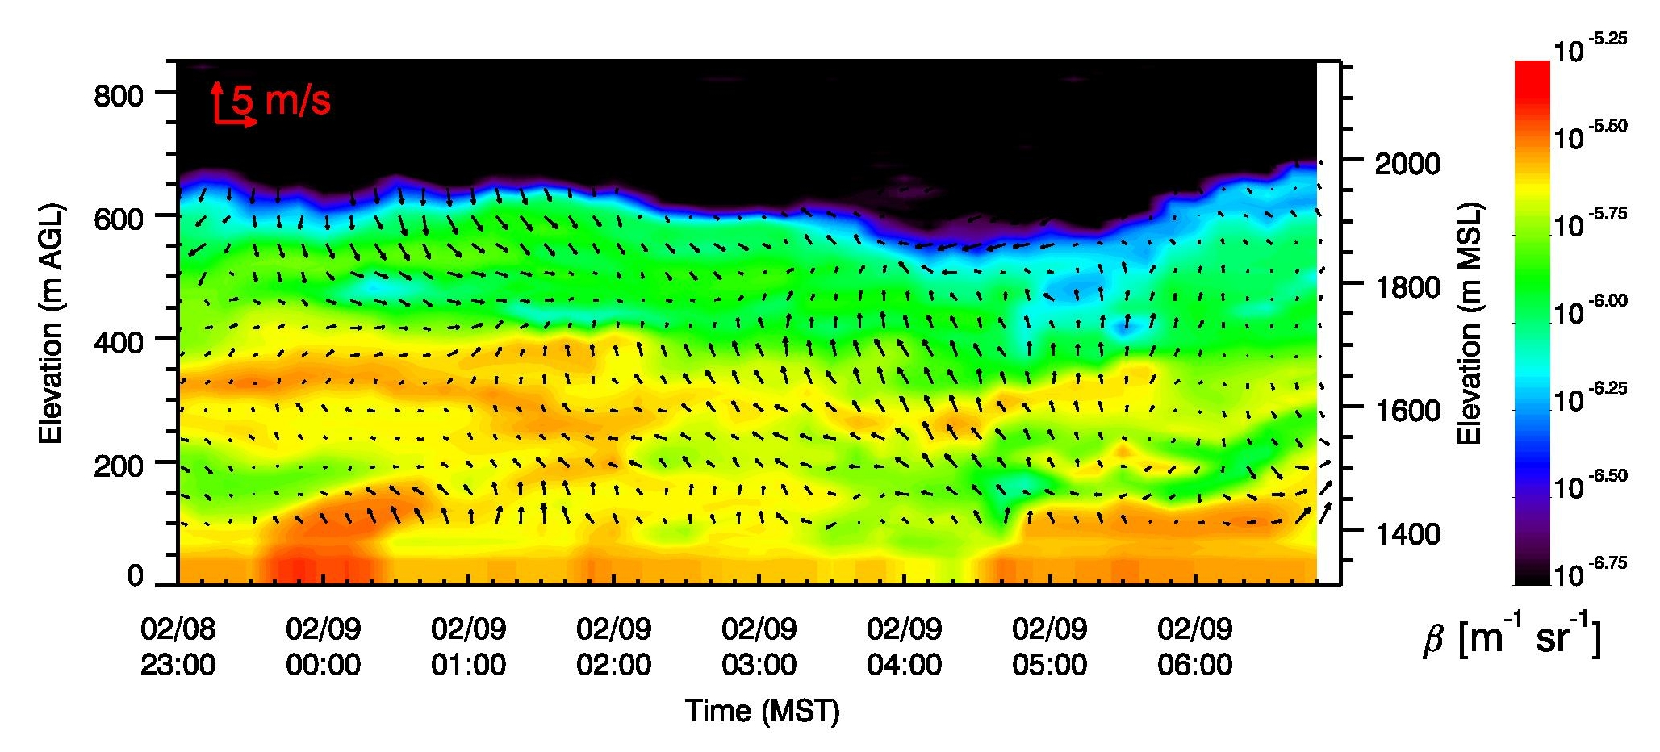
Clean air injection – Center of Basin – Ceilometer / Lidar
09 February case
Clean-air injections into CAP!

Slide 16
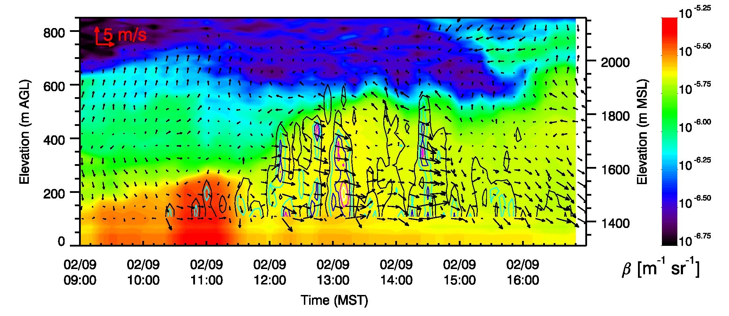
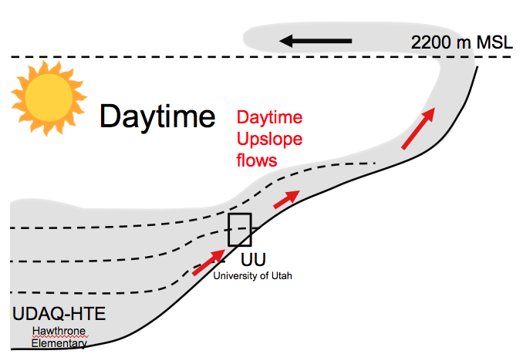
Daytime heating – Upslope flows – Aerosol layering?
σ_{w} contours
σ_{w} (vertical velocity variance) from Lidar stares shows convection at the base of the CAP
Pollution is ejected along the sidewalls into elevated layers and advected with the weak mean flow. ➔Ventilation

Slide 17
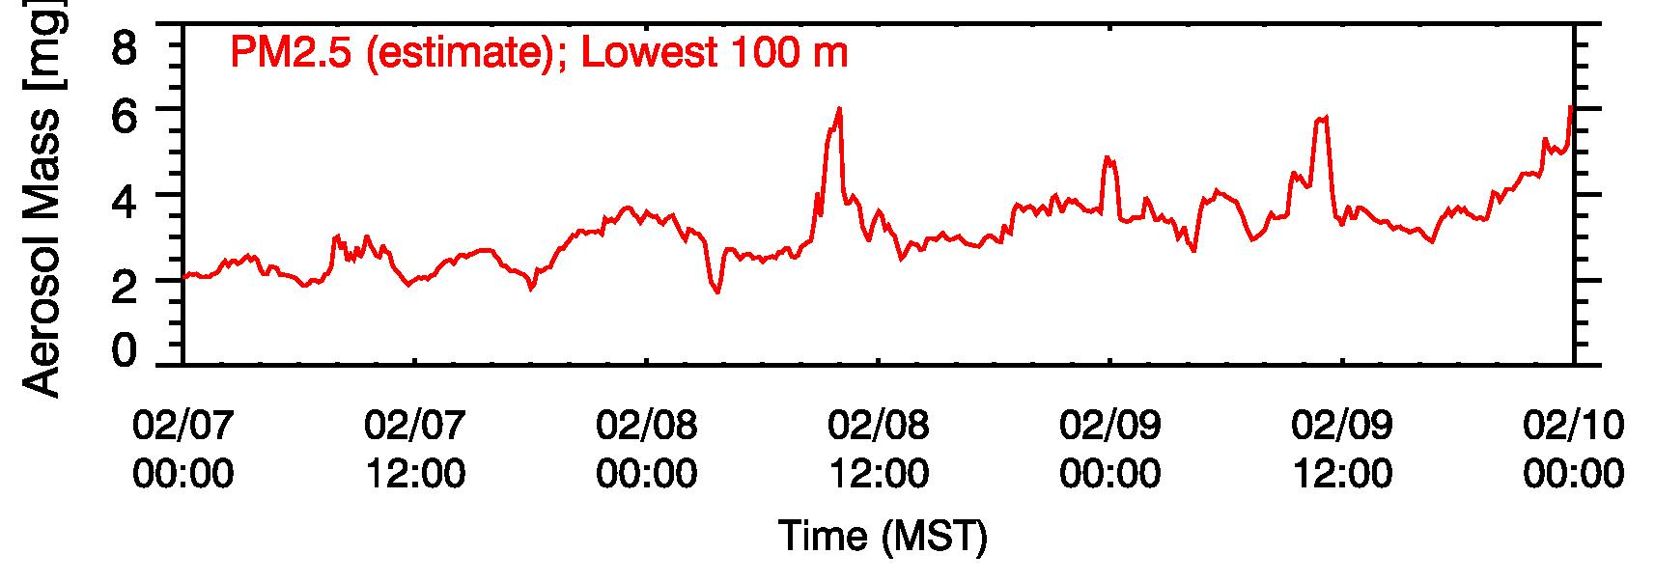
Aerosol formation (?)

Slide 18
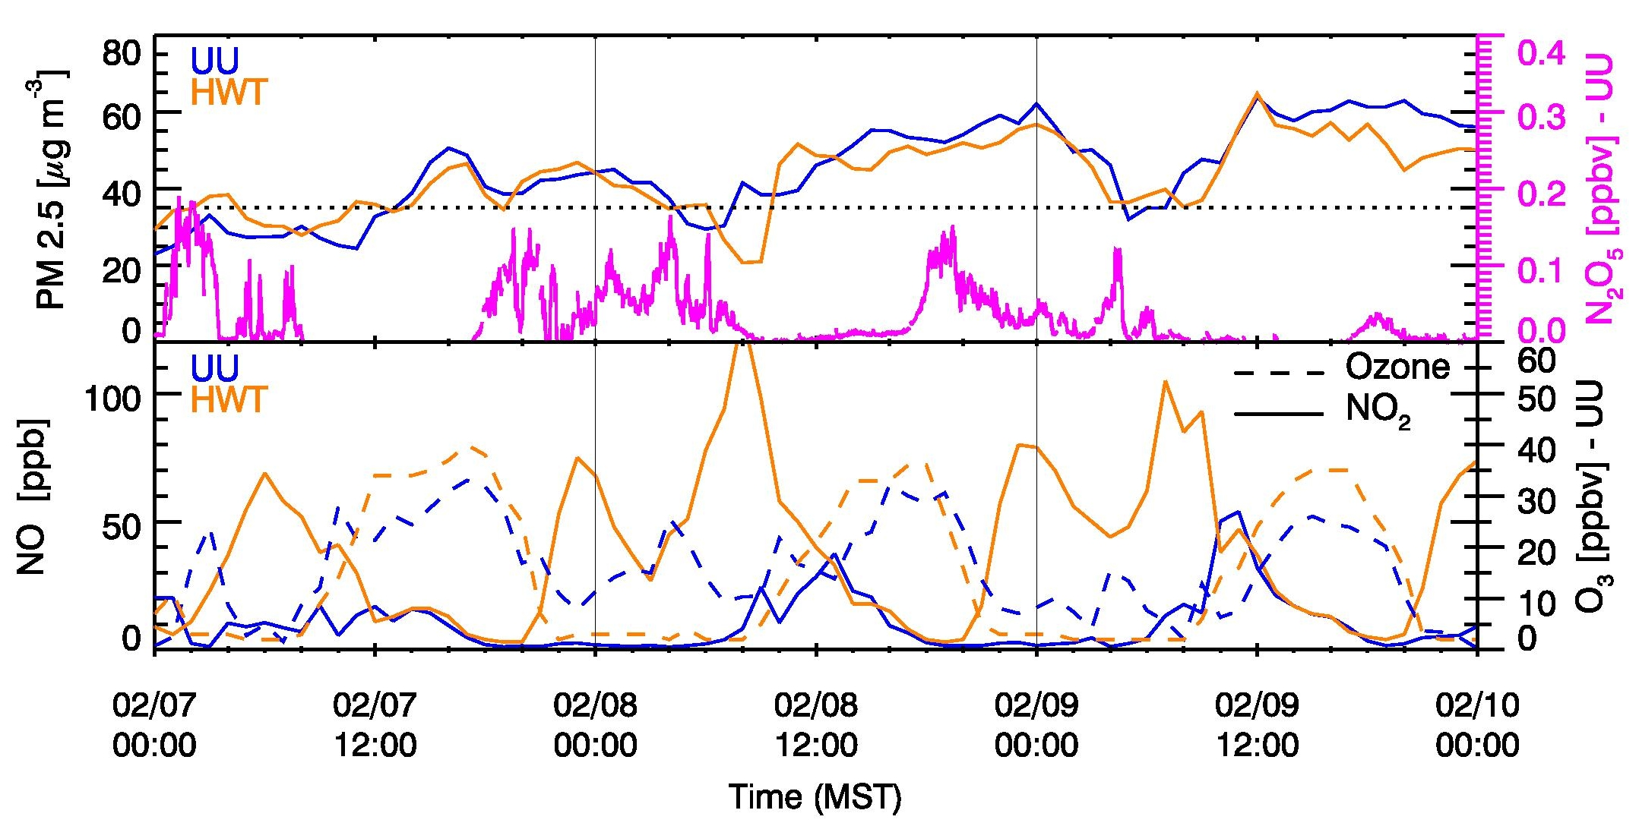
Chemistry
Nighttime Chemistry (N₂O₅ )
Early Morning – Post Sunrise Production
NO₂

Slide 19
Summary / Conclusions
A lot more than expected is happening in a Persistent Cold Air Pool!
Air mass exchanges between sub-basins, and with the lake boundary layer modulate pollutant concentrations.
Down-canyon flows bring cleaner air to the mouths of the canyons at night.
Cleaner air is also observed at elevated levels within the CAP at night. Clean air injections (at night) may trigger NH₄NO₃ formation (O₃ injection).
Vertical mixing – even under CAP conditions – leading to upward mixing of pollutants.
Ventilation processes are indicated along the basin sidewalls during daytime (ejections / formation of elevated pollutant layers).
Two processes are indicated to lead to HNO₃ (and therefore NH₄NO₃) formation.

Slide 20
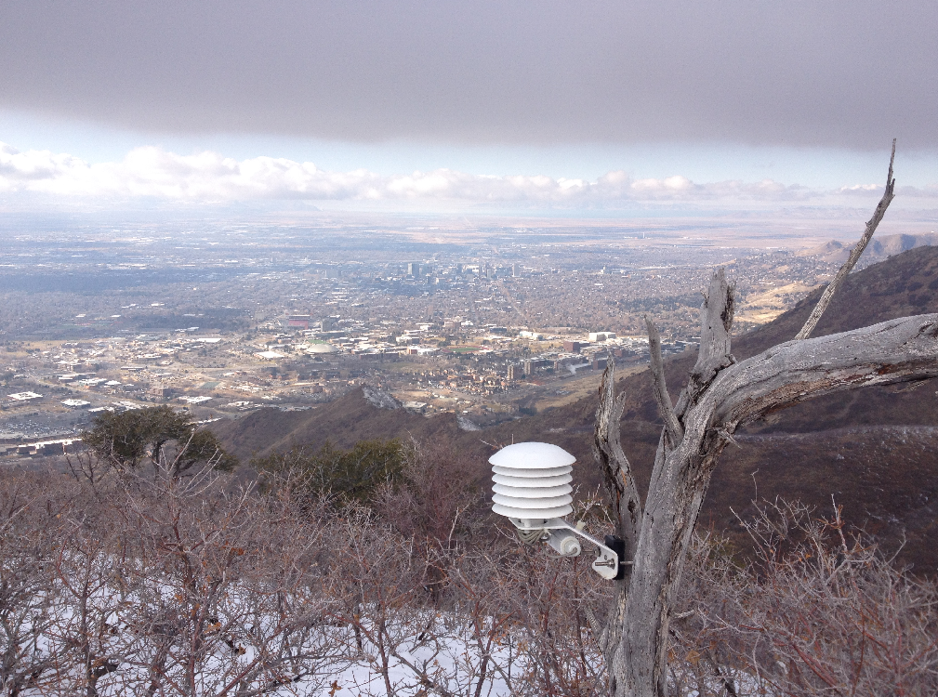
Acknowledgements
Funding: Utah Division for Environmental Quality
All PI’s, students and volunteers involved in the project!

Slide 21
Additional Slides

Slide 22
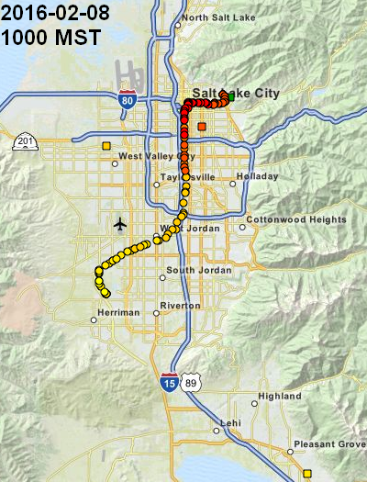
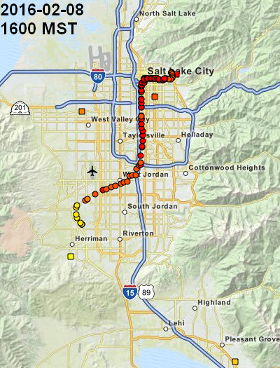
Results – Spatial Variations (horizontal)
+3 to +4 C
calm
+1 to +4 C
1-2 m/s
+5 to +6 C
1-2 m/s
- 4 to -1 C
Flow through gap
~6 m/s
1-2 m/s
+3 to +4 C
Southerly flow through Jordan Narrows diluting pollutants south to north.
Flow weakens and is replaced by weak afternoon up-valley / lake breeze flow.

Slide 23
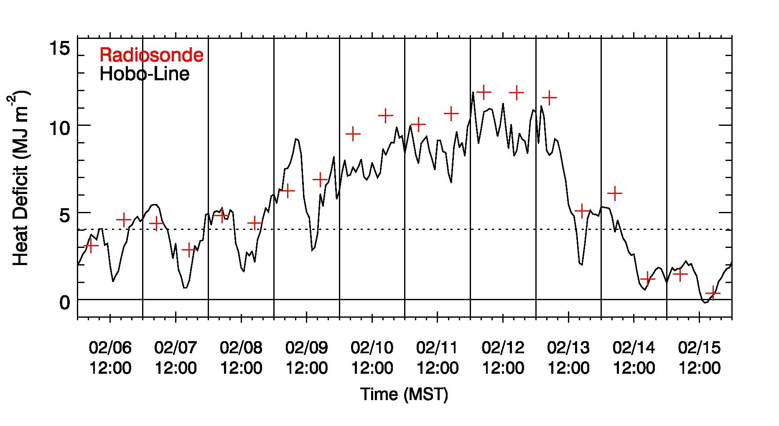
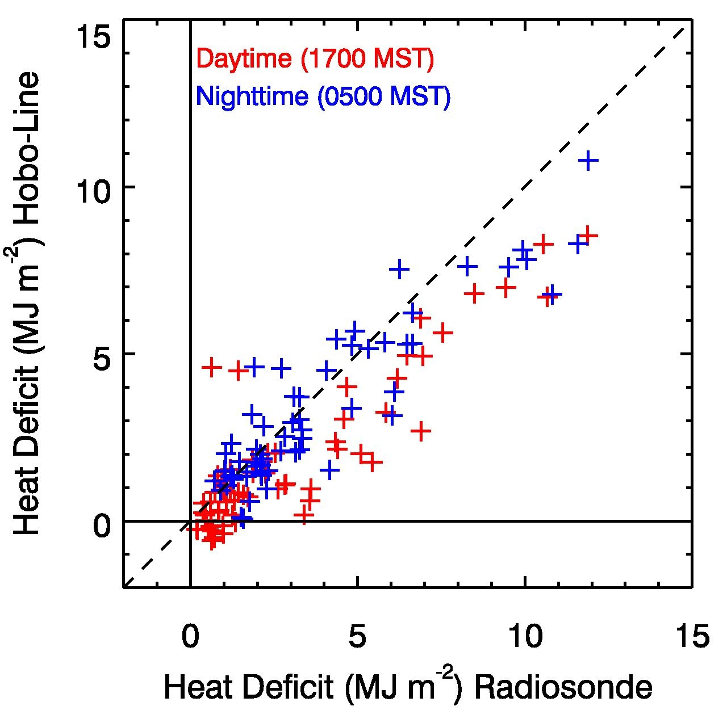
Valley Heat Deficit 6-16 February 2016
r = 0.64
r = 0.60
r = 0.67
“Clear”
“Haze/Fog”

Slide 24
Results – Spatial Variations (horizontal)
TRAX
Canyon exits areas and
Salt Lake Basin “benches” often show reduced PM_{2.5} concentrations.

Slide 25
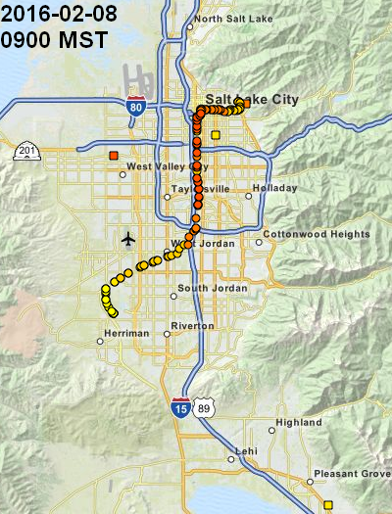
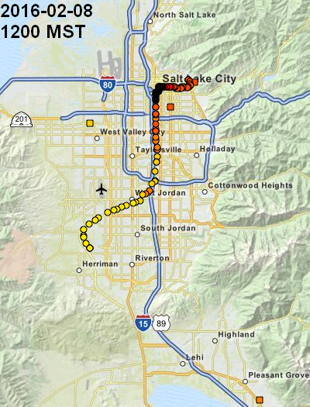
Results – Spatial Variations (horizontal)
TRAX

Slide 26
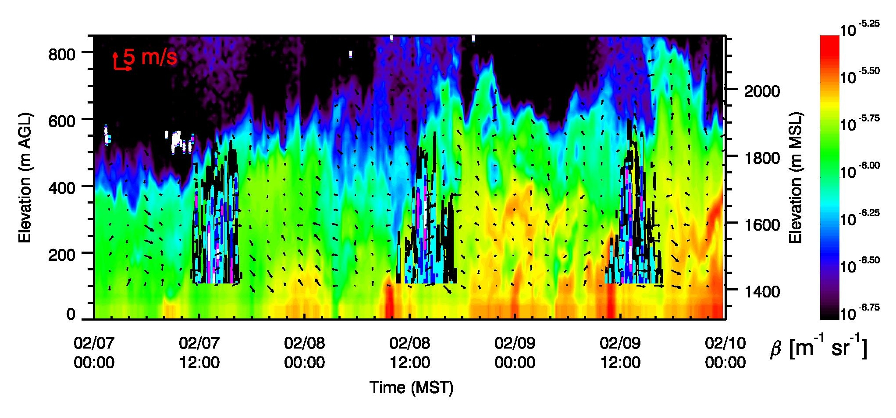
σ_{w}
σ_{w}
σ_{w}
Mixing ➔ lowering of near-surface concentrations
➔ lofting of pollutants.

Slide 27
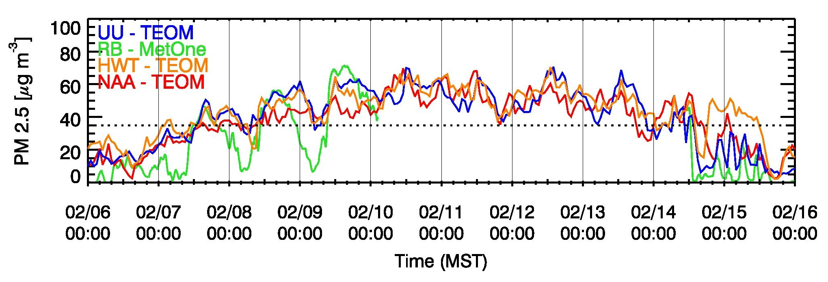
Chemistry

Slide 28
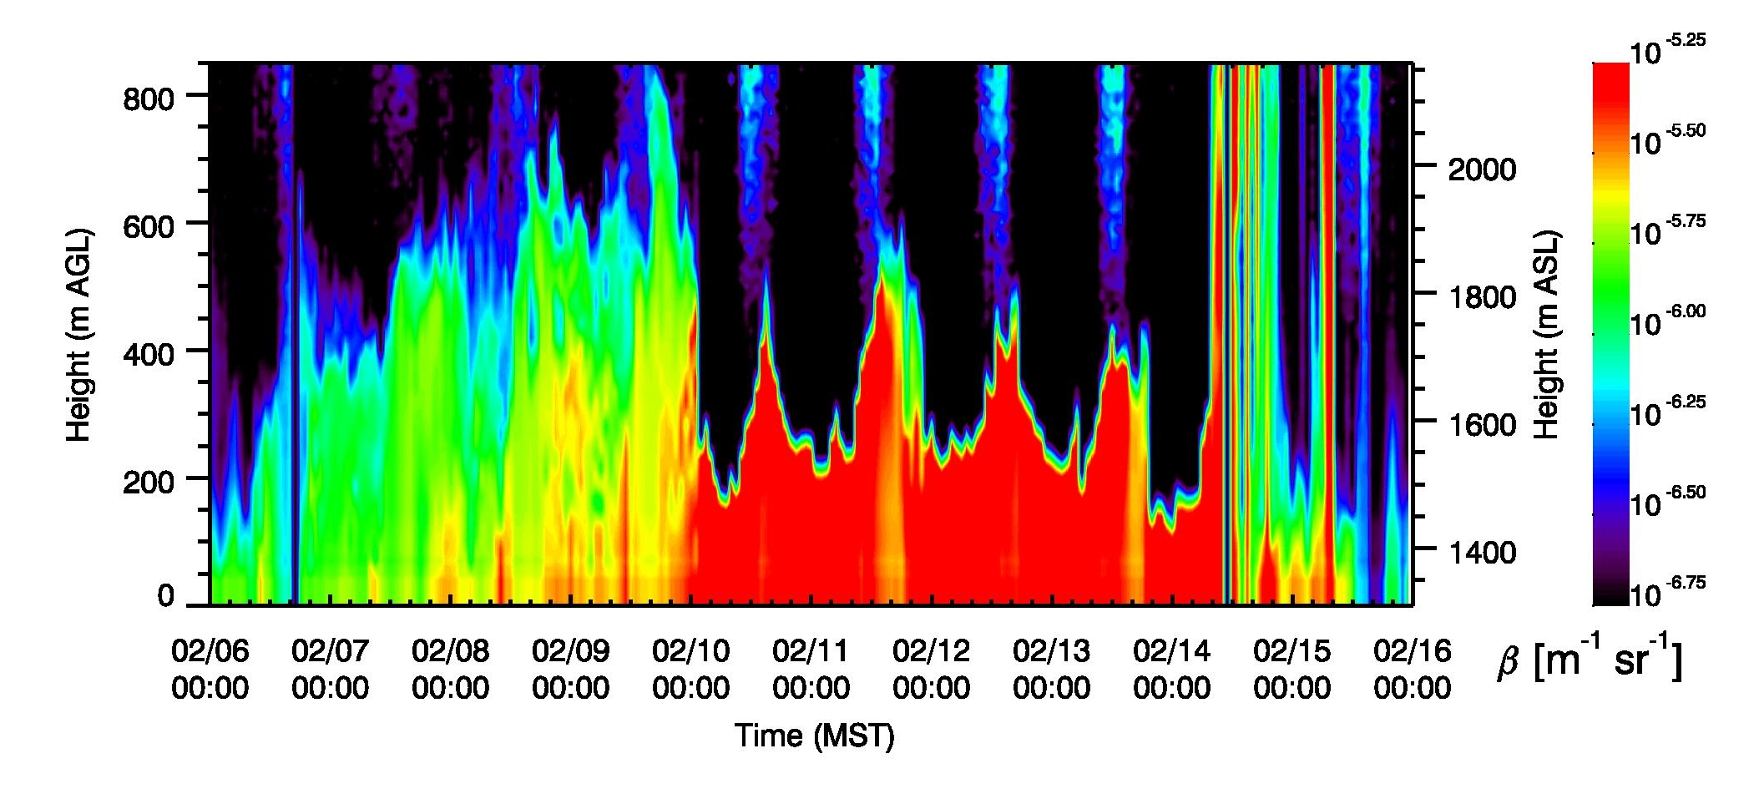
Aerosol Backscatter 6-16 February 2016
“Clear”
“Haze/Fog”

Slide 29
Daytime
OH + NO₂ HNO₃ (sunlight!)
Nighttime
NO₂ + O₃ NO₃ + O₂
NO₃ + NO₂ + M N₂O₅
N₂O₅ +H₂O_{(l)} 2 HNO₃
We have plenty of NO₂ !
We need Ozone O₃ !
If too much NO then NO reacts with NO3,
Preventing
O₃ is titrated !
NO + O₃ NO₂+O₂
Daytime – Chlorine ClNO₂ radical ? Photochemical activation – OH⁻ …

Slide 30
Background (why; problem; what we know)
Approach (What we don’t know and how we’re trying to find out more)
SLC basin
Instrumentation
Mobile Instrumentation
Winter 2015/2016
The 6-16 February episode
Backscatter
Heat Deficit (diurnal)
Temperature Structure (Hobos)
Transition profiles
Results:
Variations
1. Temporal:
2. Spatial:
Trax:
a) Cleaner benches
b) Spatial gradients (Lake Breeze / partial mix-out )
Topography effects
Nighttime: Canyon Inflows
Nightime: Cold air injections (in cold pool)
c) Daytime: Upslope ejection
Chemistry: Two types of chemistry (nighttime / early morning)
Outline

