Slide 1
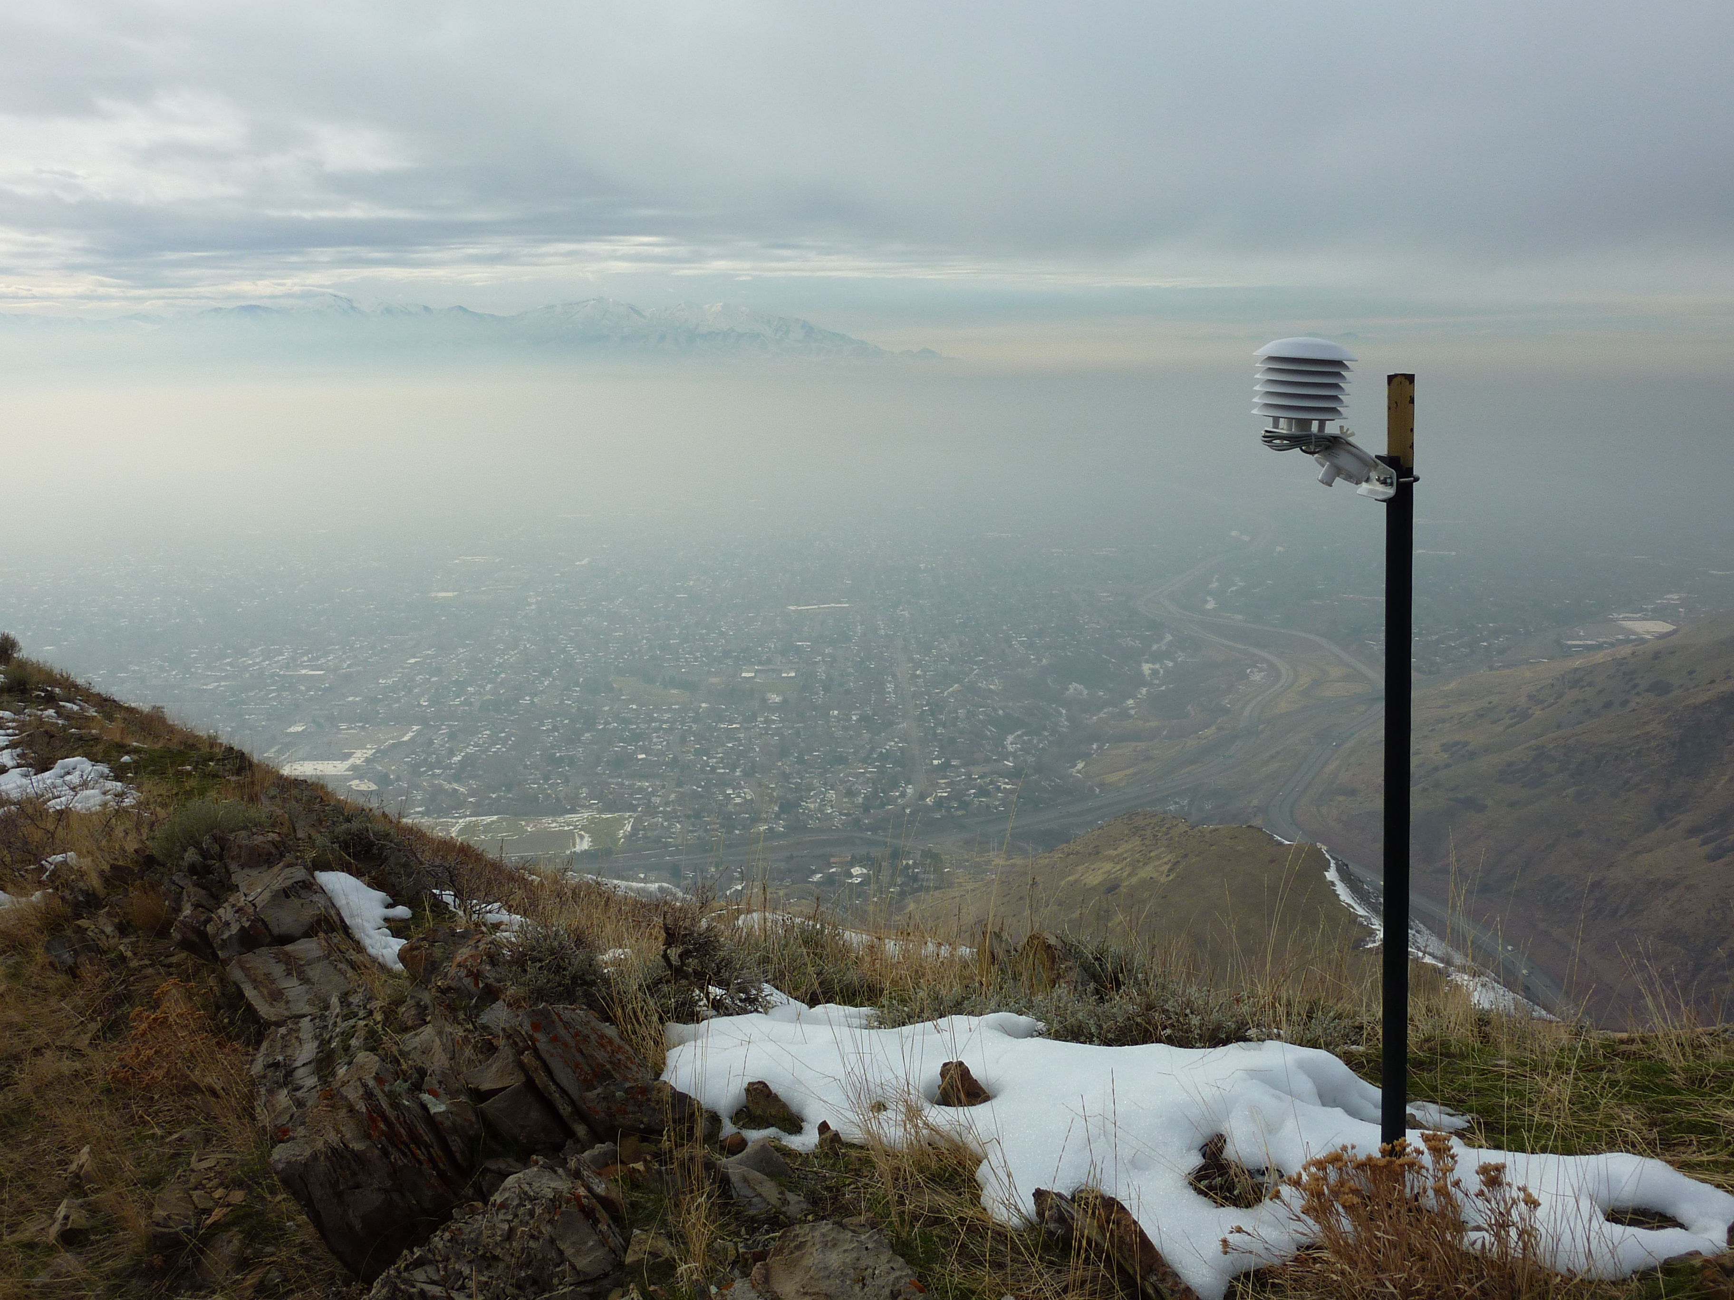

Meteorological observations during the Salt Lake Valley PM2.5 Pollution Study
Sebastian W. Hoch, Atmospheric Sciences, University of Utah
23 March 2016 UPDATE
Web: http://www.inscc.utah.edu/~hoch/daqstudy.xhtml
sebastian.hoch@utah.edu

Slide 2
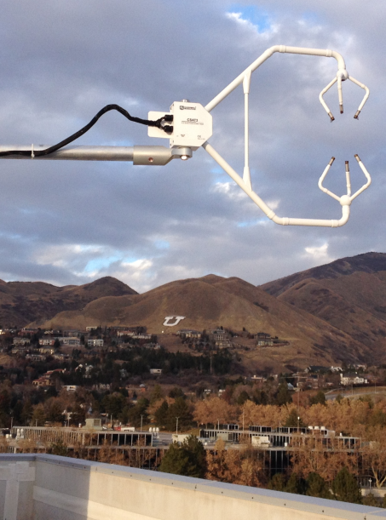
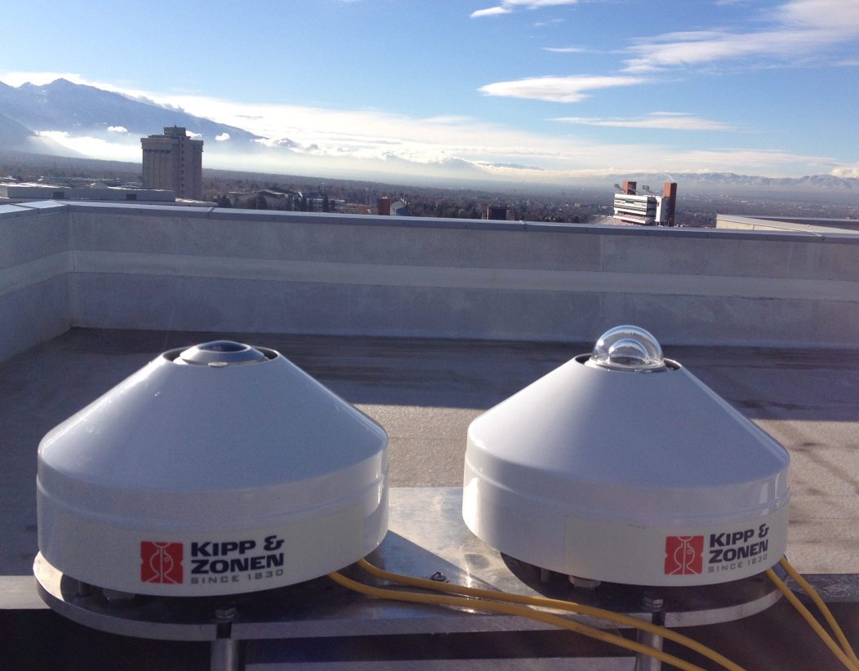
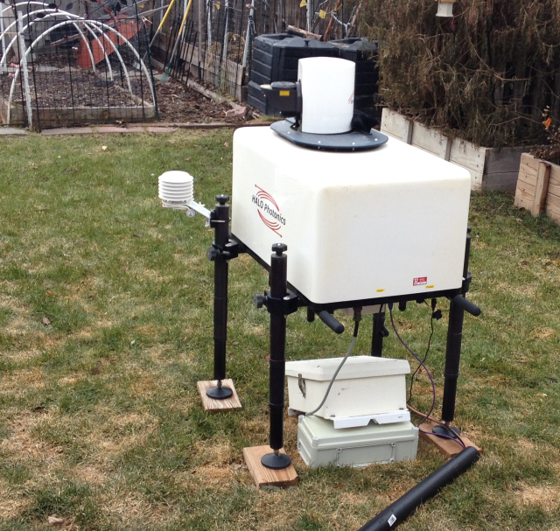
Motivation
Goal is to characterize persistent wintertime cold air pools associated with pollution episodes.
What are the meteorological processes controlling cold-pool evolution and spatial variations?
What meteorological processes modulate local pollutant concentrations under cold-pool conditions?

Slide 3
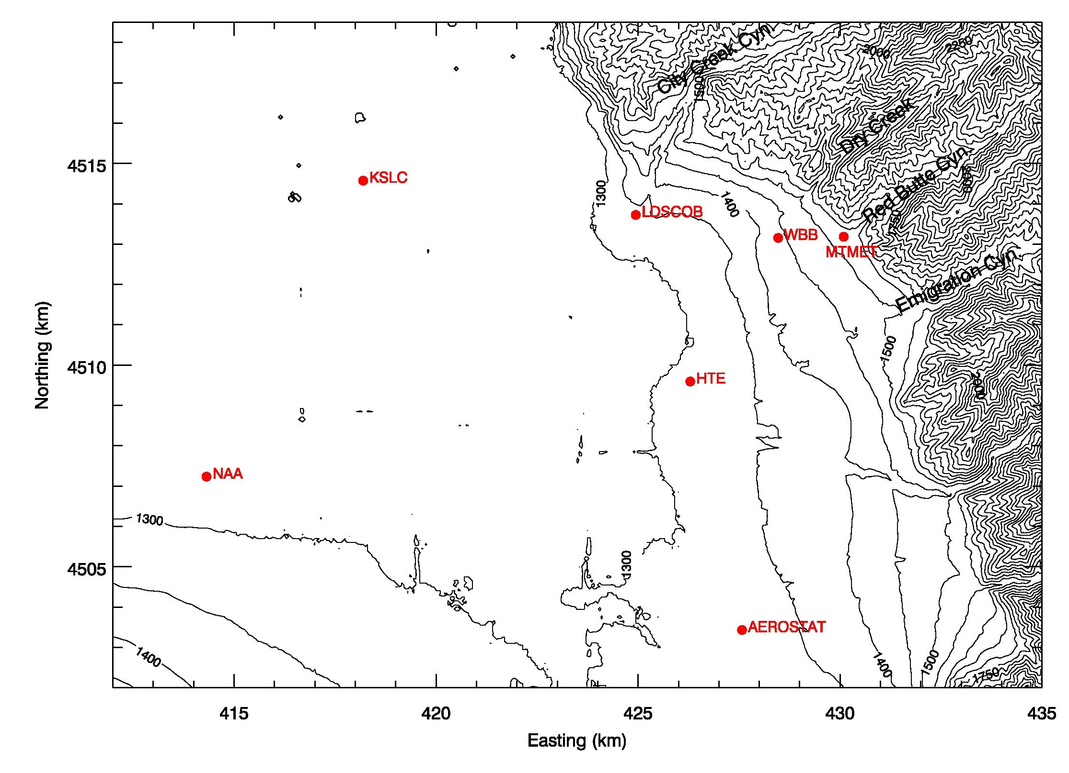
Map

Slide 4
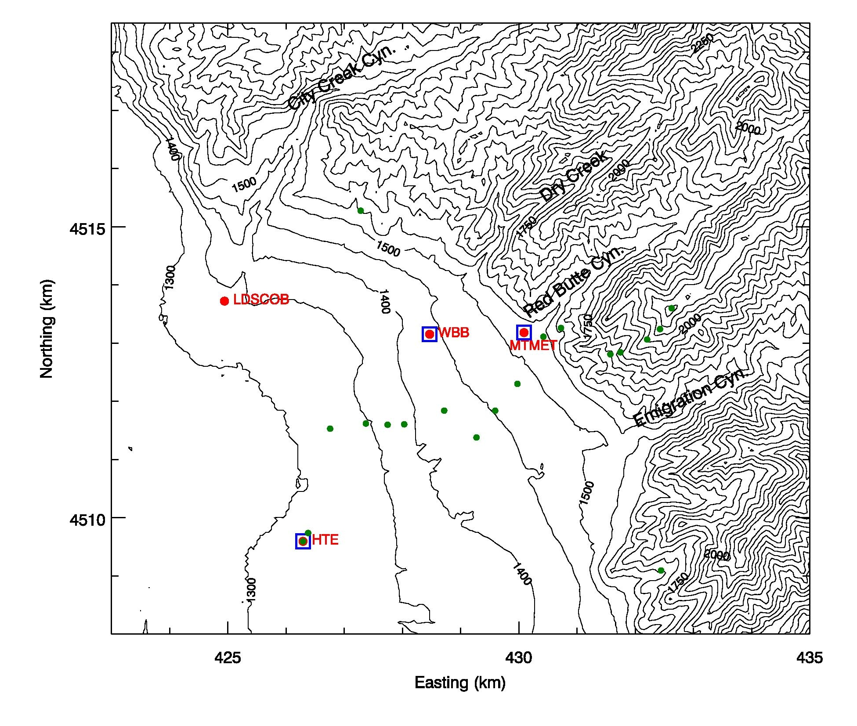
Map – Elevation Transect
Ceilometer
Hobo

Slide 5
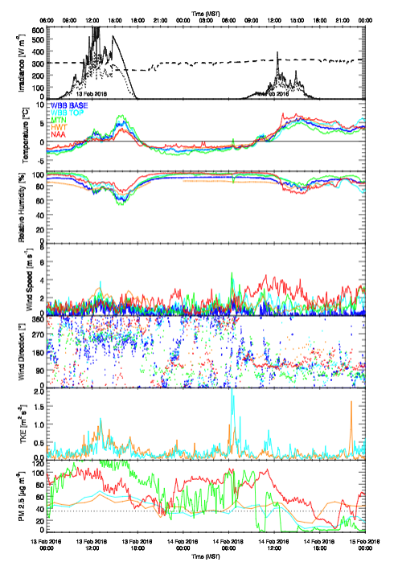
Quicklooks
1) “AWS – Meteo”
http://www.inscc.utah.edu/~hoch/DAQSTUD/quicklooks/aws_meteo/

Slide 6
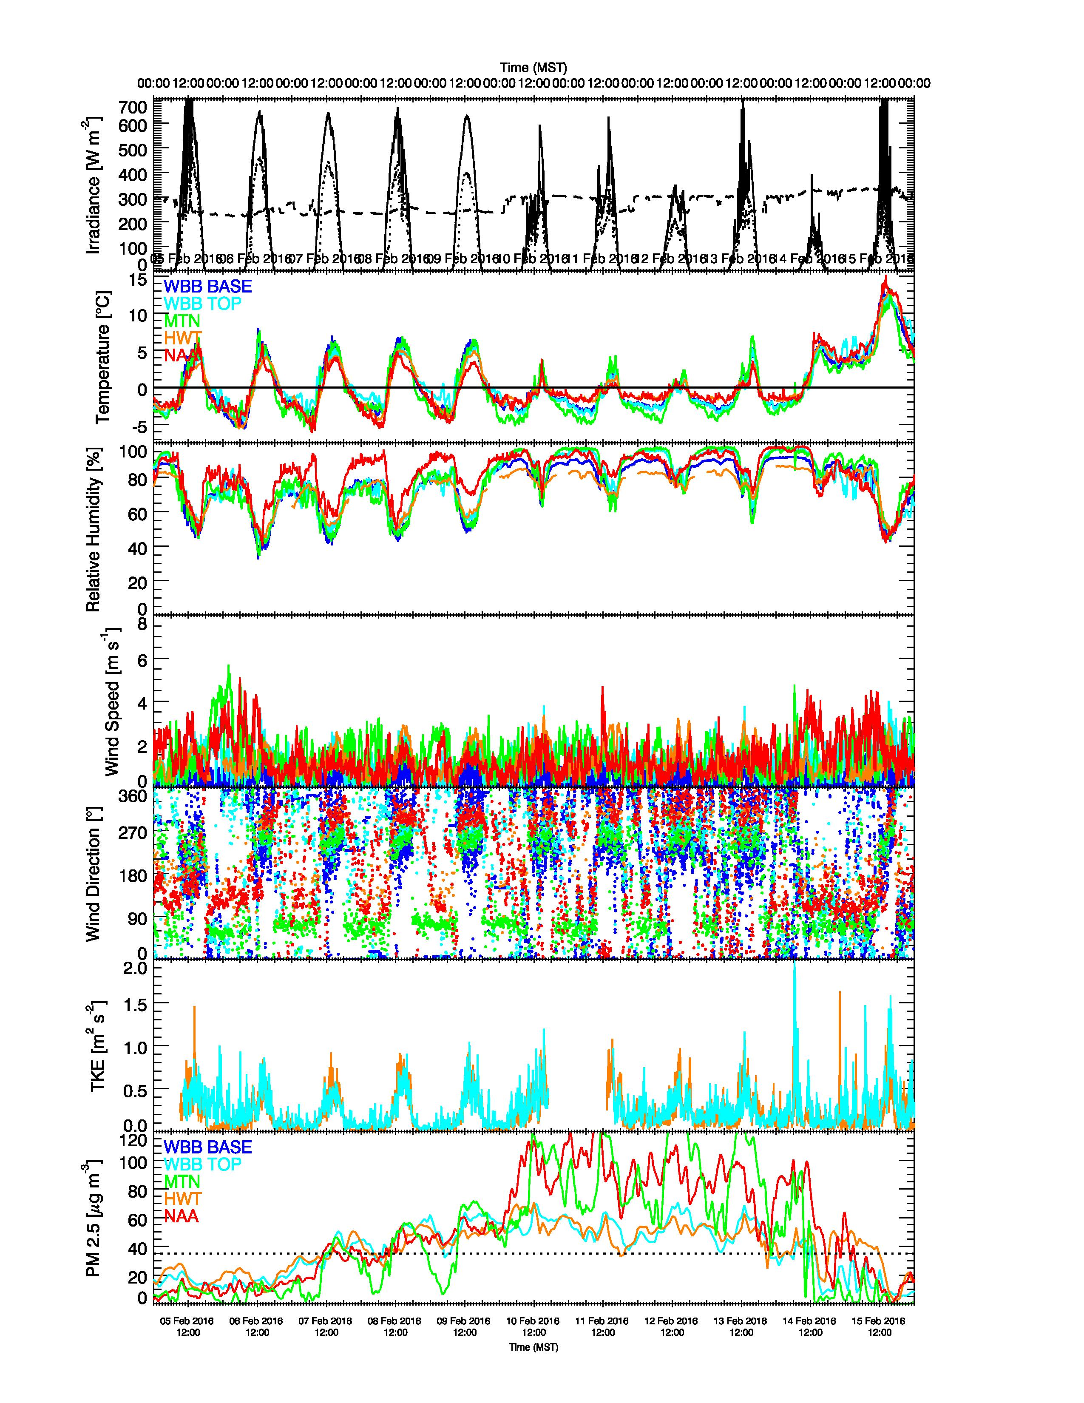
Overview also for Episodes
For example:
6-16 February 2016
Things to look at:
TEOM vs Met-One

Slide 7
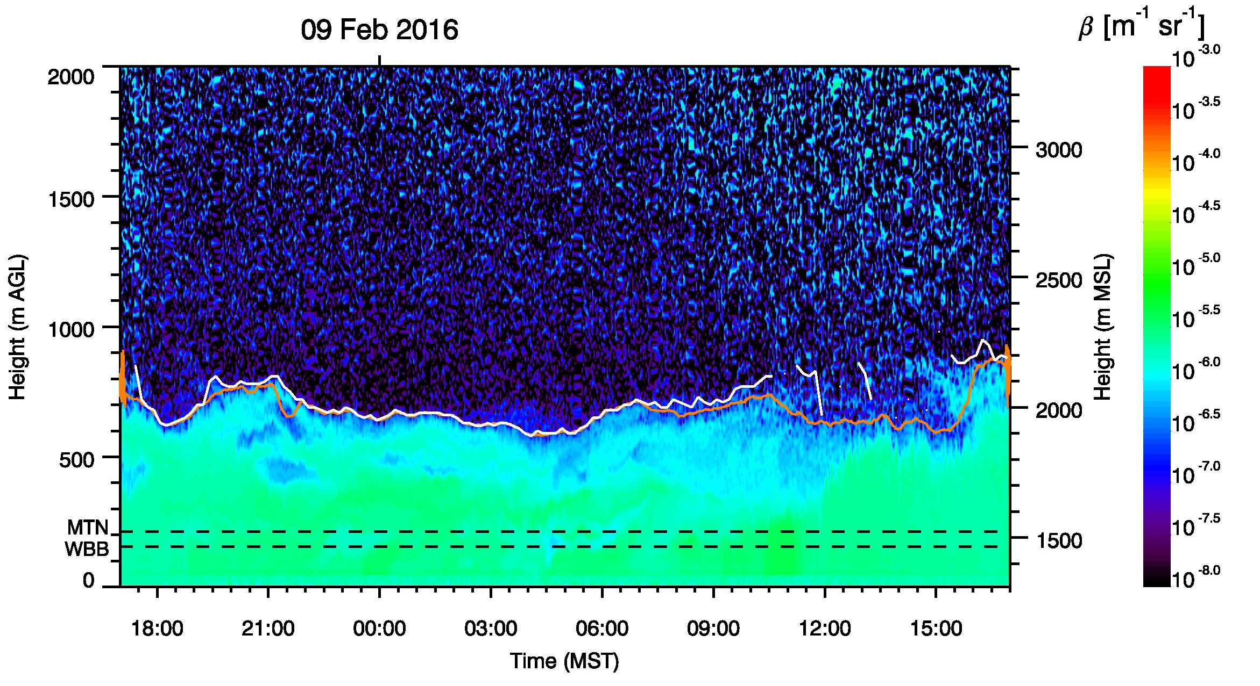
Quicklooks
2) “Ceilometer”
http://www.inscc.utah.edu/~hoch/DAQSTUD/quicklooks/
ceil_wbb/ WBB Building UU
ceil_hwt/ Hawthorne Elementary
ceil_mtn/ Mnt. Met Lab. /
Red Butte Canyon

Slide 8
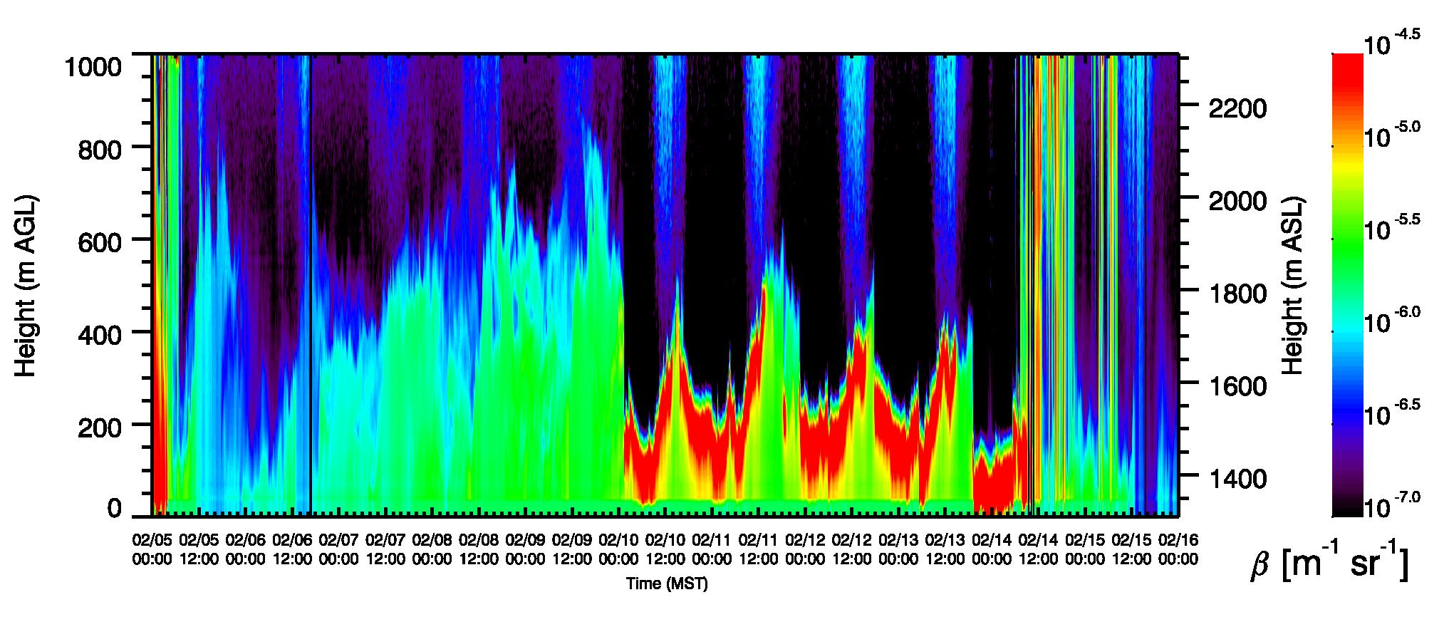
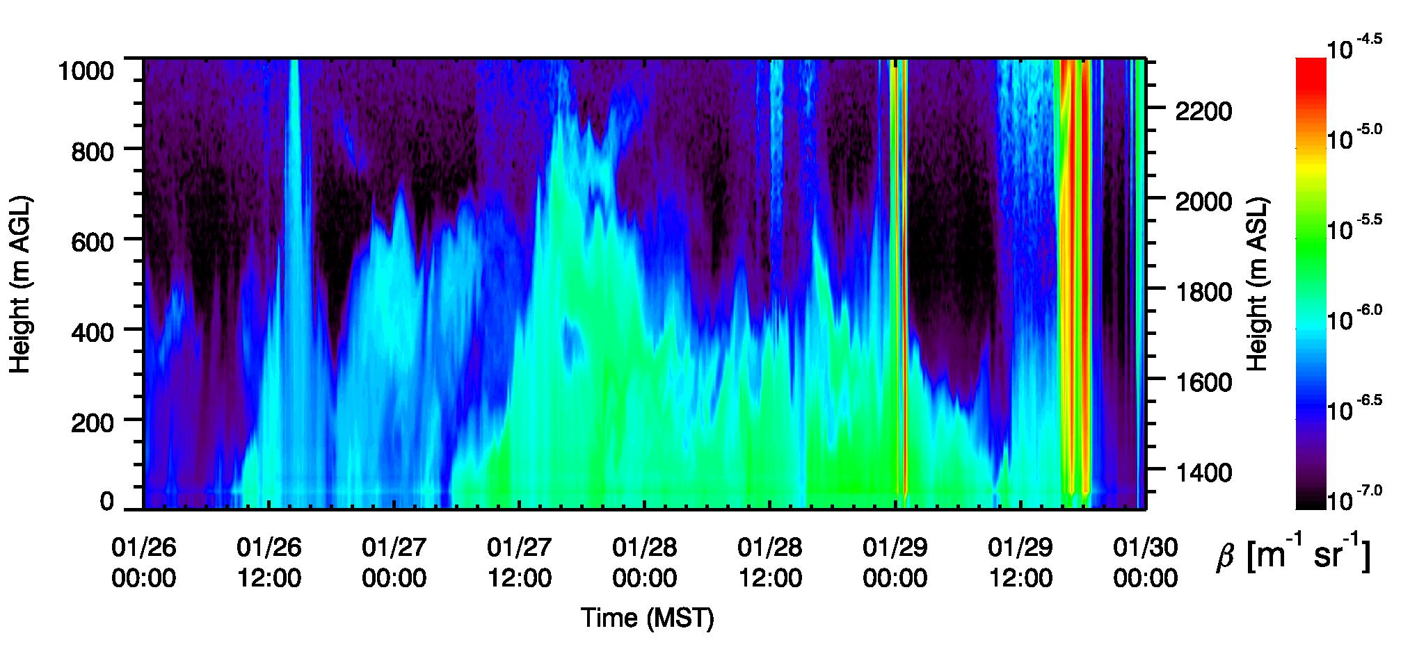
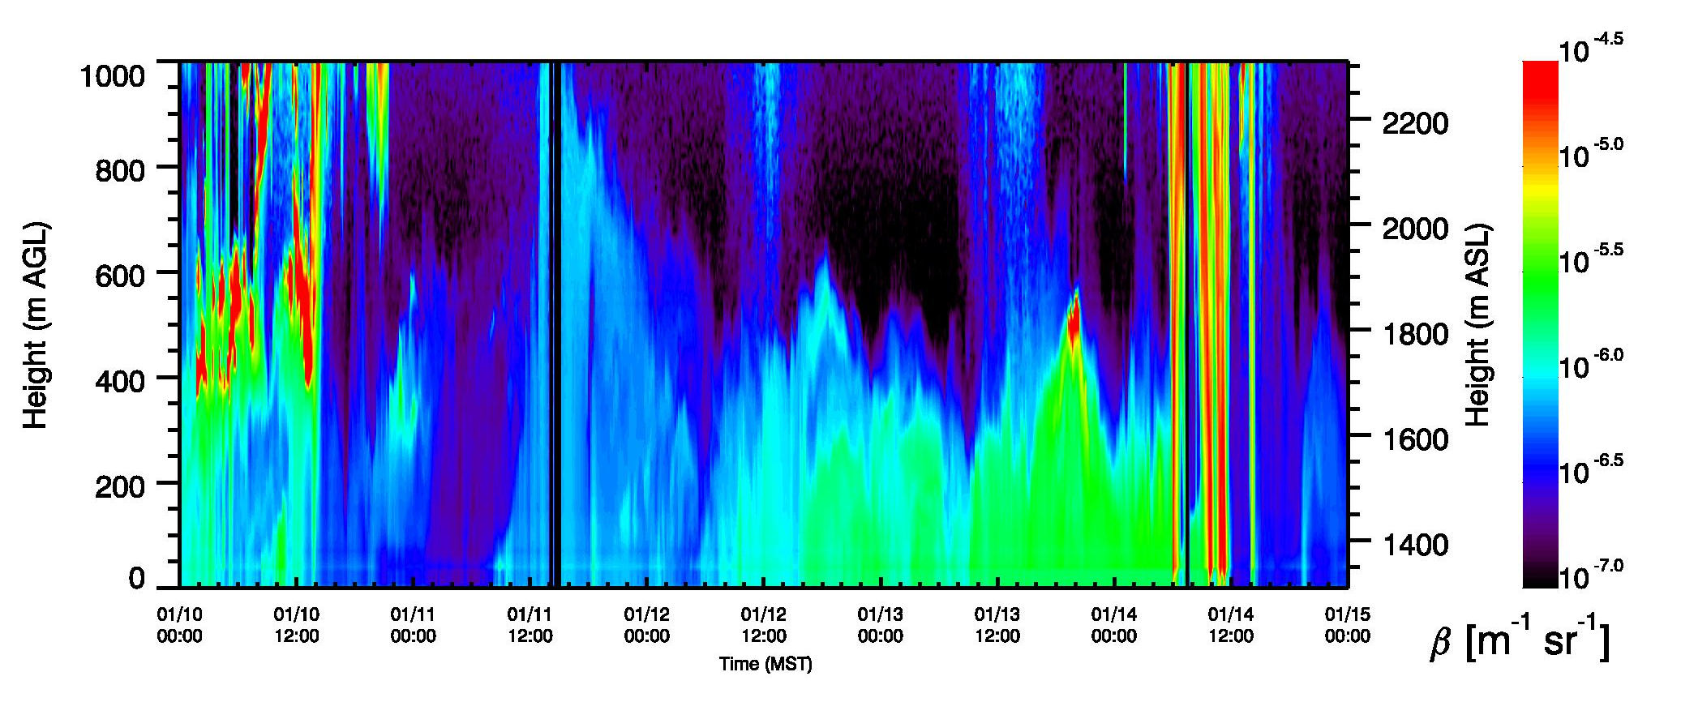
6-16 Feb.
26-30 Jan.

Slide 9
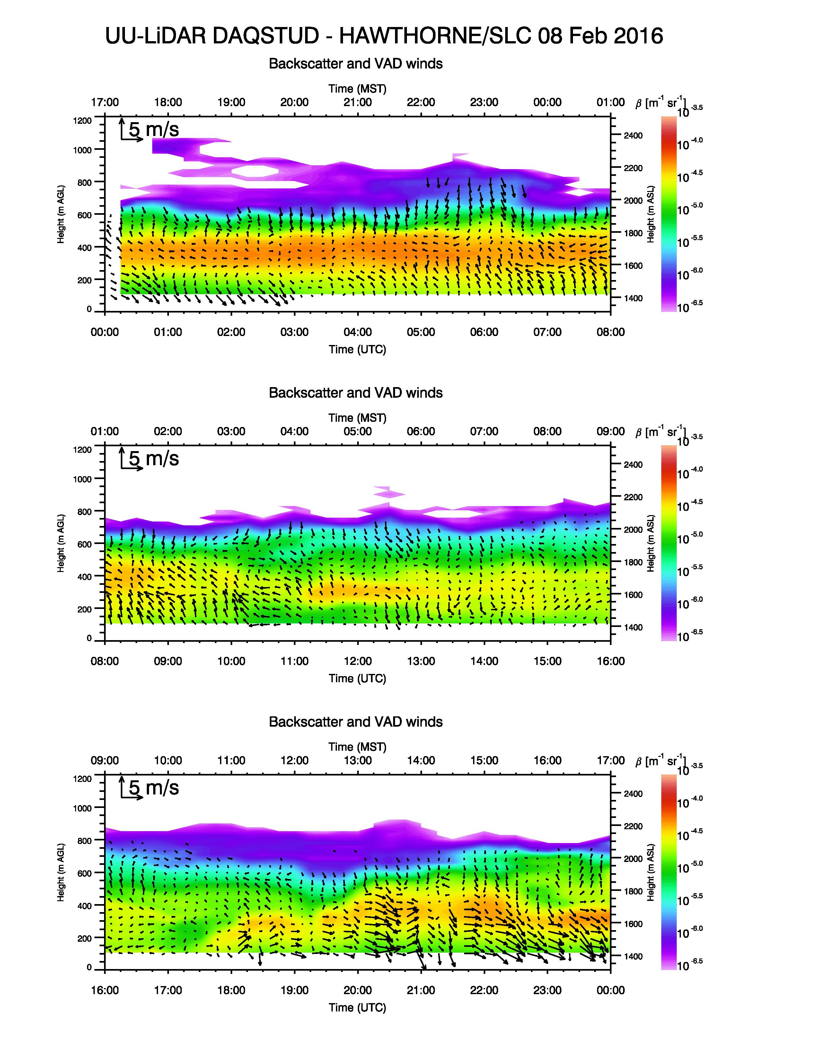
Quicklooks
3) “LiDAR”
http://www.inscc.utah.edu/~hoch/DAQSTUD/quicklooks/lidar_hwt/
Things to look at:
Turbulence from LiDAR observations

Slide 10
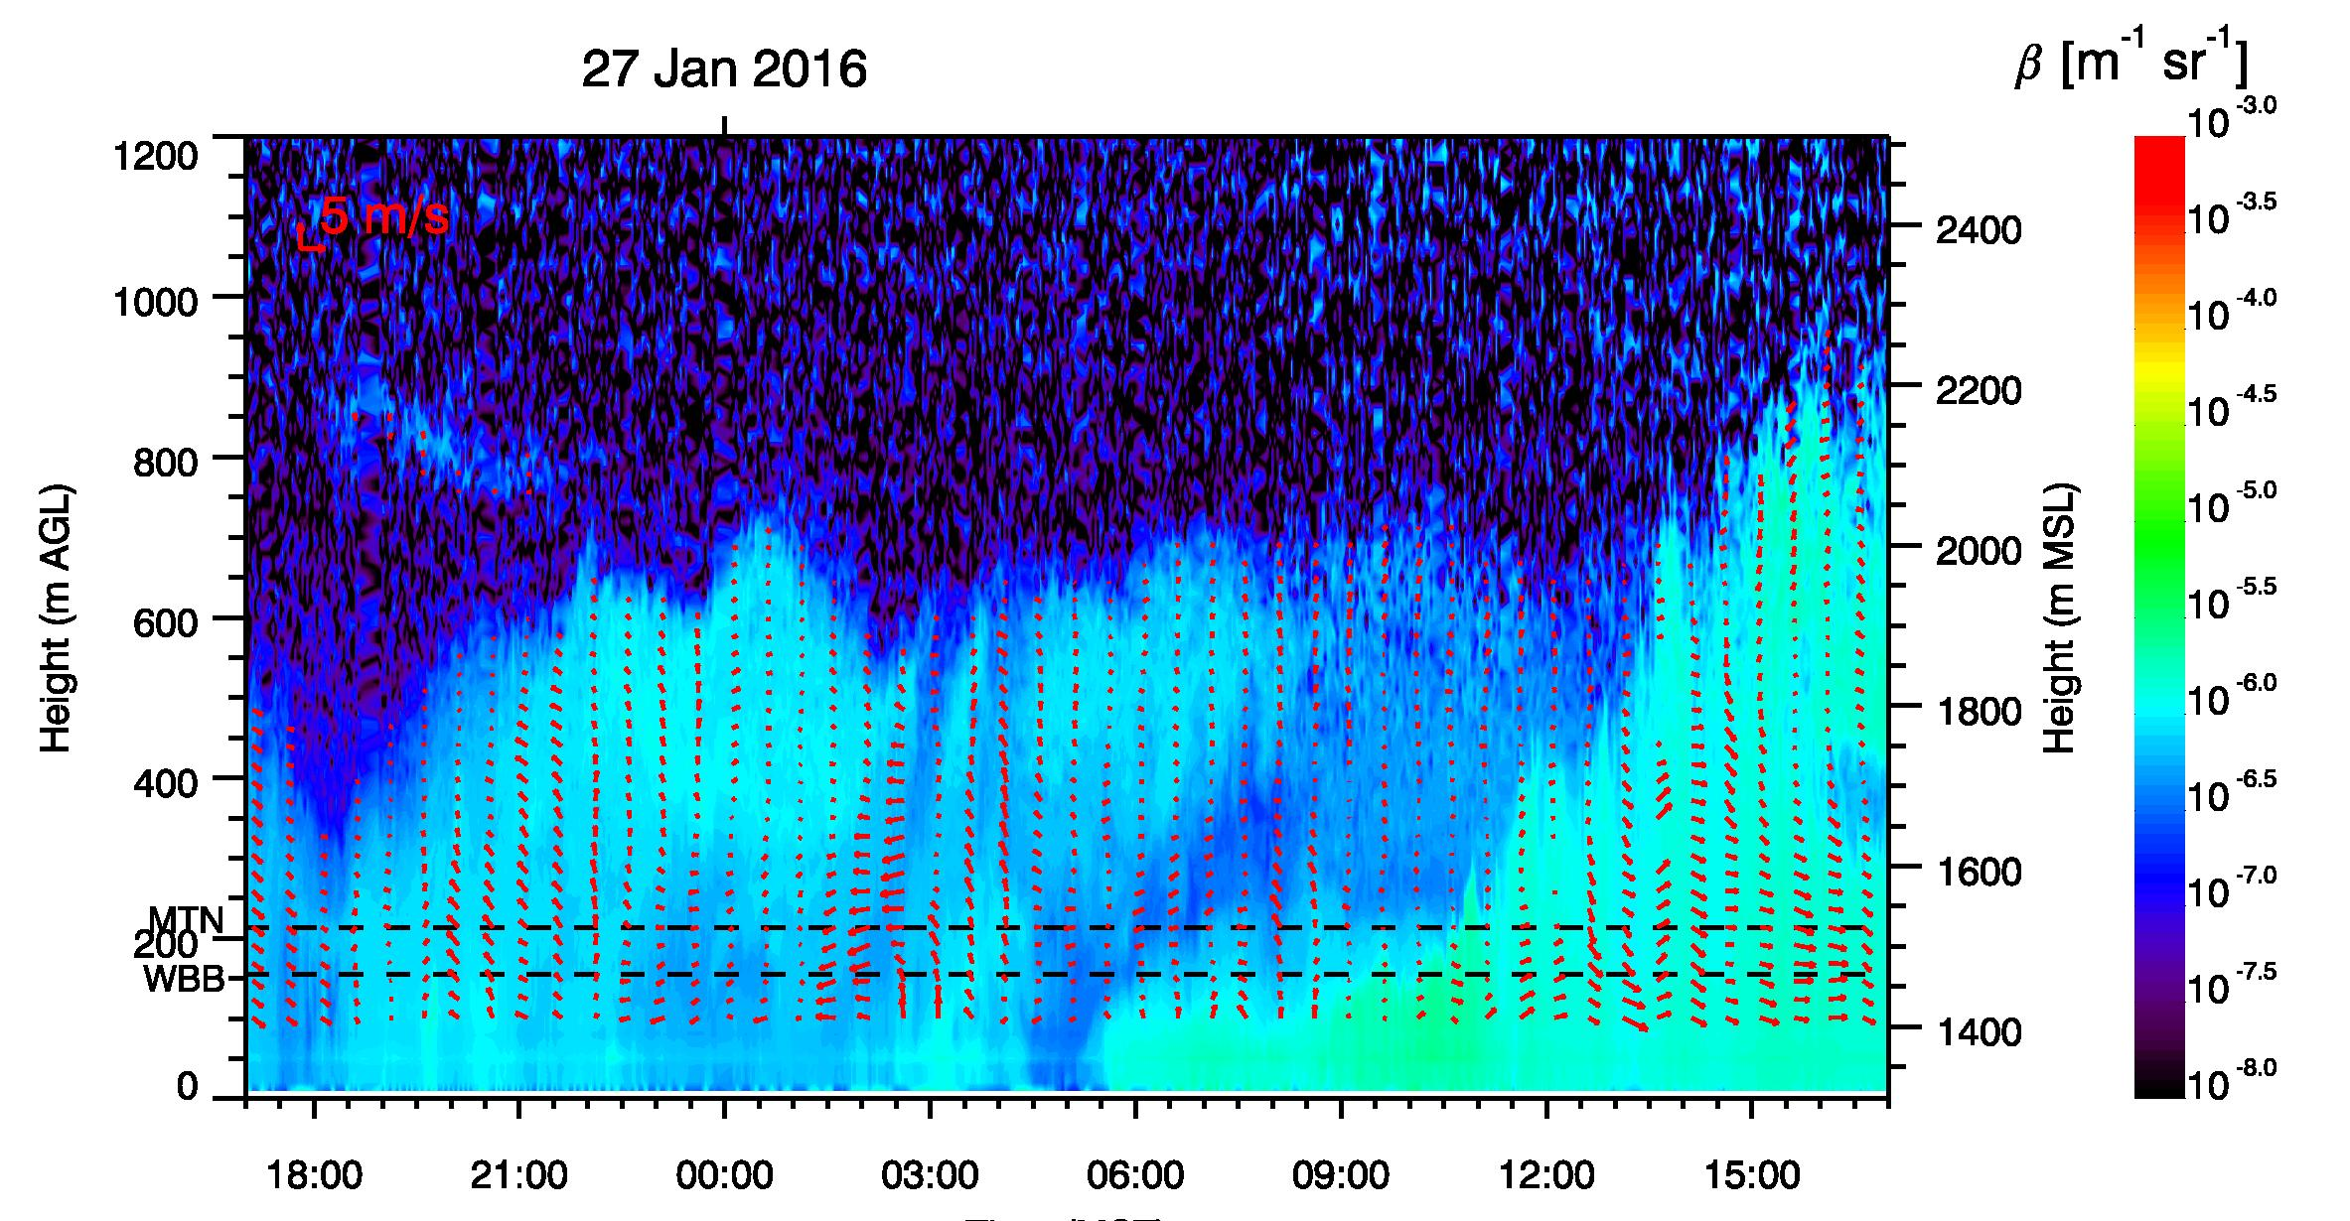
Combination of LiDAR winds and ceilometer backscatter

Slide 11
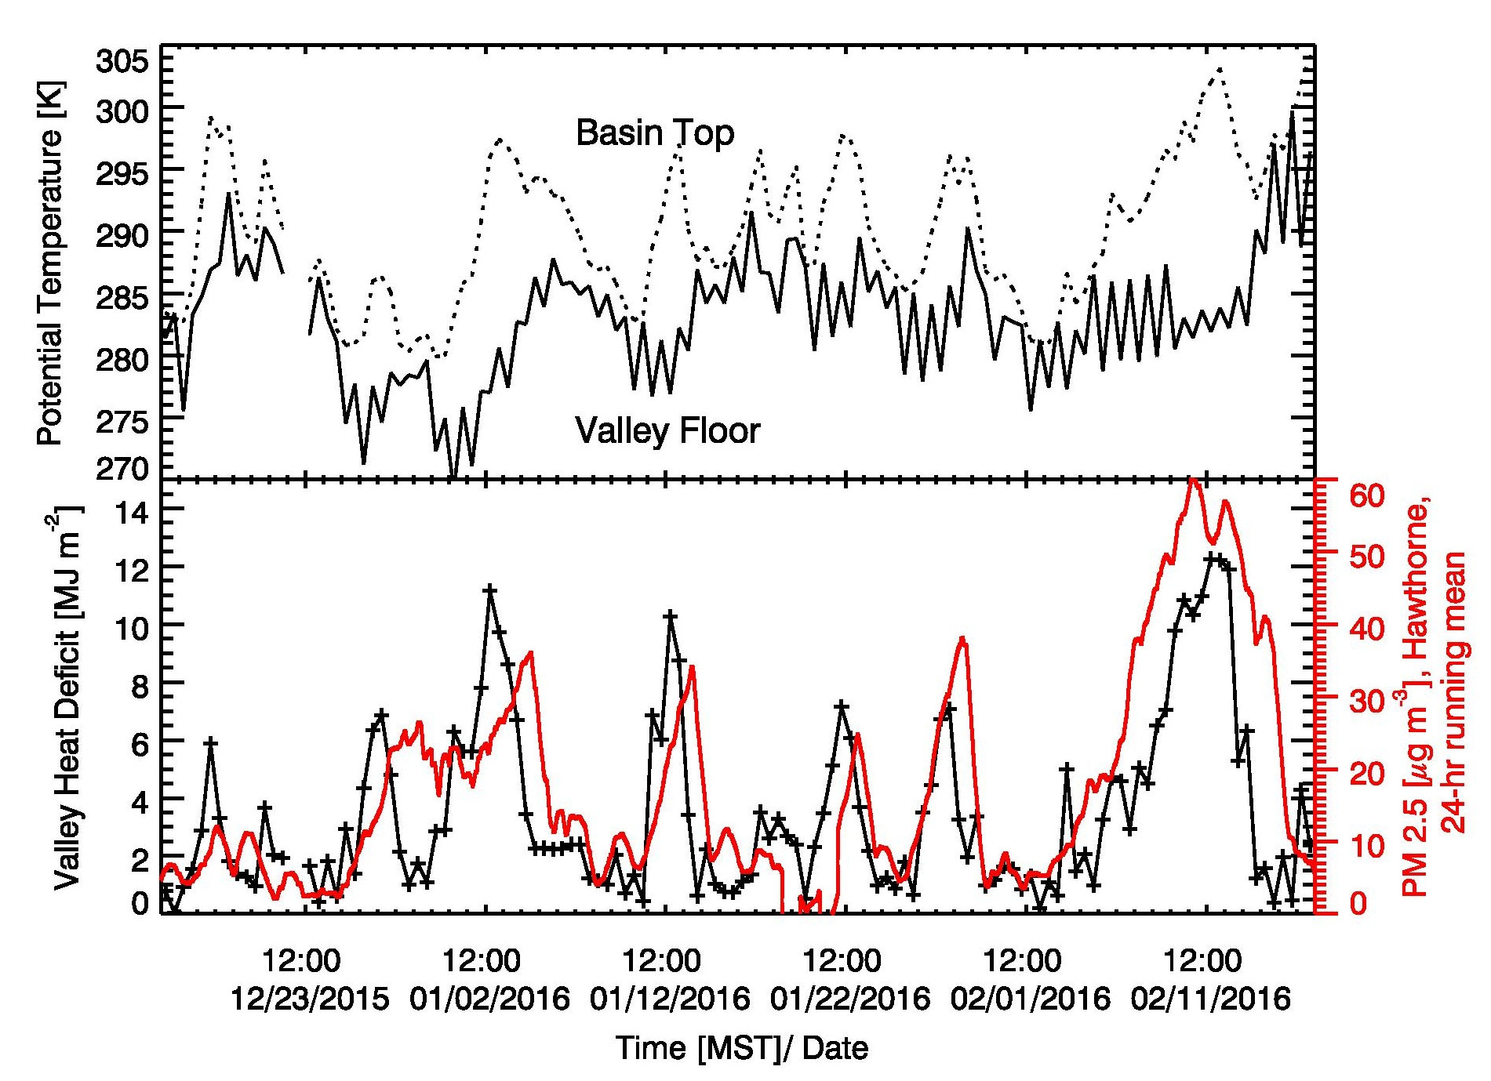
Overview over winter season
Valley Heat Deficit and Hawthorne PM2.5

Slide 12
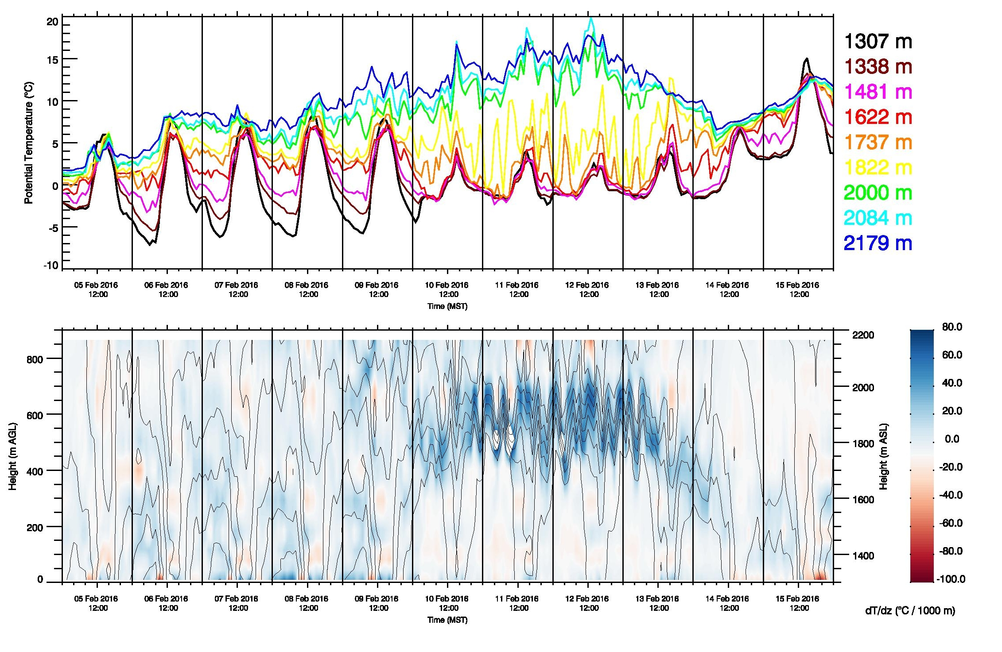
Hobo-Line 6-16 February 2016

Slide 13
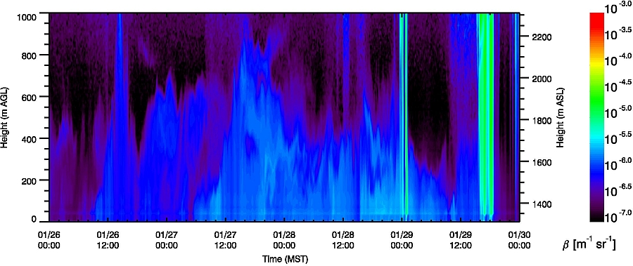
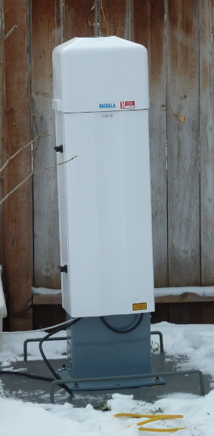
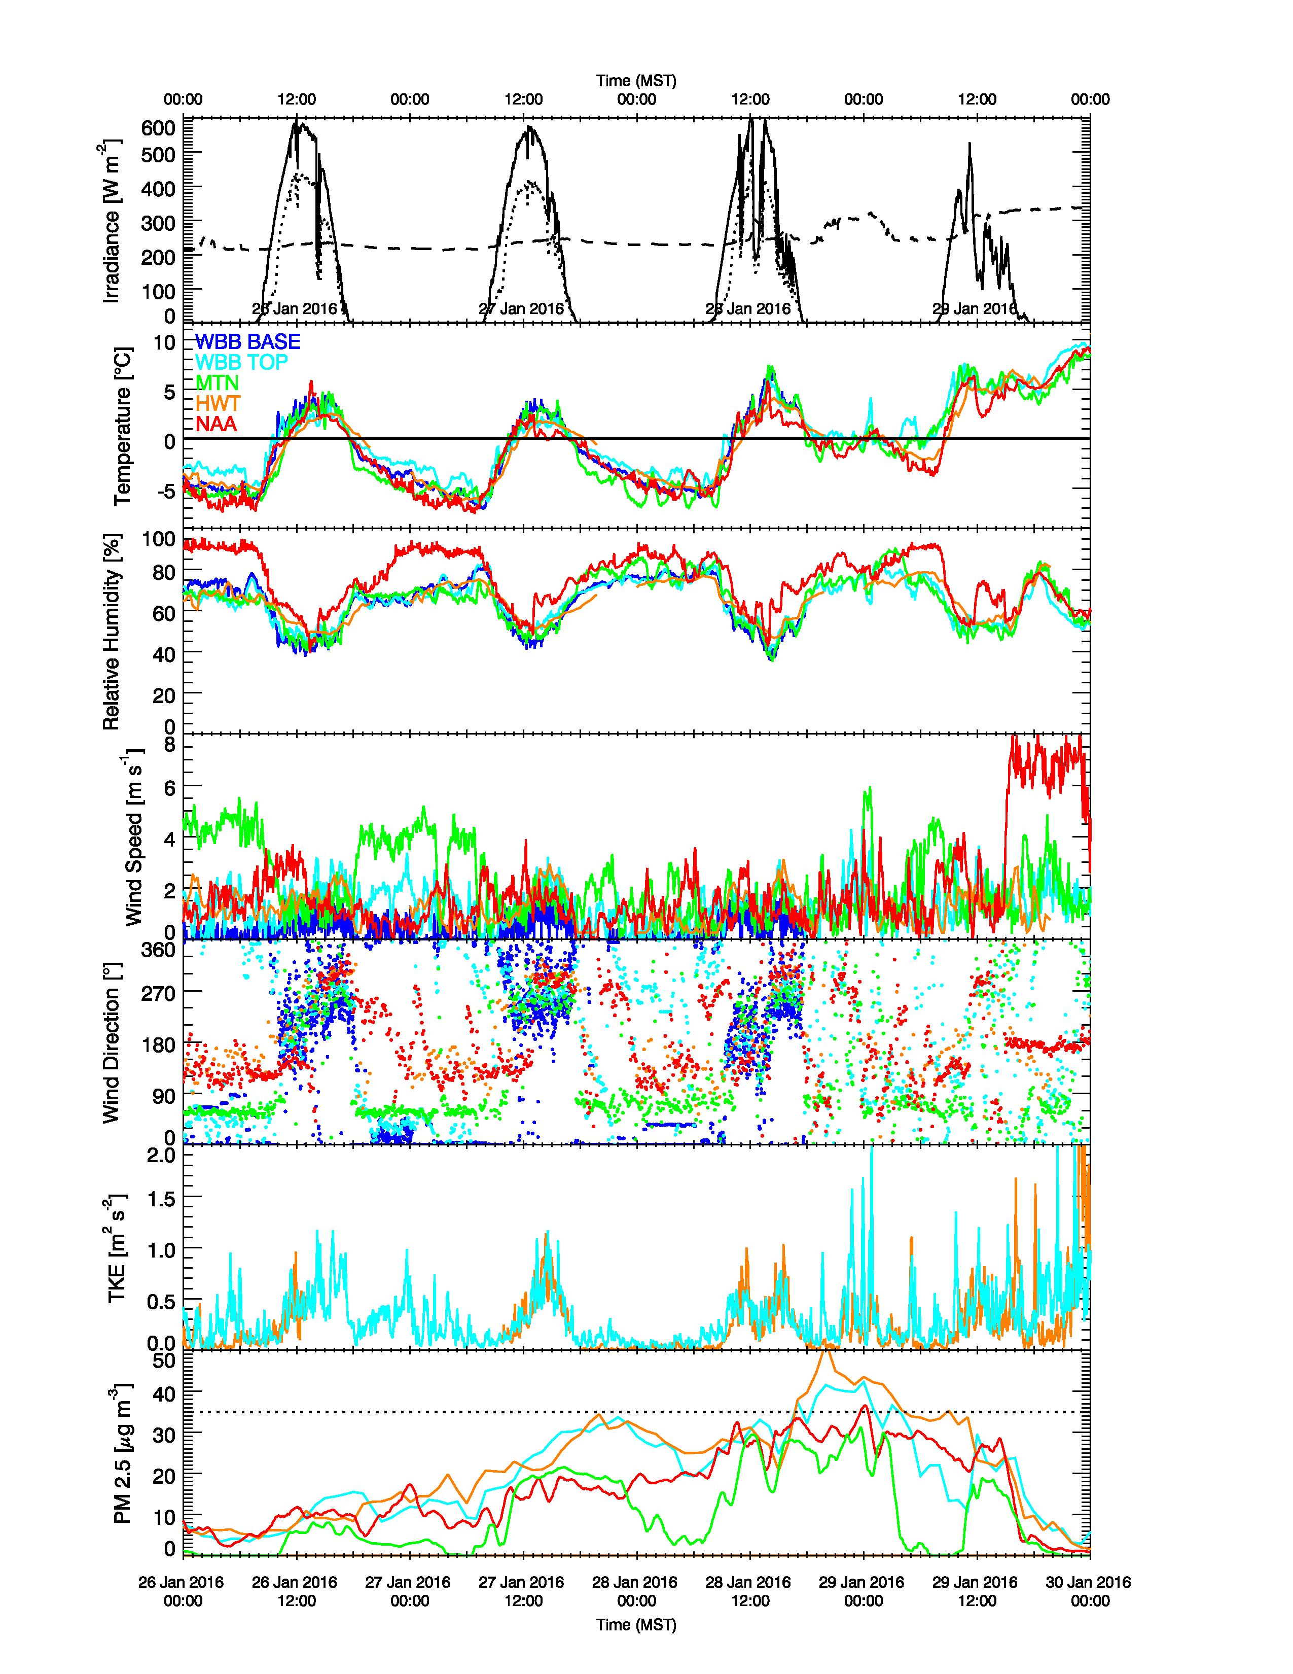
Aerosol Backscatter, Particulate Pollution, and Mixing Height
26-30 Jan. 2016
Basin Top
CL31 ceilometer
Hawthorne
U. of Utah
Red Butte
NAA

Slide 14
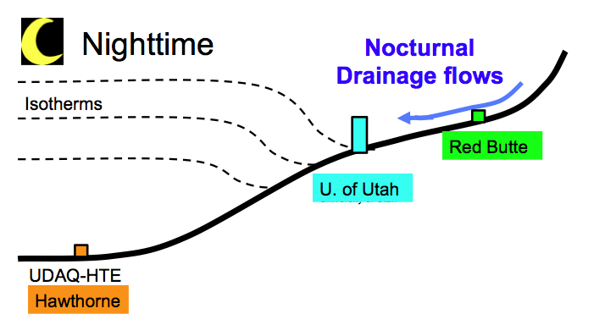
Tributary valleys,
down-valley flows, and air quality
Hawthorne
U. of Utah
Red Butte
NAA

Slide 15
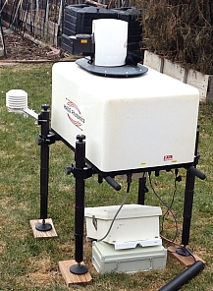
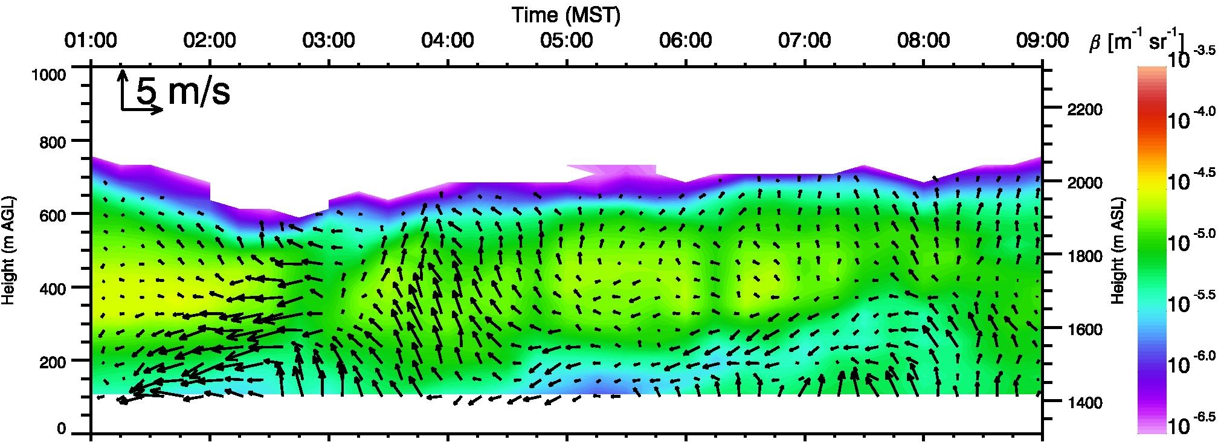
Variation of wind speed with height from Doppler Wind LiDAR measurements
Advection of cleaner air from easterly direction. Possible influence of drainage flows from Red Butte or Mill Creek Canyons.

Slide 16
Summary / Preliminary results
Persistent cold air pools are a typical wintertime phenomena in the topographic basins of Northern Utah. Cold air is being trapped in basins as warm air is advected above.
Emitted pollutants and precursors accumulate in these cold air pools as vertical mixing is inhibited.
Flows out of tributary valleys play an important role by advecting cleaner air into the basins.
Other phenomena, such as a lake breeze circulation from the Great Salt Lake are also investigated.
http://www.inscc.utah.edu/~hoch/daqstudy.xhtml

