Slide 1
EVENT 1
Dust event with frontal passage
27 February 2016
Sebastian Hoch / University of Utah

Slide 2
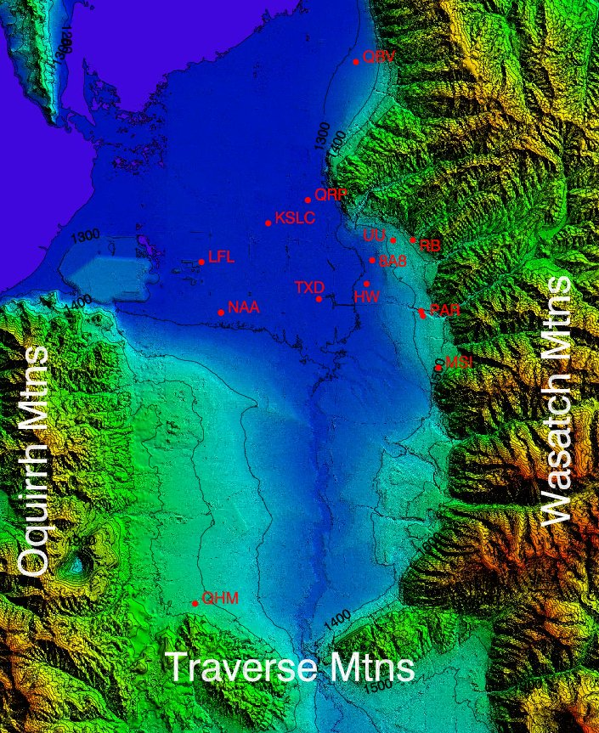
The Salt Lake Valley

Slide 3
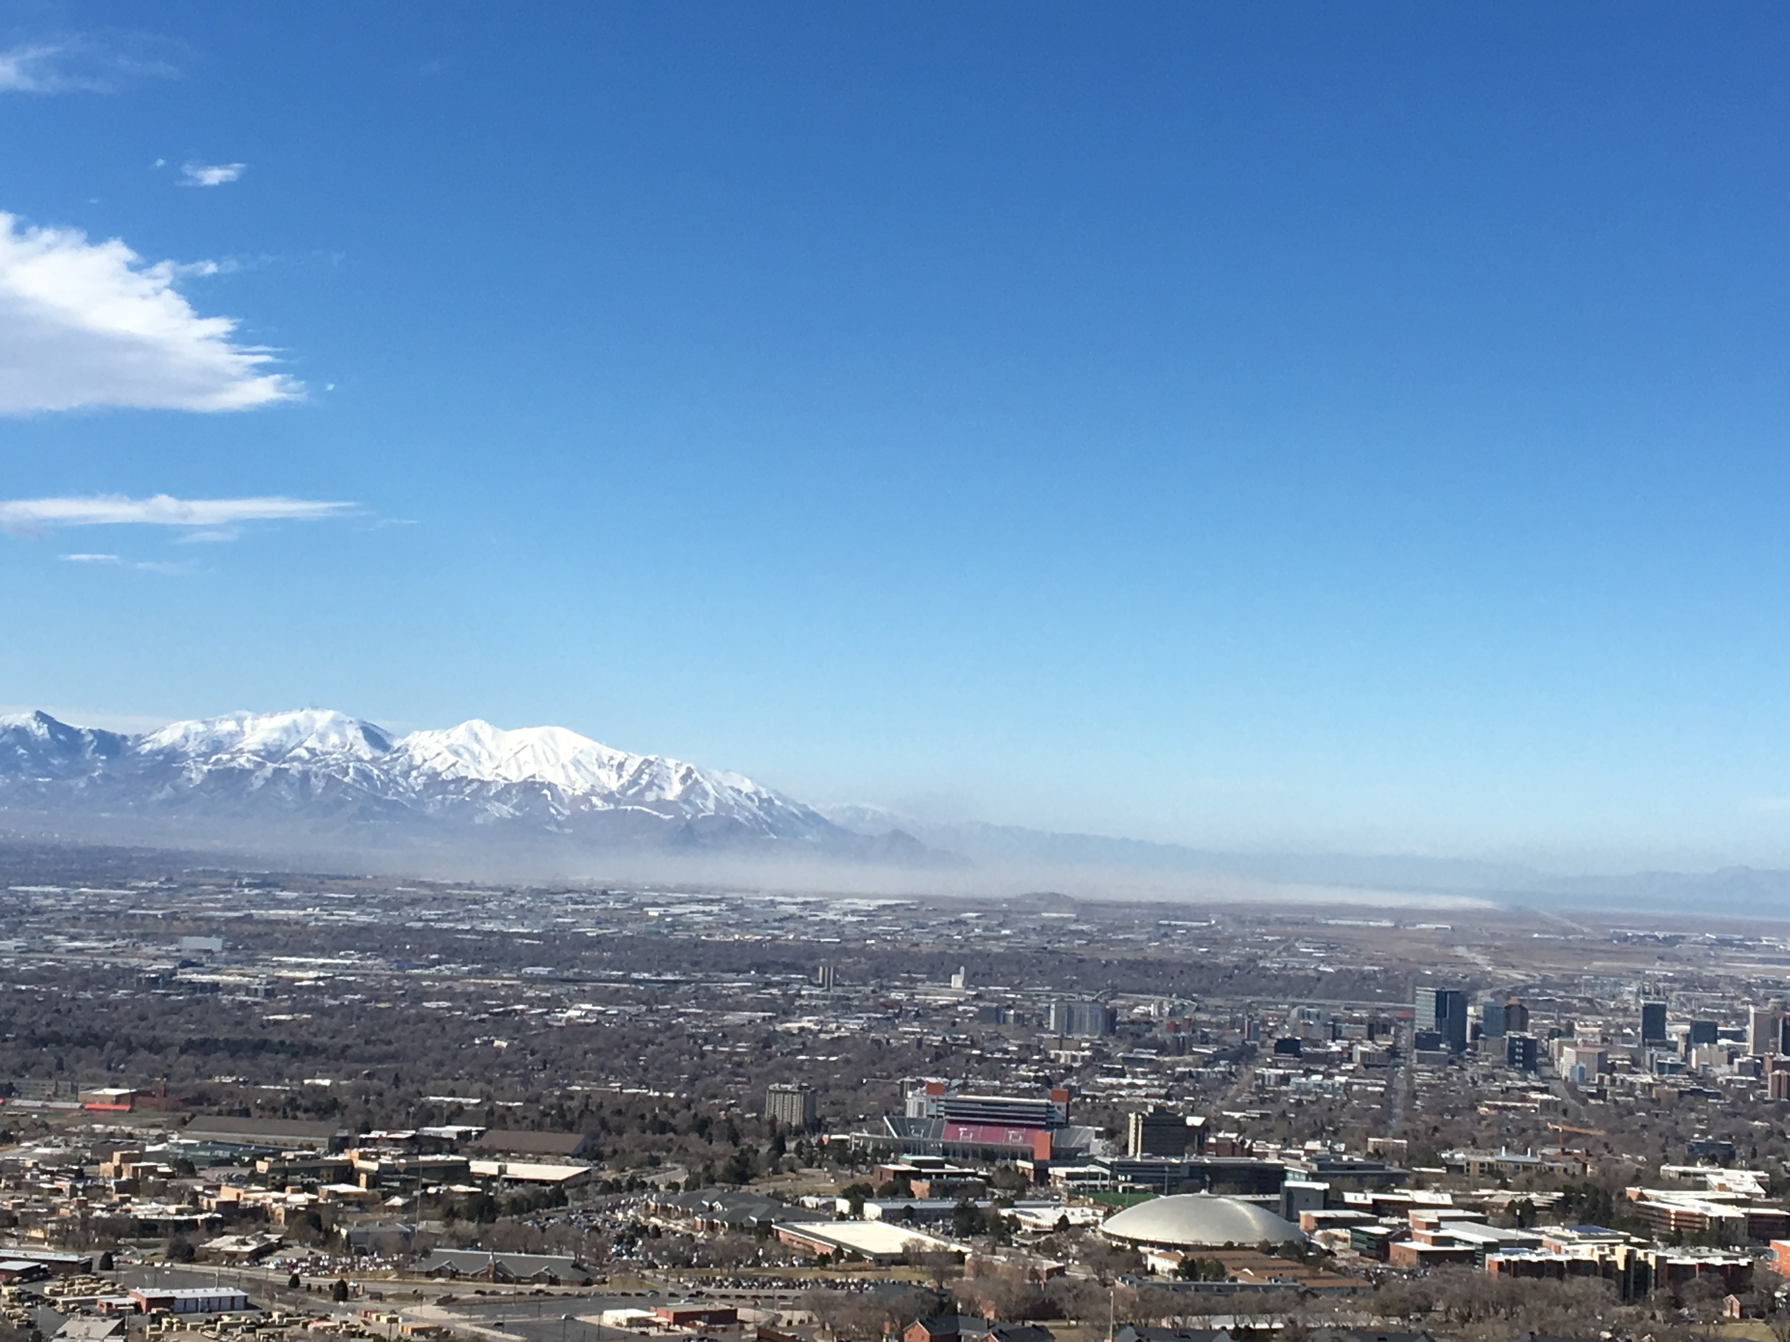
27 February 2016
11:57:22 MST

Slide 4
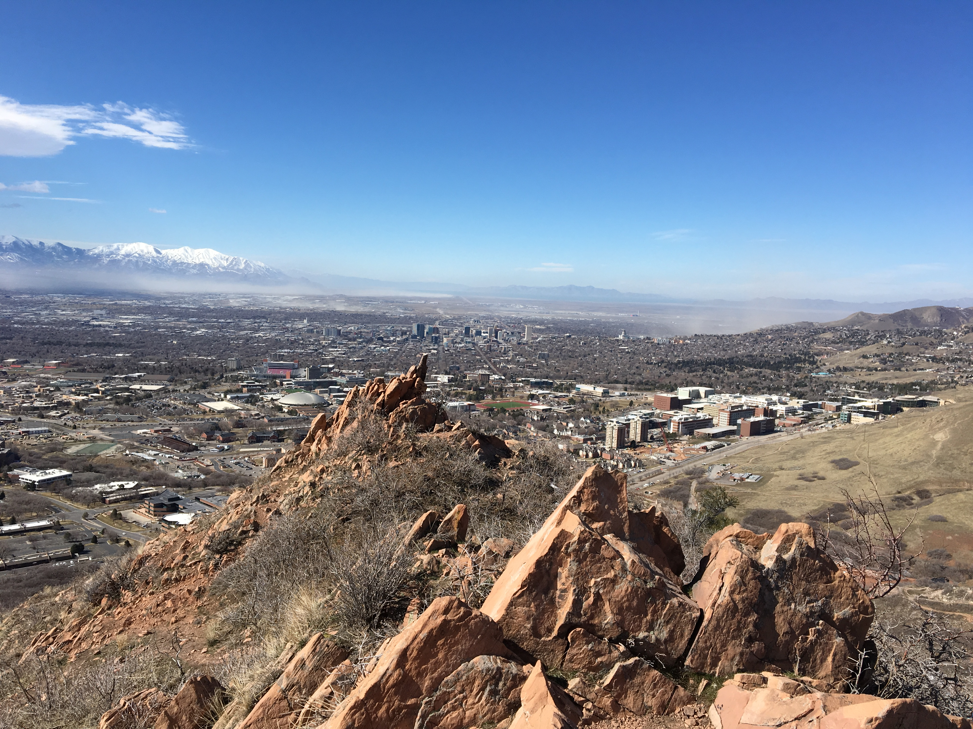
27 February 2016
12:04:04 MST

Slide 5
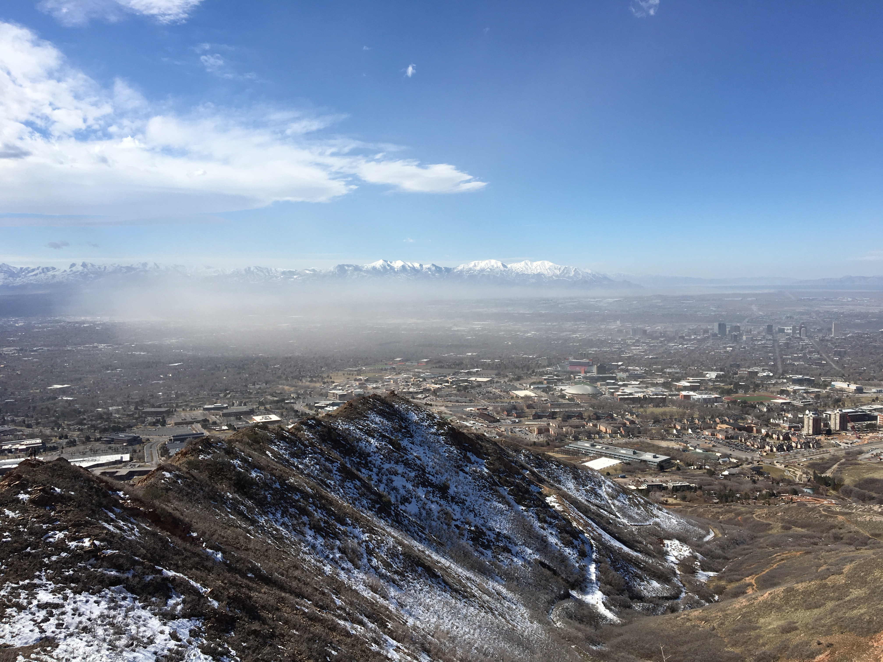
27 February 2016
12:13:54 MST

Slide 6
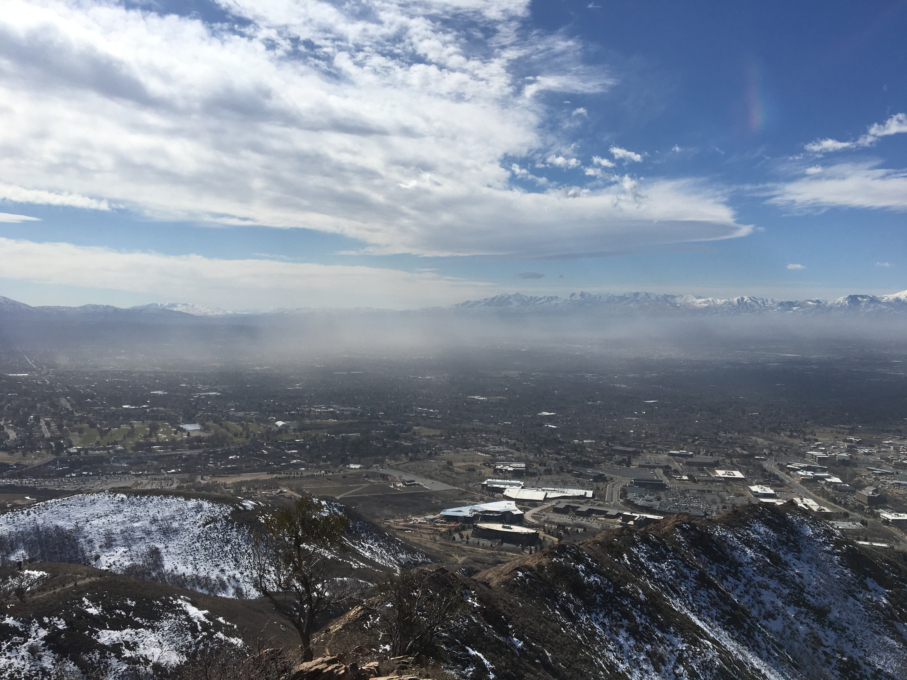
27 February 2016
12:19:12 MST

Slide 7
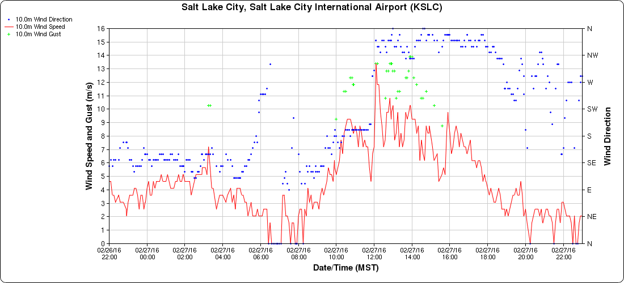
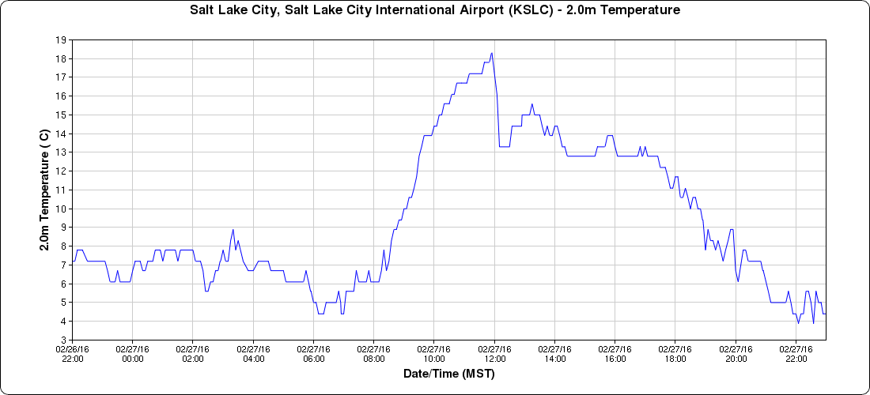
KSLC
Gusts
Wind Speed
Wind Direction
KSLC
Temperature

Slide 8
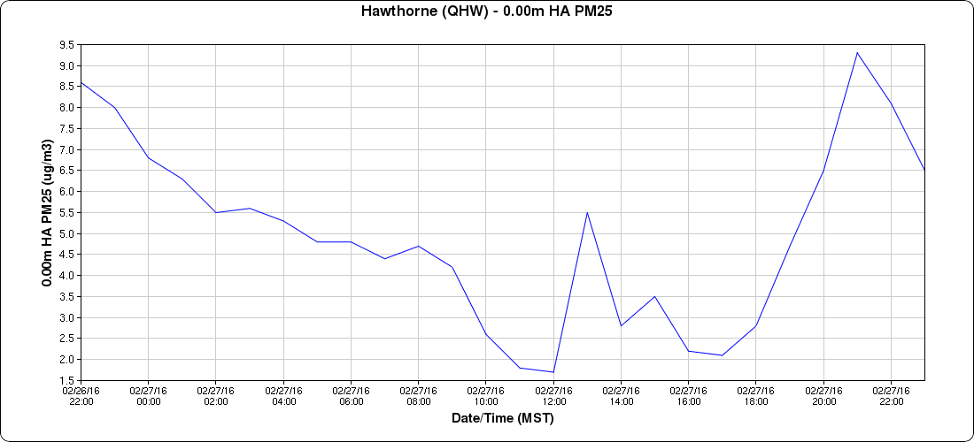
UDAQ Sensor
QHW - Hawthorne Elemetary
Hourly averages < 10 μg m⁻³

Slide 9
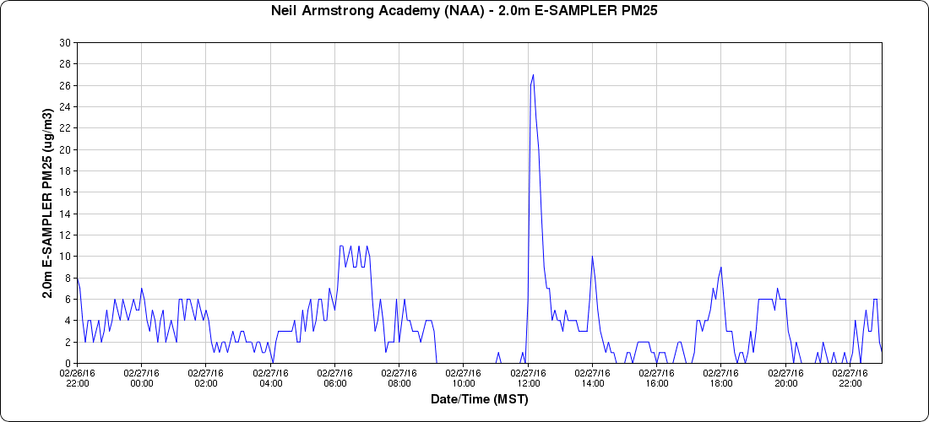
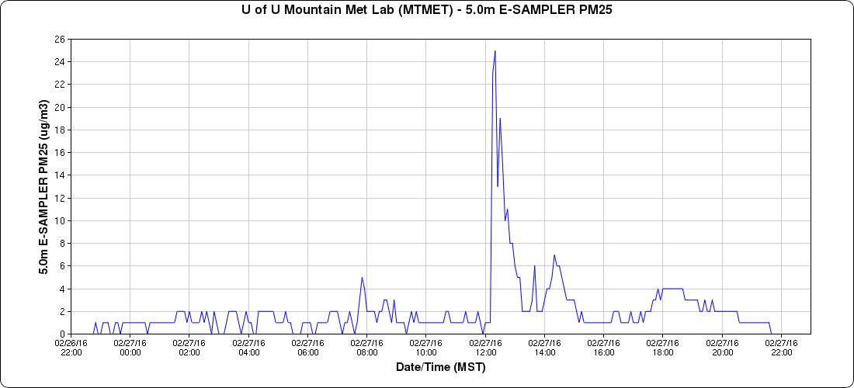
NAA
25 μg m⁻³
University of Utah , E-Sampler; PM2.5
MTN
25 μg m⁻³
NAA
TRAX

Slide 10
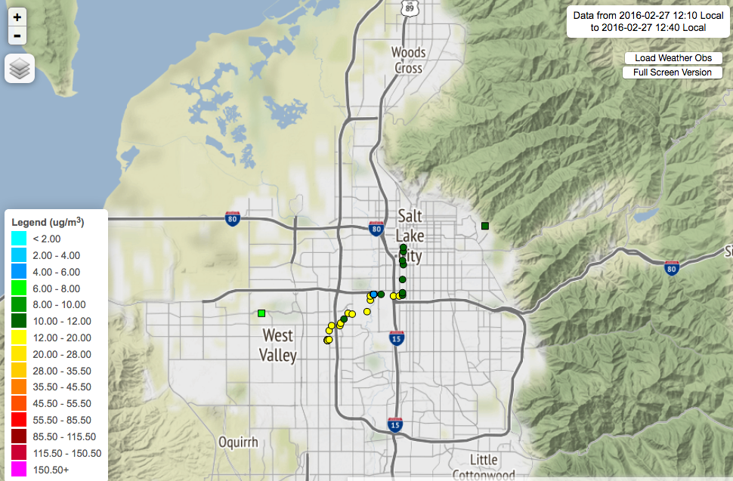
E-Sampler on TRAX / UTA light rail
12:19 – 12:40 MST
http://meso2.chpc.utah.edu/aq/

Slide 11
LiDAR backscatter / LiDAR winds (near Hawthorne Elementary)
27 February 2016

Slide 12
Combination of Ceilometer backscatter with LiDAR winds
(near Hawthorne Elementary)
27 February 2016

Slide 13
Combination of Ceilometer backscatter with LiDAR turbulence (sigma_w, vertical stares)
(near Hawthorne Elementary)
27 February 2016
sigma_w ontours: 0.25 (black), 1 (white) and 2 m² s⁻² (red)

