Slide 1
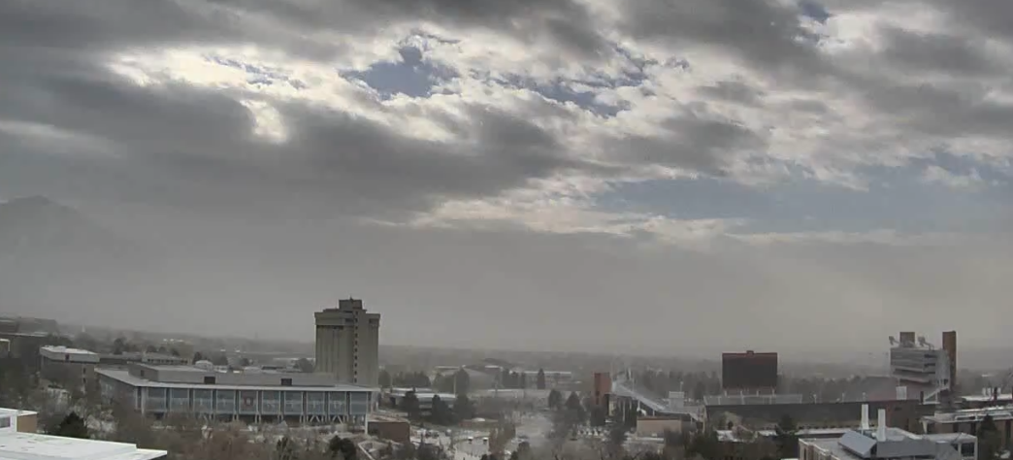
EVENT 2
Dust event with pre-frontal southerly flow
20 December 2017
Sebastian Hoch / University of Utah

Slide 2
Movie

Slide 3
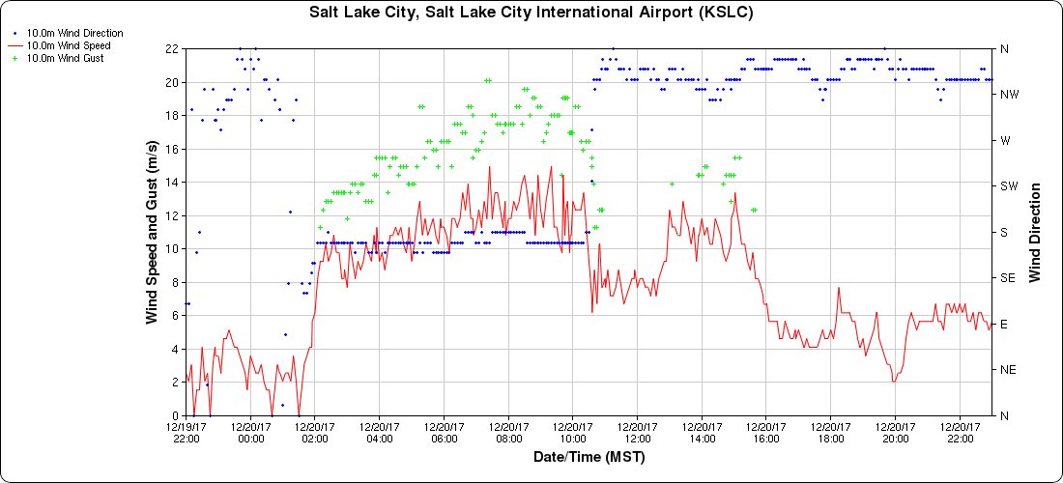
KSLC

Slide 4
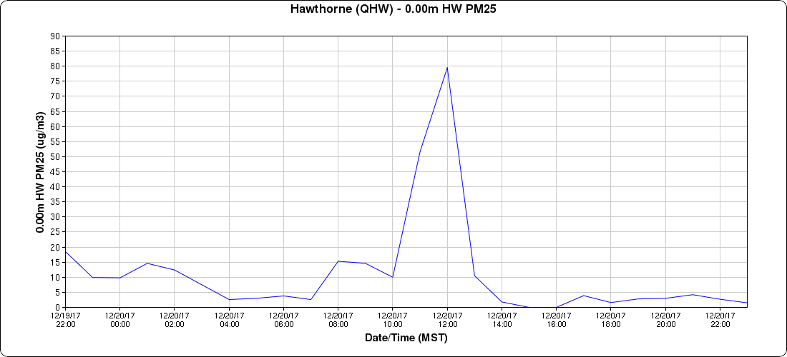
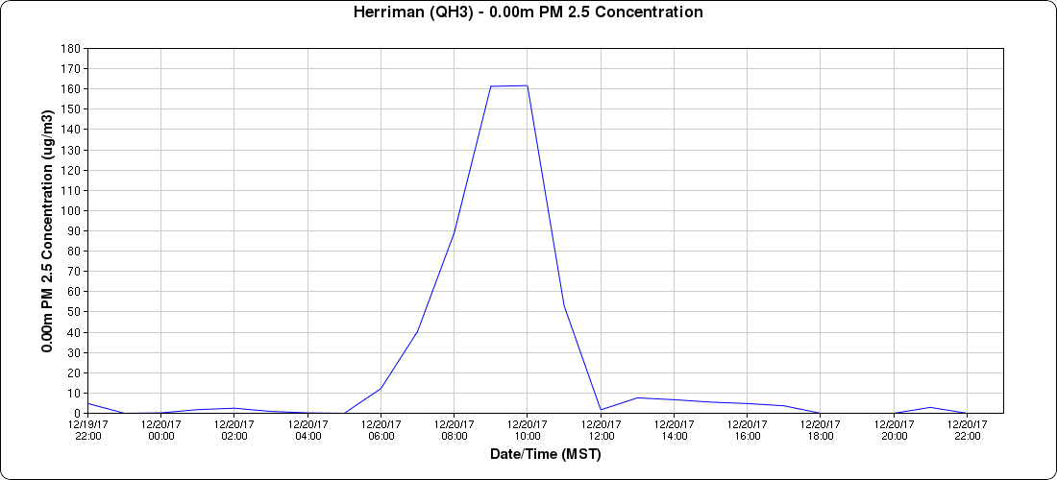
UDAQ Sensors
HAWTHORNE
80 ug m⁻³
HERRIMAN
(southern SLV)
160 ug m⁻³

Slide 5
Ceilometer near HAWTHORNE (800 E & 800 S)

Slide 6
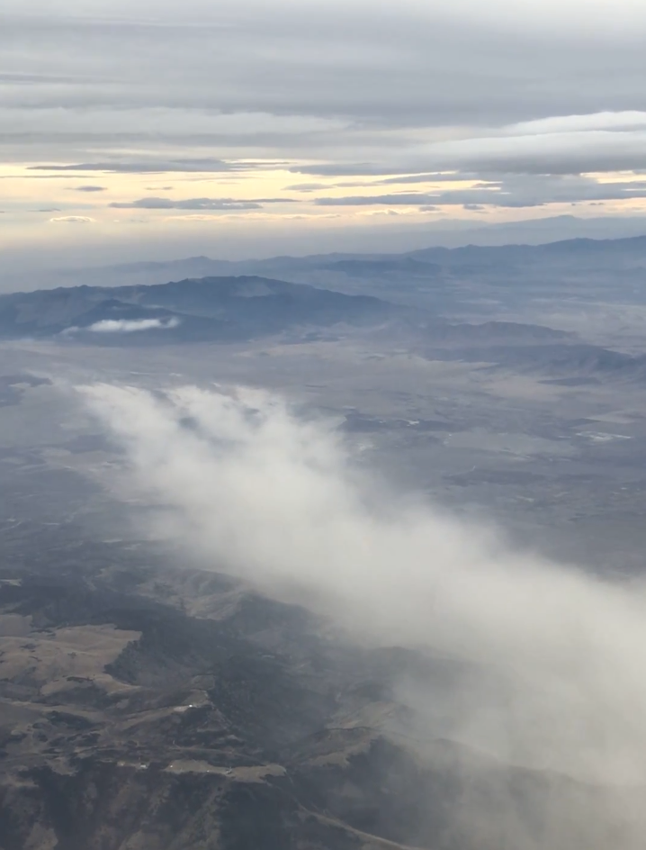
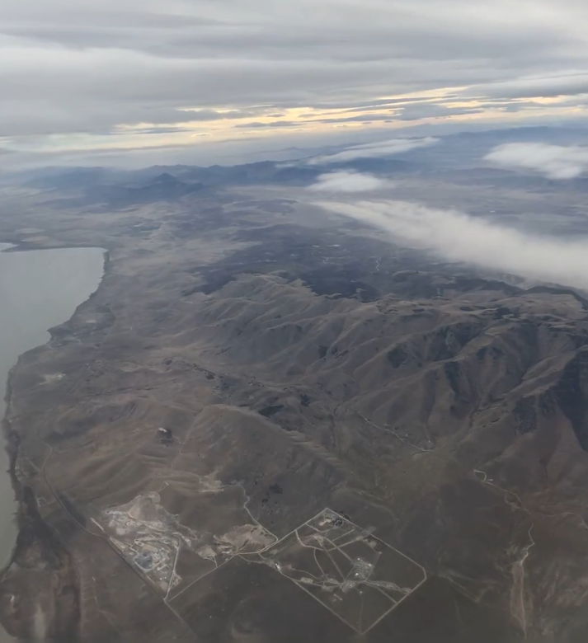

Slide 7
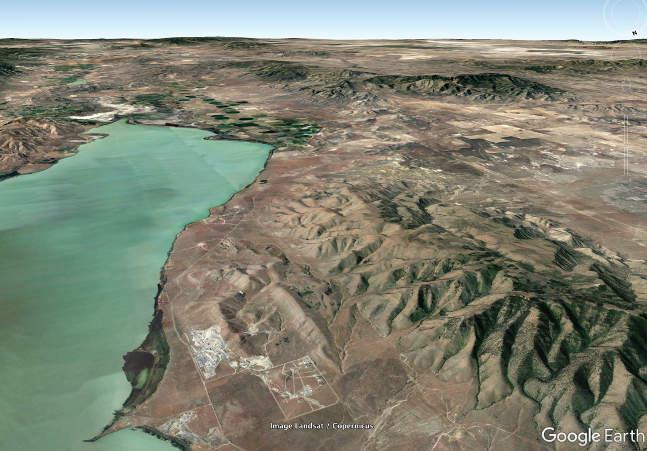
Utah Lake

Slide 8
