Slide 1
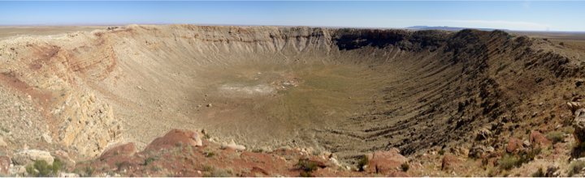
METCRAX-II kick-off & planning

Slide 2
Equipment – Deployment planning and discussion
LiDARs
Towers
PAMS – (additl. limited PAMs in Crater?)
Hobos
Pressure sensors (more ?)
Tethersondes
IOP Planning
Communication

Slide 3
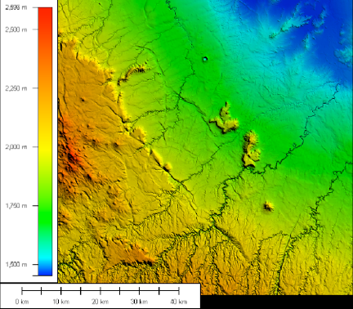
The bigger picture

Slide 4
LiDAR Siting
sites and ranges
alignment & geometry

Slide 5
CROSS SECTION THROUGH CRATER
With LIDAR RANGES
- SCANNING STRATEGIES

Slide 6
EXAMPLE of LIDAR RANGES @ MATERHORN

Slide 7
MAP OF PLANNED
Towers
&
PAM sites
Mini-PAM in Crater Basin ???

Slide 8
MAP OF PLANNED
PRESSURE SENSORS / WISHLIST

Slide 9
MAP OF PLANNED HOBOS

Slide 10
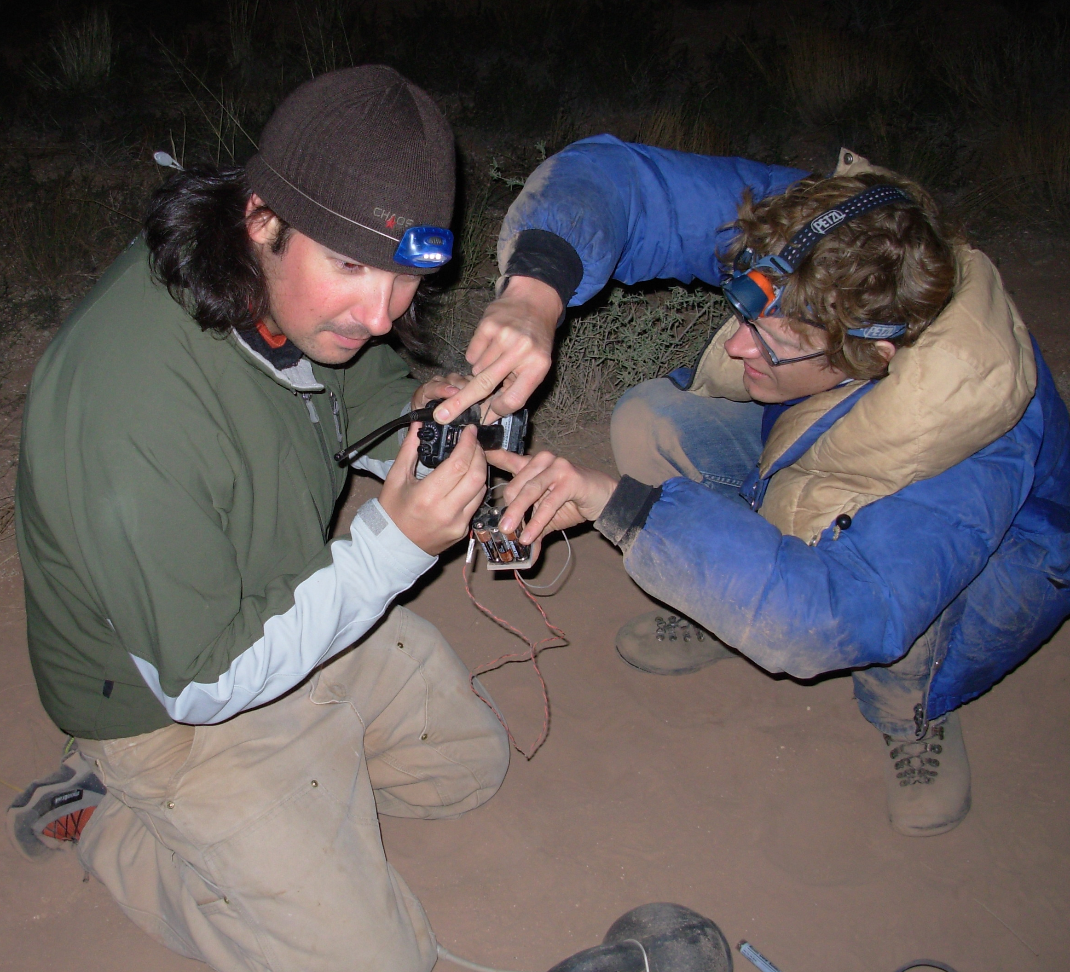
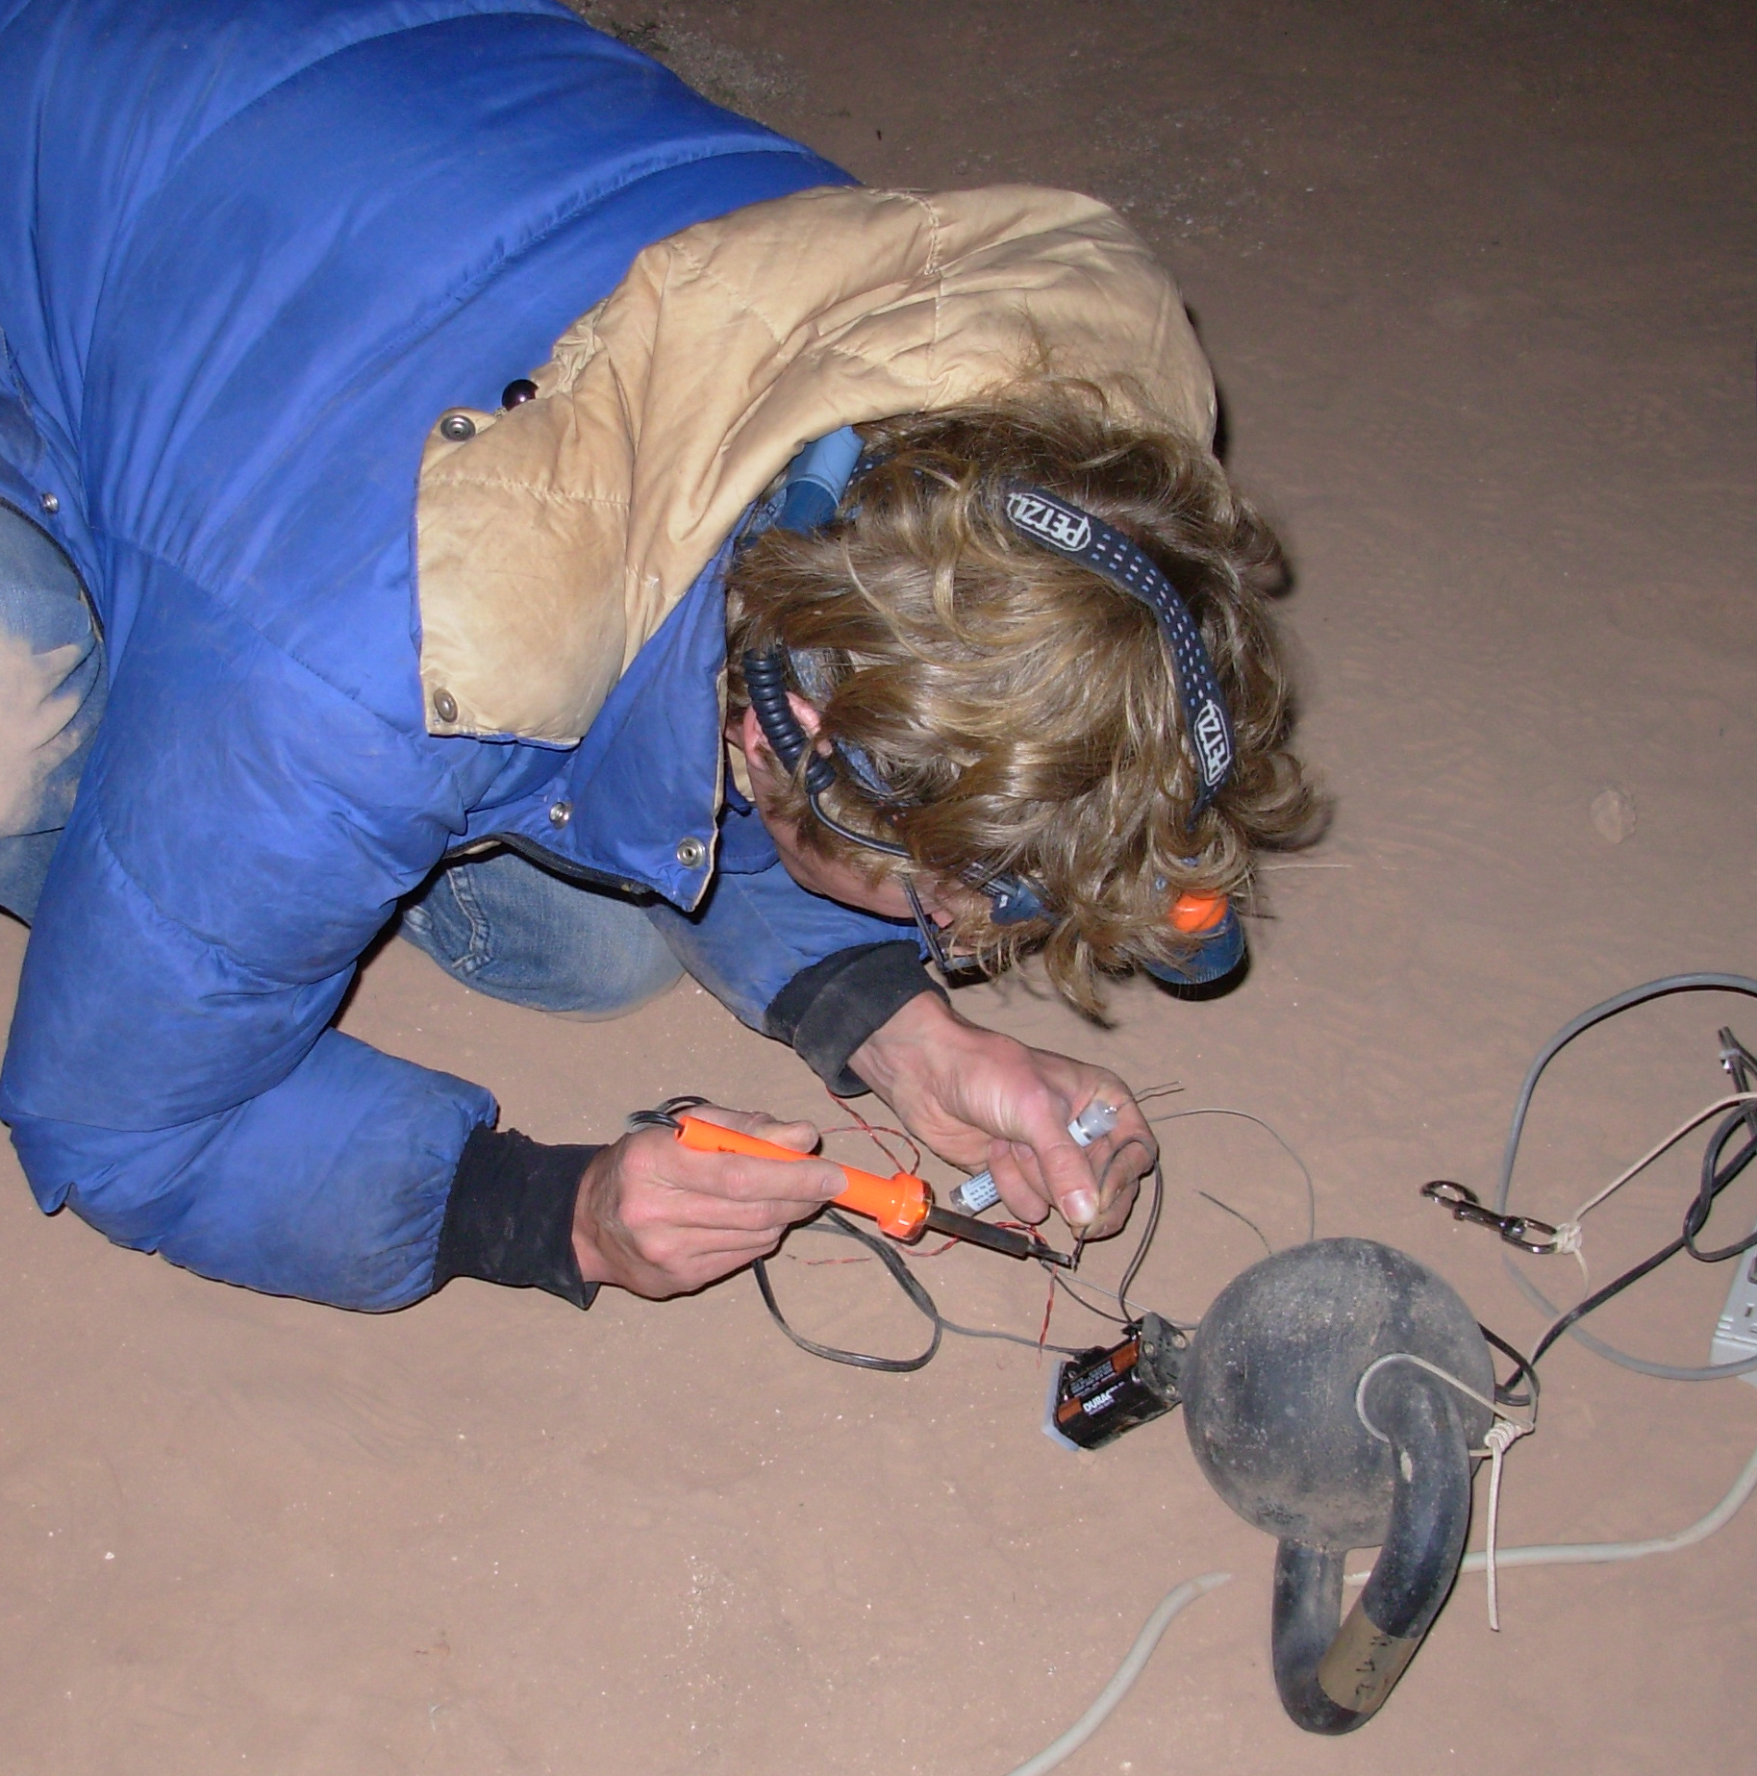
Communication
“I press the button, you do the talking …”
METCRAX 2006 - IOP Communication

Slide 11
Radios
Meteor Crater Radio Network / Repeater
Hand-held walkie-talkies
Cell Phone Coverage
None in the crater (2006)
“Reception shadow” behind rim (2006)
Verizon at site B with aux. antenna (2008)
Check with Brad Andes / carriers

Slide 12
IOP Planning
& Forecasting
Dates; ALL OF OCTOBER 2013

Slide 13
MAP OF PLANNED
UU- AWS

