Slide 1






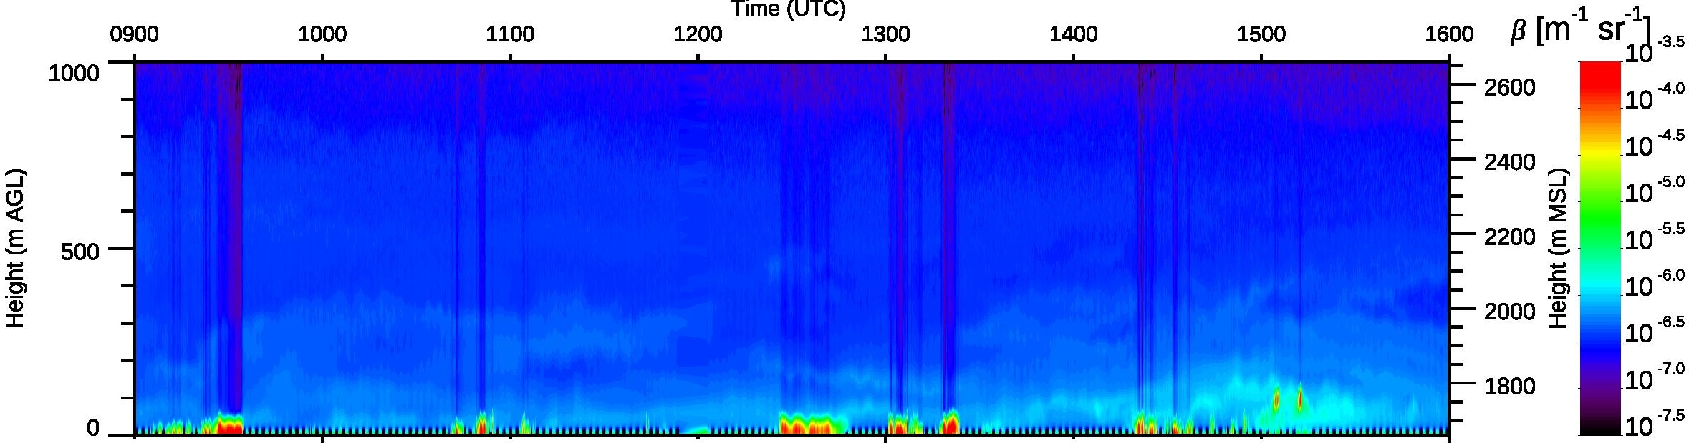
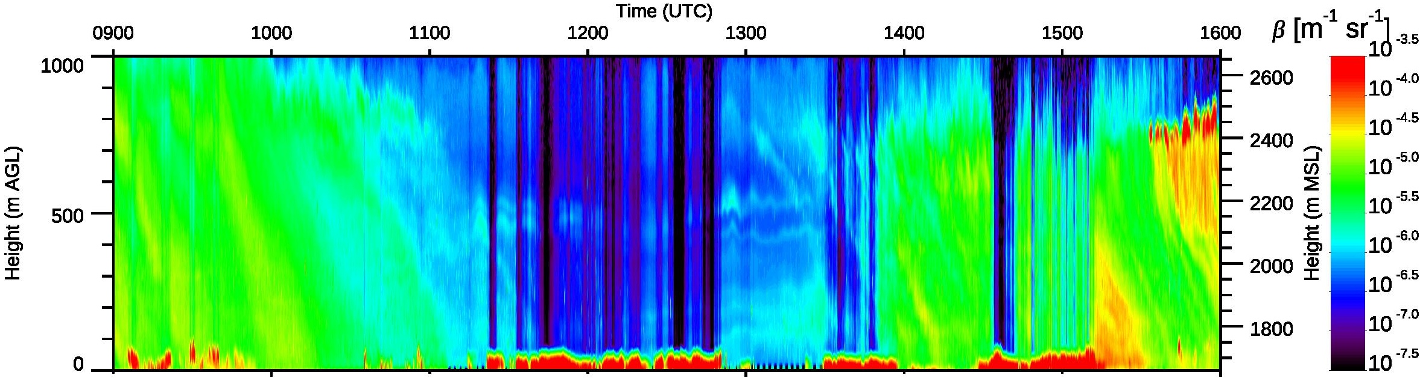
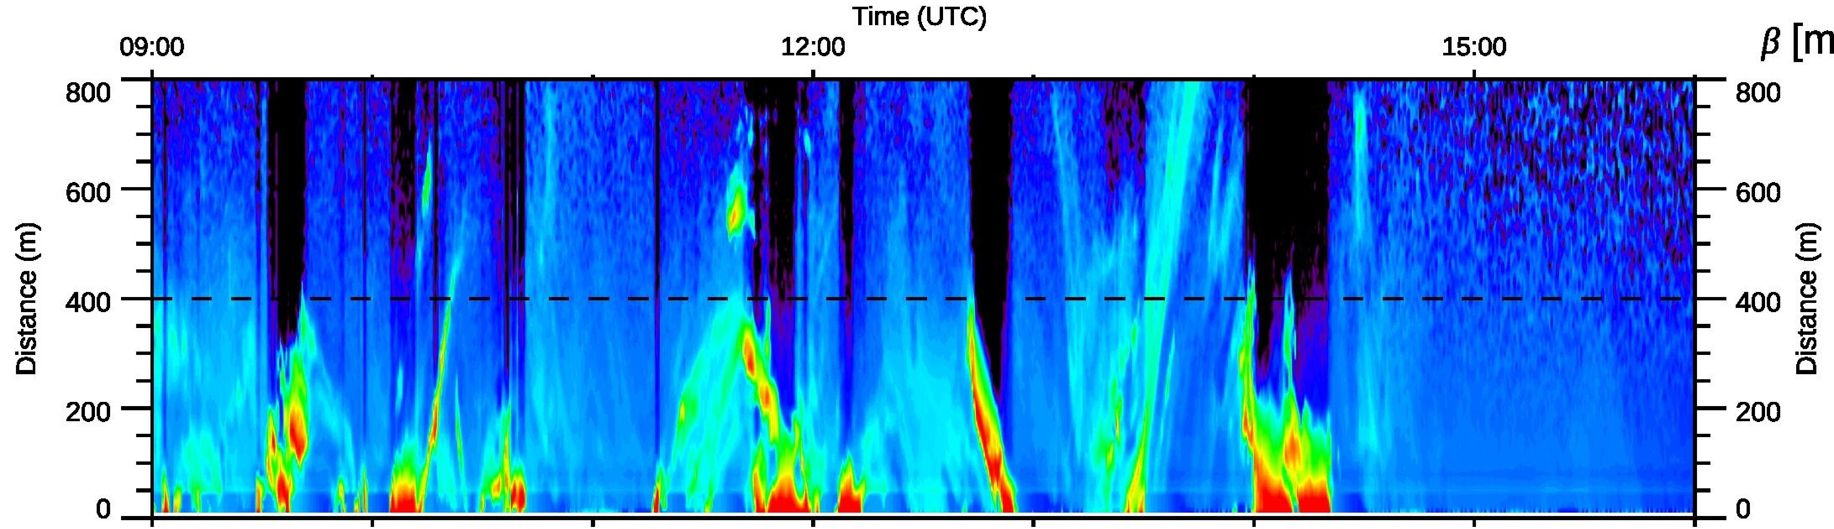
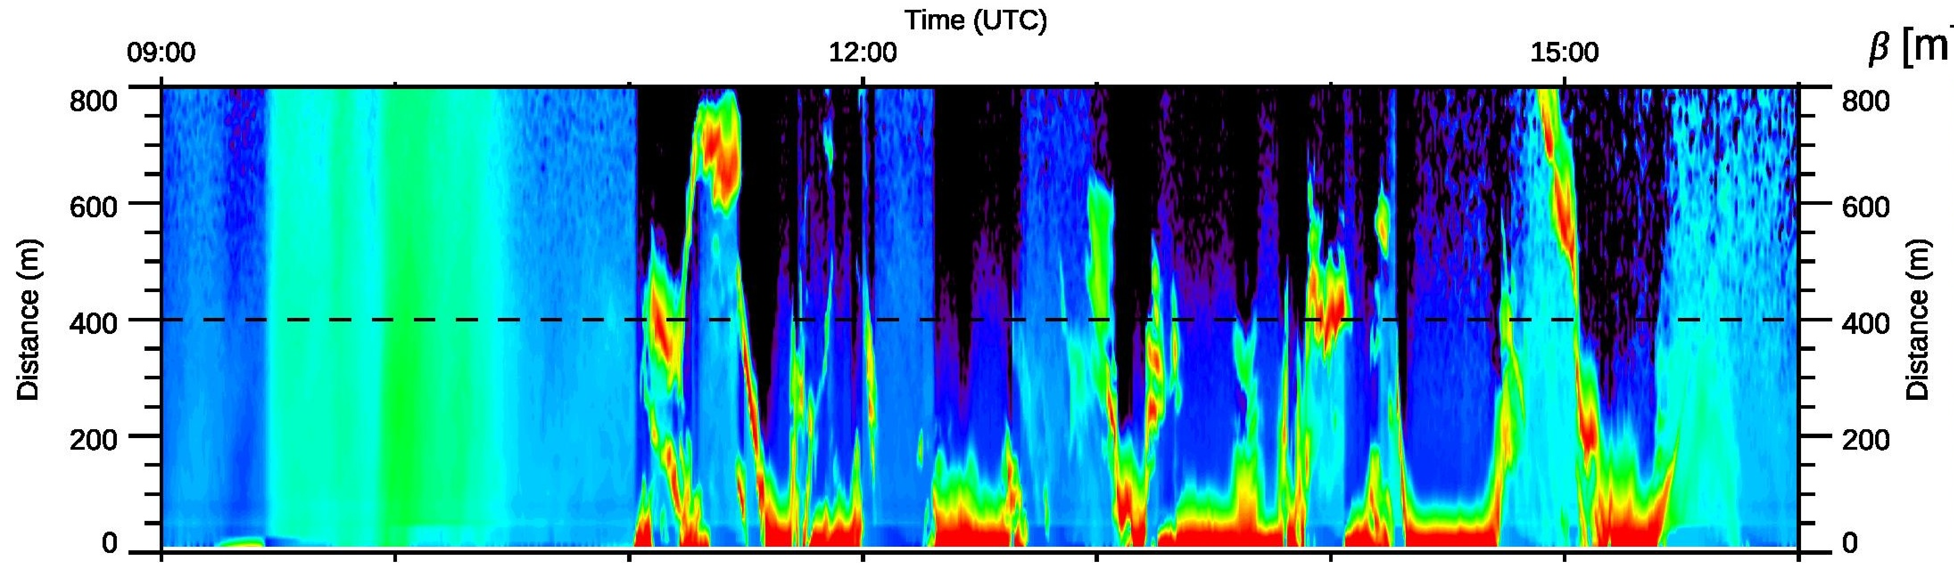
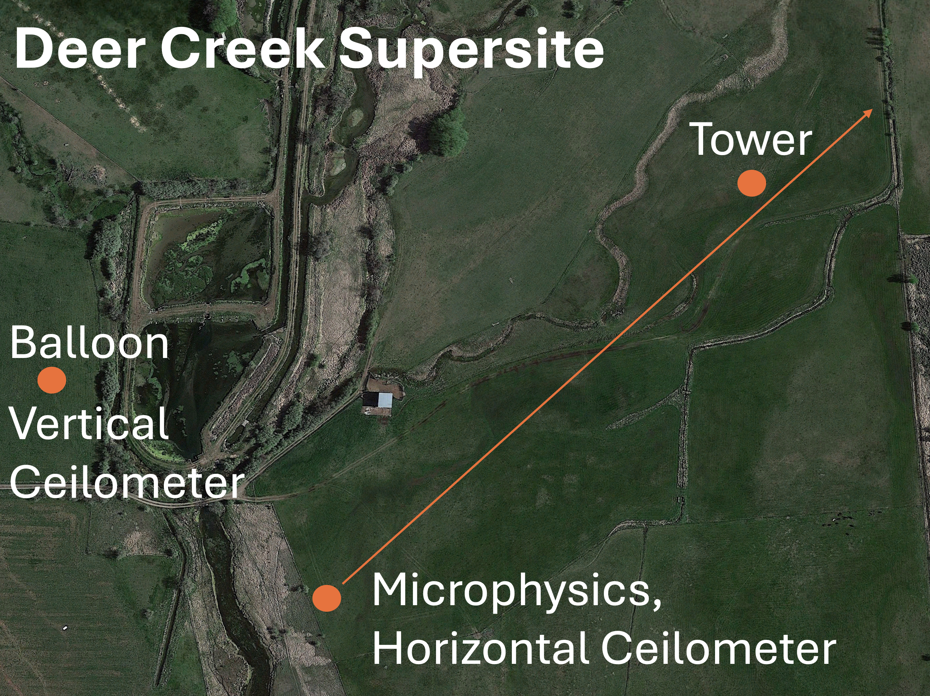
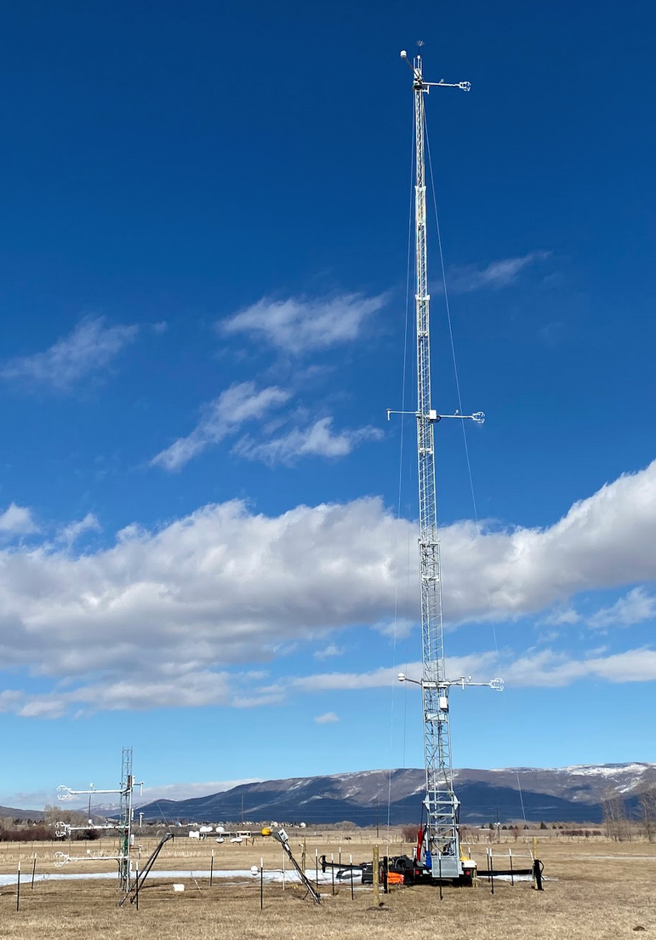
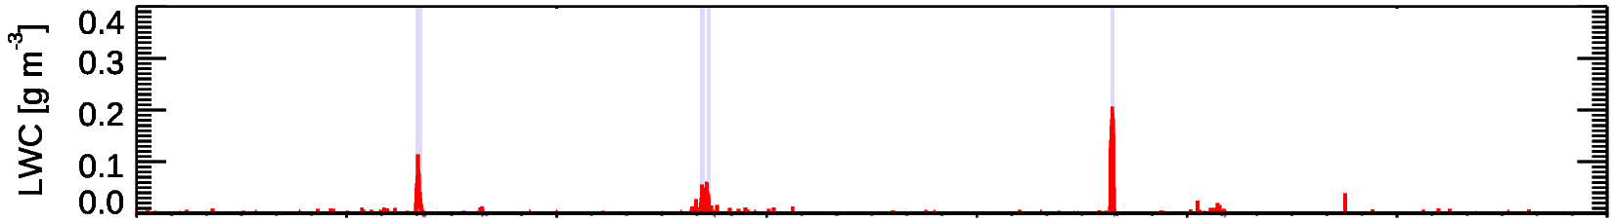
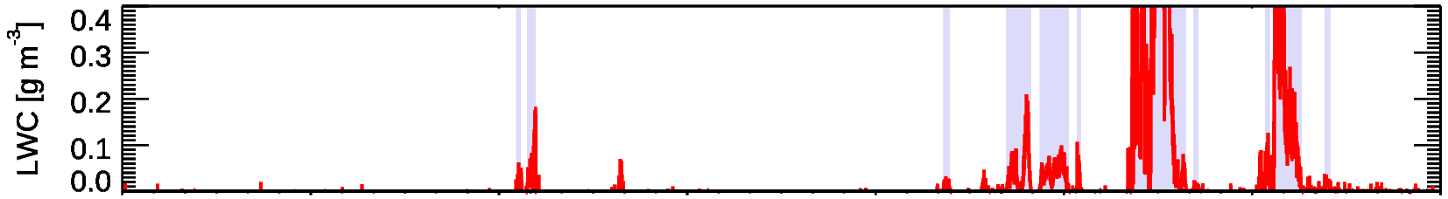
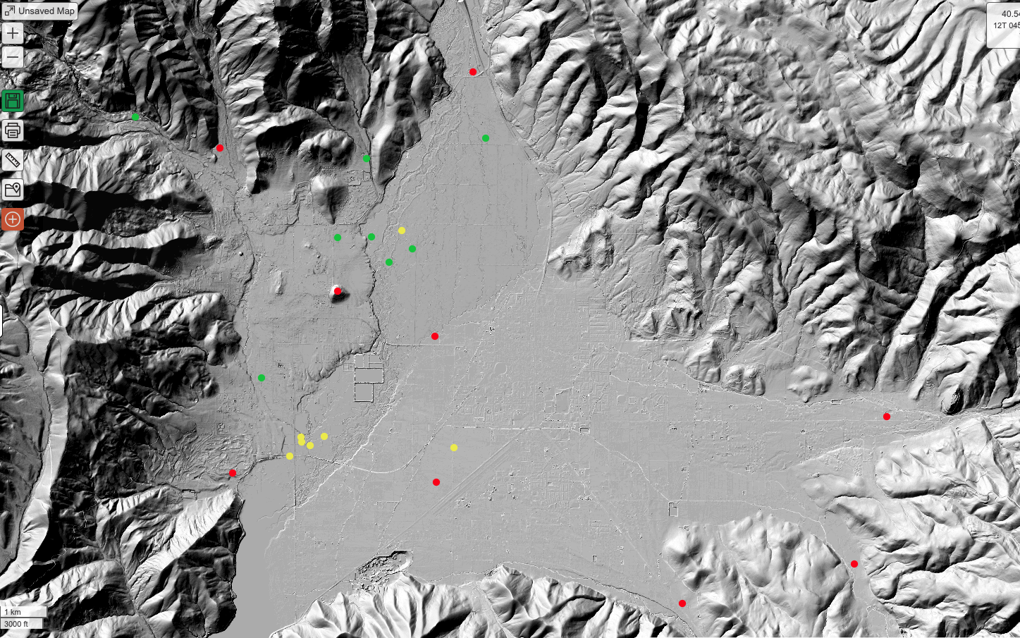
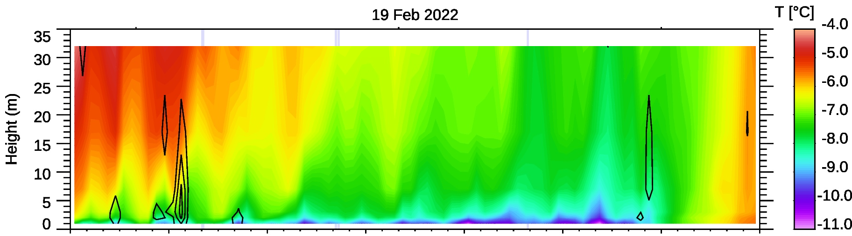
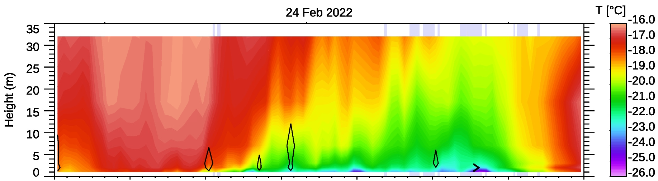
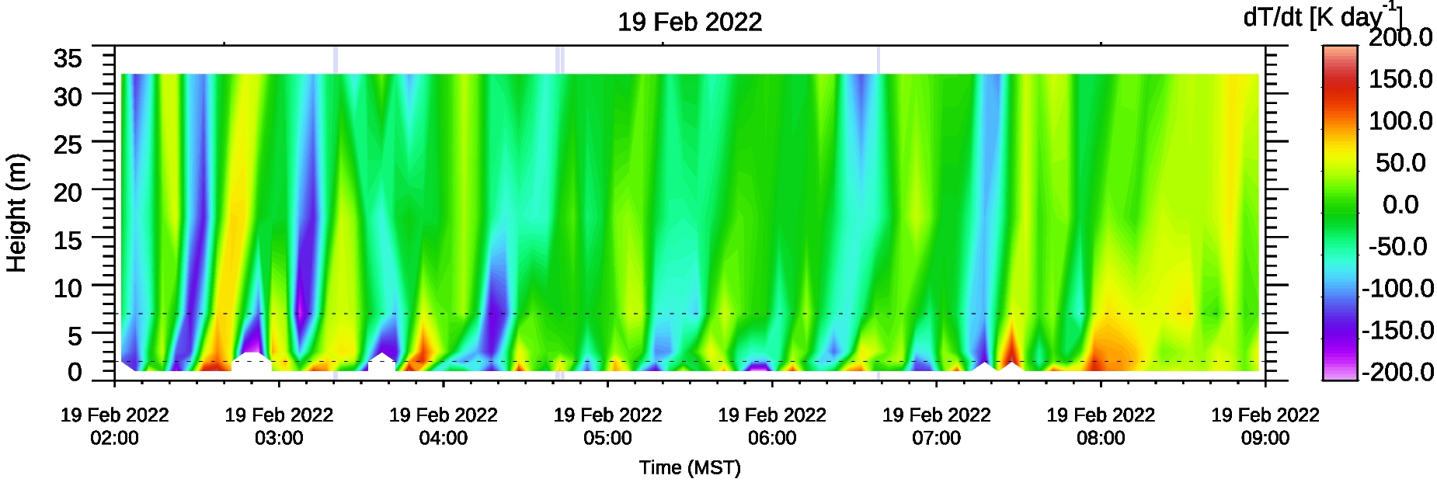
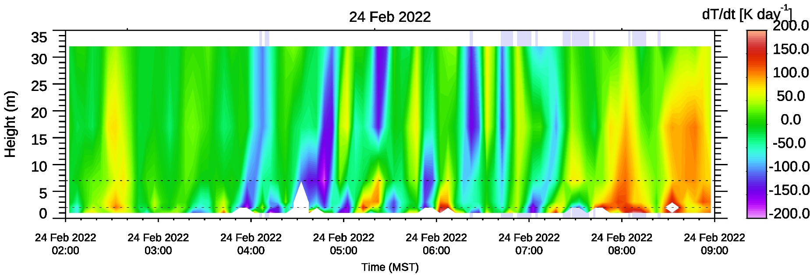
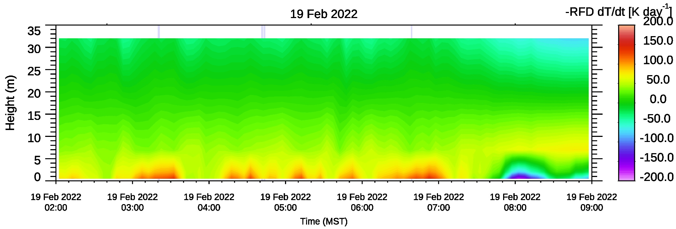
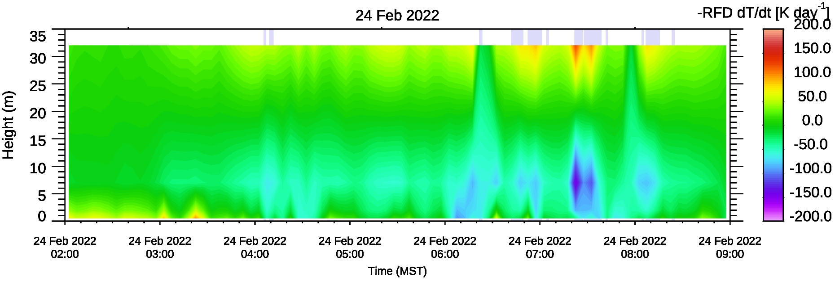
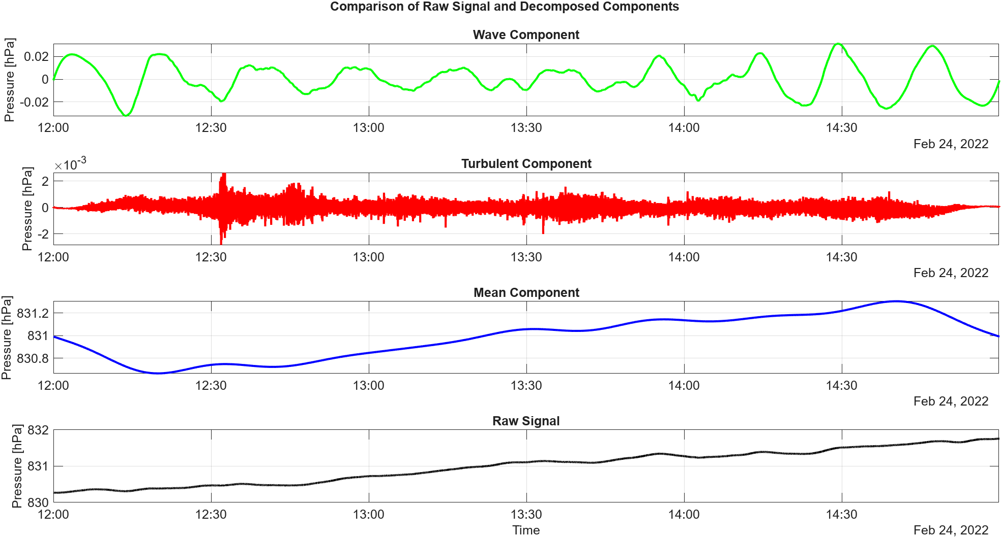
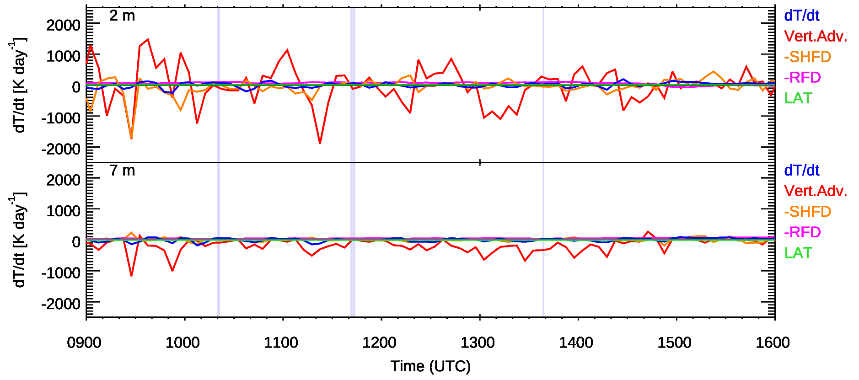
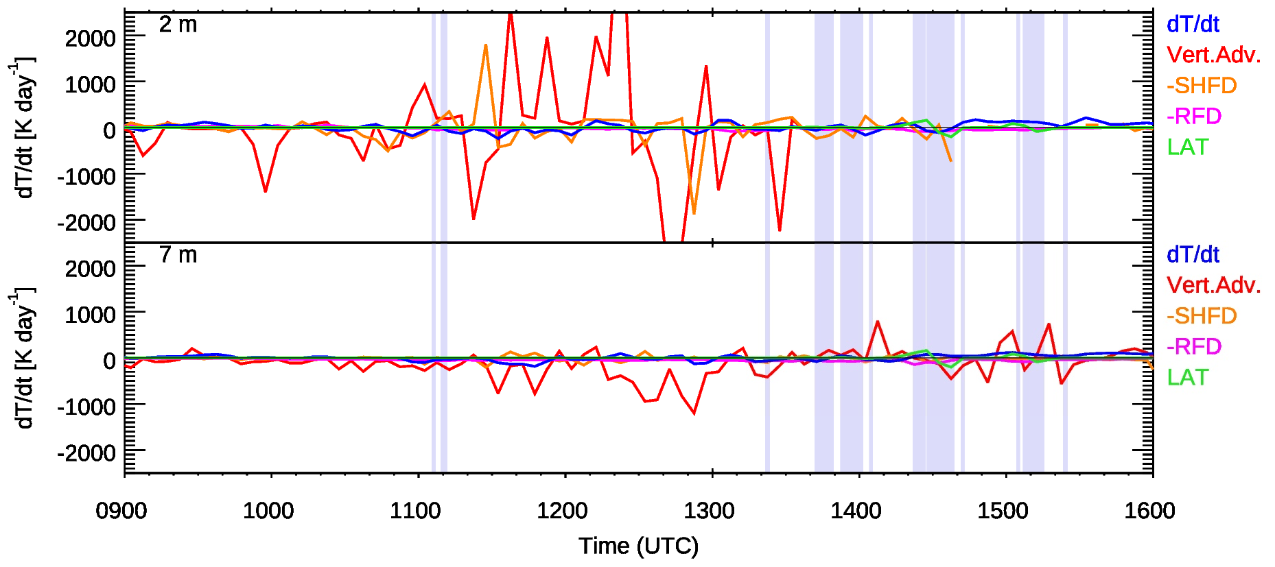
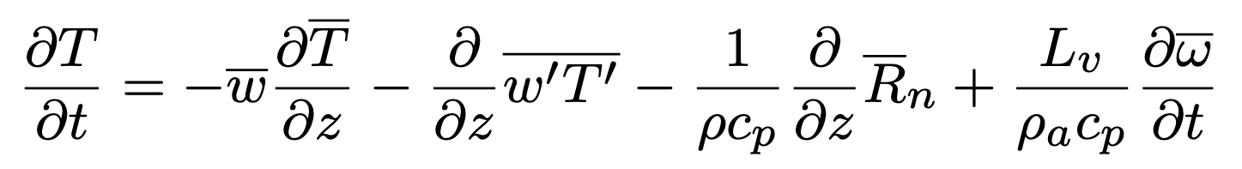
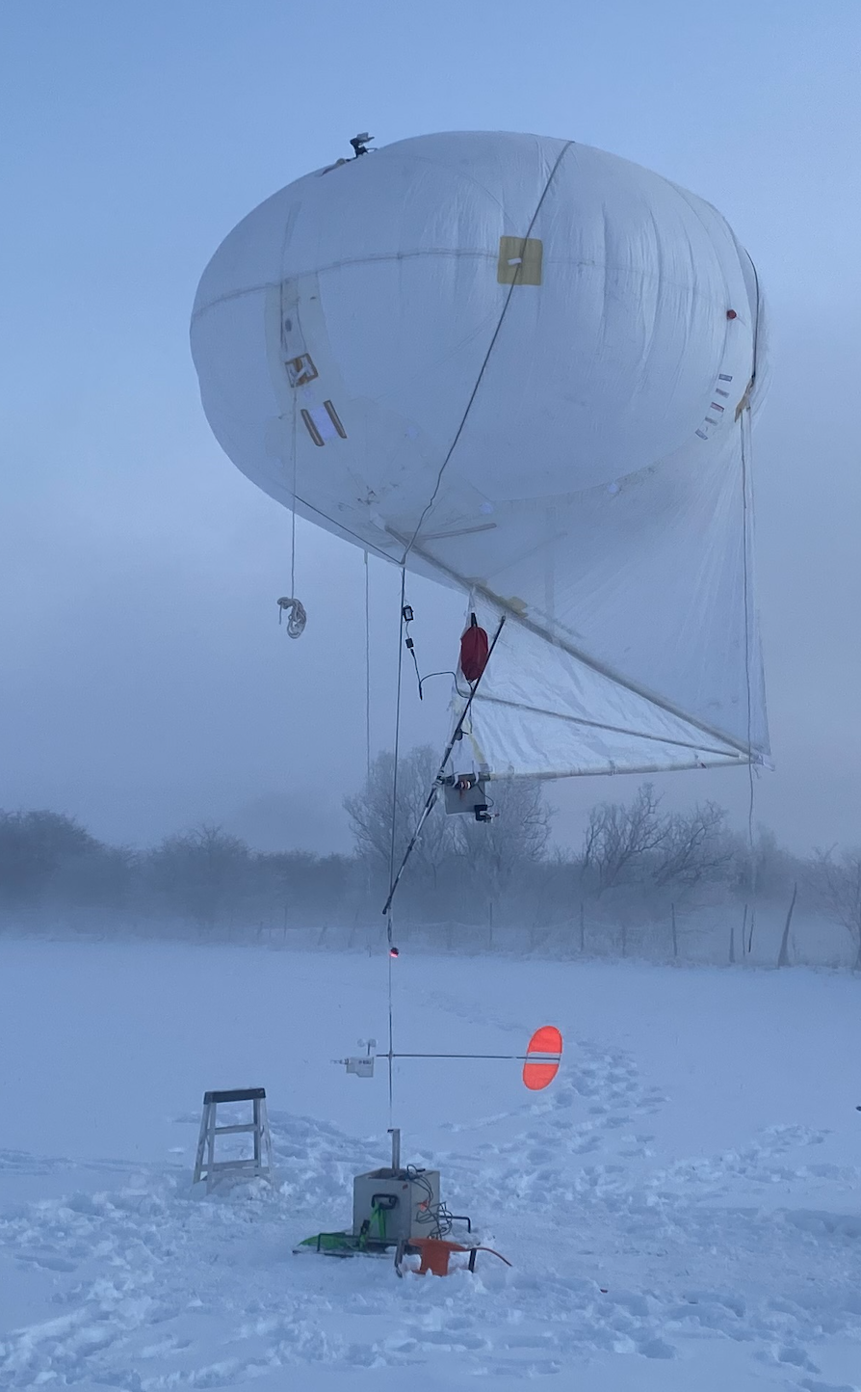
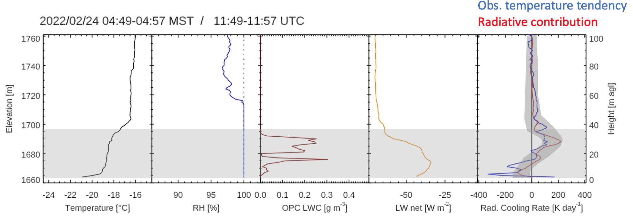
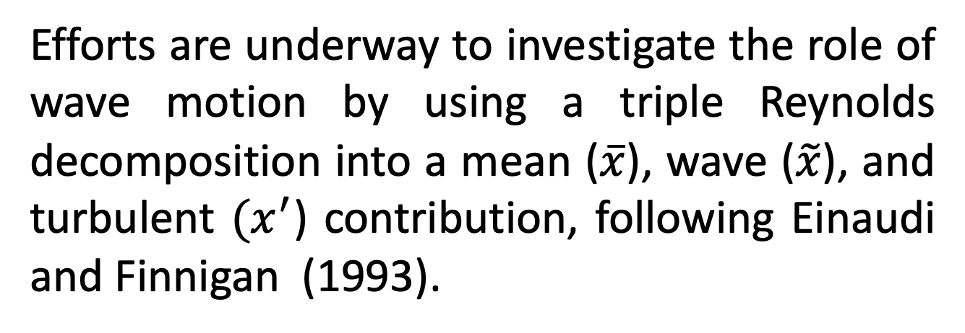
The Heat Budget of the Near-Surface Atmosphere under Varying Cold-Fog Conditions
Sebastian W. Hoch^{1,2}, E. R. Pardyjak³, A. Perelet³, Z. Ruble³, K. Rees², I. Gultepe⁴, S. Oncley¹, A. G. Hallar², Z. Pu², W. Brown¹
P553
¹ Earth Observing Laboratory, NCAR, Boulder, CO; ² University of Utah, Atmospheric Sciences, Salt Lake City, UT;
³ University of Utah, Mechanical Engineering, Salt Lake City, UT; ⁴ Engineering and Appl. Sci., Ontario Tech University, Oshawa, Ontario, Canada
Introduction
19 February Case: Intermittent formation of ephemeral fog due to mixing events
24 February Case: Strong cooling after precipitation event. Fog persisted over several hours until after sunrise.
Summary / Key Findings
The Cold-Fog Amongst Complex Terrain (CFACT experiment), conducted in early 2022 in Heber Valley, Utah, offers a unique dataset to study the life cycle of ephemeral and persistent fog events. CFACT was designed to investigate the complex interactions between multi-scalar meteorological and microphysical processes that govern the formation of cold fog in a typical alpine basin.
Heber Valley was instrumented with two supersites and nine satellite sites with meteorological flux and surface energy balance towers. Microphysical and aerosol observations were made at the Deer Creek supersite. Doppler wind LiDARs, ceilometers, and a wind profiler probed the boundary layer. Intensive observational periods added a tethersonde and frequent radiosonde ascents.
Ceilometer, Vertical
Ceilometer, Vertical
Mountain Cold Fog is highly variable in time and space.
Observations under condensing conditions with state-of-the-art instrumentation is very challenging.
Individual terms of the heat budget can be an order of magnitude greater than the temperature tendency.
Vertical advection (including wave motions at time scales > 5 min) is the dominant of the terms computed here.
Latent and longwave radiative heating or cooling contributions are on the same order of magnitude as temperature tendency.
Horizontal advection must play a key role.
Balloon Example
Ceilometer, Horizontal
Ceilometer, Horizontal
UP
32 m
17 m
7 m
3 m
2 m
1 m
L8
PC
L7
L6
L2
L3
PRSS
Provo River
Supersite
MH
L4
L5
TKE
L1
MW
TKE
Outlook / Wave motion
DC AT
Dear Creek
Supersite
LC
SH
DC S
DC MP
DC FT
NP
Efforts are underway to investigate the role of wave motion by using a triple Reynolds decomposition into a mean ($\overline{x}$), wave ($\tilde{x}$), and turbulent ${(x}^{′}$) contribution, following Einaudi and Finnigan (1993).
DC L
SP
Airport
1 km
Deer Creek Reservoir
DC
CC
Fig. 1: Heber Valley basin with observation sites for CFACT, layout of the Deer Creek Supersite and the Deer Creek 32-m flux tower.
Heat Budget
Here, we investigate the heat budget in the lowest ~30 m of the boundary layer under conditions conducive for the formation of cold fog. Examples include the formation of ephemeral (i.e. short-lived) fog caused by intermittent mixing (19 February 2022 case), and conditions when more persistent fog covered the experimental area for several hours (24 February 2022 case). By investigating the individual terms of the heat budget and their relative importance we hope to determine the different mechanisms modulating the fog life cycle.
1 2 (Vert Adv) 3 (- SHFD) 4 (-RFD) 5 (LAT)
The local rate of change of temperature (1) is governed by vertical (temperature) advection (2), sensible heat flux divergence (3), radiative flux divergence (4), and the latent heating (5) due to phase change (condensation or evaporation of fog droplets). Here, we are neglecting horizontal advection.
Balloon Data: Radiative Heating rates derived from balloon-borne ob-servations of long-wave radiative fluxes match the temperature tendency, resolve fog-top cooling.
Instrumentation: 6 levels (1, 2, 3, 7, 17, 32 m) of sonic anemo-meters/gas analyzers (CSAT3/ EC150), and slow response T/RH sensors. Longwave radiative fluxes were measured at 4 heights (0.5, 2, 7, 32 m), and on a tethered balloon. Fast response pressure and an optical particle counter (OPC) were available at 2 m. Fluxes were calculated using 5-minute averaging periods.
References
Einaudi and Finnigan, 1993: Wave-Turbulence Dynamics in the Stably Stratified Boundary Layer. J. Atmos. Sci., 50, 1841–1864
Acknowledgments: CFACT is sponsored by the NSF grant 2049100. We thank all CFACT participants, including EOL ISFS and ISS, and all volunteers – we could not have done it without you!
Contact: hoch@ucar.edu

