Slide 1
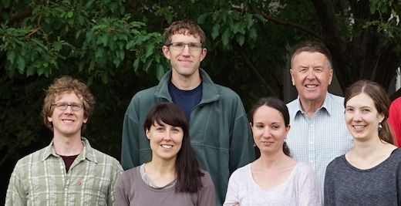
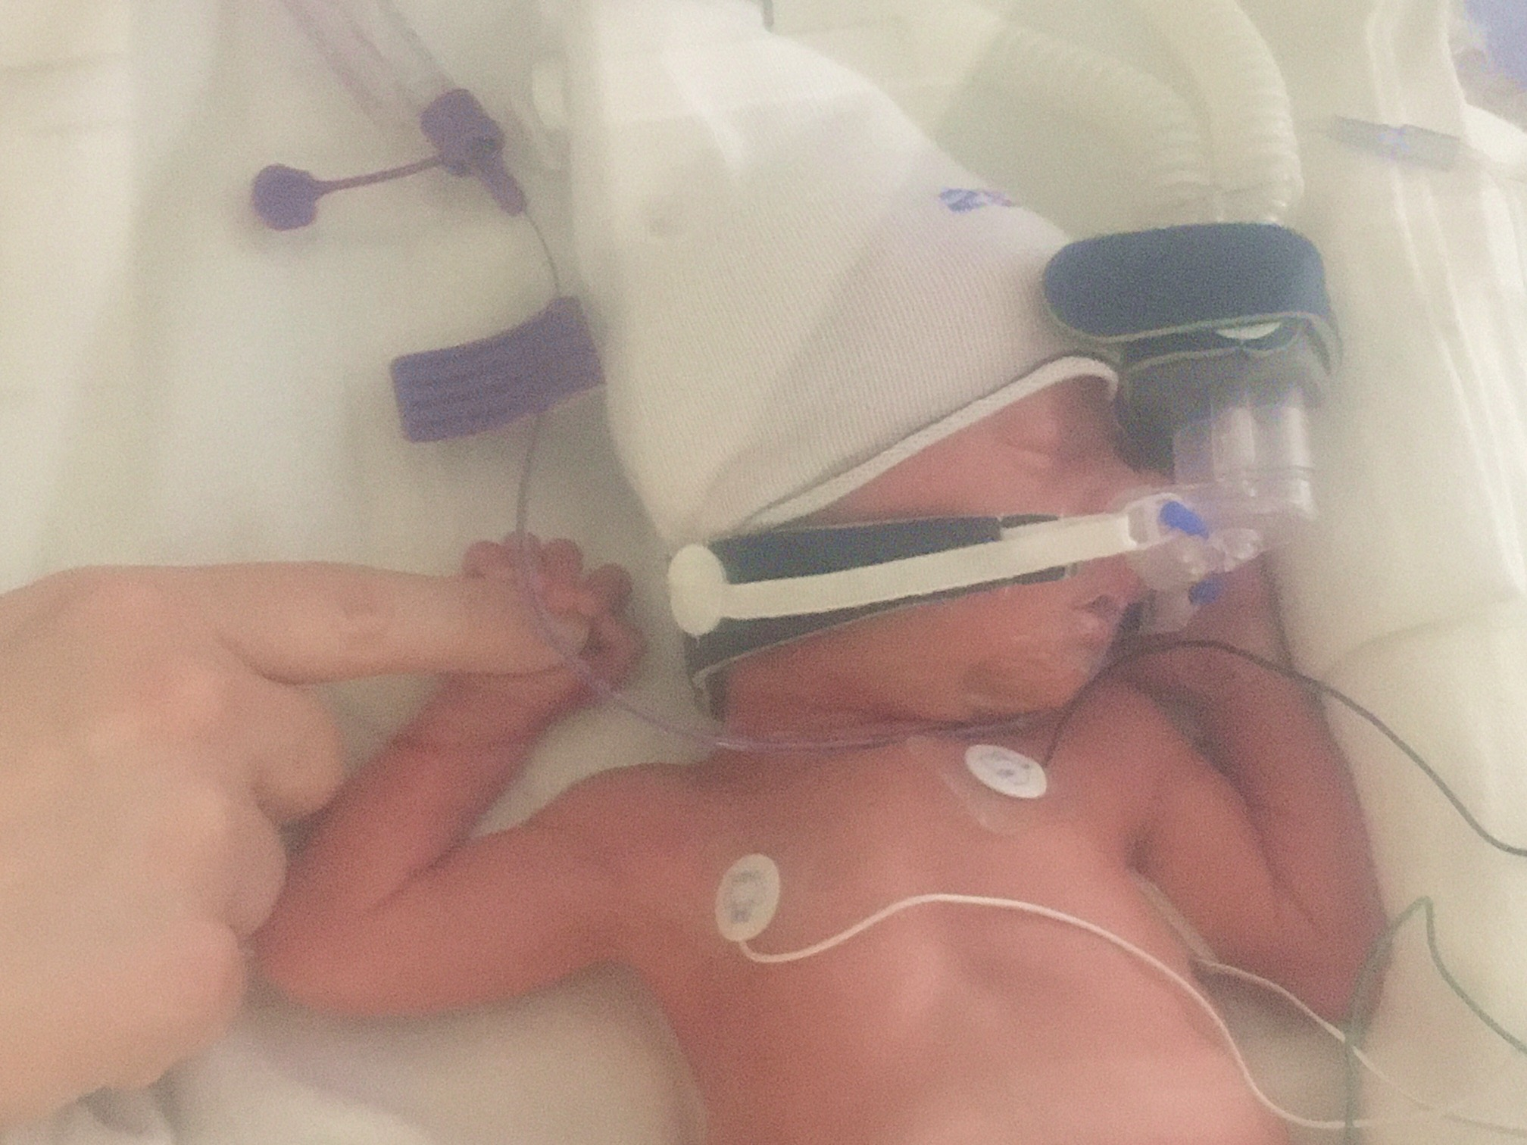
(Whiteman)/Hoch/Lehner
Research Group
Research Professors
Whiteman
Hoch
Jeglum
Hills
Hoch Jr.
Stiperski
Lehner
Feigenwinter
Visiting scientists:
Manuela Lehner (Innsbruck)
Ivana Stiperski (Innsbruck)
Iris Feigenwinter (Uni Basel/ CH)
Volkmar Wirth (Uni Mainz/Germany)
Mountain meteorology
Thermally driven flows, Dynamic flows, Air quality, Surface Energy Balance, Instrumentation, and Field Studies
Collaborating closely with:
Horel, Steenburgh, Baasandorj, Lin, Pu, Perry, Pardyjak (ME), …
Teaching:
Mountain Meteorology:
Atmos 3200 (Spring 2018)

Slide 2
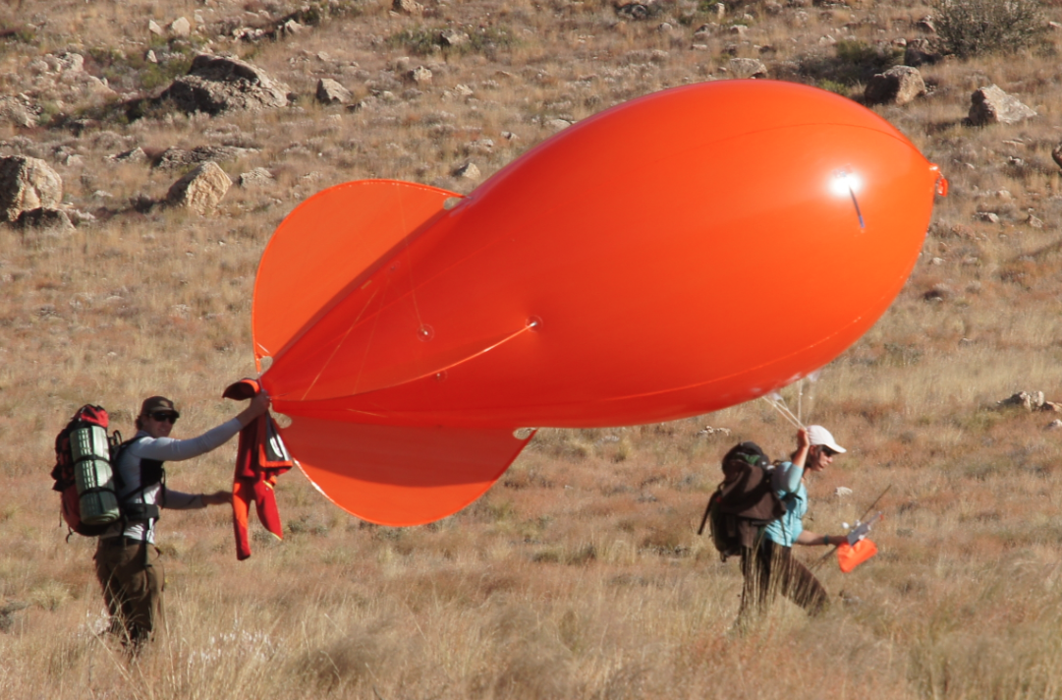
Work presently underway:
2nd Meteor Crater Experiment - METCRAX II (with Dave Whiteman, Manuela Lehner, Bianca Adler, Norbert Kalthoff, Rich Rotunno and Ron Calhoun, …)
Hills
Meteor Crater, Arizona
Nocturnal katabatic flow

Slide 3
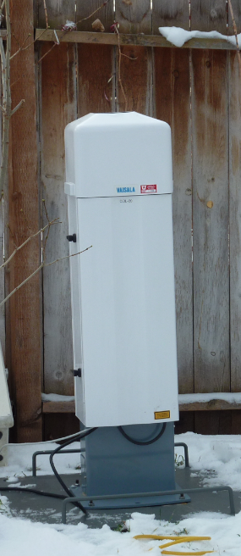
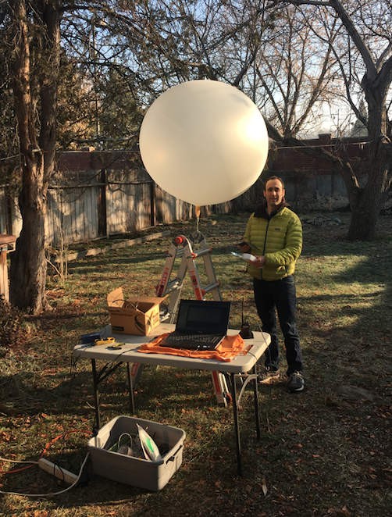
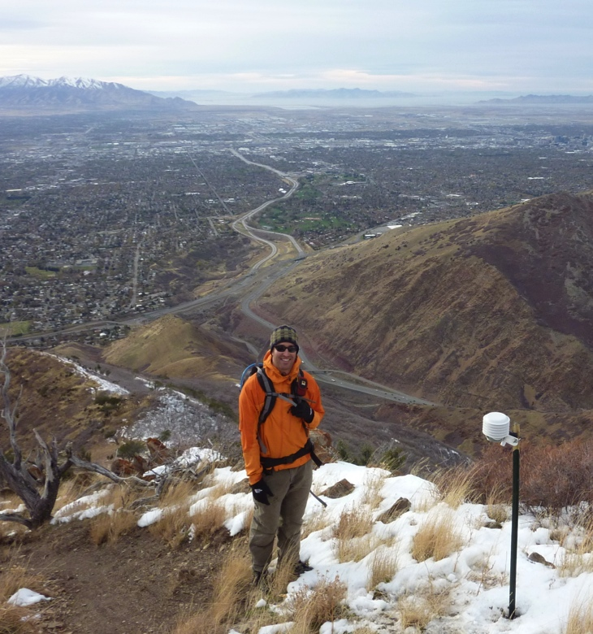
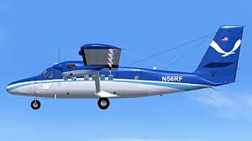
Work presently underway:
Wintertime Persistent Cold-Air Pool and PM_{2.5} Air Pollution Studies (with Munkh Baasandorj, Erik Crosman, John Lin, John Horel, Dave Whiteman, DAQ, NOAA …)
Salt Lake City, “undercast”
Hills
Installing HOBOs on
Grandeur Peak
NOAA Twin Otter

Slide 4
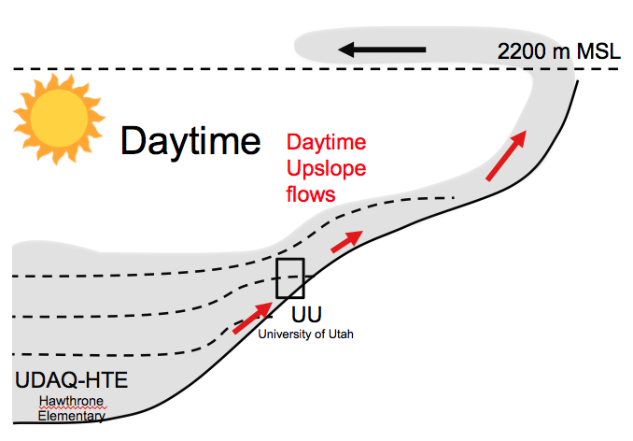
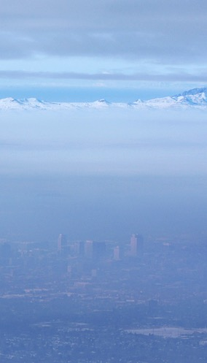
How do meteorological processes modulate PM2.5 pollution?
Tongue of pollution advected from the lake into the valley.
Elevated Pollution Layer
CBL
Growth
Downtown
SLC
MST

Slide 5
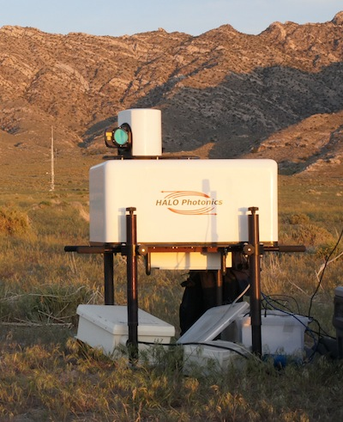
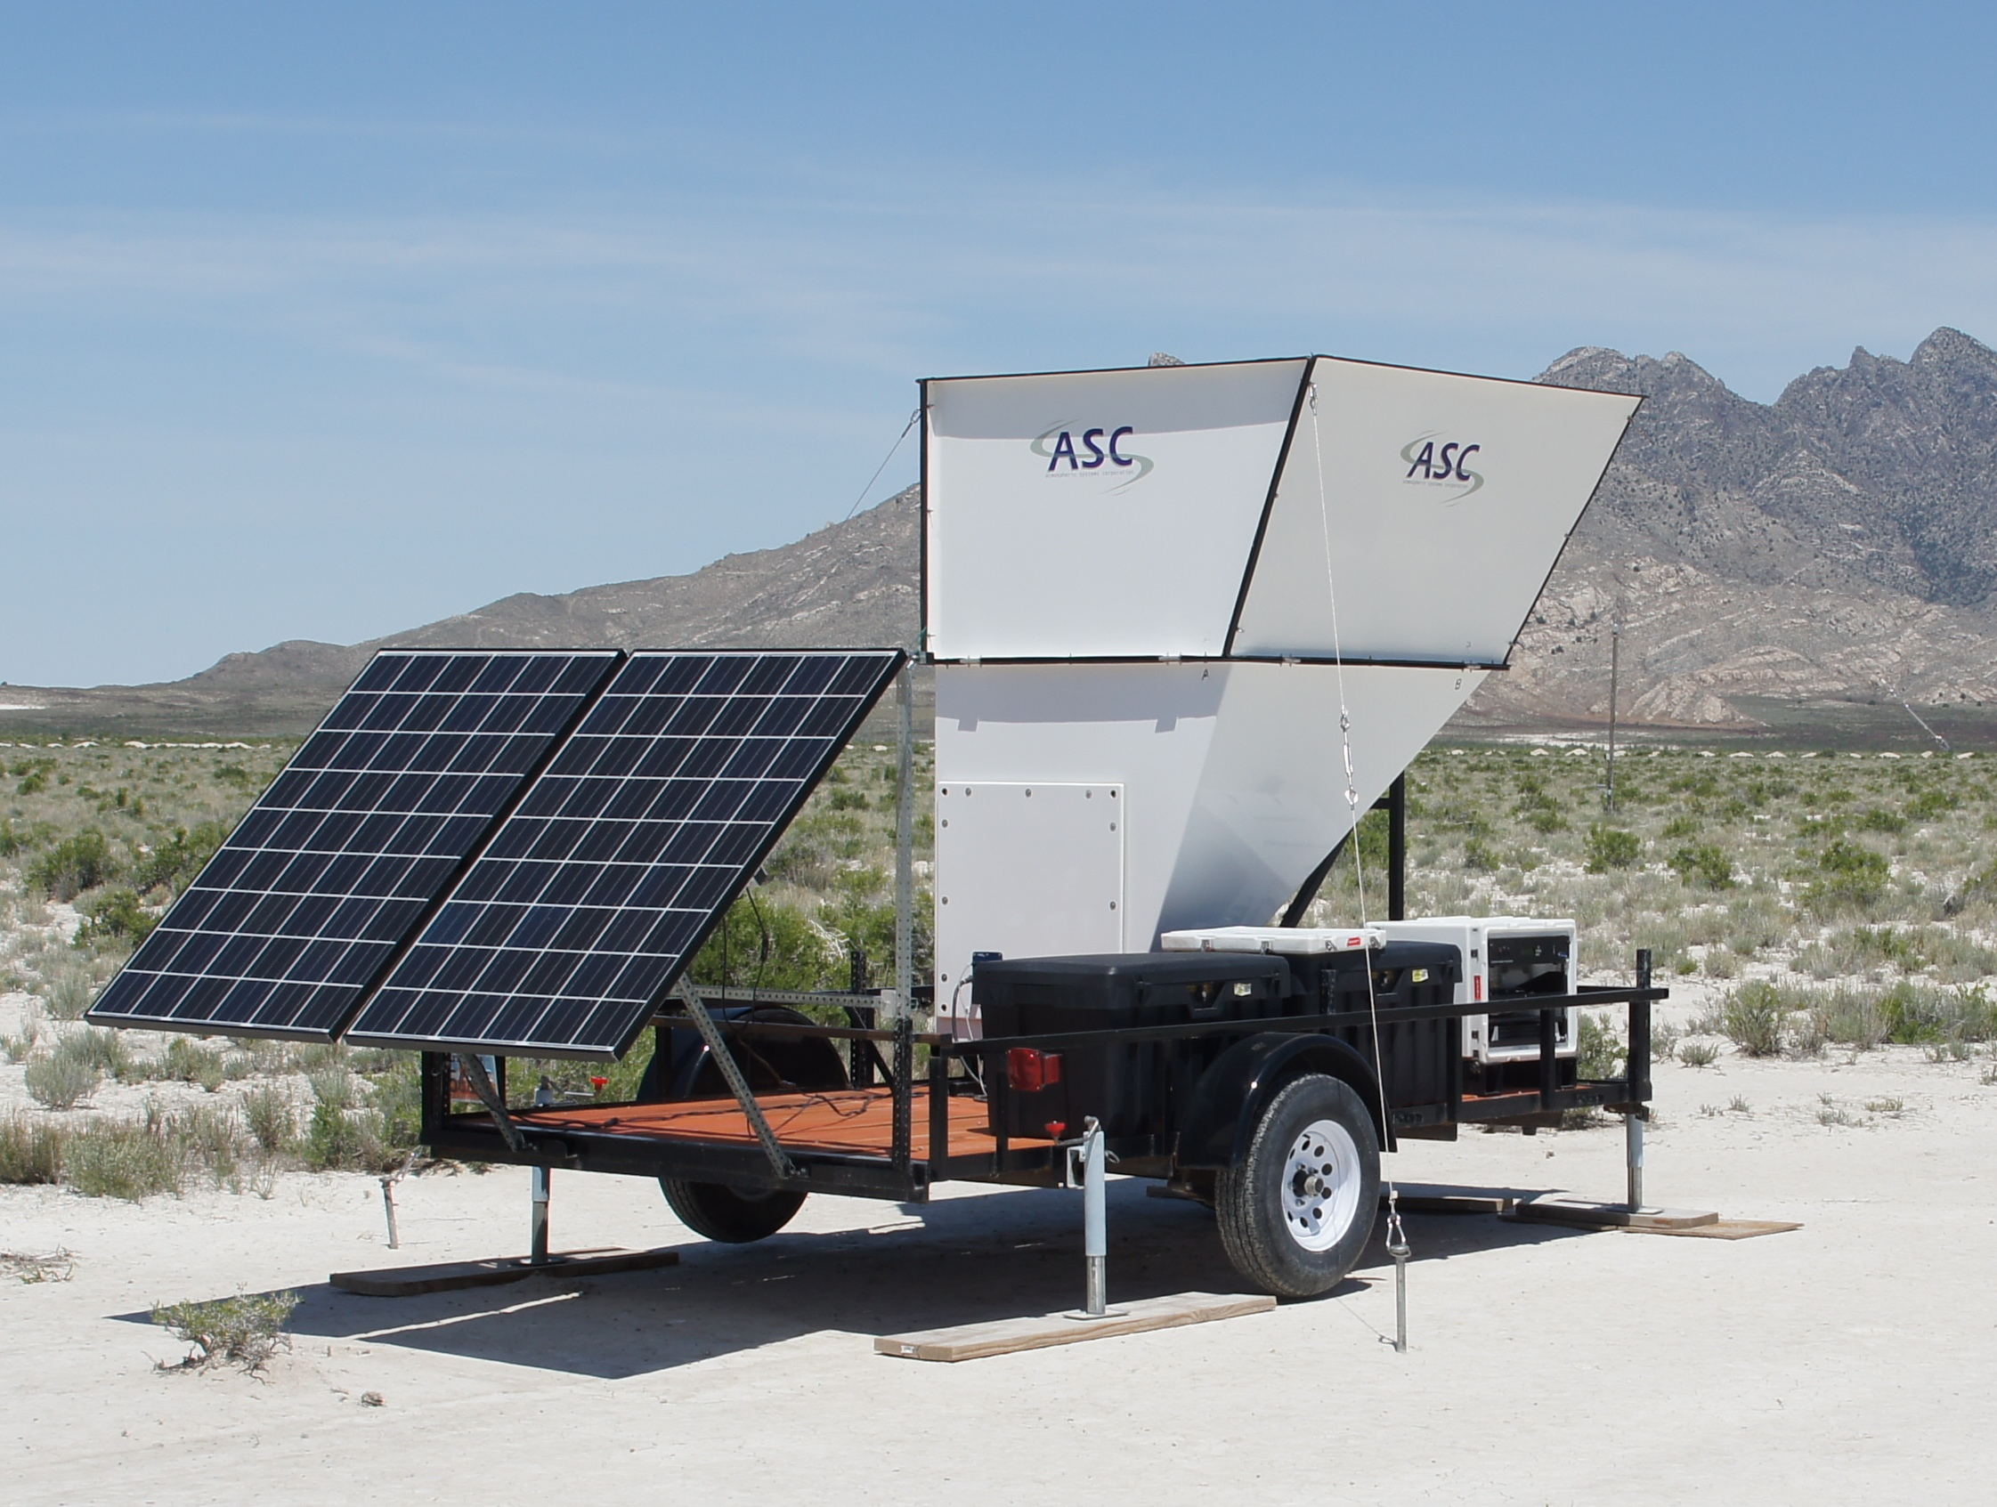
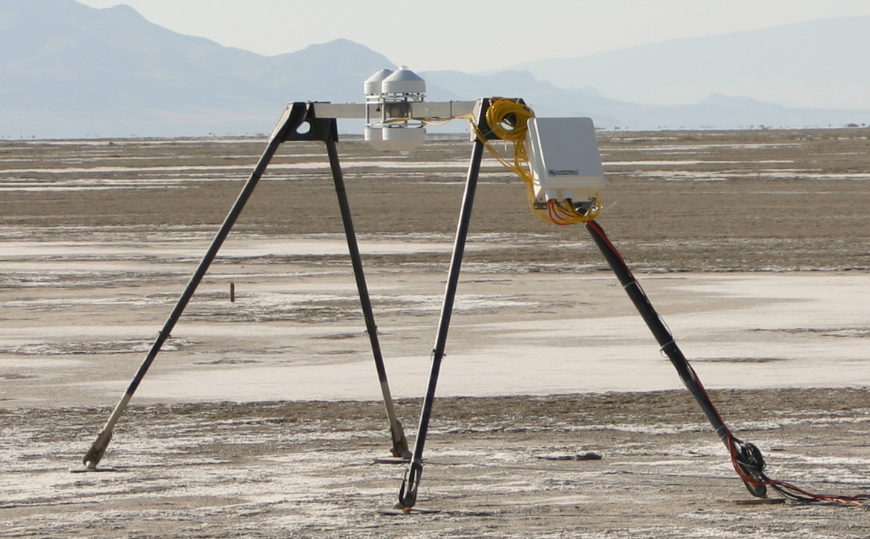
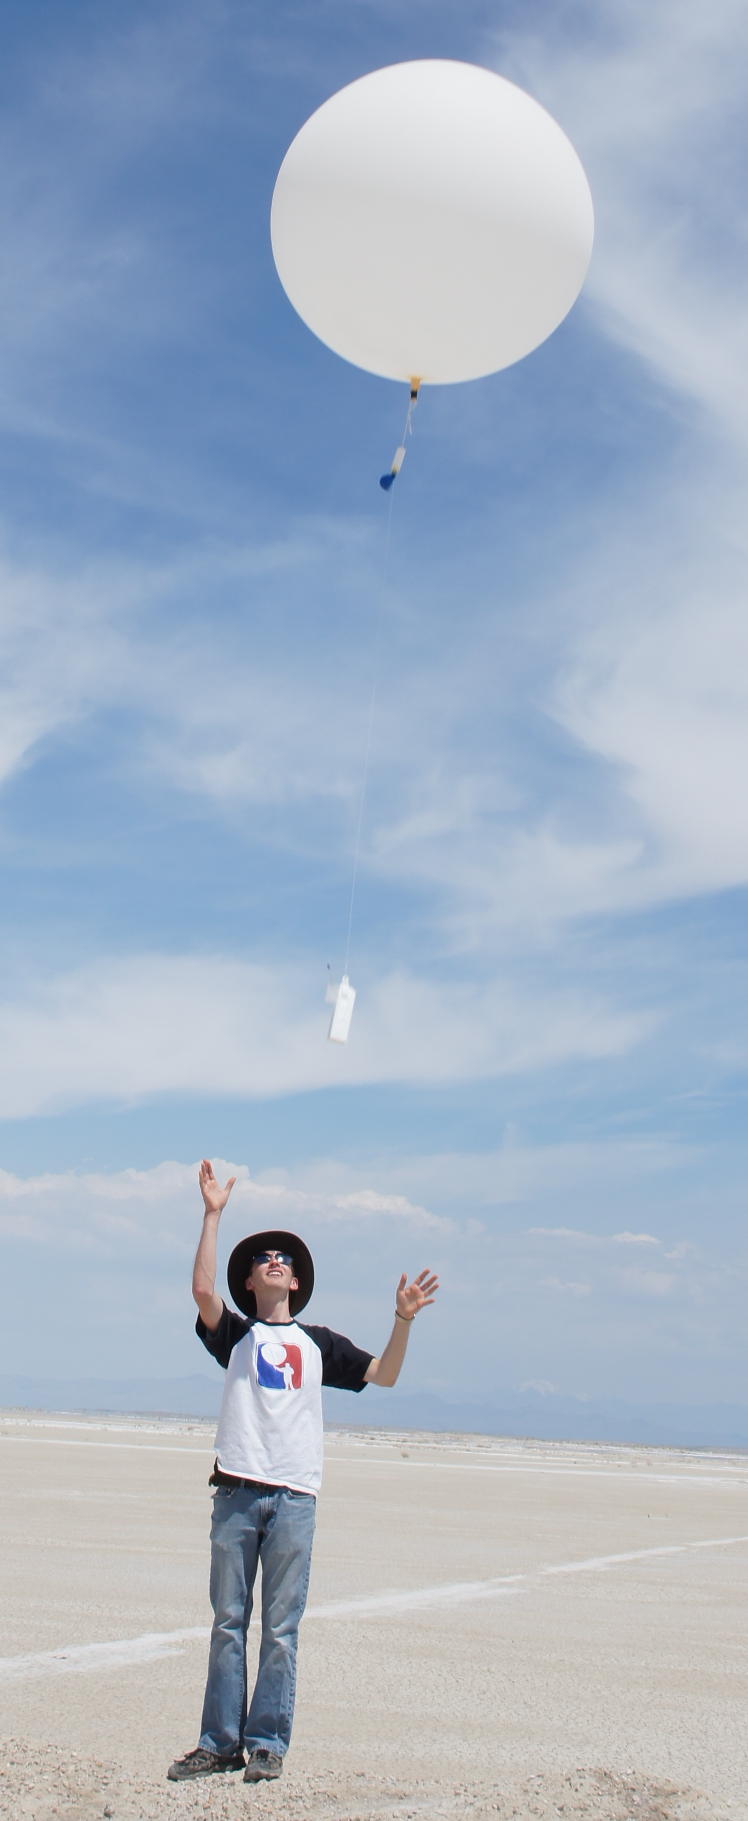
Instrumentation & Field Projects:
LiDAR, SoDAR, Surface Energy Balance,, radiosondes, ceilometers, …
Future Plans:
Banner Cloud Observations at the Matterhorn (CH)
Valley Exit Jets (Wasatch)
Valley Fog Study (Utah)
Past Projects:
METCRAX 2006
Acoustic-Seismic Coupling
PCAPS
Bingham Mine Study
MATERHORN (I+II)
MATERHORN-FOG
DISCHMA-TAL EXPERIMENT (Switzerland)

