Slide 1
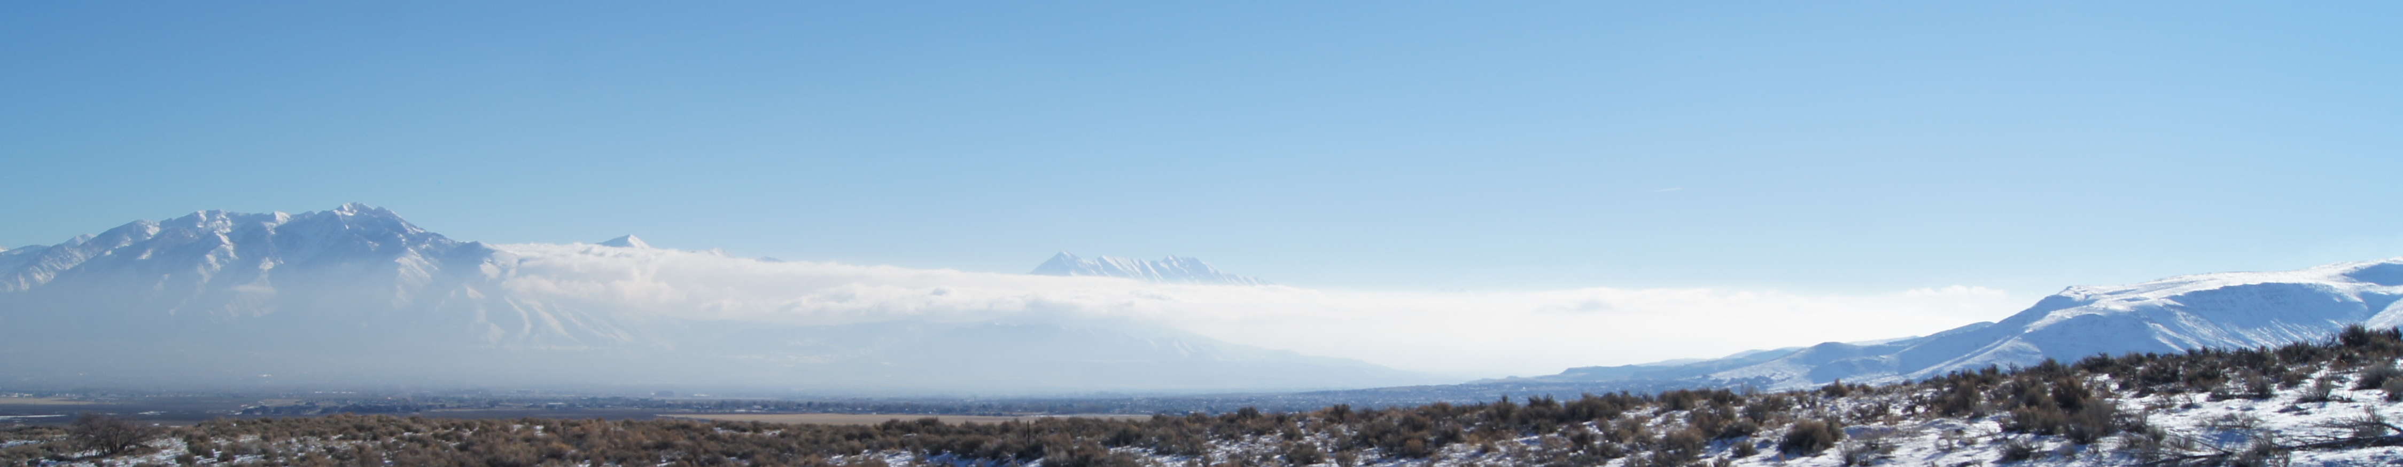




Results from the Jordan Narrows Gap Ammonia Transport Study: Inter-basin Airmass and Pollutant Exchange Estimates using Doppler Wind LiDAR
Sebastian W. Hoch, Erik T. Crosman, Randal A. Martin
¹ University of Utah, Department of Atmospheric Sciences, Salt Lake City, Utah, USA
² West Texas A&M University, Department of Life, Earth, and Environmental Sciences, Canyon, TX, USA
³ Utah State University, Department of Civil and Environmental Engineering, Logan, Utah, USA
Air Quality: Science for Solutions - 4th Meeting. June 18, 2020.

Slide 2
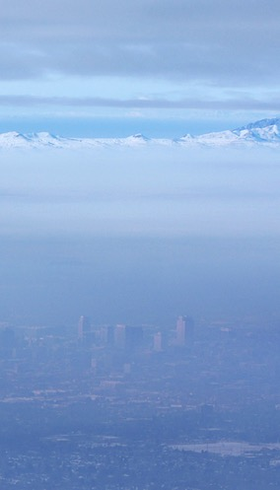
Introduction and Motivation
The Salt Lake Valley basin is one of the three populated Utah valleys struggling with non-attainment of PM_{2.5} pollution standards (UDEQ 2015).
Adverse health effects of PM_{2.5} are well documented, both for short term and long term exposure (Beard et al. 2012, Pope et al. 2006, WHO 2016, yesterday’s S4S talks).
Chemical composition of PM_{2.5} pollution in Utah valleys shows high mass contribution of ammonium nitrate (NH₄NO₃; 70-80%), a secondary pollutant forming from gaseous ammonia (NH₃) and nitric acid (HNO₃) (Kelly et al. 2013, Kuprov et al. 2014).
The reactive pathways for NH₄NO₃ formation and their dependence on meteorological processes need to be better understood. Role of oxidants (O₃)?
Sources of precursor ammonia (NH₃)? (This morning’s S4S talks!)
SLC, UT. 14 Jan 2011

Slide 3

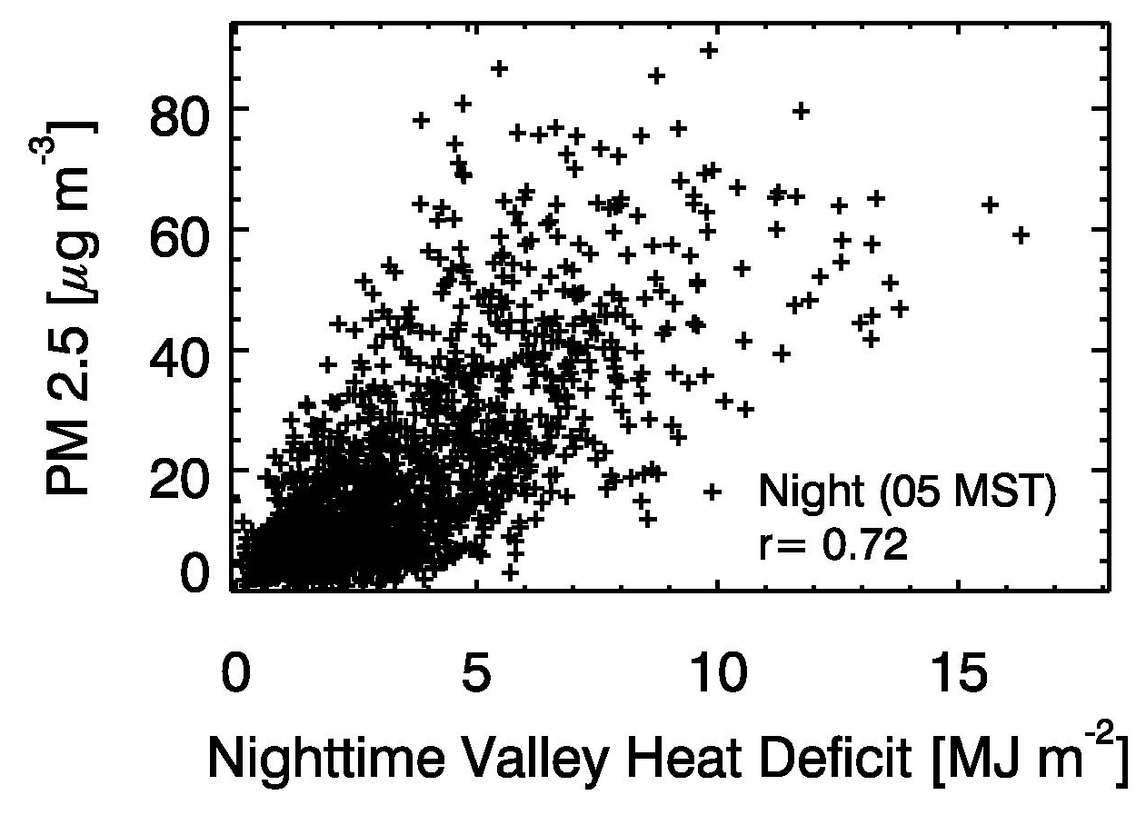
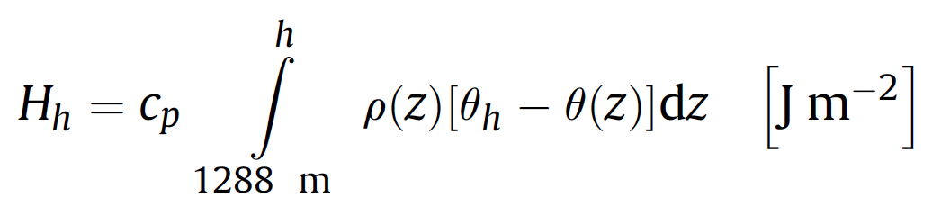
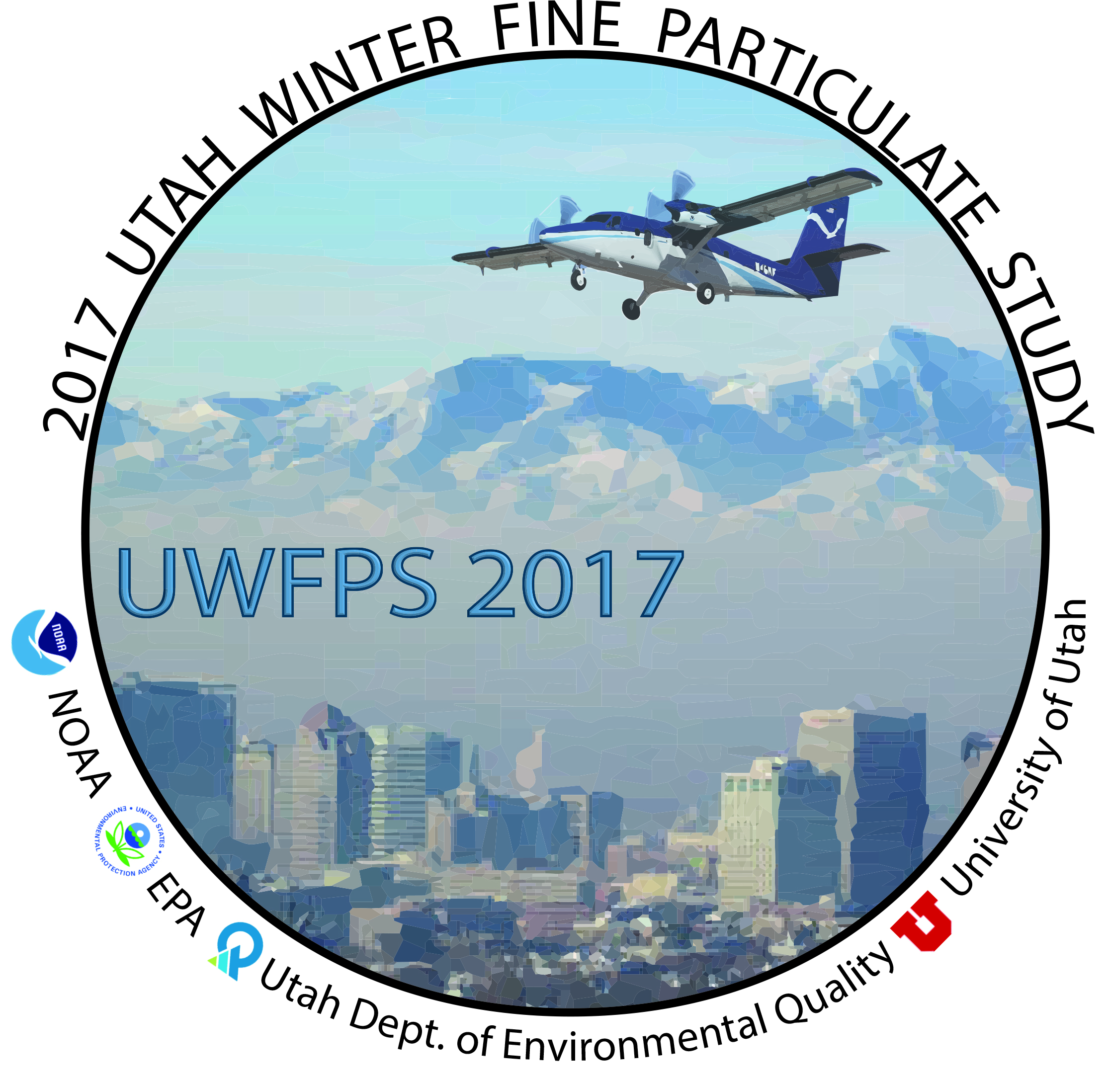
Introduction and Motivation
Wintertime pollution episodes are closely linked to persistent cold-air pools (PCAPs) (Lareau et al. 2013).
The life cycle of PCAPs and their dependence on meteorological processes has previously been investigated (PCAPS, COLPEX,…). The valley heat deficit concept is very useful (Whiteman et al. 2014, Green et al. 2015).
Very little is known about the spatial and temporal variation (timescales < 24 hours) of PM_{2.5} concentrations and precursor gases within a PCAP.
Valley
Heat
Deficit H_{h}
Whiteman et al. 2014, Atmos. Env.

Slide 4
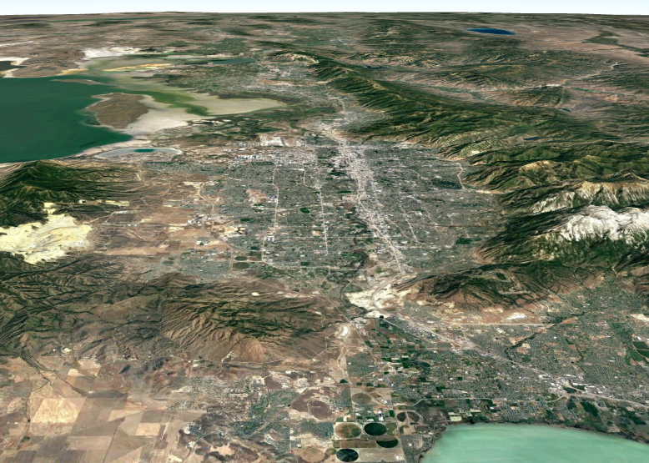

Persistent Cold-Air Pools (PCAPs) are characterized by limited mixing – nevertheless some mixing and transport processes can occur.
NIGHT
Down-Canyon
Flows
Lake
Exchange
Surface
layer
decoupling
Inter-Basin
Exchange
Down-Canyon
Flows

Slide 5

Diurnal variations in the meteorological forcing of the basin cold-pool drives transport and mixing processes.
DAY
Up-Canyon
Flows
Lake
Exchange
Surface-
based
mixing
Inter-Basin
Exchange
Up-Canyon
Flows

Slide 6
Diurnal variations in the meteorological forcing of the basin cold-pool drives transport and mixing processes.
Thermally-driven slope and valley circulations on basin sidewalls and through tributary canyons (sidewall ventilation, nocturnal injections of low-PM_{2.5}, high-O₃ air).
DAY
Up-Canyon
Flows
Thermally-driven and synoptically-forced air-mass exchanges with the Great Salt Lake
Lake
Exchange
Surface-
based
mixing
Daytime vertical mixing in convective boundary layer (CBL) at the base of the cold pool, decoupling at night.
Inter-Basin
Exchange
Up-Canyon
Flows
We have ample qualitative evidence of these processes. But we need to start quantifying their impact to evaluate their importance!

Slide 7
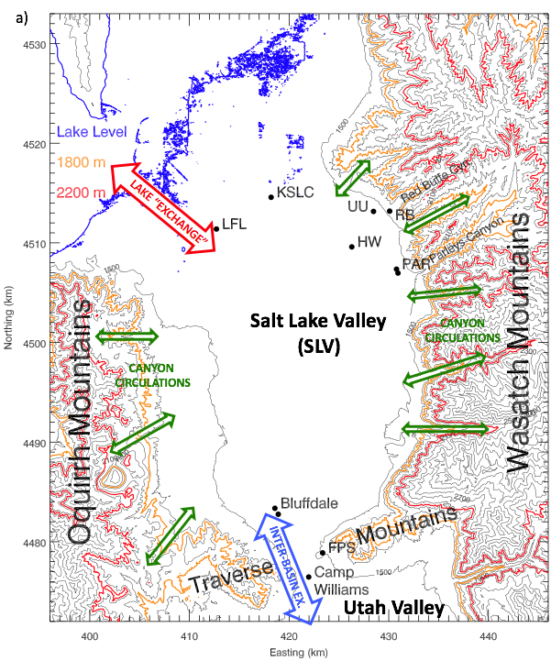
Thermally-driven slope and valley circulations on basin sidewalls and through tributary canyons (sidewall ventilation, injections of “cleaner” air).
The development of a convective boundary layer (CBL) at the base of the cold pool leading to vertical mixing during daytime (& sidewall ventilation), decoupling at night.
Thermally-driven and synoptically-forced air-mass exchanges with the Great Salt Lake
Inter-basin exchange with the Utah Valley (thermally-driven and synoptically forced).
We have ample qualitative evidence of these processes. But we need to start quantifying their impact to evaluate their importance!

Slide 8
Observations
Jordan Narrows Gap Ammonia Transport Study - Meteorological support for the Wasatch Front Ammonia and Chloride Observations (WaFACO) study.
Meteorological observations in the Jordan Narrows (Jan-Mar 2019)
Analysis of existing and study-specific meteorological datasets
Provide forecast support for the WaFACO science team
Developed a methodology to investigate air mass exchange and ammonia transport between the Salt Lake and Utah Valleys.
Salt Lake Valley

Slide 9
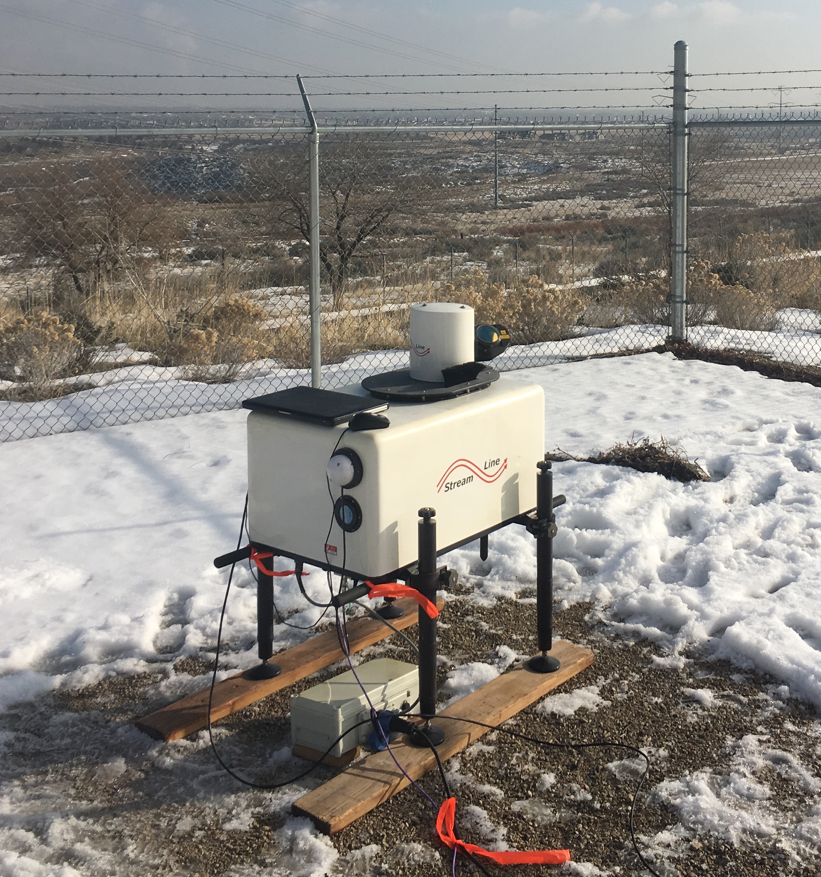
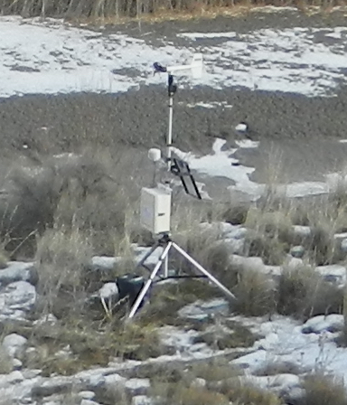
Observations
Camp Williams:
Doppler Wind LiDAR
Automatic Weather Station (AWS)
Ammonia concentrations (Randy Martin / WaFACO)
Ceilometer
Bluffdale:
Automatic Weather Station (AWS)
Ceilometer
Other available recources
MesoWest AWS - Flight Park South
UDAQ sites: ceilometers
Salt Lake Valley

Slide 10
Methodology: Transport estimate through a topographic gap
Data available / needed:
Topography (DEM)
Wind / flow field (LiDAR, AWS; V)
Concentration ([NH₃] / WaFACO)
Assumptions …
height z
flow layer,
V(z, x, t)
Gap cross section (A(z))
distance x
(gap width)
[NH₃] (z,x, t)

Slide 11
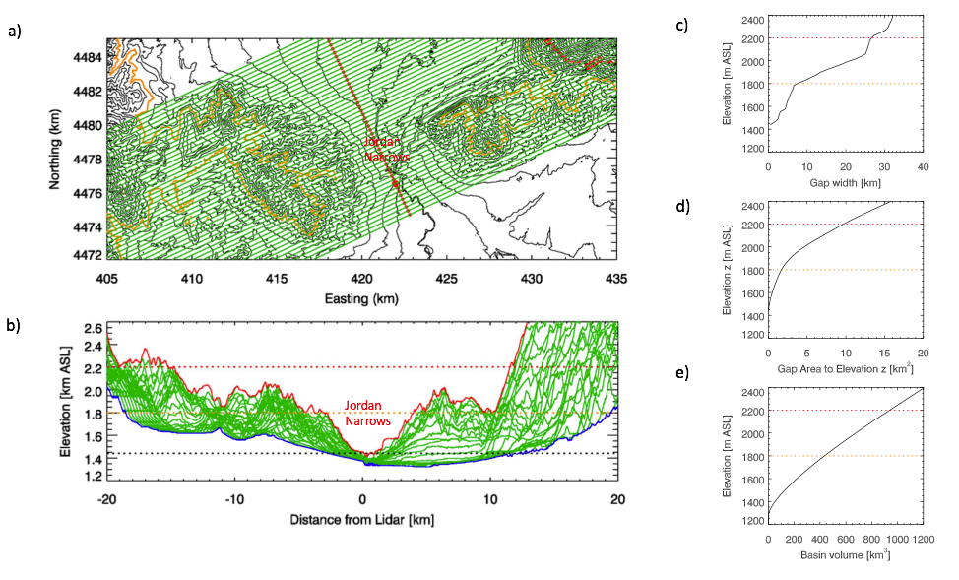
Methodology - Topographic calculations
gap
width (z)
gap
area (z)
Definition of the topographic gap
2200 m
~7220 ft
1800 m
SLC
basin
volume (z)
~1200 ft
~5900 ft

Slide 12
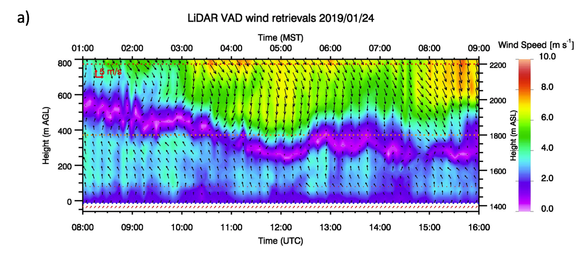
Results – Flow field / LiDAR retrieval
Example 8-hour period (0100 – 0900 MST 24 January 2019)
2200 m
Elevated northerly flow (N➔S, Salt Lake to Utah County)
1800 m
Near-surface southerly flow (S➔N, Utah to Salt Lake County)
AWS
How to read the wind arrows:
flow
north
to south
flow west
to east

Slide 13
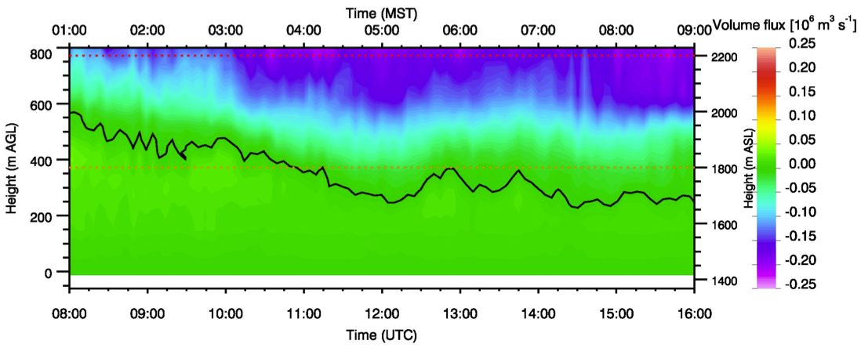
Results
Example 8-hour period (0100 – 0900 MST 24 January 2019)
Wind profile
flow field
gap-normal flow component & gap width
volume flux (z)
Flow N➔S
Flow S➔N

Slide 14
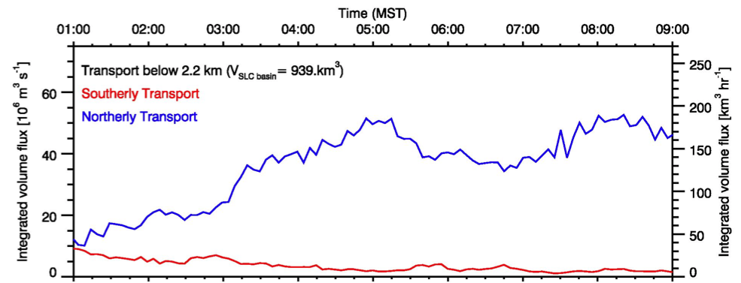
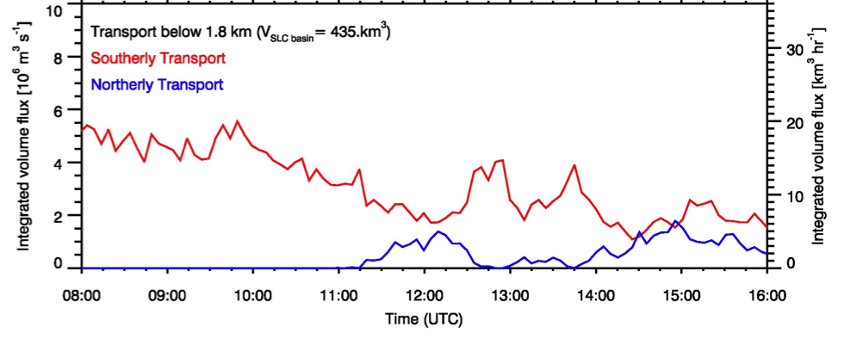
Results
Example 8-hour period (0100 – 0900 MST 24 January 2019)
Wind profile
Integration over flow layer (or different heights)
Volume flux (z)
Integrated to 2200 m
Volume flux
through gap
Flow N➔S
Flow S➔N
Integrated to 1800 m
Flow S➔N
Volume flux of surface-based flow layer
Flow N➔S
Notes:
o

Slide 15
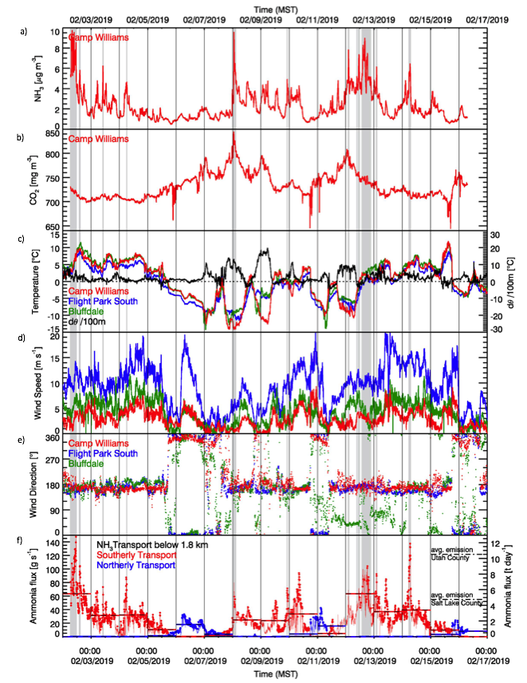
Observations – Ammonia / Stability / Surface winds
[NH₃]
[NH₃]
Measure of atmospheric stability
[CO₂]
Periods of elevated [NH₃] follow periods of elevated atmospheric stability

Slide 16
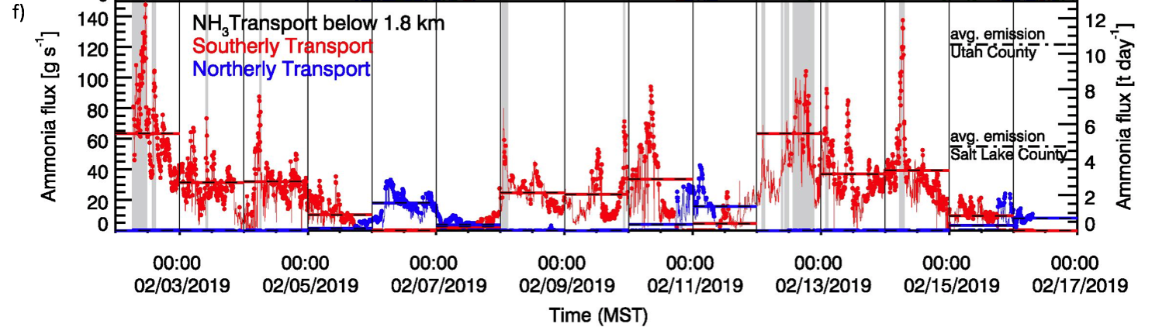
Results
Volume flux of surface-based flow layer
Surface concentrations
=
x
Mass transport
Ammonia transport estimate through the Jordan Narrows (2-16 Feb 2019)
Transport below 1800 m
S➔N
N➔S
*
Inter-basin transport of ammonia seems to be significant for the budgets in the individual basins.
*
metric tons

Slide 17
Summary / Conclusions
We used the combination of Doppler Wind LiDAR-derived wind profiles, topographic calculations, and surface-based measurements of ammonia (NH₃) concentrations to estimate the transport of ammonia through the Jordan Narrows, the topographic gap between the Salt Lake Valley and Utah Valley basins.
During the limited (14-day) period with ammonia observations, southerly flow and transport through the Jordan Narrows dominated.
Our estimates show that the NH₃ transport through the Jordan Narrows is significant when compared to average daily wintertime NH₃ emissions of Salt Lake (4.74 t/day) and Utah (12.52 t/day) counties (UDEQ, personal communication).
On average, Utah county exported about 20% of its daily NH₃ emission through the Jordan Narrows into the Salt Lake Basin. In turn, Salt Lake county imported an additional 45% of its own emission by means of this inter-basin exchange.
Some assumptions used in the methodology, such as the representativeness of surface concentrations when estimating concentrations of the flow layer, should be evaluated in future experiments.

Slide 18
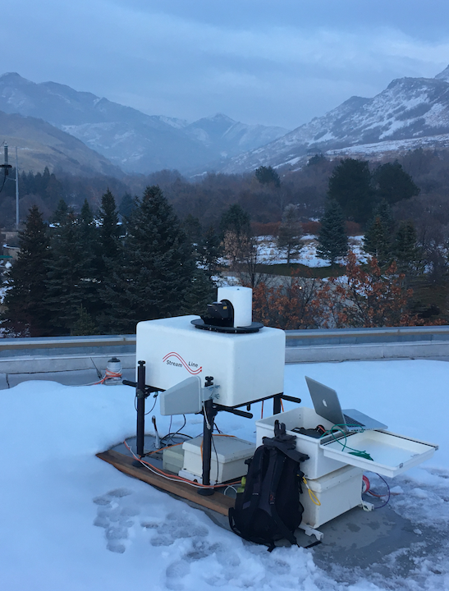
Ongoing and Future Research
Red Butte Canyon Pollution Transport Study: Application of the same simple method for PM_{2.5} and ozone mass transport estimates, investigating the role of thermally driven valley circulations.
More quantitative estimates of pollution and precursor transport are needed to understand their budgets in individual basins.
The planned AQUARIUS project may be ideally suited to evaluate the (relative) importance of identified transport and mixing processes.
Red Butte
Drainage
Acknowledgements
Funding from the Utah Department of Environmental Quality
Support from George Summit (Camp Williams), North Star Academy, Bluffdale Elementary School
Contact
Questions or comments? Contact me at sebastian.hoch@utah.edu

Slide 19
References
Baasandorj, M., S. W. Hoch, R. Bares, J. C. Lin, S. S. Brown, D. B. Millet, R. Martin, K. Kelly, K. J. Zarzana, C. D. Whiteman, W. P. Dube, G. Tonnesen, I. C. Jaramillo, and J. Sohl, 2017: Coupling between Chemical and Meteorological Processes under Persistent Cold-Air Pool Conditions: Evolution of Wintertime PM2.5 Pollution Events and N2O5 Observations in Utah’s Salt Lake Valley. ES&T, 51 (11), 5941-5950, DOI: 10.1021/acs.est.6b06603
Beard, J.D., C. Beck, R.A. Graham, S.C. Packham, M. Traphagan, R.T. Giles, and J.G. Morgan, Winter temperature inversions and emergency department visits for asthma in Salt Lake County, Utah, 2003-2008. Environn. Health Perspect., 2012. 120: p. 1385-1390.
Whiteman, C. D., S. W. Hoch, J. D. Horel, A. Charland, 2014: Relationship between particulate air pollution and meteorological variables in Utah's Salt Lake Valley. Atmos. Environ., 94, 742-753.
Lareau, N., E. Crosman, C. D. Whiteman, J. D. Horel, S. W. Hoch, W. O. J. Brown, and T. W. Horst, 2013: The Persistent Cold-Air Pool Study. Bull. Amer. Meteor Soc., 94, 51-63.
Hoch, S. W., E. T. Crosman, M. Baasandorj, 2018: Mixing and Air Mass Exchange Processes within Salt Lake Valley Persistent Cold-Air Pools and their Effect on Particulate Pollution Concentrations. 18th Conference on Mountain Meteorology, 25 – 29 June 2018, Santa Fe, NM.
Hoch, S.W., E. T. Crosman, M. Baasandorj, A. Jacques, 2017: Cold-air Pool Exchange Processes and their impact on Air Quality in the Salt Lake City Basin. Air Quality - Science for Solutions Conference, 30 March 2017, Salt Lake City, UT
Hoch, S. W., E. T. Crosman, M. Baasandorj, J. C. Lin, R. Bares, R. S. Martin, J. Sohl, J. D. Horel, and C. D. Whiteman, 2016: Case Study of the 6-16 February 2016 Salt Lake Valley Persistent Cold-Air Pool. 17th Conference on Mountain Meteorology, 27 June – 1 July 2016 Burlington, VT.
Kelly, K.E., R. Kotchenruther, R. Kuprov, and G.D. Silcox, Receptor model source attributions for Utah's Salt Lake City airshed and the impacts of wintertime secondary ammonium nitrate and ammonium chloride aerosol. Journal of the Air & Waste Management Association, 2013. 63(5): p. 575-590.
Kuprov, R., D.J. Eatough, T. Cruickshank, N. Olson, P.M. Cropper, and J.C. Hansen, Composition and secondary formation of fine particulate matter in the Salt Lake Valley: Winter 2009. Journal of the Air & Waste Management Association, 2014. 64(8): p. 957-969.

