Slide 1
Aquarius Slides – Sebastian Hoch

Slide 2
Pollution episodes are favored by meteorological processes limiting vertical & horizontal mixing as they allow for emission accumulation
Persistent Cold-Air Pools (PCAPs) [UT]
? Central Valley [CA]
PCAPs evolve and can take different forms which affects chemical processes
  Stratified (“clear”, but daytime coupling through CBL)
  Well-mixed under stratus/fog (“cloudy”), very strong capping layer
  Temperature range (above / below freezing, snow cover)
  Wet & dry deposition
Meteorological processes altering pollution layer (structure & concentrations) include
  Thermally driven diurnal winds (slope and valley wind systems)
  Lake Breezes [UT]
  Inter-Basin Exchange
  Ventilation Processes
  Surface-based mixing (CBL)
  Synoptic influences (top-down erosion, CAP displacement, …)

Slide 3
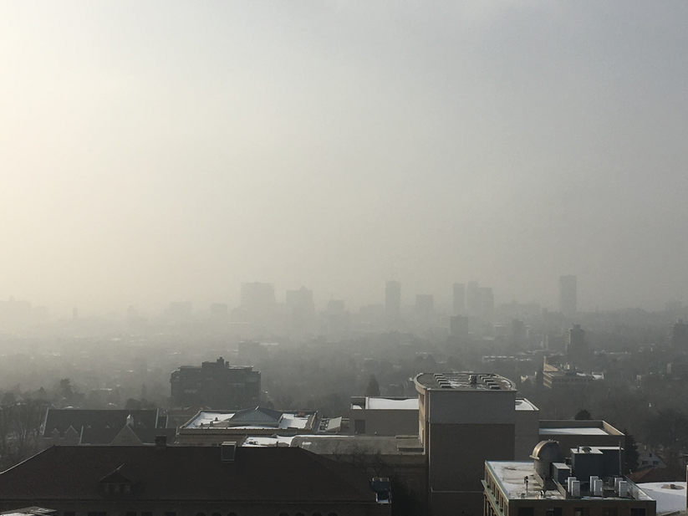
Cold-Air Pools
Transport (PM_{2.5}, O₃, …)
Mixing
Layering/vert. Structure
Clouds & Fog
Deposition
Meteorology
Air Chemistry

Slide 4
CAP “Exchange Processes”

Slide 5
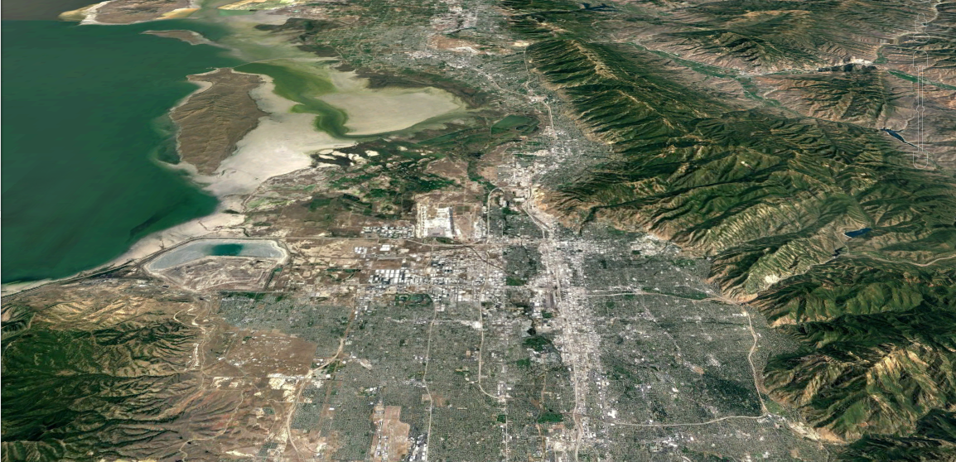

Night-time exchange processes
NIGHT
Lake Exchange
Down-Canyon Flows
Valley Cold Pool

Slide 6

Day-time exchange processes
DAY
Lake Exchange
Up-Canyon Flows
Surface-based mixing
Valley Cold Pool

Slide 7
Previous sites investigation cold-air pool exchange processes in the Salt Lake Valley basin.
LAKE “EXCHANGE”
CANYON
CIRCULATIONS
CANYON
CIRCULATIONS
INTER-BASIN EX.

Slide 8
PCAP Formation – clear AQ link

Slide 9
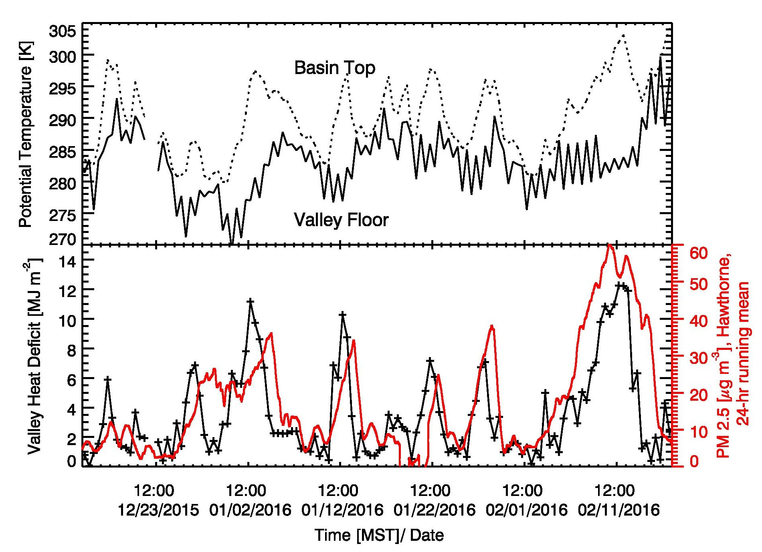
The 2015-2016 Cold Season
Valley Heat Deficit and PM_{2.5}
(2200 m MSL)
(1300 m MSL)
4 Jan.
NAAQS
(below 2200 m MSL)
7 – 14 Feb.
9 Exceedances (typically 18) of the NAAQS of 35 μg/m³

Slide 10
PCAP “Structure” Variability

Slide 11
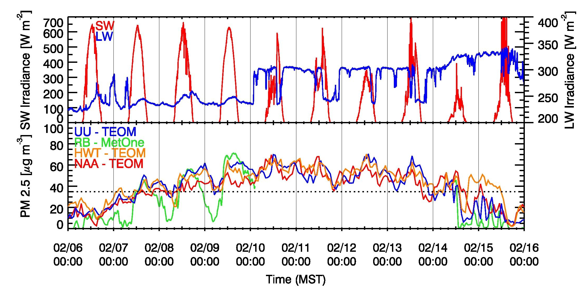
PCAP temporal variations (6-16 February 2016 example)
“Clear”
“Haze/Fog”
Daily increase by ~10-15 μg/m³
(Whiteman et al. 2014: 10 μg/m³ )
Constant level of ~60 μg/m³
(Whiteman et al. 2014: 60 μg/m³ )

Slide 12
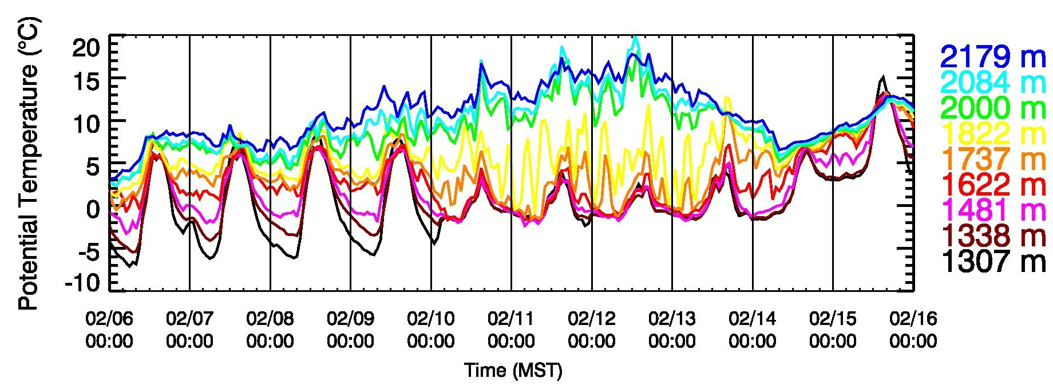
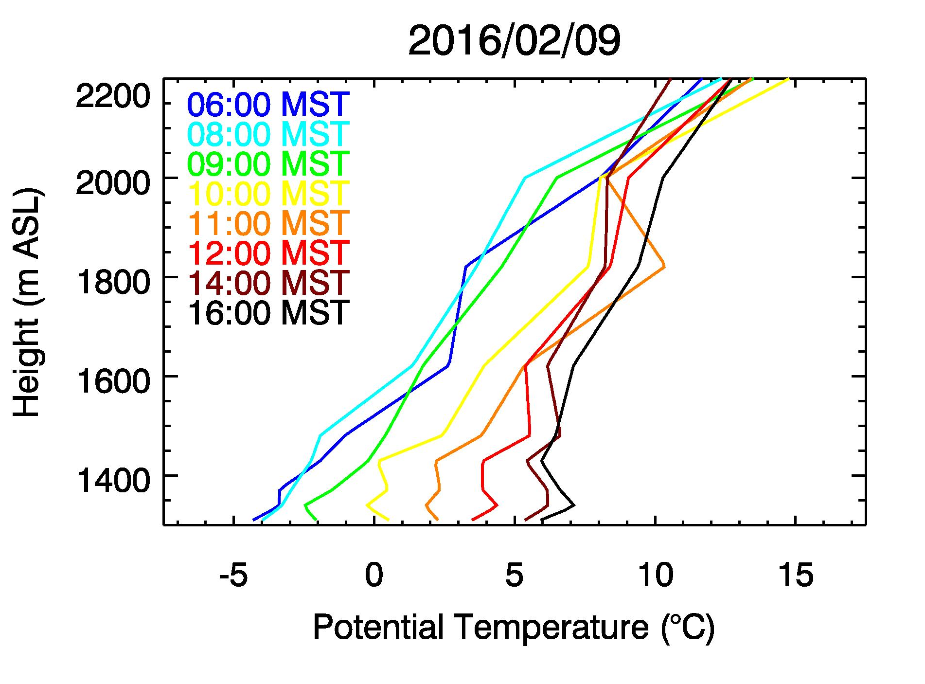
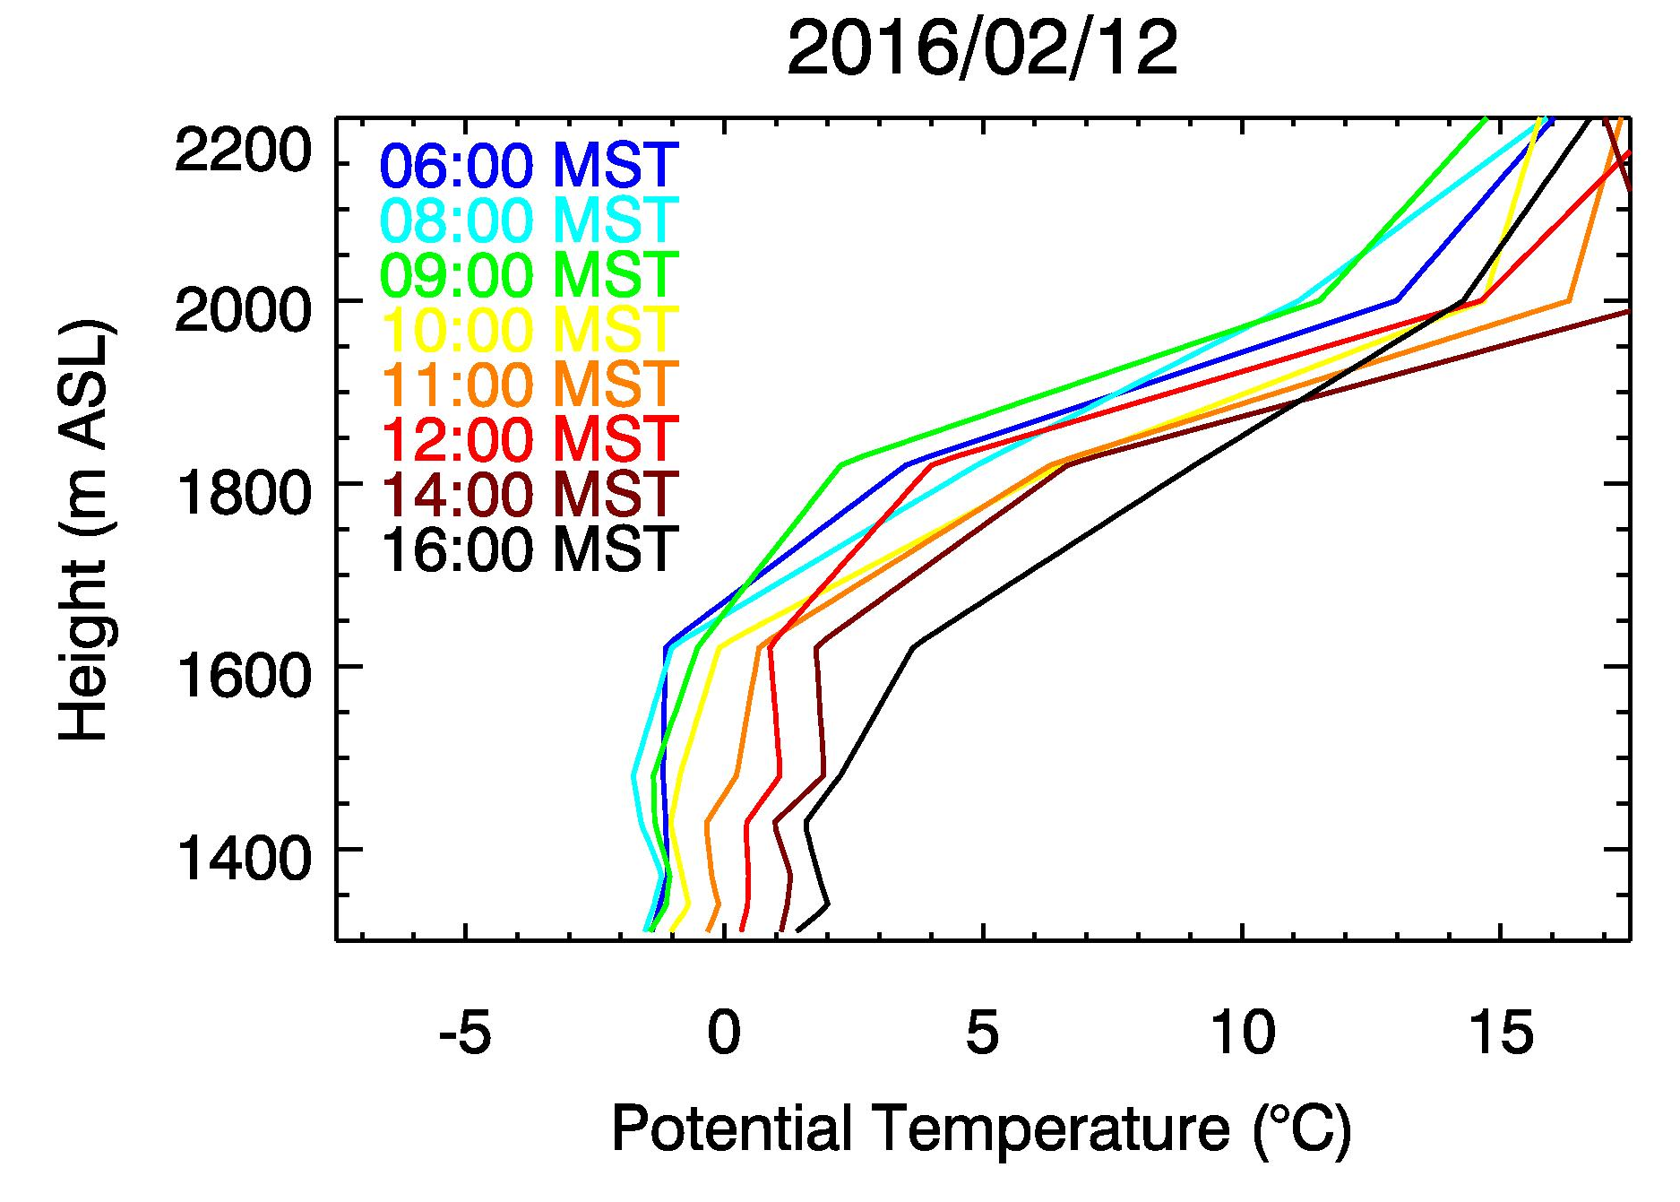
Temperature Structure 6-16 February 2016
“Clear”
“Haze/Fog”
Effect on chemical processes!
Nocturnal strengthening of CAP (de-coupling)
Daytime heating & mixing (re-coupling)
Dampening of diurnal cycle
Lowest 400 m remain “well mixed”

Slide 13
Sidewall Ventilation Process

Slide 14


  Thermally driven diurnal winds (slope and valley wind systems)
2200 m MSL
Nighttime
Nocturnal
Downslope
flows
Daytime
Daytime
Upslope
flows
Isotherms
UU
University of Utah
UDAQ-HW
Hawthorne
Elementary

Slide 15
CBL Growth

Slide 16
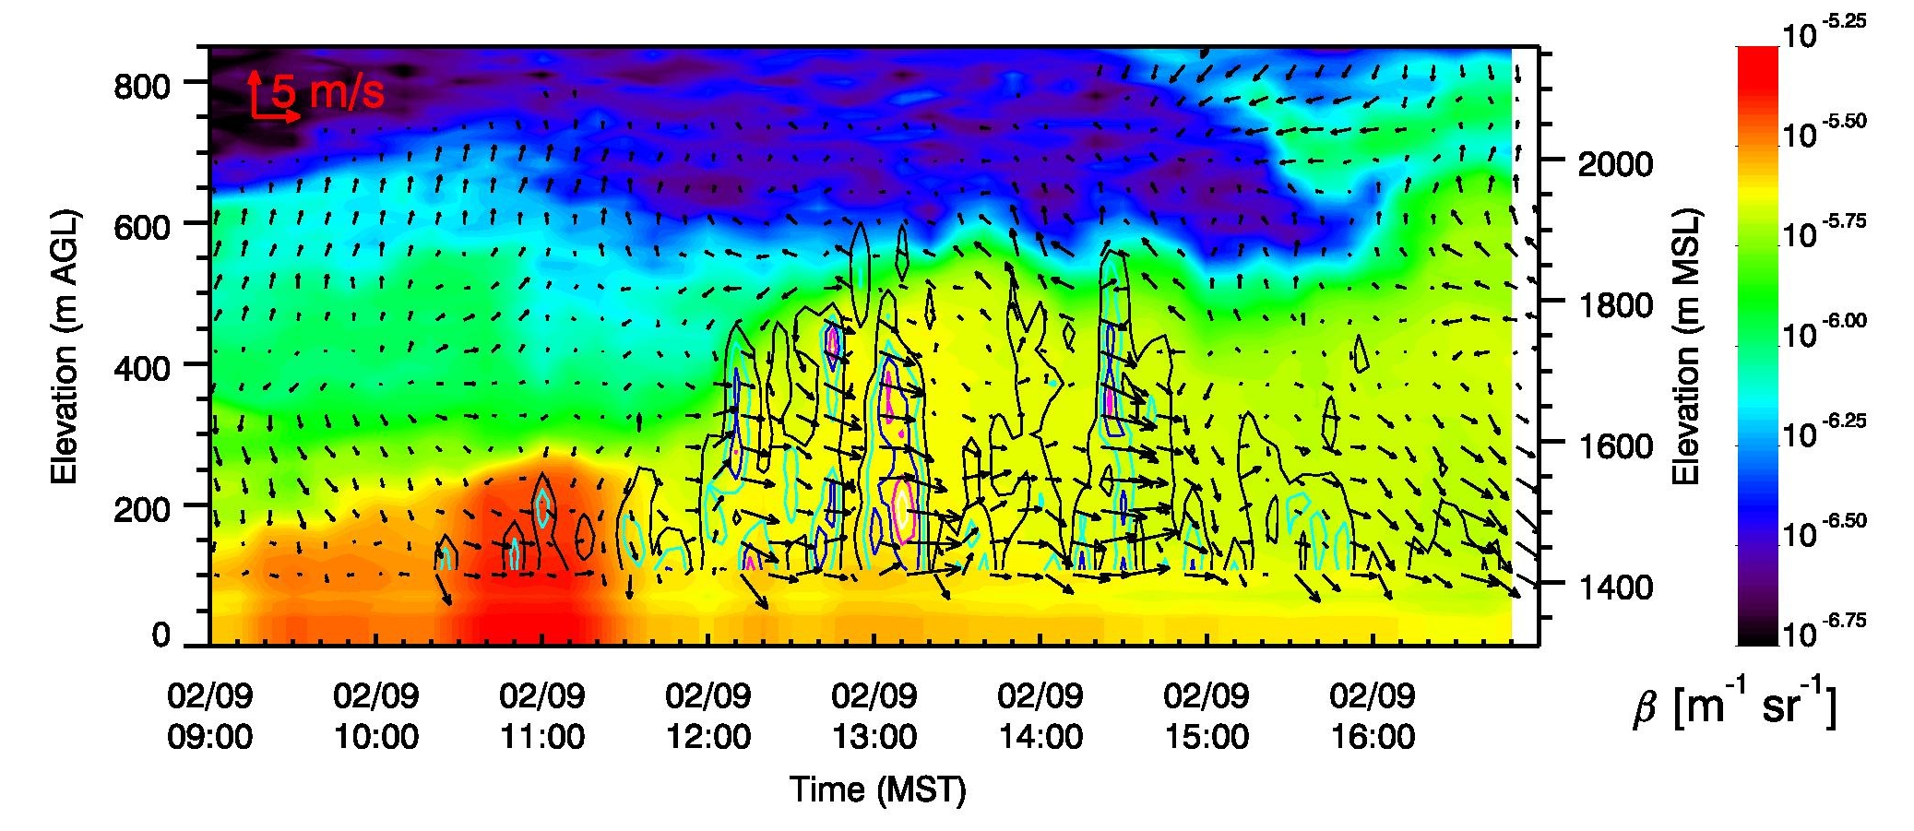
Daytime heating – Ventilation – Aerosol layering?
σ_{w} contours
σ_{w} (vertical velocity variance) from Lidar stares shows convection at the base of the PCAP

Slide 17
Clear-Air Injections

Slide 18
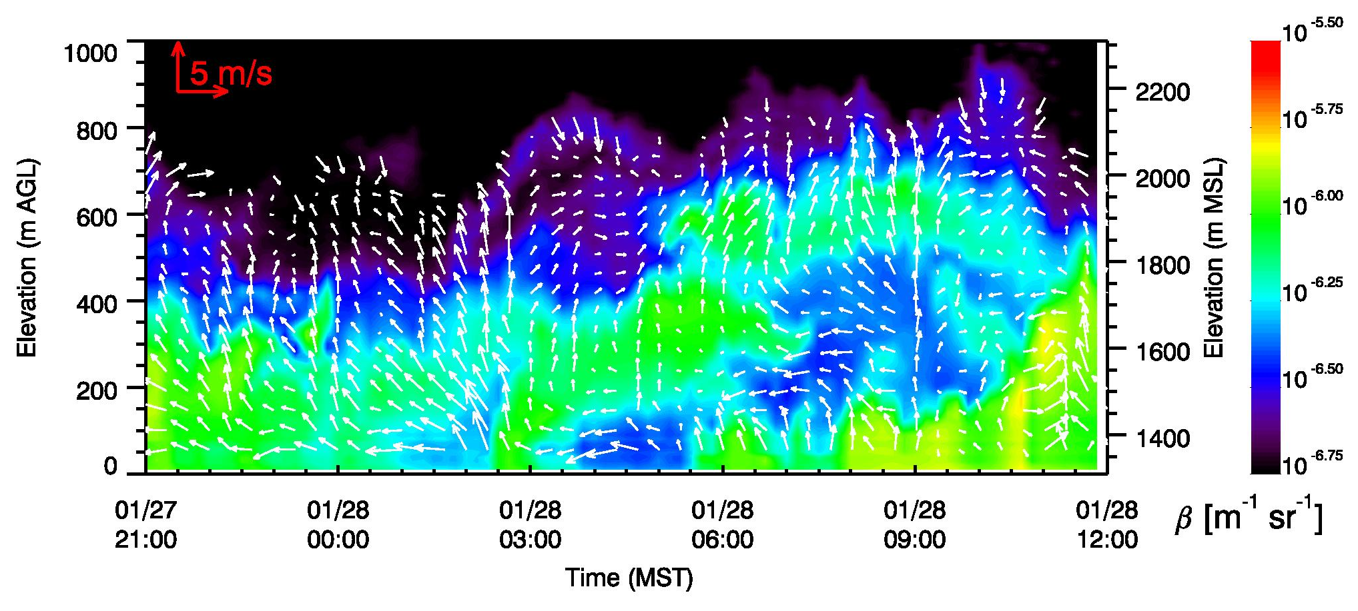
Effect of drainage flows near the basin center
Time–height cross section of LiDAR wind, aerosol backscatter at Hawthorne Elementary
Injection of low-PM_{2.5} and high-O₃ air

Slide 19
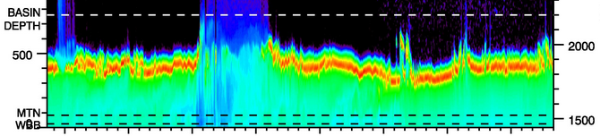
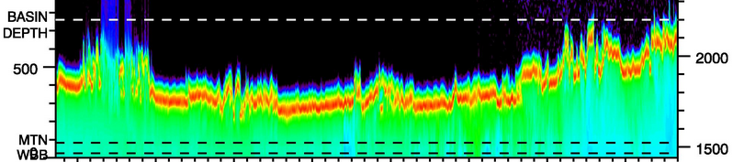
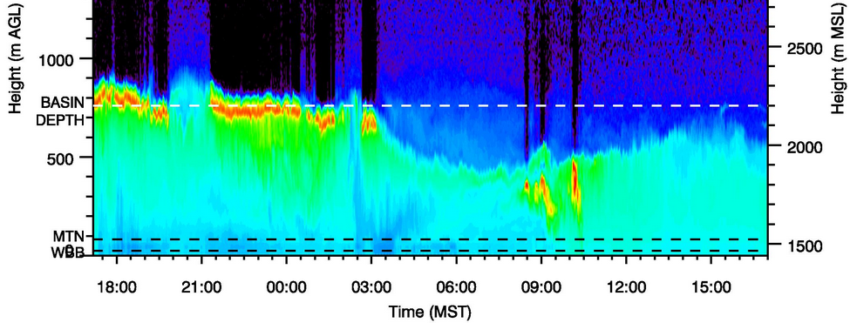
Lindon, Utah Valley
Jan 14 2017
Jan 15 2017
Jan 17 2017

Slide 20
Example “Lake recharge”

Slide 21
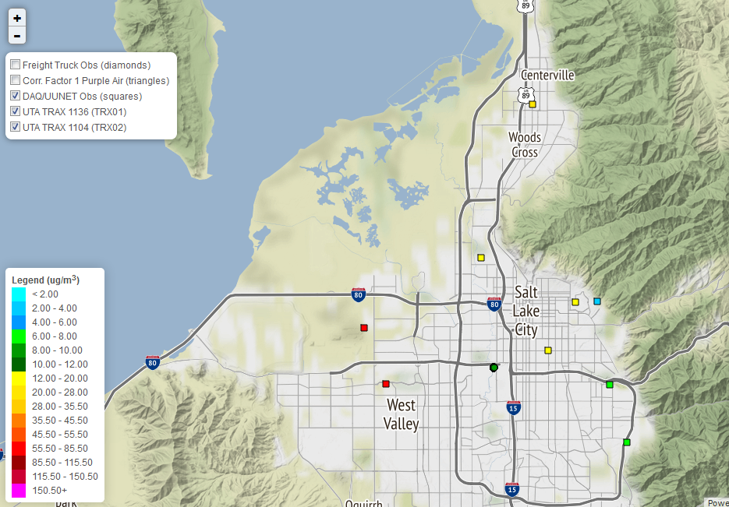
3 February 2017
0900 MST
20
PM_{2.5} [μg/m³]
Dirty lake air
18
13
5
61
15
57
10
7
6
Slide developed by Erik Crosman

Slide 22
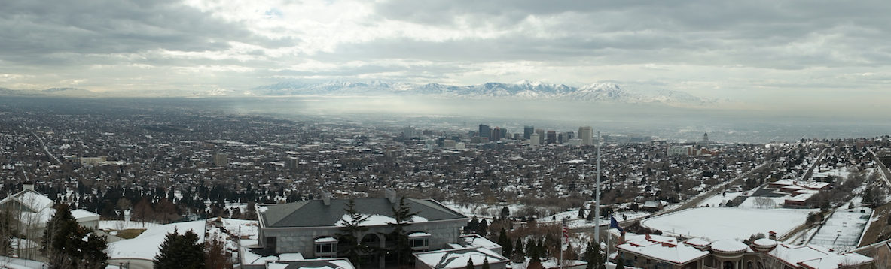
View from the “avenues”, 3 February 2017

Slide 23
Inter-Basin Exchange

Slide 24
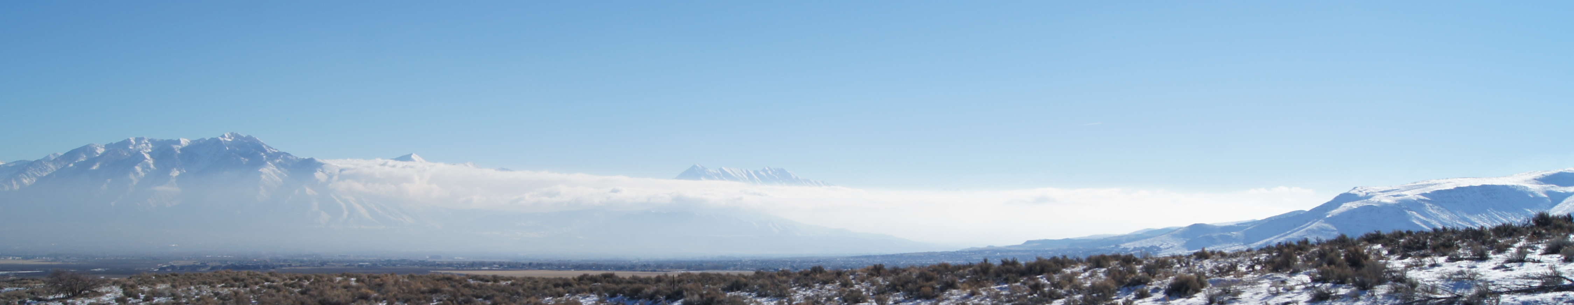
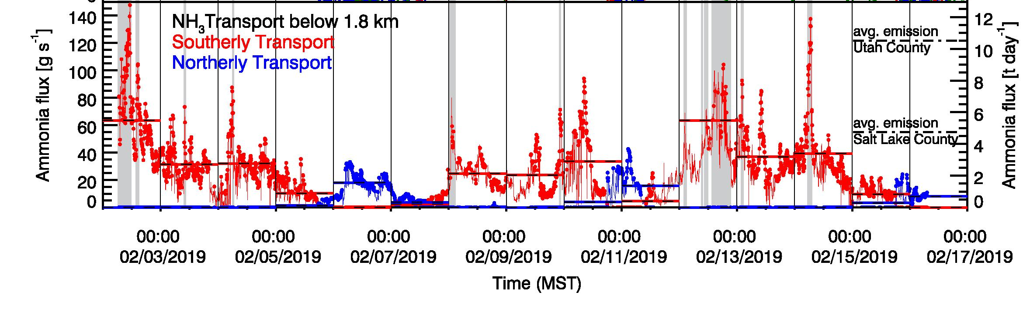
Inter-Basin transport
Ammonia transport through the Jordan Narrows (Salt Lake <-> Utah Valley)
Combining LiDAR winds & surface concentrations
Transport through gap is significant (typically >20% of average daily emissions)

Slide 25
Example Spatial Variations / Chopper flight

Slide 26
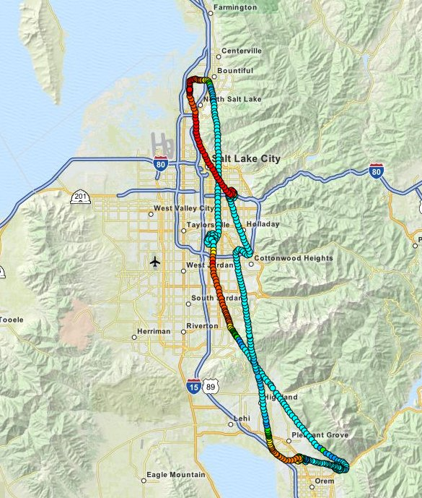
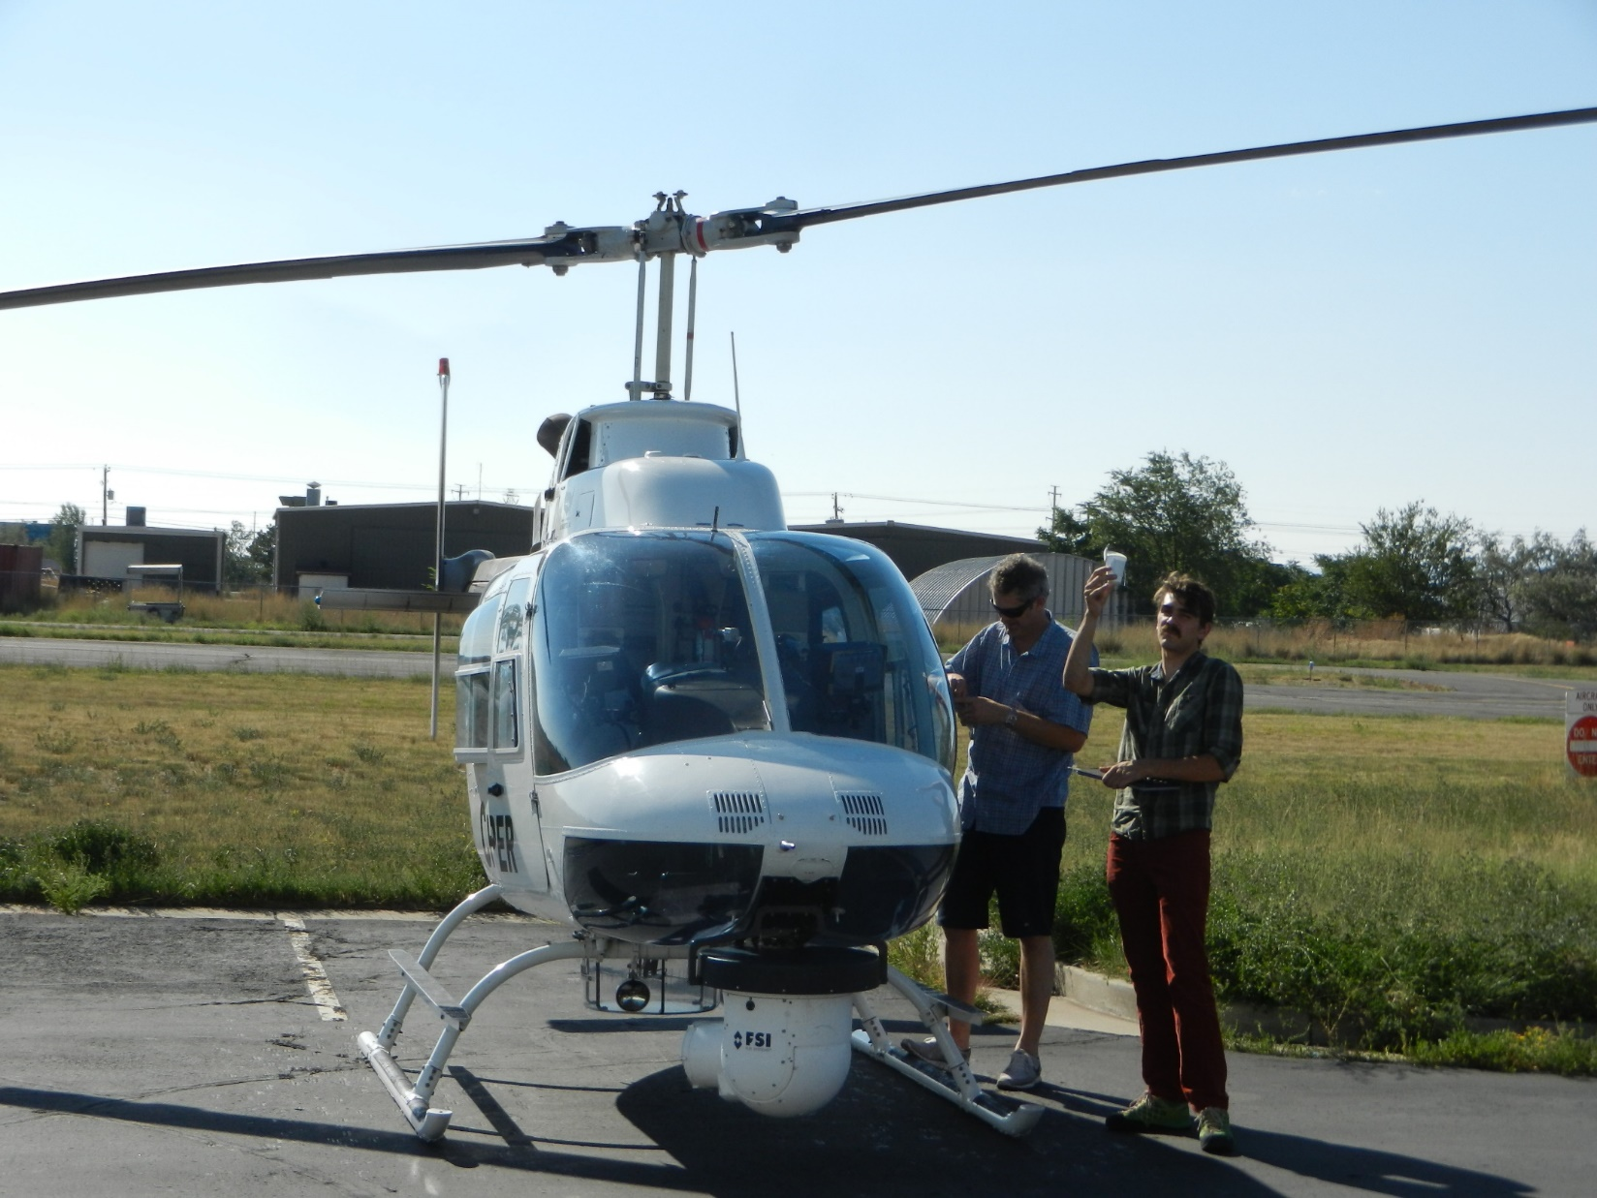

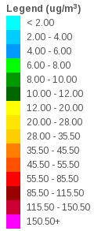
Results – Spatial Variations (vertical)
9 Feb. 2016
1) Takeoff
~1 Hour flight
4) Landing
Chopper
2) Dip-down
South SLC
3) Dip-down
Utah Basin

Slide 27
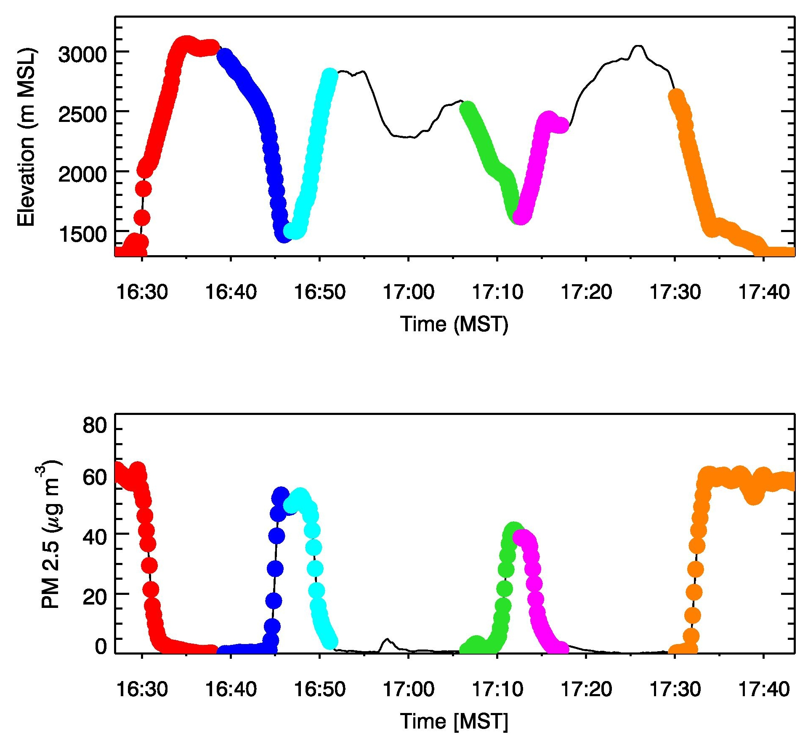
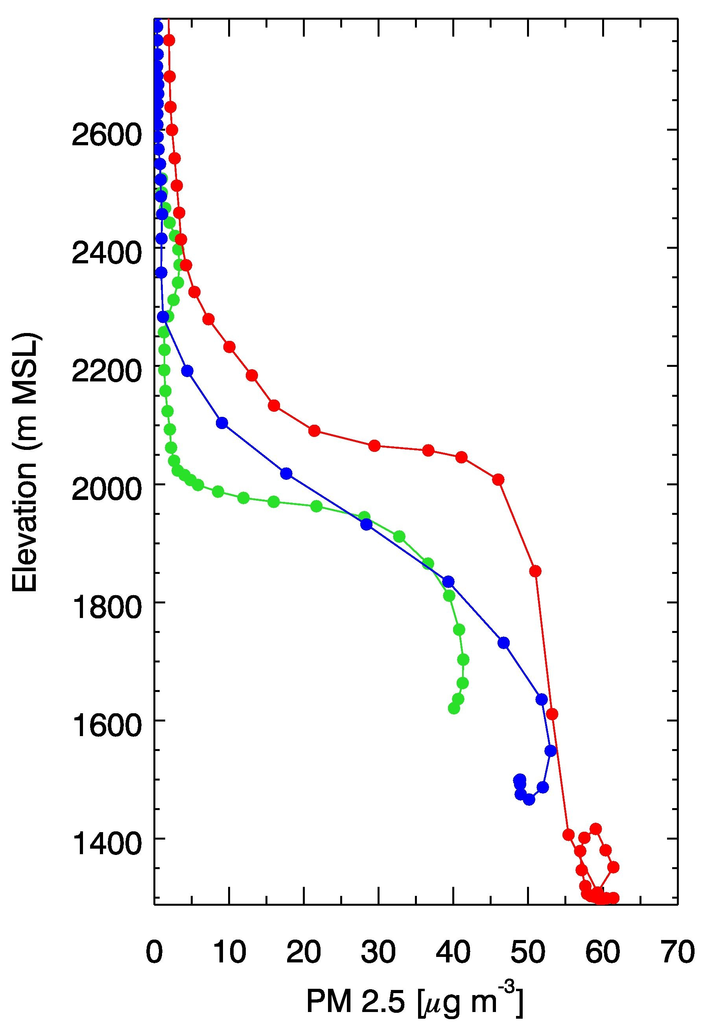
Spatial Variations : News Helicopter Flight 9 Feb. 2016
North Salt
Lake Basin
South Salt
Lake Basin
Utah
Basin
North Salt
Lake Basin
Salt Lake City Basin
Utah Basin

Slide 28
Example diurnal aerosol evolution

Slide 29
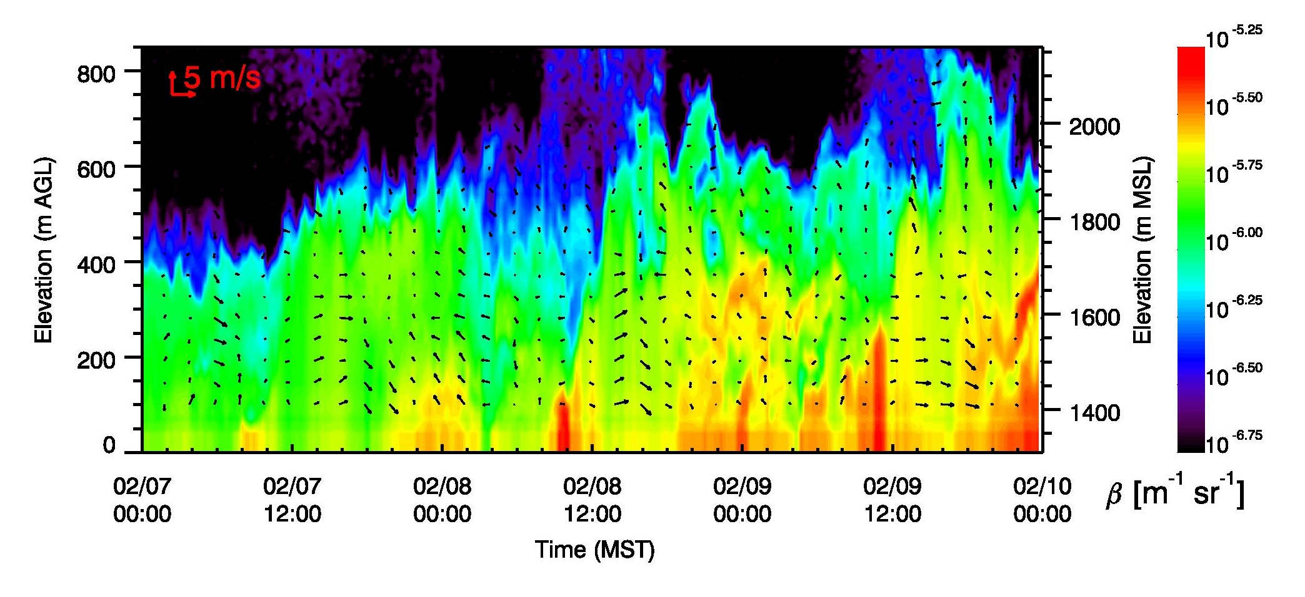
Aerosol formation / droplet growth ?
Post-sunrise
Nighttime

