Slide 1
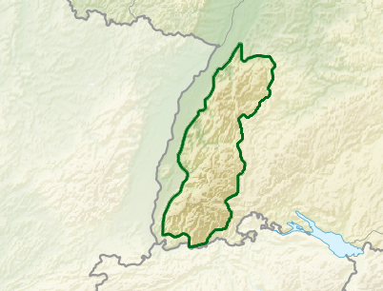

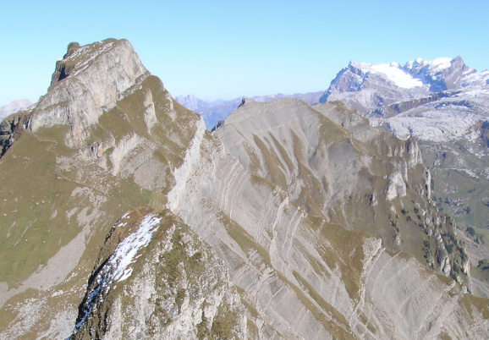

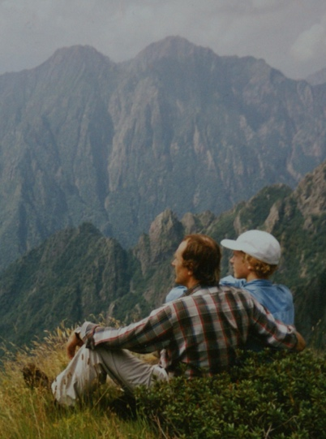

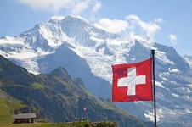
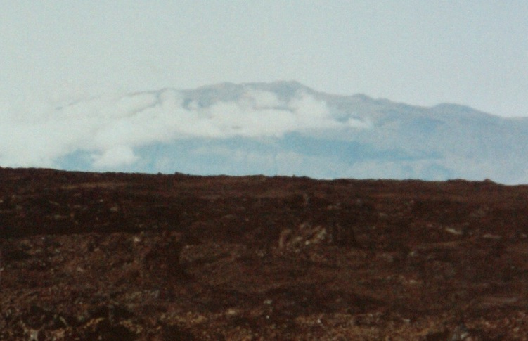
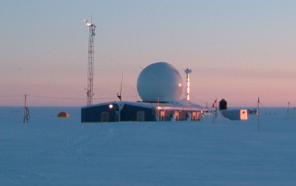
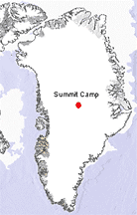
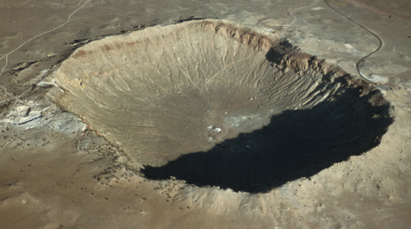
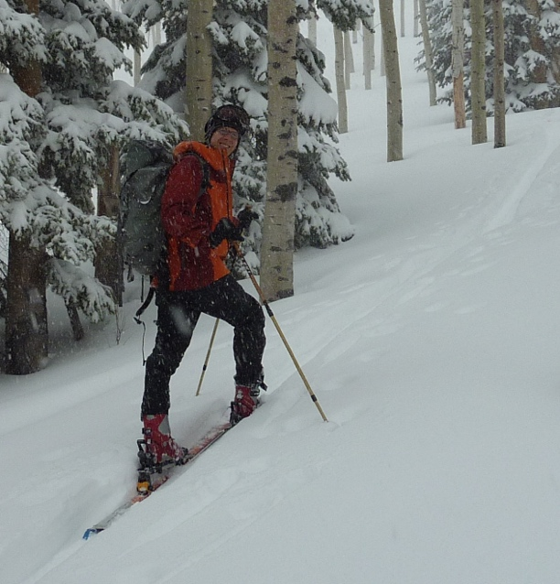
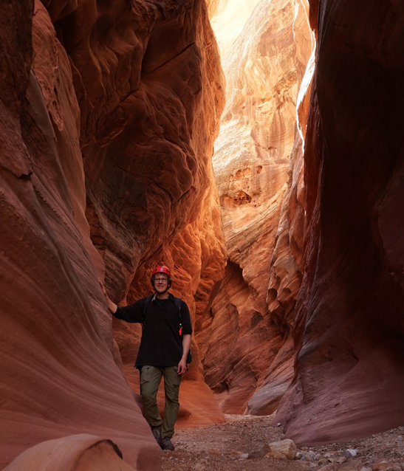
Hiking in the Italian Alps as a teenager
Sebastian Hoch
Research Associate Professor
Swiss Alps
France
The Black Forest
Born in the Black Forest (Southern Germany).
Foreign exchange – Alaska
Month-long field trip to Hawaii
Studies in Earth Sciences at ETH (Swiss Federal Institute of Technology)
PhD work on the Greenland Ice Sheet
Postdoc at the University of Utah with Dave Whiteman (2006)
Mauna Kea from Mauna Loa
Summit Camp, Greenland
Arizona Meteor Crater
Skiing Utah
Hiking Utah

Slide 2
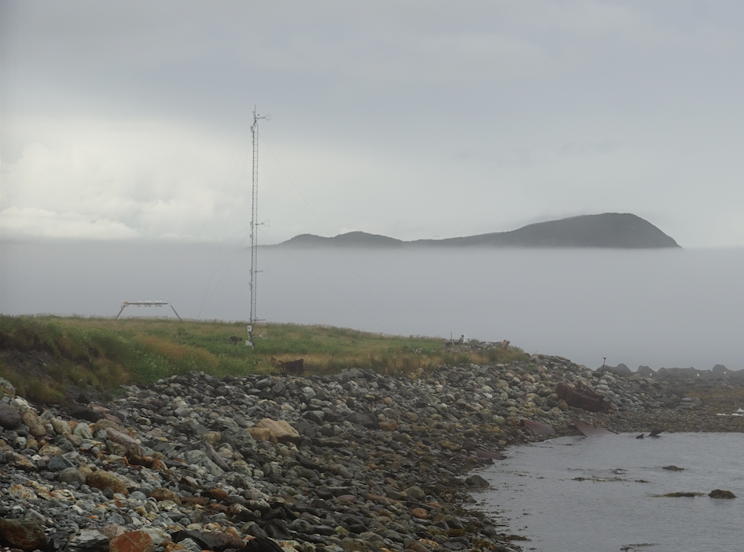
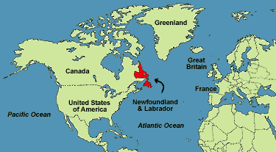
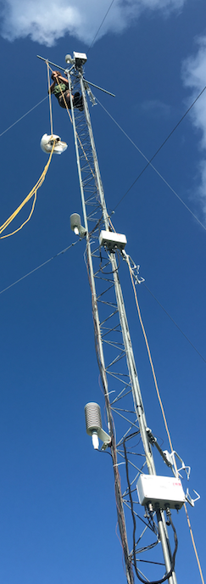
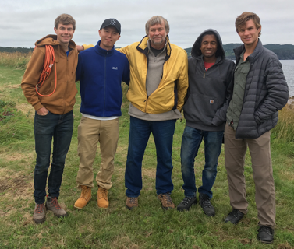

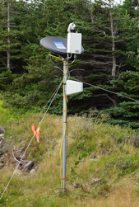
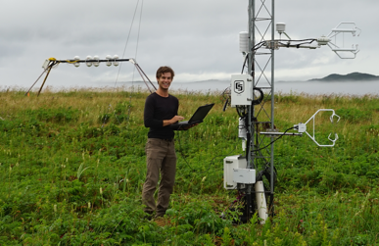
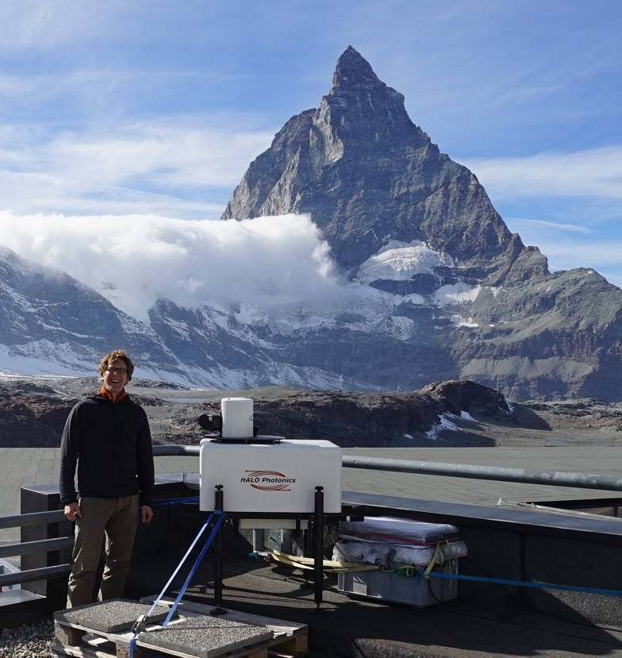
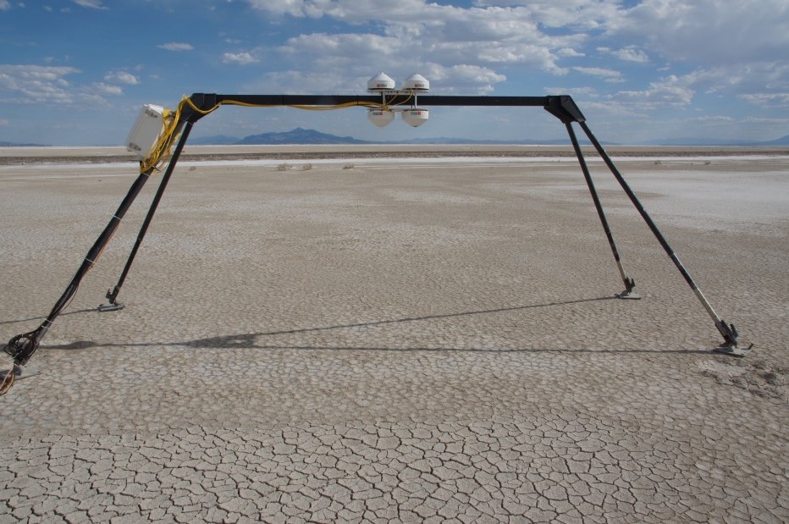

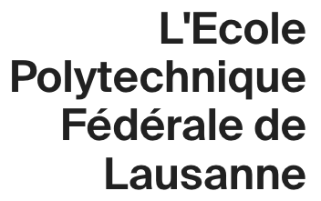
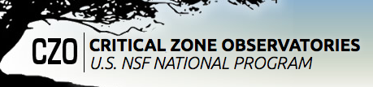
Sebastian Hoch
Toward Improving Coastal Fog Prediction
Newfoundland, Canada.
CFOG
Boundary layer processes in complex terrain
Mountain Meteorology Group
Mountain Weather and Climate (Atmos 3200)
Field Work / Experiments / Instrumentation
The Red Butte Canyon Air Mass Exchange and Pollution Transport Study
Zermatt,
Switzerland
DUST^2 (With Kevin Perry & Derek Mallia)
Salt Lake City,
Utah

Slide 3
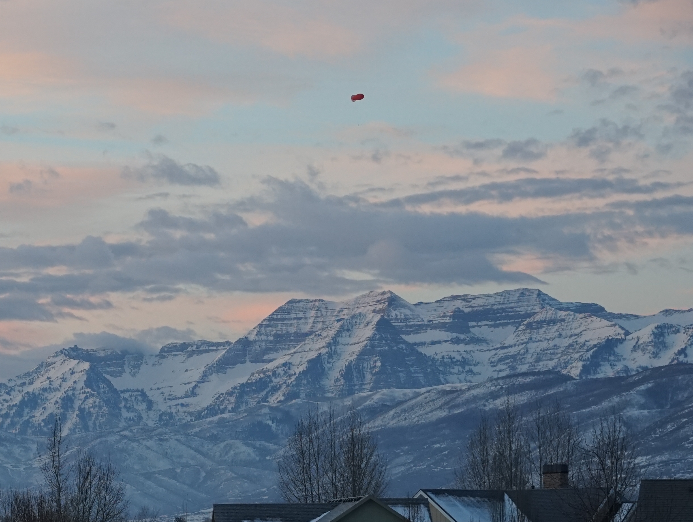
Cold Fog Amongst Complex Terrain | CFACT
Heber Valley – Dec. 2021-Feb. 2022
(Group)

