Slide 1
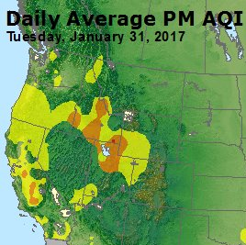
Meteorology-Chemistry Coupling in Western Basins
What’s similar, what’s different, what’s missing?
John Horel¹, Erik Crosman², Sebastian Hoch¹
¹University of Utah
²West Texas A&M

Slide 2
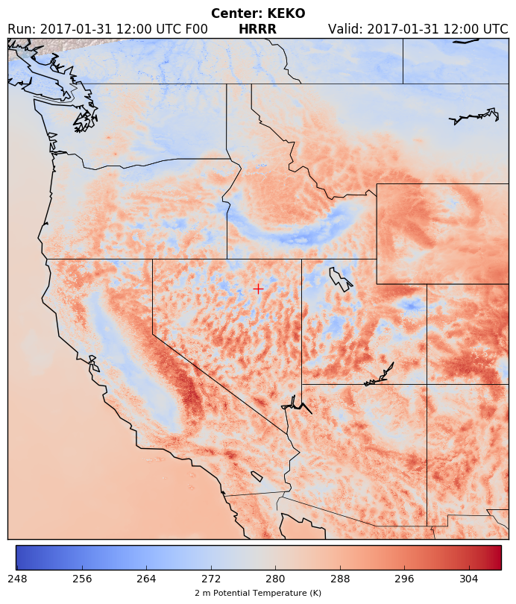
Meteorology-Chemistry Coupling in Western Basins
What’s similar, what’s different, what’s missing?
John Horel¹, Erik Crosman², Sebastian Hoch¹
¹University of Utah
²West Texas A&M
Blue: Valley & Basin Cold-Air Pools

Slide 3
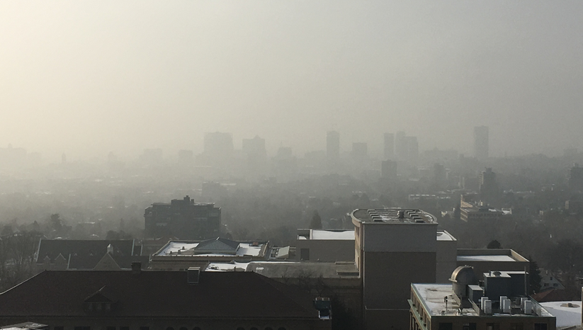
Geometry, land-use & population
Existing resources & flight restrictions
Surface state: snow-covered or wet/dry
Basin
Air Chemistry

Slide 4
Geometry, land-use & population
Existing resources & flight restrictions
Surface state: snow-covered or wet/dry
Synoptic/mesoscale controls
Free atmos.-boundary layer exchanges Lateral transport within boundary layer
Terrain-flow interactions
Structure/turbulence in boundary layer
Water/ice clouds & deposition
Basin
Air Chemistry
Meteorology

Slide 5


Topography
(Basins, Valleys)
Synoptic conditions
Valley/Basin Meteorology
Persistent Cold-Air Pools
Surface conditions (snow cover, …)
Vertical temperature structure and mixing
Terrain-Flow interactions
Geometry, land-use & population
Existing resources & flight restrictions
Surface state: snow-covered or wet/dry
Synoptic/mesoscale controls
Free atmos.-boundary layer exchanges Lateral transport within boundary layer
Terrain-flow interactions
Structure/turbulence in boundary layer
Water/ice clouds & deposition
Land use
Emission sources
Chemical pathways
Limiting reactants
…
Air Chemistry
Meteorology
Microphysics / Nucleation
Fog/Clouds
Radiative feedbacks
Deposition

Slide 6
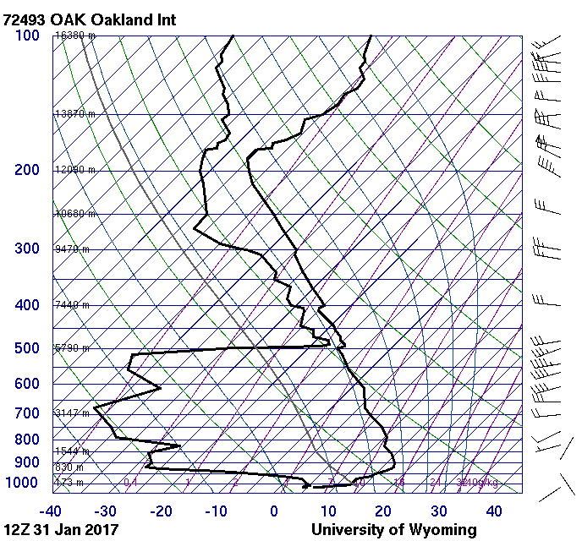
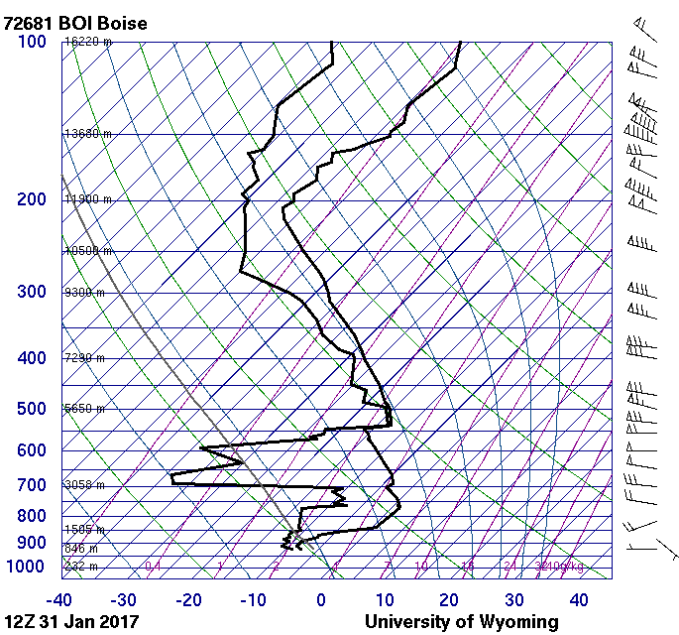
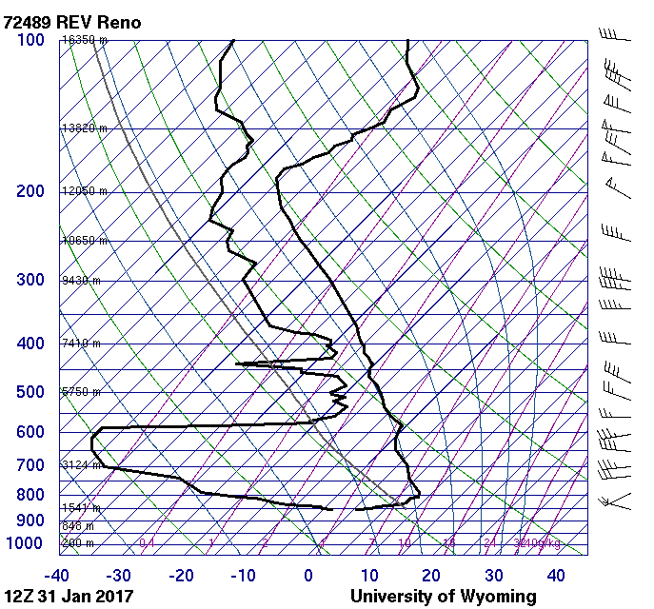
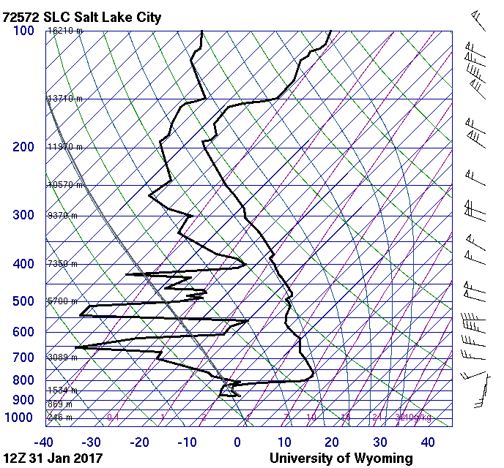
Vertical Structure
January 31,2017
12 UTC
Haze
V 5mi
V 10mi
ZOOM TO BL ?
-> Mention Heat deficit
Fog
V 3 mi
V 10 mi

Slide 7
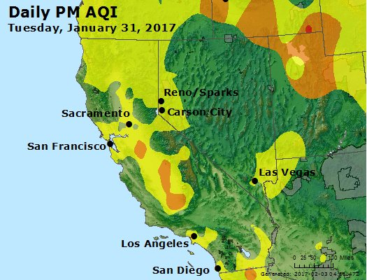
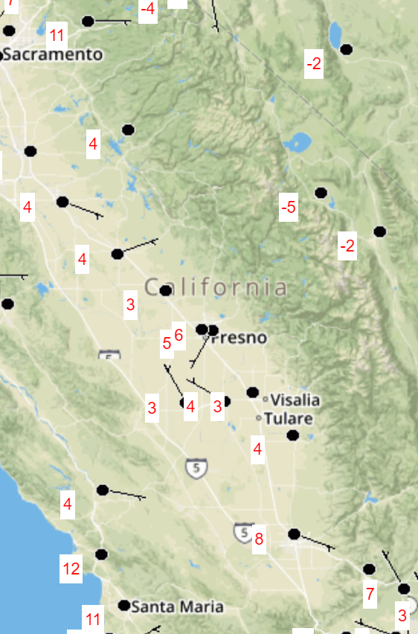
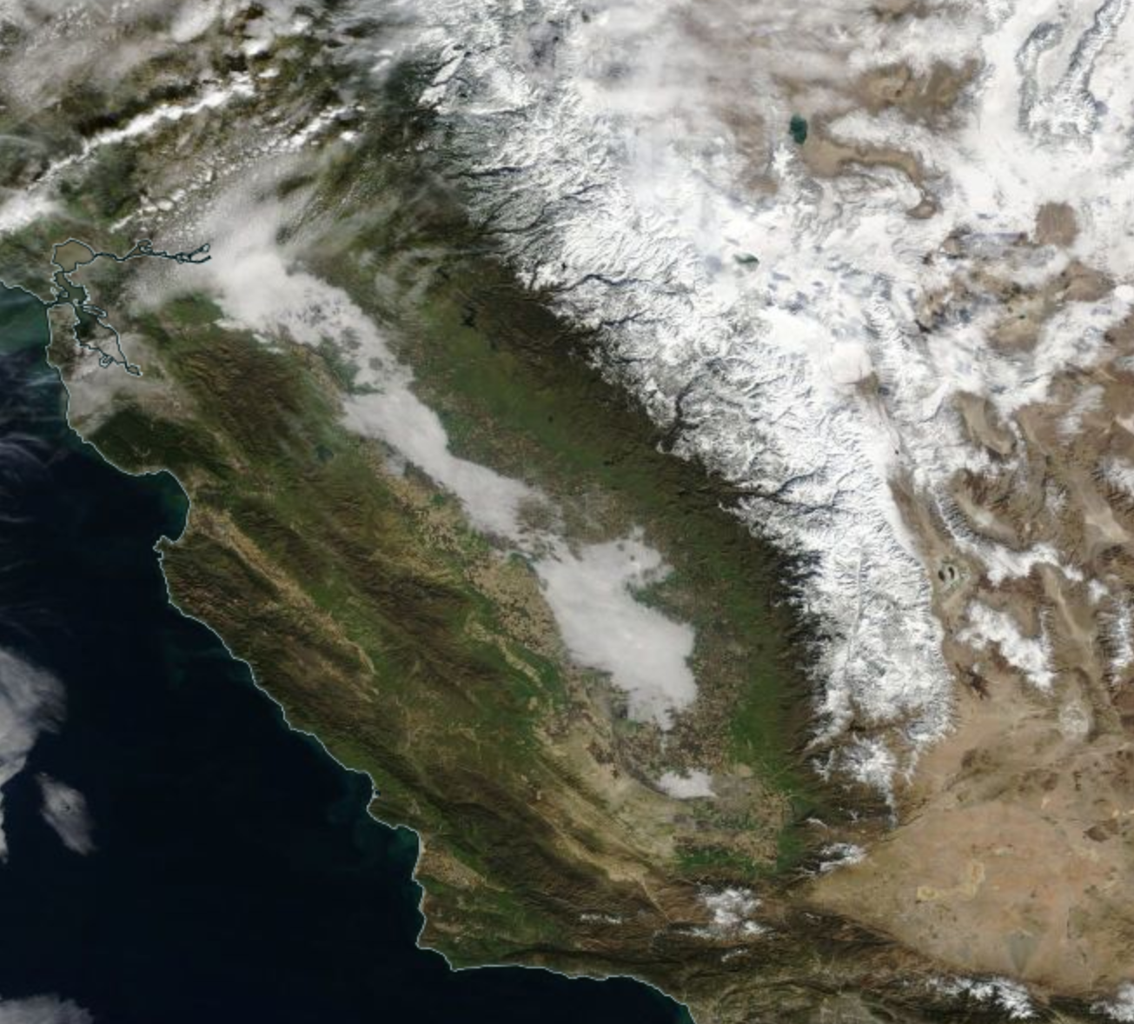
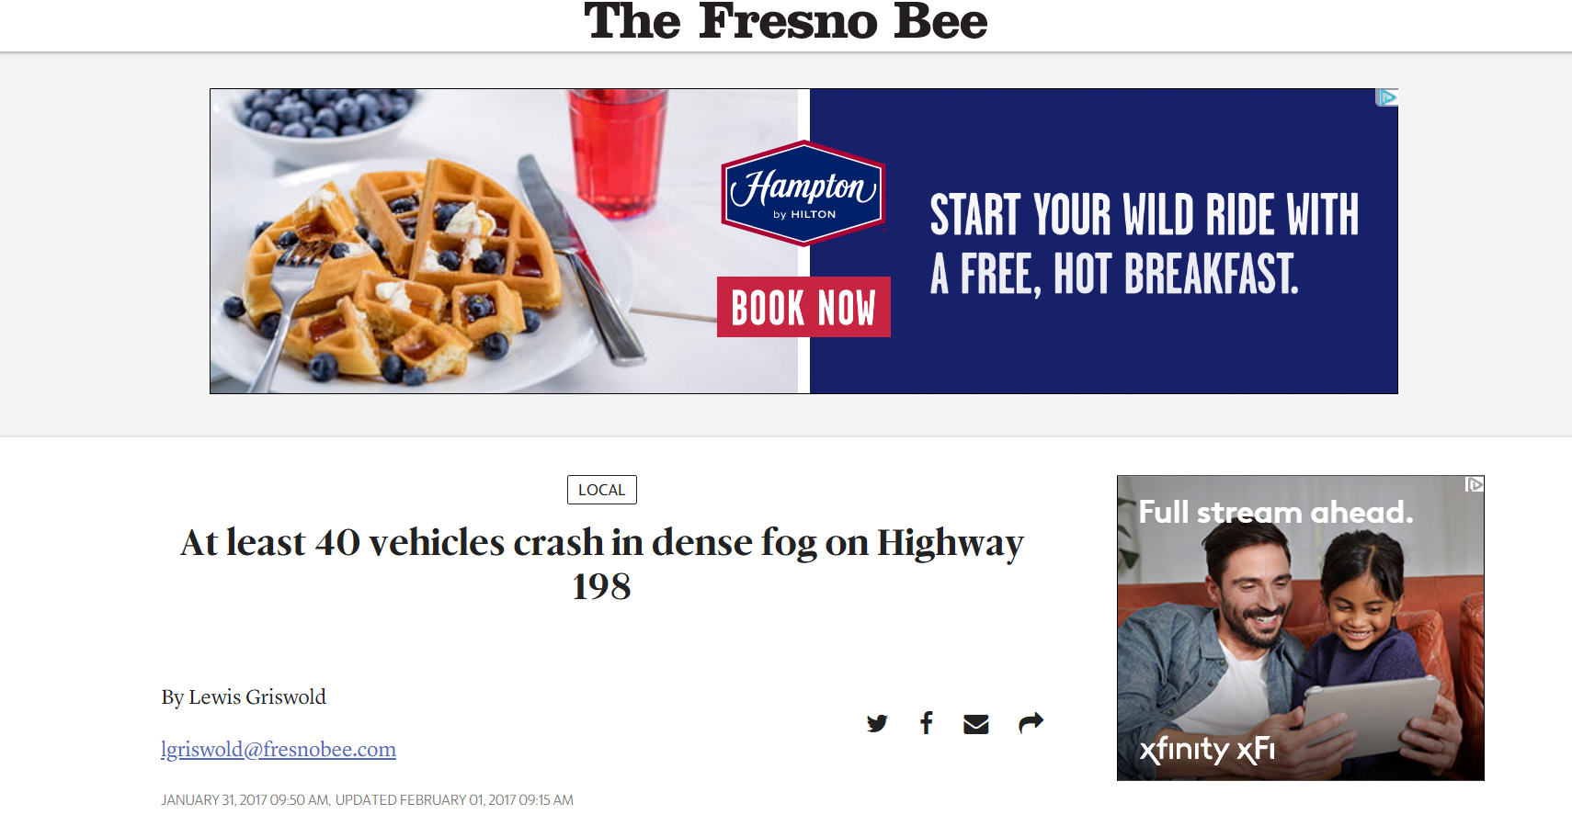
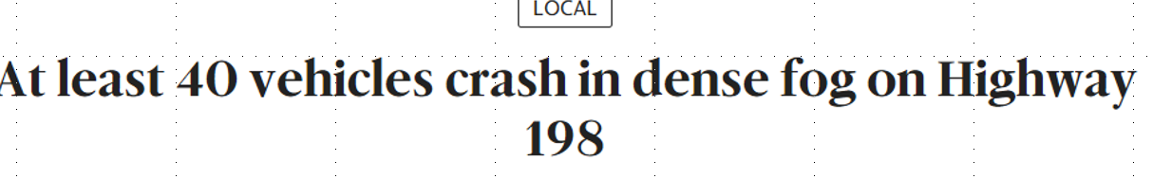
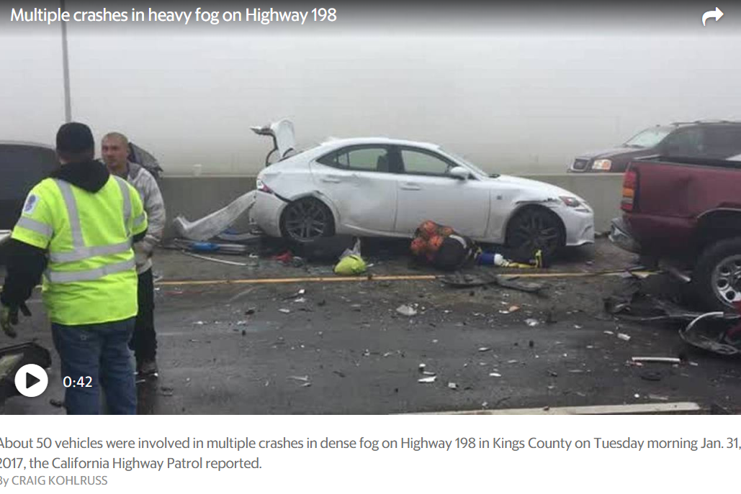
January 31, 2017
San Joaquin Valley
Temperature (ºC)

Slide 8
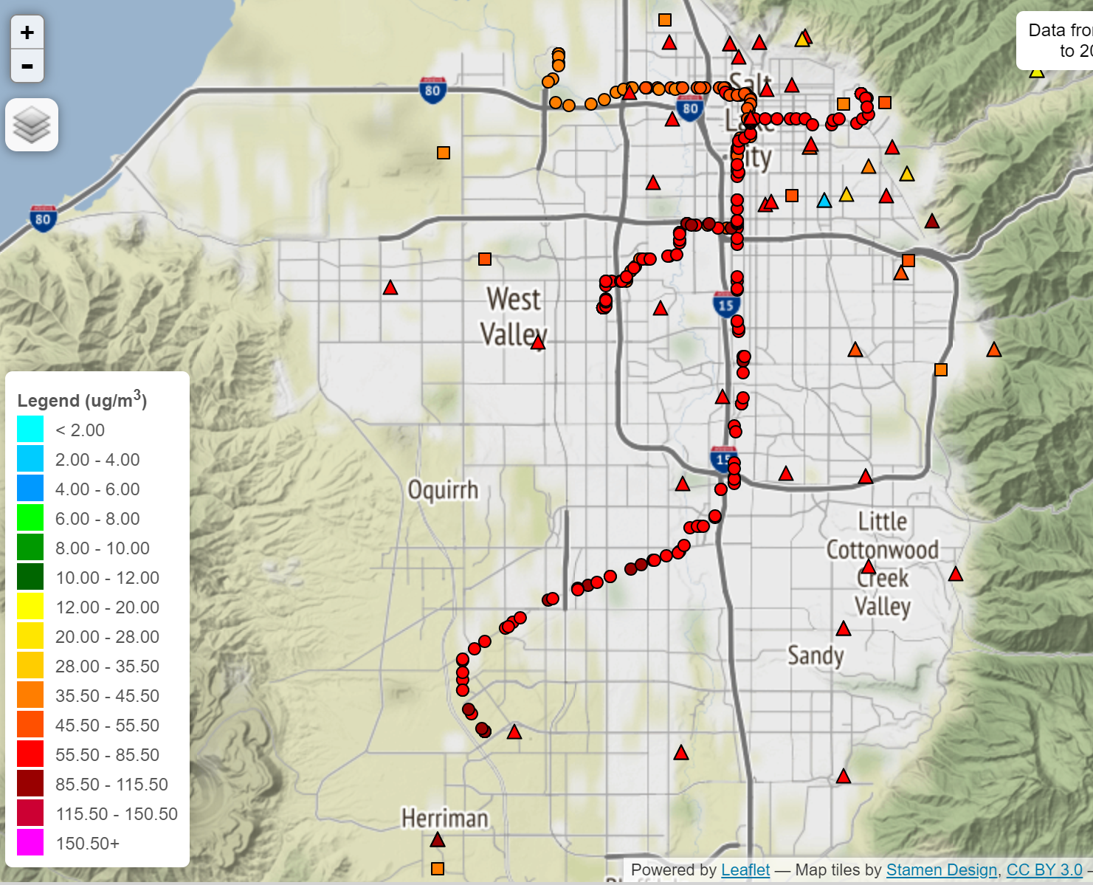
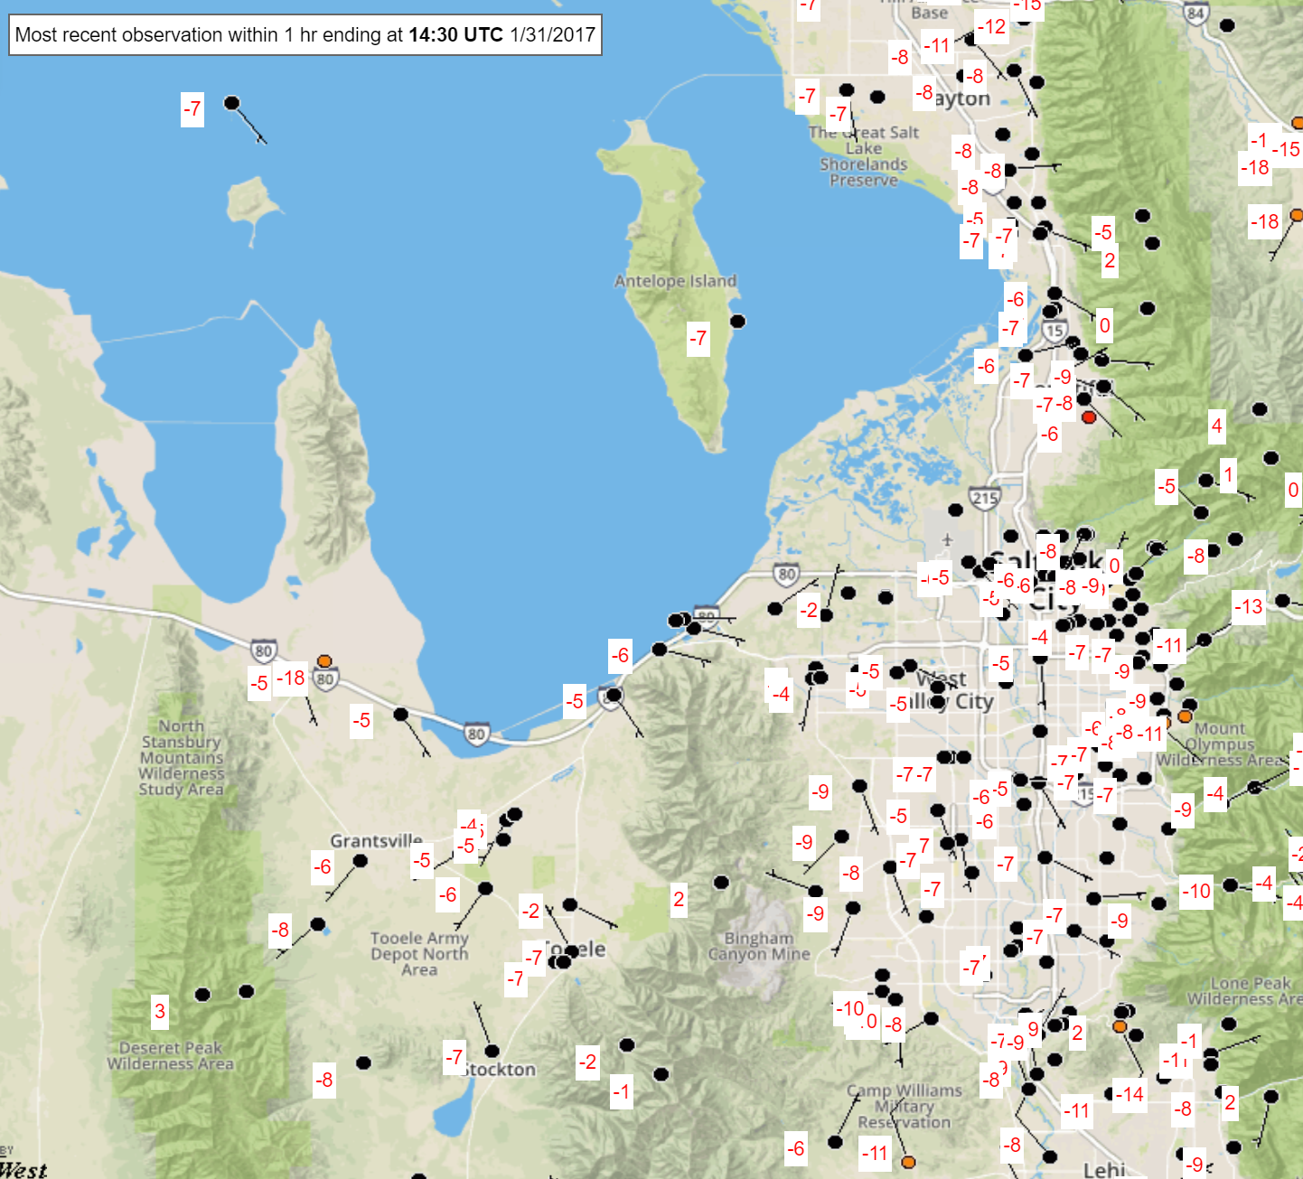
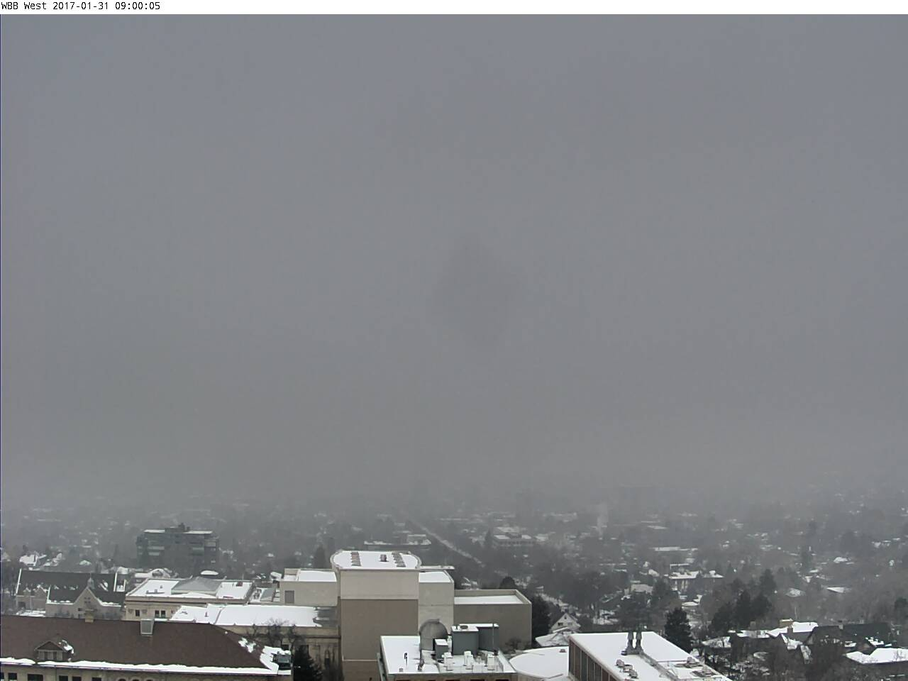
January 31, 2017
Salt Lake Valley
Temperature (ºC)
Mention or print mean T/PM ?

Slide 9
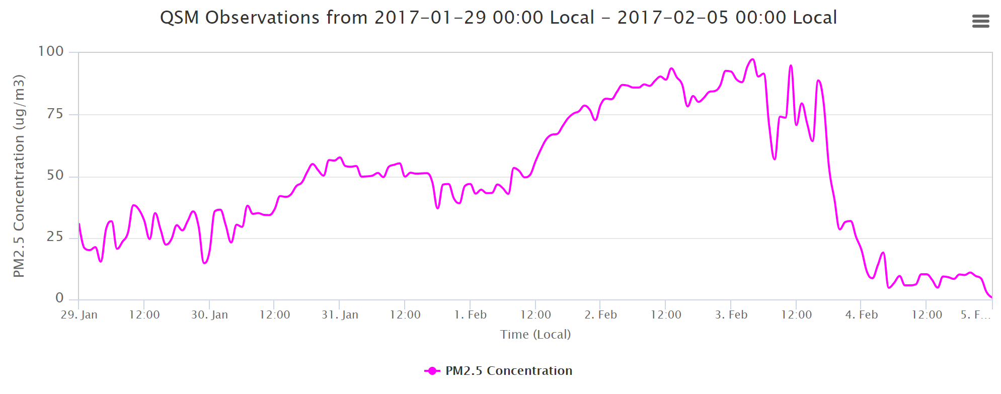
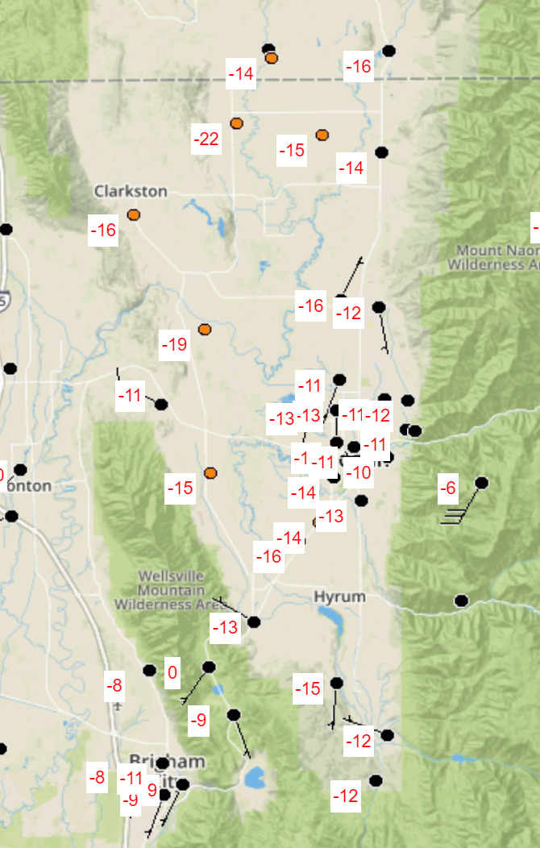
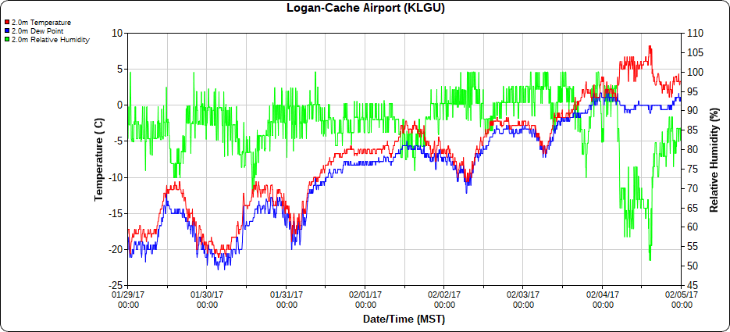
January 31, 2017
Cache Valley, UT
Temperature (ºC)
WEBCAM ? Mention or print mean T/PM ?

Slide 10
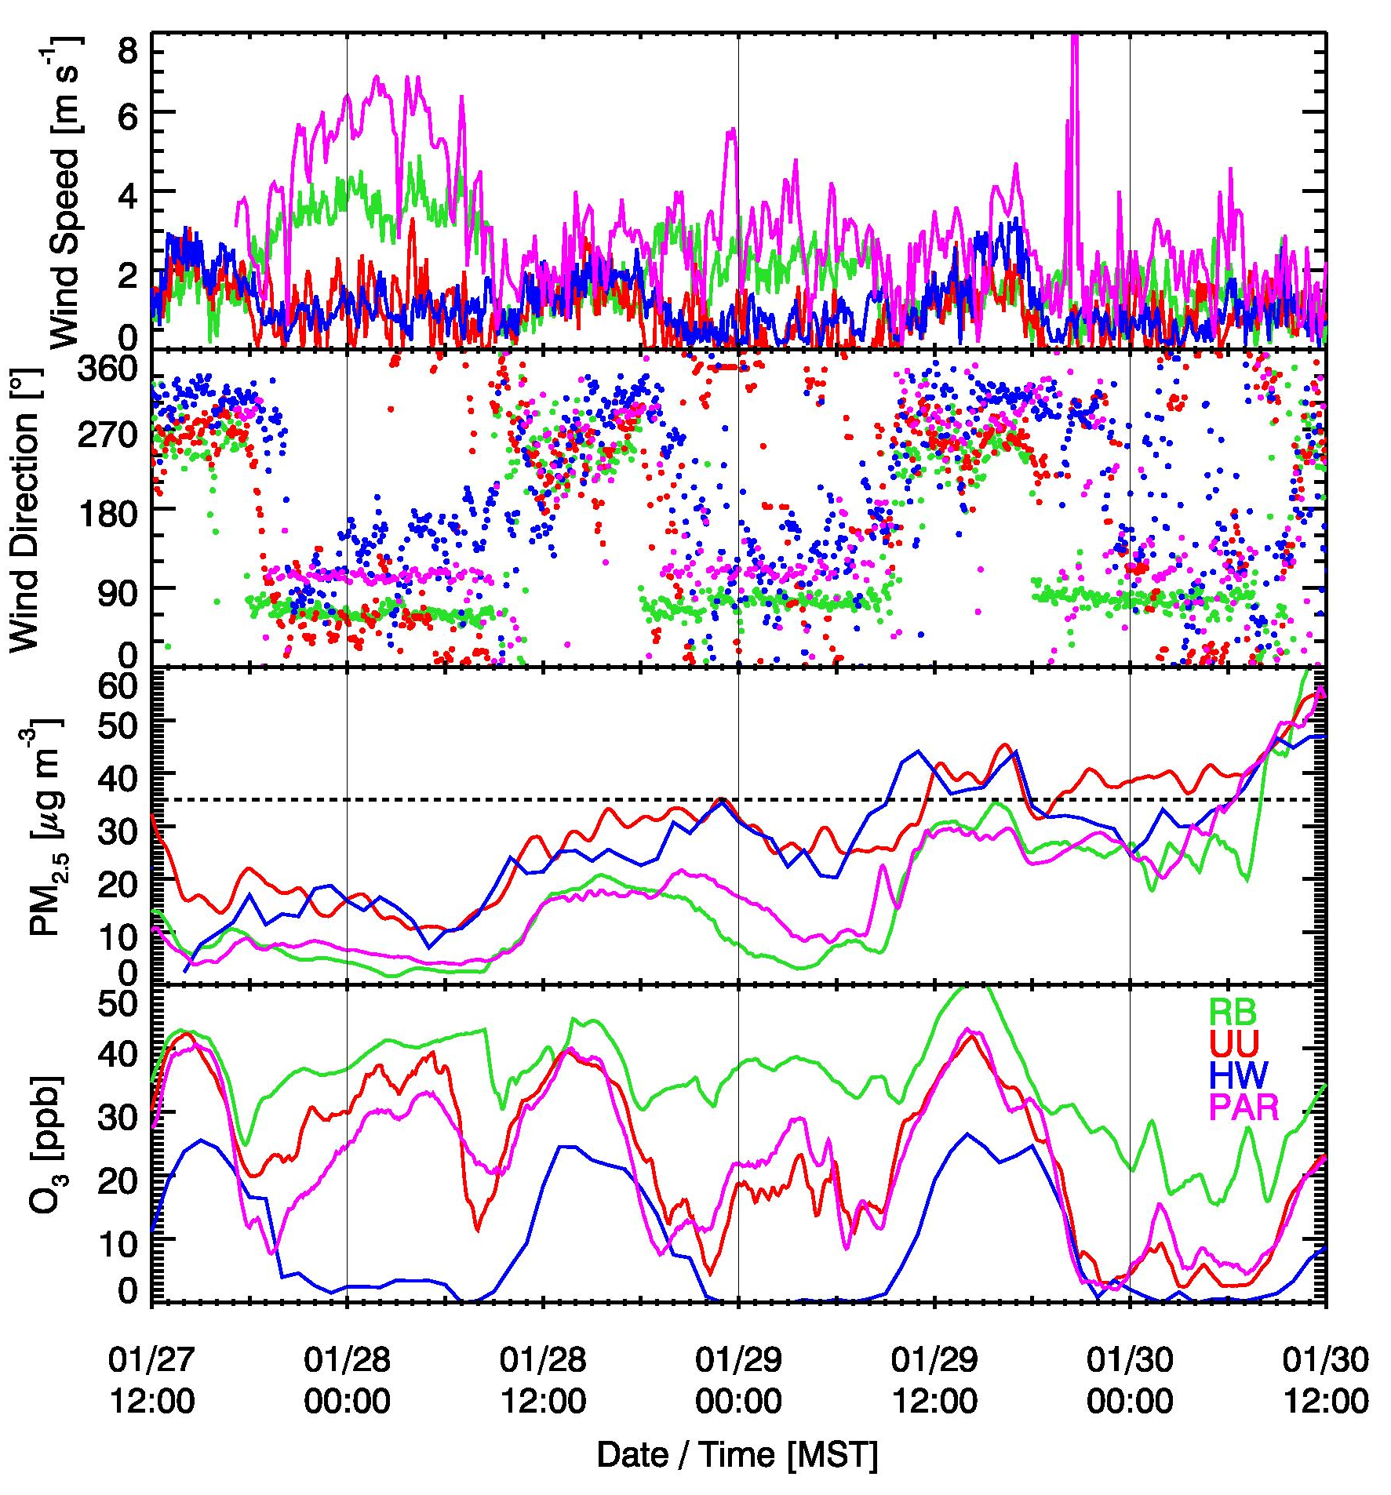
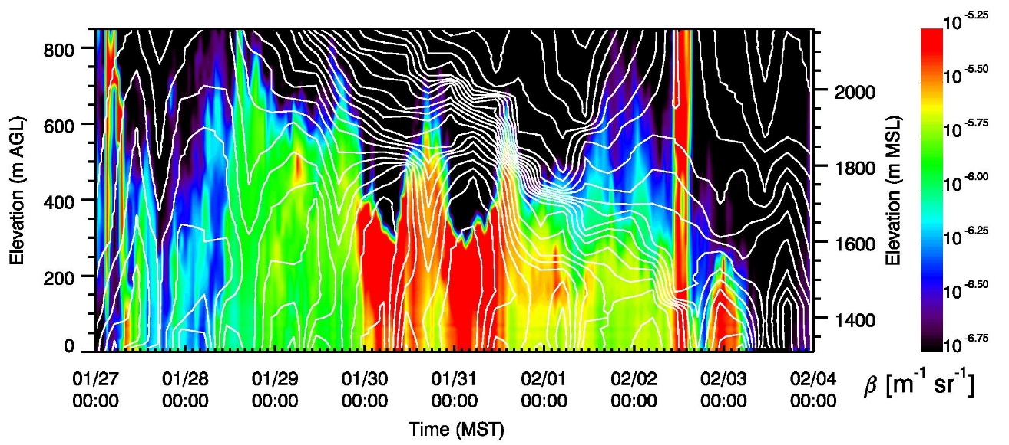
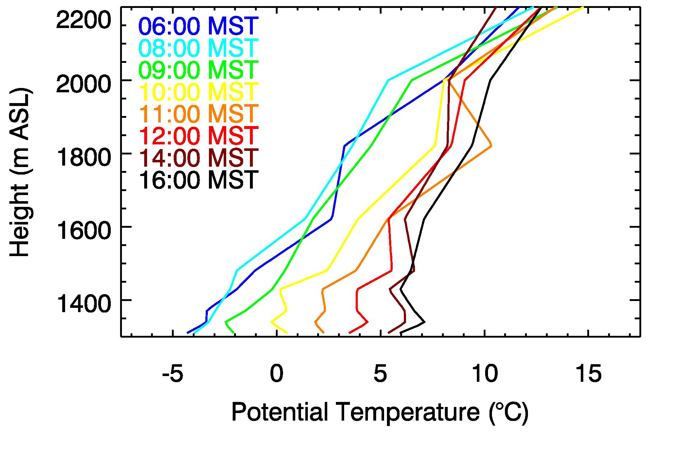
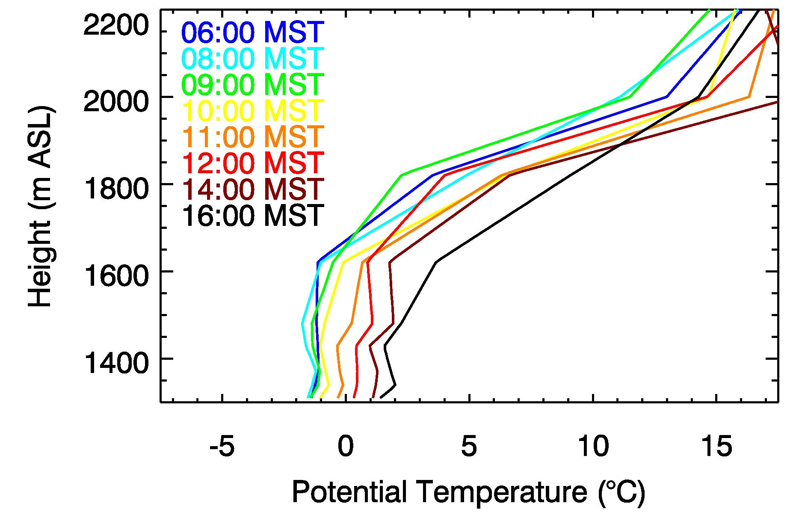
Boundary layer & slope flow evolution in the Salt Lake Valley: Jan. 31, 2017
~12 UTC
Reduction in drainage flow intensity
Subsidence inversion
“Clear”
“Foggy
Cloudy”
“Clear”
“Foggy
Cloudy”
PCAP
Night-time injection of low-PM_{2.5}, high O₃ air is reduced
“Clear”
PCAP
Nocturnal strengthening of CAP
Daytime heating & mixing
Dampening of diurnal cycle
Layer remains “well mixed”
NSF RAPID / METEO DURING UWFPS

Slide 11
January 31, 2017
Similarities
Differences
Large-scale ridging
Conditions evolving diurnally & over lifetime of pollution event
Fog/stratus present at times in some basins
Basin dimensions
Land-use & population
Snow-free/snow-covered
Temperature regime
Resulting Effects modifying Meteo-Chem feedback:
Thermally-driven slope and valley flows (intrabasin mixing)
Presence/absence of convective boundary layers, residual layers, and capping stable layers
…
Ventilation processes
Special processes (lake, playa breezes)

Slide 12
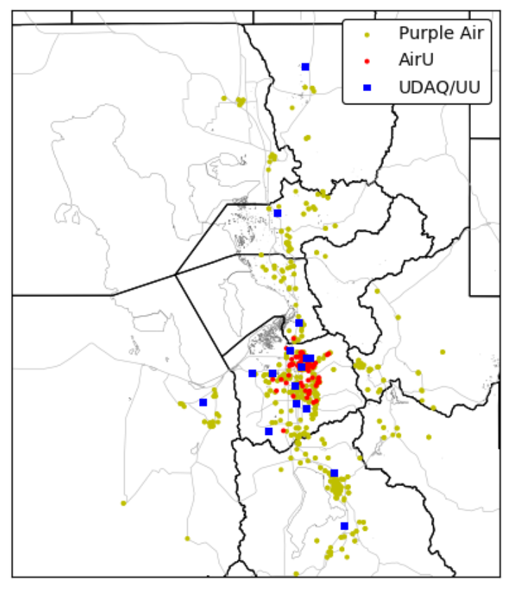
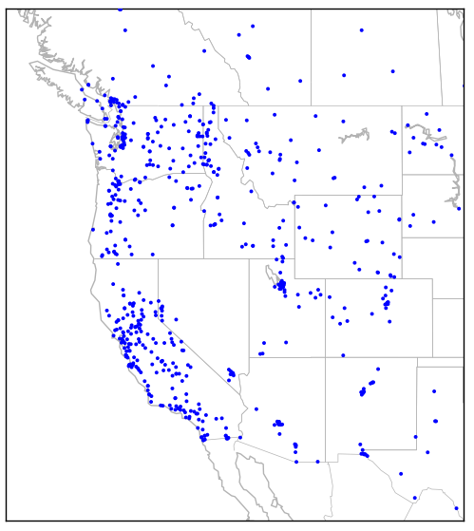
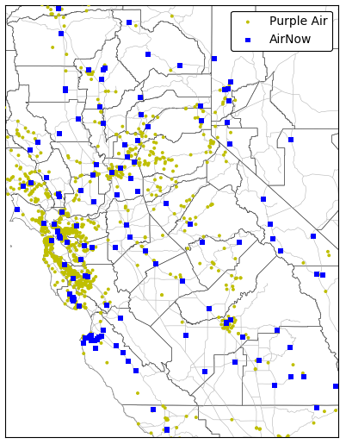
Planning & Situational Awareness Resources: PM2.5
> 700 state/county locations
> 130 CARB/county
> ~1400 Purple Air
16 DAQ/UUtah
> 90 AirU sites; ~400 Purple Air

Slide 13
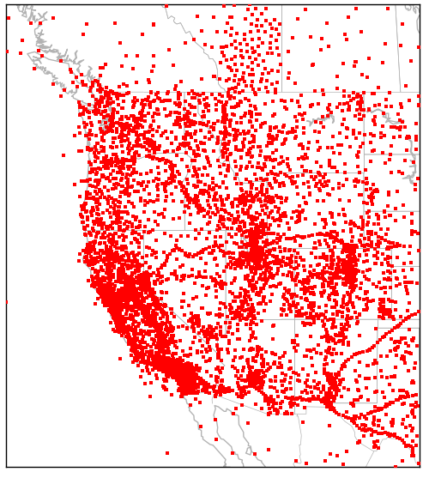
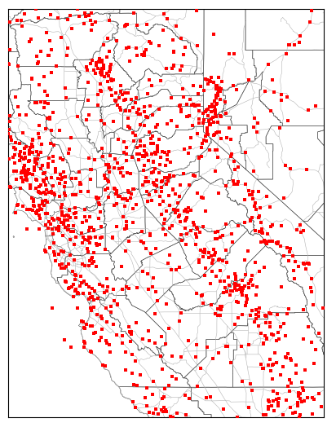
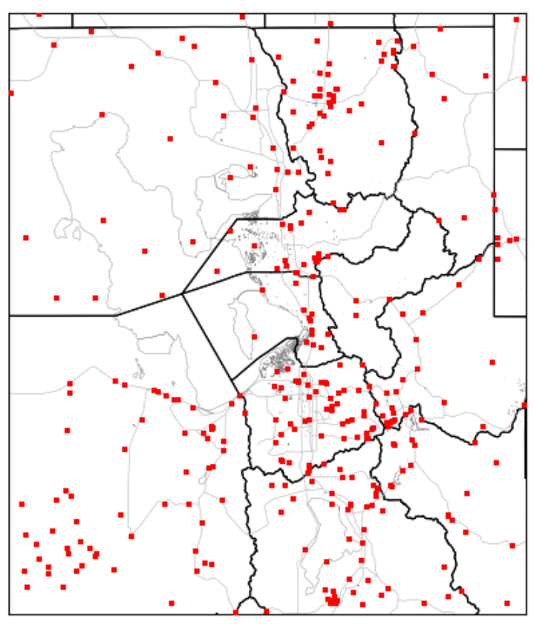
Planning & Situational Awareness Resources: Surface Wind Observations
> 7500 locations
> 1300 locations
> 300 locations

Slide 14
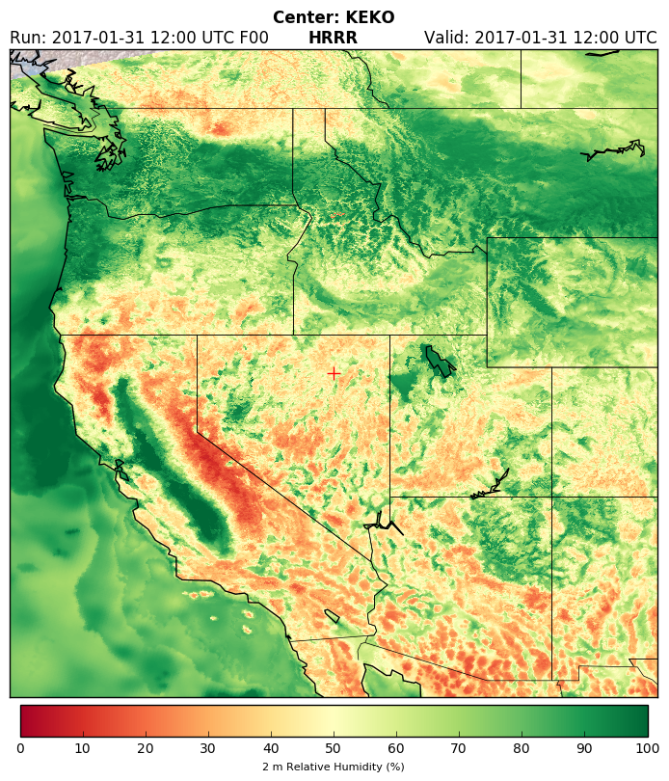
Planning & Situational Awareness
Synoptic/mesoscale conditions usually simulated adequately by operational models
But…
  Breakup phase harder to forecast than onset
  Transition from clear-air to cloudy boundary layers (and vice versa) difficult
  Boundary layer processes tend to be overly dispersive/damped

Slide 15
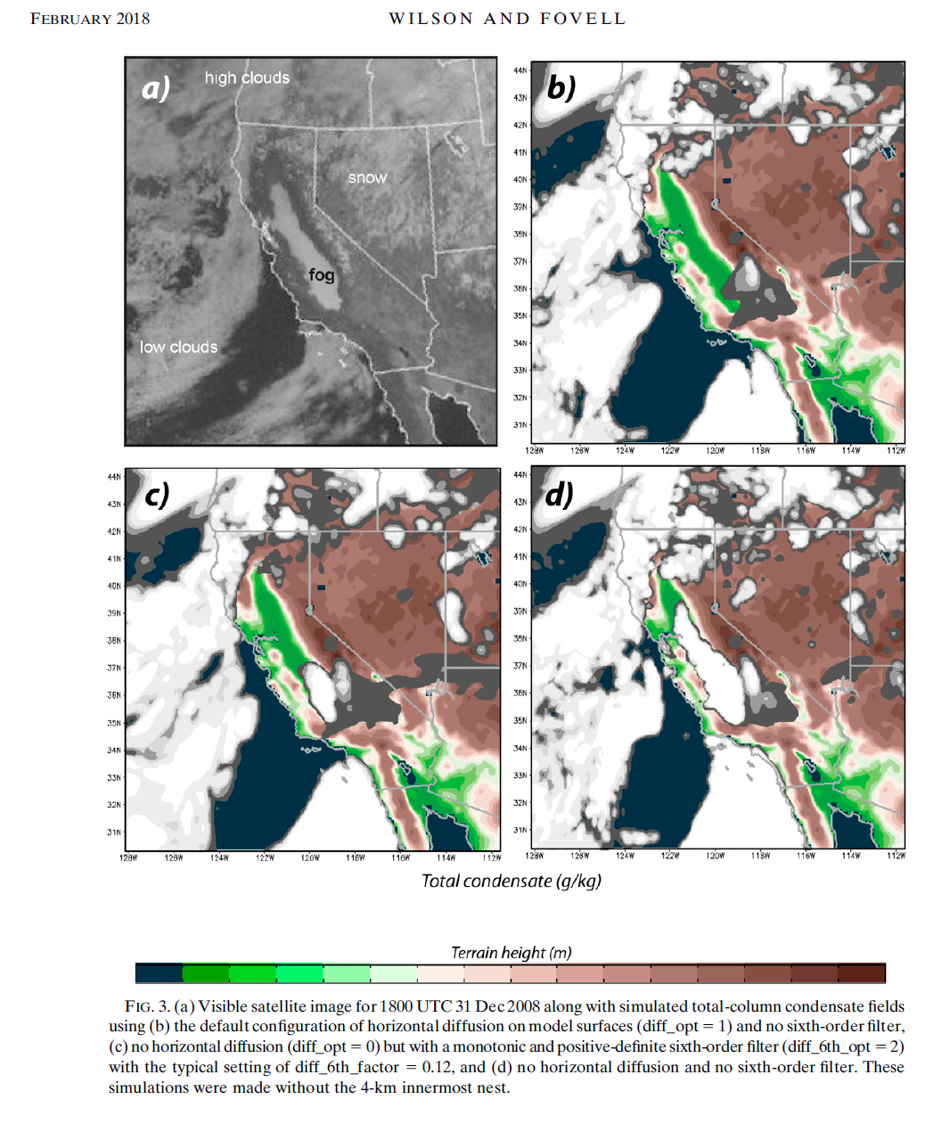
Planning & Situational Awareness
Research model simulations highlight considerable work underway but much remains to improve treatment of boundary layer processes whether on the scales of Convection-Allowing Models (1-3 km) or Large-Eddy Simulations (10’s-100’s m)

Slide 16
What is missing and will need to be in place?
…
…
Routine sounding observations throughout the depth of the boundary layer (in multiple locations in large basins)
Boise, Denver, Reno, Salt Lake have twice-daily NWS soundings
Central Valley does not

Slide 17
Summary- planning steps to meet program objectives?
There are fundamental meteorological capabilities needed in order to be able to address overall program objectives
  Complexity of events in all basins requires a mix of meteorological sensor types and deployment strategies (e.g., in situ and surface-based remote)
  Requires continuous or regularly-spaced in time observations throughout the day and night to be able to monitor clear and cloudy conditions within the boundary layer
Boundary layer meteorology/air chemistry processes are too intertwined to treat independently
  Understanding pollutant events from beginning to end requires close coordination to understand how chemical species evolve as the conditions evolve
  Critical questions remain regarding how pollutant concentrations depend on aerosol sensitivity to water loading and aqueous chemistry
QUALITY is KNOWN, NEED to QUANTYFY

Slide 18
A slide linking met and aq / timeseries?

Slide 19
Content below as extras or to fill in above

Slide 20
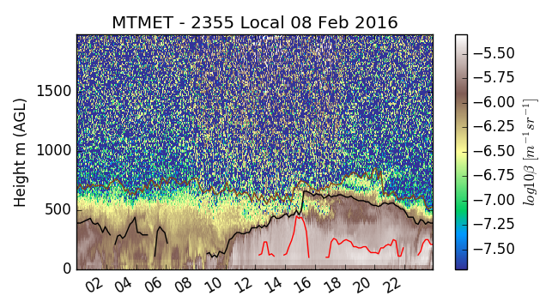
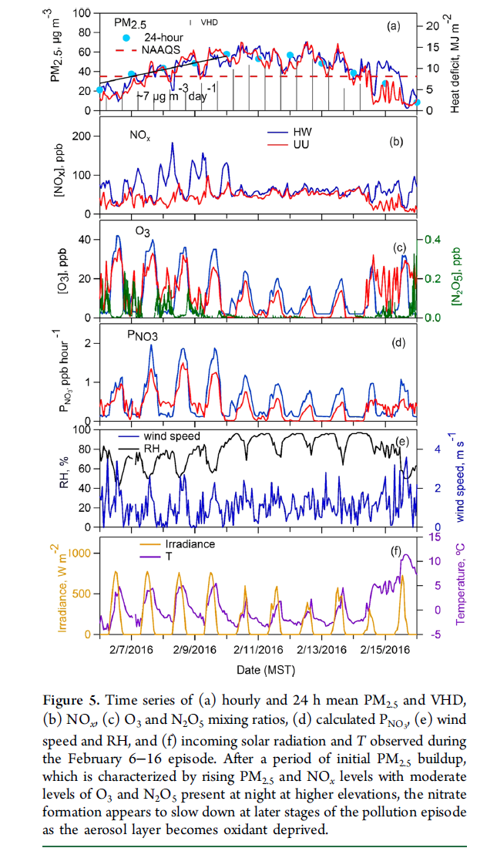
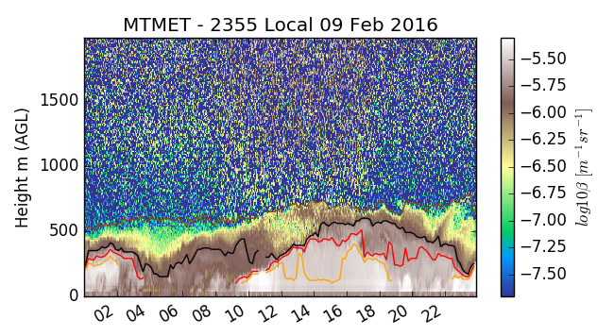
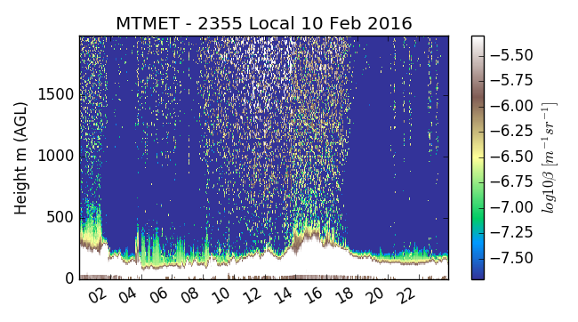
Periods when ppt

Slide 21
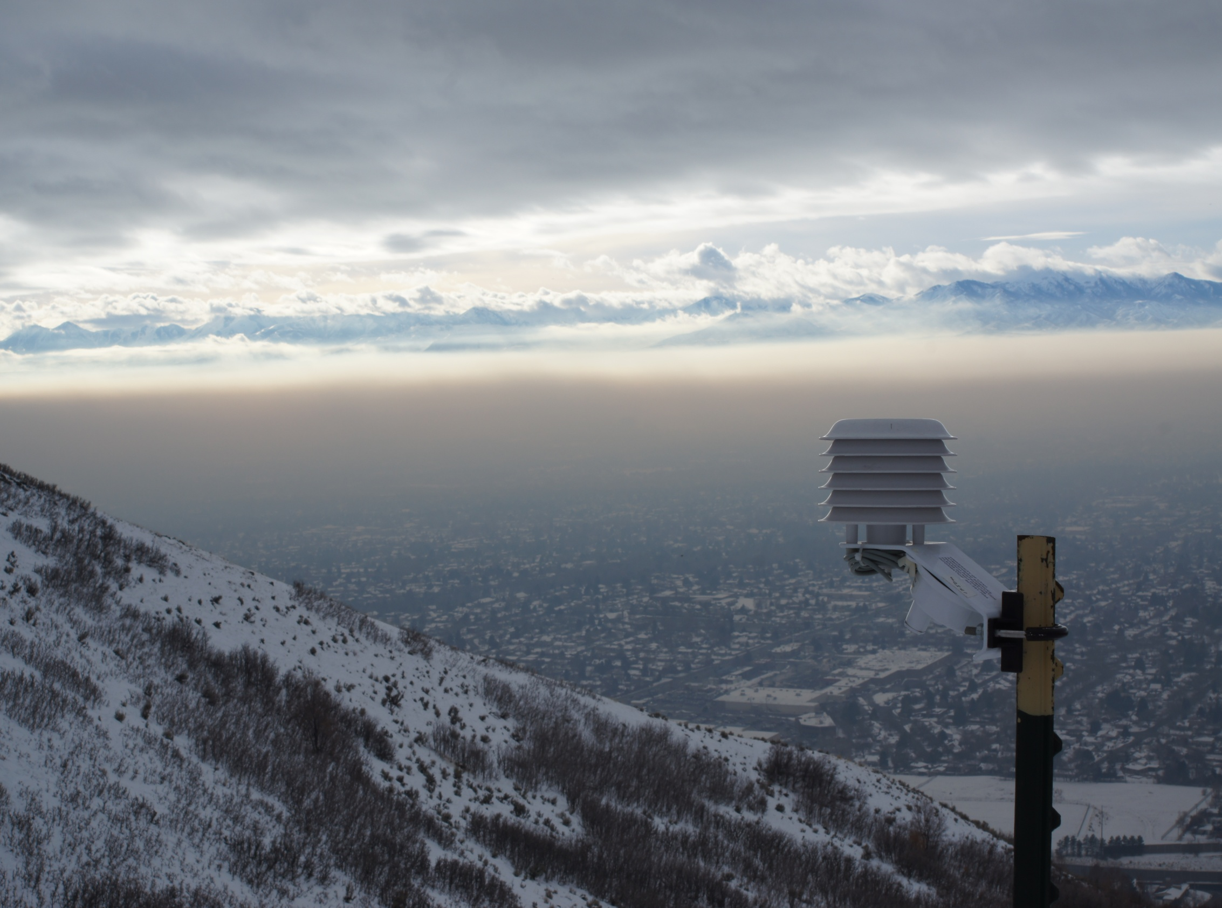
The Basic Ingredients for Persistent Cold-Air Pool Type Events
Warmer air aloft
H
High pressure
Pollutants
Cold air pool
Light winds

Slide 22
Complicating Factors
Turbulent Mixing
Transport
Clouds
Depth of
polluted layer
Transport
Surface fluxes

Slide 23
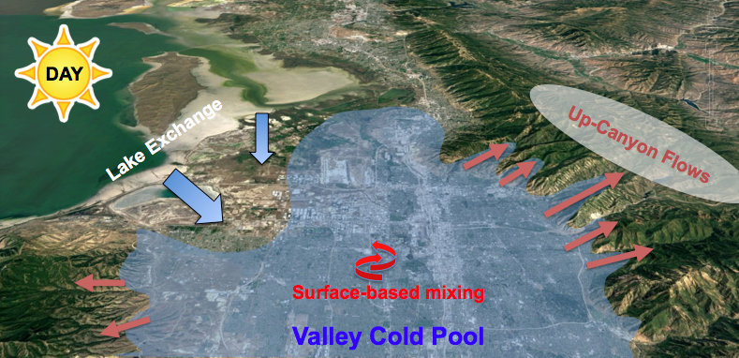
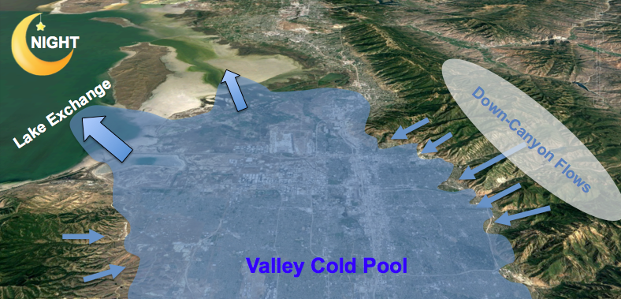
Pollution Transport (“Flows”) (updated version w flow to/from south?)
Salt Lake Valley
Slide courtesy Sebastian Hoch

Slide 24
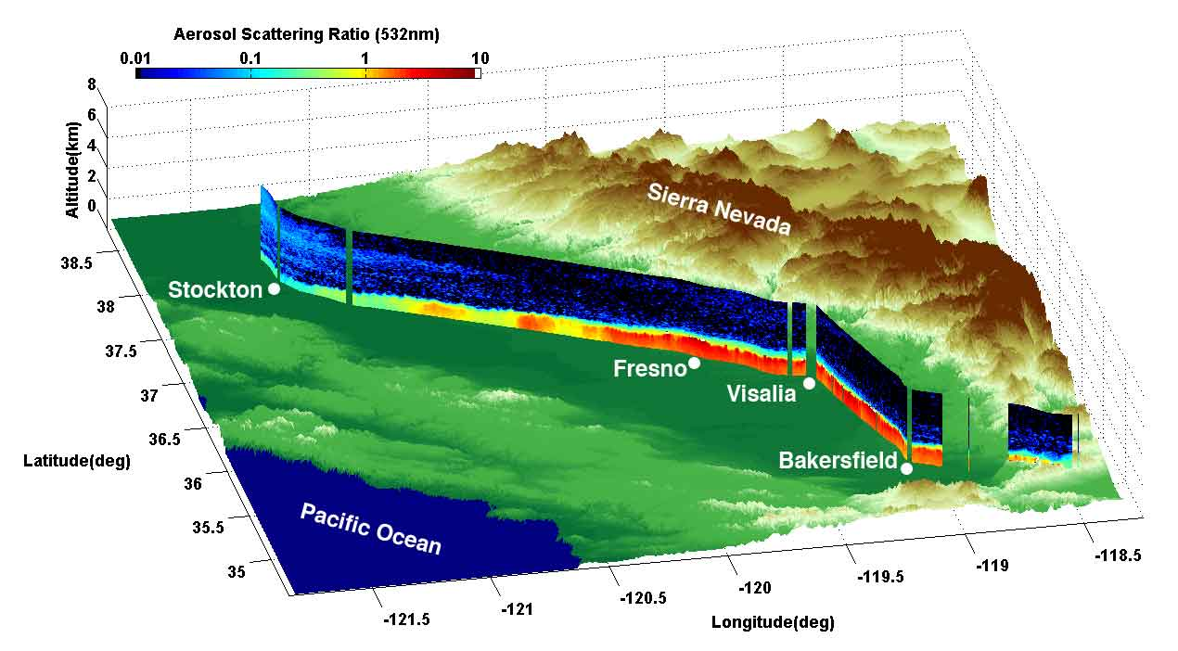
February 15, 2007

Slide 25
What meteorological factors contribute to the life cycle of chemical species within basins?
A long laundry list…

Slide 26
To what extent are chemical processes controlled by vertical mixing and entrainment between layers of differing stability relative to horizontal transport (interbasin and intrabasin)?
Rarely steady-state- large 3D variations throughout the day & over time
  Horizontal advection is large within the boundary layer and even more so aloft leading to large variations in conditions
Downward mixing of background air (with high ozone)

Slide 27
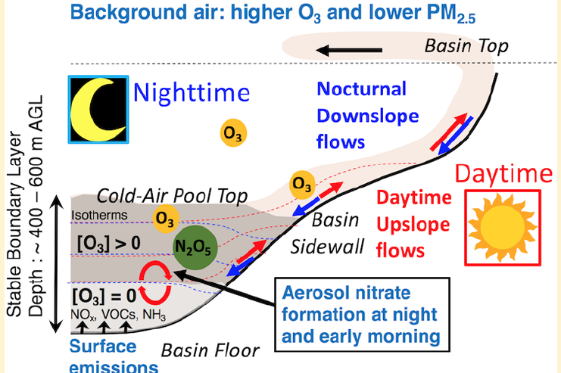
How are chemical pathways affected by differences between thermodynamic and dynamical processes in the core of basins relative to those processes near their edges?
Depends on the size of the basin-
  SLV: ~narrow valley with steep side walls then edge effects important
  Central Valley: edges likely less critical relative to other factors
Baasandorj et al. 2017

Slide 28
How do variations in the fluxes of heat, moisture, and momentum arising from heterogeneous surfaces within and between basins (e.g., rural or urban; vegetated, snow or water covered) lead to variations in the production and destruction of pollutants?
How to distribute ground-based sensors and flights to cover the heterogeneous mix recognizing that these fluxes are not steady-state?
What are impacts of restricted flight zones on the coverage?

Slide 29
Do chemical processes affect the structure of the boundary layer, for example, through contributing to the formation of clouds or reducing solar insolation received at the surface?
Why are aerosols not impacted more by scavenging in the presence of precipitation?

Slide 30
What are the appropriate modeling approaches to use within wintertime basins and how may that differ as a function of factors such as basin dimensions, surface characteristics, exposure to differing mesoscale and synoptic conditions, etc.?
Will require a lot of different strategies beyond performing sensitivity experiments to various paramterizations

Slide 31
What meteorological observations are required to help validate photochemical models?
Surface-based in-situ & remote sensors able to evaluate conditions throughout the boundary layer continuously in both clear and cloudy conditions

Slide 32
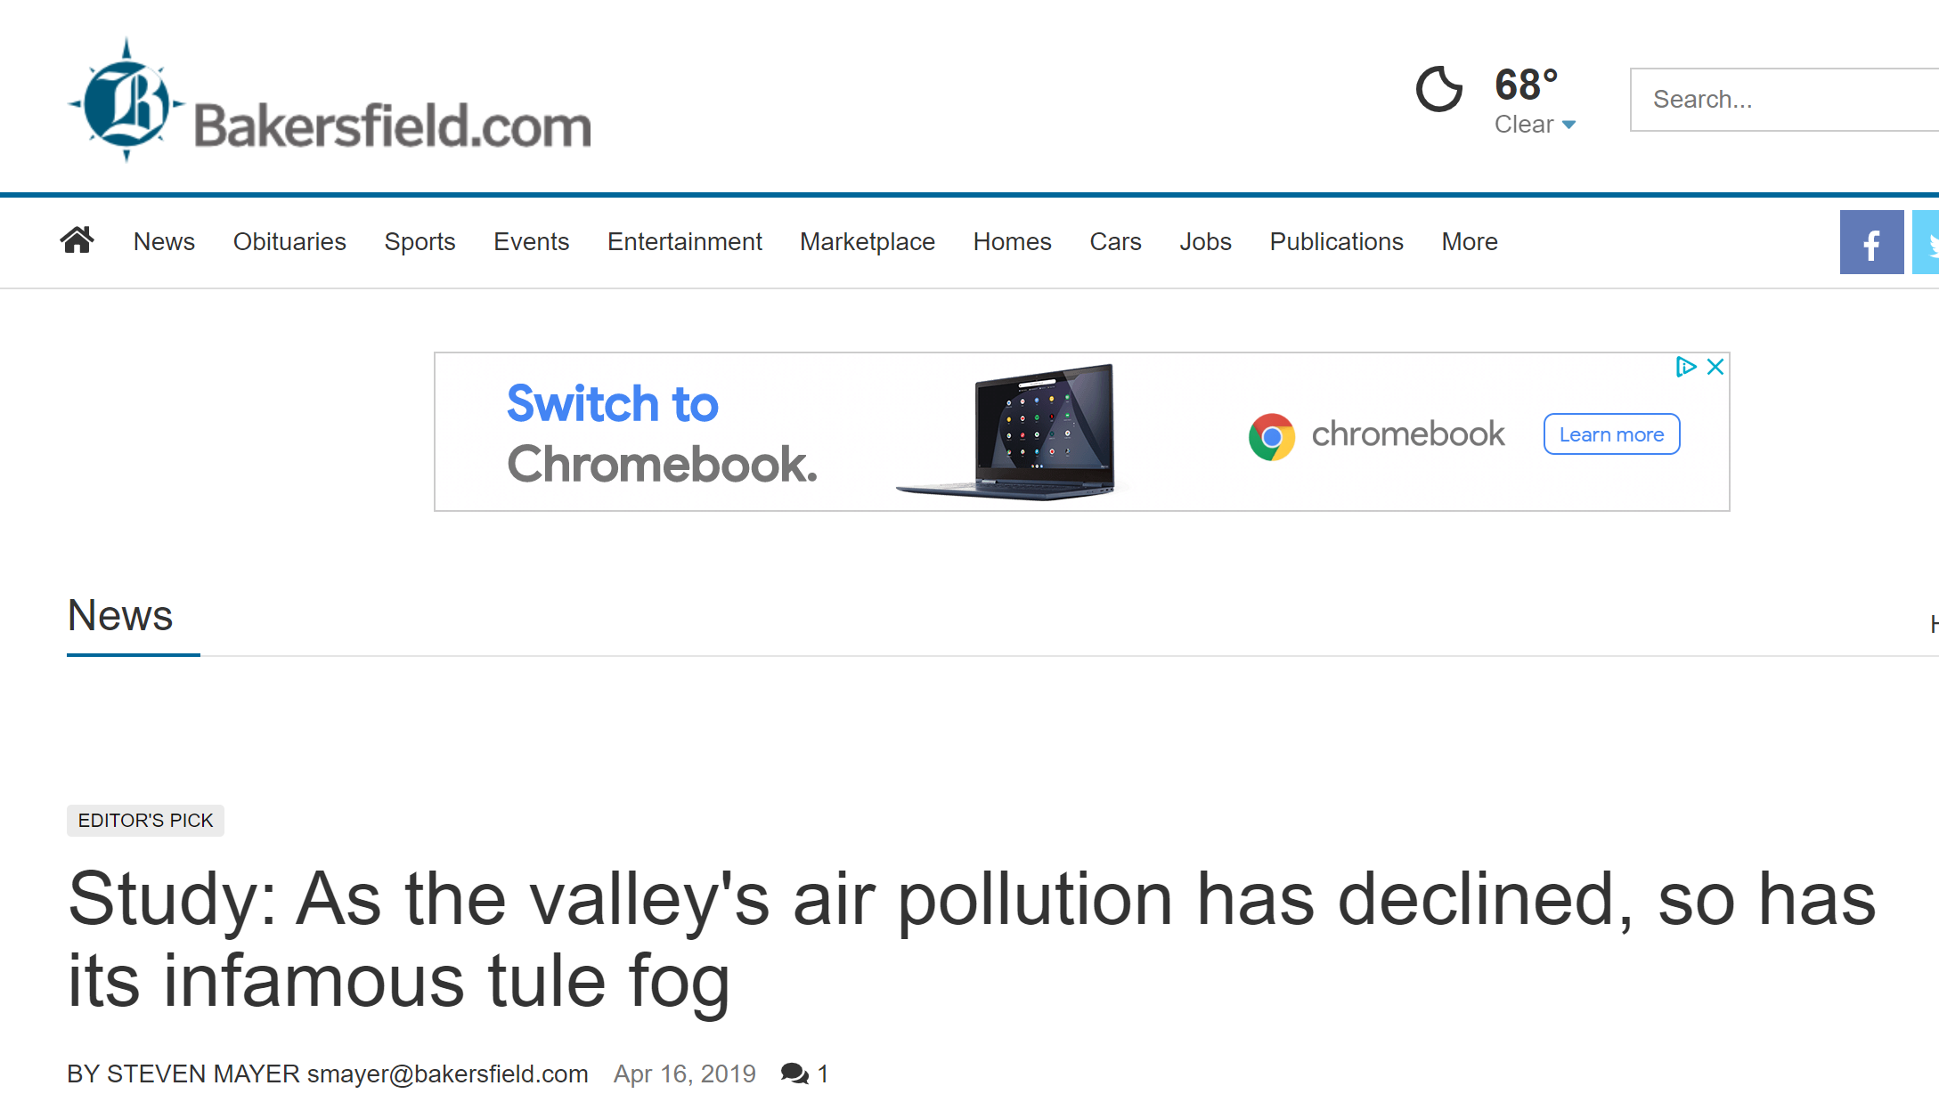
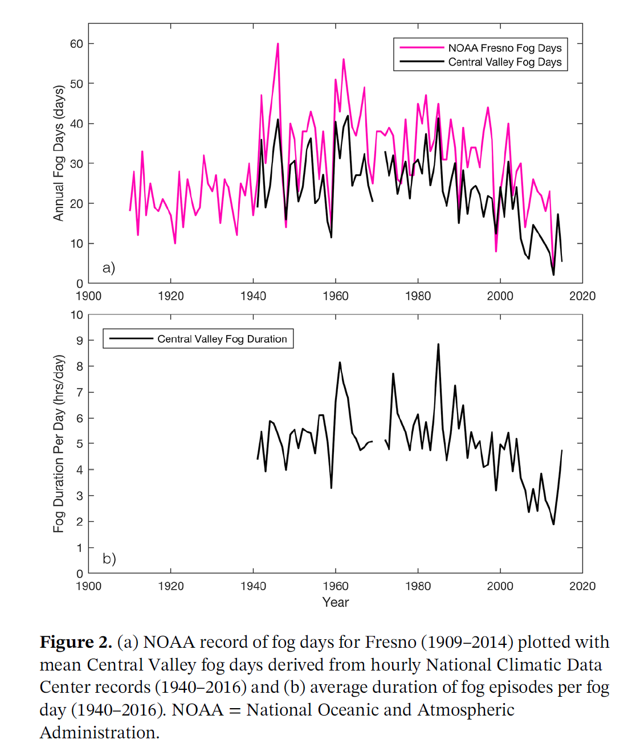
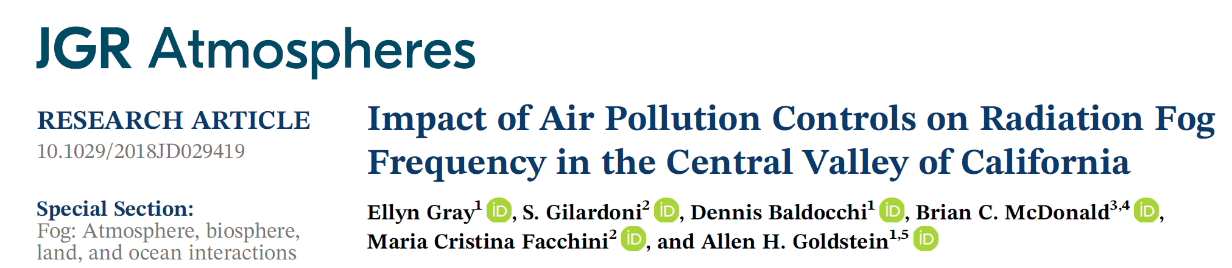
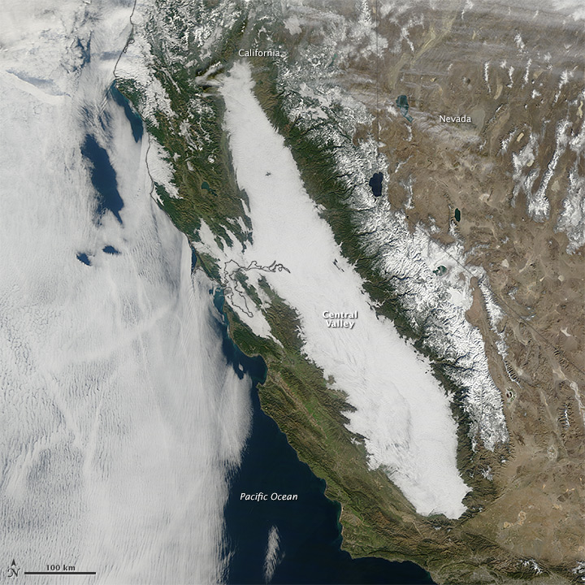

Slide 33
Wish List for Coupled Meteorology and Chemistry Observations of Cold-Air Pools
The magnitude of exchange processes and impacts on daytime and nighttime chemistry (canyon, gap, diurnal mixing, residual layers, ventilation)
Clouds-aqueous chemistry-photochemistry coupling
Lifecycle measurements (how does the meteorological and chemical coupling vary over lifecycle of a 1, 2, 5, 7, or 14 days cold-air pool?

Slide 34
Wish List for Meteorology Modeling to Support Chemistry of Cold-Air Pools
Accurate vertical mixing height, transport, clouds and solar insolation (photochemistry)
Determine if high resolution simulations are helpful or not
~∆z ~ 25 m; ∆z ~ 200 m
Observations with sufficient spatiotemporal resolution to validate and determine current model weaknesses and what future model requirement are

Slide 35
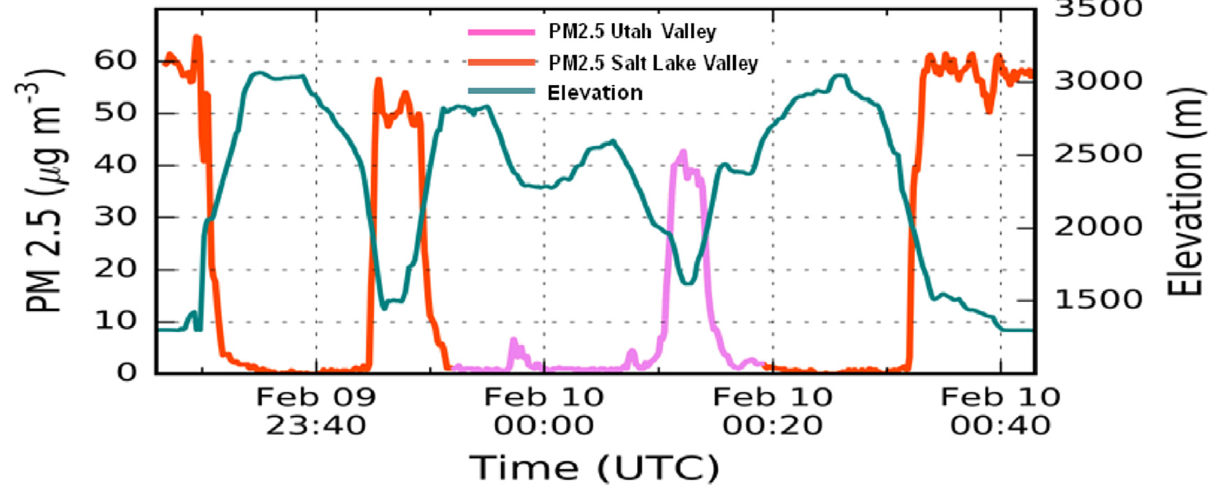
Chopper Observing Wintertime Cold-Air Pools

Slide 36
Remainder from Sebastian to help fill in content

Slide 37
Pollution episodes are favored by meteorological processes limiting vertical & horizontal mixing as they allow for emission accumulation
Persistent Cold-Air Pools (PCAPs) [UT]
? Central Valley [CA]
PCAPs evolve and can take different forms which affects chemical processes
  Stratified (“clear”, but daytime coupling through CBL)
  Well-mixed under stratus/fog (“cloudy”), very strong capping layer
  Temperature range (above / below freezing, snow cover)
  Wet & dry deposition
Meteorological processes altering pollution layer (structure & concentrations) include
  Thermally driven diurnal winds (slope and valley wind systems)
  Lake Breezes [UT]
  Inter-Basin Exchange
  Ventilation Processes
  Surface-based mixing (CBL)
  Synoptic influences (top-down erosion, CAP displacement, …)

Slide 38
CAP “Exchange Processes”

Slide 39
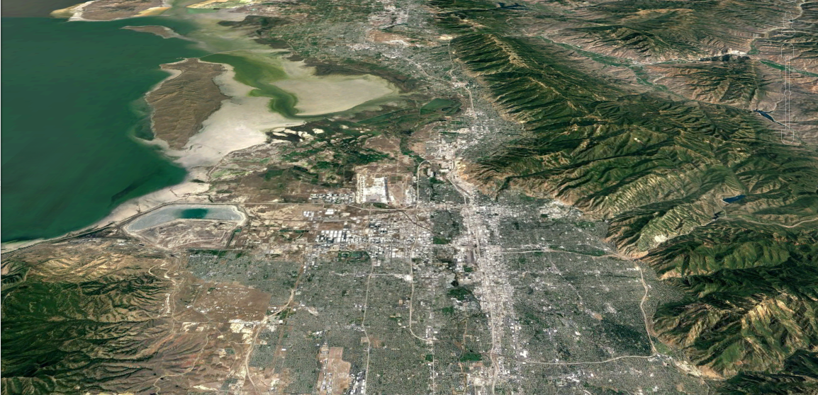

Night-time exchange processes
NIGHT
Lake Exchange
Down-Canyon Flows
Valley Cold Pool

Slide 40

Day-time exchange processes
DAY
Lake Exchange
Up-Canyon Flows
Surface-based mixing
Valley Cold Pool

Slide 41
Previous sites investigation cold-air pool exchange processes in the Salt Lake Valley basin.
LAKE “EXCHANGE”
CANYON
CIRCULATIONS
CANYON
CIRCULATIONS
INTER-BASIN EX.

Slide 42
PCAP Formation – clear AQ link

Slide 43
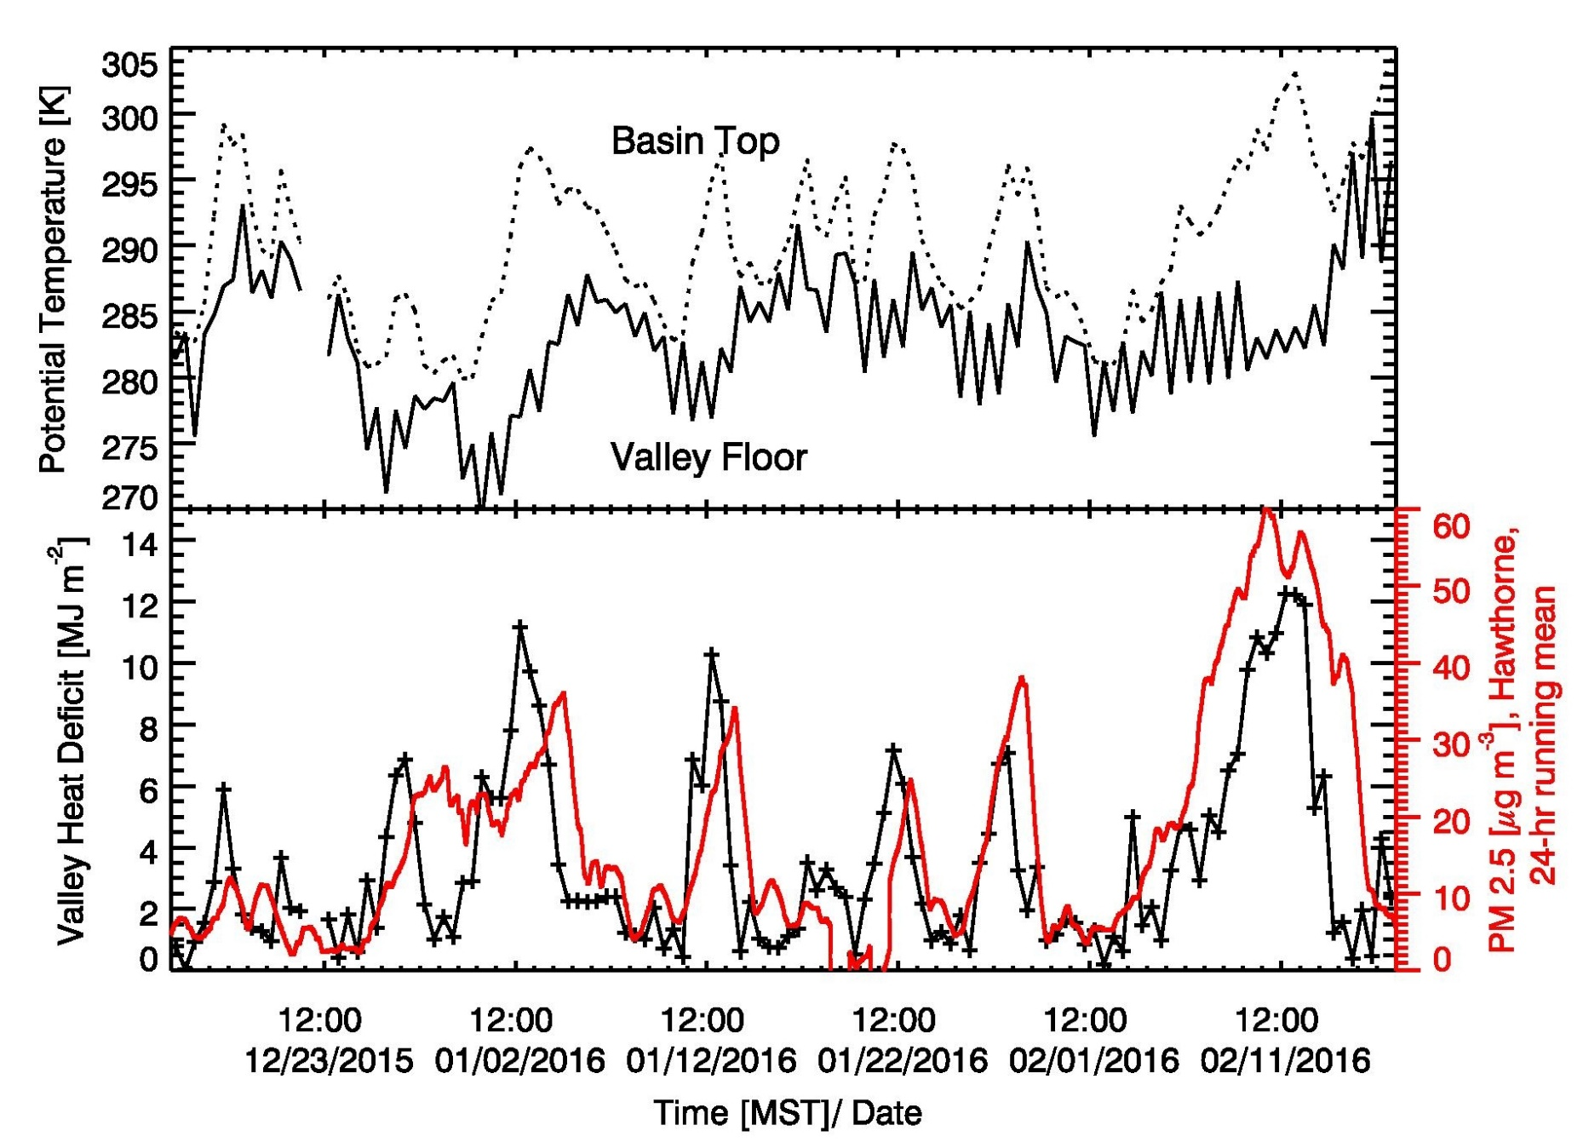
The 2015-2016 Cold Season
Valley Heat Deficit and PM_{2.5}
(2200 m MSL)
(1300 m MSL)
4 Jan.
NAAQS
(below 2200 m MSL)
7 – 14 Feb.
9 Exceedances (typically 18) of the NAAQS of 35 μg/m³

Slide 44
PCAP “Structure” Variability

Slide 45
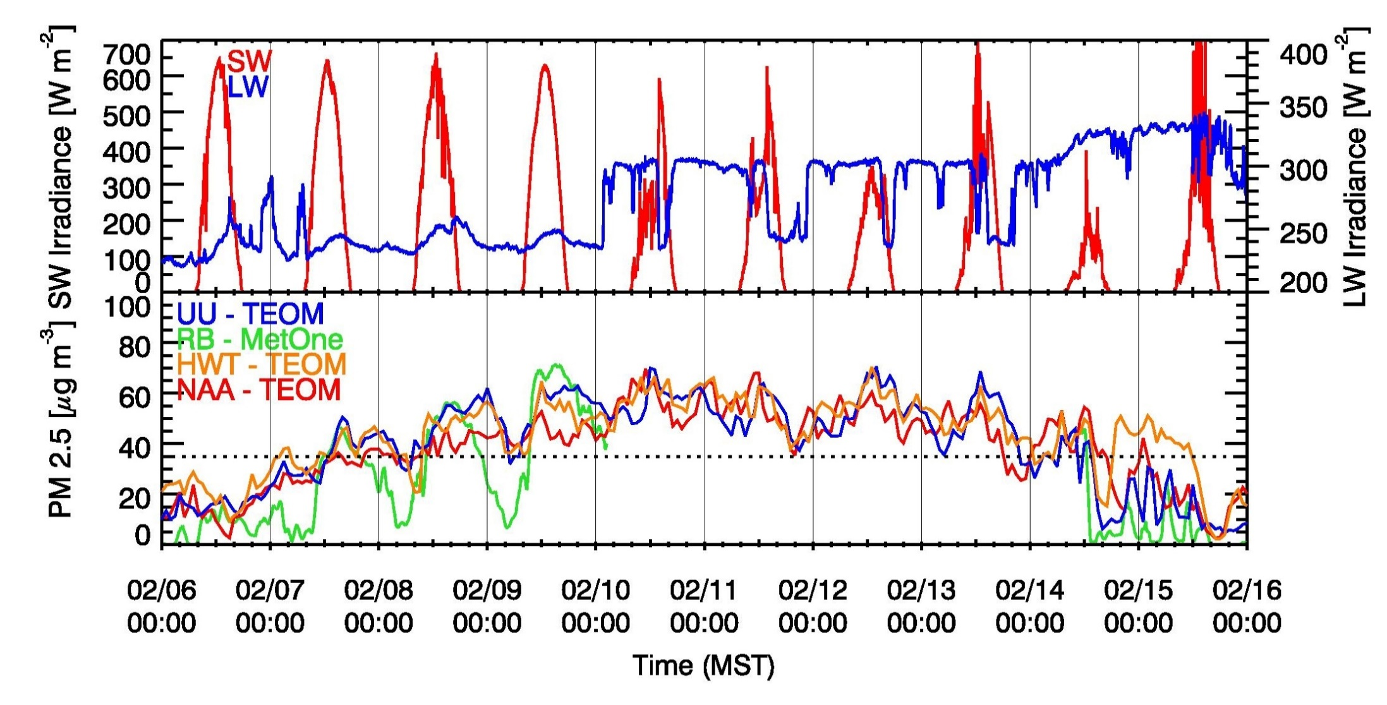
PCAP temporal variations (6-16 February 2016 example)
“Clear”
“Haze/Fog”
Daily increase by ~10-15 μg/m³
(Whiteman et al. 2014: 10 μg/m³ )
Constant level of ~60 μg/m³
(Whiteman et al. 2014: 60 μg/m³ )

Slide 46
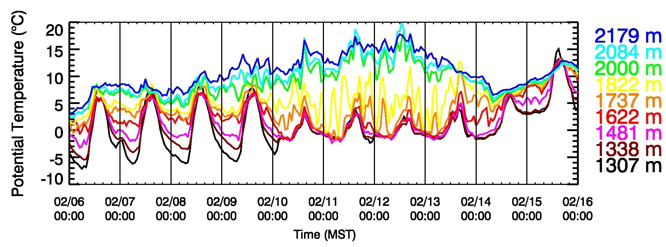
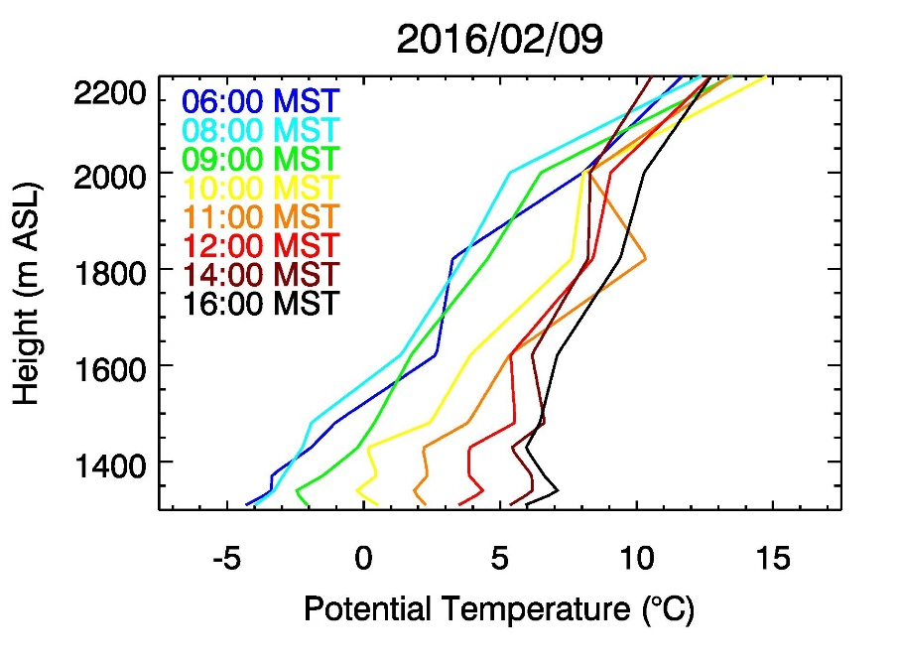

Temperature Structure 6-16 February 2016
“Clear”
“Haze/Fog”
Effect on chemical processes!
Nocturnal strengthening of CAP (de-coupling)
Daytime heating & mixing (re-coupling)
Dampening of diurnal cycle
Lowest 400 m remain “well mixed”

Slide 47
Sidewall Ventilation Process

Slide 48


  Thermally driven diurnal winds (slope and valley wind systems)
2200 m MSL
Nighttime
Nocturnal
Downslope
flows
Daytime
Daytime
Upslope
flows
Isotherms
UU
University of Utah
UDAQ-HW
Hawthorne
Elementary

Slide 49
CBL Growth

Slide 50

Daytime heating – Ventilation – Aerosol layering?
σ_{w} contours
σ_{w} (vertical velocity variance) from Lidar stares shows convection at the base of the PCAP

Slide 51
Clear-Air Injections

Slide 52

Effect of drainage flows near center of narrow basin
Time–height cross section of LiDAR wind, aerosol backscatter at Hawthorne Elementary
Injection of low-PM_{2.5} and high-O₃ air

Slide 53



Lindon, Utah Valley
Jan 14 2017
Jan 15 2017
Jan 17 2017

Slide 54
Example “Lake recharge”

Slide 55

3 February 2017
0900 MST
20
PM_{2.5} [μg/m³]
Dirty lake air
18
13
5
61
15
57
10
7
6
Slide developed by Erik Crosman

Slide 56

View from the “avenues”, 3 February 2017

Slide 57
Inter-Basin Exchange

Slide 58


Inter-Basin transport
Ammonia transport through the Jordan Narrows (Salt Lake <-> Utah Valley)
Combining LiDAR winds & surface concentrations
Transport through gap is significant (typically >20% of average daily emissions)

Slide 59
Example Spatial Variations / Chopper flight

Slide 60




Results – Spatial Variations (vertical)
9 Feb. 2016
1) Takeoff
~1 Hour flight
4) Landing
Chopper
2) Dip-down
South SLC
3) Dip-down
Utah Basin

Slide 61


Spatial Variations : News Helicopter Flight 9 Feb. 2016
North Salt
Lake Basin
South Salt
Lake Basin
Utah
Basin
North Salt
Lake Basin
Salt Lake City Basin
Utah Basin

Slide 62
Example diurnal aerosol evolution

Slide 63

Aerosol formation / droplet growth ?
Post-sunrise
Nighttime

