Slide 1
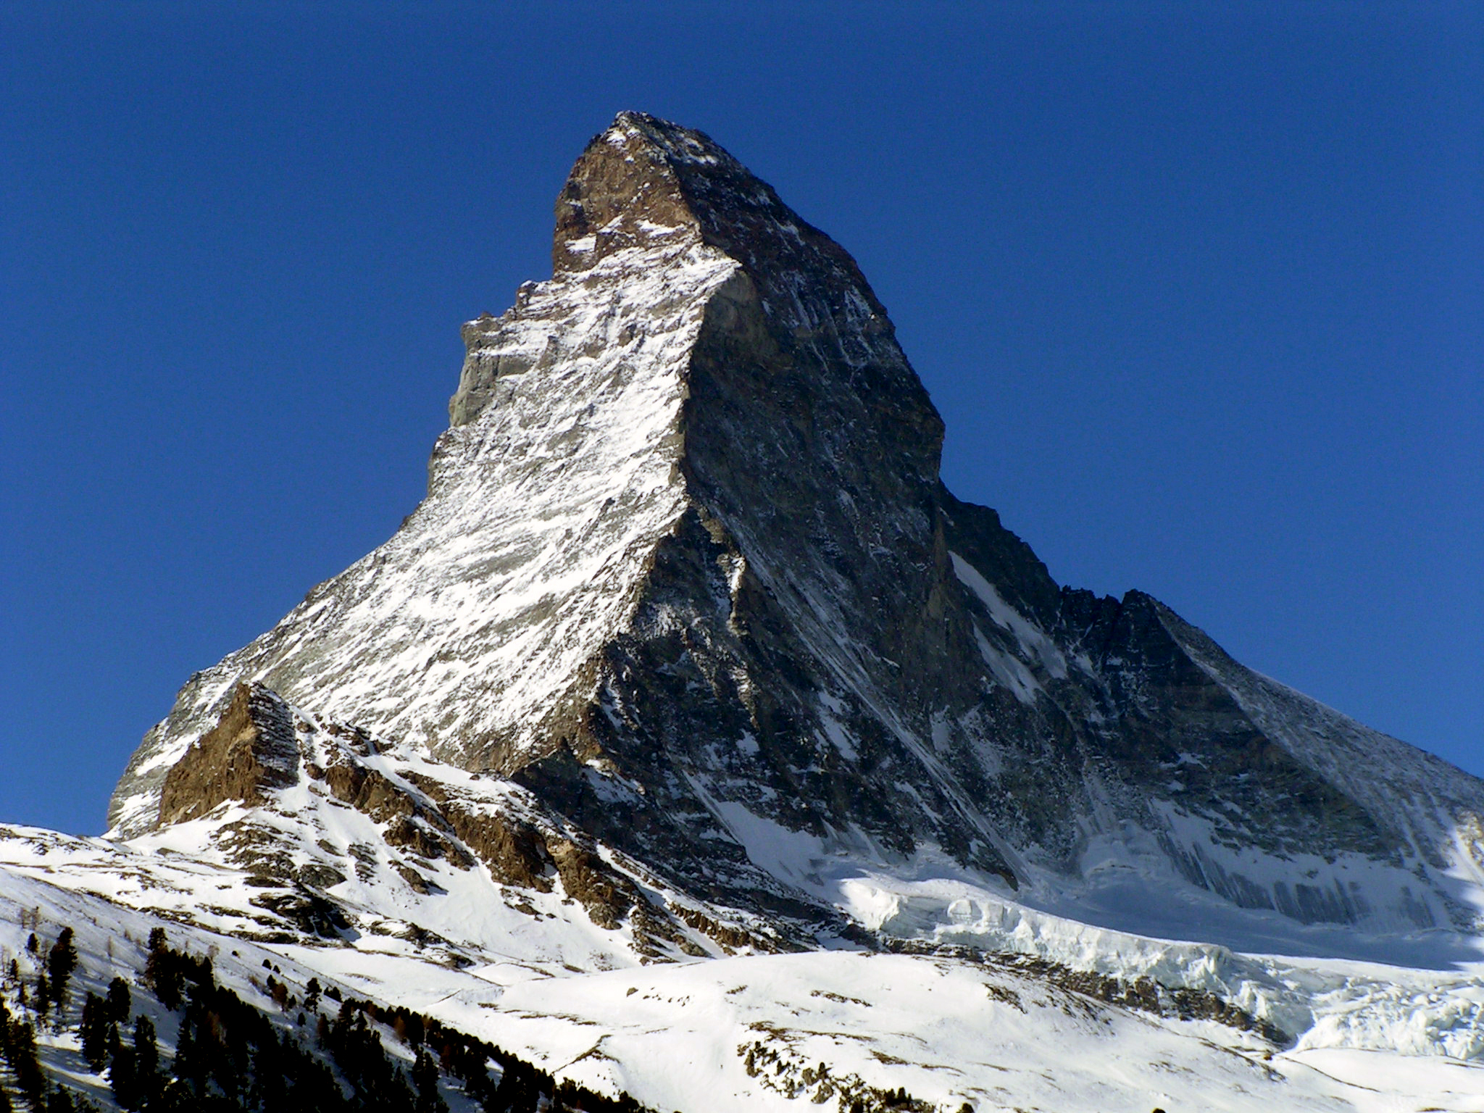
Materhorn X:
Field studies
Dave Whiteman & Sebastian Hoch
Matt Jeglum & Leah Campbell
University of Utah
© Marcel Wiesweg, Wikipedia Commons

Slide 2
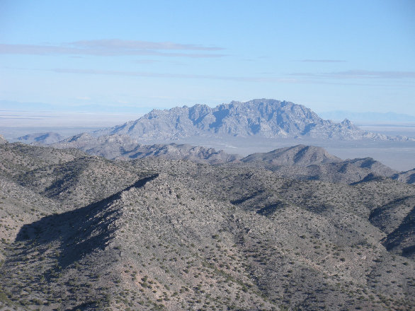
MATTERHORN
MATTERHORN
© Marcel Wiesweg, Wikipedia Commons
From WillhiteWeb.com

Slide 3
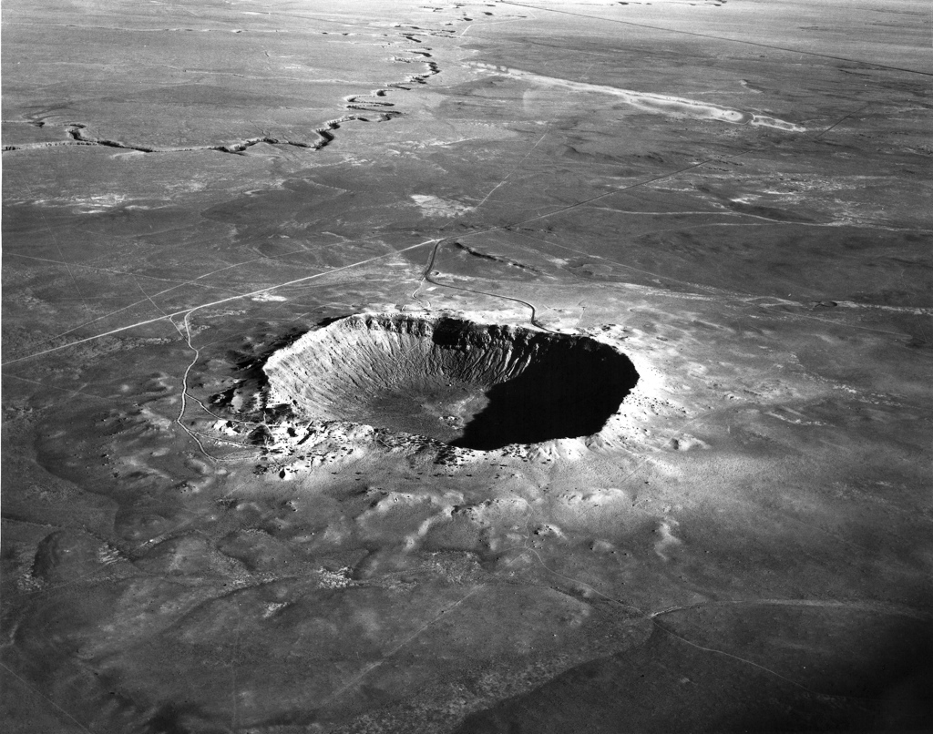
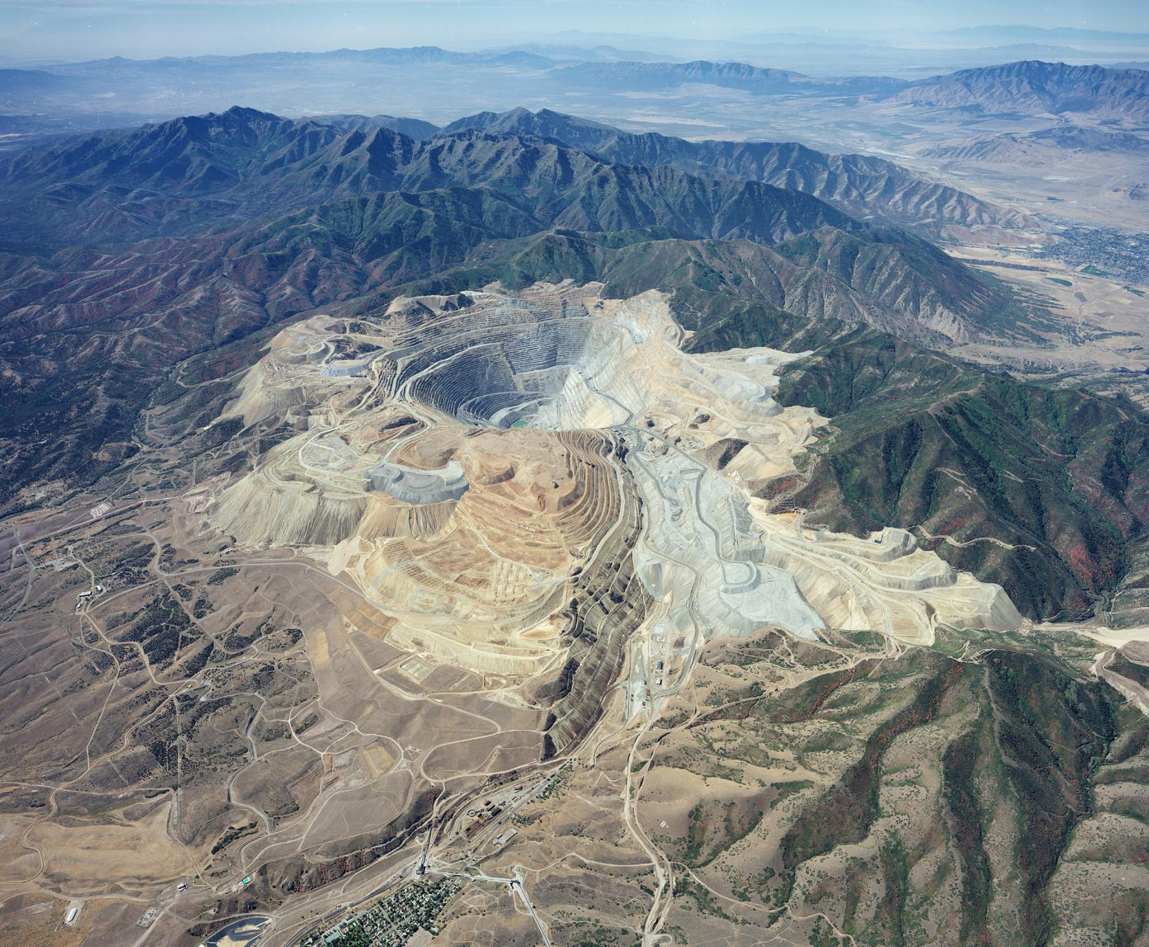
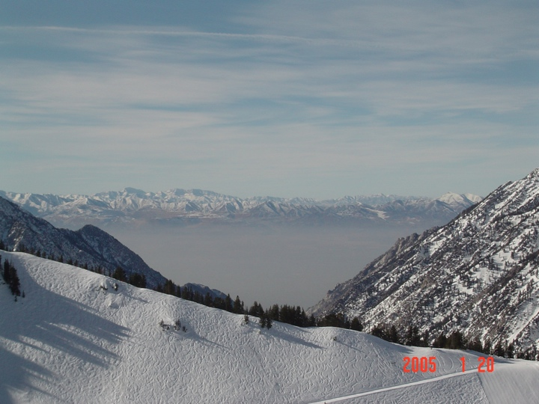
J. Sheldon photo
KUC photo
J. Steenburgh photo
WillhiteWeb.com

Slide 4
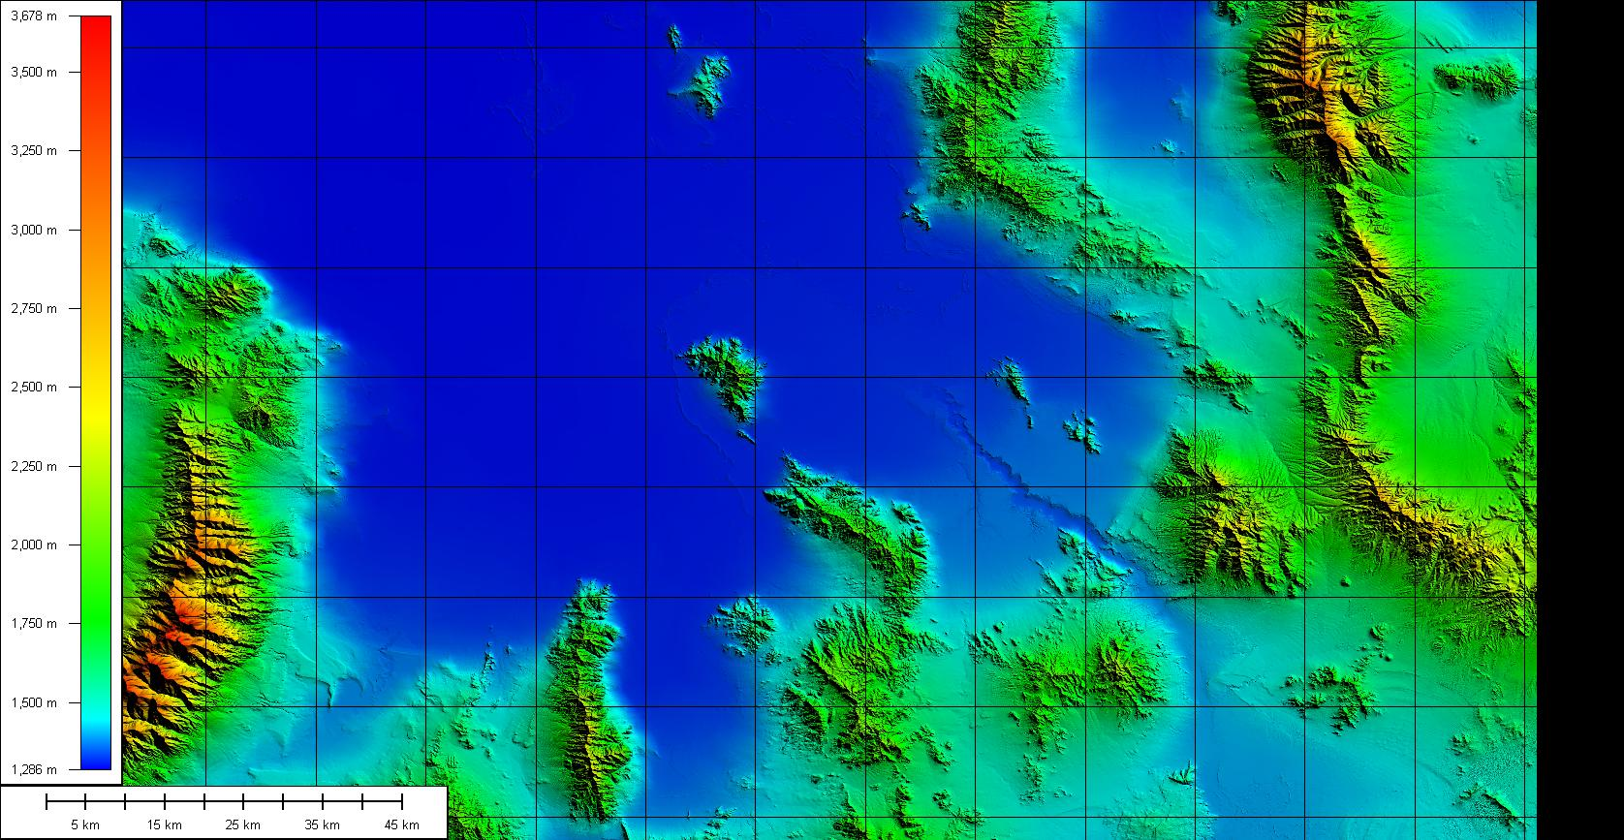
Dugway Proving Ground - Topography
Playa / Sagebrush flats
~ 1300 m
Granite Peak
2159 m (7082 ft)
Deep
Creek
Range
>3500 m

Slide 5
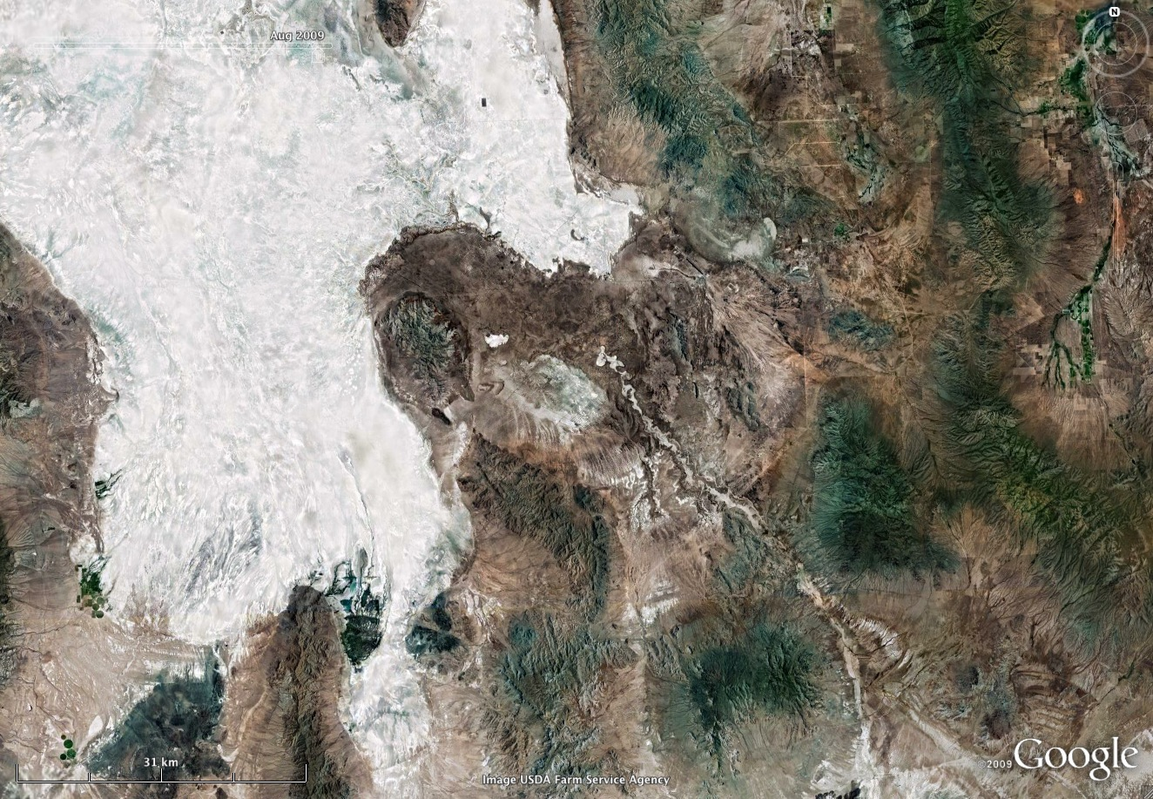
Dugway Proving Ground seen from space

Slide 6
Dugway Topography
Elevations & View from Space
Previous Work
Cold-Air Drainage simulations
Wind field analysis
Slope flow analysis
Planned Work
Extended Flux Sites
Slope Flow Evolution and Interaction

Slide 7
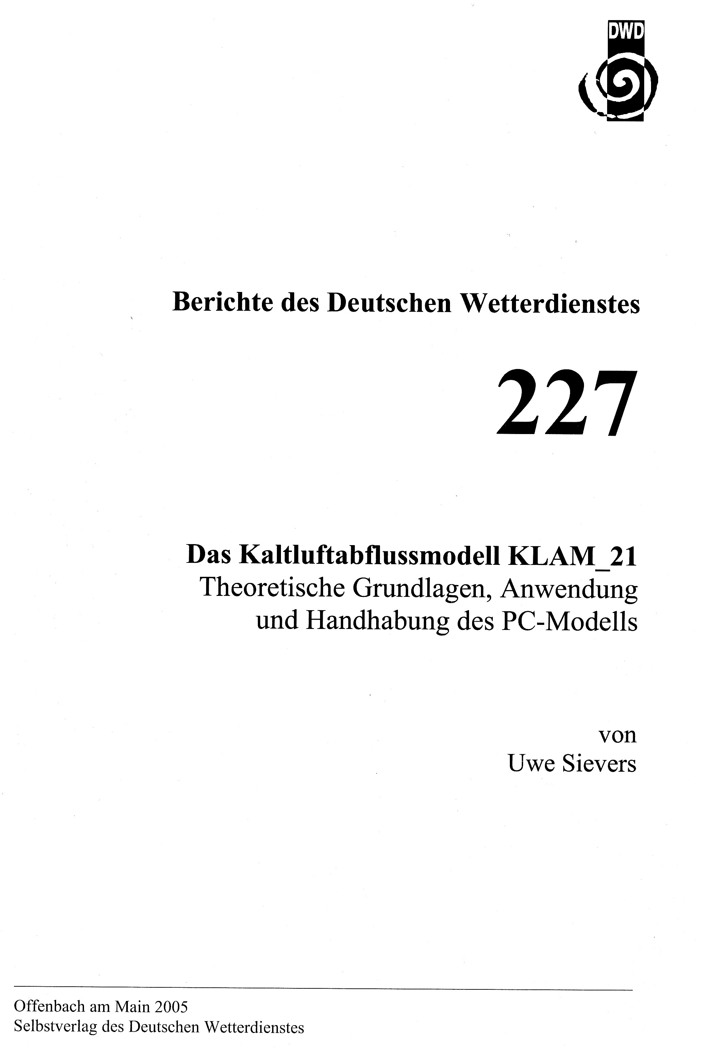
Cold–Air Drainage Model KLAM 21
Single-layer model
Predicting depth and the mean wind of a surface based stable layer
Flow prediction is based on vertically averaged momentum tendency equations.
Temporal changes in the total heat deficit in the cold air layer heat deficit are calculated from a prescribed local heat loss rate [here 30 W/m²].
Sievers, U., 2005: Das Kaltluft-Abfluss-Modell KLAM_21. Grundlagen, Anwendungen und Handhabung des PC-Modells. Berichte des Deutschen Wetterdienstes 227. Deutscher Wetterdienst, Offenbach a.M., Germany, 101 pp.

Slide 8
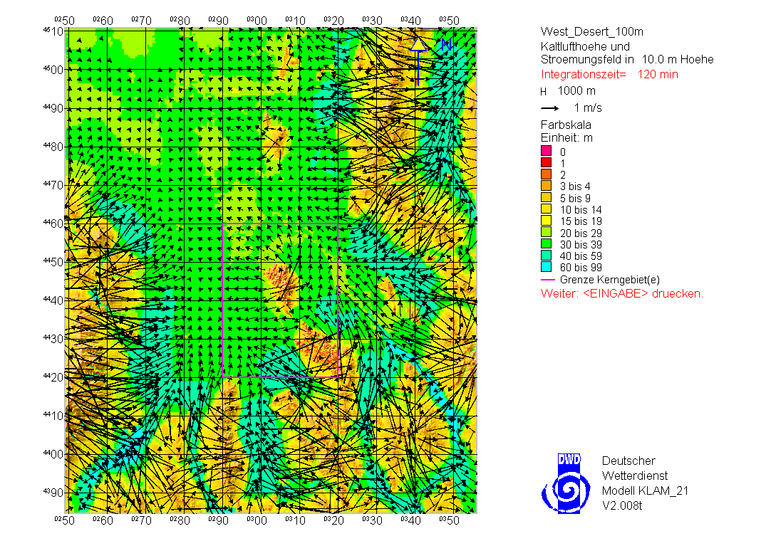
2 hours
10-m wind field
Cold air depth (m)

Slide 9
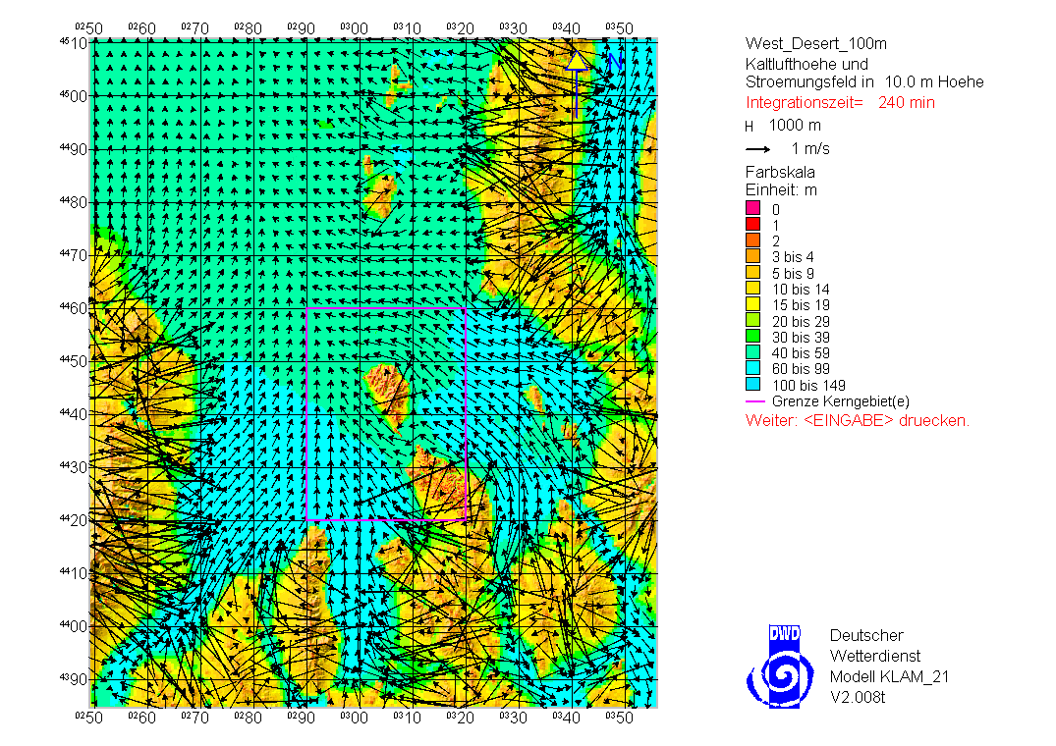
4 hours

Slide 10
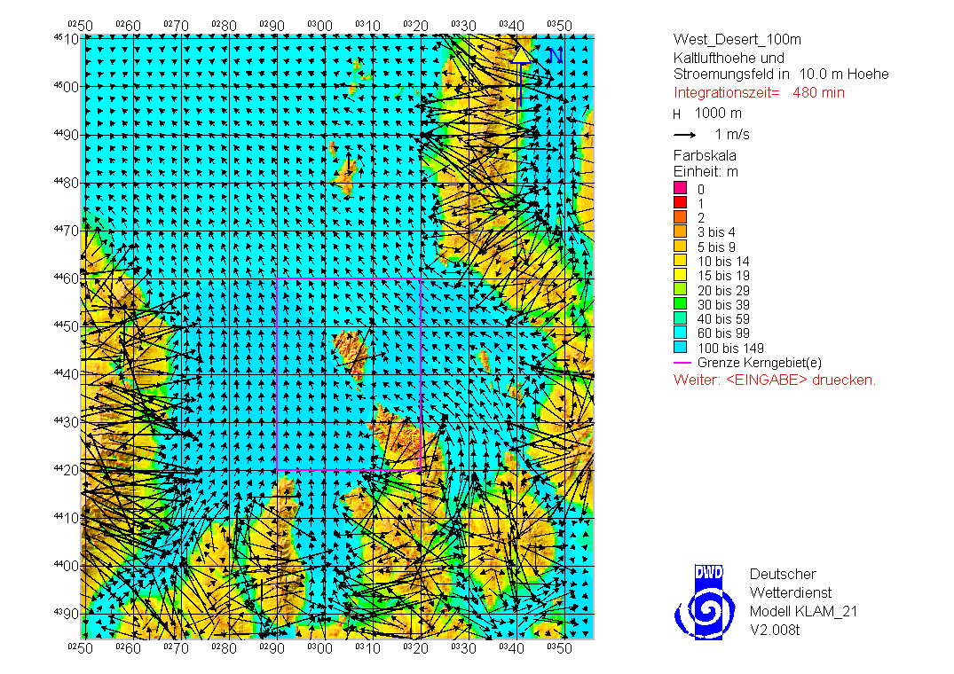
8 hours

Slide 11
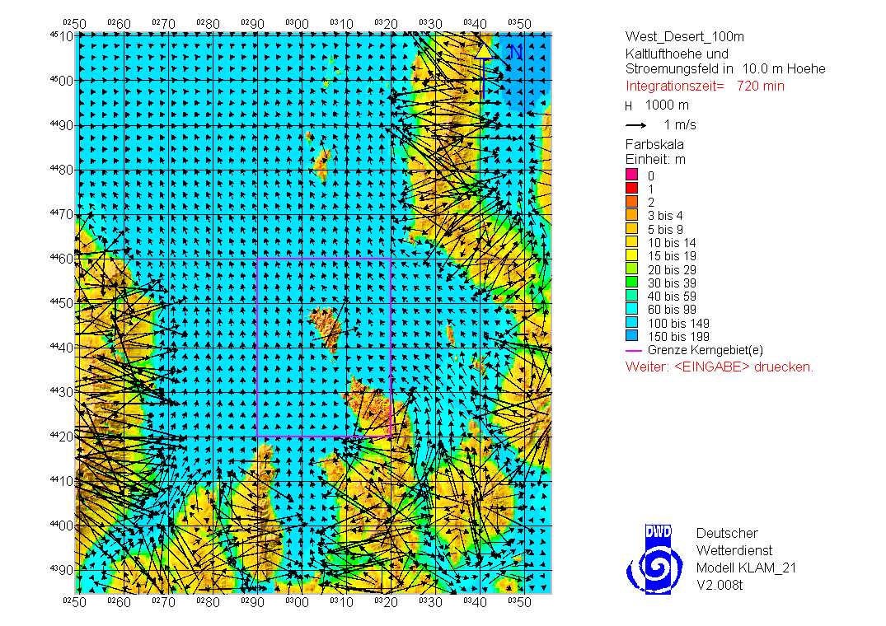
12 hours

Slide 12
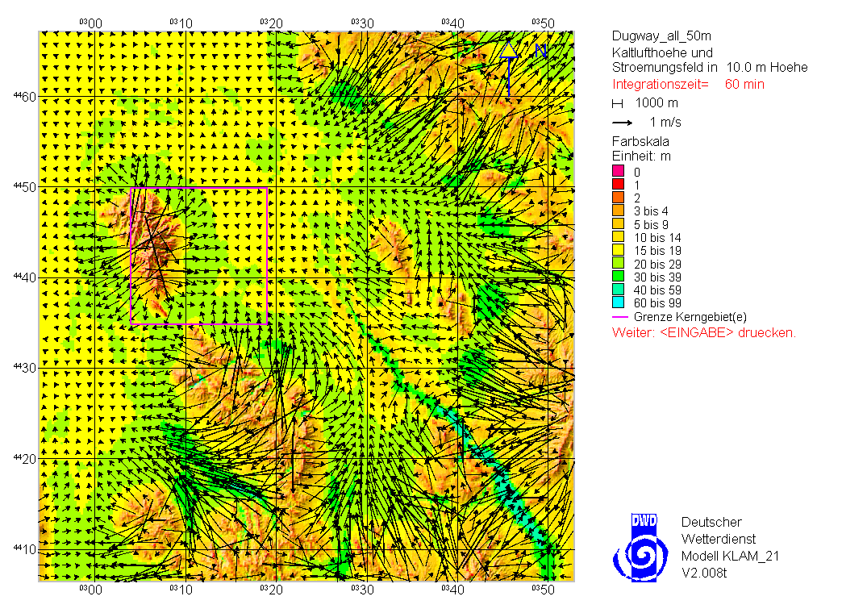
1 hour

Slide 13
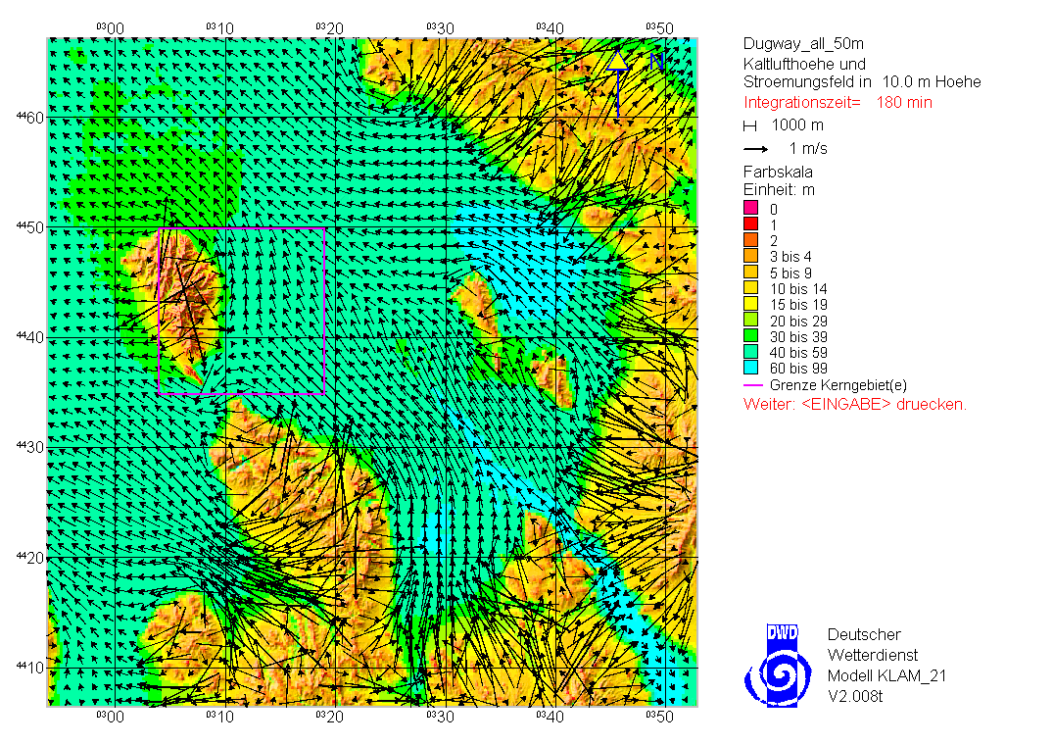
2 hours

Slide 14
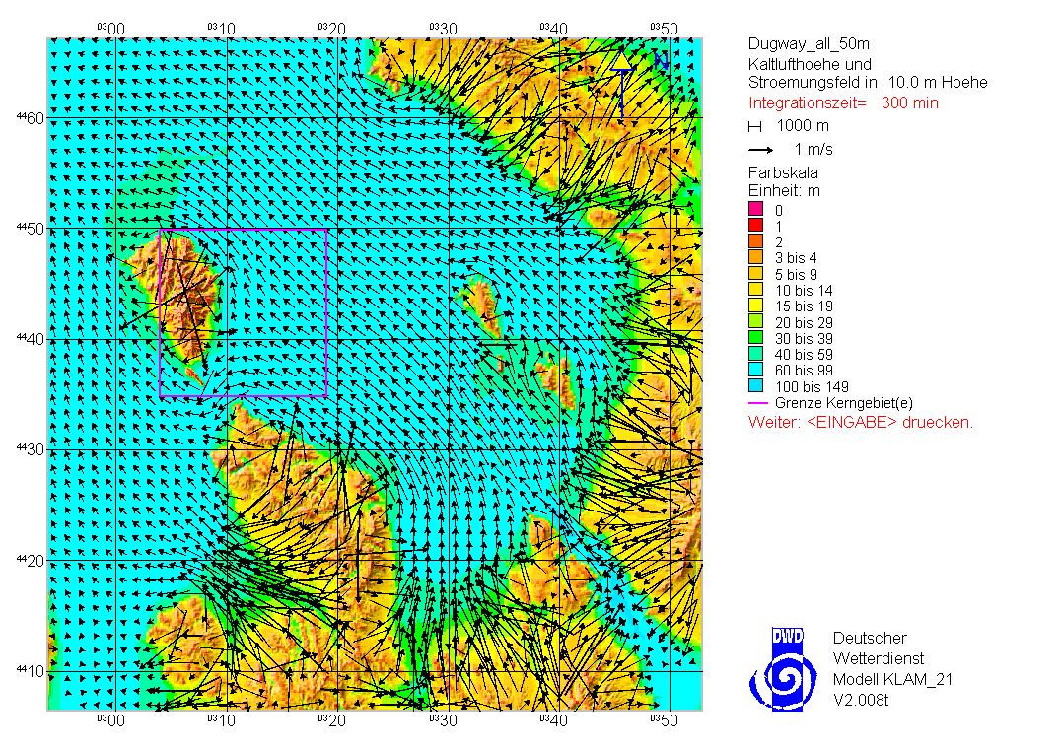
5 hours

Slide 15
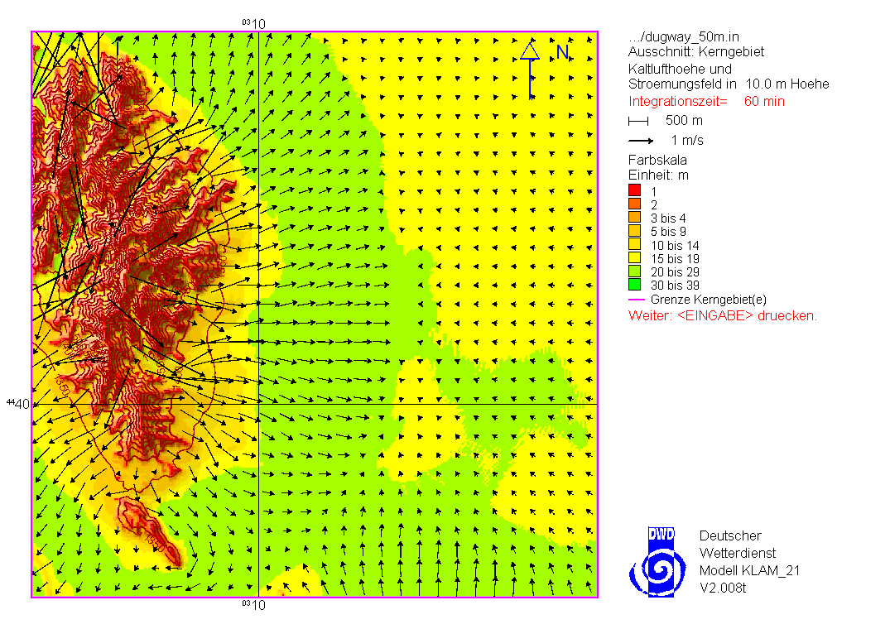
1 hour

Slide 16
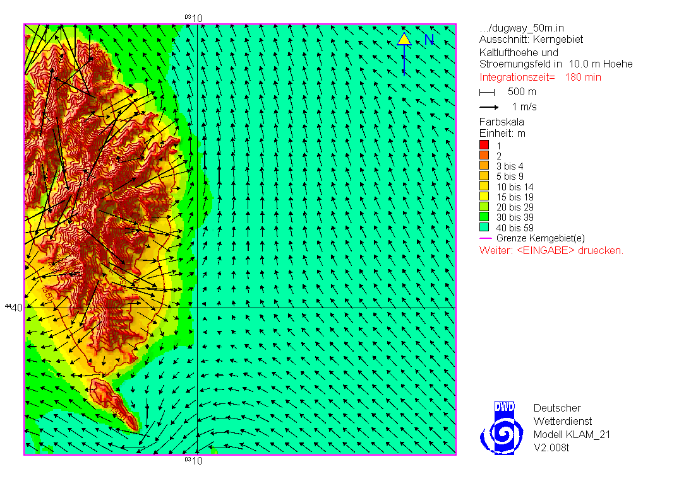
3 hours

Slide 17
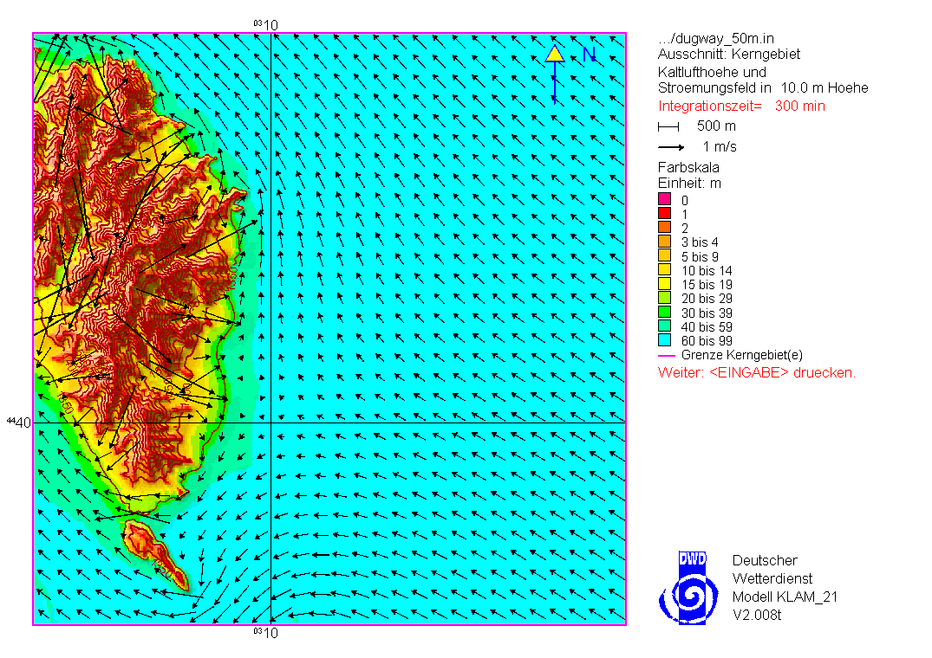
5 hours

Slide 18
Summary – KLAM 21
The nocturnal wind field at DGP is strongly influenced by thermally driven flows.
A homogeneous SE down-valley flow results across the basin east of Granite Peak.
KLAM 21 produces a cold air layer of ~100 m depth.
Local drainage flows from Granite Peak interact with the SE down-valley flow.

Slide 19
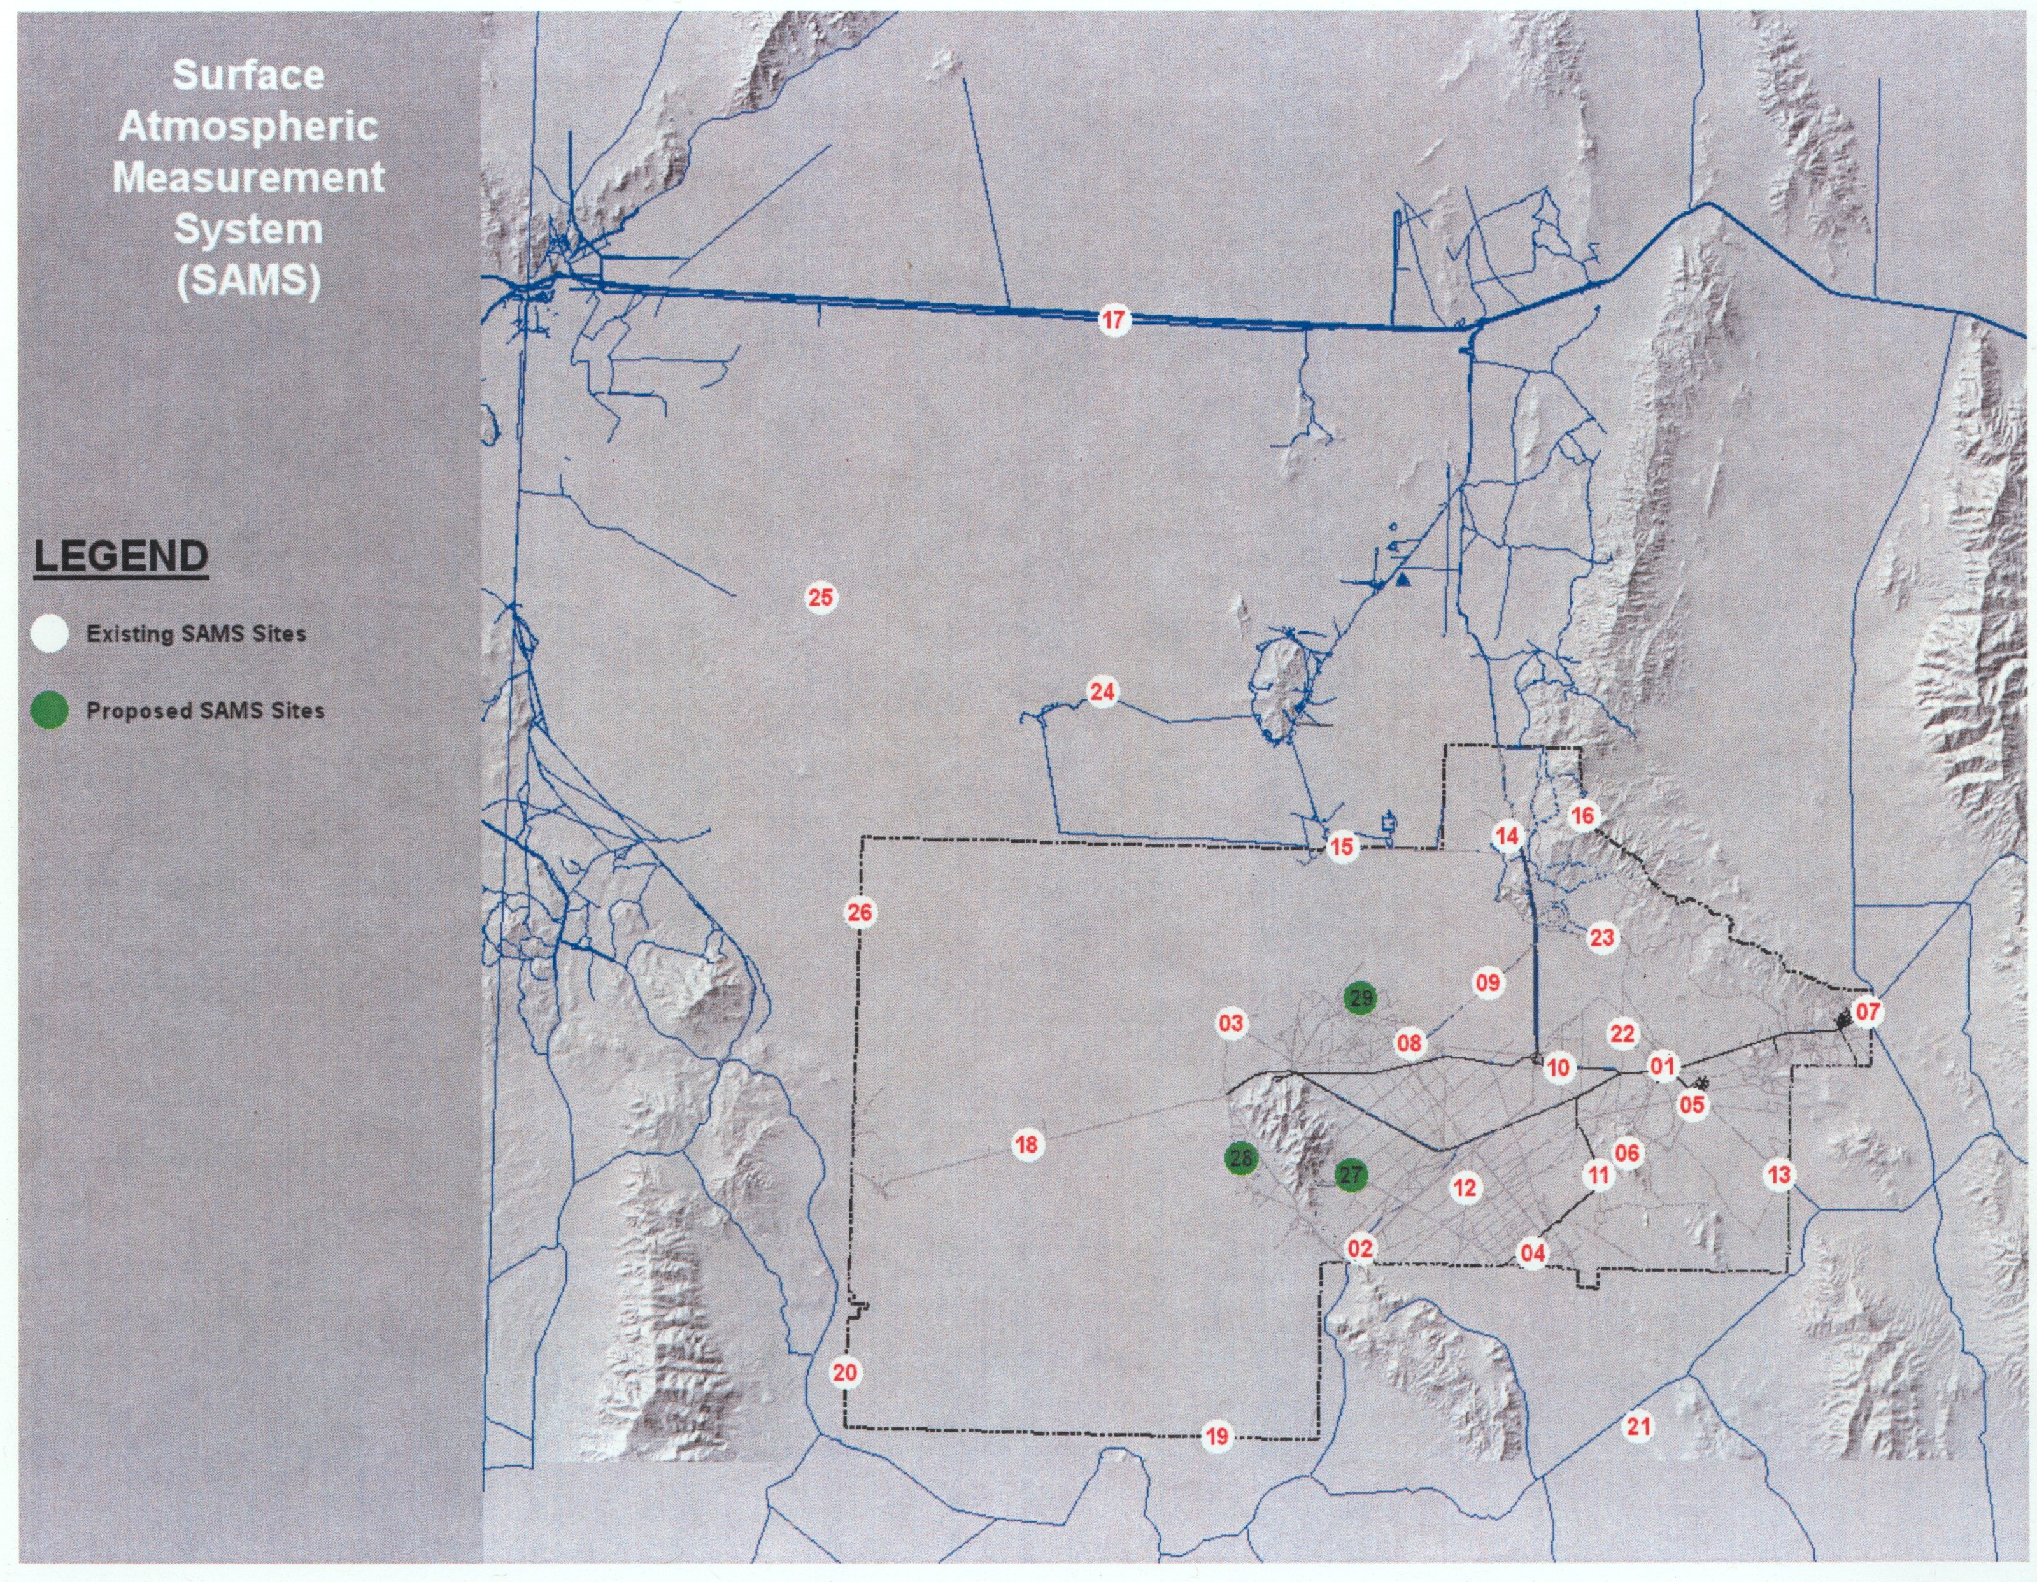
Wind field evolution over DPG during undisturbed fair weather days.
JJA 1998-2008

Slide 20
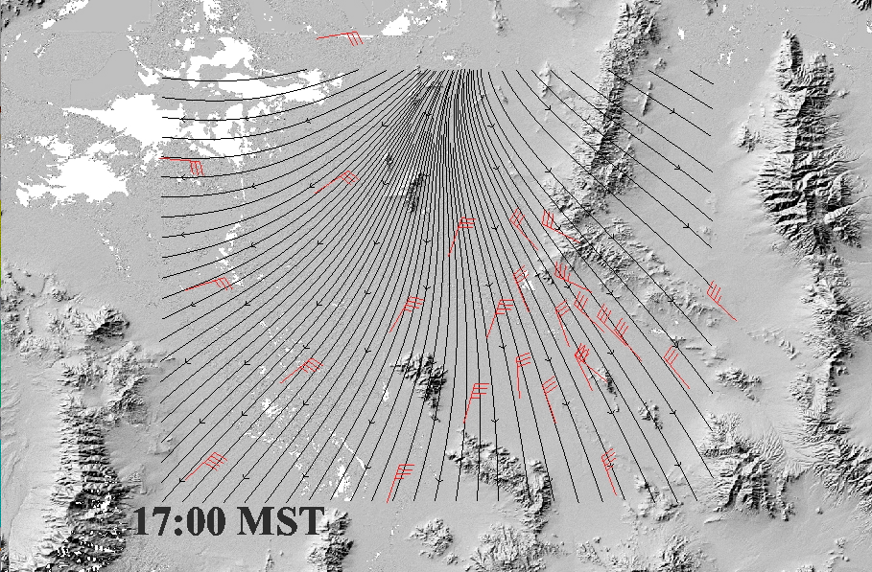
Fair weather day: 70% of total global radiation, wind speeds < 3 m/s
Tippetts, J. M., and C. D. Whiteman, 2010: Fair-weather diurnal wind field in a complex mountainous region. Amer. Meteor. Soc. Annual Meeting 9th Student Conference, 16-17 Jan 2010, Atlanta, GA.

Slide 21
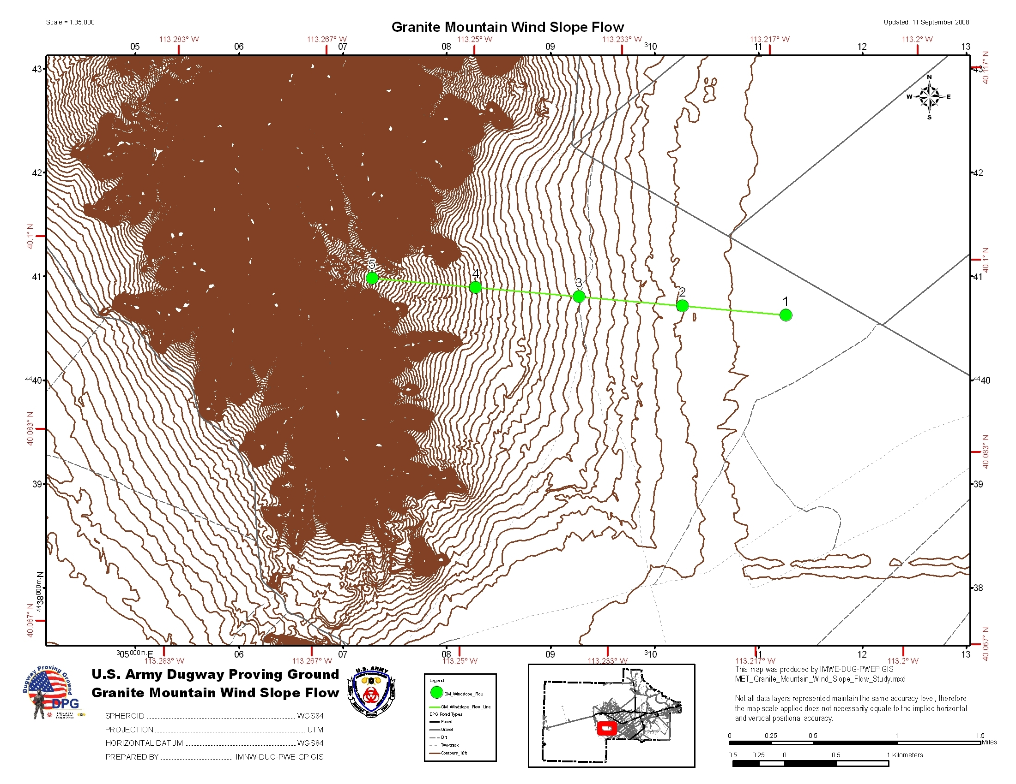
Drainage Flow Experiment
Experiment designed by Al Astling at DPG
East slope of Granite Mountain
Years 2008-2009
9 SAMS
5 PWIDS
1 32-m tower, 5 levels

Slide 22
Spring: March-May

Slide 23
Fall: September-November

Slide 24
Planned Work – MATERHORN-X
Dave Whiteman (Research Professor, University of Utah)
Sebastian Hoch (Assistant Research Professor, University of Utah)
Matt Jeglum (PhD Student, University of Utah)
Leah Campbell (Masters Student, University of Utah
Eric Pardyjak, Jim Steenburgh, Zhaoxia Pu
Research objectives
MATERHORN addresses the interaction of flows of different scales in complex terrain, and their predictability.
Local, thermally driven flows ⬅➔ synoptic scale flows
What drives the temporal evolution and spatial variability of thermally driven flows in the complex terrain around Granite Peak?
How do these flows interact with the larger scale flows?
The collected comprehensive dataset is available for model validation and parameterization development.

Slide 25
What drives the local circulations ?
Energy budget variations
    Surface Layer development
        Boundary Layer evolution

Slide 26
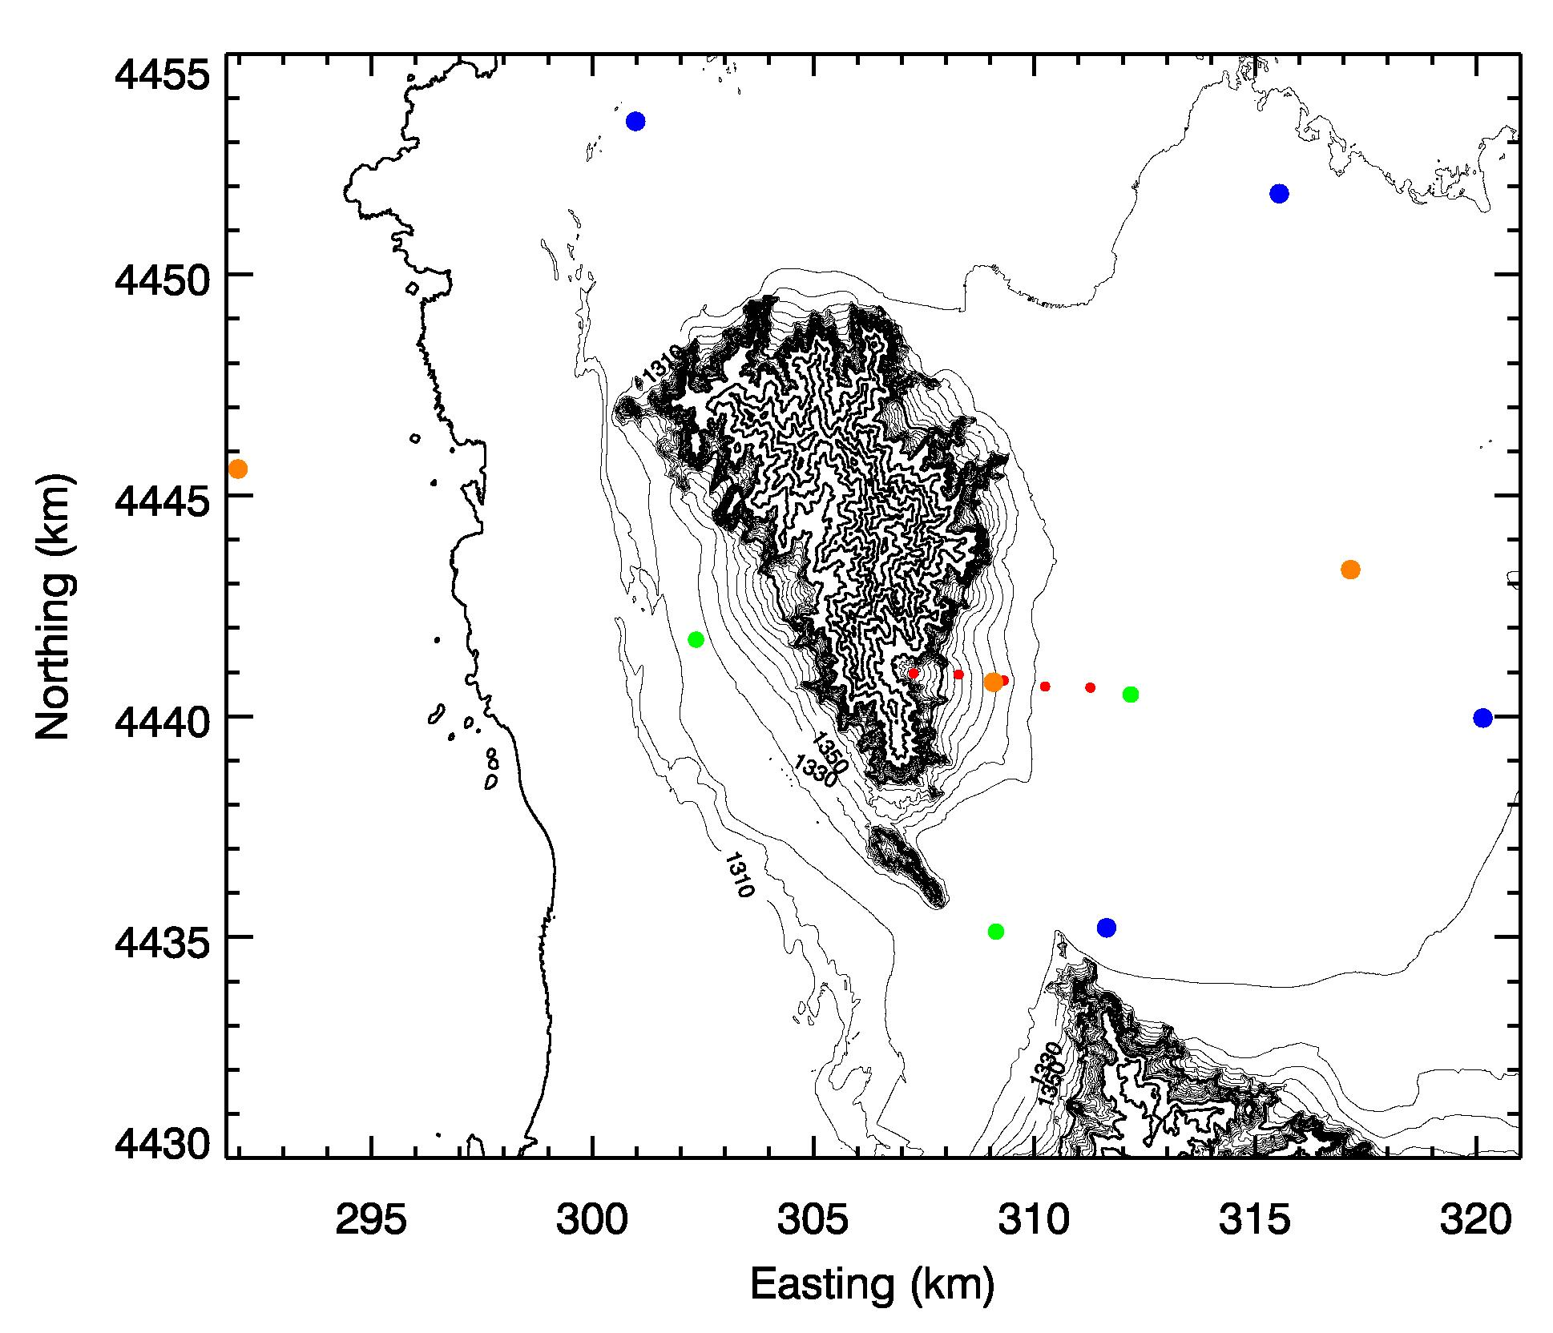
Extended Flux Sites (EFS)
3 Sites in different locations near Granite Peak:
Related work:
Whiteman et al. 2009:
Evening Temperature Rises on Valley Floors and Slopes […]
JAMC
Hoch and Whiteman 2010:
Topographic Effects on the radiation balance […]
JAMC
Hoch et al. 2011:
Mayer et al. 2010:
Observe the spatial and temporal variability of surface–atmosphere interactions: Exchange of heat and momentum.
Dataset for model validation & parameterization development
East and West of Granite Peak
High and low surface albedos (Playa – Sagebrush)
Sloping site and flat terrain
PLAYA
SAGE-BRUSH
SLOPE

Slide 27
ESF (cont.) - Observations
Full surface energy budget (SEB)
    4-Component radiation budget (SW/LW - IN/OUT)
    Ground heat flux
    Latent heat flux
    Sensible heat flux (2 levels)
      Temperature fine structure (~ 20 thermocouples)
    Surface Layer evolution
    Inversion build-up / super-adiabatic sublayers
    Radiative flux divergence (modeling, supported by TCs)
      Tethersonde observations (Playa & Sage)
    Boundary Layer evolution & interaction with larger scale flows
Comprehensive dataset collected for:
Validation of surface parameterizations – Land Surface Models and Initialization
Data to test Boundary Layer Schemes
Modelers – What data do you need? What would you like to have?

Slide 28
EFS-Playa SITE: A Super EFS (former SLTEST-Site)
Extremely homogenous playa surface -
Perfectly suited for micro-meteorological observations
    All terms in the temperature tendency equation will be measured - as a function of height!
    Dataset for Model Validation & development of new parameterizations
Exchange of heat and momentum – a very detailed look.
See Eric Pardyjak’s talk for all the details!

Slide 29
What are the local circulations ?
Slope flows and Valley flows.
How do these interact?
Gap flows
Lake- or Playa Breeze

Slide 30
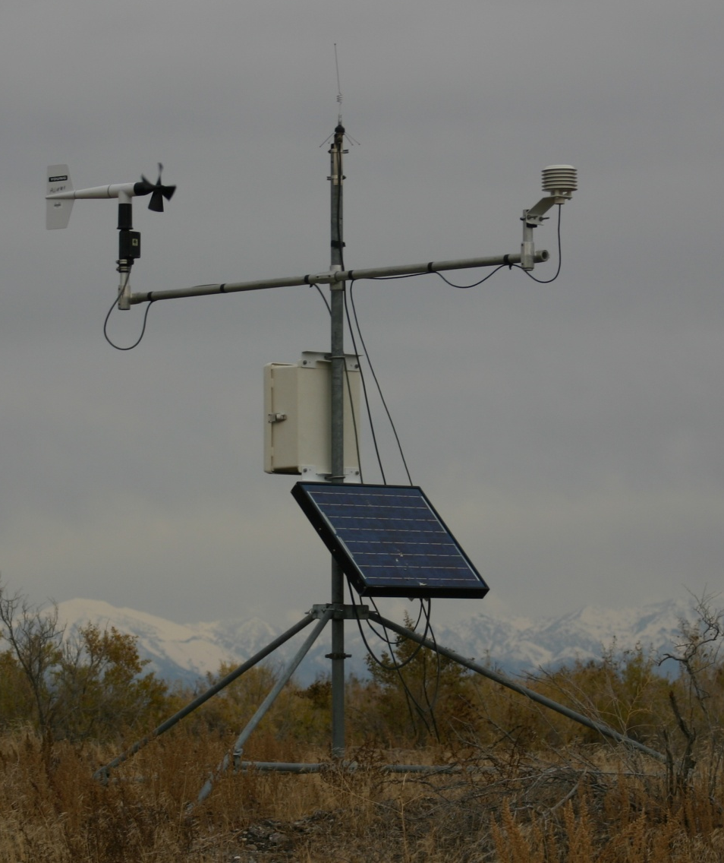
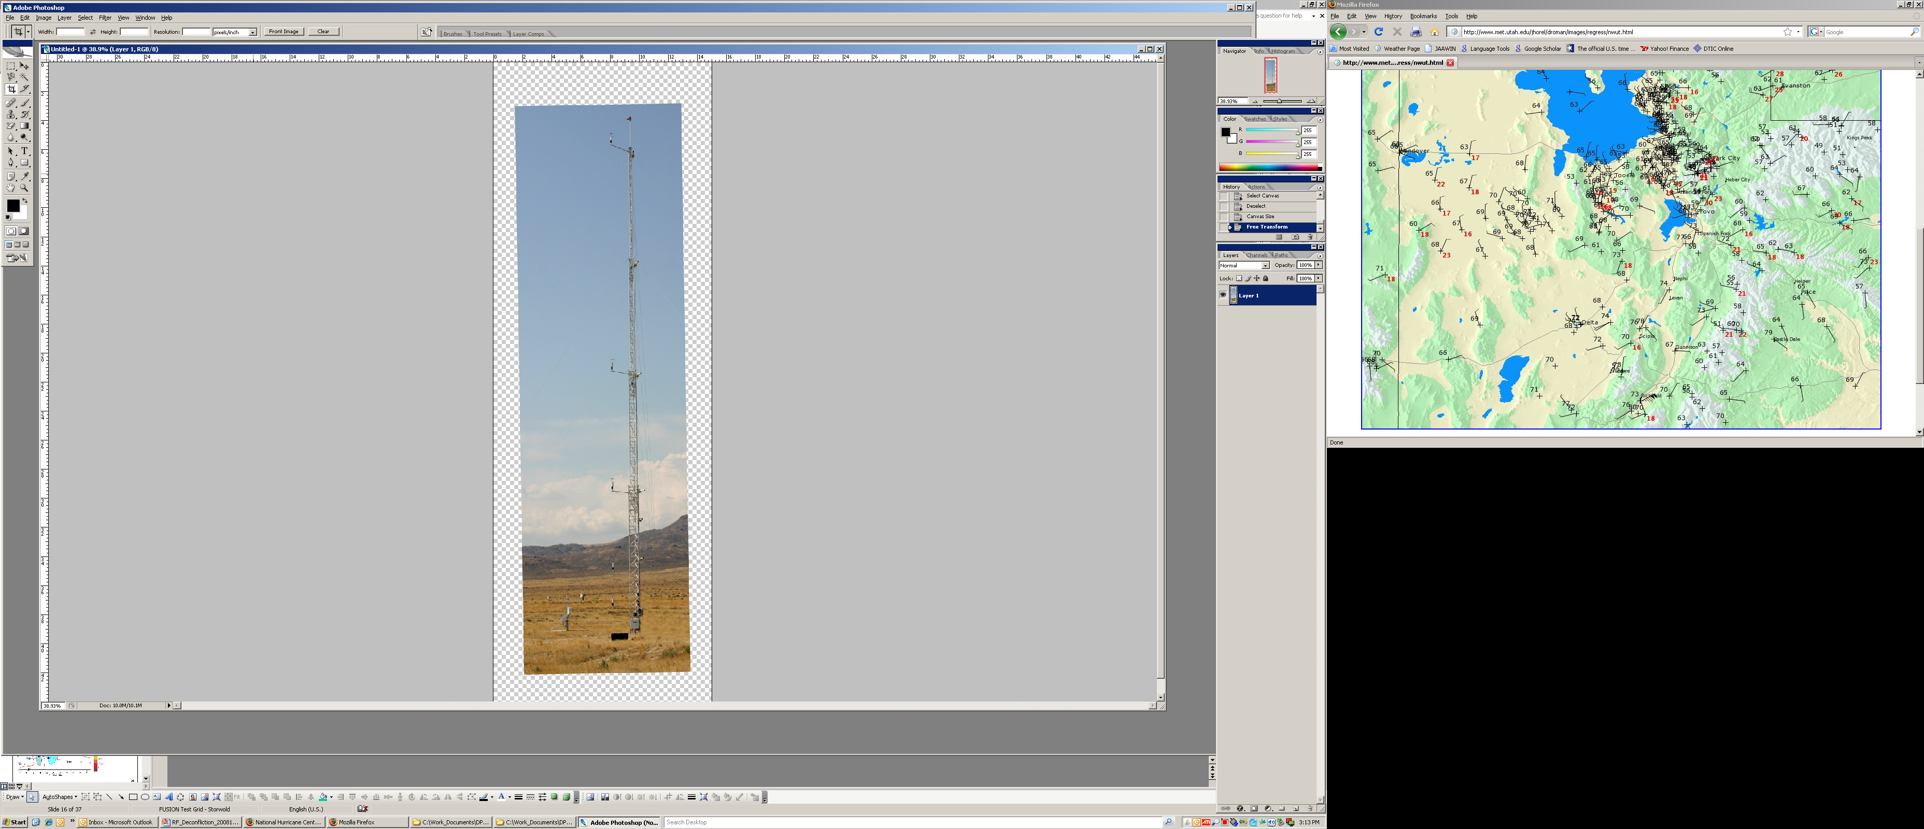
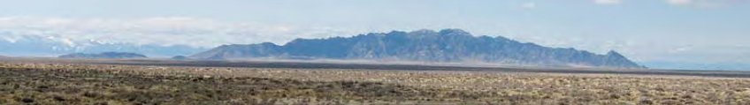
Granite Peak Slope Experiment
PWIDS - DPG photo
30 m Tower
DPG photo
East Slope of Granite Peak
Slope flow initiation – What are the driving cooling processes (SEB, div H and div R)?
Slope flow variations (spatial – along slope; temporal)
Upslope-downslope transition
Daytime upslope flow, ridge-top convergence
Interactions with valley flows
1 EFS–SLOPE (10-m tower) - Extended Flux Site + 3rd Sonic
1 DPG 30-m Tower
5(+) PWIDS (DPG Sonics ? – 2 Levels ? – discuss with Dragan)
5-10 IR Surface temperature / Air temperature
UU Halo Photonics Streamline Doppler Wind LiDAR – slope scans

Slide 31
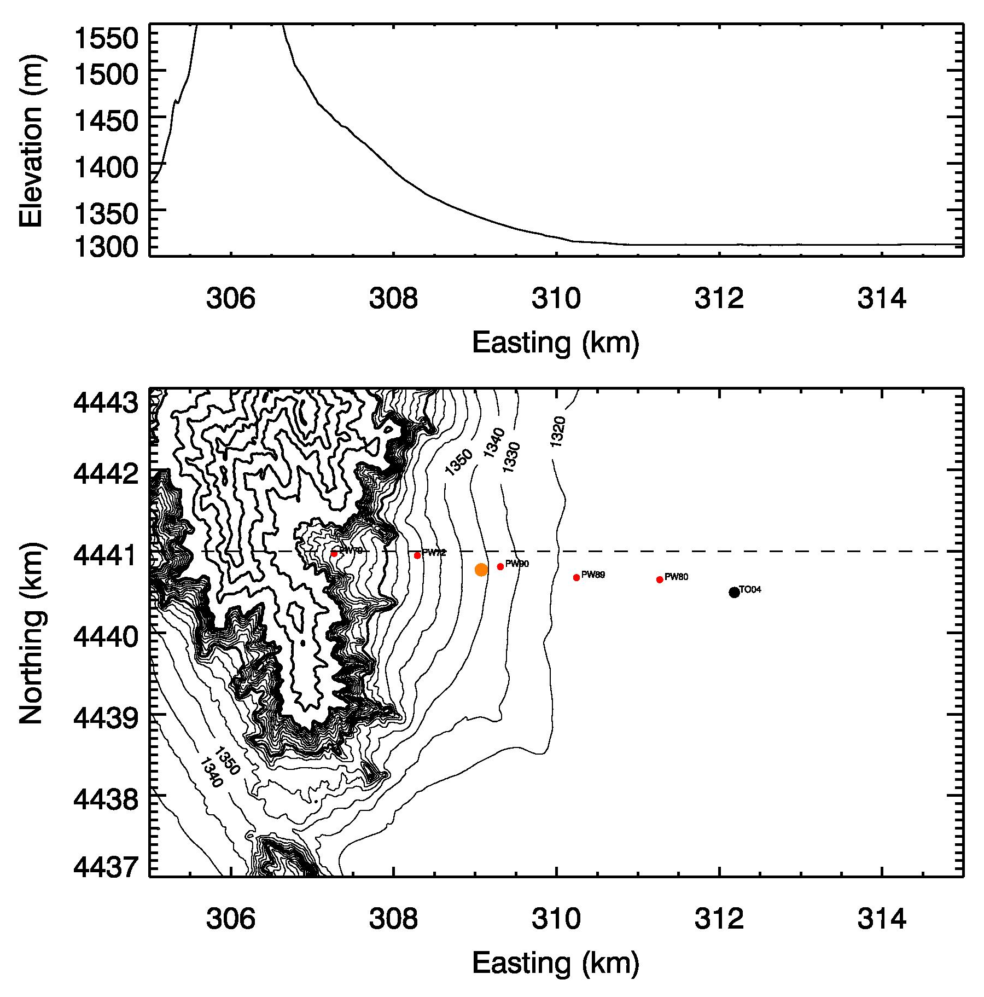
Slope angle
8°
4°
1°
PWIDS
EFS-SLOPE
DPG-30 m Tower
UU LiDAR

Slide 32
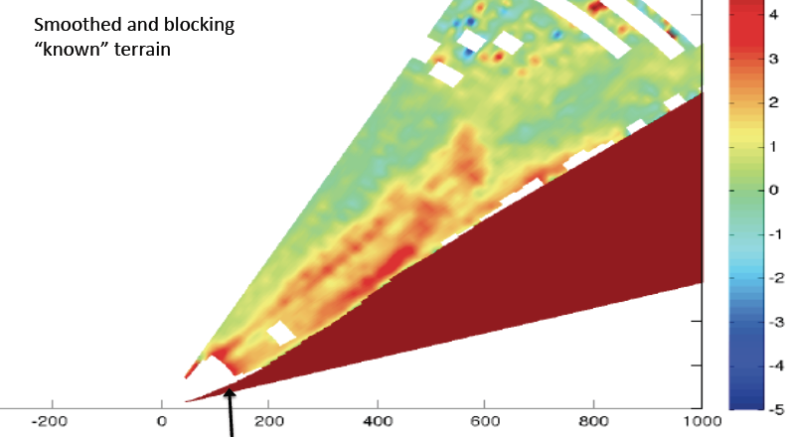
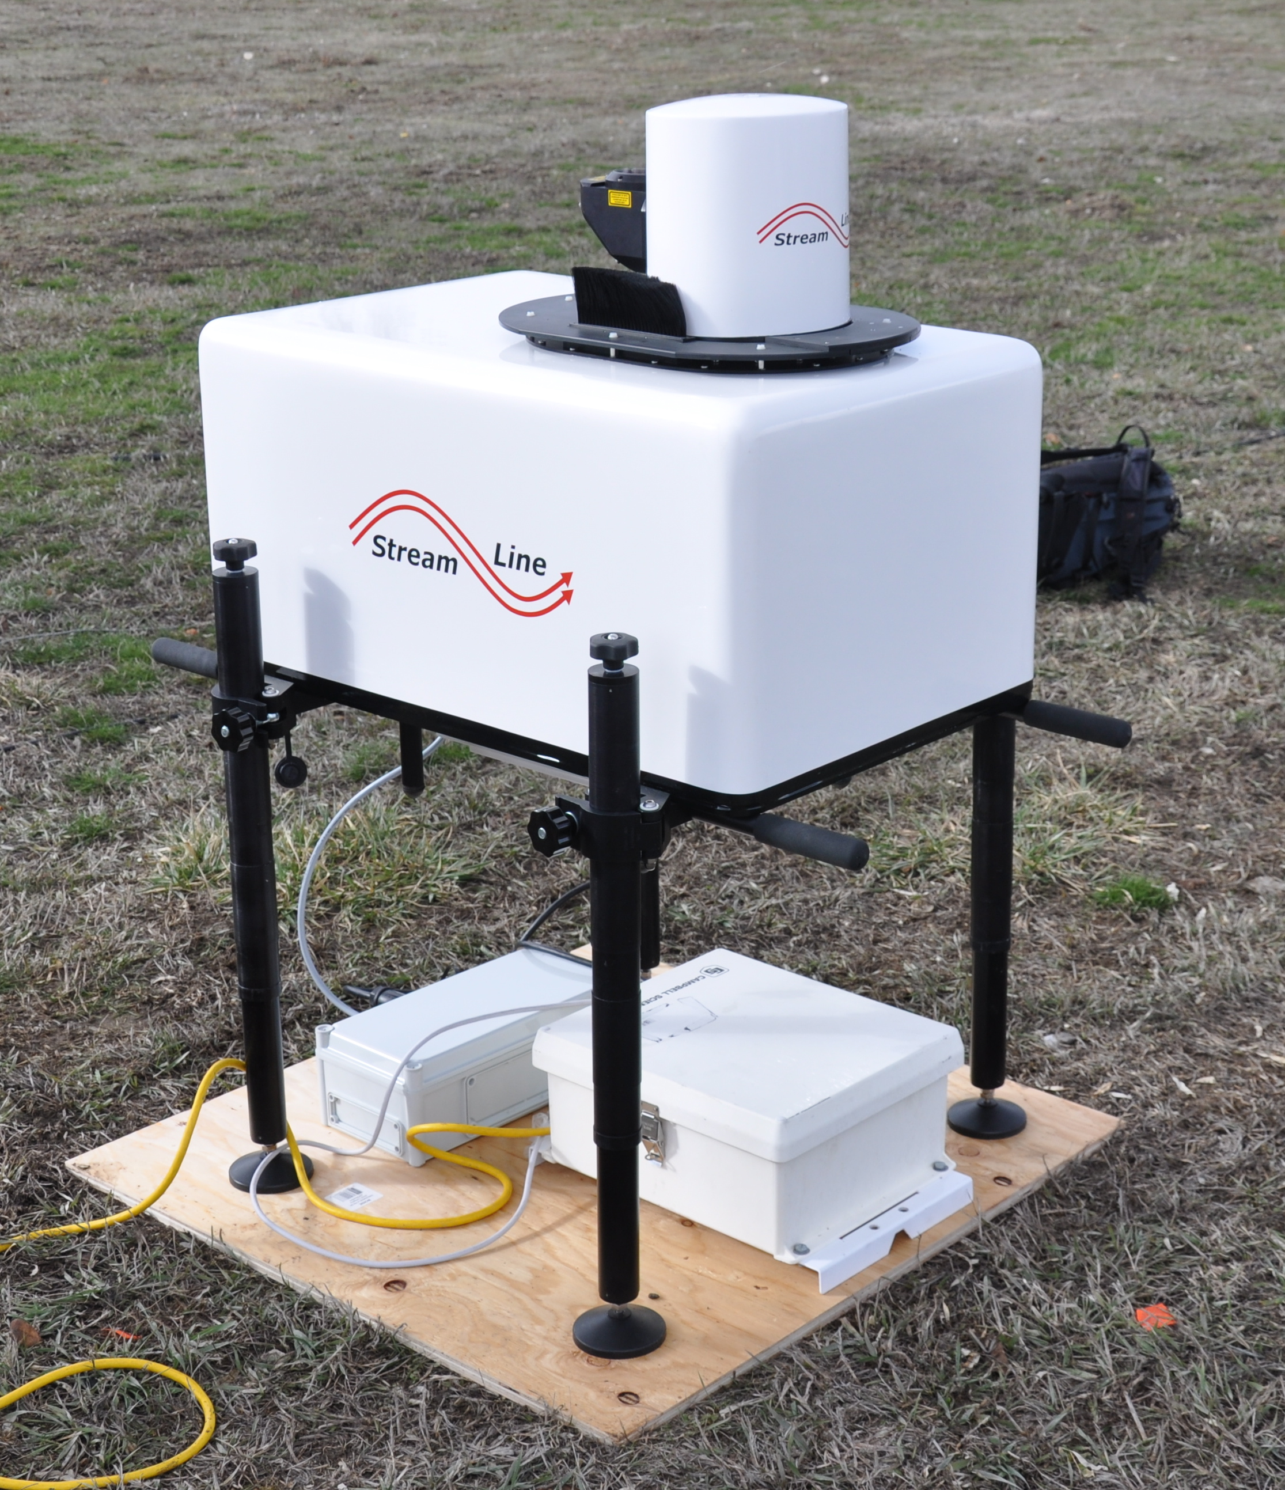
LiDAR observations with UU LiDAR – along-slope scans, range ~100-650 m
University of Utah
Scanning doppler LiDAR
Upslope flows in Val Ferret (CH)
EPFL Lausanne
Radial velocity [m/s]

Slide 33
ESF-PLAYA
ESF-SAGE
Up- and Downvalley flows
ESF-SLOPE
DGP-30 m
Tower
UU LiDAR
DGP-30 m
Tower
DGP-30 m
Tower

Slide 34
Flow interactions – with larger-scale flows
Slope flow - Valley flow interactions
Gap flows – channeled flows
Wakes
      Tethersonde observations
ESF Playa and ESF Sage
Boundary Layer Development – interaction between local scale and synoptic scale flows
      SoDAR observations
2 UU mini-SoDARs – 1 UND SoDARs. – East & West of Granite Peak, Gap
Upper Air Soundings during MATERHORN-X
160 sondes budgeted in our project (8 per IOP)
MATERHORN participants need to plan the radiosonde operation

Slide 35
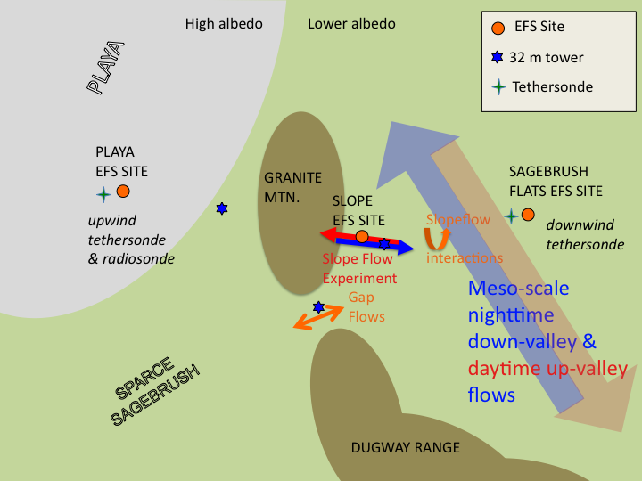
What drives the local circulations ?
Energy budget
Surface Layer development
Boundary Layer evolution

