Slide 1

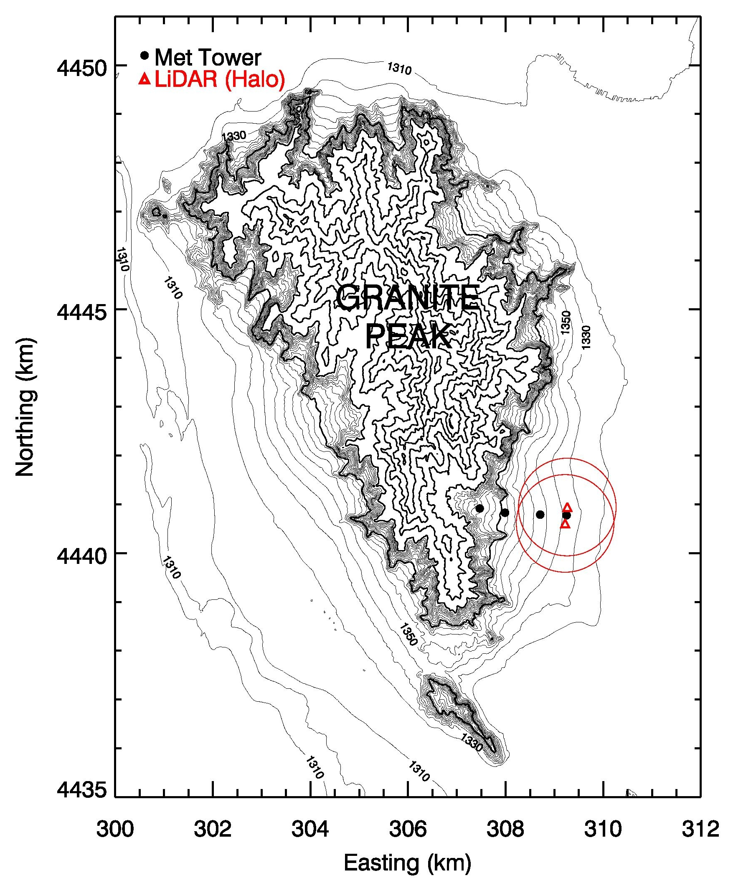
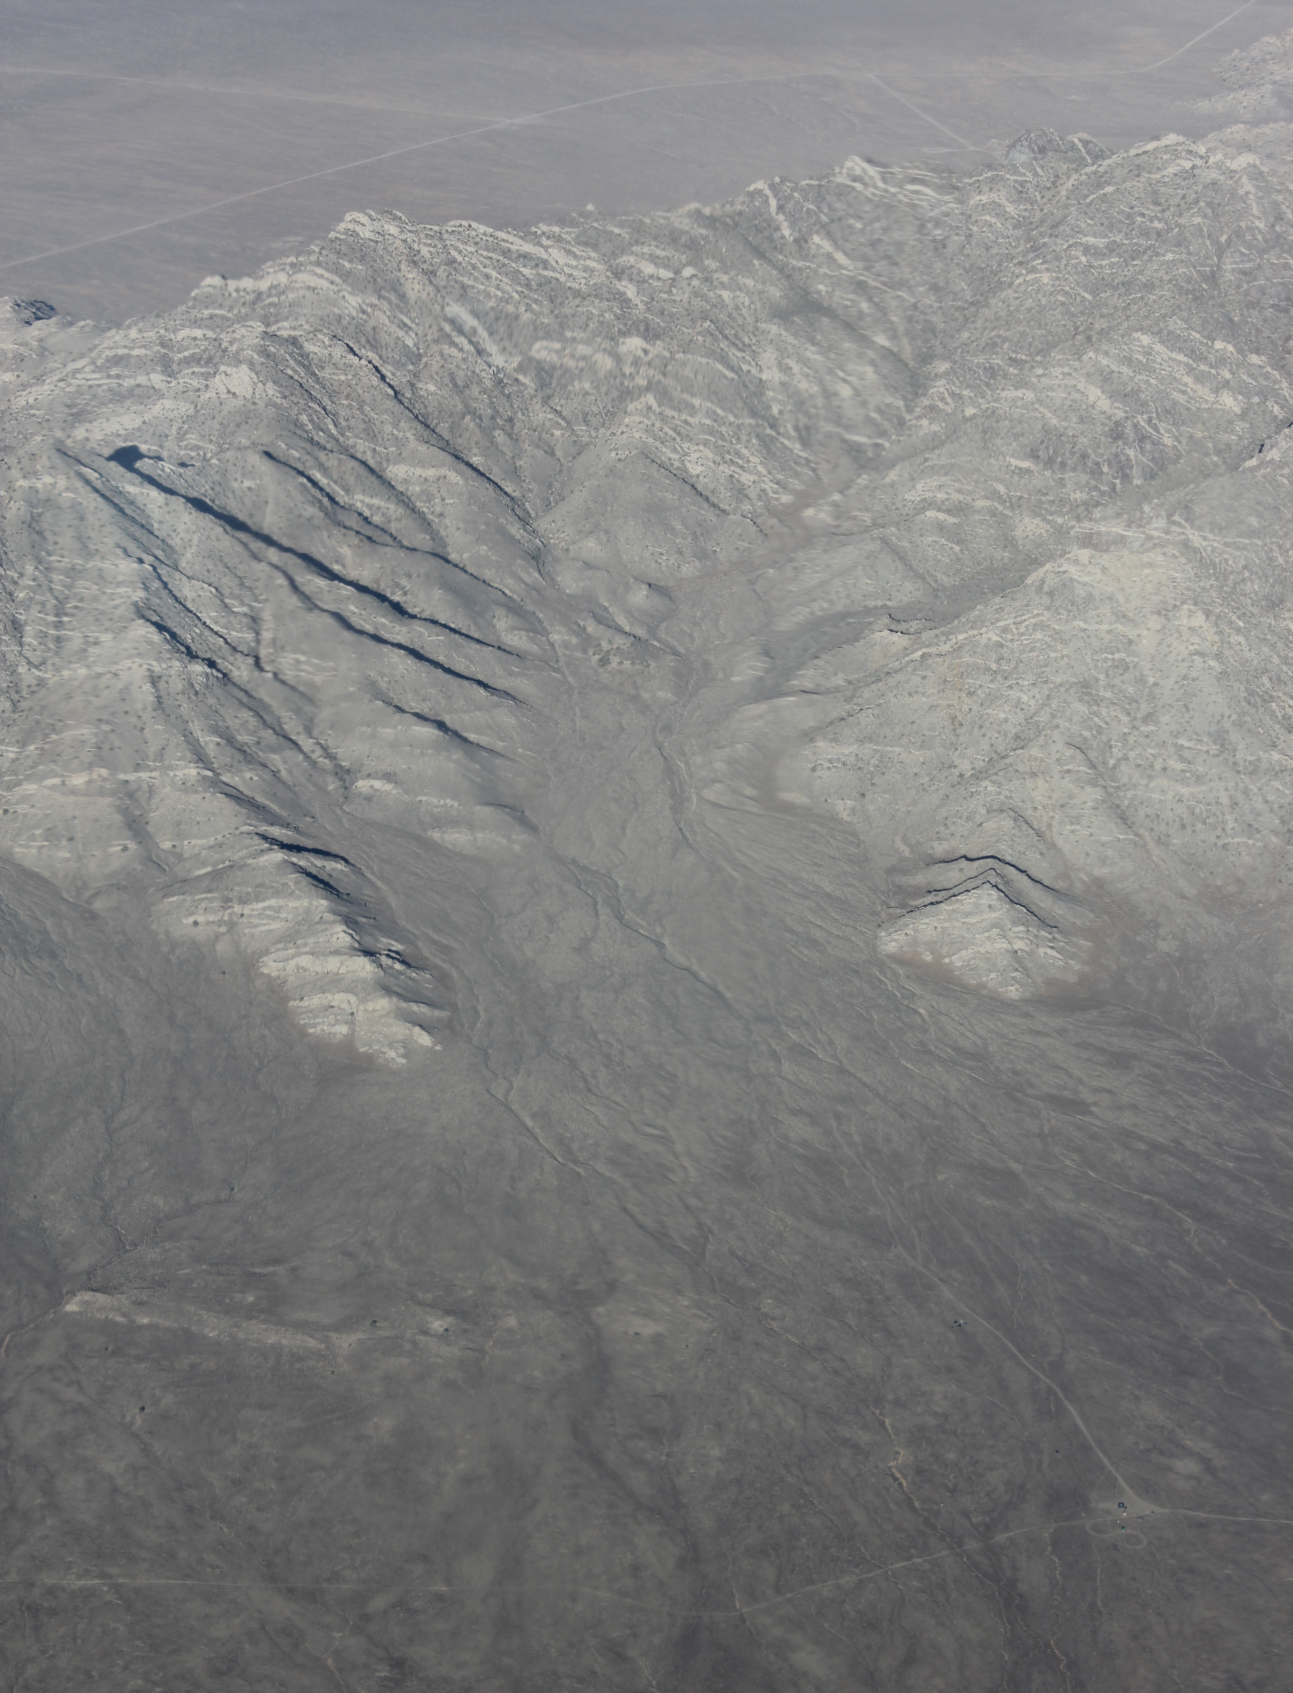
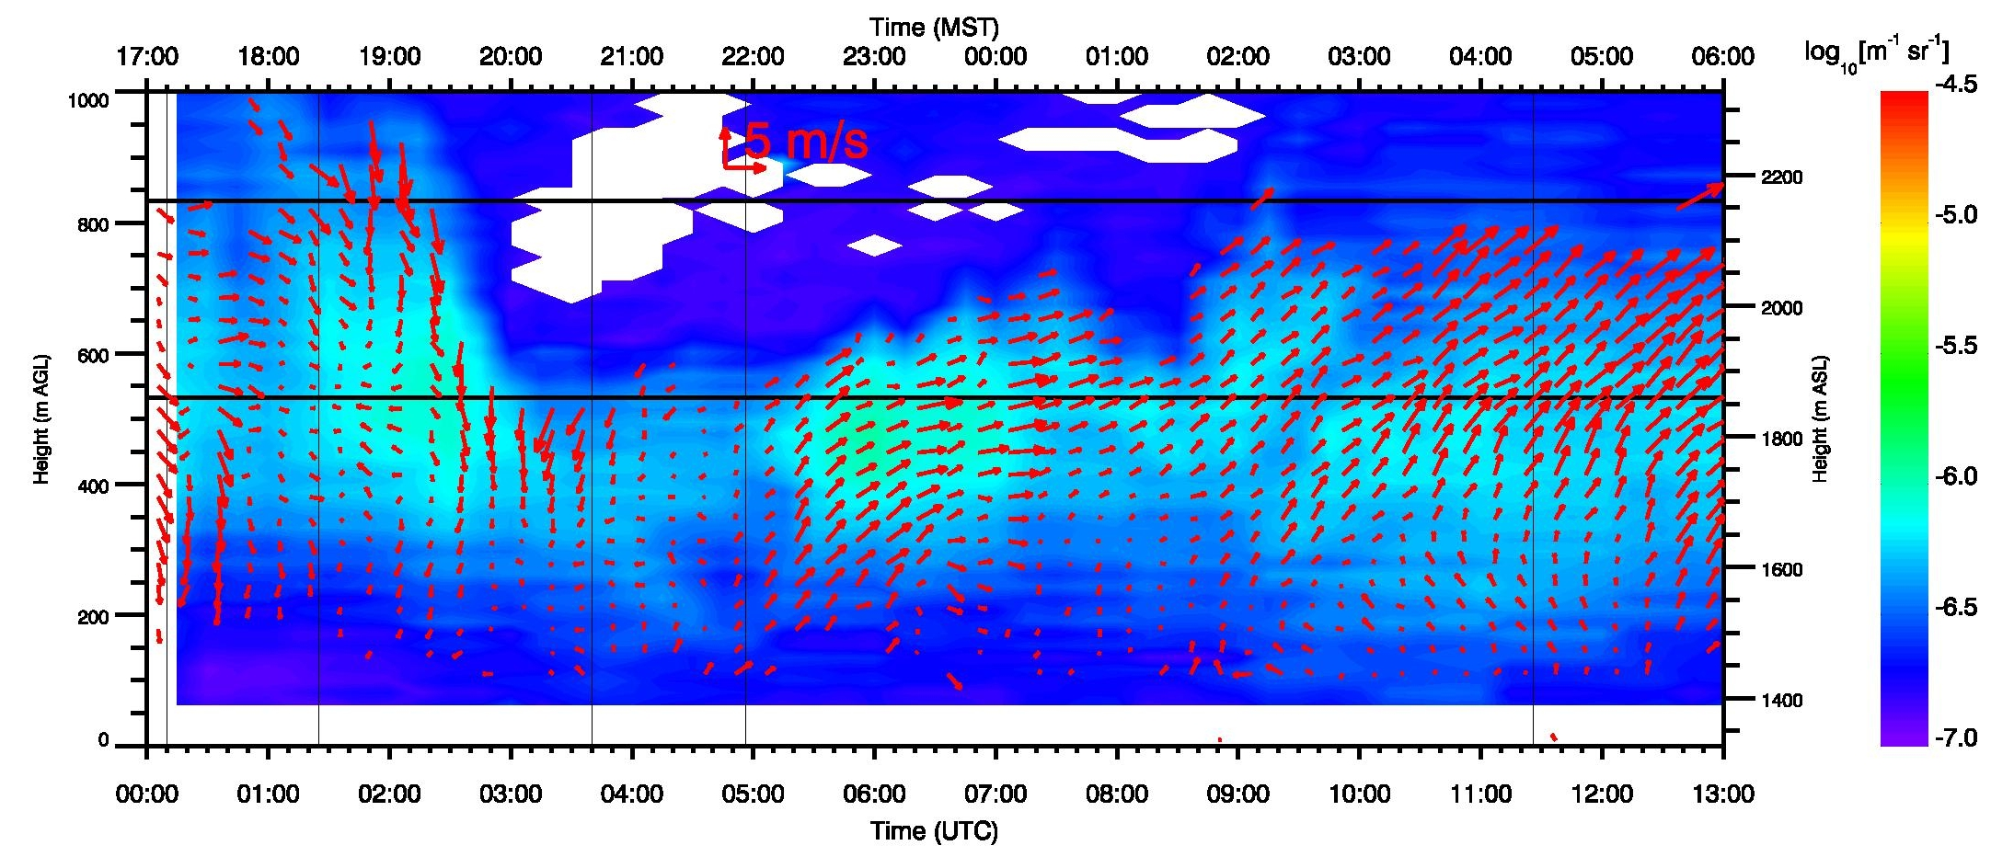
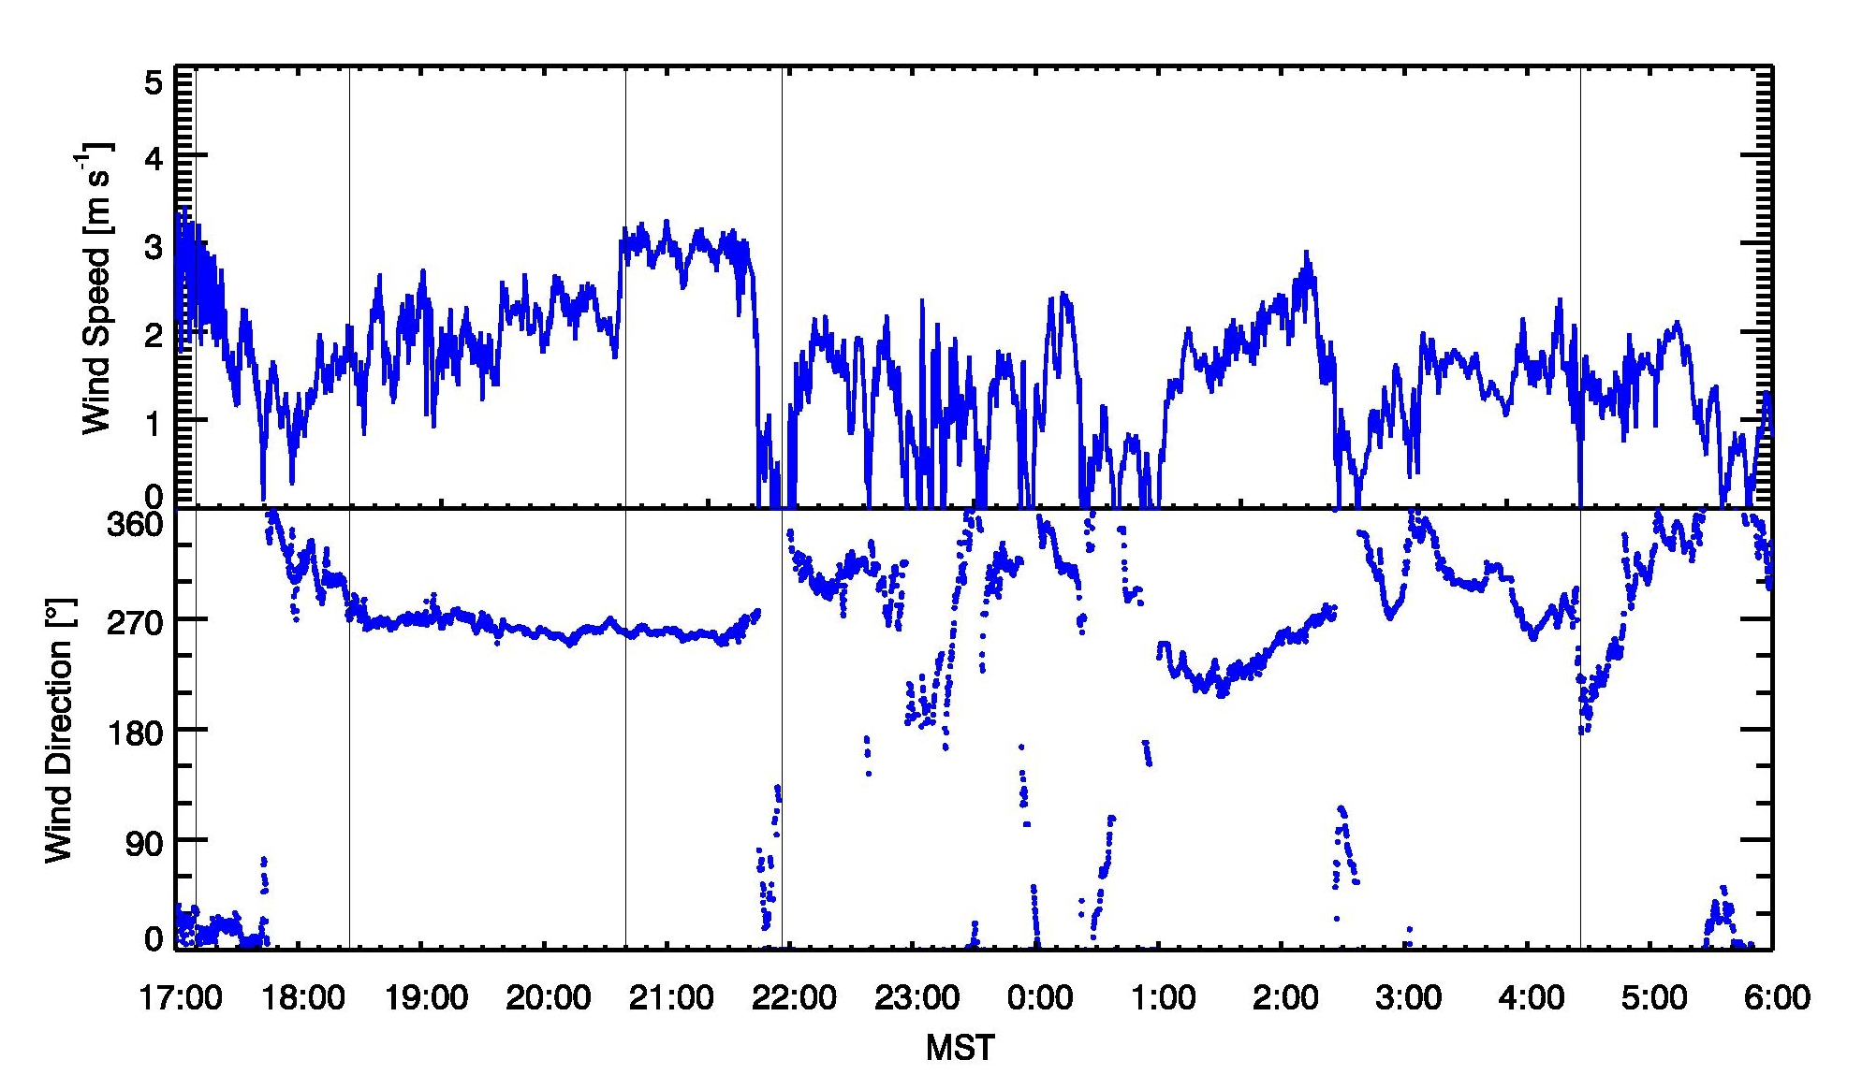
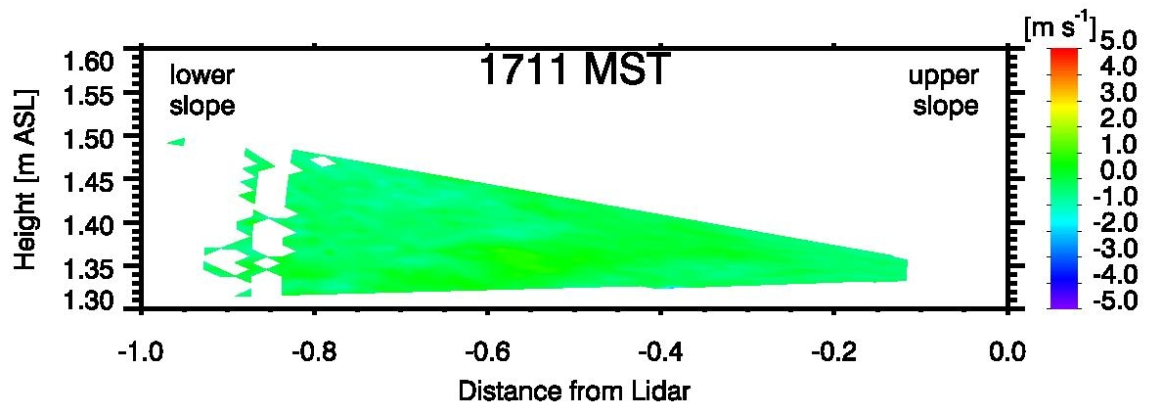
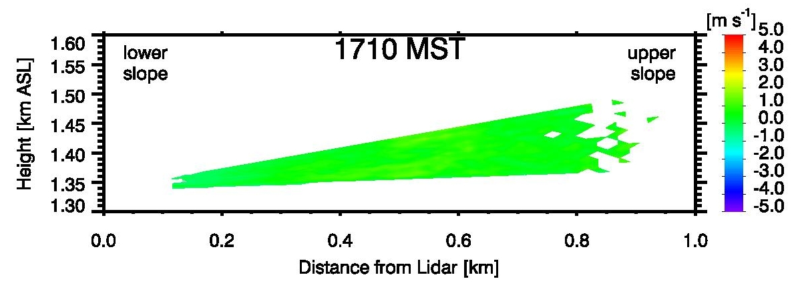
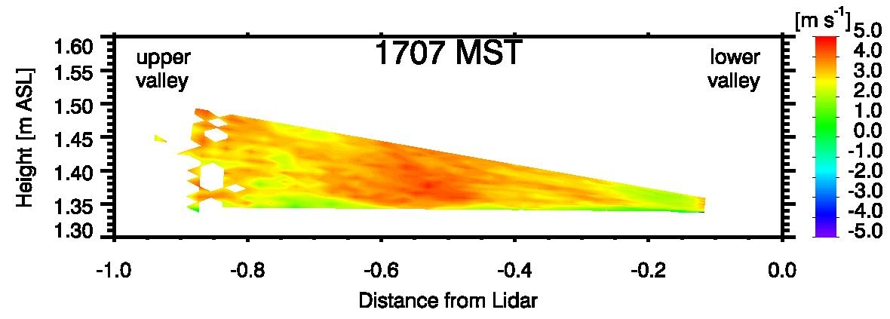
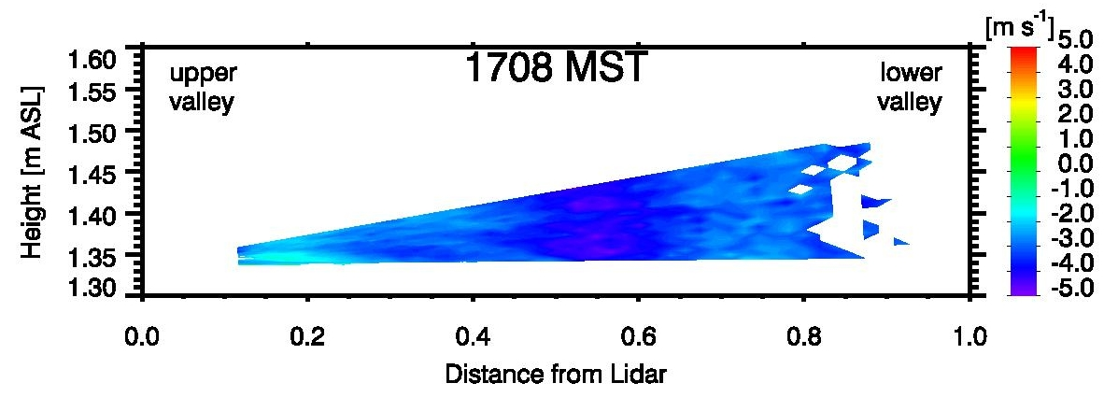
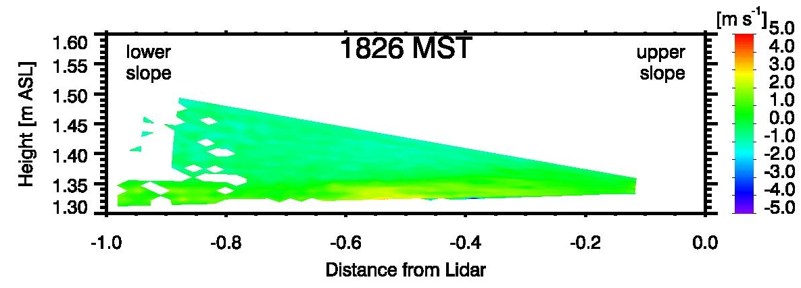
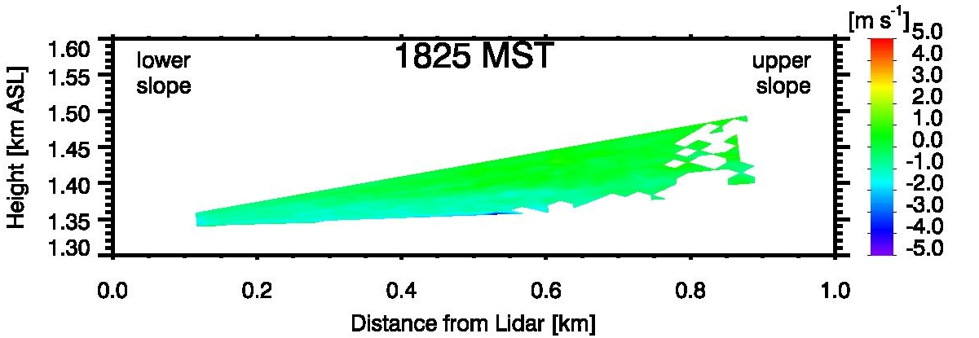
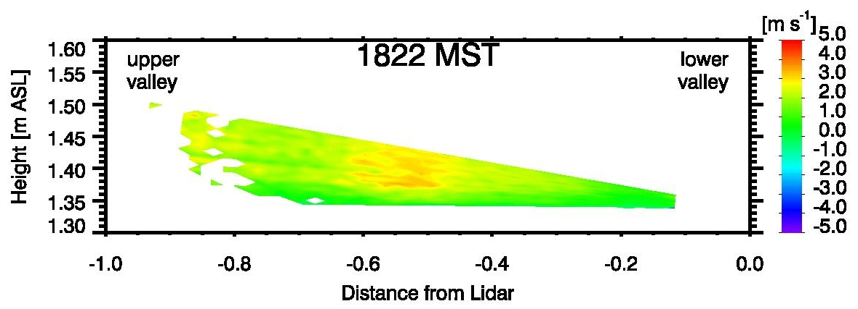
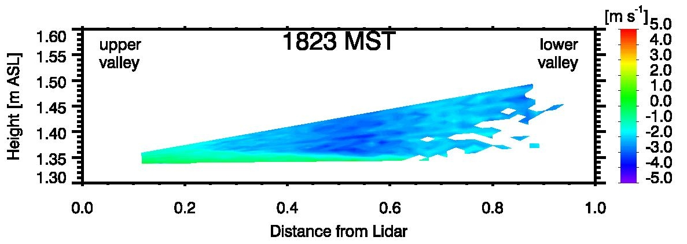
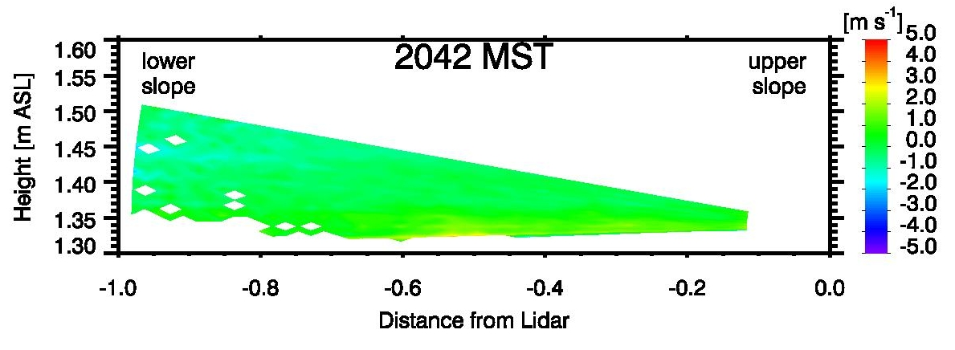
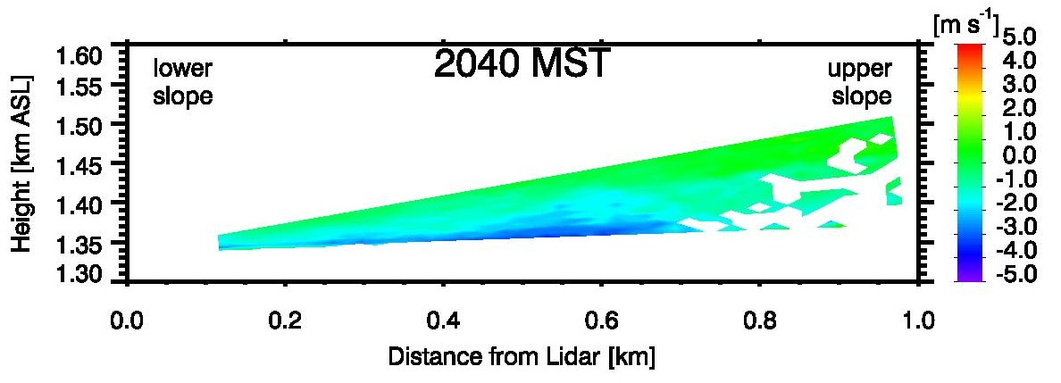
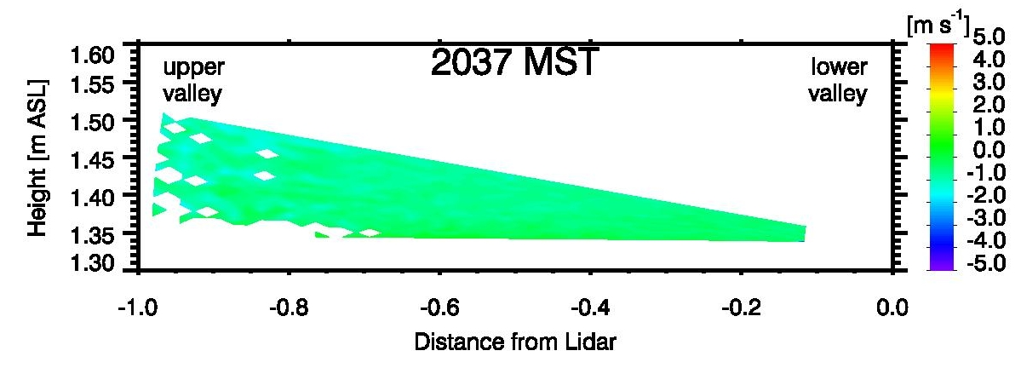
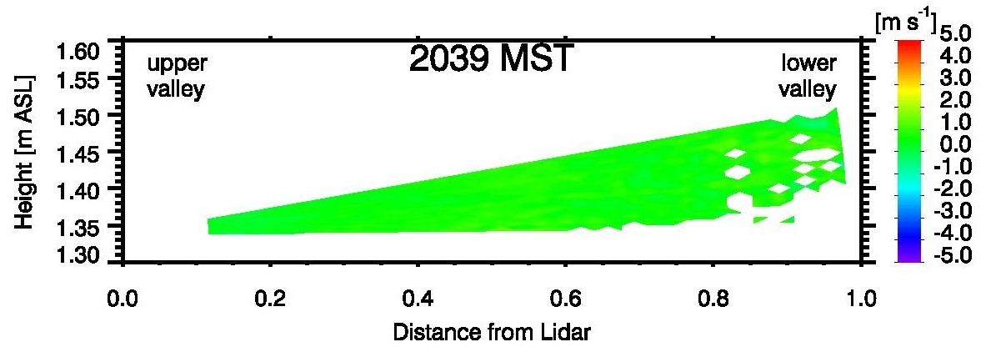
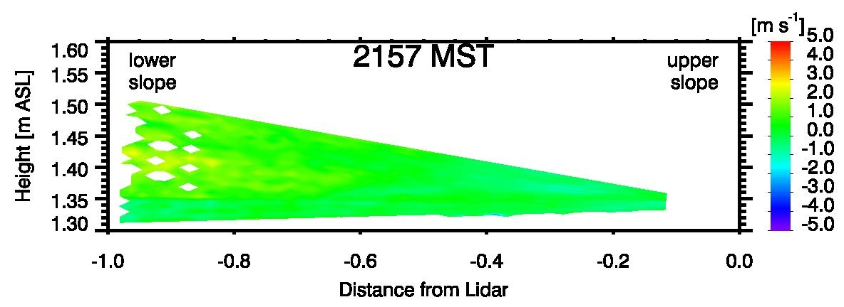
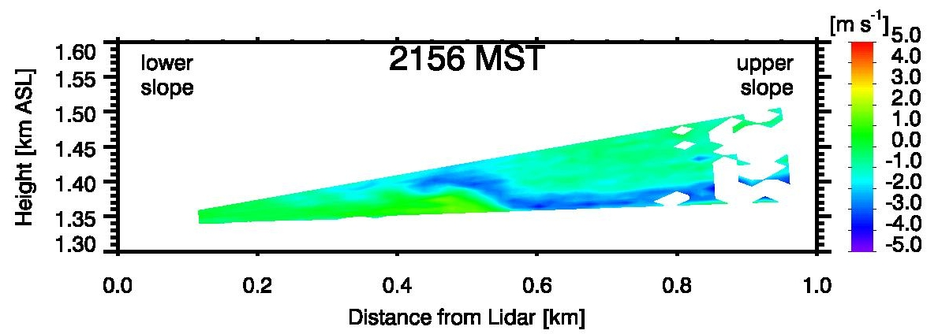
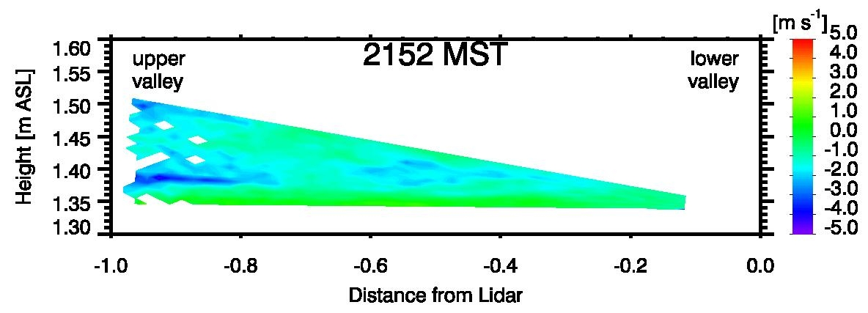
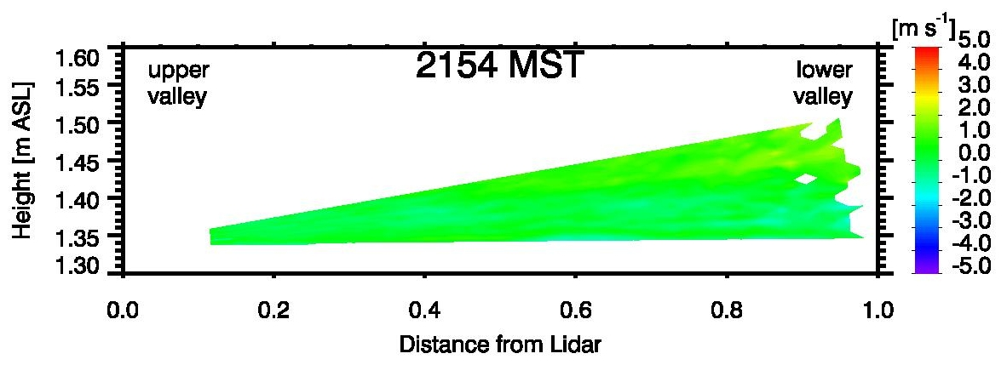
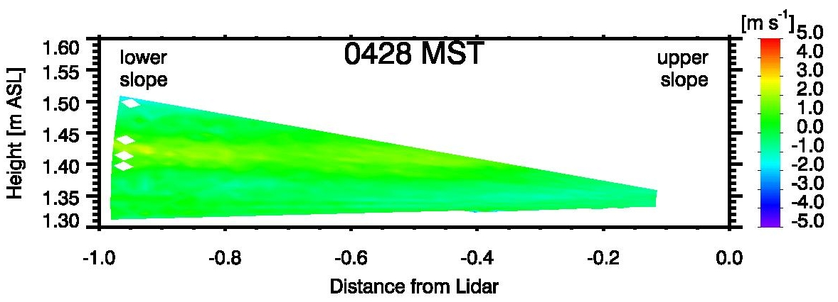
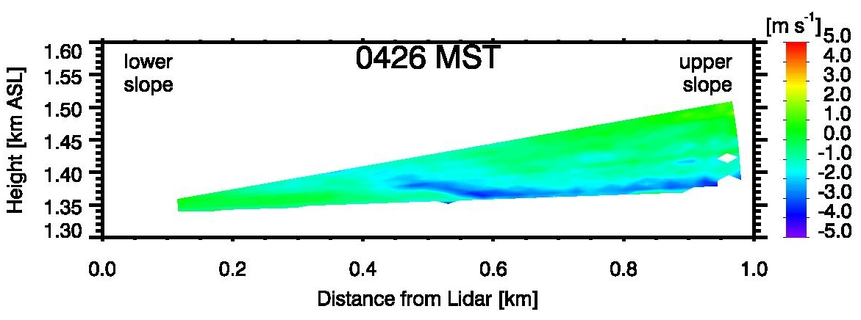
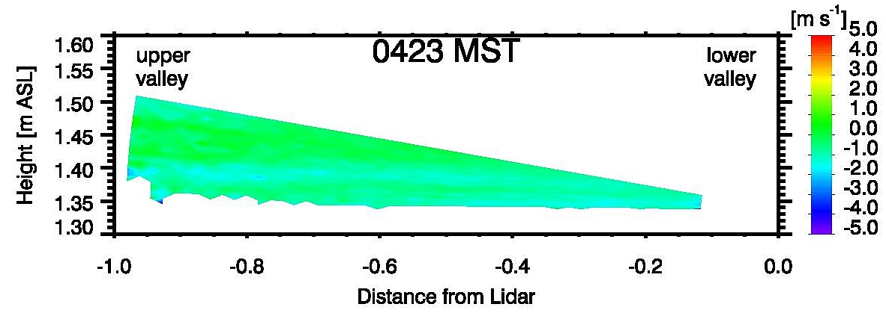
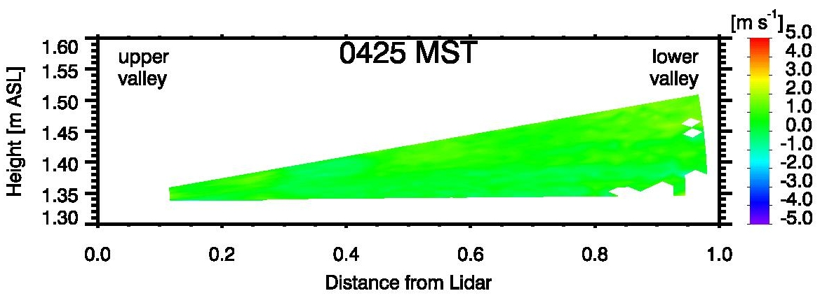
Slope- and Valley Winds and their interaction –
Observations with Doppler Wind LiDARs
during MATERHORN
ICAM 2013
International Conference
on Alpine Meteorology
Kranjska Gora, Slovenia,
3 - 7 June 2013
Sebastian W. Hoch ⁽¹⁾, Christopher Hocut ⁽²⁾, Amélie A. Klein ^{(1/3)},
Yansen Wang ⁽⁴⁾, C. David Whiteman⁽¹⁾, Harindra J. Fernando ⁽²⁾
⁽¹⁾University of Utah, ⁽²⁾University of Notre Dame, ⁽³⁾Ecole Normale Superieure de Cachan, France , ⁽⁴⁾US Army Research Laboratory, MD
The characterization of local drainage flows on an alluvial fan on the eastern slope of Granite Peak, and their interactions with the diurnal up- and down-valley circulation was one objective of the Doppler Wind LiDAR measurements during the first experimental phase of MATERHORN (Mountain Terrain Modeling and Observation Program) conducted at Dugway Proving Ground, Utah, in Fall 2012.
Fig. 3: Time-Height of LiDAR backscatter coefficient b and VAD-derived wind field.
Fig. 1: Topography of Granite Peak, UT.
Fig. 2: Areal photo of the east slope of Granite Peak.
Two Halo Photonics Streamline Doppler wind LiDARs were positioned on the eastern slope of Granite Peak (Fig. 1 and 2). The scan patterns included low-angle (0-15° elevation) RHIs in the up-slope and down-slope as well as the up-valley and down-valley directions.
The night of 1-2 October 2012 was characterized by changing interactions between synoptic northerly flow, thermally driven daytime up-valley and nighttime down-valley flows and local slope flows.
Fig. 4: Surface wind speed and direction from an automatic weather station near LiDAR.
Down-slope scan
Up-slope scan
Up-valley scan
Down-valley scan
~1710 MST
~1825 MST
~2040 MST
~2155 MST
~0420 MST
Fig. 5: Contour plots of radial (along-beam) Doppler velocities for low-angle RHI scans in azimuthal down-slope (100°), up-slope (280°) and up-valley (190°) and down-valley (10°) directions, for selected time periods in the night of 1-2 October 2012. Blue colors indicate flow towards the LiDAR, yellow and red colors flow away from the LiDAR.
Summary:
1710 MST: Up-valley circulation dominates the flow pattern on the east slope of Granite Peak. No up-slope flow is observed.
1825 MST: Onset of shallow down-slope flows. These are undercutting the up-valley circulation.
2040 MST: Down-slope flows deepen and strengthen. The up-valley circulation ceases.
2155 MST: Arrival of the cold pool from the lower basin. Surface winds calm and turn easterly, temperatures drop (not shown). The down-slope flow rides up onto col pool.
0425 MST: A brief episode of down-valley circulation dominates the flow on the slope. The local down-slope flow is entrained into the down-valley circulation.
Acknowledgments: MATERHORN is sponsored by the US Department of Defense, Office of Naval Research.
contact: sebastian.hoch@utah.edu

