Slide 1
Outline
Introduction
1. The surface energy balance – driver of thermally driven flows
2. Case study: 1-2 October 2012 (quiescent IOP 2)
synoptic overview
surface observations
upper air observations
lidar observations
3. Future work

Slide 2



Multi-Scale Flow Interactions
Observations during MATERHORN
Sebastian W. Hoch & Matt Jeglum
With contributions from
Chris Hocut, C. David Whiteman, Yansen Wang, Stephan DeWekker

Slide 3
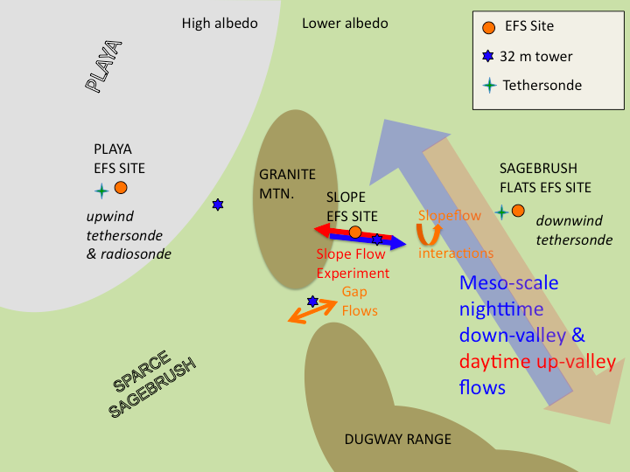
Introduction
Synoptic forcing
Land surface
contrasts
Land-Atmosphere
energy exchange
Boundary Layer
Evolution
Circulation
patterns

Slide 4
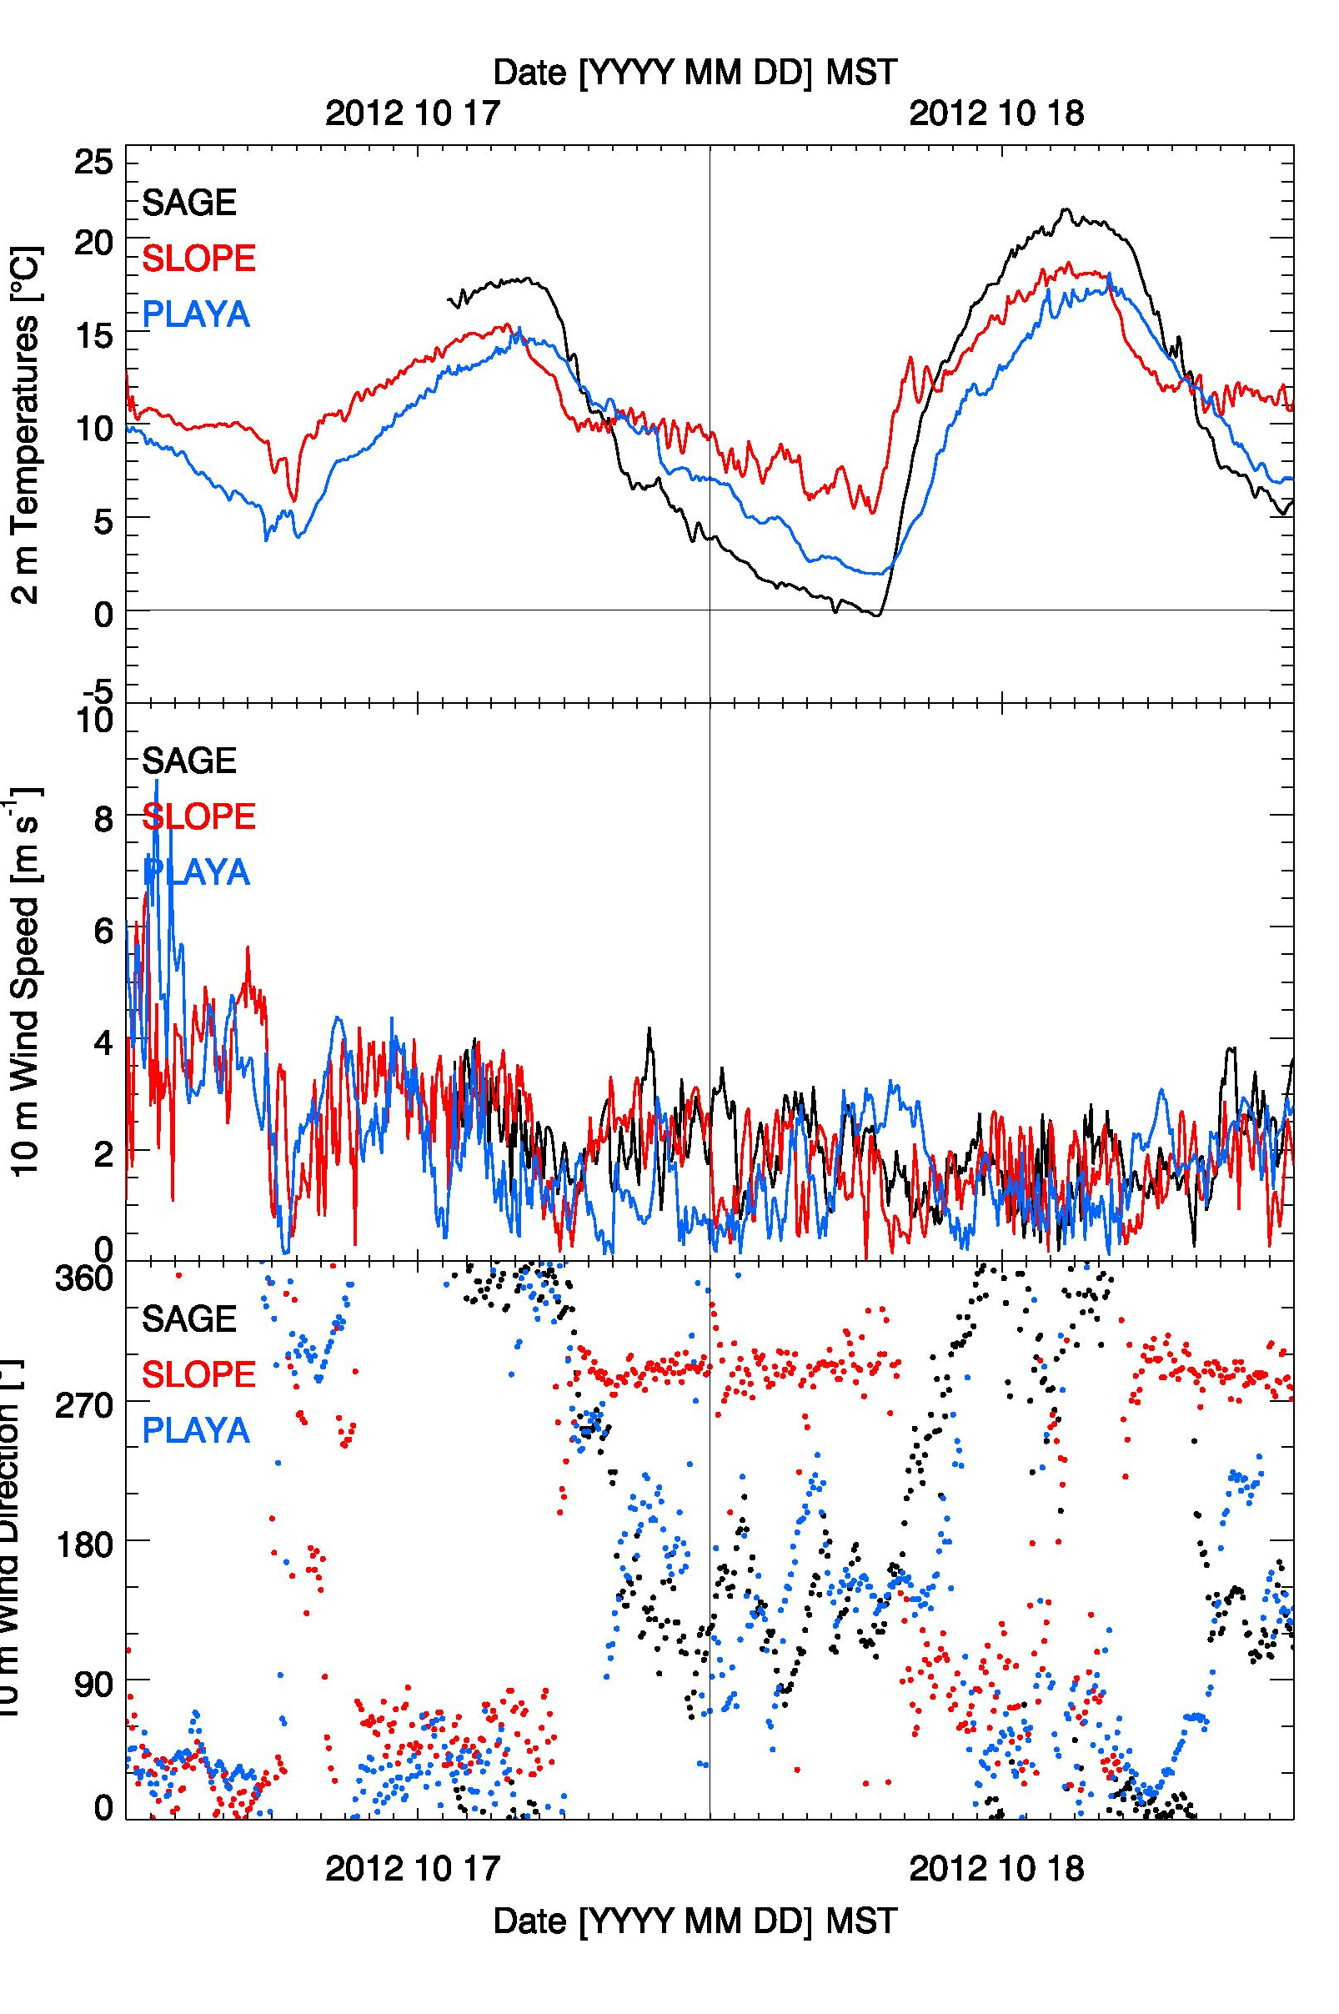
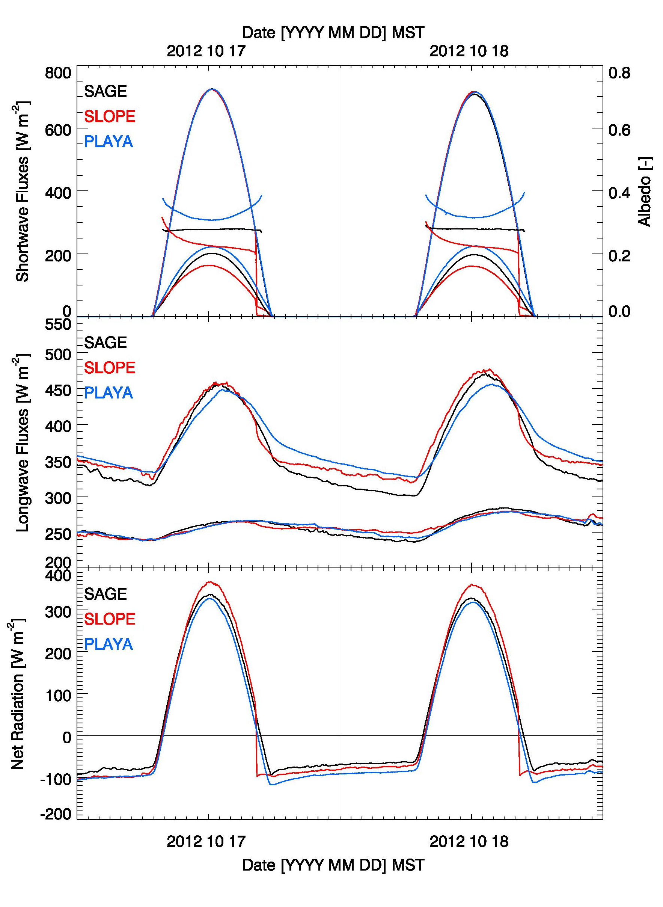
Radiation Balance at
EFS-Sites
Same shortwave (SW) energy input, so albedo differences control SW balance.
 | Albedo [-] (min & max daily means) | Thermal Conductivity [W / (m K)]
EFS-Sage | 0.27 (0.18-0.29) | 0.58
EFS-Slope | 0.23 (0.17-0.24) | 0.44
EFS-Playa | 0.31 (0.24 -0.35) | 0.89
Surface property differences (albedo & thermal conductivity) result in large longwave outgoing (LW⬆) flux differences.
Lower LW⬆ at EFS-Playa during daytime.
Higher LW⬆ at EFS-Playa during the night.
SW* and LW* differences (Playa vs Sagebrush) compensate during the day, and net radiation differences are greatest during the night

Slide 5
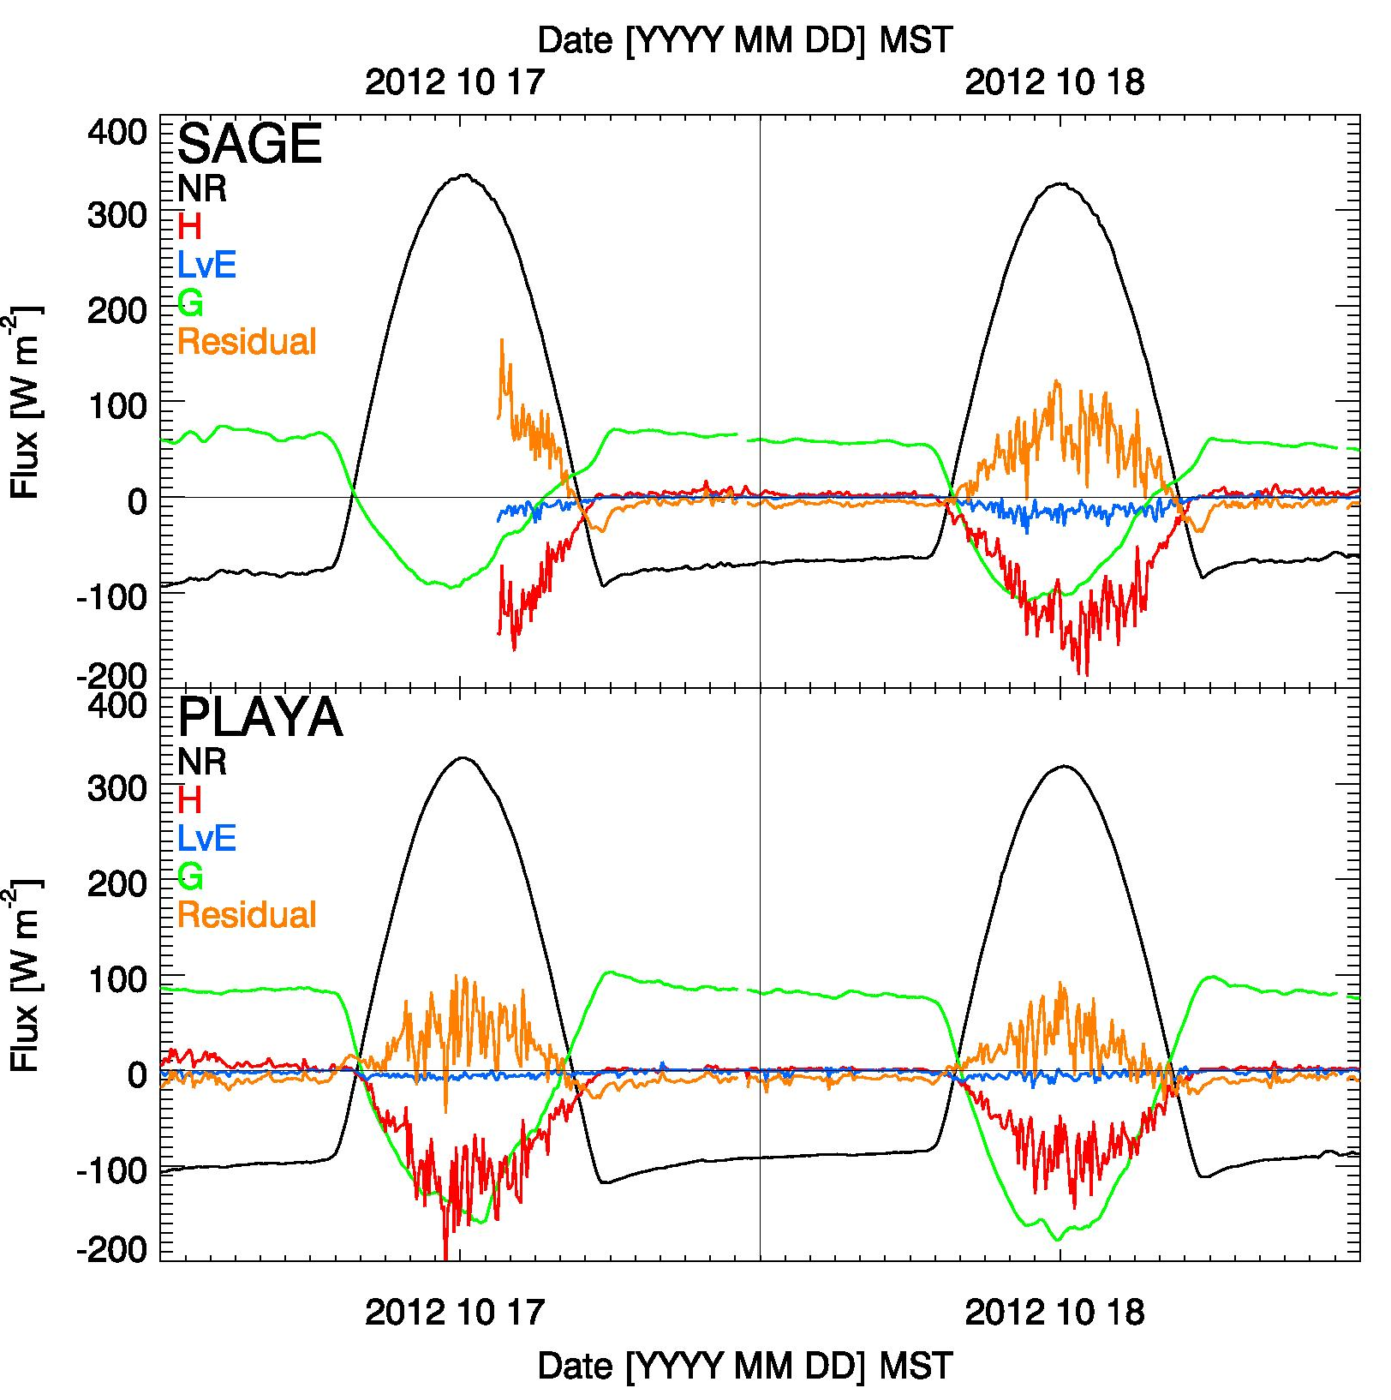
Energy balance: EFS-Playa and EFS-Sagebrush differences
Energy balance is closed at night (when G=-NR)! A residual remains during daytime.
Latent heat fluxes (LvE) are small, even at EFS-Playa
Large ground heat flux / sensible heat flux differences
Hoch et al. 2013 ICAM presentation
Notes:
Derek Jensen (H * LvE) calculations

Slide 6
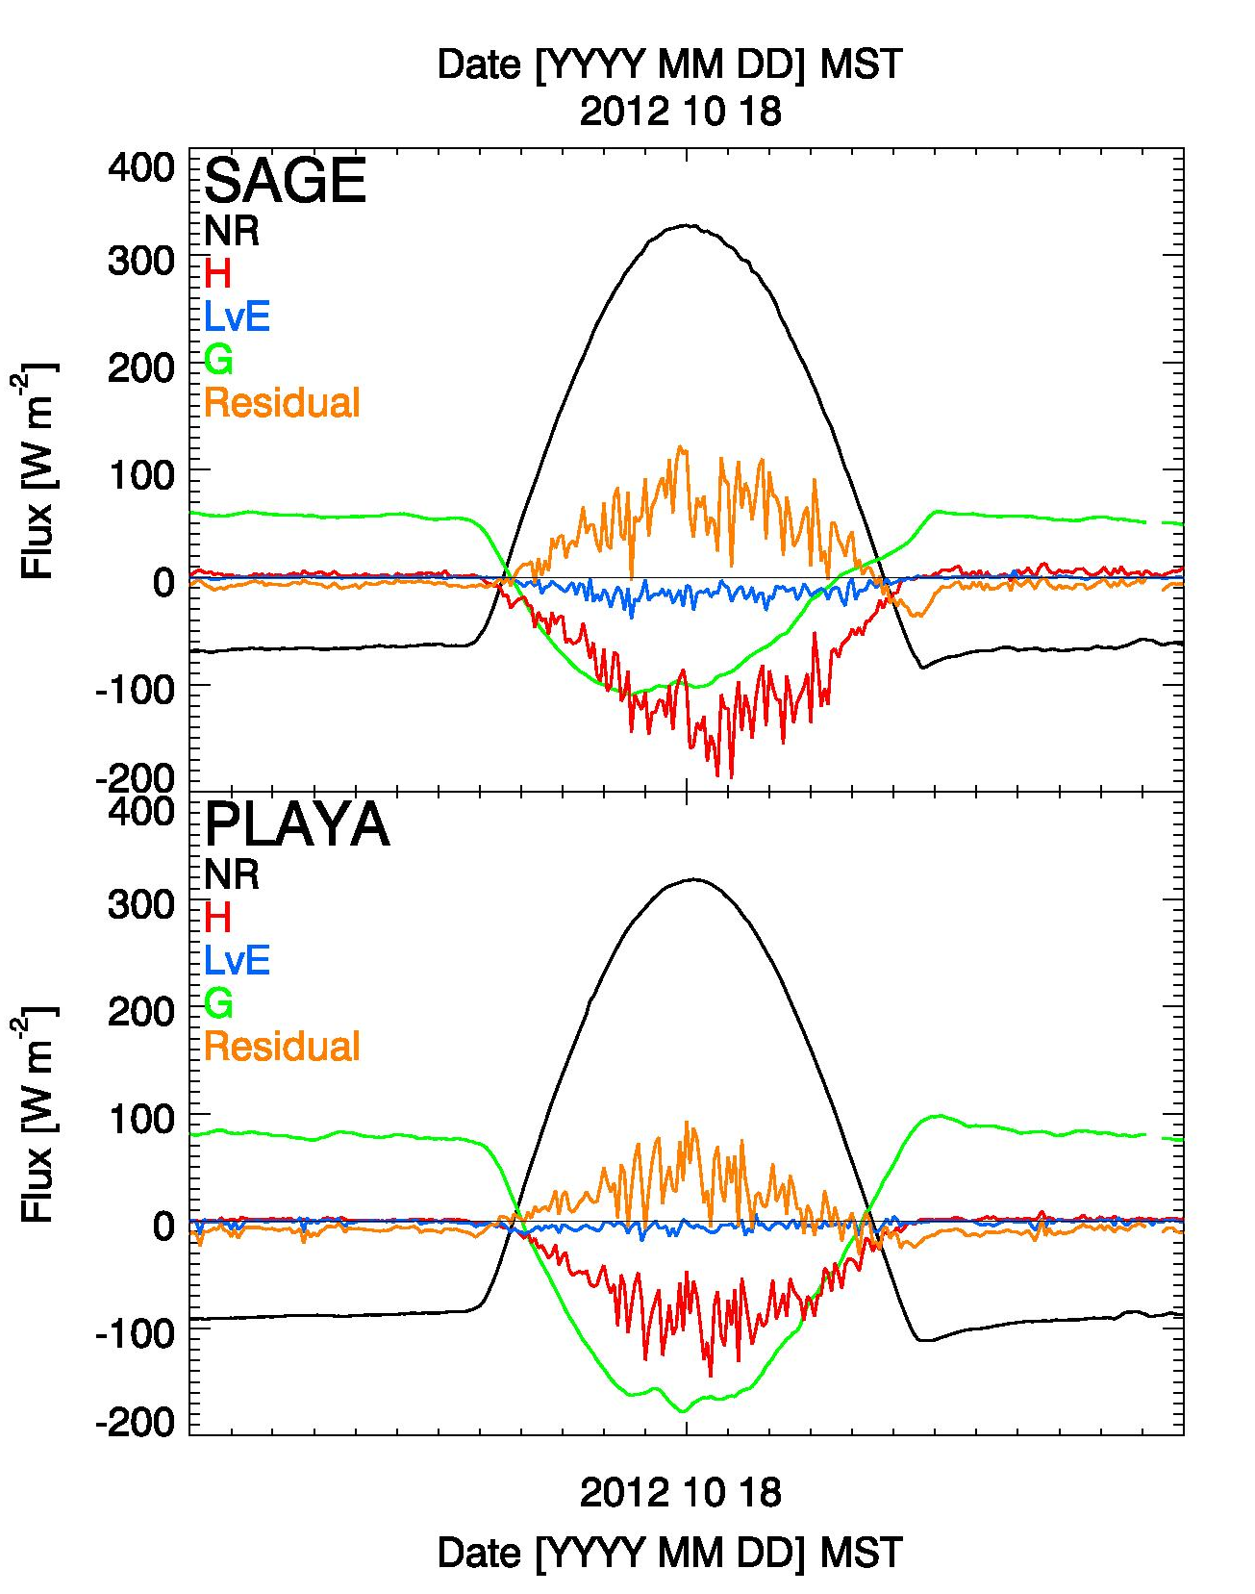
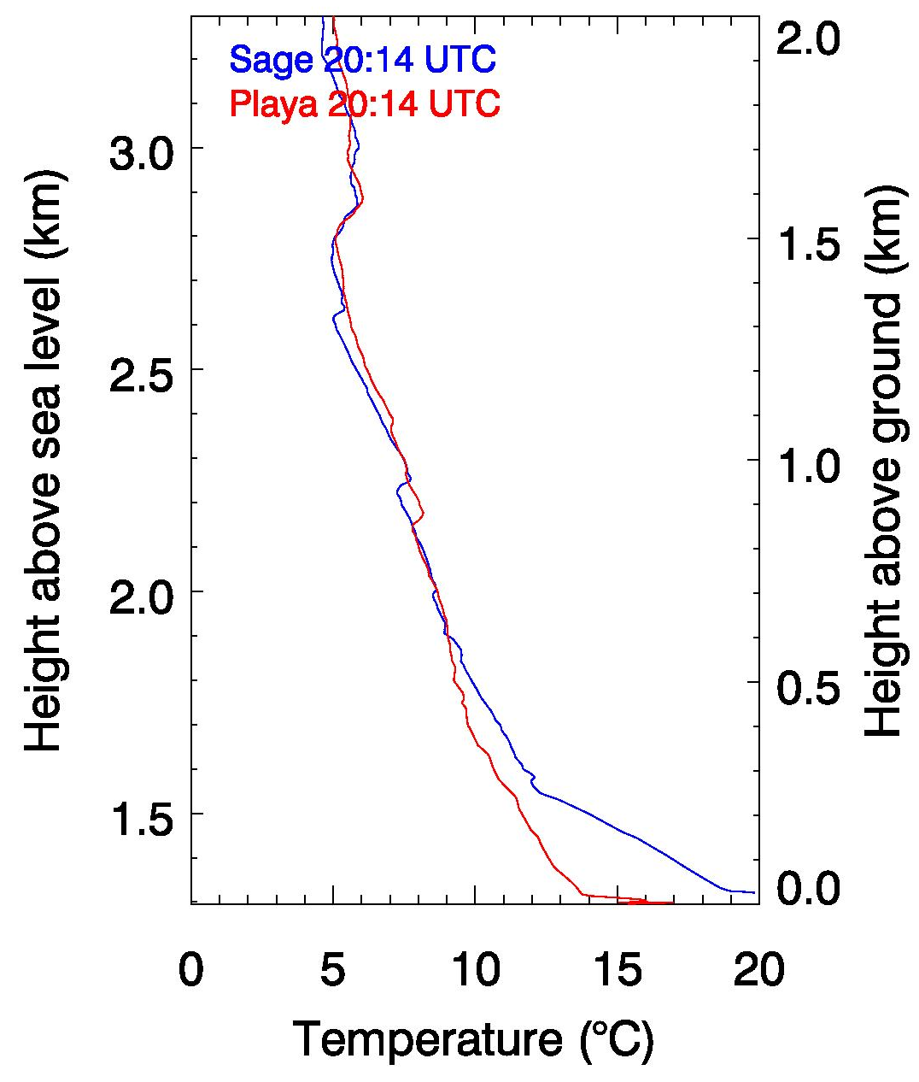
Energy balance differences and boundary layer development
Large differences in sensible heating …
… lead to differences in boundary layer development.
13:15 MST radiosonde ascents
1500 MST
Playa
Sagebrush
18 Oct. 2012 (IOP 8 MH-Fall)

Slide 7
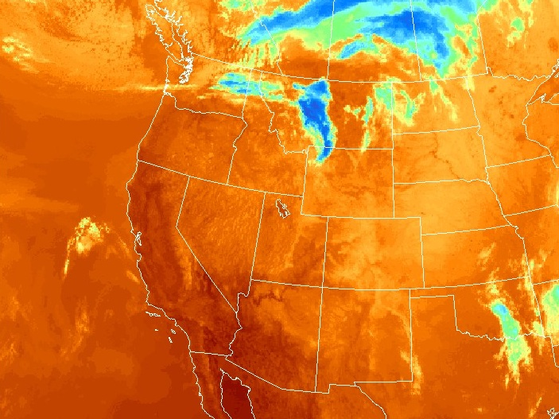
Flow interactions – case study 1-2 October 2012
Thermal satellite imagery & cloud cover
Oct 1 2012 1915 MST

Slide 8
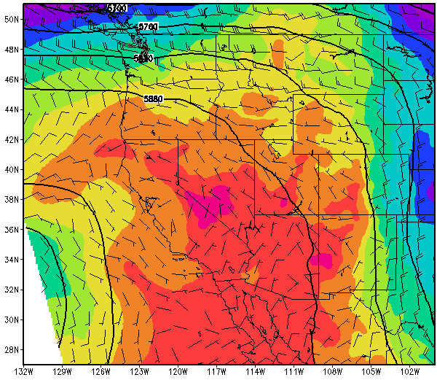
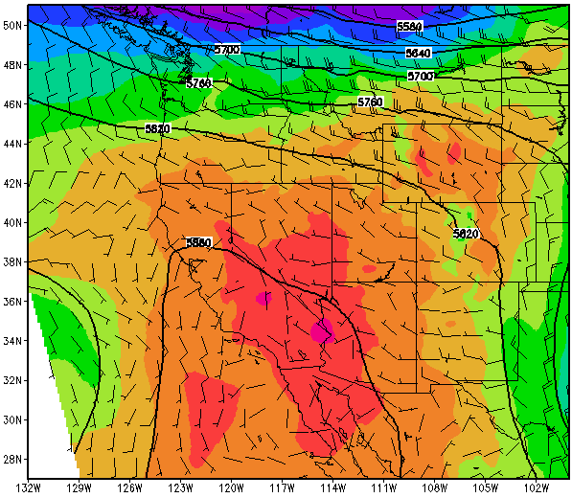
2 Oct 00 UTC (1 Oct 1700 MST)
2 Oct 12UTC (2 Oct 0500 MST)
700 mbar winds (5 m/s full barb) and 700 mbar temperatures, 500 mbar heights
Notes:
Positively tilted ridge

Slide 9
LARGER SCALE MOVIE
IMBEDDED OR SHOWN SEPERATELY
Notes:
Sunset at around 1750 (by 1725 all of east slope is shaded)
Sunrise around 0700 MST

Slide 10
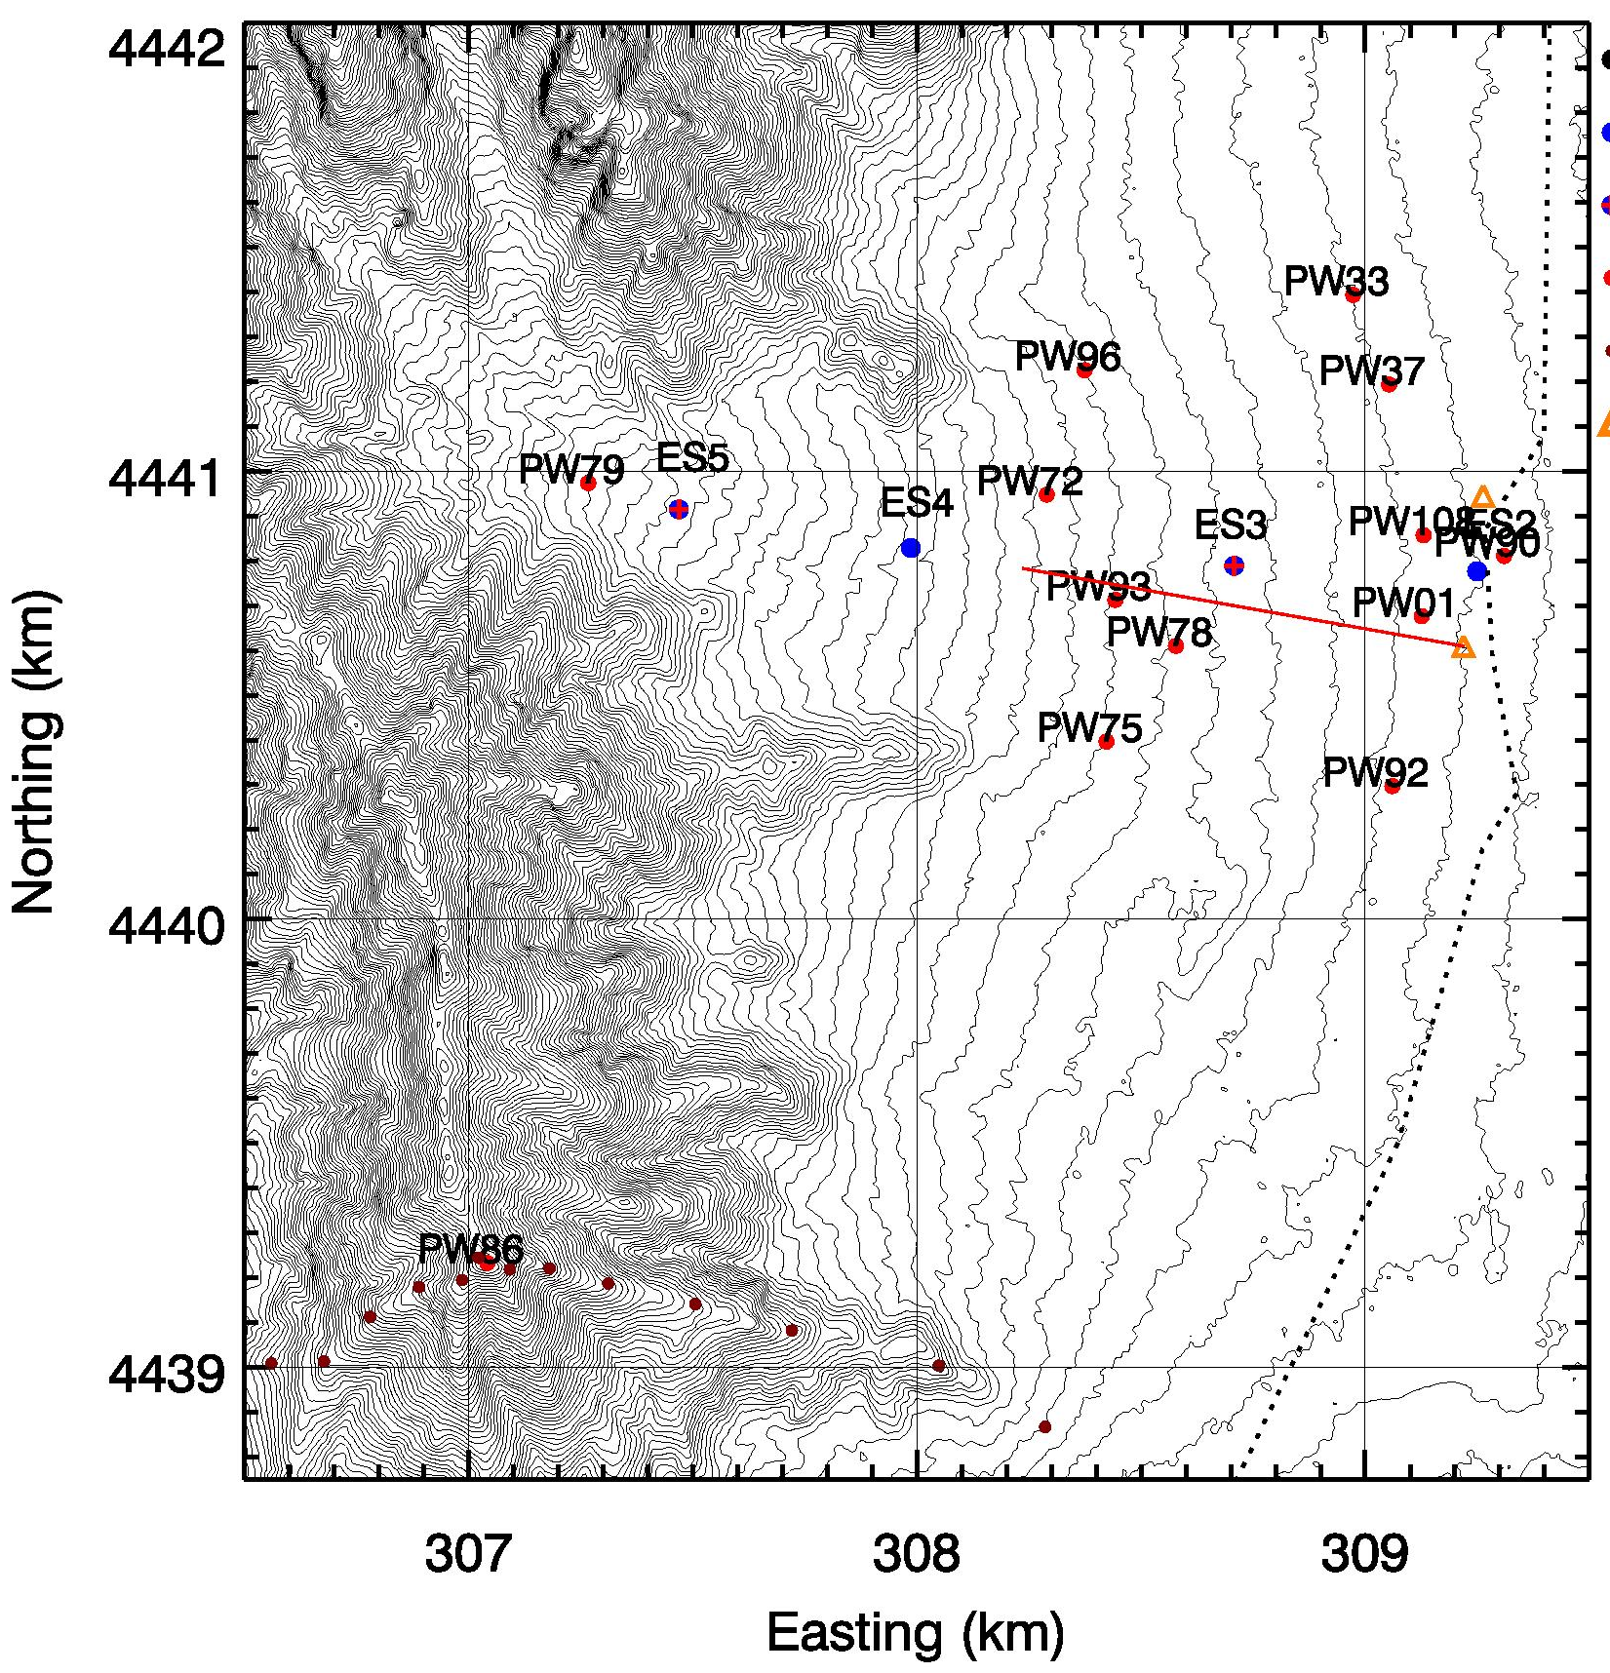

Slide 11
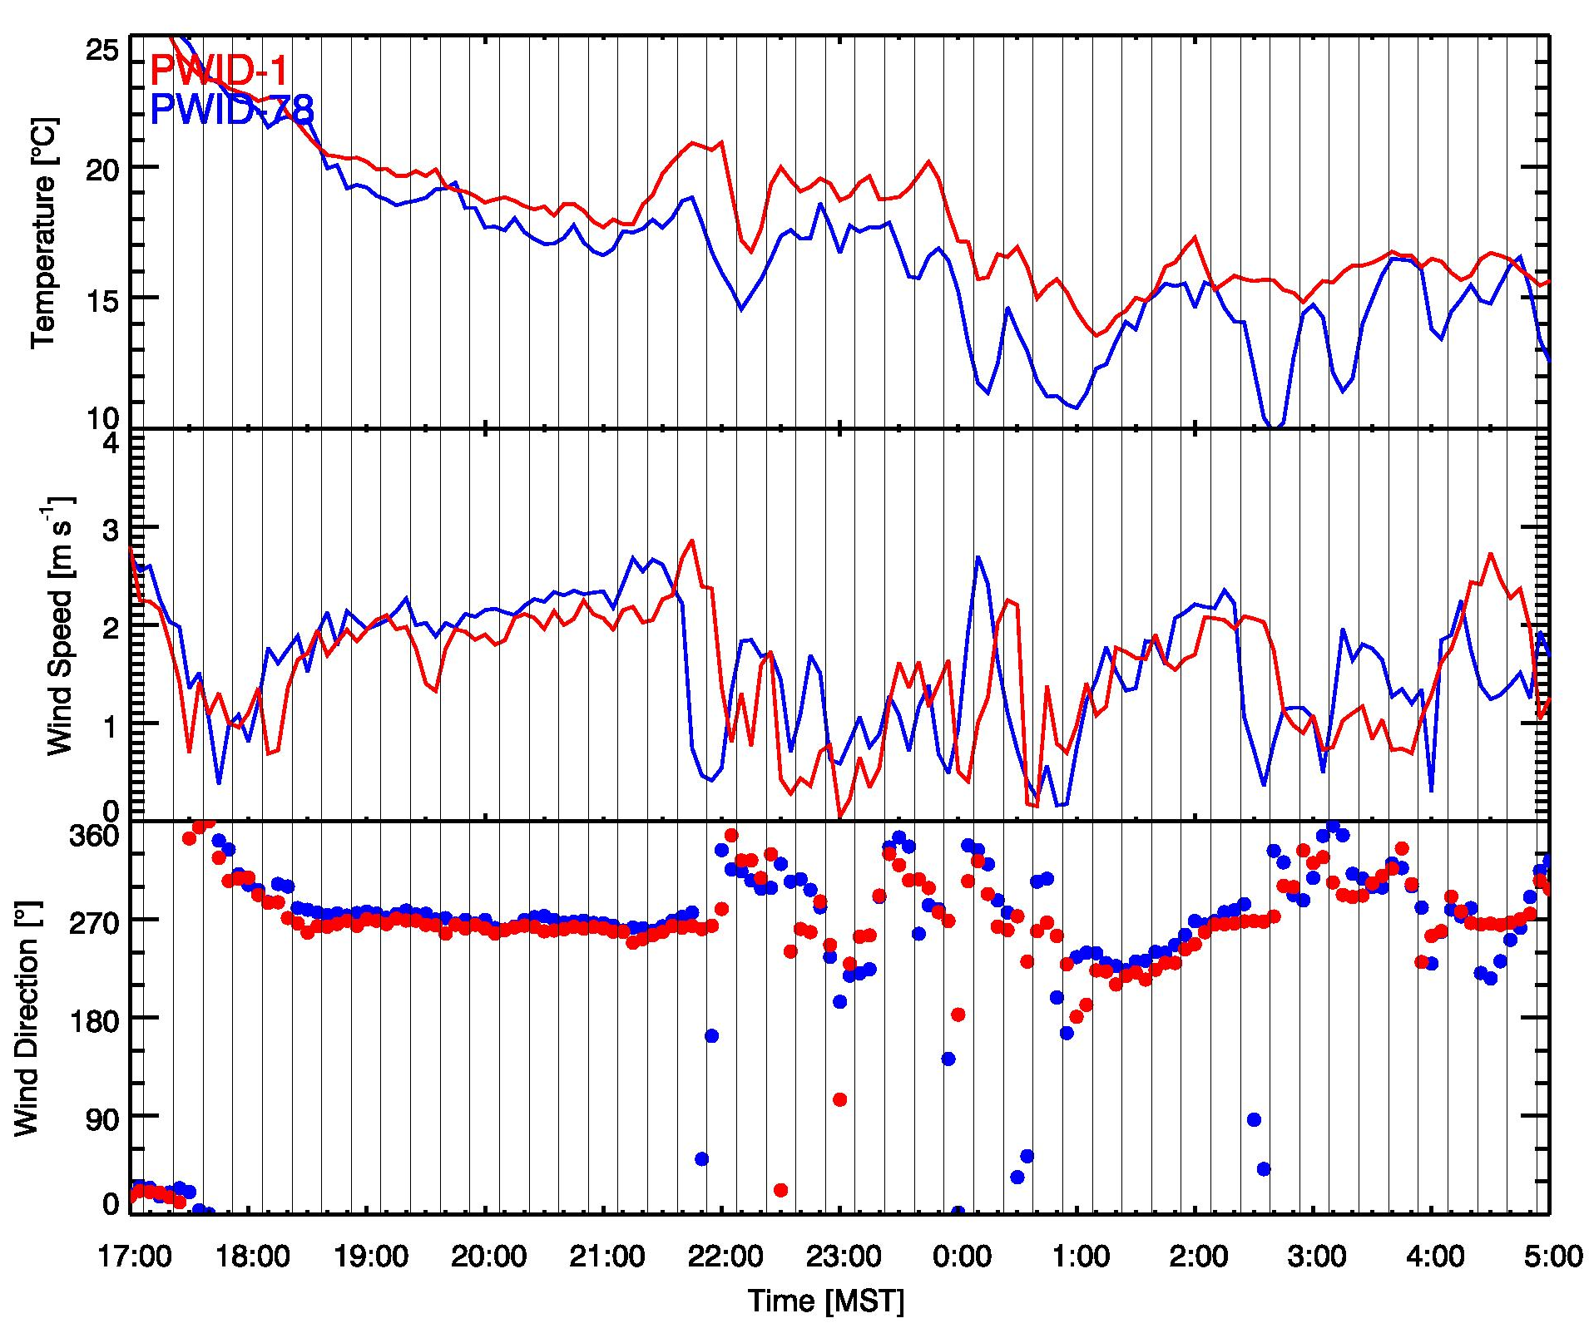
calm & variable
Downslope regime
Cold air surge

Slide 12
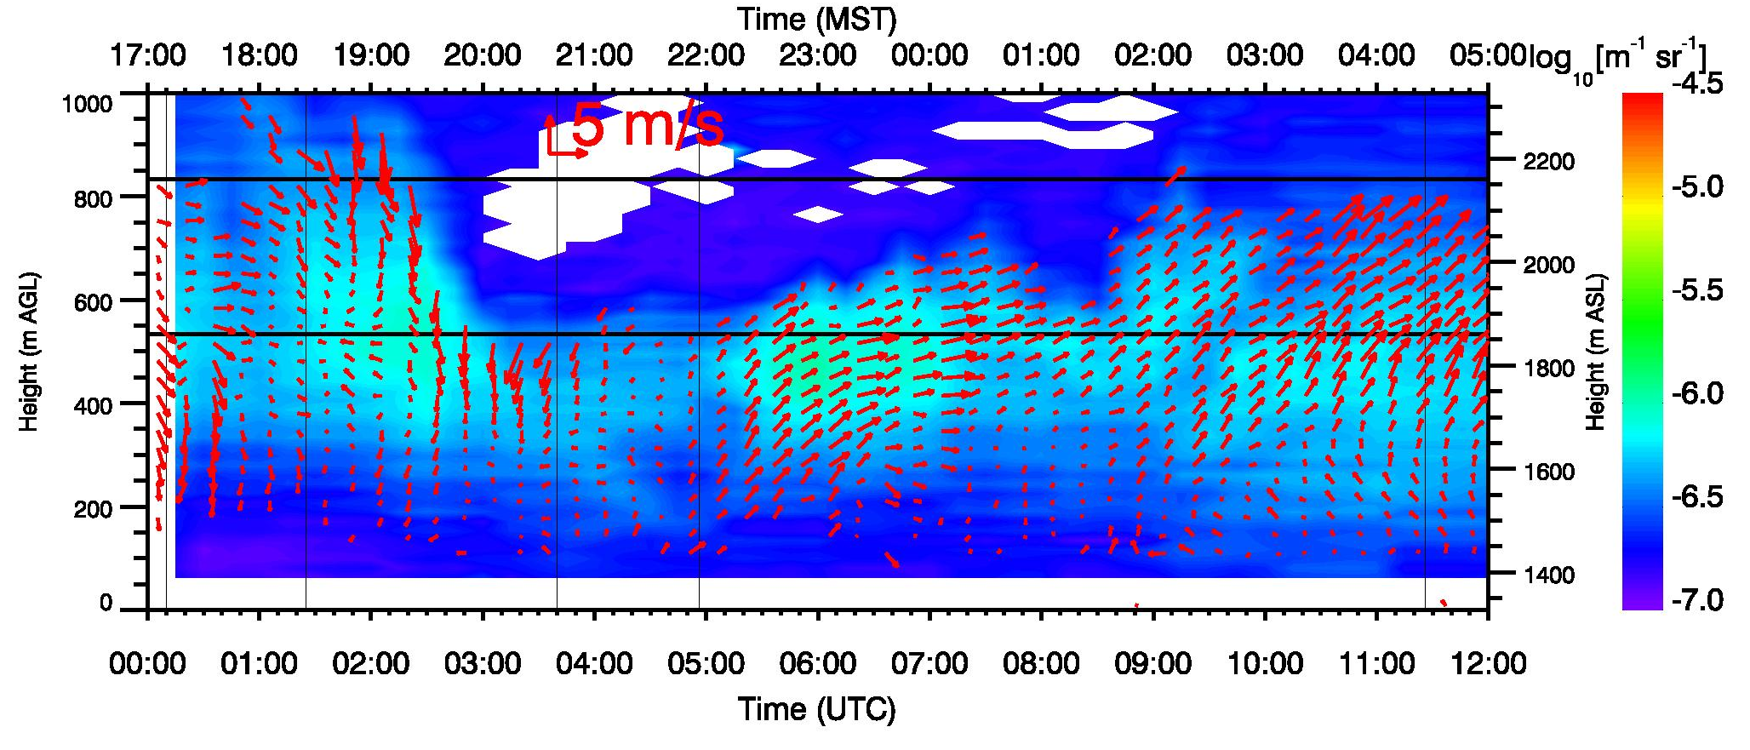
Wind profile – VAD analysis

Slide 13
1725 MST: Sunset on Slope. Fully developed up-valley flow.

Slide 14
1800 MST: Astronomical Sunset
1805-1810 MST: Onset of slope flows on East Slope of Granite Peak. Up-valley flow in main basin persists.

Slide 16
1840 MST: Slope flow on alluvial fan: Up-valley circulations deteriorating.

Slide 18
1900 MST: Calm or opposing flows on miniSAMS grid. Arrival of slope flows off Dugway Range slopes.

Slide 19
2000 MST: Basin dominated by southerly down-slope flow off Dugway Range slopes.

Slide 20
2010 MST: Slope flows from Dugway Valley / Slopes of Simpson Mountains influence eastern part of miniSAMS grid (climatological feature).

Slide 21
2050 -2100 MST: Slope flows from East Slope of Granite Peak reach and influence miniSAMS

Slide 23
2105-2115 MST: Down-valley circulation dominate miniSAMS grid. Slope flows off East Slope of Granite Peak turn north and temperatures increase by ~2 K. Corresponds to increasing SSW flow on Sapphire Mountain.

Slide 24
2125 MST: confluence of valley flow and slope flow - deflection to the North. Fully developed down-valley flow.

Slide 25
2140 MST: cold air arrives on the lower East Slope of Granite Peak, resulting in a 5 K temperature drop

Slide 26
2145 MST: Cold air 'washes up' the slope from the E and NE.

Slide 27
2210 MST: Cold air on East Slope drains back down the slope. Target R area is now now under weak northerly flow (but no flow through gap yet).

Slide 30
2225 MST: N-NW flow on East Slope. Cold air arriving from Simpson Springs slopes

Slide 31
2340 MST: Down-valley circulation becomes more easterly

Slide 32
0000 MST: A new push of cold air from basin ‘washes up’ the East Slope -- and drains towards south. Temperatures drops by 5 K.

Slide 35
0040-0100 MST: cold pool fully set up on slope and basin -- stagnation at Target R -- drain through gaps to SW has started.

Slide 36
0105 MST: Down-valley flow now dominating Target R area, draining to the NW, deflecting slope flows on the East Slope to the North.
- could it be that cold air flows over even cooler stagnant air (???) at Target R?
cold air outflow through gap

Slide 37
0100 – 0200 MST: Steady warming on East Slope and wind speed increase; linked to wind speed increase at Granite Ridge? Cold air is pushed back East; stagnation. Climatological feature: stagnation on western miniSAMS grid.

Slide 39
But not for long !
0240 MST: New pulse of cold air ‘washes up’ the lower East Slope, draining to the South. The flow on western miniSAMS grid now flowing south towards Big Gap.

Slide 41
0300 MST: Calming of winds in eastern miniSAMS grind. Cold air retreating and stagnating. Valley circulation flowing over the colder air?

Slide 42
0345 MST: Southerly winds pick up at Sapphire Mountain -- Slope flow on East Slope deflection from towards south to towards north. Gap Flows reverse as well. Warming in Gap.

Slide 44
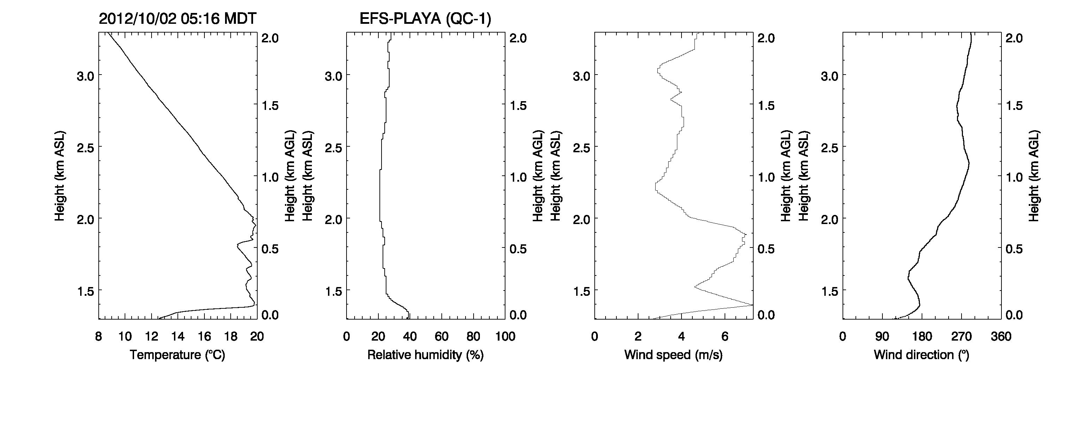
Radiosonde observation, EFS-Playa
0415 MST, 2 Oct 2012

Slide 45
0500-0600 MST: Eddy-like circulation sets up -- forced by flow across Sapphire Mountain? Cold air on slope.

Slide 46
Summary & Conclusions
MATERHORN data has surface and upper air observations of unprecedented density – allows the visualization and analysis of complex flow interactions.
Slope scale, basin scale, regional scale, and synoptic scale (or lack thereof) flows are observed.
The temporal and spatial variability of flows is much larger than anticipated – even under no synoptic forcing.
Regional scale Nocturnal Jets of (yet) unknown origin considerable modify the thermally driven surface flows in the complex terrain of DPG.
Small terrain features are very important.
This dataset should be resolved enough to provide challenging test material for of-state-of-the-science models and lead to new model development.

Slide 47
Outlook
Examples of strong synoptic forcing …
Acknowledgements
ONR
DPG

Slide 53
SLIDES WITH LIDAR CROSSECTIONS

Slide 56
 | Albedo [-] | Thermal Conductivity [W / (m K)]
EFS-Sage | 0.27 (0.18-0.29) | 0.58
EFS-Slope | 0.23 (0.17-0.24) | 0.44
EFS-Playa | 0.31 (0.24 -0.35) | 0.89
October 2012

