Slide 1
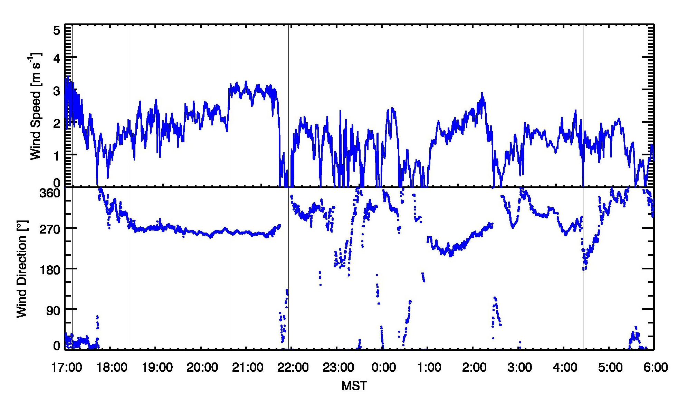
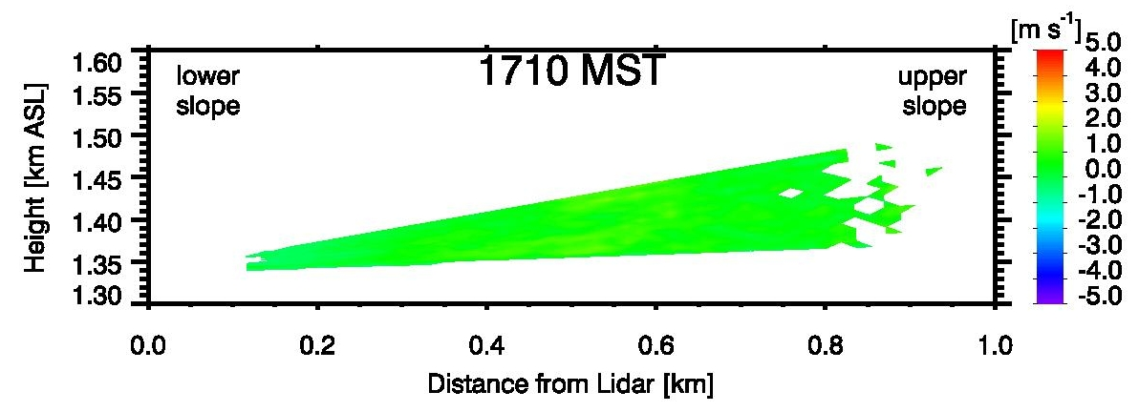
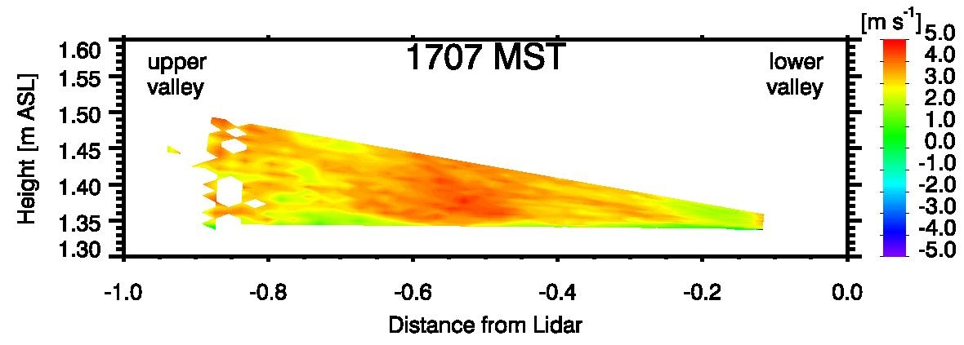
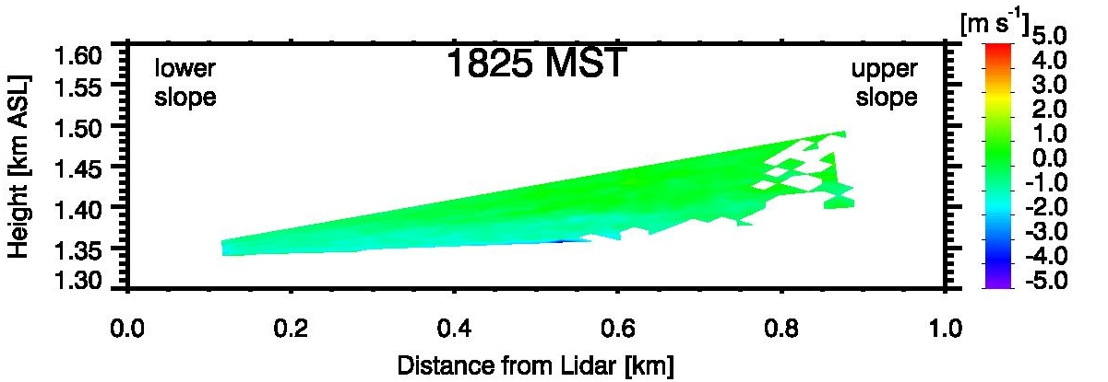
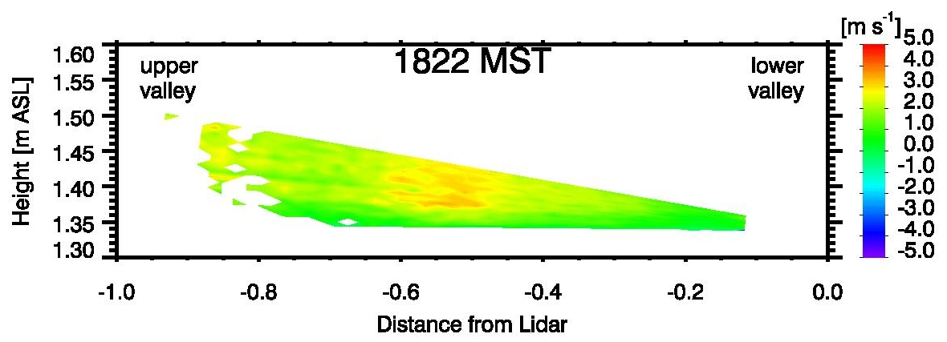
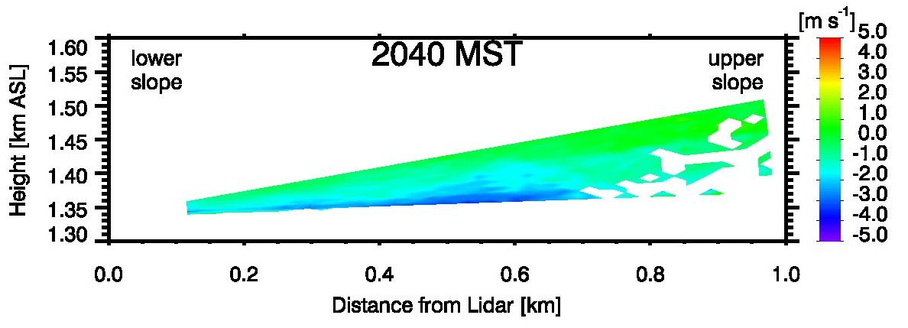
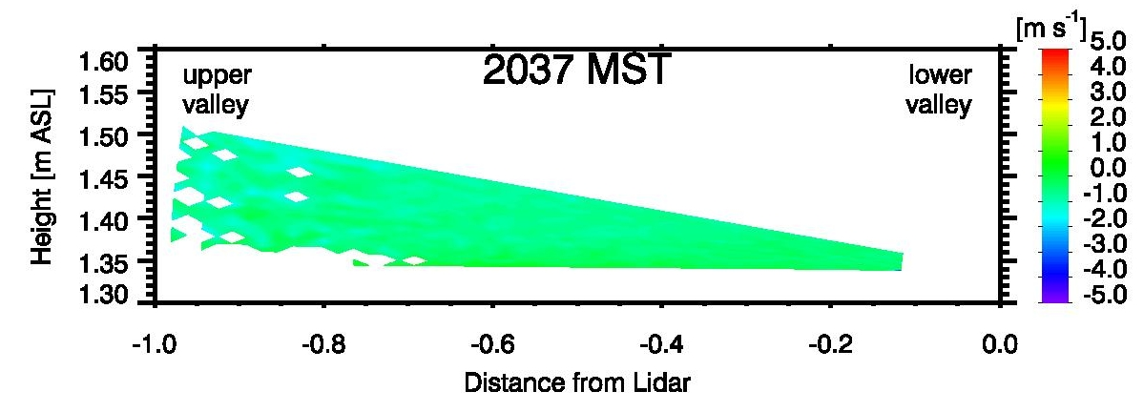
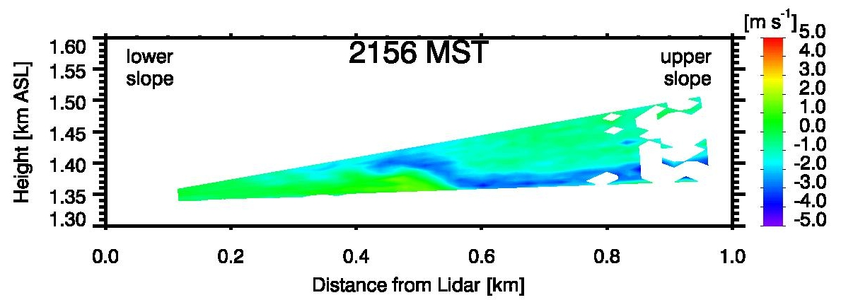
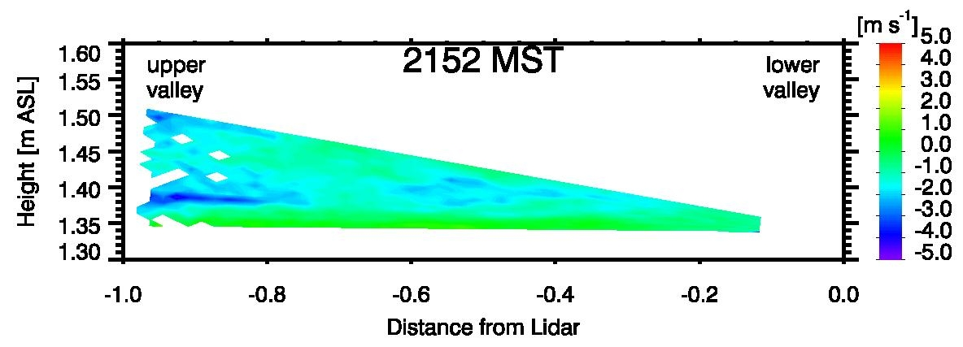
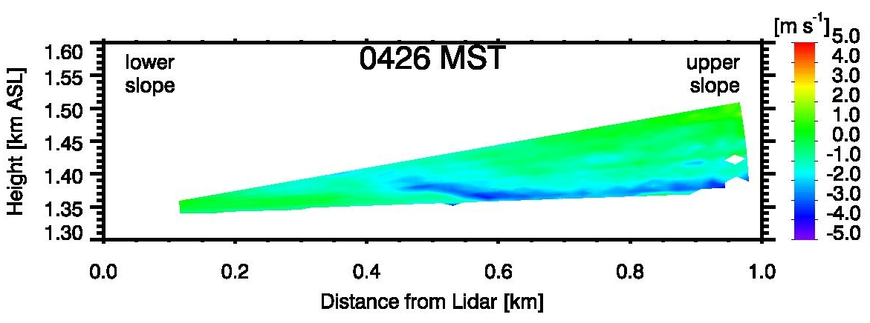
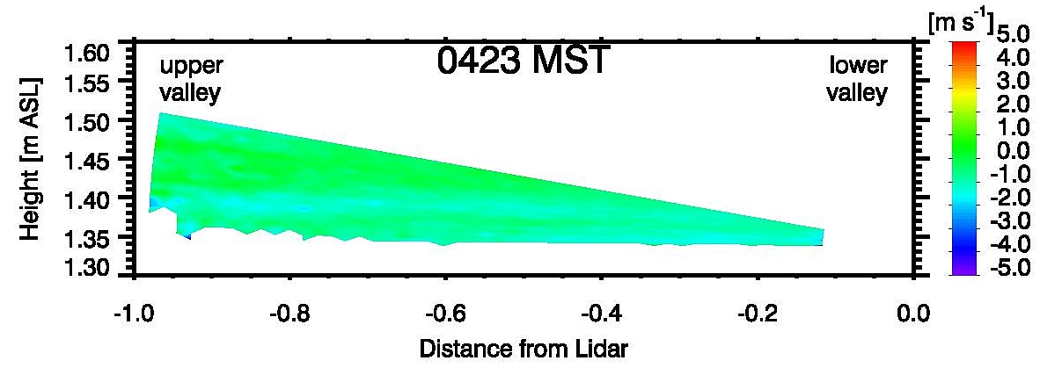
Slope flow – valley flow interactions during MATERHORN
Thermally driven circulations (slope and valley flows) and their complex interactions were observed with scanning Doppler Wind LiDARs during MATERHORN. They facilitate the interpretation of temperature and wind time series from AWS and tower observations.
Wind speed and direction from an AWS on the east slope of Granite Peak, 1-2 October 2012.
LiDAR scans allow the three-dimensional visualization and analysis of processes such as:
Evening onset, growth, and morning decay of down-slope flows
Evening cessation of up-valley circulation and onset of night-time down-valley flow
Flow interaction of slope flows with a deepening valley cold pool (flow onto colder air mass and mixing)
Morning development of up-valley circulation
Interactions of valley and slope flows with synoptically forced flows
UP-SLOPE SCAN
UP-VALLEY SCAN
Right: Up-slope and up-valley RHI scans for selected times,1-2 October 2012.

