Slide 1
Update on Grawmet-5
We do have a version that ‘Reprocesses’ our data without excessive smoothing!

Slide 2
Soundings at Weber Canyon Exit

Slide 3
Grawmet 4
Grawmet 5 – reprocessed / simulated

Slide 4
BUT:
Ground value correction NOT possible.
Launch time not given (No header at all!)
Terrible data table format
And: What happened to the winds???
-> Work in progress

Slide 5
HOBO “pseudo-vertical” profiles vs. radiosonde observation
Methodology:
For any sounding available, compare the 15 min Hobo average (around launch time) to nearest point in sounding profile (10-m interpolated file).

Slide 6
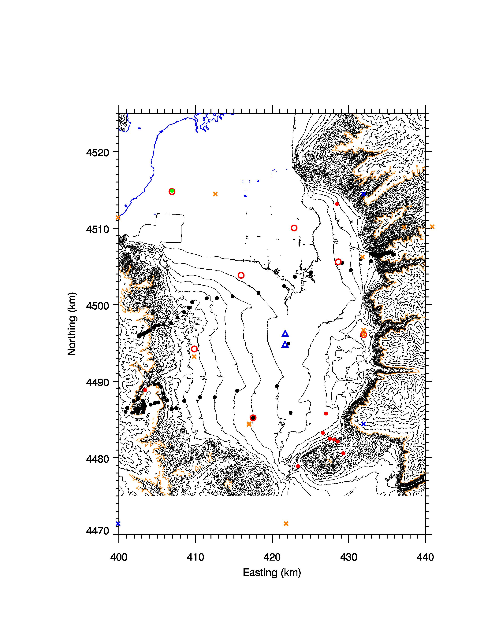

Slide 7
GRANDEUR
----------------------------------------------------------------------------------------------------------------------------------
HOBO SONDE DIFF STD N ELEV
----------------------------------------------------------------------------------------------------------------------------------
0.759533 0.651677 0.107856 1.36767 167.000 1286.00 0.00000 0.00000 0.00000 0.00000
0.915250 0.727914 0.187336 1.80879 163.000 1312.00 0.00000 0.00000 0.00000 0.00000
-1.19078 -0.946250 -0.244526 1.54073 248.000 1364.00 0.00000 0.00000 0.00000 0.00000
-0.459929 -0.501078 0.0411493 2.15827 269.000 1400.00 0.00000 0.00000 0.00000 0.00000
-0.678219 -0.681152 0.00293370 1.91197 269.000 1459.00 0.00000 0.00000 0.00000 0.00000
-0.522432 -0.845911 0.323479 1.77515 269.000 1519.00 0.00000 0.00000 0.00000 0.00000
-0.805729 -1.00648 0.200755 1.82361 310.000 1546.00 0.00000 0.00000 0.00000 0.00000
-1.02975 -1.11558 0.0858360 1.66734 310.000 1604.00 0.00000 0.00000 0.00000 0.00000
-1.36865 -1.22697 -0.141683 1.75196 310.000 1652.00 0.00000 0.00000 0.00000 0.00000
-1.57598 -1.30181 -0.274172 1.81372 310.000 1700.00 0.00000 0.00000 0.00000 0.00000
-1.46638 -1.36910 -0.0972795 1.64990 310.000 1754.00 0.00000 0.00000 0.00000 0.00000
-1.37303 -1.40000 0.0269731 1.54250 310.000 1806.00 0.00000 0.00000 0.00000 0.00000
-1.82412 -1.94147 0.117351 1.57954 252.000 1851.00 0.00000 0.00000 0.00000 0.00000
-1.42469 -1.44877 0.0240833 1.39964 310.000 1904.00 0.00000 0.00000 0.00000 0.00000
-1.49152 -1.50481 0.0132904 1.45335 310.000 1954.00 0.00000 0.00000 0.00000 0.00000
-1.69051 -1.60700 -0.0835053 1.26245 310.000 2003.00 0.00000 0.00000 0.00000 0.00000
-1.56223 -1.73265 0.170414 1.44705 310.000 2053.00 0.00000 0.00000 0.00000 0.00000
-1.81668 -1.88264 0.0659677 1.32090 310.000 2105.00 0.00000 0.00000 0.00000 0.00000
-1.81100 -1.99000 0.179004 1.34448 312.000 2153.00 0.00000 0.00000 0.00000 0.00000
-2.32360 -2.46916 0.145558 1.46708 260.000 2209.00 0.00000 0.00000 0.00000 0.00000
-2.21317 -2.38231 0.169135 1.54852 312.000 2249.00 0.00000 0.00000 0.00000 0.00000
-2.35907 -2.59888 0.239810 1.71483 312.000 2305.00 0.00000 0.00000 0.00000 0.00000
-2.73464 -2.80189 0.0672489 1.57241 312.000 2351.00 0.00000 0.00000 0.00000 0.00000
-3.31422 -3.02760 -0.286627 1.26702 312.000 2401.00 0.00000 0.00000 0.00000 0.00000
-3.49179 -3.00829 -0.483493 1.34142 293.000 2454.00 0.00000 0.00000 0.00000 0.00000
-3.80779 -3.29696 -0.510825 1.09209 293.000 2497.00 0.00000 0.00000 0.00000 0.00000
----------------------------------------------------------------------------------------------------------------------------------
AVG -1.56389 -1.56566 0.00177196 1.56240 286.654 0.00000 0.00000 0.00000 0.00000

Slide 9
Hobos colder ←→Hobos warmer

Slide 10
Hobos colder ←→Hobos warmer

Slide 11
Hobos colder ←→Hobos warmer
Mine is always warmer ...

Slide 12
Diurnal variations ?
--- KLSC 12 UTC (0415 MST) and 00 UTC (1615 MST) Soundings

Slide 13
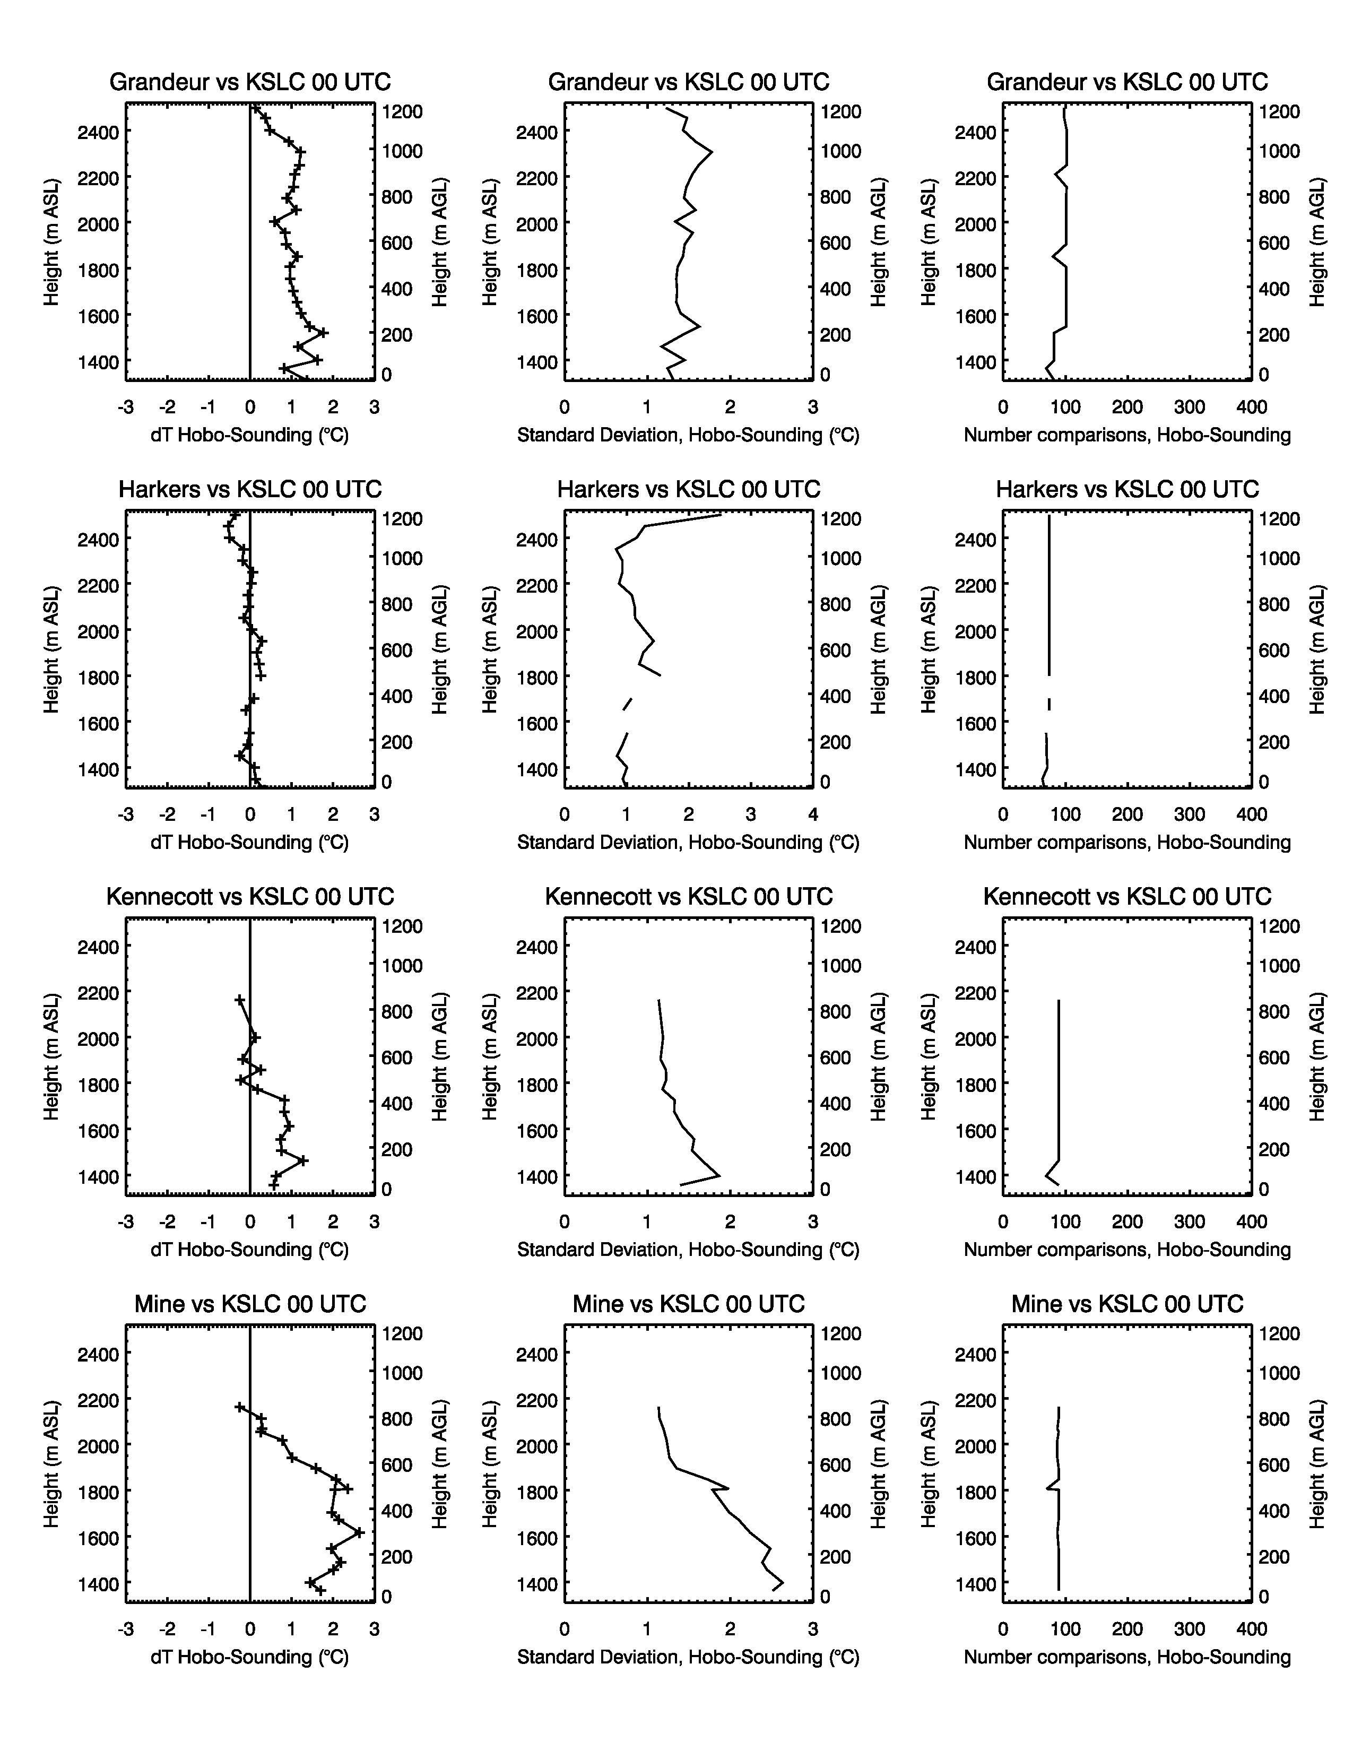
KSLC 00 UTC
1615 MST
Afternoon
Warmer
Grandeur Ridge
Warmer
Kennecott Line

Slide 14
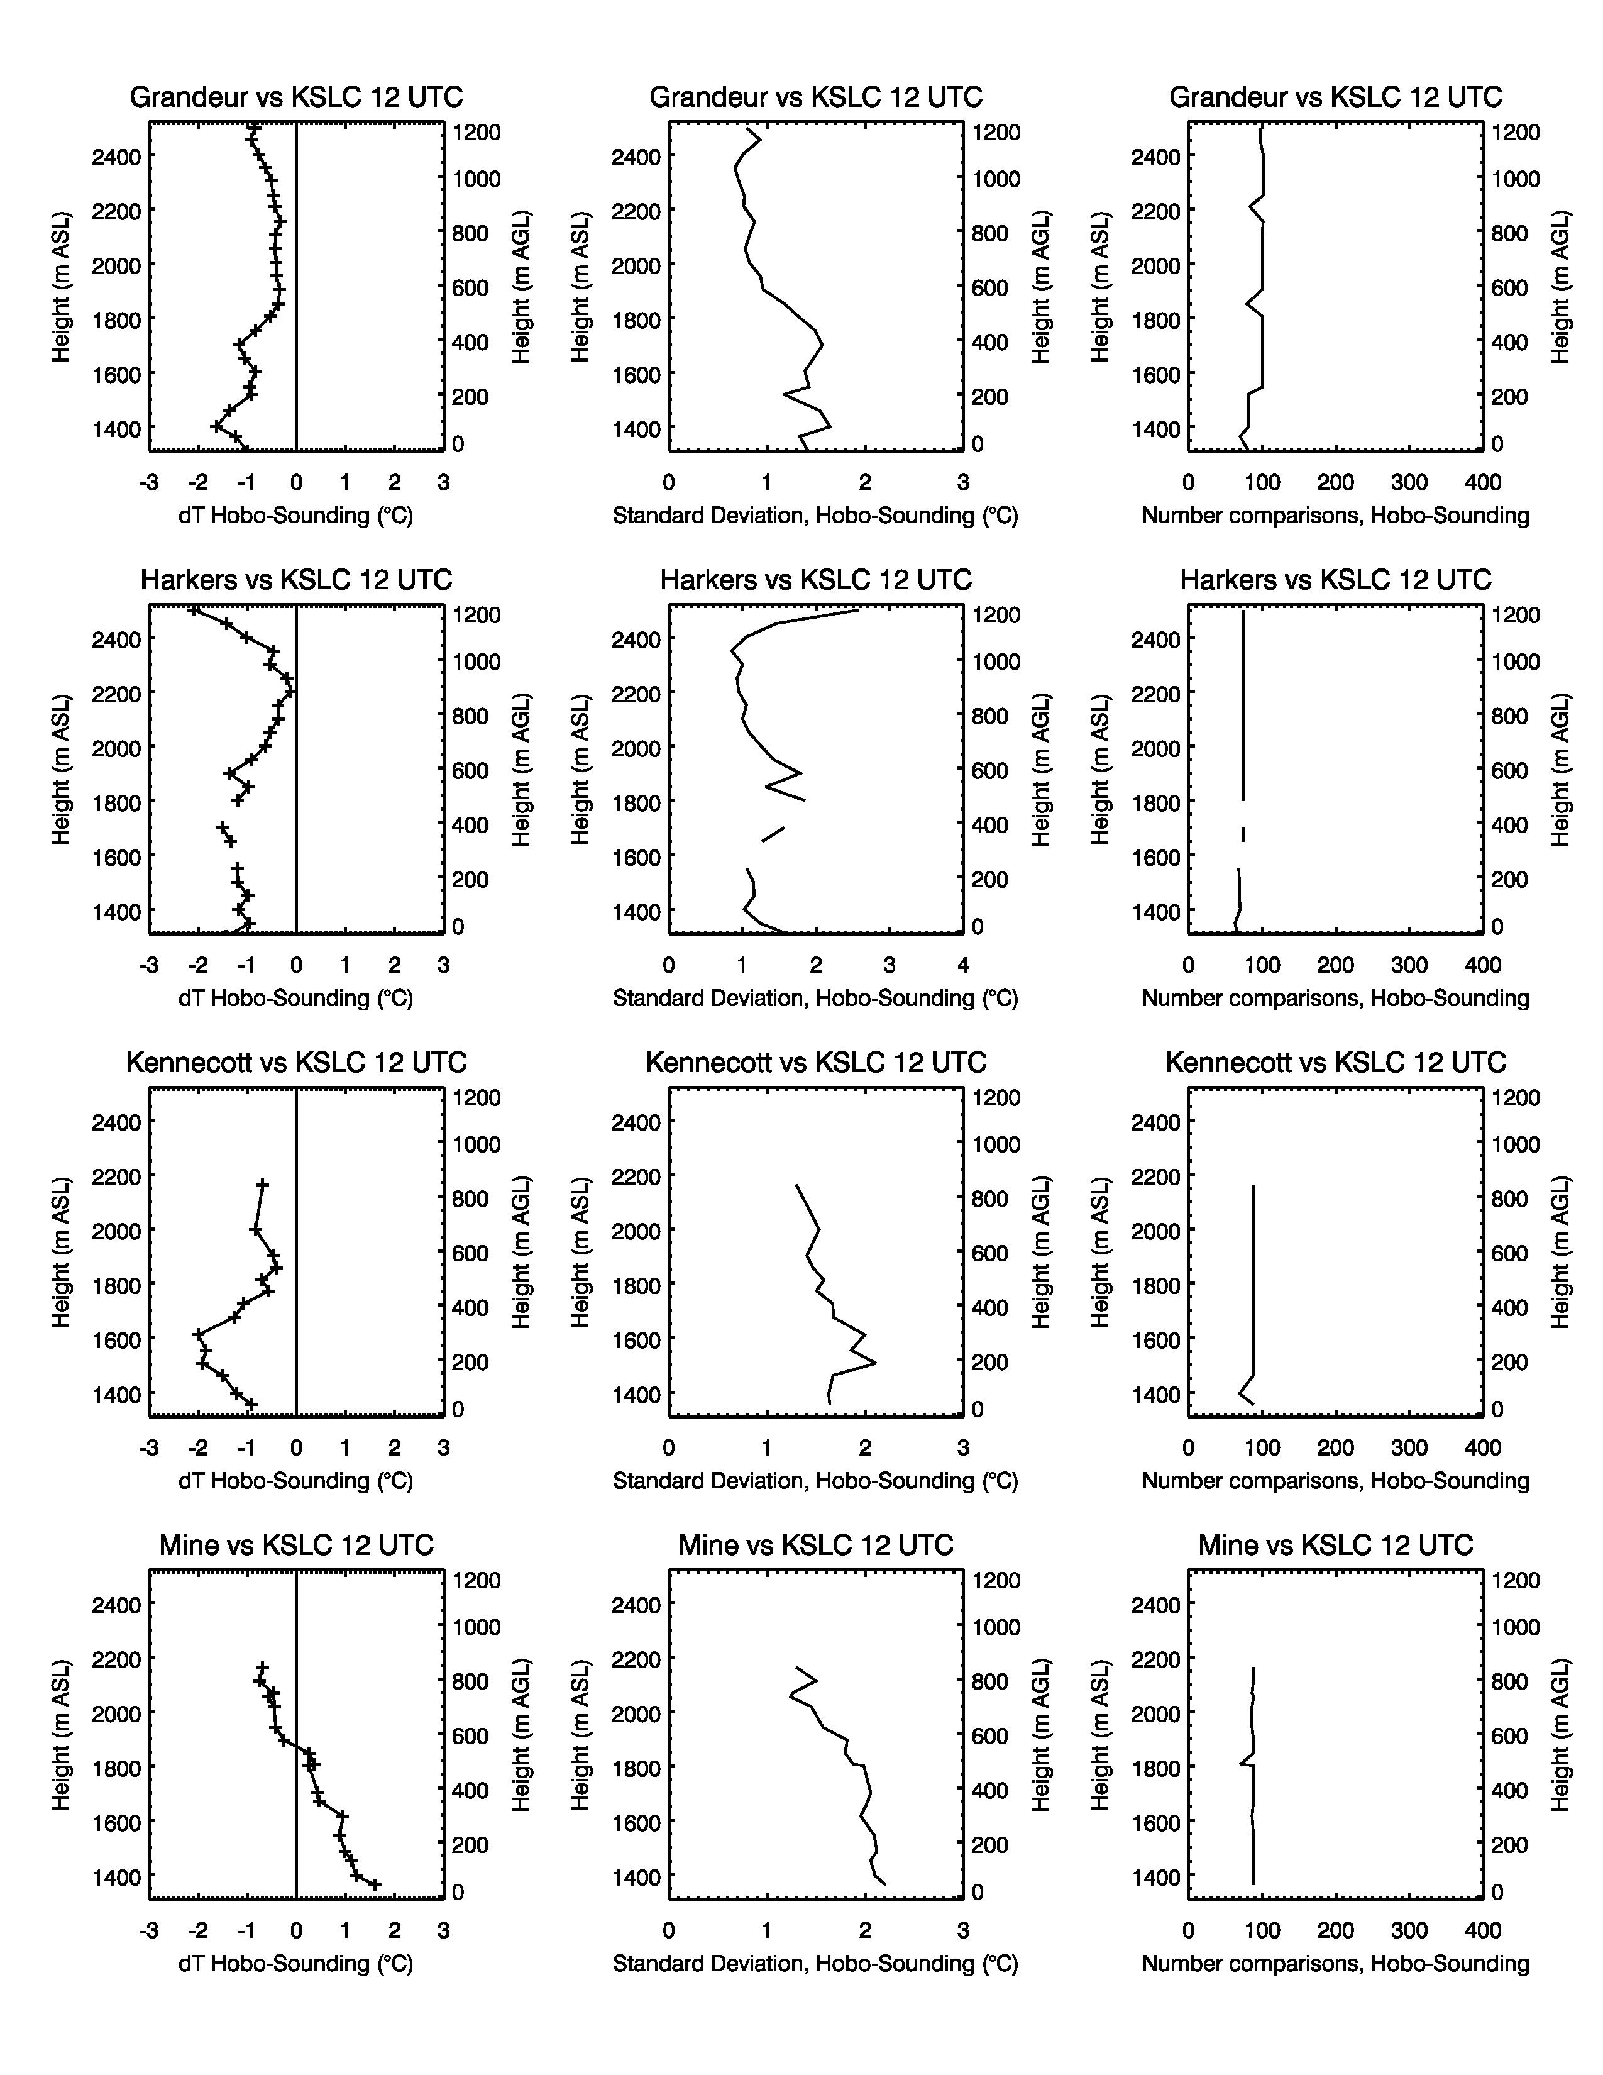
KSLC 12UTC
0415 MST
Nighttime

Slide 15
Issues:
High elevation Hobos on Harker’s Ridge may have been snow covered and need to be filtered.
Next steps:
Look at extreme mismatches – “what went wrong and when?”
Look at best matches – “when are pseudo-vertical profiles the best?”

Slide 16
ALL

Slide 17
KSLC 00 UTC

Slide 18
KSLC 12UTC

Slide 19
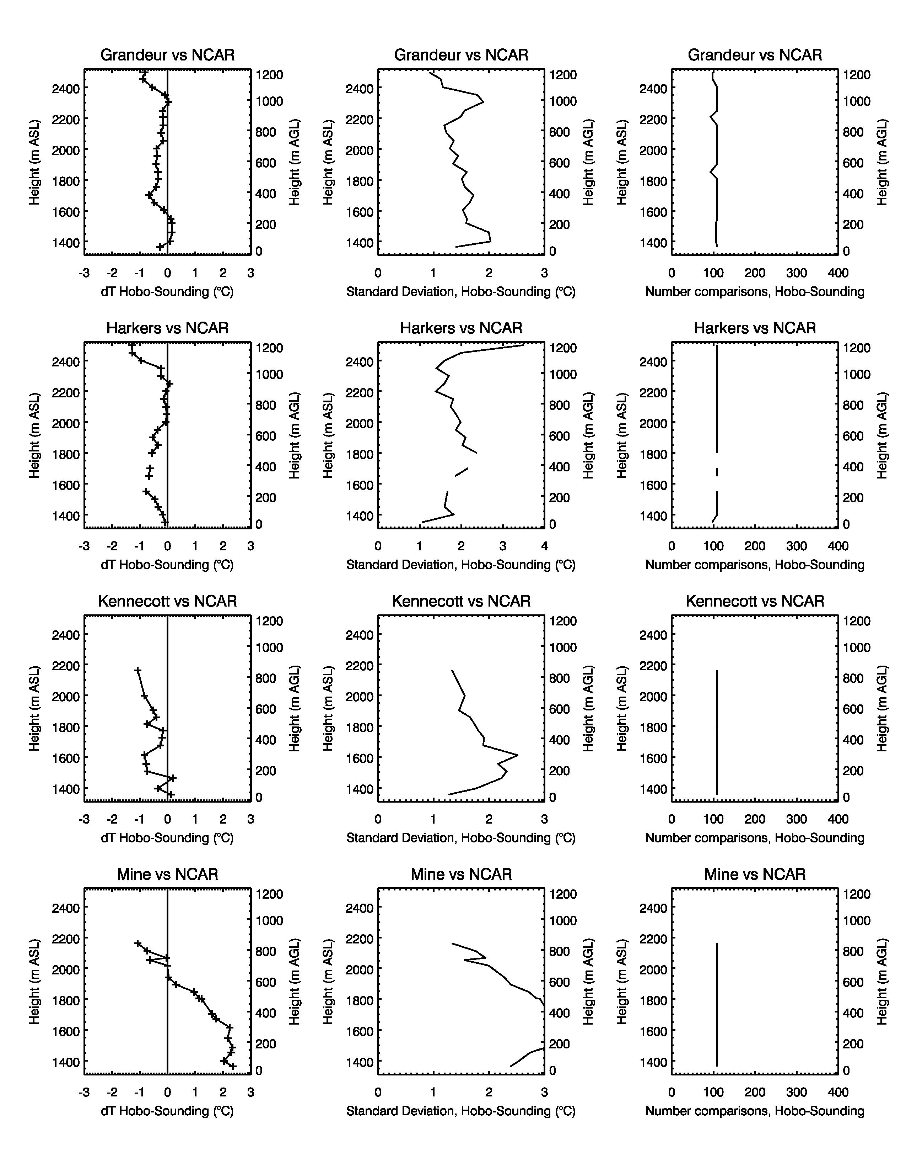
NCAR

