Slide 1
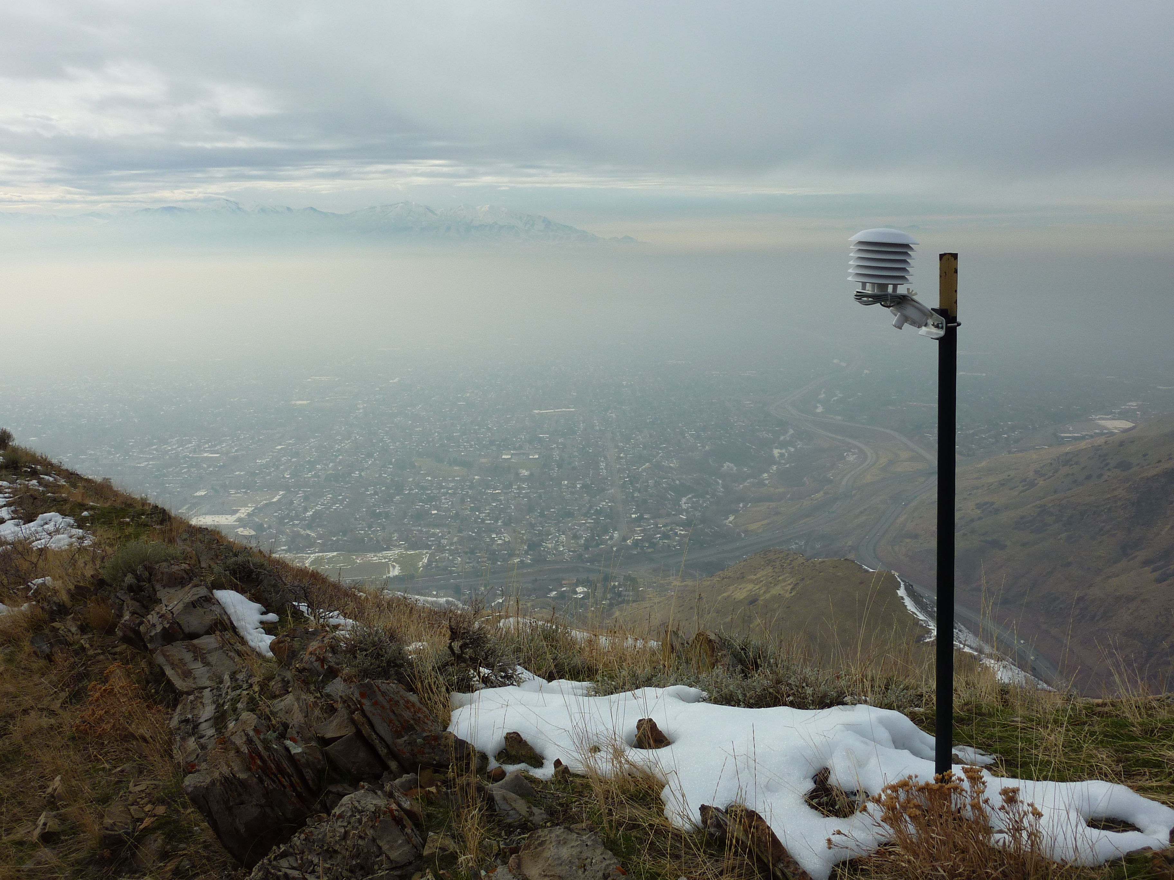

Temperature datalogger lines during PCAPS
Sebastian Hoch, Dave Whiteman & all PCAPS participants

Slide 2
Motivation
Key feature of Cold Air Pools is the vertical temperature profile.
Quasi-vertical profiles can be obtained by observations along mountain slopes.
Advantages: cheaper than radiosondes, continuous measurements.
Disadvantages: Local boundary layer influences need to be taken into account

Slide 3
Objectives
How do the characteristics of the inversions (height, strength, intensity ... ) vary spatially & temporally?
What are and what can we learn about the processes responsible for the variations?

Slide 4
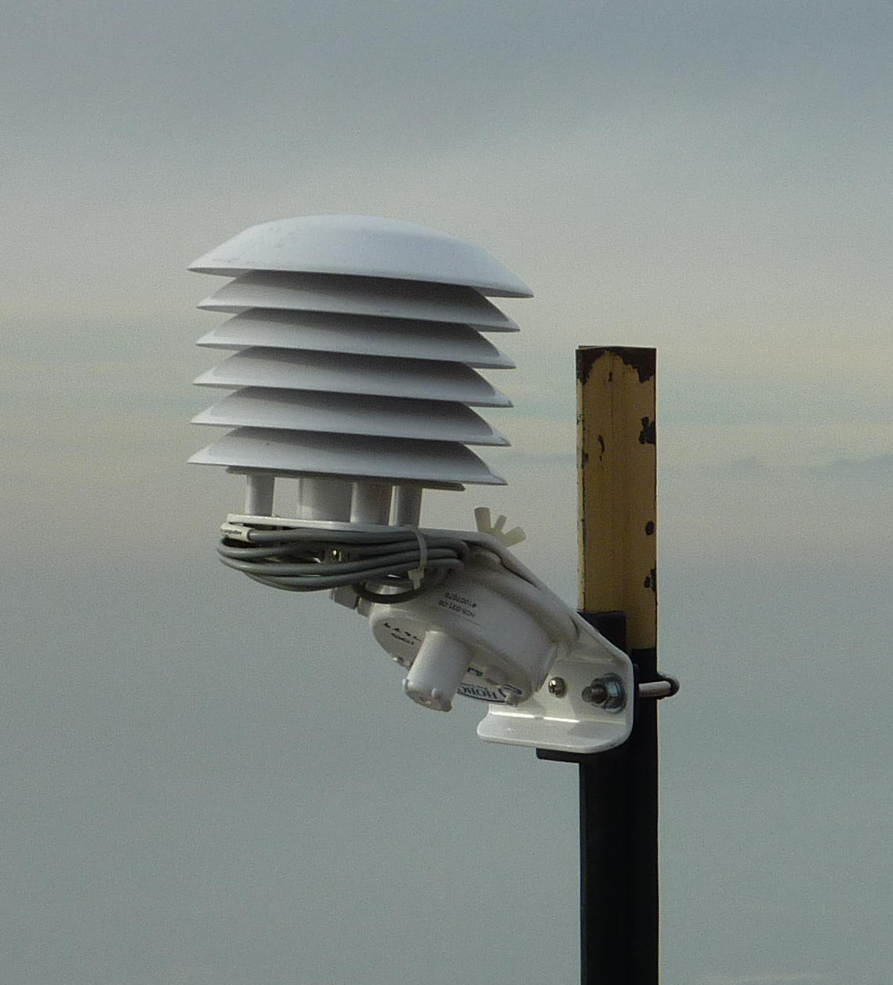
Choice of instrument – The HOBO
Inexpensive automatic temperature dataloggers (Onset Computers)
Thermistor with ~3 min response time
Mounted in radiation shields
Fastened to fence posts
Well tested in previous studies

Slide 5
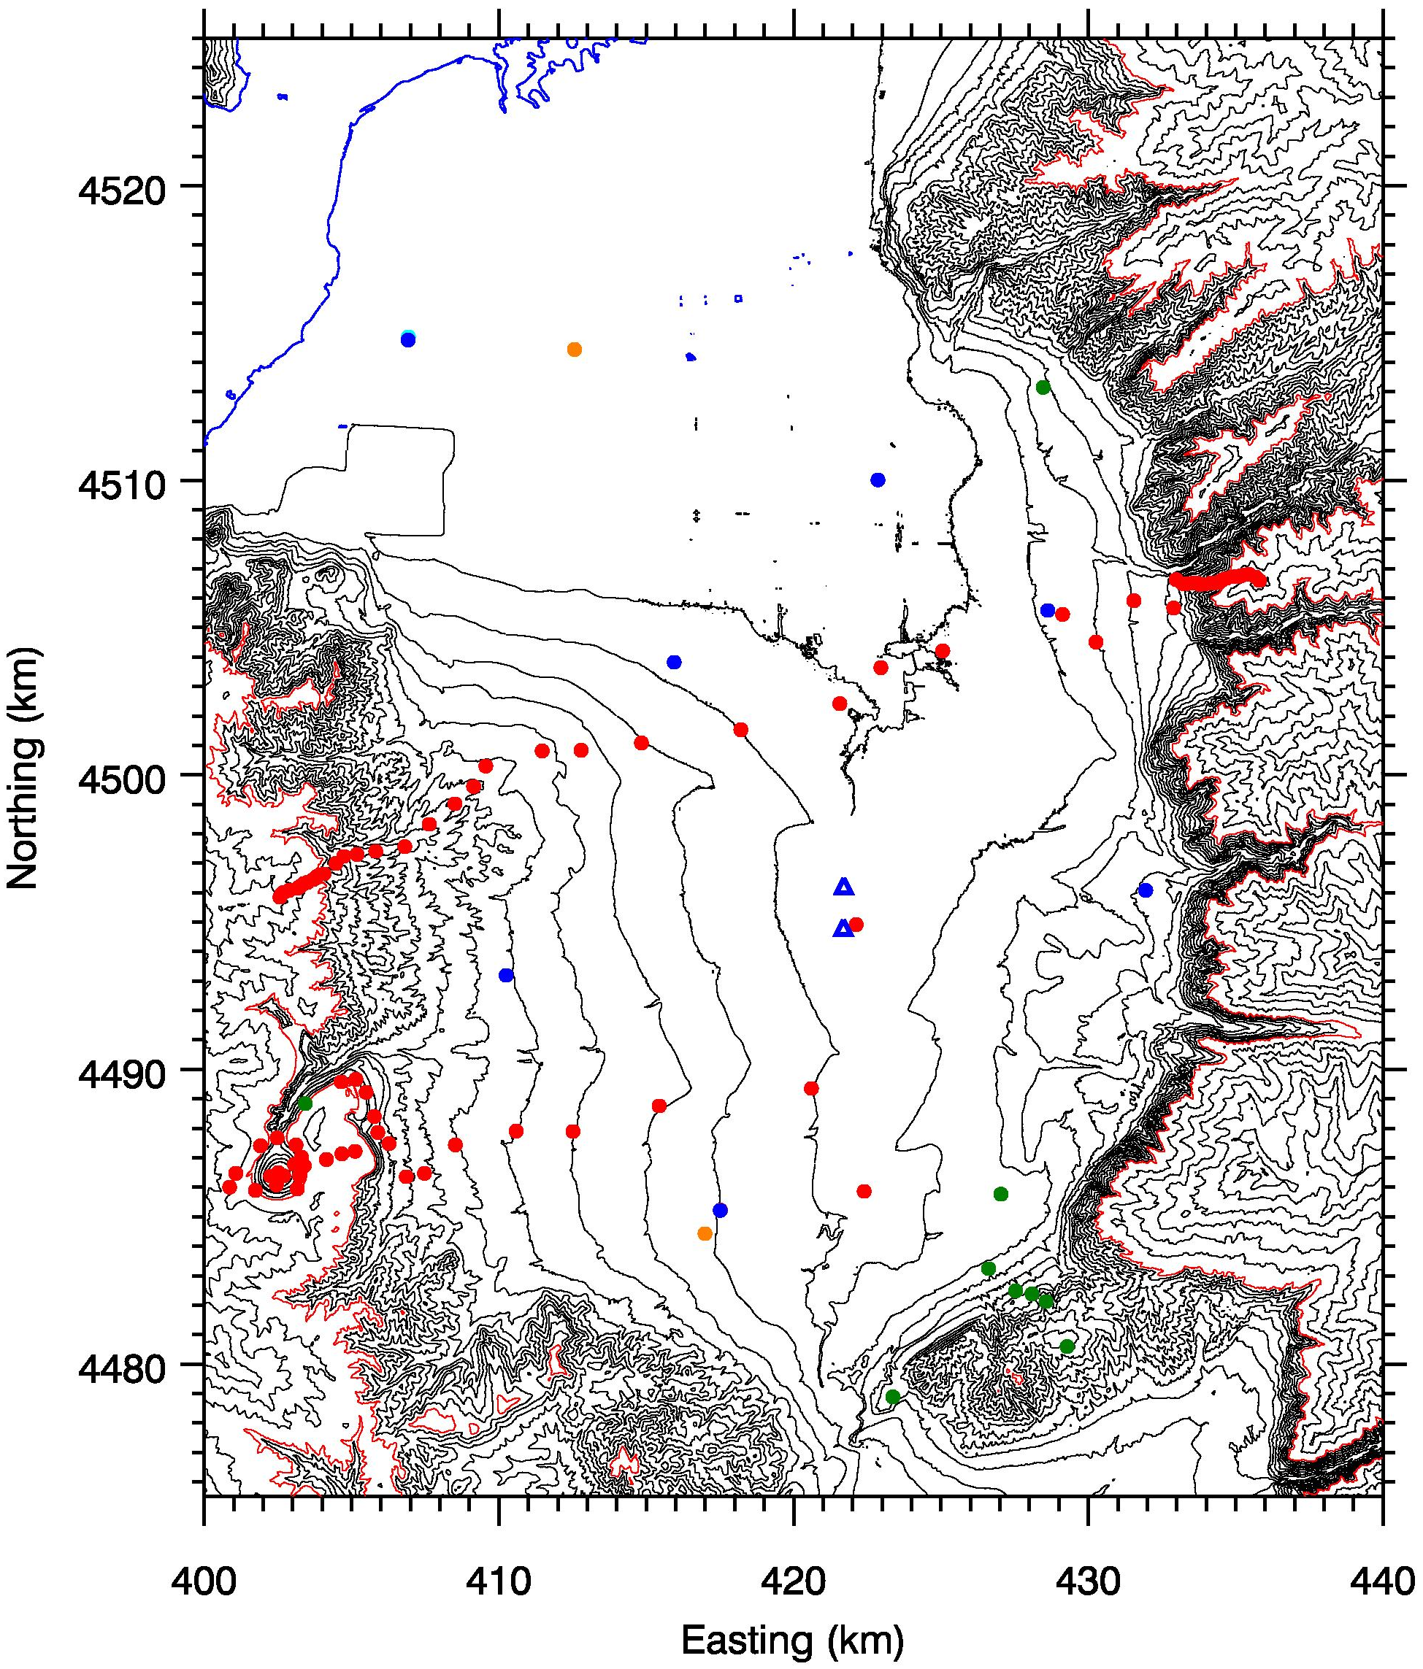
Experimental
design
85 HOBOs available
Instrument all 50-m elevation contours up to 2500 m
West and East slope of the Salt Lake basin (Harker’s vs. Grandeur Line)
Northern and Southern part of the valley (Harker’s vs. Kennecott Line)
Grandeur Line
Harker’s Line
Kennecott Line

Slide 6
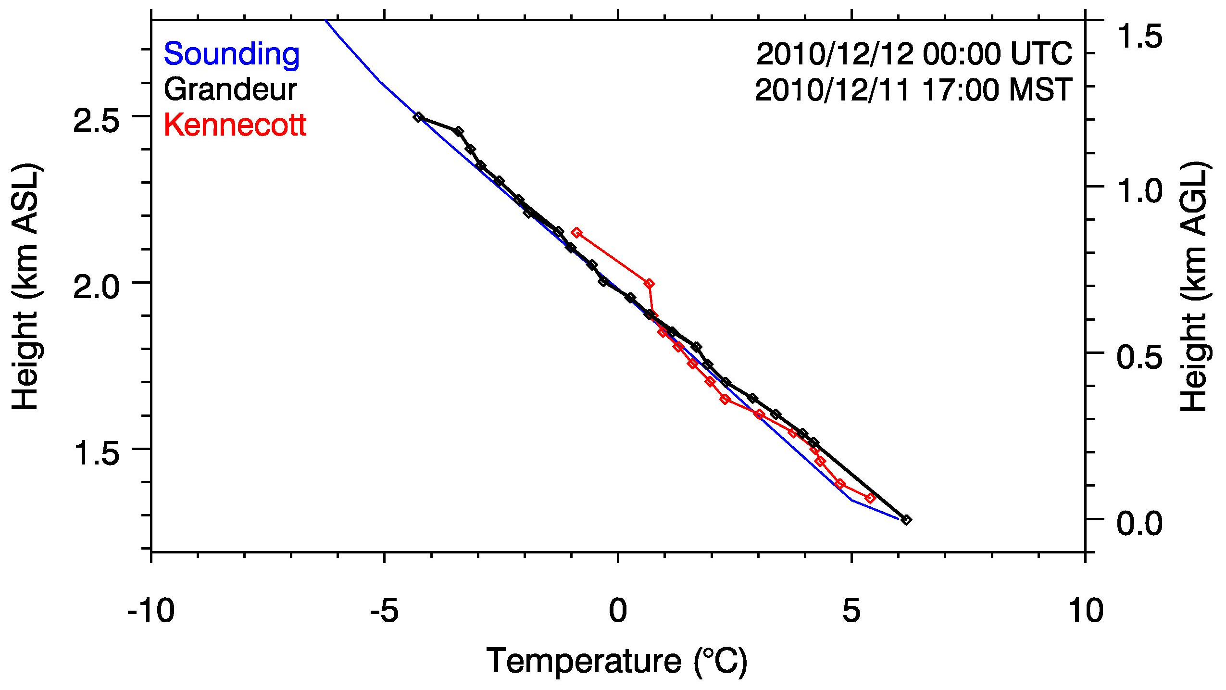
Preliminary results – Comparison with Radiosondes
There is a good correspondence between logger-lines and with radiosonde data during high-wind conditions.

Slide 7
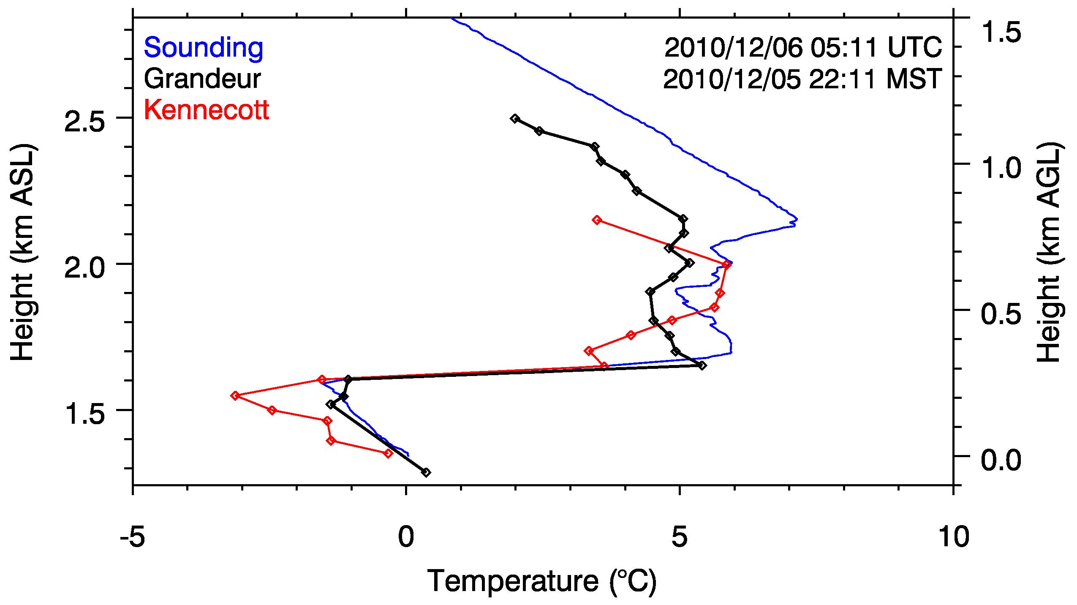
2) Spatial variations in vertical profile exist and are resolved

Slide 8
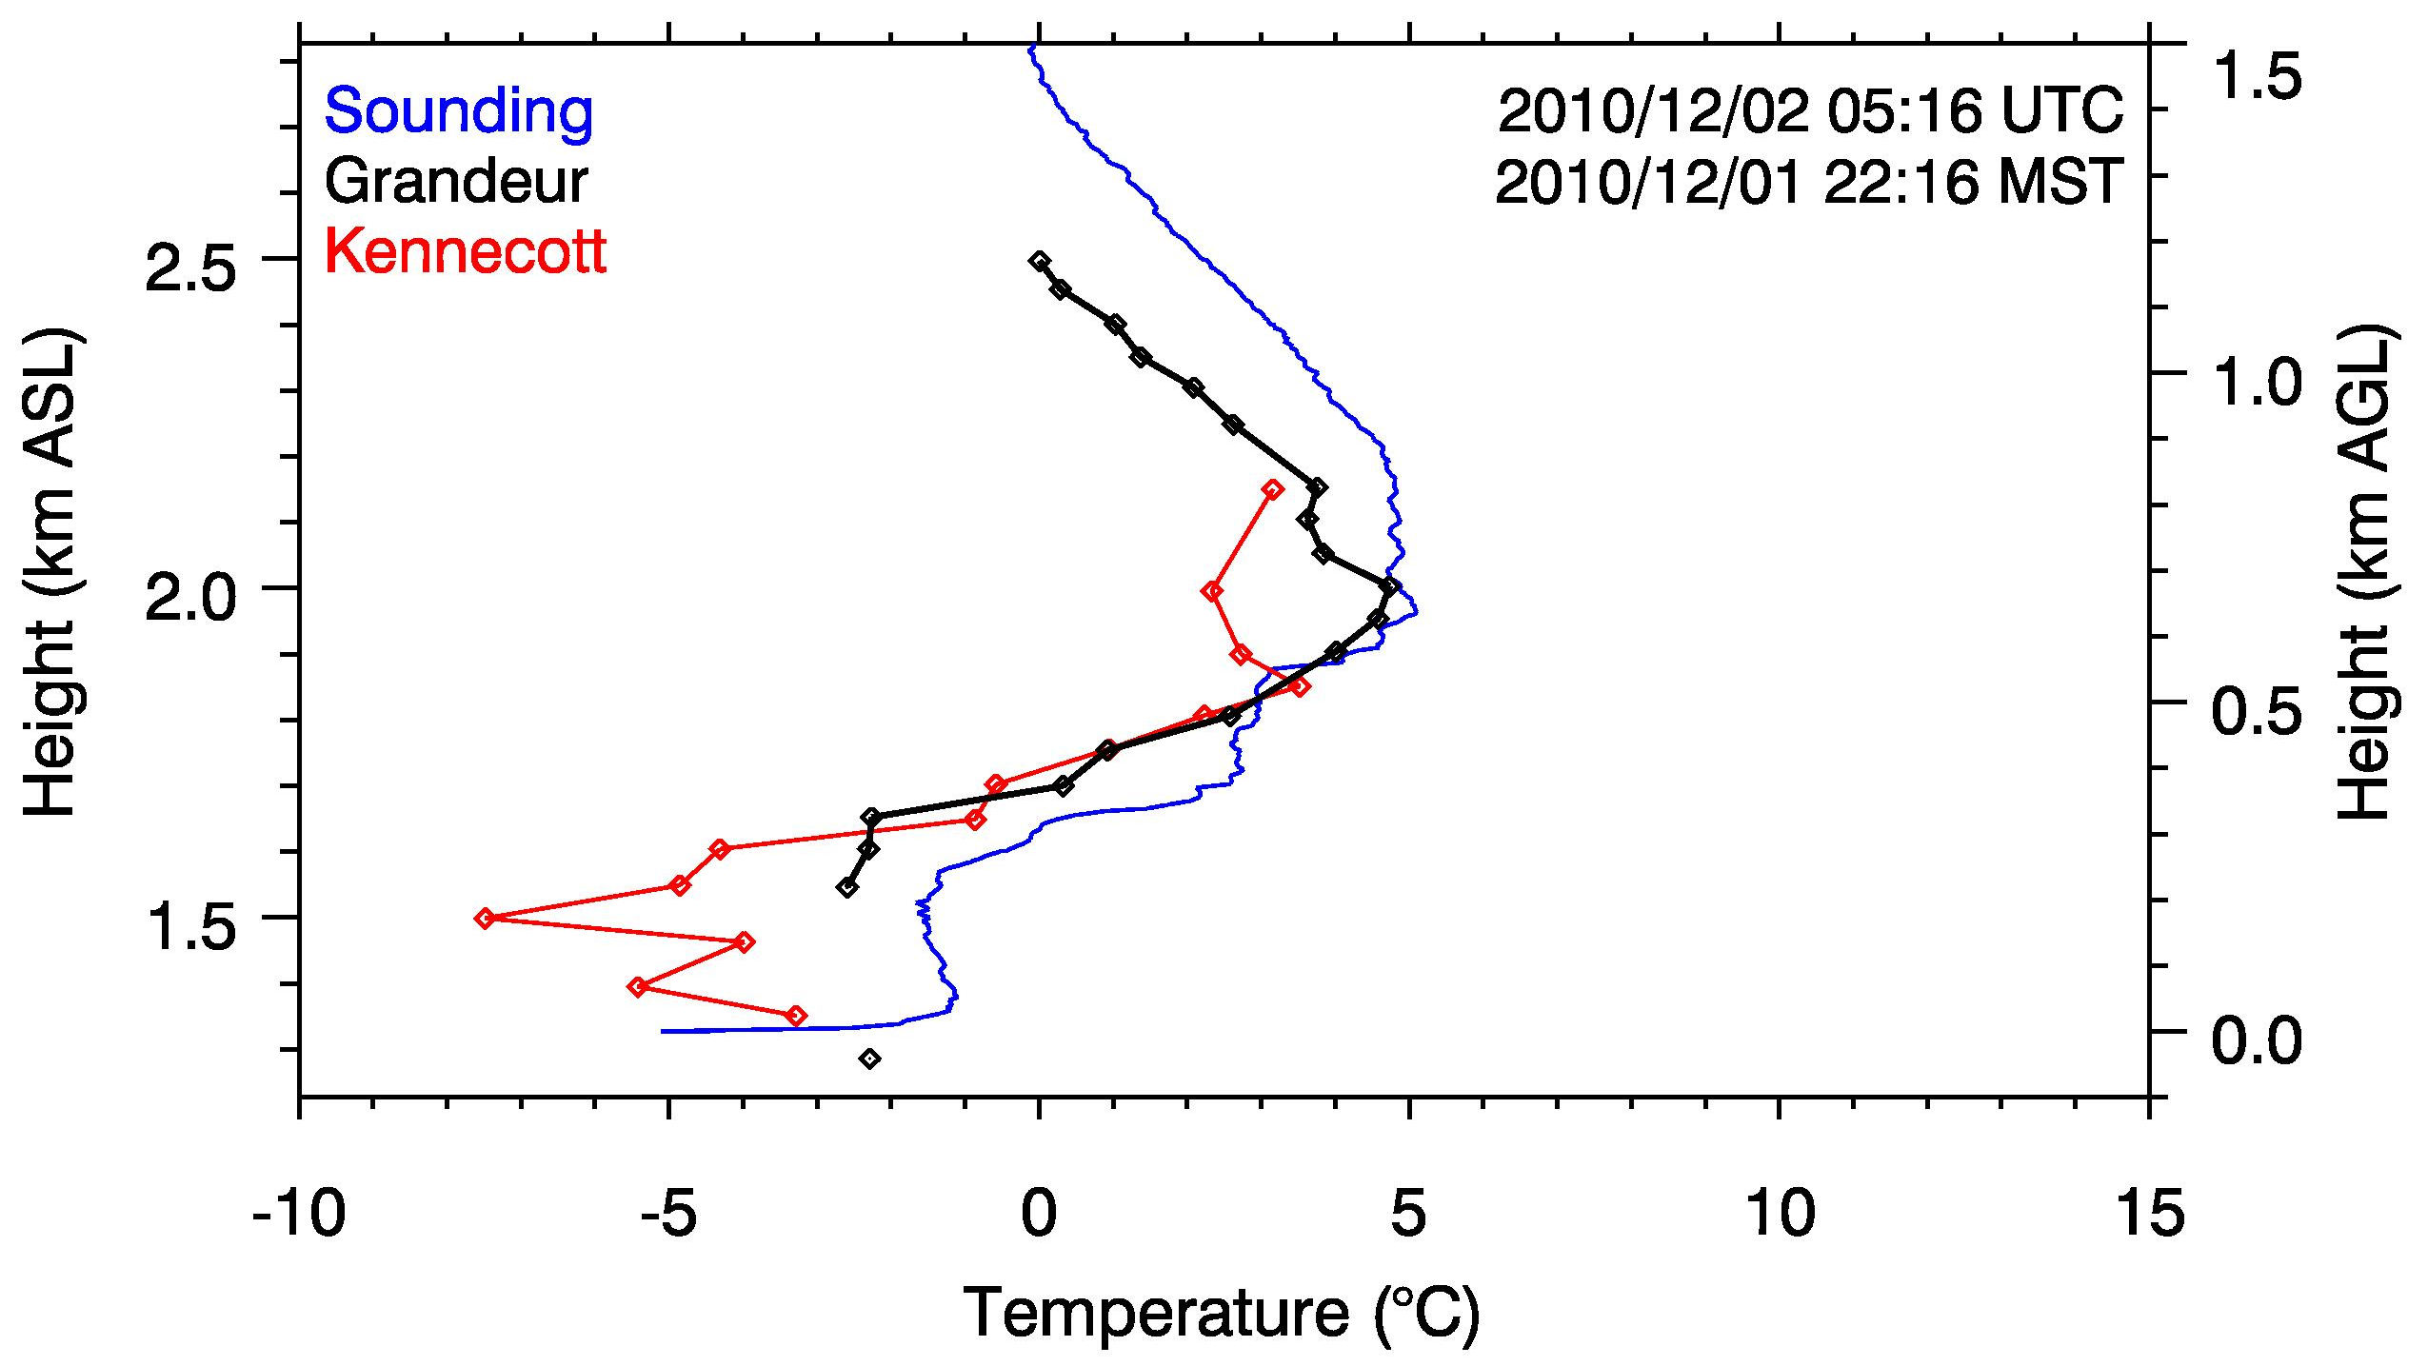
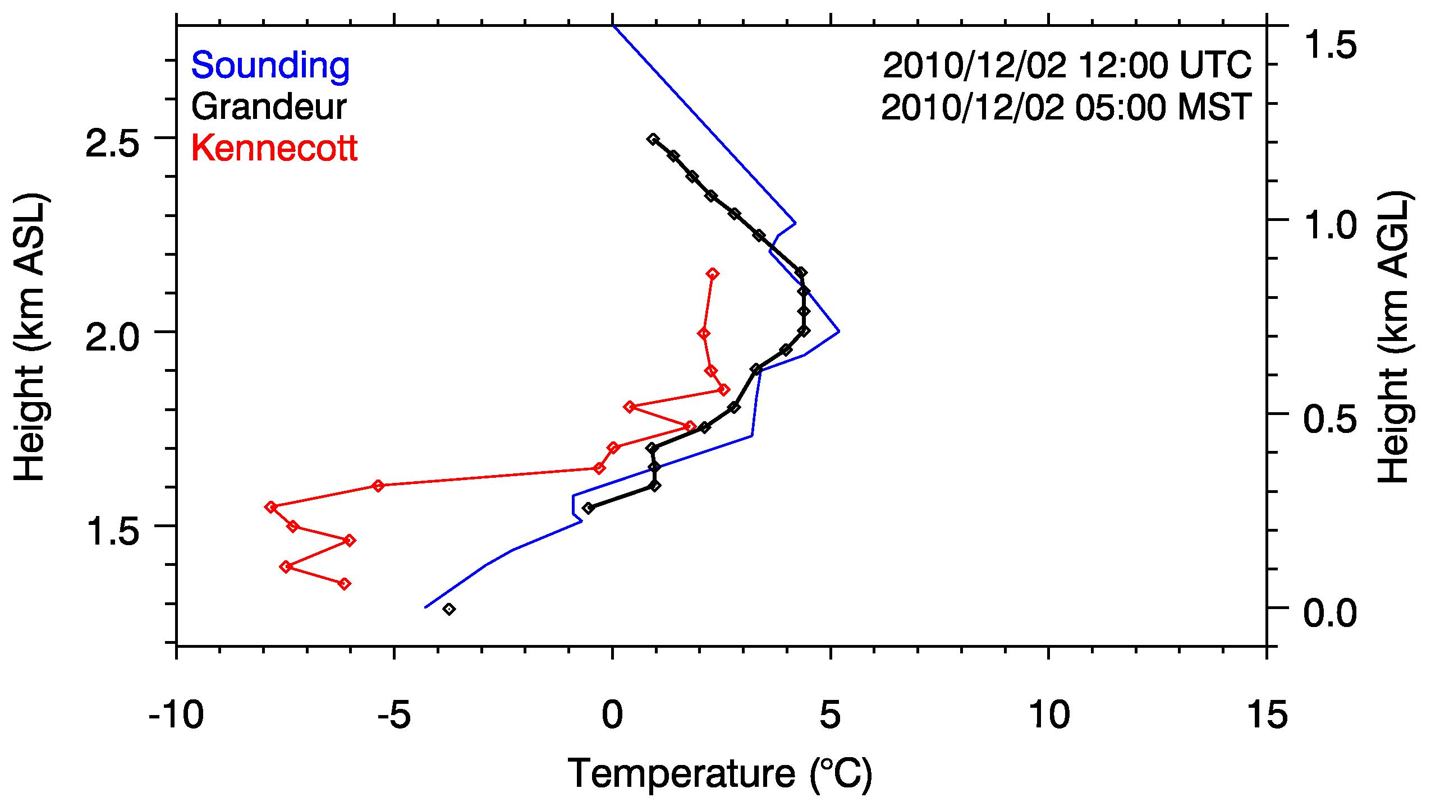
3) Differences in profiles - due to local processes?
Case 1:
Night of 1-2 December
Clear night with strong surface cooling
~ 10 PM 1 Dec.
Low slope angle
HOBO-T-profile over low slope angle sites is cooler than radiosonde profile
Local nocturnal cooling effects likely.
~ 05 AM 2 Dec.
Low slope angle

Slide 9
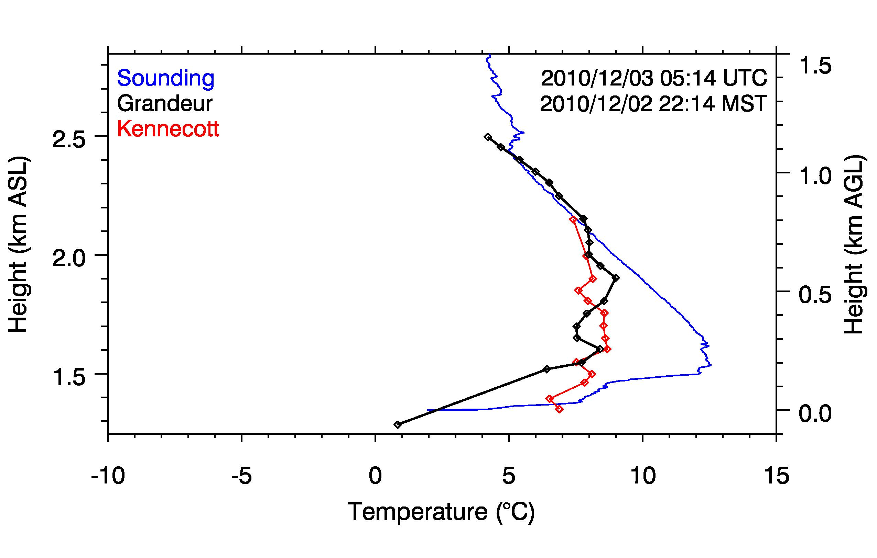
Case 2:
2-3 December:
Strong southerly winds (~15 m/s).
Pronounced temperature differences at different heights
Warmer air aloft in basin center
“Mix-out” of the inversion in southern part of the valley.
Downslope warming?
Partial mix-out of valley inversion

Slide 10
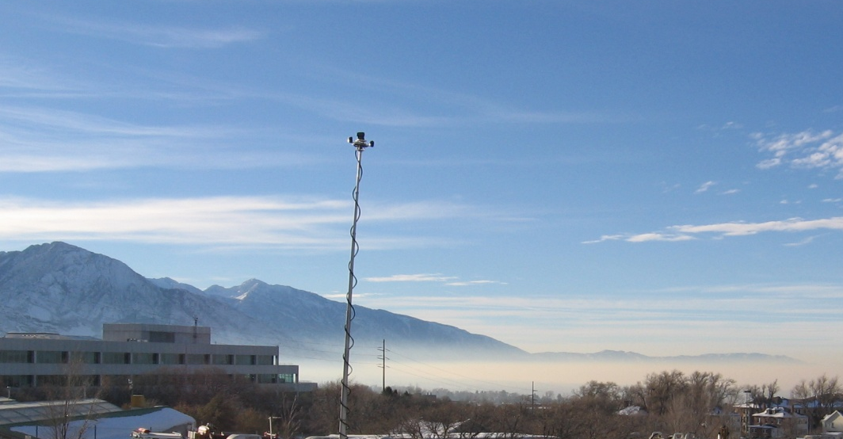
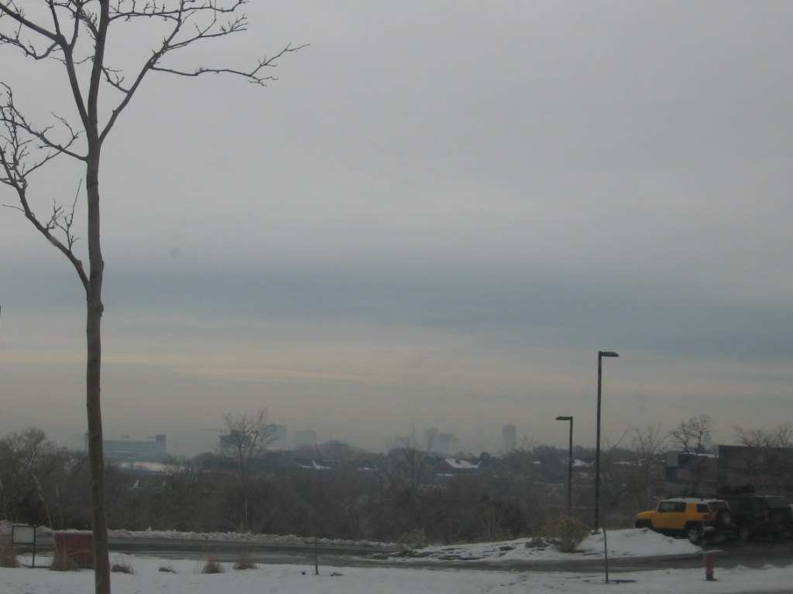
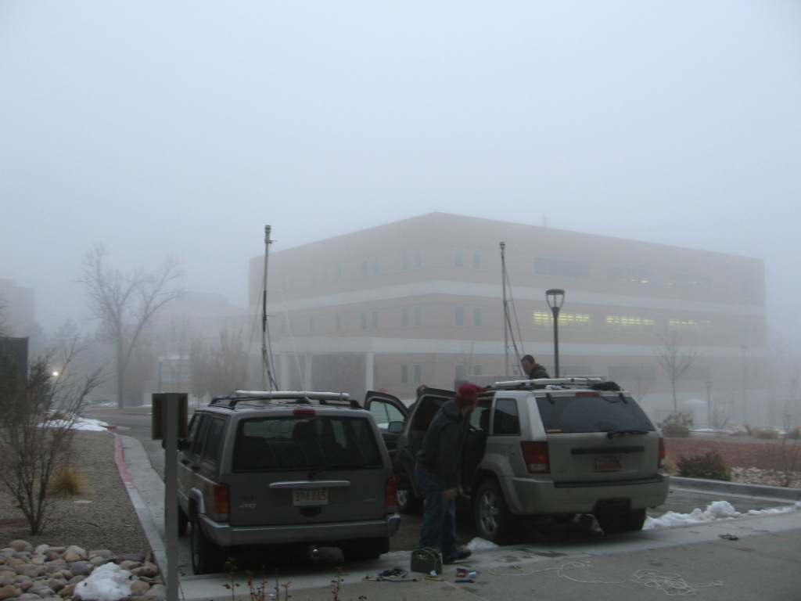
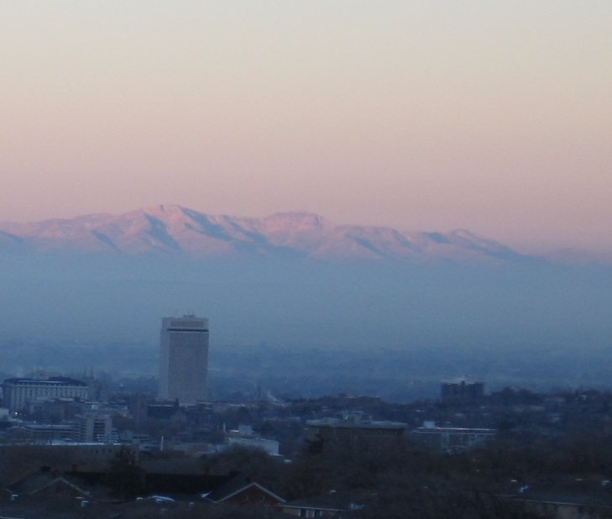
4) IOP-1 in all its complexity as seen by the HOBOs
... but first a short summary:
1-3 December: Shortwave Ridge building (peak 5 pm 2 Dec)
3 December: Short wave trough glancing by: precipitation & strong westerly flow
Partial mix-out in southern part of valley
4 December: Isothermal structure
5 December: Fog
5-6 December: Upper level clouds dissipate – strong cooling on fog / low cloud top
7 December: Mix-out
2 Dec 1000 MST
3 Dec 1130 MST
5 Dec 1600 MST
7 Dec 0800 MST

Slide 11
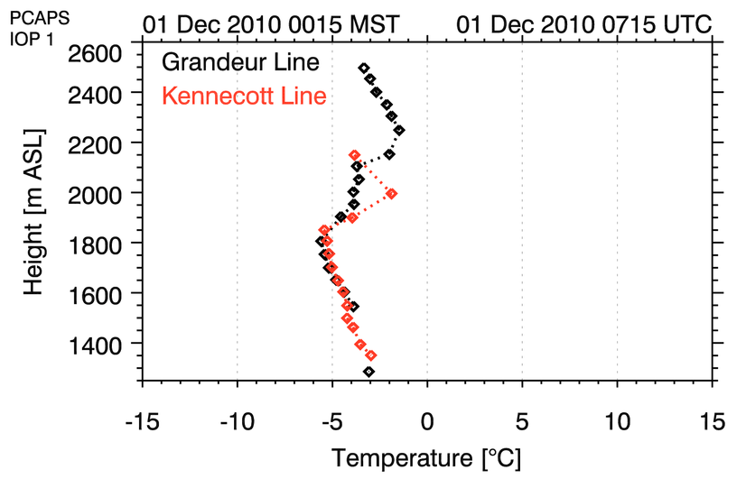

Slide 12
Summary
The HOBO temperature data logger lines give continuous quasi-vertical temperature profiles
Local effects are seen in the data
Valley inversions are very dynamic and constantly evolving
Phenomena seen in HOBO temperature signatures comprise:
Lowering subsidence inversions
Spatial differences in “mix-out” events
Downslope warming
Evaporative cooling
Cloud-(Fog)-Top cooling
Differential heating due to snow cover & insolation differences
Lake breeze surges
Sloshing & seiches ?

Slide 13
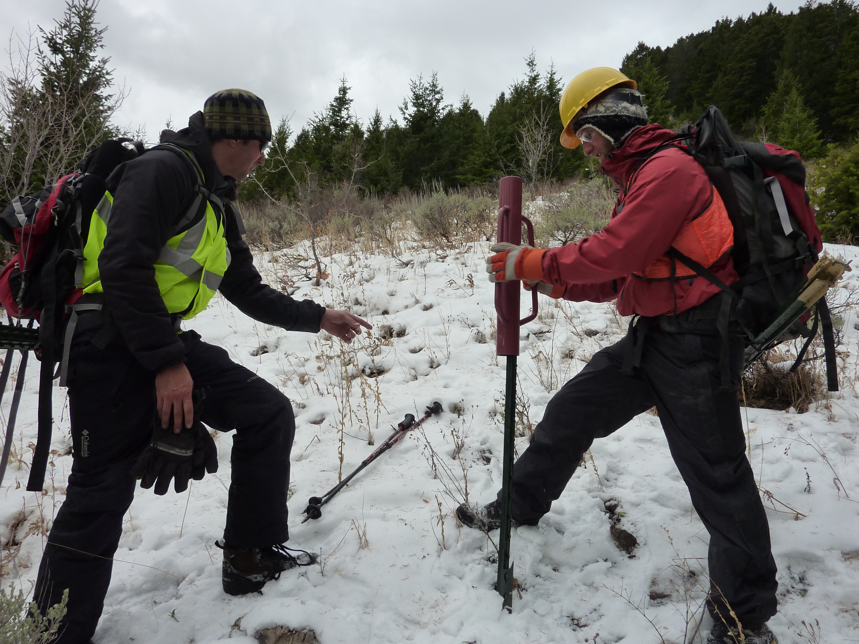
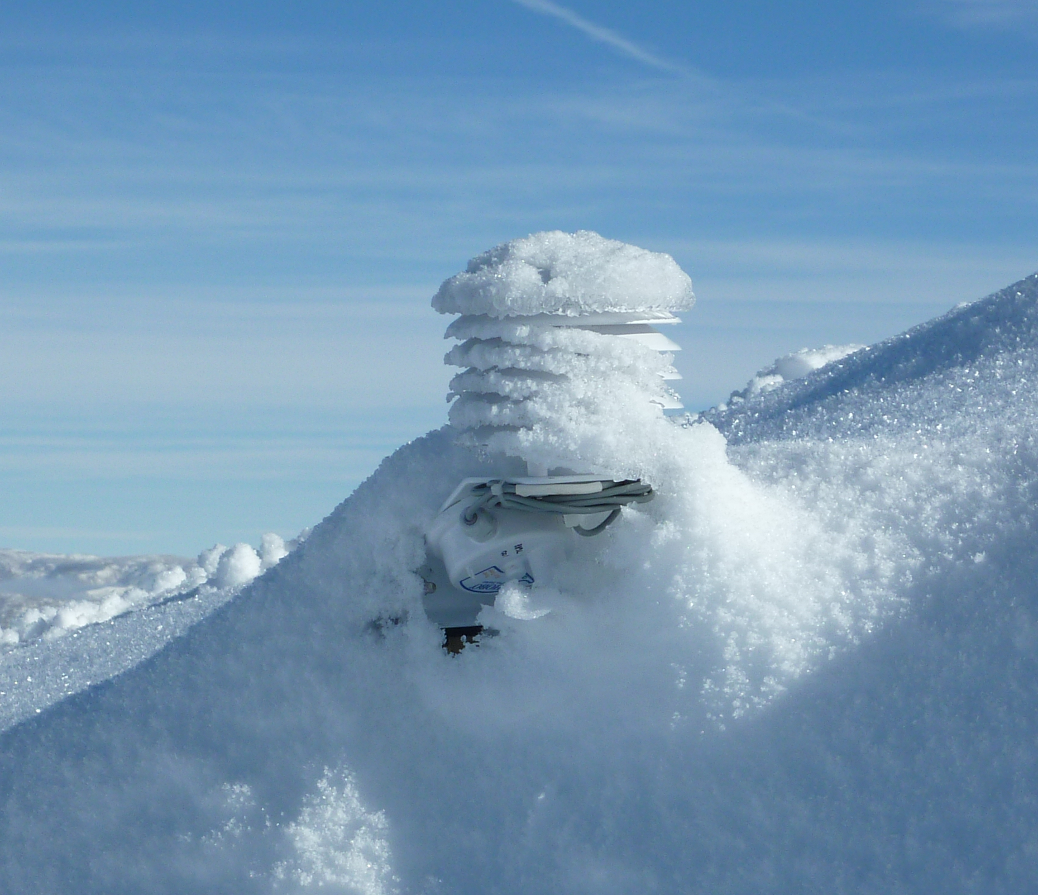
Acknowledgements
Siting of HOBOs – Thanks for giving a HOBO a home:
National Forest Service (Carol Majeske)
Rio Tinto / Kennecott Land (Chris Kaiser / Jeff Lachowski)
All the local businesses and private people that allowed a placement of a temperature sensor on their property!
Placing of HOBOs – Thanks for dealing cutting straws & with steep muddy and slopes heavy fence post pounders
HOBO-Party participants & hosts
Hiking & hauling friends

