Slide 1
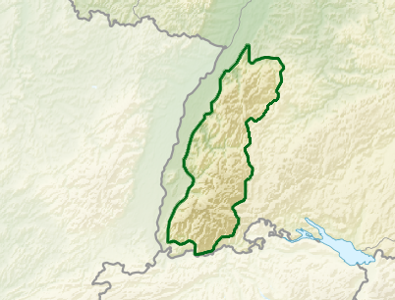
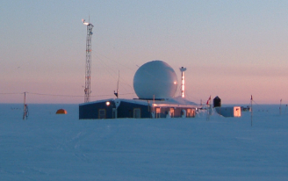
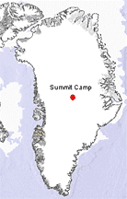
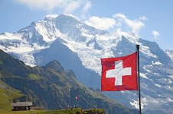
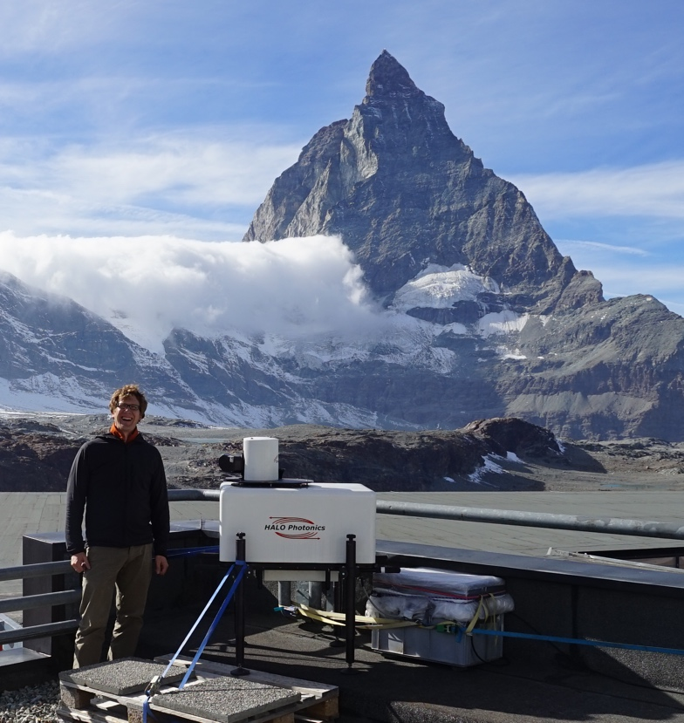
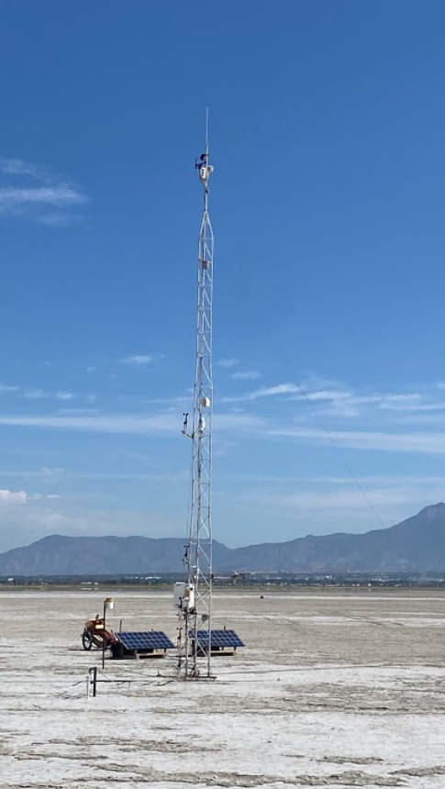
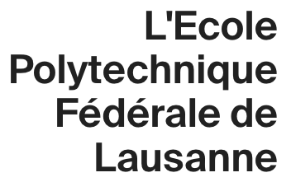
Sebastian Hoch
Research Associate Professor
France
The Black Forest
Born in the Black Forest (Southern Germany).
Studies in Earth Sciences at ETH (Swiss Federal Institute of Technology)
PhD work on the Greenland Ice Sheet
Postdoc at the University of Utah with Dave Whiteman (2006)
Summit Camp, Greenland
Zermatt,
Switzerland
Sable Island, Canada
Farmington “Bay”
Boundary layer processes in complex terrain
Field Work / Experiments / Instrumentation
Mountain Weather and Climate (Atmos 3200)
Co-advisor for Gerardo Carrillo-Cardenas
Committee Member for: Aaron McCutchan, Jacob Boomsma, Thorn Merrill, Rebecca Beal

Slide 2
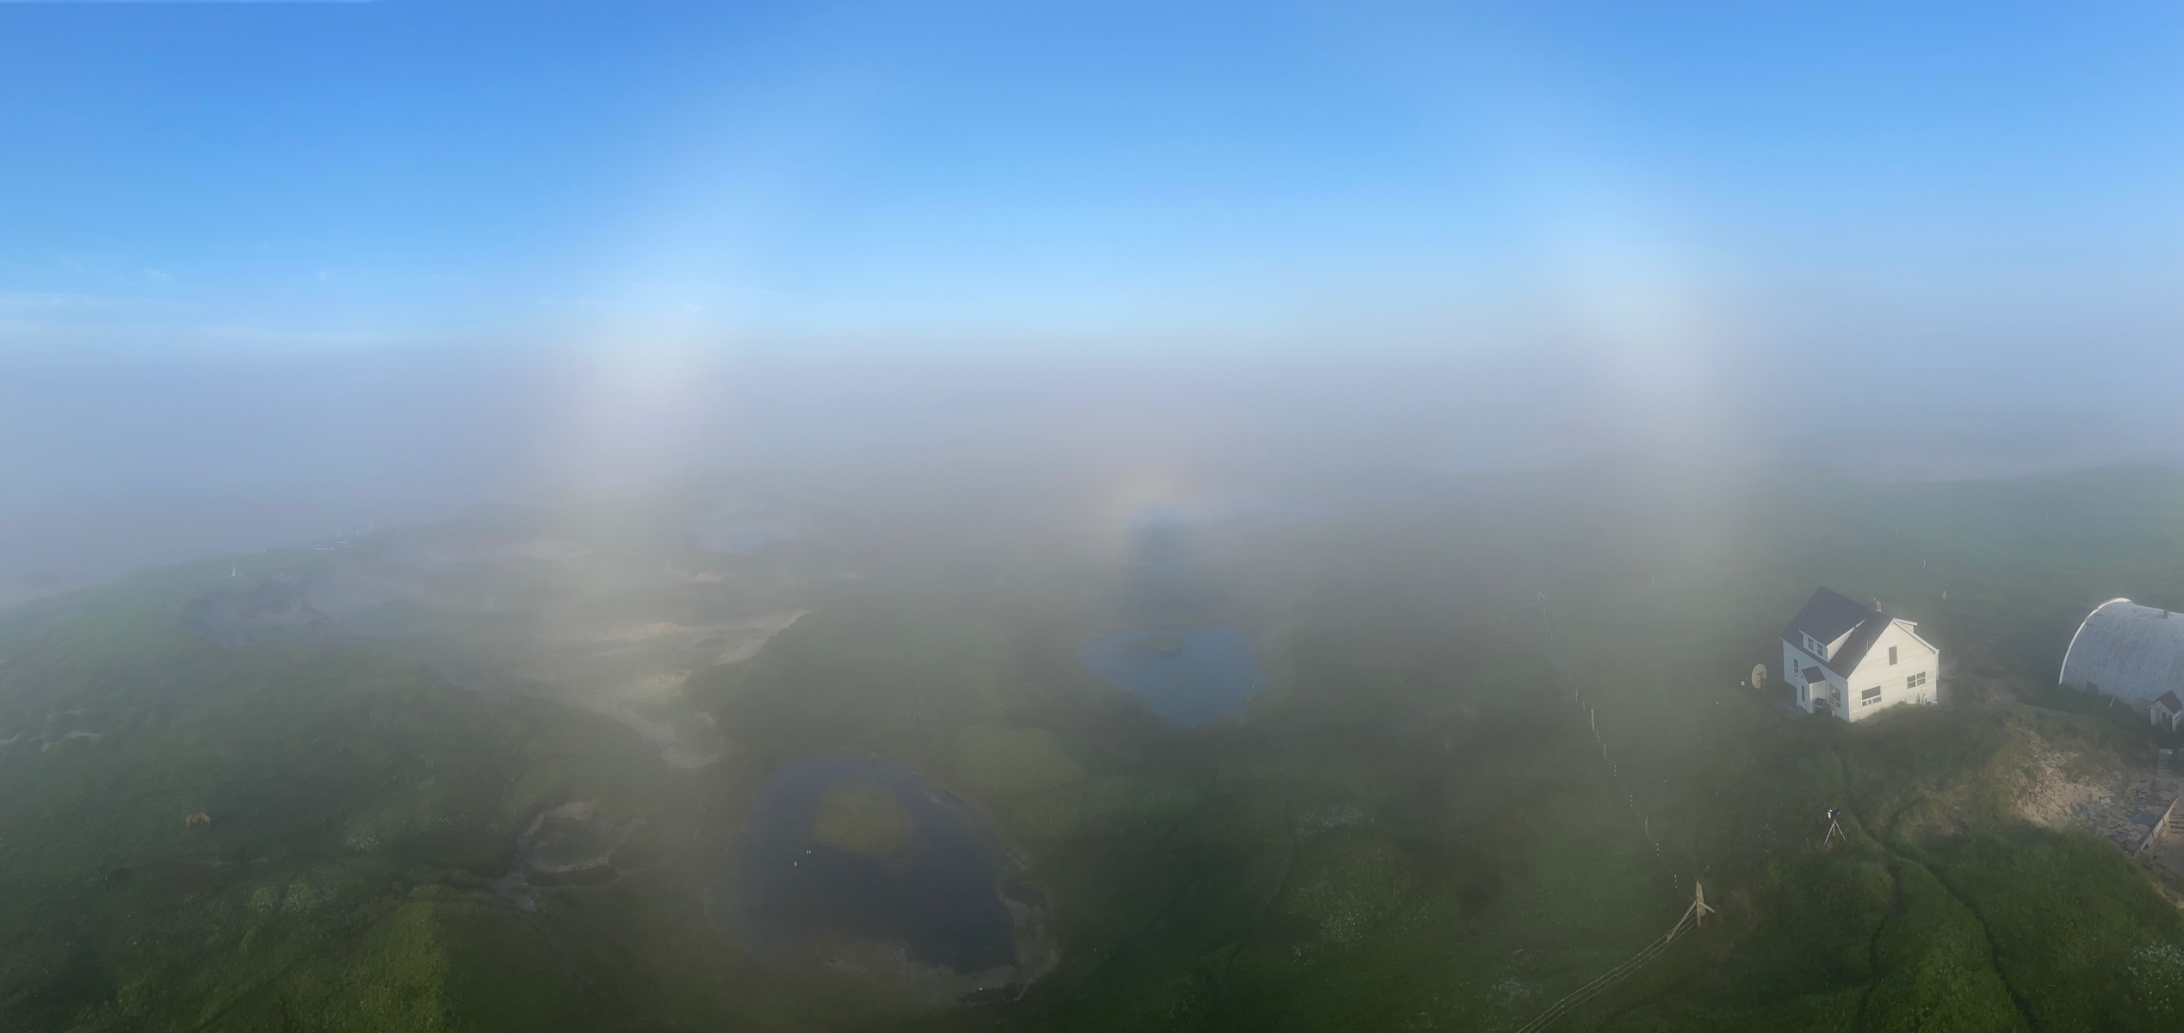
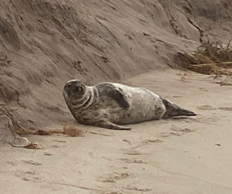
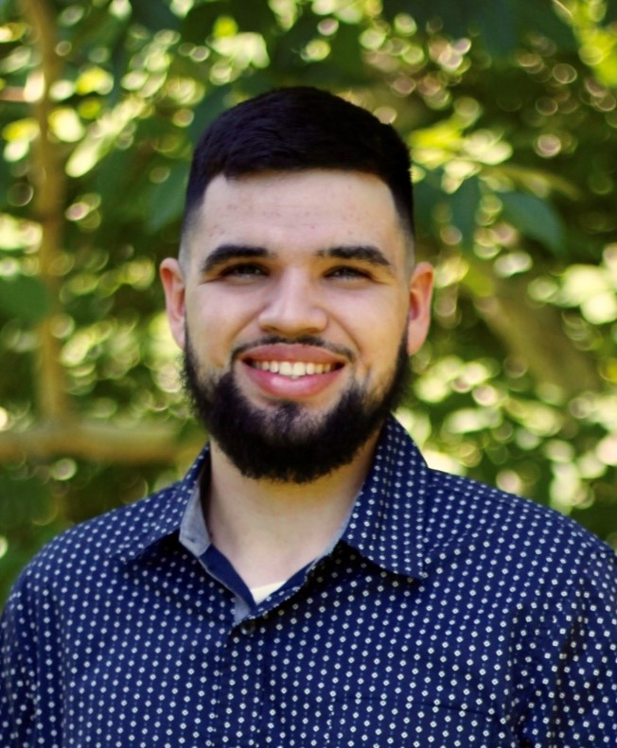
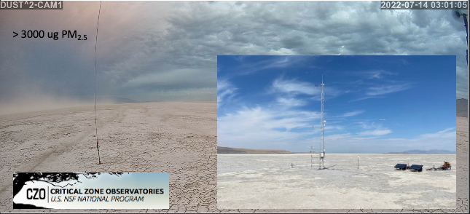
Cold Fog Amongst Complex Terrain | CFACT
FATIMA | Fog and turbulence interactions in the marine atmosphere
With Eric Pardyjak, Zhaoxia Pu, Gannet Hallar
Sable Island – NS, CA
With Eric Pardyjak
Gerardo Carrillo-Cardenas
Office of Naval Research Grant # N00014-21-1-2296
DUST^2 | A source-to-sink investigation of the dust system in the southwestern US as a component of the critical zone
DUST^2 | A source-to-sink investigation of the dust system in the southwestern US as a component of the critical zone
With Kevin Perry, Thorn Merrill & Derek Mallia
With Kevin Perry, Thorn Merrill & Derek Mallia

