Slide 1



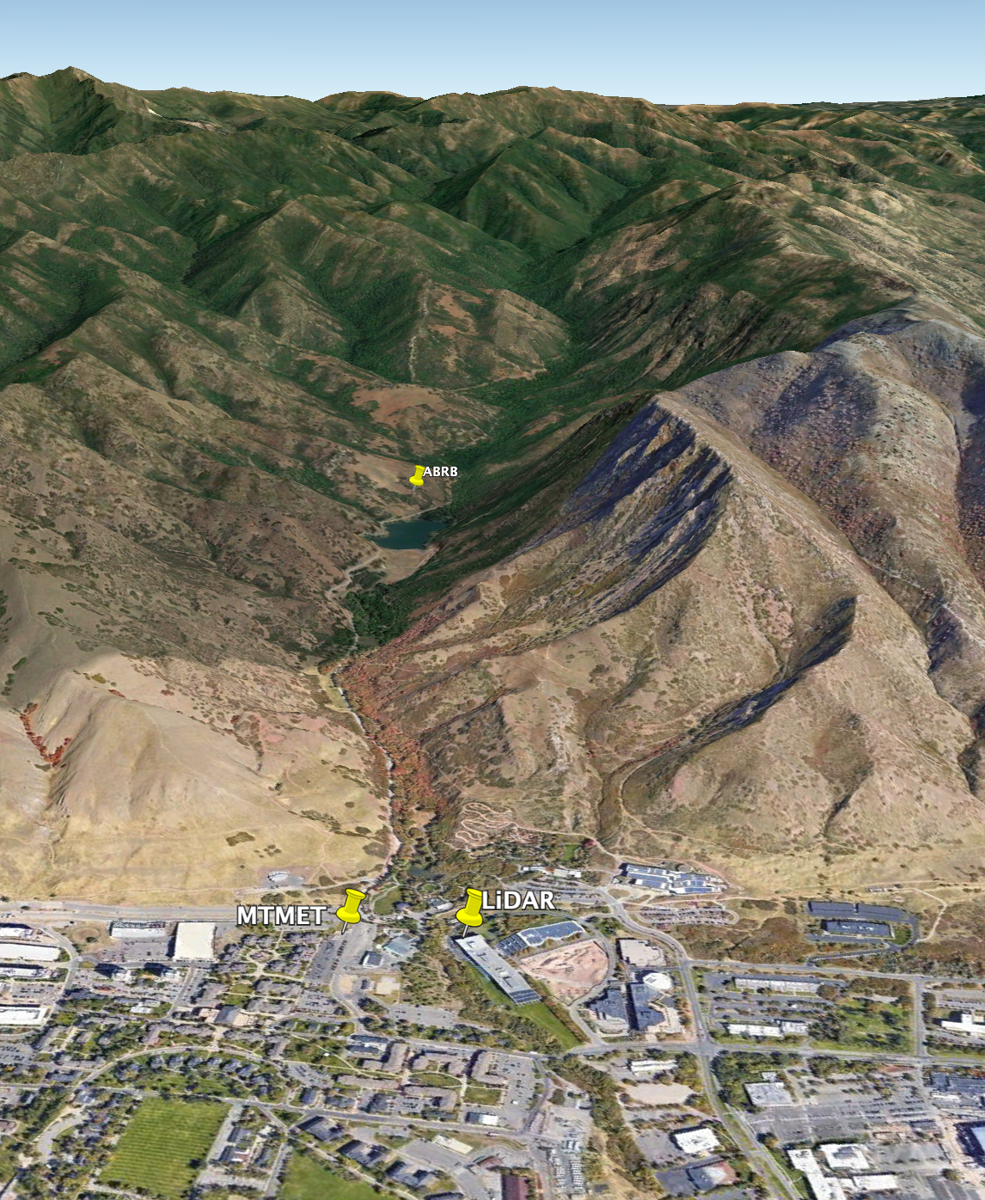
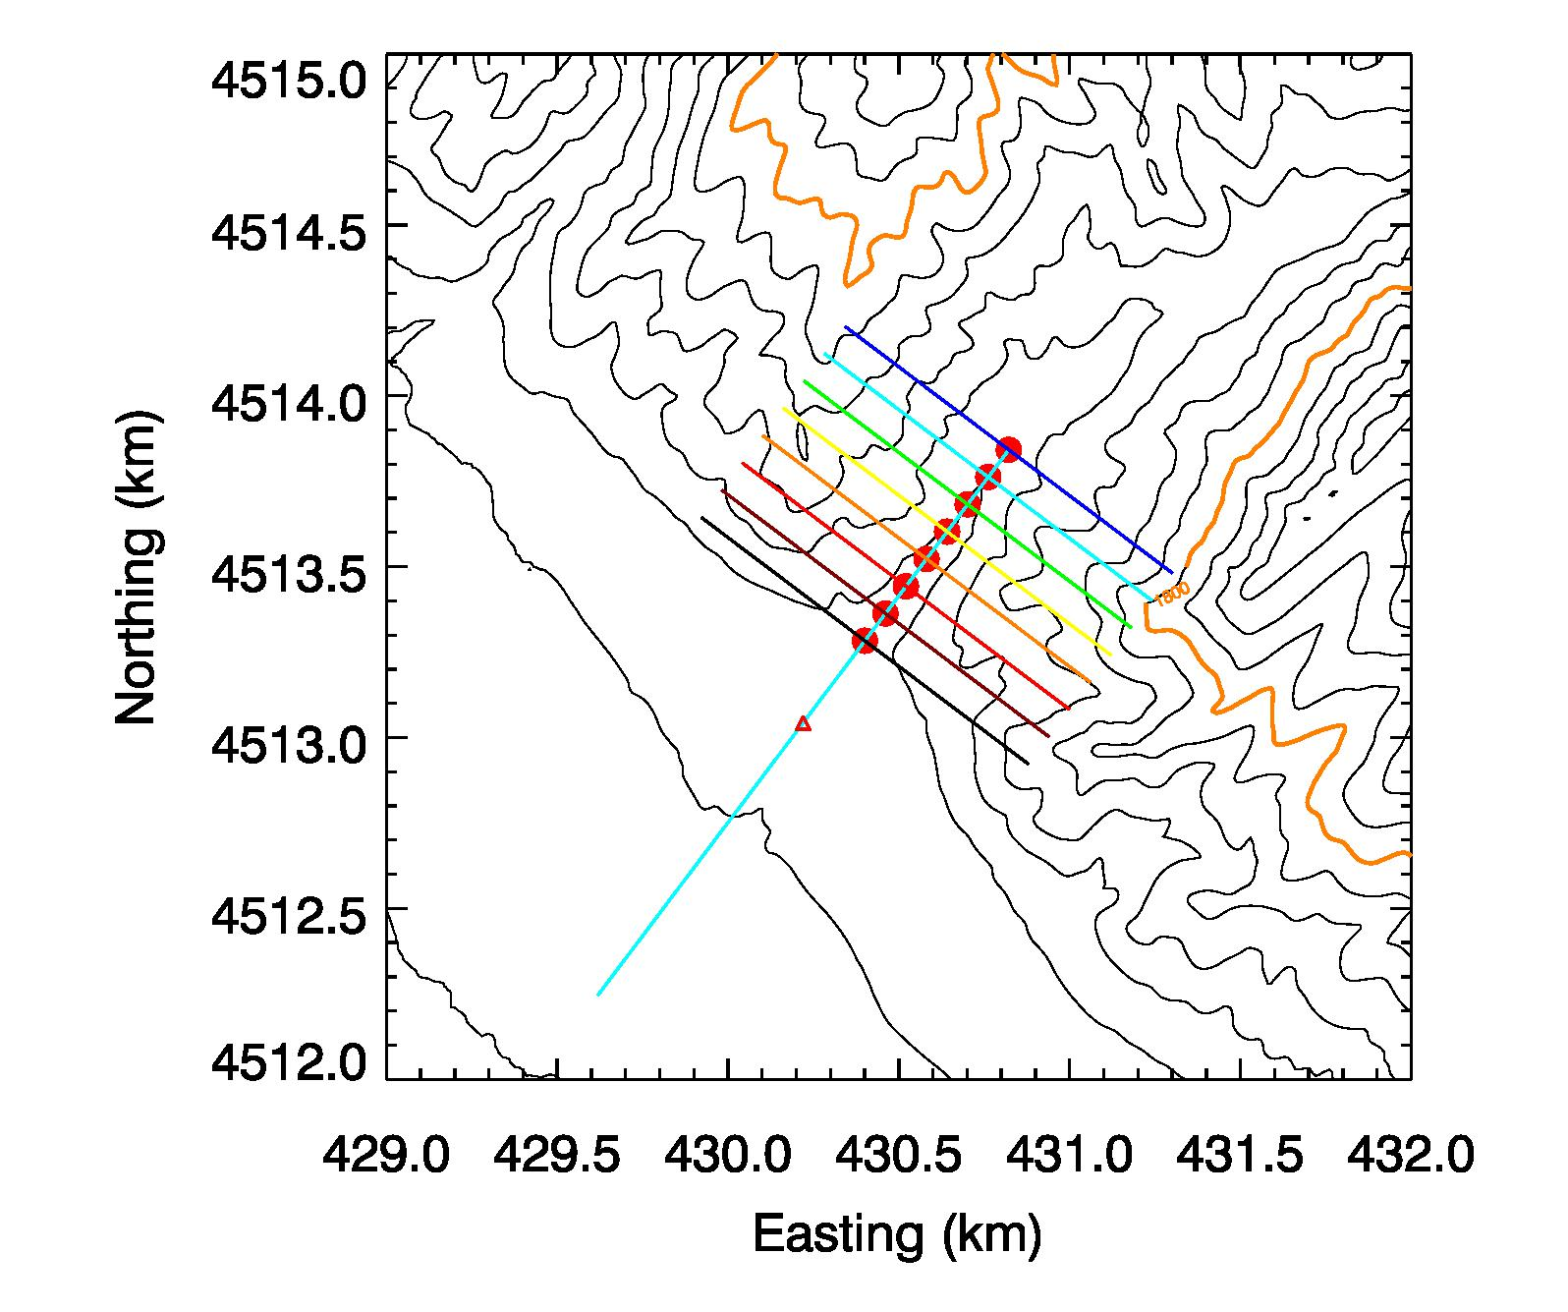
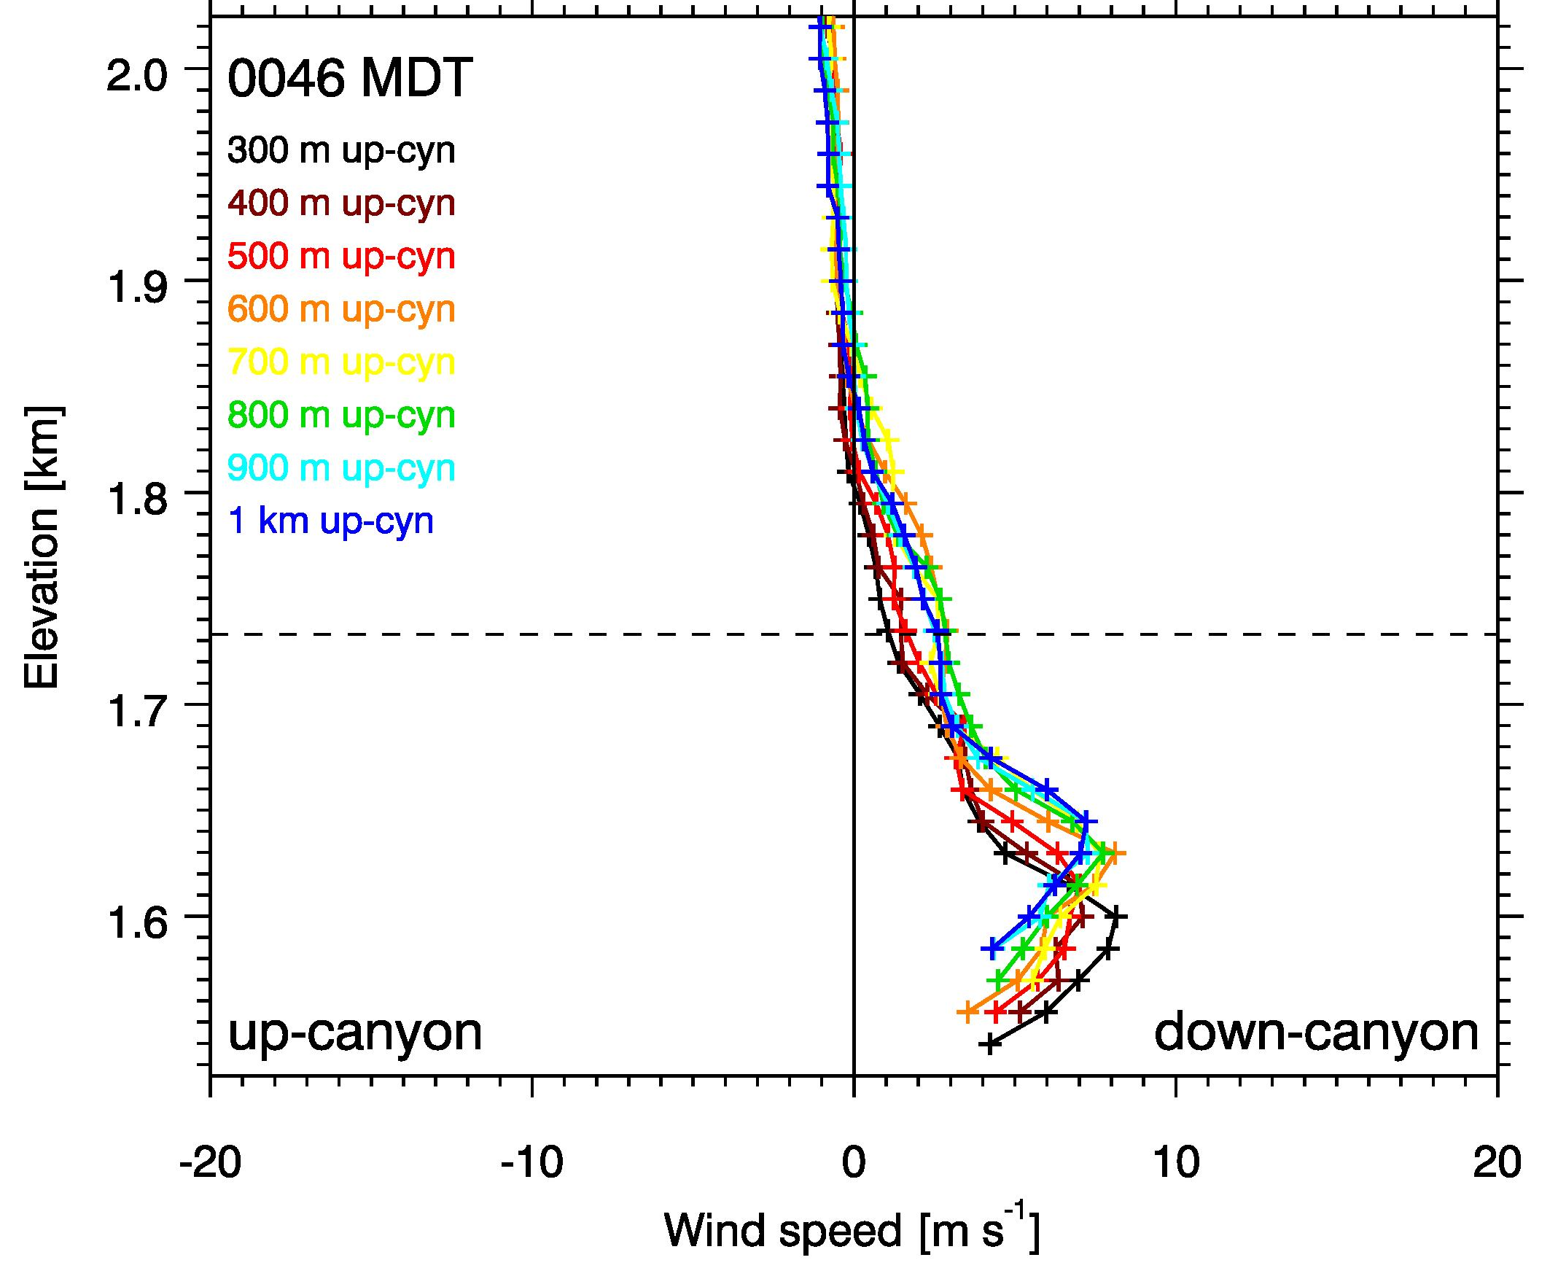
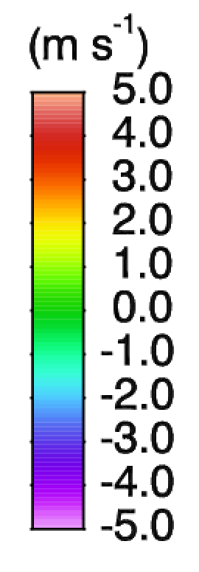
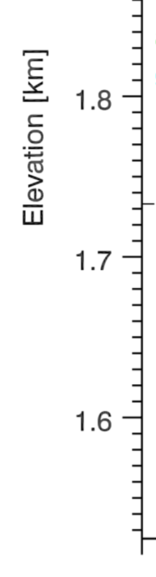
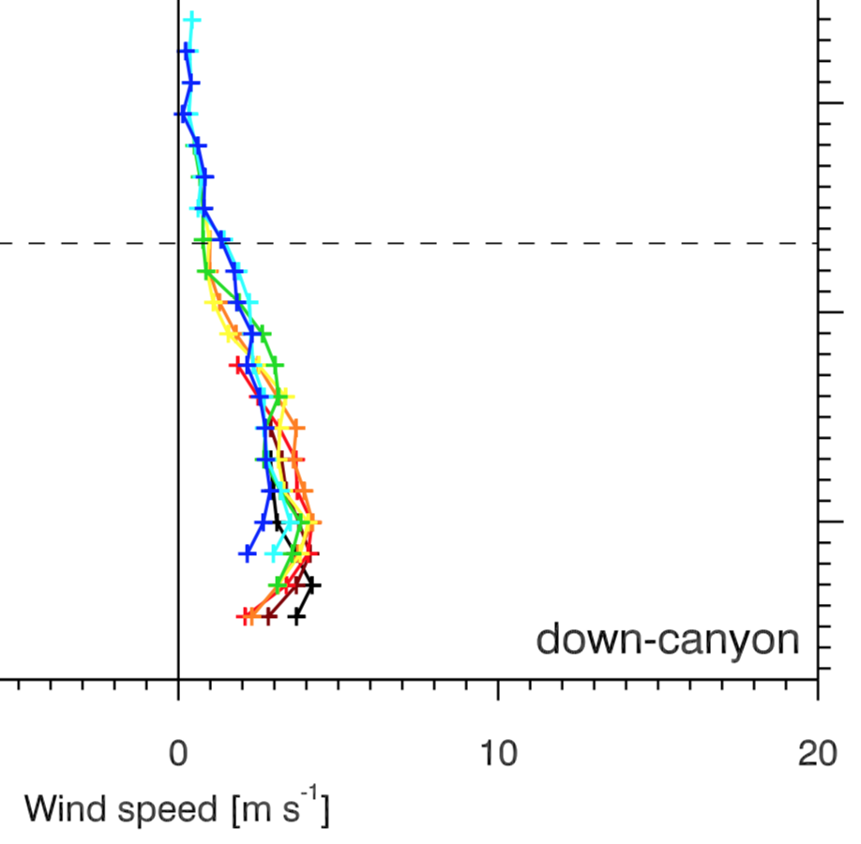
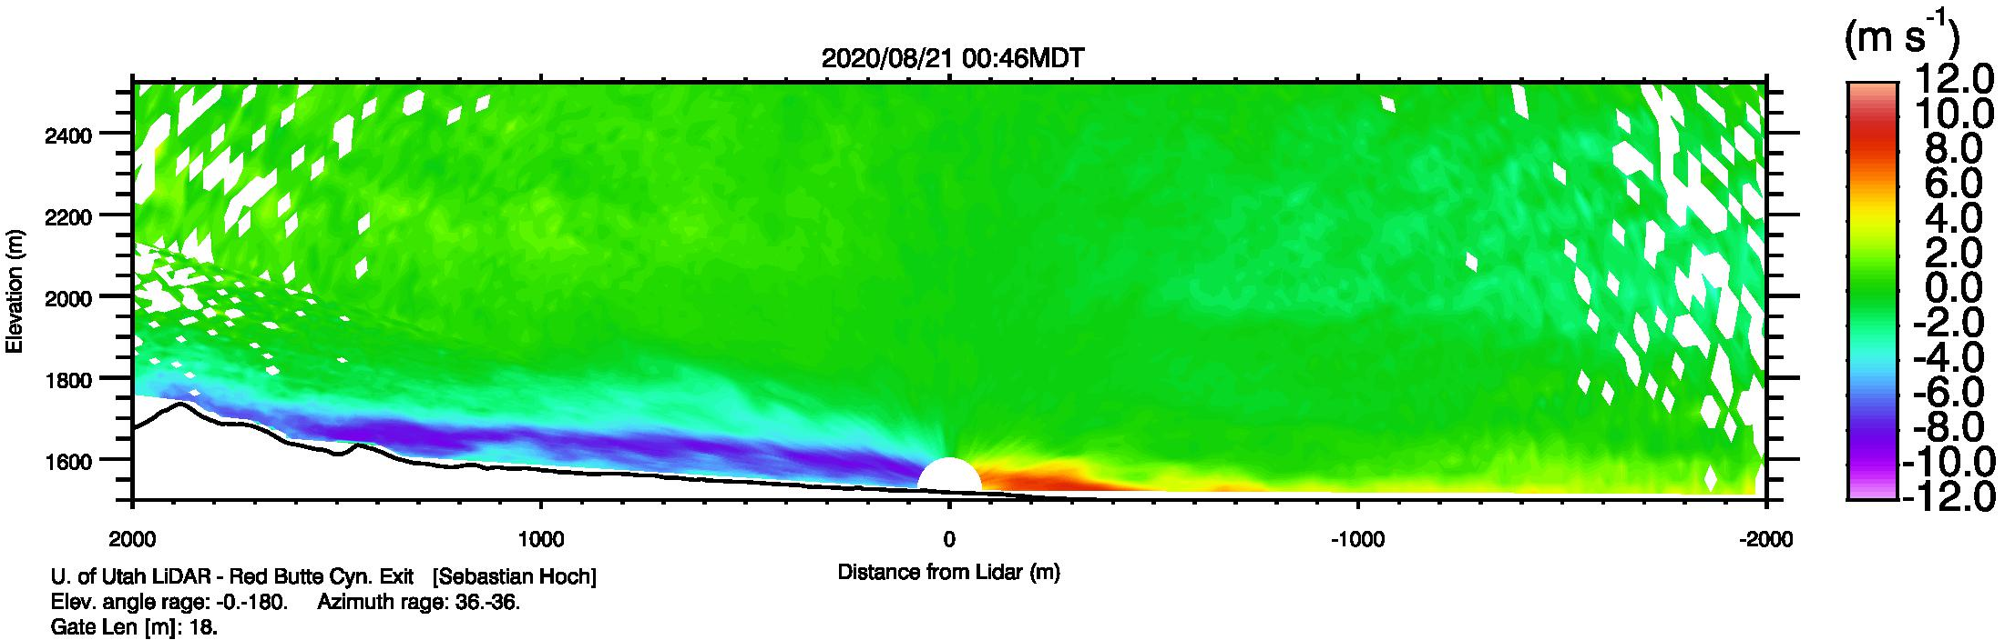
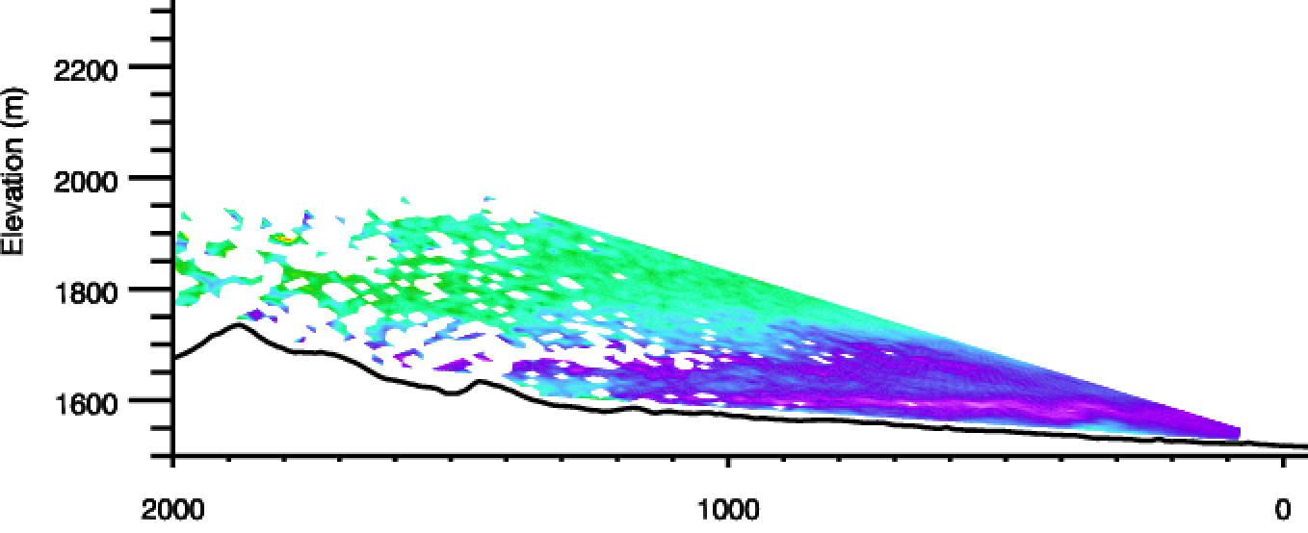
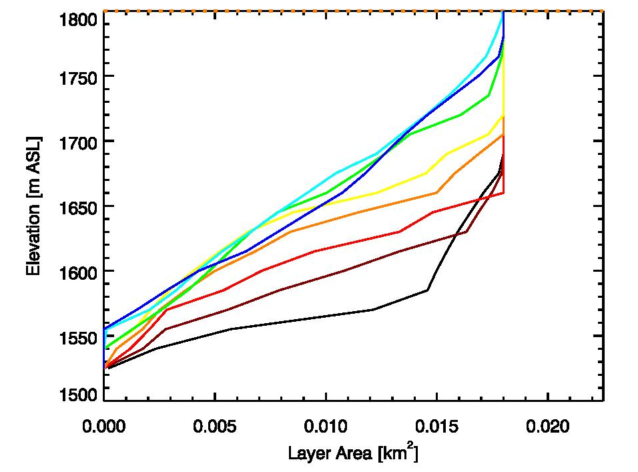
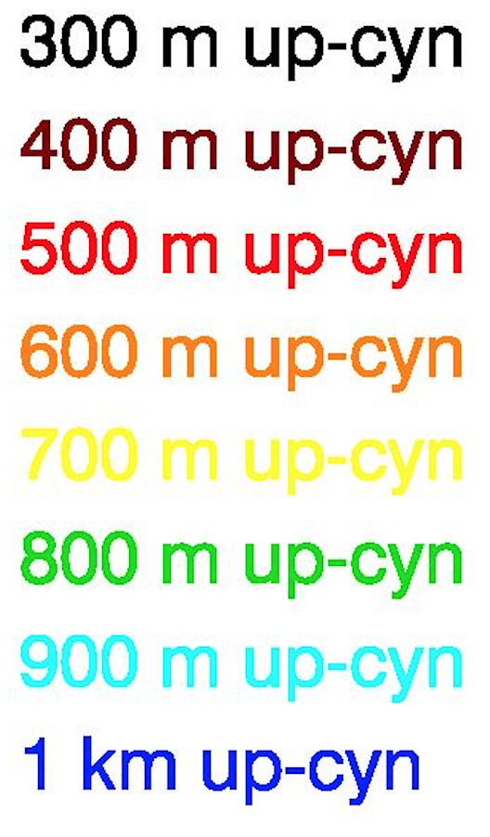

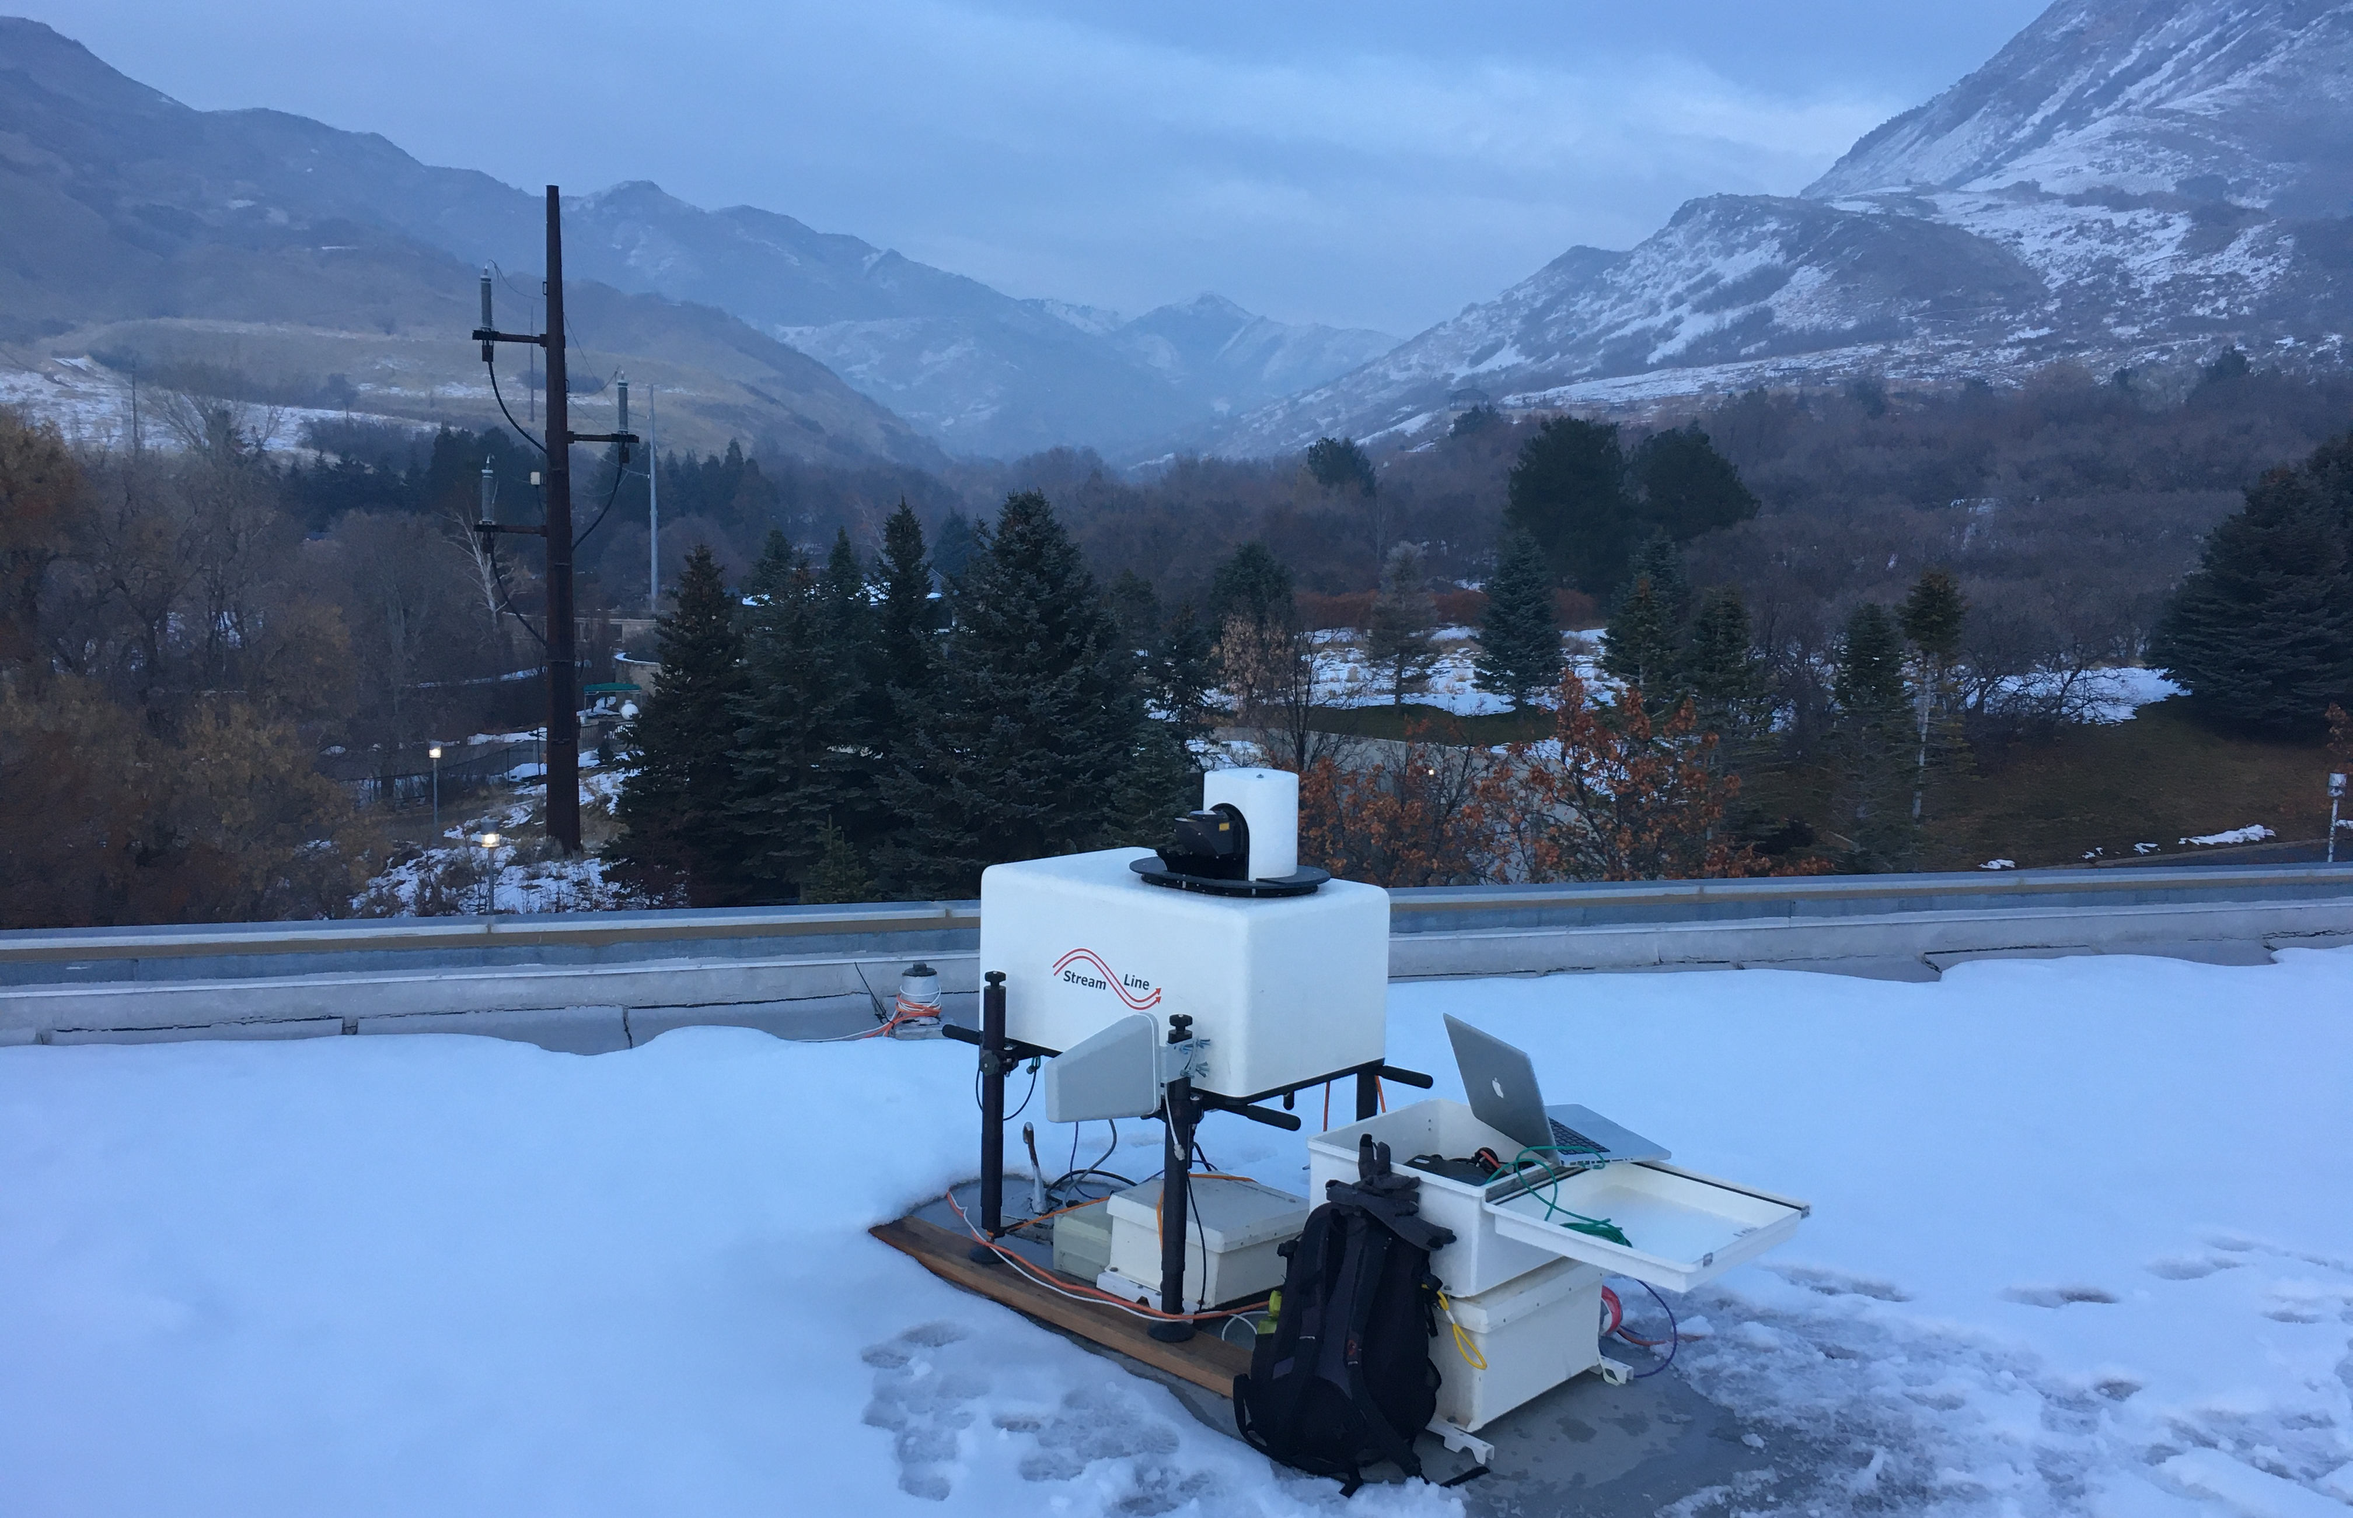
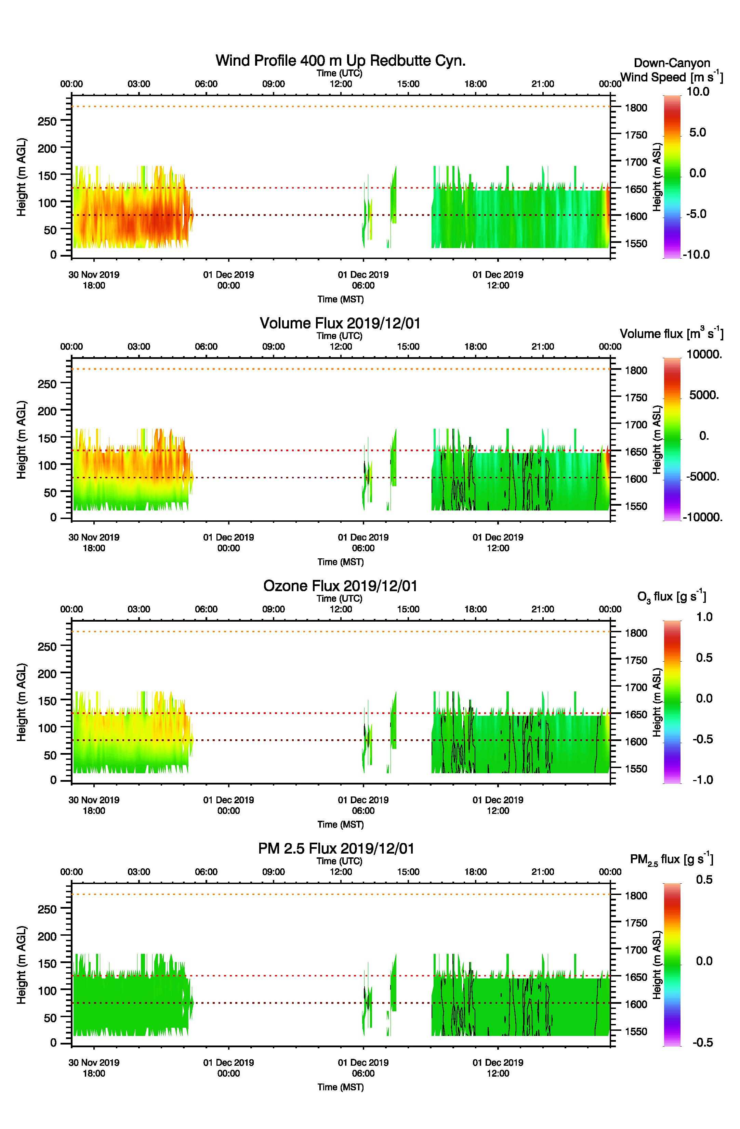
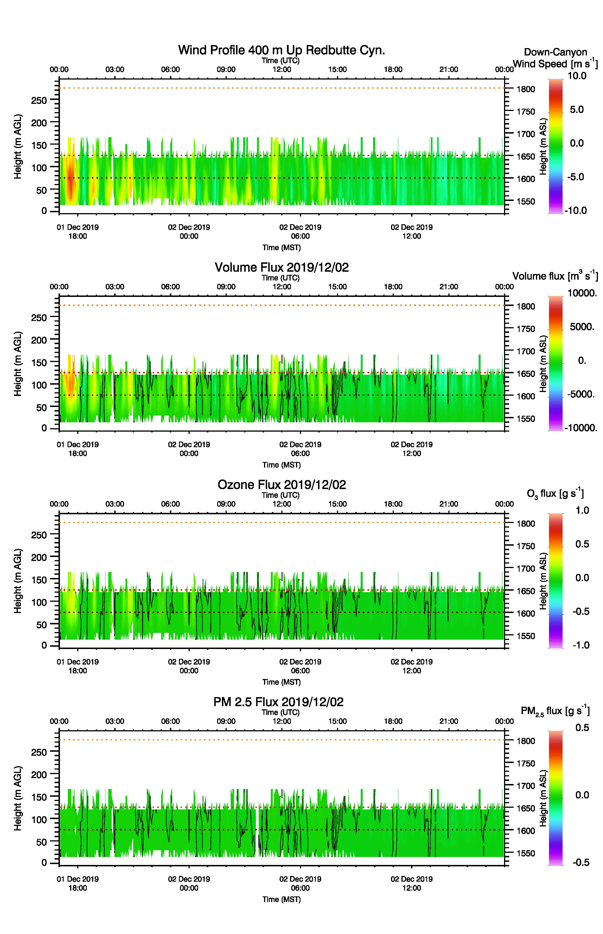
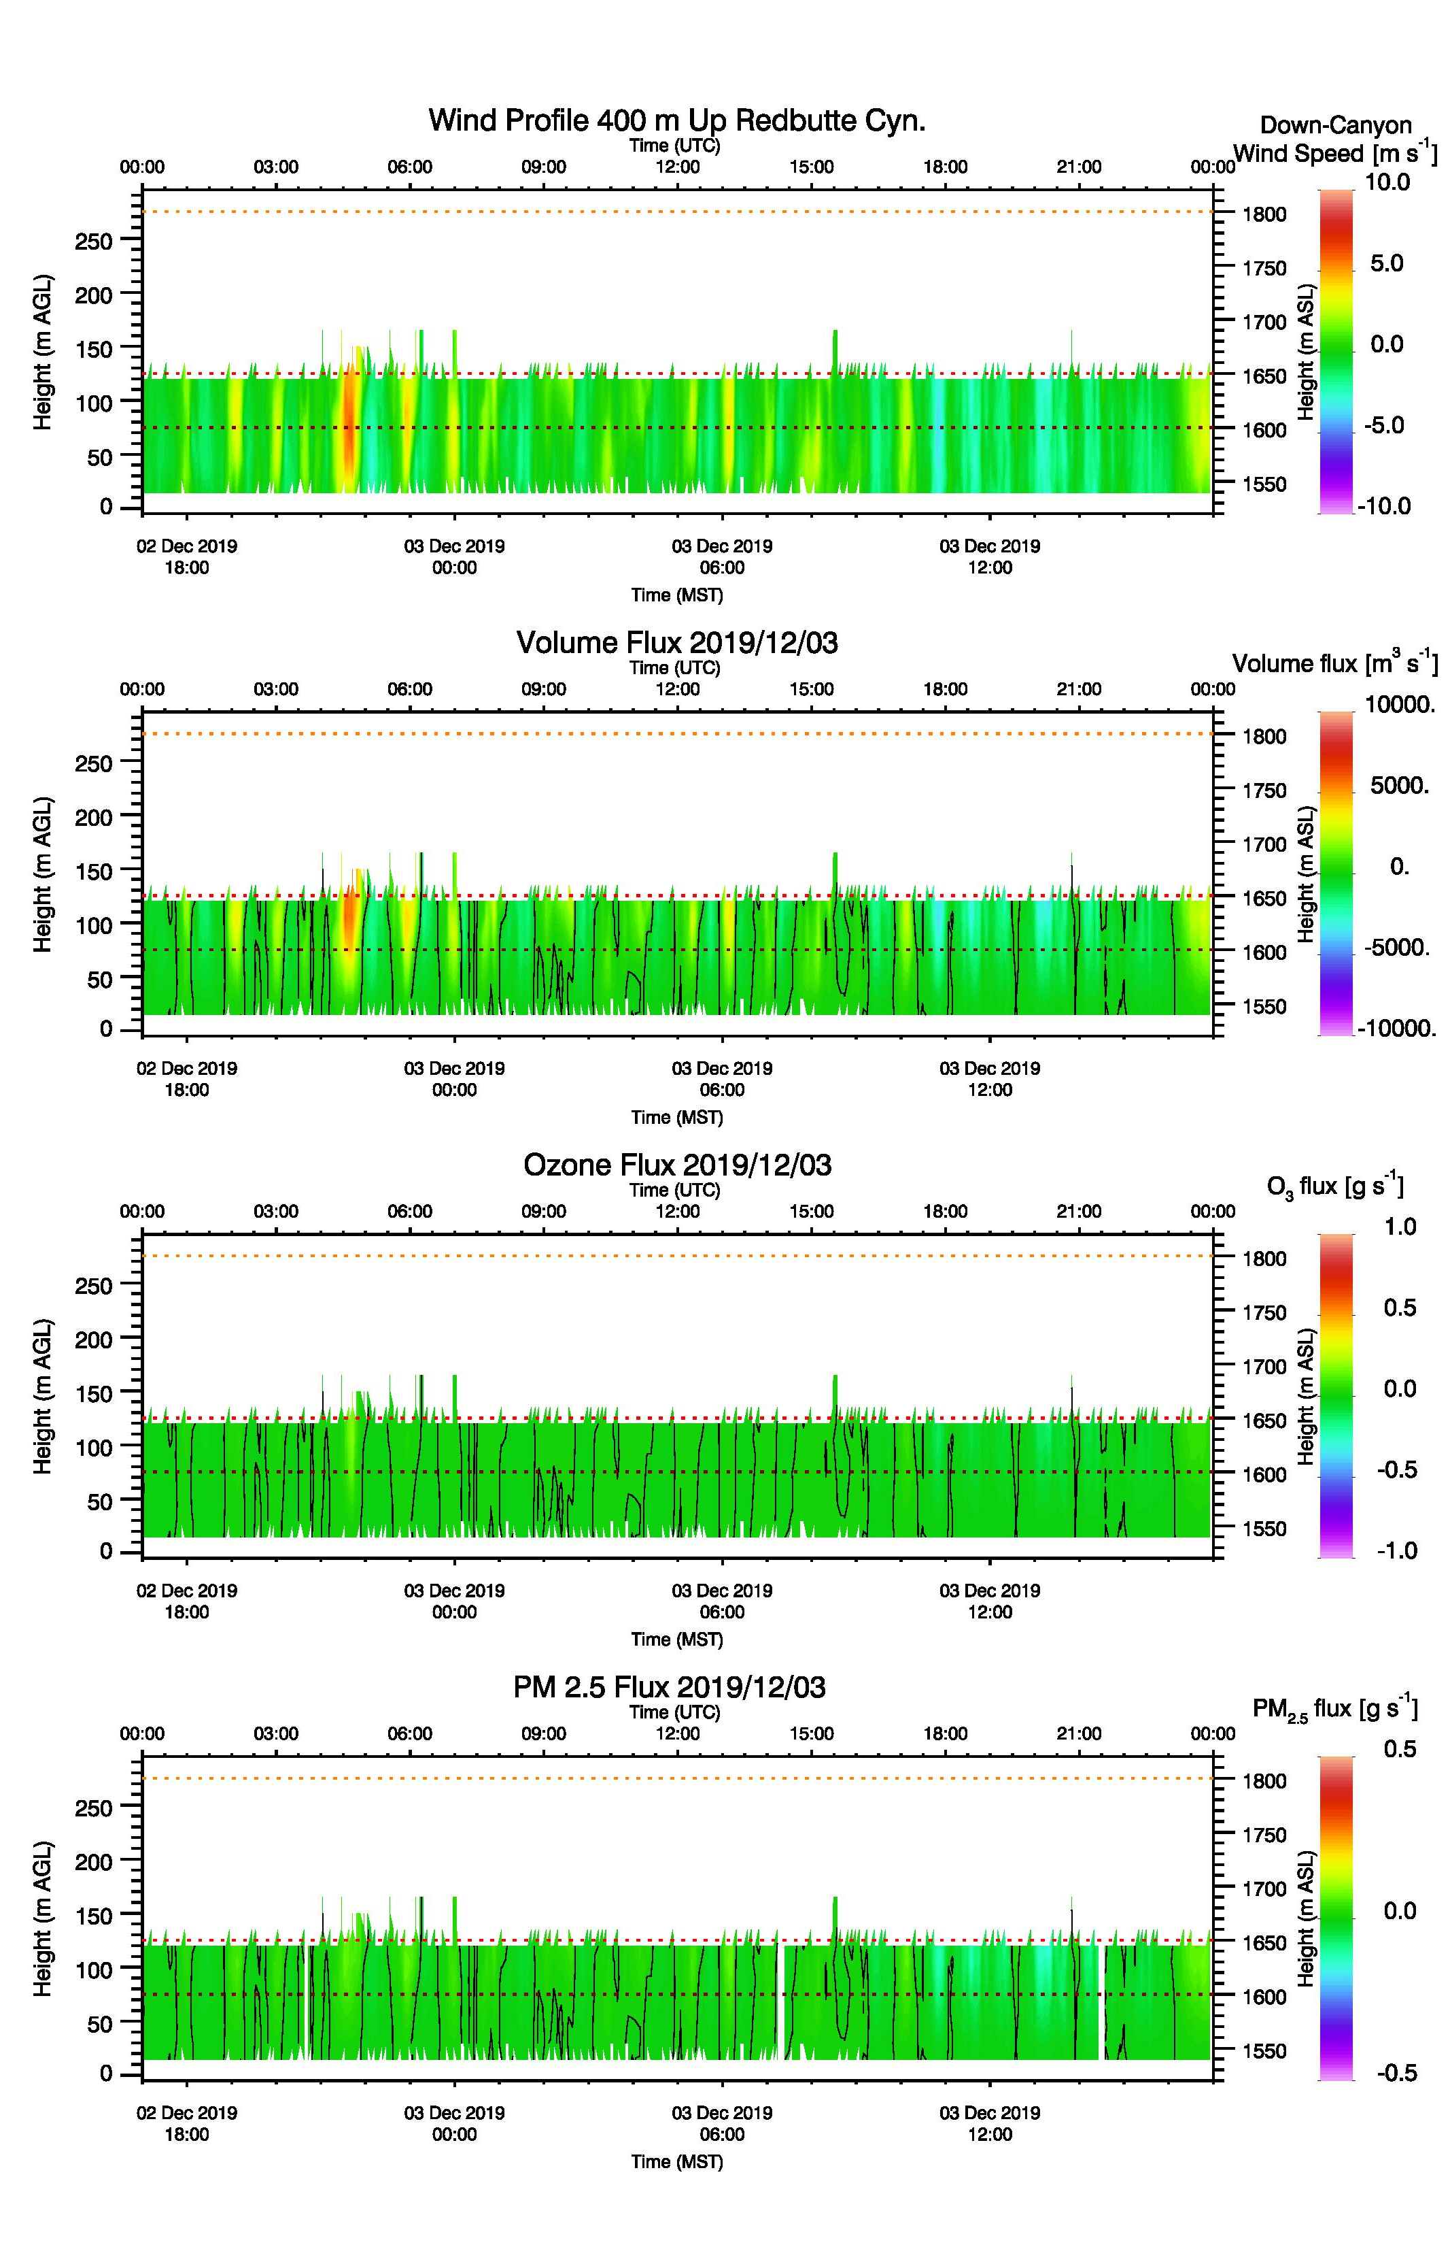
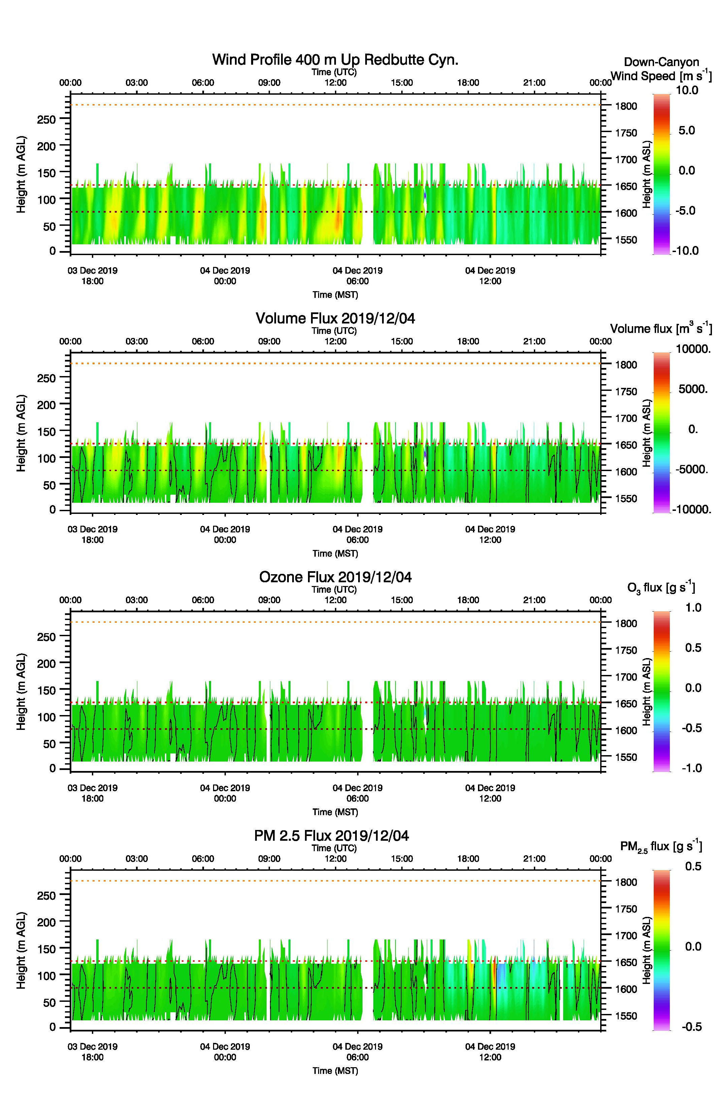
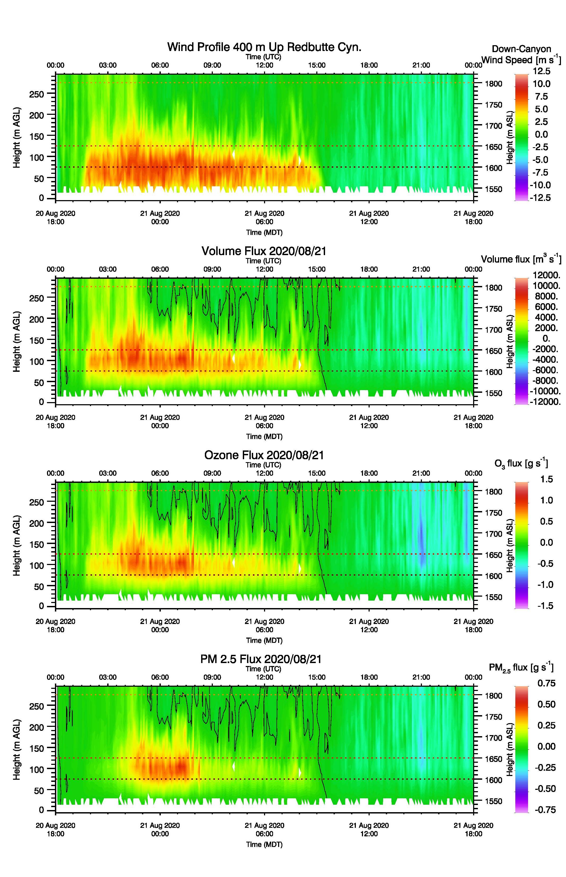
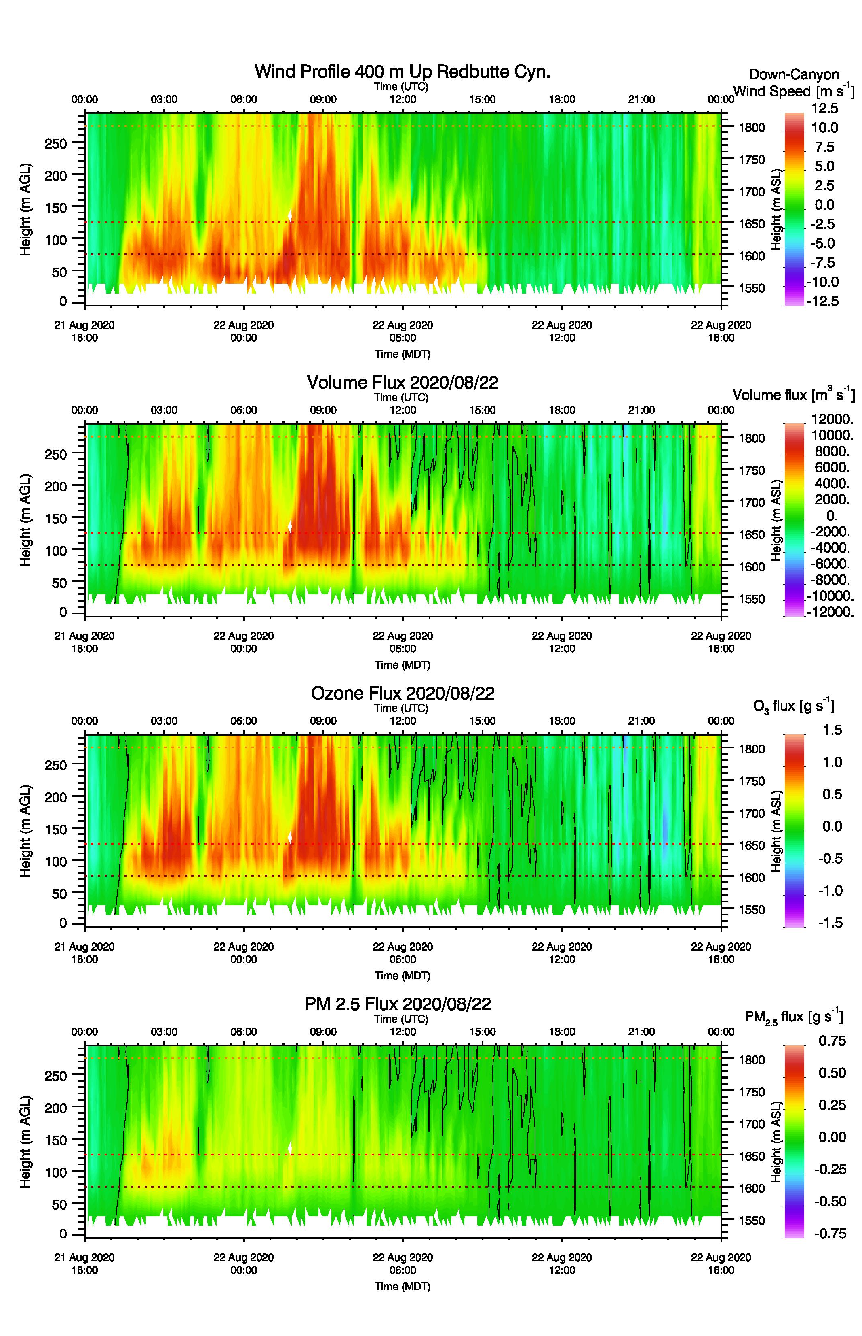
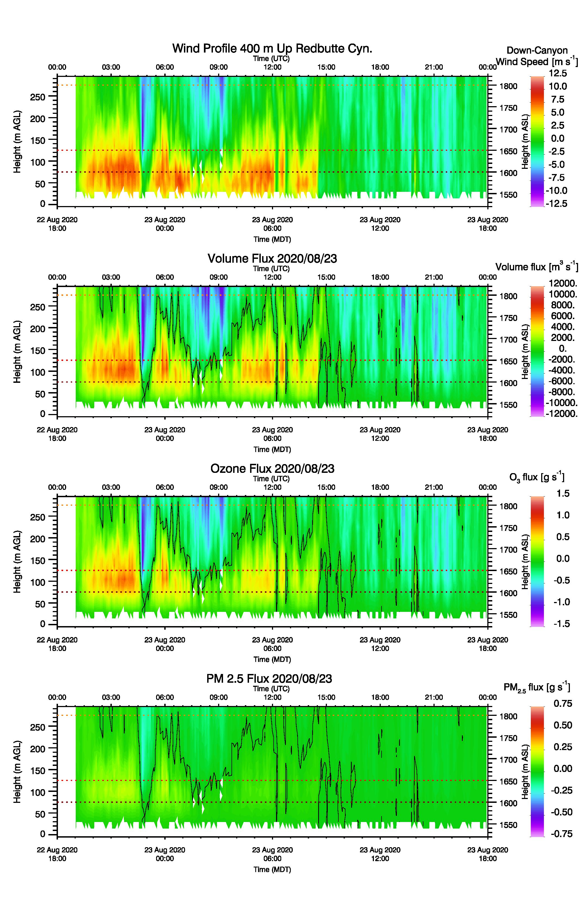
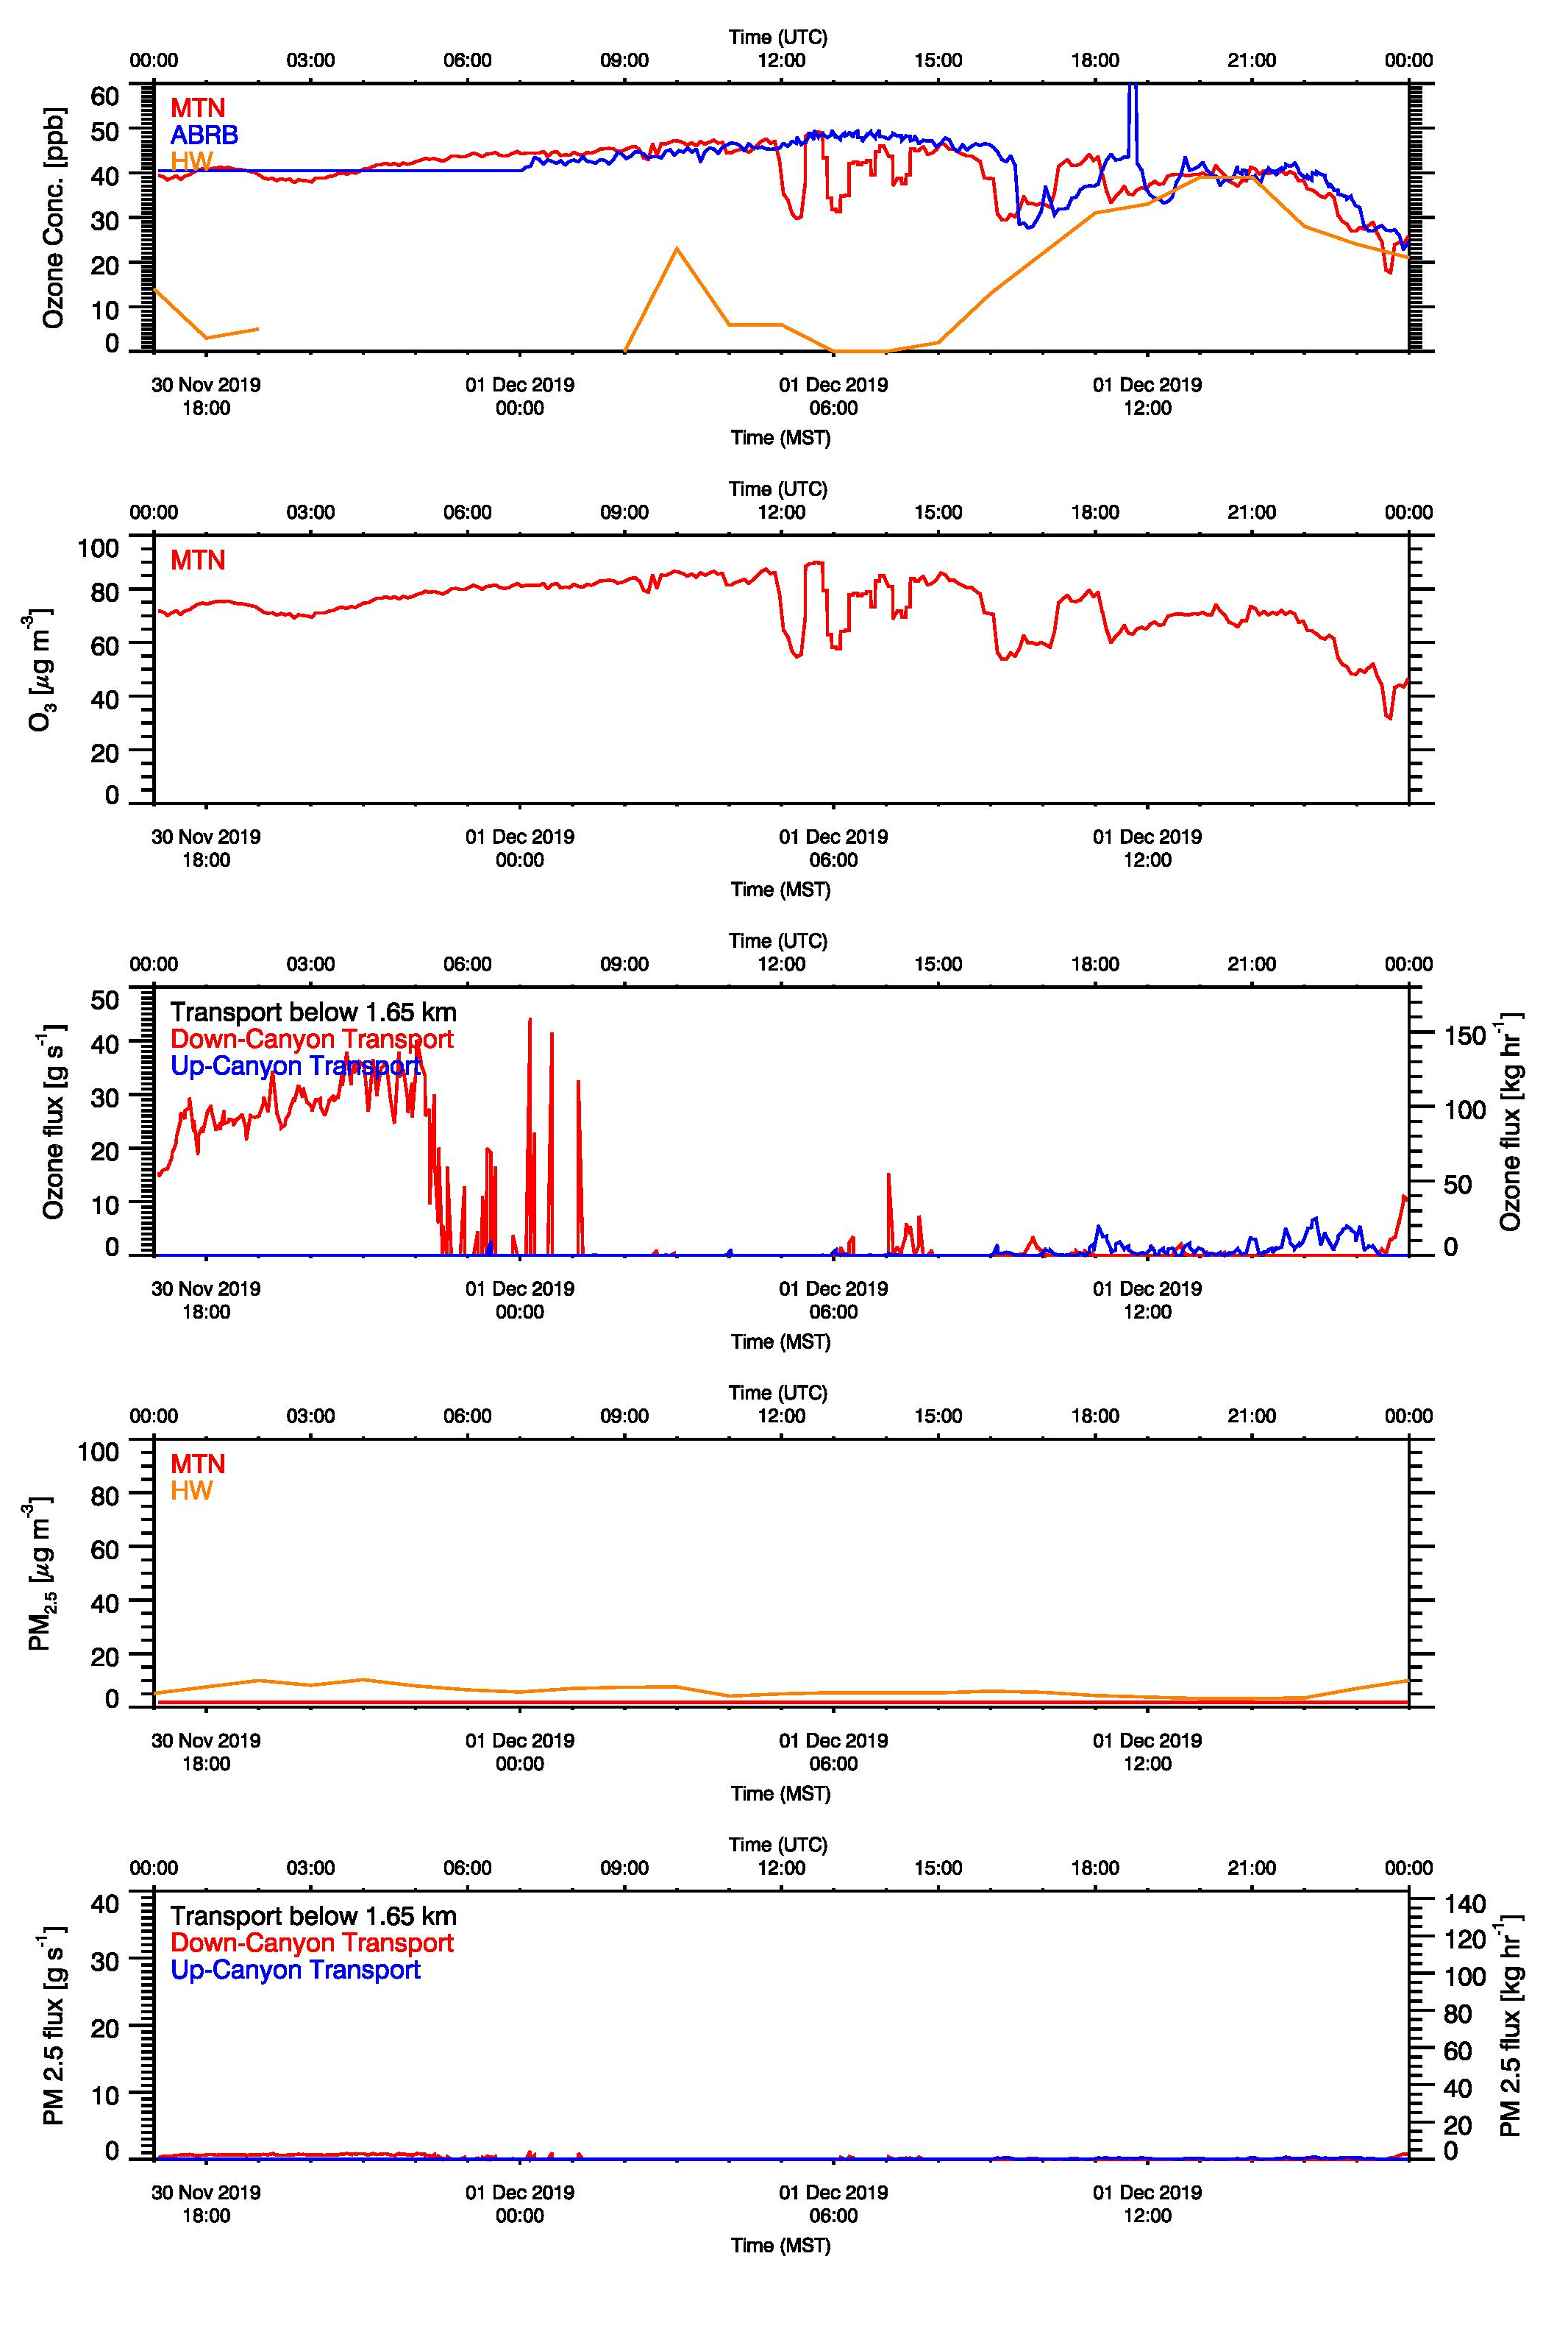
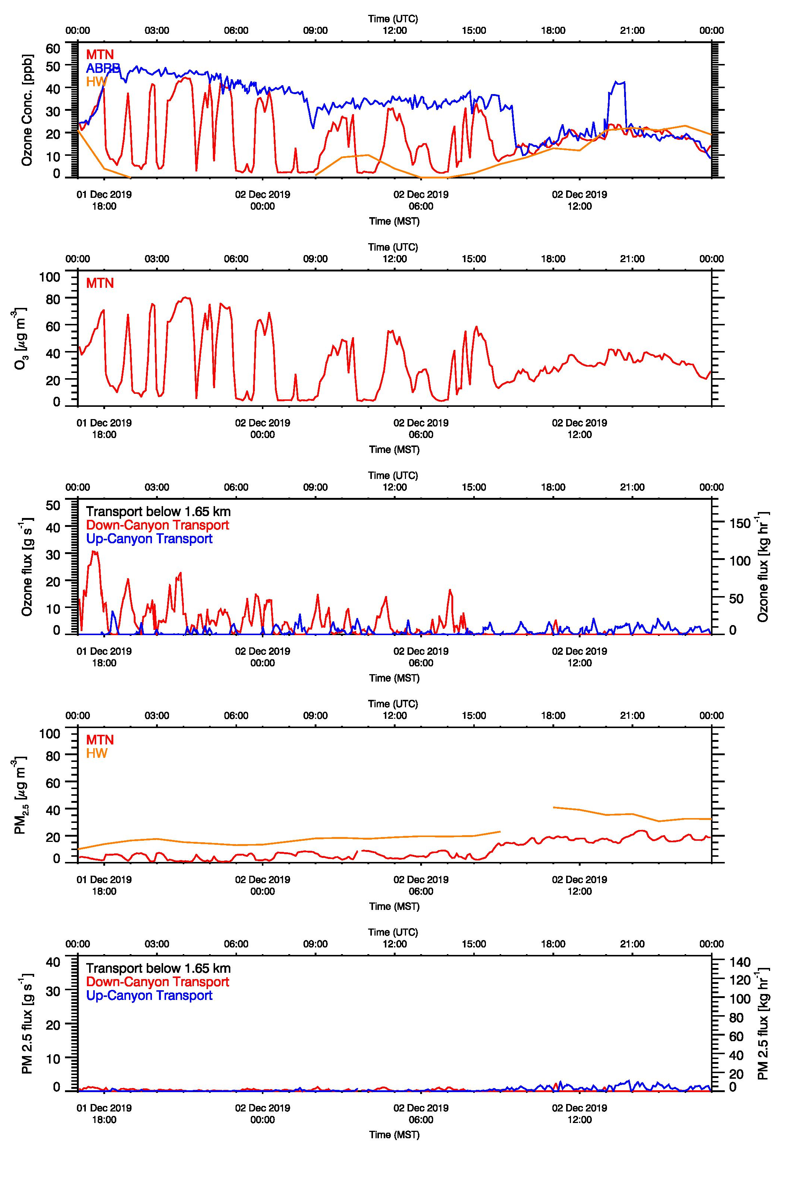
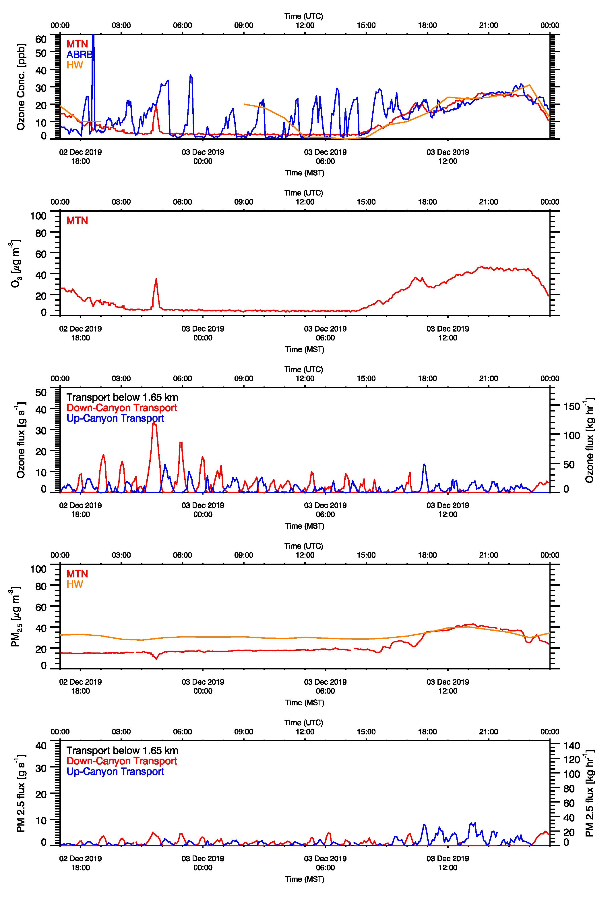
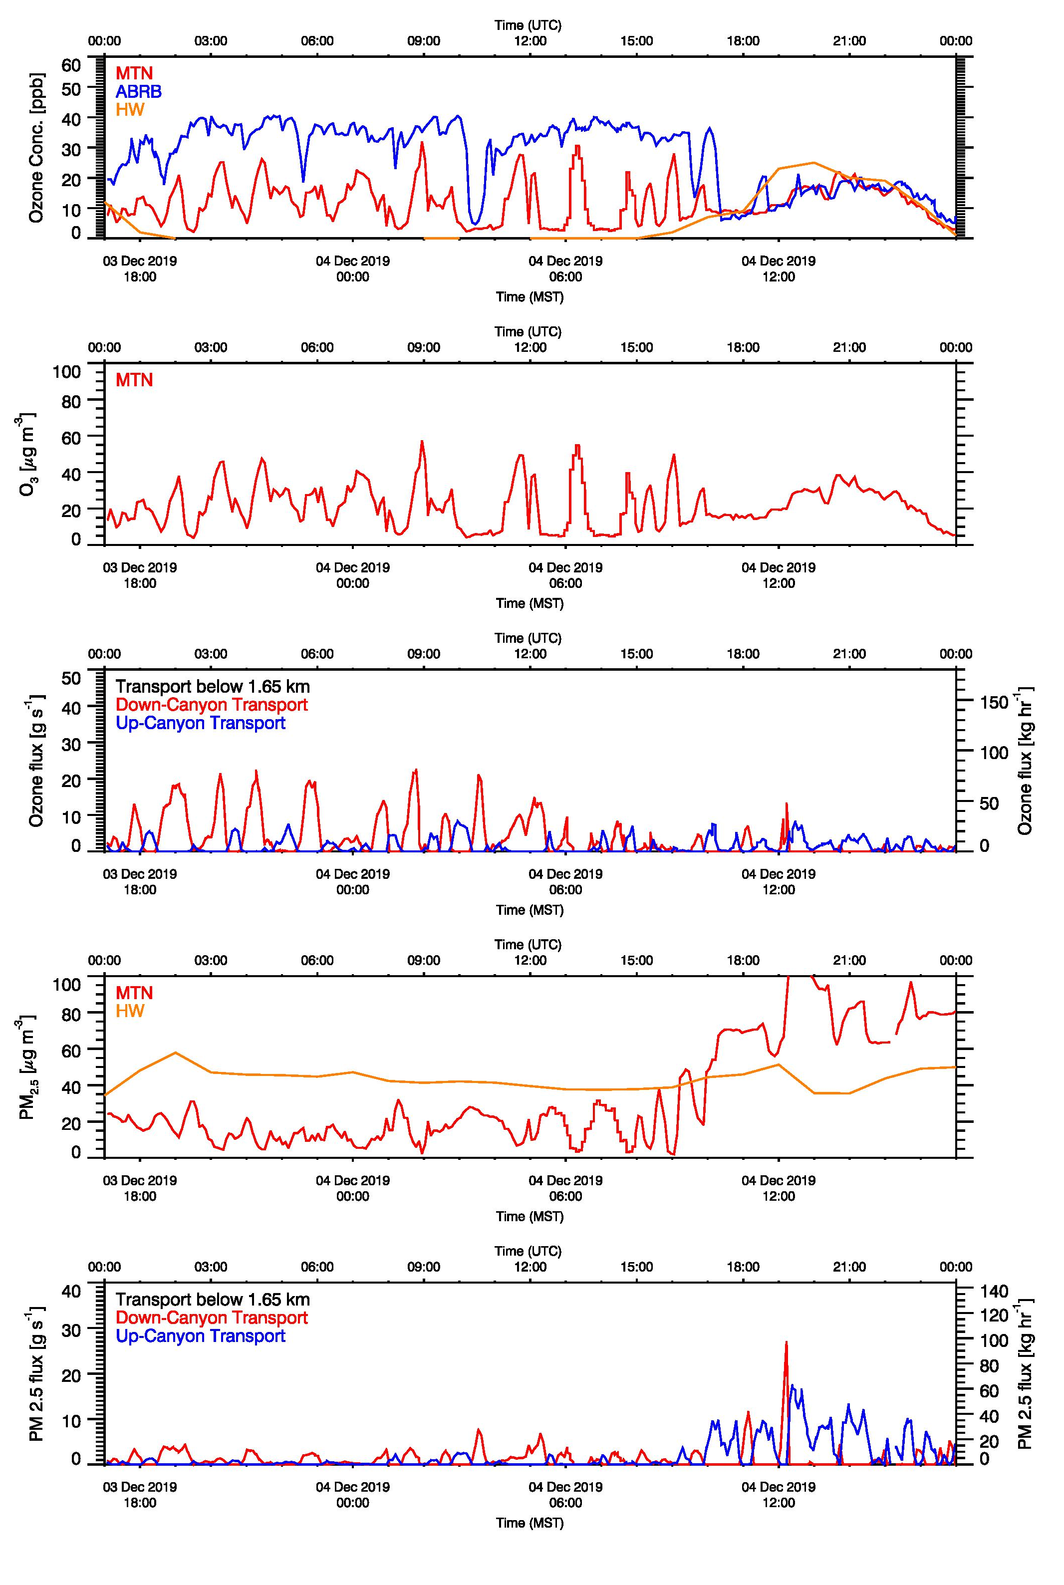
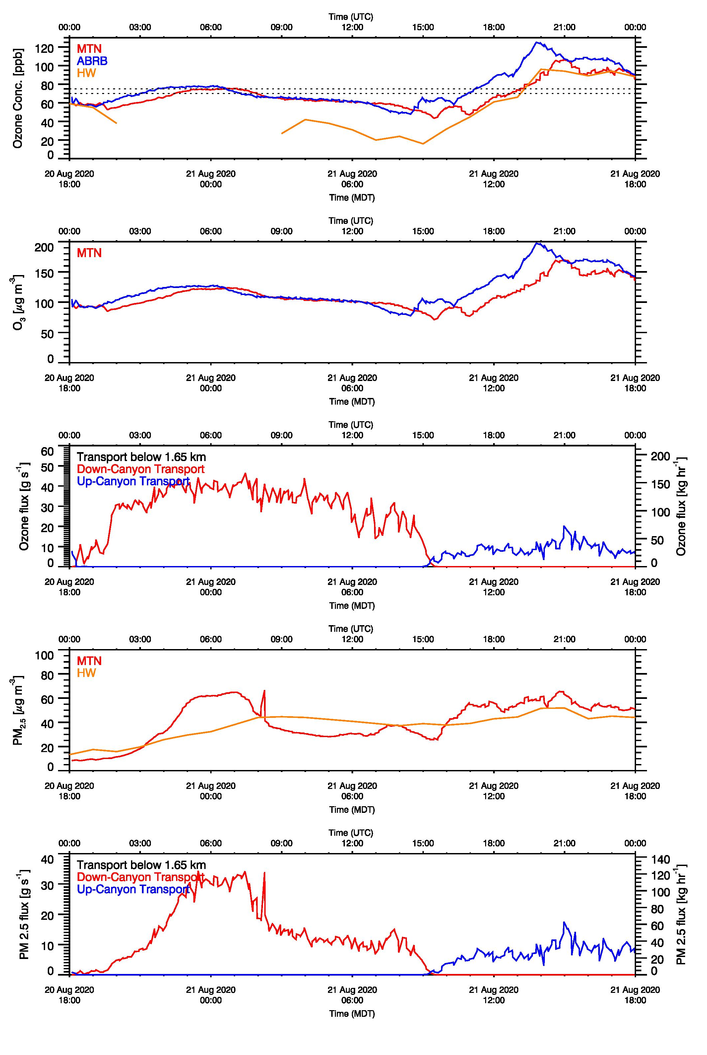
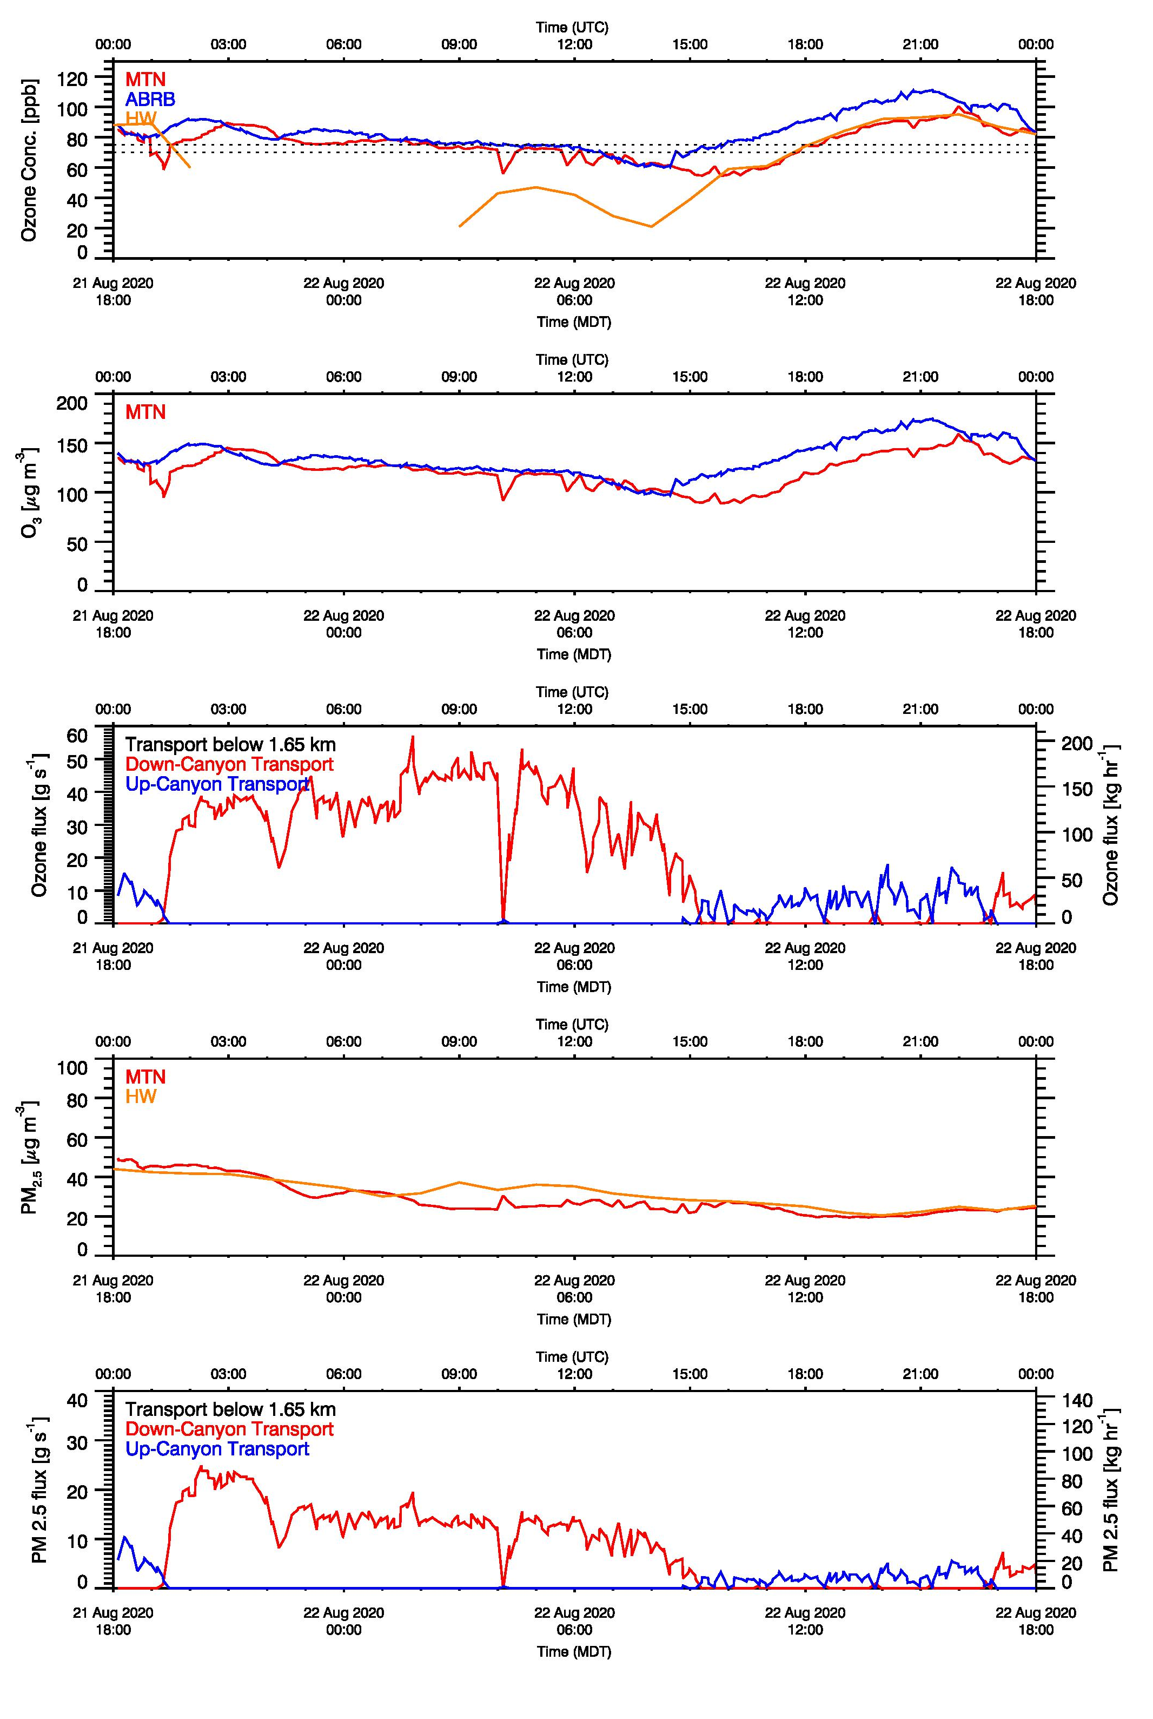
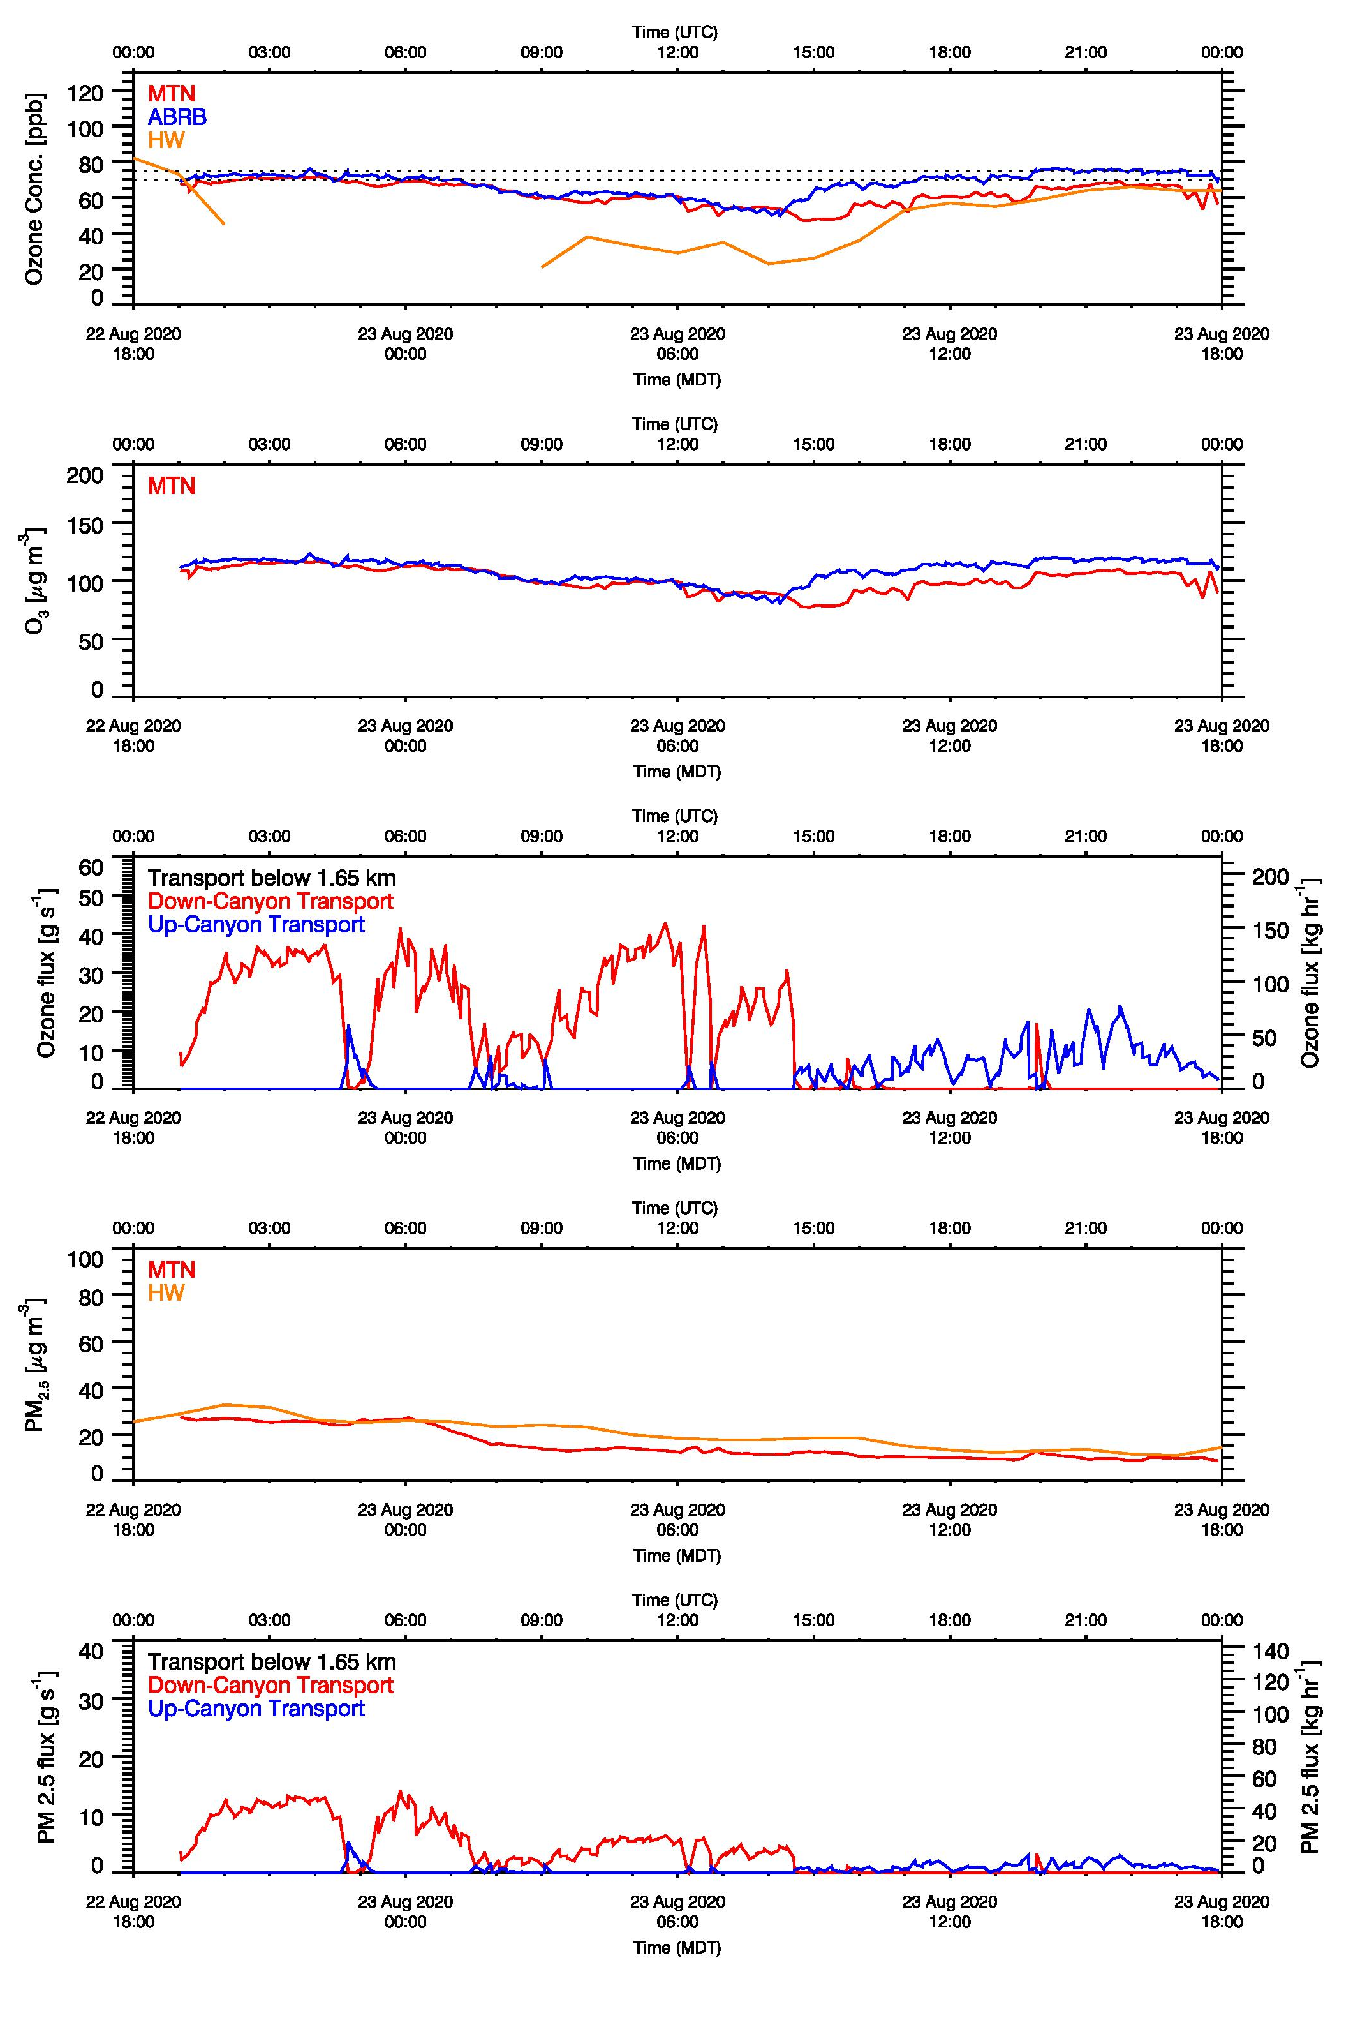

PM_{2.5} and Ozone Transport Through a Salt Lake Valley Tributary Canyon
Sebastian W. Hoch
University of Utah
2022 Air Quality: Science for Solutions
Introduction
The Salt Lake Valley and other populated topographic basins in northern Utah experience episodes of both wintertime (secondary) particulate pollution and high summertime ozone. High summertime concentrations of PM_{2.5} due to wildfire smoke have also been observed in recent years. In order to better understand meteorological transport processes and their impact on the basin budget of pollutants and pollutant precursors, a better quantitative evaluation of these exchange processes is needed.
1- 4 December 2019 Case Study
A persistent cold-air pool (PCAP) developed in early December 2019, and the 24-hr NAAQS for PM_{2.5} was exceeded 4 Dec. 2019. The LiDAR scans were very frequent but only to elevation angles of 17 degrees, which limited the depth of the flow layer that could be investigated. And example scan is shown in Fig. 4.
21-22 August 2020 Case Study
In mid/late August 2020, northern Utah was inundated by wildfire smoke while also suffering from high surface ozone concentrations. An adjusted RHI elevation angle allowed for the analysis incorporating deeper flow layers through the Red Butte Canyon drainage (Fig 5).
The Red Butte Canyon Pollution Transport Study
The Red Butte Canyon Air Mass Exchange and Pollution Transport Study, funded by the Utah Department of Environmental Quality, initially targeted observation only in the 2019-2020 winter season. Due to the pandemic it was extended through fall 2021. Goal of the study was to develop an observational strategy to quantify the mass transport of pollutants such as ozone (O₃) and fine particulate matter (PM_{2.5}) through Red Butte Canyon, a representative canyon on the northeastern side of the Salt Lake Valley.
Methodology
The University of Utah Doppler Wind LiDAR was deployed on a rooftop with a clear line-of-sight into the lower section of Red Butte Canyon, and programmed to regularly scan Range-Height-Indicator (RHI) scans into the valley cross section. Vertical wind profile estimates derived from these scans were combined with valley cross sections areas calculated from a digital elevation model (Fig. 3) to derive volume fluxes up and down the tributary canyon. These volume fluxes were then combined with nearby observations of ozone and PM_{2.5} concentrations to estimate mass transport of these pollutants.
Results
While data from almost two years are available, we here present two case studies for:
The wintertime particulate pollution episode of 1-4 December 2019
The 21-23 August 2020 summertime episode combining high-ozone and high PM_{2.5}
Figures below show time-height cross sections of the wind field, volume fluxes, ozone and PM_{2.5} mass transport, as well as time series of near-surface pollutants and of height-integrated transport.
a) b)
a) b)
Fig. 1: Main observational sites: UU Mountain Meteorology Laboratory (MTMET), the UU Lidar site, and the Red Butte Canyon Network site above Red Butte Reservoir (ABRB).
Fig. 4: a) Example RHI scan (17 deg maximum elevation angle) from 18:55 MST 3 Dec 2019, and b) derived wind profiles at the different distances up the canyon.
Fig. 5: a) RHI scan (180 deg maximum elevation angle) from 00:46 MDT 21 Aug 2020, and b) derived wind profiles at the different distances up the canyon.
Key Findings:
Derived volume fluxes show a weakening of the thermally-driven down-canyon flows after the initial night. These flows are injecting ozone as a potential oxidant into the ozone-depleted cold-air pool at a rate of more than 100 kg per hour.
As the cold-air pool deepens – reaching the height of MTMET on 3 Dec. and ABRB on 4 Dec. - a sloshing motion in and out of the Red Butte drainage replaces the typical transition from nighttime down-valley to daytime up-valley circulations. These motions lead to remarkable counter-correlating concentrations of PM_{2.5} and ozone at MTMET.
Key Findings:
Thermally-driven canyon flows dominated the flow field and pollution transport during the case study. When integrated to a height 1650 m MSL (~125 m depth), nighttime down-canyon ozone transport reached 150 kg/hour, daytime up-valley transport 50 kg/hour.
PM_{2.5} transport reached values of 100 kg/hour (down-valley).
Our dataset shows the complex implication of ozone and PM_{2.5} transport in complex terrain, but is not able to differentiate between transported and locally photochemically produced ozone.
Fig. 3: a) Map showing the locations of calculated valley cross section near the mouth of Red Butte Canyon; b) Area of cross section as a function of height at different scan distances up Red Butte Canyon. These calculations are used for volume flux estimates.
Fig. 2: UU LiDAR at the mouth of Red Butte Canyon.
1-4 December 2019
21-23 August 2020
Acknowledgments: Funding from the Utah Department of Environmental Quality
Discussions with Jackson Sponaugle and Niwde Rivera
Data From ABRB: Ryan Bares, Logan Mitchell, and David Eiriksson
Data from MTMET: John Horel and Erik Crosman
Contact: sebastian.hoch@utah.edu

