Slide 1
Winter Storm Fundamentals
Cool-Season Precipitation:
Fundamentals and Applications
Myoko Kogen, Japan (Photo: Jim Steenburgh)
Jim Steenburgh
Fulbright Visiting Professor of Natural Sciences
University of Innsbruck
Department of Atmospheric Sciences
University of Utah
jim.steenburgh@utah.edu

Slide 2
Learning Objectives
After this class you should
  Understand the processes that affect the depth and height of the transition zone, the height of the snow level, and the development of snow, ice pellets, freezing rain, or freezing drizzle
  Be able to apply top-down forecast approaches for predicting precipitation type
  Understand and apply key meteorological variables affecting the snow-to-liquid ratio during snowstorms

Slide 3
Cool-Season Precipitation Types

Slide 4
Ice Particles
Ice crystal – any one of the number of forms in which ice appears
Ice pellet – Transparent or translucent ice pellet less than 5 mm in diameter (sleet in the US)
Ice pellet aggregate – Individual ice particles linked or fused together
Stewart et al. (2015)

Slide 5
Ice Particles
Refrozen wet snow – partially melted snow that refroze
Sleet – In the US, this term refers to ice pellets
Snow – White or translucent ice crystals, chiefly in complex branch hexagonal form and often agglomerated into snowflakes
Snow pellet – White, opaque, approximately round (sometimes conical) ice particles having a snowlike structure, about 2-5 mm in diameter (a.k.a. graupel)
Stewart et al. (2015)

Slide 6
Ice Particle Examples
Ice Pellets (sleet)
Snow
Snow Pellet (Graupel)
http://photo.accuweather.com/photogallery/
details/photo/121228/Sleet+Macro
Steenburgh (2014)
Steenburgh (2014)

Slide 7
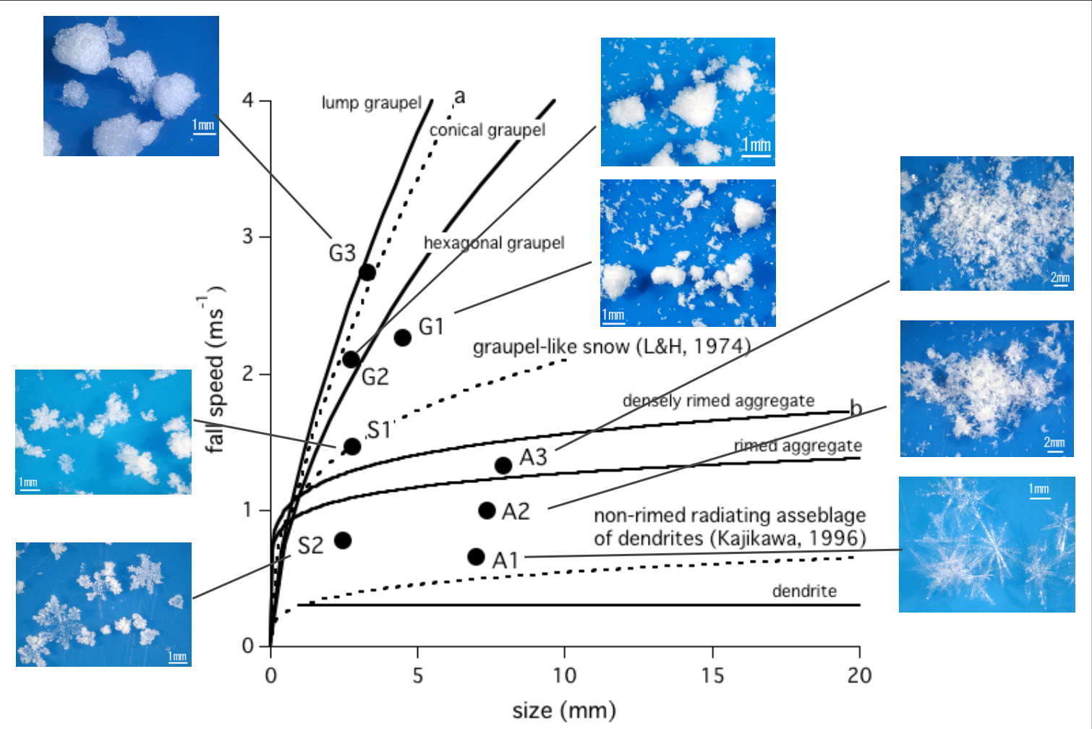
Type, Size, and Fall Speed
Courtesy Dr. Masaaki Ishizaka

Slide 8
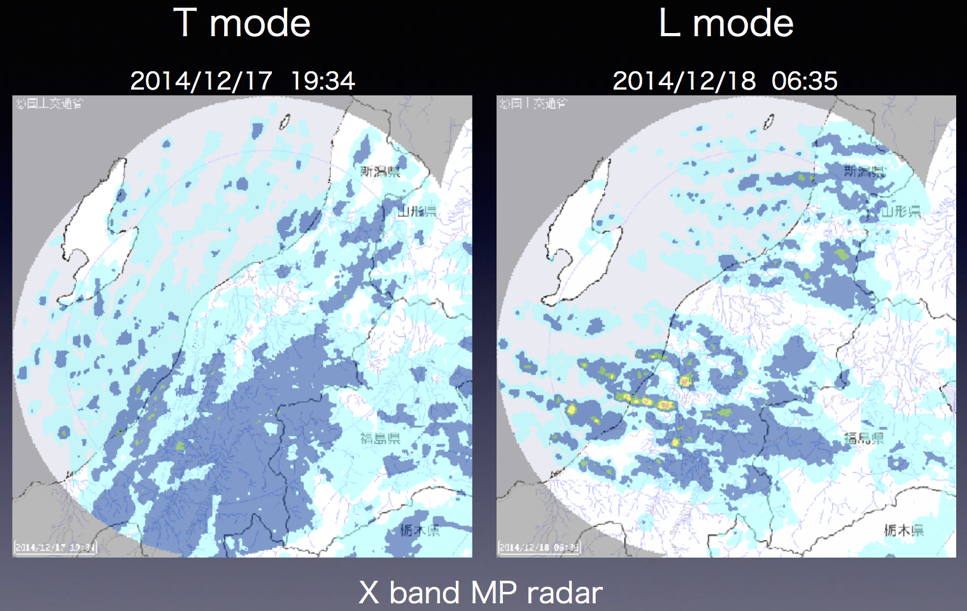
Example: Sea Effect of Japan
Courtesy Dr. Masaaki Ishizaka

Slide 9
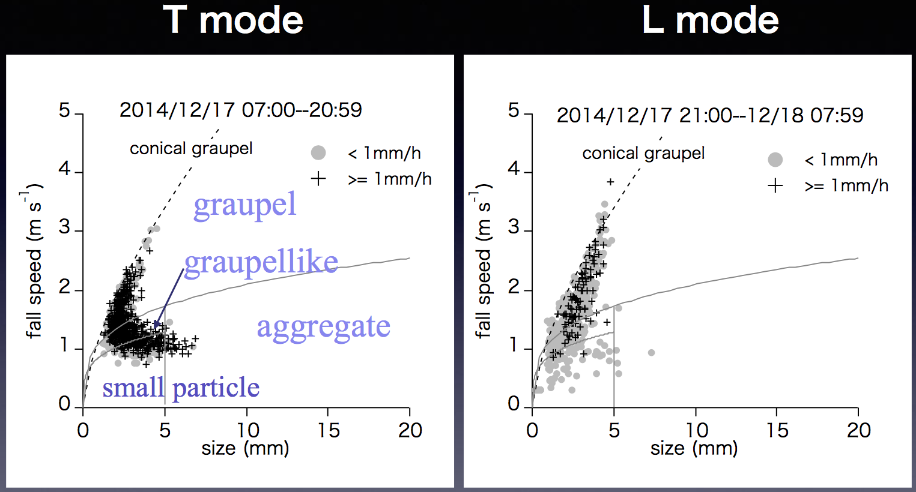
Example: Sea Effect of Japan
Courtesy Dr. Masaaki Ishizaka

Slide 10
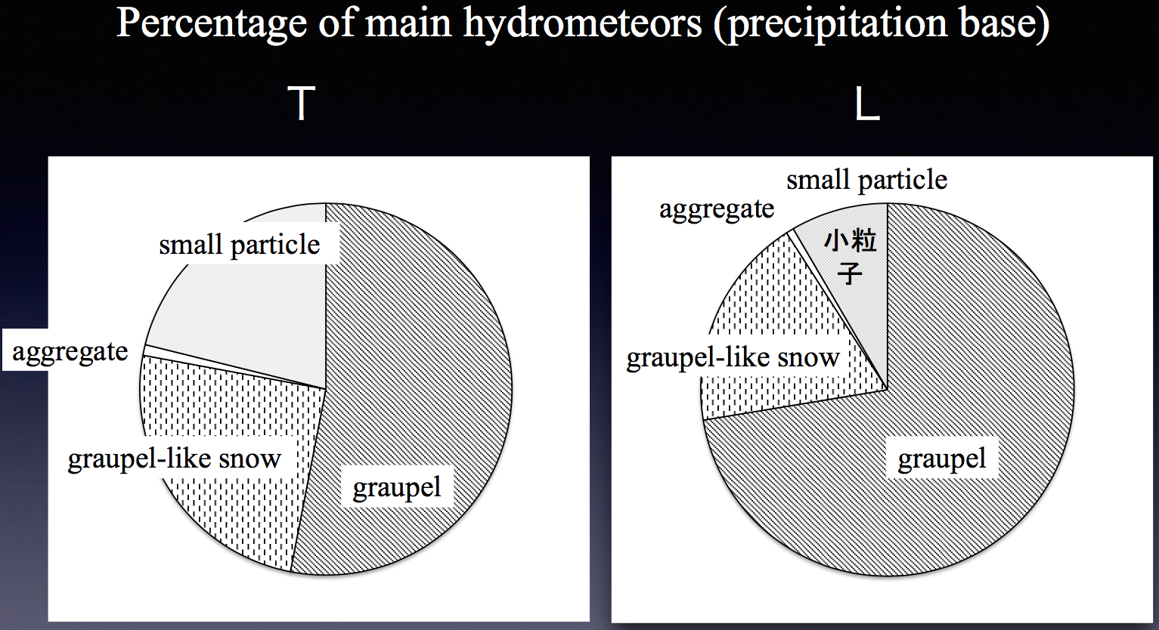
Example: Sea Effect of Japan
Courtesy Dr. Masaaki Ishizaka

Slide 11
Mixed-Phase Particles
Wet snow – Snow that contains a great deal of liquid water
Semimelted snow pellet – Snow pellet that has undergone some melting
Liquid core pellet – Partially refrozen particle with ice shell and liquid water core
Almost melted particle – Precipitation composed mainly of liquid water, but with some ice and the shape not discernible
Typically fall speeds increase as particles melt
Stewart et al. (2015)

Slide 12
Liquid Particles
Drizzle – Very small, numerous, and uniformly distributed water drops with diameters < 0.5 mm
Freezing drizzle – Drizzle that falls in liquid form but freezes on impact to form a coating of glaze
Freezing rain – Rain that falls in liquid for, but freezes on impact to form a coating of glaze
Rain – Precipitation in the form of liquid water with diameters > 0.5 mm or, if widely scattered, drops may be smaller
Supercooled rain – Liquid precipitation at temperatures below freezing
Typical fall speeds for drizzle ~2m/s; freezing rain, rain, or supercooled rain ~7–9 m/s
Stewart et al. (2015)

Slide 13
Rain-Snow Transition Zone

Slide 14
The Rain-Snow Transition Zone
A region where falling snow is warming, melting, and becoming rain
May be identified horizontally or quasi horizontally where it intersects the surface, or vertically in soundings or mountainous regions
Becomes a more complex precipitation type transition zone if there are warm layers > 0˚C, which can lead to freezing rain or ice pellets
Z
*
= Snow
= “Slush”
⦿
●
= Rain
* * * *
Freezing level
* * * *
Transition
Zone
* * * *
* *
⦿
⦿
Snow level
● ●
⦿
⦿
0ºC
T

Slide 15
The Rain-Snow Transition Zone
Freezing level
  Glossary of Meteorology: Lowest altitude at which the air temperature is 0˚C
  Practical consideration: Critical to also know the highest altitude at which the air temperature is 0˚C
  Common in aviation to report multiple freezing levels to the highest altitude at which the air temperature is 0˚C
Z
*
= Snow
= “Slush”
⦿
●
= Rain
* * * *
Freezing level
* * * *
Transition
Zone
* * * *
* *
⦿
⦿
Snow level
● ●
⦿
⦿
0ºC
T

Slide 16
The Rain-Snow Transition Zone
Snow level
  Glossary of Meteorology: No definition provided
  Common: Altitude above which snow is accumulating on the ground
  White et al. (2011): Altitude where falling snow melts to rain
  Minder et al. (2011): Level at which the precipitation mass is 50% ice
Z
*
= Snow
= “Slush”
⦿
●
= Rain
* * * *
Freezing level
* * * *
Transition
Zone
* * * *
* *
⦿
⦿
Snow level
● ●
⦿
⦿
0ºC
T

Slide 17
The Rain-Snow Transition Zone
Snow level
  Rule of thumb: ~300 meters below freezing level
  Reality: Varies depending on thermodynamic and humidity profile, as well as precipitation intensity
  As a first guess, some forecasters use the highest level at which the wet bulb temperature is 0.5˚C
  Typically lower over mountains than in free air upstream
Z
*
= Snow
= “Slush”
⦿
●
= Rain
* * * *
Freezing level
* * * *
Transition
Zone
* * * *
* *
⦿
⦿
Snow level
● ●
⦿
⦿
0ºC
T

Slide 18
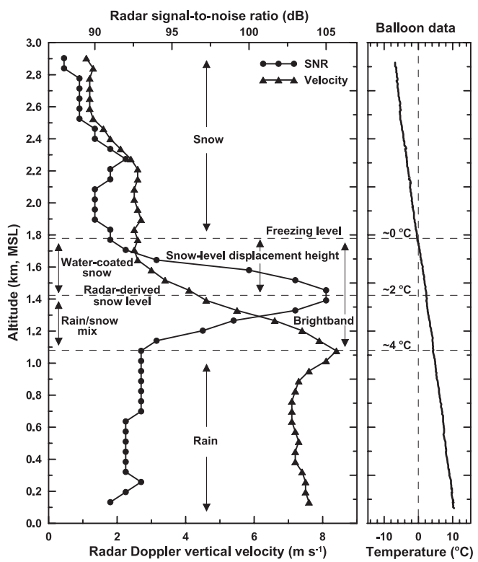
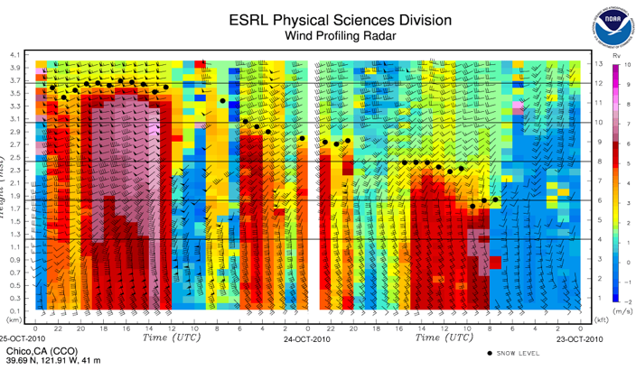
Profiling Radar Examples
NOAA/ESRL
White et al. (2011)

Slide 19
Diabatic Effects
Z
Z
0ºC
T
0ºC
T
Melting creates an isothermal layer
Increased precipitation rates deepen melting
layer and lower snow level
Evaporation results in temperatures
converging to wet bulb and lower freezing
and snow levels than indicated by solely
by temperature

Slide 20
Question
Isothermal layers at 0ºC are normally __________ over topography than over nearby flat regions
a) the same depth
b) shallower
c) deeper

Slide 21
Question
An increase in precipitation rate could _______ the height of the base of the transition region
a) raise
b) maintain
c) lower

Slide 22
Question
As one ascends the Seegrubenbahn through the transition region, which sequence best describes the change in precipitation particles with increasing altitude
a) snow, wet snow, slush, rain
b) rain, slush, wet snow, snow
c) slush, rain, snow, wet snow
d) rain, wet snow, slush, snow

Slide 23
Pathways to Freezing Drizzle (FZDZ), Freezing Rain (FZRA) and Ice Pellets (IP)

Slide 24
Pathways to FZDZ, FZRA, & IP
FZDZ: Warm-phase processes (no significant ice nucleation)
  Shallow cloud decks forming over arctic airmasses
  Cloud top temperatures > -10˚C
  Poor ice nucleation
FZRA: Deep moist layer and midlevel warm (>0ºC) layer
  Cold-air damming with overrunning
  Warm-frontal overrunning
  Cold pools and terrain-forced flows
IP: See FZRA, but add deeper/colder surface-based layer enabling refreeze before rain reaches ground
Rauber et al. (2000)

Slide 25
Example Temperature Profiles
Z
Z
Z
Cloud top
0ºC
T
0ºC
T
0ºC
T
Freezing Drizzle
Poor ice nucleation
+ warm-phase processes
Freezing Rain
Snow melts in >0˚C layer;
Rain doesn’t refreeze until
contacting ground or other objects
Sleet
Snow melts in >0˚C layer;
Rain refreezes before
reaching ground

Slide 26
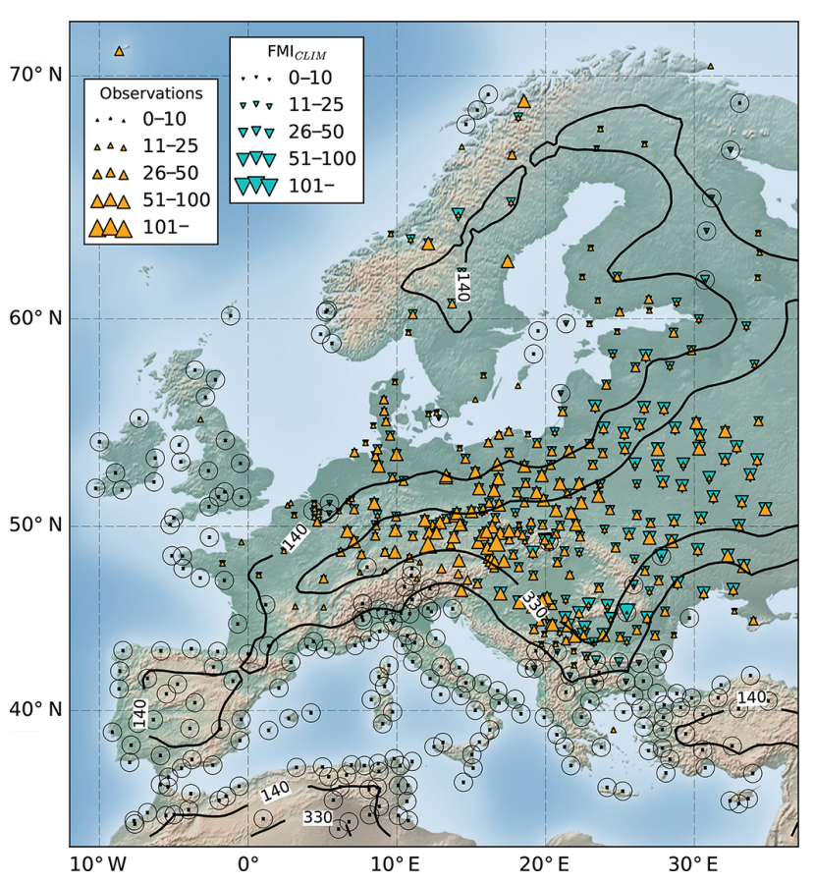
FRZA Climatology: Europe
Discussion: Where and why are freezing rain events most common in Europe
In plot
  Orange triangles = number of observed FZRA reports
  Circles = stations > 2000 m (omitted) or < 10 FZRA observations
  Contours – distance from coast
Kämäräinen et al. (2017)
Notes:
Orange triangles: Number of observations of freezing rain from SYNOP stations.
Cyan Triangles: Number of cases diagnosed by ERA-Interim
Contours: Distance from coast
Circles: Stations omitted from analysis due to elevation (>2000 m above sea level), < 10 FZRA observations.

Slide 27
FZRA Climatology
Discussion: In the continental US, why are freezing rain events most common:
  In the Columbia Basin
  In the north-central and northeast states?
  East of the southern Appalachian Mountains?
http://mcc.sws.uiuc.edu/living_wx/icestorms/index.html, https://www.reddit.com/r/MapPorn/

Slide 28
Transition Zone with Melting Layer Aloft
NOAA/NWS

Slide 29
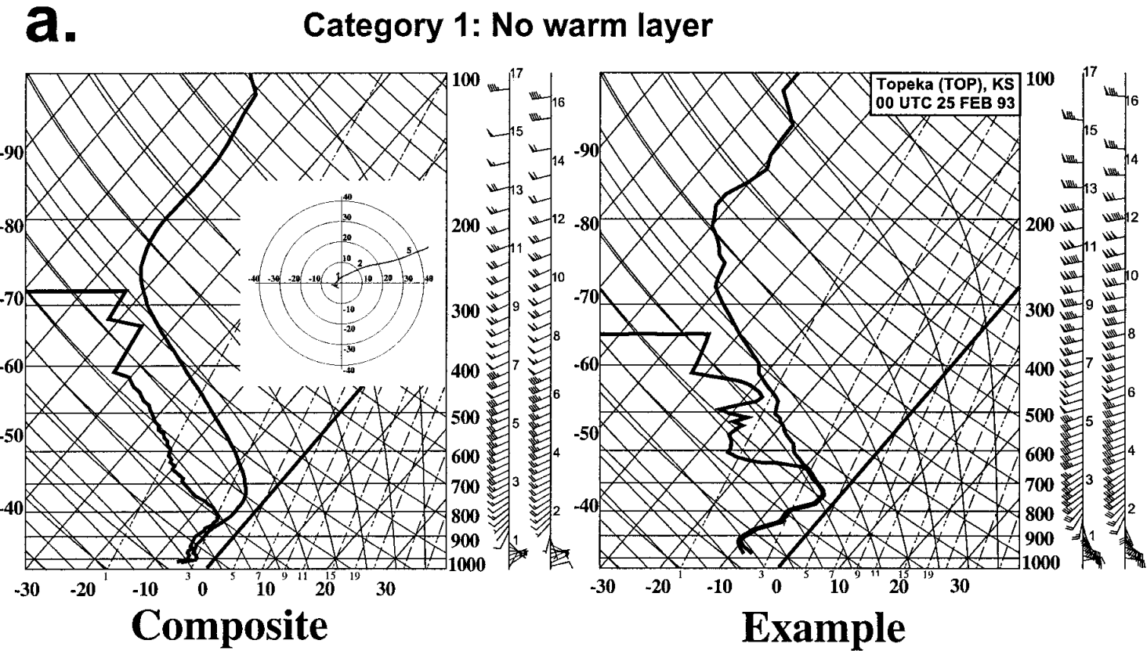

You Decide: FZDZ or FZRA?
95.4% Freezing Drizzle
4.6% Freezing Rain
Warm rain processes dominate
Rauber et al. (2000)

Slide 30
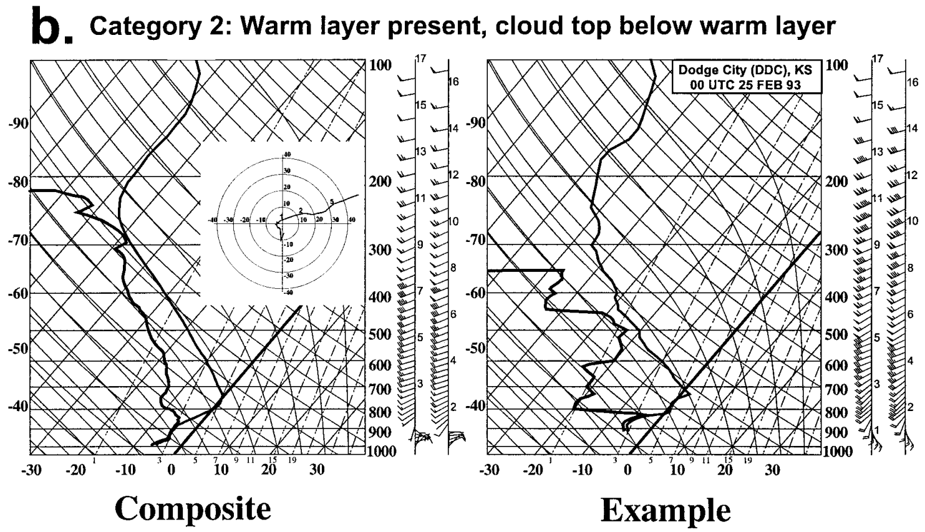
You Decide: FZDZ or FZRA?
83.8% Freezing Drizzle
16.2% Freezing Rain
Warm rain processes dominate
Rauber et al. (2000)

Slide 31
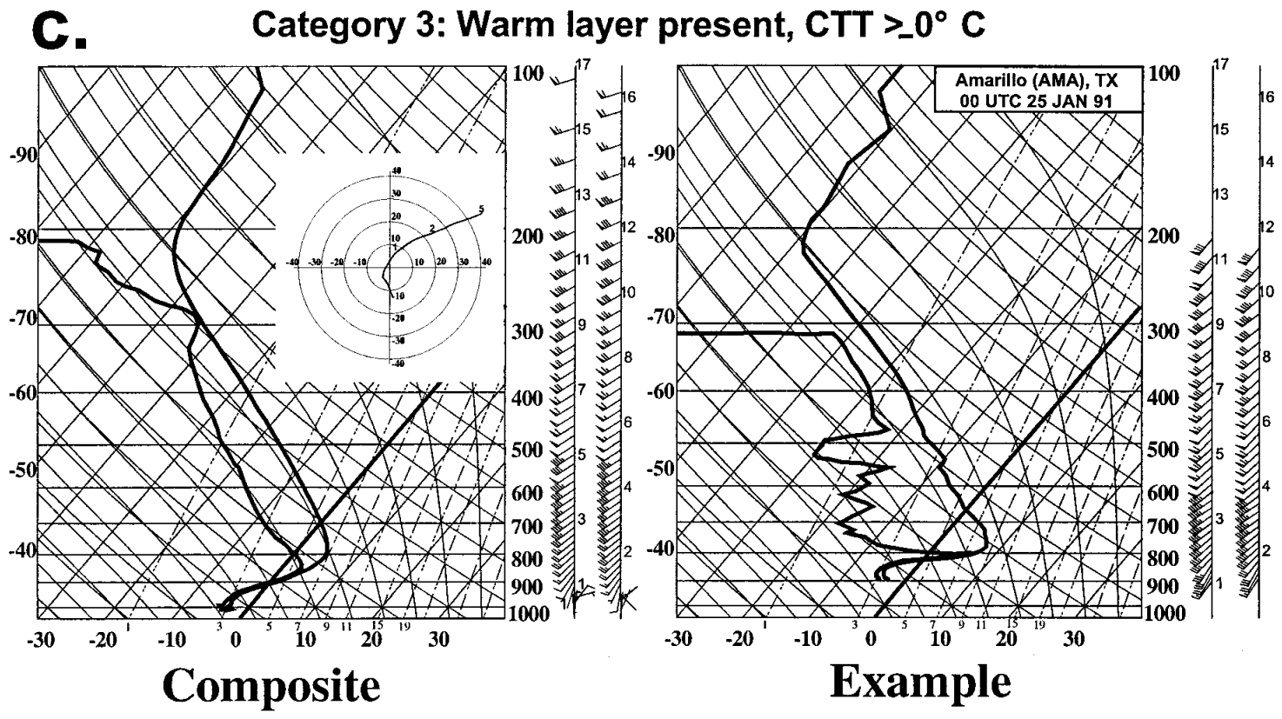
You Decide: FZDZ or FZRA?
72.3% Freezing Drizzle
27.7% Freezing Rain
Warm rain processes dominate
Rauber et al. (2000)

Slide 32
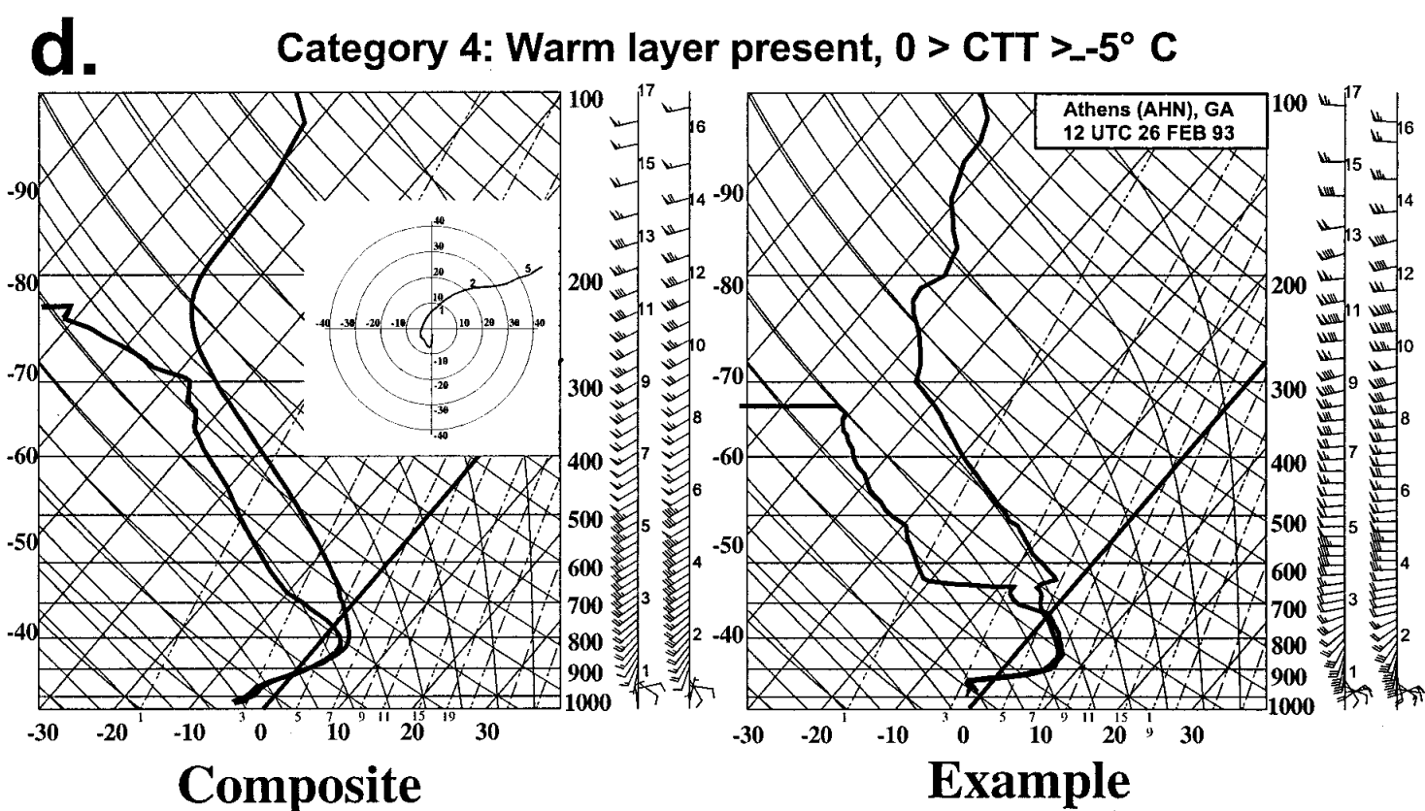
You Decide: FZDZ or FZRA?
62.4% Freezing Drizzle
37.6% Freezing Rain
Warm rain processes likely important
Rauber et al. (2000)

Slide 33
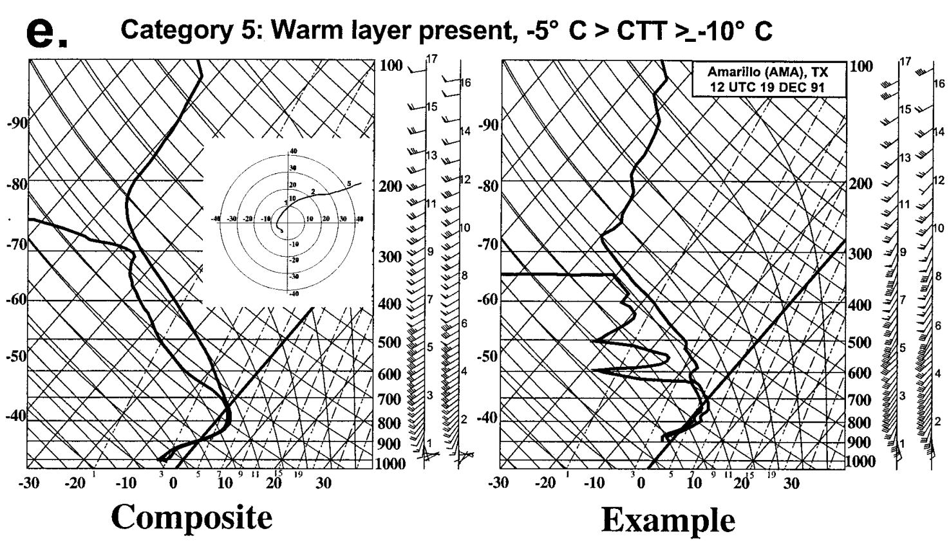
You Decide: FZDZ or FZRA?
53.1% Freezing Drizzle
46.8% Freezing Rain
Warm rain processes likely important in some cases,
ice particles falling into cloud from aloft possible
Rauber et al. (2000)

Slide 34
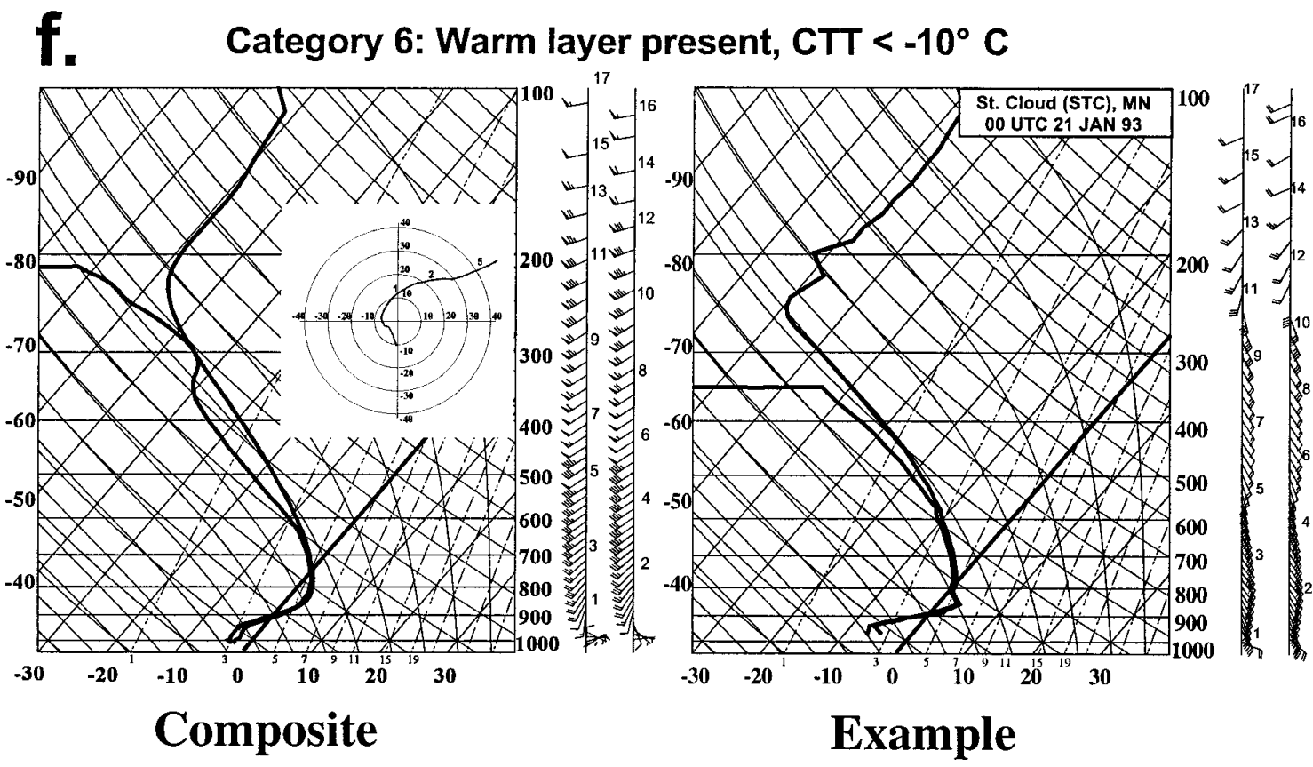
You Decide: FZDZ or FZRA?
21.5% Freezing Drizzle
78.5% Freezing Rain
Melting of snow from aloft likely dominates
Rauber et al. (2000)

Slide 35
Top Down Forecasting
A way to assess what hydrometeors will form and their evolution as they fall to the surface
Frequently based on model or observed soundings
Start at cloud top
  Mixed phase or warm phase processes?
    CTT ~ -4˚C: Little or no ice
    CTT ~ -10˚C: Commonly used cutoff temp for warm phase
  Beware of seeder-feeder from higher clouds
NWSFO, Louisville, KY

Slide 36
Top Down Forecasting
Diagnose potential for melting and freezing during fallout
  Melting in warm layer?
  Freezing in near-surface sub-freezing layer?
  Consider diabatic effects (melting, evaporation)
What precipitation will occur at the surface
  Snow, FZRA, FZDZ, IP?
NWSFO, Louisville, KY

Slide 37
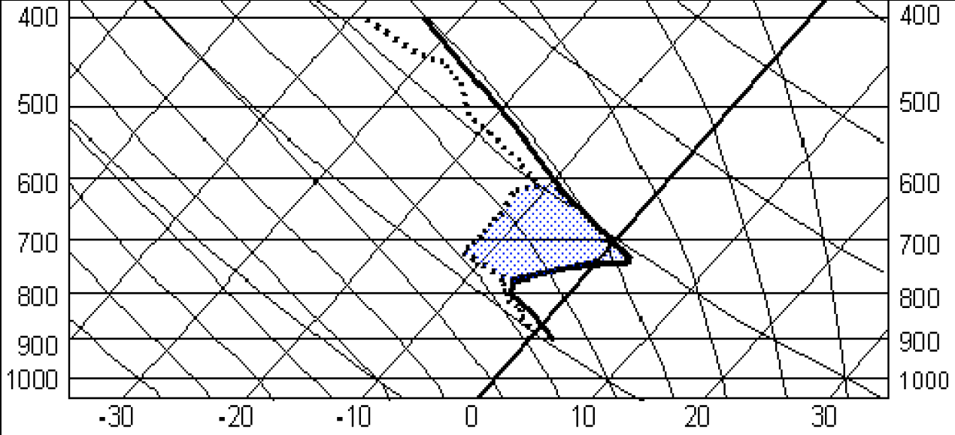
You Decide: SN, FZDZ, FZRA, or IP?
NWSFO, Louisville, KY
Notes:
Wet snow, since wet bulb is below freezing and near-surface layer is shallow and just a bit above freezing. Might be close to rain at surface.

Slide 38
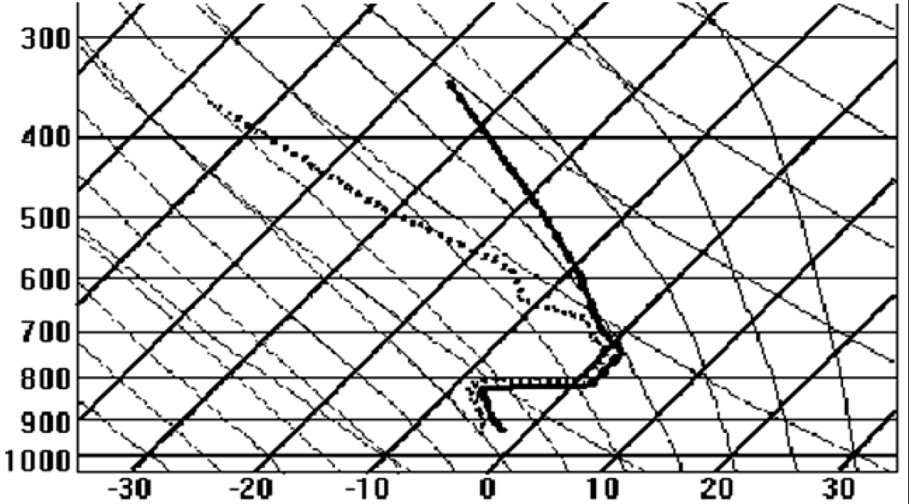
You Decide: SN, FZDZ, FZRA, or IP?
NWSFO, Louisville, KY
Notes:
CTT temps are quite warm. Probably freezing drizzle, light freezing rain, or light sleet

Slide 39
You Decide: SN, FZDZ, FZRA, or IP?
What if elevated convection develops?
NWSFO, Louisville, KY
Notes:
Note potential for this in sounding. Then transition to snow, possibly heavy.

Slide 40
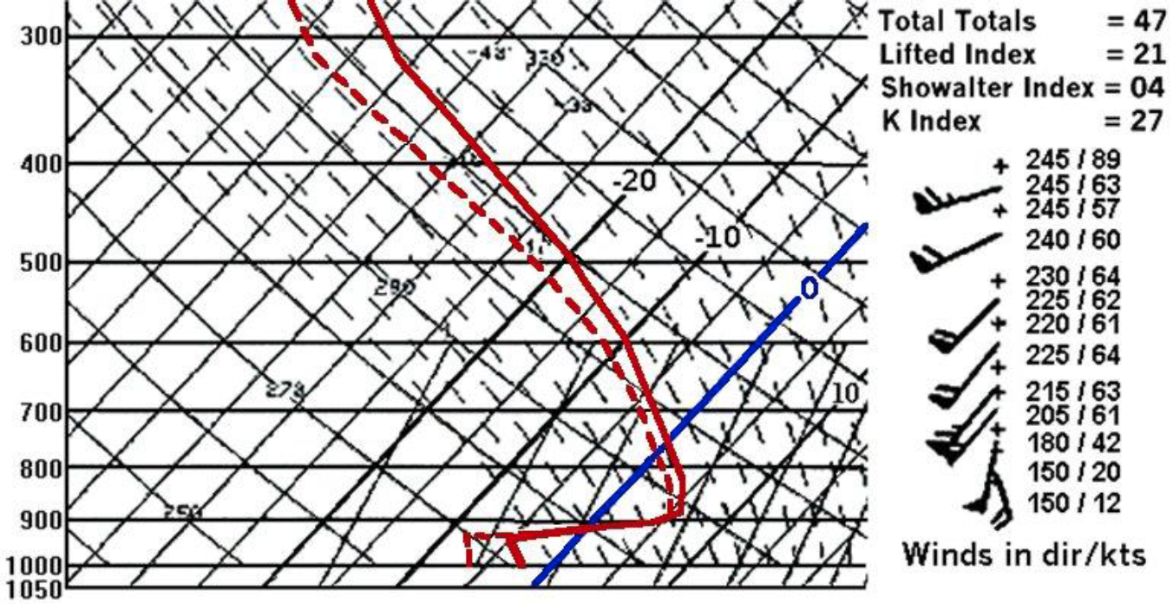
You Decide: SN, FZDZ, FZRA, or IP?
NWSFO, Louisville, KY
Notes:
Freezing rain or sleet

Slide 41
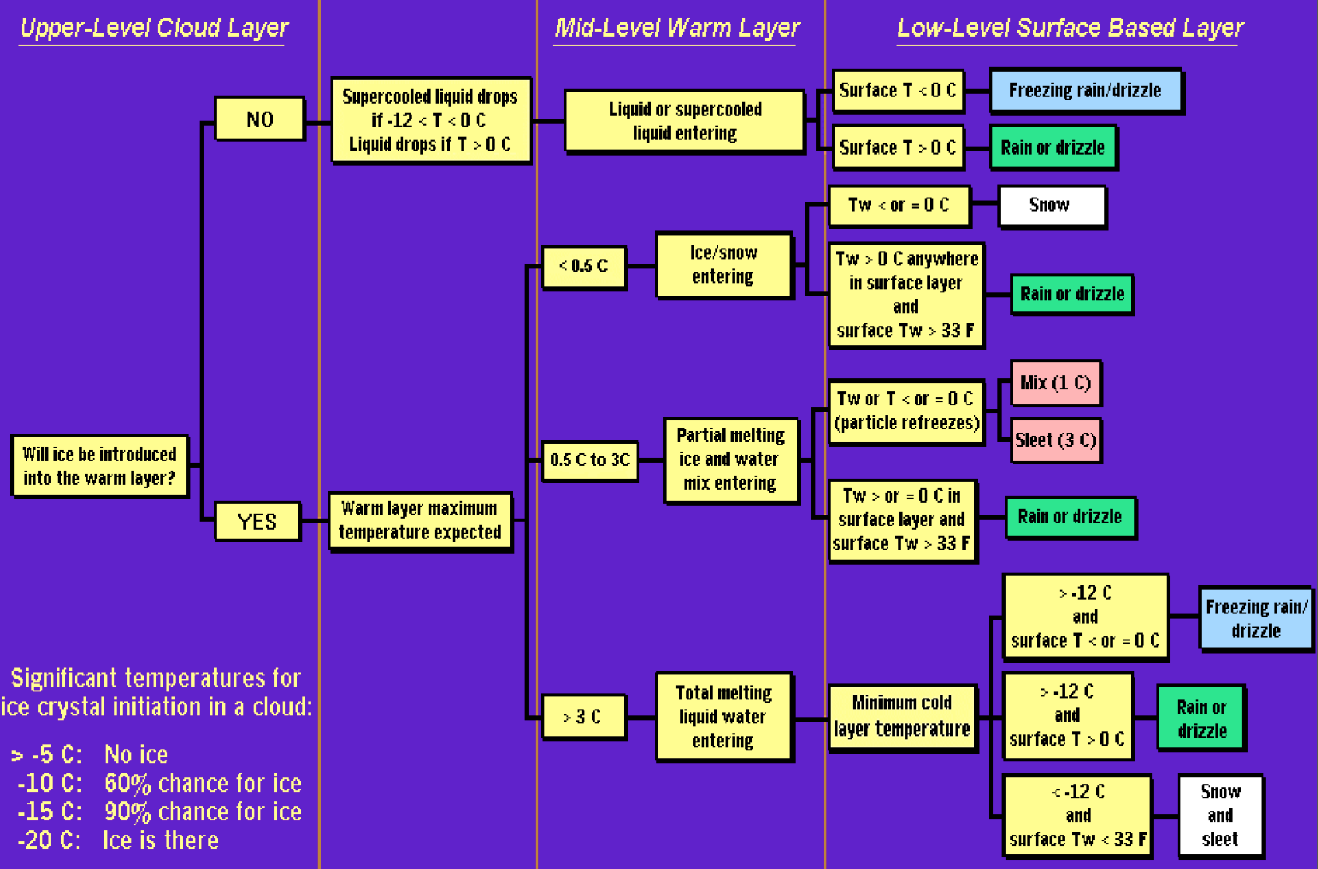
Top-Down Flowchart
NWSFO, Louisville, KY
Notes:
Freezing rain or sleet

Slide 42
Snow Levels in Mountainous Terrain

Slide 43
Questions
Compared to the free atmospheric upstream, the snow level over the mountains is usually
a) the same height
b) lower
c) higher
Why?

Slide 44
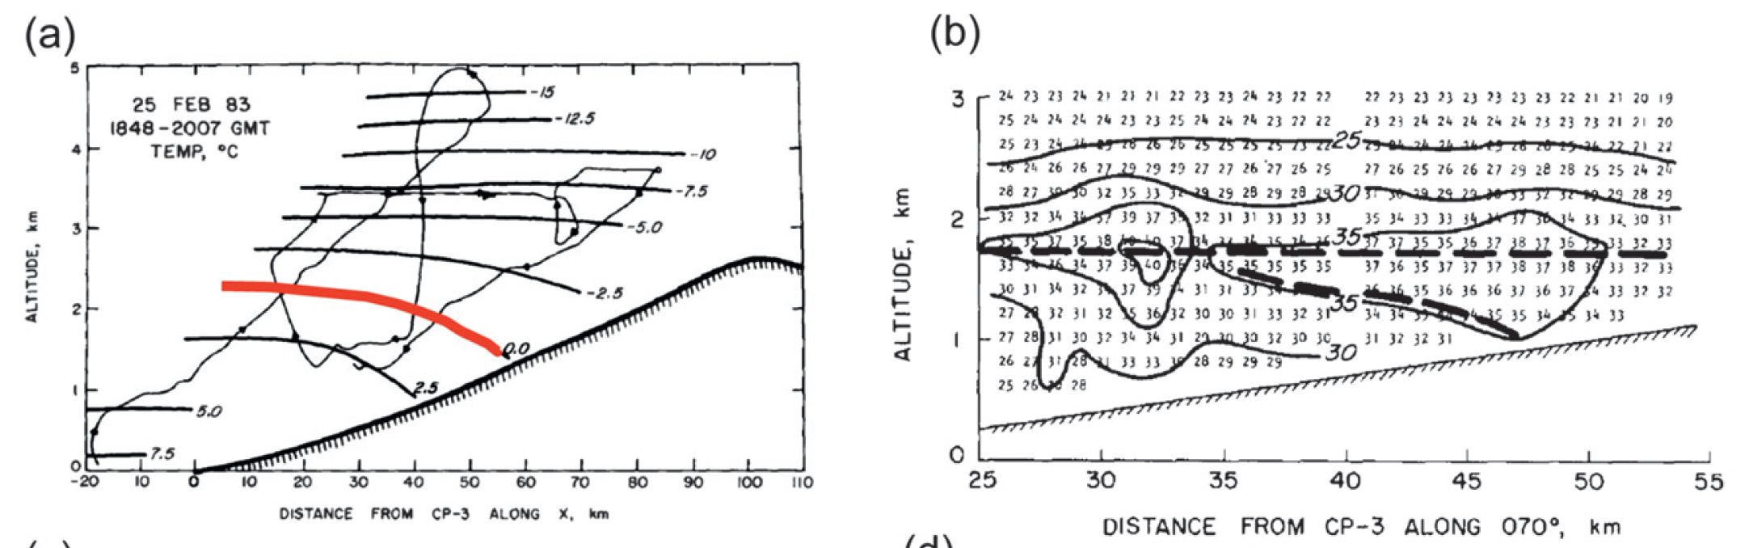
The Mountainside Snow Level
Compared to free air upstream, usually near mountains the
  Freezing level is lower
  Bright-band is deeper
  Snow level is lower
Marwitz (1983), Minder et al. (2011)

Slide 45
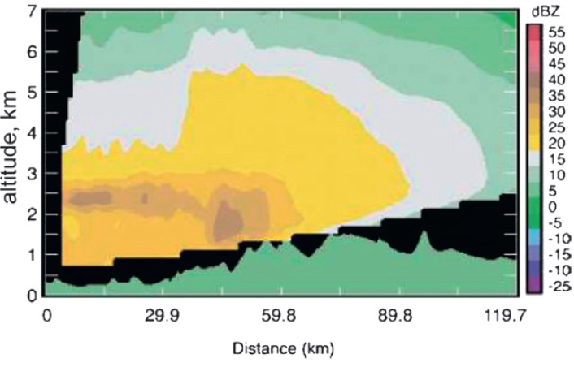
The Mountainside Snow Level
Compared to free air upstream, usually near mountains the
  Freezing level is lower
  Bright-band is deeper
  Snow level is lower
Medina et al. (2005), Minder et al. (2011)

Slide 46
Mechanisms
Latent cooling from melting precipitation
  More effective over mountains where ground limits depth of convective overturning
  Precipitation rates frequently higher over mountains
Microphysical melting distance
  Ice crystals over mountains comprised in a way that they take longer to melt (e.g., denser, more rimed)
Adiabatic cooling from forced ascent
Minder et al. (2011)

Slide 47
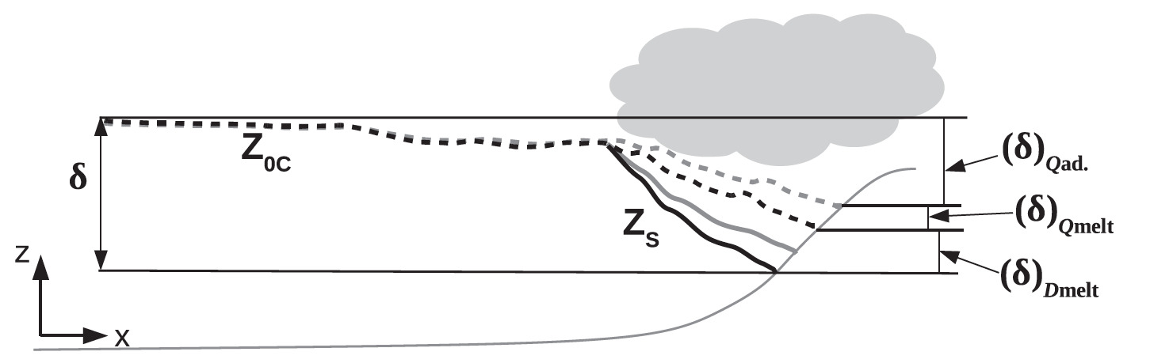
Idealized Modeling
Snow level from control
Freezing level from control
Snow level from simulation without latent cooling
Freezing level from simulation without latent cooling
Each of these mechanisms makes important contributions
(δ)_{Qad} = Change in snow level from adiabatic cooling
(δ)_{Qmelt} = Change in snow level from latent cooling of precipitation
(δ)_{Dmelt} = Change in snow level from microphysical melting distance
Minder et al. (2011)

Slide 48
Additional Details from Modeling
Magnitude of snow level decrease depends on characteristics of incident flow and terrain geometry
Depression of snow level increases with increasing temperature
  Might act as a modest buffer for mountain hydroclimates against global warming
Results dependent on cloud microphysics parameterization
  An important source of uncertainty
Minder et al. (2011)

Slide 49
Snow-to-Liquid Ratio (SLR)

Slide 50
Definition
Snow-to-liquid ratio (SLR) = New snow depth / New snow water equivalent (SWE)
Related measures include snow density, water content, and specific gravity
  snow density = ρ_{water} / SLR
  water content (%) = 100/SLR
  specific gravity = 1/SLR (rarely used)

Slide 51
SLR vs. Related Measures
 | Heavy | Average | Light
SLR | 7:1 | 14:1 | 25:1
Snow density | 143 kg m⁻³ | 71 kg m⁻³ | 40 kg m⁻³
Water content | 14.3% | 7.1% | 4.0%
Snow character | “Sierra cement” | Utah average | “Champagne powder”
Low SLR
High Density
High SLR
Low Density

Slide 52
Why Is SLR Important?
Contemporary winter precipitation forecasting typically involves three steps:
  Quantitative precipitation forecast (QPF)
  Determination of precipitation type
  Application of SLR when precipitation type is snow
    Snowfall amount = QPF x SLR

Slide 53
Why Is SLR Important?
Snow clearing operations often based on specific amount thresholds, where perfect QPF is of limited value if a poor SLR is applied
In avalanche forecasting, SLR is related to snow shear strength (Casson 2008)
Accurate SLR and snowfall amount forecasts are critical for mountain communities

Slide 54
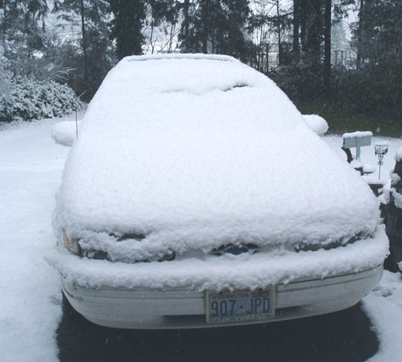
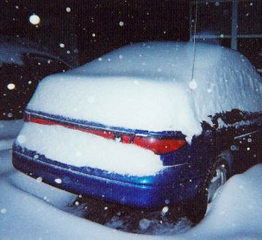
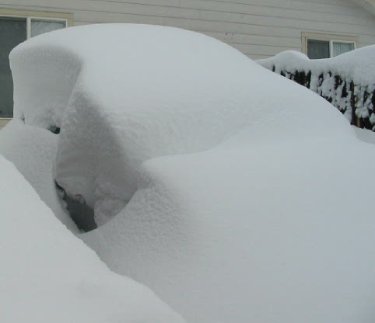
The Problem with SLR
Daily SLR varies considerably in both space and time within storms
Forecast snowfall amount strongly dependent on SLR
How much snow from a QPF of 25 mm?
3:1
10:1
30:1

Slide 55
Discussion: What Controls SLR?
Crystal type and size
Riming
Aggregation
Wind
Melting or sublimation (in atmosphere or at surface)
Vapor pressure gradient-driven metamorphosism and/or external compaction (i.e., settlement on the ground)

Slide 56
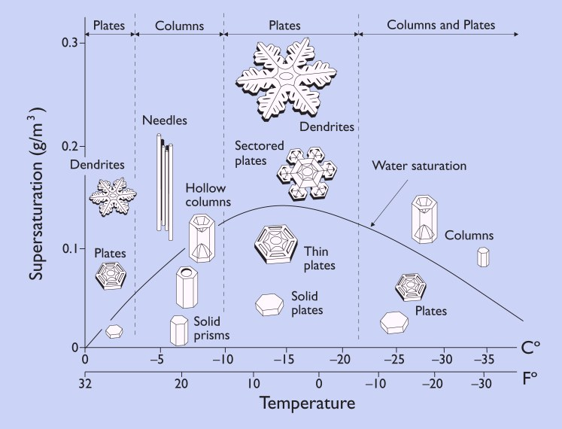
Crystal Type and SLR
25:1-100:1
15:1
20:1
12:1
12:1
10:1
10:1
10:1
Image: snowcrystals.com; SLR based on Power et. al. 1964, Dubé 2003, Cobb 2006

Slide 57
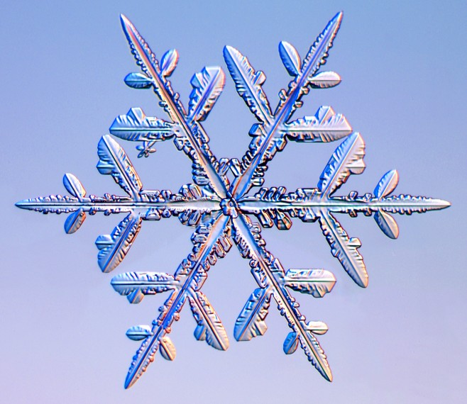
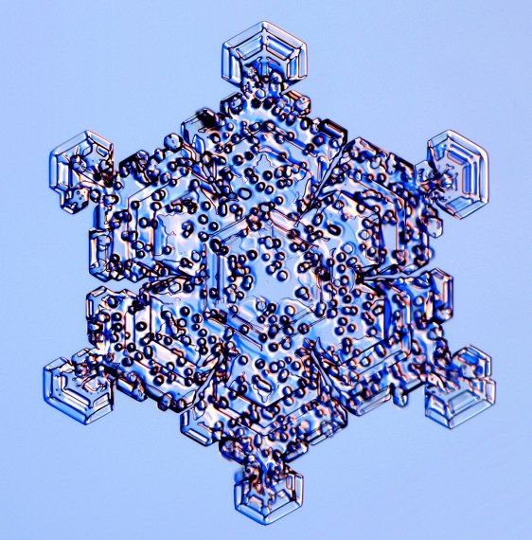
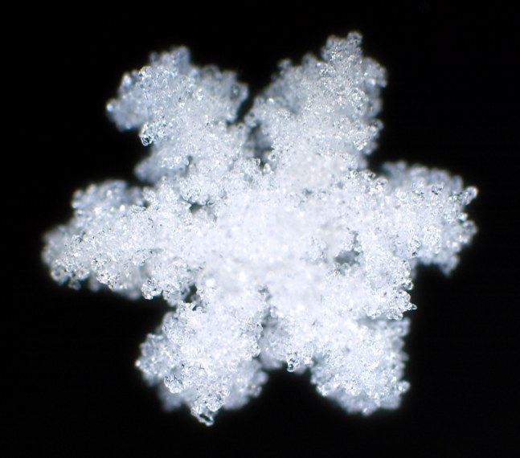
Riming and SLR
50:1
20:1
5:1
snowcrystals.com
Riming can decrease SLR by up to 90%.
Most important for temperatures above −10ºC; supercooled water more likely to be present
Tends to increase with vertical velocity

Slide 58
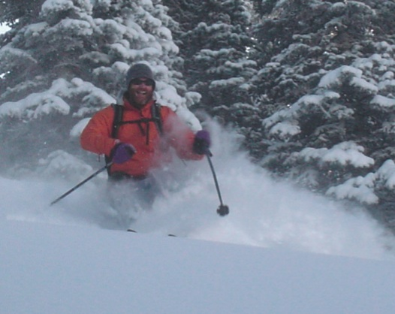
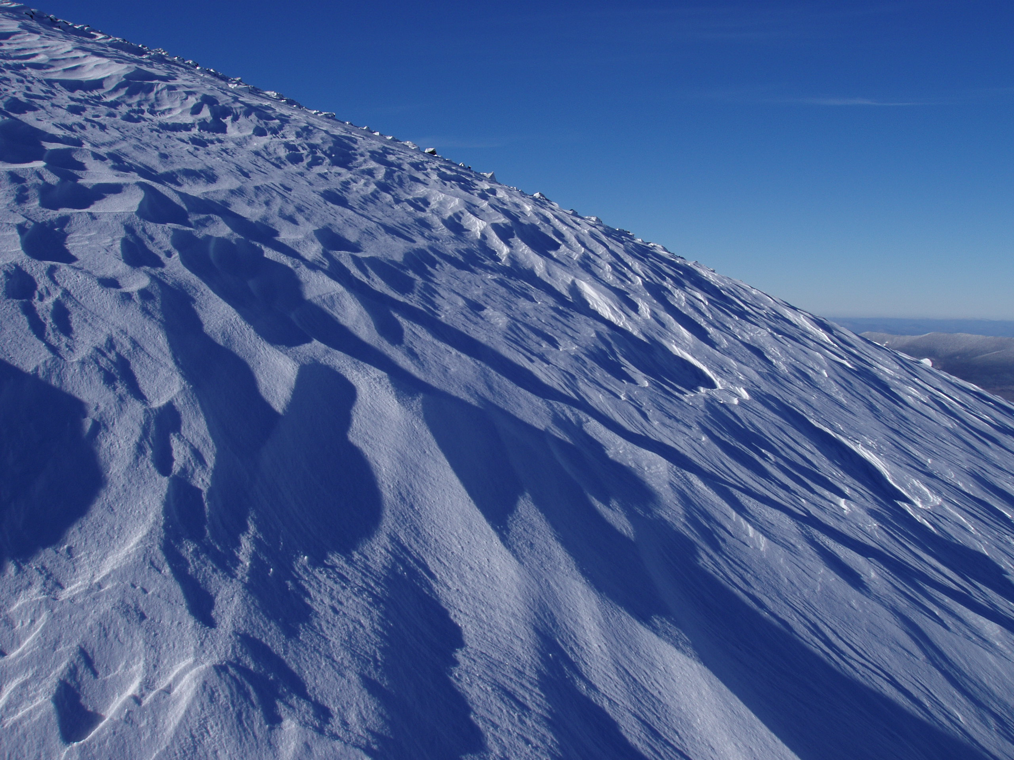
Surface Winds and SLR
Strong winds cause snow crystals to be dislodged and roll along the surface, removing outer features and decreasing SLR.
Snow transport begins at speeds of 8-10 m s⁻¹.
15:1
4:1

Slide 59
Forecasting – The 10:1 Rule
“Convenient” but innaccurate approach of multiplying QPF by 10
Inaccuracy known in the 19th century!
  “…assuming 10 inches of snow to 1 of water or some other factor, is subject to a large range of error because of the wide variability of this ratio for different kinds of snow.”
  – Report of the Chief Signal Officer, 1888

Slide 60
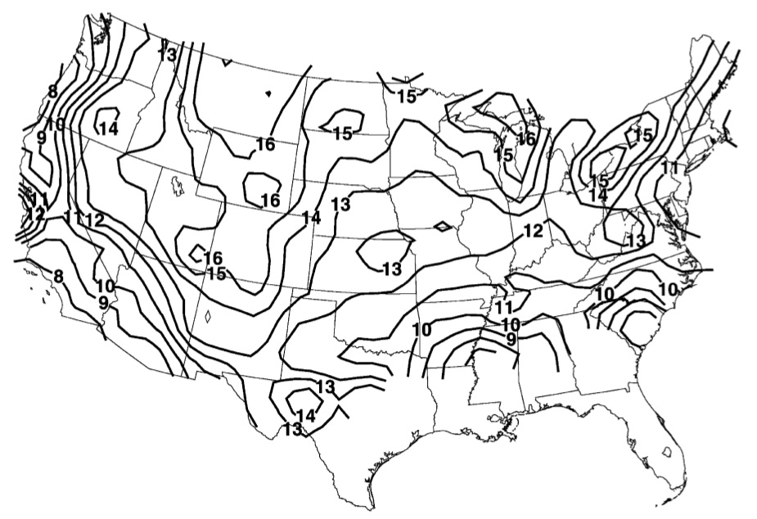
SLR Climatology
10:1 not even a good estimate of mean in many areas!
Discussion: Why is the SLR lowest along the coasts and in the south
and highest over the western interior and near the Great Lakes?
Baxter et al. (2005)

Slide 61
Group Discussion
What are the Snow-to-Liquid Ratio
Climatologies for Europe and Austria
In Austria, where are the highest and lowest
mean SLRs observed and why?

Slide 62
Improving on the 10:1 Rule
Empirical techniques have been developed, relying on surface or in-cloud temperature
  However, many of these techniques have not been verified and challenges remain
Temperature is one of the strongest predictors, but still only explains about 25-40% of the variance

Slide 63
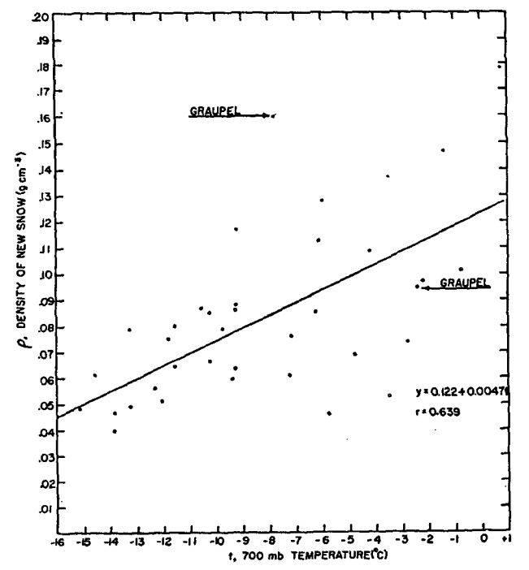
SLR Temperature Relationship
5:1
5:1
R=.64
6.7:1
10:1
20:1
SLR vs. 700-mb temperature @ Central Sierra Snow Lab (Diamond and Lowry 1954)

Slide 64
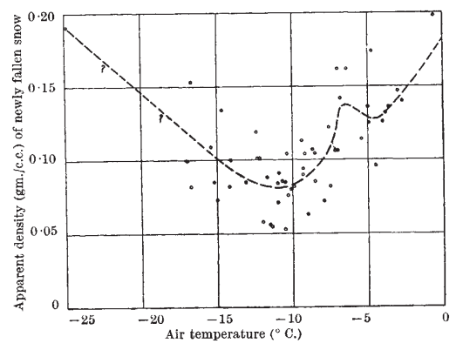
SLR Temperature Relationship
5:1
5:1
6.7:1
Group Discussion
Why is the SLR largest
at about -12˚C?
(Values increase downward)
10:1
20:1
SLR vs. Surface temperature @ Weissfluhjoch, Davos (Bossolasco 1954)

Slide 65
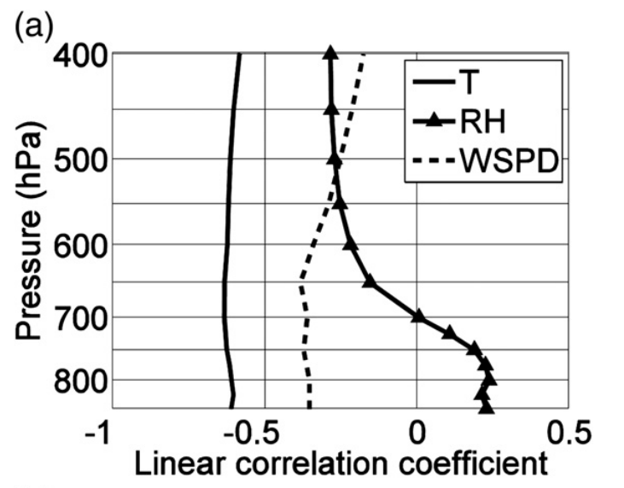
SLR @ Alta, UT
Correlation nearly
constant with
height (unusual?)
Strongest Relationship
With T
Alcott and Steenburgh (2010)

Slide 66
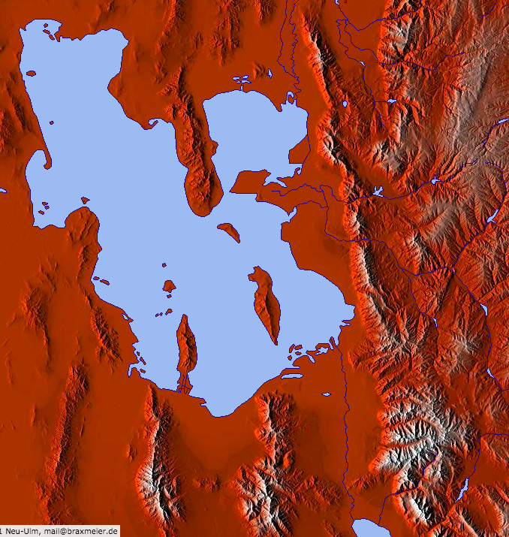
SLR @ Alta, UT
Great Salt Lake
Salt Lake City

Slide 67
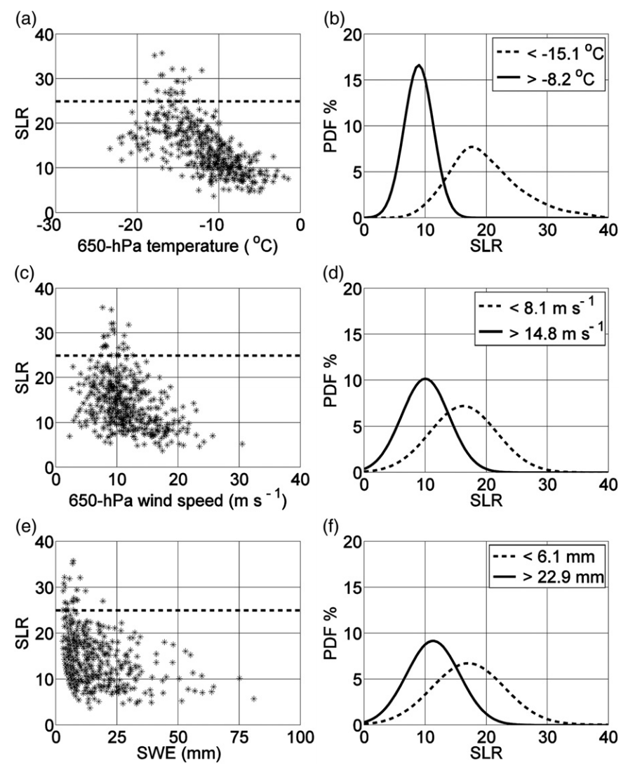
SLR @ Alta, UT
> 25:1 = “Wild Snow”
Alcott and Steenburgh (2010)

Slide 68
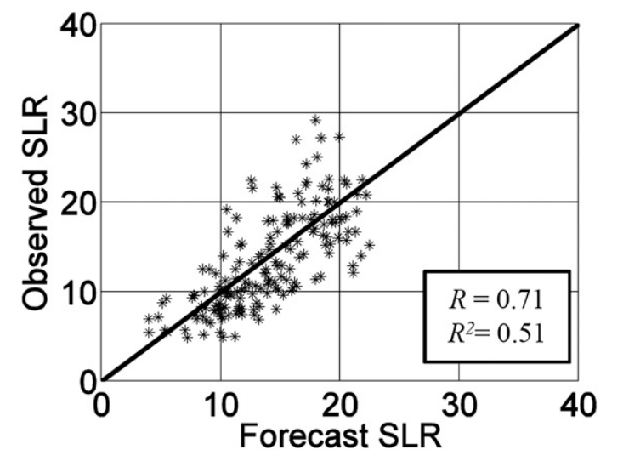
Prediction @ Alta
Stepwise Multiple Linear Regression to observed data, then apply to NWP output
Key variables: Temperature, wind speed, RH, wind direction at multiple levels, plus SWE
Improvement over other methods, but still scatter
Alcott and Steenburgh (2010)

Slide 69
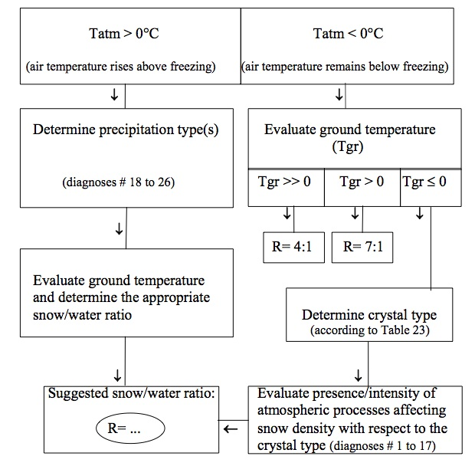
Other Methods
Look up tables
Neural network approaches (Roebber et al. 2003)
  Arguably a “smarter” version of SMLR approach
Flowcharts (Dubé 2003)

Slide 70
SLR Summary
Poor data poses a challenge
Many methods are ad hoc
Best methods are probably point specific and based on a long training dataset
Methods that can be applied broadly geographically are elusive
Good luck!

Slide 71
References
Abbe, C., 1888: Appendix 46. 1887 Annual report of the Chief Signal Officer of the Army under the direction of Brigadier-General A. W. Greely, U.S. Govt. Printing Office, Washington, DC, 385-386.
Alcott, T. I., and W. J. Steenburgh, 2010: Snow-to-liquid ratio variability and prediction at a high-elevation site in Utah’s Wasatch Mountains. Wea. Forecasting, 25, 323-337.
Baxter, M. A., C. E. Graves, and J. T. Moore, 2005: A climatology of snow-to-liquid ratio for the contiguous United States. Wea. Forecasting, 20, 729-744.
Bossolasco, M., 1954: Newly fallen snow and air temperature. Nature, 174, 362-363.
Cobb, D. K., and J. S. Waldstreicher, 2005: A simple physically based snowfall algorithm. Preprints, 21st Conf. on Weather Analysis and Forecasting and 17th Conf. on Numerical Weather Prediction, Washington, DC, Amer. Meteor. Soc., 2A.2. Available at https://ams.confex.com/ams/WAFNWP34BC/techprogram/paper_94815.htm.
Diamond, M., and W. P. Lowry, 1954: Correlation of density of new snow with 700-millibar temperature. J. Meteor., 11, 512-513.
Dubé, I., cited 2008: From mm to cm…: Study of snow/liquid water ratios in Quebec. Meteorological Service of Canada, Quebec, QC, Canada. [Available online at http://www.meted.ucar.edu/norlat/snowdensity/from_mm_to_cm.pdf.]
Kämäräinen, M., O. Hyvärinen, K. Jylhä, A. Vajda, S. Neiglick, J. Nuottokari, and H. Gregow, 2017: A method to estimate freezing rain climatology from ERA-Interim reanalysis over Europe. Nat. Hazards Earth Syst. Sci., 17, 243-259.
Minder, J. R., D. R. Durran, and G. H. Roe, 2011: Mesoscale controls on the mountainside snow line. J. Atmos. Sci., 68, 2107-2127.
NWSFO, Lousville, KY, Unknown: Precipitation type forecasting. Available at http://www.crh.noaa.gov/Image/lmk/Precip-Type-Fcstg_Top-Down.pdf.
Rauber, R. M., L. S. Olthoff, M. K. Ramamurthy, and K. E. Kunkel, 2000: The relative importance of warm rain and melting processes in freezing precipitation events. J. Appl. Meteor., 39, 1185-1195.
Roebber, P.J., S.L. Bruening, D.M. Schultz, and J.V. Cortinas, 2003: Improving snowfall forecasting by diagnosing snow density. Wea. Forecasting, 18, 264–287.
Stewart, R., 2008: Rain/Snow Transition Regions. Oral Presentation, AMS/COMET/MSC Mountain Weather Workshop, Whistler, British Columbia, Canada. Available at http://www.meted.ucar.edu/norlat/mtnwxworkshop/lectures.htm.
Stewart, R. E., J. M. Theriault, and W. Henson: On the characteristics of and processes producing winter precipitation types near 0˚C. Bull. Amer. Meteor. Soc., 96, 623-639.

