Slide 1
Cold Air Damming VU2: Course Number 707813
http://smokymountainrider.com
Jim Steenburgh
Fulbright Visiting Professor of Natural Sciences
University of Innsbruck
Department of Atmospheric Sciences
University of Utah
jim.steenburgh@utah.edu

Slide 2
Learning Objectives
After this class you should
Recognize areas of the world that are prone to cold air damming and its impacts
Understand the processes that contribute to the development and maintenance of cold air damming
Be prepared to analyze and forecast events

Slide 3
Introduction

Slide 4
Cold Air Damming
What is it?
The phenomenon of cold air becoming entrenched along the slopes of a mountain range
General characteristics
Cold air in the form of a dome
Accompanying “U-shaped” ridge in the sea level pressure field

Slide 5
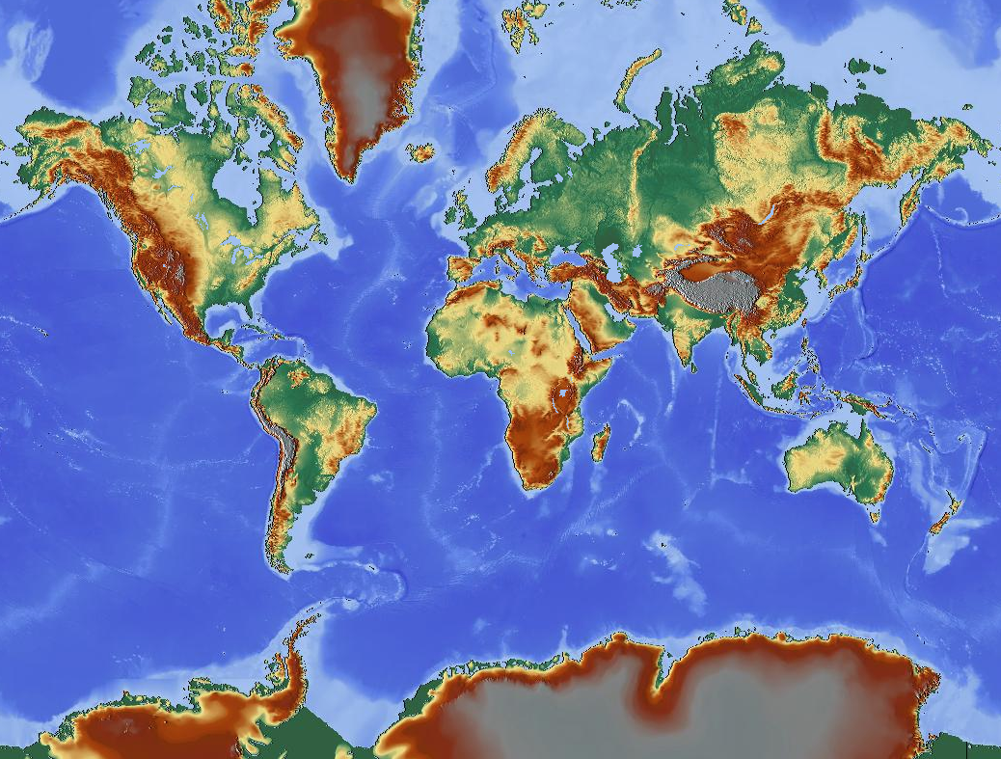
Where
Jung and Rhines 2007
Hénin 2015
Steenburgh et al. 1997
Houze 2012
Dunn 1987
Bell and Bosart 1988
Lee and Xue 2013
Prince and Evans 2018
Linacre and Geerts 1997
Schwerdtfeger 1975
+ many others
Notes:
Houze 2012- Po Valley
Henin 2015: Karst Plateau

Slide 6
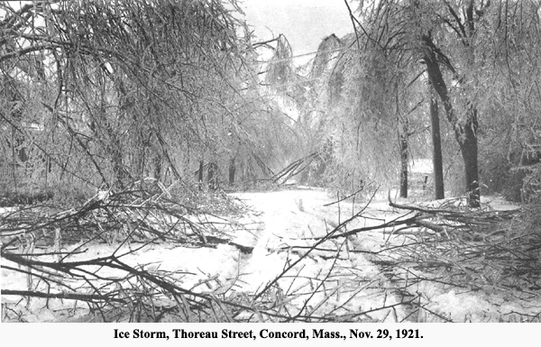
Cold Air Damming
Impacts
Locally low temperatures
Sleet, snow, or freezing rain
Fog and stratus
Enhancement of gap winds
http://www.concordlibrary.org/scollect/fin_aids/dpw.html
“In America, the ice storm is an event,
and it is not an event
which one is careless about”
- Mark Twain

Slide 7
Cold Air Damming
Median annual hours of freezing rain 1976–1990
Cortinas et al. (2004)

Slide 8
Appalachian Cold Air Damming

Slide 9
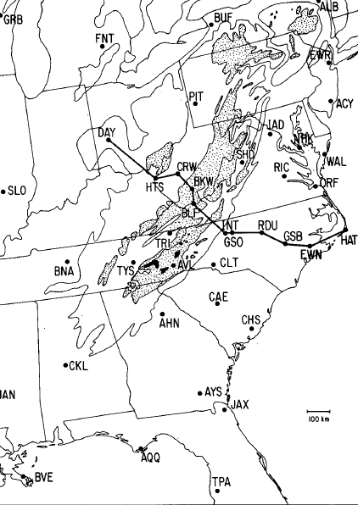
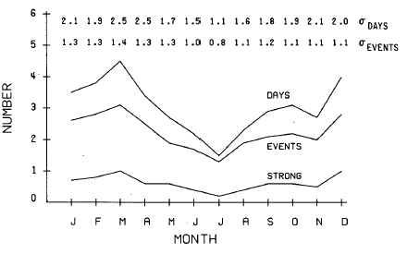
Appalachian Cold Air Damming
Damming Region
Occurs frequently east of Appalachians
Events most common from Dec–Mar
Bell and Bosart (1988)

Slide 10
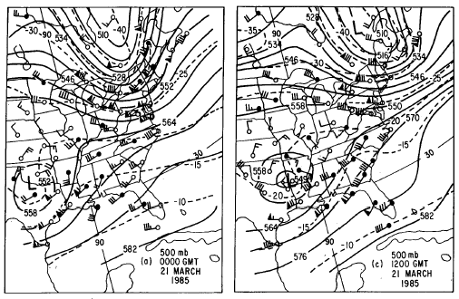
Antecedent Conditions
L
L
Large-scale upper-level confluence over eastern US
Northern upper-level trough precedes southern trough
Bell and Bosart (1988)

Slide 11
Antecedent Conditions
H
H
Surface frontal passage & building of cold anticyclone at surface
Result: Cold air becomes entrenched over eastern U.S. prior to a cyclogenesis event over southeast US
Bell and Bosart (1988)

Slide 12
Initiation Phase
Initiation phase
Low pressure develops over Gulf of Mexico in response to southern upper-level trough
High pressure drifts eastward
Result
Magnitude of easterly flow directed towards mountains increases
Along-barrier pressure gradient increases
Upslope flow experiences adiabatic cooling
10C
Bell and Bosart (1988)

Slide 13
Initiation Phase
Initiation phase
Terrain-parallel pressure gradient increases
Mountain-induced windward ridge and lee trough amplify
10C
10C
Bell and Bosart (1988)

Slide 14
Mature Phase
Mature phase
Windward (east side) flow veers and becomes terrain parallel
Cold advection becomes stronger near mountains (in this case, warm advection occurs off coast)
Equatorward movement of cold air is most rapid east of mountain slopes
10C
10C
10C
Bell and Bosart (1988)

Slide 15
Mature Phase
Mature phase
Pronounced cold dome and U-shaped mesoscale pressure ridge
10C
10C
10C
10C
Bell and Bosart (1988)

Slide 16
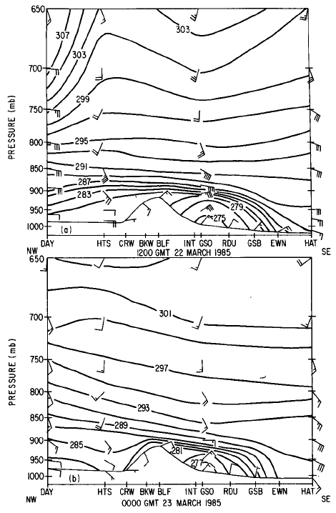
Vertical Structure
Cold-dome extends to near crest height of Appalachians
Near-surface winds are terrain parallel within dome and veer with height (warm advection above cold dome)
Bell and Bosart (1988)

Slide 17
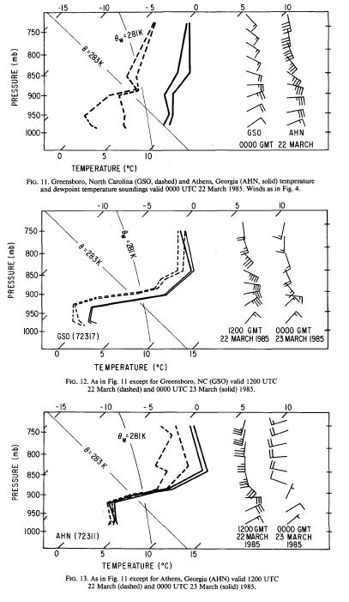
Soundings
During development of damming event, a shallow-layer of cold air deepens and becomes surmounted by an inversion
Bell and Bosart (1988)

Slide 18
Basic Dynamics
Cor
1020 mb
V
1016 mb
PG
In the absence of topography and friction, the flow exhibits geostrophic balance

Slide 19
Basic Dynamics
Cor
1020 mb
V
1016 mb
PG
If flow is characterized by a low Froude number (U/NH < 1), the the low-level flow will be blocked and decelerate as it approaches mountains

Slide 20
Basic Dynamics
Cor
Cor
1020 mb
V
1016 mb
PG
PG
Flow is deflected toward lower pressure

Slide 21
Basic Dynamics
Cor
Cor
1020 mb
V
1016 mb
PG
PG
Flow deceleration results in a piling up of mass and development of a mesoscale pressure ridge near the mountains (mutual adjustment of mass and momentum)

Slide 22
Basic Dynamics
Cor
Friction
1020 mb
V
Cor
PG
1016 mb
PG
The final near-barrier force balance

Slide 23
Mature Force Balance
Along-barrier antitripitic
Pressure gradient is balanced by friction
Cross-barrier geostrophy
Pressure gradient is balanced by Coriolis
Friction
Cor
PG

Slide 24
Real World Example
Cor
Friction
PG
V
Bell and Bosart (1988)

Slide 25
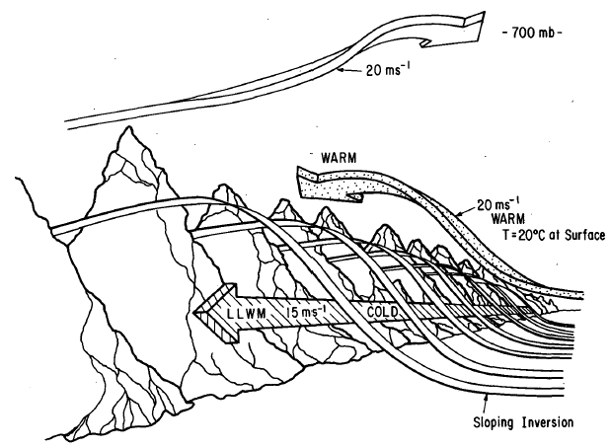
Conceptual Model
Terrain-parallel low-level wind maximum within cold dome
Easterly (or SE) flow above cold dome associated with strong warm advection
Southerly to southwesterly flow aloft
Bell and Bosart (1988)

Slide 26
Discussion
Other than terrain driven flows, what other processes contribute to the development and maintenance of cold-air damming?

Slide 27
Diabatic Processes
Sub-cloud diabatic effects can enhance and help maintain the cold dome
Cloud cover prevents or reduces surface radiative heating in upslope region
Without surface heating, low-level lapse rates remain stable—upslope adiabatic cooling results in local cold pool that would not develop if atmosphere were well mixed (dry adiabatic)
Diabatic cooling (evaporation and melting) further enhances cold pool strength
Diabatically enhanced cold pool strengthens mesoscale pressure ridging and along-barrier cold advection
Fritsch et al. (1992)

Slide 28
Event Types
Morphology based on
Three-dimensional scale variations
Relative roles of synoptic-scale and diabatic processes
Types
Classic damming
Hybrid damming
In situ damming
“Look alikes”
Hartfield (1999)

Slide 29
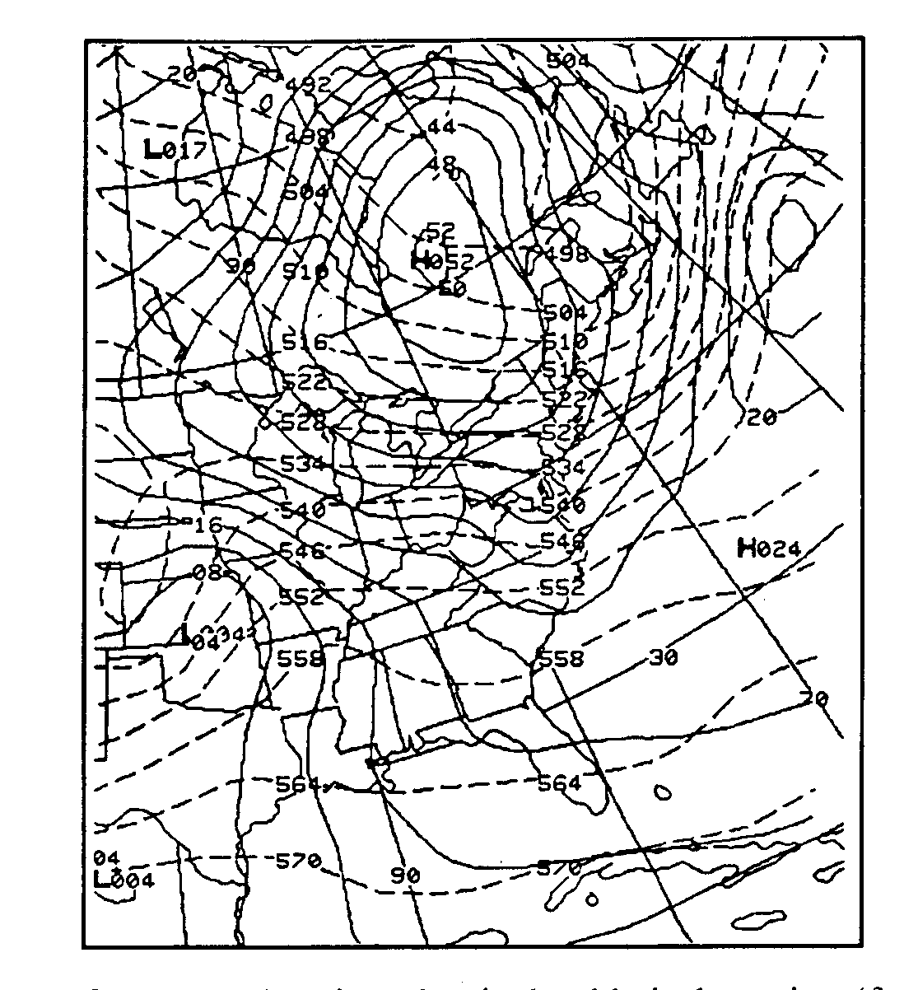
Classic Damming
Strong forcing by synoptic-scale features
Interaction of large-scale flow with topography results in upslope adiabatic cooling and along-barrier cold advection east of Appalachians
Diabatic processes not needed to initiate event, but can strengthen it
Hartfield (1999)

Slide 30
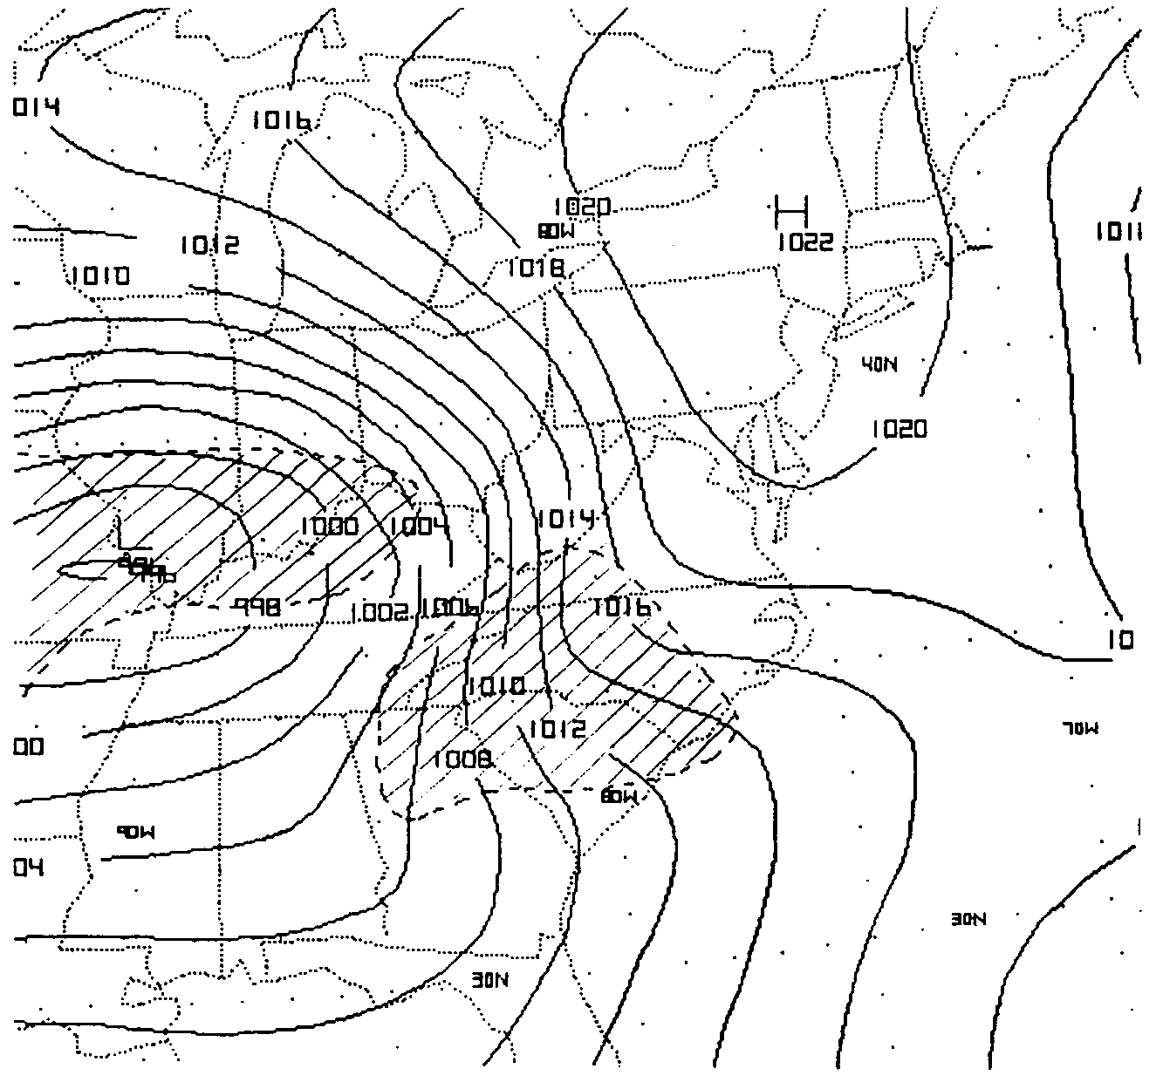
Hybrid Damming
Synoptic-scale and diabatic processes play nearly equal roles
Parent high may be:
In a good position but weak
Progressive (limited CAA)
Diabatic processes
Cool low levels
Enhance low-level stability
Ultimately enhance upslope cooling, high-pressure, and along-barrier cold advection
Hartfield (1999)

Slide 31
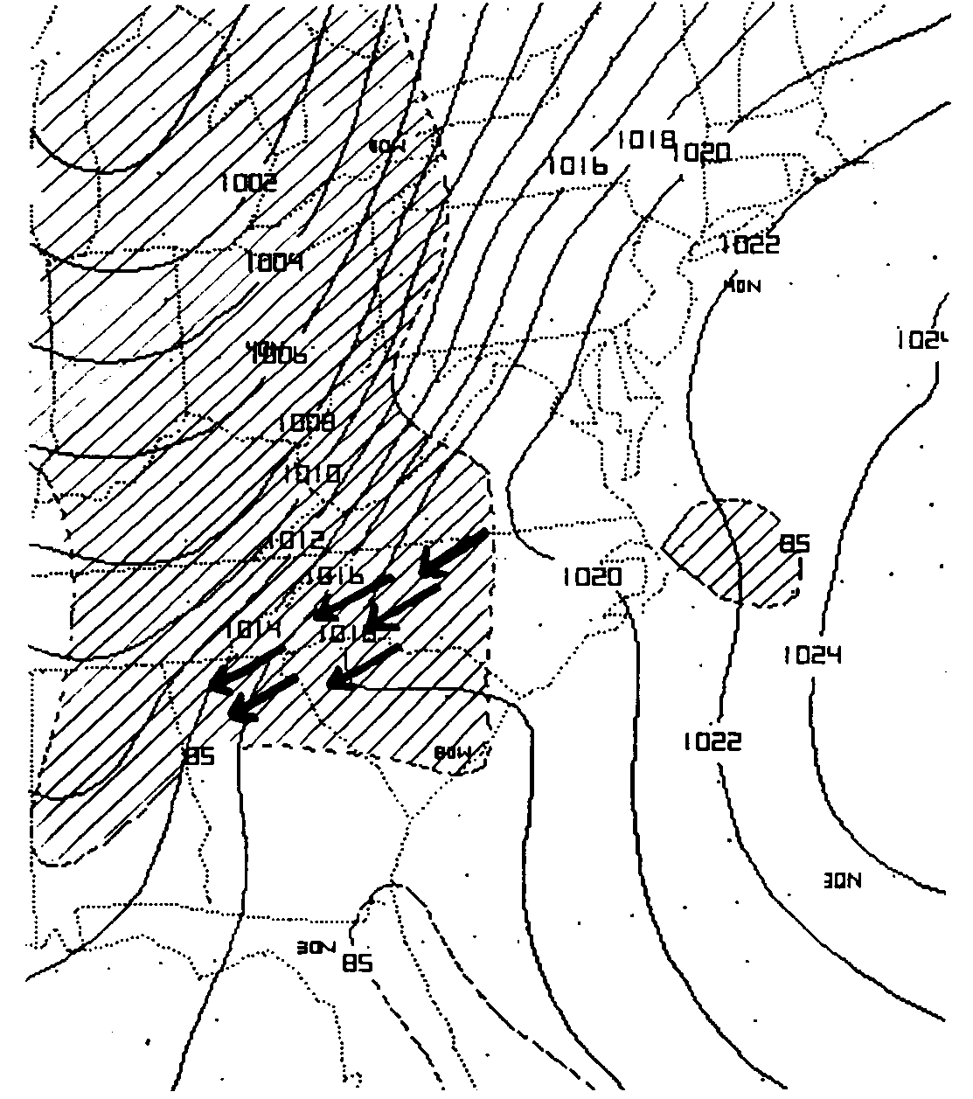
In-Situ Damming
Surface high is unfavorably located
Little or no CAA initially; cool dry air in place east of Applachians
Damming is initiated by sub-cloud evaporation and reduced solar heating
Hartfield (1999)

Slide 32
Erosion
Not handled well by current NWP models
Rules of thumb
Strong events require cold-front passage to mix out cold dome (particularly during winter)
Shallow, weak events with only fog or low cloud cover are susceptible to erosion by insolation and mixing from aloft
Hartfield (1999)

Slide 33
Gap Effects

Slide 34
Cascades
Cold, continental air dams along east slopes of Cascades
Along-barrier cold advection not as pronounced as with Rockies/Appalachians
With approach of a cyclone cold air remains entrenched along Cascades, but mixes out along southern and eastern periphery of Columbia Basin
Cold pooling also common east of Cascades
Damming Region
Steenburgh et al. (1997)

Slide 35
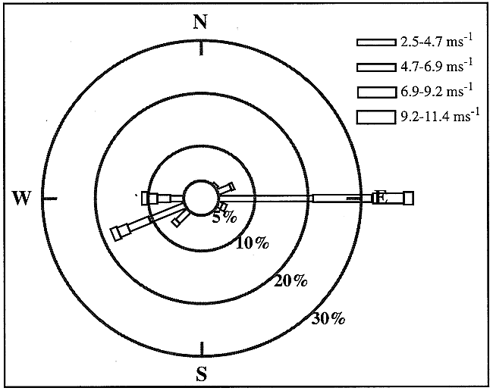
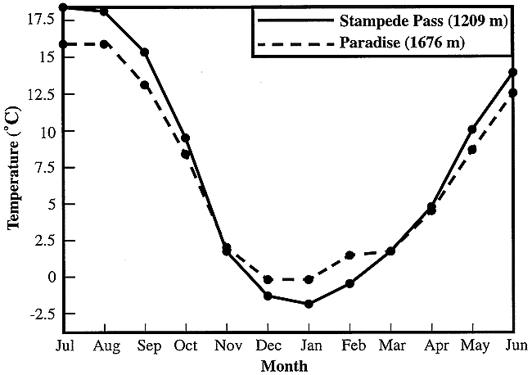
Cascades
SMP: Jan Wind Rose
Cold air from damming region tends to channel through mountain gaps during cool season
Locally lowers temperatures and snow levels while increasing snowpack
During the cool season, it is climatologically colder at 1150 meters in Stampede Pass than 1650 meters on Mt. Rainier
Steenburgh et al. (1997)

Slide 36
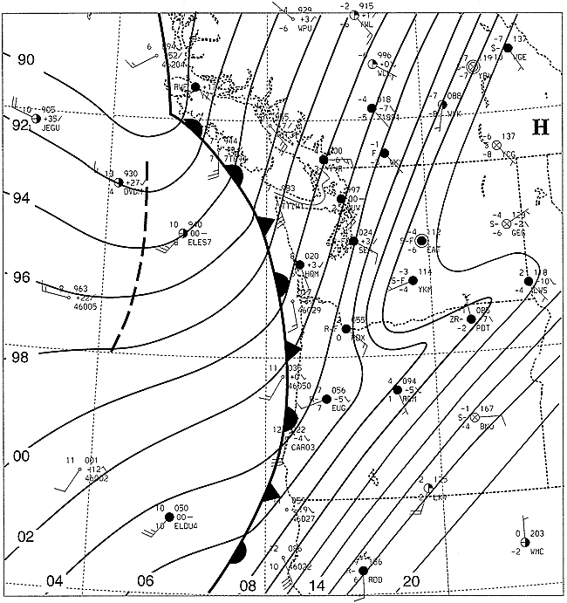
Cascade Example
Antecedent conditions
Cold air moves into and/or a period of persistent ridging establishes a cold pool over the Columbia Basin (Whiteman et al. 2001)
Initiation
Front or frontal cyclone approaches from Pacific
Cold air begins to mix out along southern and southeastern Columbia Basin
U-shaped mesoscale ridge develops east of Cascades
Steenburgh et al. (1997)

Slide 37
Cascade Example
Downslope flow develops north of Blue Mountains
Cold air remains entrenched along Cascades and over central Columbia Basin
Cross-barrier pressure and temperature gradients increase
Steenburgh et al. (1997)

Slide 38
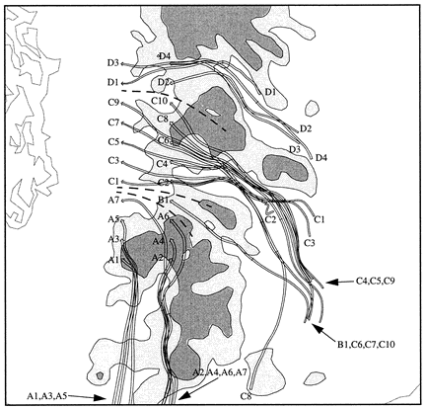
Cascade Example
Cold air channels through mountain gaps, producing locally lower temperatures and snow levels compared to sites west of Cascade Crest
Snoqualmie Pass
3000’: -6°C
Crystal Mtn
4400’: 0°C
Steenburgh et al. (1997)

Slide 39
Cascade Example
Cold air begins to mix or be advected out as front moves across Cascades
Cold air may remain entrenched along eastern slopes and in passes well after passage of front aloft
Eventually, westerly flow develops in passes and eastern Cascades
Steenburgh et al. (1997)

Slide 40
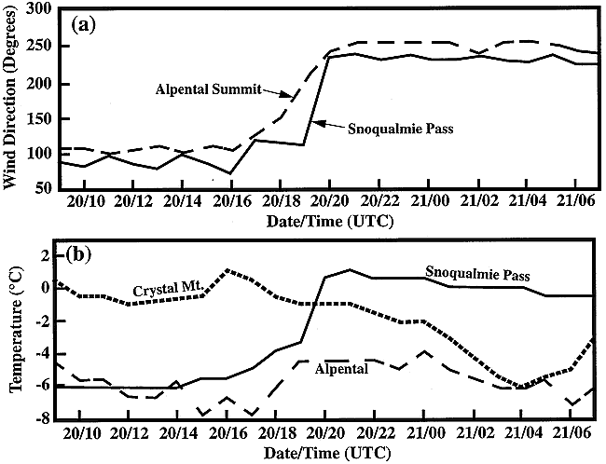
Cascade Example
Development of westerly flow results in movement of mild maritime air into passes
Rapid temperature rise
Snow may change to rain
Dangerous avalanche conditions may develop
Effects are most dramatic at pass level
Sites west of crest and away from passes may see a more “typical” fropa
Steenburgh et al. (1997)

Slide 41
Summary
Cold-air damming is the phenomenon of cold air becoming entrenched along the slopes of a mountain range
Contributing mechanisms
Windward adiabatic cooling
Along-barrier cold advection (enhanced by blocked low-Froude number flow)
Cooling due to evaporation/melting
Reduced insolation due to cloud cover
Event erosion
Need cold/occluded front passage to mix out most strong events during winter
Solar insolation or turbulent mixing more effective if dammed airmass is shallow or during the fall/spring

Slide 42
References
Bell, G. D., and L. F. Bosart, 1988: Appalachian cold-air damming. Mon. Wea. Rev., 116, 137-161.
Cortinas,J. V., Jr., B. C. Bernstein, C. C. Robbins, and J. Walter Strapp, 2004: An analysis of freezing rain, freezing drizzle, and ice pellets across the United States and Canada: 1976–90. Wea. Forecasting, 19, 377-390.
Dunn, L., 1987: Cold air damming by the Front Range of the Colorado Rockies and its relationship to locally heavy snows. Wea. Forecasting, 2, 177-189.
Hartfield, G, 1999: Cold air damming: An introduction. http://www.comet.ucar.edu/class/comap/06_Aug2_1999/docs/hartfield/cadamg/sld001.htm
Houze, R. A., Jr., 2012: Orographic effects on precipitating clouds. Rev. Geophys., 50, RG1001, doi:10.1029/2011RG000365.
Jung, T., and P. B. Rhines, 2007: Greenland’s pressure drag and the Atlantic storm track. J. Atmos. Sci., 64, 4004-4030.
Lee, J.-G., and M. Xue, 2013: A study on a snowband associated with a coastal front and cold-air damming event of 3-4 February 1998 along the eastern coast of the Korean Peninsula. Adv. Atmos. Sci., 30, 263-279.
Linacre, E. and B. Geerts, 1997: Climates and Weather Explained. Routledge, 464 pp.
Lupo, A. R., J. J. Nocera, L. F. Bosart, E. G. Hoffman, and D. J. Knight, 2001: South American cold surges: Types, composites, and case studies. Mon. Wea. Rev., 129, 1021-1041.
Hénin, R., 2015: Dynamics of Boara wind over the Adriatic Sea: Atmospheric water balance and role of air-sea fluxes and orography. Università di Bologna. http://amslaurea.unibo.it/8915/1/Henin_Riccardo_tesi.pdf.
Schwerdtfeger, W., 1975: The effect of the Antarctic peninsula on the temperature regime of the Weddell Sea. Mon. Wea. Rev., 103, 45-51.
Steenburgh, W. J., C. F. Mass, and S. A. Ferguson, 1997: The influence of terrain-induced circulations on wintertime temperature and snow level in the Washington Cascades. Wea. Forecasting, 12, 208-227.

