Slide 1
Orographic Precipitation VU2: Course Number 707813
©Jim Steenburgh
Jim Steenburgh
Fulbright Visiting Professor of Natural Sciences
University of Innsbruck
Department of Atmospheric Sciences
University of Utah
jim.steenburgh@utah.edu

Slide 2
Learning Objectives
After this class you should
Recognize the key factors and physical mechanisms that influence the distribution and intensity of precipitation in complex terrain
Be able to critically evaluate scientific literature pertaining to orographic precipitation

Slide 3
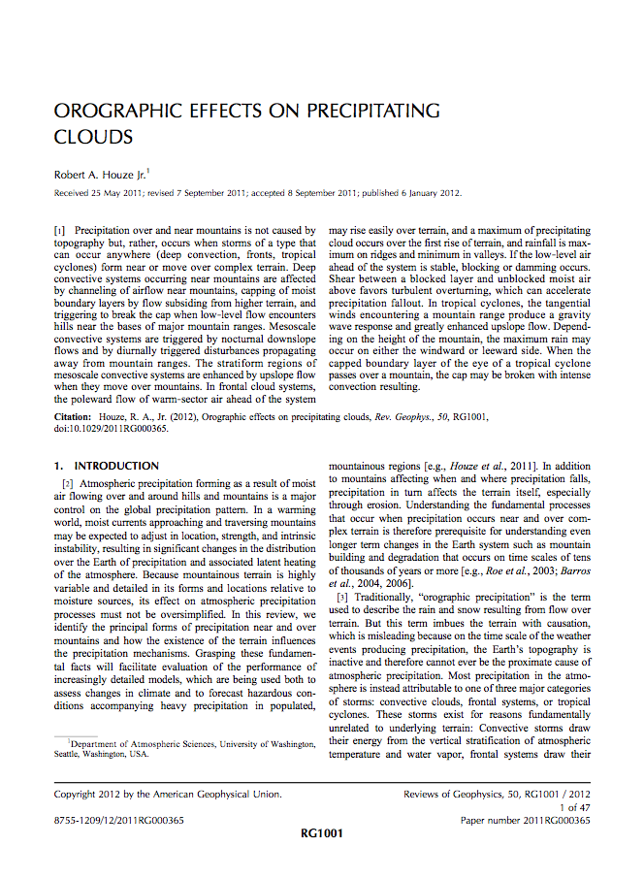
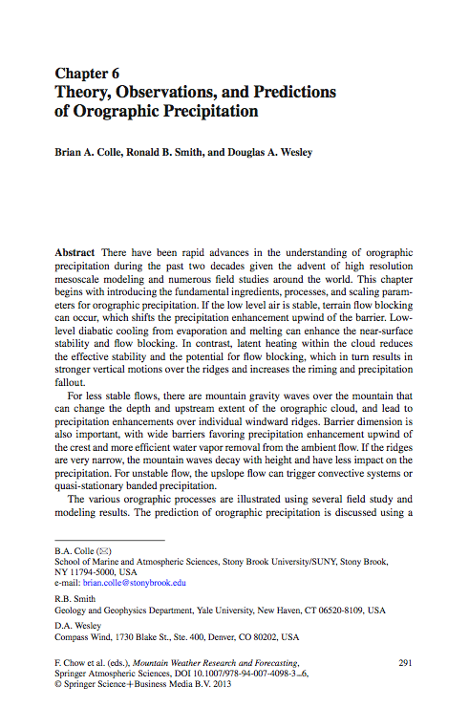
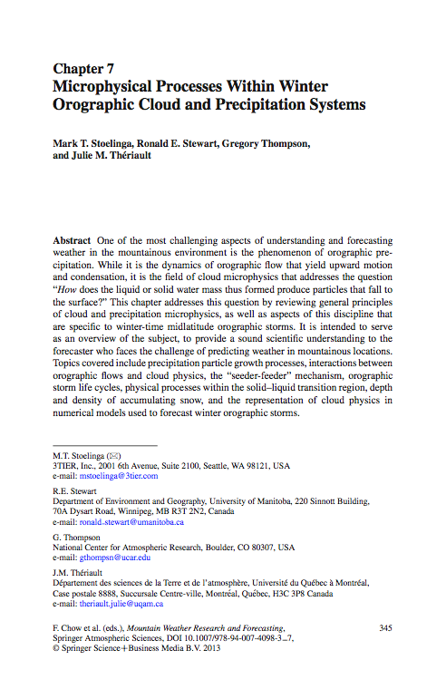
Useful Papers
Pre-class reading
Houze (2012), Colle et al. (2013), Stoelinga et al. (2013)

Slide 4
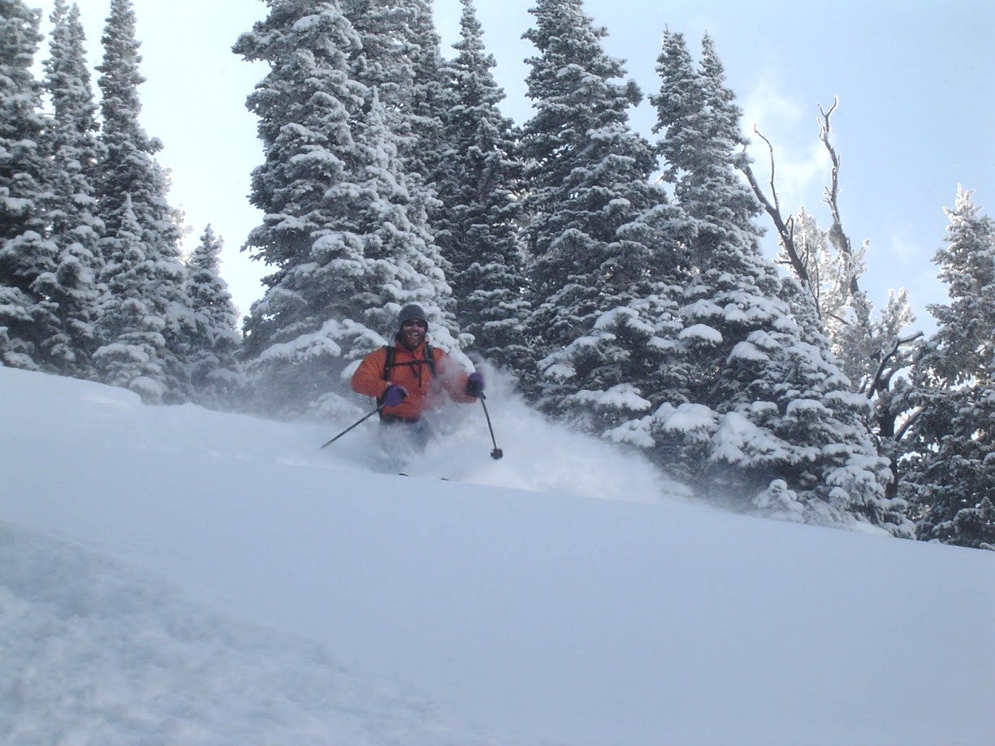
Orographic precipitation
Precipitation caused or enhanced by
one of the mechanisms of orographic lifting of moist air
(Glossary of Meteorology)
©Jim Steenburgh

Slide 5
Key Factors

Slide 6
Key Factors
Synoptic setting
Size and shape of the topography
Microphysical processes and time scales
Dynamics of the terrain-induced flow
Thermodynamics of orographically lifted air
Houze (2012)

Slide 7
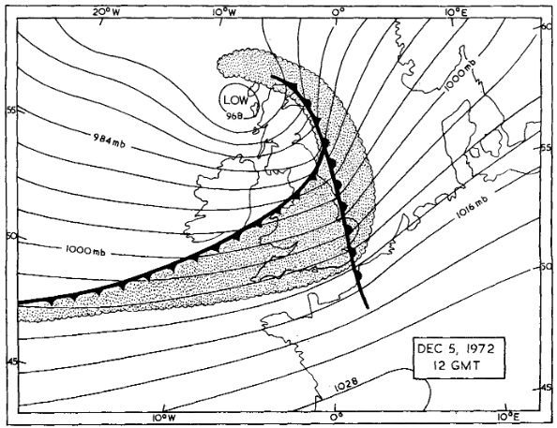
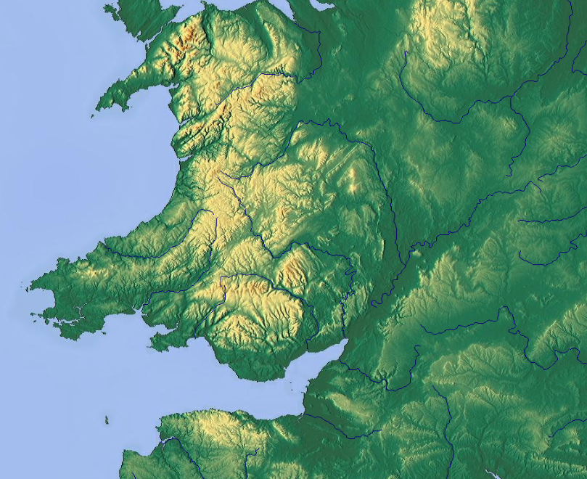
Synoptic Setting
Precip (mm)
5 Dec 1972
Low θ_{e}
High θ_{e}
5
10
15
20
25
30
“Large-scale synoptic factors determine the characteristics of the
airmass which crosses the hills [and mountains], its wind speed
and direction, its stability, and humidity”
– Sawyer (1956)
Images adapted from Browning et al. (1974)

Slide 8
Size and Shape of the Topography
How high?
How wide?
How long?
What shape?
Discussion: Why do each of these matter?

Slide 9
Size and Shape of the Topography
How high?
How wide?
How long?
What shape?
Blocked or unblocked
Type of gravity waves
Pattern and intensity of terrain induced vertical velocity
Location of hydrometeor fallout relative to crest
Flow along or around
Pattern of terrain-induced flow
and vertical velocity

Slide 10
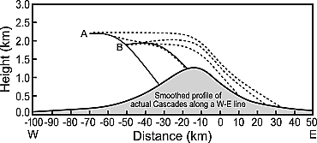
Microphysical Process and Time Scales
Heavily Rimed
Lightly Rimed
Hydrometeor growth, transport, and fallout
Hobbs et al. (1973); Houze (2012)

Slide 11
Dynamics of the Terrain-Induced Flow
Flow over or around (i.e. blocked) barrier?
Ĥ = NH/U
Nondimensional Mountain Height
(inverse Froude number)
Barrier-normal wind speed
Brunt–Väsälä Frequency
Mountain Height
Ĥ_{m} = N_{m}H/U
Moist Brunt–Väsälä Frequency

Slide 12
Dynamics of the Terrain-Induced Flow
Ĥ = NH/U
Blocking (Ĥ > 1) favored by
High stability
Large mountain
Weak cross-barrier flow
Flow over (Ĥ < 1) favored by
Low stability
Small mountain
Strong cross-barrier flow
Large N
Low U
Small N
Large U
X
Ĥ < 1
Ĥ < 1

Slide 13
Dynamics of the Terrain-Induced Flow
Critical Mountain Height (H_{c})
H_{c} = U/N
H > H_{c}: Flow is blocked
H < H_{c}: Flow surmounts barrier
H>H_{c}
Parcel blocked
H<H_{c}
Parcel surmounts barrier

Slide 14
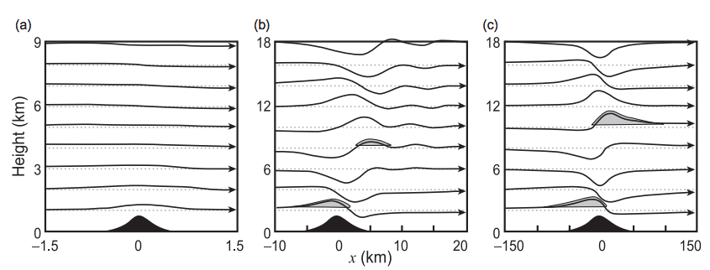
Dynamics of the Terrain-Induced Flow
Gravity Wave Structure
Flow response dependent on incident wind speed, wind shear, and static stability
as well as width, height, and shape of mountain
Important for both windward and leeward effects, as well as multiridge effects,
including role of trapped waves
Houze (2012), Durran (1986)

Slide 15
Thermodynamics of Orographically Lifted Air
Vertical profiles of temperature and humidity
Depth of moisture
Presence of stable layers, CAPE, potential instability, etc
Best diagnosed with upstream time-height sections and soundings

Slide 16
Thermodynamics of Orographically Lifted Air
weather.utah.edu

Slide 17
Thermodynamics of Orographically Lifted Air
weather.utah.edu

Slide 18
Dynamics of the Terrain-Induced Flow Implications of flow over vs. flow around

Slide 19
Importance of Terrain-Induced Flow
Determines location and intensity of orographically induced ascent/descent
Influences precipitation dynamics/microphysics
Can strongly influence transport of moisture

Slide 20
Flow Over vs. Flow Around
Flow over (“unblocked”)
Favored with weak static stability
Orographic ascent near barrier
Potential instability release (not always)
Possibility of Seeder Feeder
Can enhance contrasts in sub-cloud evaporation
Flow Around (“blocked”)
Favored with high static stability
May produce “blocking front”
Shifts orographic ascent upwind of barrier
Lowland or foothills precip can exceed high elevation precip
May result in terrain-induced convergence (windward, leeward, concavity, etc.)
Both can operate simultaneously
Blocked valley flow, but unblocked flow at mid-mountain and crest level
Blocked unsaturated flow in one region, unblocked saturated flow in another

Slide 21
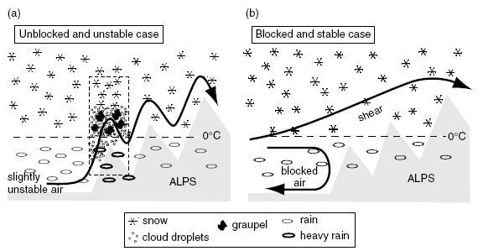
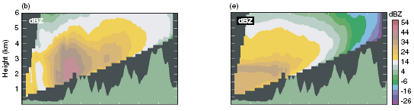
Flow Over vs. Flow Around
Unstable MAP IOP2b
Stable IOP8
Medina and Houze (2003), Rotunno and Houze (2007)

Slide 22
Flow Over vs. Flow Around
Unblocked
Blocked
Neiman et al. (2002)

Slide 23
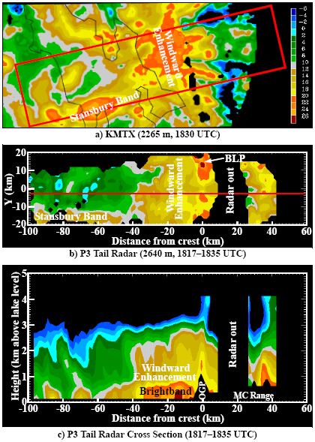
Blocking: Wasatch Range
Northern Wasatch Front
Cox et al. (2005)

Slide 24
Blocking: Wasatch Range
Cox et al. (2005)

Slide 25
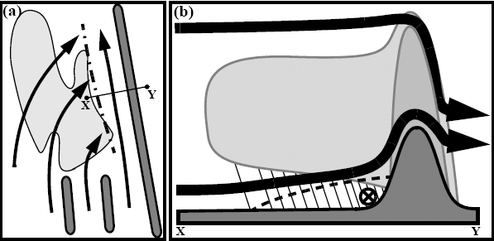
Blocking: Wasatch Range
Cox et al. (2005)

Slide 26
Discussion
Diagnose the possible flow patterns and influence on precipitation
for the following idealized flows if low-level blocking occurs
upstream of the Alps, but not over surrounding mountain ranges

Slide 27
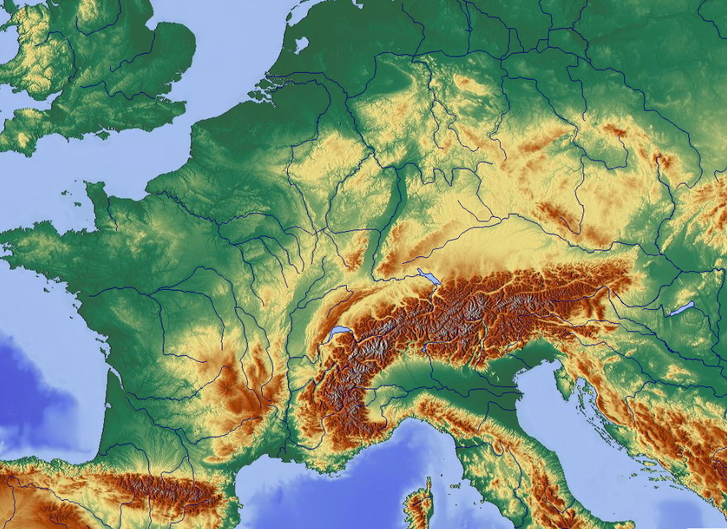
Northwesterly Flow Impinging on Alps

Slide 28
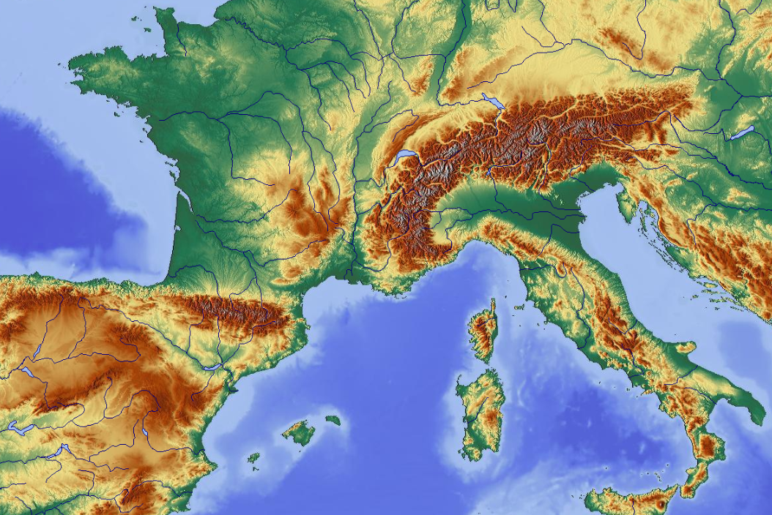
Southwesterly Flow Impinging on Alps

Slide 29
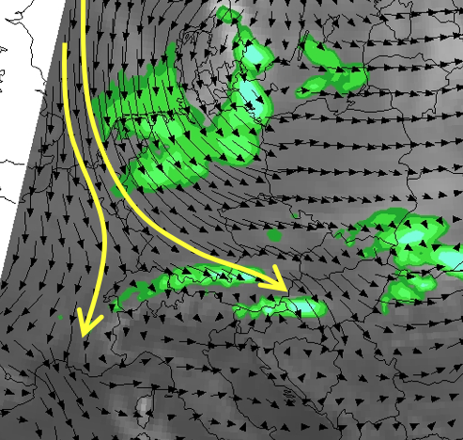
Blocking: Northern Stau
Satellite image valid
00845 UTC 25 March 2019
6hr GFS forecast valid
0600 UTC 25 March 2019

Slide 30
Hybrid: 1994 Piedmont Flood
Dry
>50 mm
>25 mm
Moist
Saturated
>25 mm
Rotunno and Ferretti (2001)
Notes:
30 km MM5

Slide 31
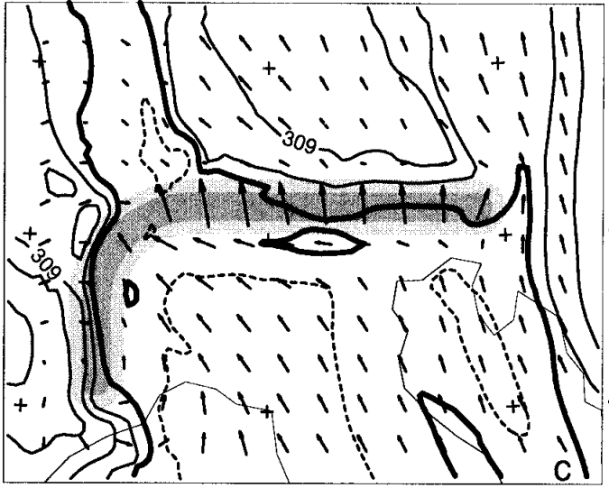
Hybrid: 1994 Piedmont Flood
>50 mm
Moist
saturated
flow over
Dry &
Blocked
>25 mm
>25 mm
“In the 1994 Piedmont case, there was a strong horizontal gradient of moisture; thus the
western moist part of the airstream flows over, while the eastern drier part is deflected
westward around the obstacle, and so a convergence is produced between the airstreams”
– Rotunno and Ferretti (2001)
Rotunno and Ferretti (2001)

Slide 32
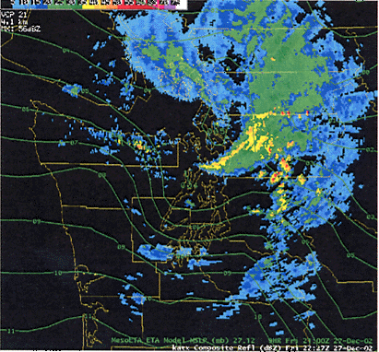
Other Flow Around Effects
McDonnal and Colman (2003)

Slide 33
Additional Physical Mechanisms

Slide 34
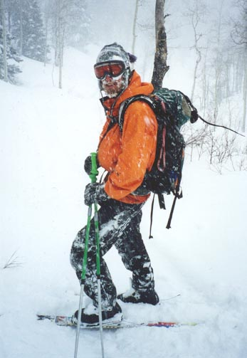
Additional Physical Mechanisms
Seeder-Feeder
Sub-cloud evaporation contrasts
Moist orographic convection
©Jay Shafer

Slide 35
Seeder Feeder
Hydrometeors (snow or rain) generated in “seeder” clouds aloft fall through low-level orographic “feeder” clouds
Feeder cloud might not precipitate otherwise
Precipitation enhanced in feeder cloud primarily by
Collision-coalescence
Accretion
Can occur when low-level flow is blocked

Slide 36
Sub-Cloud Effects
RH=50%
RH=75%
Orographic ascent doesn’t produce feeder cloud, but it does increase RH over Mountains
Results in less loss from evaporation and sublimation

Slide 37
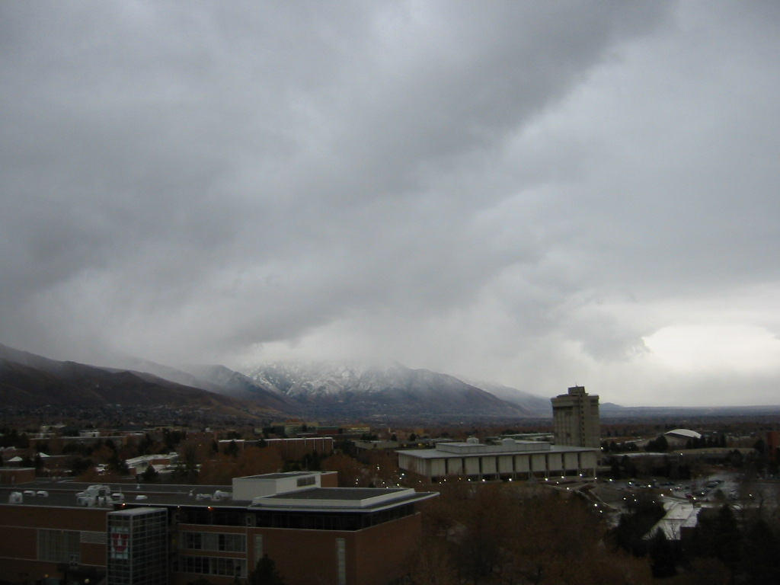
Sub-Cloud Effects
Decreasing precipitation with distance below cloud base
Vertical distribution of moisture strongly influences OR in stable events
The drier the low-levels, the larger the OR

Slide 38
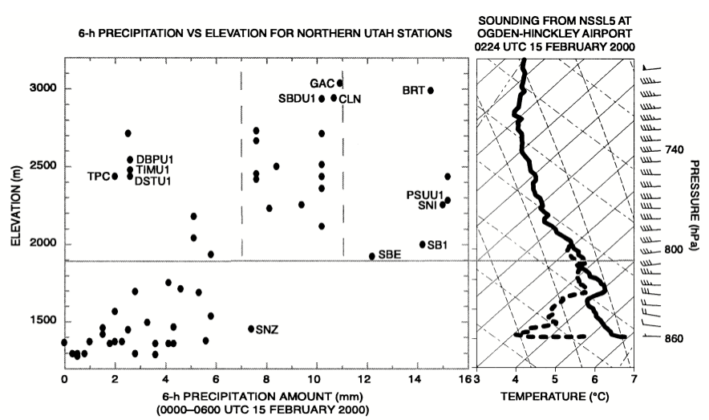
Sub-Cloud Effects
Cloud Base
“Precipitation amounts decreased with distance below cloud base, consistent with sublimation
and evaporation in the dry subcloud air” – Schultz and Trapp (2003)
Schultz and Trapp (2003)

Slide 39
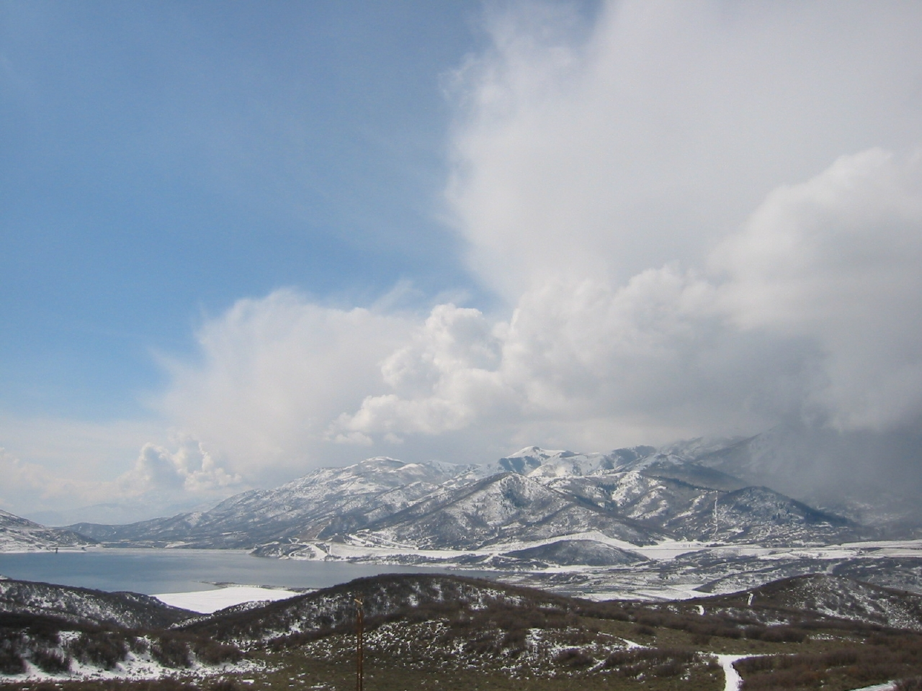
Moist Orographic Convection
“Develops when and where moist instability coincides with sufficient
terrain-induced ascent to locally overcome convective inhibition”
– Kirshbaum et al. (2018)
Kirshbaum et al. (2018)

Slide 40
Key Ingredients
Instability
Diagnosed from parcel theory
Air parcels, when displaced vertically, become saturated and accelerate away from their initial position
Moisture
Must be sufficient to produce saturation and ultimately precipitation
Lift
Must get parcels to their level of free convection (LFC)

Slide 41
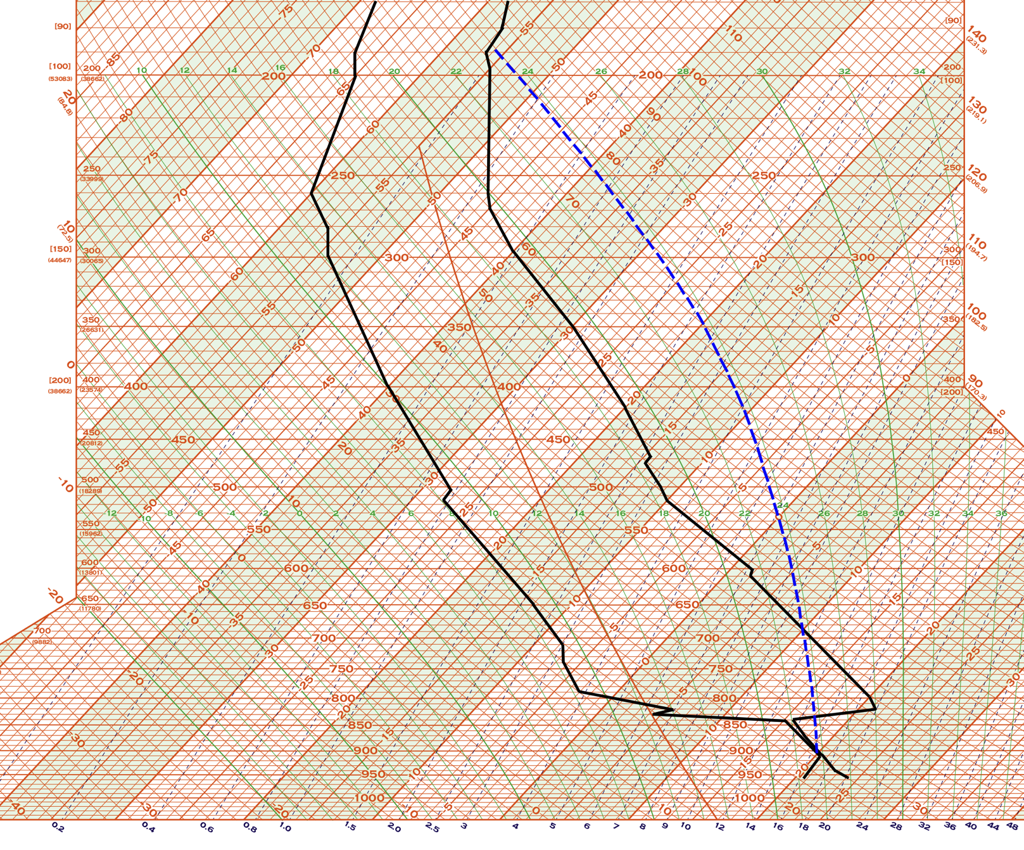
Parcel Theory
Lift an isolated parcel (e.g., surface)
Equilibrium
Level
CAPE
Convective Available
Potential Energy
LFC
Level of Free
Convection
CIN
Convective
INhibition
Dry
Adiabat
LCL: Lifting
Condensation
Level
Mixing Ratio

Slide 42
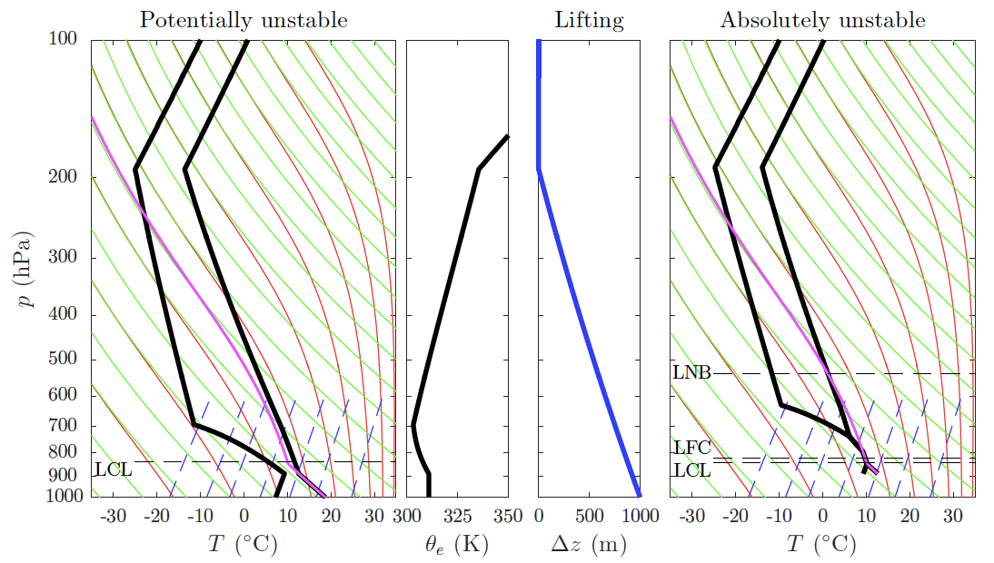
Potential Instability
Lift a layer, which becomes saturated in lower portion and absolutely unstable in a parcel sense
∂θ_{e}/∂z<0 (potentially unstable)
Kirshbaum et al. (2018)

Slide 43
Moist Orographic Convection
Orographic lift or ascent initiates/triggers convection
Ascent can be
Mechanical: Due to airflow over or around obstacle
Thermal: Due to differential heating over sloping terrain)
Kirshbaum et al. (2018)

Slide 44
Mechanical Trigger Mechanisms
Ascent in blocked flow with Ĥ ⪆ 1
Terrain forced ascent in unblocked flow
Streamlines must be displaced to LFC
or
Potentially unstable air brought to saturation
Convection initiates where flow reaches LFC
Can be low on slope if H >> LFC
Lee-side convergence
Kirshbaum et al. (2018)

Slide 45
Thermal Trigger Mechanisms
Thermally forced anabatic ascent with
convection near crest
Nocturnal katabatic flow with
convection near base
Kirshbaum et al. (2018)

Slide 46
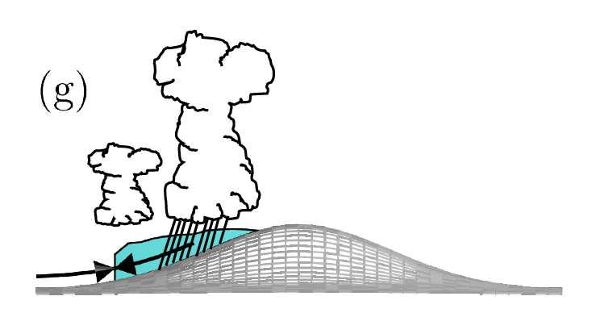
Hybrids and Feedbacks
Lee-side upslope with gravity-wave ascent aloft
Secondary initiation associated with
convective cold pool
Kirshbaum et al. (2018)

Slide 47
Mechanically Forced
Steenburgh (2014)

Slide 48
Thermally Forced
Brian Blaylock, University of Utah

Slide 49
Potential Instability Release
Precip (mm)
5 Dec 1972
Low θ_{e}
High θ_{e}
5
10
15
20
25
30
Can be effective over small hills or large barriers depending on synoptic setting
e.g., low hills of British Isles in warm sector within 300 km of cold front
Strong enhancement can occur even if convection is shallow
Adapted from Browning et al. (1974)

Slide 50
Impacts on Precipitation

Slide 51
Discussion
What synoptic patterns and physical mechanisms would yield:
a. Large orographic enhancement
b. Small orographic enhancement (or more lowland than mountain precipitation)

Slide 52
Orographic Ratio
Mountain
Lowland
Mountain Precipitation (Water Equivalent)
Lowland Precipitation (Water Equivalent)
OR =

Slide 53
Orographic Ratio
Favoring Large OR
Flow over barrier
Strong cross-barrier flow
Sub-cloud sublimation & evaporation
Weak frontal/synoptic forcing
Potential instability release
Favoring Small OR
Flow around/along barrier
Weak cross-barrier flow
Shallow, moist airflow toward barrier
Strong frontal/synoptic forcing
*Interactions between these factors create a wide spectrum of possibilities

Slide 54
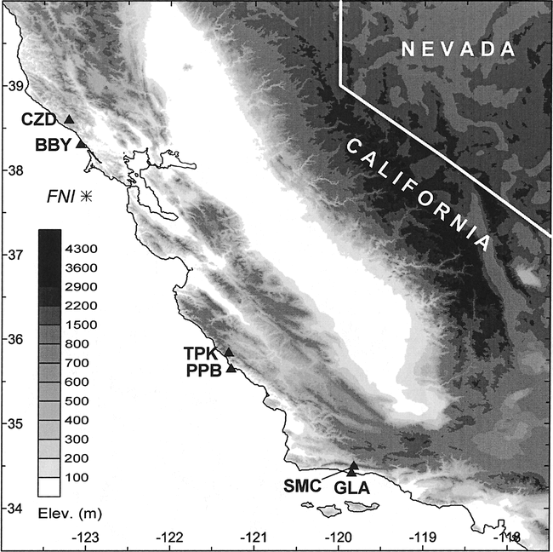
Orographic Ratio
OR<1
Neiman et al. (2002)

Slide 55
Unblocked Precip Rates
J
J
Profiler
CZD
BBY
Neiman et al. (2002)
Notes:
Neiman et al. (2002-MWR). Unblocked case. 0600 UTC 11 Jan and 0000 UTC 13 Jan 1998

Slide 56
Unblocked Precip Rates
Upslope flow vs. precip rate
Correlation vs. Altitude
Neiman et al. (2002)
Notes:
Neiman et al. (2002-MWR). Unblocked case. 0600 UTC 11 Jan and 0000 UTC 13 Jan 1998

Slide 57
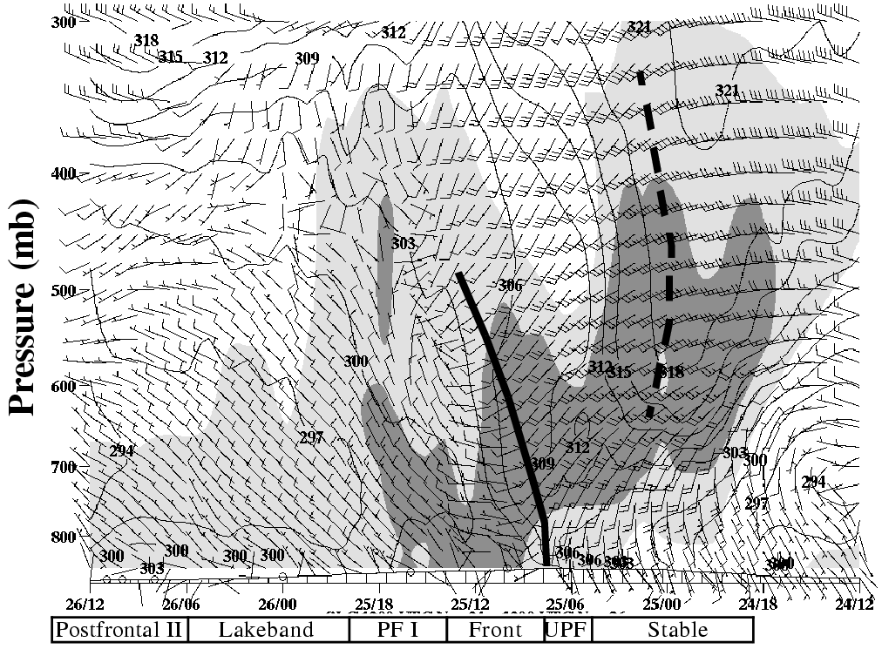
Importance of Synoptic Forcing
PostFront II Lakeband Postfront I Frontal UPF Stable
SLC Wind/Theta-e/RH Time-Height Section
Steenburgh (2003, 2004)

Slide 58
Importance of Synoptic Forcing
OR smallest during frontal passage
Steenburgh (2003, 2004)

Slide 59
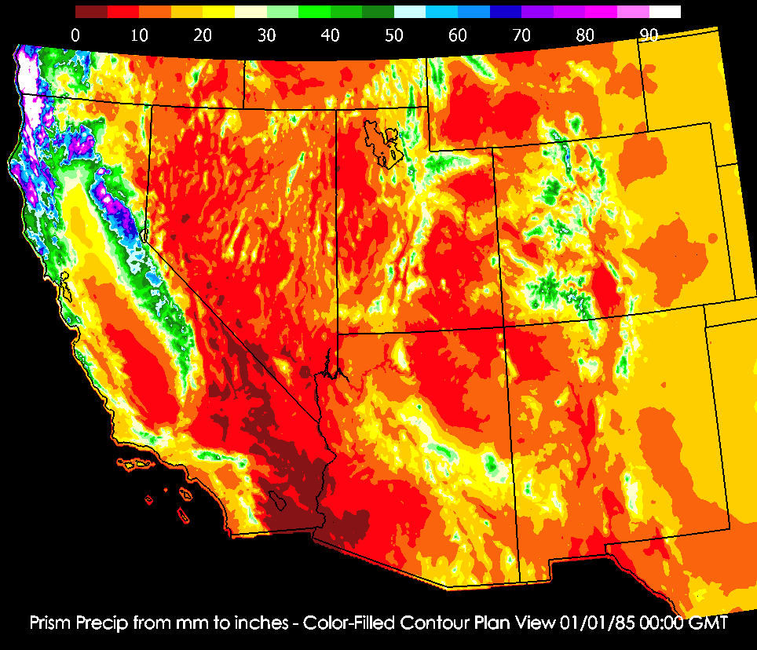
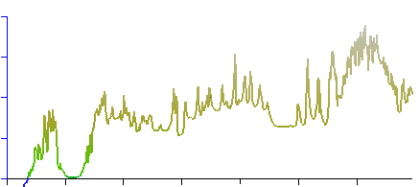
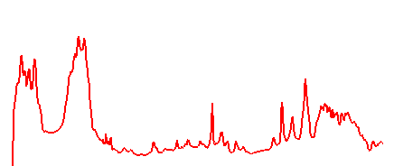
Wide vs. Narrow Barriers
Asymmetrical precipitation distribution with broad windward-to-near crest max across wide barriers (e.g., Coast Range, Sierra)
Symmetrical distribution with near-crest max over narrow barriers (e.g., Ruby, Wasatch)
4000 m
100”
Elev/Precip
Sierra Hum Ruby Wasatch
OSU/PRISM Climate Group, USGS

Slide 60
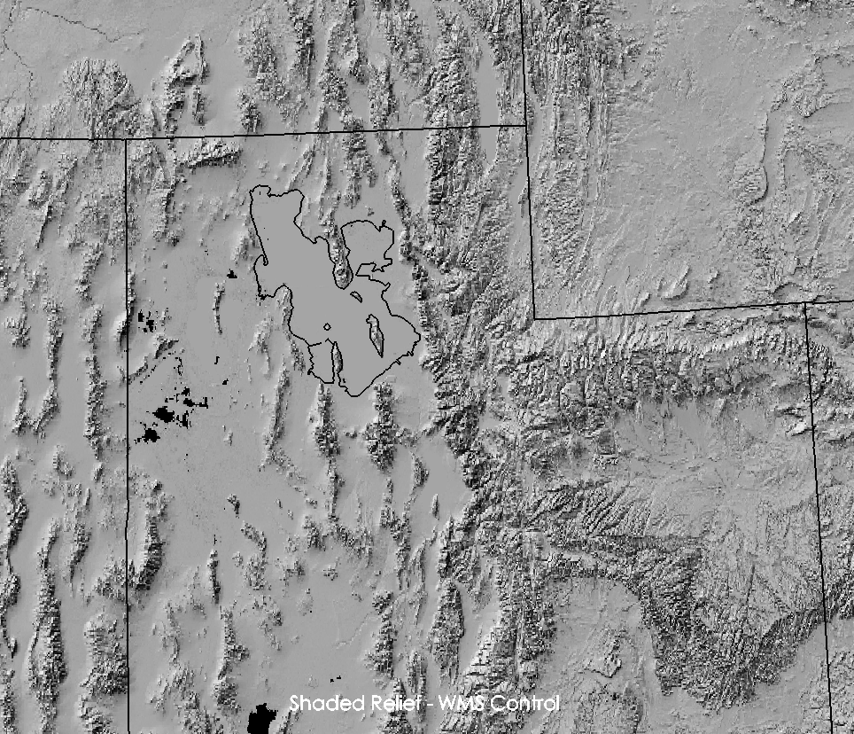
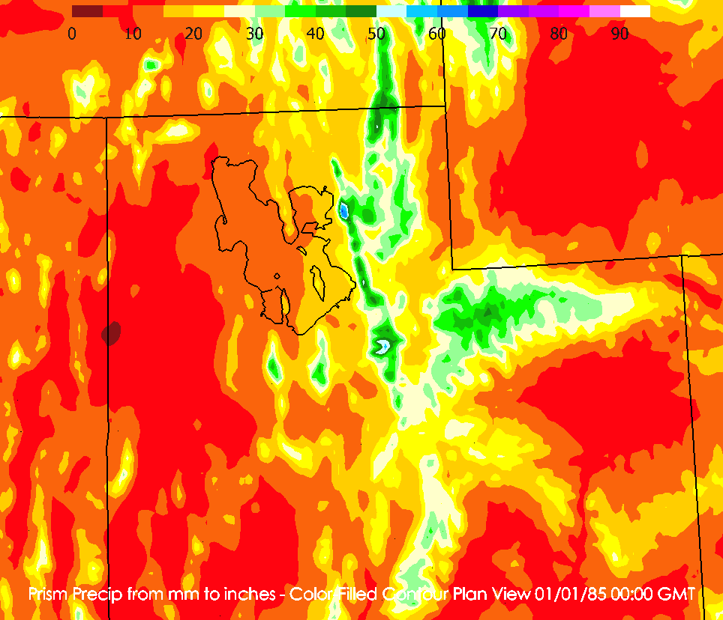
Sub-Regional Terrain Effects
0
4
4
0
8
-8
Wetter
Drier
12
-4
-4
-8
Departure from
Mean P-A relationship
On sub-regional scale, adjusting for mean precipitation-altitude
relationship reveals areas that are locally wet or dry for their elevation
See also: Tirol
OSU/PRISM Climate Group, USGS, Shafer et al. (2006)

Slide 61
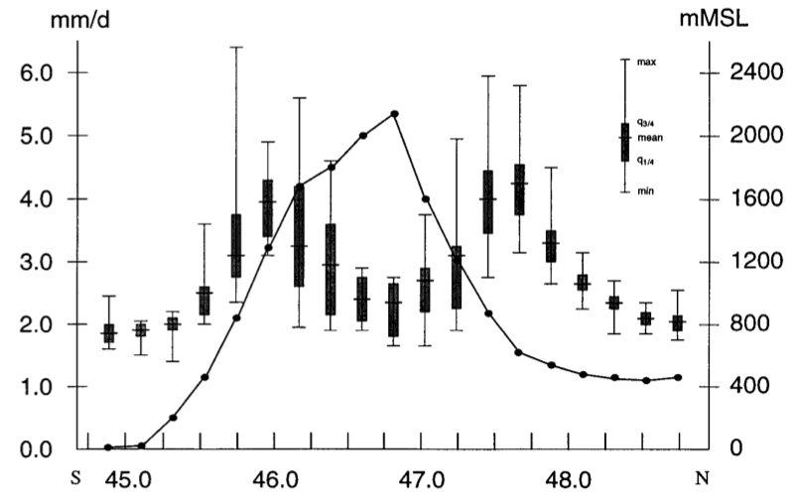
Wide and Sub-Regional Effects in Alps
Frei and Schär (1998); Hydrologic Atlas of Switzerland

Slide 62
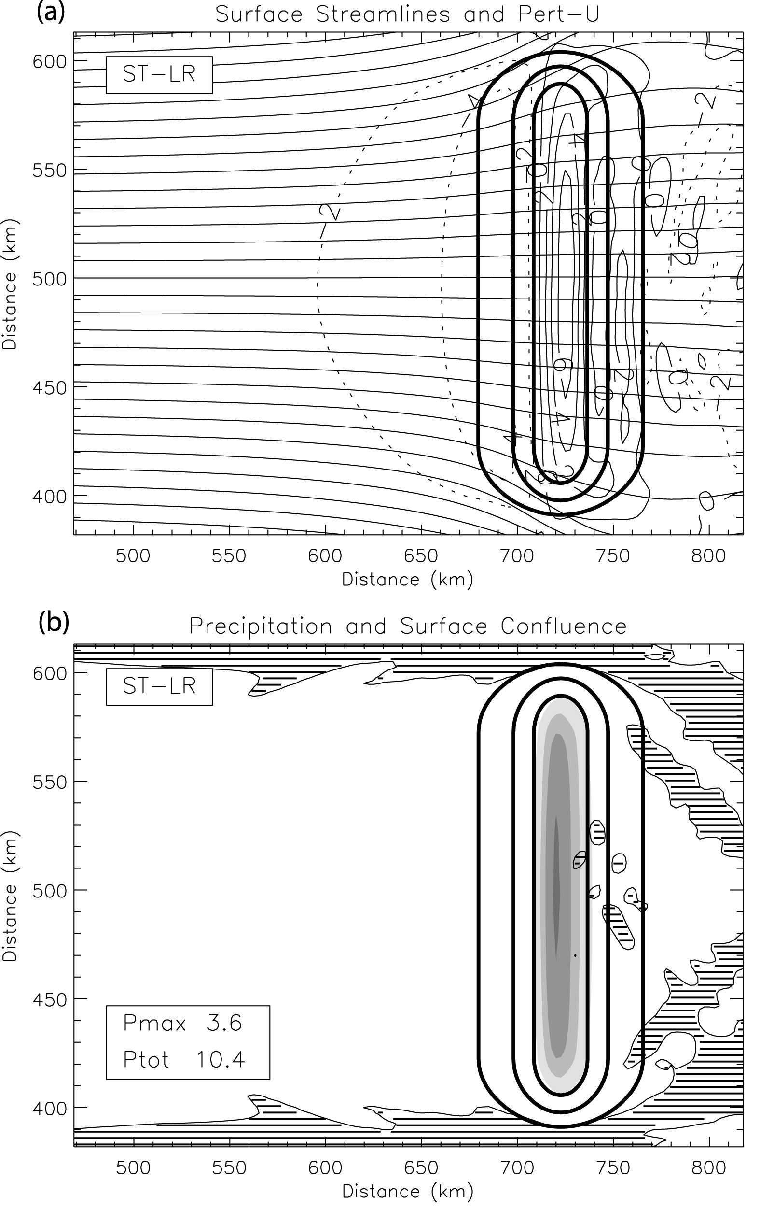
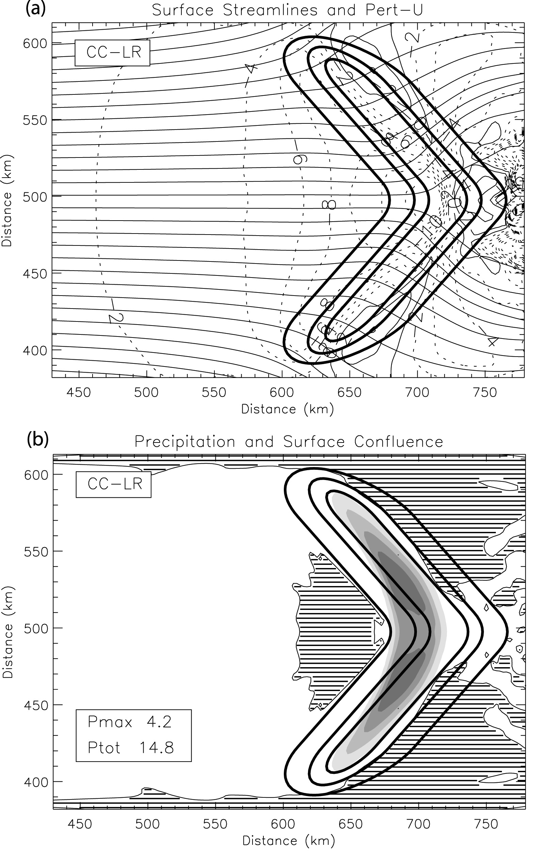
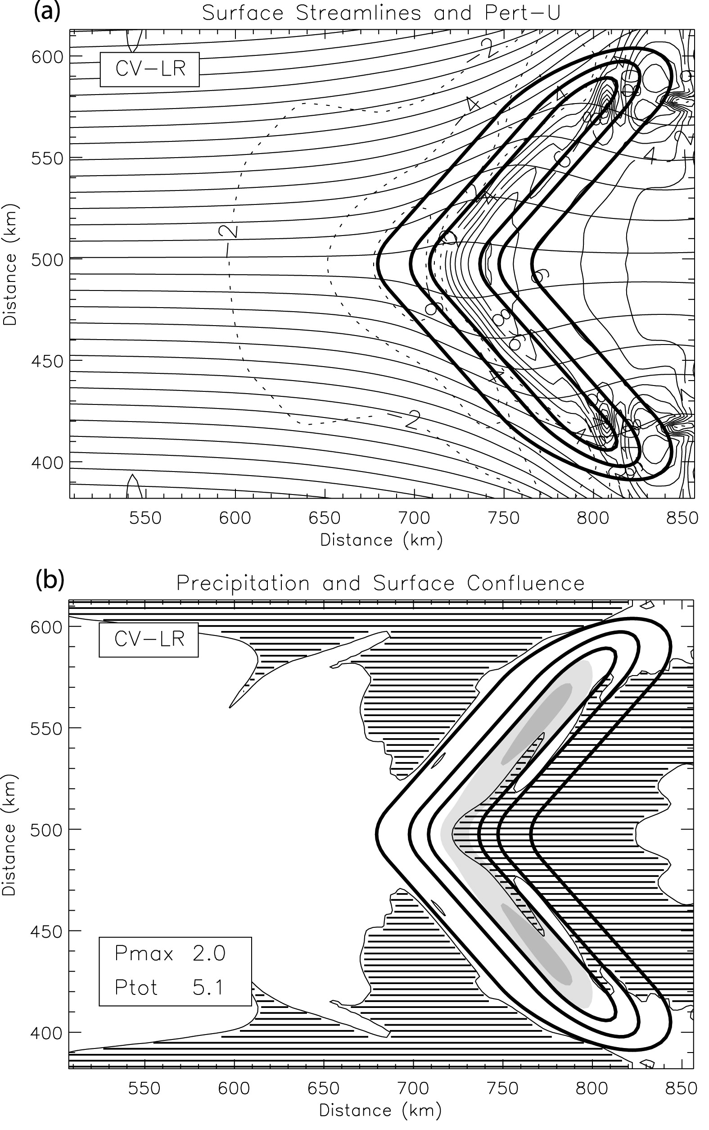
Terrain Shape
Dry Froude Number ~1
Watson and Lane (2012)

Slide 63
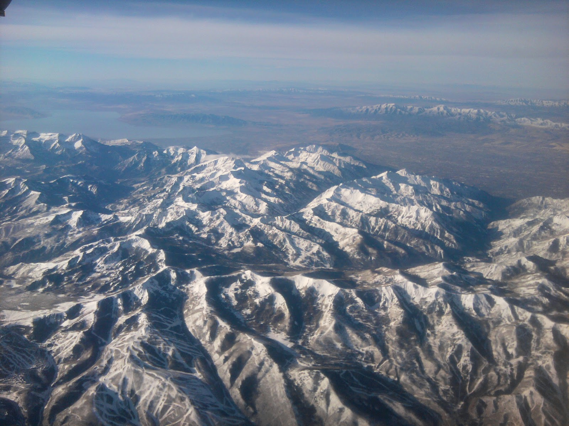
Snowfall (cm)
Snowfall variations a function of precipitation, snow fraction, SLR
Salt Lake City
250
122
762
1293
LCC
236
~10 km
1026
762
BCC
802
Park
City
508
Estimated
WRCC/COOP
Photo: http://sharewhat.blogspot.com/2010_11_01_archive.html; Data: PRISM, WRCC, Steenburgh (unpublished)

Slide 64
Discussion
The orographic ratio varies depending on climate, terrain characteristics, geography, and season
Diagnose and compare the seasonality in OR between northern Utah and three Austrian sites in the next four slides
What are the similarities and differences and why do they exist?

Slide 65
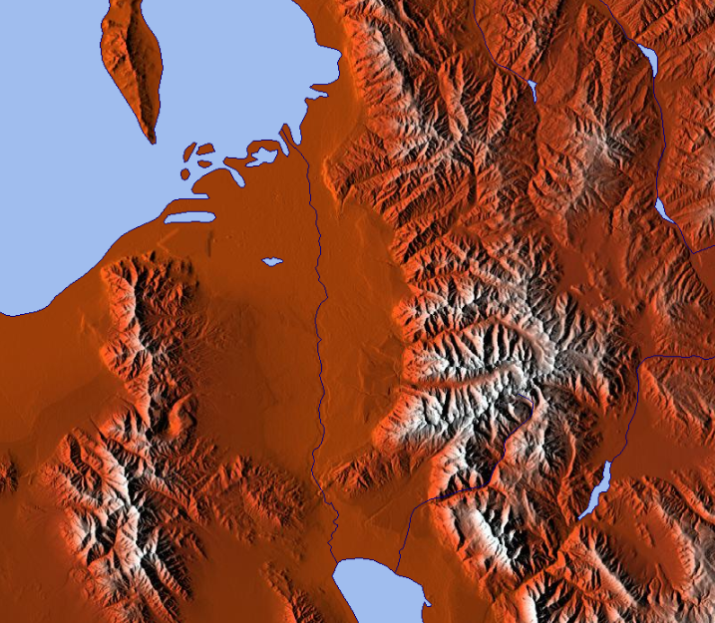
Seasonality
Salt Lake City
1288 m
Alta
2660 m

Slide 66
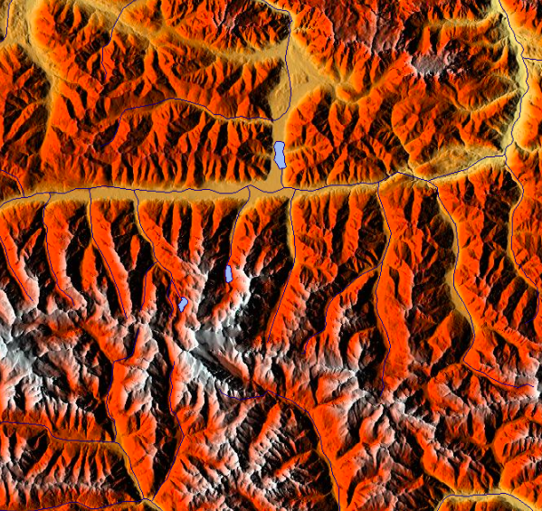
Seasonality
Zell am See
770 m
Rudolfshutte
2317 m

Slide 67
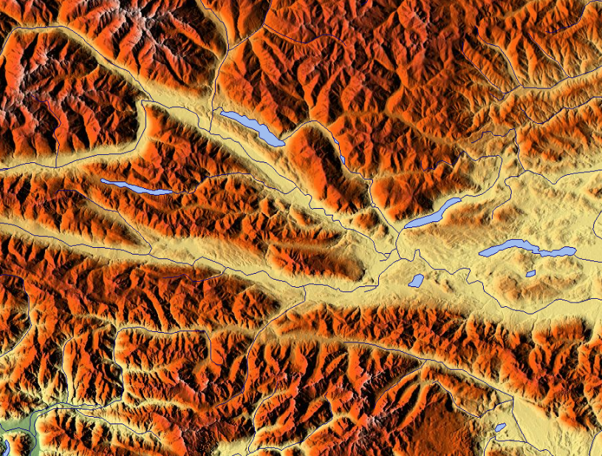
Seasonality
Villach
493 m
Villacher Alpe
2140 m

Slide 68
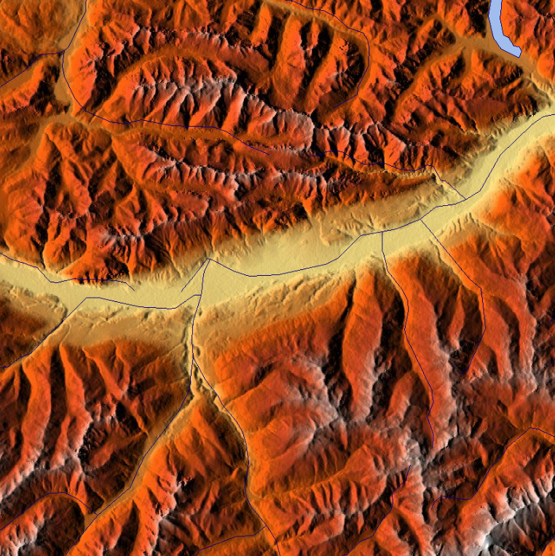
Seasonality
Innsbruck
579 m
Patscherkofel
2247 m

Slide 69
The End…

Slide 70
References
Browning, K. A., F. F. Hill, and C. W. Pardoe, 1974: Structure and mechanism of precipitation and the effect of orography in a wintertime warm sector. Quart. J. Roy. Meteor. Soc., 100, 309-330.
Colle, B. A., R. B. Smith, and D. A. Wesley, 2012: Theory, observations, and predictions of orographic precipitation. Mountain Weather Research and Forecasting, F. Chow, S. de Wekker, and B. Snyder, Eds., 291-344.
Cox, J. A. W., W. J. Steenburgh, D. E. Kingsmill, J. C. Shafer, B. A. Colle, O. Bousquet, B. F. Smull, and H. Cai, 2005: The kinematic structure of a Wasatch Mountain winter storm during IPEX IOP3., Mon. Wea. Rev., 133, 521–542.
Durran, D. R., 1986: Mountain waves. Mesoscale Meteorology and Forecasting. P. S. Ray, Ed., American Meteorological Society, 472-492.
Frei, C., and C. Schär, 1998: A precipitation climatology of the Alps from high‐resolution rain‐gauge observations. Int. J. Climatol., 18, 873–900.
Hobbs, P. V., R. C. Easter, and A. B. Fraser, 1973: A theoretical study of the flow of air and fallout of solid precipitation over mountainous terrain: Part II. Microphysics, J. Atmos. Sci., 30, 813–823.
Houze, R. A., Jr., 2012: Orographic effects on precipitating clouds. Rev. Geophys., 50, RG1001.
Kirshbaum, D. J., B. Adler, N. Kalthoff, C. Barthlott, and S. Serafin, 2018: Moist orographic convection: Physical mechanisms and links to surface-exchange processes. Atmosphere, 9, 80; doi:10.3390/atmos9030080.
Medina, S., and R. A. Houze, Jr., 2003: Air motions and precipitation growth in Alpine storms. Quart. J. Roy. Meteor. Soc., 129, 345-371.
McDonnal, D., and B. Colman, 2003: Unpublished.
Medina, S. and R. Houze, 2003: Air motions and precipitation growth in alpine storms. Quart. J. Roy. Meteor. Soc., 129, 345–371.

Slide 71
References
Neiman P. J., F. M. Ralph, A. B. White, D. E. Kingsmill, and P. O. G. Persson, 2002: The statistical relationship between upslope flow and rainfall in California’s coastal mountains: Observations during CALJET. Mon. Wea. Rev., 130, 1468–1492.
Rotunno, R., and R. Ferretti, 2001: Mechanisms of intense Alpine rainfall. J. Atmos. Sci., 58, 1732-1749.
Rotunno, R. and R. A. Houze, 2007: Lessons on orographic precipitation from the Mesoscale Alpine Programme. Quart. J. Roy. Meteor. Soc., 133, 811–830.
Sawyer, J. S., 1956: The physical and dynamical problems of orographic rain. Weather, 11, 375-381.
Schultz, David M., Robert J. Trapp, 2003: Nonclassical cold-frontal structure caused by dry subcloud air in northern Utah during the Intermountain Precipitation Experiment (IPEX). Mon. Wea. Rev., 131, 2222–2246.
Shafer, J. C., W. J. Steenburgh, J. A. W. Cox, and J. P. Monteverdi, 2006: Terrain influences on synoptic storm structure and mesoscale precipitation distribution during IPEX IOP3. Mon. Wea. Rev., 134, 478–497.
Steenburgh, W. J., 2003: One hundred inches in one hundred hours: Evolution of a Wasatch Mountain winter storm cycle. Wea. Forecasting, 18, 1018–1036.
Steenburgh, W. J., 2004: THE MAP ROOM: One hundred inches in one hundred hours. Bull. Amer. Meteor. Soc., 85, 16–20.
Steenburgh, J., 2014: Secrets of the Greatest Snow on Earth. Utah State University Press, 186 pp.
Stoelinga, M. T., R. E. Stewart, G. Thompson, and J. M. Theriault, 2012: Microphysical processes within winter orographic cloud and precipitaiton systems. Mountain Weather Research and Forecasting, F. Chow, S. de Wekker, and B. Snyder, Eds., 345-408.
Watson, C. D., and T. P. Lane, 2012: Sensitivities of orographic precipitation to terrain geometry and upstream conditions in idealized simulations. J. Atmos. Sci., 69, 1208-1231.

