Slide 1
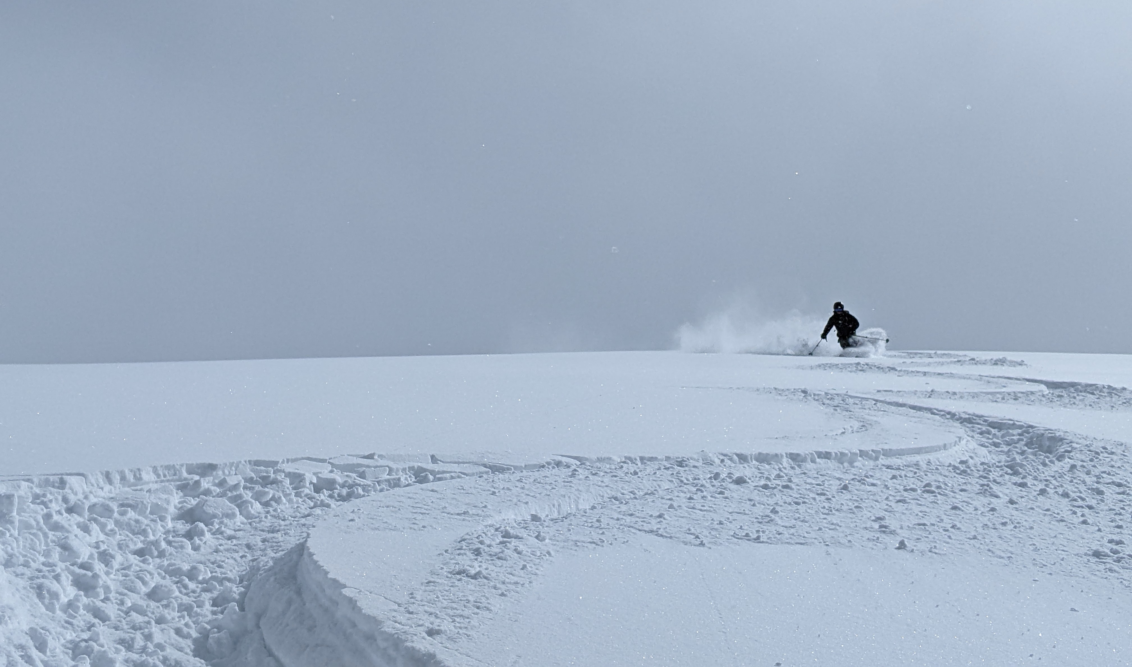
Predicting Snow-to-Liquid Ratio over the Mountain West
Jim Steenburgh, Peter Veals, and Michael Pletcher
Department of Atmospheric Sciences
University of Utah
jim.steenburgh@utah.edu
Special Thanks
Andrew Schwartz
Central Sierra Snow Lab
Mike Wessler
NOAA/NWS
Trevor Alcott
NOAA/ESRL
Kirstin Harnos, Jimmy Correia, Massey Bartolini
WPC
Randy Chase, CoCoRAHS Team
Colorado State University
Funding: NOAA Weather Program Office
Photo: Jim Steenburgh

Slide 2
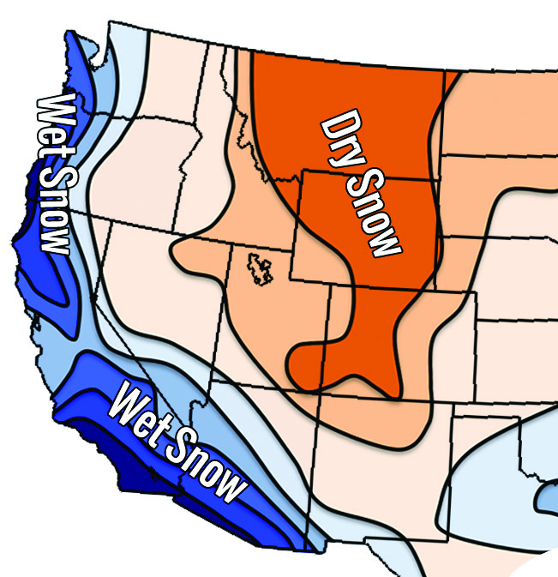
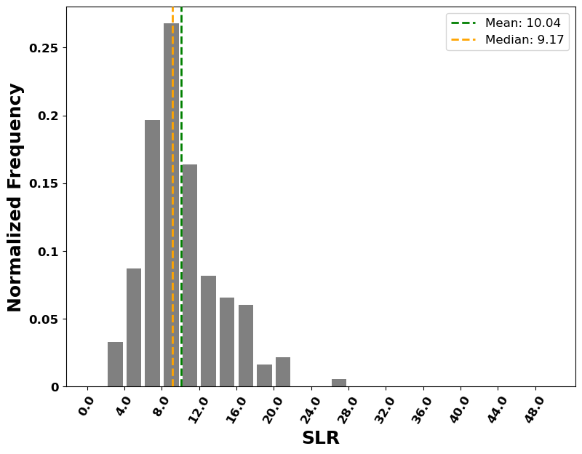
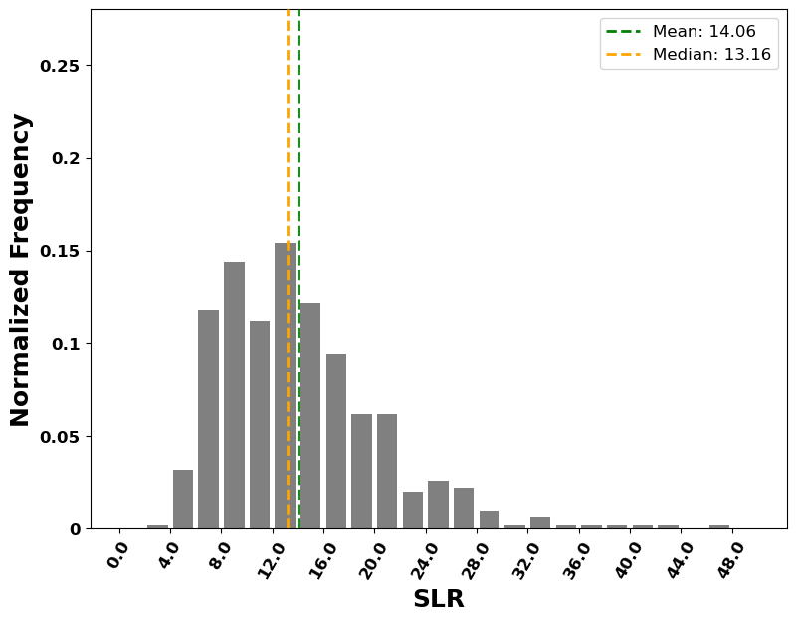
Snow-to-Liquid Ratio (SLR)
Mean 10:1
Median 9:1
Mean 14:1
Median 13:1
Central Sierra Snow Lab, CA
Alta, UT
Mean (Steenburgh 2023)
On average, decreases from coast to interior,
but exhibits large spatiotemporal variability

Slide 3
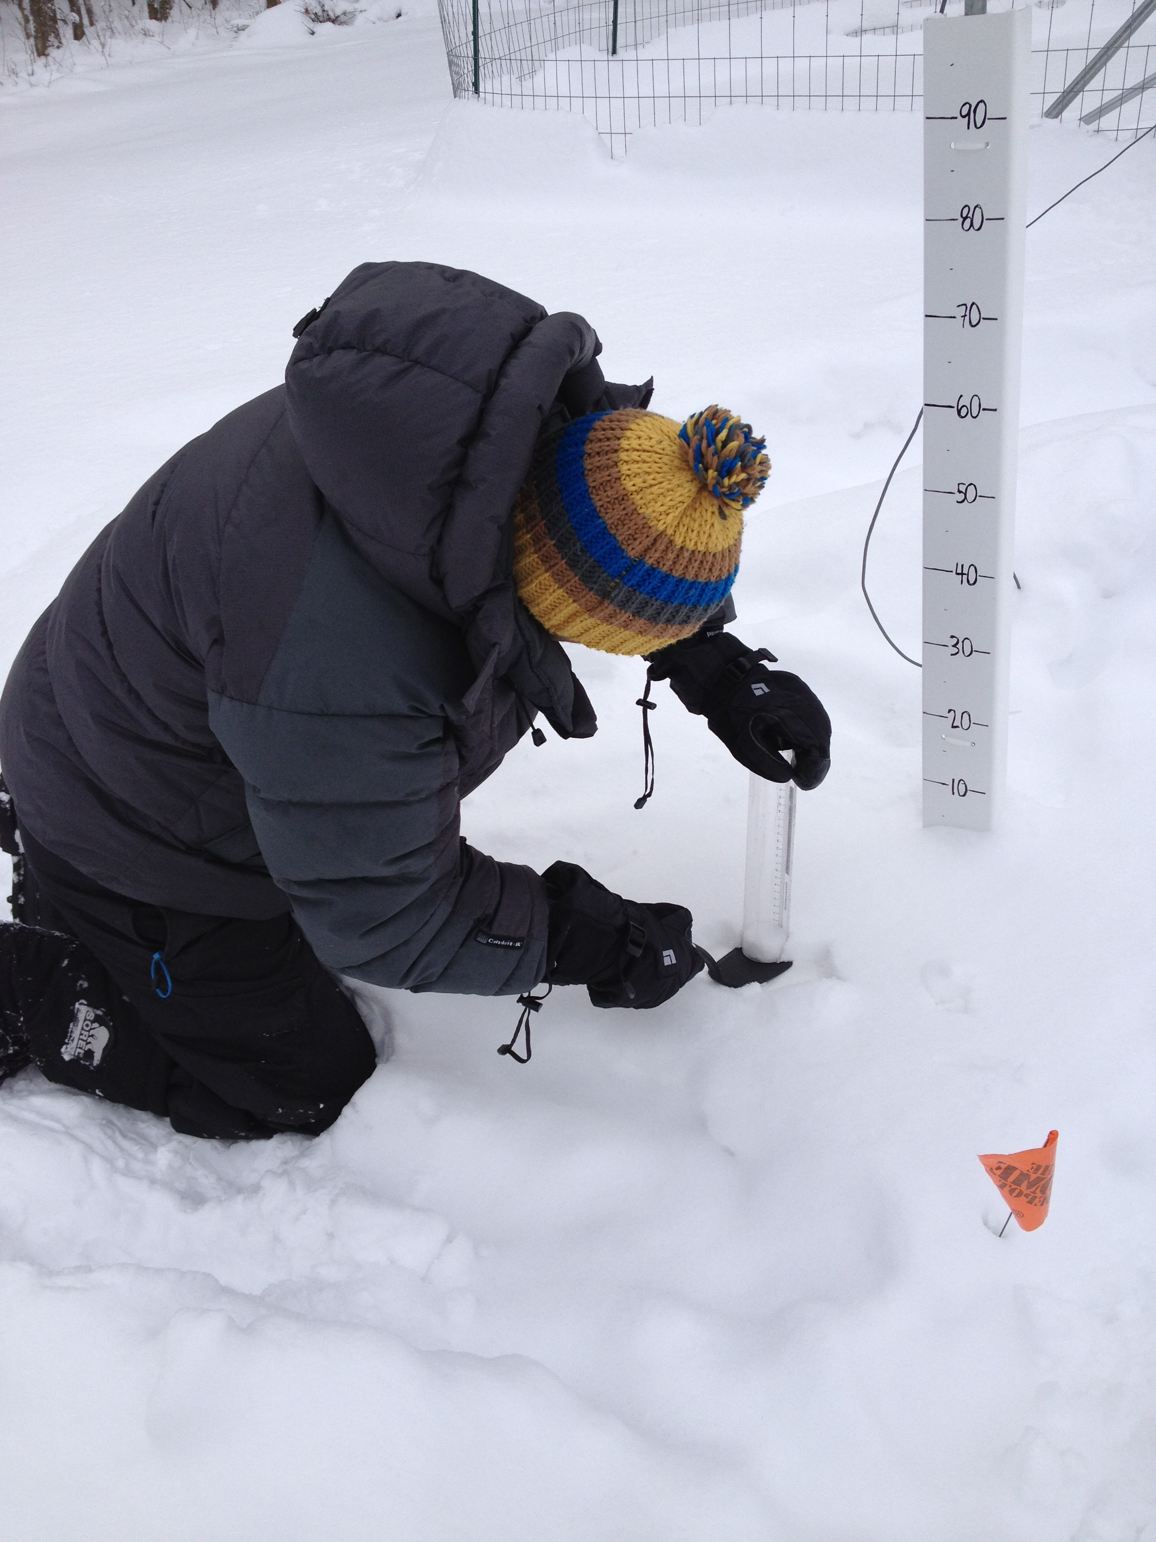
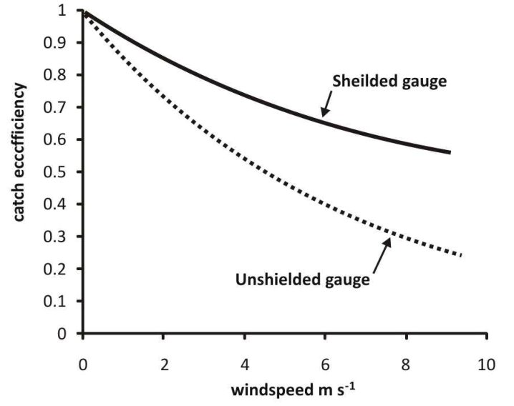
Our Approach
Focus on training and testing with
high-quality observations (i.e., manual
obs from snow-safety teams and
other trained observers)
Gauge undercatch issues
(MacDonald and Pomeroy 2007)

Slide 4
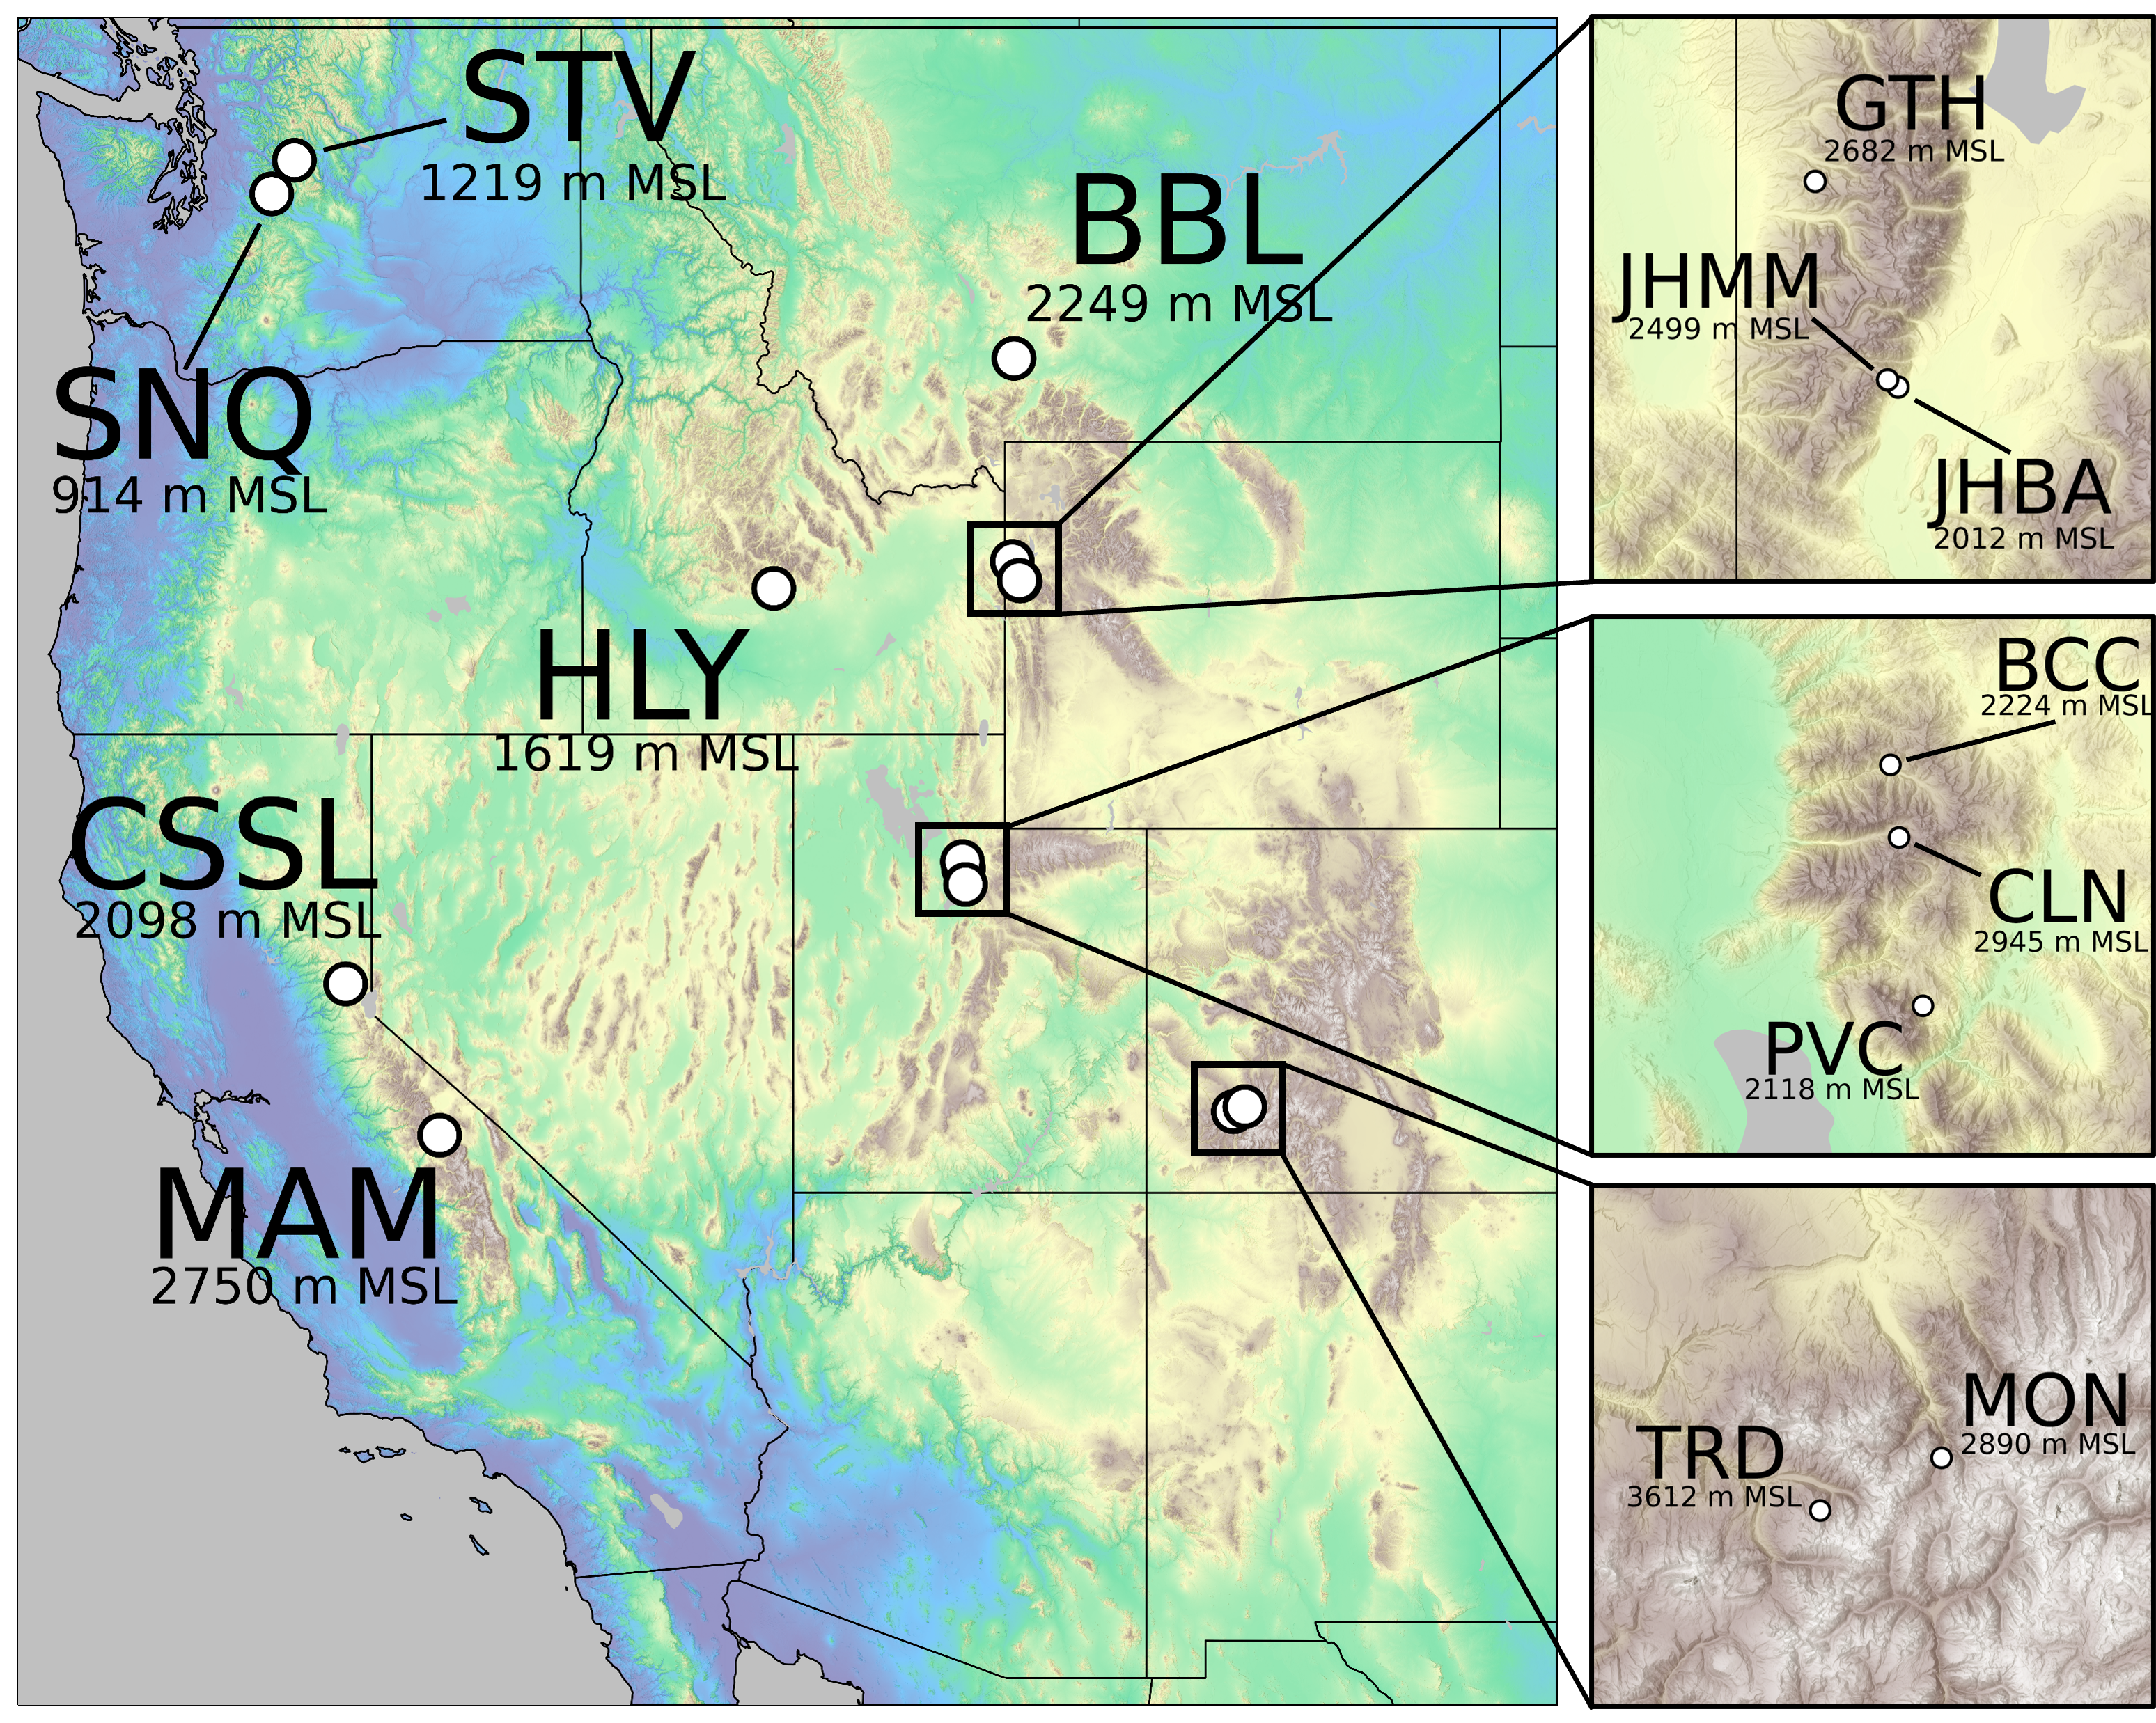
Western CONUS Sites
Data from 14 sites Nov–Apr 2018–2024
(CSSL, STV, and HLY 1-2 seasons less)
Events: > 5 cm snow; > 2.8 mm water
Toss 10:1 (placeholder)
QC based on nearby MesoWest sites

Slide 5
GFS and HRRR Training/Testing
Training variables based on prior studies (e.g., Roebber et al. 2003; Alcott and Steenburgh 2010)
  AGL: Temperature, specific humidity, relative humidity, wind speed interpolated from pressure to AGL at 400 m intervals to 5000 m AGL
  Pres: Geopotential height at selected pressure levels
  Others: Cloud top temperature, solar angle (mean and maximum), SWE (forecast and observed) lapse rates (1–2 km AGL, 2-3 km AGL, 1–3 km AGL, 3-5 km AGL), CAPE
Training/testing based on random 60/40 split
Showing selected results here based on 100 randomized trials (R2 and MAE are means; plots based on trial with result close to R2 and MAE means)

Slide 6
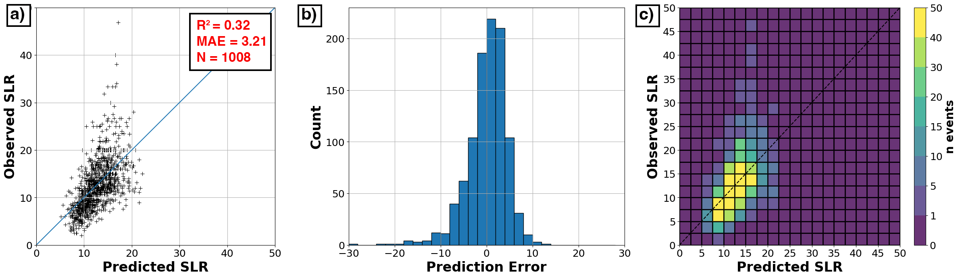
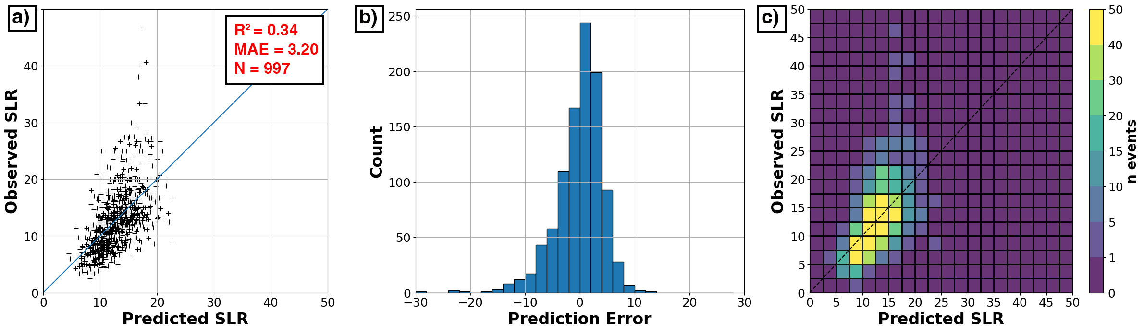
Simple Is as Simple Does
Multiple Linear Regression with T and Speed at 400 and 2400 m AGL
GFS Train and Test
MAE 3.21
HRRR Train and Test
MAE 3.20

Slide 7
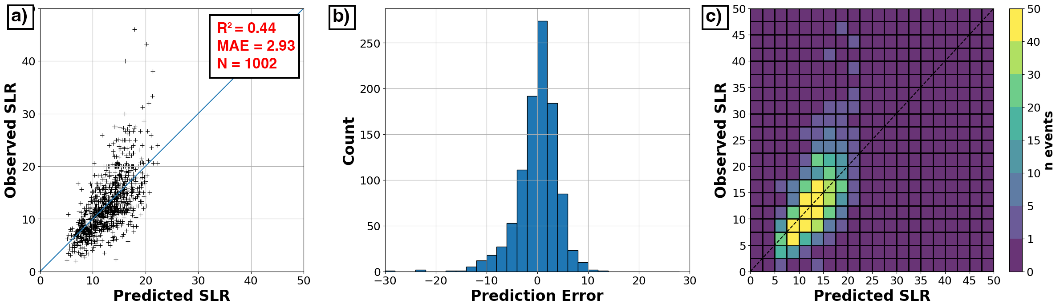
“Best” Results
Random Forest with T, Spd, Q, RH at 400 & 2400 m, 500-mb Ht, Model QPF, Max Solar Angle
HRRR Train and Test
MAE 2.93

Slide 8
“Best” Results
Random Forest with T, Spd, Q, RH at 400 & 2400 m, 500-mb Ht, Model QPF, Max Solar Angle
HRRR Train and Test
MAE 2.93
High SLR Events a Challenge

Slide 9
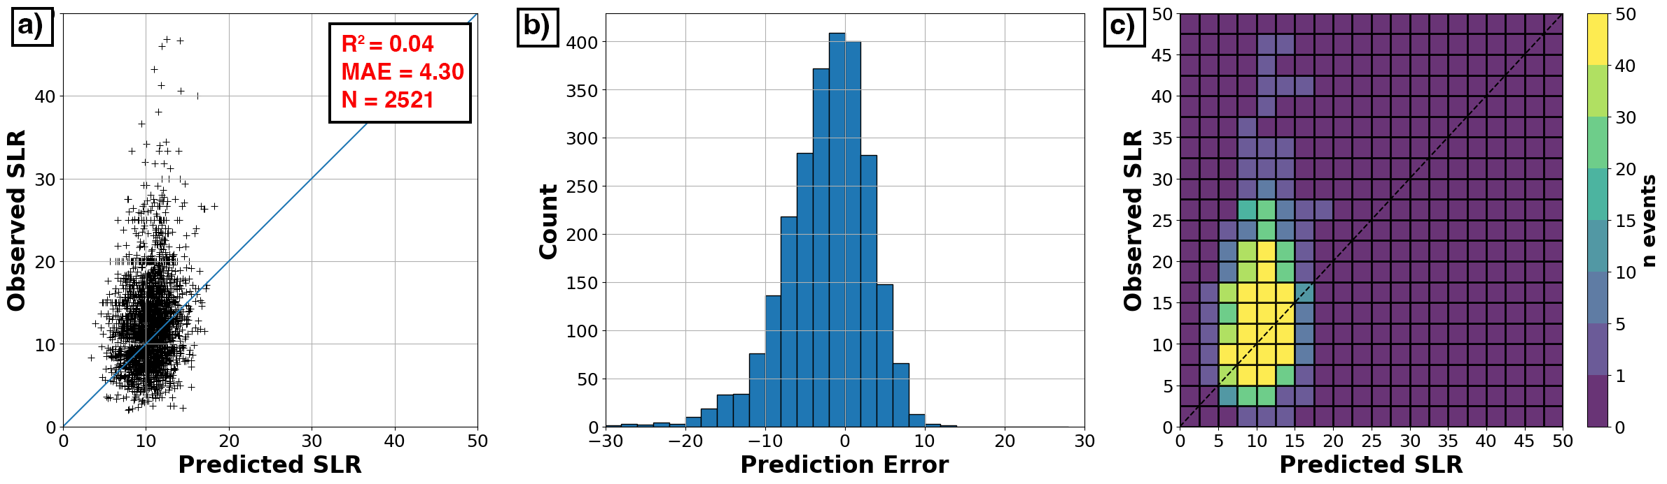
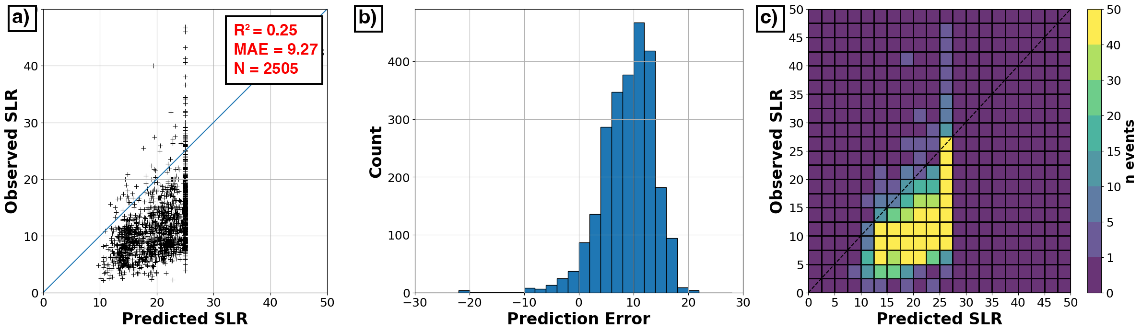
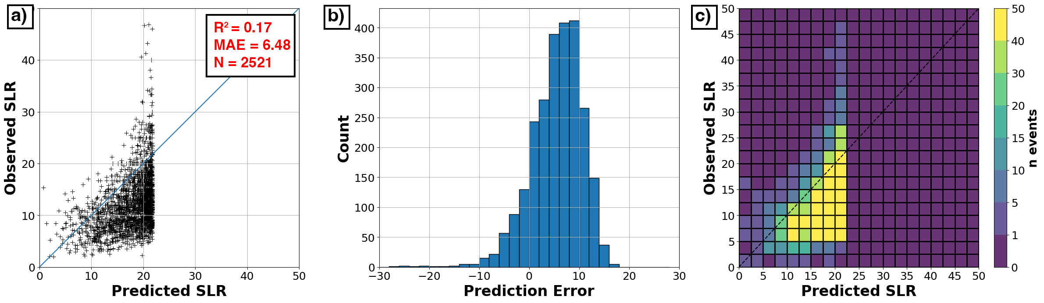
Current NBM Techniques
Cobb
MAE 4.30
Roebber
MAE 9.27
MaxTAloft
MAE 6.48

Slide 10
Caveats and Limitations
Testing and Training focuses on high-elevation sites
    Reduces importance of p-type or on-the-ground melting considerations that might be occur more frequently during lower-elevation events
Snowfall forecasts also a function of QPF
    See Pletcher et al. (2024, WAF) for how a bad SLR plus a bad QPF can sometimes give you a good QSF.

Slide 11
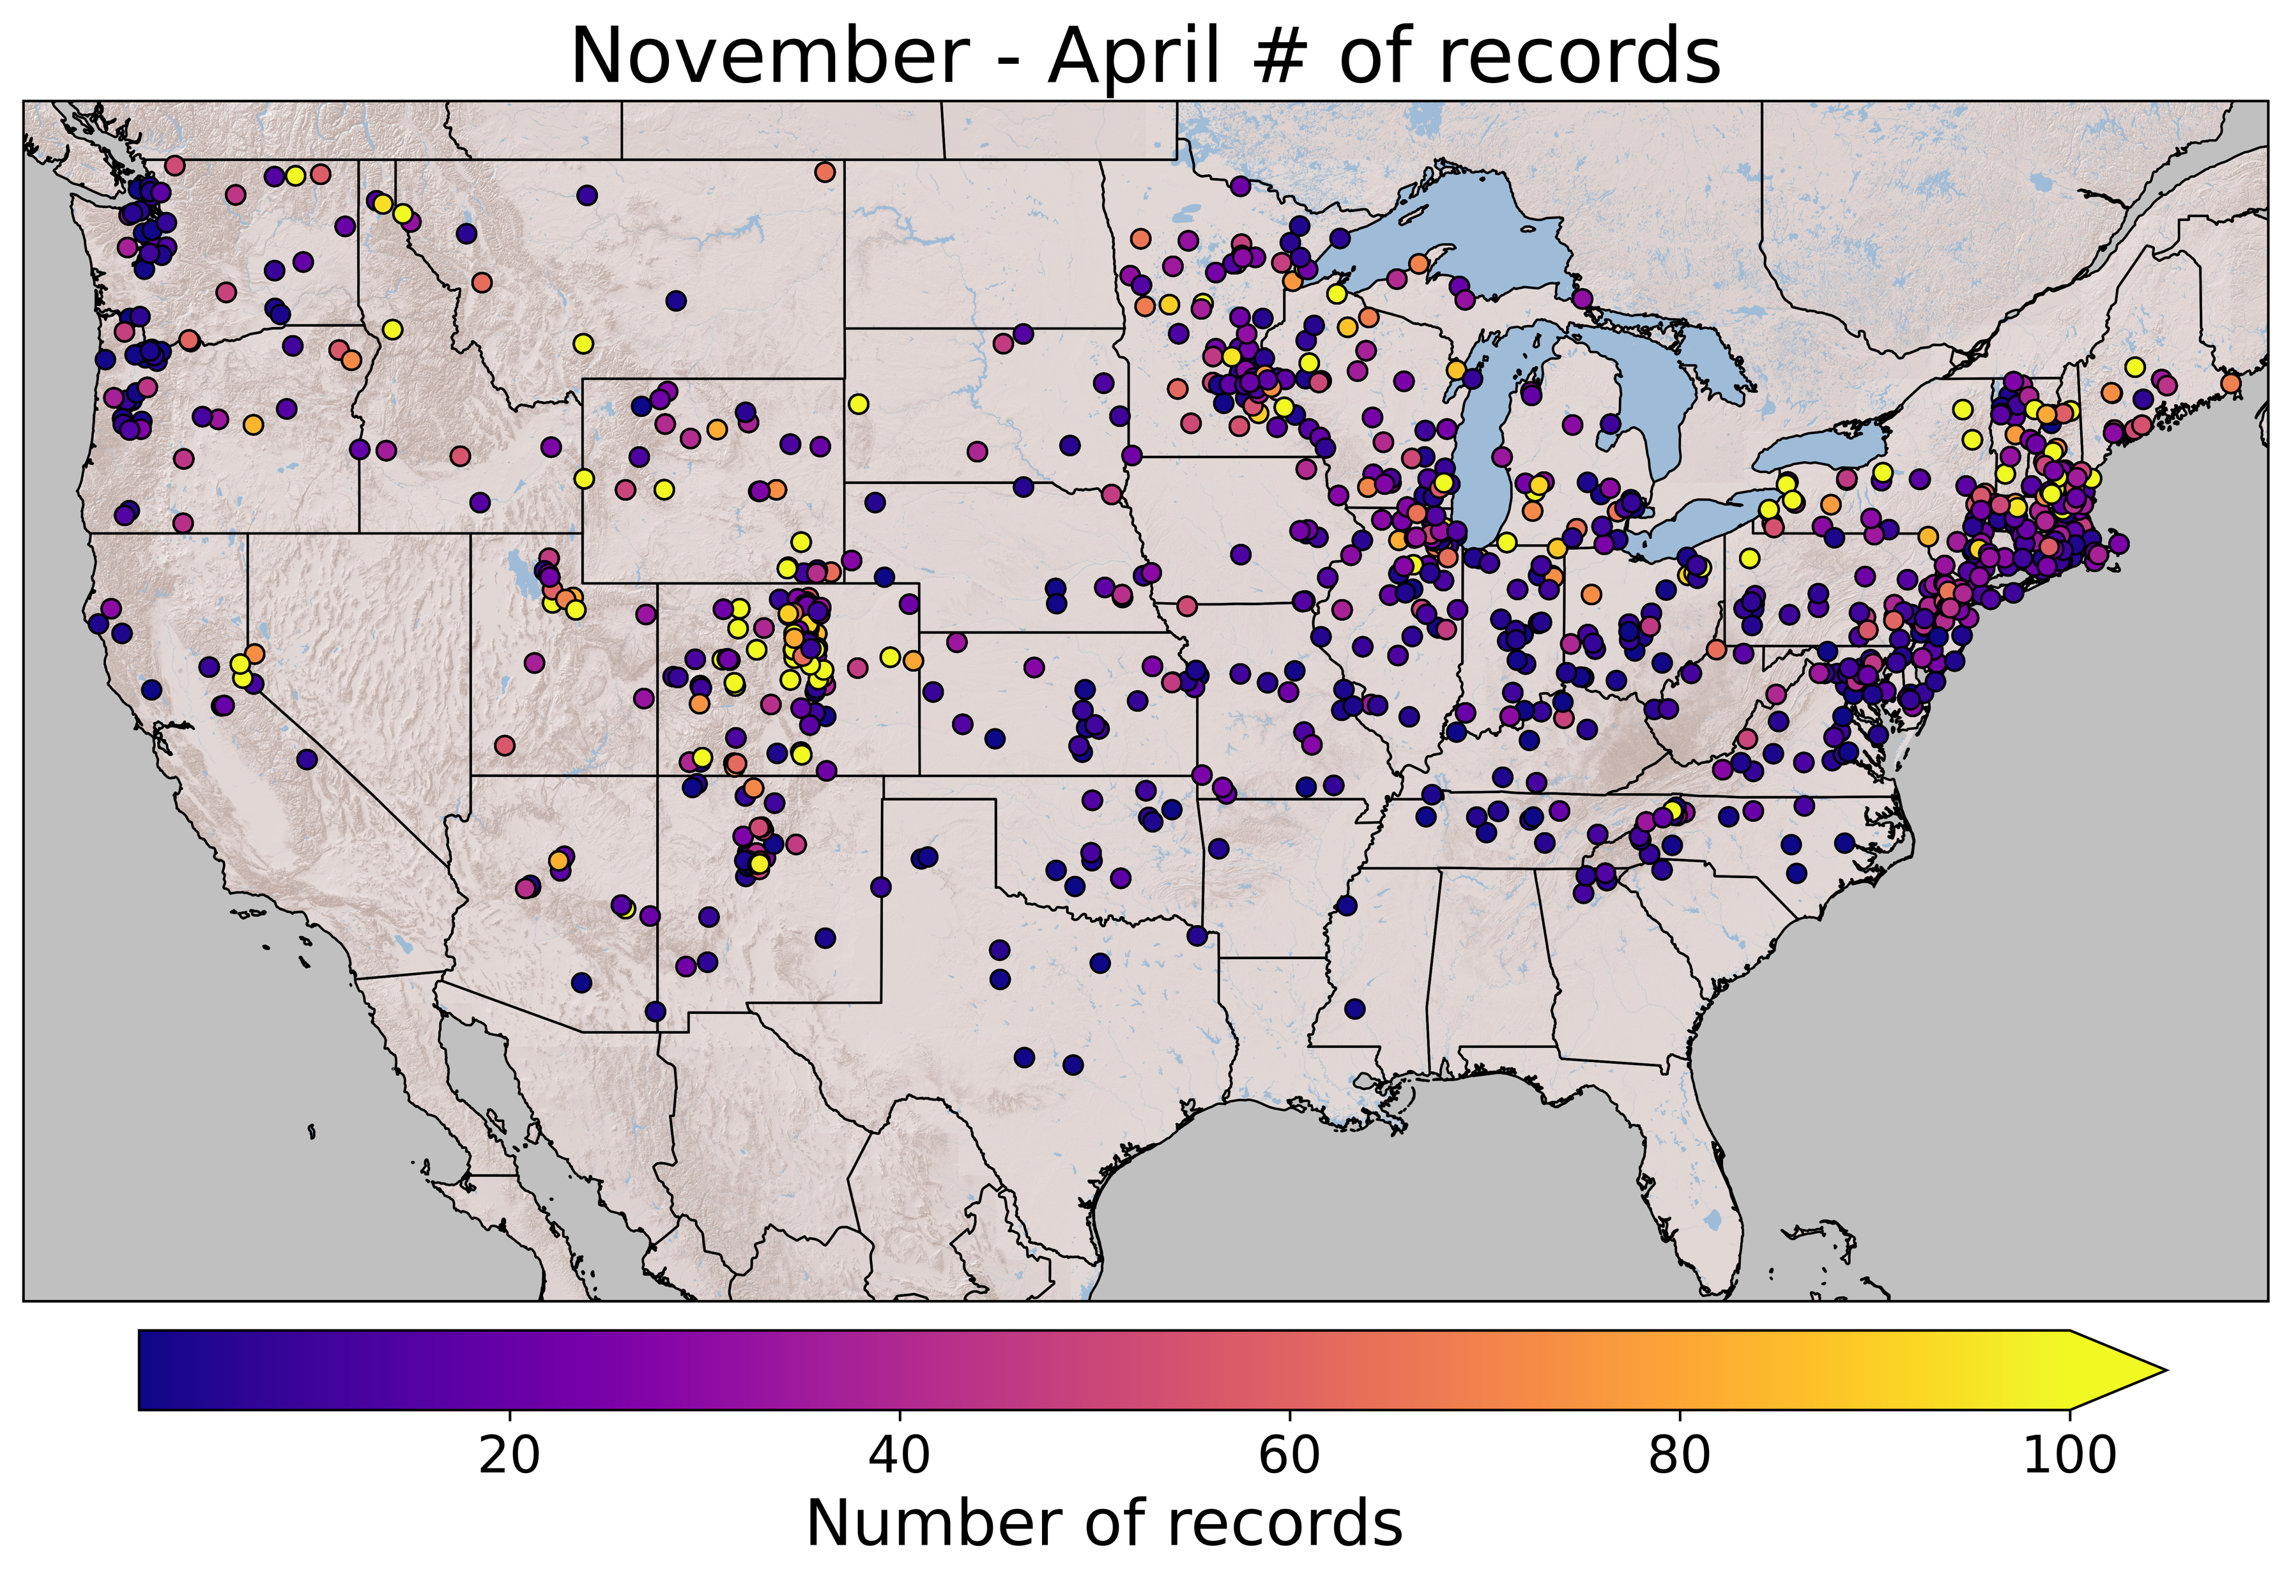
Current Work
“Select” CoCoRAHS
Daily Obs
2004–2023
Regional and CONUS-wide
training

Slide 12
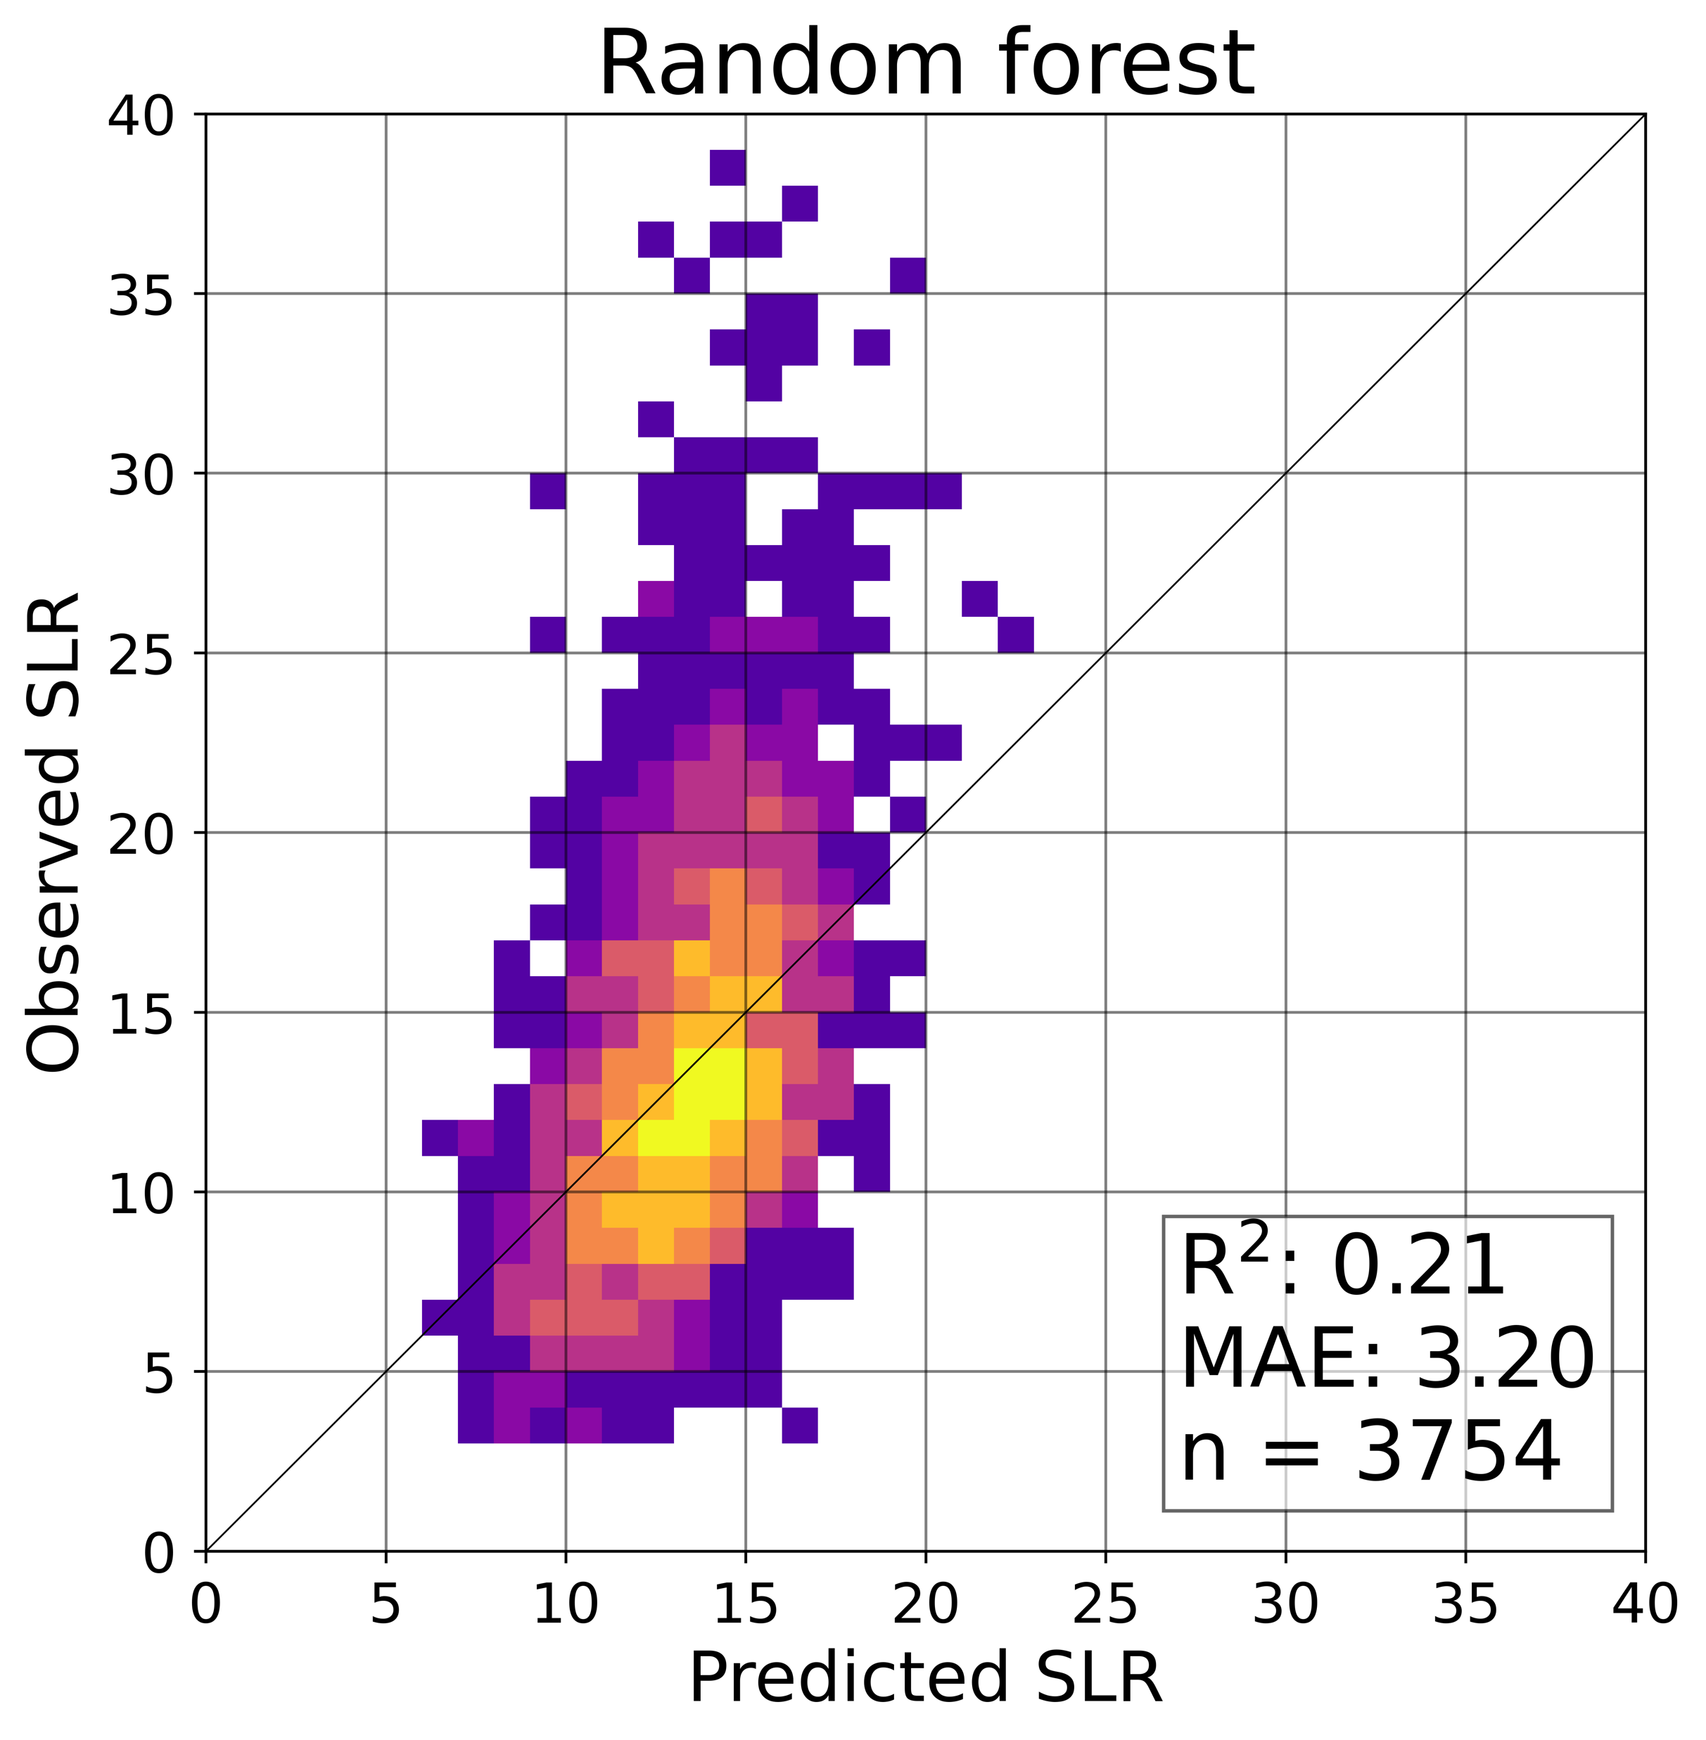
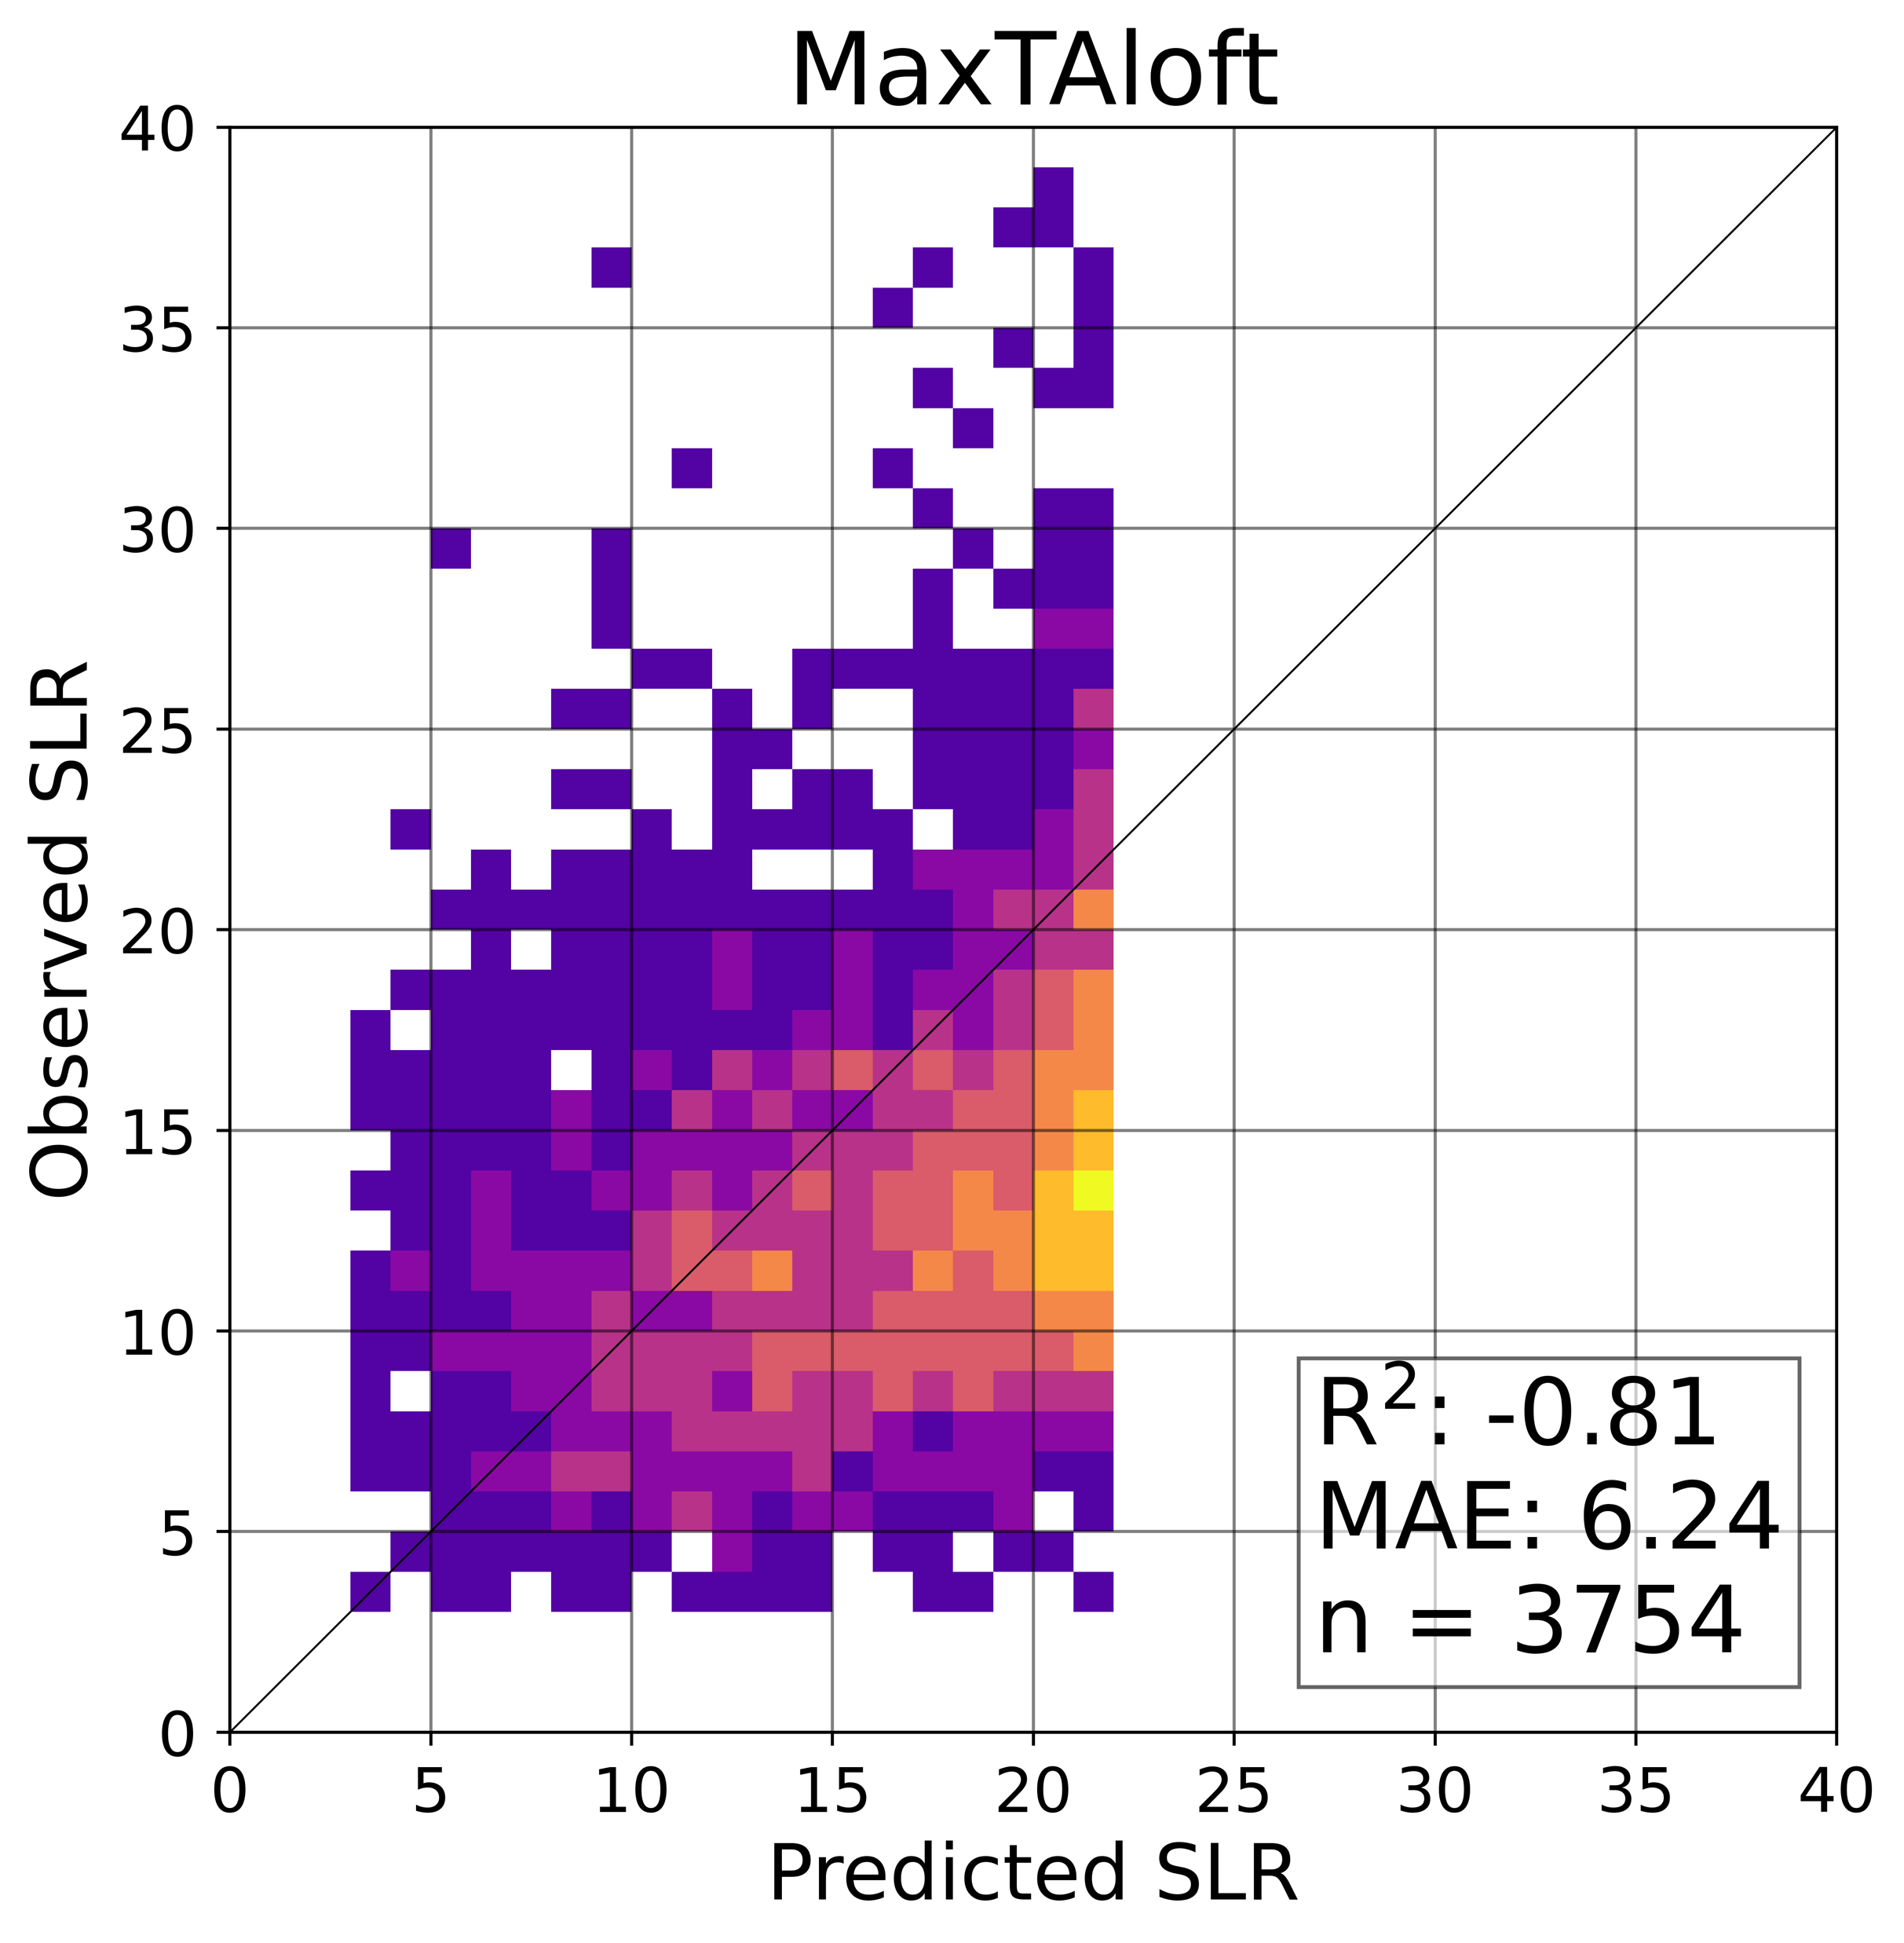
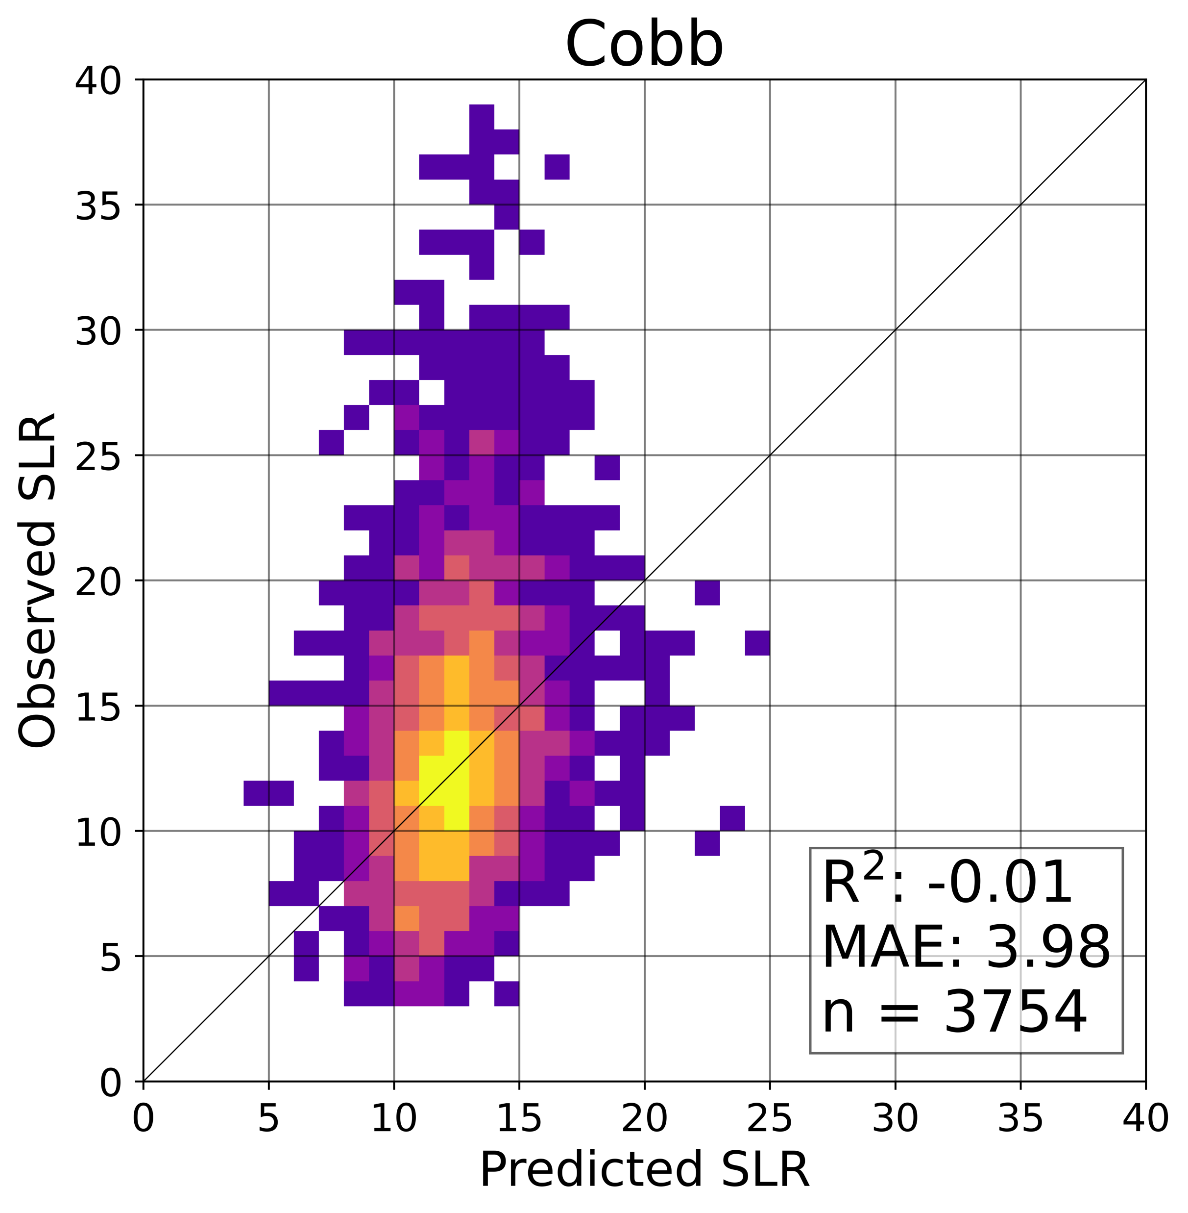
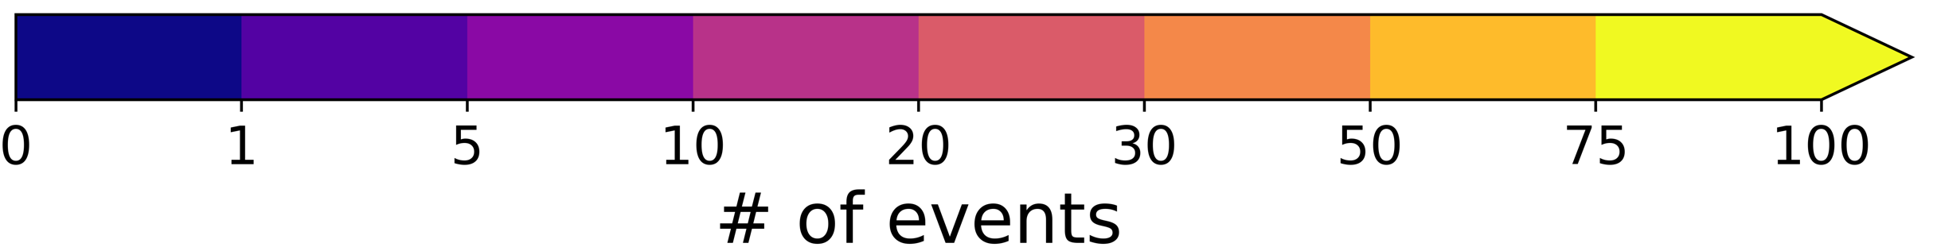
Current Work
Western CONUS
ERA5 Train/Test

Slide 13
Extending to Operations
Simplest approach would be linear regression with a small number of variables
Could use ERA-5 trained results to apply to any model
    Results don’t suffer that much

Slide 14
Summary
Based on training and testing using high-quality western US snow observations it is possible to develop techniques that outperform existing operational methods
Sensitivity to training dataset/variables/method is not large
    MAEs generally 2.9–3.25
Possible to transfer simple approaches quickly to operations
Challenges remain near transition zone and for high SLR events

