Slide 1
Precipitation Systems and Microphysical Processes VU2: Course Number 707813
©Jim Steenburgh
NASA Terra/Modis
14 January 2017
Jim Steenburgh
Fulbright Visiting Professor of Natural Sciences
University of Innsbruck
Department of Atmospheric Sciences
University of Utah
jim.steenburgh@utah.edu

Slide 2
Precipitation Systems

Slide 3
Generating Clouds and Precipitation
Clouds form when water vapor in the atmosphere condenses into cloud droplets or ice crystals
Requires air to become supersaturated through evaporation or cooling
Ascent and associated adiabatic expansion and cooling is the primary (but not only) mechanism for generating supersaturation in precipitating clouds
Precipitation occurs when hydrometeors grow sufficiently large to fall and reach the ground
Typically cannot be accomplished through condensation alone
May involve multiple microphysical processes

Slide 4
Group Discussion
What weather systems are primarily
responsible for precipitation in the
tropics and extratropics?

Slide 5
Major Precipitation Systems
Extratropical cyclones, fronts, and “large-scale forcing”
Tropical cyclones
Convection
Mesoscale convective systems
Orographic
*Systems not necessarily independent “actors”

Slide 6
Extratropical Cylcones/Fronts
NASA Earth Observatory

Slide 7
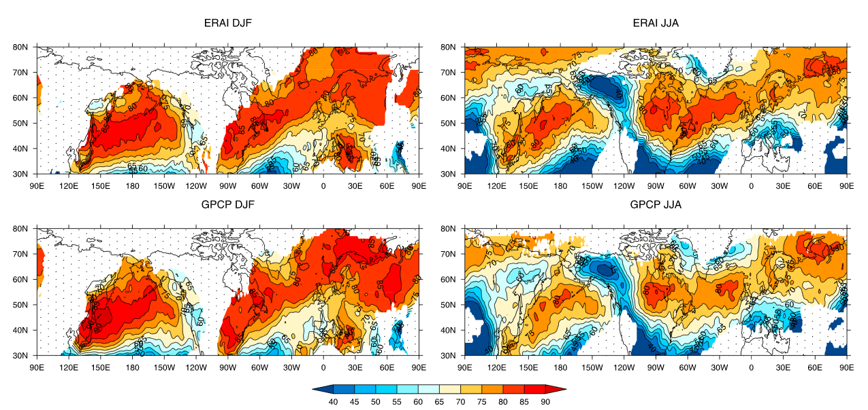
Cyclone Contribution
Source: Hawcroft et al. (2012), http://onlinelibrary.wiley.com/doi/10.1029/2012GL053866/abstract

Slide 8
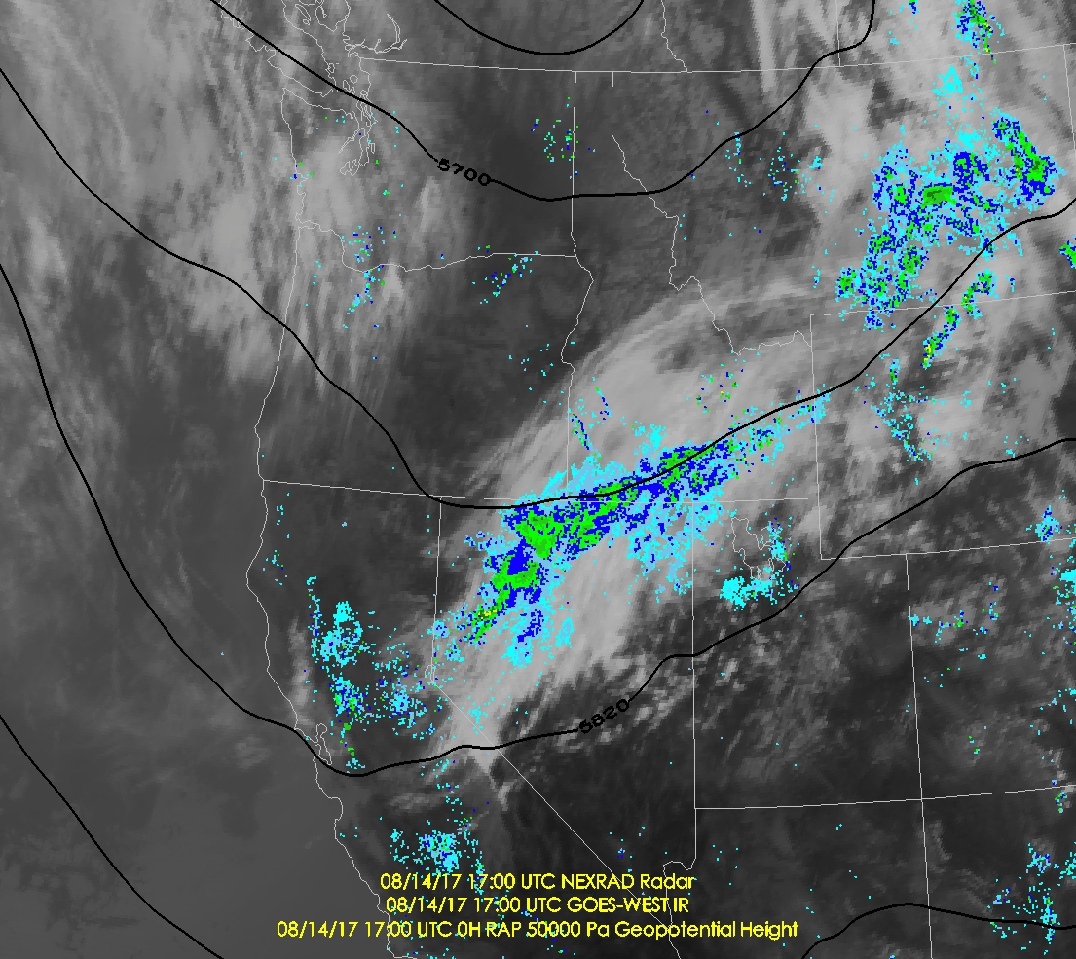
Large-scale forcing

Slide 9
Convection
Vertical motions due to an imbalance of forces in the vertical
Precipitating clouds generated by rising parcels that are warmer than their environment, resulting in an updraft
Key ingredients
Instability, moisture, & lift
©Derek Gee/Buffalo News

Slide 10
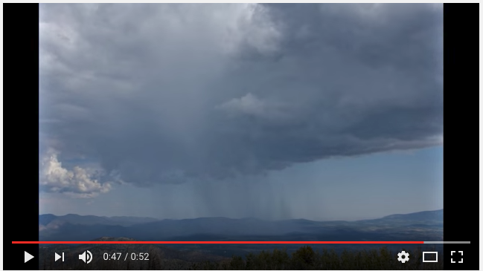
Convection
https://www.youtube.com/watch?v=Py9thuWwofI

Slide 11
Mesoscale Convective Systems
Organized collection of two or more cumulonimbus clouds that interact to form an extensive region of precipitation
Precipitation region is nearly contiguous and contains convective and stratiform elements, with the latter typically more extensive
http://www.nickengerer.org/projects
http://www.wxonline.info/topics/mcs.html
Trapp (2013)

Slide 12
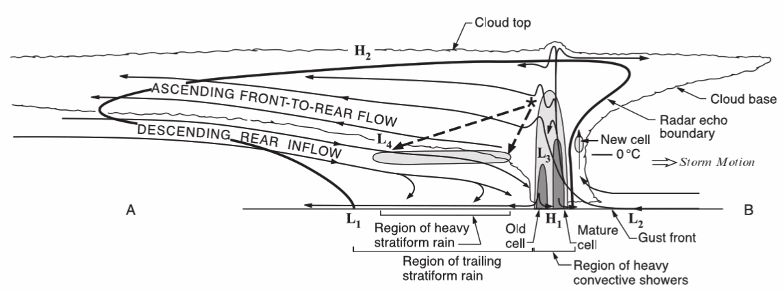
Mesoscale Convective Systems
Hydrometeor detrainment and transport from convective line and “layer lifting” important in precipitation dynamics of the stratiform region
Example is of a convective-line MCS (a.k.a. squall line)
Stratiform
Region
http://www.scienceofthesouth.com/tag/qlcs/
Convective Line
Houze et al. (1989), Houze (2004)

Slide 13
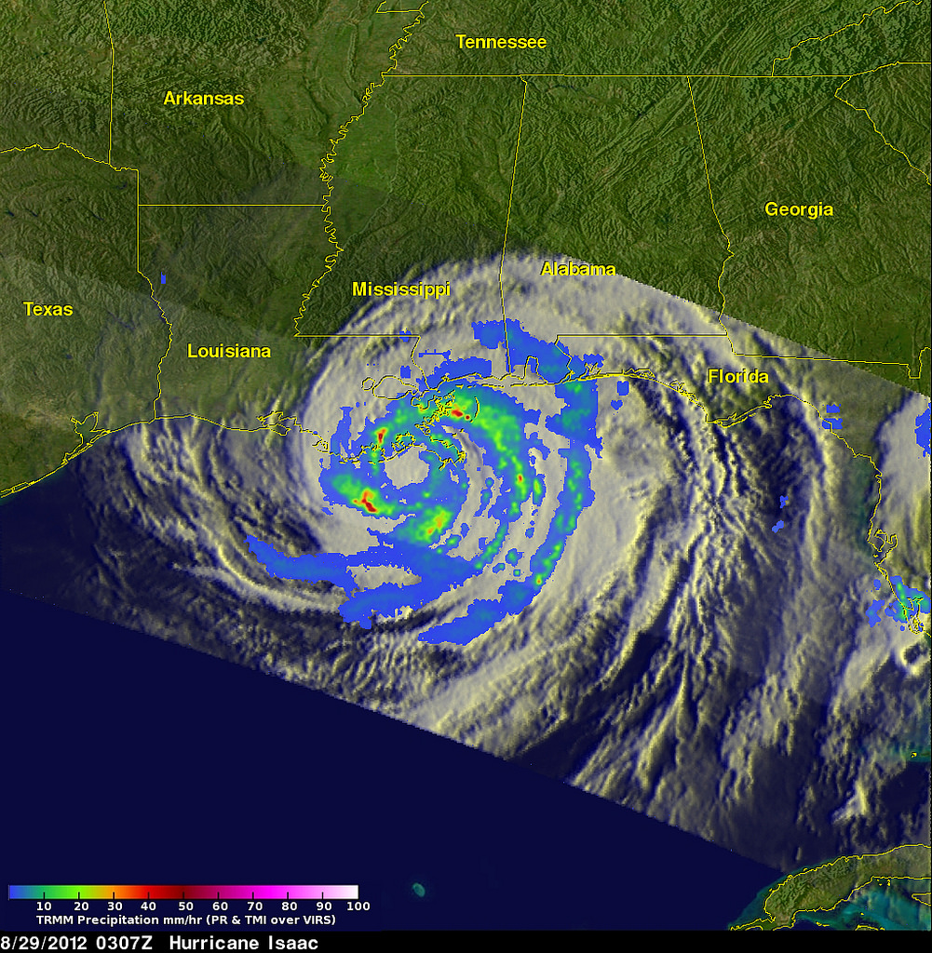
Tropical Cyclones
NASA

Slide 14
Orographic
Steenburgh (2014)

Slide 15
Microphysical Processes

Slide 16
Microphysical Processes
Cloud droplet formation
CCN and droplet size spectra
Warm cloud processes
Collision-coalescence
Mixed-phase processes
Ice nucleation
Ice multiplication
Depositional growth (a.k.a., the Bergeron-Findeisen Process)
Accretional growth
Aggregation

Slide 17
Microphysical Processes
Ice nucleation,
Ice multiplication
& crystal growth
Mostly
ice
Cloud Droplets
Photo: Jim Steenburgh

Slide 18
Droplet Formation
Cloud droplets form on soluble atmospheric aerosols
Heterogeneous nucleation
Cloud condensation nuclei (CCN)
Aerosol which serve as nuclei for water vapor condensation
On average, there is an order of magnitude more CCN in continental air than maritime air
Wallace and Hobbs (1977)

Slide 19
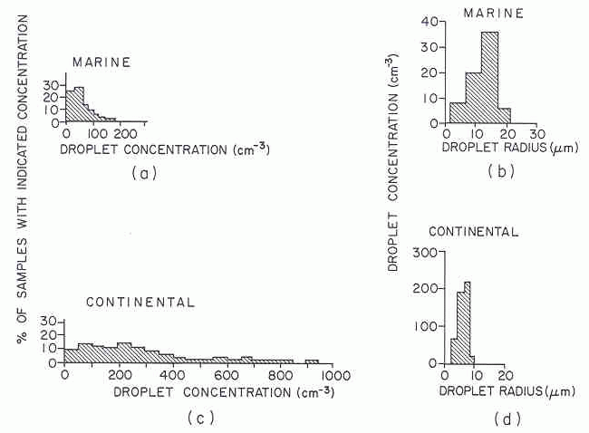
Size Spectra
Marine
Continental
Continental clouds frequently feature
Large cloud droplet number concentrations & smaller cloud droplets
Maritime clouds frequently feature
Smaller cloud droplet number concentrations & larger cloud droplets
Wallace and Hobbs (1977)

Slide 20
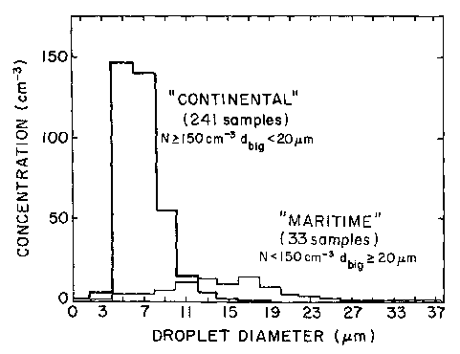
Size Spectra
Cloud droplet spectra
Storm Peak Lab
Steamboat, CO
In continental areas, however, there are large intra- and inter-storm variations depending on aerosol characteristics
Maritime size spectra are rare, but possible
Significance: Impacts hydrometeor growth (more later)
Hindman et al. (1994)

Slide 21
Warm Cloud Processes
“Warm Cloud”
Clouds that lie entirely below the 0°C level or consistent entirely of liquid water
Mechanisms for warm cloud hydrometeor growth
Condensation
Collision-coalescence

Slide 22
Condensation
Droplet radius
Condensation growth
Time
Droplet growth by condensation is initially rapid, but slows with time
Condensational growth too slow to produce large raindrops

Slide 23
Collision–Coalescence
C/C growth
Droplet radius
Condensation growth
Time
Growth of small droplets into raindrops is achieved by collision-coalescence
Fall velocity of droplet increases with size
Larger particles sweep out smaller cloud droplets and grow
Becomes more efficient as radius increases
Turbulence may contribute to this growth mechanism

Slide 24
Warm Cloud Processes
C/C growth
Droplet radius
Condensation growth
Time
Cloud droplet growth initially dominated by condensation
Growth into raindrops dominated by collision-coalescence
Most effective in maritime clouds due to presence of larger cloud droplets (due to fewer CCN)

Slide 25
Hawaiian Warm-Phase Clouds
Freezing Level (0˚C)
Liquid water cloud droplets
&
Collision-coalescence
Rain
Photo: Steve Businger

Slide 26
Mixed-Phase Cloud Processes
Glaciation
Ice nucleation & multiplication
Depositional growth
Accretion
Aggregation

Slide 27
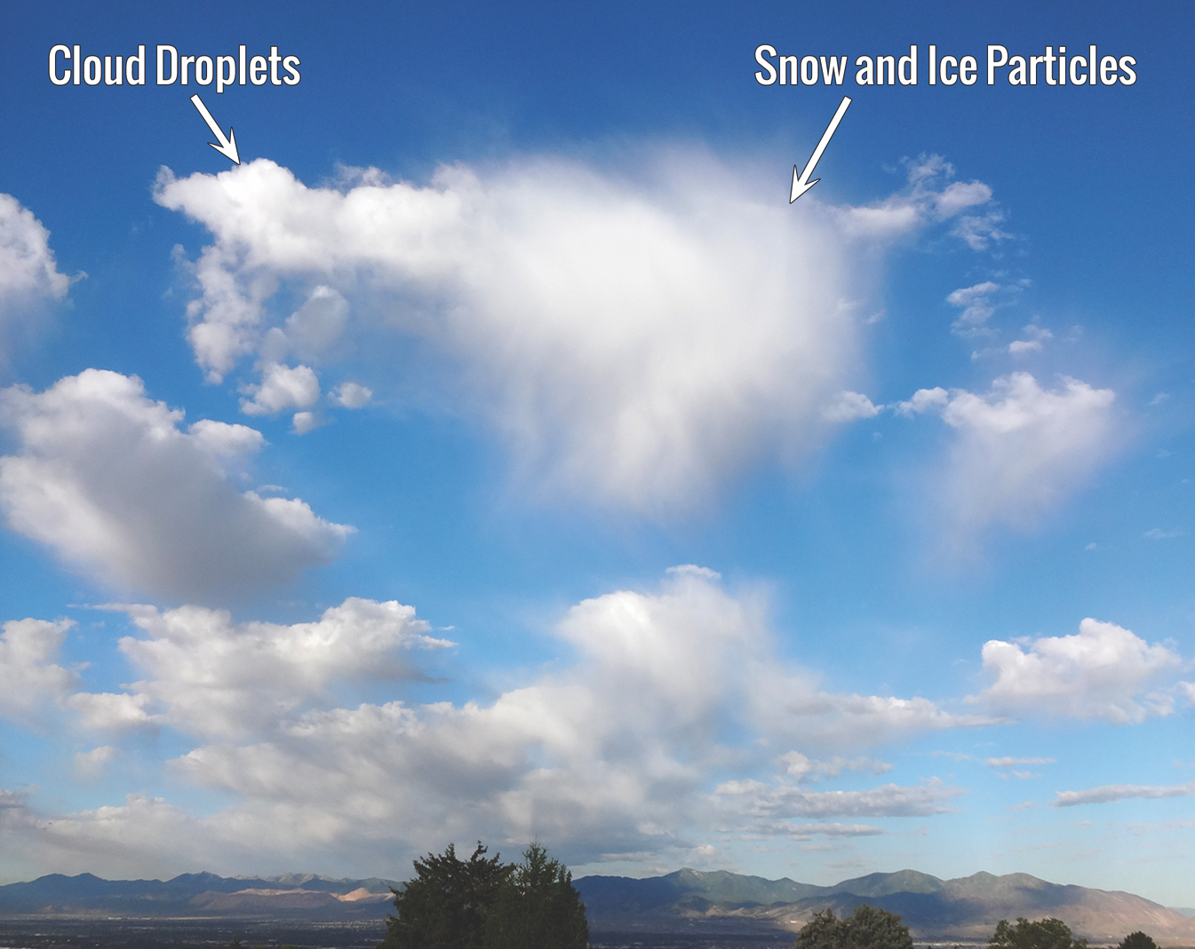
Glaciating Cloud Example
Steenburgh (2014)

Slide 28
Ice Nucleation
Water does not freeze at 0°C
Pure water does not freeze until almost -40°C (homogeneous nucleation)
Supercooled liquid water (SLW) – water (rain or cloud droplets) that exists at temperatures below 0°C
Ice nuclei – enable water to freeze at temperatures above -40°C
The effectiveness of potential ice nuclei is dependent on
Molecular spacing and crystal structure - similar to ice is best
Temperature – Activation is more likely as temperature decreases
Ice nuclei concentration increases as temperature decreases

Slide 29
Ice Nucleation
Ice nuclei
Warm Cold
Temperature
Ice nuclei increase by an order of magnitude for every 4˚C drop in temperature
Wallace and Hobbs (1977)

Slide 30
Ice Nucleation
Significance?
Cloud will not necessarily glaciate at temperatures below 0°C
Want snow (or even rain in many cases)? Need ice!
If temperatures in cloud are
-4°C or warmer VERY LITTLE chance of ice
-10°C 60% chance of ice
-12°C 70% chance of ice
-15°C 90% chance of ice
20°C VERY GOOD chance of ice

Slide 31
Ice Multiplication
Still have a few problems
There are still very few ice nuclei even at cold temperatures
Ice particle concentrations greatly exceed ice nuclei concentrations in most mixed phase clouds
How do we get so much ice?
Ice multiplication – creation of large numbers of ice particles through
Mechanical fracturing of ice crystals during evaporation
Shattering of large drops during freezing
Splintering of ice during riming (Hallet-Mossop Process)

Slide 32
Deposition (WBF Process)
40
30
.24
Water saturation vapor pressure (mb)
.16
20
e_{s}-e_{si} (mb)
10
.08
-40
-20
0
20
40
Temperature (°C)
Wegener–Bergeron–Findeisen Process
Saturation vapor pressure for ice is lower than that for water
Air is near saturation for water, but is supersaturated for ice
Ice crystals/snowflakes grow by vapor deposition
Cloud droplets may lose mass to evaporation

Slide 33
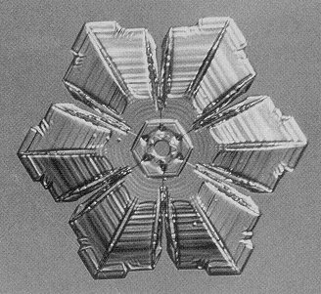
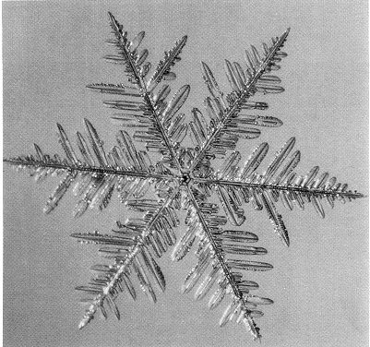
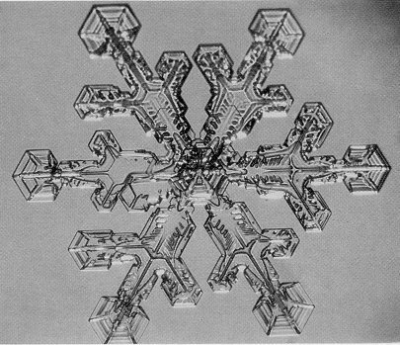
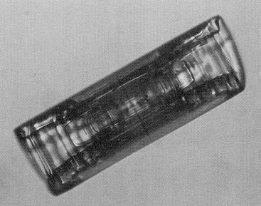
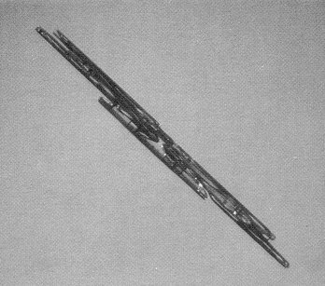
Deposition (WBF Process)
Sector Plate Stellar Dendrite Dendritic Sector Plate Hollow Column
Habits – types of ice crystal shapes created by vapor deposition
Needle
Snowcrystals.com

Slide 34
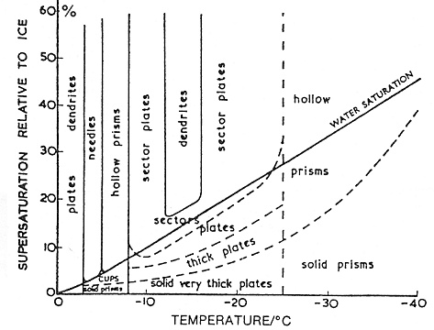
Deposition (WBF Process)
Habit is a function of
temperature and
supersaturation with
respect to ice
Snowcrystals.com

Slide 35
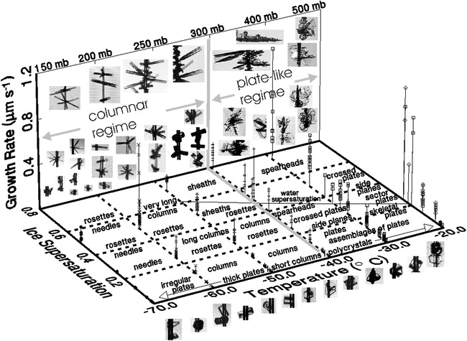
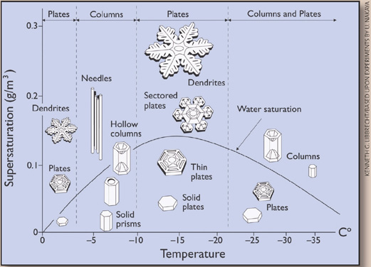
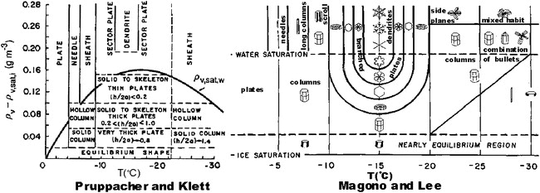
More Habit Diagrams
“A review of over 70 years of ice crystal studies reveals a bewildering variety of habit diagrams”
- Bailey and Hallett (2009)
Magono and Lee (1966), Pruppacher and Klett (1997), Bailey and Hallett (2009), Snowcrystals.com

Slide 36
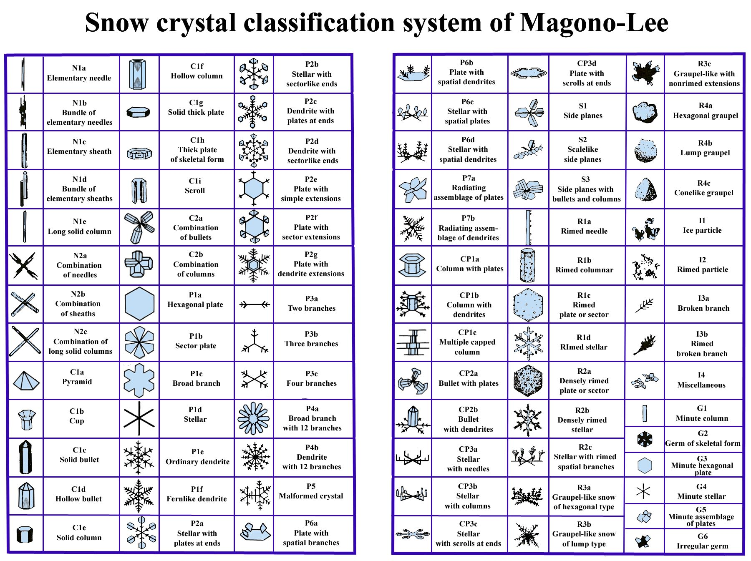
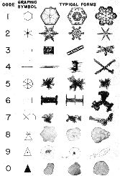
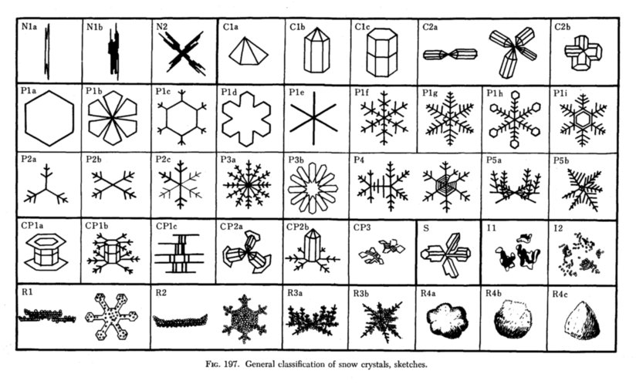
Classification Systems
Magono
And
Lee
International
Nakaya
Magono and Lee (1966), storyofsnow.com, snowcrystals.com

Slide 37
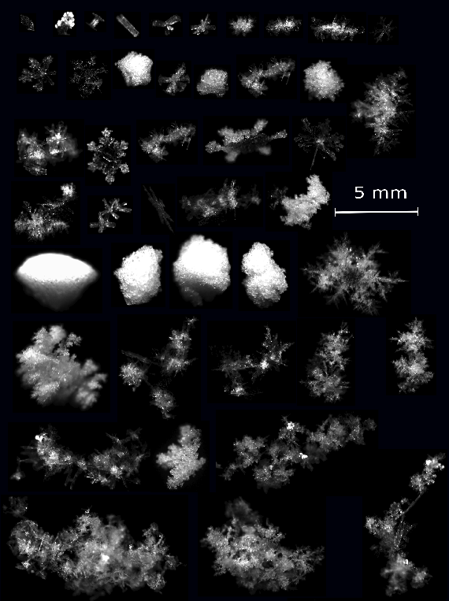
Reality
“While aesthetically appealing and offering a striking subject for photography, the fact is that most ice crystals are defective and irregular in shape”
- Bailey and Hallett (2009)
Bailey and Hallett (2009), Garrett et al. (2012)

Slide 38
Accretion
Graupel (UCLA)
Hexagonal
Lump
Cone
Magono and Lee (1966)
Growth of a hydrometeor by collision with supercooled cloud drops that freeze on contact
Graupel – Heavily rimed snow particles
3 types: cone, hexagonal, lump

Slide 39
Accretion
Graupel (UCLA)
Hexagonal
Lump
Cone
Magono and Lee (1966)
Favored by
Warmer temperatures (more cloud liquid water, less ice)
Maritime clouds (fewer, but bigger, cloud droplets)
Strong vertical motion (larger cloud droplets lofted, less time for droplet cooling and ice nuclei activation)

Slide 40
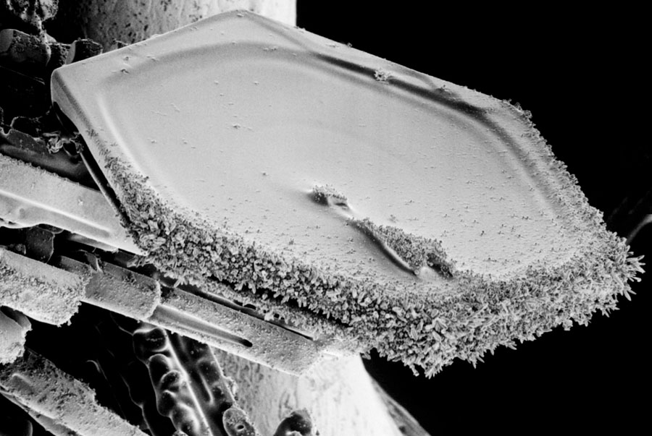
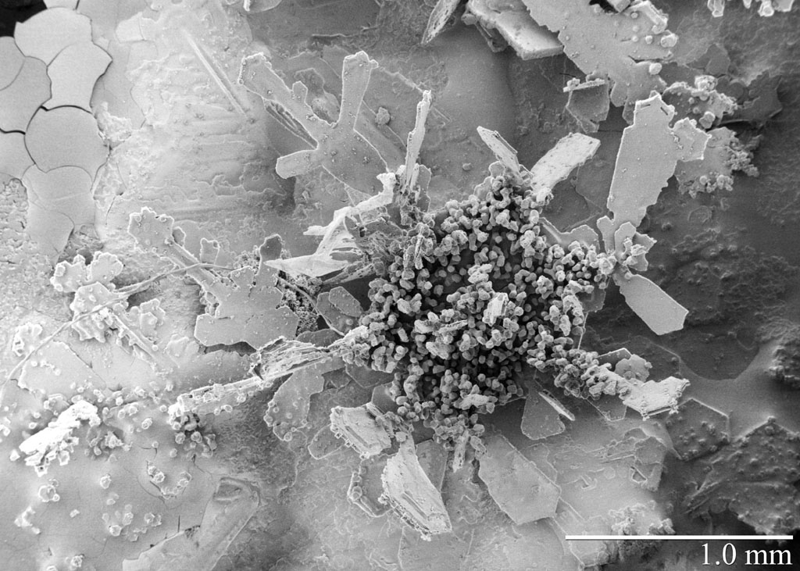
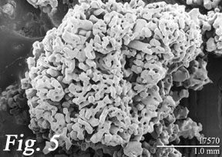
Accretion
Rimed Dendrite
Rimed Plate
Graupel
USDA Beltsville Agricultural Research Center

Slide 41
Aggregation
Ice particles colliding and adhering with each other
Can occur if their fall speeds are different
Adhering is a function of crystal type and temperature
Dendrites tend to adhere because they become entwined
Plates and columns tend to rebound
Crystal surfaces become stickier above –5°C

Slide 42
Aggregation
Bigger particles
Impact on precipitation rate is probably small
May impact crystal transport and fallout across mountain barriers
May affect mass loss from sublimation/evaporation below cloud base

Slide 43
Yesterday’s Aggregates (1148)

Slide 44
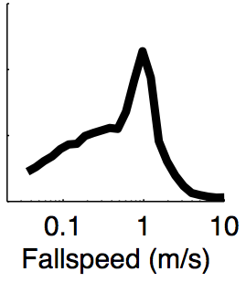
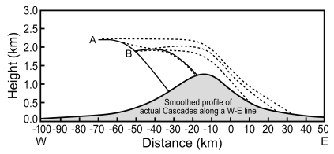
Growth, Transport, & Fallout
Growth, fallspeed, transport, and terrain scale affect precip rate and distribution
Typical fall speeds
Small ice particles: << 1 m/s
Snow: ~1 m/s
Graupel: ~3 m/s
Rain ~ 7 ms⁻¹
Fallspeed of particles @ Alta
Solid Lines = Heavily Rimed Particles
Dashed Lines = Lightly Rimed Particles
Hobbs et al. (1973), Houze (2012), Garrett et al. (2012)

Slide 45
Discussion
What evidence is there that these microphysical processes operate in the Tirol?
Do you have a “microphysical experience” you could share with the group?

Slide 46
References
Bailey, M. P., and J. Hallett, 2009: A comprehensive habit diagram for atmospheric ice crystals: confirmation from the laboratory, AIRS II, and other field studies. J. Atmos. Sci., 66, 2888–2899.
Garrett, T. J., C. Fallgatter, K. Shkurko, and D. Howlett, 2012: Fallspeed measurment and high-resolution-multi-angle photography of hydrometeors in freefall. Atmos. Meas. Tech., 5, 2625-2633.
Hindman, E. E., M. A. Campbell, and R. D. Borys, 1994: A ten-winter record of cloud-droplet physical and chemical properties at a mountaintop site in Colorado. J. Appl. Meteor., 33, 797-807.
Hobbs, P. V., R. C. Easter, and A. B. Fraser, 1973: A theoretical study of the flow of air and fallout of solid precipitation over mountainous terrain: Part II. Microphysics, J. Atmos. Sci., 30, 813–823.
Houze, R. A., Jr., 2004: Mesoscale convective systems. Rev. Geophys., 42, RG4003, doi: 10.1029/2004RG000150.

Slide 47
References
Houze, R. A., Jr., 2012: Orographic effects on precipitating clouds. Rev. Geophys., 50, RG1001.
Houze, R. A., Jr., 2014: Cloud Dynamics, 2nd Ed., Elsevier/Academic Press, Oxford, 432 pp.
Magono, C., and C. W. Lee, 1966: Meteorological classification of natural snow crystals. J. Faculty Sci., II, 321–335.
Pruppacher, H. R., and J. D. Klett, 1997: Microphysics of Clouds and Precipitation. Kluwer Academic, 954 pp.
Trapp, R. J., 2013: Mesoscale-Convective Processes in the Atmosphere. Cambridge University Press, New York, 336 pp.
Wallace, J. M., and P. V. Hobbs, 1977: Atmospheric Science: An Introductory Survey. Academic Press, 467 pp.

