Slide 1
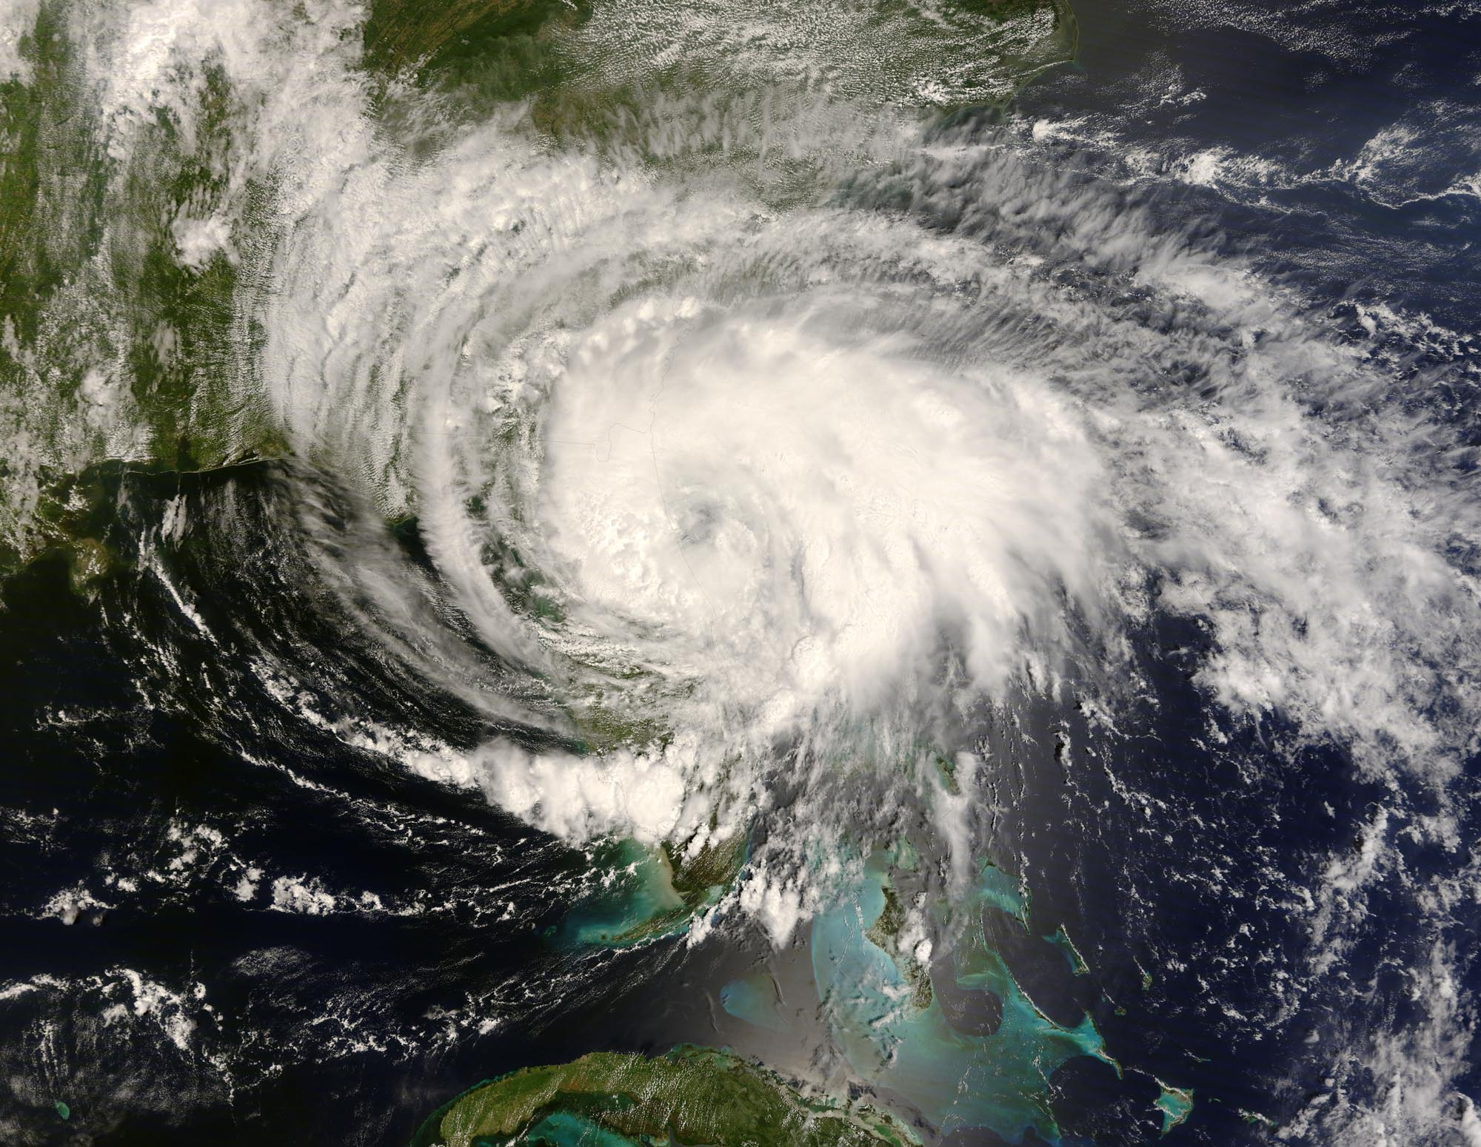
ATMOS 1010: Severe and Unusual Weather FASB 295 MW 11:50-1:10
Instructors: Erik Crosman, Research Assistant Professor
Taylor McCorkle, Graduate Research Assistant

Slide 2
Assignments
Chapter 5, 6 Quiz Canvas due 14 Sept
Module 1 Practice test/study guide
Module 1 review/test prep 12 Sept
Module 1 test (in class) 17 Sept

Slide 3
Remember to Do Quizzes/Assignments
There will be ~8 quizzes
Quizzes are 25% of class grade
So each one > 3% of grade
For those who missed quiz 1, I have reopened it until 11:59 tonight for partial credit (up to 50%)
There will be around ~8 in-class assignments
15% of grade
So each one is around 1.5-2.0% of grade

Slide 4
Chapter 5-6 Quiz
Heat transfer
What causes seasons/weather?
Parcel theory/stability (today/wednesday)
Makes sense to wait until after Wednesday to do quiz (but take look at sooner)

Slide 5
Module 1 Test
Focus on making sure you understand PPT slides on canvas through 10 Sept.
Use study guide on canvas in concert with PPT presentations
Make sure you understand all of the quiz and practice test problems
Test will have several questions from quizzes and practice test repeated verbatim
Several questions from test will be variations on quiz and practice test problems

Slide 6
Module 1 Test Review
Class period, Wednesday 12 September
Bring any questions you have! (there are no stupid questions).
We will work through answers to practice test questions, etc.
Email me if you have any questions and want to meet one-on-one to discuss.
I will be available after class each day as well.

Slide 7
Test 1
Entire class period, Monday September 17th
No notes or textbook allowed. No calculator needed.
Scantron true, false, or multiple choice (see practice test.
50 questions (2 points each).
Look at study guide for few quantitative numbers, etc you need to memorize.

Slide 8
Atmospheric Stability (Chapter 6: 1st half)
What do the terms stable, unstable, and neutral mean?
What factors control the stability of the atmosphere?
How does the temperature of a dry air parcel change when it is lifted?
How does the temperature of a saturated air parcel change when it is lifted?

Slide 9
Stability Definitions
Stable: An object that is displaced will return to its original location
Unstable: An object that is displaced will accelerate away from its original location
Neutral: An object that is displaced will remain in its new position when the displacement force ceases

Slide 10
Stable, Unstable, or Neutral?

Slide 11
Stable, Unstable, or Neutral?

Slide 12
Stable, Unstable, or Neutral?

Slide 13
Stable, Unstable, or Neutral?
In atmosphere…

Slide 14
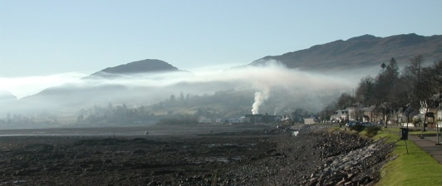
Stable, Unstable, or Neutral?
In atmosphere…

Slide 15
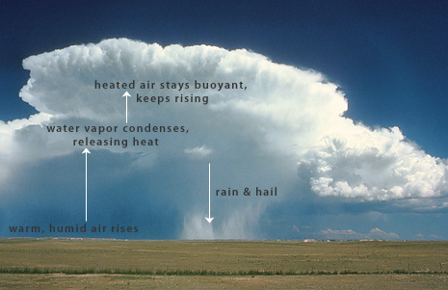
Stable, Unstable, or Neutral?
In atmosphere…

Slide 16
What Factors Control the Stability of the Atmosphere?
Environmental lapse rate (ELR)
How rapidly the temperature changes with height controls the stability of the atmosphere
Change in Temperature (°C)
Lapse Rate =
Change in Height (km)

Slide 17
Atmospheric Lapse Rates
Lapse rate is the rate at which temperature decreases (lapses) with increasing altitude
Is it usually cooler or warmer at Alta (elevation 2600 m) than at Salt Lake City (1300 m)?
20 °C (SLC) – 10 °C (Alta) = 7.69°C/km
Lapse Rate =
1.3 km – 2.6 km

Slide 18
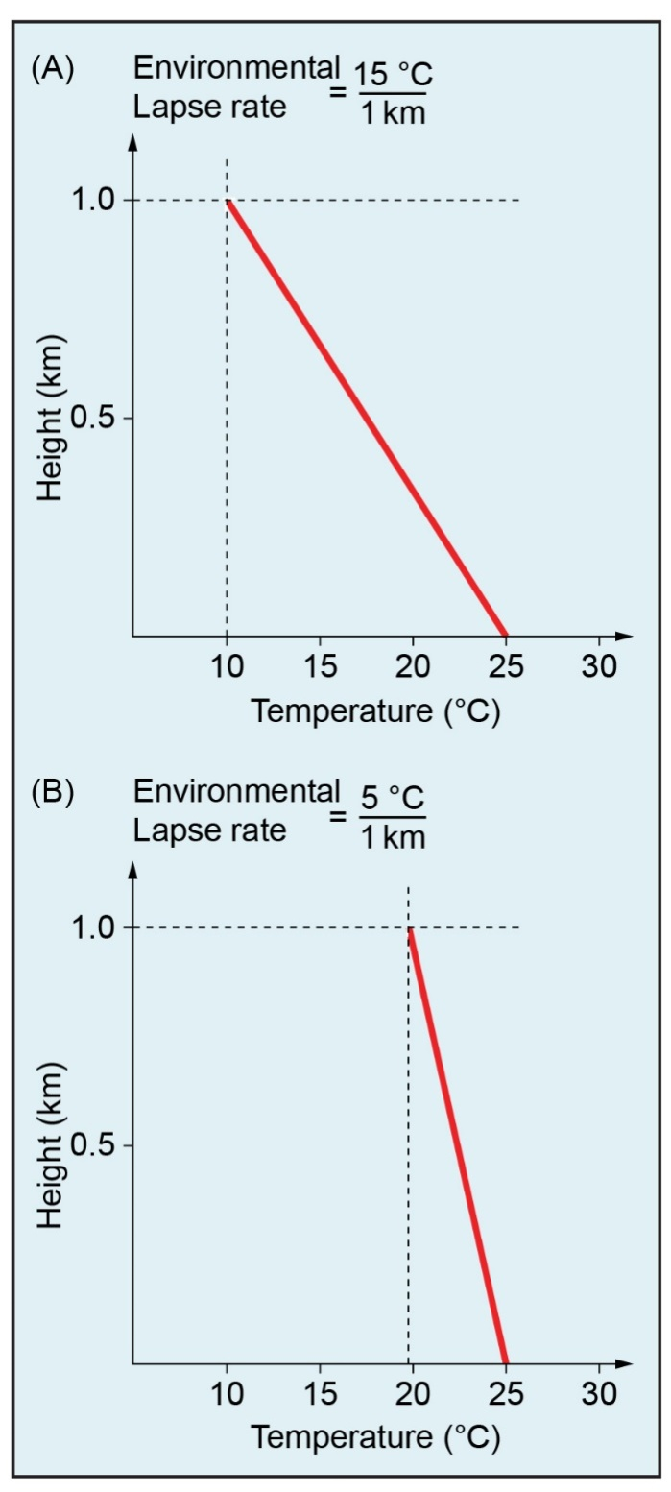
Example Environmental Lapse Rates Temperature decreases (lapses) with increasing altitude (be able to read lapse rate on these for test)

Slide 19
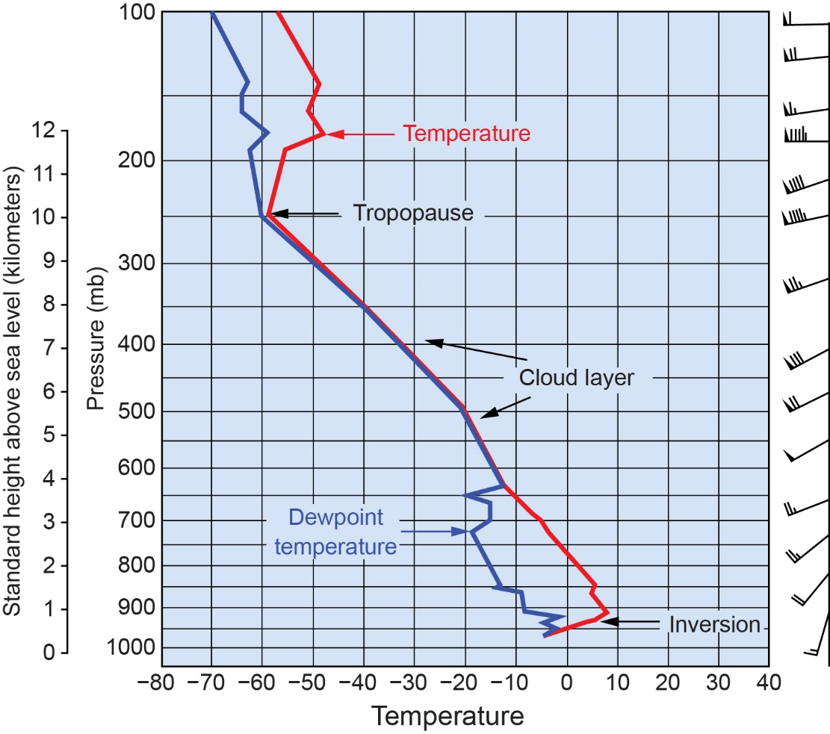
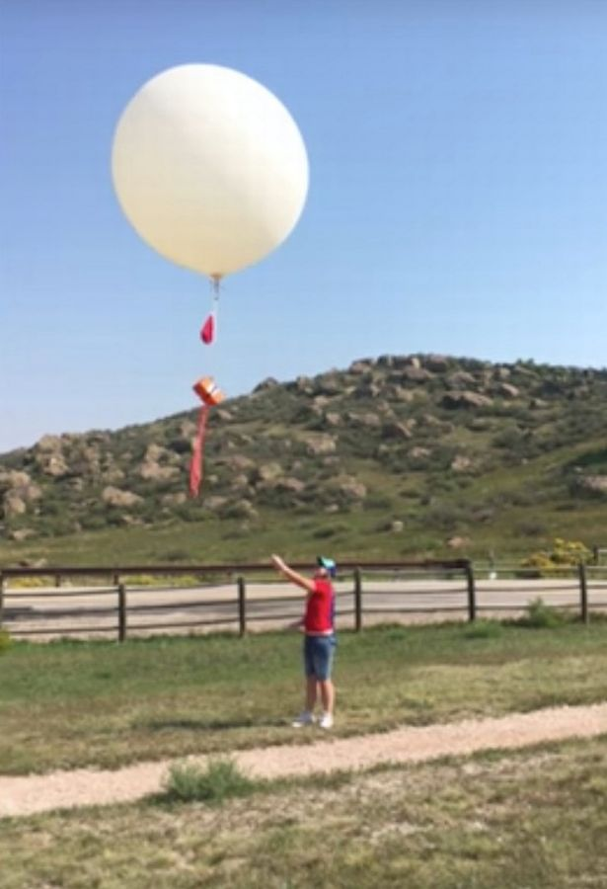
2.6
Stuve Diagram: Red line = Temperature
Blue line = Dewpoint temperature
We determine
environmental
lapse rate with
rawinsonde!
Courtesy of Bob Rauber.

Slide 20
Stable, Unstable, or Neutral?
Environment
Parcel

Slide 22
Buoyancy: Cool Air Sinks &Warm Air Rises

Slide 23
Why does warm air rise and cold air sink?
Warm air is
less dense

Slide 24
More on Density
Hot air rises because when you heat air (or any other gas for that matter), it expands. When the air expands, it becomes less dense than the air around it. The less dense hot air then floats in the more dense cold air much like wood floats on water because wood is less dense than water.

Slide 25
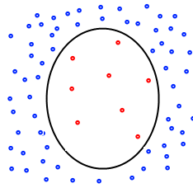
Why does a helium weather balloon rise?
Helium is
less dense
Than
Our atmosphere

Slide 26
Parcel Theory & Stability
Apply the same concept of stability to air parcels of different temperature in the atmosphere
Assume an adiabatic process (parcel does not mix with or exchange heat with its environment (imagine air in a flexible balloon that expands as it rises or contracts as it sinks)

Slide 27
Parcel vs. Environment
A parcel is a theoretical concept
We make assumptions about how the parcel will behave
We may assume the parcel:
Begins and remains unsaturated or
Begins and remains saturated or
Starts unsaturated and becomes saturated or vice versa
We usually assume the parcel does not exchange energy with the environment (adiabatic)
The surrounding environment is what is observed
The environment changes in time and space

Slide 28
Parcel vs. Environment
A parcel that is WARMER than its environment will RISE (unstable)
--Think hot air balloon, warm thunderstorm updraft
A parcel that is COOLER than its environment will SINK (stable)
--Think cold outflow
A parcel that is SAME TEMPERTURE as its environment will not move (neutral)

Slide 30
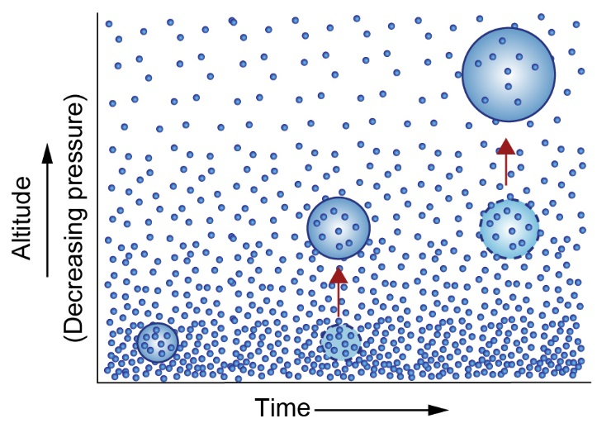
As air parcel rises, encounters lower pressure causing parcel to expand and temperature to decrease
Parcel rises, expands, and cools
Number of molecules in parcel stays same but mean vibrational speed of molecules decreases (temperature)

Slide 31
Rising Air Parcels Cool

Slide 32
Sinking Air Parcels Warm

Slide 34
Buoyant ‘Parcels’ are What Drive Thunderstorm Instability
https://www.youtube.com/watch?v=-xZMcCkzGCk
https://www.youtube.com/watch?v=LYubHpEMTPM

Slide 35
Air Parcel and Surrounding Environment
Environment
Temperature = 50 F
Air Parcel temperature = 30 F

Slide 36
Stable Situation Parcel “sinks” back down if lifted up
Environment
Temperature = 50 F
Air Parcel temperature = 30 F
Parcel temperature cooler than
environment

Slide 37
Stable Situation Parcel “sinks” back down if lifted up
Environment
Temperature = 50 F
Environment
Temperature = 50 F
Air Parcel temperature = 30 F
Air Parcel temperature = 30 F
Parcel temperature cooler than
environment

Slide 38
Unstable Situation Parcel keeps “rising” after being lifted up
Environmental
temperature = 30 F
Parcel temperature warmer than
environment
Parcel temperature = 50 F

Slide 39
Unstable Situation Parcel keeps “rising” after being lifted up
Parcel temperature warmer
Than environment
Environmental
temperature = 30 F
Parcel temperature = 50 F

Slide 42
Dry Adiabatic Lapse Rate (DALR)
Dry: A dry air parcel is defined as subsaturated air (i.e., RH < 100%)
Adiabatic: No exchange of mass or energy with the environment
If these conditions are met, then the temperature of an air parcel will ALWAYS decrease at a rate of 10°C km⁻¹ (i.e., the DALR) if it is lifted upward.

Slide 43
Moist Adiabatic Lapse Rate (MALR)
Includes effects of latent heat release associated with phase changes as vapor condenses to water or ice (latent heat warms parcel).
Saturated parcel does not cool off as fast as it rises because condensation process heats the air, partially offsetting the simultaneous rising and cooling.
Moist Adiabatic Lapse Rate varies 6-8 °C km⁻¹

Slide 45
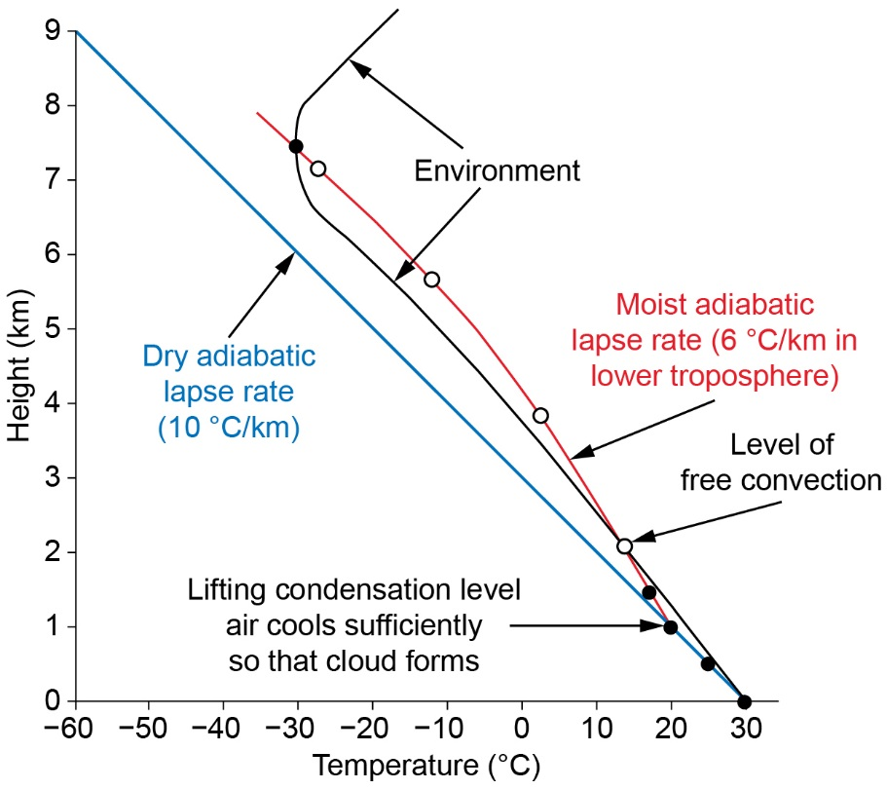
Moist Parcel Cools Less As It Rises

Slide 46
Video
https://www.youtube.com/watch?v=ltVSKahLlss
1 – 5 min on video

