Slide 1
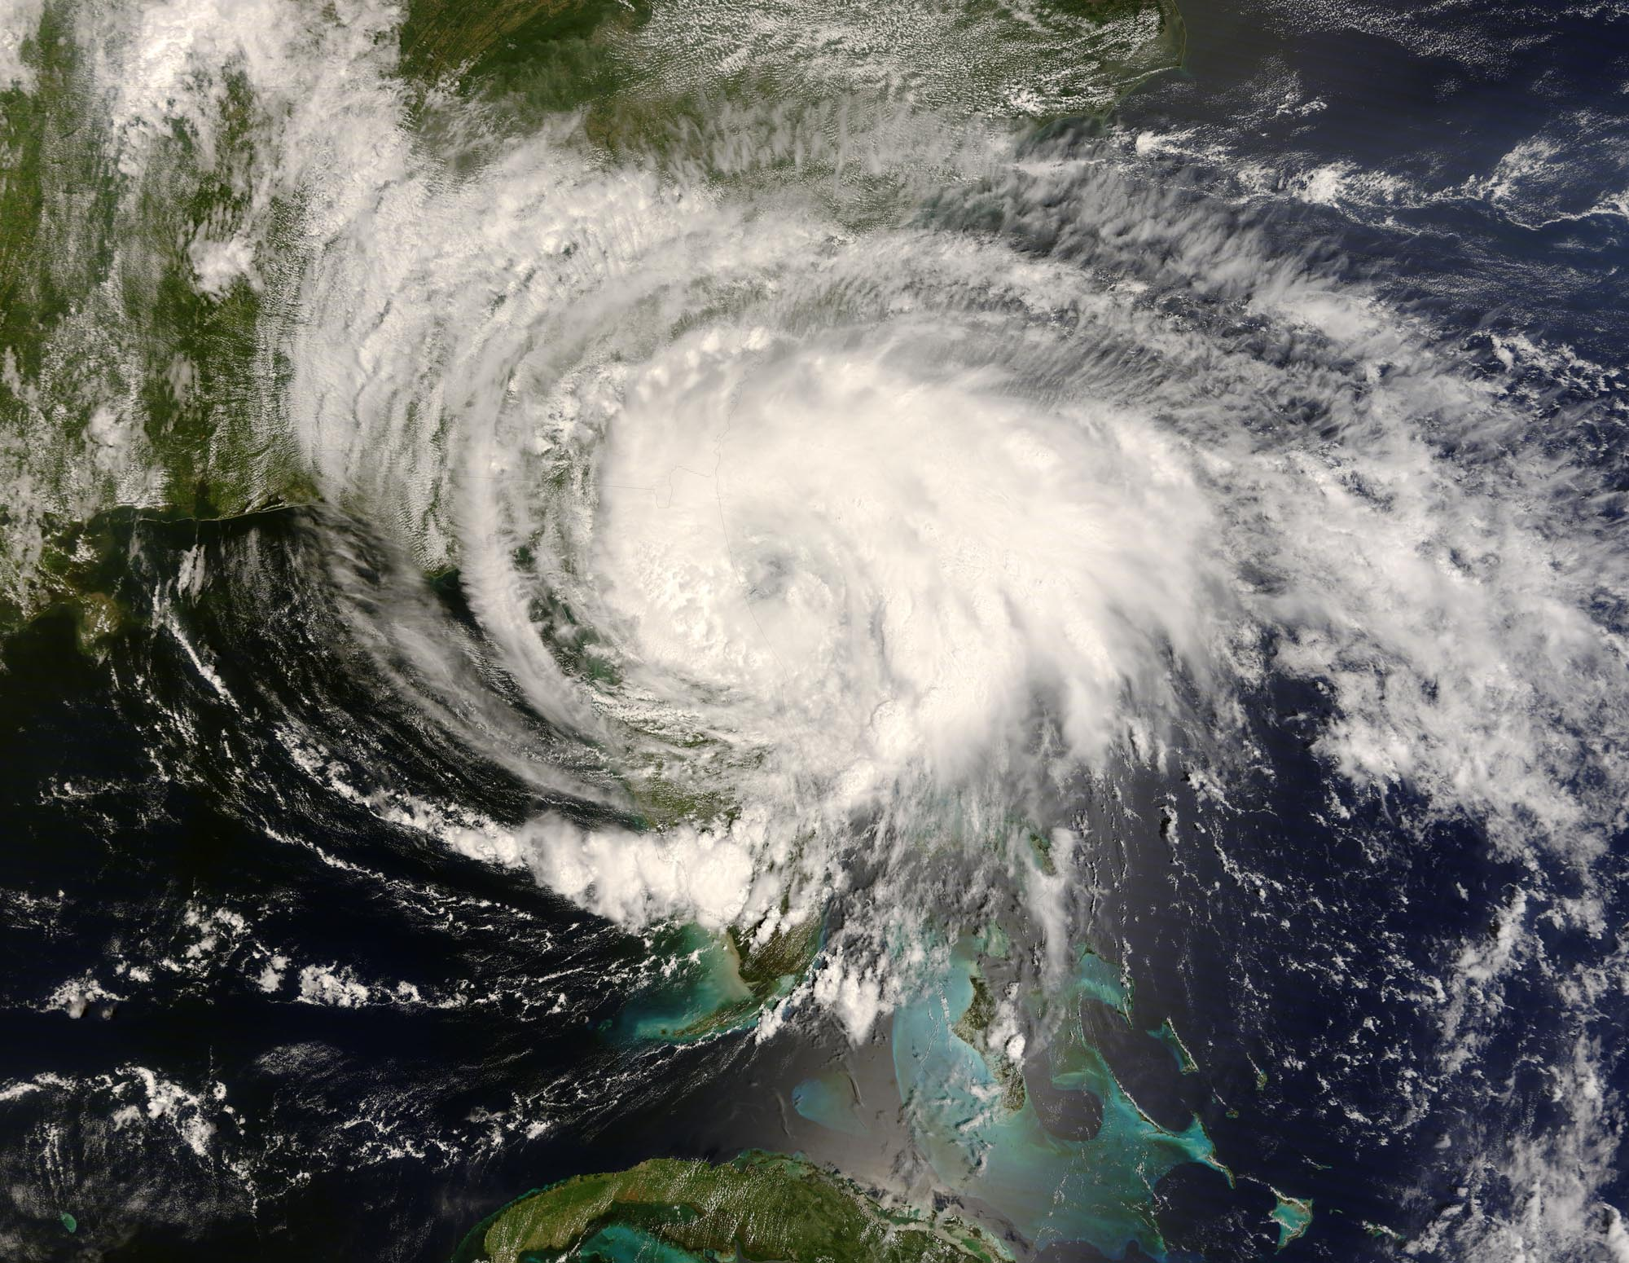
ATMOS 1010:
Severe and Unusual Weather
FASB 295 MW 11:50-1:10
Instructors: Erik Crosman, Research Assistant Professor
Taylor McCorkle, Graduate Research Assistant

Slide 2
Assignments
Chapter 5, 6 Quiz Canvas due 14 Sept
Module 1 Practice test/study guide
Module 1 review/test prep today
Module 1 test (in class) 17 Sept

Slide 3
Chapter 5-6 Quiz
Heat transfer
What causes seasons/weather?
Parcel theory/stability
Don’t forget!

Slide 4
Module 1 Test
Focus on making sure you understand PPT slides on canvas through 10 Sept.
Use study guide on canvas in concert with PPT presentations
Make sure you understand all of the quiz and practice test problems
Test will have several questions from quizzes and practice test repeated verbatim
Several questions from test will be variations on quiz and practice test problems

Slide 5
Test 1
Entire class period, Monday September 17th
No notes or textbook allowed. No calculator needed.
Scantron true, false, or multiple choice (see practice test.
50 questions (2 points each).
Look at study guide for few quantitative numbers, etc you need to memorize.

Slide 6
Module 1 Review and Test Prep
All material thus far in class
Only time you will be directly tested on these concepts (other modules are NOT comprehensive)

Slide 7
Module 1 Review and Test Prep
Atmospheric composition
Atmospheric pressure, temperature, water vapor, winds
Rawinsonde/Radiosonde/Weather Balloon
Radar
Weather satellite
Planetary orbit
Atmospheric stability

Slide 8
Module 1 Review and Test Prep
Atmospheric composition
Atmospheric pressure, temperature, water vapor, winds
Rawinsonde/Radiosonde/Weather Balloon
Radar
Weather satellite
Planetary orbit
Atmospheric stability

Slide 9
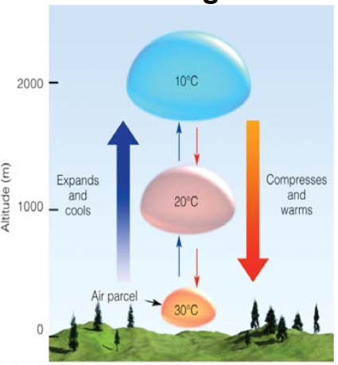

Slide 10
Dry Adiabatic Lapse Rate (DALR)
Dry: A dry air parcel is defined as unsaturated air (i.e., RH < 100%)
Adiabatic: No exchange of mass or energy with the environment (imagine a sealed balloon)
If these conditions are met, then the temperature of an air parcel will ALWAYS decrease at a rate of 10°C km⁻¹ (i.e., the DALR) if it is lifted upward.

Slide 11
How Does the Temperature of a Dry Air Parcel Change When it is Lifted?
2
1
0
Dry Adiabatic Lapse Rate (DALR)
= -10 °C km⁻¹
Altitude (km)
0 10 20
Temperature (°C)

Slide 12
How Does the Temperature of a Dry Air Parcel Change When it Forced Downward?
2
1
0
Dry Adiabatic Lapse Rate (DALR)
= +10 °C km⁻¹
Altitude (km)
0 10 20
Temperature (°C)

Slide 13
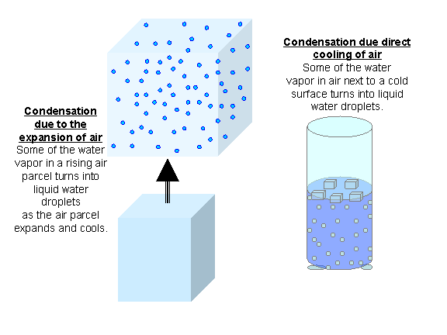
Moist Adiabatic Lapse Rate (MALR)
Moist: A moist air parcel is defined as saturated air (i.e., RH = 100%)
Condensation process “warms” parcel --offsetting rising and cooling process
Heat release from
phase change

Slide 14
Moist Adiabatic Lapse Rate (MALR)
Includes effects of latent heat release associated with phase changes as vapor condenses to water or ice (latent heat warms parcel).
Saturated parcel does not cool off as fast as it rises because condensation process heats the air, partially offsetting the simultaneous rising and cooling.
Moist Adiabatic Lapse Rate varies 6-8 °C km⁻¹

Slide 15
How Does the Temperature of an Moist Air Parcel Change When it is Lifted?
2
1
0
MALR
What is the relative humidity in this layer?
RH = 100%
Altitude (km)
What is the relative humidity in this layer?
DALR
RH < 100%
0 10 20
Temperature (°C)

Slide 16
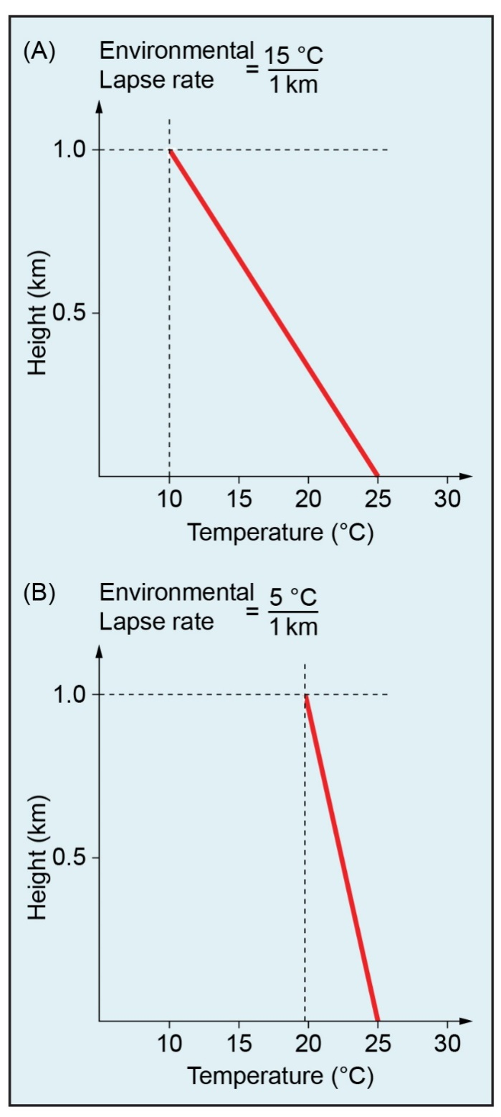
Example Environmental Lapse Rates
Temperature decreases (lapses) with increasing altitude
(be able to read lapse rate on these for test)

Slide 17
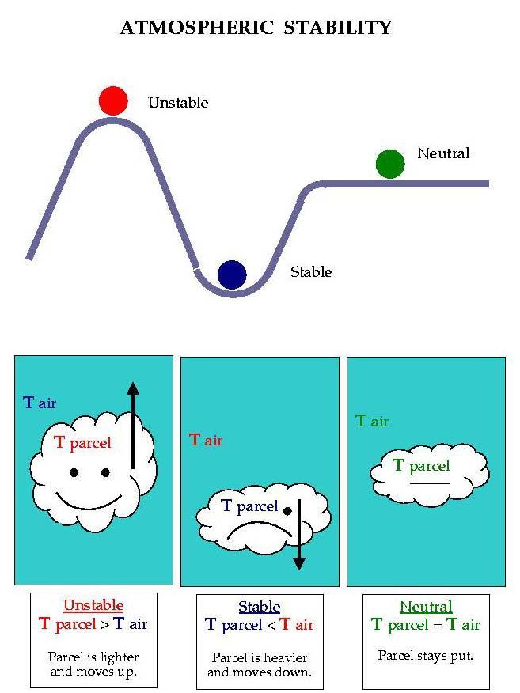
Putting it all together…
Parcel + environmental temperature

Slide 18
Atmospheric Stability
We think of stability in terms of how a parcel of air behaves in its environment
If a parcel temperature is warmer than its environment it is unstable (and will rise)
If a parcel temperature is cooler than its environment it is stable (and will sink)
If a parcel is the same temperature as its environment it is neutral (and will not rise or sink)

Slide 19
Determining Atmospheric Stability (Example #1: Isothermal Atmosphere)
= Rawinsonde (environment)
= Air Parcel
Is the air parcel colder or warmer than the environment after it has been lifted?
2
1
0
Colder
Is the air parcel more or less dense than the environment?
Altitude (km)
More Dense
Will the air parcel rise, sink, or remain stationary?
Sink
Is the atmosphere stable, unstable, or neutral?
Stable
0 10 20
Temperature (°C)

Slide 20
Determining Atmospheric Stability (Case #2: ELR > DALR)
= Rawinsonde (environment)
= Air Parcel
Is the air parcel colder or warmer than the environment after it has been lifted?
2
1
0
Colder
Is the air parcel more or less dense than the environment?
Altitude (km)
More Dense
Will the air parcel rise, sink, or remain stationary?
Sink
Is the atmosphere stable, unstable, or neutral?
Stable
0 10 20
Temperature (°C)

Slide 21
Determining Atmospheric Stability (Case #3: ELR = DALR)
= Rawinsonde (environment)
= Air Parcel
Is the air parcel colder or warmer than the environment after it has been lifted?
2
1
0
Same
Is the air parcel more or less dense than the environment?
Altitude (km)
Same
Will the air parcel rise, sink, or remain stationary?
Remain Stationary
0 10 20
Is the atmosphere stable, unstable, or neutral?
Neutral
Temperature (°C)

Slide 22
Determining Atmospheric Stability (Case #4: ELR < DALR)
= Rawinsonde
= Air Parcel
Is the air parcel colder or warmer than the environment after it has been lifted?
2
1
0
Warmer
Is the air parcel more or less dense than the environment?
Altitude (km)
Less Dense
Will the air parcel rise, sink, or remain stationary?
Rise
Is the atmosphere stable, unstable, or neutral?
Unstable
0 10 20
Temperature (°C)

Slide 23
Determining Atmospheric Stability (Case #5: Temperature Inversion)
= Rawinsonde
= Air Parcel
Is the air parcel colder or warmer than the environment after it has been lifted?
2
1
0
Colder
Is the air parcel more or less dense than the environment?
Altitude (km)
More Dense
Will the air parcel rise, sink, or remain stationary?
Sink
Is the atmosphere stable, unstable, or neutral?
Stable
0 10 20
Temperature (°C)

Slide 24
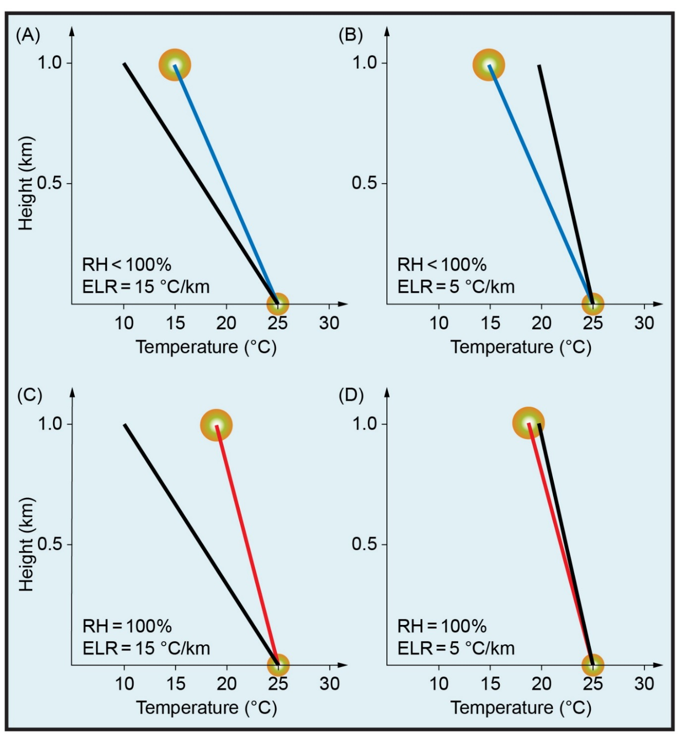
Parcel vs Environment
UNSTABLE
STABLE
DRY
Black line = Environmental temperature
Red line = Saturated rising parcel temperature (MALR)
Blue line = Dry rising parcel temperature (DALR)
UNSTABLE
STABLE
SATURATED

Slide 25
Atmospheric Stability: What to Know for Test

Slide 26
Atmospheric Stability
(Chapter 6: 1st half)
What do the terms stable, unstable, and neutral mean?
What factors control the stability of the atmosphere?
How does the temperature of a dry air parcel change when it is lifted?
How does the temperature of a saturated air parcel change when it is lifted?

Slide 27
Stability Definitions
Stable: An object that is displaced will return to its original location
Unstable: An object that is displaced will accelerate away from its original location
Neutral: An object that is displaced will remain in its new position when the displacement force ceases

Slide 28
Stable, Unstable, or Neutral?

Slide 29
Stable, Unstable, or Neutral?

Slide 30
Stable, Unstable, or Neutral?

Slide 31

Stable, Unstable, or Neutral?
In atmosphere…

Slide 32
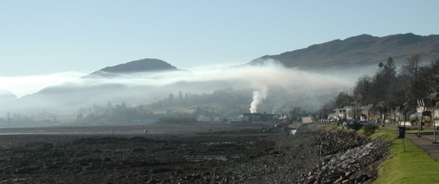
Stable, Unstable, or Neutral?
In atmosphere…

Slide 33
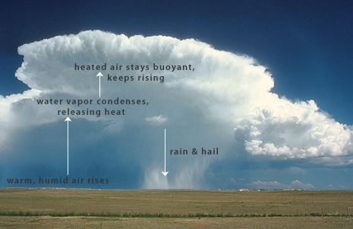
Stable, Unstable, or Neutral?
In atmosphere…

Slide 34
What Factors Control the Stability of the Atmosphere?
Environmental lapse rate (ELR)
How rapidly the temperature changes with height controls the stability of the atmosphere
Change in Temperature (°C)
Lapse Rate =
Change in Height (km)

Slide 35
Atmospheric Lapse Rates
Lapse rate is the rate at which temperature decreases (lapses) with increasing altitude
Is it usually cooler or warmer at Alta (elevation 2600 m) than at Salt Lake City (1300 m)?
20 °C (SLC) – 10 °C (Alta) = 7.69°C/km
Lapse Rate =
1.3 km – 2.6 km

Slide 36
Example Environmental Lapse Rates
Temperature decreases (lapses) with increasing altitude
(be able to read lapse rate on these for test)

Slide 37
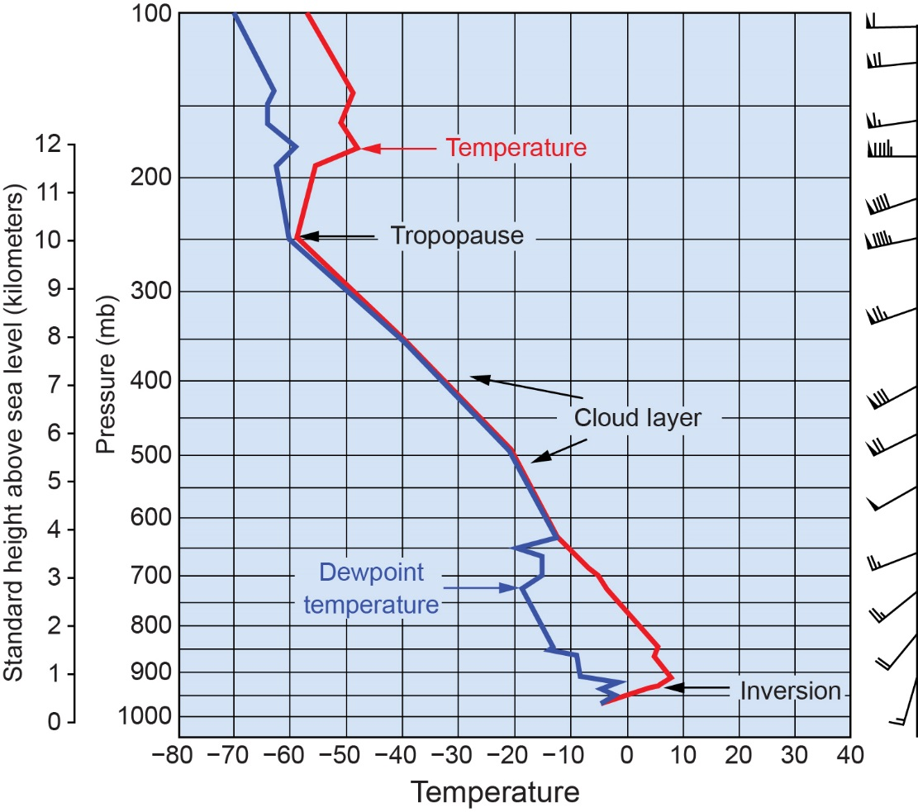
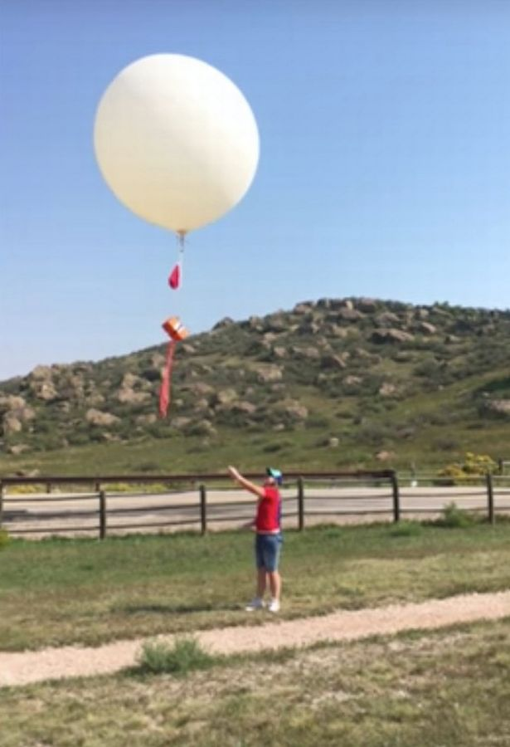
2.6
Stuve Diagram: Red line = Temperature
Blue line = Dewpoint temperature
We determine
environmental
lapse rate with
rawinsonde!
Courtesy of Bob Rauber.

Slide 38
Stable, Unstable, or Neutral?
Environment
Parcel

Slide 39
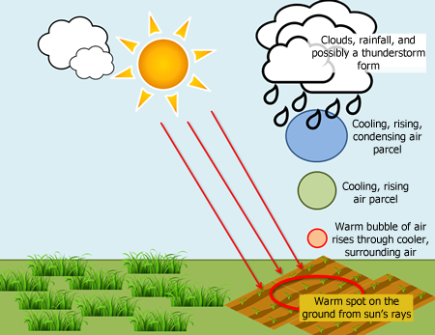

Slide 40
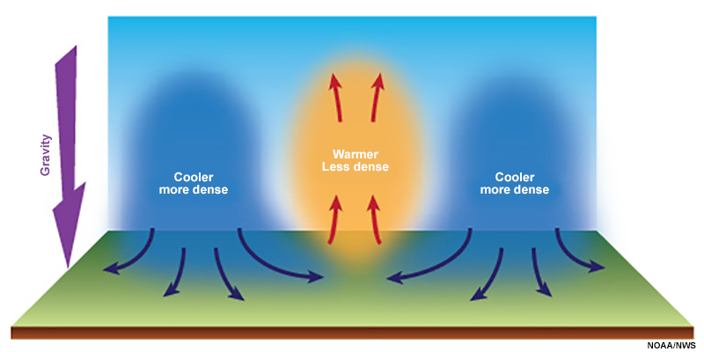
Buoyancy: Cool Air Sinks &Warm Air Rises

Slide 41
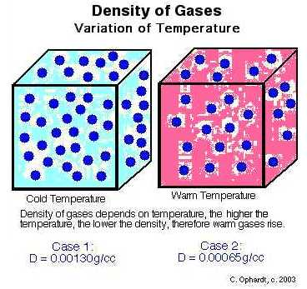
Why does warm air rise and cold air sink?
Warm air is
less dense

Slide 42
More on Density
Hot air rises because when you heat air (or any other gas for that matter), it expands. When the air expands, it becomes less dense than the air around it. The less dense hot air then floats in the more dense cold air much like wood floats on water because wood is less dense than water.

Slide 43
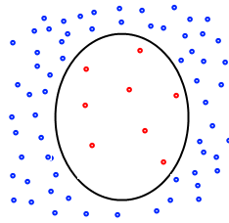
Why does a helium weather balloon rise?
Helium is
less dense
Than
Our atmosphere

Slide 44
Parcel Theory & Stability
Apply the same concept of stability to air parcels of different temperature in the atmosphere
Assume an adiabatic process (parcel does not mix with or exchange heat with its environment (imagine air in a flexible balloon that expands as it rises or contracts as it sinks)

Slide 45
Parcel vs. Environment
A parcel is a theoretical concept
  We make assumptions about how the parcel will behave
  We may assume the parcel:
    Begins and remains unsaturated or
    Begins and remains saturated or
    Starts unsaturated and becomes saturated or vice versa
  We usually assume the parcel does not exchange energy with the environment (adiabatic)
The surrounding environment is what is observed
  The environment changes in time and space

Slide 46
Parcel vs. Environment
A parcel that is WARMER than its environment will RISE (unstable)
--Think hot air balloon, warm thunderstorm updraft
A parcel that is COOLER than its environment will SINK (stable)
--Think cold outflow
A parcel that is SAME TEMPERTURE as its environment will not move (neutral)

Slide 47

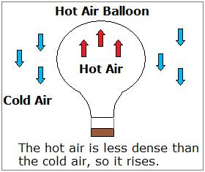

Slide 48
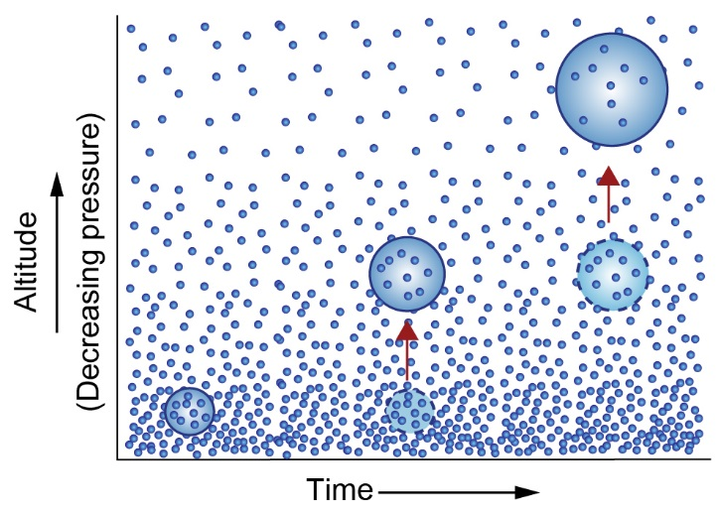
As air parcel rises, encounters lower pressure causing parcel to expand and temperature to decrease
Parcel rises, expands, and cools
Number of molecules in parcel stays same but mean vibrational speed of molecules decreases (temperature)

Slide 49
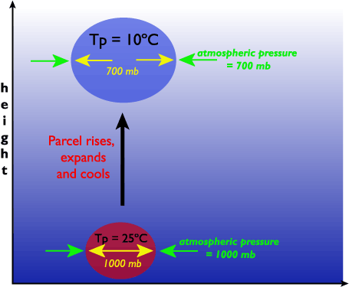
Rising Air Parcels Cool

Slide 50
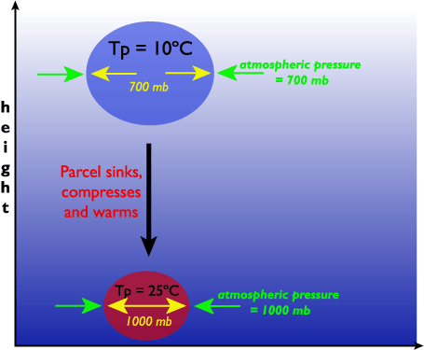
Sinking Air Parcels Warm

Slide 52
Buoyant ‘Parcels’ are What Drive Thunderstorm Instability
https://www.youtube.com/watch?v=-xZMcCkzGCk
https://www.youtube.com/watch?v=LYubHpEMTPM

Slide 53
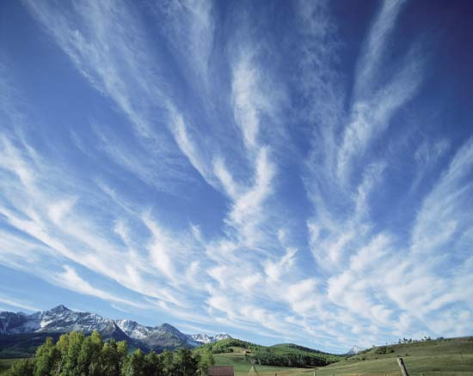
Air Parcel and Surrounding Environment
Environment
Temperature = 50 F
Air Parcel temperature = 30 F

Slide 54
Stable Situation
Parcel “sinks” back down if lifted up
Environment
Temperature = 50 F
Air Parcel temperature = 30 F
Parcel temperature cooler than
environment

Slide 55
Stable Situation
Parcel “sinks” back down if lifted up
Environment
Temperature = 50 F
Environment
Temperature = 50 F
Air Parcel temperature = 30 F
Air Parcel temperature = 30 F
Parcel temperature cooler than
environment

Slide 56
Unstable Situation
Parcel keeps “rising” after being lifted up
Environmental
temperature = 30 F
Parcel temperature warmer than
environment
Parcel temperature = 50 F

Slide 57
Unstable Situation
Parcel keeps “rising” after being lifted up
Parcel temperature warmer
Than environment
Environmental
temperature = 30 F
Parcel temperature = 50 F

Slide 58
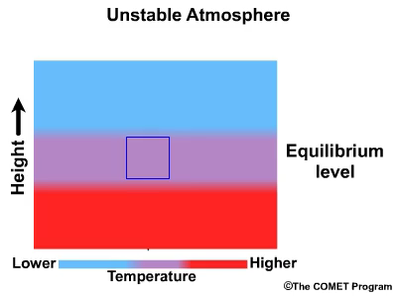

Slide 59
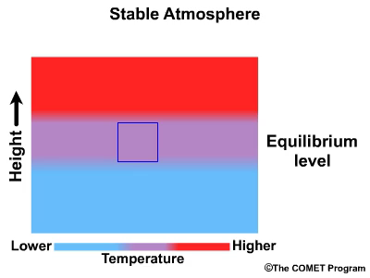

Slide 60
Dry Adiabatic Lapse Rate (DALR)
Dry: A dry air parcel is defined as subsaturated air (i.e., RH < 100%)
Adiabatic: No exchange of mass or energy with the environment
If these conditions are met, then the temperature of an air parcel will ALWAYS decrease at a rate of 10°C km⁻¹ (i.e., the DALR) if it is lifted upward.

Slide 61
Moist Adiabatic Lapse Rate (MALR)
Includes effects of latent heat release associated with phase changes as vapor condenses to water or ice (latent heat warms parcel).
Saturated parcel does not cool off as fast as it rises because condensation process heats the air, partially offsetting the simultaneous rising and cooling.
Moist Adiabatic Lapse Rate varies 6-8 °C km⁻¹

Slide 62
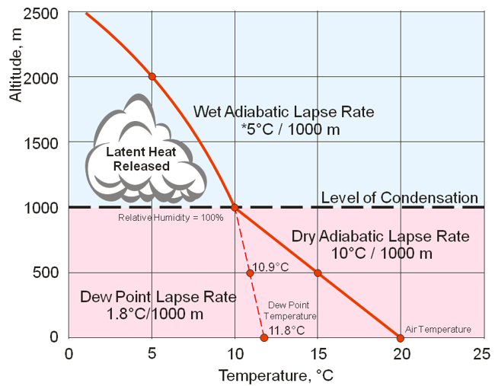

Slide 63
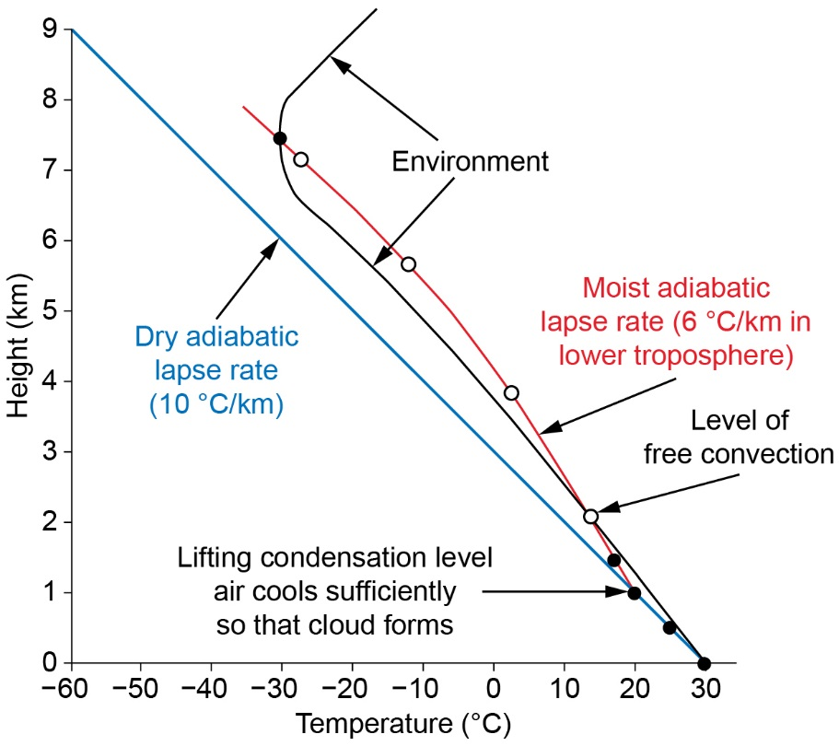
Moist Parcel Cools Less As It Rises

Slide 64
Video
https://www.youtube.com/watch?v=ltVSKahLlss
1 – 5 min on video

Slide 65
Analyzing Atmospheric Stability

Slide 66
c
UNSTABLE
STABLE
DRY
Black line = Environmental temperature
Red line = Saturated rising parcel temperature (MALR)
Blue line = Dry rising parcel temperature (DALR)
UNSTABLE
STABLE
SATURATED

Slide 67
What is the Lifting Condensation Level?
2
1
0
MALR
Lifting Condensation Level
(LCL)
Altitude (km)
Where is the cloud in this situation?
DALR
0 10 20
Temperature (°C)

Slide 68
Conditionally Unstable
Conditional instability. Environmental lapse rate is between the moist adiabatic lapse rate and dry adiabatic lapse rate. If a parcel becomes saturated it is unstable. If a parcel is unsaturated (dry) then is stable.
The atmosphere is often in a conditionally unstable state

Slide 69
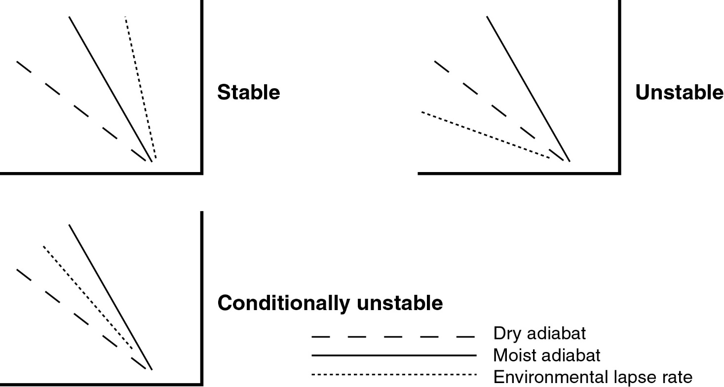
Source: http://www.ux1.eiu.edu/~cfjps/1400/stability.html

Slide 70
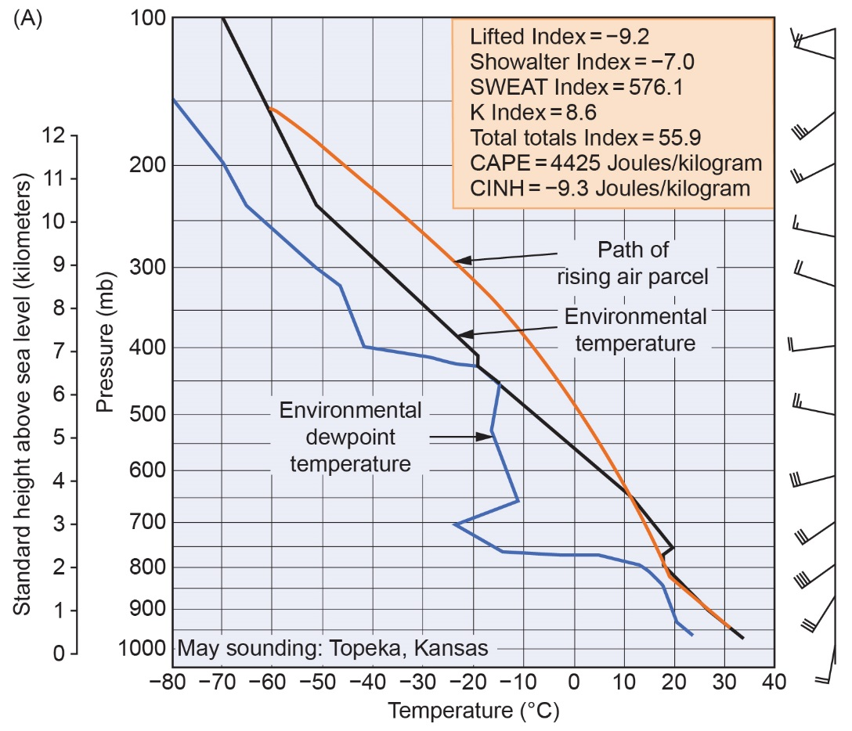
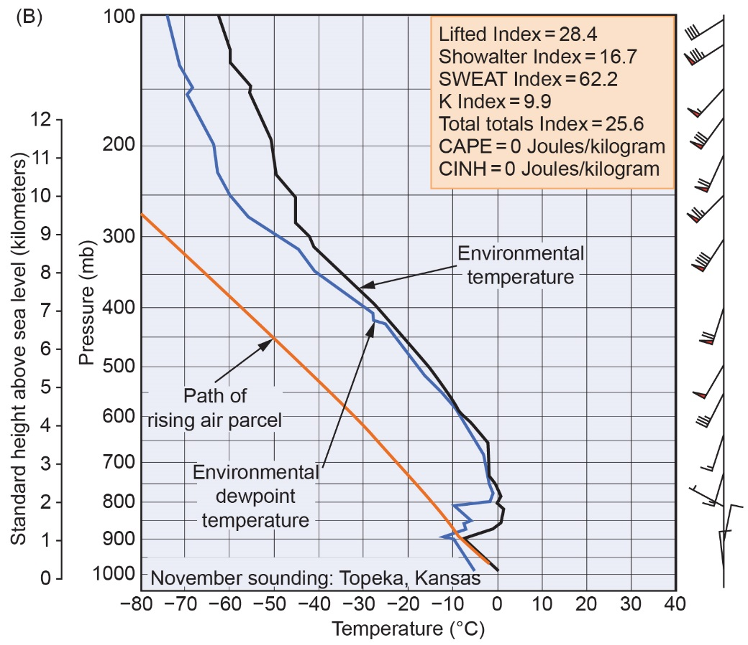
Real Examples using Stuve Diagrams
CONDITIONALLY UNSTABLE
VERY STABLE

