Slide 1
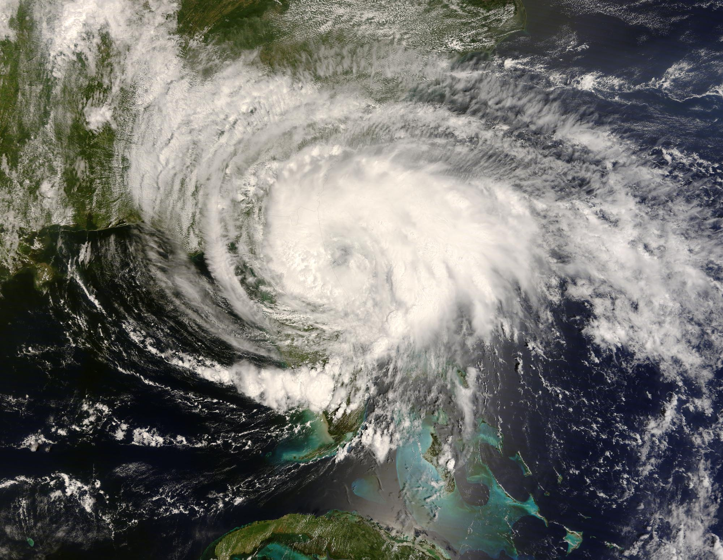
ATMOS 1010:
Severe and Unusual Weather
FASB 295 MW 11:50-1:10
Instructors: Erik Crosman, Research Assistant Professor
Taylor McCorkle, Graduate Research Assistant

Slide 2
Why Take This Course?
Fulfills Science Foundation requirement
It’ll immerse you in science that affects your life every day
We’ll discuss current weather locally and around the world
We’ll cover a few key weather subjects in depth
You’re at a research university with one of the best atmospheric science programs in the country
Weather is exciting!

Slide 3
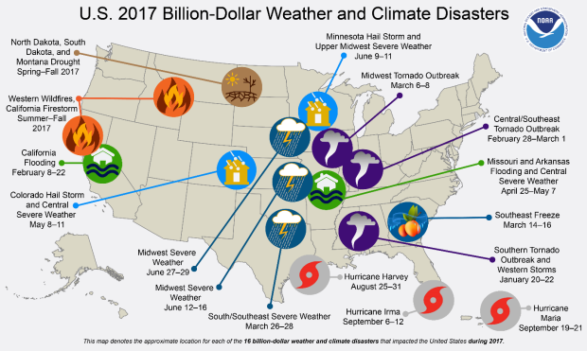

Slide 4
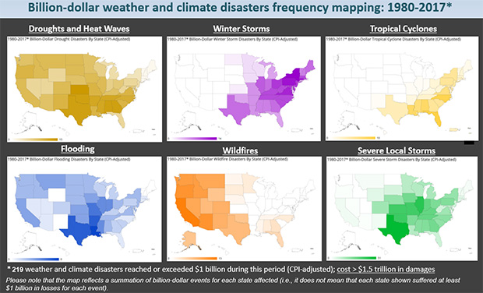
https://www.climate.gov/news-features/blogs/beyond-data/2017-us-billion-dollar-weather-and-climate-disasters-historic-year

Slide 5
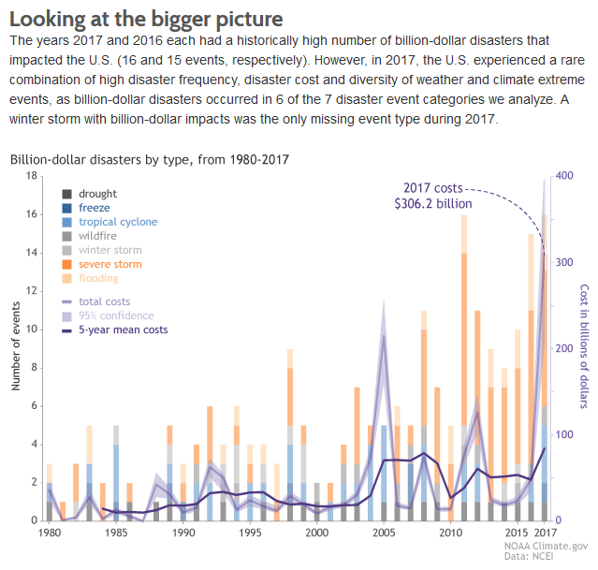

Slide 6
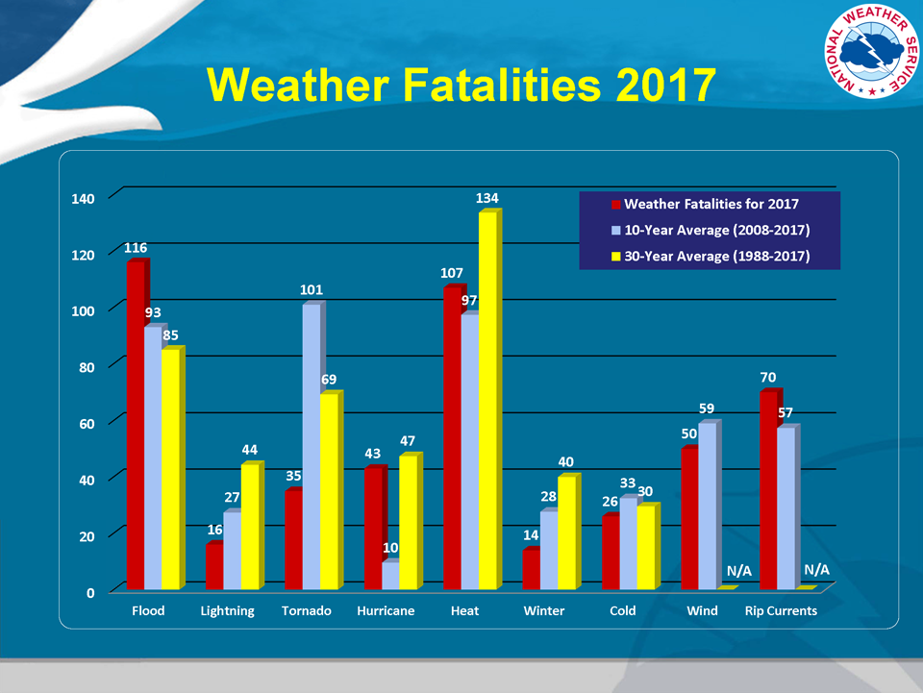
Weather Impacts
http://www.nws.noaa.gov/om/hazstats.shtml

Slide 7
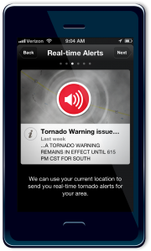
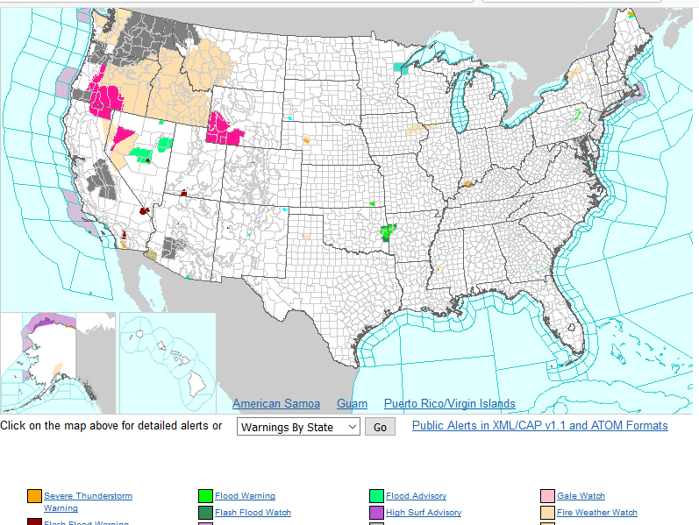
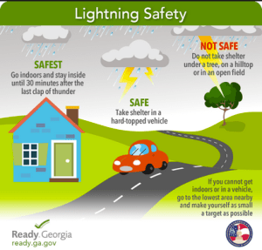

www.weather.gov

Slide 8
Student Expectations
No prerequisites
Show interest in learning about atmosphere and fundamental laws of nature
Participate in class discussions and assignments
Willingness to learn scientific process and critical thinking skills

Slide 9
Quick Introductions
Your first name
Major (if declared)
Fr/So/Jr/Sr
Most interesting aspect of weather to you (if you have one)….frequent answer in Utah is snow!

Slide 10
After completing the course, you should know…
discuss societal impacts of weather including local air quality and severe storms
relate how to be safe out of doors
apply basic math concepts to the physical world
know where to go for current and past weather information
have some familiarity with how environmental instrumentation works
define some of the causes for weather that may affect you during all seasons

Slide 11
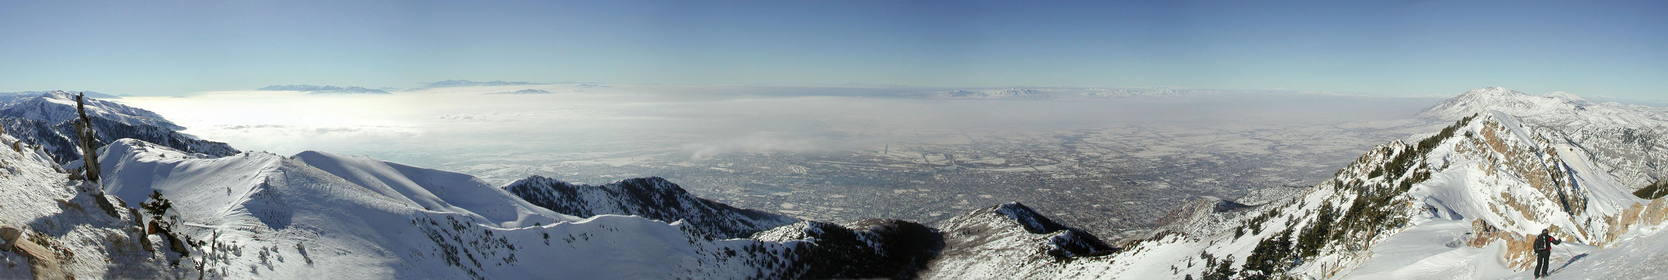
Course Outline
Four ‘modules’ or blocks each lasting 3-4 weeks:
(1) The basics
    Properties of atmosphere, observing weather
(2) Summer thunderstorms and other severe weather
    Leading cause of weather-related deaths in Intermountain Region
(3) Weather forecasting and mid-latitude cyclones
    Major impact on economy of Intermountain Region
(4) Clouds, snow, avalanches, and air quality
    Wasatch mountain ski weather!
Photo: D. Judd

Slide 12
Classroom Structure
First 10-20 minutes of class:
Weather discussion. Show and discuss recent “breaking” weather impacting Utah or USA. Please be involved!
Remainder of class:
Lecture/class activities. Please ask questions/interrupt if something is not clear to you!

Slide 13
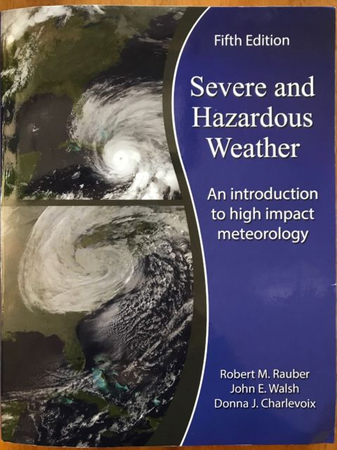
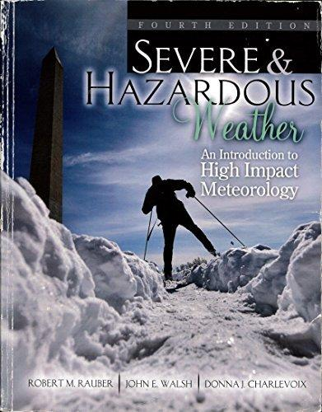
Course Textbook: Severe and Hazardous Weather (3rd, 4th, or 5th edition)
Library reserve copy available. Refer to
http://campusguides.lib.utah.edu/course_reserves_guide

Slide 14
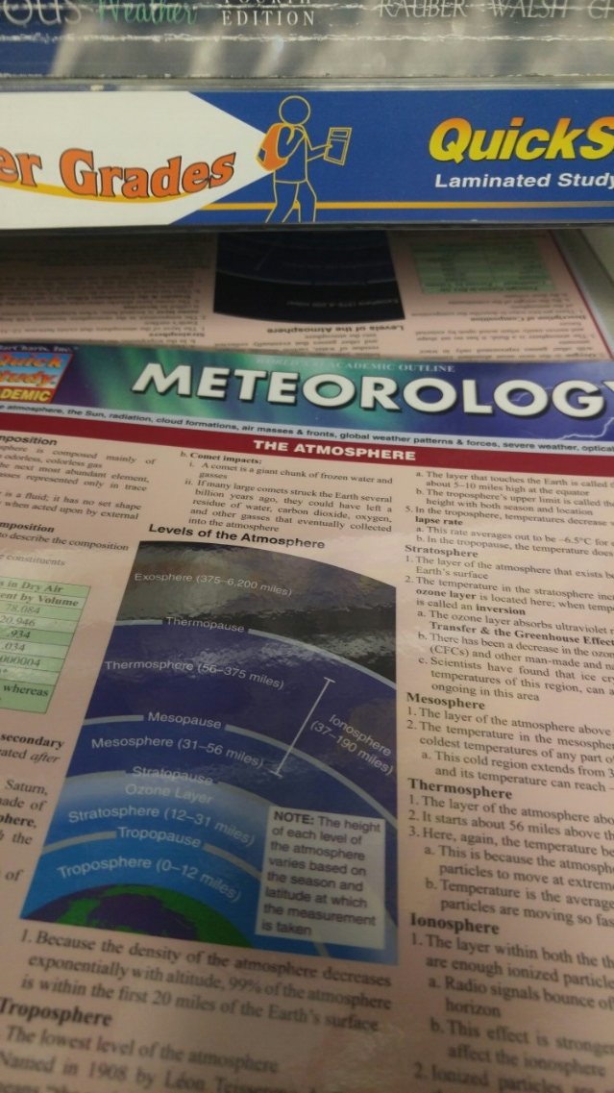
Handout at bookstore NOT required

Slide 15
Grading: see syllabus
Lowest of 4 exam grades will be dropped
There are no makeup exams after the scheduled exam periods
With petition by the student at least two days in advance and instructor approval, a student may be able to schedule taking an exam early.
3 exams worth 60% of total grade
Assignments (in-class 15%; online quizzes 25%) worth 40% of total grade
THERE IS NO EXTRA CREDIT
Final grades are based on the following scale:
> 90 % guarantees an A or A-
> 80 % guarantees a B+, B, or B-
> 70 % guarantees a C+, C, or C-
> 60 % guarantees a D+, D, or D-
< 60% may result in an E
Cutoff points for the specific grades are identified to define reasonable distribution of grades

Slide 16
During Each of the Four Blocks…
1-3 canvas-based quizzes or in-class required assignments
In-class exam review session
Practice exam on canvas – no points but a few or similar questions will also be on the exam
1 exam (final exam for module 4 is not comprehensive)

Slide 17
Homework/Quiz Assignments
Designed to review and expand on material presented in class
Assignments completed in canvas or in class
Exam content will depend in part on homework
Intended to take 1-2 hours to complete

Slide 18
Grade Anxiety?
Your grade will improve if YOU:
come to class with the class notes
take notes!!
ask questions in class, via canvas or email, or during office hours
complete all homework
complete the practice exam

Slide 19
Class Policies
Official Syllabus in canvas and Distributed in Class
Missing just one class may result in a lack of understanding for future classes
Be on time and stay for the entire class period
You are expected to participate in class and pay attention: use of cell phones and mobile devices is discouraged except when they are used in the context of the class to access weather information or other course content
Class policies and requirements may be modified during the semester as necessary, especially if unusually high rates of student absenteeism arise due to illness
ADA Accommodations: see online syllabus

Slide 20
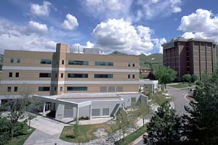
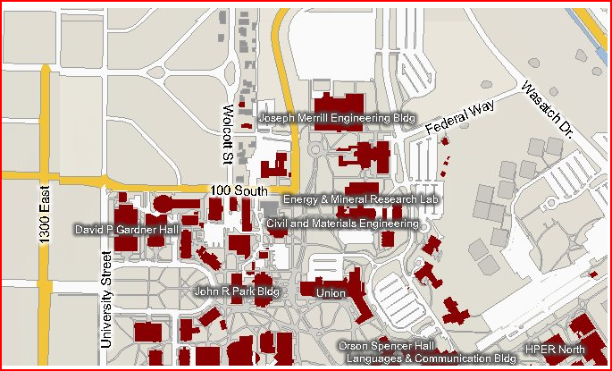
Office Location – INSCC 480/483
INSCC
TA: Nola Lucke
office: 484 INSCC
Erik Crosman
phone: 505-570-0552 office: 480-10 INSCC
Won/Wed 4-5 pm or appt
Taylor McCorkle
phone: 918-284-2379
office: 480-5 INSCC
Tues, 10-12 or by appt.

Slide 21
Canvas
Check class lectures online before class (and after).
Simplifies the need to be taking rapid-fire notes
Official course syllabus online
All course material (including lecture material) will be available in Canvas
Many assignments will be posted and completed using Canvas
It is your responsibility to become familiar with Canvas-
For help, contact support at http://www.tacc.utah.edu/ or call 585-5959 immediately.

Slide 22
Summary
Take charge of your education
  Be an active learner
  You (or someone!) is paying for your education
  Take full advantage of opportunities
Be prepared to participate fully in class
  Read and do prep before class
  Take notes during class
  Ask questions
  Share your experiences related to the class content

Slide 23
Module 1 Topics
Properties of the atmosphere (Chapter 1)
Meteorological measurements (Chapter 2; Surface station beginning Chapter 3)
Radiation and the seasons (Chapter 5)
Atmospheric stability (Chapter 6)
Forces and force balances (Chapter 7)

Slide 24
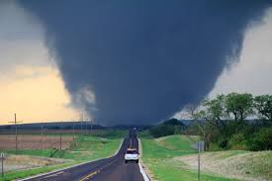
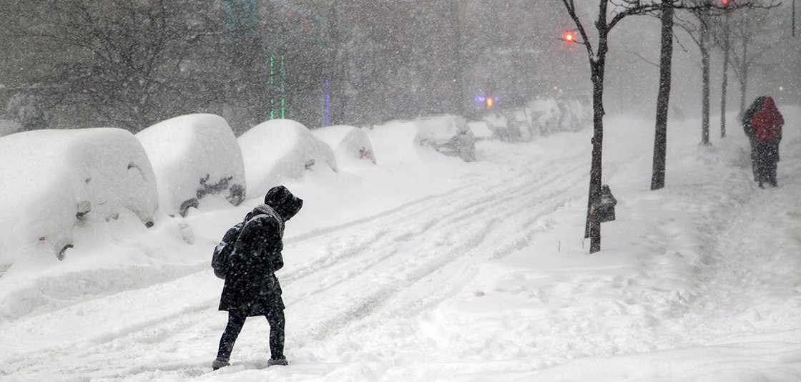
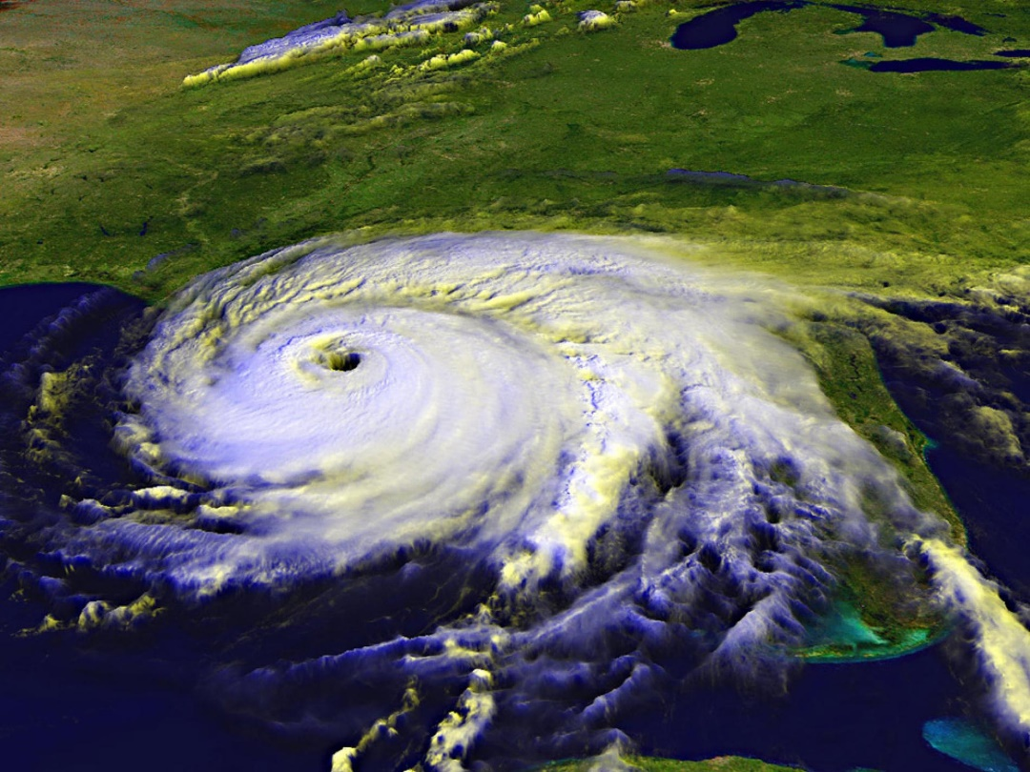
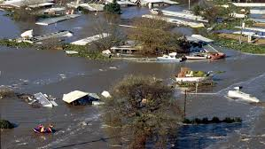
In order to discuss this…

Slide 25
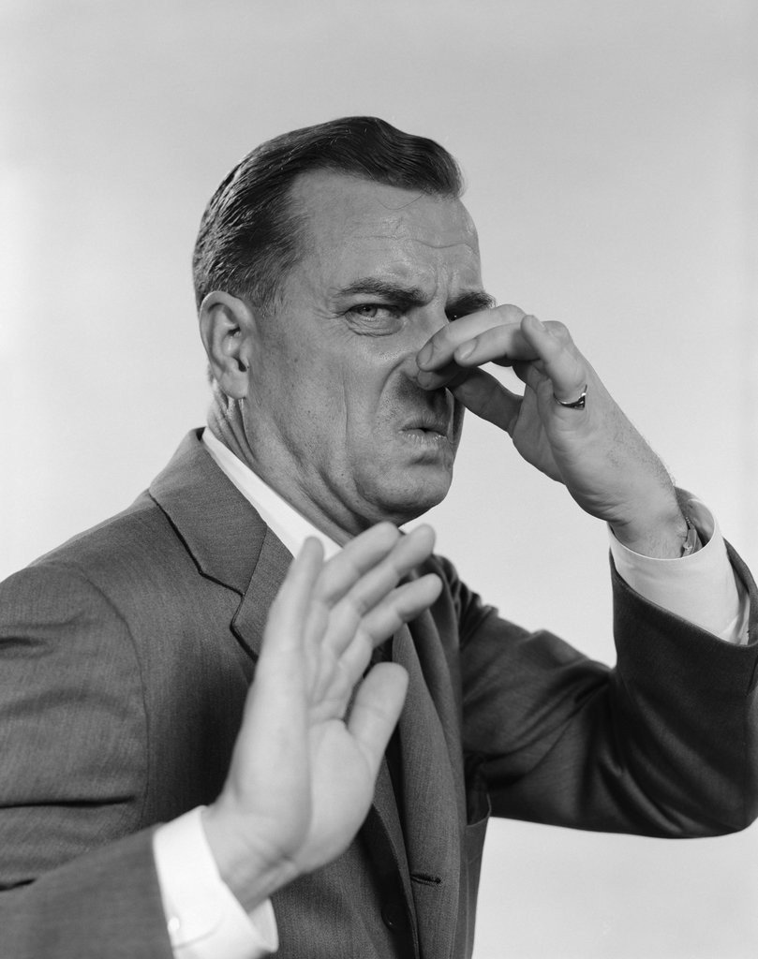
We need to get some stuff out of the way ☺

Slide 26
Properties of the Atmosphere (Chapter 1)
Why does the Earth have an atmosphere?
Composition of the Earth’s atmosphere
Temperature definition/Temperature Scales
Pressure definition/units

Slide 27
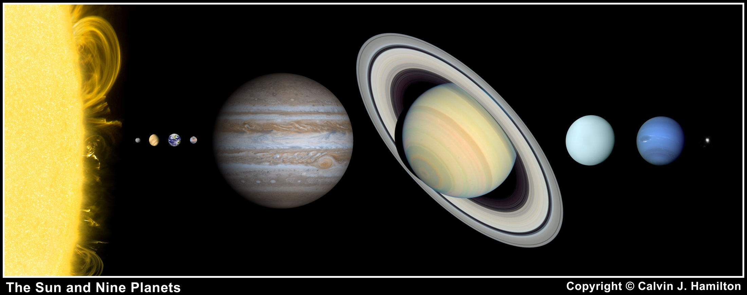
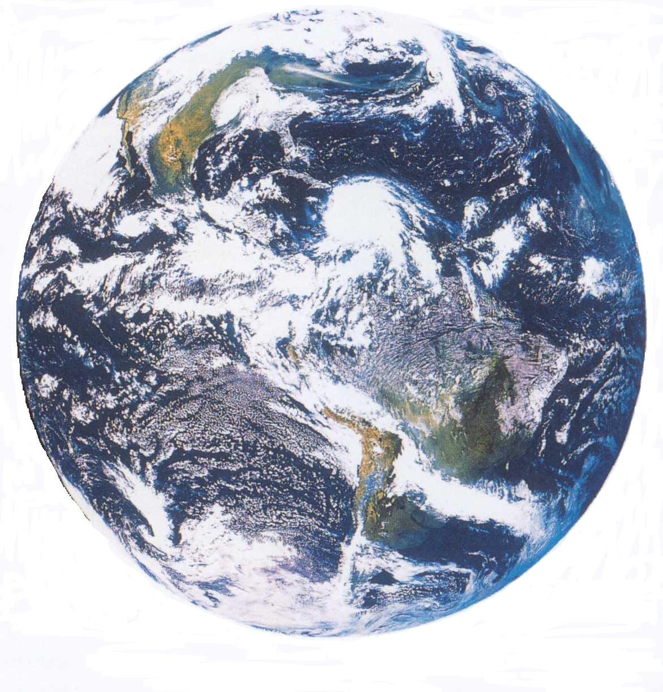
Venus’s atmosphere is much more dense than Earth’s
Jupiter, Saturn, Uranus, and Neptune are the gas giants
Earth’s atmosphere is much more dense than Mars’s
Mercury and Pluto have almost no atmospheres

Slide 28
Why Does the Earth
Have an Atmosphere?
Gravity is Important
  Higher gravity increases the likelihood that a planetary body will have an atmosphere
Need a Source of Gases
  Volcanoes
Must be Shielded from the Solar Wind
  Need a magnetic field or distance from the sun

Slide 29
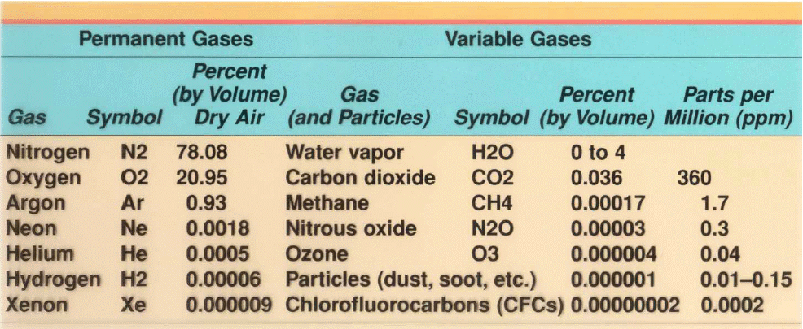
Atmospheric Composition

Slide 30
Atmospheric Composition
Nitrogen (78%) – Important building block for life. Soil forms nitrates out of nitrogen in the air.
Lightning also reacts with nitrogen and adds nitrates to soil.
Oxygen (21%) – Role in survival of many forms of life elevates its significance.
Water vapor (0-4%) – Most important greenhouse gas, keeps earth warm enough to support life. Superb solvent, carries nutrients to cells and waste away
Carbon Dioxide, Methane – Important greenhouse gases. CO2 vital for plant processes – photosynthesis
Ozone – Good up high, bad down low

Slide 31
Properties of the Atmosphere
We describe the atmosphere in terms of its properties
These include: temperature, pressure, moisture, wind, clouds, precipitation, etc
Our ability to measure and predict these properties have become increasingly complex

Slide 32
What’s Temperature?
Measure of the vibrational energy of molecules in solids or the average speed at which molecules in a gas (or liquid) move
Cold air: air molecules are moving slower
Hot air: air molecules are moving faster
Jiggling atoms video demonstration
https://www.youtube.com/watch?v=StLulh_KKd0

Slide 33
English vs. Metric Units
English units: conventional but awkward
  We’ll use English units when relating weather to common experience
  Temperature (Fahrenheit ºF)
Metric units: easier to use
  Most homework and exams will expect answers in metric units, make sure to specify units you are using
  Temperature (Celsius ºC)
  Guestimating: ºF ~ 2 * ºC + 30. So 10 ºC ~ 50ºF
  But, have to know that 0ºC = 32ºF melting point of ice

Slide 34
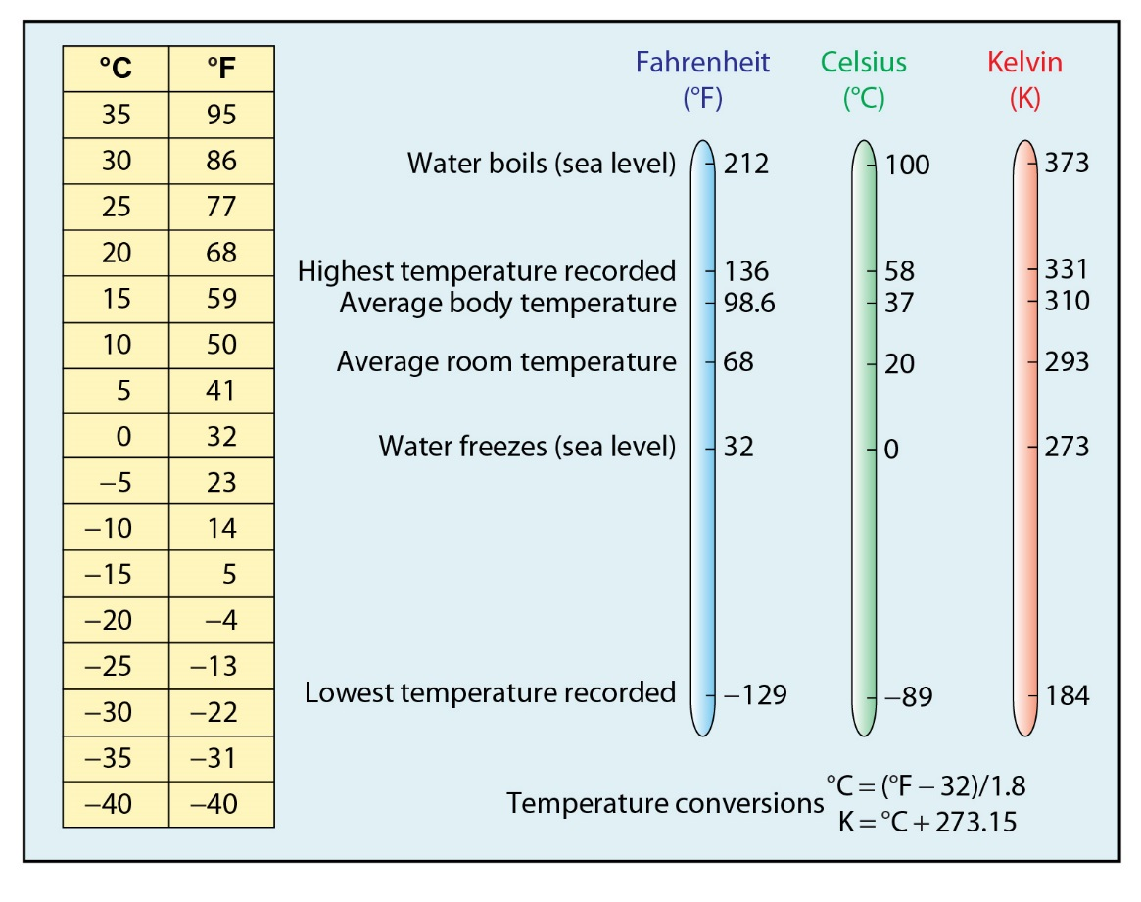
Temperature

Slide 35
What’s Pressure?
Atmospheric pressure - force (weight) of column of air above a 1 m² surface
Depends the most on the number of air molecules above you
Pressure ALWAYS decreases with height
(Temperature usually decreases with height)
1 m²

Slide 36
What is Pressure?
The force applied divided by the area over which the force is distributed (i.e., Force/Area)
Pressure in the atmosphere can be thought of as the weight of the gases that are above
https://www.youtube.com/watch?v=xg5NiOwf_Zw

Slide 37
Can Crushing Demonstration
Step 1: Place water in an aluminum can and place it on a stove.
Step 2: Wait for the water in the can to boil. (This replaces all of the air inside the can with water vapor.)
Step 3: Turn the can upside down and place the top of the can in an ice bath.
Step 4: All of the water vapor inside the can condenses which creates a near vacuum inside the can.
Step 5: The atmospheric pressure (14.7 pounds per square inch at sea level) crushes the can.
Demonstration

Slide 38
Pressure Units
Atmospheric pressure - force (weight) of column of air above a 1 m² surface
English units of lbs per square inch rarely used. Meteorologists use special unit called millibar
1 atmosphere (atm) = 1013.25 millibars (mb)
1 atmosphere (atm) = 29.92 inches of mercury

Slide 39
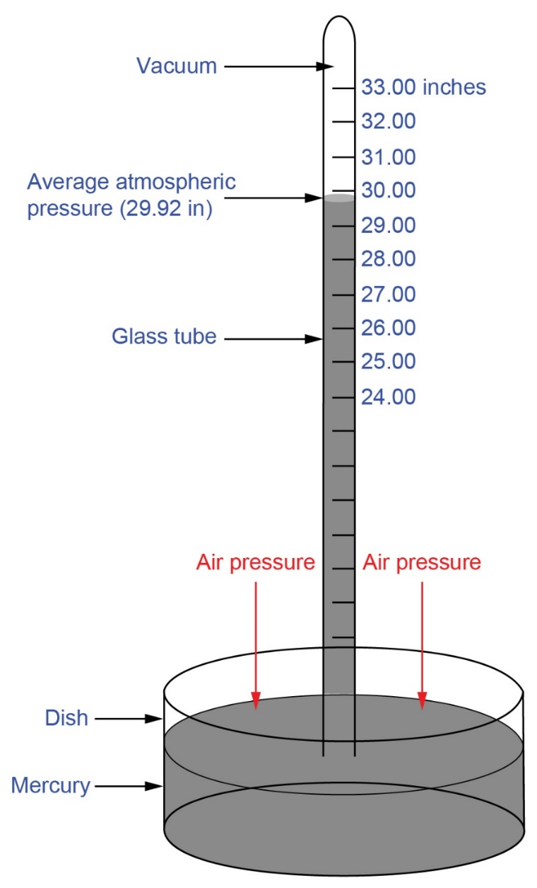
Mercury Barometer
The height of the mercury column is proportional to atmospheric pressure

Slide 40
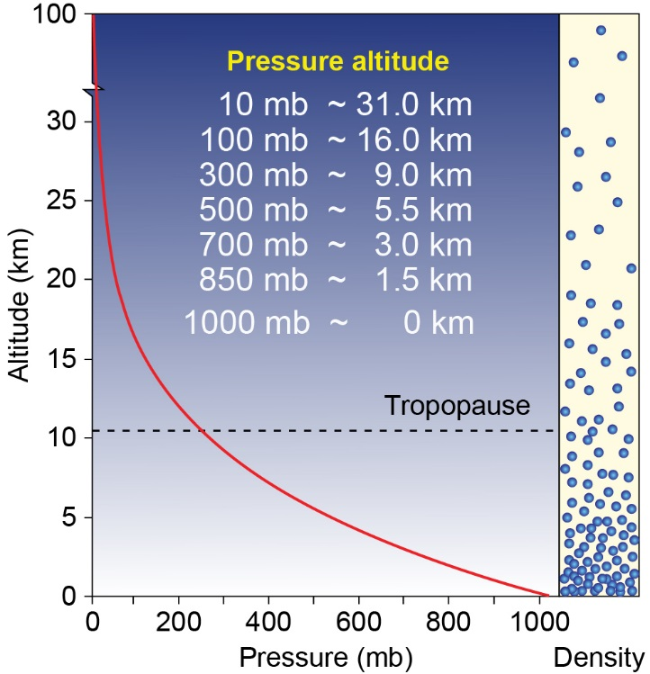
Decrease of pressure with height
Sea level

Slide 41
Decrease of pressure with height
1.5 km: Salt Lake

Slide 42
Decrease of pressure with height
3 km:Alta

Slide 43
DEFINITIONS
Atmosphere: The envelope of gases that surround a planet and are held to it by the planet’s gravitational attraction
Mass: The amount of matter contained in a physical object (units are kg)
Volume: The size or extent of a three-dimensional object or region of space (units are cubic meters: m³)
Density: The mass per unit volume of a substance (Mass/Volume) (units are kg/m³)
Pressure: The force applied over a given surface area (Force/Area) (common units are millibars, hectopascals, inches of mercury, torr)

Slide 44
Summary:
What you should have
Syllabus
For Wednesday
Can start reading textbook chapters 1,2
Check out wed in-class lecture on canvas (will be posted this evening).

