Slide 1
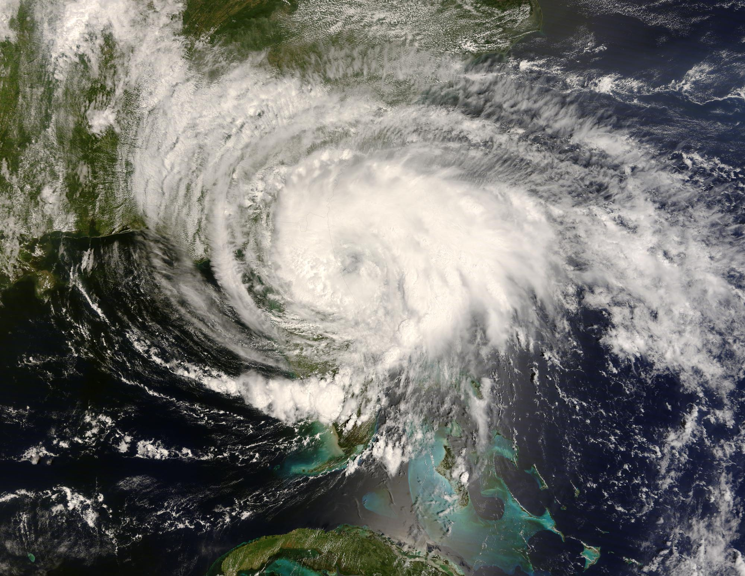
ATMOS 1010:
Severe and Unusual Weather
FASB 295 MW 11:50-1:10
Instructors: Erik Crosman, Research Assistant Professor
Taylor McCorkle, Graduate Research Assistant

Slide 2
Assignments
Chapter 1 + 2 Quiz Canvas due 5 Sept
In-class exercise 1 Due at end of today’s class
In-class exercise 2 (next week)
Chapter 5, 6, 7 Quiz Canvas due 14 Sept
Module 1 Practice test/study guide Available on canvas 10 Sept
Module 1 review/test prep 12 Sept
Module 1 test (in class) 17 Sept

Slide 3
Module 1 Topics/Text Reference
Properties of the atmosphere (Chapter 1)
Meteorological measurements (Chapter 2; Surface station beginning Chapter 3 pg 46-48)
Radiation and the seasons (starting 2 pages of Chapter 5 pg 83-84)
Atmospheric stability (Chapter 6 112-123)
Forces and force balances (Chapter 7 132-137)

Slide 4
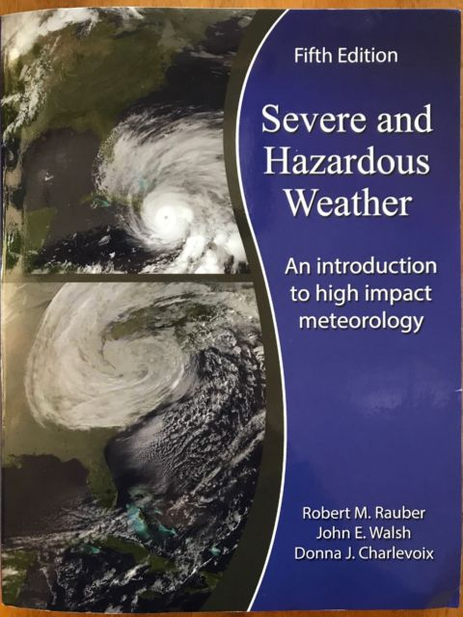

Course Textbook: Severe and Hazardous Weather (3rd, 4th, or 5th edition)
Library reserve copy available. Refer to
http://campusguides.lib.utah.edu/course_reserves_guide
Reserve copy also available next to my office 480-INSCC

Slide 5

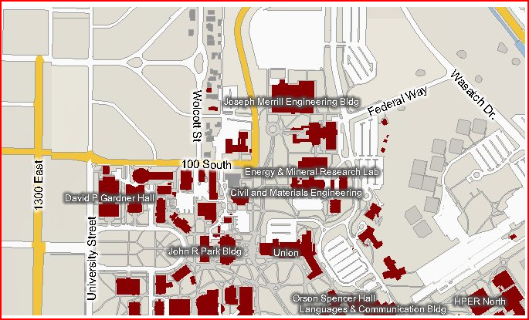
Office Location – INSCC 480/483
INSCC
Erik Crosman
phone: 505-570-0552 office: 480-10 INSCC
Won/Wed 4-5 pm or appt
Taylor McCorkle
phone: 918-284-2379
office: 480-5 INSCC
Tues, 10-12 or by appt.

Slide 6
What’s Wind
Trucks versus wind video
https://www.youtube.com/watch?v=uOwbbsgaRaQ
https://www.youtube.com/watch?v=tZefhS7XBa4

Slide 7
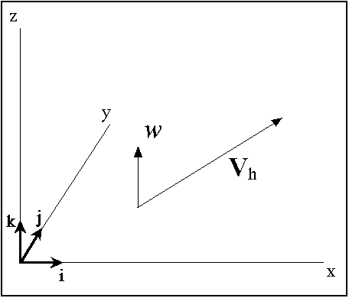
What’s Wind?
Bulk movement of air
3-dimensional
  Horizontal wind
    Wind speed and direction
    Direction from which wind blows
    Or zonal (east-west); meridional (north-south)
  Vertical component of the wind (speed and up/down)
  Horizontal wind speeds can be much larger than vertical ones (~50 m/s vs ~1 m/s)
  But vertical motions of 1-5 m/s often associated with severe weather
South-north
West -east

Slide 8
Measuring the Horizontal Wind
Has both a magnitude (speed) and direction
Metric unit of speed: meters per second (m/s)
  1 mile per hour equals .45 m/s
  10 miles per hour ~ 5 m/s
Horizontal direction defined in degrees from 0-360 or “cardinal directions (N,E,S,W)”
  The direction of the wind is the direction from which the wind is blowing
  A north wind means you would feel on your face the wind when you face north

Slide 9
Summary of Chapter 1
We described the following key atmospheric processes:
Temperature
Pressure
Moisture
Clouds
Wind

Slide 10
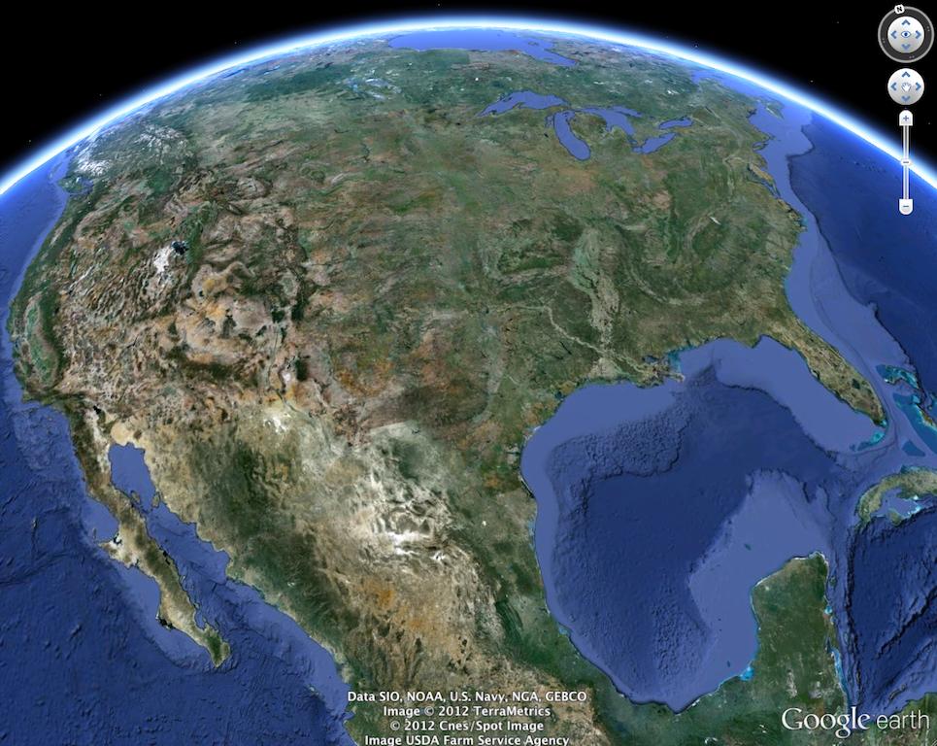

Changes in the Atmosphere in Space and Time
Atmospheric fields change in 4 dimensions
horizontal (2 dimensions)
vertical
time
Later Time
Time
North-South
North-South
Up-Down
Up-Down
East-West
East-West

Slide 11
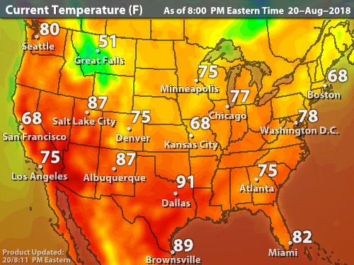
Examples of Variations in Atmospheric Properties

Slide 12
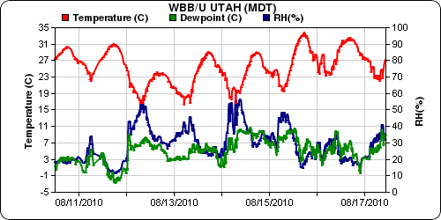
Variation in Temperature with Time: 1 Week
mesowest.utah.edu

Slide 13
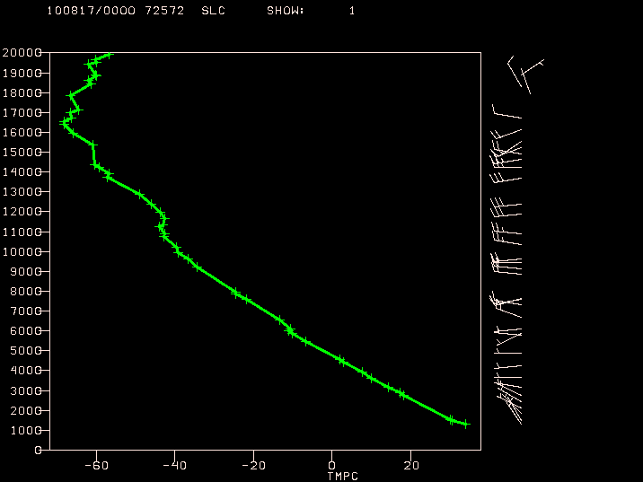
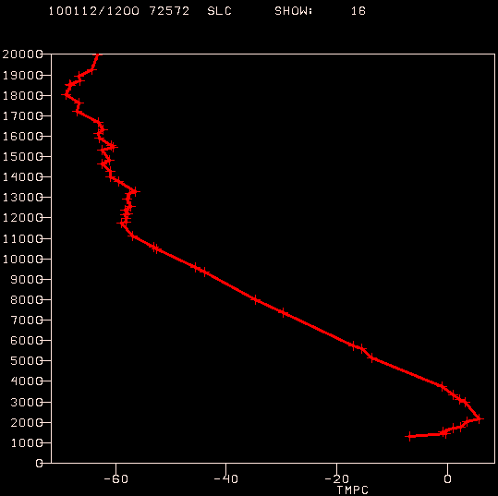
Summer afternoon
Winter morning
Summer afternoon
Height
Inversion
Temperature
Temperature

Slide 14
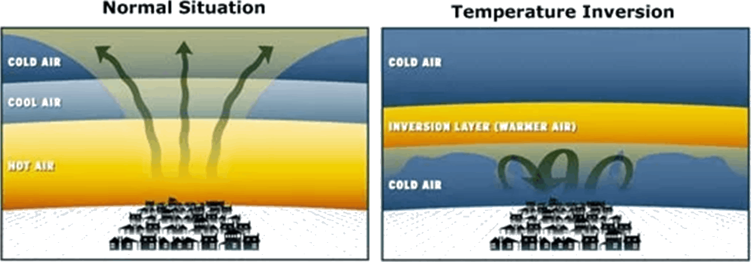
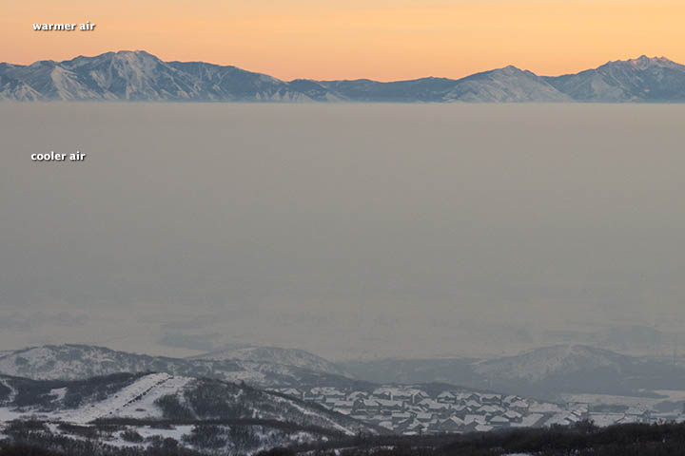
‘Temperature Inversion’

Slide 15
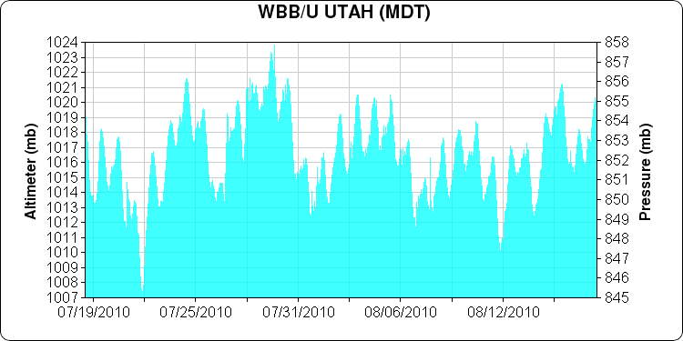
Variation of Pressure in Time: 1 month
Changes in pressure with time are much smaller than those with height

Slide 16
Dew Point Temperature
Dew point temperature T_{d} : temperature to which air must be cooled at constant pressure until saturation occurs
Although dew point temperature is reported in (ºC), it is a measure of moisture content
Relative Humidity
Relative humidity measures how close the air is to saturation with respect to invisible water vapor
Relative humidity has no units and is reported as a percent value ranging from 0-100%

Slide 17
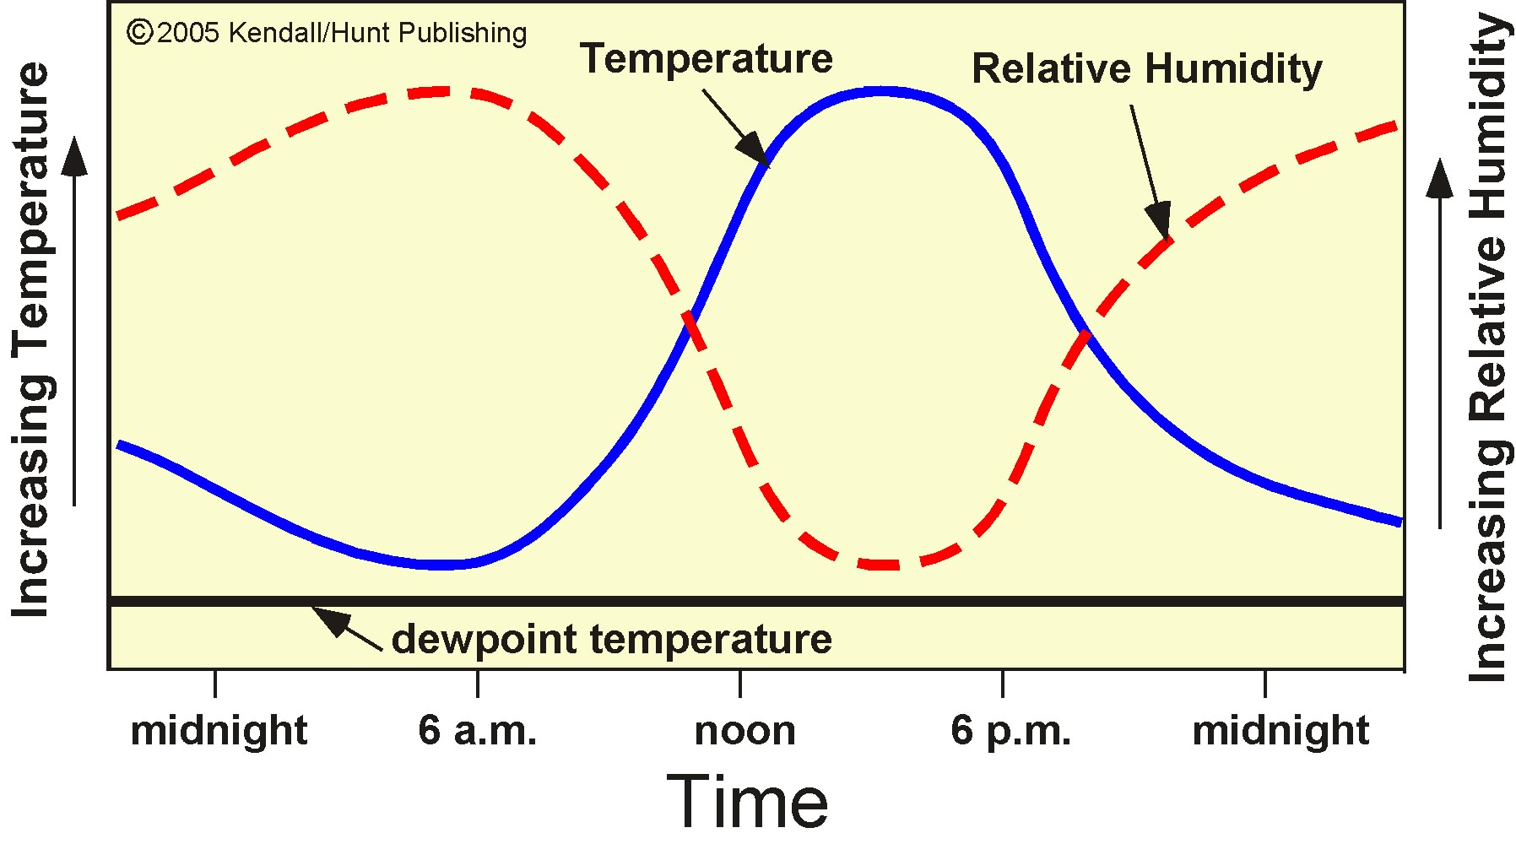
Common Daily (Diurnal) Changes
Small difference between air and dewpoint temperature
Large
difference between air and dewpoint temperature
amount of water vapor constant

Slide 18
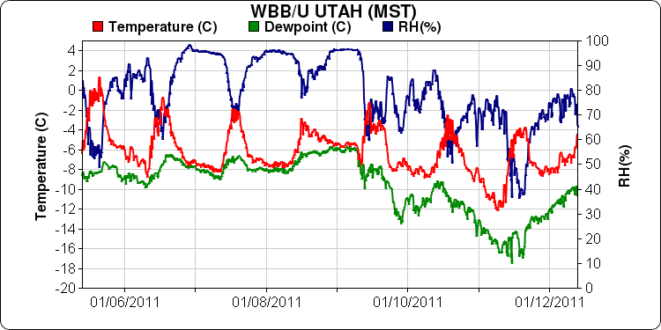
Variation in T, TH,TD with Time: 1 Week

Slide 19
Summary
Wind, temperature, pressure, moisture and clouds vary in all 4 dimensions (horizontally, vertically, and in time)
Changes in those parameters in the vertical tend to be much more abrupt than those horizontally
How much water vapor is in the atmosphere is measured by the dew point temperature or the vapor pressure
The degree of saturation in the atmosphere is measured by relative humidity
  The water vapor present over a summer desert when the relative humidity is 10% may be higher than that on a cold day when the RH is 100%

Slide 20
Meteorological Measurements
(Chapter 2)
Universal Coordinated Time (UTC)
What meteorological measurements need to be made?
Automated Surface Weather Observing System (ASOS)
Surface station model description
Upper-air measurement system (Rawinsonde)
Radar
Satellite

Slide 21
Universal Coordinated Time (UTC)
Is defined as the time in the Greenwich England (time zone Z)
All meteorological measurements are reported in UTC time to avoid confusion
UTC is sometimes called Zulu (Z) time or Greenwich Mean Time (GMT)

Slide 22
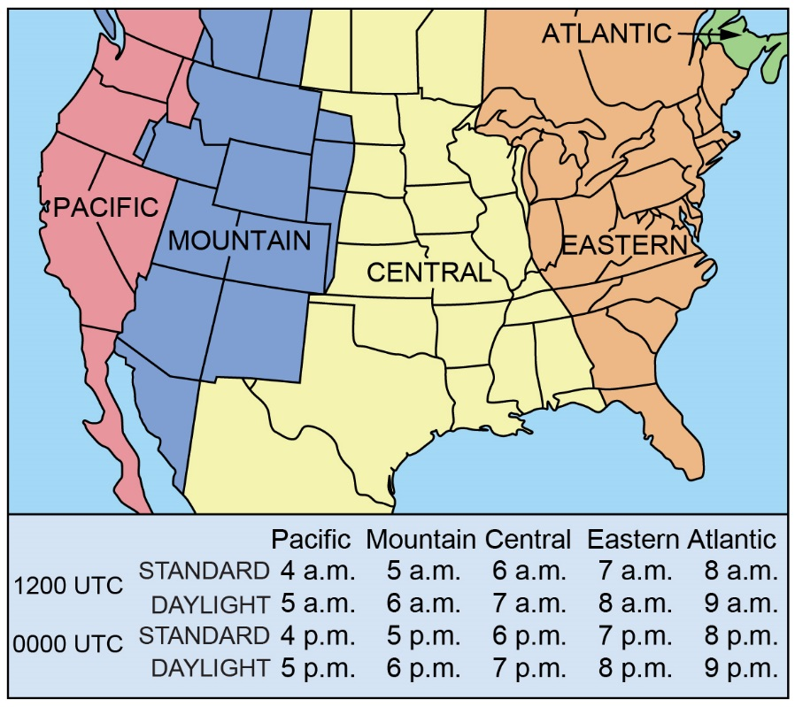
2.1
Courtesy of Bob Rauber.

Slide 23
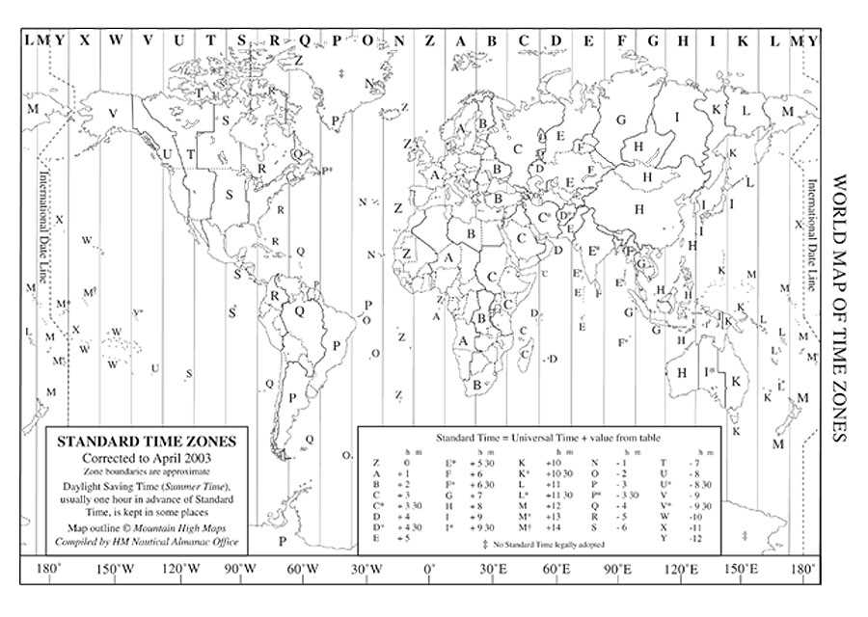
Conversion to UTC
Convert 0600 MST to UTC
Convert 2100 MST to UTC
Convert 1200 MDT to UTC
Convert 2300 MDT to UTC
Convert 0600 Z to MST
Convert 1200 Z to MDT
1300 Z
0400 Z
1800 Z
0500 Z
2300 MST
0600 MDT

Slide 24
What measurements need to be made?
Temperature
Dewpoint Temperature/Relative Humidity
Pressure
Windspeed/Wind Direction
Precipitation Amount/Type/Intensity
Cloud Coverage/Height
Visibility
Lightning

Slide 25
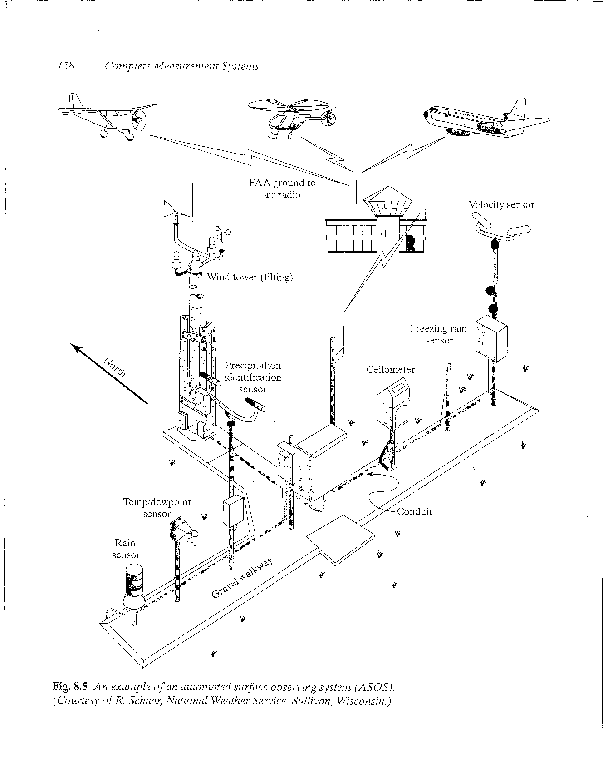
Automated Surface Weather Observing System (ASOS)
Visibility Sensor
Usually located near airport runways
Completely automated
Introduced in 1994
Freed meteorologists to do other tasks
Very reliable and cost effective
Measurements taken hourly in the last 10 minutes of the hour

Slide 26
ASOS Instruments
Temperature/Humidity Windspeed/Direction
Precipitation
Visibility
Cloud coverage/amount

Slide 27
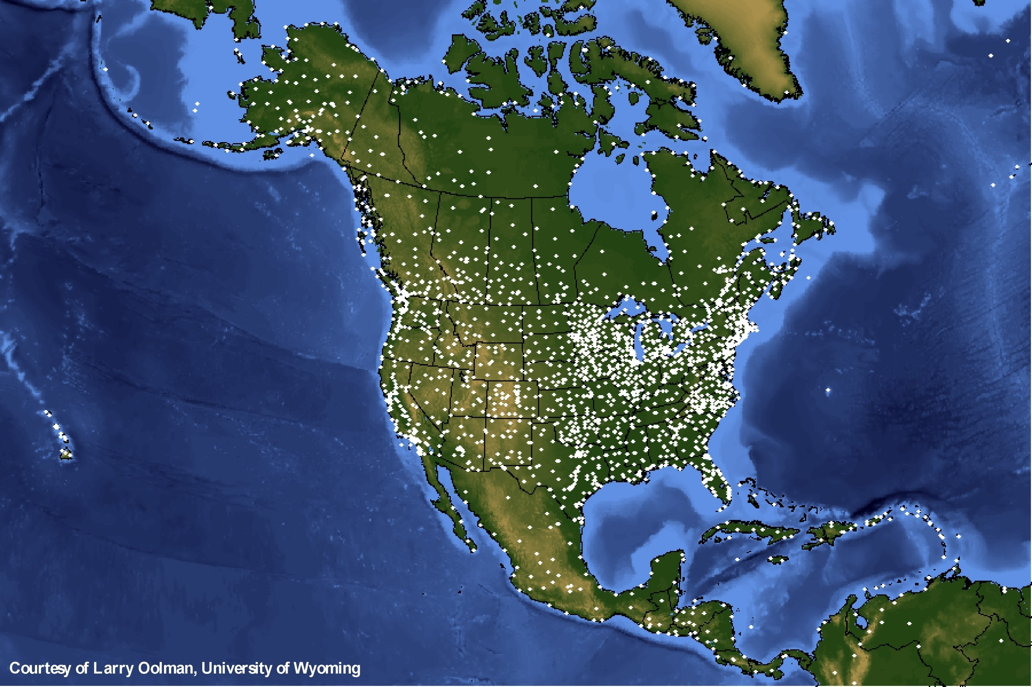
Routine
Surface
Observations
(mainly at
airports)

Slide 28
Surface Station Model Explained (beginning of Chapter 3; not included on tests)
TT is the temperature in ˚F
Td is the dewpoint temperature in ˚F
Vis is the visibility in statute miles
ppp is the sea-level pressure in tenths of a millibar (leading 10 or 9 removed)
Wind speed/direction are given in knots by arrow with barbs
Wx is a placeholder for symbols that can be used to describe the present weather at the site (see Figure 3.1 in book for details)
Cloud coverage
  CLR = 0/8
  FEW = 1/8 – 2/8
  SCT = 3/8 – 4/8
  BKN = 5/8 – 7/8
  OVC = 8/8
TT
ppp
Vis
Wx
Td

Slide 29
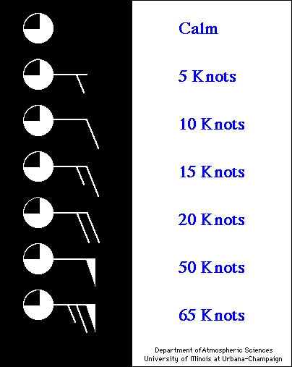
Wind Speed Barbs
1 knot = 1.15 mph = 0.514 meters/second

Slide 30
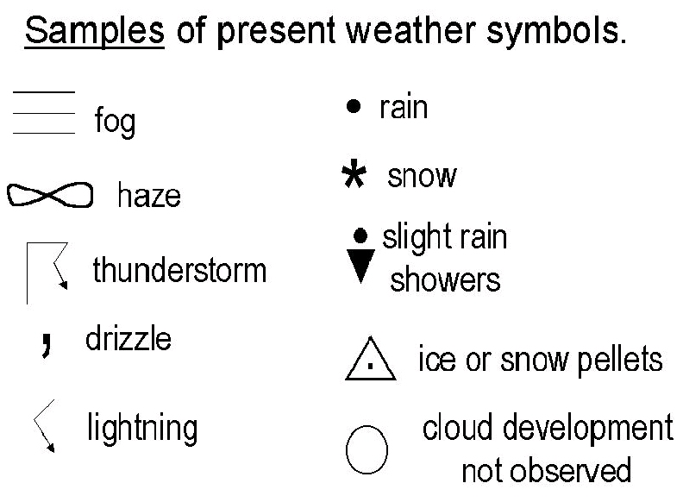

Slide 31
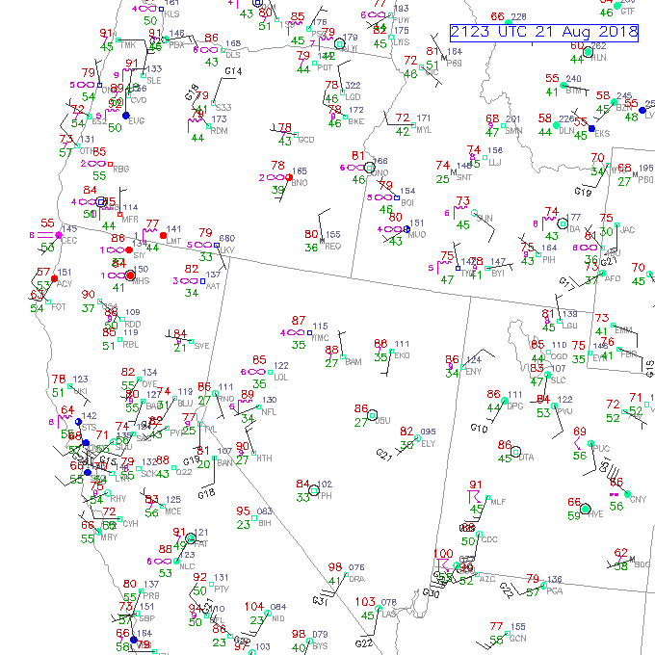

Slide 32
Upper-Air Observing System
Rawinsondes are a critical data source for the National Weather Service and Climate Research
Provide measurements of temperature, dewpoint temperature, pressure, windspeed, and wind direction from the surface to the lower stratosphere (meteorologists call them “Soundings”)
Observations are collected twice daily (00Z and 12Z) from an extensive network spanning the globe
Data can be accessed at
  http://weather.uwyo.edu/upperair/sounding.html

Slide 33
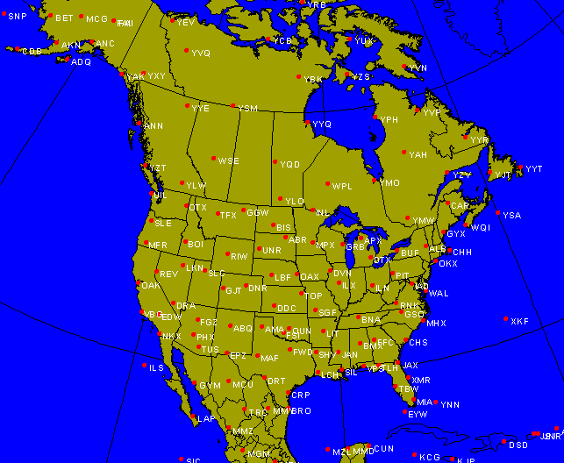
Upper Air Network

