Slide 1
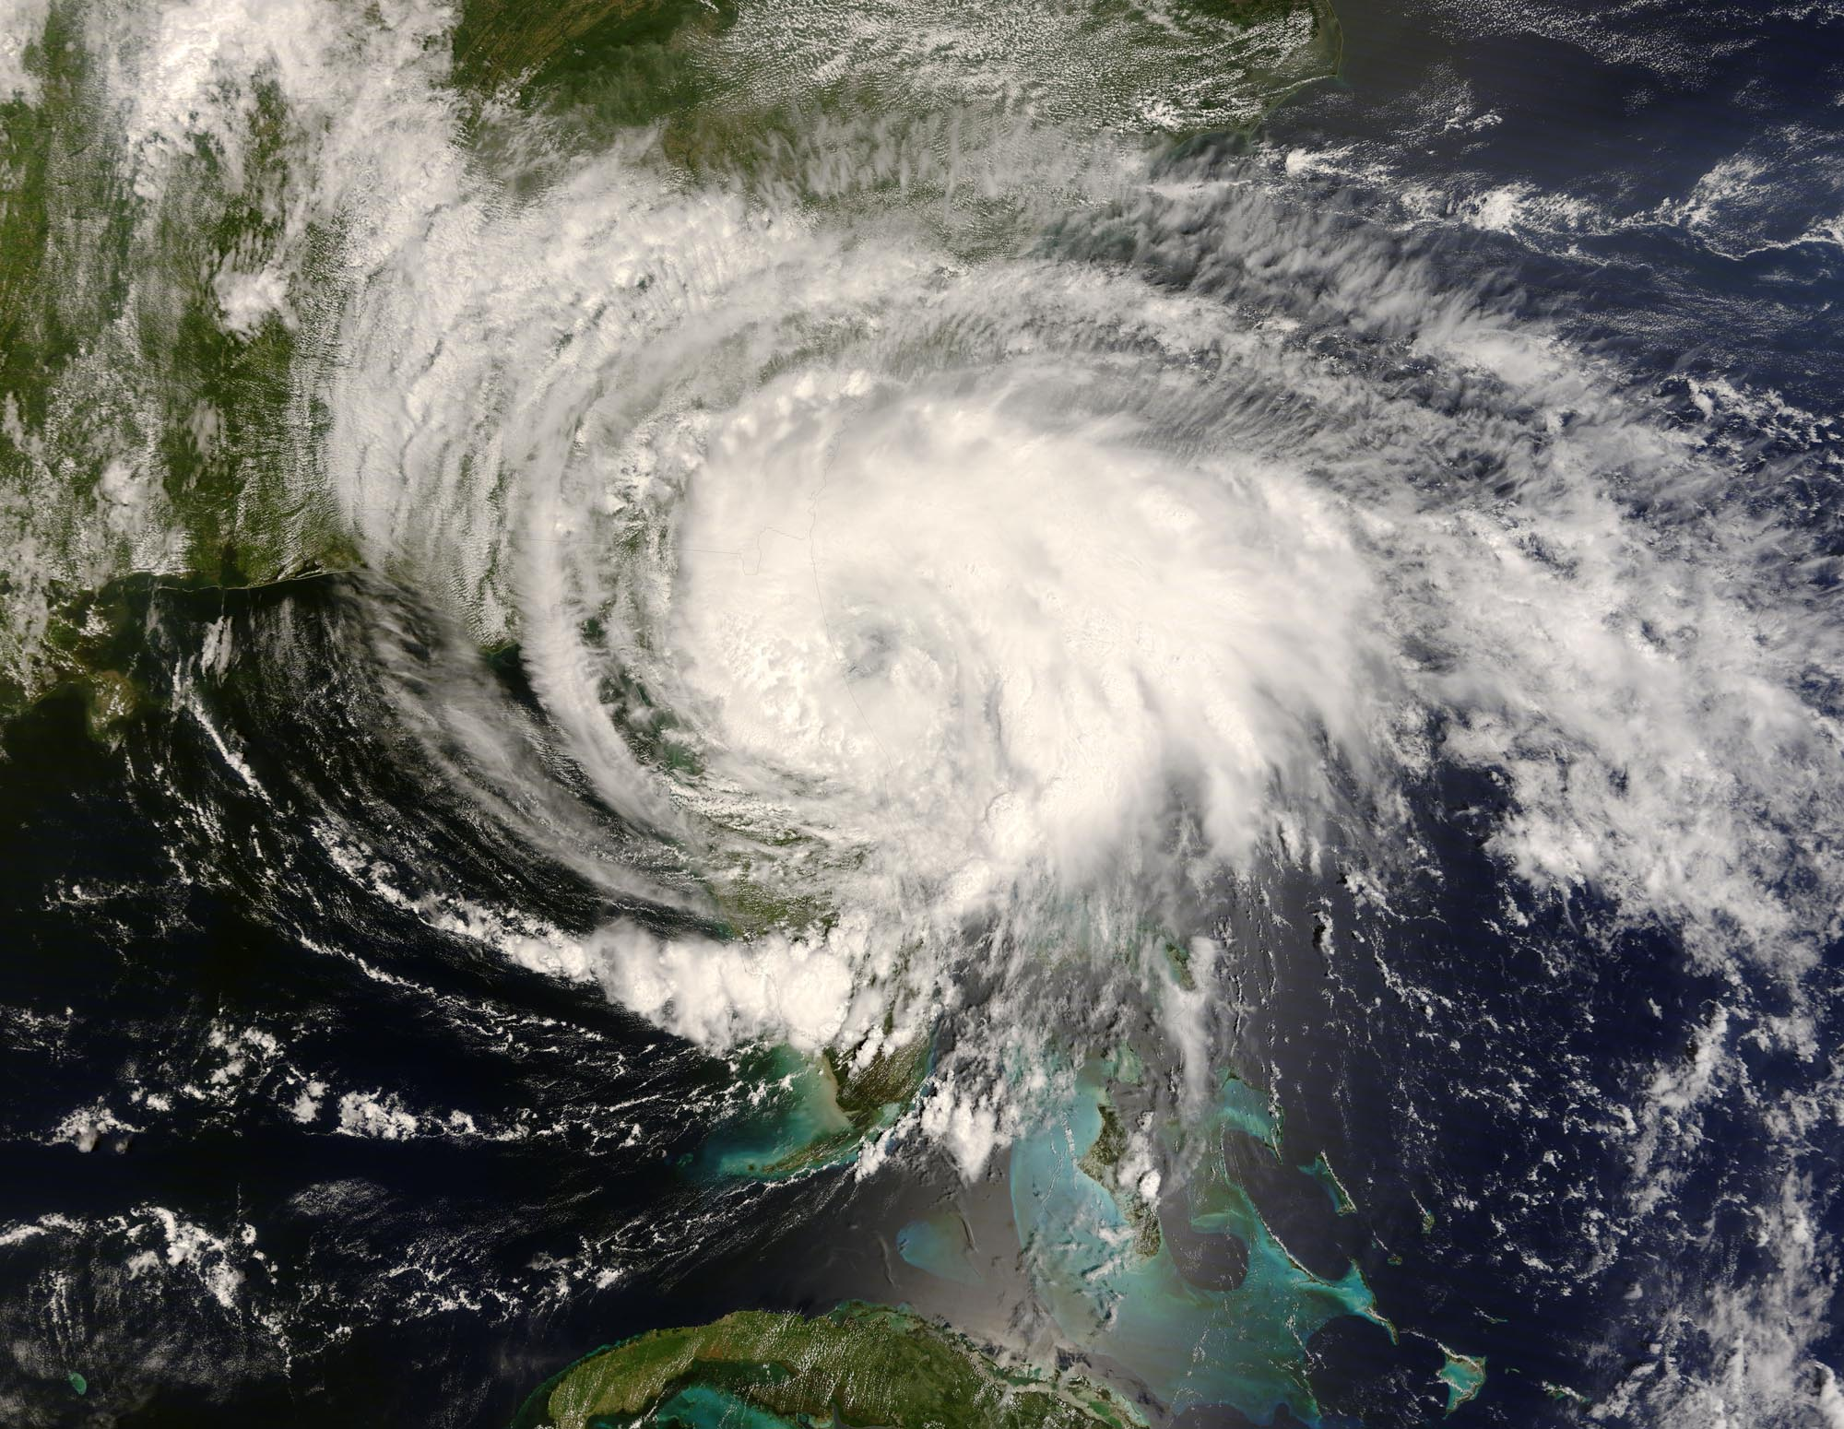
ATMOS 1010:
Severe and Unusual Weather
FASB 295 MW 11:50-1:10
Instructors: Erik Crosman, Research Assistant Professor
Taylor McCorkle, Graduate Research Assistant

Slide 2
Assignments
Chapter 1 + 2 Quiz Canvas due 7 Sept
In-class exercise 2 (next week)
Chapter 5, 6 Quiz Canvas due 14 Sept
Module 1 Practice test/study guide Available on canvas 10 Sept
Module 1 review/test prep 12 Sept
Module 1 test (in class) 17 Sept

Slide 3
Module 1 Topics/Text Reference
Properties of the atmosphere (Chapter 1)
Meteorological measurements (Chapter 2; Surface station beginning Chapter 3 pg 46-48)
Radiation and the seasons (starting 2 pages of Chapter 5 pg 83-84)
Atmospheric stability (Chapter 6 112-123)

Slide 4
In-Class Hand-Held Weather Station Results
ATMOS 1010 Fall 2018 – In-Class Activity 1 Worksheet
Date: __________ Time (UTC): ____________ Time (MST/MDT): ______ Location: __________________
Current Conditions
1. Wind speed (tenths m/s): 0.3 -2.7 2. Direction (whole degrees and direction) N, NW, NE, SE
3. Temperature (tenths °C): __21-26_______ 4. Relative humidity (whole %): _20-40%___
5. Pressure (tenths mb) 851-863_________ 6. Cloud amount (clear, scattered, mostly cloudy, overcast): ____________
7. Any other interesting weather taking place now? ___________________________Hazy/Smokey________________

Slide 5
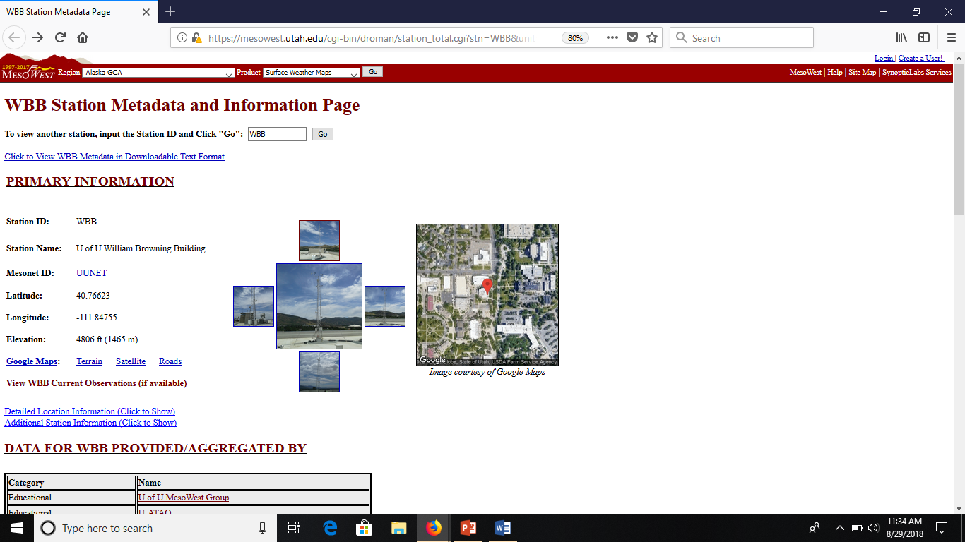
NW wind
NE wind
South wind
South wind

Slide 6
Upper-Air Observing System
Rawinsondes are a critical data source for the National Weather Service and Climate Research
Provide measurements of temperature, dewpoint temperature, pressure, windspeed, and wind direction from the surface to the lower stratosphere (meteorologists call them “Soundings”)
Observations are collected twice daily (00Z and 12Z) from an extensive network spanning the globe
Data can be accessed at
  http://weather.uwyo.edu/upperair/sounding.html

Slide 7
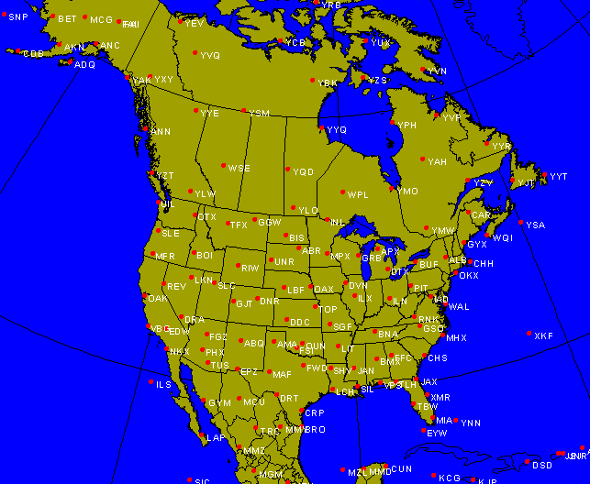
Upper Air Network

Slide 8
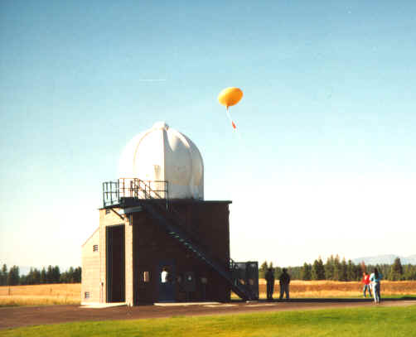

Slide 9
Fun Wx Balloon Launching Video
https://www.youtube.com/watch?v=DKwKmN4kHl4
http://www.youtube.com/watch?v=WTnRV38ubf8
http://www.youtube.com/watch?v=i0xNFh5Wm4U
What caused it:
http://www.abc.net.au/science/articles/2010/10/25/3047696.htm
http://www.youtube.com/watch?v=m9UB_ENmWwY
http://www.youtube.com/watch?v=fja3qfm7rwU
Go pro http://www.youtube.com/watch?v=6kSju2rIFPs

Slide 10
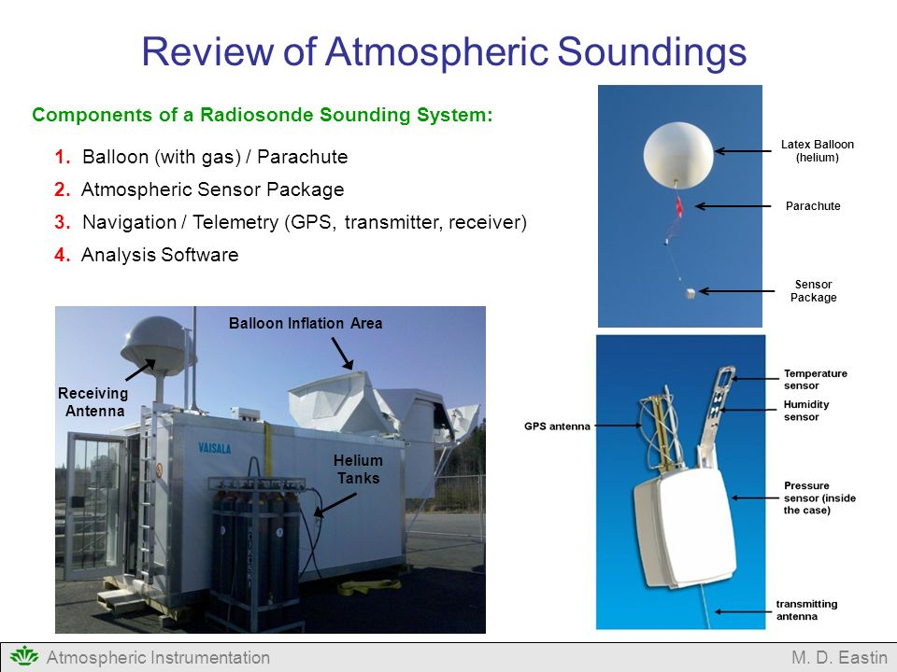

Slide 11
NWS Weather Balloon Launch Process
https://www.youtube.com/watch?v=dLpyTodmfg8
https://www.youtube.com/watch?v=9CjjbauSvBE

Slide 12
What are Stuve or Skew-T Diagrams?
It is a plot of temperature/dewpoint temperature on the x-axis versus pressure/height on the y-axis
Useful for identifying moist layers, dry layers, temperature inversions, tropopause height, etc.

Slide 13
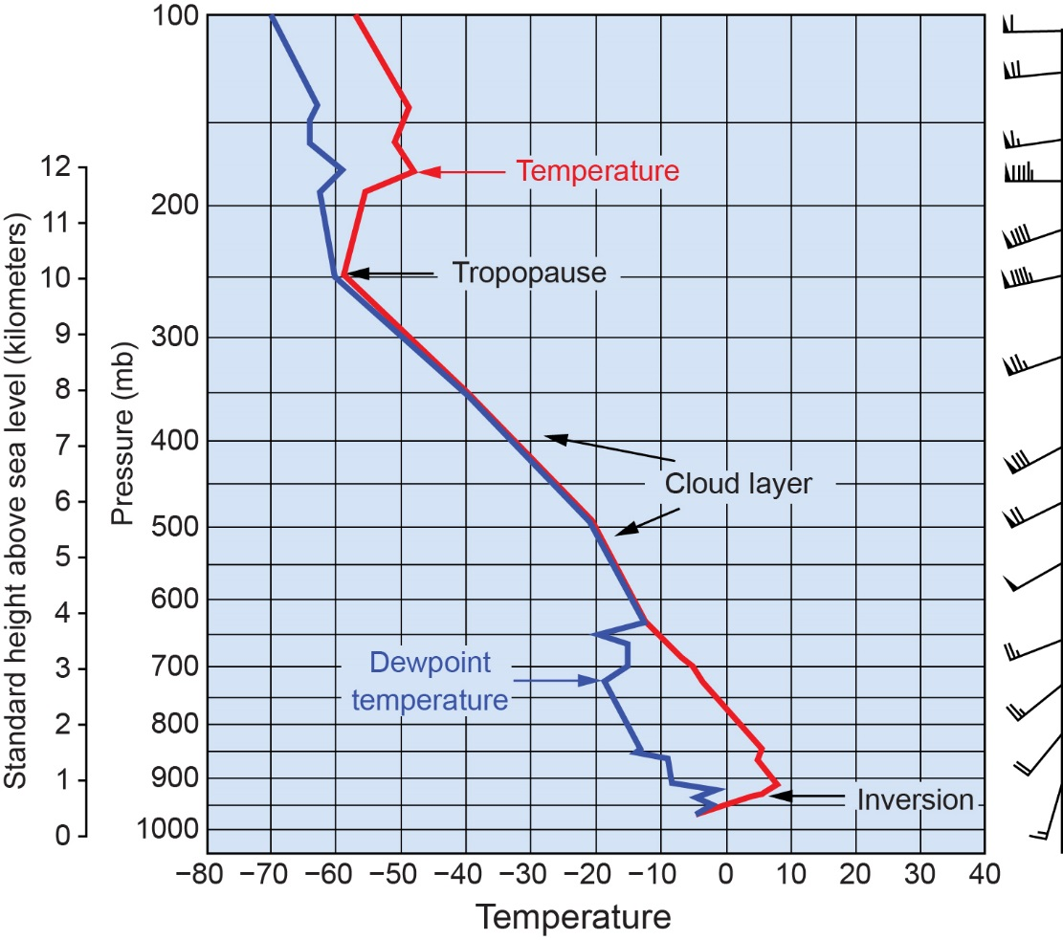
2.6
Stuve Diagram: Red line = Temperature
Blue line = Dewpoint temperature
Cloud layers→
Saturated air→
Temperature =
Dew point
temperature
Courtesy of Bob Rauber.

Slide 14
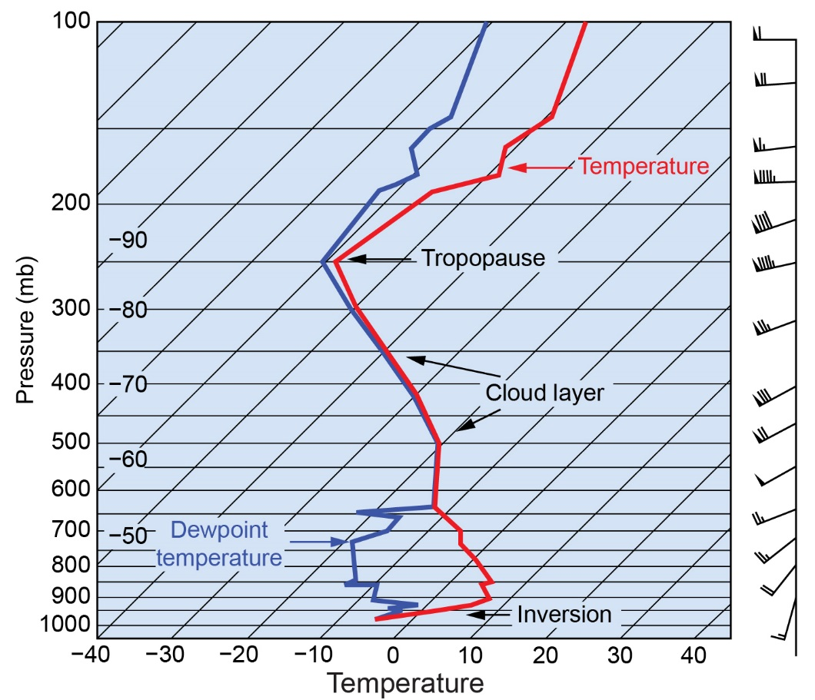
2.7
Skew-T Diagram: Red line = Temperature
Blue line = Dewpoint temperature
Lines of
temperature
Are ‘skewed’
Courtesy of Bob Rauber.

Slide 15
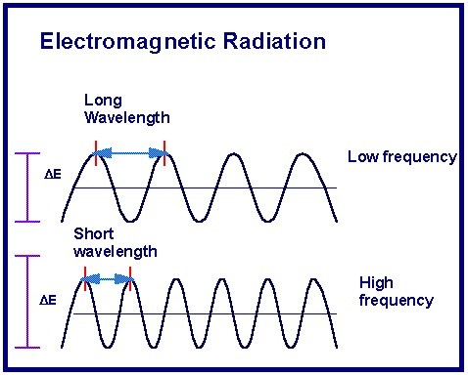
Frequency and Wavelength
Frequency = The number of oscillations of a wave per unit time
Wavelength = Distance between adjacent peaks or troughs is the wavelength

Slide 16
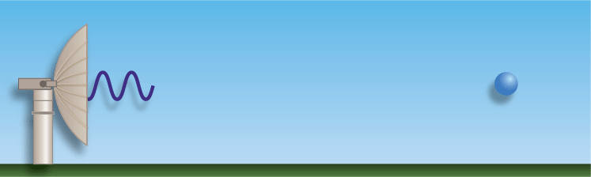
RADAR
RAdio Detection And Ranging
Developed during WWII for detection of enemy aircraft
Useful in identifying location and intensity of precipitation
Backscatter
Transmitted energy

Slide 17
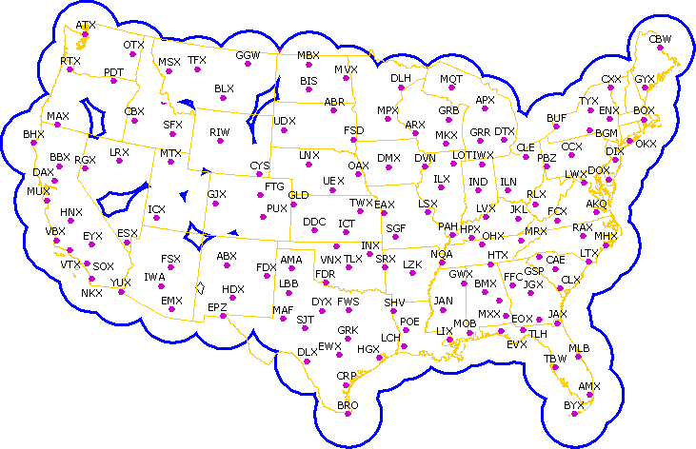
WSR-88D Network
Weather Surveillance Doppler Radar

Slide 18
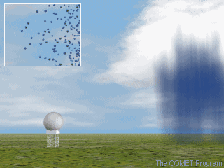

Slide 19
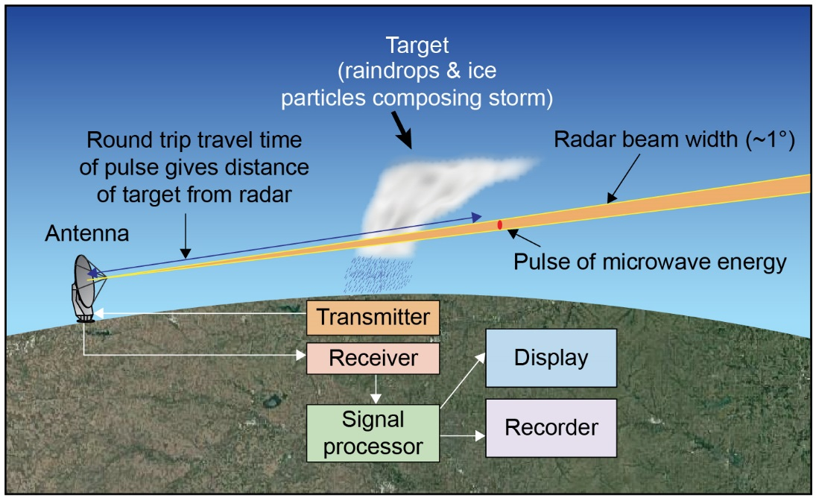
Principal Components of Radar

Slide 20
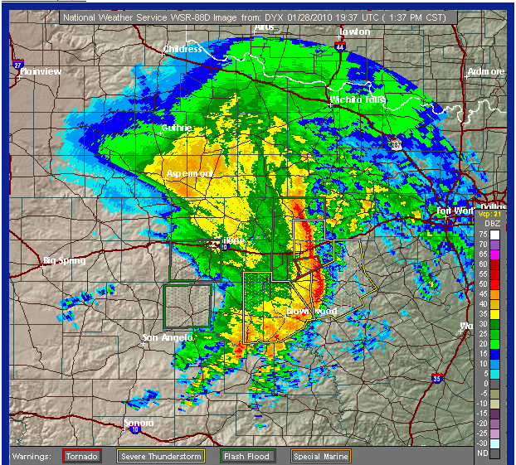

Slide 21
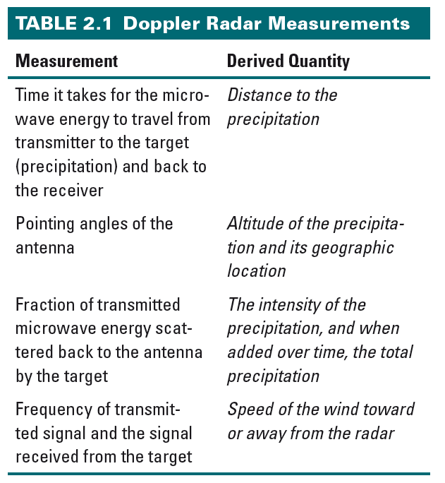
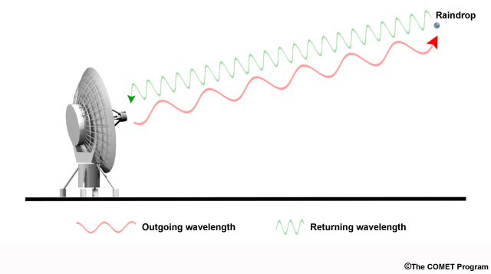

Slide 22
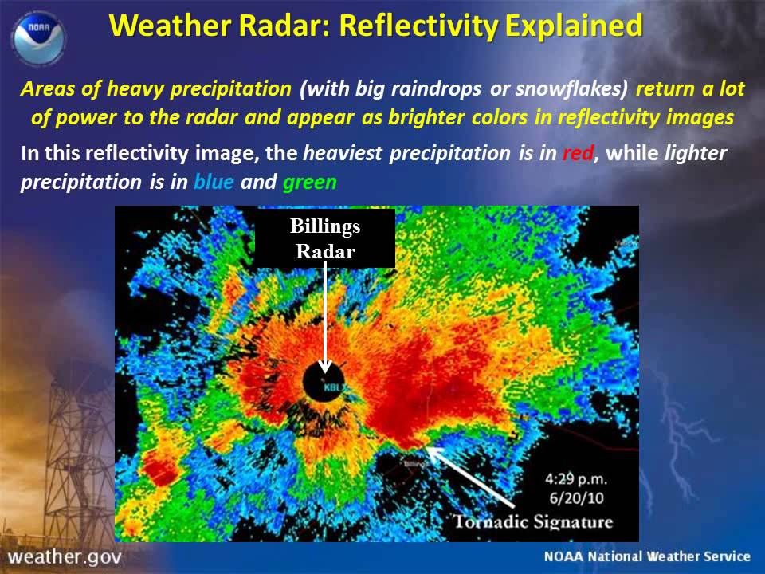

Slide 23

Radar Return Signal Strength
Return signal strength is measured in dBZ
Rainfall Rate (in/hr) | dBZ
Trace | 20
0.1 | 30
0.3 | 36
0.5 | 41
1.3 | 47
2.5 | 52
4.0 | 55
8.0 | 60
16.0+ | 65

Slide 24
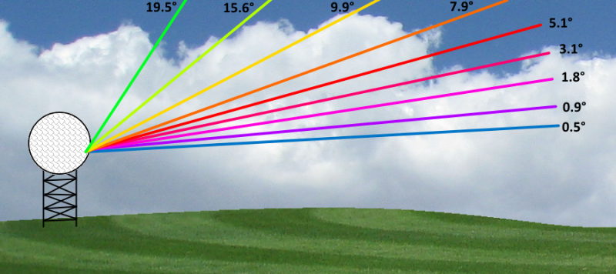
Radar Scan Cycle

Slide 25
Doppler Effect
Based on frequency changes associated with moving objects
E-M energy scattered by hydrometeors moving toward/away from radar cause frequency change
Frequency of return signal compared to transmitted signal frequency → radial velocity

Slide 26
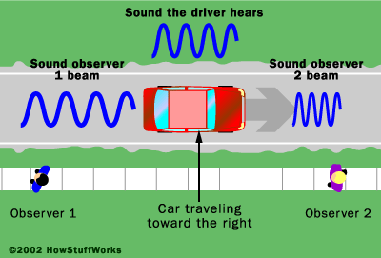

Slide 27
Explanation
You may have noticed that as a fast moving siren or loud engine passes by you, the pitch of the siren or engine abruptly drops in pitch. At first, the siren (engine) is coming towards you, when the pitch is higher. After passing you, the siren (engine) is going away from you and the pitch is lower. This is a manifestation of the Doppler effect.

Slide 28
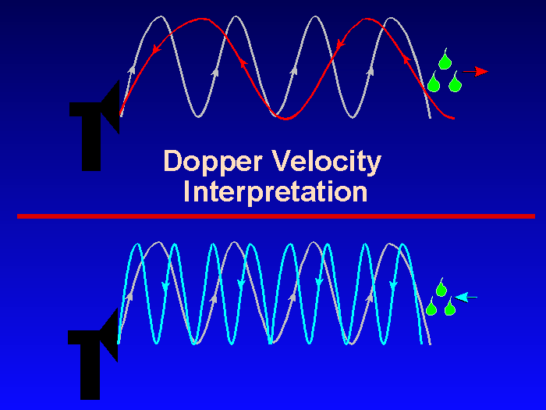
Frequency of Radar Signal Changes Based on Wind Speed
when a target (usually precipitation in the case of a weather radar) is moving away from the radar, the wavelength of the return echo is longer than that of the emitted electromagnetic pulse. When the target is moving toward the radar, the return echo has a shorter wavelength than that of the emitted pulse

Slide 29
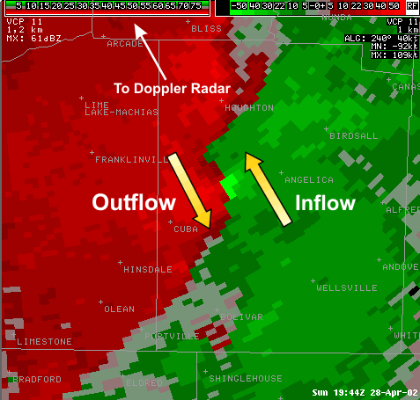
mesocyclone
Buffalo, NY (KBUF)
1944 UTC 28 April 2002
Storm-Relative Velocity
(http://www.srh.weather.gov/jetstream/remote/srm.htm)

Slide 30
Billings NWS Radar Explanation
https://www.youtube.com/watch?v=WrNNb4wHDMg
Doppler Radar Wind Velocity Examples
http://ww2010.atmos.uiuc.edu/(Gh)/guides/rs/rad/ptrn/ptrn1.rxml

Slide 31
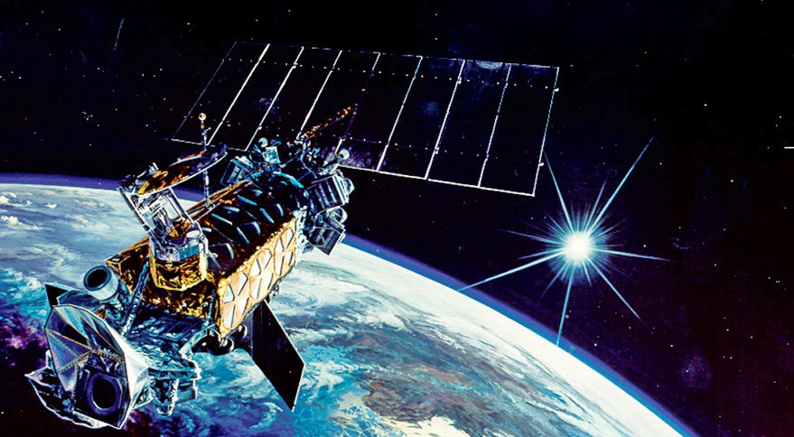
Weather Satellites and Satellite Imagery
First successful meteorological satellite was in 1960.
Today many satellites are used in daily weather operations globally.

Slide 32
Critical Aspects of Satellite Observations (Chapter 2)
satellite orbit
  Geostationary (GOES)
    ~36000 km above surface
    Remains fixed above particular point on equator
    Rotates with earth
  Polar (POES) (“low earth orbits”)
    ~850 km above surface
    Earth rotates beneath satellite (satellite is sun synchronous)
    Travels north and south over poles
    https://www.youtube.com/watch?v=NIyFJCBUdpY
    https://www.youtube.com/watch?v=6dISKhVdX7g

Slide 33
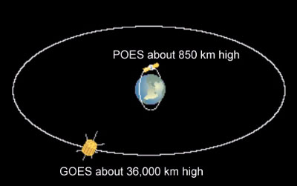
Polar vs. geostationary orbit

Slide 34
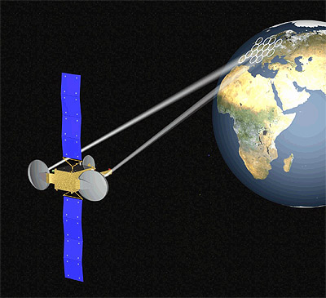
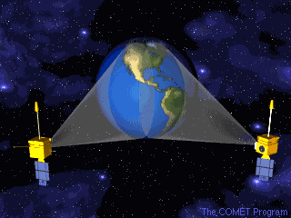
GOES satellites

Slide 35
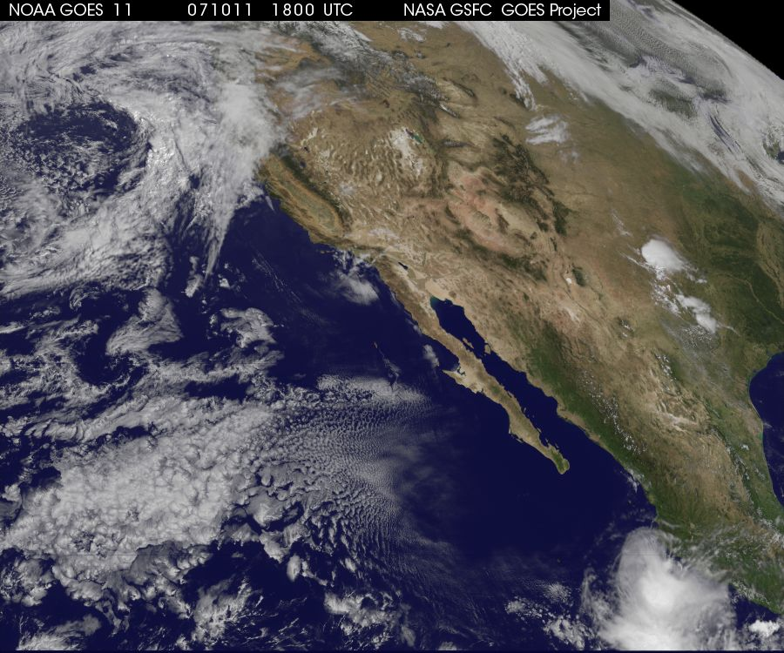

Slide 36
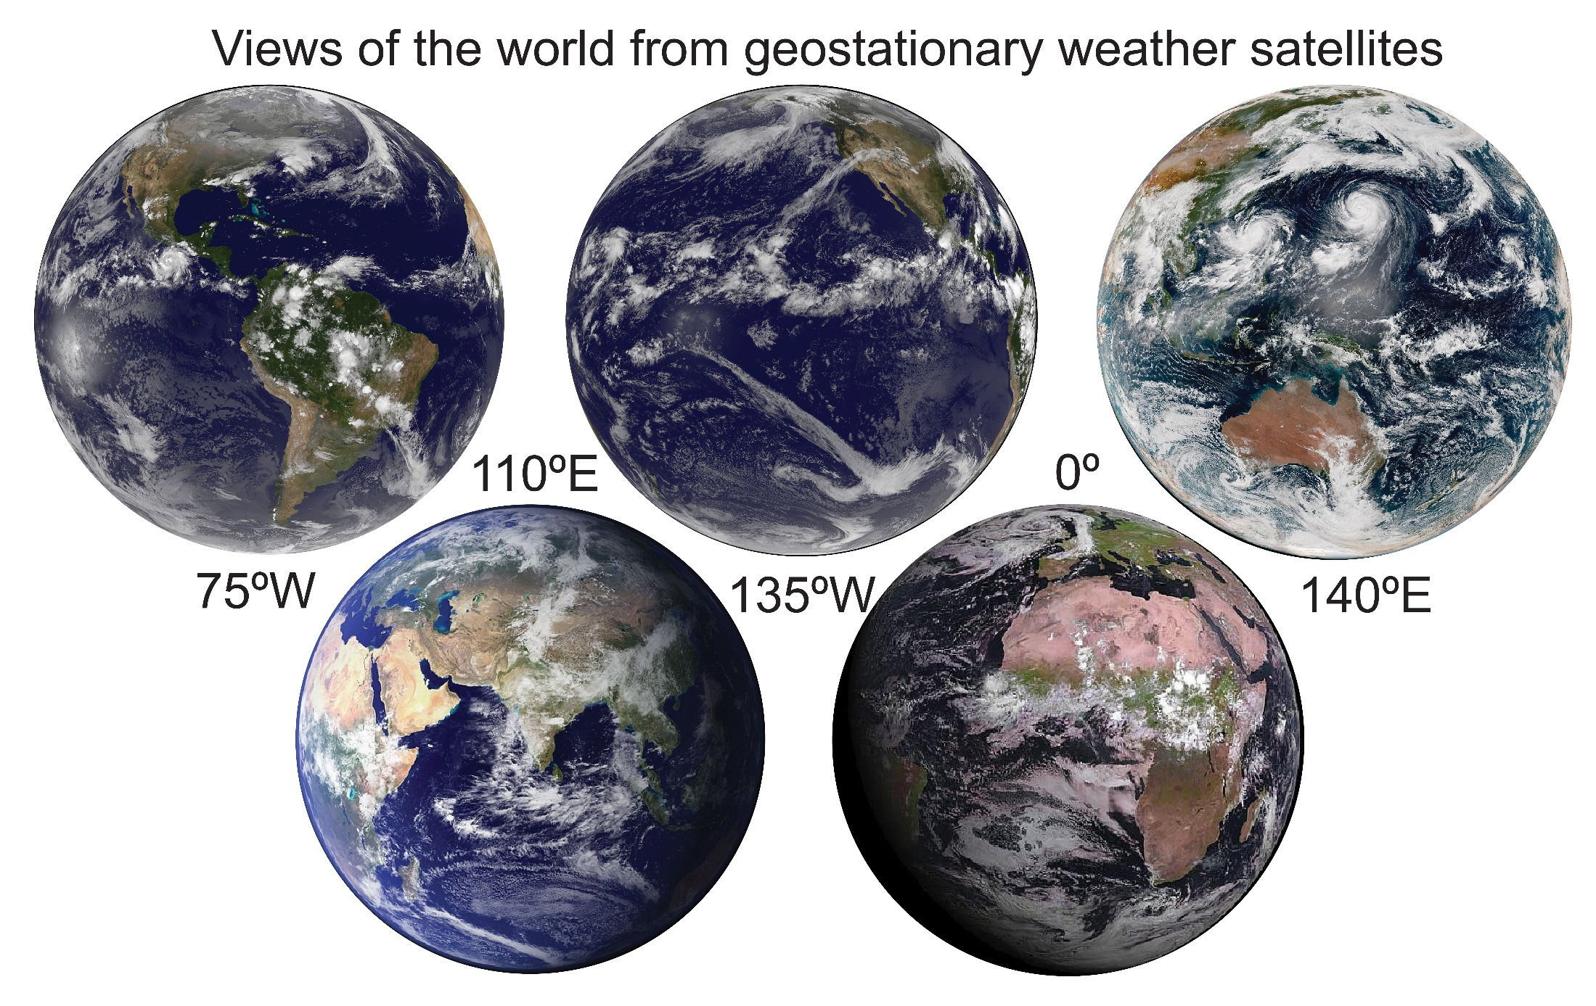

Slide 37
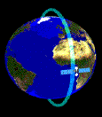
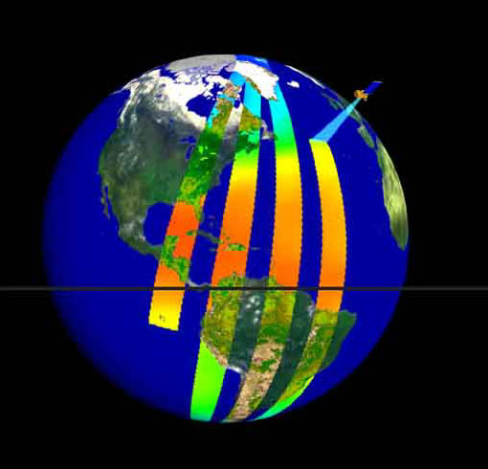
Polar orbits

Slide 38
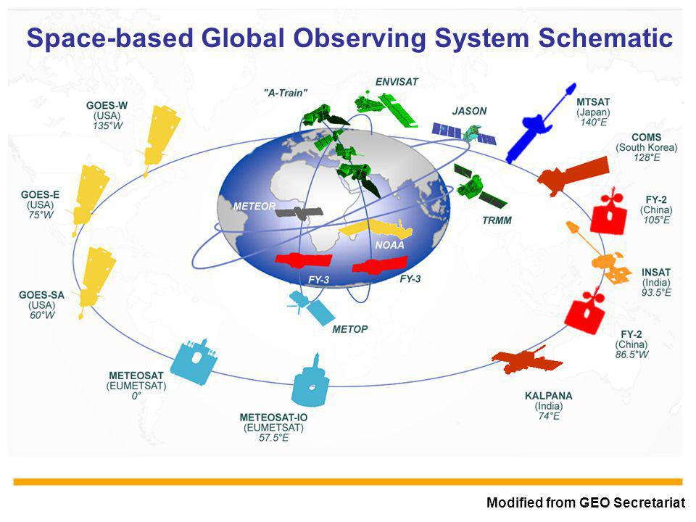
Lots of Weather Satellites up There!

Slide 39
New Advances in Geostationary Satellites!
GOES 16 → 17 years from development to launch in 2016
Advanced Baseline Imager (ABI)
16 spectral bands (up from 5 on old geostationary satellites)
Four times greater spatial resolution
Five times great temporal image frequency

Slide 40
GOES16 (previously named GOESR)
https://www.youtube.com/watch?v=ttOHhnBwukU
https://www.youtube.com/watch?annotation_id=annotation_3161642435&feature=iv&src_vid=ttOHhnBwukU&v=6Q7Leqvzfg4

Slide 41
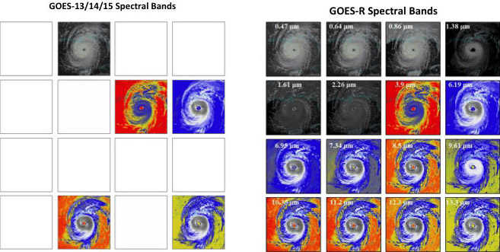
https://www.goes-r.gov/spacesegment/abi-improvements.html

Slide 42
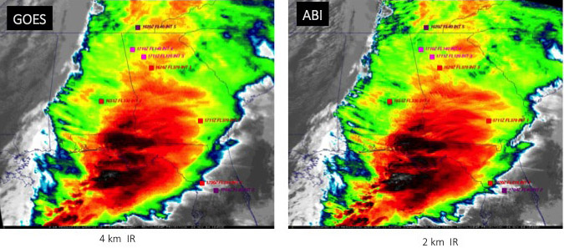
https://www.goes-r.gov/spacesegment/abi-improvements.html

Slide 43
Website to Watch GOES16 Satellite Data
http://rammb-slider.cira.colostate.edu/

Slide 44
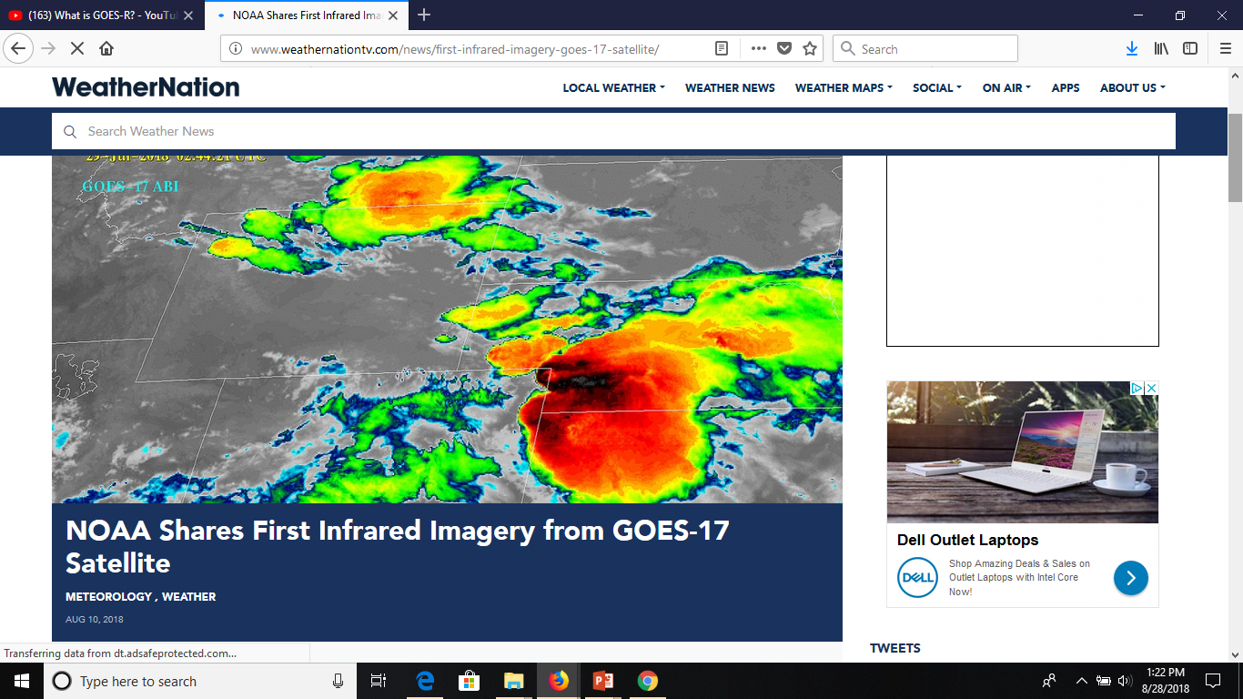
Just Online This Month: GOES 17!

Slide 45
ATMOS 1010:
Severe and Unusual Weather
FASB 295 MW 11:50-1:10
Instructors: Erik Crosman, Research Assistant Professor
Taylor McCorkle, Graduate Research Assistant

Slide 46
Assignments
Chapter 1 + 2 Quiz Canvas due 7 Sept
In-class exercise 2 (next week)
Chapter 5, 6 Quiz Canvas due 14 Sept
Module 1 Practice test/study guide Available on canvas 10 Sept
Module 1 review/test prep 12 Sept
Module 1 test (in class) 17 Sept

Slide 47
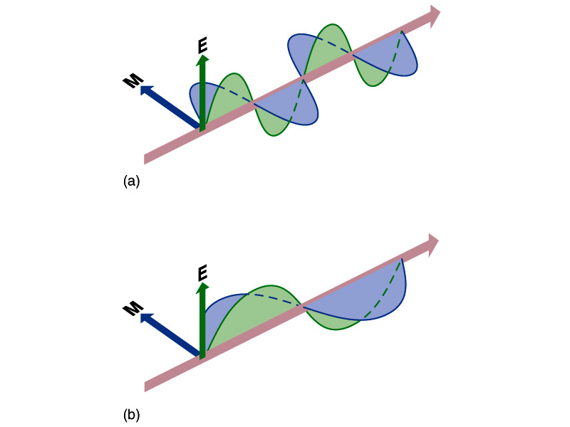
What is Radiation? (Start of Chapter 5)
Transfer of energy by electromagnetic waves
  Doesn’t require a medium for transport
  Travels at the speed of light 186,000 miles per second!
  Only takes 8.5 minutes to travel from the sun to the Earth

Slide 48
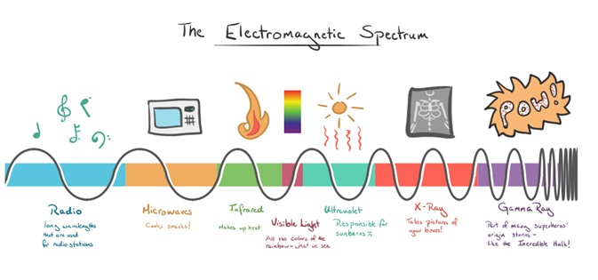
Electromagnetic Spectum

Slide 49
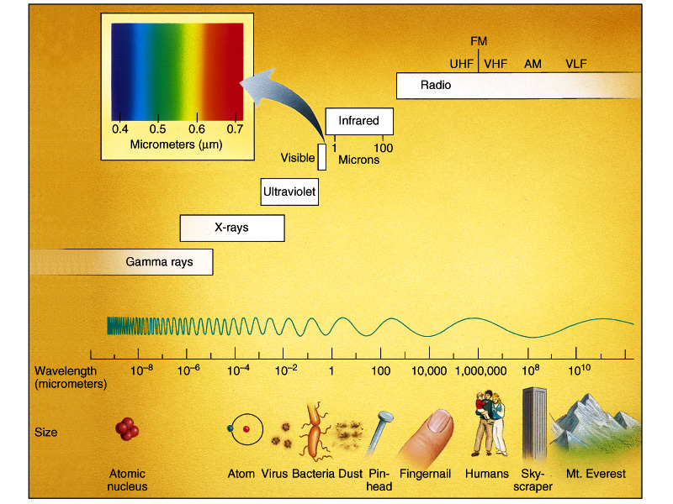
Types of Radiation
Microwave
/Radio

Slide 50
What Controls the Type of Radiation Emitted by an Object?
All objects emit electromagnetic radiation
Hotter objects emit shorter wavelengths of radiation
Cooler objects emit longer wavelengths of radiation
https://www.youtube.com/watch?v=nNzDXXUiqRs

Slide 51
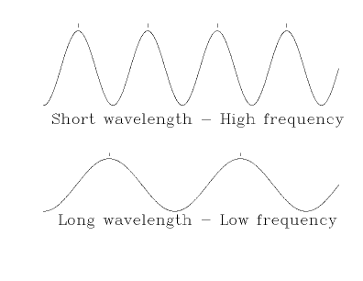
Shortwave solar radiation from sun
Temperature = 9,941 F
Longwave radiation from Earth
Temperature 58 F

Slide 52
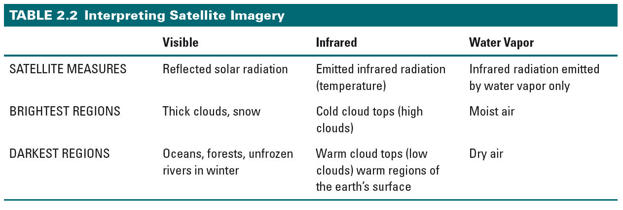

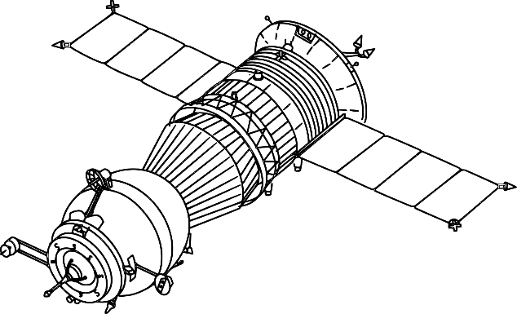
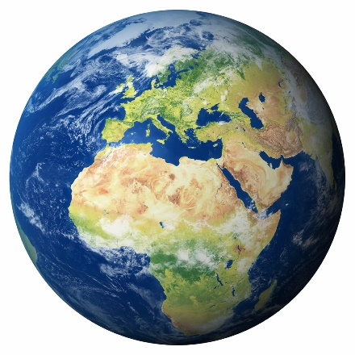
Reflected
Solar radiation
Solar radiation
Longwave radiation
from Earth

Slide 53
Satellite Observations (Chapter 2)
Portion of electromagnetic spectrum that sensor measures
  Visible light (wavelength ~ .4 - .7 microns)
  Water vapor (wavelength ~ 6-7 microns)
  Infrared (wavelength 10-11 microns)
Satellite sensor sees radiation returned upwards from earth’s surface or top of clouds
If atmosphere or clouds absorb radiation before it reaches top of atmosphere, then sensor can not detect it

