Slide 1
MODULE 4 WINTER WEATHER HAZARDS
ATMOS 1010 – Fall 2018
Erik Crosman and Taylor McCorkle
11/19/2018 – 12/13/2018

Slide 2
AIR POLLUTION
ATMOS 1010 – Fall 2018
Module 4: Winter Weather Hazards
Erik Crosman
11/26/18

Slide 3
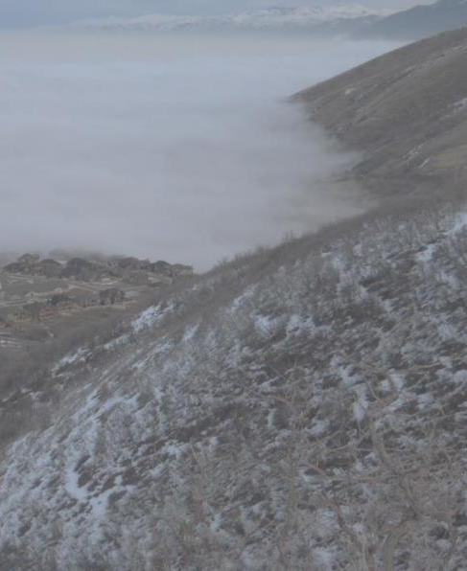
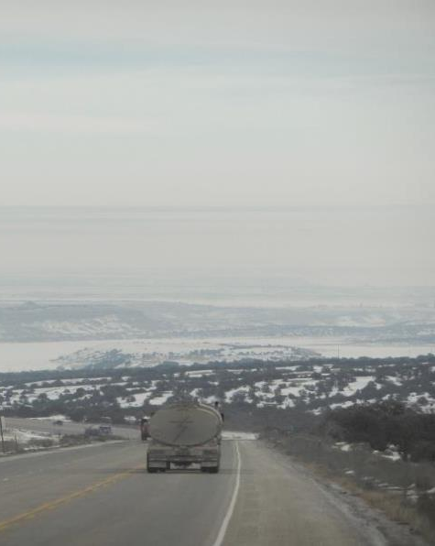
Air Pollution in Utah
Multiple seasons:
summer and winter
Multiple pollutants:
particulates and ozone
Multiple causes:
people, industry, fires

Slide 4
MULTIPLE SEASONS
Winter
Along Wasatch Front: particulates
Uintah Basin: ozone
Spring (and fall)
Dust storms associated with strong weather systems
Summer
Ozone
Particulates from wildfires

Slide 5
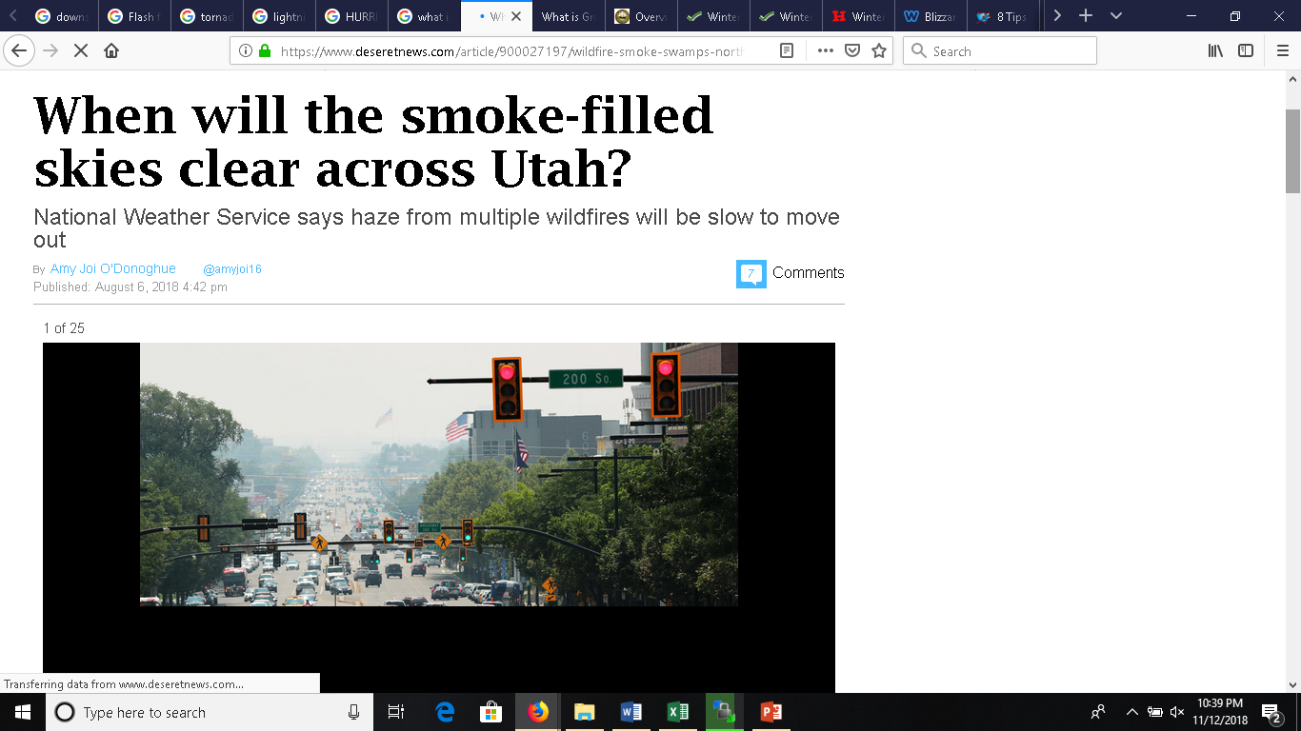
MULTIPLE CAUSES OF BAD AIR QUALITY IN UTAH
People, industry
Wildfires
Inversions in winter and high pressure systems and heat in summer exacerbate pollution episodes

Slide 6
TOPICS
What is particulate pollution?
What is ozone pollution?
How does the weather impact pollution?
Where can I get information on pollution levels?
How can I protect myself from pollution?

Slide 7
PARTICULATE MATTER
Particulate matter (PM) is a term used to describe mixture of solid particles and liquid droplets. It can be either human-made or naturally occurring (dust, ash and sea-spray).
Particulate matter (including soot) is emitted during the combustion of solid and liquid fuels, such as for power generation, domestic heating and in vehicle engines.
Particulate matter varies in size (i.e. the diameter or width of the particle). PM_{2.5} means the mass per cubic metre of air of particles with a size (diameter) generally less than 2.5 micrometres (µm).

Slide 9
PM 2.5 PARTICULATE POLLUTION

Slide 10
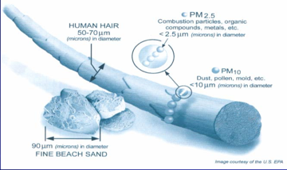
Why are Small Particulates (PM2.5) a Health Problem?
Particles smaller than 2.5 micrometers are hazardous to human health because they are readily inhaled into human lungs, where they can be deposited
The Environmental Protection Agency's (EPA) standard has been established because of known health effects, including:
reduced lung function,
harmful cardiovascular effects such as heart attacks and strokes, and
premature death,
Web resource on PM 2.5 issues:
http://home.chpc.utah.edu/~whiteman/PM2.5/PM2.5.html

Slide 11
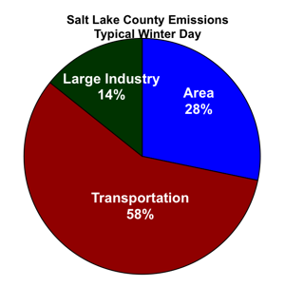
Primary Sources of Wintertime PM 2.5 in Salt Lake
Home heating

Slide 12
EPA STANDARD FOR PM2.5 http://www.airnow.gov/
Annual average: 12 micrograms per cubic meter
Daily average: 35 micrograms per cubic meter
Air Quality Index (AQI)
Evaluates daily air quality
Calculated for both particulate and ozone levels
Focuses on health effects you may experience within a few hours or days after breathing polluted air

Slide 13
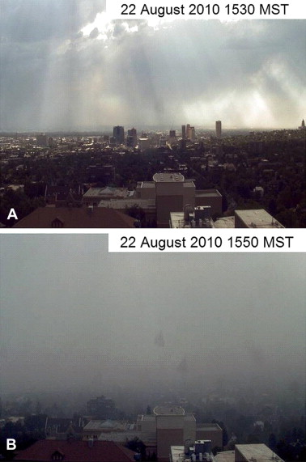
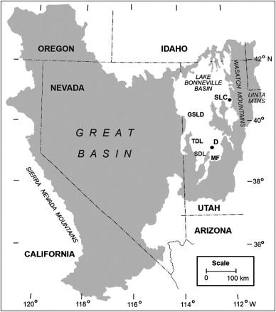
Utah Dust Storms
Hahnenburg and Nicoll 2012

Slide 14
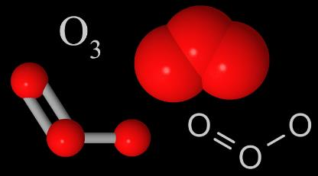
OZONE
An unstable toxic gas with a pungent odor and powerful oxidizing properties, formed from oxygen by electrical discharges or ultraviolet light. It differs from normal oxygen (O₂) in having three atoms in its molecule (O₃).
Created by chemical reactions between oxides of nitrogen (NOx) and volatile organic compounds (VOC) in the presence of sunlight

Slide 15
OZONE POLLUTION
https://airnow.gov/

Slide 16
WILDFIRE POLLUTION

Slide 17
http://www.climatecentral.org/gallery/graphics/smoke-pollution-health-impacts

Slide 18
OZONE POLLUTION

Slide 19
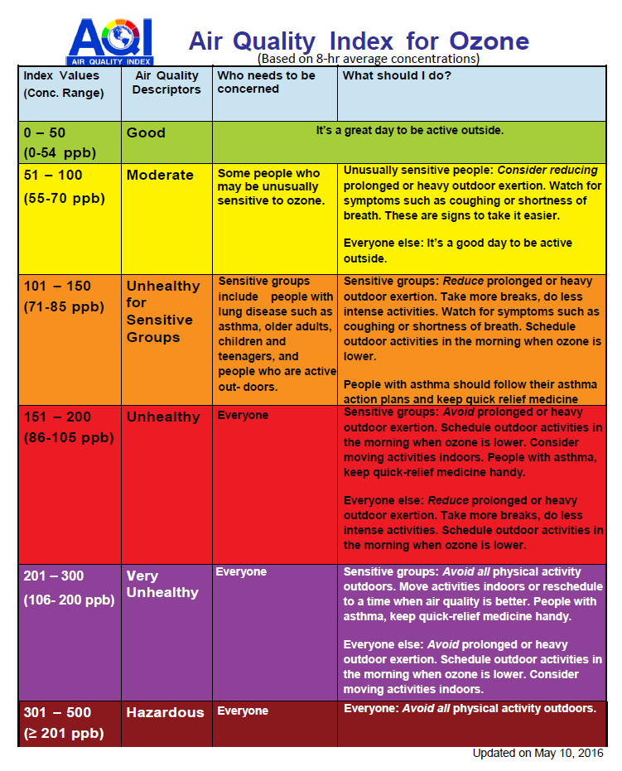
EPA STANDARD FOR OZONE http://www.airnow.gov/
EPA ozone standard is set at a level of 70 ppb averaged over an 8-hour period

Slide 20
HEALTH EFFECTS OF OZONE AND PARTICULATE MATTER

Slide 21
WEATHER AND POLLUTION
Summertime: High pressure and heat → high ozone
Summertime: High winds and heat → Wildfires and ozone and PM_{2.5}
Wintertime: High pressure and inversions → PM_{2.5}
Springtime: High winds (dust storms) → PM₁₀

Slide 22
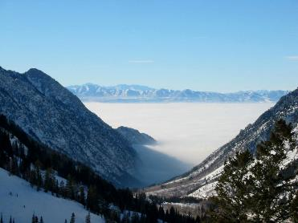
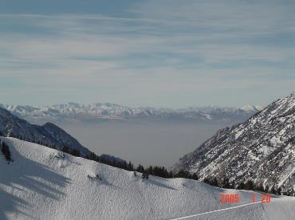
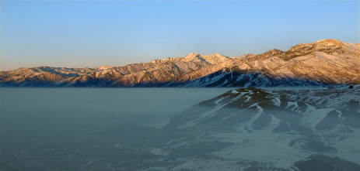
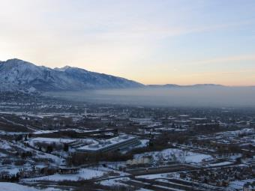
The Dreaded Wintertime “inversions”
Cloudy
Dry
Craig Clements photo
Jim Steenburgh photo
Heterogeneous
Homogeneous
Erik Crosman photo

Slide 23
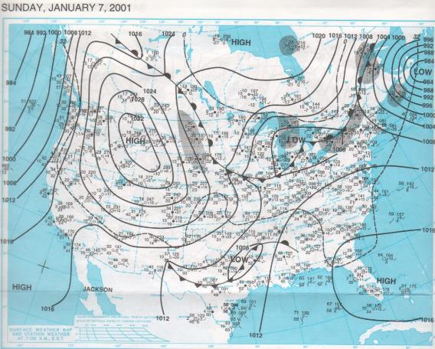
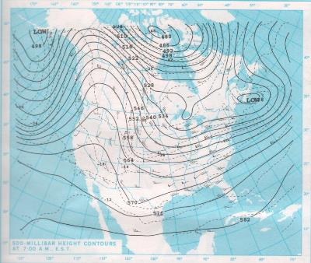
Typical “Inversion” weather maps
SLC persistent cold-air pool 1 Jan 2001-9 Jan 2001
H
‘Ridge’
Surface pressure
Why does ‘high pressure’ or an ‘anticyclone’
lead to bad air quality?
Middle of Atmosphere

Slide 24
High Surface Pressure Low Surface Pressure
Sinking air –
Warms at the dry adiabatic lapse rate
~10 C/km
Rising air

Slide 25
Cold-Air Pools (CAPs)
Inversion (warmer)
Cold Pool

Slide 26
Cold-Air Pools (CAPs)
A cold-air pool forms because a topographical depression fills with dense, cold air, with warmer air aloft acting like a ‘lid’
The topography keeps the pollution trapped in the basin
Inversion (warmer)
Cold Pool

Slide 27
Persistent Cold-air Pools (PCAPs)
Stagnant, stable layer of cold air confined in a topographical depression by warmer air aloft
Solar heating insufficient to destroy low level volume of cold air
Onset coincident with warming aloft, removed by cooling aloft
Typical atmospheric
temperature profile
Height
Inversion (warmer)
Cold Pool
inversion
Temperature

Slide 28
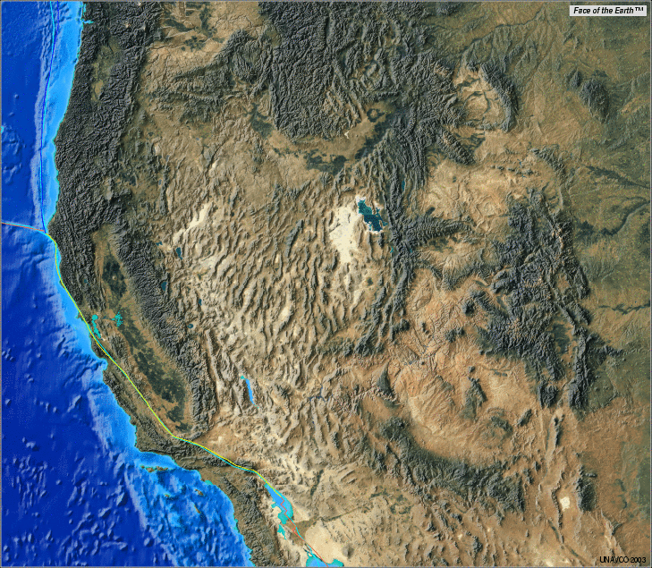
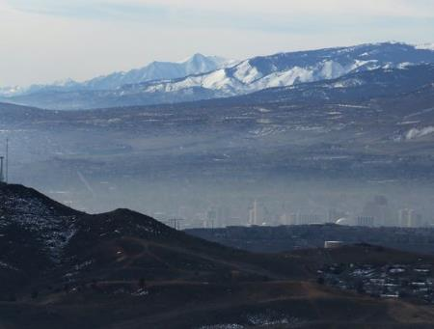
Confining Topography in Western US
Most polluted metropolitan areas by dangerous “spikes” (episodes) in particulate matter (PM2.5) (source: EPA State of the Air report, Tuesday, April 19 2017)
8. Logan, UT
7. Salt Lake City, UT
5. Reno-Carson City-NV
7. Provo, UT
6. San Jose-
San Francisco-
Oakland, CA
4. Modesto, CA
3. Fresno, CA
2. Hanford, CA
1. Bakersfield, CA
9. Los Angeles-
Long Beach, CA
Reno Nevada: Jason Bean RGJ

Slide 29
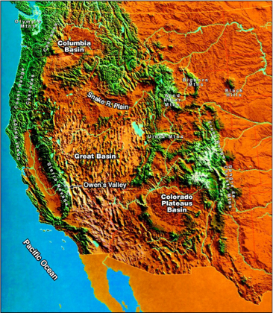
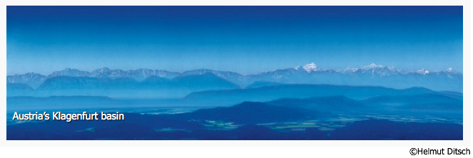
Stable layers form in basins/valleys all over the world, and occur often at night and in winter in non-mountain areas
Vail, CO

Slide 30
SALT LAKE VALLEY SURROUNDED BY “CONFINING TOPOGRAPHY”

Slide 31
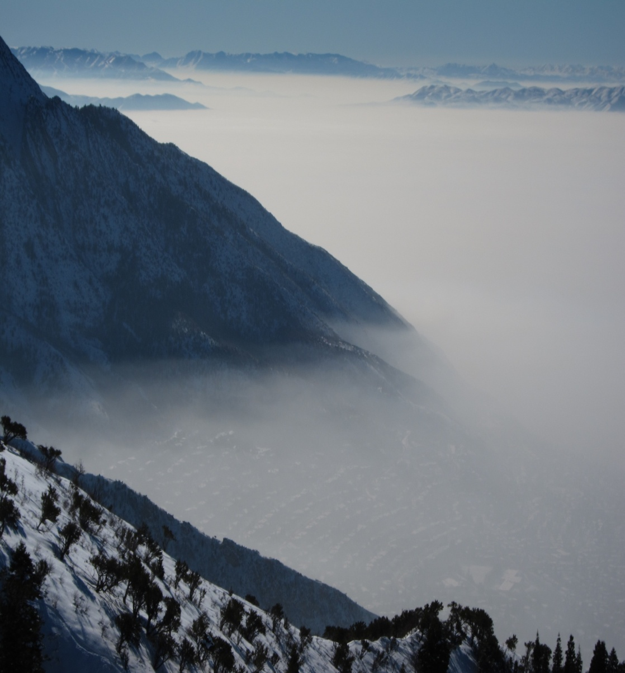
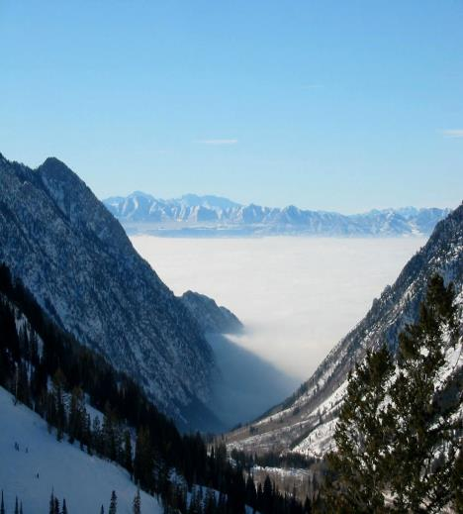
TEMPERATURE PROFILES IN INVERSIONS
Height
Height
Elevated
inversion
Sfc-based
inversion
Temperature
Temperature

Slide 32
Air Quality Observations Online
Various air quality observations:
http://meso2.chpc.utah.edu/aq/
Utah Division of Air Quality:
https://deq.utah.gov/division-air-quality
Web resource on PM 2.5 issues:
http://home.chpc.utah.edu/~whiteman/PM2.5/PM2.5.html
Ozone:
https://www.epa.gov/ozone-pollution/basic-information-about-ozone

Slide 33
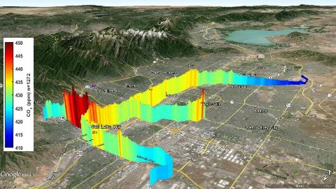
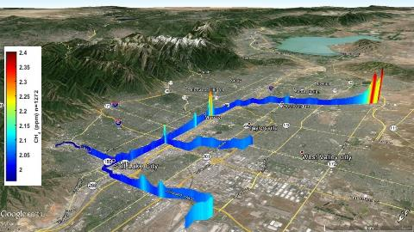
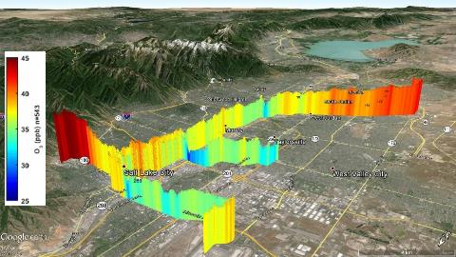
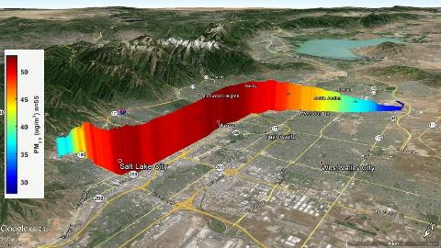
CO₂ Annual average
Lower CO₂ on urban periphery
CH₄ Annual average
Natural gas power plant
Brick factory
Landfill
Higher CO₂ in urban corridor
Higher CO₂ along roads
O₃ Seasonal average
Higher O₃ on urban periphery
PM_{2.5} Case studies
Lower O₃ in urban corridor
Typical patterns during inversions, thermal/terrain circulations, etc.
Air Quality on TRAX

Slide 34
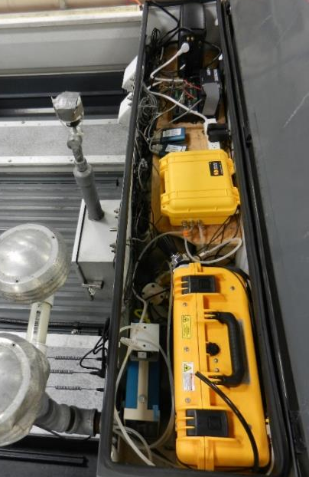
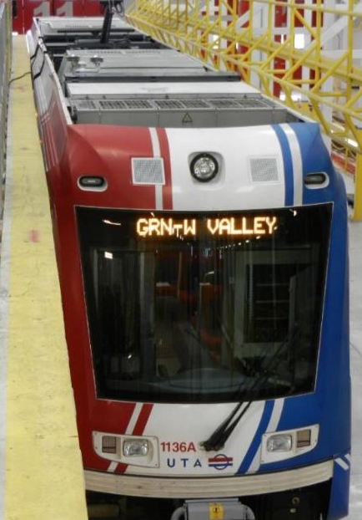

Slide 35
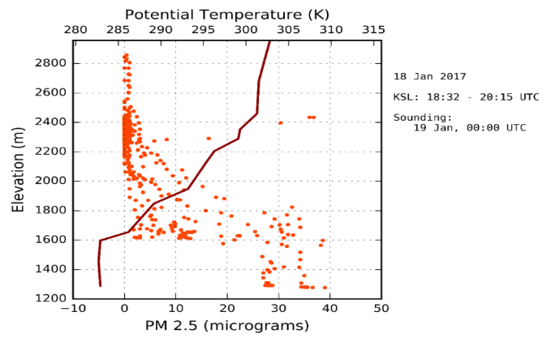
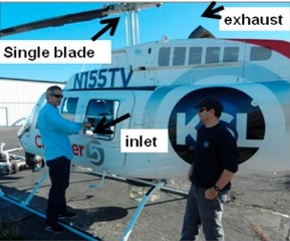
AIR QUALITY ON KSL CHOPPER

Slide 36
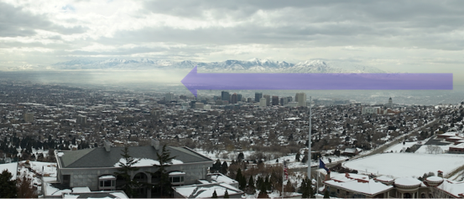
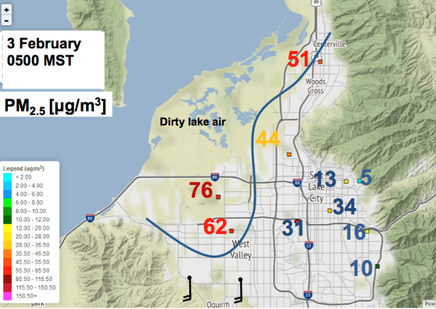
“Dirty” Winter Great Salt Lake Breeze

Slide 37
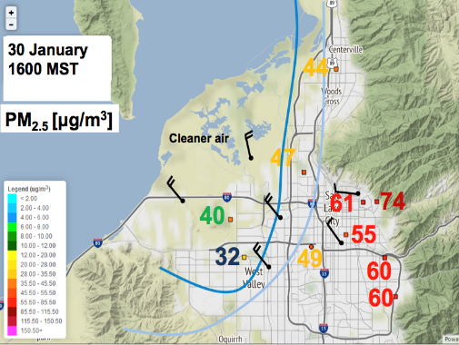
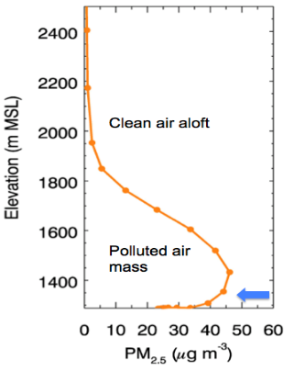
“Clean” Winter Great Salt Lake Breeze

Slide 38
AIR QUALITY SAFETY
Check daily air pollution forecasts.
Avoid exercising outdoors when pollution levels are high.
When the air is bad, exercise indoors.
Always avoid exercising in high traffic areas
Don't burn wood or trash.
Don't allow anyone to smoke indoors.

Slide 39
Utah DEQ Website https://air.utah.gov/forecast.php

Slide 40
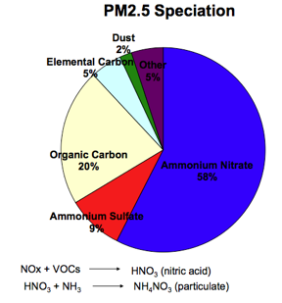
Measuring PM2.5
Primary pollutants
Emitted from a source
Dust
Organic carbon
Secondary pollutants
Chemical reactions in atmosphere
Ammonium sulfate
Ammonium nitrate

Slide 41
PM 2.5 Salt Lake City 12/1/13-01/10/14
PM 2.5 Salt Lake City
Cold-Air Pools (CAPs)
Stably stratified air masses in mountain valleys and basins
May persist for many days leading to prolonged air pollution episodes
Issues
see Atmospheric Boundary Layers and Diurnal Cycles: Challenges for Weather and Climate Models. Holtslag et al. 2013, BAMS
Complex dynamical, thermodynamical, and radiative interactions during CAPs even though conditions appear “quiescent”
Models struggle to simulate characteristics of CAPs- heightened sensitivity to underlying sfc conditions, model resolution, treatment of clouds, etc.
Limited observations and validation of models above surface

