Slide 1
MODULE 3 REVIEW
WEATHER FORECASTING
AND MID-LATITUDE CYCLONES

Slide 2
MODULE 3 TOPICS
WEATHER FORECASTING
AND MID-LATITUDE CYCLONES
October 24 Clouds/ High and low pressure systems (Chapter 8)
October 29 High and low pressure systems and Airmasses and fronts (Chapter 9)
October 31 Weather forecasting and numerical models (Chapter 4)
November 5 Mid-latitude cyclones (Chapter 10 + 11)
November 7 Mid-latitude cyclones (Chapter 11)
November 12 Module 3 review
November 14 Module 3 exam

Slide 3
MODULE 3 REVIEW
WEATHER FORECASTING
AND MID-LATITUDE CYCLONES
Key Study Points:
Several quiz and practice test questions will be repeated on the exam verbatim
Several questions SIMILAR to quiz and practice test questions will also be included on the exam
All material on exam covered in powerpoint slides

Slide 4
CLOUDS
ATMOS 1010 – Fall 2018
Module 3: Weather Forecasting and
mid-latitude cyclones
Erik Crosman
10/24/18

Slide 5
Test Study: Classifying Clouds
Classified mainly on the height of cloud base and on the cloud’s appearance
Ingredients for making clouds: Lift, instability, moisture

Slide 6
CLOUDS
Be able to identify 10 different cloud types from photos (e.g., cirrus versus stratus; cumulonimbus).
DON’T MEMORIZE THE CLOUD NAMES, THEY WILL BE PROVIDED BUT YOU NEED TO IDENTIFY WHICH IS WHICH
If altostratus/altocumulus or cirrostratus/cirrocumulus are included the other clouds options in question should be easier to identify.
Know the three factors to produce clouds: Lift, instability and moisture

Slide 7
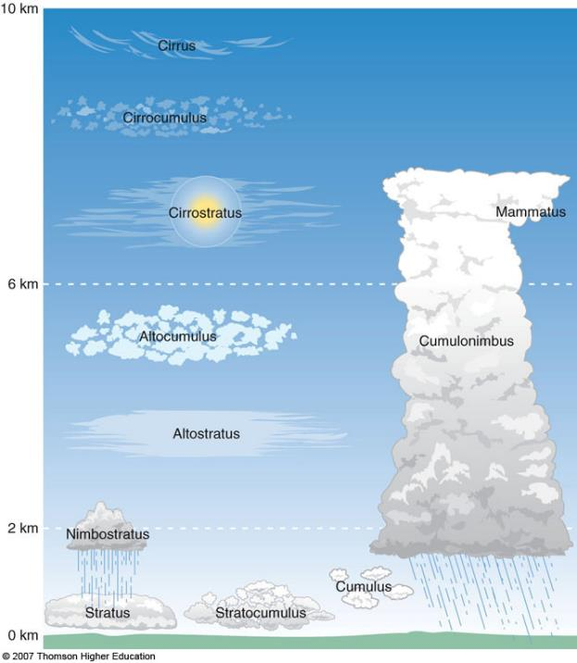
High clouds
Mid-level clouds
Low clouds
FOG

Slide 8
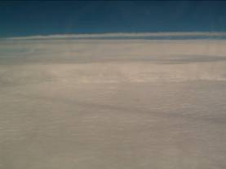
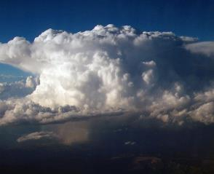
Cloud Characteristics
Stratus
  Layered
Nimbus
  Precipitating

Slide 9

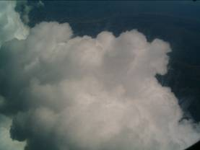
Cloud Characteristics
Cirrus
  Fibrous
Cumulus
  Heaped or Piled

Slide 10
HIGH AND LOW PRESSURE SYSTEMS
ATMOS 1010 – Fall 2018
Module 3: Weather Forecasting and
mid-latitude cyclones
Erik Crosman
10/24/18

Slide 11
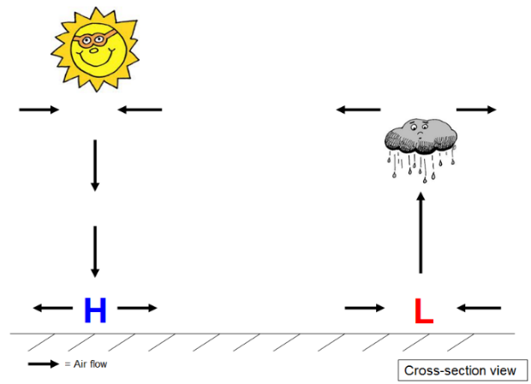
High Surface Pressure Low Surface Pressure
Quiet weather
Convergence aloft
Sinking motion
Stormy weather
Divergence aloft
Rising motion
Sinking air
Rising air

Slide 12
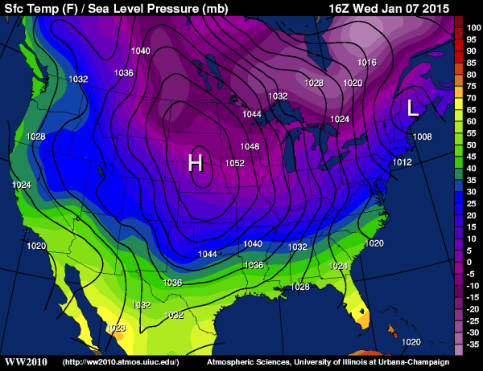
High and Low Pressure Systems (chapter 8)
1008 mb
1052 mb
p_{s}
p_{s}

Slide 13
What Causes High and Low Pressure?
Recall back to Module 1: Pressure is the total mass (weight) of the atmosphere (column) above you
The mass of an air column can increase or decrease depending on whether the air flow is decelerating or accelerating above that point
Air convergence – mass of air in column increases with time
Air divergence – mass of air in column decreases with time

Slide 14
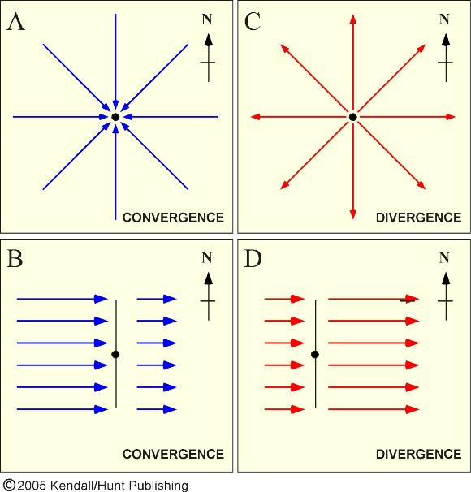
Wind Convergence and Divergence
A change in wind speed can cause the air to pile up (converge) or spread apart (diverge)

Slide 15
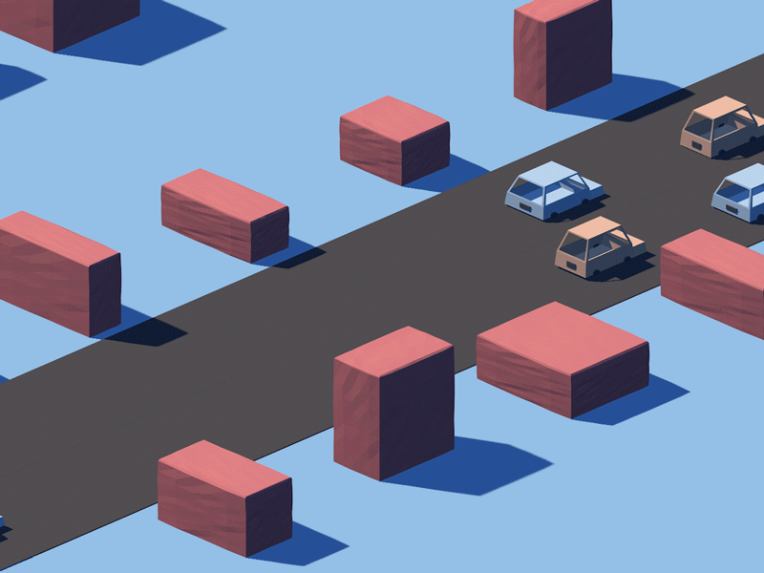
Convergence and Divergence:
When cars are piling up during first half of animation they are “converging”
When cars are accelerating away during second half of animation we have “divergence”

Slide 16
Wind Convergence and Divergence
Horizontal variations in the direction of the wind can cause the air to pile up (converge) or spread apart (diverge)

Slide 17
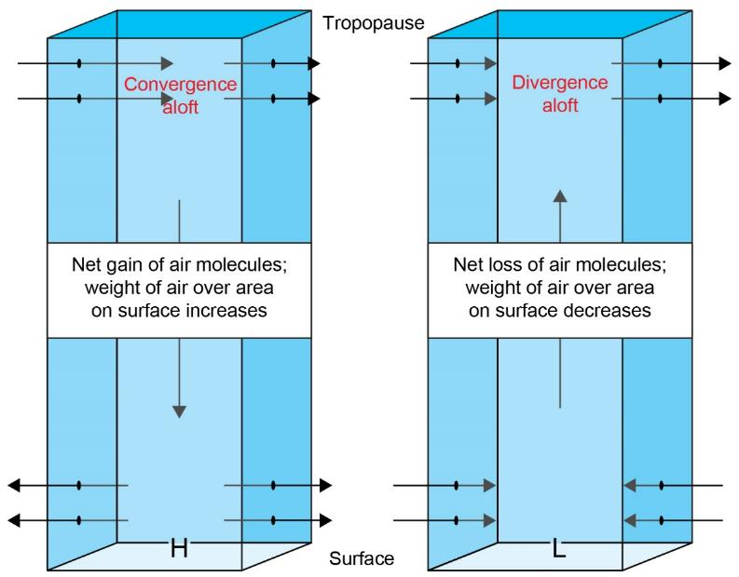
8.8
Courtesy of Bob Rauber.

Slide 18
High and Low Pressure Systems (chapter 8)
1008 mb
1052 mb
p_{s}
p_{s}

Slide 19
Air convergence – mass of air in column increases with time
Air divergence – mass of air in column decreases with time
Divergence and convergence in upper atmosphere is associated with jet stream flow!
Divergent and convergent flow aloft leads to development of high and low pressure systems.

Slide 20
AIRMASSES AND FRONTS
ATMOS 1010 – Fall 2018
Module 3: Weather Forecasting and
mid-latitude cyclones
Erik Crosman
10/29/18

Slide 21
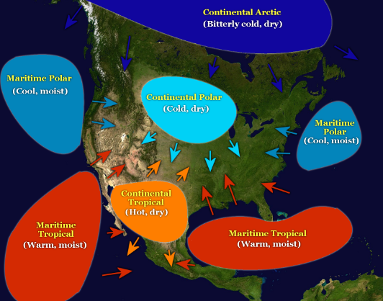
Airmasses
An airmass is a large body of air with relatively uniform thermal and moisture characteristics
Airmasses form when air remains over relatively flat regions of the earth for an extended period of time
(several days or more)
DO NOT need to memorize
air mass names.
Know difference between continental (land based) and maritime (ocean) based air masses
Know that maritime tend to be moist and continental tend to be dry
Polar and arctic are cold
Hurricane Floyd, 1999

Slide 22
Fronts
A cold front advances into warm air, lifting the warm air
A warm front -- cold air retreating and warm air advancing
Type of precipitation along a cold or warm fronts depends on the characteristics of the warm air
The transition zone between two air masses
Typically narrow in width (few hundred kilometers)
Typically slopes vertically
Hurricane Floyd, 1999

Slide 23
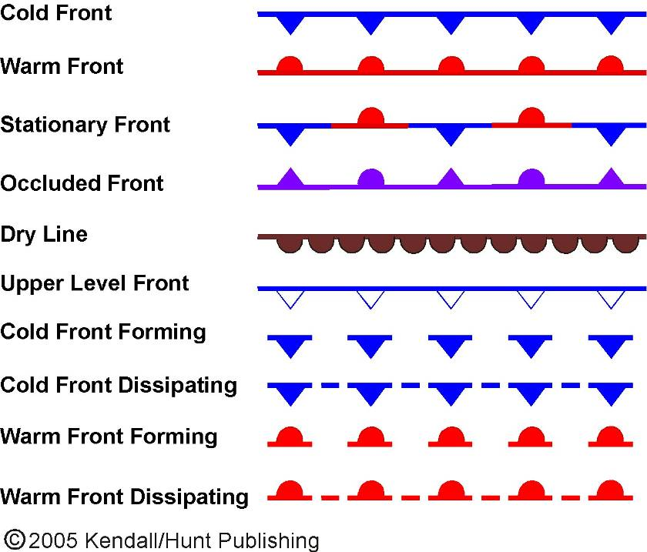

Slide 24
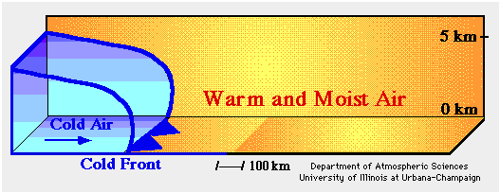
Cold Frontal Movement

Slide 25
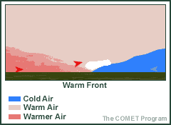

Slide 26
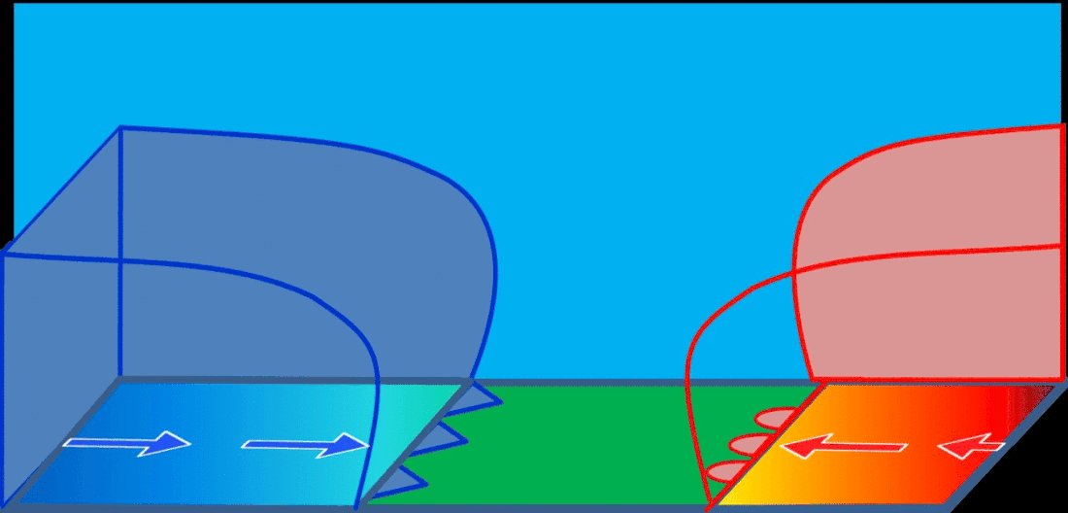
Stationary front

Slide 27
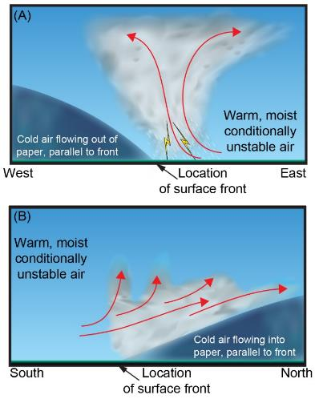
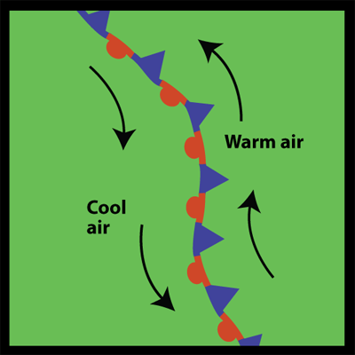
Stationary front
Although airmass boundary is stationary (staying in one place), air on both sides can be moving still

Slide 28
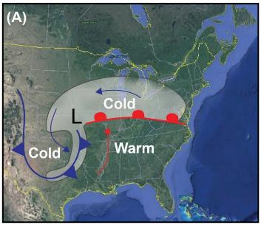
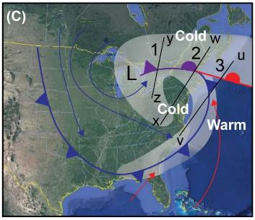
During the lifecycle of a cyclone, the cold front may overtake the warm front, creating a new boundary called an occluded front.

Slide 29
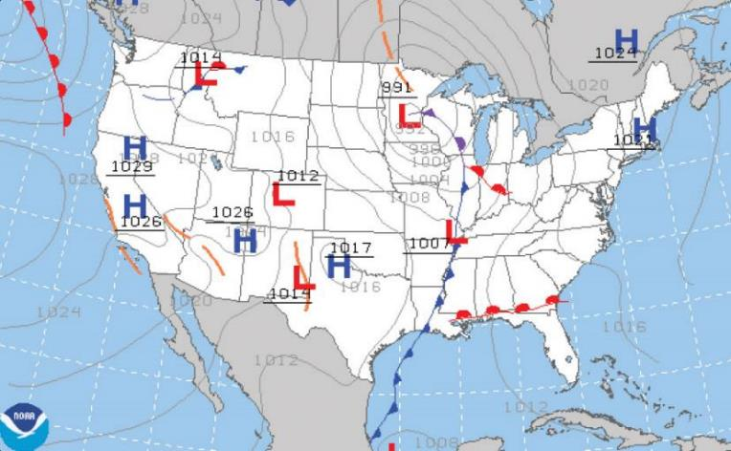
Be able to identify low pressure/high pressure and surface fronts if you see them on map like this

Slide 30
8.8
Courtesy of Bob Rauber.

Slide 31
FORECASTING AND SIMULATING WEATHER
(Chapter 4)
ATMOS 1010 – Fall 2018
Module 3: Weather Forecasting and
mid-latitude cyclones
Erik Crosman
10/31/18

Slide 32
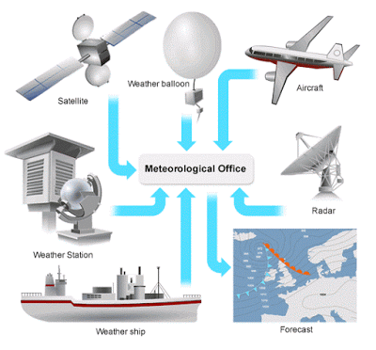
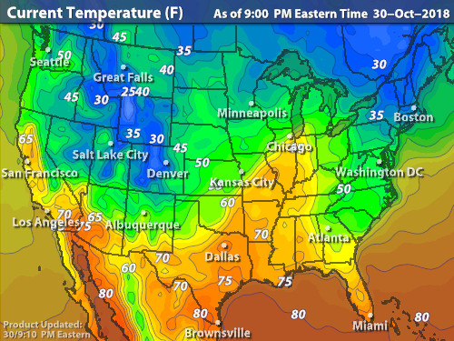
How are weather forecasts made?
Step 1:
Forecasting the weather begins by continuously observing the state of the atmosphere, the ocean, and land surface.

Slide 33
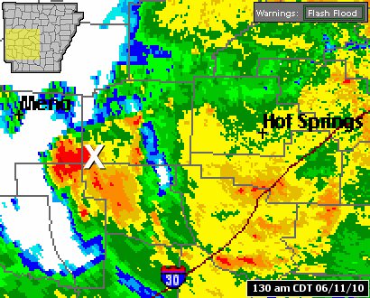
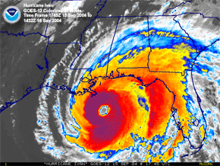
How are weather forecasts made?
Step 2:
For time scales on the order of a few minutes to a few hours, forecasters rely heavily on an extrapolation of current weather trends. Called “Nowcasting.”

Slide 34
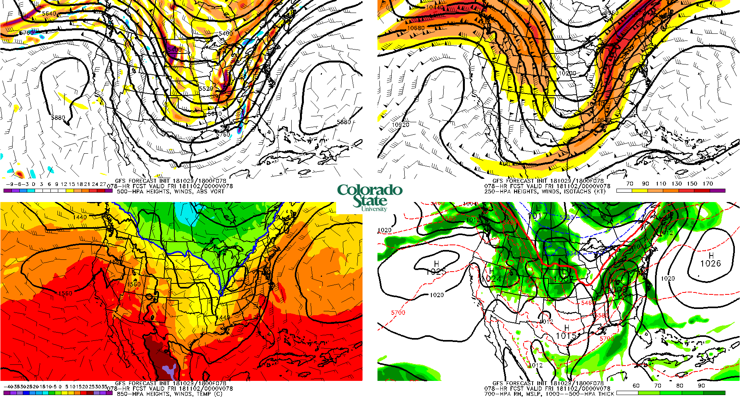
How are weather forecasts made?
Step 3:
At time scales of a few hours to a week or more, weather models (known as numerical weather prediction -- NWP) is the dominant forecasting tool.

Slide 35
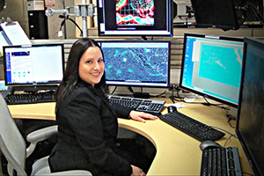
How are weather forecasts made?
Step 4: Experienced forecasters will determine the shortcomings in models and adjust their forecasts based on pattern recognition and local experience.
Human forecasters at National Weather Service and Storm Prediction Center will then issue weather watches and warnings.

Slide 36
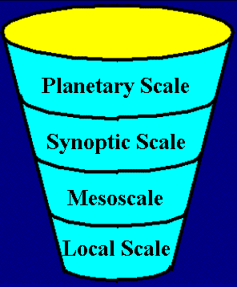
The Weather Forecast Funnel Technique
Start big → end small
Forecasters will typically use the "Forecast Funnel" technique
Forecast Funnel focuses the forecasters' attention first on large scale processes, and then on increasingly smaller scales
10000s km
1000s km
10-100s km
0-10s km

Slide 37

Numerical Weather Prediction
Forecasting the weather requires using computer models
Computer models – run an interconnected set of math and physics equations describing atmosphere
Today’s weather forecasts made 4 days in advance are about as accurate as 2-day forecasts in 1980’s
Most of improvements in forecast accuracy due to improvements in computer models
NOAA's weather and climate operational supercomputing system. 8.4 petaflops of total processing speed and pave the way for improved weather models and forecasts. (NOAA )

Slide 38
Numerical Weather Prediction Model
To make a NWP model forecast we need:
Observations of the present state of the atmosphere, ocean, and land surface (snow, soil moisture, etc.)
Description of the behavior of the atmosphere in quantifiable manner (requires math/physics equations)
Numerical methods to run model forward in time
Computer resources sufficient to run model and make a forecast in reasonable amount of time

Slide 39
Why aren’t weather forecasts better?
Major point: even if we had a perfect model for the atmosphere we could not predict the weather more than a week or two in advance.
Why??!
Always errors in the initial weather conditions put into the model
These small errors in initial conditions always grow over time in the model, such that model predictions beyond a week or two in advance are largely useless (The “butterfly effect”)
Also, current models cannot realistically capture all the physical processes that occur in the real atmosphere (e.g., inadequate resolution)

Slide 40

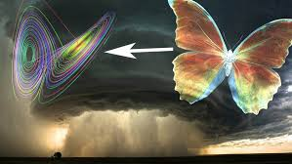
https://www.youtube.com/watch?v=FYE4JKAXSfY
https://www.youtube.com/watch?v=EF5Wvi_Iiy4

