Slide 1
MODULE 4
WINTER WEATHER HAZARDS
ATMOS 1010 – Fall 2018
Erik Crosman and Taylor McCorkle
11/19/2018 – 12/13/2018

Slide 2
MODULE 4 (WINTER WEATHER)
19 November --> Mountain downslope windstorms (Chapter 17)
21 November --> Icestorms (Chapter 12) and Weather safety review class (few points of extra credit to attend)
26 November --> Erik Air Quality
28 November --> Mountain snowstorms and orography (Chapter 16)
3 December --> Mountain snowstorms and avalanches (Chapter 16)
5 December --> Lake effect snow (chap 13) and class review.
13 December Thursday 10:30-12:30 Module 4 exam (not cumulative)

Slide 3
MOUNTAIN DOWNSLOPE WINDSTORMS (Chapter 17)
ATMOS 1010 – Fall 2018
Module 4: Winter Weather Hazards
Erik Crosman
11/19/18

Slide 4
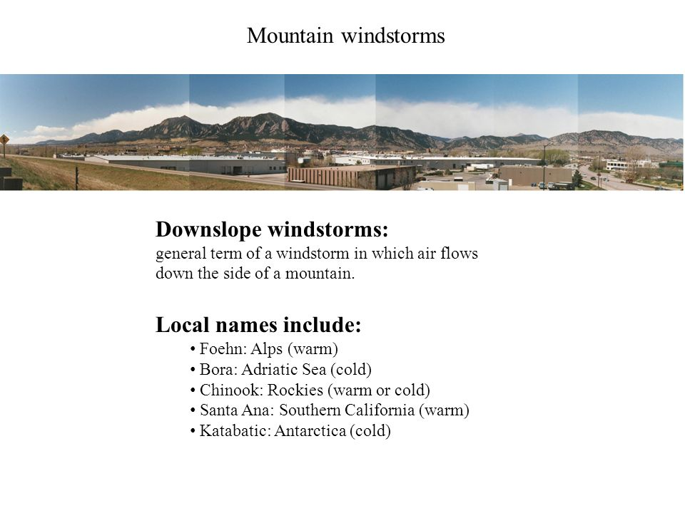
Downslope Windstorms
Downslope windstorms occur along many of the world’s major mountain ranges
Hurricane force winds can persist for a day or more

Slide 5
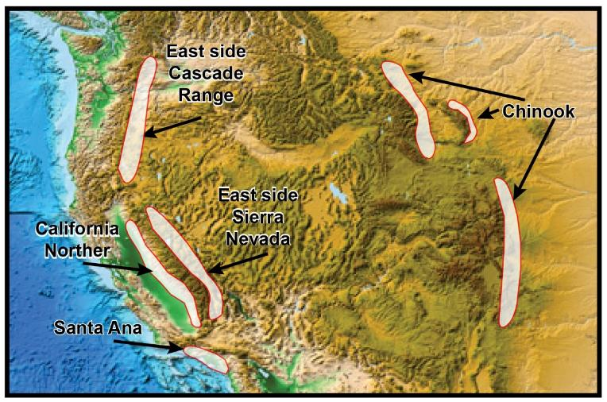
Common Downslope Windstorms Locations in USA

Slide 6
Downslope Windstorms
Downslope windstorms occur along many of the world’s major mountain ranges
Hurricane force winds > 100 mph can persist for a day or more
Damage to roofs, utility structures, turn over vehicles, topple trees, wildfire concerns, evaporate snow
The physical processes that lead to downslope windstorms vary from region to region
The most common are driven by strong pressure gradients driving winds blowing across mountains, and will be what we cover in this class

Slide 7
Dynamics of Downslope Windstorms
Windward side – upwind side mountain range
Leeward side – downwind side of a mountain range
As air encounters a blocking mountain range the flow rises on the windward side and descends on the leeward side
Very strong surface winds sometimes develop when air flows over a high mountain ridge with a steep lee slope
Air flow
Leeward (downwind)
H
L
Strong downslope
winds!
Windward (upwind)
Mountain

Slide 8
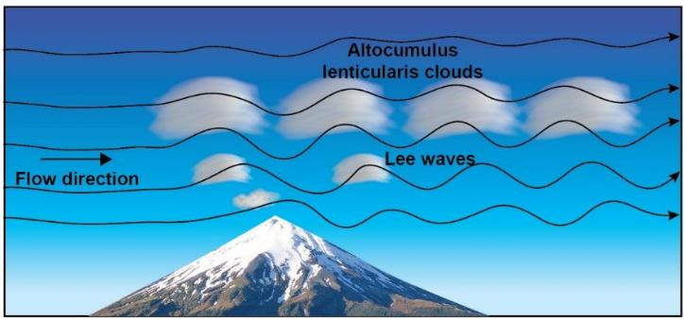
Mountains and Lee Waves
When air approaches a mountain, it must rise on the
windward side descend on the leeward side.
A series of waves will form downstream of the mountain.
These waves are called lee waves and are commonly observed east of the Rockies

Slide 9
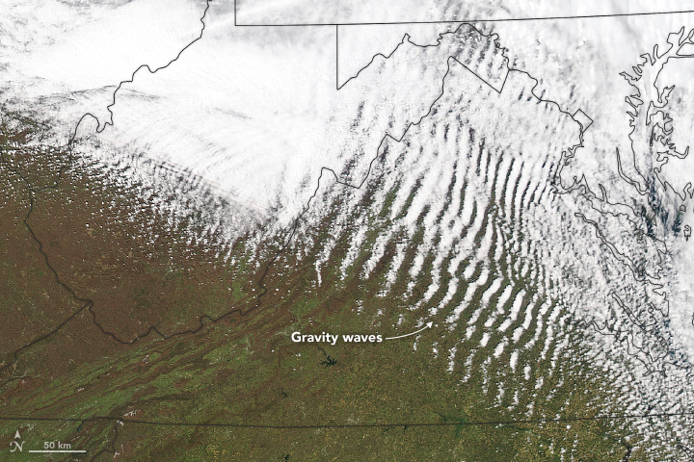
Mountain Wave Clouds on Satellite

Slide 10
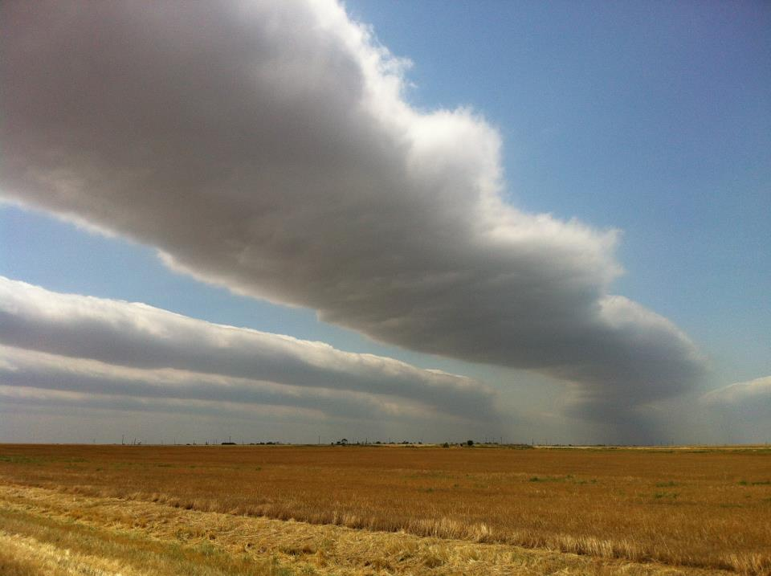
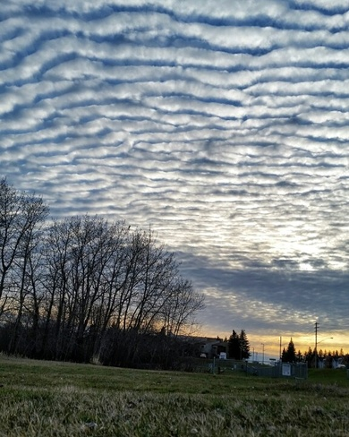

Slide 11
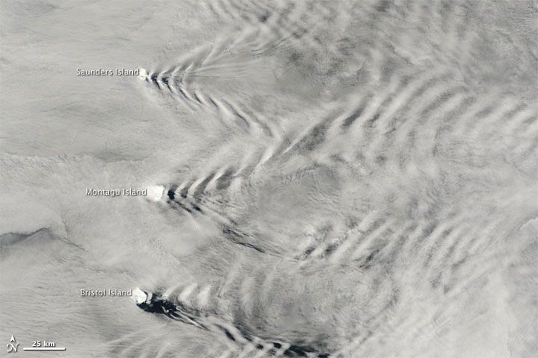
Mountain Wave Clouds South Sandwich Islands

Slide 12
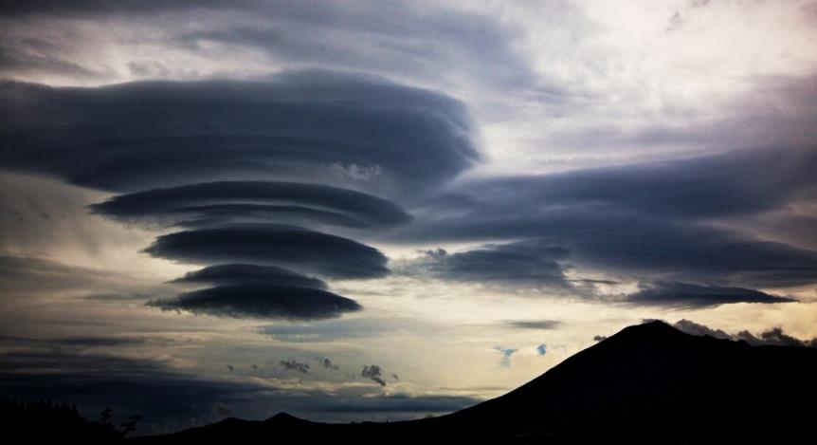
Mountain Wave Cloud (Lenticular)

Slide 13
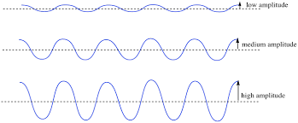
Downslope Windstorms
Downslope windstorms are produced by high-amplitude mountain waves.
Lee Waves
Downslope
Windstorm

Slide 14
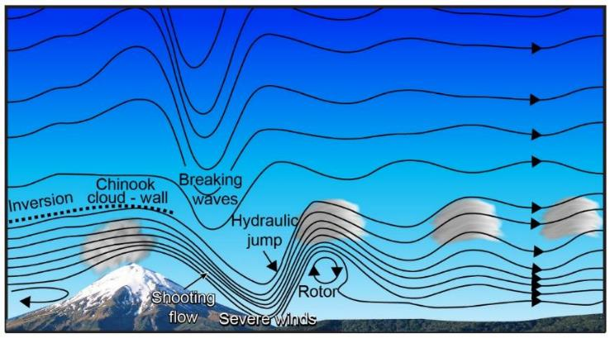
Dynamics of Downslope Windstorms
Black lines show
flow over
a mountain
barrier
Strongest
winds occur
where
streamlines
are closest
together
Large volume of
air that must pass
between mountain and inversion causes fast “shooting” wind flow
Clear air turbulence

Slide 15

Dynamics of Downslope Windstorms
This type of flow can form when winds are strong upstream of the mountain
and an inversion layer is present above the top of the mountains.

Slide 16
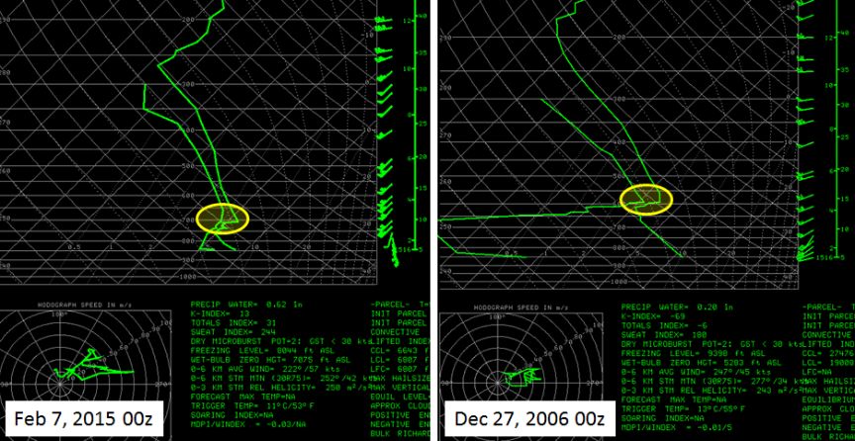
Inversion Layer for Downslope Windstorm
S
Strong wind speed across the mountain
Inversion layer to confine the fast flow
vertically as it ‘squeezes’ through
gap between mountain top and inversion
bottom

Slide 17
Dynamics of Downslope Windstorms
The hydraulic jump marks the transition from strong winds upstream of the
jump to weaker winds downstream of the jump.
Strong vertical winds and turbulence occur at the hydraulic jump, creating
dangerous conditions for aircraft.

Slide 18
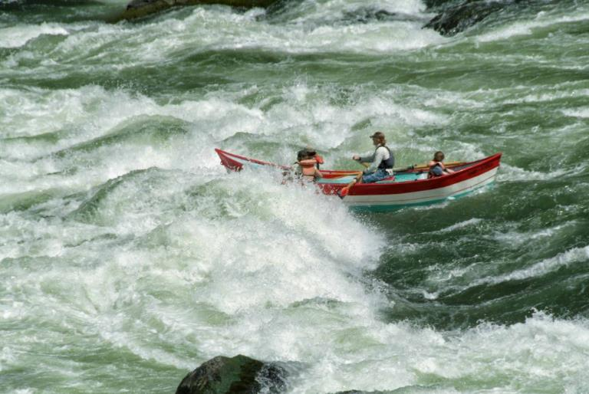
Whitewater Rapids Analogy
Hydraulic
Jump
Fast or
“shooting”
Flow

Slide 19
Whitewater Rapids Analogy
Imagine flow along a rocky stream bed:
  Water under air is analogous to the layer air at the surface trapped by inversion under a layer of air above!
  Notice the water waves are trapped from moving upward into the air similar to how the waves in the air are trapped from moving upward.
  When water is much deeper than rocks, turbulence, water flows across the rocks with little turbulence. You could take a boring raft trip down such a laminar stream.

Slide 20
Whitewater Rapids Analogy
Now imagine that the water lowers to be just deeper than the rocks. Now you have whitewater! The water plunges down the lee side of the rocks and even digs a little hole, depressing the surface and blowing out rocks etc.
The same is true for the downslope wind. Trapped beneath the inversion, the wave amplifies and breaks!

Slide 21
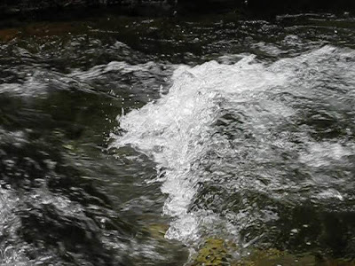
Whitewater Rapids Analogy
Hydraulic
Jump
Fast or
“shooting”
Flow

Slide 22
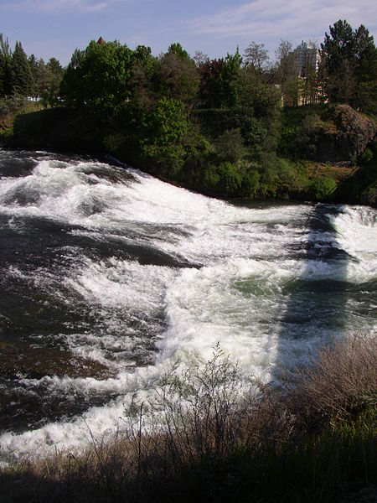

Slide 23
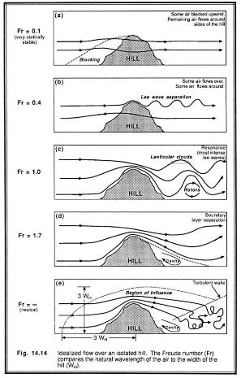
Summary of Ingredients
For a Downslope Windstorm
Three main variables determine the reaction of the approach flow with the terrain barrier:
  High stability from a temperature inversion (“lid”). The more stable, the more resistant to lifting.
  Strong wind speed across the mountain (Moderate to strong flows are necessary).
  Topographic characteristics: (Steep slopes) of barrier …
Froude Number
Fr = (2πU) /(N 2W)
(Fr Number NOT ON TEST)
Natural wavelength of air / effective wavelength of obstacle.
U: mean cross-barrier speed
N: Brunt-Väisälä Frequency
W: Length of obstacle

Slide 24
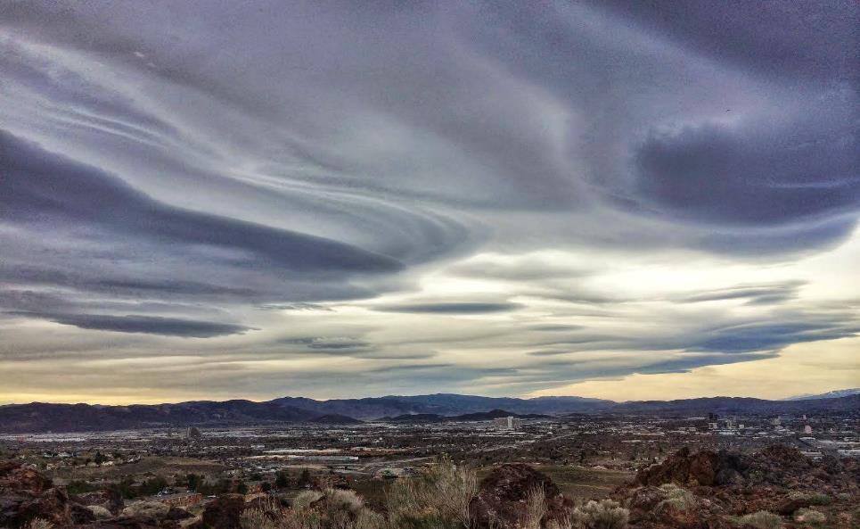
Photo: NWS Reno, March 15th, 2015
http://nwsreno.blogspot.com/2015/03/what-is-downslope-wind-caution.html
https://www.facebook.com/NWSReno/videos/1032145103513996/

Slide 25
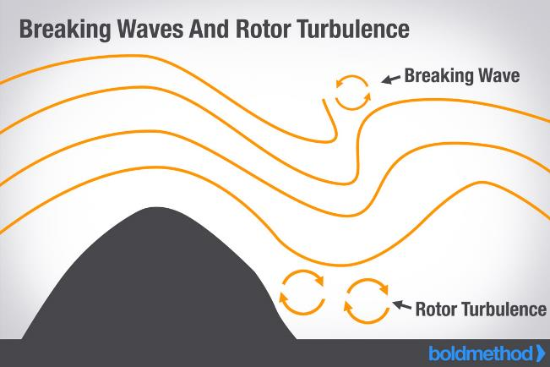
Mountain Waves: Hazard to Aviation
Breaking waves and rotors associated with Mountain Waves can create severe or extreme turbulence, which is dangerous for aircraft

Slide 26
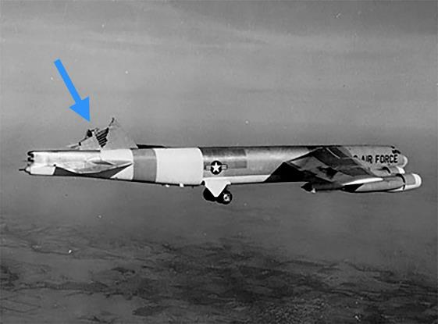
Mountain Waves: Hazard to Aviation
Breaking waves and rotors associated with Mountain Waves can create severe or extreme turbulence, which is dangerous for aircraft

Slide 27
Clear Air Turbulence: Hazard to Aviation
https://www.skybrary.aero/index.php/Clear_Air_Turbulence_(CAT)
https://www.boldmethod.com/learn-to-fly/weather/how-mountain-wave-forms-and-the-dangers-it-can-create/

Slide 28
Downslope Windstorms Videos
https://www.youtube.com/watch?v=3XV2mJHayi8
https://abcnews.go.com/GMA/video/santa-ana-winds-ravaging-western-united-states-insane-15071562
https://www.youtube.com/watch?v=jV9SGl77fJg
Atmospheric Sciences Playlist:
https://www.youtube.com/watch?v=niWBenrjdbs&list=PLGoTUrjiamHj4d1uI_jDQyZh_ZB16J46l&index=2
http://www.nycaviation.com/2012/04/audio-severe-turbulence-injures-four-aboard-us-airways-flight-to-denver/22036

Slide 29
Dec 1 2011 Utah Downslope Windstorm
https://www.ksl.com/?sid=18309646
http://archive.sltrib.com/article.php?id=53029513&itype=cmsid

Slide 30
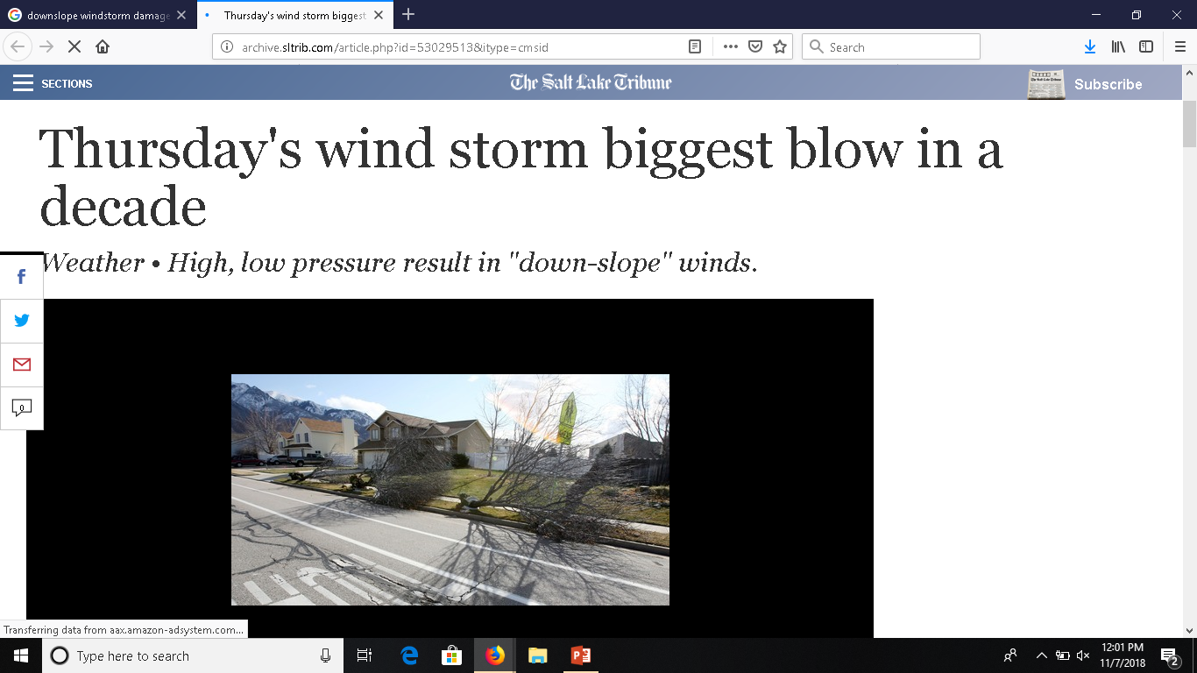
1 Dec 2011: Centerville, 9 a.m. • 102 mph
West Bountiful, 8 a.m. • 92 mph
http://archive.sltrib.com/article.php?id=53029513&itype=cmsid

Slide 31
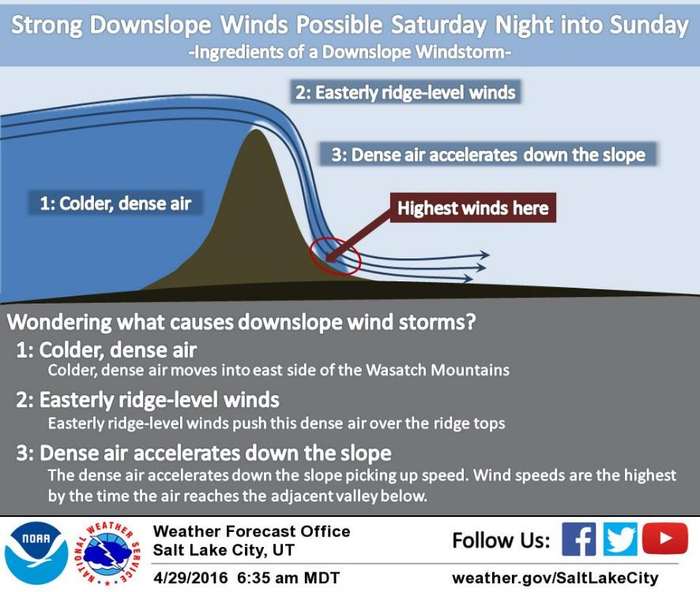
Ingredients for Wasatch Downslope Winds
Wasatch
Mountains
Bountiful

Slide 32
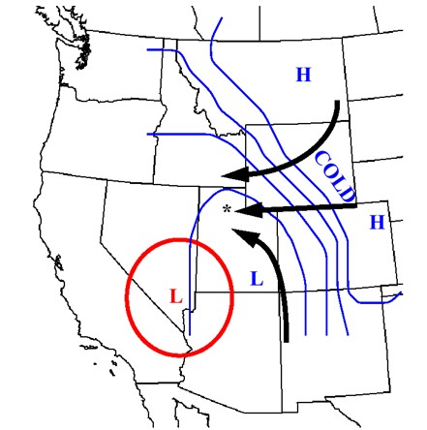

Slide 33
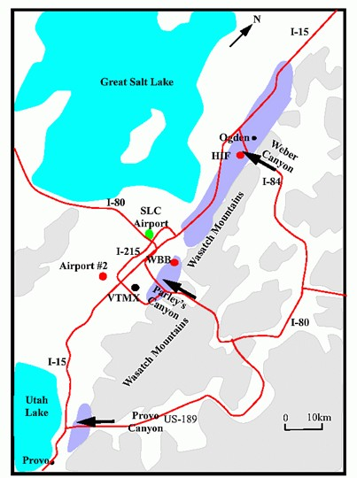
Typical High Downslope Wind Areas Along Wasatch Front

Slide 34
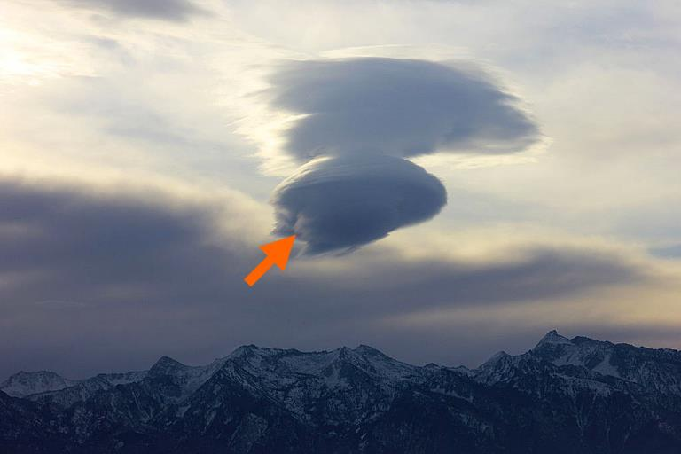
The End

Slide 35
NEXT SLIDES ON METEOR CRATER NOT COVERED ON TEST

Slide 36
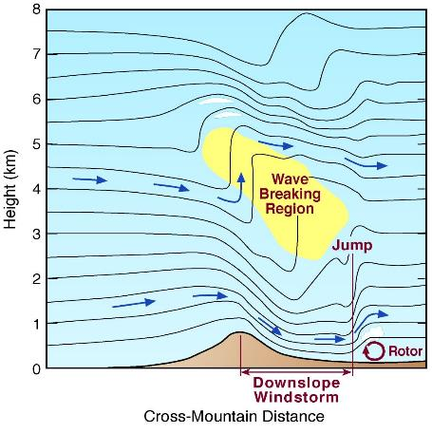

Downslope Windstorms in Sierras
--Strong jet perpendicular to the mountain
--A ridgetop inversion is needed to develop the wave breaking region
--Typically occur 3-6 times a year late October through early May
--Strongest winds in the lee of the Sierra
--Wind speeds 60 to 90 mph in Reno area. 100 to 150 mph observed in the Sierras. Source: NWS Reno

Slide 37
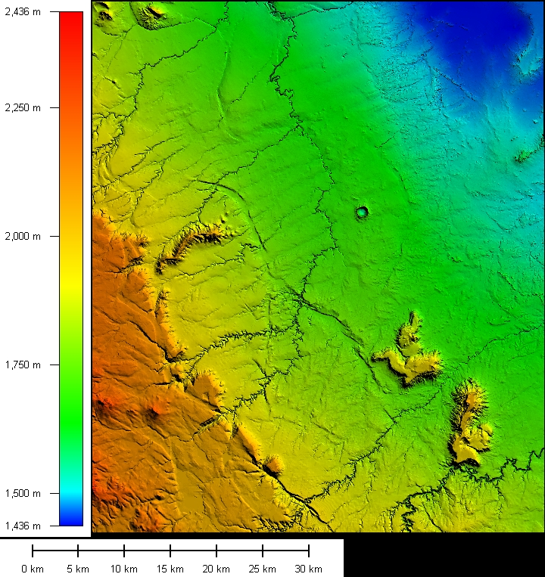
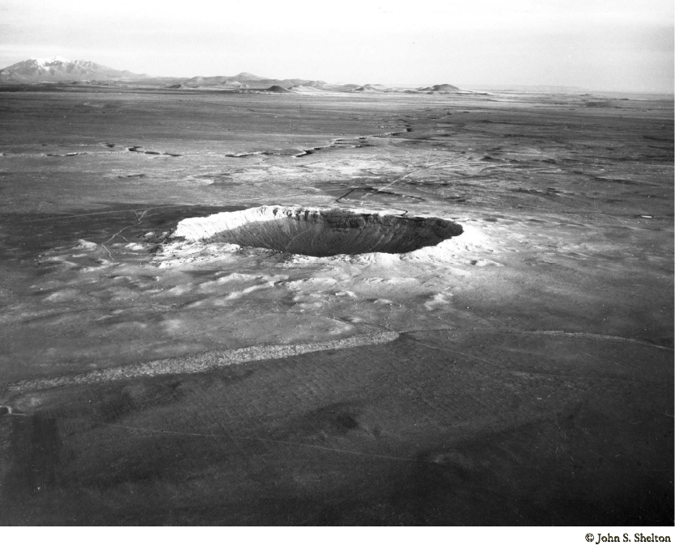
METCRAXII 2013: Why Arizona’s Meteor Crater to Study Downslope Winds?
The compact Meteor Crater topography allows the various thermally and dynamically driven phenomena to be thoroughly investigated in the small crater environment using an extensive data set from a variety of surface-based in situ and remote sensing instruments.

Slide 38
METRAXII Science Questions
What is the three-dimensional structure of downslope-windstorm-type flow that develops behind the circular ridge of Meteor Crater?
What are the controlling upstream parameters (e.g., inversion depth and stability, wind speed and vertical shear) that cause the downslope flow to develop?
Can modeling studies result in better forecasting of large-scale downslope windstorms (like observed in Reno, Nevada)?

Slide 39
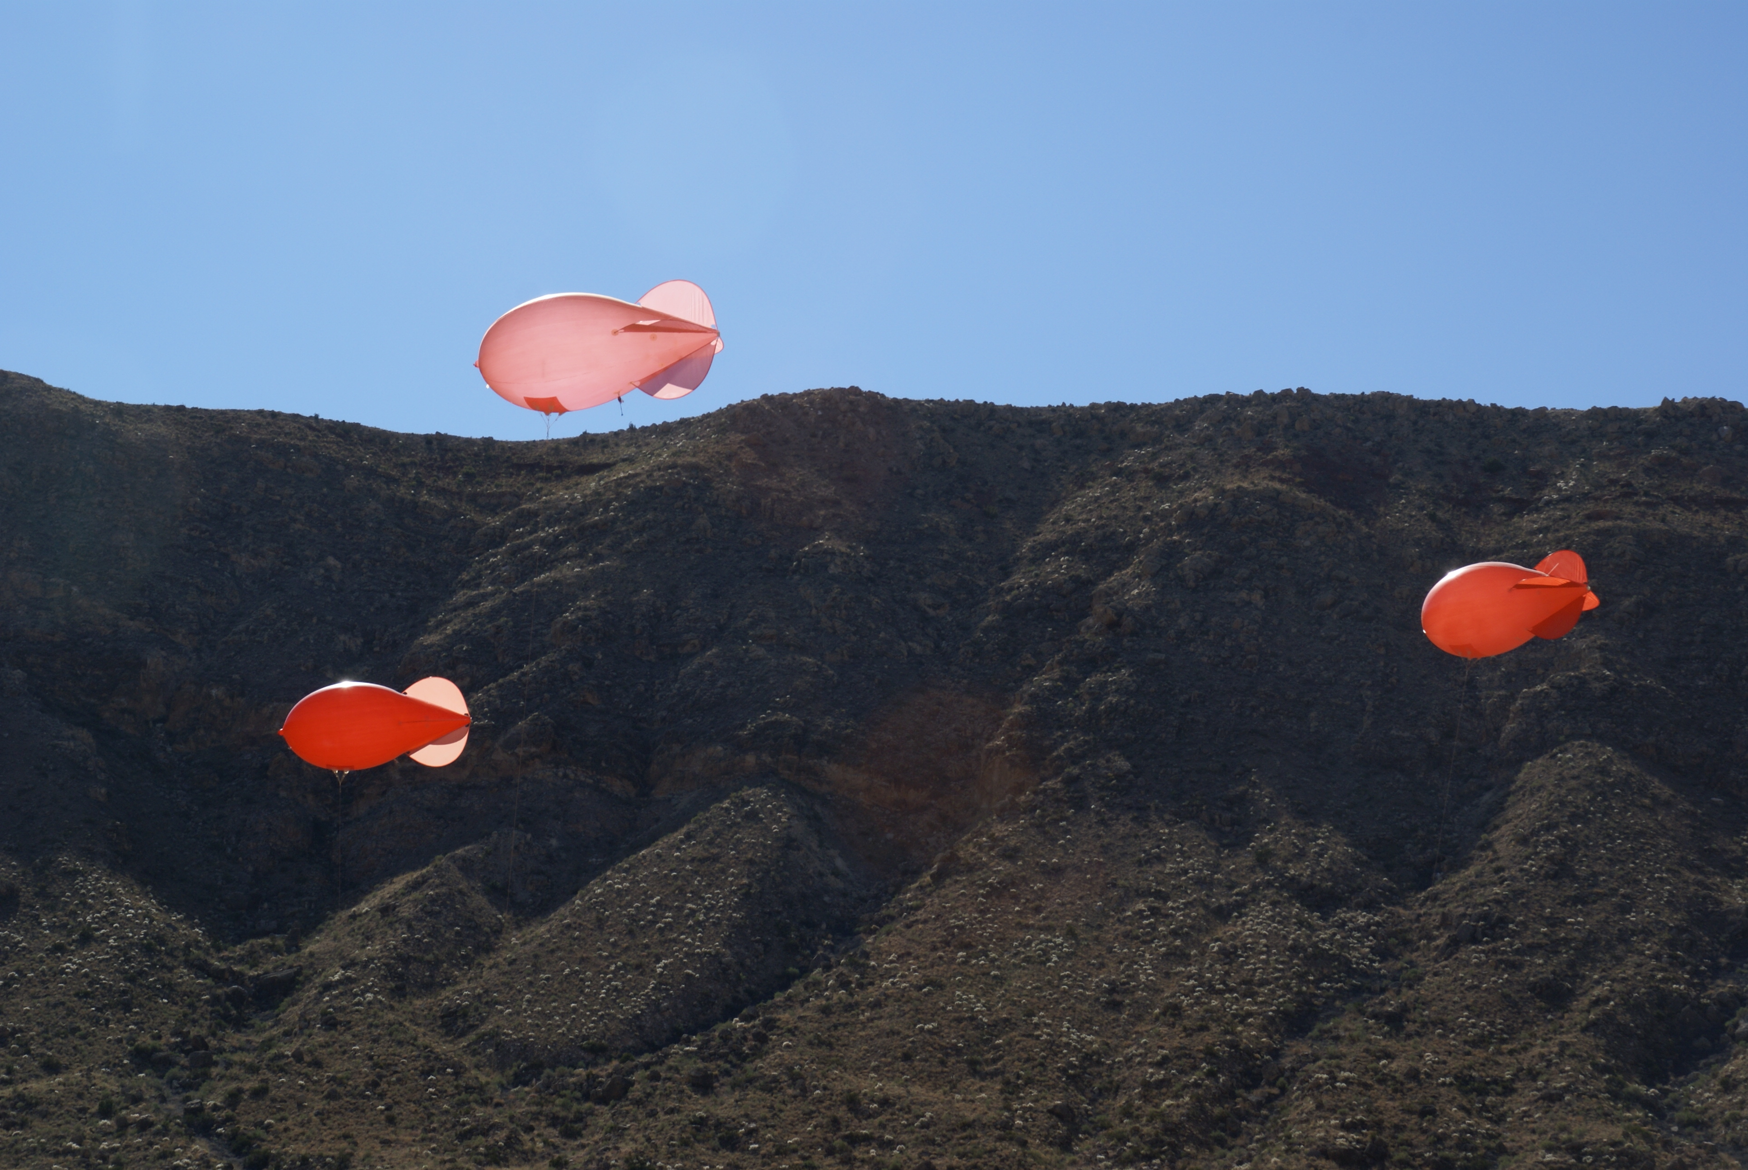

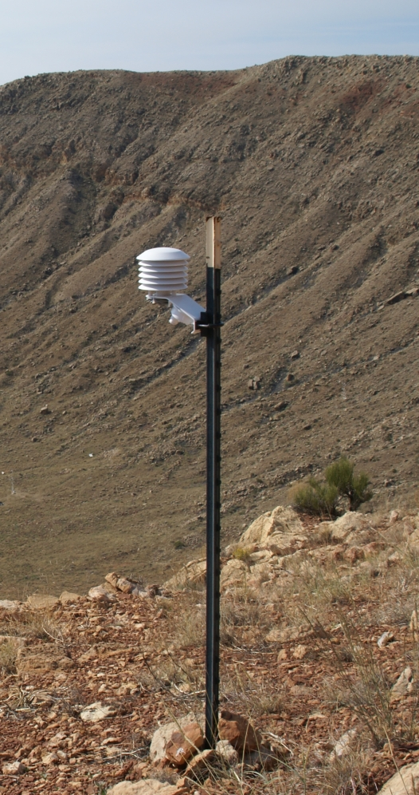
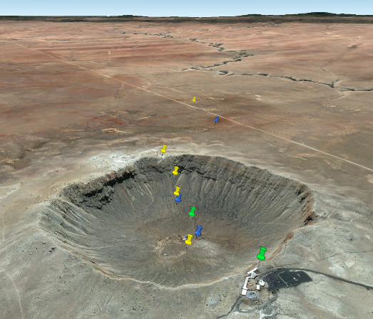
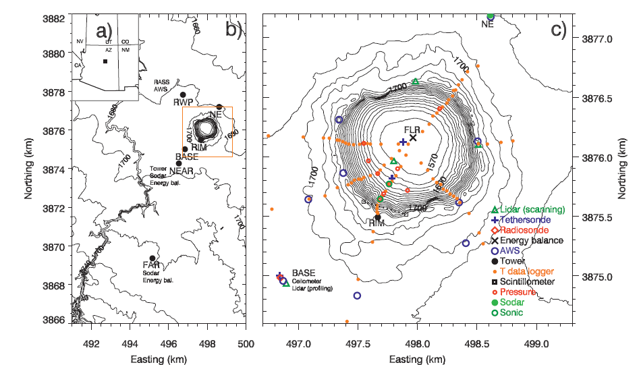
1200 m diameter
170 m deep
30-50 m rim
plain slopes up to SW 1°
katabatic
flow

Slide 41
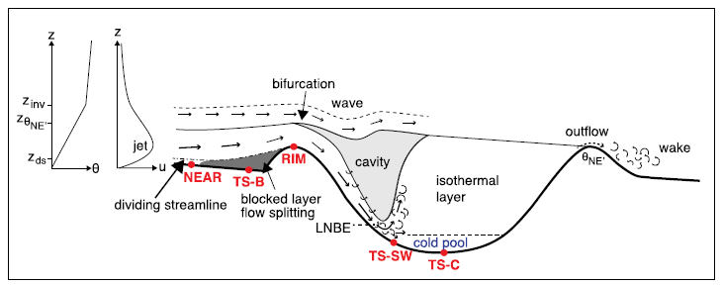
Conceptual Model

Slide 42
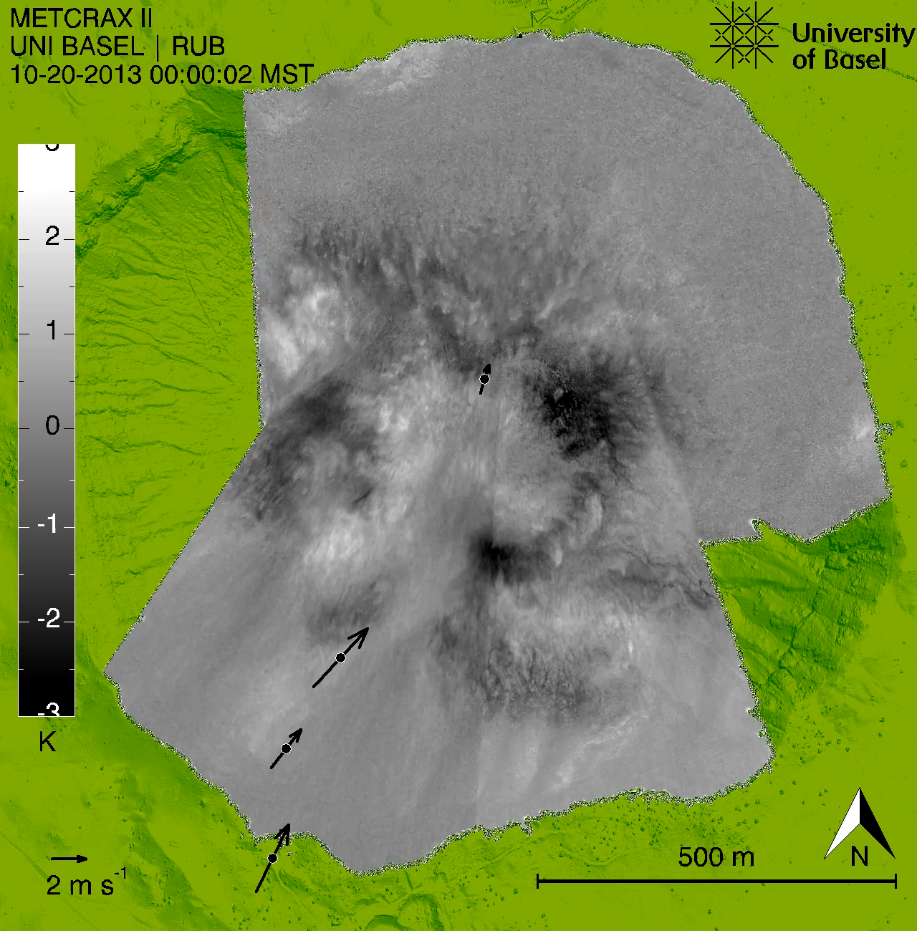

Slide 43

Downslope windstorm
Under certain stability, wind flow and topography conditions, the entire mountain wave can undergo a sudden transition to a hydraulic flow involving a hydraulic jump and a turbulent rotor. This exposes the lee side of the barrier to sweeping, high speed turbulent winds that can cause forest blowdowns and structural damage.
Whiteman (2000) adapted from Carney et al. (1996)

