Slide 1

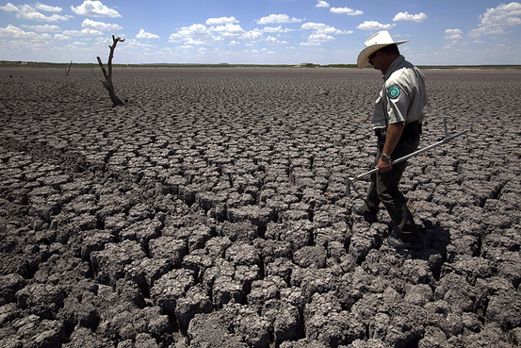
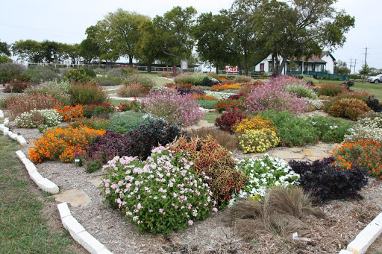
Climate Change and Gardening in West Texas
Dr. Erik Crosman
Assistant Professor
Department of Life, Earth and Environmental Sciences
West Texas A&M University
Presentation to the Randall County Master Gardeners
9 February 2021

Slide 2
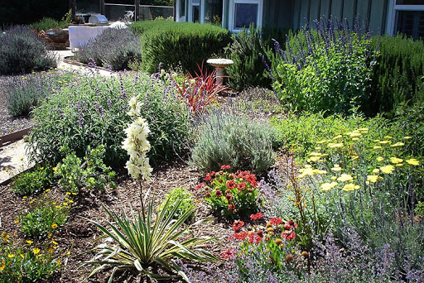
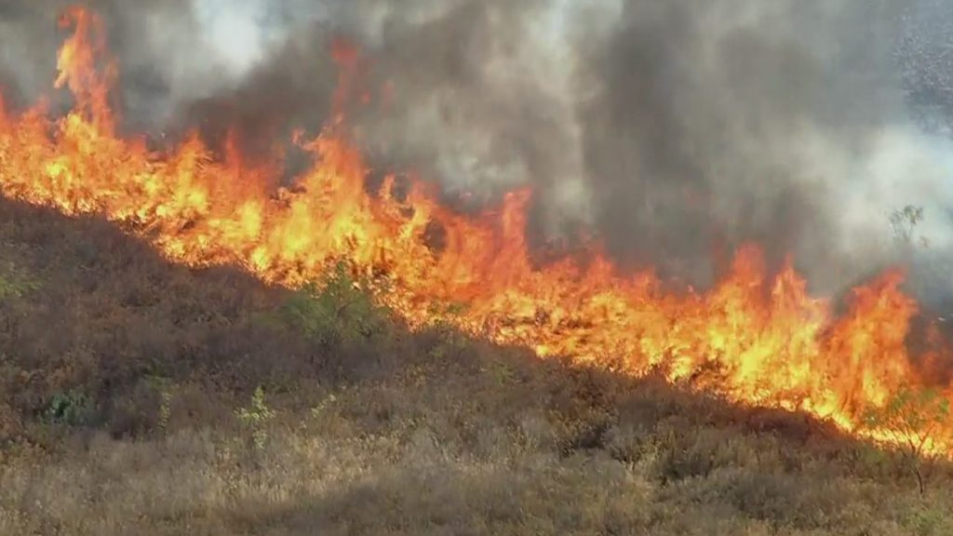
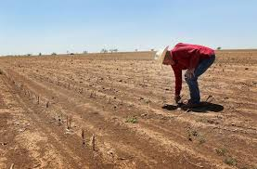
Overview
Climate change overview
What can we expect to see in West Texas?
How will these climate changes impact gardening?
Advice for gardening in a changing climate

Slide 3
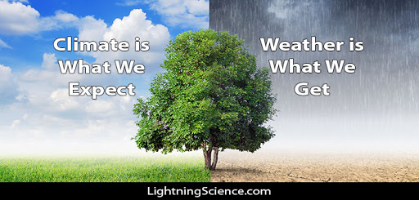
Climate vs. Weather
Climate is the average state of the weather that has been collected over long periods (10-100 years).
Weather is the state of the atmosphere at a given place or time. Always changing!

Slide 4
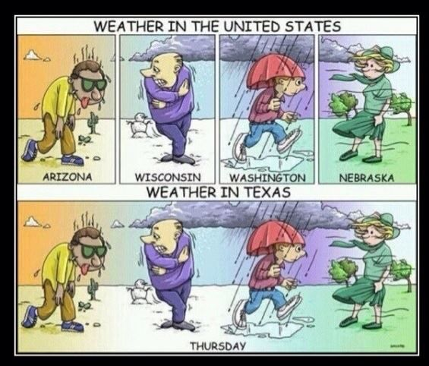

Slide 5
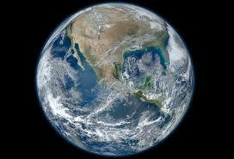
What is Climate Change?
Climate change - A large shift in the “average” weather
Occurs on many time and space scales
Evidence indicates the climate of the Earth has changed many times

Slide 6
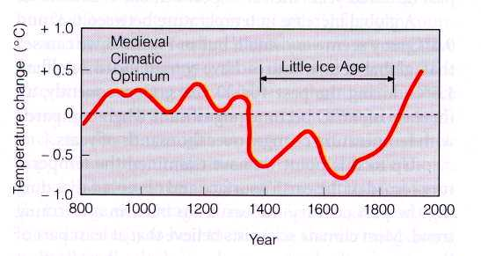
Natural Climate Changes Impacted Mankind
Viking settlements lost in Greenland
Viking colonization in Greenland
Ahrens, Fig 13.4
Temperatures for eastern Europe during the last 1200 years.

Slide 7
Rapid Recent Climate Changes
The Earth’s climate has been changing for a long, long time
…much longer than humans have been emitting significant fossil fuel greenhouse gases
However, the rate of change of the climate change we are currently experiencing is unprecedented due to greenhouse gas emissions

Slide 8
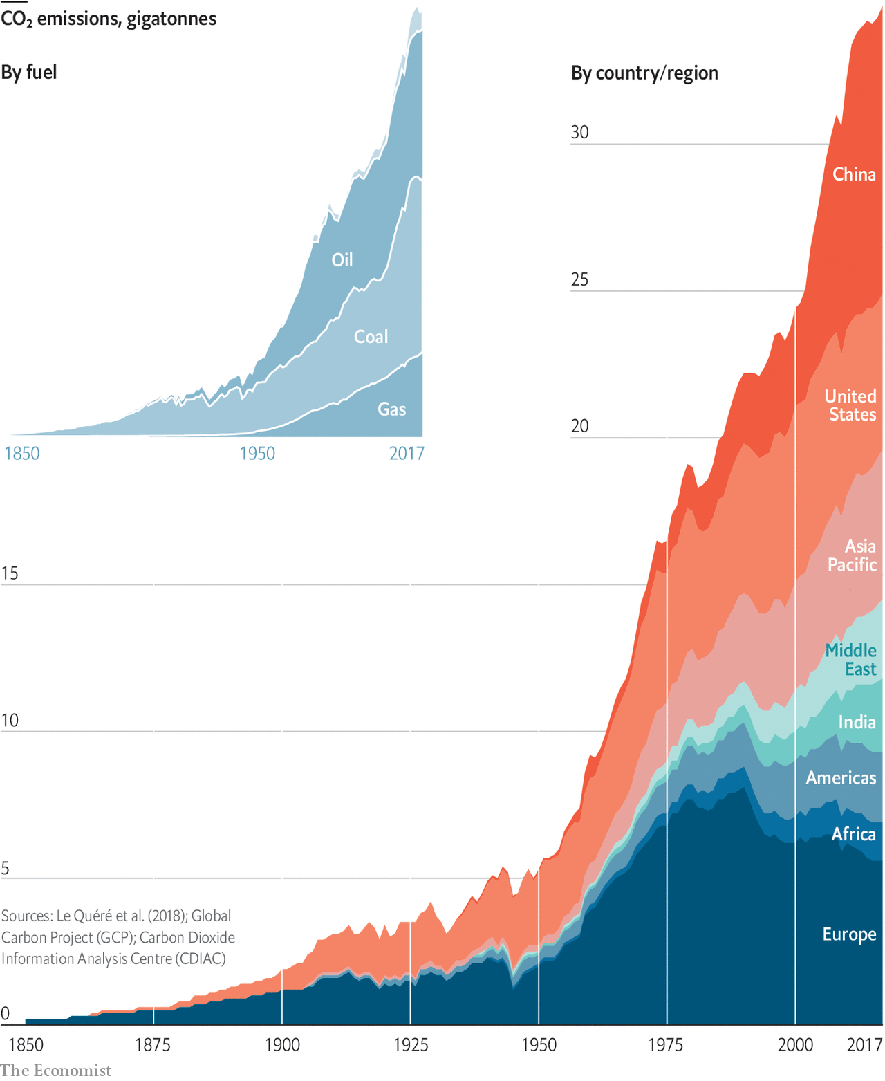
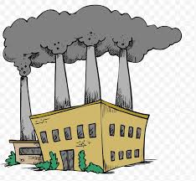
Increasing Carbon Dioxide (CO₂) Emissions
(CO₂) stays in the atmosphere for hundreds of years on average!

Slide 9
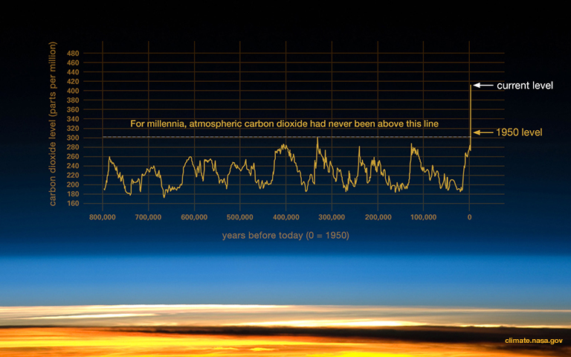

Slide 10
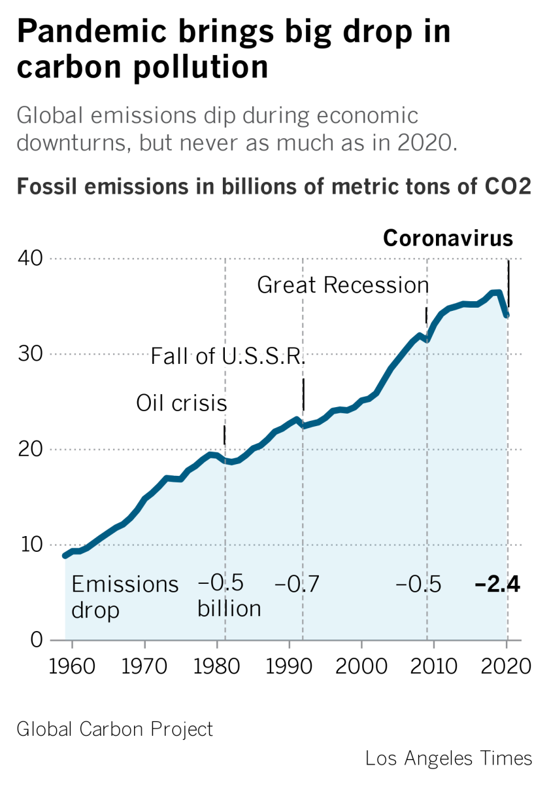
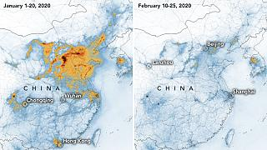
https://www.euronews.com/2020/03/04/nasa-confirms-a-fall-in-greenhouse-gas-emissions-in-china-amid-coronavirus-outbreak

Slide 11
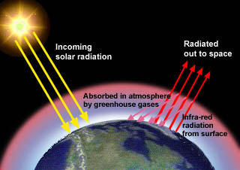
The Greenhouse Effect
Earth’s surface would be on average 60 degrees F cooler than today…no crops, no food, would not support life like it now does.
Notes:
The greenhouse effect: certain “greenhouse” gases in the atmosphere permit sunlight to pass through the atmosphere, but absorb much of the infrared (heat) radiation from Earth’s surface. The atmosphere warms, and radiates additional heat to the surface. The planet’s temperature is therefore higher than it would be without greenhouse gases, and it stands to reason that adding more greenhouse gases to the atmosphere is likely to warm the planet.

Slide 12
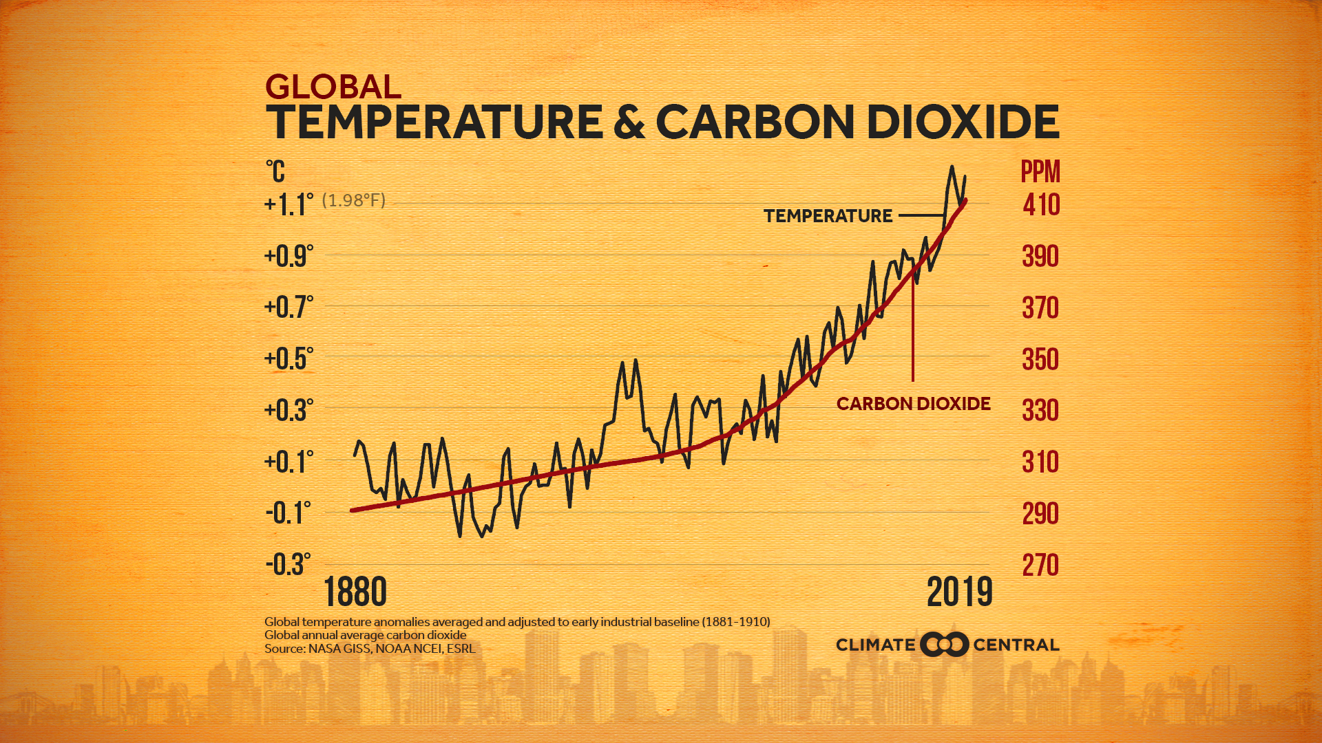

Slide 13
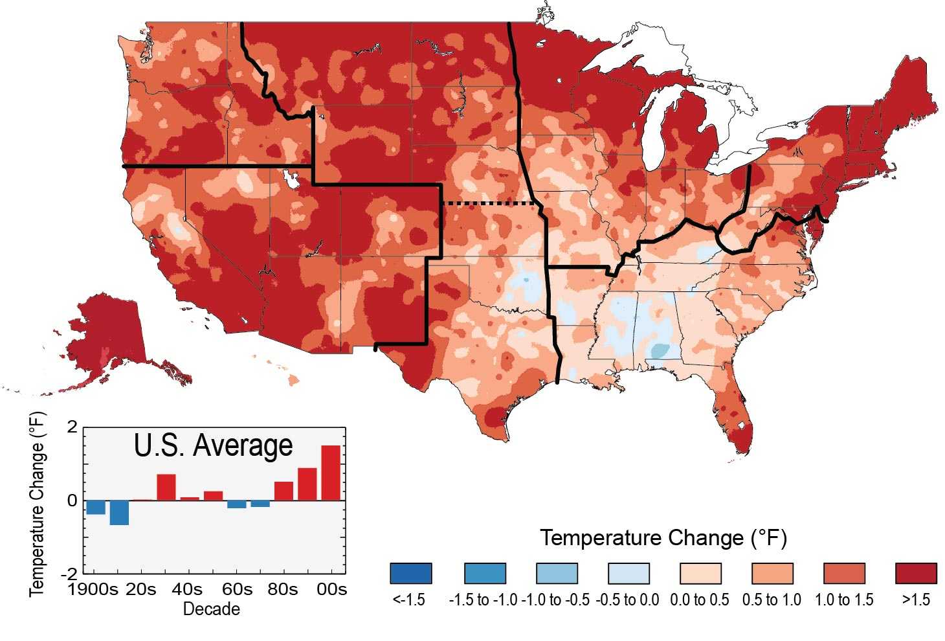
Observed Warming
~+1.5 ◦F West Texas
1991-2012 vs
1901-1960
Average
https://nca2014.globalchange.gov/highlights/report-findings/our-changing-climate/graphics/observed-us-temperature-change

Slide 14
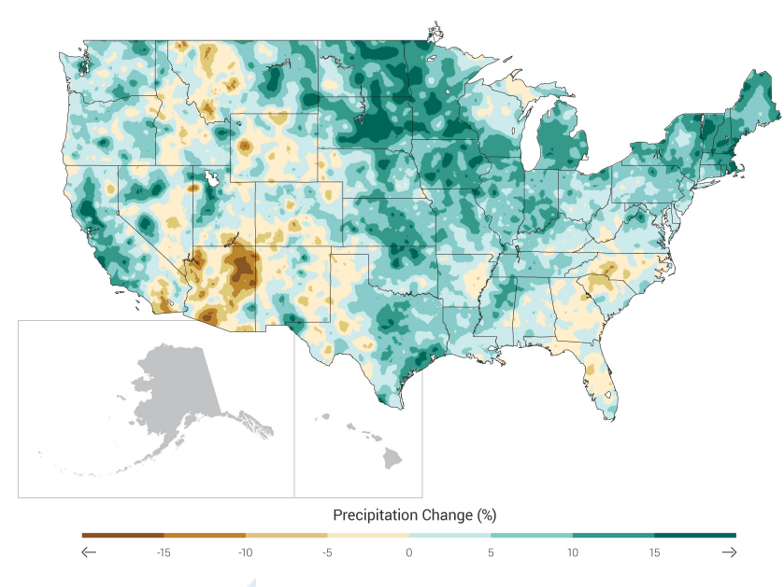
Observed Changes in Precipitation
1991-2012 vs
1901-1960
Average
https://nca2014.globalchange.gov/report/our-changing-climate/precipitation-change

Slide 15
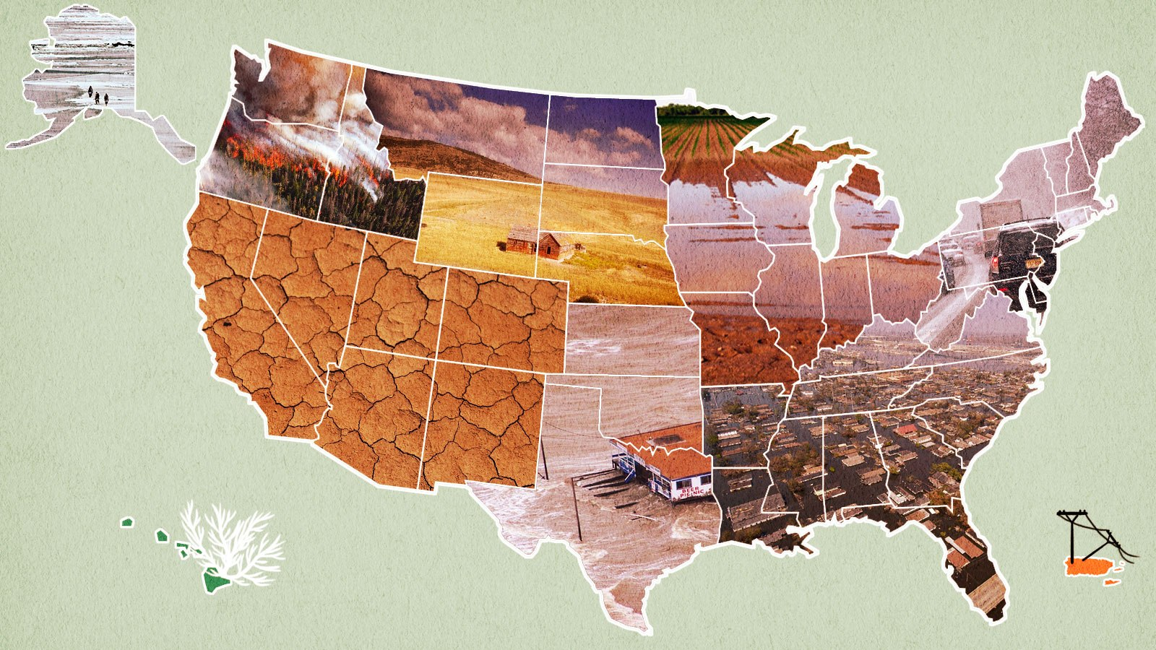
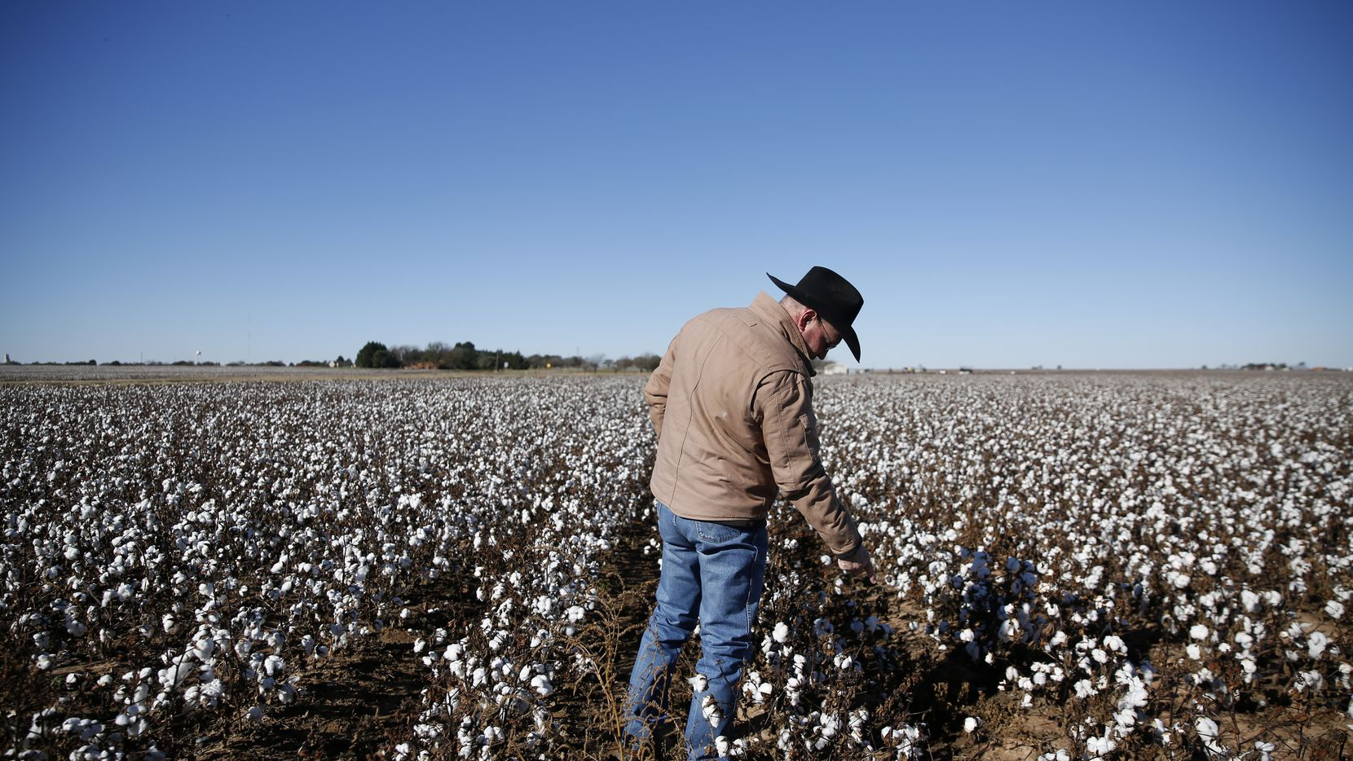
Climate Change in West Texas
What to Expect?

Slide 16
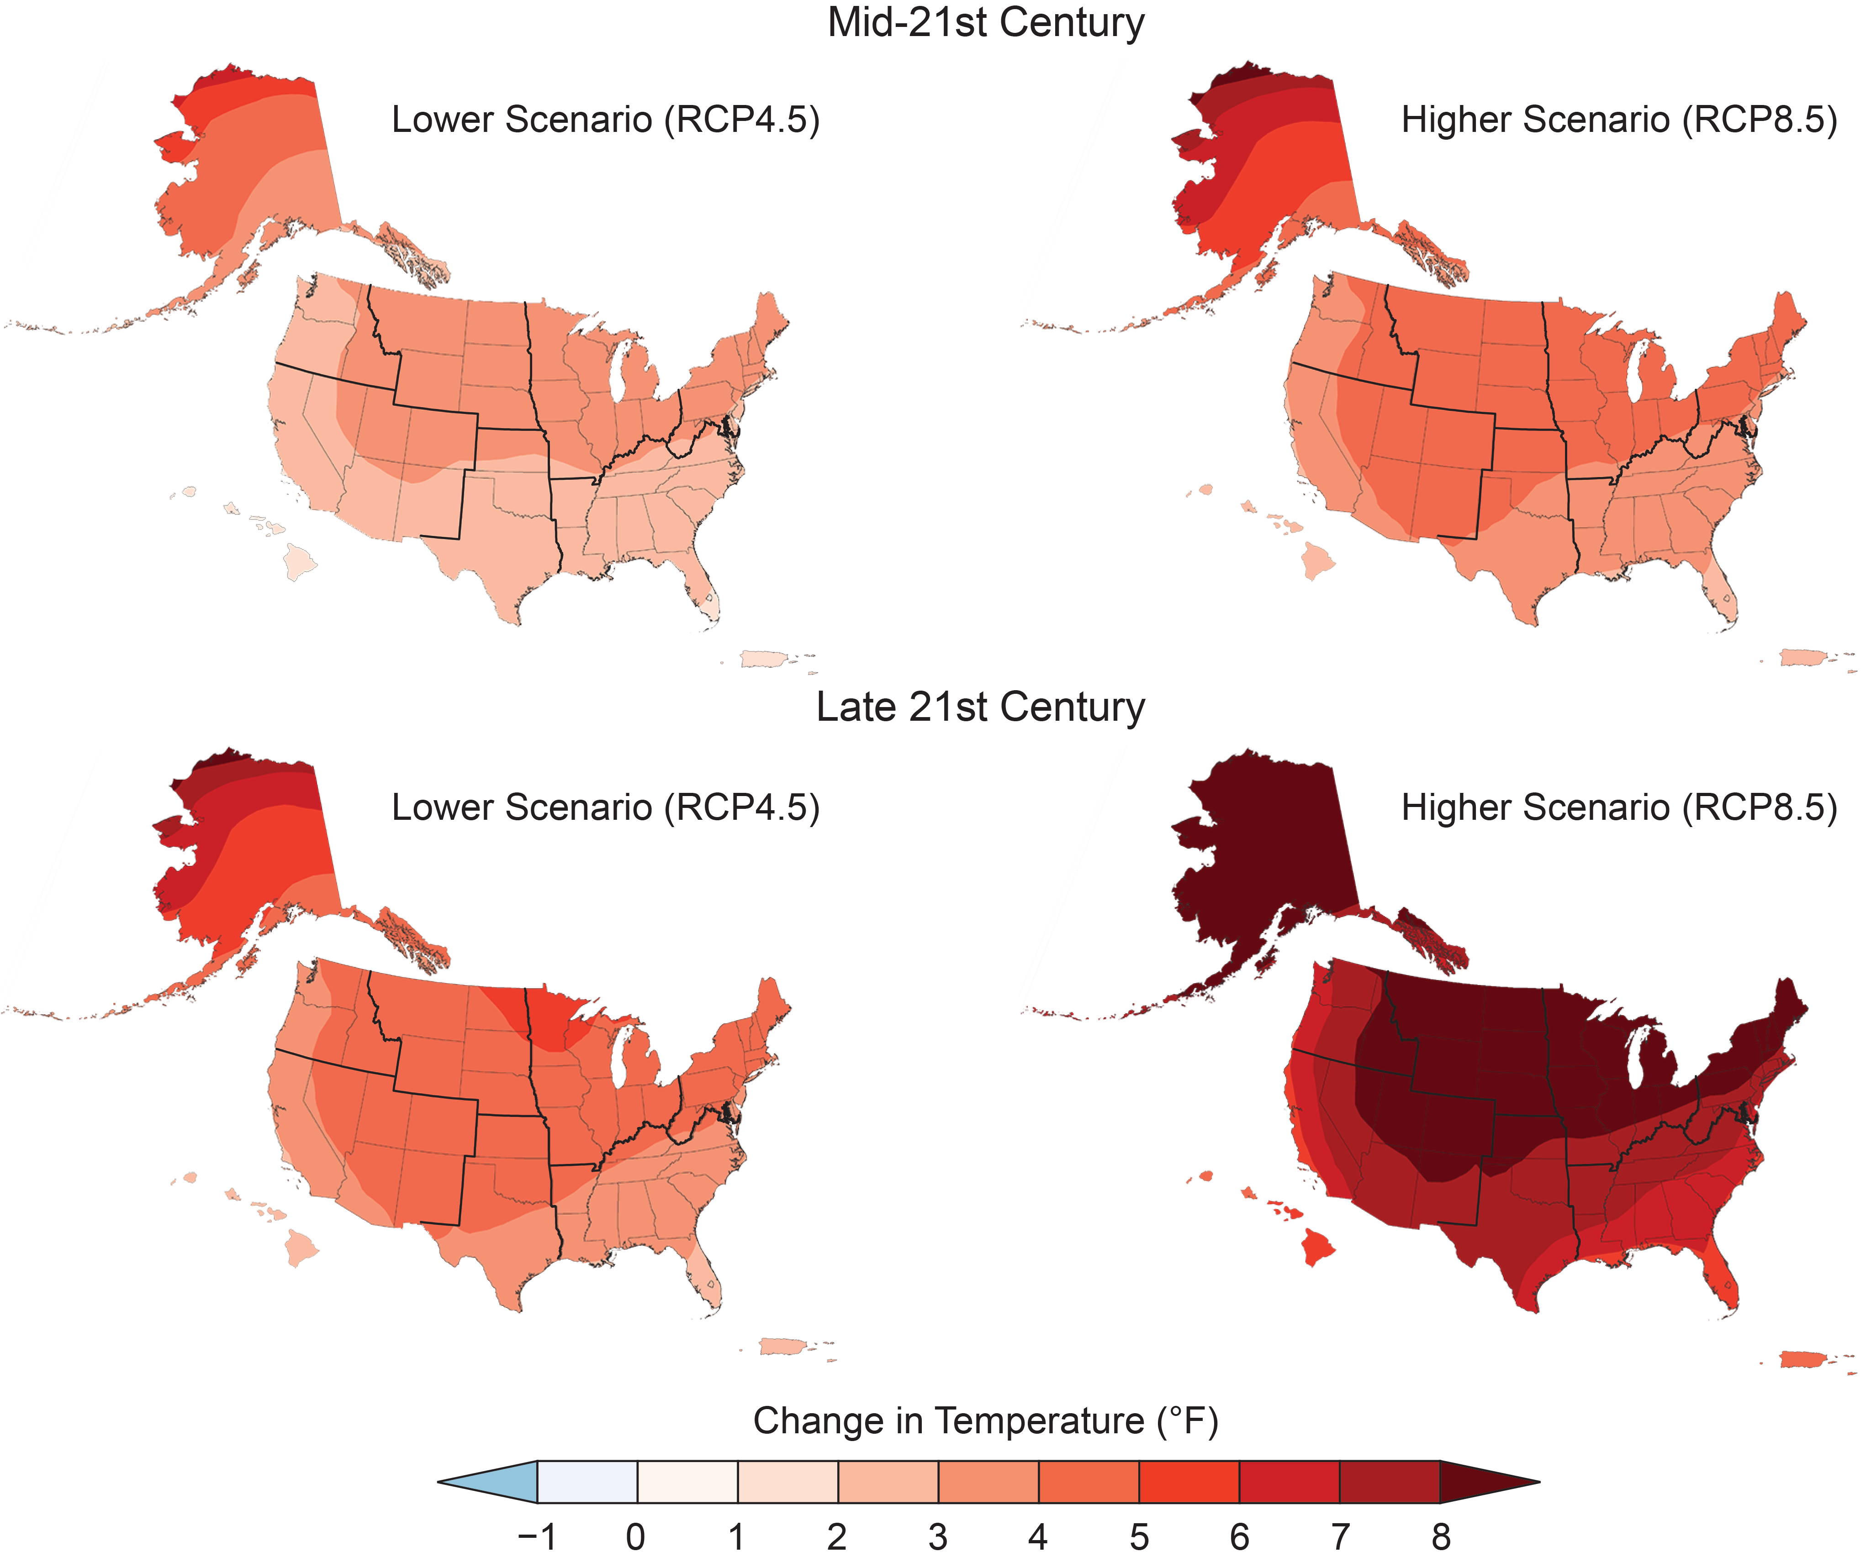
Climate Model Predictions for 2050:
Temperature
High CO2 emissions scenario
Low CO₂ emissions scenario
NATIONAL CLIMATE ASSESSMENT https://nca2018.globalchange.gov/chapter/1/

Slide 17
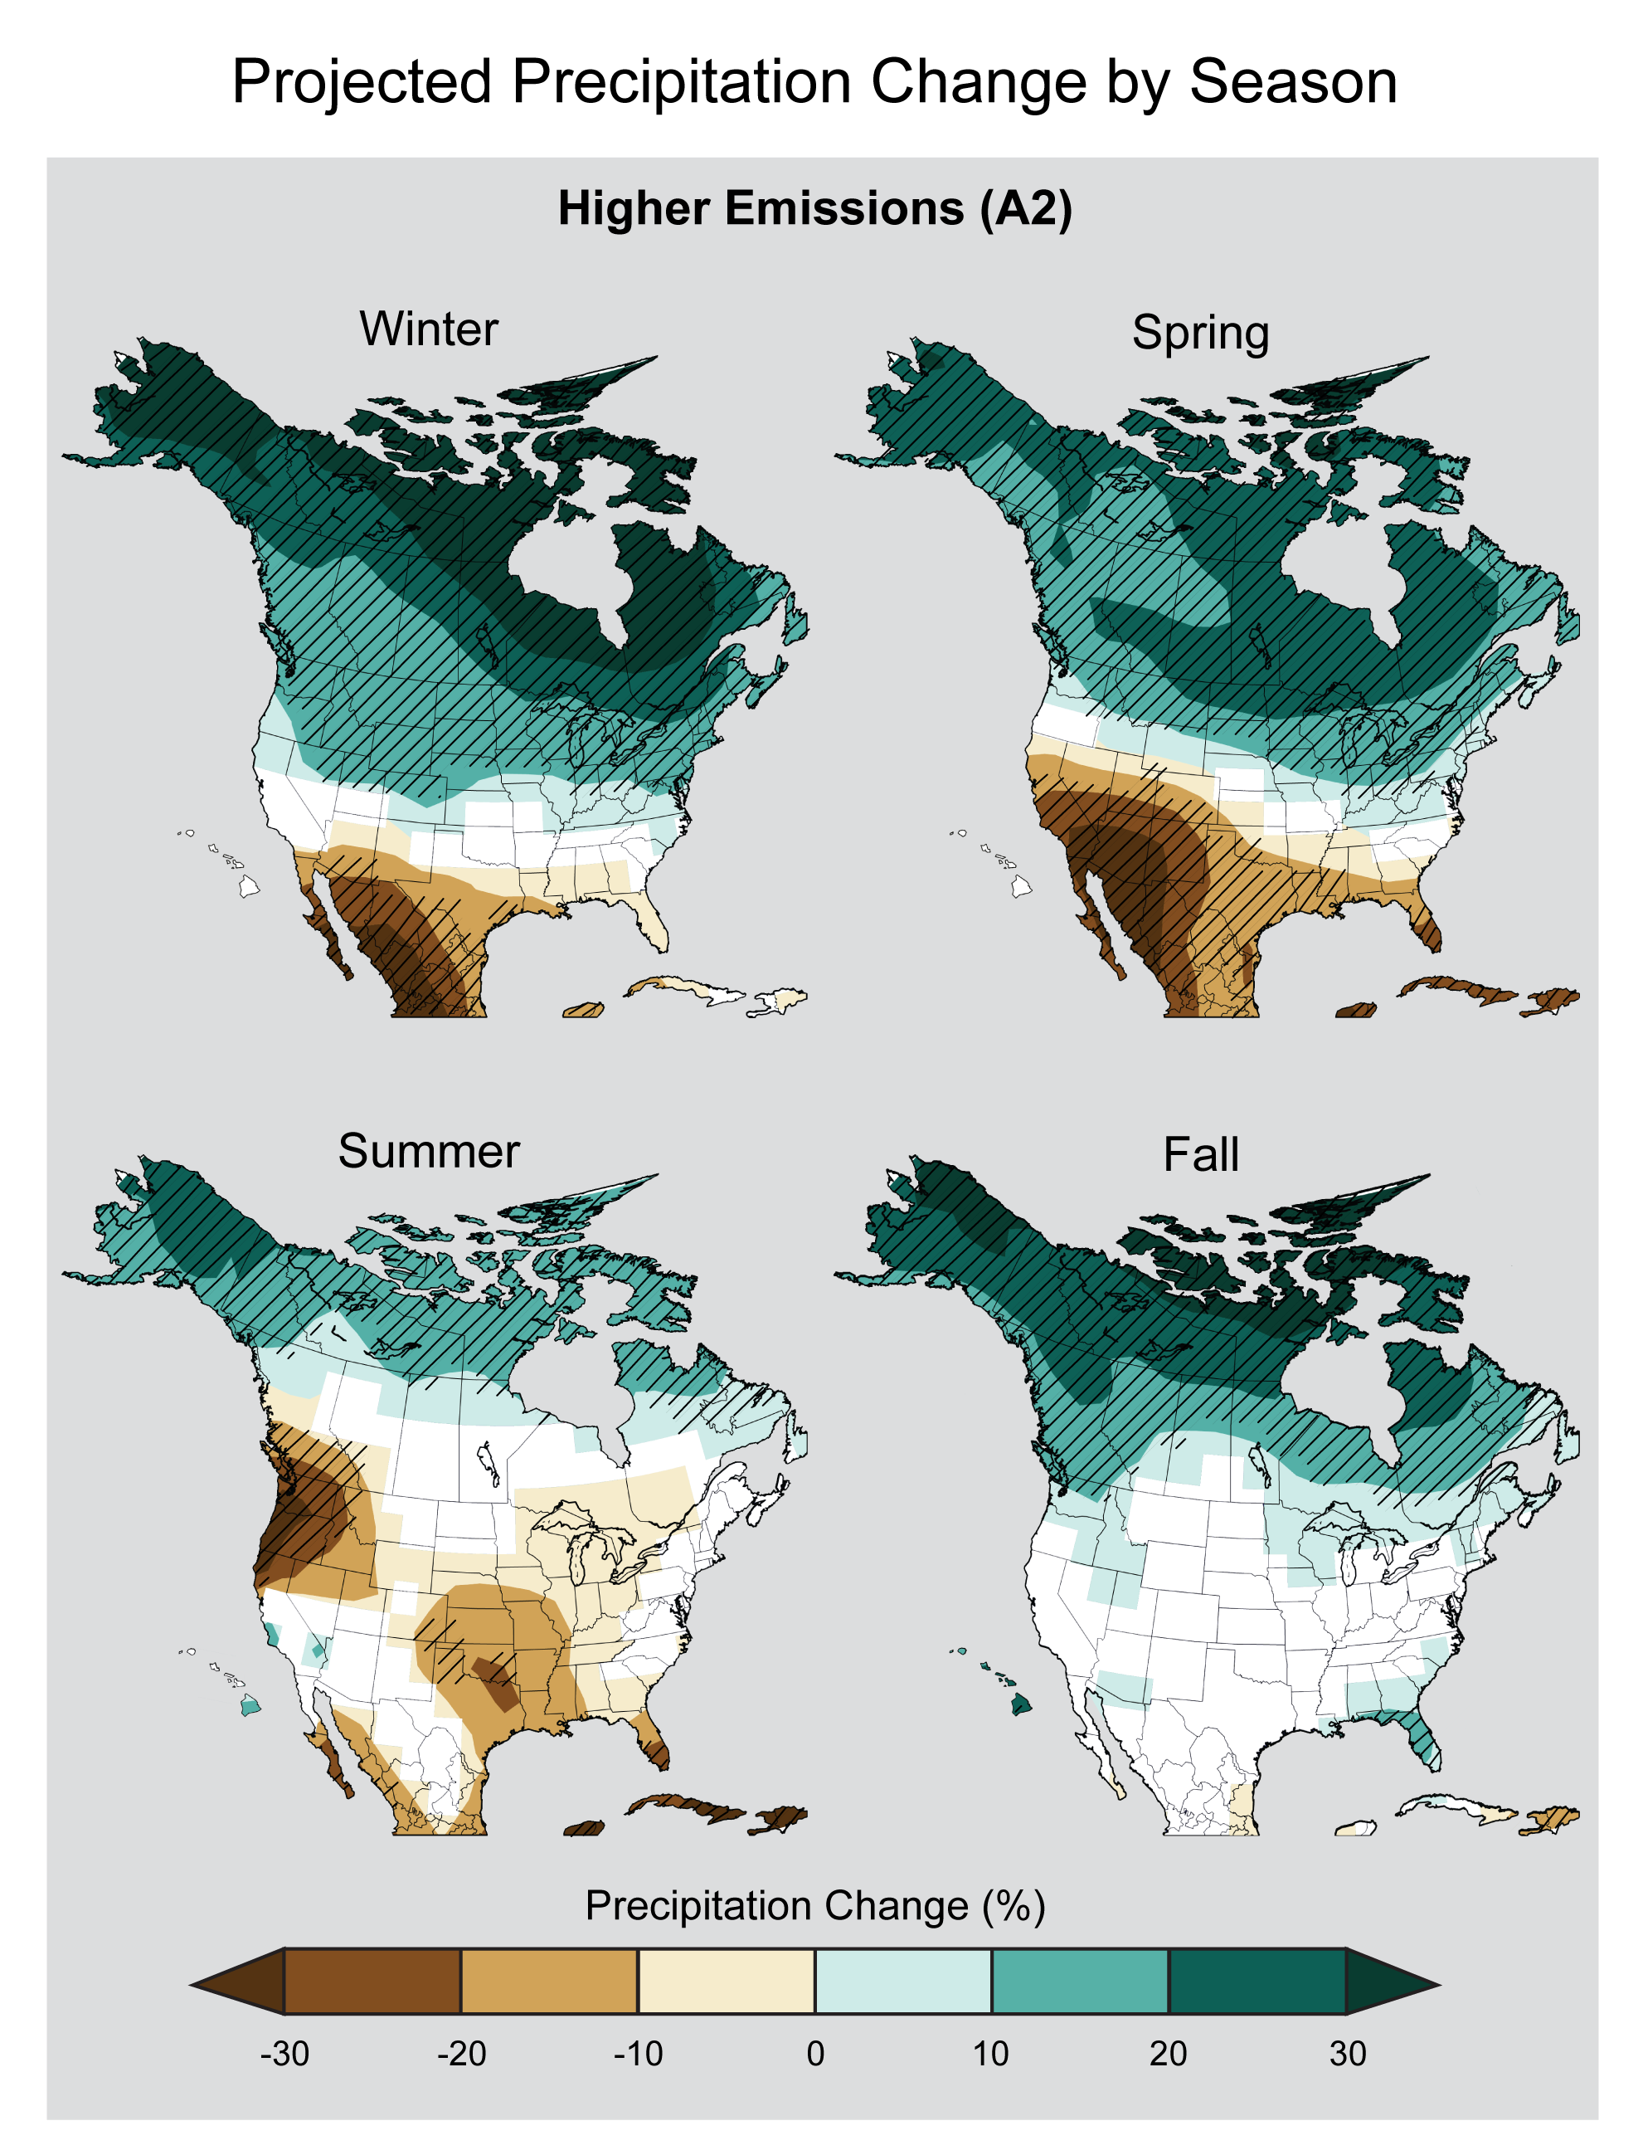
Climate Model Predictions for 2050:
Precipitation
Drier Spring and Summers in Texas Panhandle
https://nca2014.globalchange.gov/report/our-changing-climate/precipitation-change

Slide 18
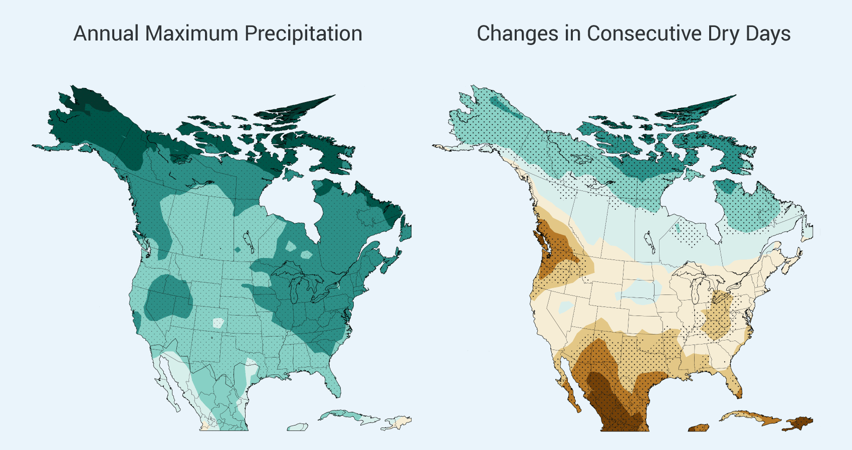
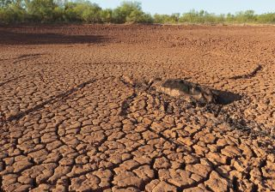
Climate Model Predictions:
Droughts
Longer/more intense droughts
https://nca2014.globalchange.gov/report/our-changing-climate/precipitation-change/graphics/annual-maximum-precipitation

Slide 19
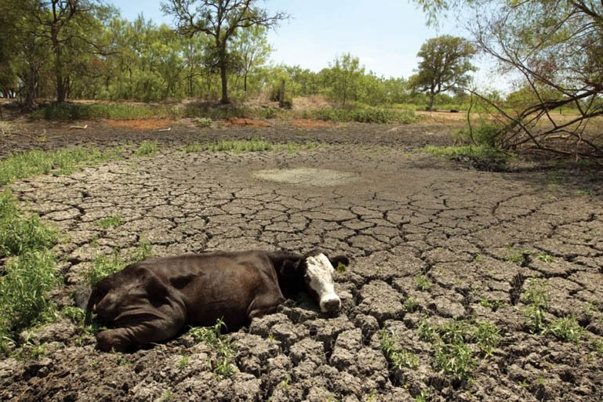
Texas Drought of 2011
For cattle ranchers in Texas, 2011 was a terrible year—the hottest and driest year observed since record keeping began in 1895. In 2011, Texas saw more than 90 days with temperatures over 100ºF (38ºC)—roughly double the normal number. Lakes, streams, and stock-watering ponds dried up and disappeared along with the grass on baking pastures, leaving cattle thirsty and starving.
Photo: https://www.texasobserver.org/dry-season-the-texas-drought-of-2011/

Slide 20
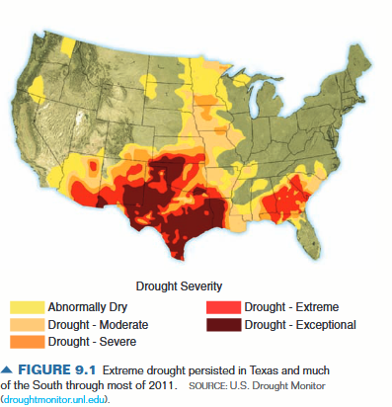
Texas Drought of 2011
Texas ranchers were forced to sell or slaughter 1.4 million cattle --biggest sell-off in American history
Just over half of the state’s 20 million acres of cropland were harvested. >50% cotton crop failed
Total economic losses > $10 billion
Worst fires in Texas history. 4 million acres burned
Industries such as petroleum refineries, a cornerstone of the Texas economy, threatened water shortage

Slide 21
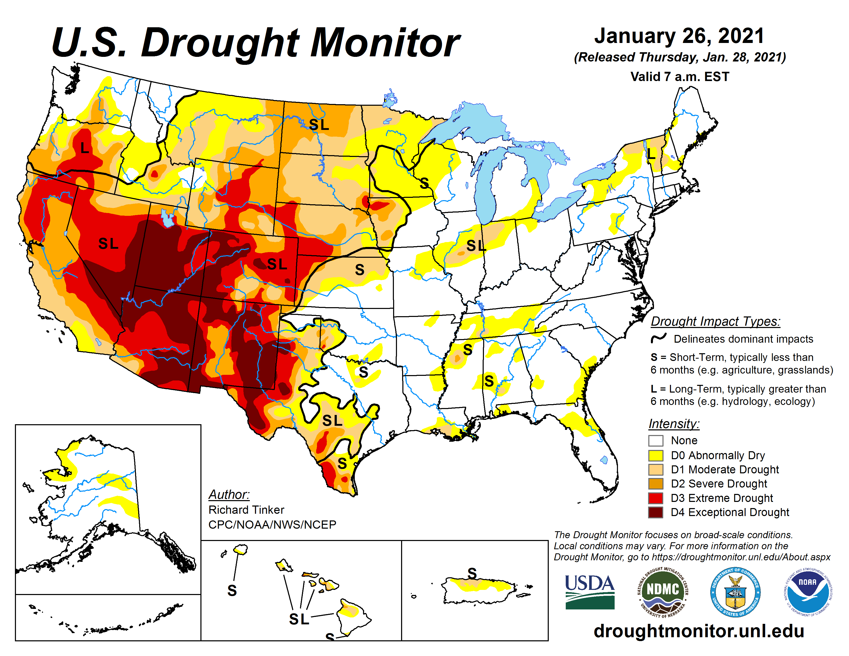
Current Drought
Drought Monitor: https://droughtmonitor.unl.edu/

Slide 22
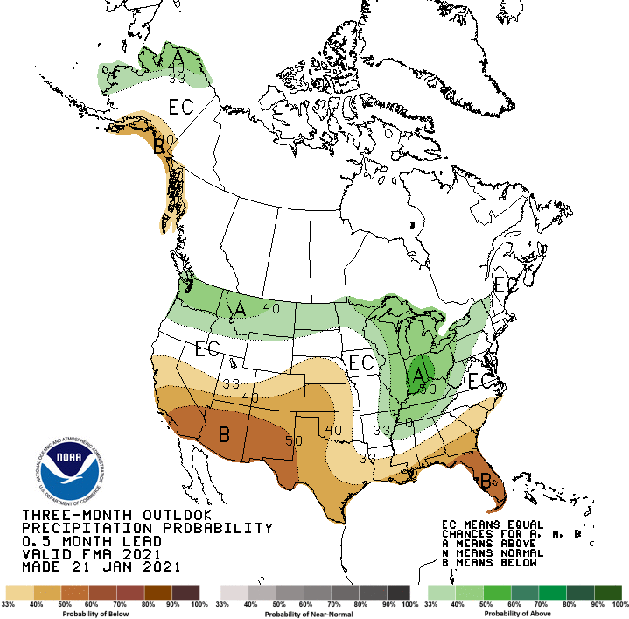
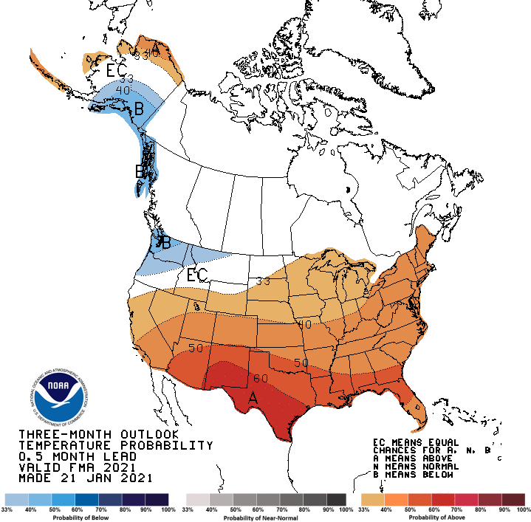
NOAA Climate Prediction Center: https://www.cpc.ncep.noaa.gov/

Slide 23
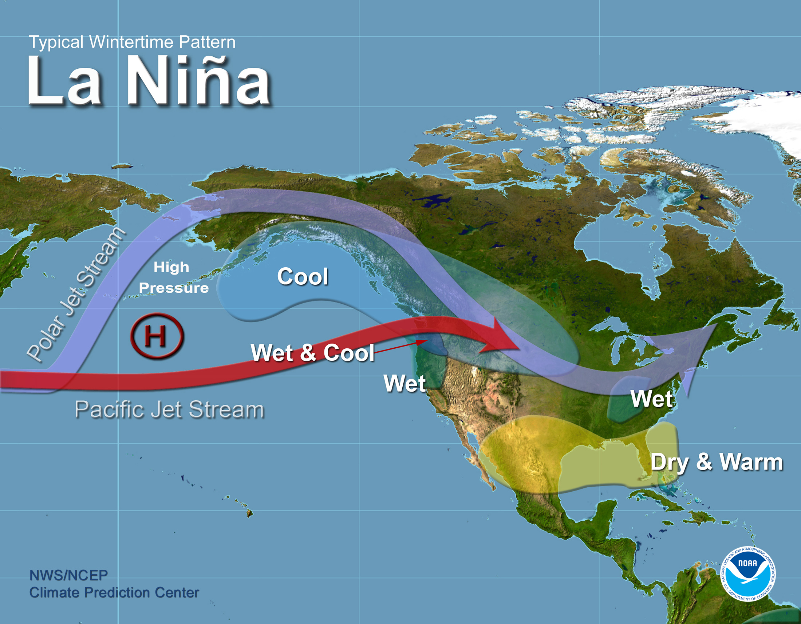

Slide 24
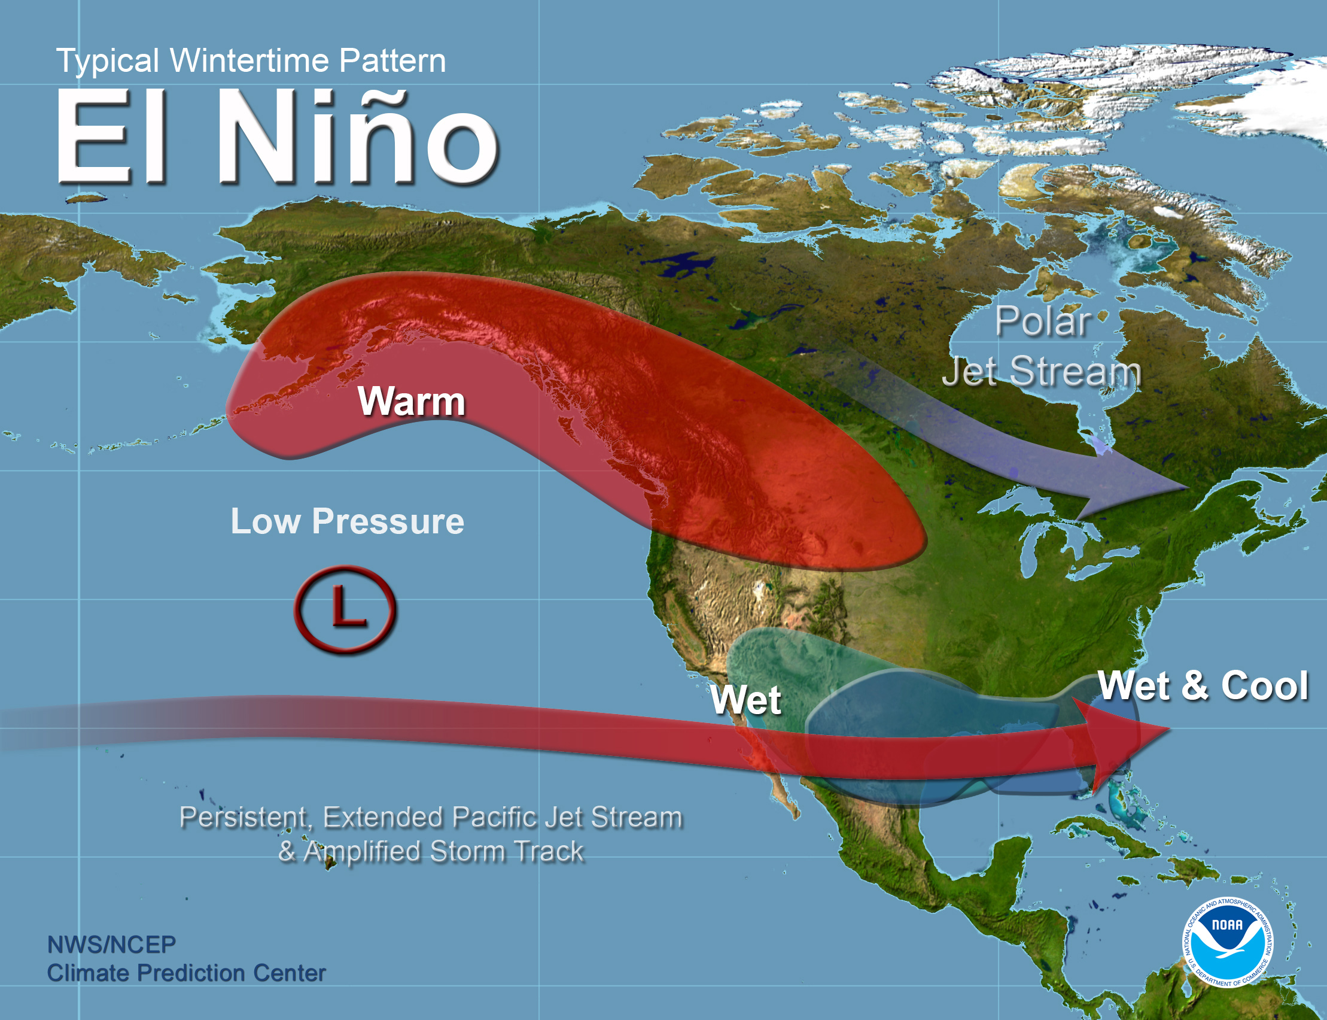

Slide 25
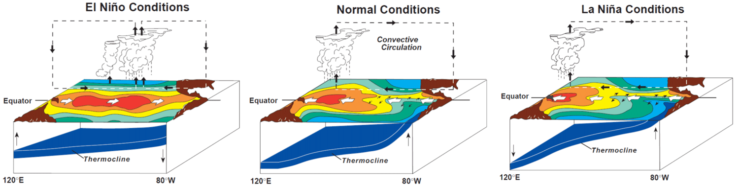
El Nino Southern Oscillation (ENSO)
The El Niño Southern Oscillation (ENSO) is a periodic shift of the ocean-atmosphere system in the tropical Pacific that impacts weather around the world. It happens every 3-7 years (5 years on average) and typically lasts nine months to two years. It is associated with floods, droughts, and other global disturbances.

Slide 26
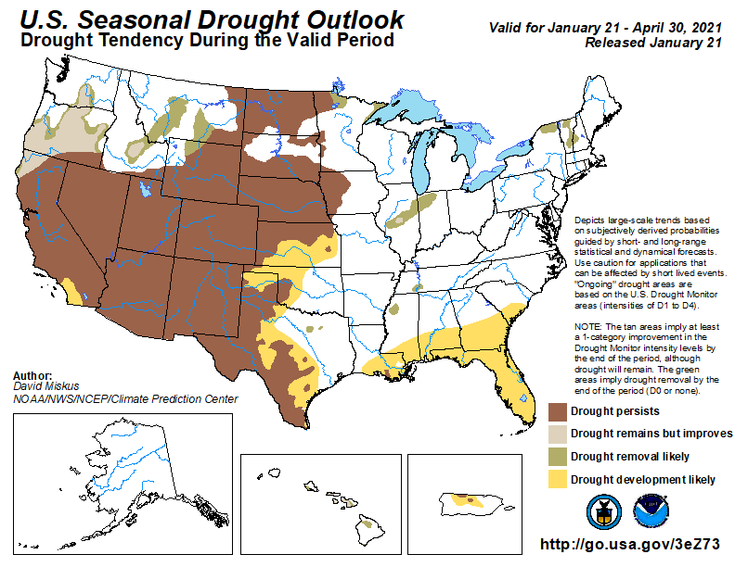
NOAA Climate Prediction Center: https://www.cpc.ncep.noaa.gov/

Slide 27
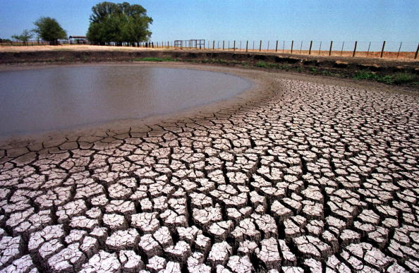

Bottom Line
The droughts seen across much of the southern and central United States, and many other regions of the world, represent a long-term shift toward increased heat and energy storage in the atmosphere.
If we don’t act soon those changes will shift us to an entirely new climate regime. The evidence indicates that extreme summer heat, with drying soil and crops, will be the new normal for much of the southern US. Texas will look like Arizona. Illinois and Iowa, the center of our farm economy, will look like Texas today.
https://dribbble.com/shots/6613775-Texas-Heat

Slide 28
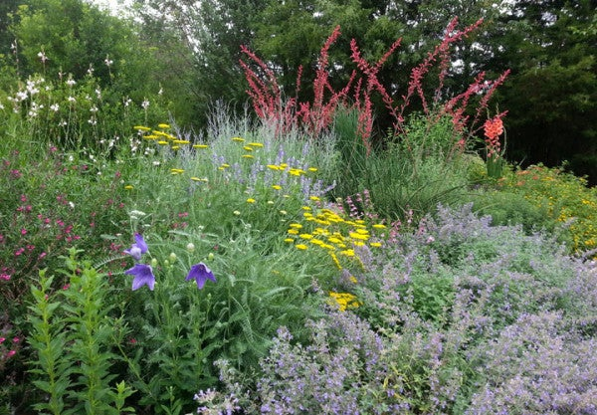
How Will Climate Change Impact Gardening in West Texas?

Slide 29
Gardening in West Texas: Climate Change
Increased droughts
Increased heat and heat waves
Extension of the growing season
Later first fall frost
Earlier last spring frost
Pest issues uncertain
Heavier t-storms, hail uncertain

Slide 30
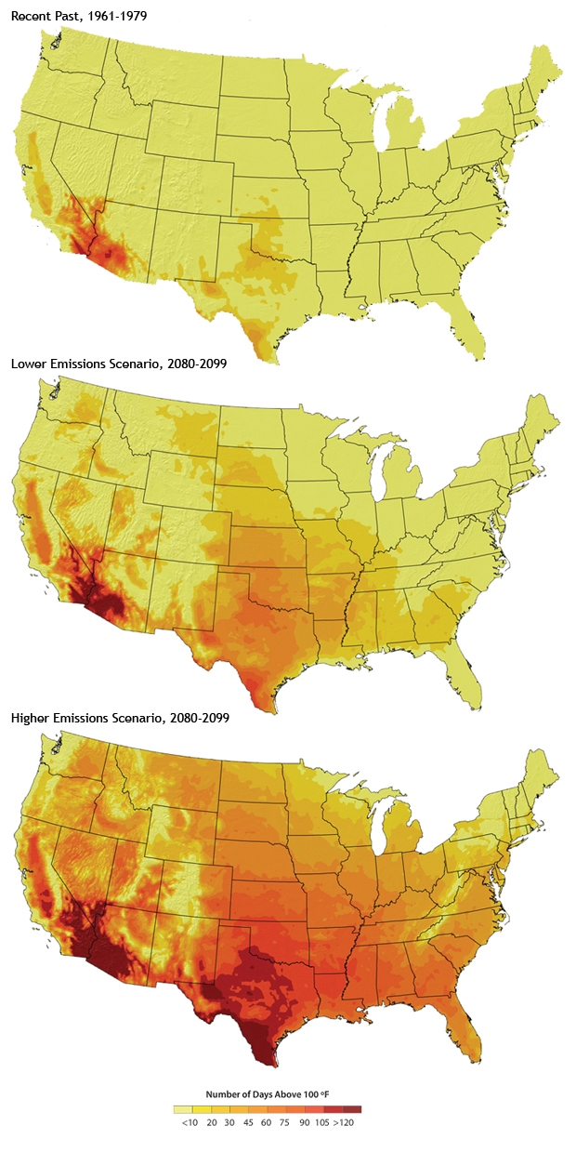
The Heat is On!
Increasing number of summer days over 100 degrees with climate warming

Slide 31
Climate Change Adaptation: Sheltering Plants from Heat
Shaded part of the day
Good mulch
Rocks
Protect from desiccating winds

Slide 32
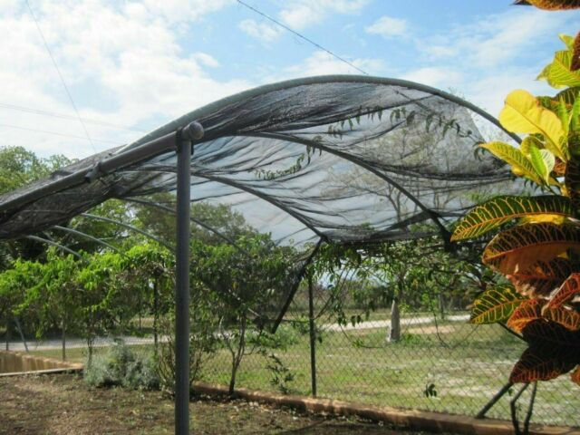
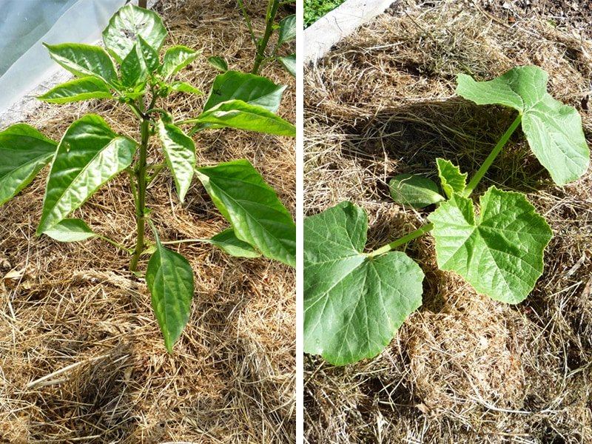
Recommended Gardener Response
Reflective (white/light color) mulch, will be cooler
Shaded side of wall, or shade cloth
Neighbor plant shading
https://learn.eartheasy.com/articles/how-to-protect-your-garden-during-a-heat-wave/

Slide 33
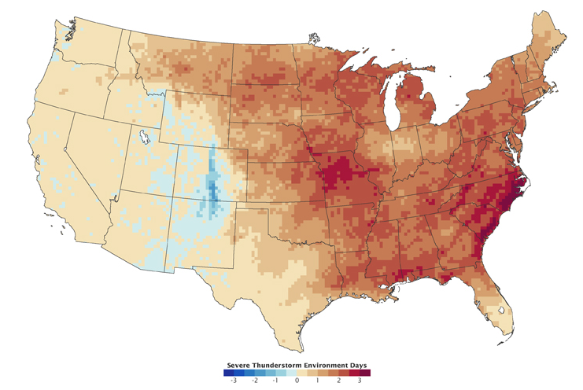
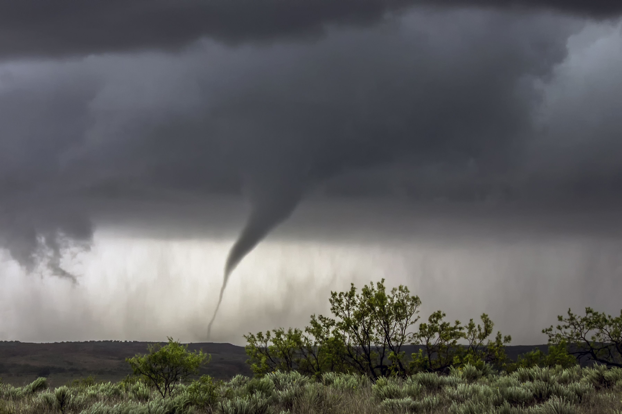
Increase in Severe Thunderstorm Days?
https://climate.nasa.gov/news/897/severe-thunderstorms-and-climate-change/

Slide 34
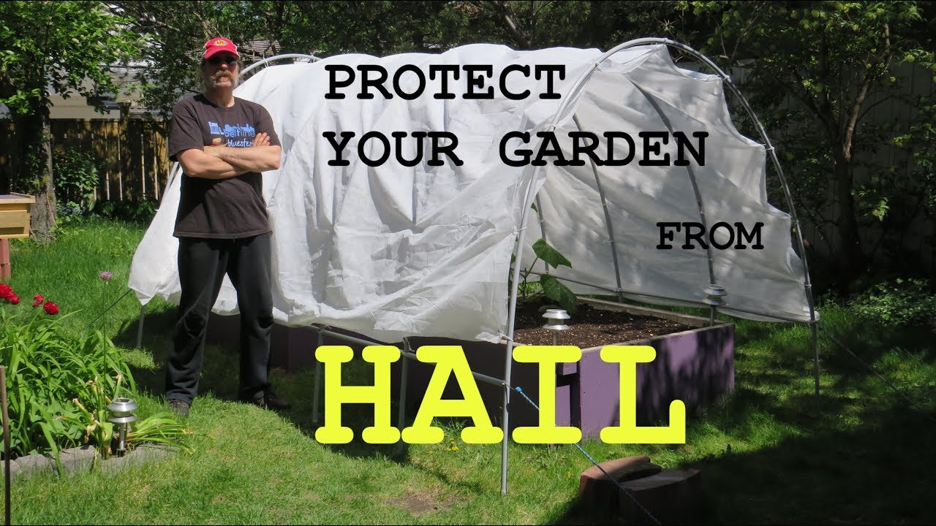
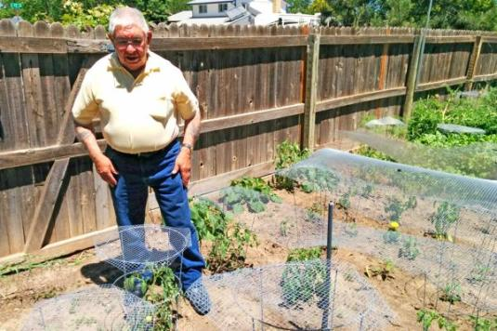
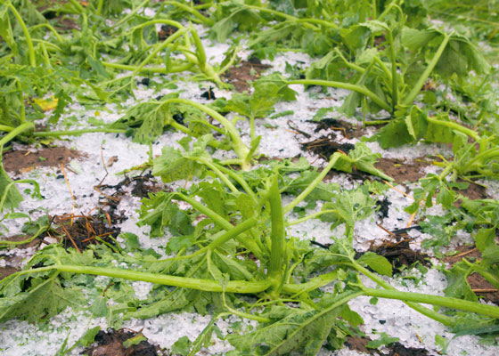
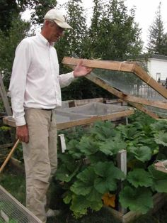

Slide 35
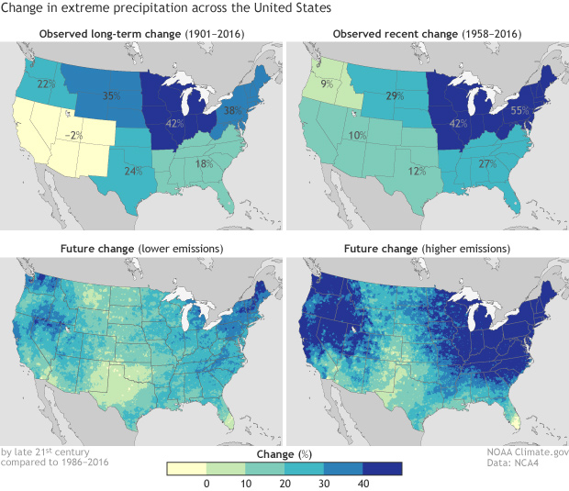
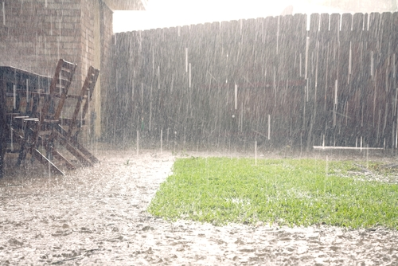
Increase in Heavy Rainfall?

Slide 36
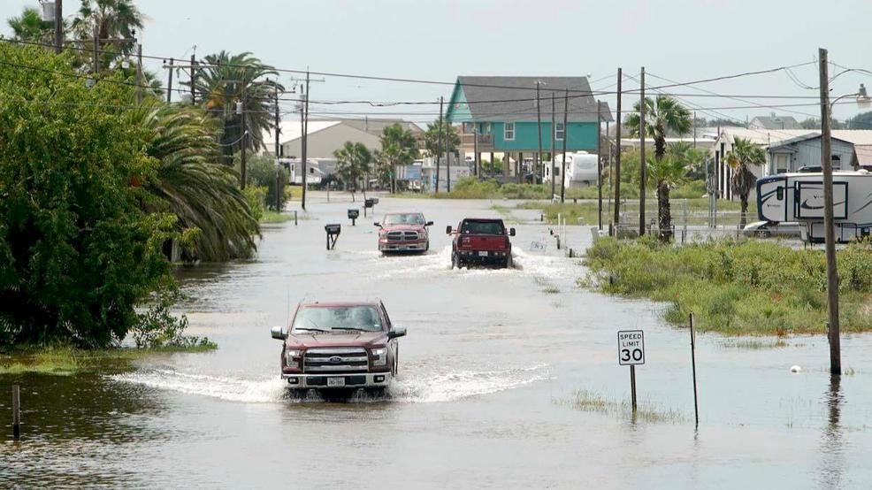
Managing Deluges
More frequent heavy rains are another outcome of climate change.
Gardeners will need to be able manage more rainfall on our properties. Heavy rain can damage soil structure, wash away topsoil and produce standing water.
You can protect your soil structure by mulching (yet another benefit of mulching.)

Slide 37
Gardening in West Texas & Climate Change: Bottom Line
“Higher temperatures and shifting precipitation patterns are causing plants to bloom earlier, creating unpredictable growing seasons.
Invasive, non-native plants and animals’ ranges are expanding.
Important connections between pollinators, breeding birds, insects, and other wildlife and the plants they depend on will be disrupted.
Pollinators such as hummingbirds and bees may arrive either too early or too late to feed on the flowers on which they normally rely.”
https://www.nwf.org/Our-Work/Environmental-Threats/Climate-Change/Greenhouse-Gases/Gardening-for-Climate-Change

Slide 38
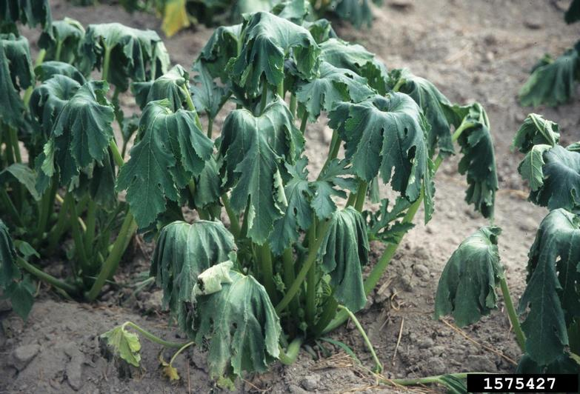
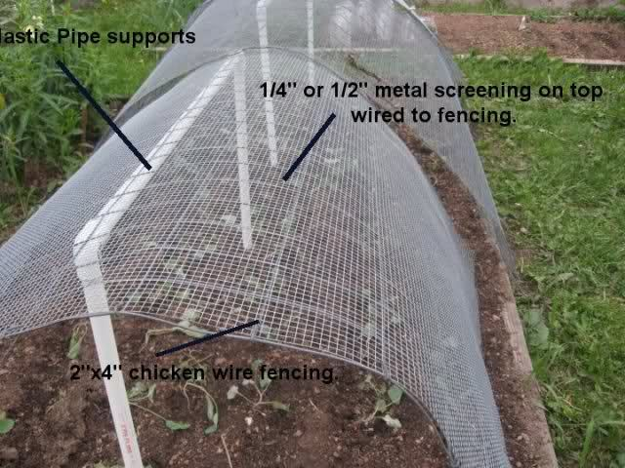
Gardening in West Texas & Climate Change: Bottom Line
Studies show any potential benefits from a longer growing season will be outmatched by a host of problems—from watering restrictions and damaging storms, to the expansion of unruly weeds and garden pests.
https://www.nwf.org/Our-Work/Environmental-Threats/Climate-Change/Greenhouse-Gases/Gardening-for-Climate-Change

Slide 39
Agroclimate Indicators
First fall frost (FFF)
Last spring frost (LSF)
Growing season (GSL) length
“Overall, we find that the observed changes in agroclimate, were beneficial for crop yields in the CONUS, albeit some crop and region specific exceptions.”
https://www.nature.com/articles/s41598-018-25212-2

Slide 40
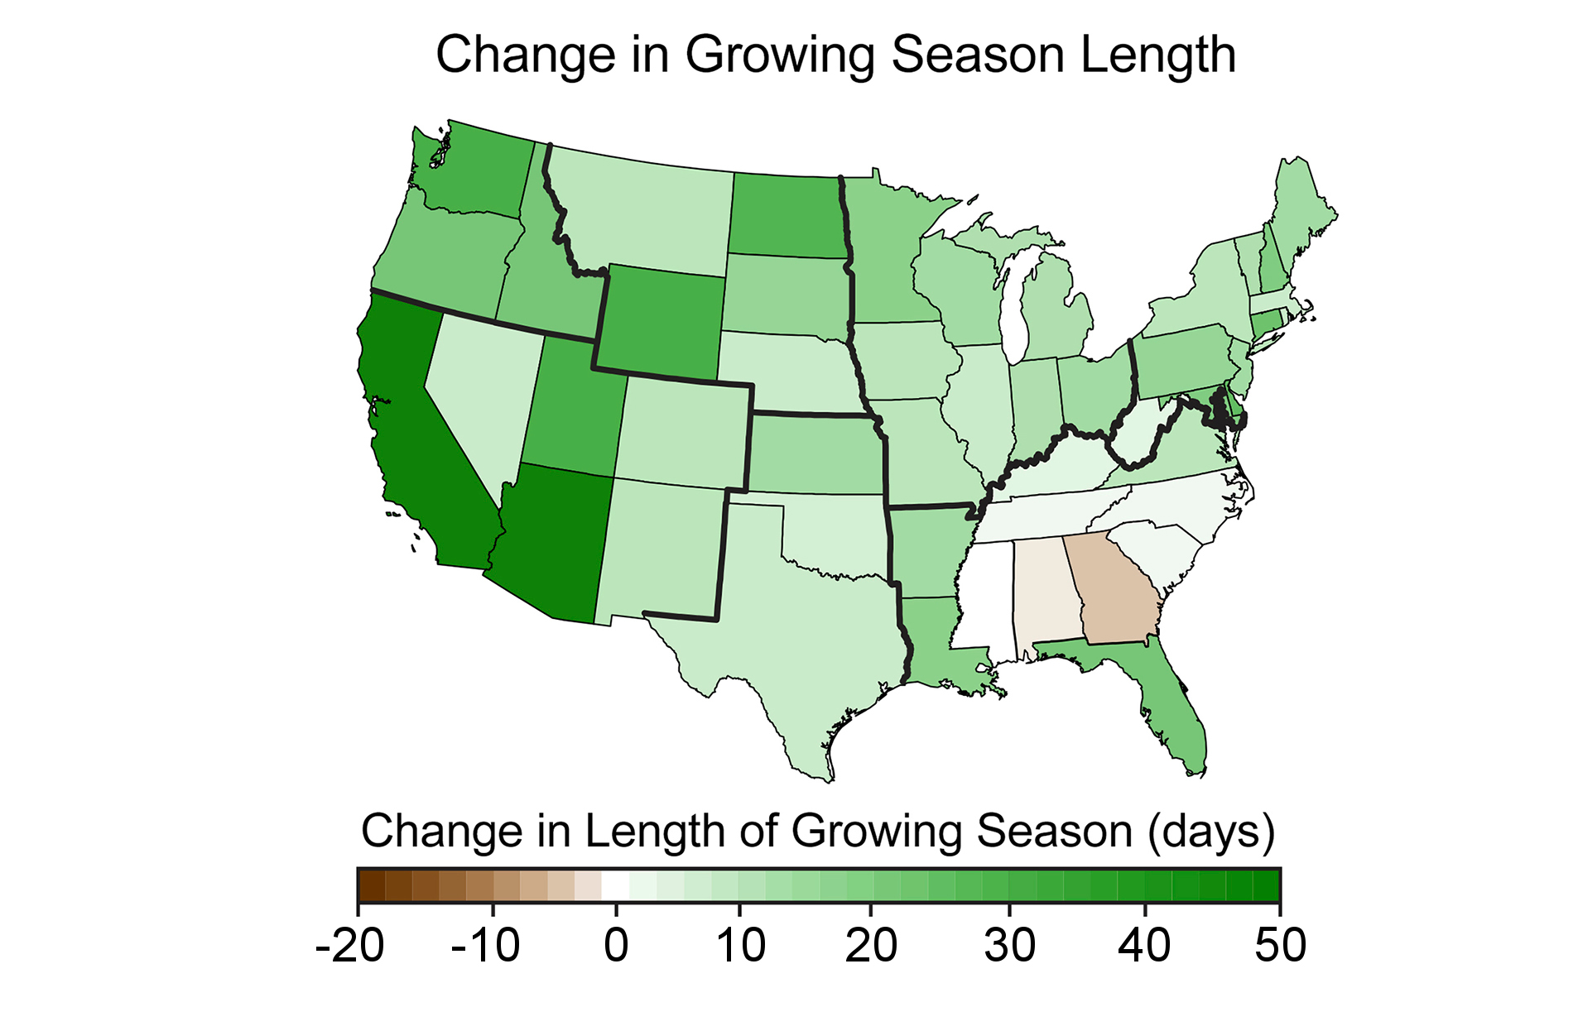
First Fall Frost 5+ days later
Last Spring Frost 5+ days earlier
Growing Season Length is getting longer

Slide 41
Plant Hardiness Zones
Plant Hardiness Zones are based on the lowest temperatures that can be expected each year for a given location.
These temperatures are referred to as average annual minimum temperatures, and they play a critical role in the ability of a plant to survive in a specific region.
https://www.howdogardener.com/439-2/plant-hardiness-zones

Slide 42


Slide 43


Slide 44


Slide 45

2040

Slide 46
It is Tough to Know What to Plant in The Future…
“Species recommendations are diﬃcult to make because large amounts of variability in response to stressors, such as extreme drought, reﬂects characteristics of the individual plants (e.g., age, size) and local site conditions (Fahey et al., 2013).”

Slide 47
Fruit Trees Example: Climate Change
Warmer winters are causing problems, by allowing more pests to survive.
Warmer springs also make fruit trees flower earlier, increasing the risk of the blossom being damaged by late frosts. Apple growers lost a quarter of their fruit in 2017.
The good news is that scientists are working on creating new breeds of trees to adapt to the changing climate.
However, new trees typically take two decades of methodical breeding to create, exposing existing varieties to the rapid climate changes

Slide 48


https://www.climatecentral.org/gallery/graphics/fruit-trees-need-winter-chill-for-spring-growth

Slide 49

Drought-tolerant plants for the Texas Panhandle
Drought-tolerant plants for the Texas Panhandle
“The Texas Panhandle is well known for being hot, dry, and prone to spring tornados. It is a beautiful part of the state, however, especially if you can keep your yard healthy through the oppressive summer heat and humidity. Give the following plants a try:”
Agave (most varieties)
Aster
Bluestem grass
Chrysanthemum
Columbines
Dianthus
English lavender
Evening primrose
Hollyhocks
Hyssop
Phlox
Prickly poppy
Sage
Zexmenia
Nandina
Wild indigo
Yarrow
https://www.bestpickreports.com/blog/post/drought-tolerant-plants-for-texas-yards/

Slide 50
Drought Tolerant Vegetable Varieties
Drought resistant vegetables are often those with short days to maturity.
Other options include the miniature varieties, bell peppers and eggplant for example. They need less water for development than their larger cousins.
Rhubarb (once mature) Swiss chard ‘Hopi Pink’ corn ‘Black Aztec’ corn Asparagus (once established) Sweet potato Jerusalem artichoke Green-striped cushaw squash ‘Iroquois’ cantaloupe Eggplant Mustard greens Okra Peppers Armenian cucumber Legumes (Chickpea Tepary bean Moth bean Cowpea (black-eyed pea) ‘Jackson Wonder’ lima bean)
Gardening Know How: Drought Resistant Vegetables: Growing Drought Tolerant Vegetables In Gardens https://www.gardeningknowhow.com/special/xeriscape/drought-resistant-vegetables.htm

Slide 51

Final Thoughts: Benefits of Gardens For Combating Climate Change
Moisture collection
Improved air circulation and cooling through plant transpiration and shading
Mitigate and adapt to the urban heat island effect
https://link.springer.com/chapter/10.1007/978-3-319-56091-5_14

Slide 52

Questions?
Photo by Rob Greebon Photography
https://texashighways.com/wildflowers/texas-wildflower-season/

