Slide 1
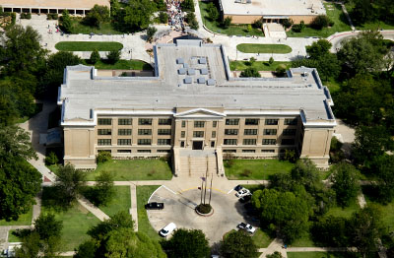
Graduate Seminar
ENVR 6111

Slide 2
Cut Unnecessary Words!
https://www.youtube.com/watch?v=91jo4kX7Cq0

Slide 3
Introduction
Purpose of introduction is to give reader essential information to understand why you did the study
Good introduction will “sell” the study to audience
Structure can be visualized as a funnel—general context narrow down to your study objective

Slide 4
Introduction
Ask yourself if you are happy with outline
First discuss general background
Outline what is known and still unknown about your topic area
Why study is needed and important

Slide 5
Introduction
Proceed to the problem statement of the paper—actual start of your storyline
Final paragraph of the introduction will attract readers attention

Slide 6
Introduction
End introduction by stating your research question and what you have done to answer this question
Use clear, clean language. Active voice. Use present tense for established facts (e.g., “low back pain is a common reason to consult physical therapists”)

Slide 8
Methods
Methods section is like the recipe that lists the needed ingredients of the study
Allows dish to be prepared again with the same result
Links the introduction to the results section

Slide 9
Methods
Basic elements:
Study design
Setting and data collection
Data analysis

Slide 11
Results
Presents a clear concise and objective description of study findings
Is mostly written in past tense
Findings presented without interpretation

Slide 12
Results
Mirror the results section. For every method that you did, there should be a corresponding result
Figures/Tables & descriptive text

Slide 14
Discussion
Purpose is to give the reader a summary of the main findings and put them in context by comparing with previous work and discussing future implications
Limitations/shortcomings/needed future work

Slide 15
Discussion
Start by presenting the main findings by answering the research question in the introduction (short 3 sentences)
Mention unexpected findings or weaknesses
Separate subsection on strengths and weaknesses of your study

Slide 16
Discussion
Write discussion by imagining yourself in a dialog with an interested reader
Anticipate reader questions and answer them
Formulate implications of your research (who cares?)

Slide 18
Chapter 1: Writing in Science
As a scientist, you are a professional writer.
Success as a scientist is not simply a function of the quality of the ideas we hold in our heads, or of the data we hold in our hands, but also of the language we use to describe them.

Slide 19
Chapter 1: Writing in Science
That last point may be the overriding principle that all the others in this book grow out of, so let me repeat it, louder. It is the author’s job to make the reader’s job easy.

Slide 20
Chapter 1: Writing in Science
Rewriting is the essence of writing. I pointed out the professional writers rewrite their sentences over and over and then rewrite what they have rewritten. William Zinsser, On Writing Well
The last word on rewriting comes from Anne Lamott, who addresses it with humor and insight:
“Shitty First Drafts. All good writers write them.
That is how they end up with good second draft s
and terrific third drafts.

Slide 21
https://www.elsevier.com/connect/infographic-tips-to-writing-better-science-papers

Slide 22
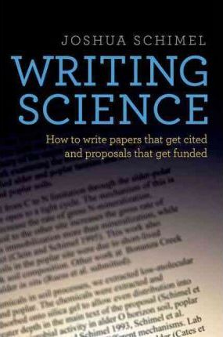
Writing Science: How to Write Papers That Get Cited and Proposals That Get Funded. Schimel, Joshua. Oxford University Press, USA, 2012. Online textbook (free to read online through WT University System). PDF will be accessible through the course page on WTClass.

Slide 23
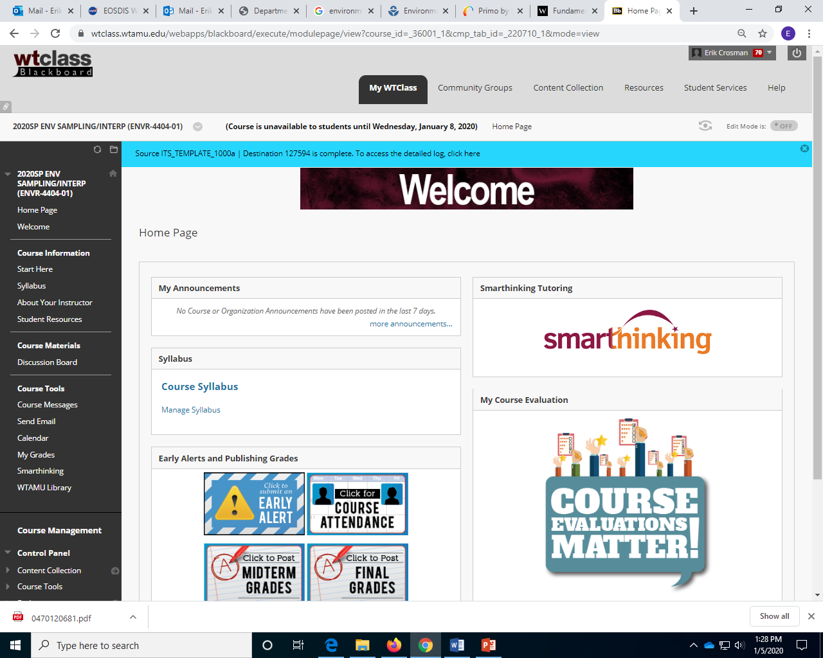
WTClass https://wtclass.wtamu.edu

Slide 24
Writing Science: How to Write Papers That Get Cited and Proposals That Get Funded. Schimel, Joshua. Oxford University Press, USA, 2012. Online textbook (free to read online through WT University System). PDF will be accessible through the course page on WTClass.

Slide 25
Chapter 1: Writing in Science
As a scientist, you are a professional writer.
Success as a scientist is not simply a function of the quality of the ideas we hold in our heads, or of the data we hold in our hands, but also of the language we use to describe them.

Slide 26
Chapter 1: Writing in Science
That last point may be the overriding principle that all the others in this book grow out of, so let me repeat it, louder. It is the author’s job to make the reader’s job easy.

Slide 27
Chapter 1: Writing in Science
Rewriting is the essence of writing. I pointed out the professional writers rewrite their sentences over and over and then rewrite what they have rewritten. William Zinsser, On Writing Well
The last word on rewriting comes from Anne Lamott, who addresses it with humor and insight:
“Shitty First Drafts. All good writers write them.
That is how they end up with good second draft s
and terrific third drafts.

Slide 28
Chapter 2 - Science Writing as Storytelling
Stories include more than result & methods -- they need introductions and discussions. Data without interpretation & perspective is not a story.
Scientists struggle for clarity
Scientists inherently don't see it as story telling
See the focus of your work (molecules, concepts, etc.) as characters: as we analyze "let them speak to us & develop the story" -- don't impose it on them -- listen to them! Data will never be the story. Readers seek insights --> understanding.

Slide 30
Chapter 2 - Science Writing as Storytelling
There are three aspects to effective storytelling.
The first is content — what makes a story engage and stay with us?
The second is structure— how do you put together that content to make it easy for us to get?
The third is language — how do you write the story in the most compelling way possible? This book is about these three issues.

Slide 31
Class Writing Storytelling Exercise
Pick one of the top 10 science stories of 2019
Identify what we think the key story points are.

Slide 32
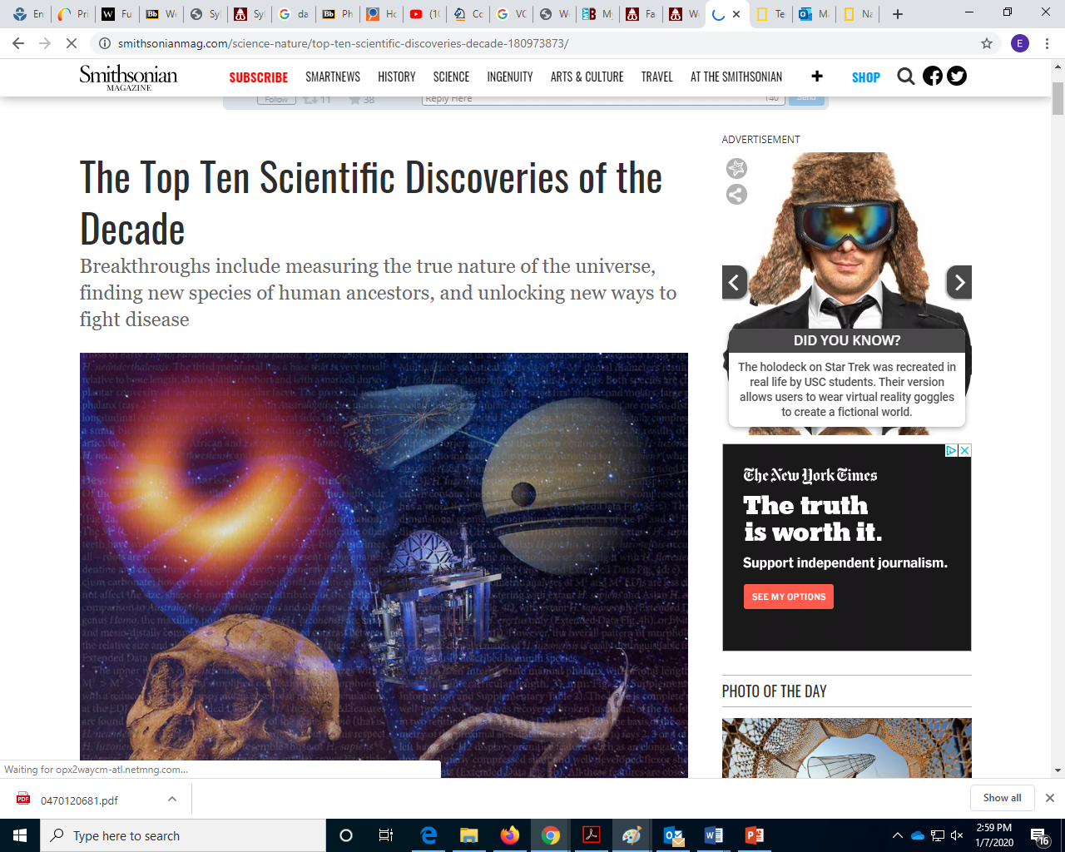

Slide 33
Write a short article
Step 1. Identify the Key Story Points for your Work. For each question, write a short paragraph — no more than two to three sentences. These identify the essential story elements.
1. What is your opening? This should identify the larger problem to which you are contributing, give readers a sense of the direction your paper is going, and make it clear why it is important. It should engage the widest audience practical.
2. What is your specific question or hypothesis?
3. What are the key results of your work? Identify these in a short list. There should be no more than two to three points.

Slide 34
Write a short article or abstract
Step 2. Write the Article. Write a short article describing your research. Your target audience is scientists who are not specialists in your discipline. You are trying to tell the story of your work and engage and educate your readers, not write a technical paper.
The tone can range between somewhat technical and more casual, but it must be something that technical readers would find interesting. Use your answers from step 1 to frame the story you write in this part of the exercise. The word limit is strict: 400 words.

Slide 35
Write a short article or abstract
Step 3. Analyze your writing. Circulate your articles among your writers’ group (a group of three to four people seems ideal for this). Analyze and edit each other’s work. Then discuss the articles. Ask and answer the questions listed on handout.

Slide 36
Write a short article or abstract
Step 4: What is your main conclusion? What did you learn about nature? This should use the results from section 3 to answer the question from 2, and should address the larger problem identified in 1.

Slide 37
Ch. 3 - Making a Story Sticky

Slide 38
Video
https://youtu.be/q3mrRH2aS98

Slide 39
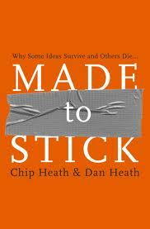

Slide 40
Ch. 3 - Making a Story Sticky
Simple
Main idea expressed in clear / compact manner. At the same time be mindful of "simplistic" as an enemy. As Albert Einstein would say: "Simple as possible but not simpler". The art, science, and struggle for SIMPLIFICATION cannot be overstated. It distinguishes good from great.
Process of simplification...
Words & equations ....
Cartoons -- YES. [ I agree 100% ]
Be aware of schemas -- pre-existing ideas we bring to new ideas Leverage them. Know what schemas your audience holds

Slide 41
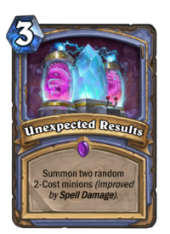
Ch. 3 - Making a Story Sticky
Unexpected
New and unexpected make stories memorable. Origin = questions posed and interpretations shared.
Your job -- find what is novel, highlight it, and frame new questions. identify the unknown INSIDE the mass of pre-existing data.
"identify ignorance in the midst of knowledge" Facts first, outcomes first - no. Set the stage with good questions.

Slide 42
Ch. 3 - Making a Story Sticky
Concrete
Tangible, real.
Strunk and White -- in the end seek to be specific, definite, and concrete
Specific - narrow the field
Definite - don't equivocate, say what is good or clear & what is not so good and clear.
Concrete - enable the reader to visualize, feel, smell, taste, your work.

Slide 43
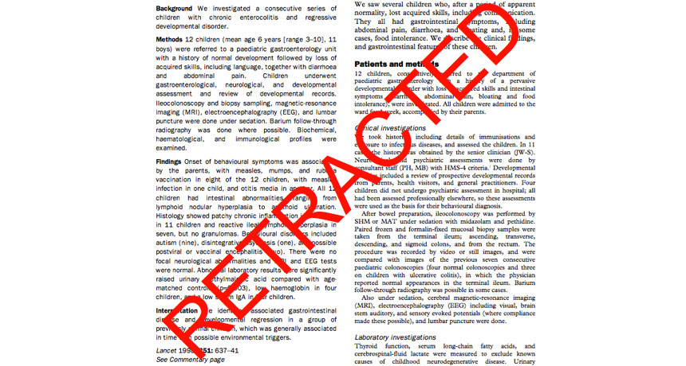
Ch. 3 - Making a Story Sticky
Credible
Direct assume the reader is skeptical
Ideas are grounded by previous work Data is grounded with our methds, presentation clarity, and well-accepted statist

Slide 44
Ch. 3 - Making a Story Sticky
Emotional
Curiosity is well accepted emotion, show it. Adding information reflects our inner nerd, the join of accumulating information. Change the mindset of "what information can I share" to "what insights or new knowledge can I share" Move from answers/answers/answers focus to a question/question/ answer. The 2nd well-accepted emotion - excitement, find ways to build that excitement in your readers.

Slide 45
Video
https://www.coursera.org/lecture/wharton-contagious-viral-marketing/emotional-stories-lhQE5

Slide 46
Ch. 3 - Making a Story Sticky
Stories
Modules of tales good paper = single large story built from threads of smaller stories. Integration of the threads is key. seek UNITS - subsections of your work that can parceled out as coherent modules MAKE the READERS JOB EASIER -- these modules will improve assimilation.

Slide 47
Ch. 3 - Making a Story Sticky
Find the simple story. build it around key questions that engage U and E and this will guide your choices to ensure its C and C.

Slide 48
For Next Week
Read Chapter 4
Look at Dr. Hiranuma content (public speaking starts the week after next)

