Slide 1
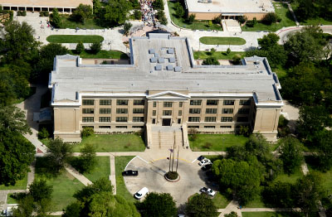
Graduate Seminar
ENVR 6111

Slide 2
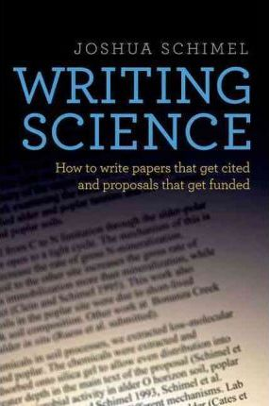
Writing Science: How to Write Papers That Get Cited and Proposals That Get Funded. Schimel, Joshua. Oxford University Press, USA, 2012. Online textbook (free to read online through WT University System). PDF will be accessible through the course page on WTClass.

Slide 3
Chapter 4 – Story Structure
Basic Science Elements = OCAR,
Opening - Challenge - Action - Resolution

Slide 4
Chapter 4 – Story Structure
Basic Science Elements = OCAR,
Opening - Challenge - Action - Resolution

Slide 6
Chapter 4: Story structures
These slides were prepared by Sylvie Noël with minor modifications for CS by D. Avis
https://www.slideshare.net/SylvieNol

Slide 7
From
Writing Science: How to Write Papers That Get Cited and Proposals That Get Funded, Joshua Schimel, 2011

Slide 8
The elements of a story’s structure
Opening (O)
Challenge (C)
Action (A)
Resolution (R)

Slide 9
Hourglass structure

Slide 10
Opening
Who are the characters, including the main character the story is about?
Where does the story take place?
What do you need to understand to follow the story?
What is the larger problem being addressed?

Slide 11
Challenge
What are your characters trying to accomplish?
What specific question are you trying to answer?

Slide 12
Action
What happens to address the challenge?
What work did you do or are proposing to do (for a proposal)?

Slide 13
Resolution
Extremely important
Show how your work has changed our understanding of the world
Map back your resolution to your opening
It must say something about the larger problem you identified there
Your conclusion should address a topic as wide as your opening

Slide 14
Hourglass structure

Slide 15
Four core story structures
OCAR
Slowest, takes time to work into the story
ABDCE
Faster, starts in the action
LD
Faster yet
LDR
Fastest with the whole story up front

Slide 16
OCAR
Opening –Challenge – Action – Resolution
Typical of science papers
Challenge is at the end of the introduction
Resolution comes at the conclusion

Slide 17
ABDCE
Action
Starts with dramatic action to immediately engage readers
Background
Describe characters and setting so that readers can understand the story
Development
Follow the action as the story develops to the climax

Slide 18
ABDCE
Climax
Bring all the threads of the story together and address them
Ending
Same as resolution: what happened to the characters after the climax?
Typical of modern fiction and scientific proposals

Slide 19
A good story is circular
Typical of OCAR and ABDCE structures
By the end, we are back at the beginning
But things have changed, and we need to highlight how they have changed

Slide 20
LD
Lead/Development or the inverted pyramid of news stories
Core of the story is in the first sentence (lead)
Rest of the story fills out the story (development)
In LD, the lead collapses opening, challenge and resolution into a single short section (as short as a sentence).

Slide 21
LDR
Lead/Development and Resolution
Typical of magazine articles
The lead must be engaging, but the resolution is left for the end, to entice the reader to go to the end

Slide 22
Story structure in science writing
Scientific paper: OCAR
O: opening is larger problem and central “characters”
C: challenge is interesting question
A: action is research plan and results
R: resolution is conclusion about how our understanding about the world has changed as a result of the work

Slide 23
Story structure in science writing
Generalist journals (Nature, Science): LDR
Editors are professionals, not scientists
Structure should be similar to other magazines
Start with a strong lead to interest the editors

Slide 24
Story structure in science writing
Proposals: LDR or ABDCE
Your proposal must convince reviewers that the topic identified in the opening is important
It must fill them with excitement at the questions posed in the challenge
If it has not done so within the first two pages, you will lose your audience and not get funded

