Slide 1
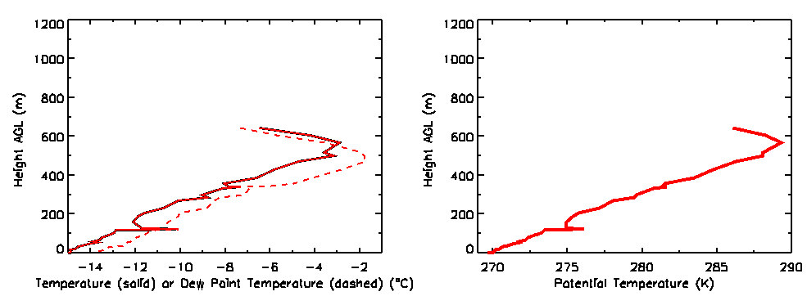

11
Wednesday January 23rd 1800 UTC

Slide 2
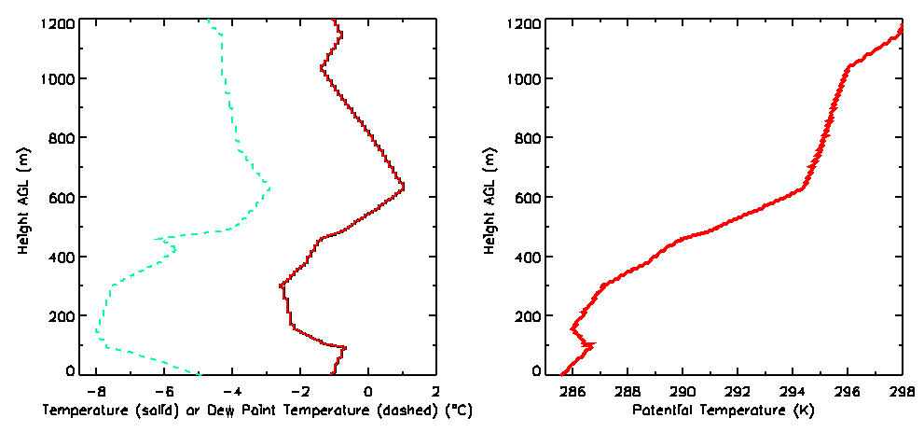

Saturday January 26th 1800 UTC

