Slide 1
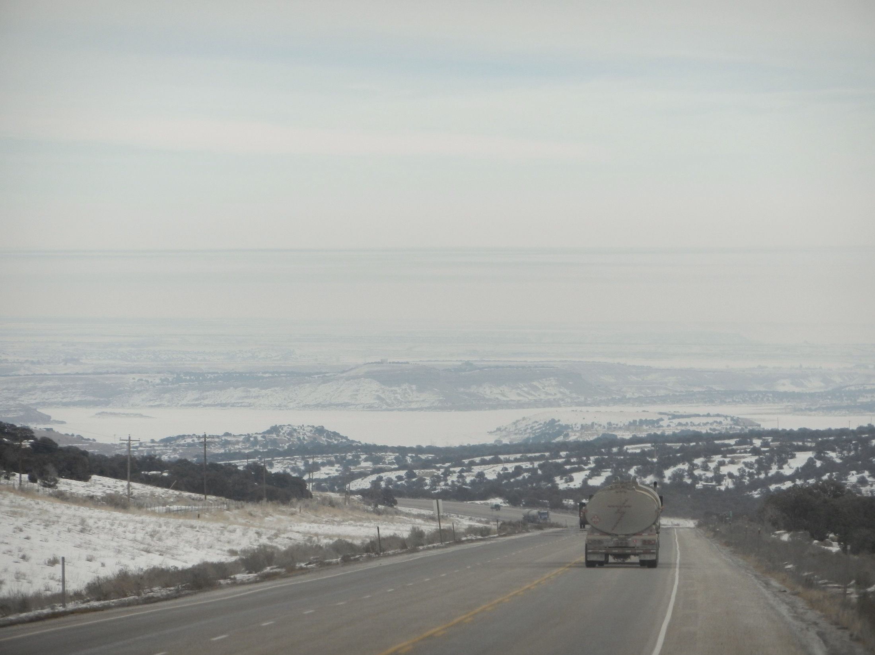
Characterizing the Boundary-Layer During the Uintah Basin Ozone Study
John Horel
Erik Crosman, Matt Lammers, Alex Jacques, Nola Lucke, John Lawson, Maggie Schoonover, Erik Neemann and Joe Young
University of Utah
Department of Atmospheric Sciences

Slide 2
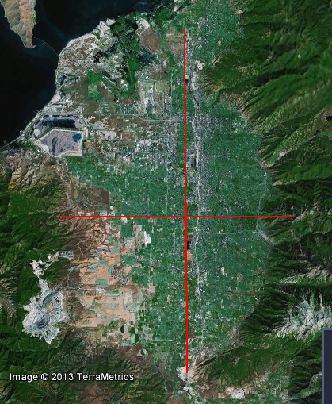
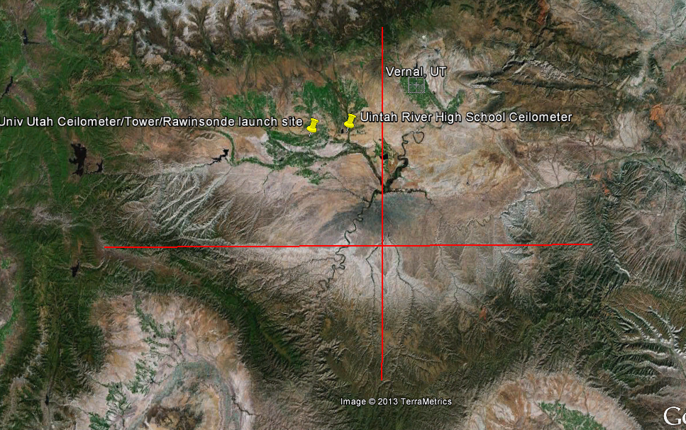
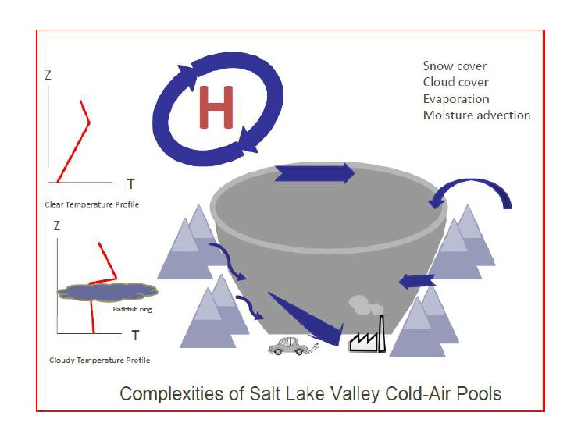
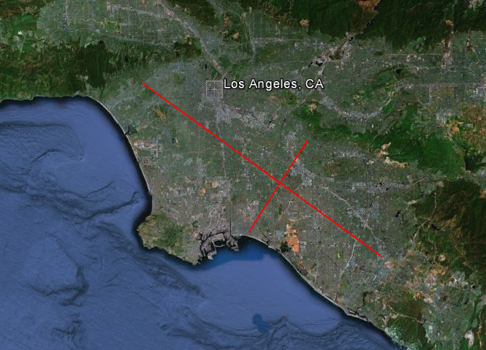
New territory: If the SL Basin is a ‘tea cup’ then the Uintah Basin is ‘large kettle’
SALT LAKE ‘BASIN’
UINTAH BASIN
20 km
45 km
200 km
140 km
LOS ANGELES BASIN
‘Tea Cup’ Model
65 km
20 km

Slide 3
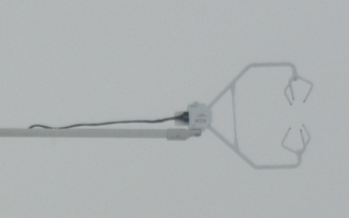
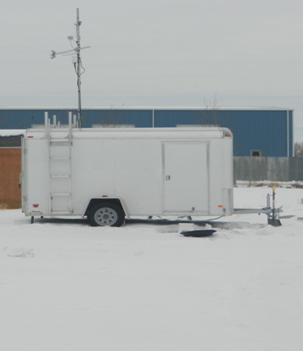
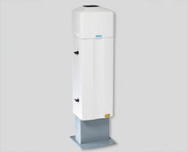
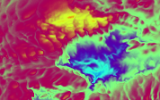
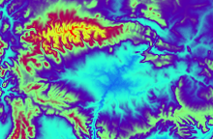
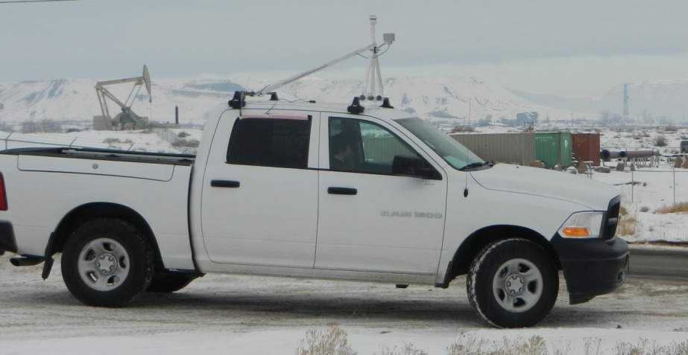
Characterizing the Boundary Layer During UBOS
CS Sonic Anemometer
Boundary-layer height and the vertical structure profiles
(2 ceilometers, rawinsondes)
Near-surface turbulence (sonic anemometer)
Spatial variations in BL
(WRF model simulations, MesoWest, UU2DVAR, mobile ozone and met obs)
Viasala CL31 ceilometer
WRF near-surface temp (left) and terrain (right) 12 UTC Feb 13 2011
Mobile Ozone/Met

Slide 4
University of Utah Observations
Roosevelt South (Ceilometer; Sonic Anememeter and met station; periodic rawinsonde
Fort Duschesne Uintah River High School (Ceilometer; periodic rawinsonde
Mobile ozone and met (various transects throughout basin)

Slide 5
(Very) Preliminary Observations from 14-28 January Uintah Basin Cold Air Pool
Laser ceilometer profiles
1800 UTC Jan 26 Rawinsonde
23 and 25 Jan mobile ozone/met

Slide 6
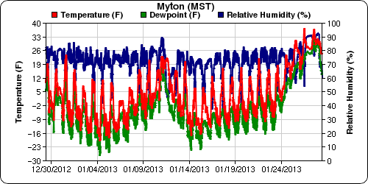
Cold Air Pool Boundary-Layer Evolution
Phase 2
Phase 1
Phase 1: 15-23 Jan: Persistent cold air pool in place in basin with only slight warming of boundary layer through period.
Phase 2: 23-28 Jan: Dramatic warming of the boundary layer while temperature inversion remains intact (due to clouds and infrared radiative warming of boundary-layer, differential warming aloft, precipitation). End of cold air pool with frontal passage on Jan 28th.

Slide 7
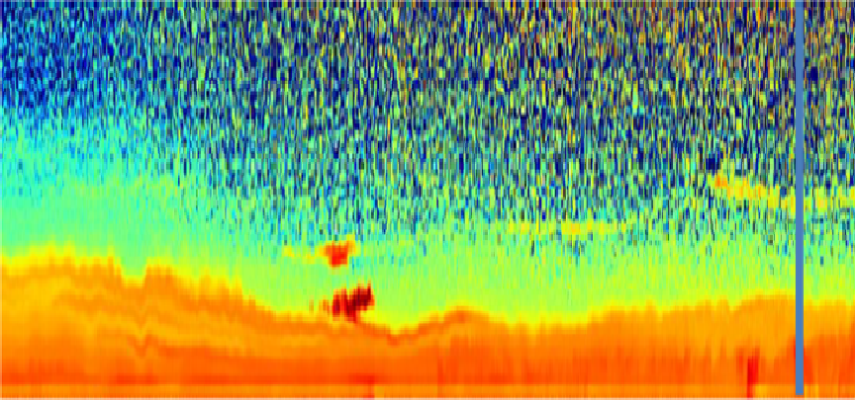
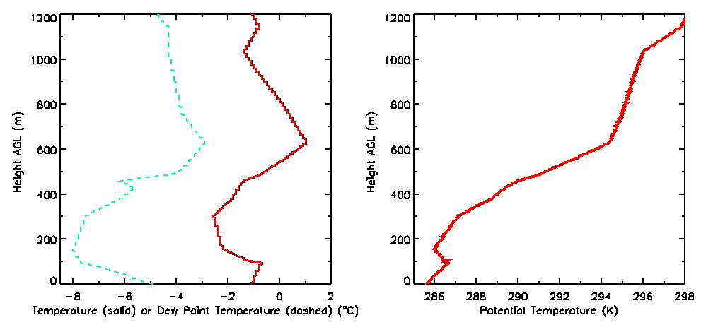
1000 m
Viasala Ceilometer Backscatter
(Red high backscatter)
500 m
Waves and
Changes in height of primary polluted layer
0 m
6 am MST 26 Jan
9 am MST
11 am MST
26 Jan 11 am MST Rawinsonde
‘Layering’ in aerosol backscatter
corresponds to distinct temperature
layers in the boundary layer
Saturday January 26th 1800 UTC

Slide 8
Boundary-Layer Evolution Noon-6 pm
20 Jan 2013
24 Jan 2013
Top 200 m of inversion less polluted on 24 Jan than on 20 Jan
Concentrated surface layer 150 m deeper on 24 Jan than on 20 Jan

Slide 9
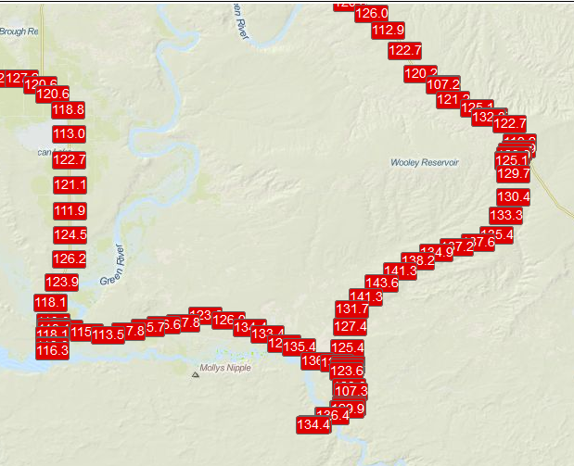
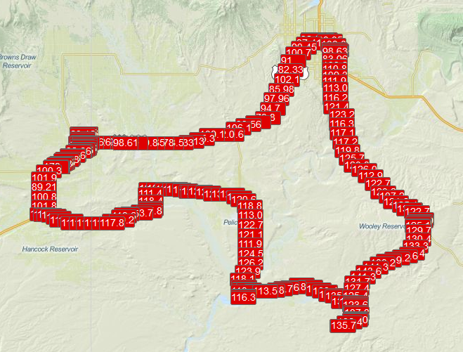
Mobile Ozone/Met Observations 25 January
Ozone (ppb)
Temp (⁰C)
ozone high ~145 ppb
ozone low ~80 ppb

Slide 10
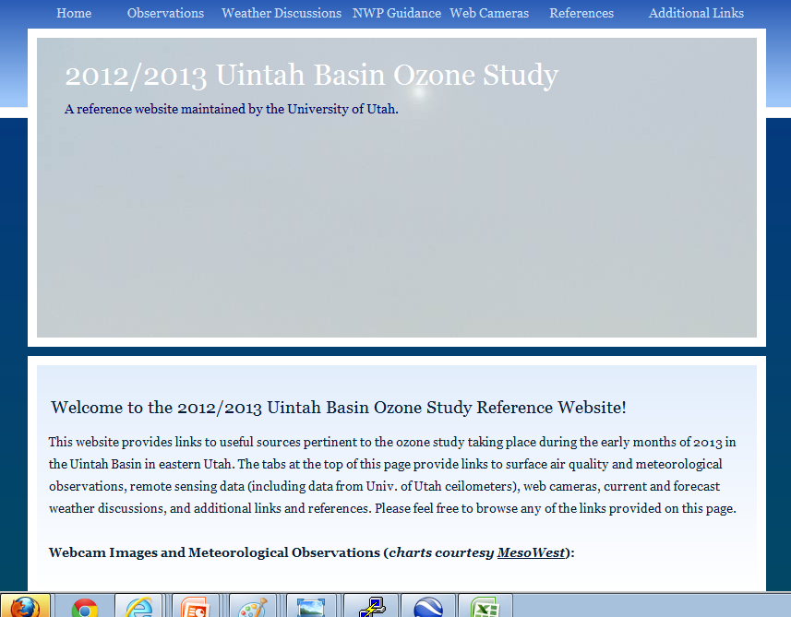
UU UBOS Webpage:
http://home.chpc.utah.edu/~u0198116/uintahbasin.html
Ceilometers/Sonic Anemometer/Rawinsonde/mobile data available under ‘observations’

