Slide 1
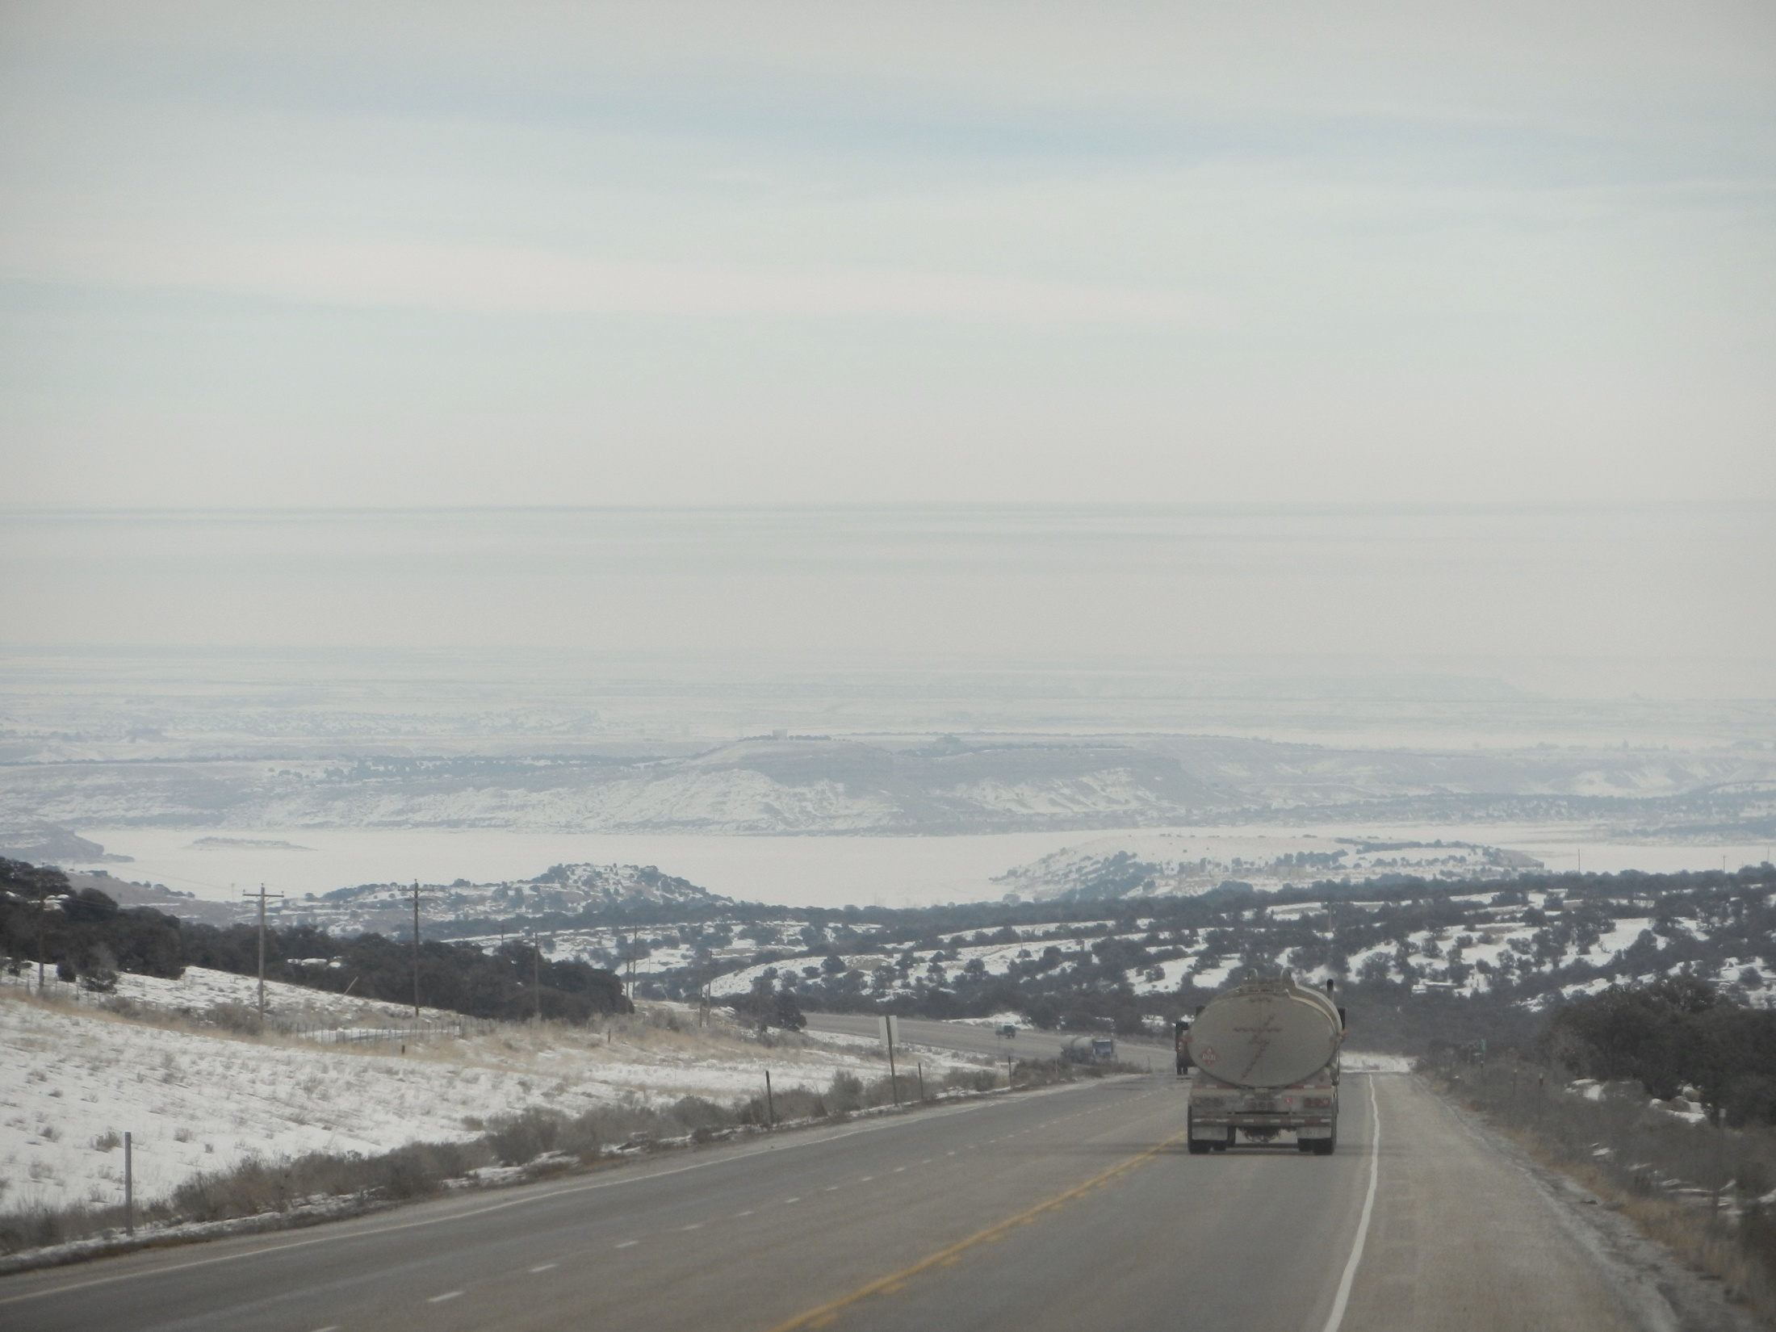
Characterizing the Boundary-Layer During the Uintah Basin Ozone Study
Erik Crosman
John Horel
Others: Matt Lammers, Alex Jacques, Nola Lucke, John Lawson, Maggie Schoonover, Erik Neemann, Joe Young
University of Utah
Department of Atmospheric Sciences

Slide 2
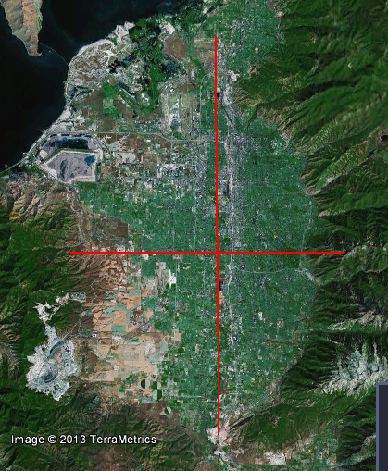
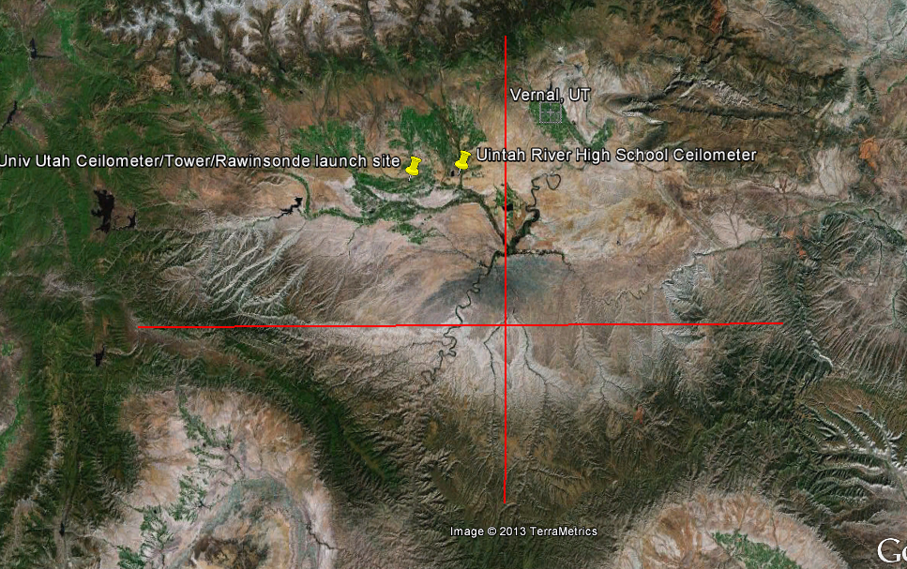
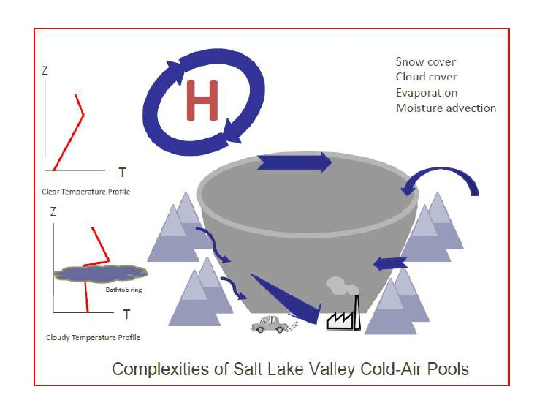
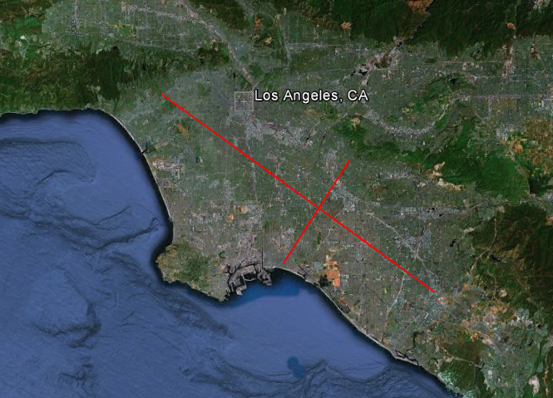
New territory: If SL Basin is a ‘tea cup’ then Uintah Basin is a ‘large kettle’
SALT LAKE ‘BASIN’
UINTAH BASIN
20 km
45 km
200 km
140 km
LOS ANGELES BASIN
‘Tea Cup’ Model
65 km
20 km
Lareau et al. (Jan 2013 BAMS)

Slide 3
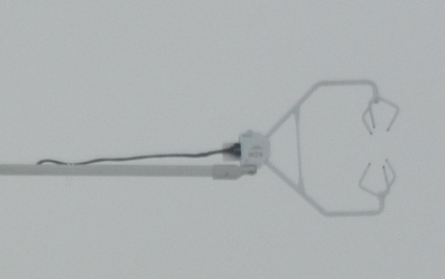
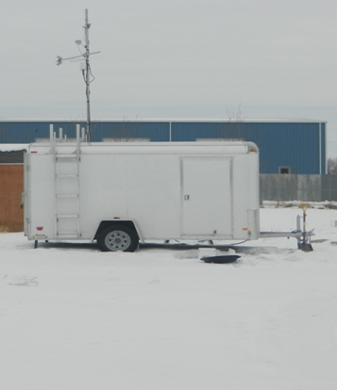
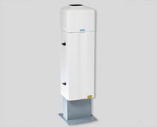
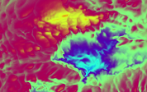
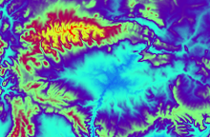
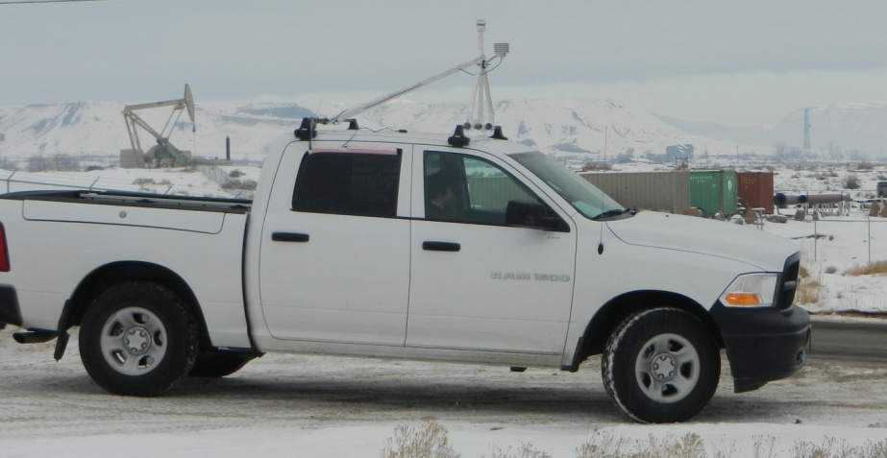
Characterizing the Boundary Layer During UBOS
CS Sonic Anemometer
Boundary-layer height and vertical profiles
(ceilometers, rawinsondes)
Near-surface turbulence (sonic anemometer)
Spatial variations in BL
(WRF model simulations, MesoWest, UU2DVAR, mobile ozone and met obs)
Viasala CL31 ceilometer
WRF near-surface temp (left) and terrain (right) 12 UTC Feb 13 2011
Mobile Ozone/Met

Slide 4
(Very) Preliminary Observations from 14-28 January Uintah Basin Cold Air Pool
Laser ceilometer profiles
1800 UTC Jan 26 Rawinsonde
25 Jan mobile ozone/met

Slide 5
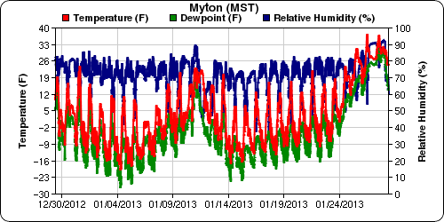
Cold Air Pool Boundary-Layer Evolution
Phase 1
Phase 2
Phase 1: 15-23 Jan: Persistent cold air pool in place in basin with only slight warming of boundary layer through period
Phase 2: 23-28 Jan: Dramatic warming of boundary layer while temperature inversion remains intact (due to clouds and infrared radiative warming of boundary-layer, differential warming aloft, precipitation late)
End of cold air pool with frontal passage on Jan 28th

Slide 6
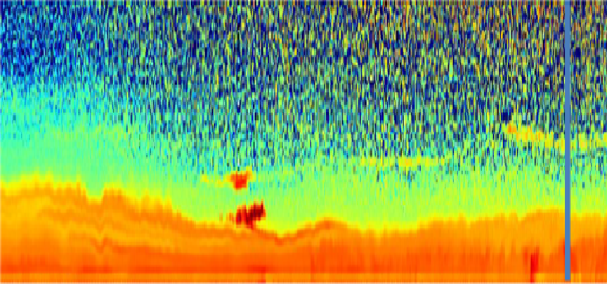
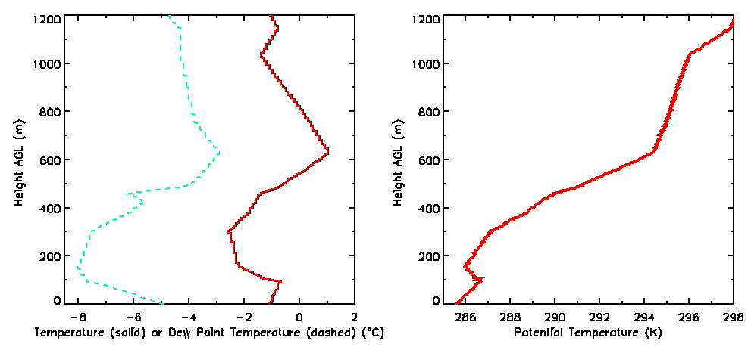
1000 m
Viasala Ceilometer Backscatter
(Orange/Red high backscatter)
500 m
Waves & changes in height of primary aerosol layer
0 m
6 am MST 26 Jan
9 am MST
11 am MST
26 Jan 11 am MST Rawinsonde
‘Layering’ in aerosol backscatter
corresponds to distinct temperature
layers in the boundary layer
Saturday January 26th 1800 UTC

Slide 7
Contrasting Boundary Layers Noon-6 pm
1000 m
500 m
0 m AGL
Phase 1: 19 Jan 2013.
High aerosol concentrations in shallow layer with thin aerosol layers above
1000 m
500 m
0 m AGL
24 Jan 2013
Phase 2: 25 Jan 2013.
Higher aerosol concentrations in deeper layer with clouds above

Slide 8
Mobile Ozone/Met Observations 25 January http://home.chpc.utah.edu/~u0732636/Mobile_Viewer/mapUBOSO3.html
Ozone (ppb)
Mobile consistent with measurements at fixed sites
Interactive display
Vernal
Roosevelt
Horsepool
nr Horsepool
Myton
Vernal
Roosevelt

Slide 9
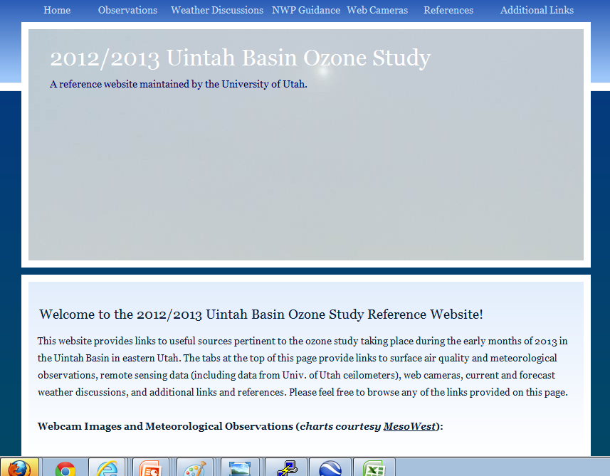
UU UBOS Webpage:
http://home.chpc.utah.edu/~u0198116/uintahbasin.html
Ceilometers/Sonic Anemometer/Rawinsonde/mobile data
available under ‘observations’

