Slide 1
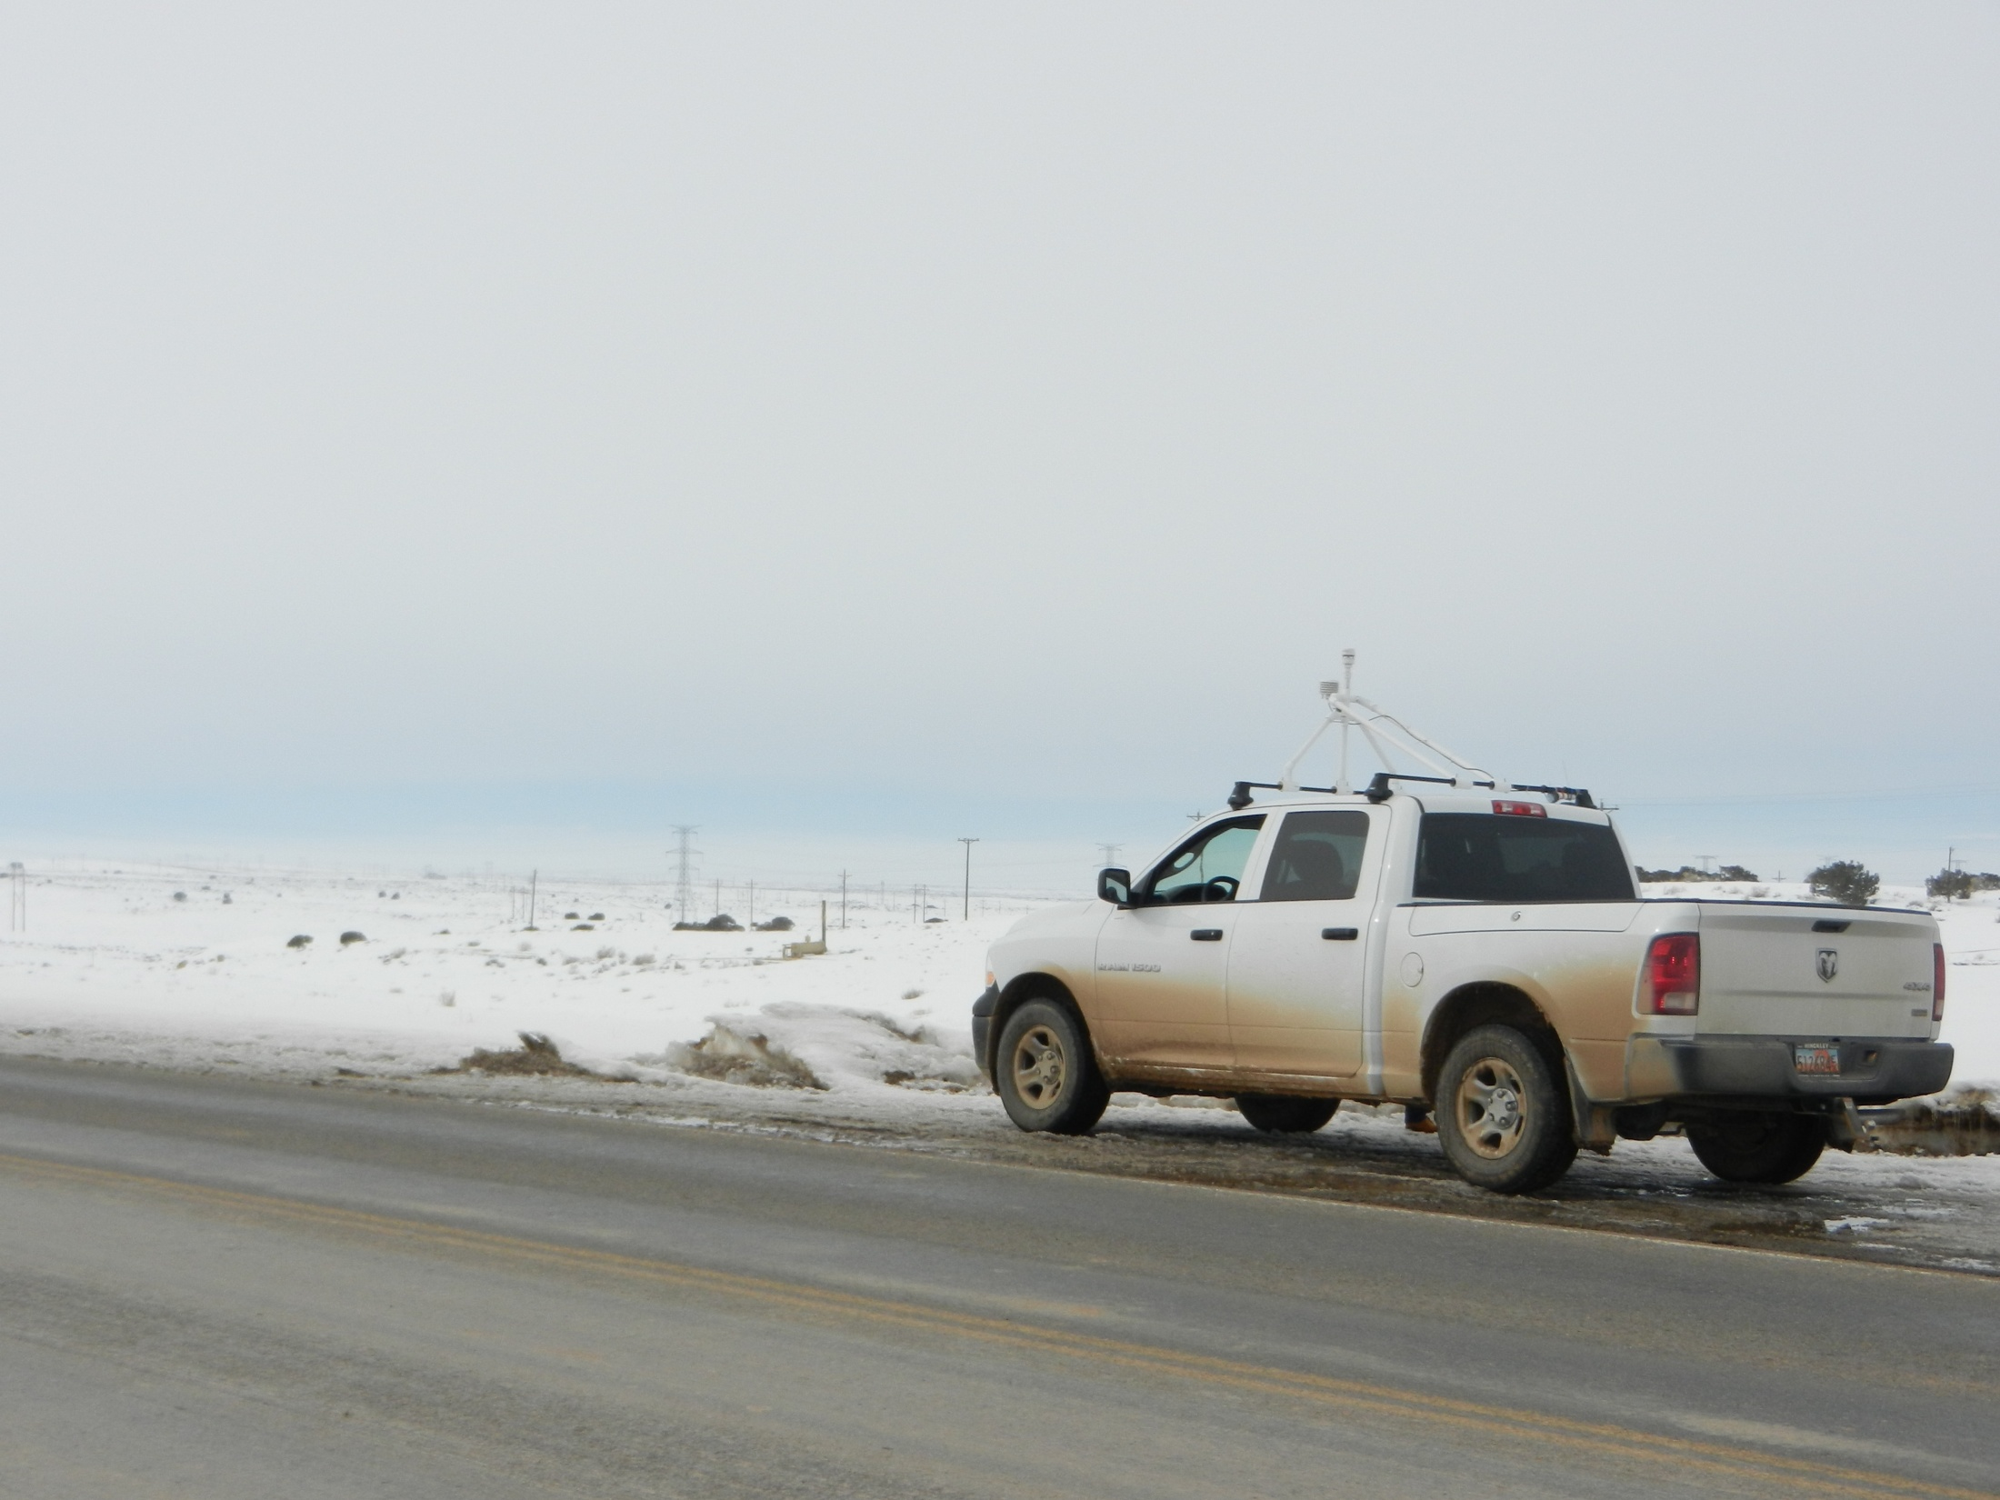


Meteorological Overview of 1-10 February 2013 Cold Air Pool
Erik Crosman
John Horel
Others: Matt Lammers, Alex Jacques, Nola Lucke, John Lawson, Maggie Schoonover, Erik Neemann, Joe Young
University of Utah
Department of Atmospheric Sciences

Slide 2
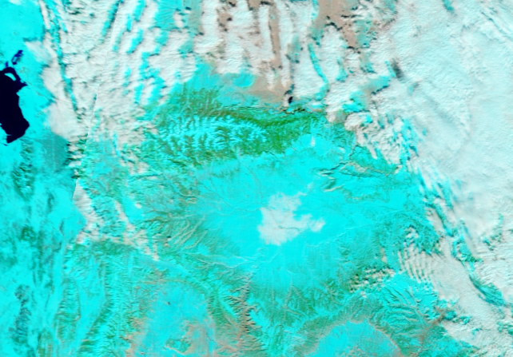
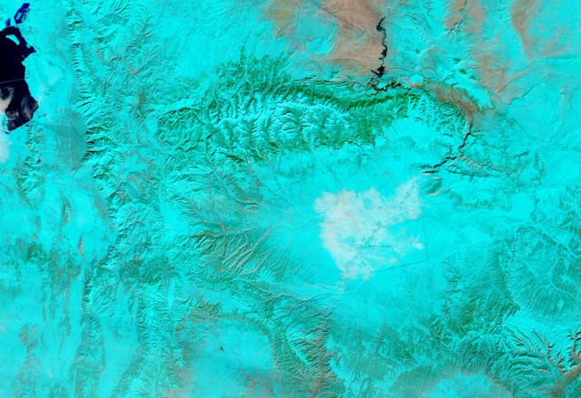
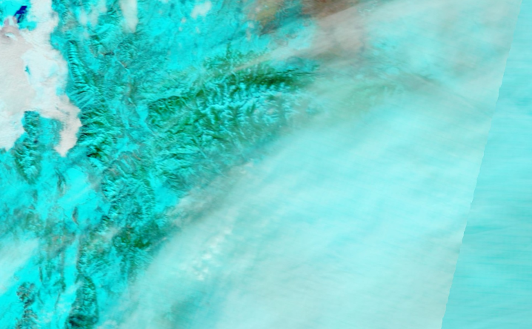
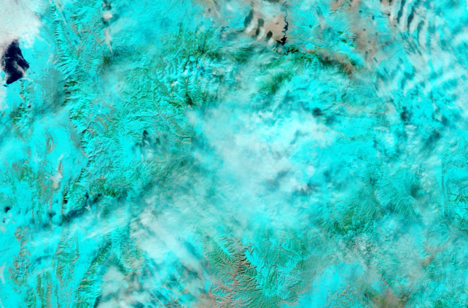
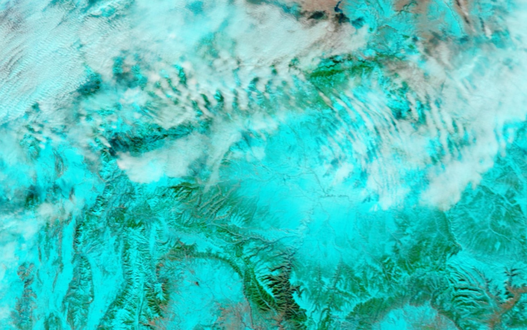
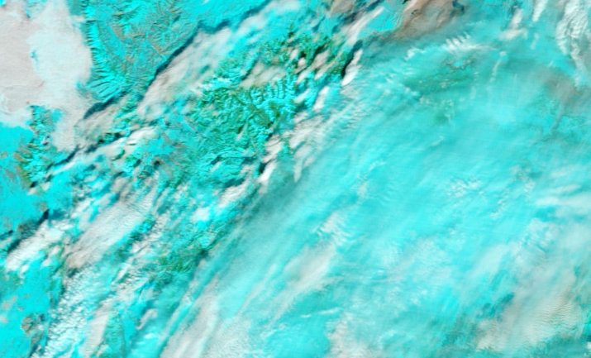
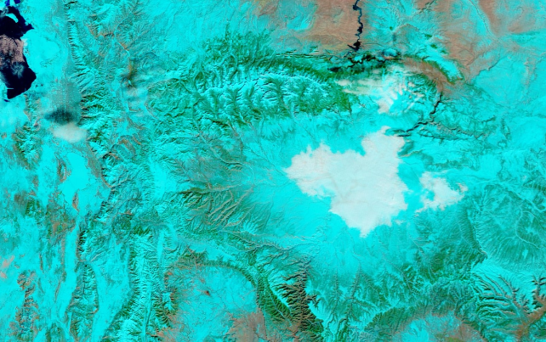
1 Feb
2 Feb
3 Feb
4 Feb
5 Feb
6 Feb
Mostly clear skies outside of patchy low clouds and fog on
1 and 2 February gave way to variable mid and high clouds 3-6
February. Clearing aloft on 7 February was noted but the
most persistent low cloud deck of entire period was noted in
basin.
7 Feb

Slide 3
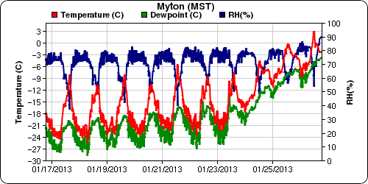
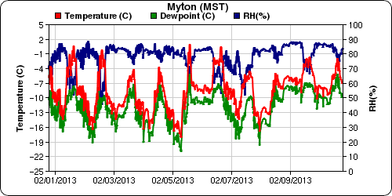
A Tale of Two Inversions
Cold air pool 1: 14-28 January 2013
Very cold air in place at start
Temperatures slowly warm over
event
Cold air pool 2: 1-10 February 2013
Not as cold at start
Mean temperatures cool through
February 5th, then fluctuate through
the rest of the event.

Slide 4
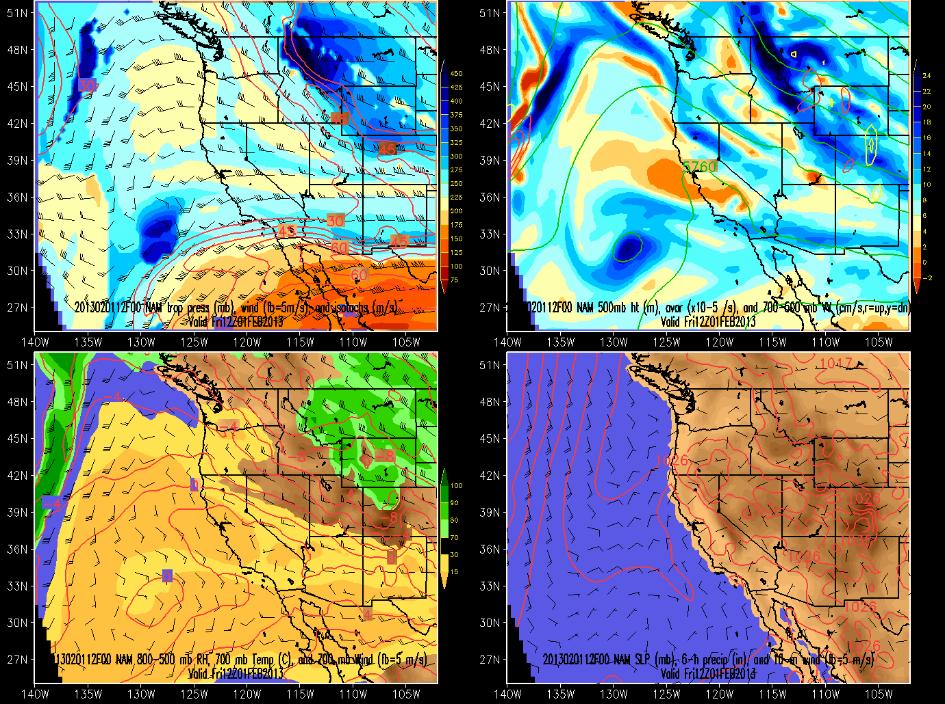
1 February 12 UTC NAM Analysis

Slide 5
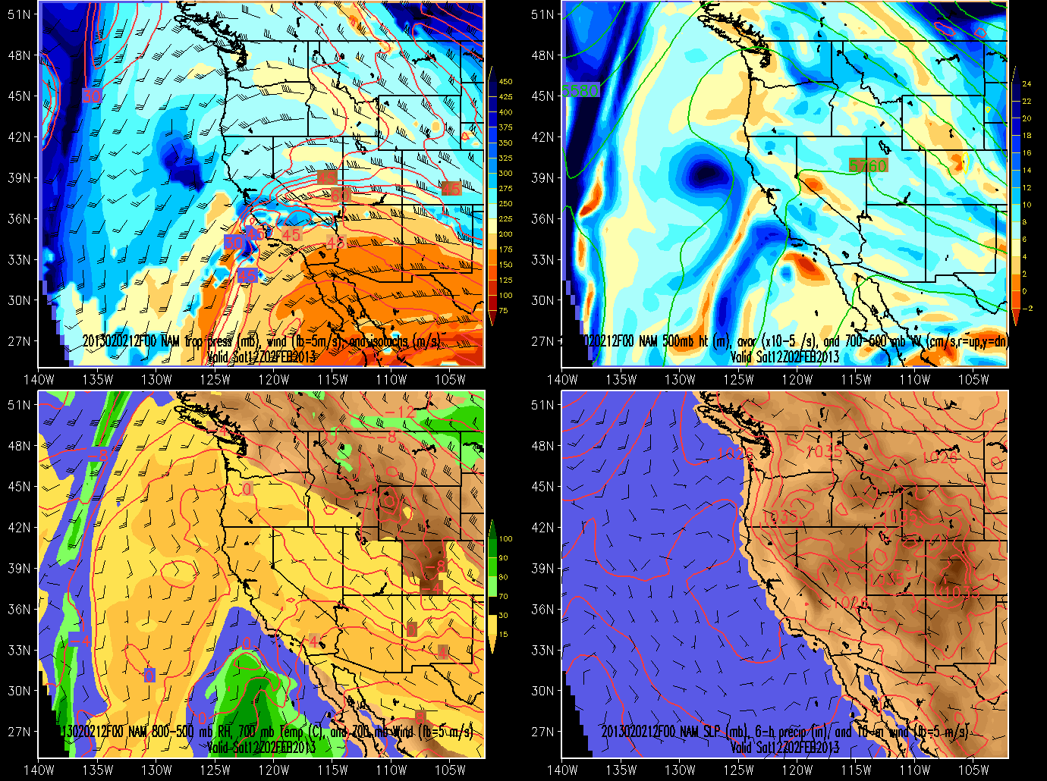
2 February 12 UTC NAM Analysis

Slide 6
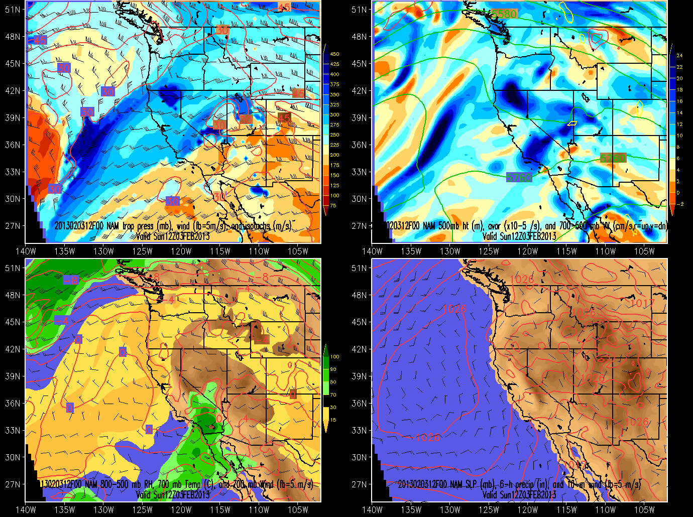
3 February 12 UTC NAM Analysis

Slide 7
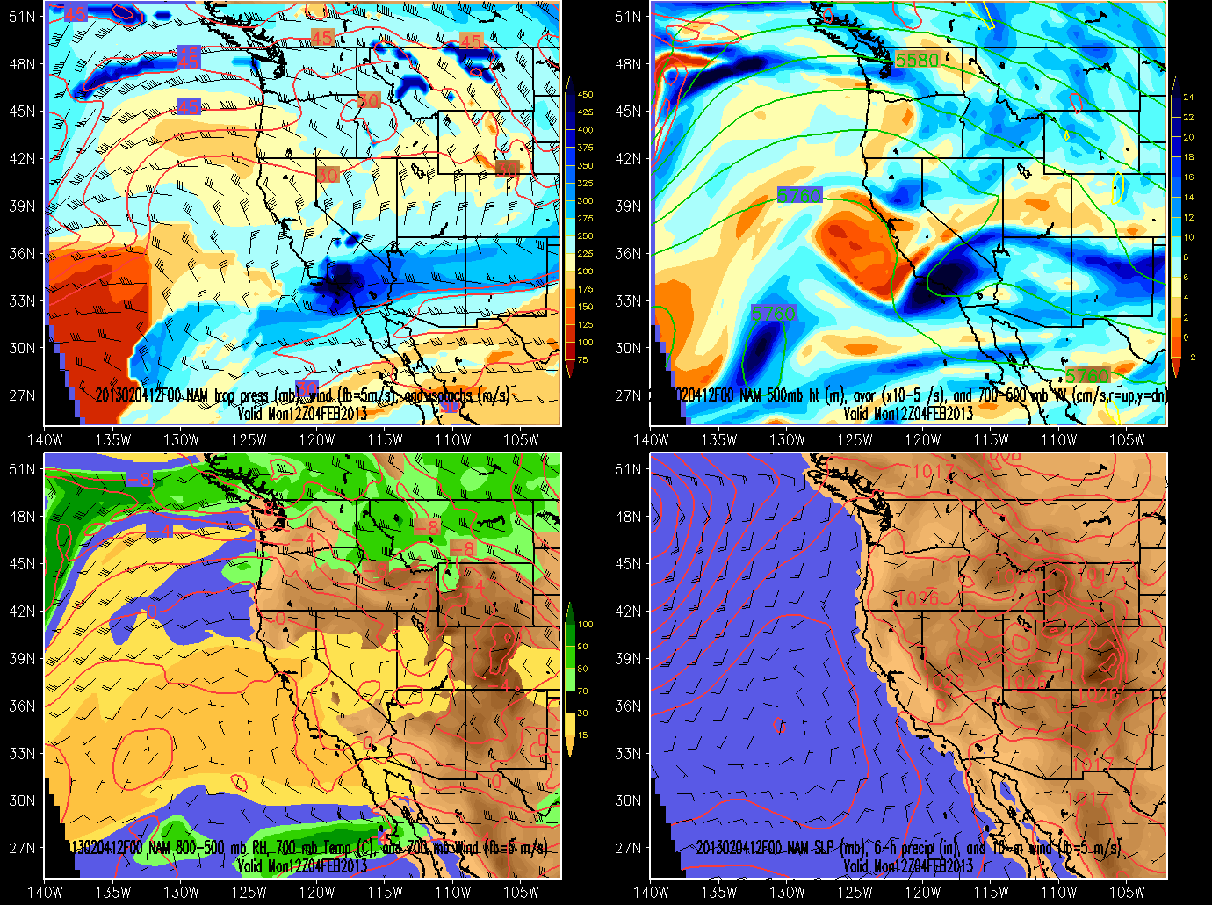
4 February 12 UTC NAM Analysis

Slide 8
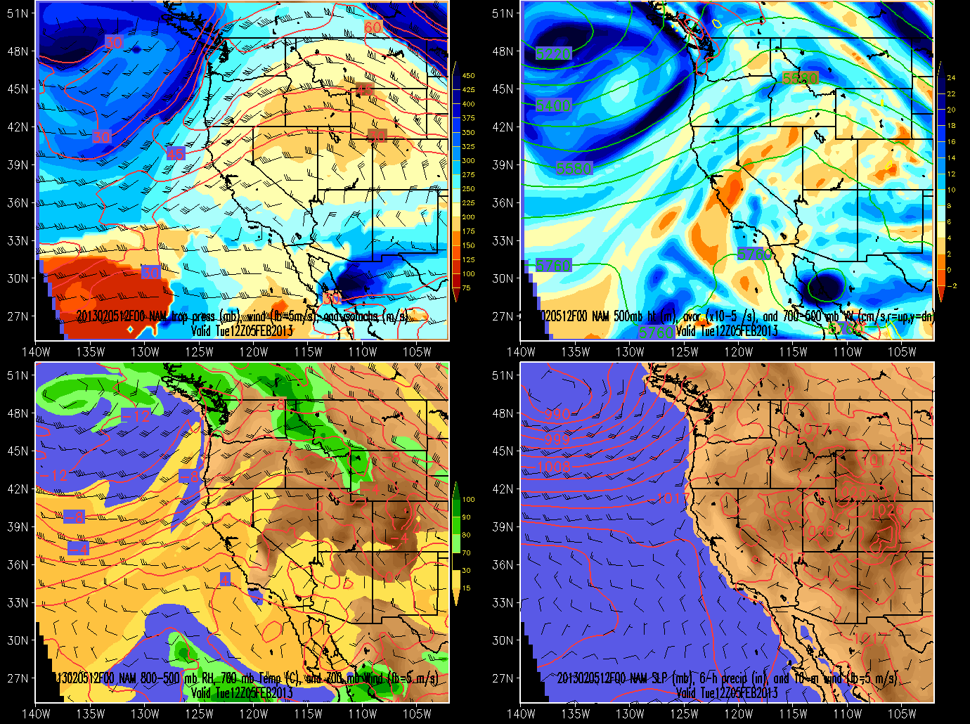
5 February 12 UTC NAM Analysis

Slide 9
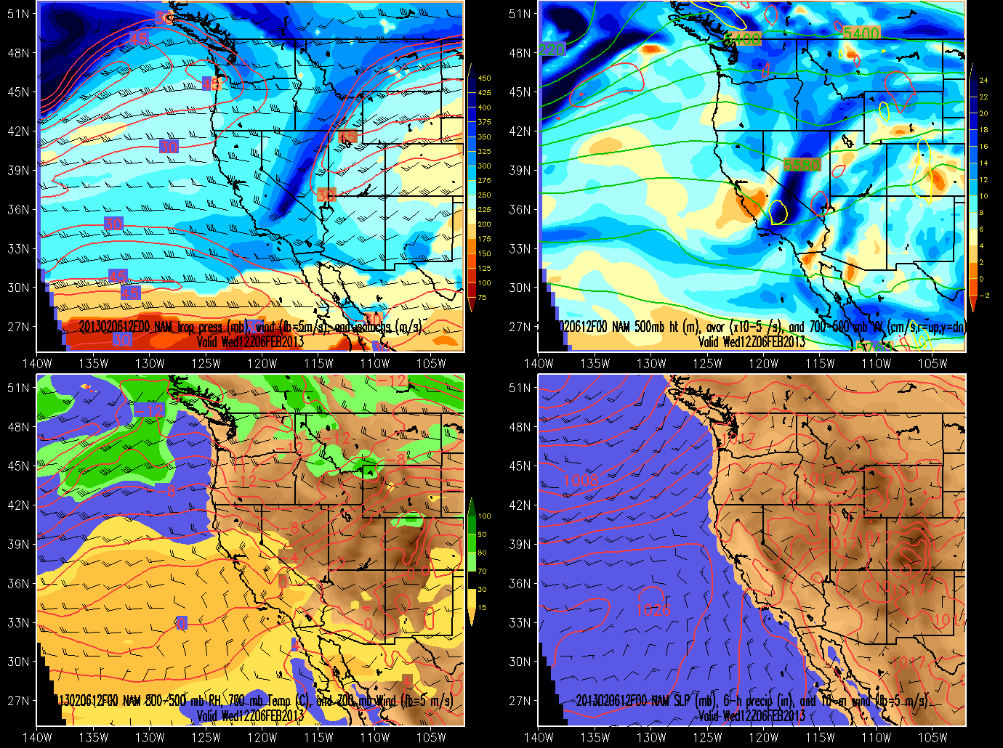
6 February 12 UTC NAM Analysis

Slide 10
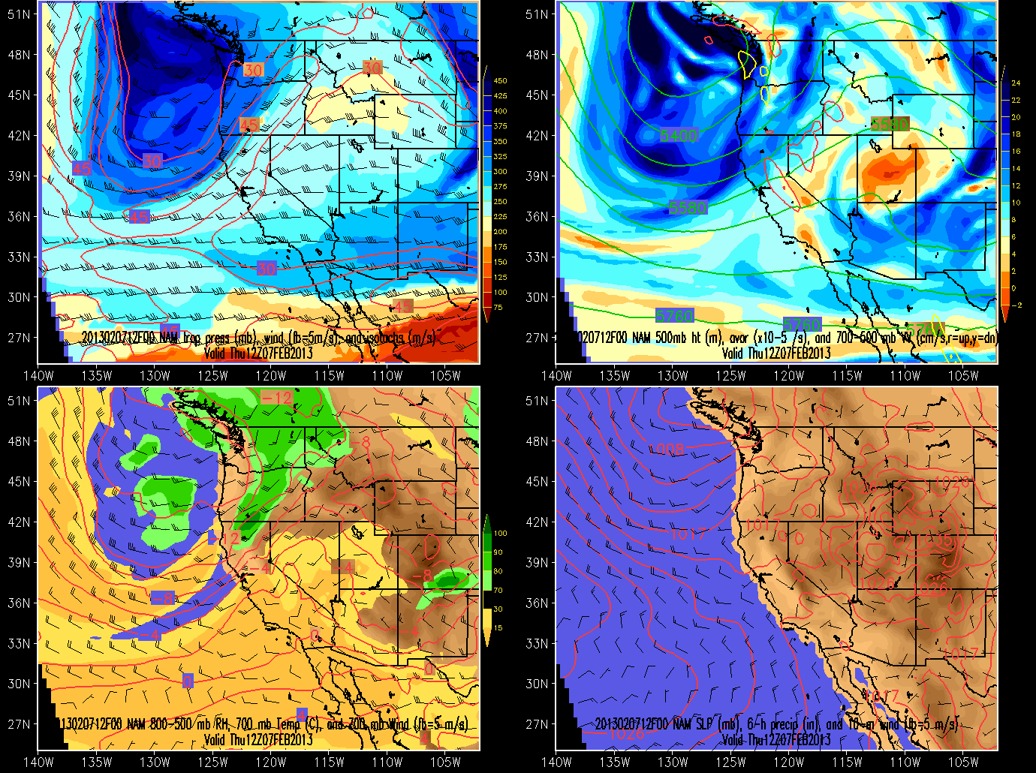
7 February 12 UTC NAM Analysis

Slide 11
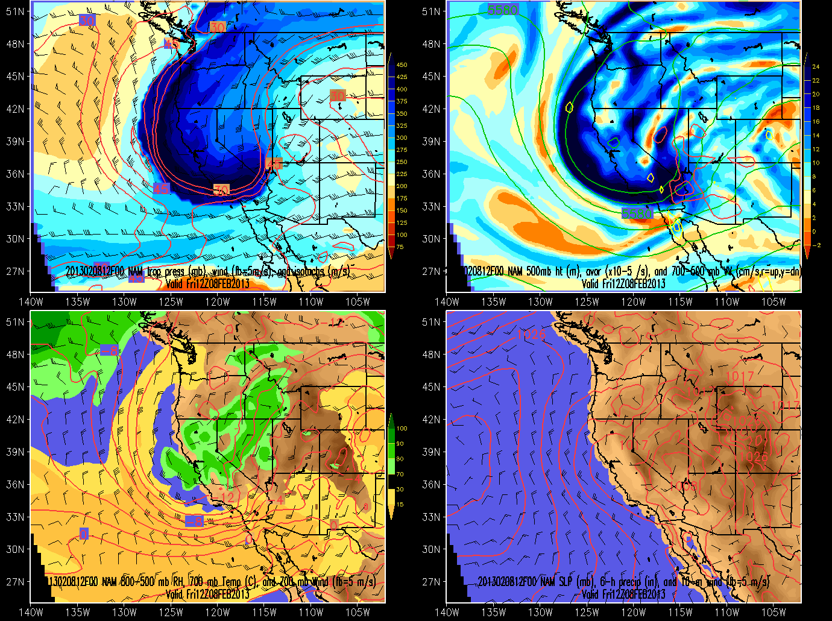
8 February 12 UTC NAM Analysis

Slide 12
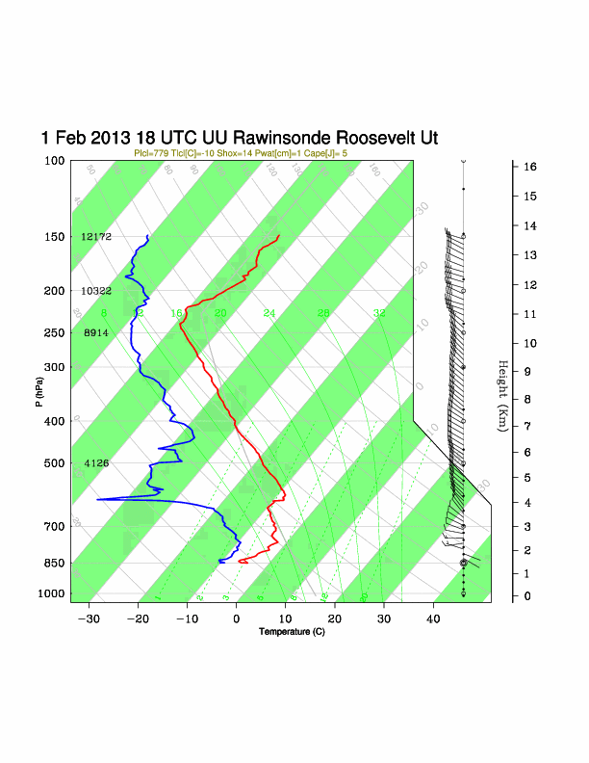
Evolution of University of Utah Roosevelt Soundings

Slide 13
1-4 February
Cold pool deepens below 600 m AGL with moderate westerly winds above 900 m AGL buffeting basin (and research aircraft) on every day but 2 Feb.
NOTE: Starting height for soundings is 1562 m (0 m AGL on graphs)

Slide 14
4-8 February
Cold pool becomes shallower between 4 and 6th Feb as a descending subsidence inversion (on 5th) and weak northerly downslope flow off Uintah Mountains (on 6th) warms layer 400-1000 m AGL and infrared warming of near surface results in a warmer but very shallow mixed layer (~100 m at 11 am) below an overlying stable layer on the highest ozone day (Feb 6th). Cooling aloft associated with wind shift and cloud effects (not shown) result in deeper mixed layers near surface (~200m) and lower near-surface ozone concentrations on 7 and 8 Feb.
NOTE: Starting height for soundings is 1562 m (0 m AGL on graphs)

Slide 15
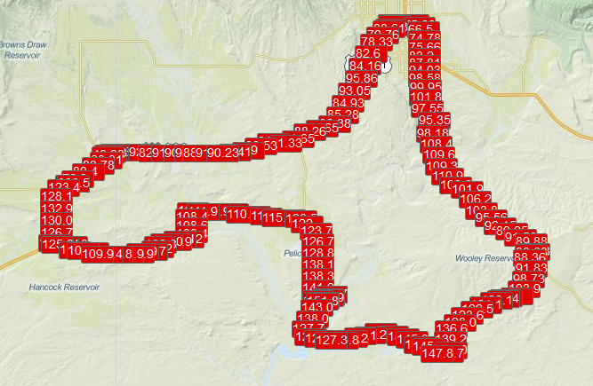
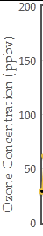
Mobile Ozone/Met Observations 6 February http://home.chpc.utah.edu/~u0732636/Mobile_Viewer/mapUBOSO3.html
Ozone (ppb)
Mobile consistent with measurements at fixed sites
Interactive display
Vernal
Roosevelt
Horsepool
nr Horsepool

Slide 16
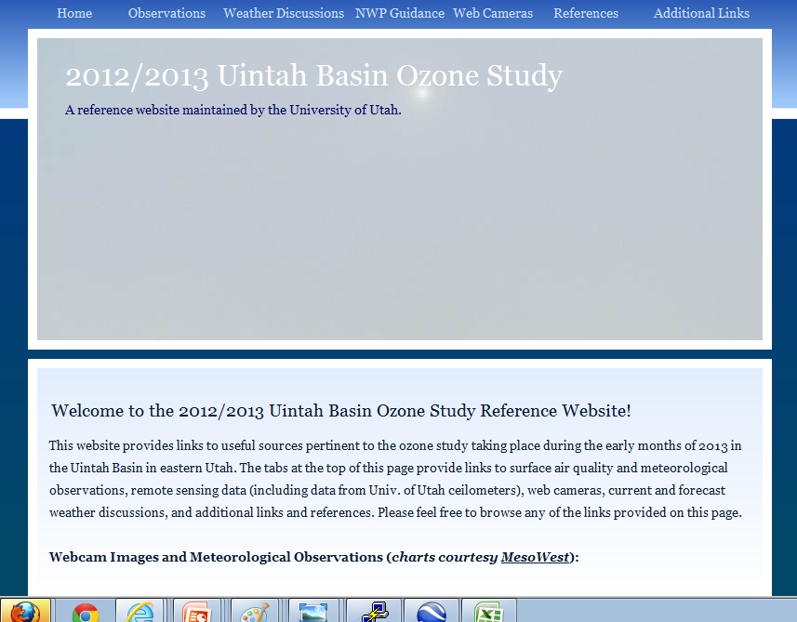
UU UBOS Webpage:
http://home.chpc.utah.edu/~u0198116/uintahbasin.html
Ceilometers/Sonic Anemometer/Rawinsonde/mobile data
available under ‘observations’

