Slide 1
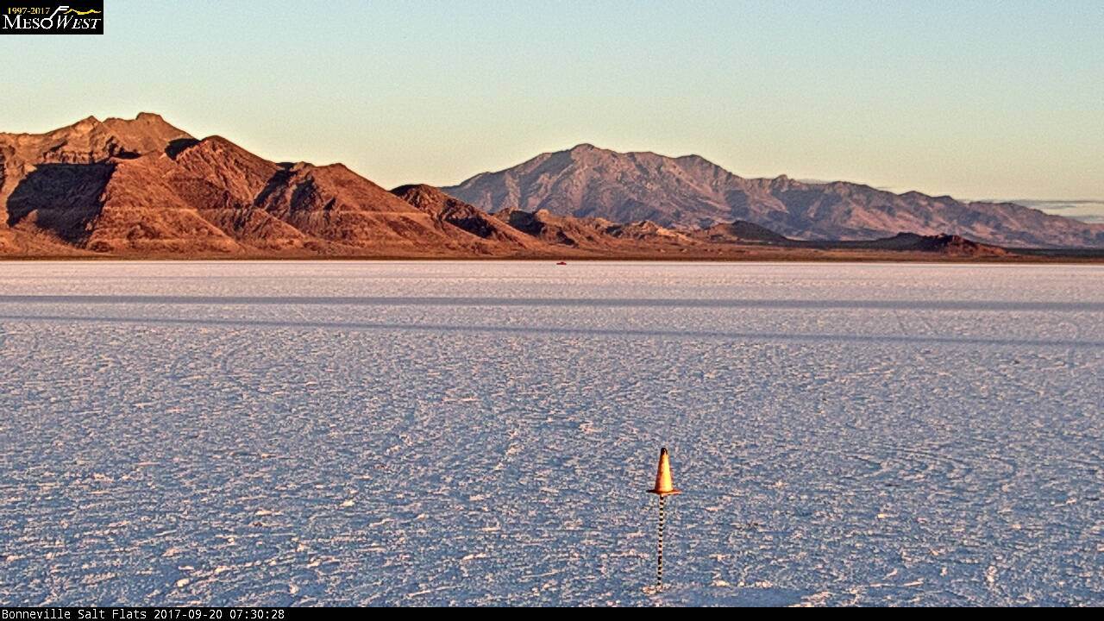
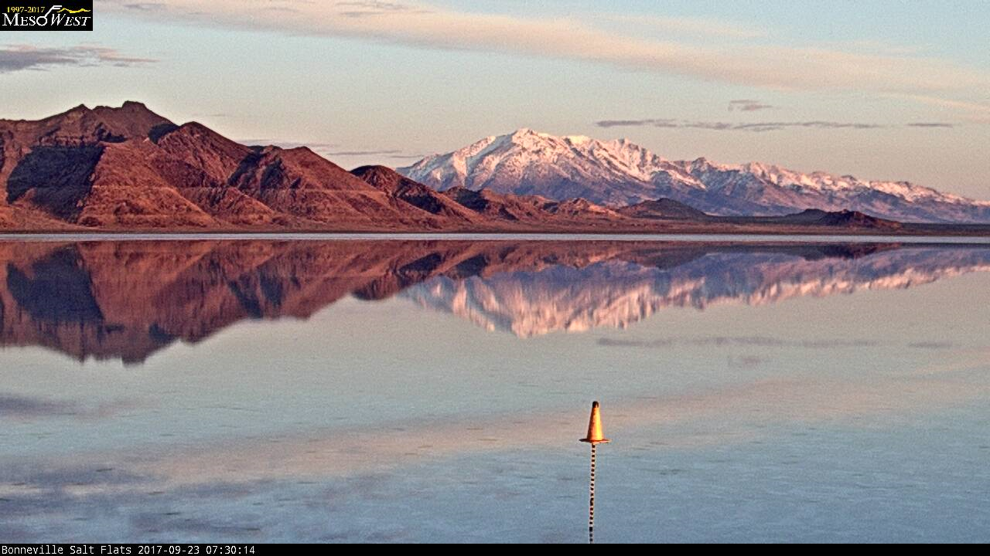
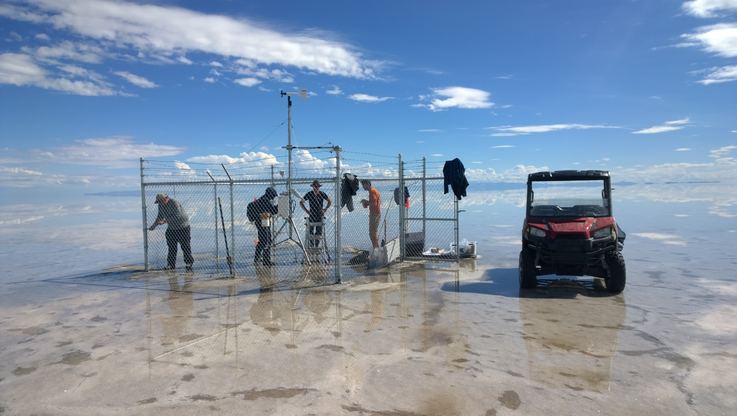
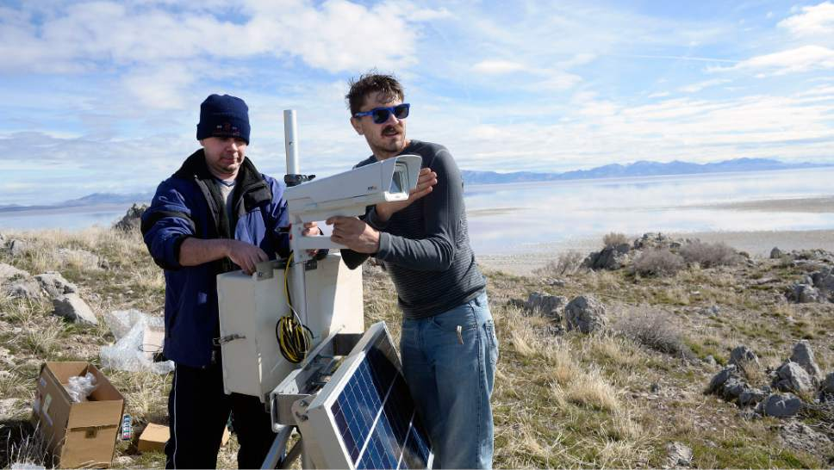
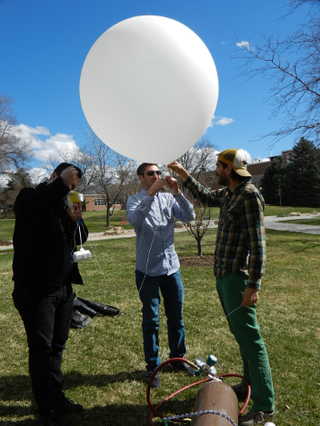
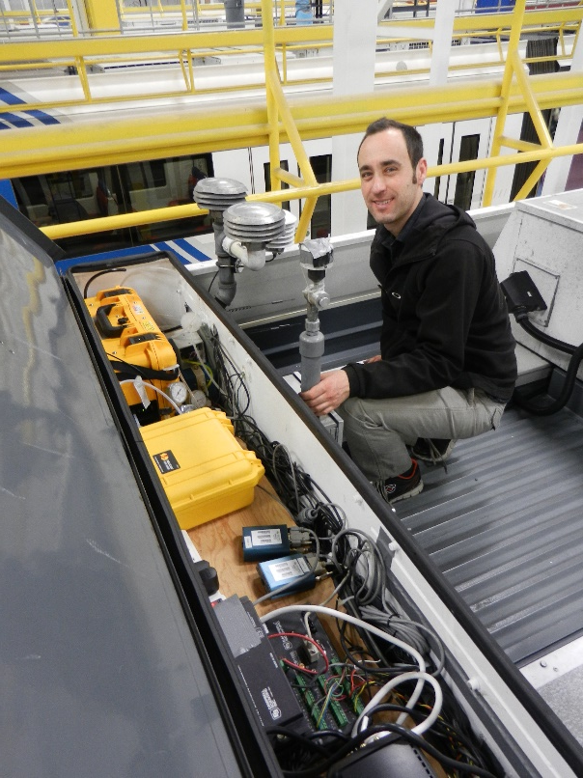
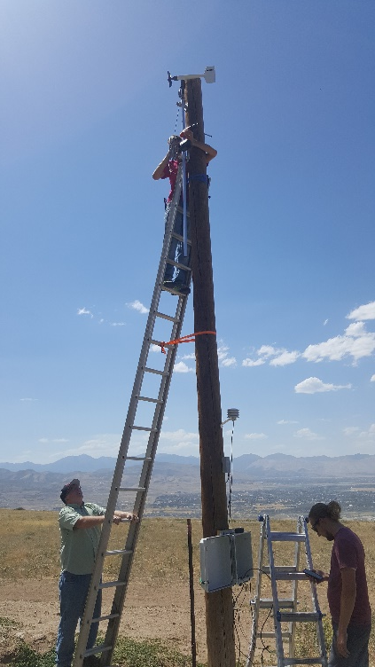
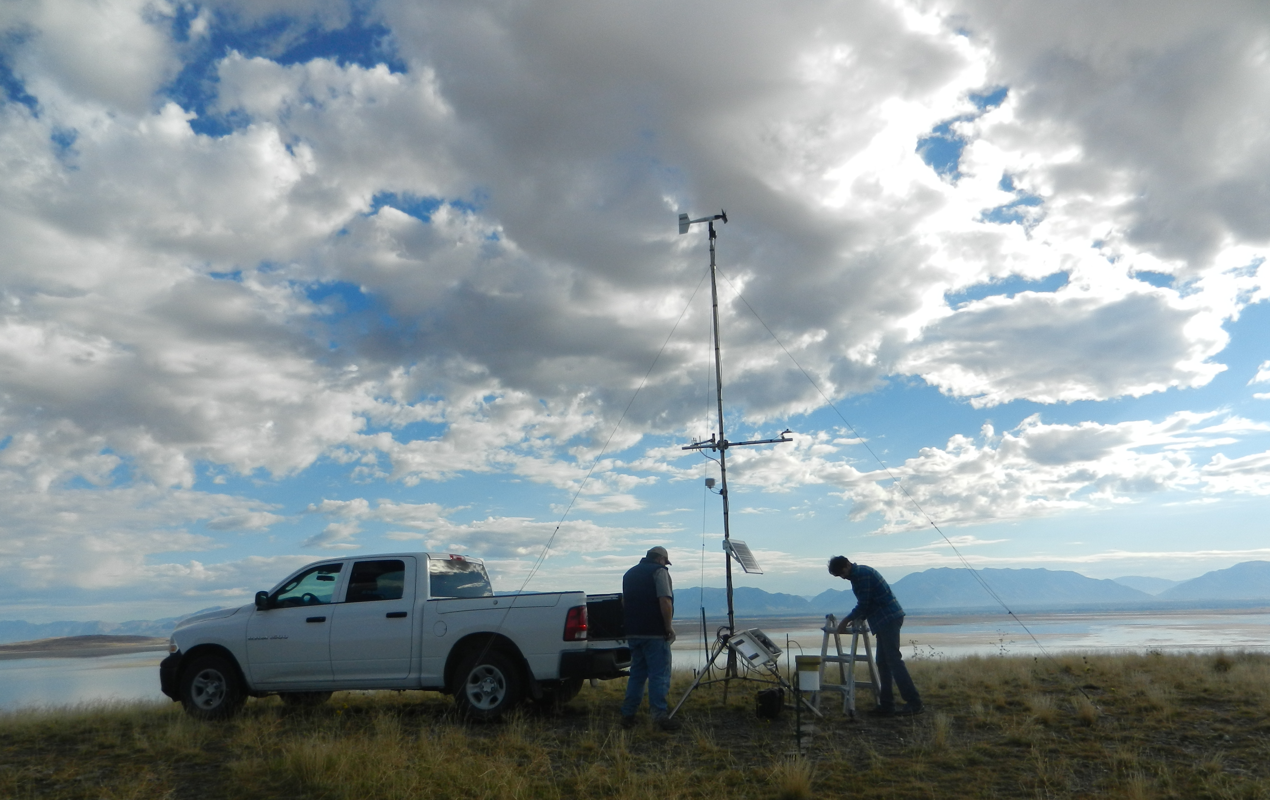
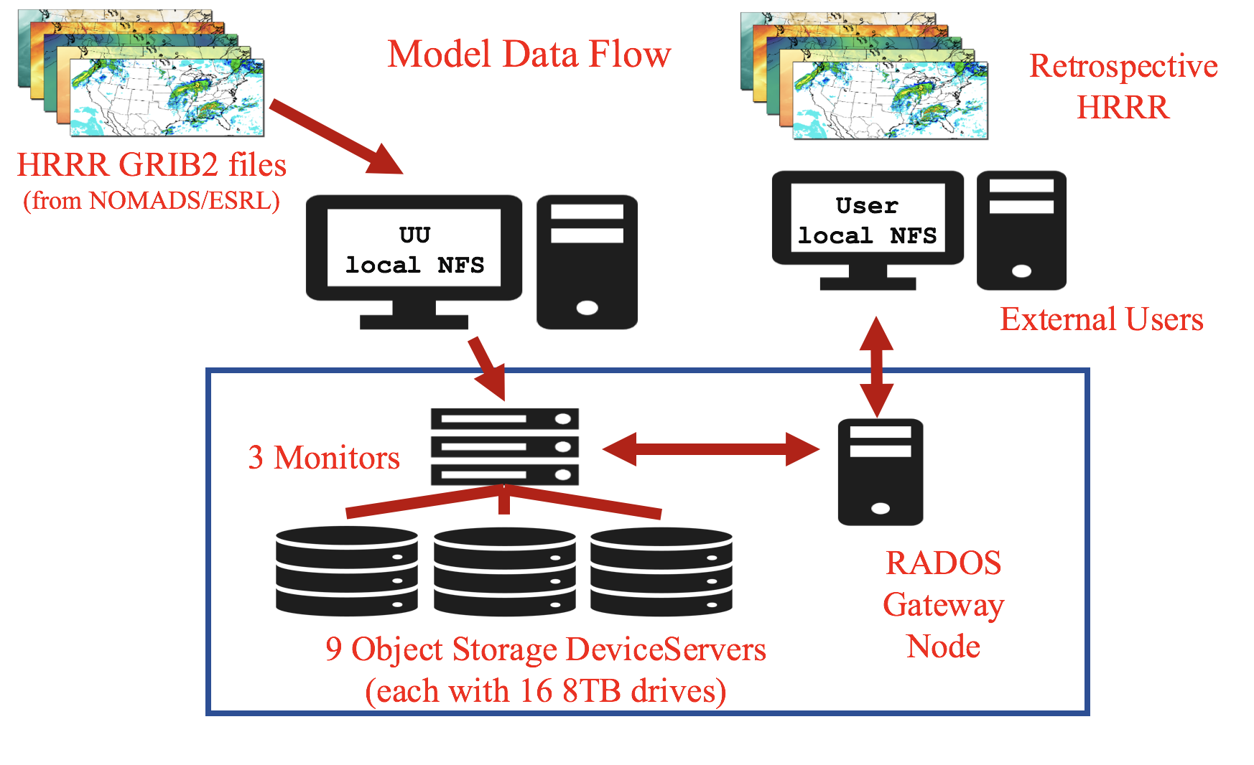
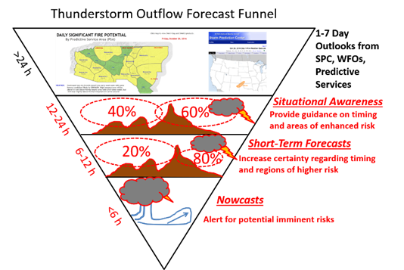
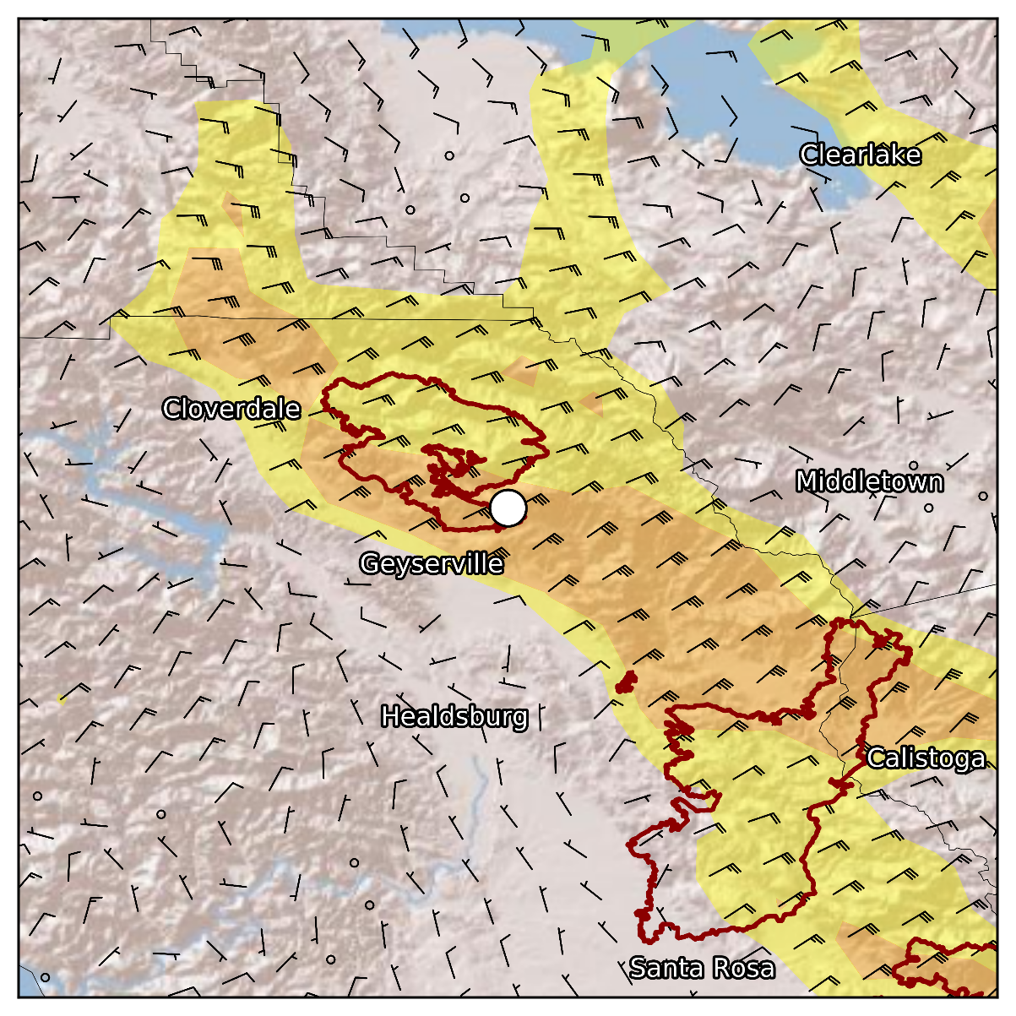
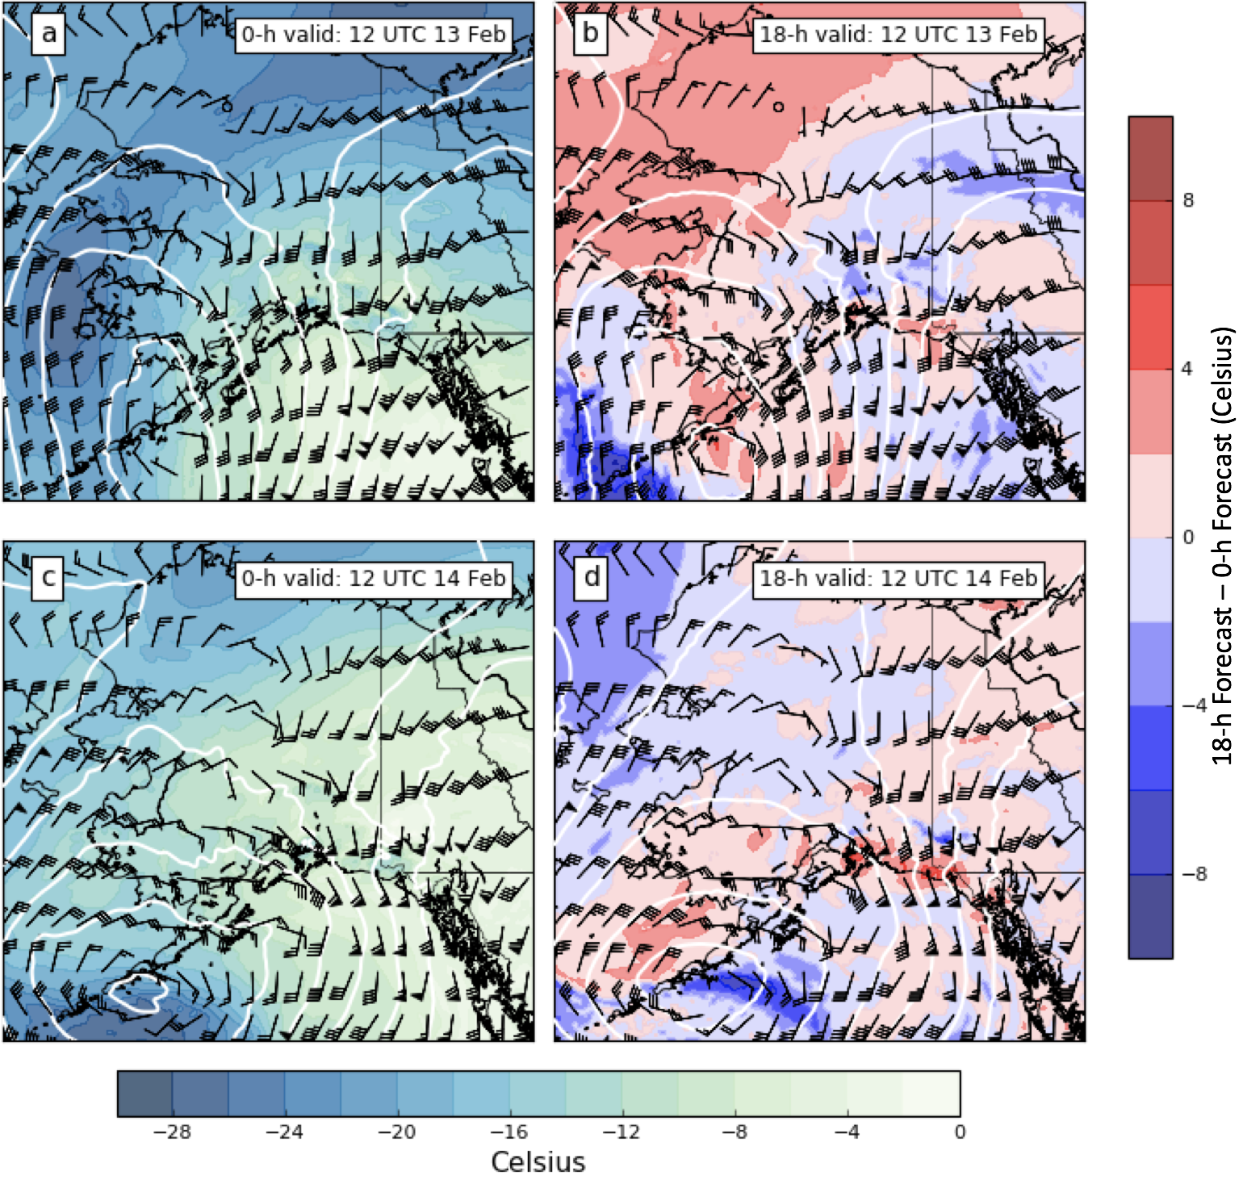
John Horel & Erik Crosman
MesoWest
NWS
Fire Weather
Field Projects
Research & Public Service
Air Quality
Road Weather
Research & Public Service
Observation, analysis, and simulation of weather and climate processes in mountainous regions
Extensive development of operational fire weather software for the nation focusing on the Great Lakes region and Alaska
Impacts of convective outflows on wildfire behavior under investigation
Verification of HRRR-AK forecast products and NASA IMERG precipitation analyses in Alaska underway
Development of novel sensor deployment systems using a quad copter, inexpensive sondes, TRAX light rail cars, and the KSL traffic helicopter
Collaboration with Lin Group on methane emissions in the Uintah Basin and TRAX air quality monitoring
13 papers published or submitted during 2016-18
Research funding: National Science Foundation, National Oceanic and Atmospheric Administration, Joint Fire Science Program, National Institutes of Health, Department of the Interior, Utah Division of Air Quality, Great Lakes Consortium
Access, archive, & disseminate publicly-accessible environmental data for diverse educational, research, & public service applications
For further information
Summary: meso1.chpc.utah.edu/mesowest_overview
MesoWest: mesowest.utah.edu
SynopticLabs: synopticlabs.org
Great Lakes Fire and Fuels: glffc.utah.edu
Alaska Fire and Fuels: akff.mesowest.org
TRAX: meso1.chpc.utah.edu/mesotrax
Chopper/air quality http://meso2.chpc.utah.edu/aq/
HRRR Archive: http://hrrr.chpc.utah.edu/
Wildfire Convective Outflows: http://meso1.chpc.utah.edu/jfsp_convective/
Our research team: undergraduate- Andrew Parks; graduate students- Brian Blaylock, Kevin Craft, Chris Foster, Taylor McCorkle, Mike Wessler; postdoctoral research associate- Alex Jacques; staff- Chris Galli, Nola Lucke, Judy Pechmann, Joe Young
HRRR-AK 700 hPa height, wind, and temperature fields for f00 and f18 forecasts valid at (a,b) 12 UTC 13 Feb 2017 and (c,d) 12 UTC 14 February 2017
Half, full and flag wind barbs represent 5, 10, and 25 m s-1, respectively.
Monitoring Wildfires across the CONUS and Alaska
F00 HRRR 10-m vector winds for 0600 UTC 9 October 2017 near the time of the start of the North Bay wildfires. Yellow (red) shading indicates areas where wind speeds are greater than 10 (15) m s⁻¹ fire perimeters (red outlines).
High Resolution Rapid Refresh (HRRR) archive is being used by 100s of researchers
Constraining Emissions of Methane in Utah’s Uintah Basin with Ground-based Concentration Observations and a Time-Reversed Lagrangian Transport Model (STILT) with Lin (LAIR) Group
There are currently ~ 3 years worth of CH₄ data available at 3 sites within the Uintah Basin: Fruitland (FRU), Roosevelt (ROO), Horsepool)
CH4 concentrations at the three basin sites show daily and seasonal variations consistent with boundary layer evolution and stability

