Slide 1

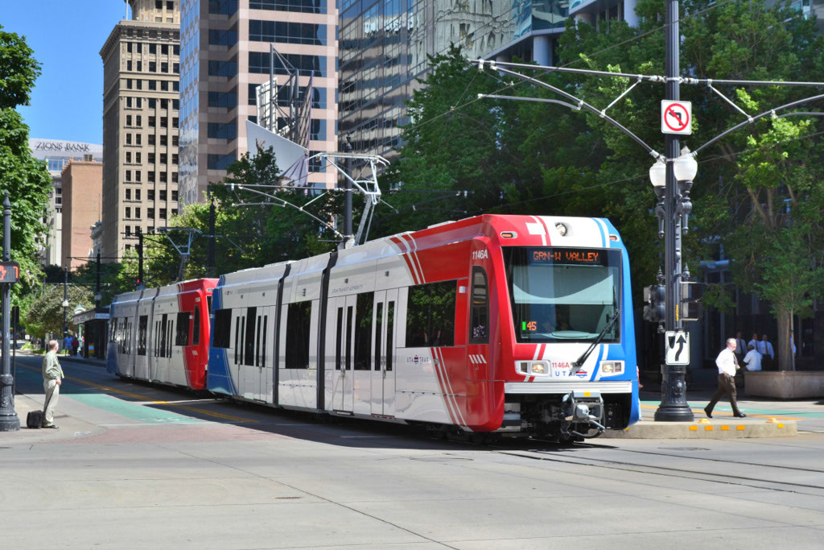


TRAX Monitoring of Air Quality in the Salt Lake Valley

Slide 2
History of TRAX Pilot Project 2014-2018
Focused on understanding the spatial and temporal distributions of pollutants as well as how pollution episodes develop and evolve
Two sets of pollution monitors installed on TRAX
Car 1136 → December 2, 2014
Car 1104 → February 2, 2016
Requires monthly maintenance & inspection visits
Outcomes:
Air quality information available via the internet to the public, educators, and researchers http://utahaq.chpc.utah.edu/
Several dozen TV & radio news stories, blogs & press releases
Two published scientific papers, several in preparation
Over 12 presentations in United States air quality conferences
Many presentations involving educators and K-12 students
2

Slide 3
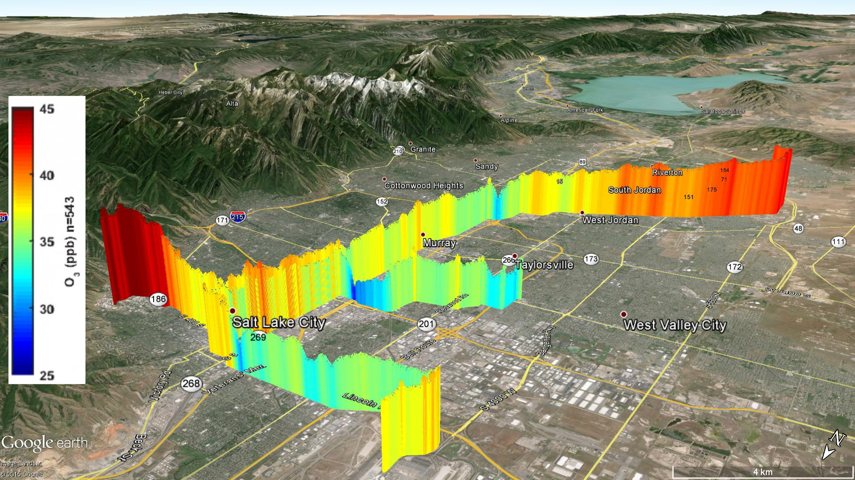
Average Summer Ozone along the Red and Green lines
May 2015 – Sept 2015
Hours: 0400-2400
Higher O₃ on urban periphery
Lower O₃ in urban corridor
3

Slide 4
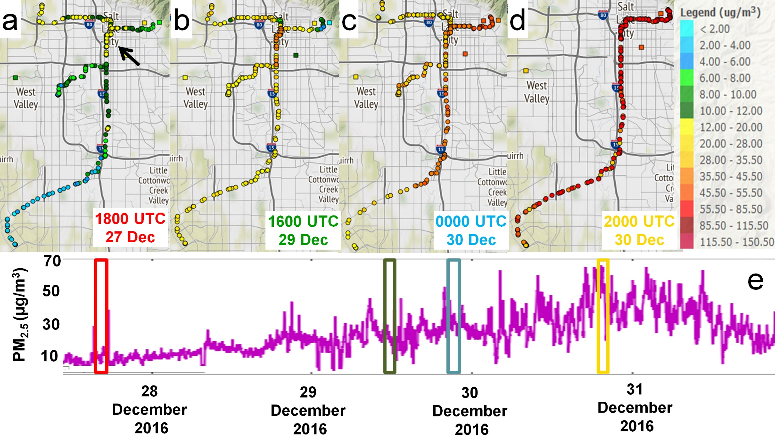
Spatial PM2.5 Concentrations -- Inversion Episode from TRAX

Slide 5
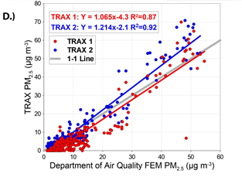
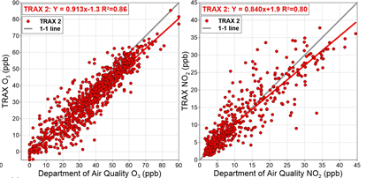
Research-grade Instrumentation Initial Validation
Evaluated the TRAX observations against the Utah Division of Air Quality (DAQ) Hawthorne site maintained by the state of Utah for US EPA regulatory purposes February 2016 PM_{2.5} (correlation coefficients ~0.87-0.92)
Summer 2016 – Summer 2017 O₃ (correlation coefficients 0.80-0.86)
Much more rigorous validation planned as part of new funded study
Monitoring of greenhouse gases and pollutants across an urban area using a light-rail public transit platform
Logan E. Mitchell^{1,*}, Erik T. Crosman¹, Alexander A. Jacques¹, Benjamin Fasoli¹, Luke Leclair-Marzolf¹, John Horel¹, David R. Bowling², James R. Ehleringer², John C. Lin¹
Atmospheric Environment, In review
PM_{2.5} validation
O₃ validation
NO₂ validation

Slide 6
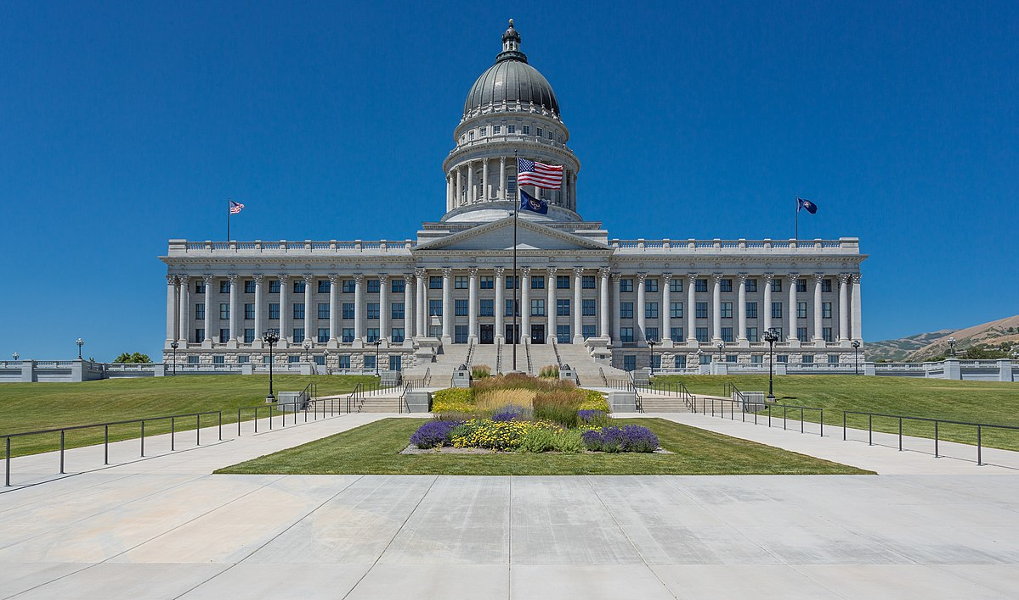
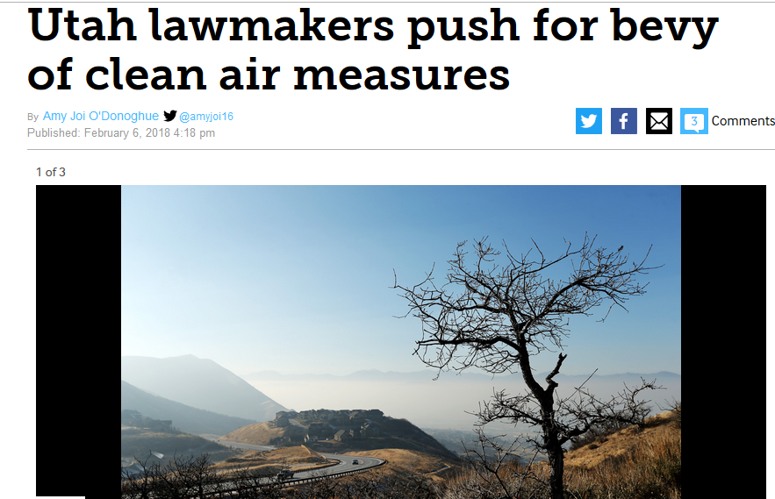
Legislative Support for TRAX in 2018 Session
Sen. Luz Escamilla and Rep. Angela Romero showed interest in the TRAX pilot project. Of particular interest to them is to obtain data on the west side communities where no UDAQ regulatory observation sites exist.
Sen. Escamilla proposed an appropriation of $100,000 ongoing for 5 years. Daniel and Erik garner support with key appropriations committee members alongside Rep. Romero to make sure legislative support is there for the proposed appropriation. Presentations made to Appropriation Committee and air quality advisory board.
Funding appropriation request was approved in March 2018 alongside Utah state budget

Slide 7
Key Message During Legislative Appropriations Process
The TRAX Pilot Project has been successful improving understanding of characteristics of air pollution episodes experienced by Salt Lake Valley residents
Therefore, continued support of PM2.5 and O3 data collection requires:
Sustained air quality monitoring (sensors need replacement or repair/maintenance)
Calibrating/QC of data so that it is suitable for public health usage (both real-time exposure and health research)

Slide 8

Next Steps Transitioning from Pilot Study to Operational Data Collection
Funding was appropriated to the Utah DEQ from the Utah DNR fund
We were told the next step will be to write a proposal to DEQ on deliverables, report schedule, etc
Look forward to working synergistically with DAQ to provide spatially resolved data for health studies
A budget and statement of work already on public record to the legislature will need to be fleshed out in more detail in proposal to DEQ
Monthly/annual reports submitted to DEQ on deliverable tasks

Slide 9
Proposed Year 1 TRAX Air Quality Deliverables
Replace aging instruments for PM_{2.5} and ozone and support communication and other sensor maintenance costs
Support research time to conduct rigorous quality control/validation
Support data archive for use by scientific and public community
Support technician time to install/repair instruments, filters, and required UTA monthly safety inspections
Provide detailed documentation (monthly updates, annual report) to DEQ of data archive, QC, validation comparison

Slide 10
Proposed Year 1 TRAX Air Quality Deliverables Continued…
Added this slide in response to John H’ comment will let him fill in…info along the lines of:
Goal is to provide a high resolution data (temporally order ~1 minute, spatially order 1 km) that can be used synergistically with DEQ FEM fixed site air quality data for health scientists and public policy makers to characterize the variability in criteria pollutants along the TRAX train routes
Value of this data for looking at meteorological controls on pollution variability (e.g., dust storms, lake breezes, shallow inversions) has already been shown

Slide 11
Making the Data Usable and Trustworthy
Pilot project was successful but did not include funding for quality control or validation of the data collected.
Frequent calibration and inspection/flow checking of PM_{2.5} and O₃ sensors
Due to recommendations of Air Quality Advisory board chairperson Kerry Kelly and Dept. of Atmos Sci Professor Gannet Hallar, we will deploy 2 PM_{2.5} validation stations with identical instruments as on the train – one at the DEQ Hawthorne location and one located along the TRAX line

Slide 12
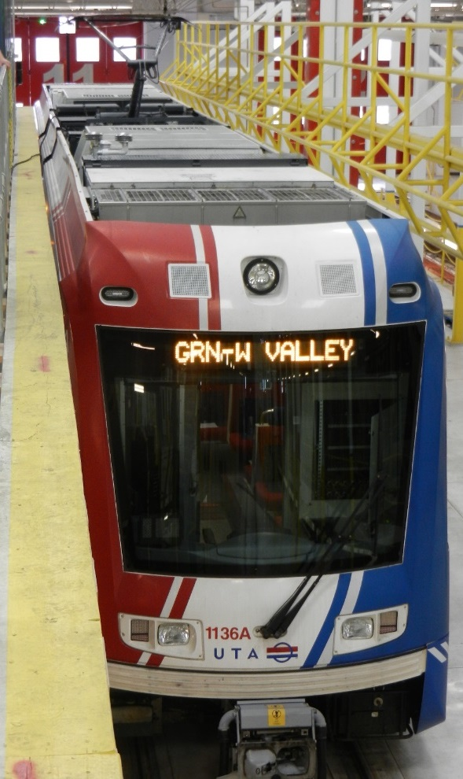
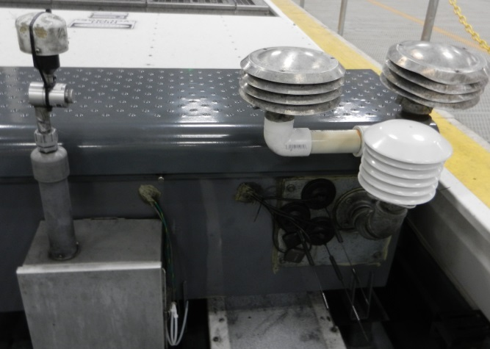
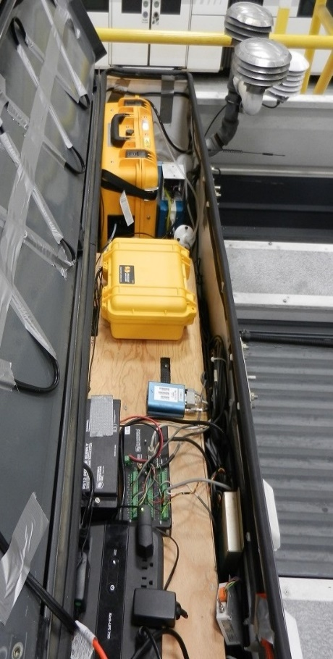
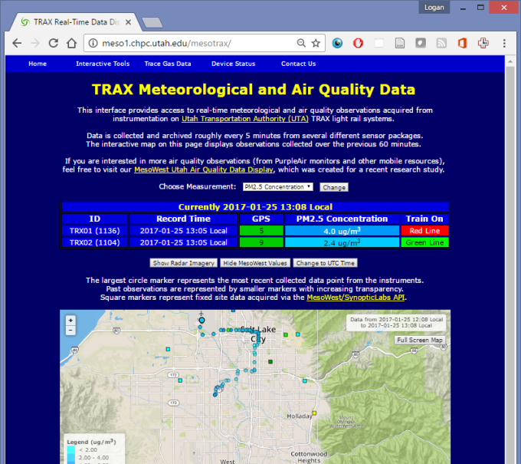
Purchase New Air Quality Sensors
Met one ES-642 Nephalometer
Temperature/Humidity/Pressure
GPS
2B Ozone 205 FEM monitor
Data loggers
Cell modems
Data are publicly available via the web links: http://utahaq.chpc.utah.edu/aqmobile
https://air.utah.edu/
12

Slide 13
Preliminary Draft Year 1 Budget
Replace aging instrument and communications equipment
  Monthly inspections
  Maintenance/repairs
  Calibration
  Validation
  Data QC and archive for public health
  Public access to data
  Data user support
2018-2019 Budget for TRAX Sensor System Ongoing Operation | Subtotal
O&M for 2 train sensor systems per year:
1 part-time maintenance technician (inspections; repairs; calibration) | ~20,000
2 part-time research scientists (grad student; post-doc) for QC and 3-year data archive validation/calibration, research and public access and user support | ~20,911
Sensor repair, maintenance (pumps, filters, factory calibration), cellular communications | ~10,000
Replacement of sensors (no indirect cost) | ~40,000
University of Utah indirect cost for state agencies | 9,091
Subtotal for ongoing annual costs | 100,000
13

Slide 14


Thank You!

