Slide 1

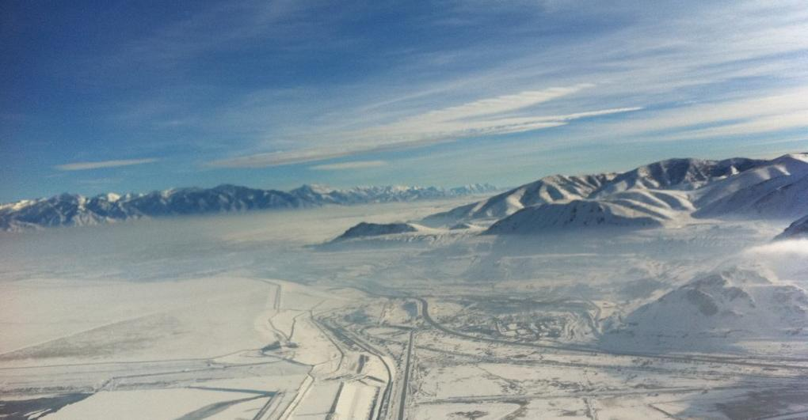
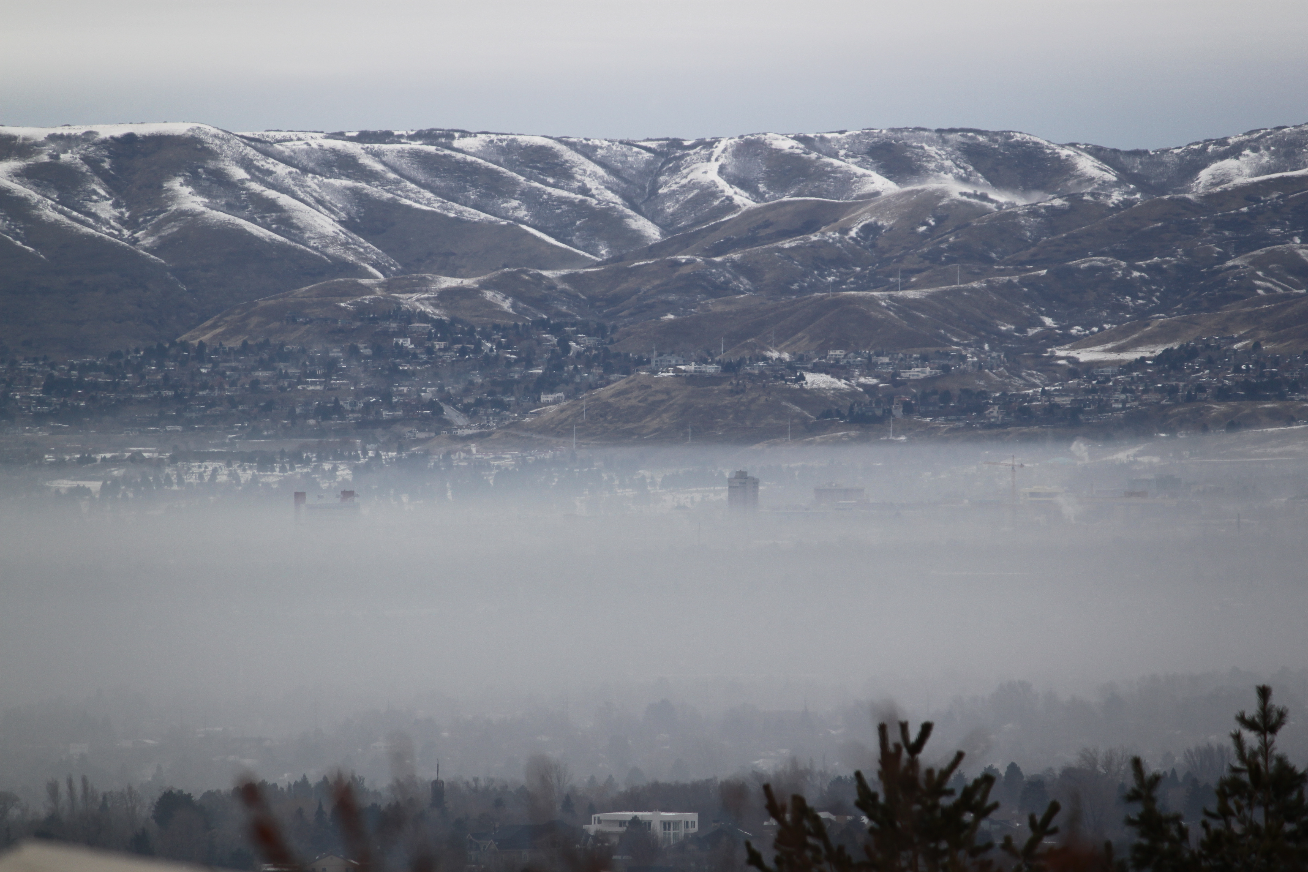
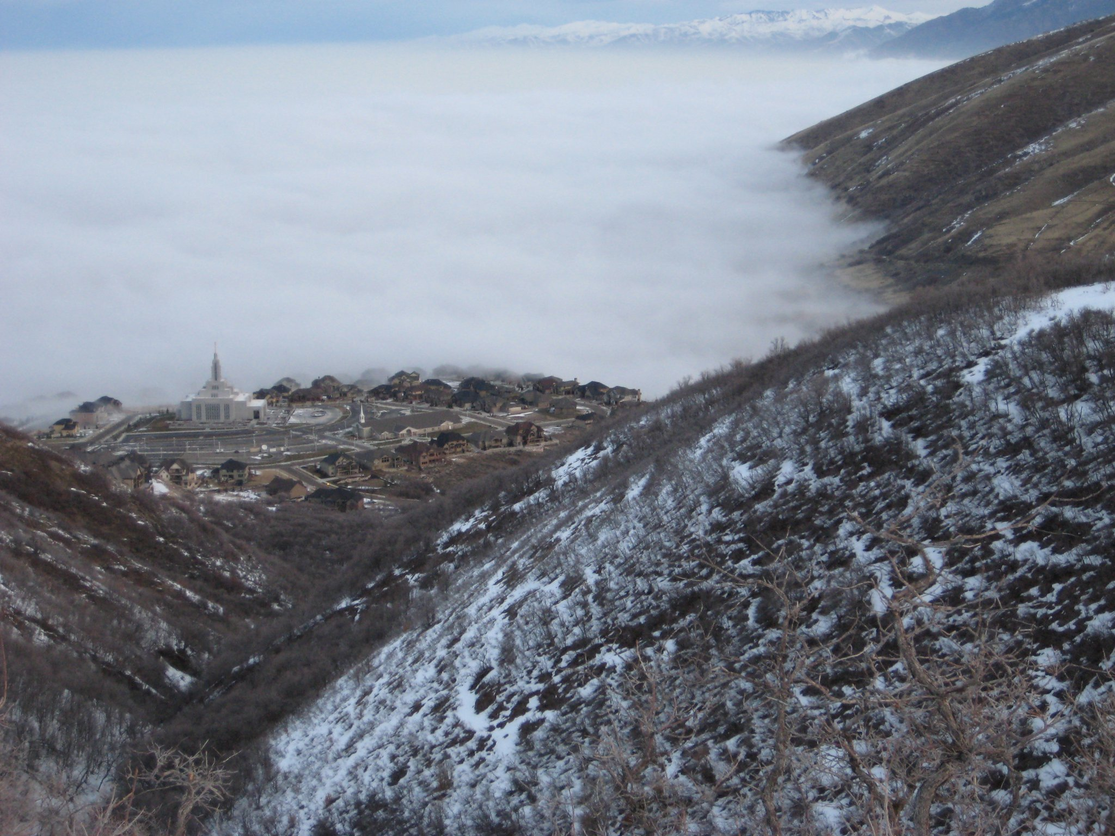
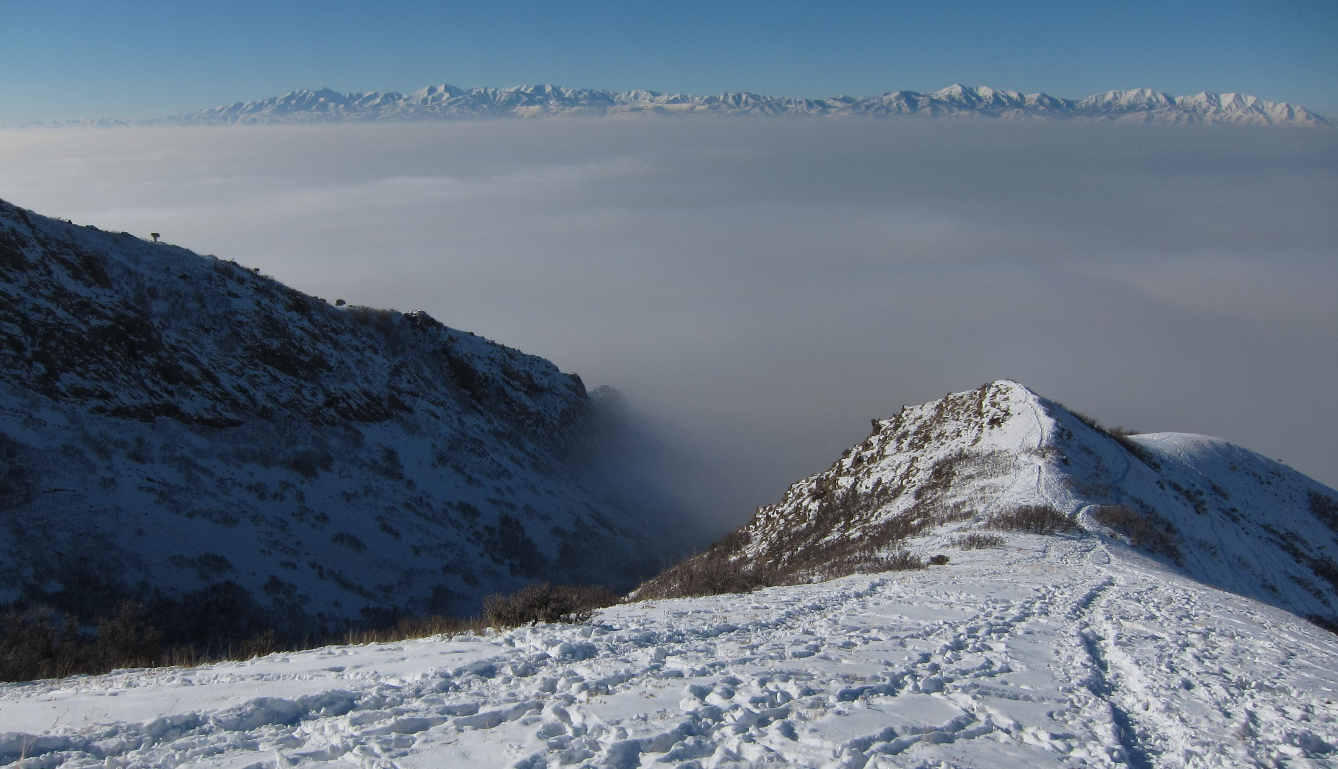
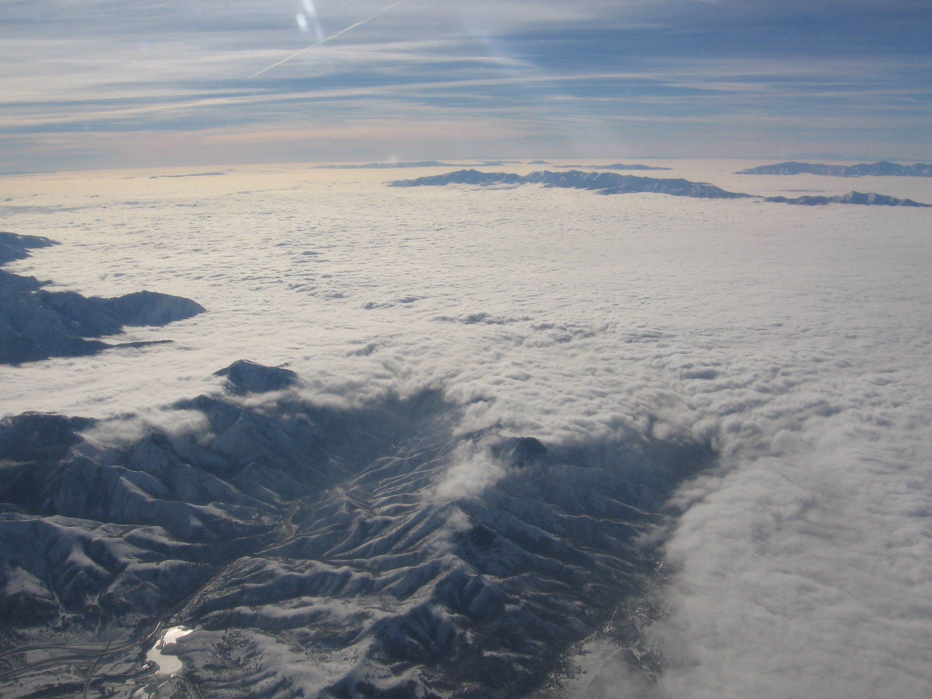
a)
Oquirrh Mountains
trapped pollutants and fog
Salt Lake Valley
c).
b)
c)
pollutants
near-surface pollutants and fog
d)
e)
f)
shallow clouds
middle depth clouds
deep clouds

Slide 2
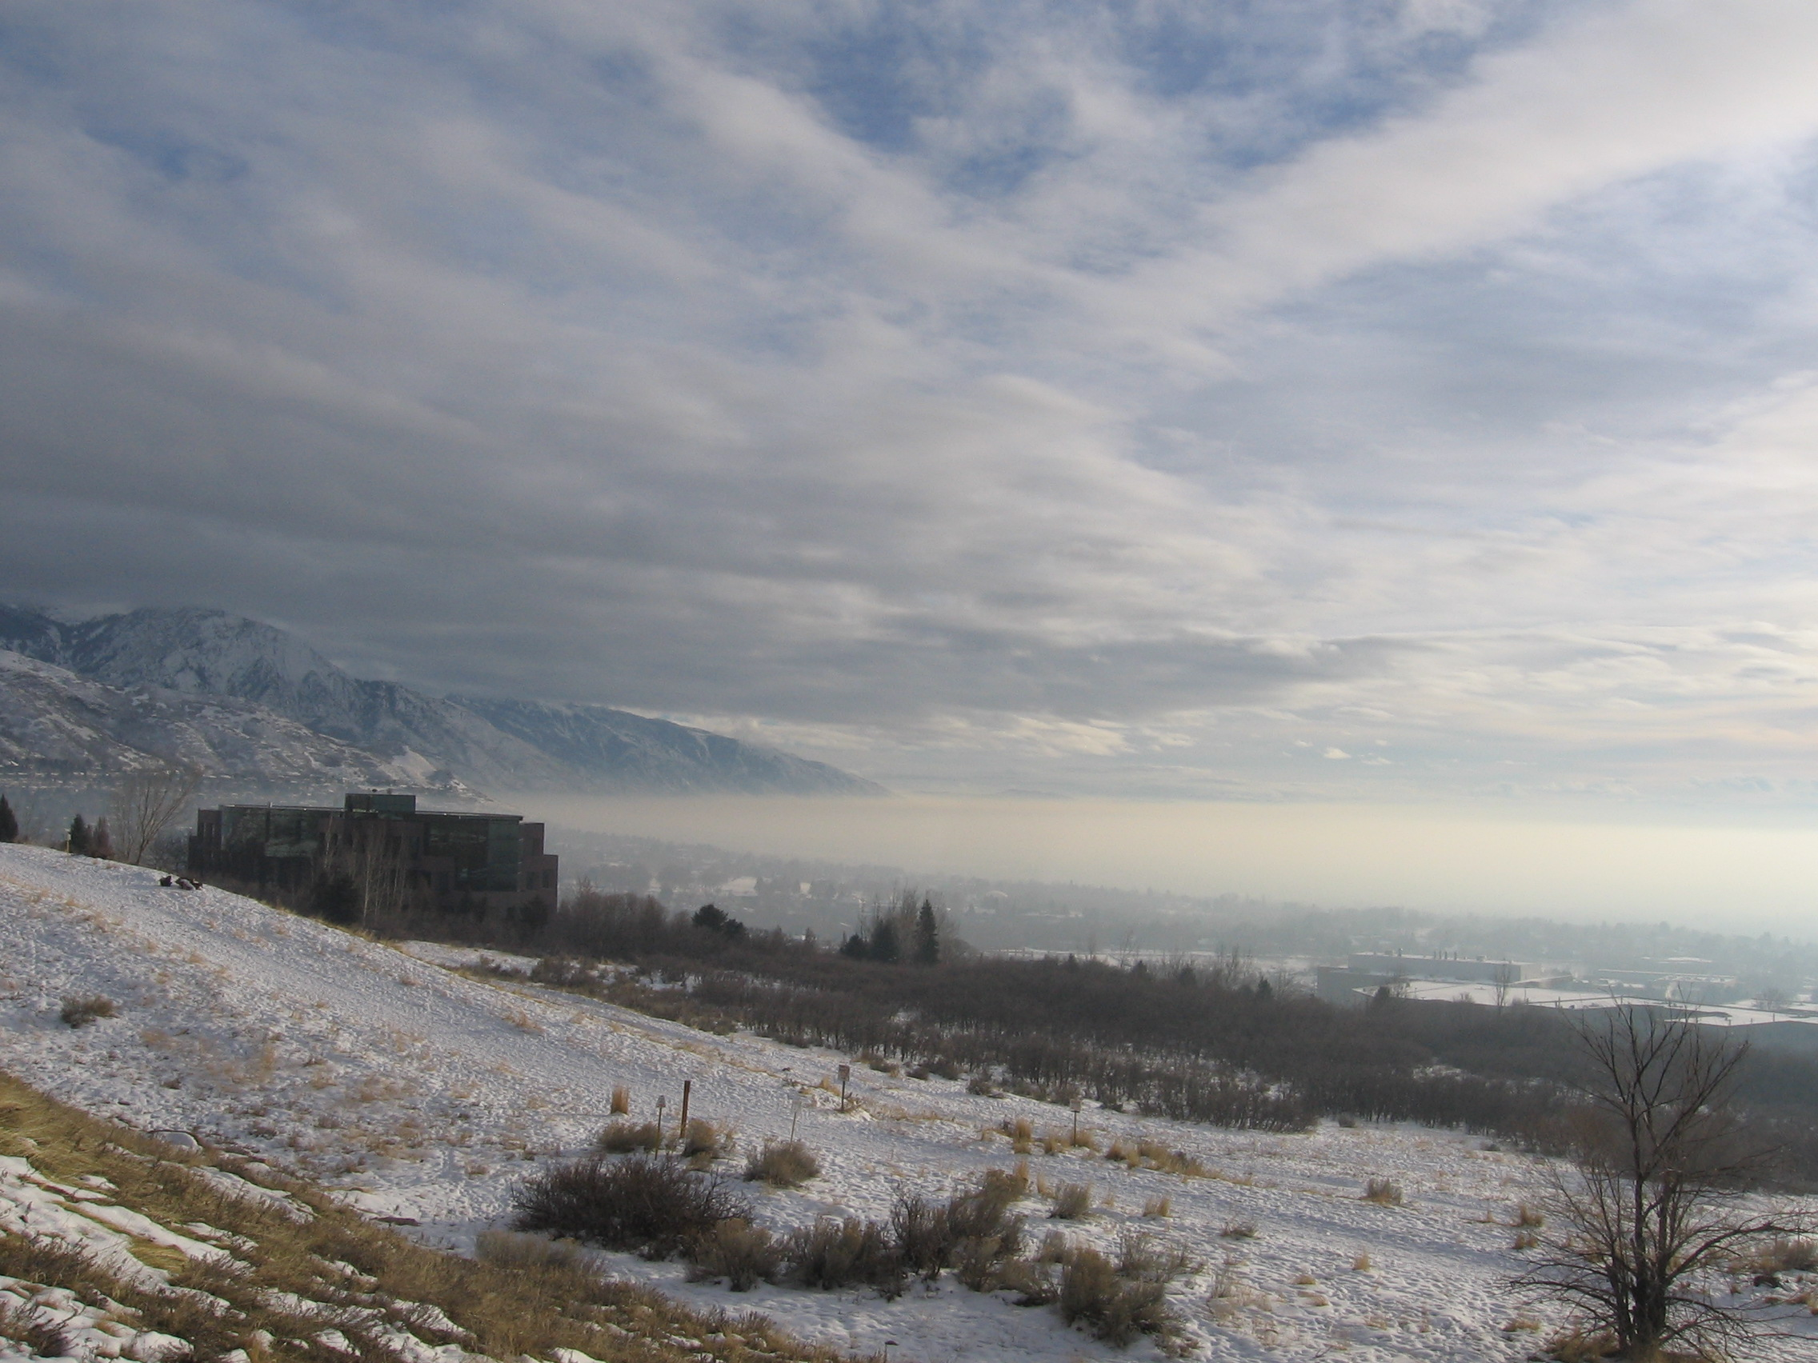
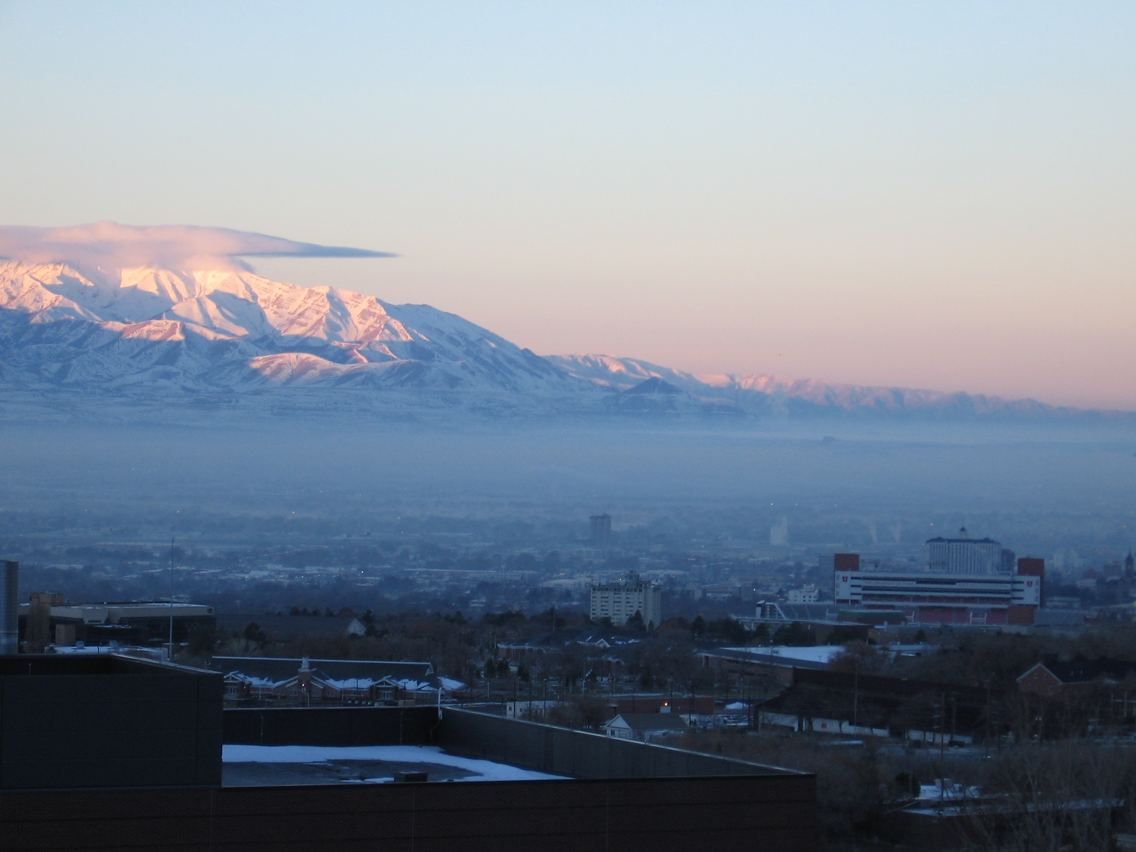



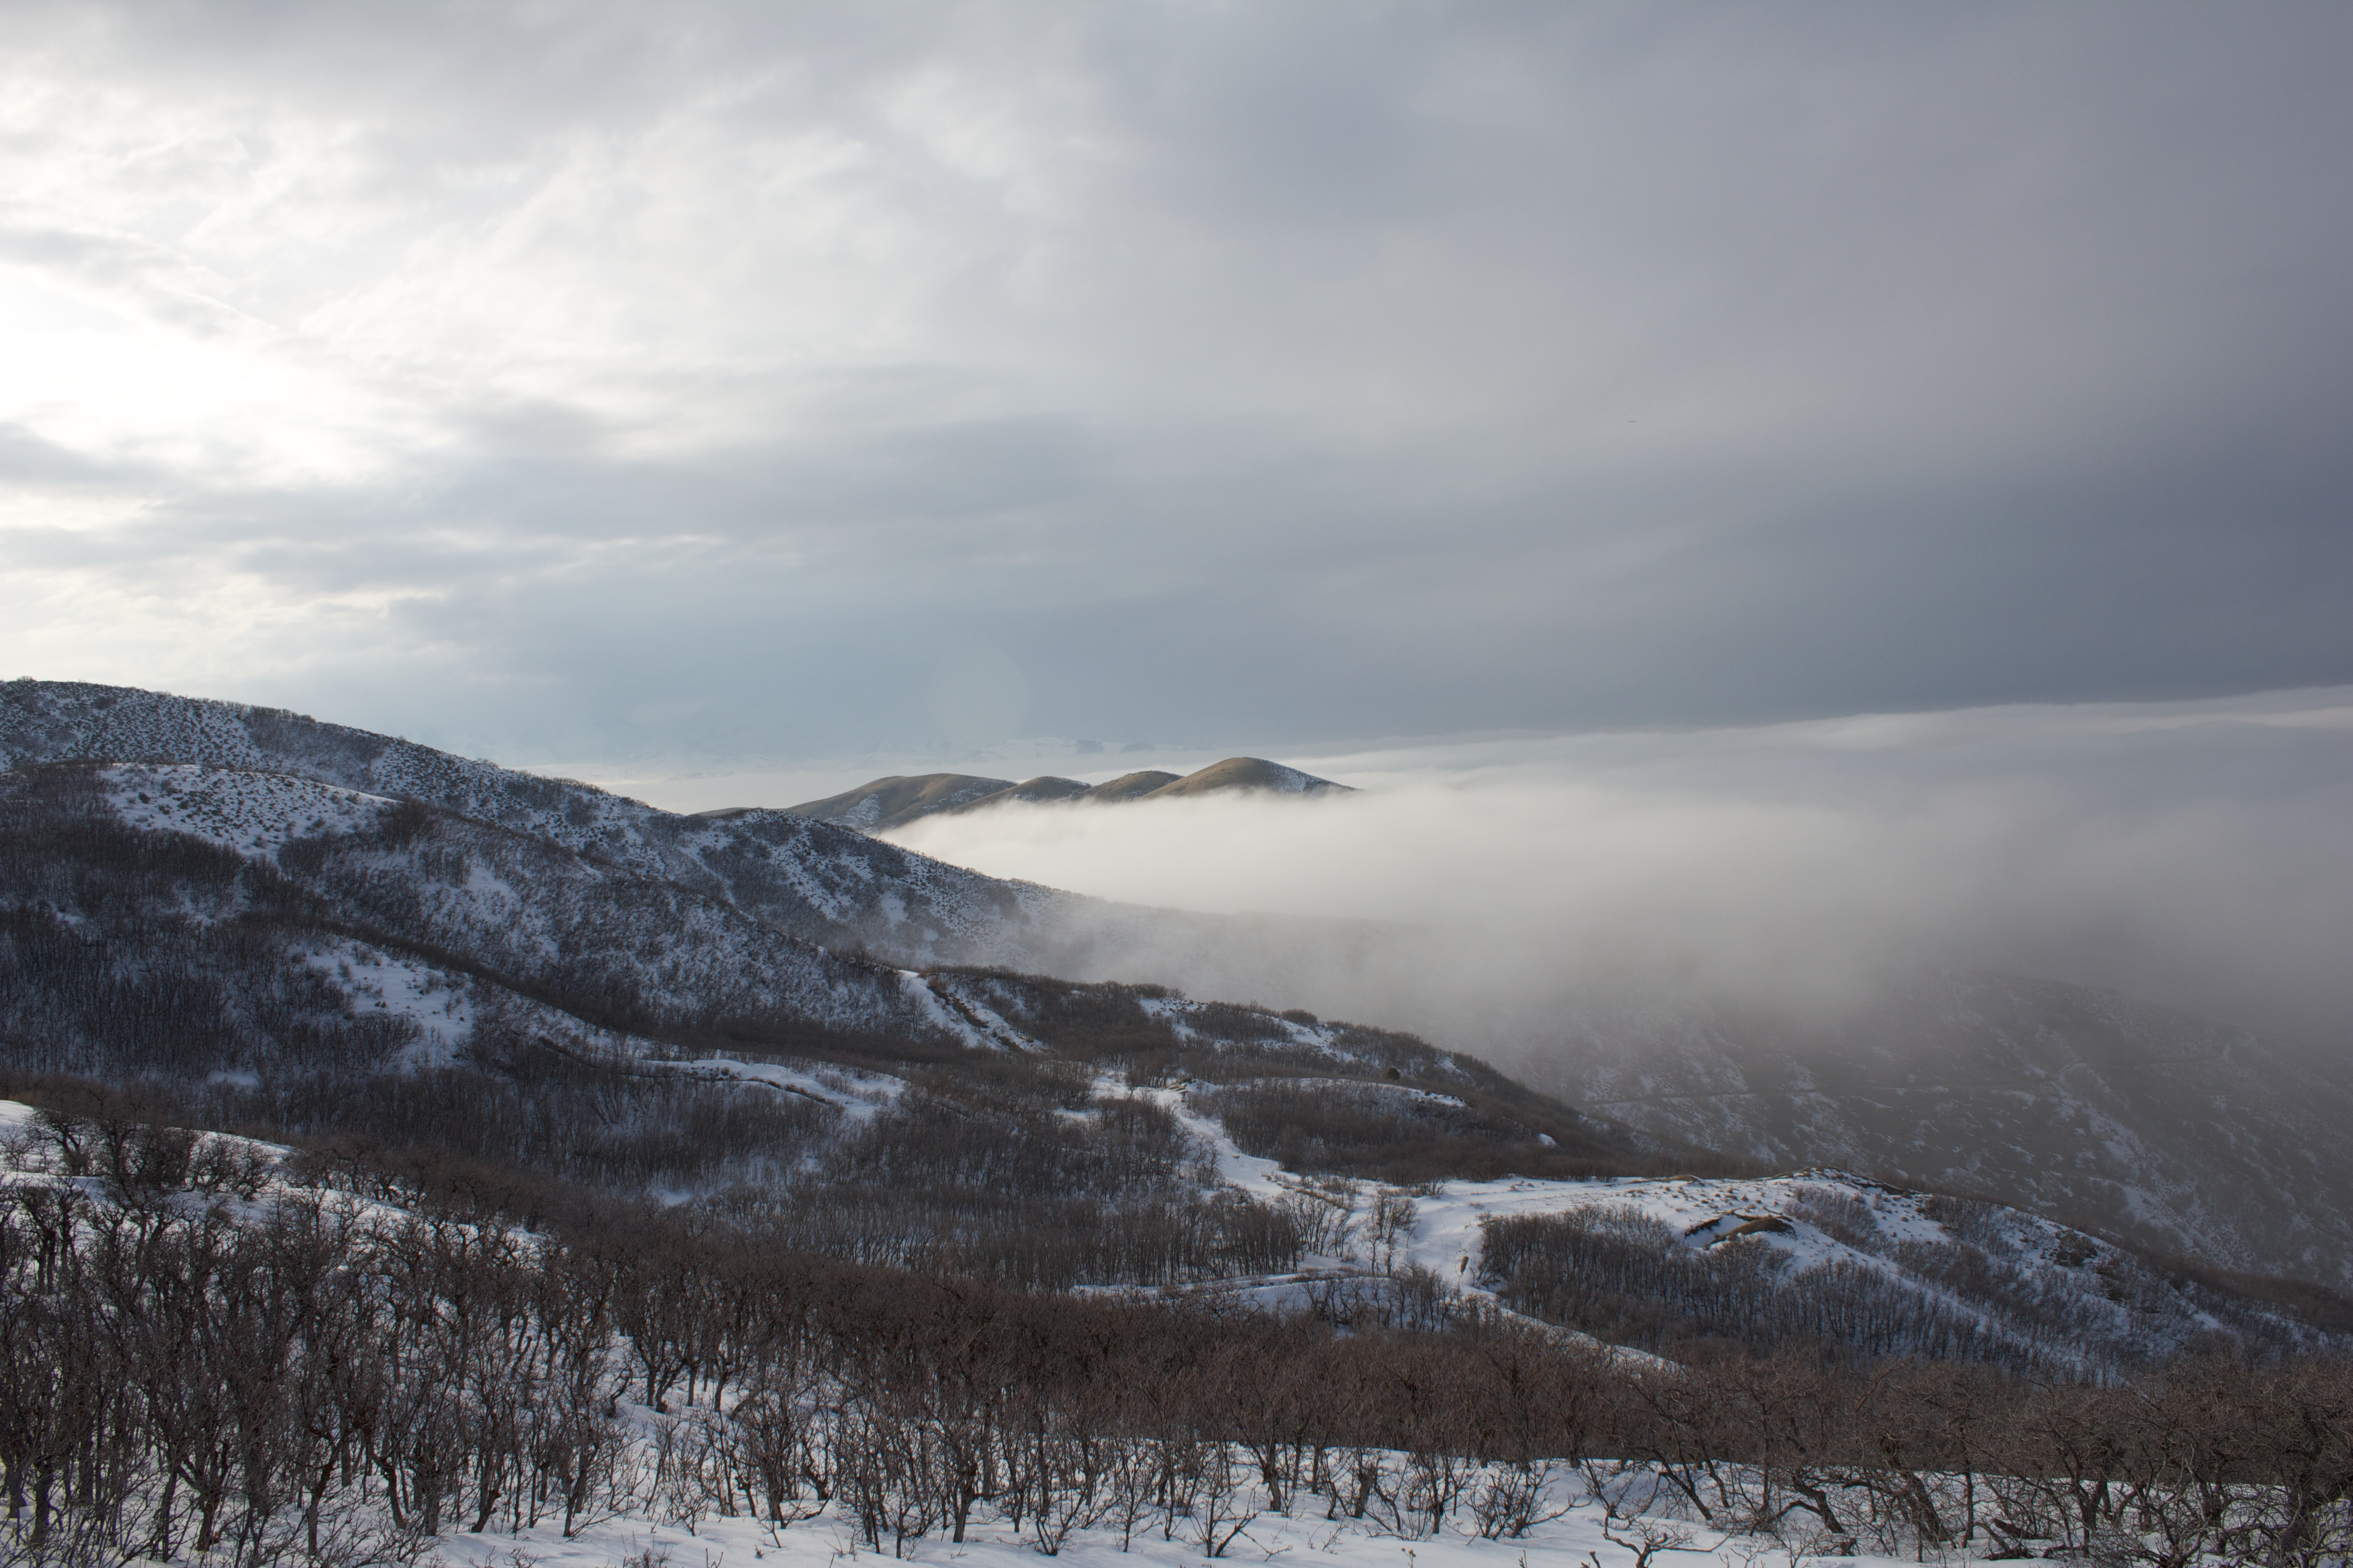
2 Dec
7 Dec
24 Dec
7 Jan
14 Jan
16 Jan
23 Jan
30 Jan

