Slide 1
UU Unitah Basin WRF Model Configuration
See Alcott and Steenburgh 2013 for further details on most aspects of this numerical configuration:
http://journals.ametsoc.org/doi/abs/10.1175/MWR-D-12-00328.1
Namelist used for real.exe is located at: http://home.chpc.utah.edu/~u0198116/ubos/namelist_wps
Namelist used for wrf.exe is located at: http://home.chpc.utah.edu/~u0198116/ubos/namelist.input
Overview summary of WRF Namelist options
map_proj= 1: Lambert Conformal
NAM analyses provide initial cold start and land-surface conditions, and lateral boundary.
Idealized snowcover as function of height input to replace poor NOHRSC snow
Domain (see next slide)
Number of vertical levels = 109
Time step = 45 seconds (15, 5 s for inner 2 grids)
Microphysics: Thompson scheme
Radiation: RRTM longwave, RRTMG shortwave
Surface layer: Monin-Obukov
NOAH land-surface option
YSU PBL Scheme
Kain-Fritsch cumulus scheme in outer coarse 12 km grid
Slope effects for radiation, topo shading turned on
2nd order diffusion on coordinate surfaces
Horizontal Smagorinsky first-order closure for eddy coefficient

Slide 2
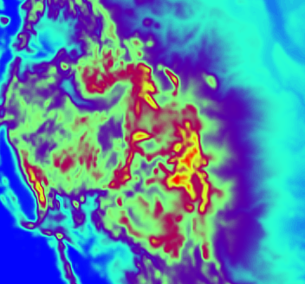
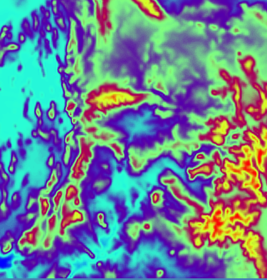
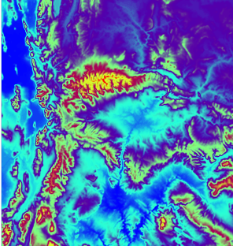
Domains
1 - Outer (12.15km)
2 - Middle (4.05km)
3 - Inner (1.35km)

