Slide 1
Column Integrated Cloud Liquid Water

Slide 2
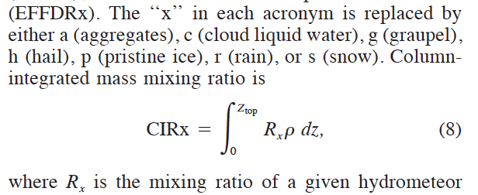
Theory
Grasso and Greenwald 2004
  Monthly Weather Review

Slide 3
I multiply and then sum the layers
  CIRx = sum(Rx*rho*dz) 0 t z top
I use geopotential to find z so that dz is centered on rho and R

Slide 4
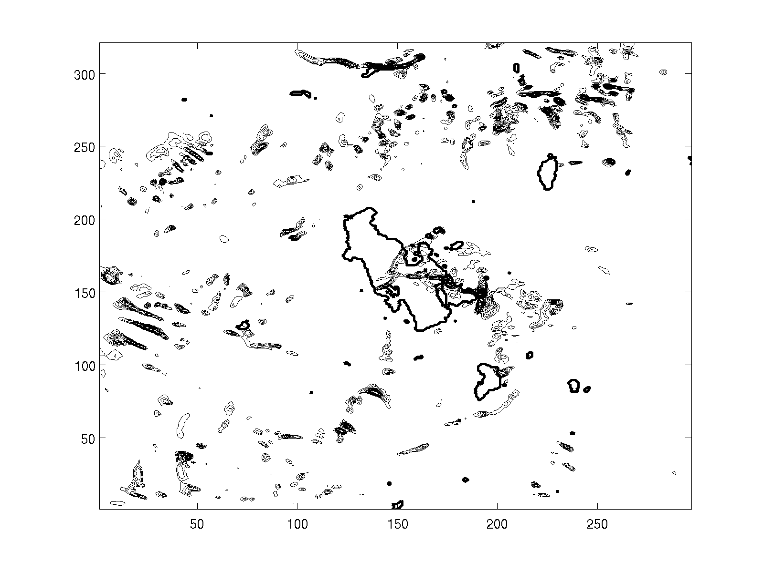
My Code
RIP
Good representation of pattern even though the interval probably isn’t identical and the maxima were nearly identical

