Slide 1
Introduction to the Developmental Testbed Center's Model Evaluation Tools with an emphasis on object-based verification using the MODE tool
John D McMillen

Slide 2
MET
http://www.dtcenter.org/met/users/index.php
http://www.dtcenter.org/met/users/support/online_tutorial/METv4.1/index.php
Locally:
  /uufs/chpc.utah.edu/sys/pkg/MET/v4.1/bin/

Slide 3
MET
Gridpoint to gridpoint comparisons
Gridpoint to fixed point comparisons
Object-Based Analysis
Ensemble Statistics
Wavelet decomposition
Several statistical analysis tools to produce information about several comparisons
  Filtering
  Aggregating
  Summaries
Tools to format input data correctly for MET tools to work
  Bufr, GRIB, MADIS

Slide 4
Data Format
Biggest challenge for me was getting my wrfout precip and radar estimated precip data into a file format that could be used by the MET tools
  I used the netcdf format of files from the tutorial to form netcdf files of each data set
    Headers and metadata all spoofed
    I regridded wrf data to the radar grid
      The radar grid was already regridded when saved via the NOAA toolkit

Slide 5
netcdf WRF20111203 {
dimensions:
lat = 372 ;
lon = 446 ;
variables:
double lat(lon, lat) ;
double lon(lon, lat) ;
double APCP(lon, lat) ;
APCP:name = "APCP" ;
APCP:long_name = "Total precipitation" ;
APCP:level = "A12" ;
APCP:units = "mm" ;
APCP:FillValue = -9999. ;
APCP:init_time = "DTG matches tutorial to spoof MET" ;
APCP:init_time_ut = 1123372800 ;
APCP:valid_time = "DTG matches tutorial to spoof MET" ;
APCP:valid_time_ut = 1123459200 ;
APCP:accum_time = "Time matches tutorial to spoof MET" ;
APCP:accum_time_sec = 43200 ;
// global attributes:
:FileOrigins = "pcp_combine format spoofed with MATLAB. precipnetcdf.m" ;
:MET_version = "V4.1" ;
:MET_tool = "NONE" ;
:RunCommand = "Accumulation periods vary by case" ;
:Projection = "LatLon" ;
:lat_ll = 40.1044728531061 ;
:lon_ll = -113.695467396193 ;
:delta_lat = 0.00537799245557125 ;
:delta_lon = 0.00537799245557125 ;
:Nlat = 372. ;
:Nlon = 446. ;
netcdf NEXRAD20111203 {
dimensions:
lat = 372 ;
lon = 446 ;
variables:
double lat(lon, lat) ;
double lon(lon, lat) ;
double APCP(lon, lat) ;
APCP:name = "APCP" ;
APCP:long_name = "Total precipitation" ;
APCP:level = "A12" ;
APCP:units = "mm" ;
APCP:FillValue = -9999. ;
APCP:init_time = "DTG matches tutorial to spoof MET" ;
APCP:init_time_ut = 1123459200 ;
APCP:valid_time = "DTG matches tutorial to spoof MET" ;
APCP:valid_time_ut = 1123459200 ;
APCP:accum_time = "Time matches tutorial to spoof MET" ;
APCP:accum_time_sec = 43200 ;
// global attributes:
:FileOrigins = "pcp_combine format spoofed with MATLAB. precipnetcdf.m" ;
:MET_version = "V4.1" ;
:MET_tool = "NONE" ;
:RunCommand = "Accumulation periods vary by case" ;
:Projection = "LatLon" ;
:lat_ll = 40.1044728531061 ;
:lon_ll = -113.695467396193 ;
:delta_lat = 0.00537799245557125 ;
:delta_lon = 0.00537799245557125 ;
:Nlat = 372. ;
:Nlon = 446. ;
UNIX EPOCH TIME

Slide 6
MET
Config Files
  Tells the MET tool what to do

Slide 7
MET
To Run Locally:
  .aliases file entry:
    setenv METBIN /uufs/chpc.utah.edu/sys/pkg/MET/v4.1/bin/
  Command:
    $METBIN/grid_stat data/WRF20101027.nc data/NEXRAD20101027qcd.nc config/GridStatConfig -outdir out/grid_stat/2010_10_27 -v 4

Slide 8
Output

Slide 9
Object-Based Verification
The Method for Object-based Diagnostic Evaluation (MODE) developed by Davis et al. (2006a,b) is Used to:
  Identify Precipitation Objects
  Quantify Precipitation Object Attributes
  Compare Objects from REP and Simulated Precipitation
MODE was Tuned to Identify GSLE Objects Specifically

Slide 10
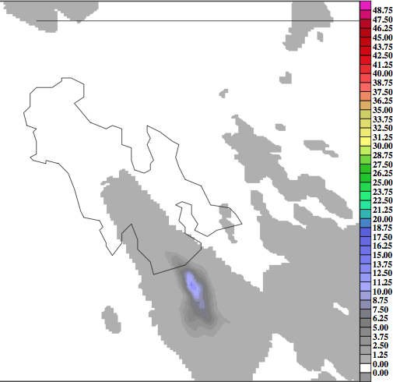
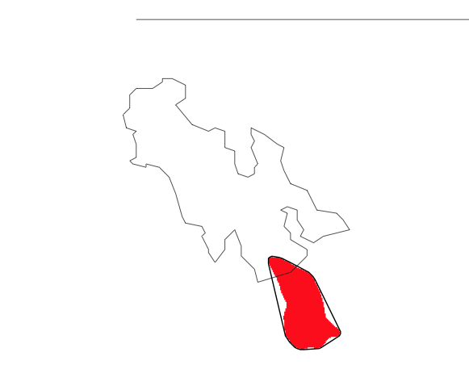
Object-Based Verification
WRF
WRF Object
R = 4 grid points, T = 1mm, Ignore Objects < 100 grid points

Slide 11
Object-Based Verification
90°
Orientation Angle
a
Centroid
Aspect Ratio = a/b
b

Slide 12
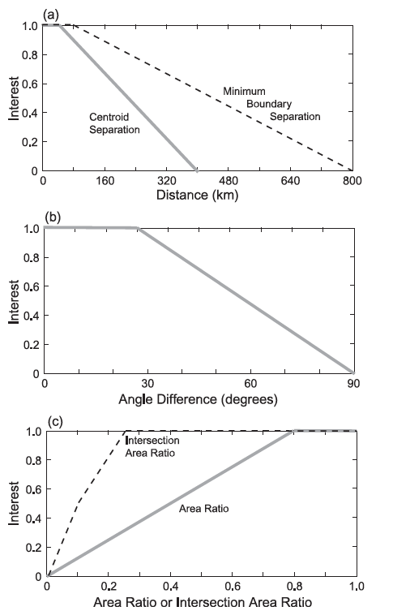

Adjusting MODE
Interest Function
  0-1, 1 is a perfect match
  Defined by a function
Weight
  How much influence a variable has in the Total Interest
  Integer
Confidence
  0-1, 1 is total confidence
  Usually 1 except for orientation angle and centroid separation

Slide 13
Output

Slide 15
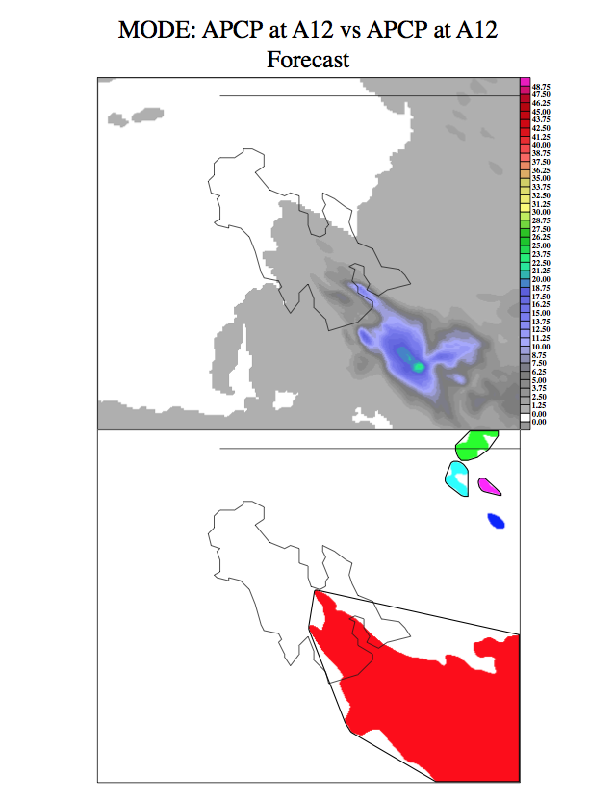

Slide 16
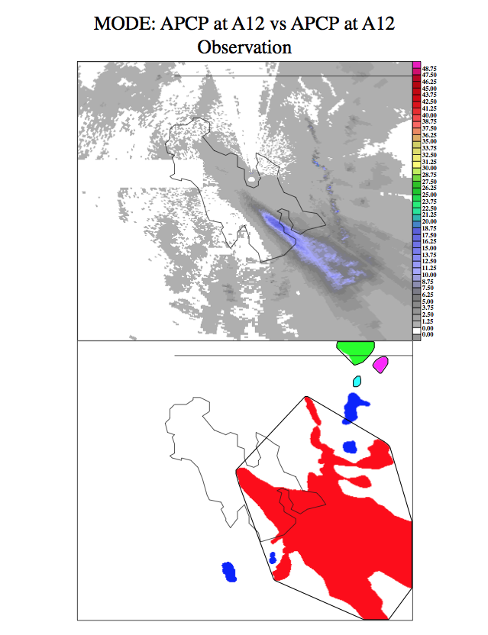

Slide 17
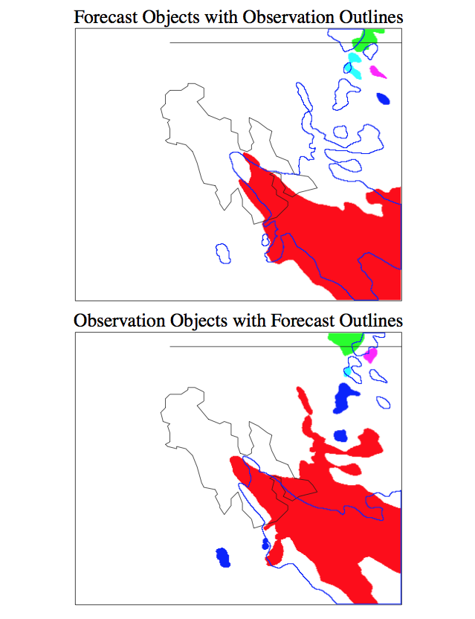

Slide 18
